Slide 1
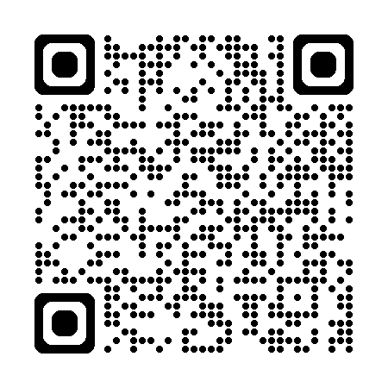
Log in with Game Code and select your team!

Slide 2
ANTICOAGULATION JEOPARDY
PICK YOUR
POISON
Xa MARKS
the SPOT
TOO MUCH OF
A GOOD
THING
LONDON
BRIDGES
FRAGRANT
TWIGS
$100
$100
$100
$100
$100
$200
$200
$200
$200
$200
$300
$300
$300
$300
$300
$400
$400
$400
$400
$400
$500
$500
$500
$500
$500

Slide 3
PICK YOUR POISON - $100
These are the coagulation factors and regulatory proteins that are vitamin K dependent and that are affected by warfarin administration.
What are factors II, VII, IX, and X
and protein C and protein S?

Slide 4
PICK YOUR POISON - $200
You diagnose a 75 year old man who is on hemodialysis for ESRD with an acute proximal DVT after laparoscopic cholecystectomy. You start IV unfractionated heparin and warfarin. This is the recommendation for when the heparin can be discontinued.
What is after 5 days of concomitant therapy and after INR
has been in therapeutic range for 2 days (drawn 24 hours apart)?

Slide 5
PICK YOUR POISON- $300
Your 60 year old patient with hypertension and type 2 diabetes mellitus is diagnosed with paroxysmal atrial fibrillation. His CHADS-vasc score is 2, indicating anticoagulation is appropriate. He has no insurance, and you decide that warfarin is the most appropriate anticoagulant to prescribe. This is the recommended outpatient starting dose for this patient.
What is 10 mg po q day x 2 days then dose based on the INR value?

Slide 6
PICK YOUR POISON- $400
These are three reasons for which the INR goal is 2.5-3.5 (rather than the usual 2-3).
What are:
Mechanical valve in the mitral position
2) Mechanical valve + additional risk factor
3) Systemic embolization despite adequate INR (2-3)

Slide 7
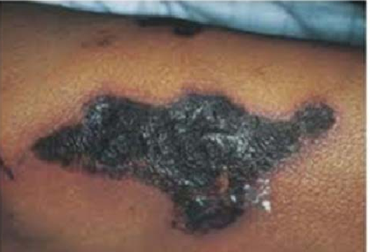
PICK YOUR POISON- $500
You started your patient on warfarin 5 days ago for atrial fibrillation. Today, she calls your office with complaints of painful skin lesions (seen below). This is what you suspect for the diagnosis AND its mechanism.
What is warfarin skin necrosis due to protein c deficiency?

Slide 8
Xa MARKS THE SPOT- $100
This is the creatinine clearance for which rivaroxaban is contraindicated.
What is a creatinine clearance of < 15 ml/min?

Slide 9
Xa MARKS THE SPOT- $200
This is the significance of an elevated INR in a patient who is on a Xa inhibitor drug such as rivaroxaban, apixaban, or edoxaban.
What is NO significance in terms of anticoagulation?

Slide 10
Xa MARKS THE SPOT - $300
These are the three classes of drugs that should be avoided in patients who take rivaroxaban for anticoagulation purposes.
What are:
Azole antimycotics (increase potency)
HIV protease inhibitors (increase potency)
Anti-epileptic drugs (decrease potency)?

Slide 11
Xa MARKS THE SPOT - $400
This is the recommended length of time for which to hold Apixaban before a procedure that has moderate to high risk of bleeding and this
is the length of time to hold Apixaban before a procedure with a low risk of bleeding.
What is 48 hours prior to a moderate to high risk procedure and
24 hours before a low risk procedure?

Slide 12
Xa MARKS THE SPOT - $500
According to the package insert, a patient with 2 of the following 3 risk factors should be dosed at 2.5 mg BID as opposed to the usual 5 mg BID of Apixaban (Eliquis).
What is:
1)Age ≥ 80 years,
2)Body weight ≤ 60 kg, and
3)Creatinine ≥ 1.5 mg/dL?

Slide 13
TOO MUCH of a GOOD THING - $100
This is the drug used to reverse the effects of unfractionated heparin in a patient with life-threatening bleeding.
What is protamine sulfate?
(1mg neutralizes 100U of heparin)
Monitor aPTT for normalization

Slide 14
TOO MUCH of a GOOD THING - $200
These are TWO key interventions recommended in CHEST 2012 to manage a patient on warfarin who presents with a life-threatening bleed and any degree of INR elevation.
What are BOTH:
1) 3- factor prothrombin complex
concentrate (PCC) AND
2) IV vitamin K 10 mg slow infusion?

Slide 15
TOO MUCH of a GOOD THING - $300
These are the CHEST 2012 recommendations for management of a patient on warfarin who presents with an INR of 4-10 who is not bleeding.
What is
1-2.5 mg mg dose of ORAL vitamin K?

Slide 16
TOO MUCH of a GOOD THING - $400
This is what you give to a patient who is having life-threatening bleeding or who needs emergency surgery who is on apixaban or rivaroxaban.
What is 4- factor Prothrombin Complex Concentrate?
Notes:
Can consider giving Andexanet alfa but very expensive not readily available and possible some increased rates of ischemic strokes and thrombotic risks in some studies

Slide 17
TOO MUCH of a GOOD THING - $500
This is the pharmacologic therapy for a patient on dabigatran
who presents with life-threatening bleeding or need
for emergency surgery and its
mechanism of action.
What is idarucizumab (Praxbind?)
Monoclonal antibody fragment that binds to dabigatran with a higher affinity (350x) than dabigatran binds to thrombin, neutralizing its effect immediately.

Slide 18
London Bridges - $100
These 3 oral anticoagulants require bridging with parenteral agents and these 2 oral anticoagulants do NOT require bridging with parenteral agents.
What are:
Require bridging: warfarin, dabagatran, and edoxaban
Do not require bridging: rivaroxaban and apixaban ?

Slide 19
London Bridges- $200
These 3 categories of patients on anticoagulation are considered LOW risk for thrombosis and do not require bridging parenteral anticoagulation around the perioperative period.
Who are patients with:
Atrial fibrillation, CHADS ≤ 2, and no previous thromboembolism
or intracardiac thrombus
Bileaflet mechanical aortic valve in sinus rhythm with
no previous thromboembolism
3) VTE greater than 3 months ago without active cancer

Slide 20
London Bridges- $300
Your patient needs an elective surgery and is on warfarin anticoagulation for combined atrial fibrillation (CHADS-vasc- 5) and a mechanical aortic valve. He has normal renal function. In addition to stopping the warfarin 5 days prior to surgery, this is the appropriate perioperative bridging strategy.
What is:
Start LMWH 1 mg/kg q 12 hours 3 days PTS
Last dose of LMWH 24 hours PTS
(PTS= Prior to surgery)

Slide 21
London Bridges- $400
Your patient needs an elective surgery and is on warfarin anticoagulation for atrial fibrillation and a previous thromboembolic stroke. He has normal renal function. In addition to stopping the warfarin 5 days prior to surgery, this is the appropriate perioperative bridging strategy.
What is:
Start LMWH 4 days prior to surgery (1.5 mg/kg q day)
Last dose of LMWH 24 hours prior to surgery

Slide 22
London Bridges- $500
Your patient needs an elective surgery and is on warfarin anticoagulation for atrial fibrillation and a previous thromboembolic stroke. (CHADS-vasc 6) He has CKD 4 with a creatinine clearance of 23 mL/min. In addition to stopping the warfarin 5 days prior to surgery, this is the appropriate perioperative bridging strategy.
What is:
Start LMWH at renal dose for CrCl 15-30 q day
(1 mg/kg q day)
Last dose of LMWH dose on day prior to surgery
(No longer recommending routine measurement of anti Xa levels)

Slide 23
Fragrant Twigs- $100
This is the first thing you order for a patient who presents with dyspnea and a high pre-test probability for PE by Well’s criteria who is hemodynamically stable.
What is an order for therapeutic anticoagulation?

Slide 24
Fragrant Twigs- $200
A patient with a provoked VTE should not undergo a hypercoagulable workup.
For cases of UNPROVOKED VTE, a patient should be worked up for a hypercoagulable state if they are < 50 years of age and have one of the following of these
FOUR risk factors:
What is one of the following:
1 ) positive family history (first degree relative)
2) unusual vascular bed (splanchnic, cerebral)
3) on oral contraception/pregnancy,
4) warfarin skin necrosis?

Slide 25
Fragrant Twigs- $300
A person with any one of these three medical issues may be at increased risk of developing anaphylaxis to protamine sulfate therapy.
What are:
Diabetes mellitus on NPH
An allergy to fish (salmon)
A prior vasectomy?

Slide 26
Fragrant Twigs- $400
A patient who develops sudden onset of hypertension, tachycardia, and fever within 30 minutes of an IV heparin bolus should have this laboratory value checked stat.
What is a platelet level?
(Diagnosis: Acute HITT)

Slide 27
Fragrant Twigs- $500
These are 3 tools that can help you favor long-term anticoagulation in a patient with a first episode of unprovoked VTE.
What are:
Elevated d-dimer test one month after stopping anticoagulation
Residual thrombus on doppler ultrasound
Clinical prediction rule: Men and HERD002?

