Slide 1
Colorectal Cancer
Zachary Yeung MD
GI Medical Oncology

Slide 2
Objectives
Identify epidemiologic trends and risk factors for colorectal cancer (CRC)
Explain staging and workup of colon cancer based on clinical presentation
Understand indications for adjuvant therapy in stage III disease and high risk features of stage II colon cancer who benefit from chemo
Describe the role of MMR and RAS/BRAF mutations in determining therapy
Review therapy of metastatic disease with attention to actionable biological targets and oligometastatic disease

Slide 3
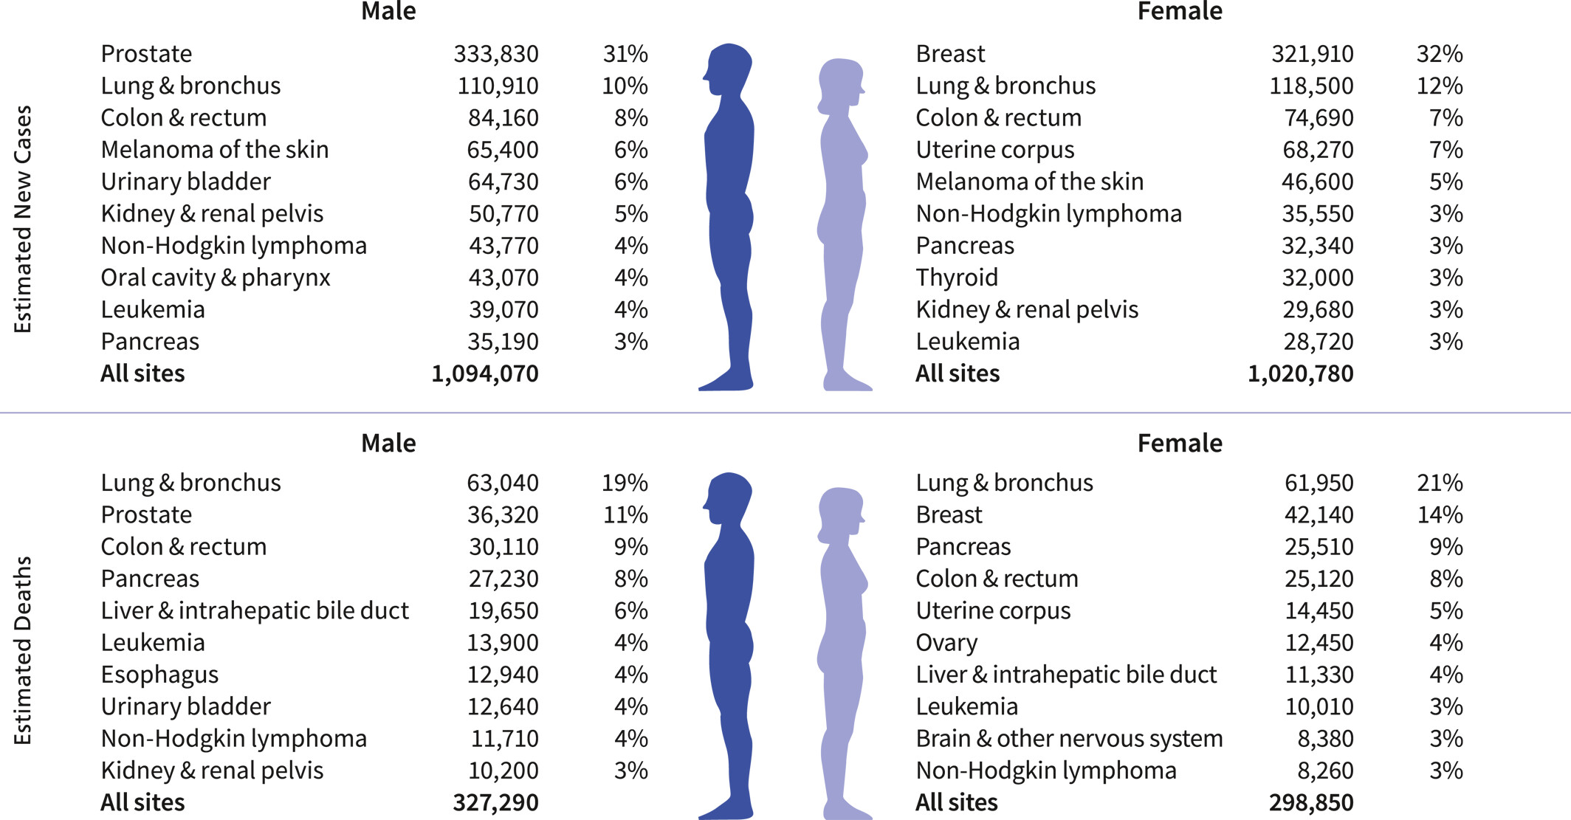
Epidemiology
#4 most frequent cancer diagnosis and #2 cause of cancer death (~10%) in the US
2026: 158,850 estimated new cases; 55,230 estimated deaths
CA A Cancer J Clinicians, Volume: 76, Issue: 1, First published: 13 January 2026, DOI: (10.3322/caac.70043)

Slide 4
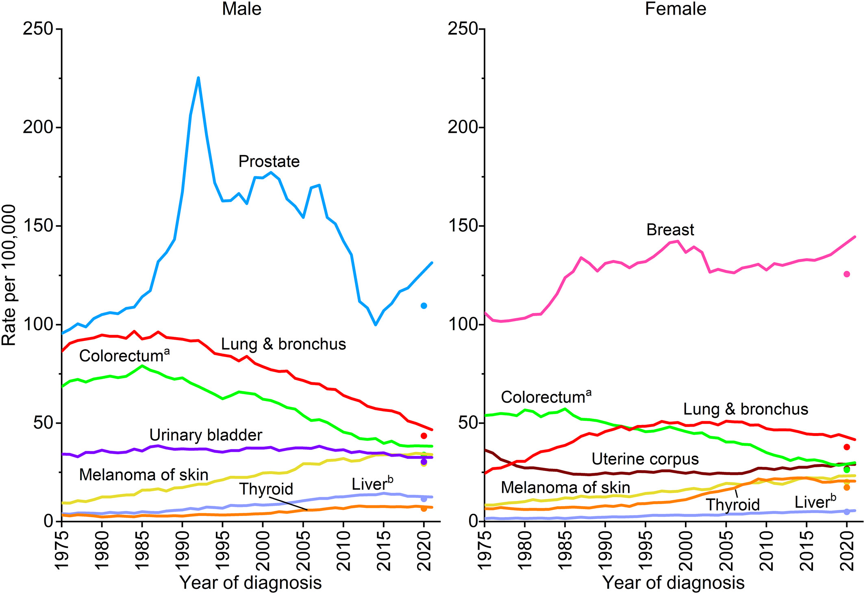
Overall CRC incidence declined with more screening since 2000s
Notes:
Trends in incidence rates for selected cancers by sex, United States, 1975 to 2021. Rates are age adjusted to the 2000 US standard population and adjusted for delays in reporting. Data for 2020 are shown separate from trend lines

Slide 5
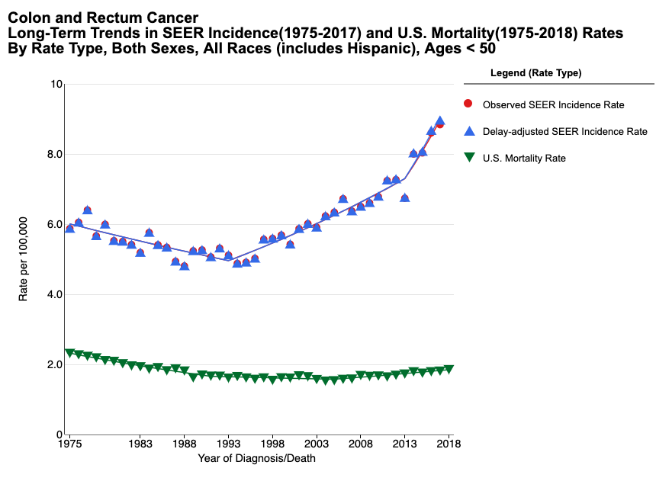
Incidence has increased in younger patients
Incidence among <65 y.o. increased annually by 1%
  Increased 2.9% for <50 y.o.
  Pace of increase < 50 y.o. accelerated from 1.3% per year from the mid-1990s to 2019 to 6.4% per year b/c screening initiation in individuals aged 45–49 years and the diagnosis of asymptomatic cancers
Increase is mostly in left-sided and rectal cancer
Mortality decreased except for age <50
Etiology is unknown; most cases are sporadic and not familial
Notes:
CRC death rates declined 3% annually for those 65 years and older compared to a 0.6% annual decline for individuals aged 50 to 64 and a 1.3% Annual increase for individuals younger than 50 years.
Based on current trends, in 2030, the incidence rates for colon and rectal cancers will increase by 90.0% and 124.2%, respectively, for patients 20 to 34 years and by 27.7% and 46.0%, respectively, for patients 35 to 49 years.

Slide 6
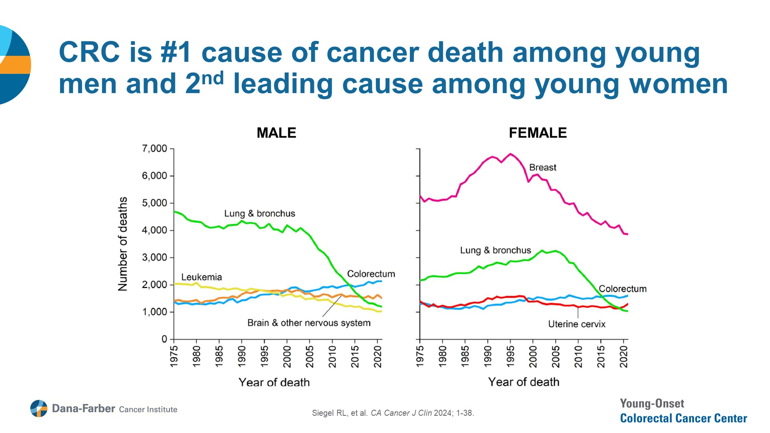

Slide 7
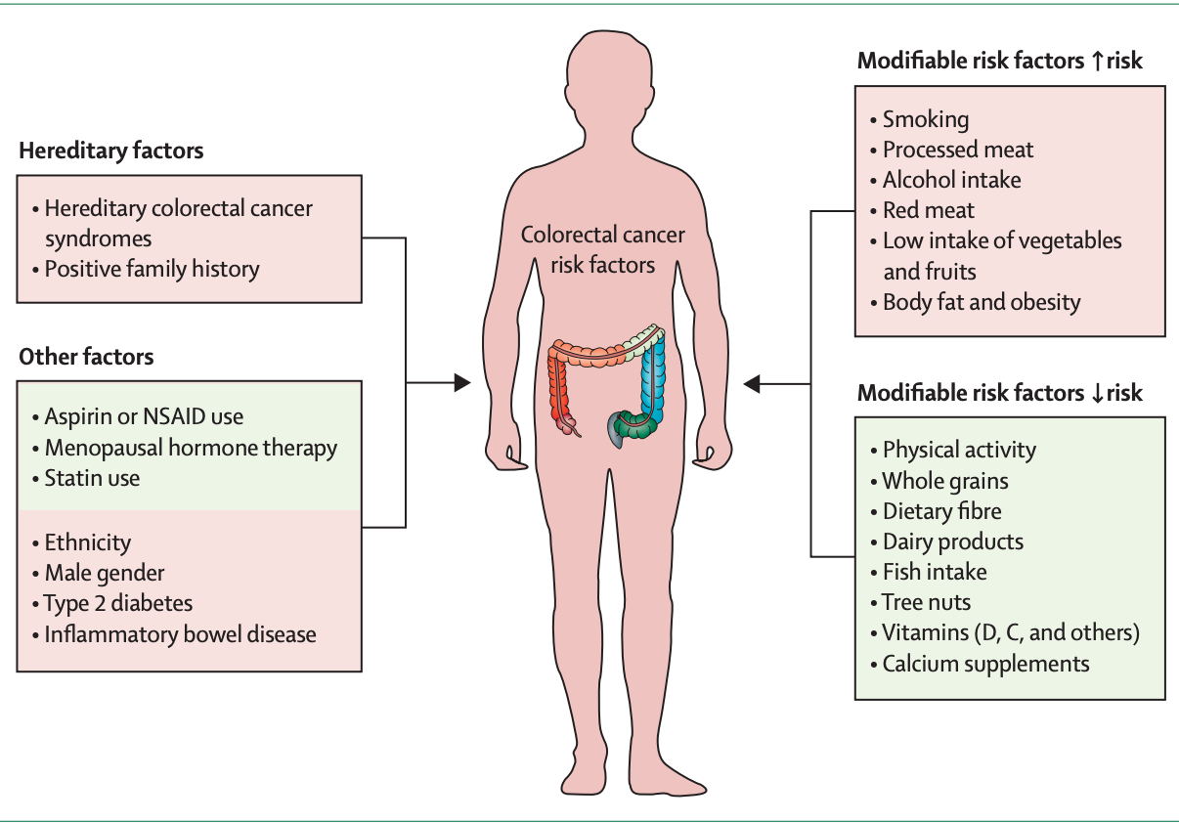
Risk Factors

Slide 8
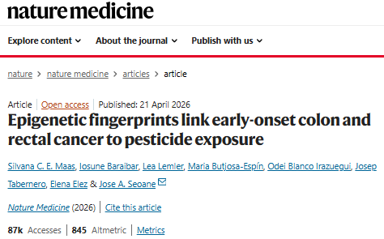
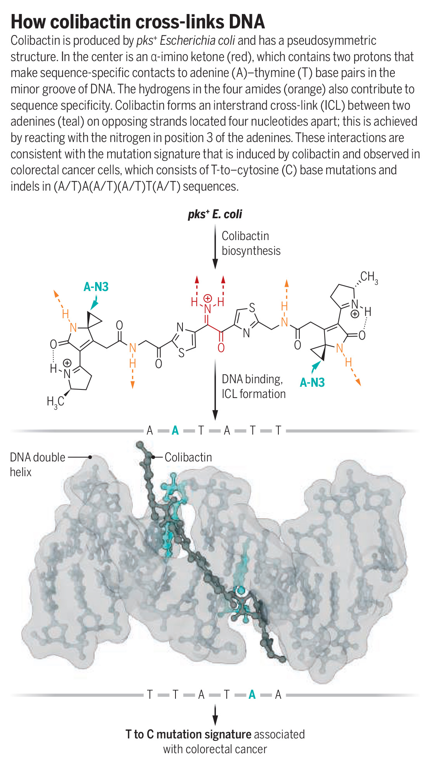
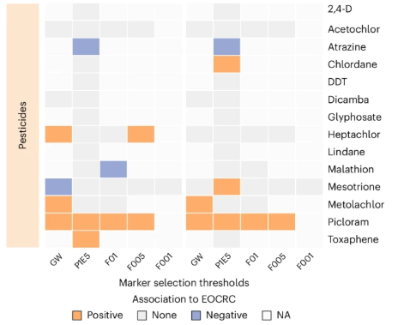

Slide 9
Clinical presentation/Diagnosis
Most commonly found on colonoscopy; pathology yields diagnosis → Adenocarcinoma
Left-sided (bowel habits, cramping, hematochezia) vs. Right-sided (IDA)
Perforation: page surgery stat
Obstruction: Surgery (colectomy vs diversion) vs. endoscopic stent vs medical management
Rectal: Below the peritoneal reflection

Slide 10
Workup at diagnosis/presentation of colon cancer
-H&P with family history, surgical history, attention to HTN, CV risk, DM with neuropathy
-CBC, CMP: Counts limit chemo, kidney function, liver function
-CT C/A/P with IV contrast: find the primary site
-CEA: follow for response
-Pathology: What does the report say?
-All tissue should undergo testing with MMR IHC
-Next Generation Sequencing (NGS) with RNA Seq: KRAS/NRAS/BRAF testing, HER2+ IHC/ERBB2 amplifications, MSI testing, POLE/POLD, NTRK/RET fusions
-If young and child bearing age, counsel on fertility

Slide 11
Obstruction
Call surgery stat
CBC, CMP, PT/INR/PTT, type and screen, two large bore IVs
Frequent serial assessment to look for peritoneal signs, findings suggestive of perforation, and clinical deterioration
Options:
  Emergency resection with exploratory laparotomy
  Temporary diversion/bridge to surgery w/ proximal decompressing stoma/self-expandable metal stent (SEMS)

Slide 12
What is different about the work up for rectal cancer?
Colonoscopy: how far is it from the anal verge; for low rectal cancers, do a DRE!
Staging with CT C/A with contrast for distant disease
MRI Pelvis w/w/o contrast with T2 diffusion weighted images for locoregional T/N/M staging and determination of circumferential resection margin

Slide 13
Tumor biology: Genetics is part of the diagnosis

Slide 14
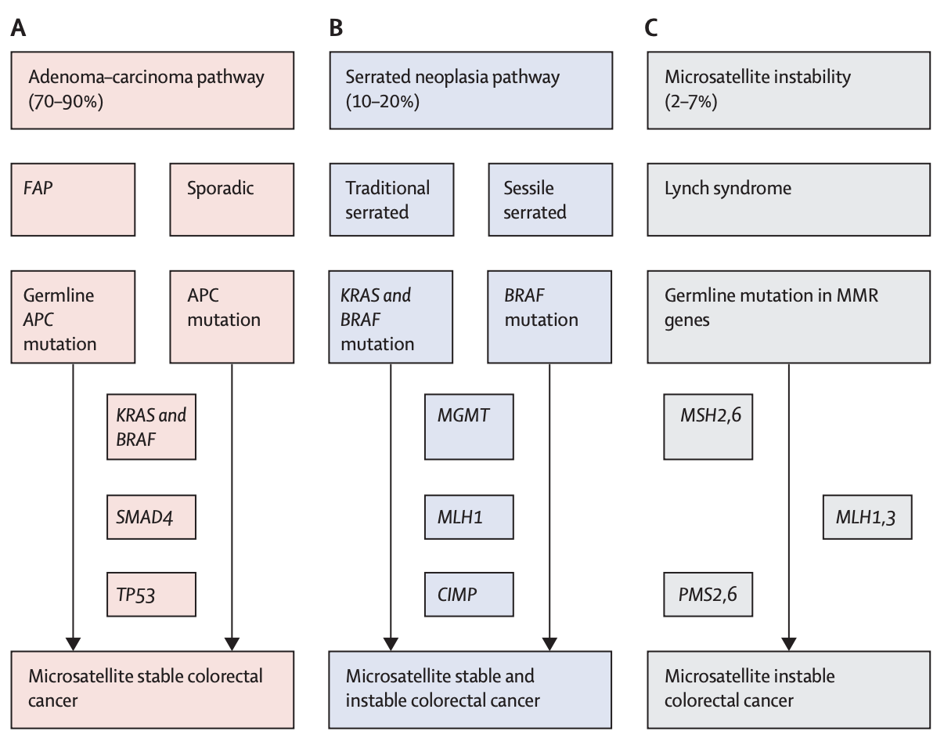
Pathogenesis

Slide 15
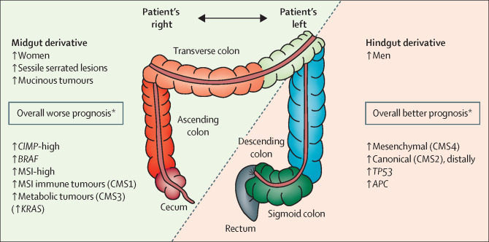
Sidedness in Tumor Biology

Slide 16
Test your tumor:
PMMR/MSS vs DMMR/MSI-H
90-95% of CRC
Rx: Chemotherapy/Radiation
5-10% of CRC
Rx: Checkpoint Immunotherapy
Sporadic vs Germline (Lynch)
All colorectal tumors should be screened for mismatch repair deficiency
Deficiency in a mismatch repair protein should prompt germline screening for Lynch Syndrome
except
BRAFV600E MSI-H tumors are sporadic

Slide 17
Lynch Syndrome: inherited deficient mismatch repair (dMMR)
-Autosomal dominant inheritance of germline mutation in mismatch repair gene
-Universal screening for dMMR in CRC and endometrial: IHC for MLH1, MSH2, MSH6, and PMS2 or MSI-H by PCR/NGS or deletion in EPCAM
-Clinical features: 40-50% lifetime risk, ⅔ present as right-sided, better prognosis, >1 primary
-Related CA can include ovarian, small bowel, gastric, pancreas, biliary, GBM, Prostate/bladder, adrenal cortical, sebaceous gland tumors (Muir Torre)
-Send to Genetic Counseling for germline testing!
-Surveillance and cancer prevention including possible hysterectomy should be guided by the risk associated with each gene; yearly colonoscopies start in the 20s
Notes:
MLH1 50%>MSH2 30-40%
MSH6 10% less risk and later onset
PMS2 <5% is attenuated form
EPCAM presents like MSH2
MLH1 dimerizes with PMS2 to form MutLa which coordinates mismatch repair polymerases and helicases
MSH2 dimerizes with MSH6 in sliding clamp model
IHC has a 5-10% false negative rate

Slide 18
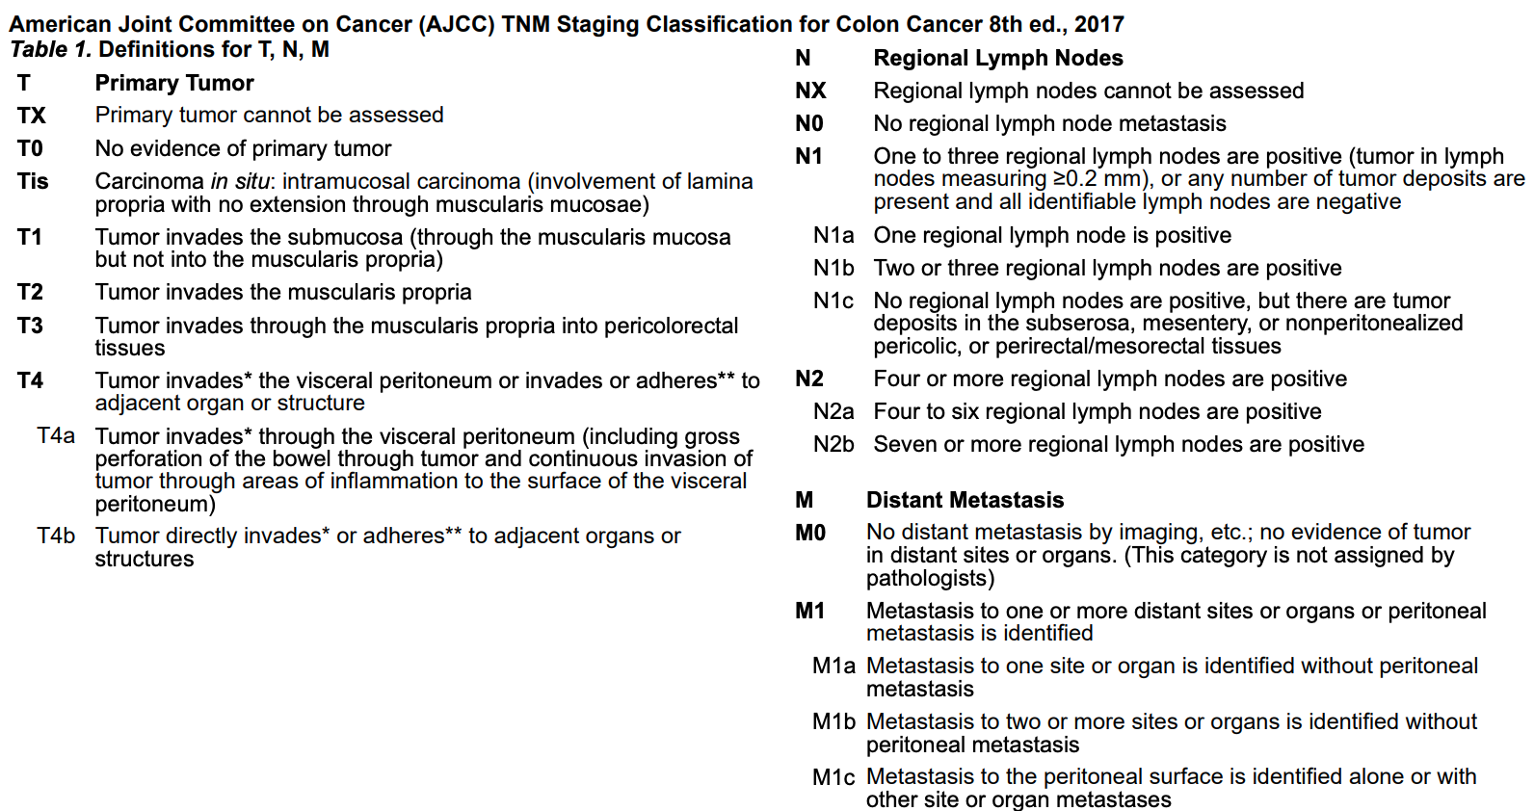
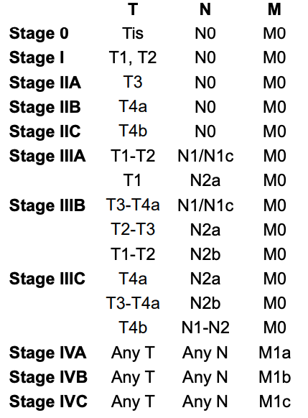
Staging: TNM

Slide 19
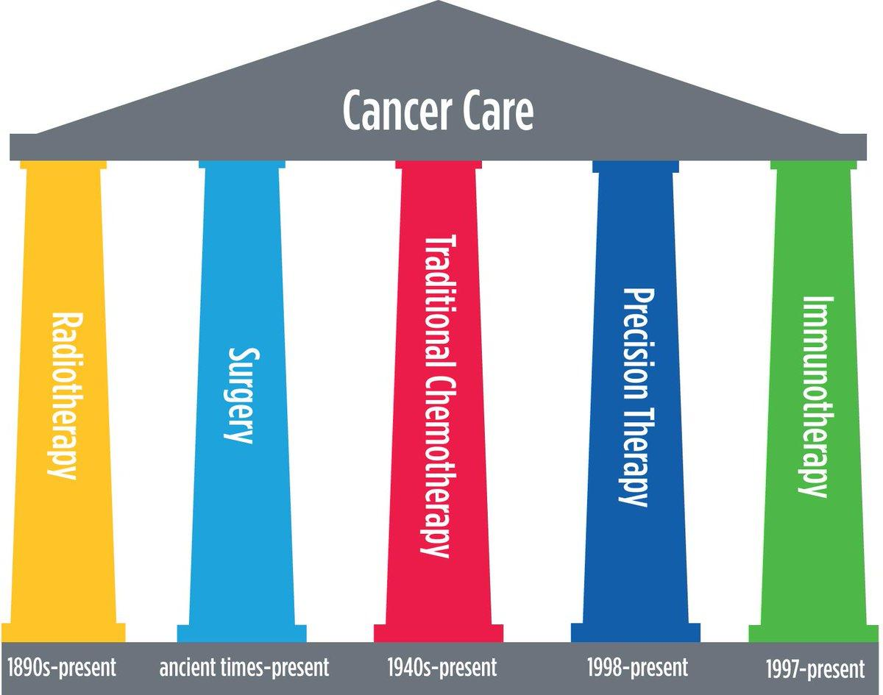
Pillars of Therapy

Slide 20
Localized disease (Stage I-III)

Slide 21
Management of Localized Disease: curative intent
-Adequate R0 resection (en bloc partial colectomy) with favorable histologic features, clear negative margins is curative for stage I colon cancer
-high grade, budding or LVI may prompt extended colectomy
-For rectal Stage I disease: resection with TME

Slide 22
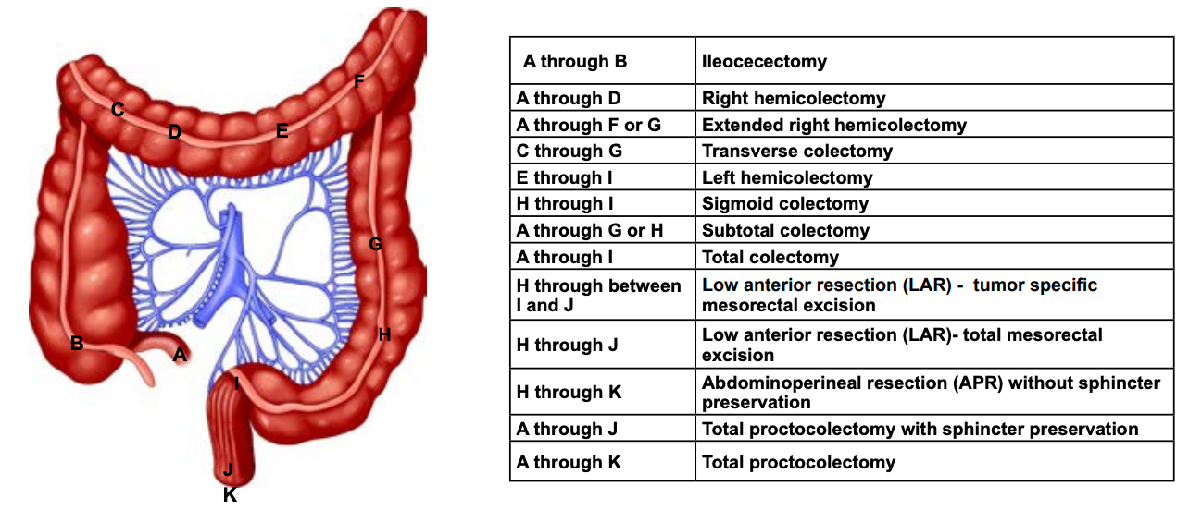
Adequate colon cancer surgery: R0 en bloc resection with 12 nodes

Slide 23
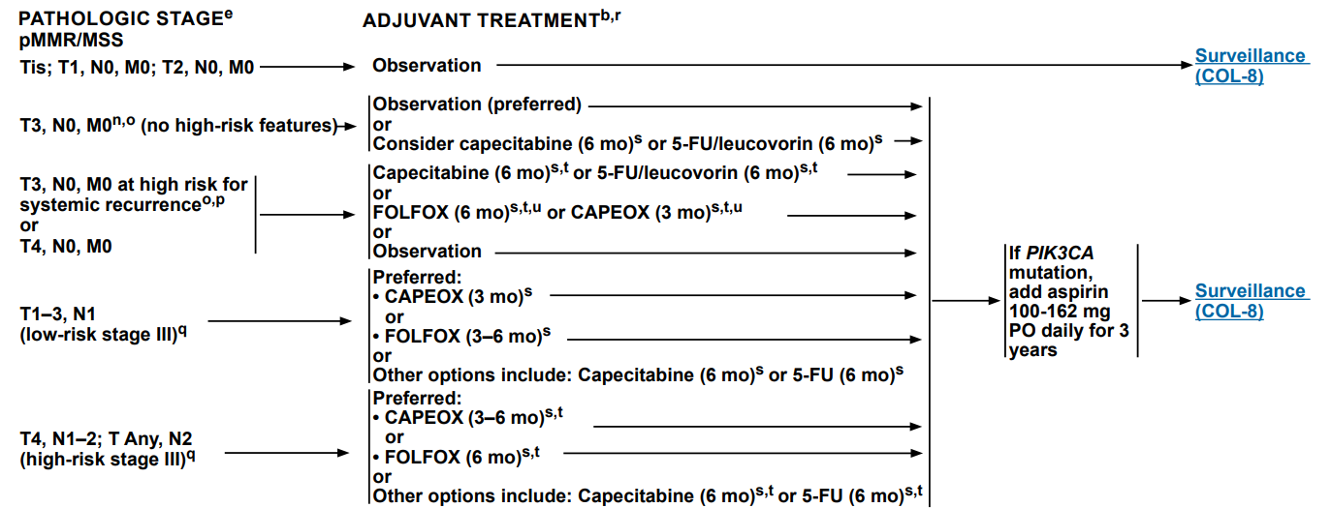
NCCN Guidelines for PMMR colon cancer

Slide 24
Adjuvant therapy in proficient mismatch repair colon cancer
After en bloc resection: Should we give chemo? What chemo should we give? (MOSAIC)
Stage II: In most uncomplicated cases, no chemo
OS benefit no more than 5%.
Stage II with high risk features (T4) → Chemo
high grade, inadequate surgery, lymphovascular invasion (LVI), +margins, obstruction, or perforation
Stage III (node positive): chemo
Notes:
High risk features:
The cancer looks very abnormal (is high grade) when viewed closely in the lab.
The cancer has grown into nearby blood or lymph vessels.
The surgeon did not remove at least 12 lymph nodes.
Cancer was found in or near the margin (edge) of the removed tissue, meaning that some cancer may have been left behind.
The cancer had blocked (obstructed) the colon.
The cancer caused a perforation (hole) in the wall of the colon.

Slide 25
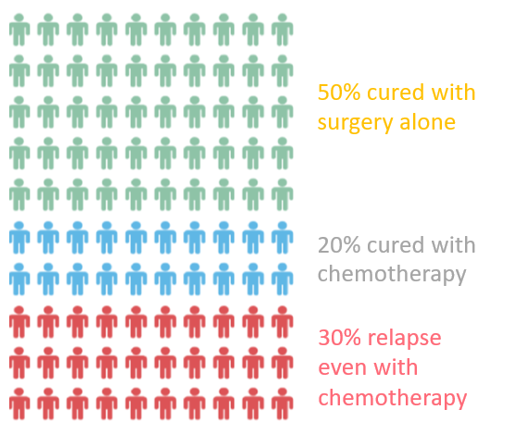
Why do we do adjuvant therapy?

Slide 26
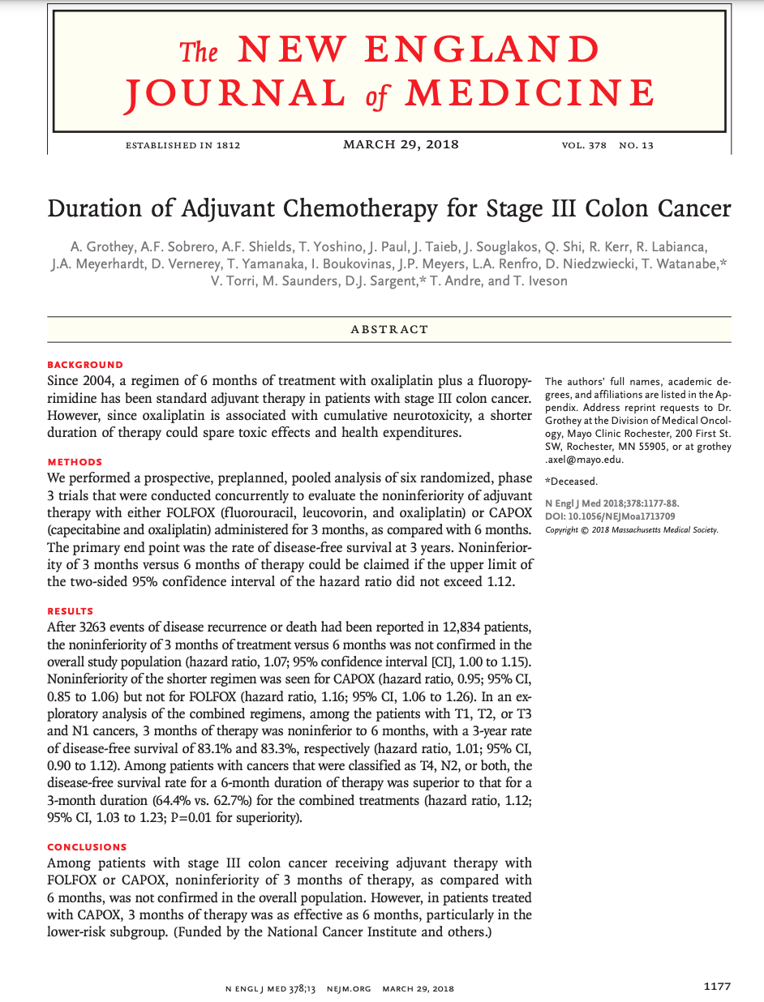
Adjuvant chemotherapy is Fluoropyrimidine and platinum-based
Low intensity: 6 months of Capecitabine or 5-FU
Low risk stage III: 3 months of CAPEOX (XELOX) or 6 months of FOLFOX (IDEA)
High risk stage III (T4 or N2): 6 months of FOLFOX or CAPEOX
Capecitabine is an oral pill
5FU infuses through a pump attached to a port
Capecitabine is converted by the body into 5FU

Slide 27
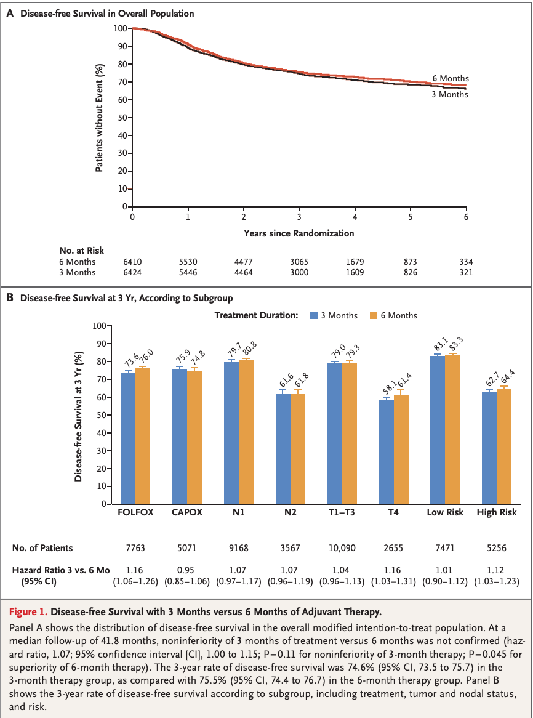
What type of chemo should we give?
Low intensity: 6 months of Capecitabine or 5-FU
T1-3N1: 3 months of CAPEOX (XELOX) or 6 months of FOLFOX (IDEA)
High risk (T4 or N2): 6 months of FOLFOX or CAPEOX
G3 Neurotoxicity rates are lower for patients who receive 3 months of CAPEOX (3%) vs 6 months of therapy (9-16%)
Recent analysis shows that if you can give 75% of oxaliplatin cumulative dose, survival benefit is relatively equivalent

Slide 28
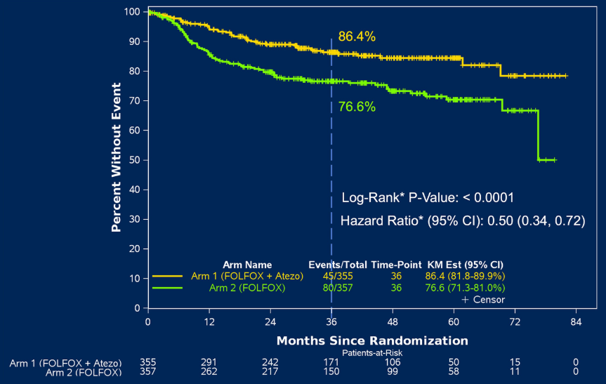
What about adjuvant therapy of DMMR/MSI-H colon cancer?
MSI-H/DMMR tumors have better prognosis
5FU/Capecitabine alone without benefit
ATOMIC TRIAL: Adjuvant FOLFOX+ Atezolizumab for Stage III DMMR colon cancer

Slide 29
What can we do to improve outcomes in survivorship besides perioperative therapy?

Slide 30
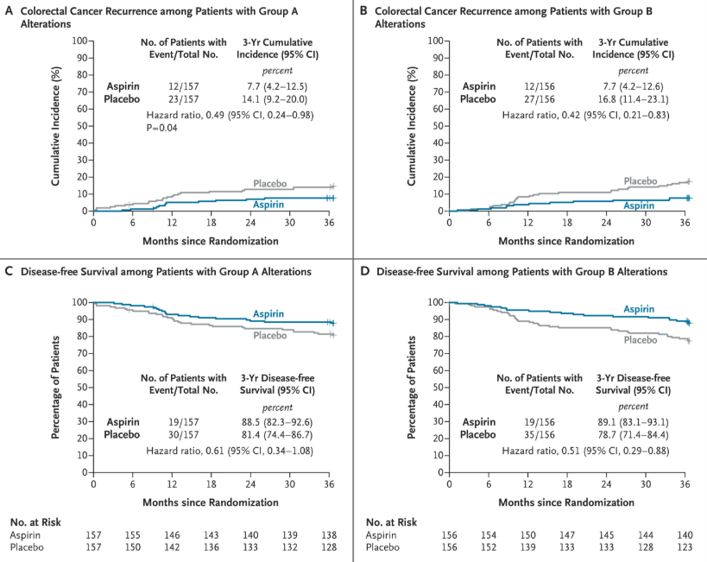
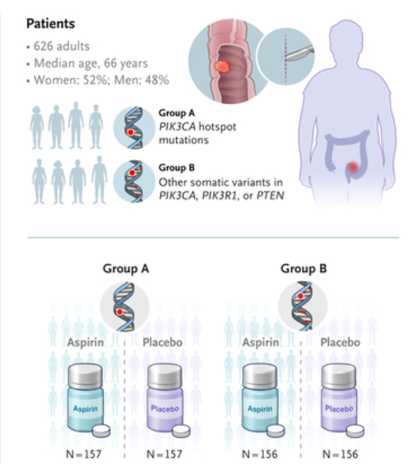
ALASCCA: ASA160

Slide 31
ASA 160 in PIK3CA mutated CRC
Aspirin may be an effective targeted adjuvant therapy in approximately 40% of patients with resected colorectal cancer
51% reduction in recurrence at 3 years

Slide 32
Exercizumab: CHALLENGE trial
Does structured exercise improve outcomes in resected CRC?
Goal of the exercise program was to increase recreational aerobic exercise from baseline by at least 10 metabolic equivalent task (MET)–hours per week during the first 6 months and then to maintain or further increase the amount during the final 2.5 years
The focus was on promoting aerobic exercise of at least moderate intensity, such as brisk walking, which has an intensity of approximately 4 METs

Slide 33
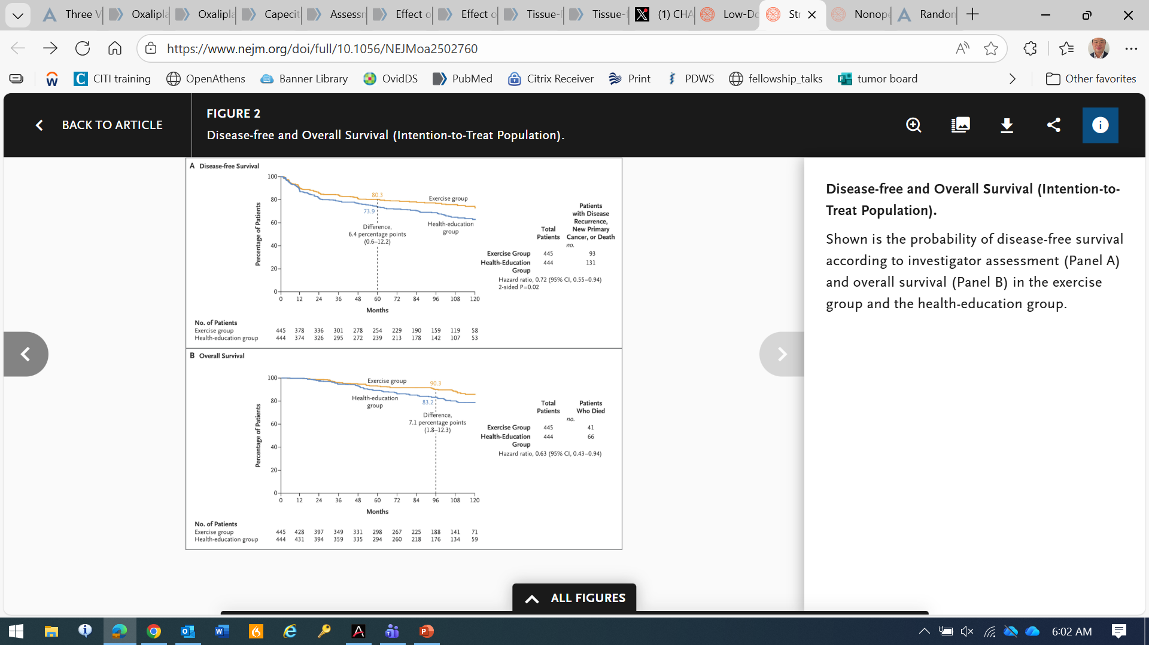
CHALLENGE Trial

Slide 34
CHALLENGE Trial

Slide 35
Case
A 56 yo M with HTN presents to his internist with fatigue, restless legs for the past 3 months. He notes frequent trips to Sonic because he craves their nugget ice. Hemoglobin is 9.5 with MCV of 66, Platelets are 740K. Ferritin is 15, Transferrin saturation is 5%. Creatinine is normal. Colonoscopy is performed demonstrating a 5 cm mass at the hepatic flexure, pathology with moderately differentiated adenocarcinoma. CEA is 45. CT C/A/P w/ contrast demonstrates no distant spread. Patient undergoes right hemicolectomy.
Pathology demonstrates G2 moderately differentiated adenocarcinoma, mismatch repair proteins are intact. pT4N0, R0 resection with all margins negative. There is lymphovascular invasion, no perineural invasion. 0/11 LNs involved with carcinoma. He presents to oncology clinic for evaluation and treatment recommendations
What Stage is this cancer? (I, II, IIII, or IV)
What high risk features are present?
Would you give adjuvant chemotherapy?

Slide 36
Case
A 56 yo M with HTN presents to his internist with fatigue, restless legs for the past 3 months. He notes frequent trips to Sonic because he craves their nugget ice. Hemoglobin is 9.5 with MCV of 66, Platelets are 740K. Ferritin is 15, Transferrin saturation is 5%. Creatinine is normal. Colonoscopy is performed demonstrating a 5 cm mass at the hepatic flexure, pathology with moderately differentiated adenocarcinoma. CEA is 45. CT C/A/P w/ contrast demonstrates no distant spread. Patient undergoes right hemicolectomy.
Pathology demonstrates G2 moderately differentiated adenocarcinoma, mismatch repair proteins are intact. pT4N0, R0 resection with all margins negative. There is lymphovascular invasion, no perineural invasion. 0/11 LNs involved with carcinoma. He presents to oncology clinic for evaluation and treatment recommendations
What Stage is this cancer? (I, II, IIII, or IV). Stage II
What high risk features are present? T4, Lymphvascular invasion, inadequate surgery < 12 lymph noodes
Would you give adjuvant chemotherapy? Yes
T4 High risk stage II actually has worse prognosis than low risk stage III

Slide 37
Case
64 yo M with comorbid DM c/b peripheral neuropathy and CKD3 presents to his internist with constipation. Colonoscopy is performed demonstrating a 4 cm mass in the sigmoid colon, pathology with poorly differentiated adenocarcinoma. CEA is 157. CT C/A/P w/ contrast demonstrates no distant spread. Patient undergoes left hemicolectomy.
Pathology demonstrates G3 poorly differentiated adenocarcinoma, mismatch repair proteins are intact. pT4N2, R0 resection with all margins negative. There is lymphovascular invasion and perineural invasion. 6/24 LNs involved with carcinoma. He presents to your oncology clinic for evaluation and treatment recommendations
What Stage is this cancer? (I, II, IIII, or IV)
Would you give adjuvant chemotherapy?
If so, which regimen? What duration?

Slide 38
Case
64 yo M with comorbid DM c/b peripheral neuropathy and CKD3 presents to his internist with constipation. Colonoscopy is performed demonstrating a 4 cm mass in the sigmoid colon, pathology with poorly differentiated adenocarcinoma. CEA is 157. CT C/A/P w/ contrast demonstrates no distant spread. Patient undergoes left hemicolectomy.
Pathology demonstrates G3 poorly differentiated adenocarcinoma, mismatch repair proteins are intact. pT4N2, R0 resection with all margins negative. There is lymphovascular invasion and perineural invasion. 6/24 LNs involved with carcinoma. He presents to your oncology clinic for evaluation and treatment recommendations
What Stage is this cancer? (I, II, IIII, or IV) High risk IIIC
Would you give adjuvant chemotherapy? Yes
If so, which regimen? 6 months FOLFOX

Slide 39
Rectal cancer: Treat before you cut
Location matters!
  Low/distal rectal cancers may involve sphincter → surgery is abdominoperineal resection (APR) with colostomy
  Proximal rectal cancers → Low anterior resection (can often avoid ostomy)
Early stage disease → T1-T2 → resection
PMMR T3-4 or N+ → total neoadjuvant therapy with chemoradiation and 12 weeks FOLFOX before surgery
  Complete responses in 30-45% patients that allow for watch and wait and organ/sphincter preservation (avoid colostomy)
DMMR: Dostarlimab PD-1 immunotherapy → complete response → no surgery → organ preservation

Slide 40
Metastatic disease: Stage IV

Slide 41
Oligometastatic disease: Stage IV disease with the potential for curative intent
Definition: metastatic spread involving up to 2 or occasionally 3 sites with up to 5 total metastases
Usually: 1-3 well-defined metastases of the lung or liver
Tx: multidisciplinary staged resection and systemic therapy sometimes with local therapy (Y90/ablation/stereotactic radiation)
Outcomes: achieve 5 yr OS 30-50% of cases

Slide 42
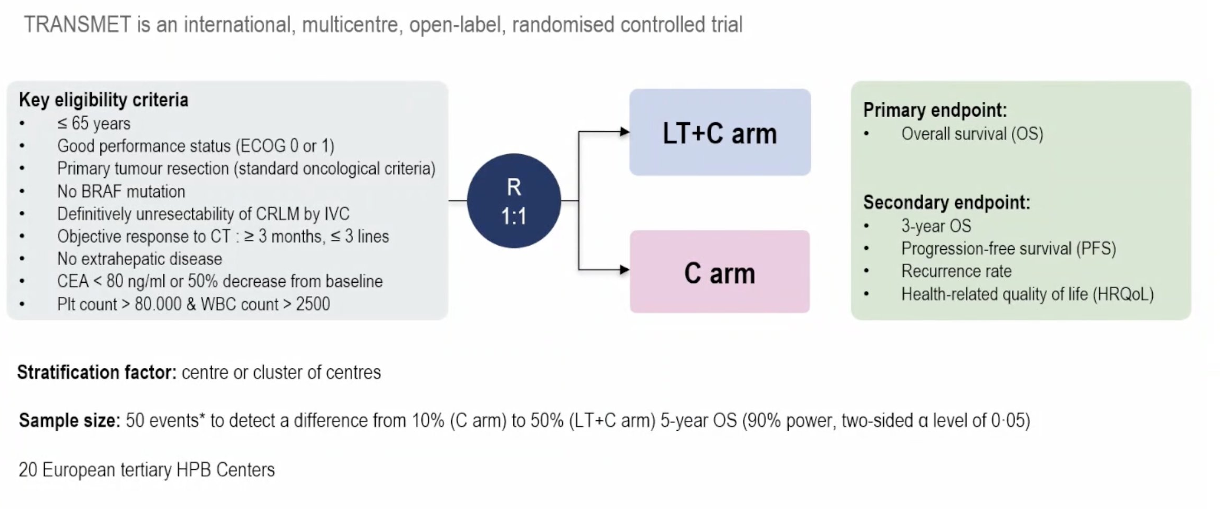
TRANSMET: Transplant for CRC with liver only metastases

Slide 43
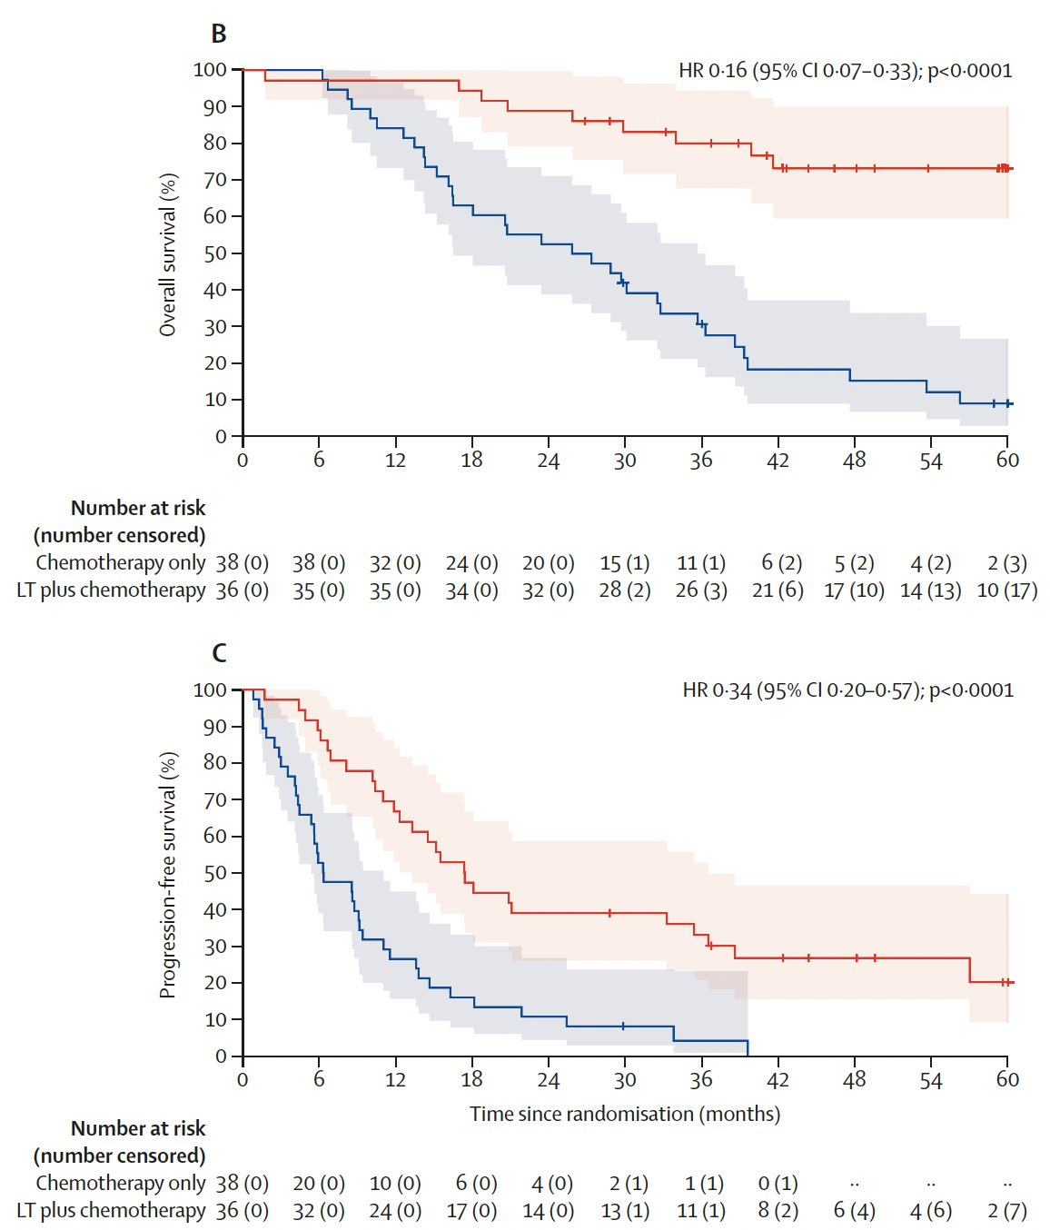
Per protocol
5-yr OS: 56.6 vs 12.6%
ITT
Notes:
Adam R, Piedvache C, Chiche L, Adam JP, Salamé E, Bucur P, Cherqui D, Scatton O, Granger V, Ducreux M, Cillo U, Cauchy F, Mabrut JY, Verslype C, Coubeau L, Hardwigsen J, Boleslawski E, Muscari F, Jeddou H, Pezet D, Heyd B, Lucidi V, Geboes K, Lerut J, Majno P, Grimaldi L, Levi F, Lewin M, Gelli M; Collaborative TransMet group. Liver transplantation plus chemotherapy versus chemotherapy alone in patients with permanently unresectable colorectal liver metastases (TransMet): results from a multicentre, open-label, prospective, randomised controlled trial. Lancet. 2024 Sep 21;404(10458):1107-1118. doi: 10.1016/S0140-6736(24)01595-2. PMID: 39306468.

Slide 44
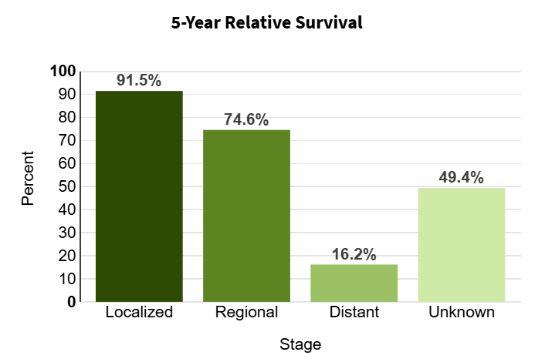
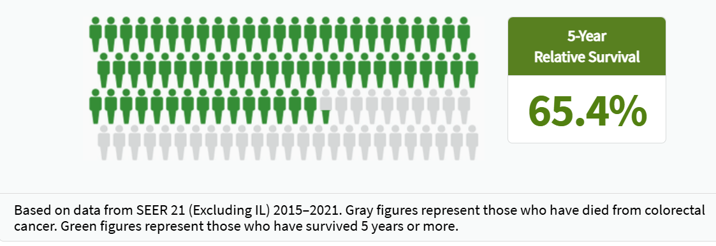
Keeping Goals in mind in Stage IV
Prolong survival
  Median OS
Minimize toxicity

Slide 45
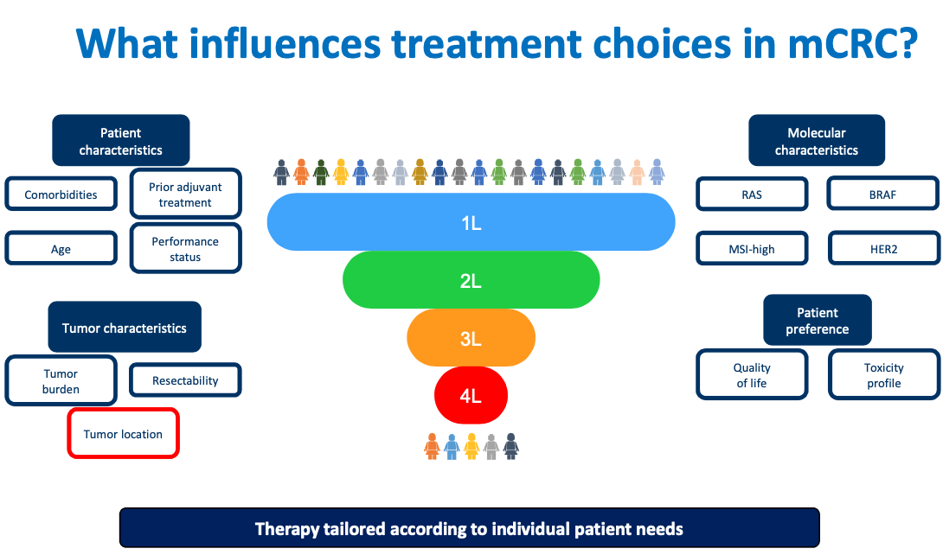
The Continuum of Care: OS and maintaining quality of life
Is the patient fit? PS? Comorbidities?
Standard of care testing: dMMR/MSI-H; RAS/BRAF/KRAS/HER2
BRAFV600E: poor prognosis
Side?
Candidate for Bevacizumab?
Asymptomatic primary should be left in place

Slide 46
1L systemic therapy: Keeping it simple
Stage IV
MSI-H: Immunotherapy
RAS WT Left: FOLFOX + antiEGFR
BRAFV600E: FOLFOX/FOLFIRI encorafenib + cetuximab
Right sided or RASmut: FOLFOX or FOLIFIRI + Bevacizumab

Slide 47
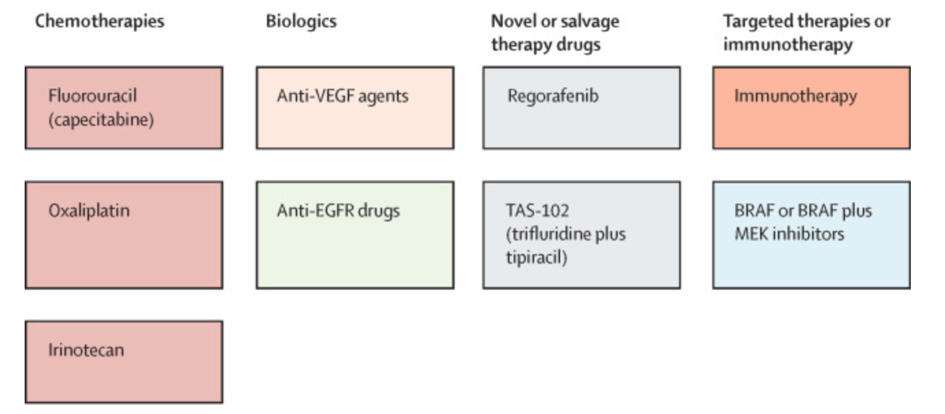
Metastatic/Recurrent disease: Initial therapy selection for PMMR colon cancer
-Initial systemic therapy: 5FU/Capecitabine backbone doublet preferred (FOLFOX/FOLFIRI/CAPEOX)
-Add anti-VEGF if right sided
-Add EGFR antibody if RAS WT and left sided
-BRAFV600E+: FOLFOX + Encorafenib + Cetuximab
Fruquintinib
Encorafenib +Cetuximab
Notes:
Resection of the primary tumor does not improve survival

Slide 48
Take into account toxicity of therapy
Drugs | Route | Toxicity | Contraindications | Other Notes
Infusional 5-FU | Pump via port | Neutropenia/mucositis (drop bolus), HFS | DPD deficiency | Coronary vasospasm; requires disconnect at 46 hours, port
Capecitabine | PO | Hand Foot Syndrome (palmar plantar erythrodysesthesia), diarrhea | DPD deficiency black box warning | Coronary vasospasm
Oxaliplatin | IV | Peripheral Neuropathy/Cold sensitivity, low Mg/K | Hypersensitivity | Sinusoidal liver dysfunction
Irinotecan | IV | Diarrhea (cholinergic) | UGT1A1*28 homozygous a/w severe neutropenia | Colitis (delayed diarrhea)/rare pulmonary
Bevacizumab/VEGF TKIs | IV/PO | HTN/CV | Fistulas | Wound healing; no surgery for 6-8 weeks
Cetuximab/Panitumumab | IV | Aceniform, Rash | Anaphylaxis, alpha Gal with Ceutximab | RAS/NRAS/KRAS/BRAF WT, left-sided

Slide 49
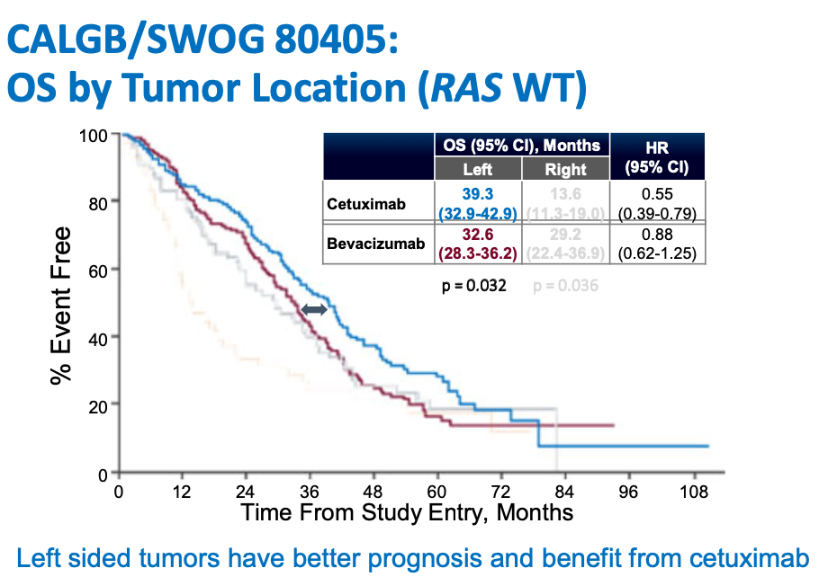
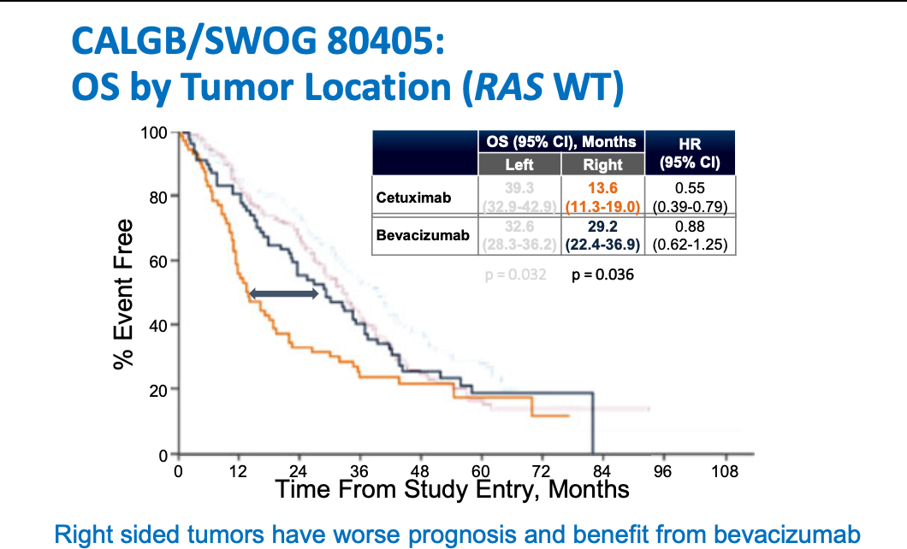
Back to sidedness: EGFR abs when no BRAF, KRAS, or NRAS mutations

Slide 50
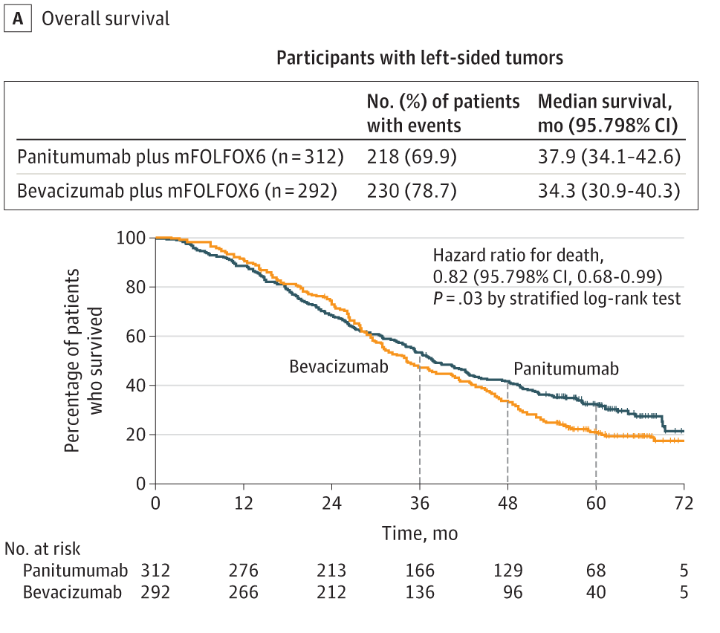
PARADIGM Trial: Panitumumab vs Bevacizumab Added to Standard First-line Chemotherapy improves Overall Survival Among Patients With RAS Wild-type, Left-Sided Metastatic Colorectal Cancer

Slide 51
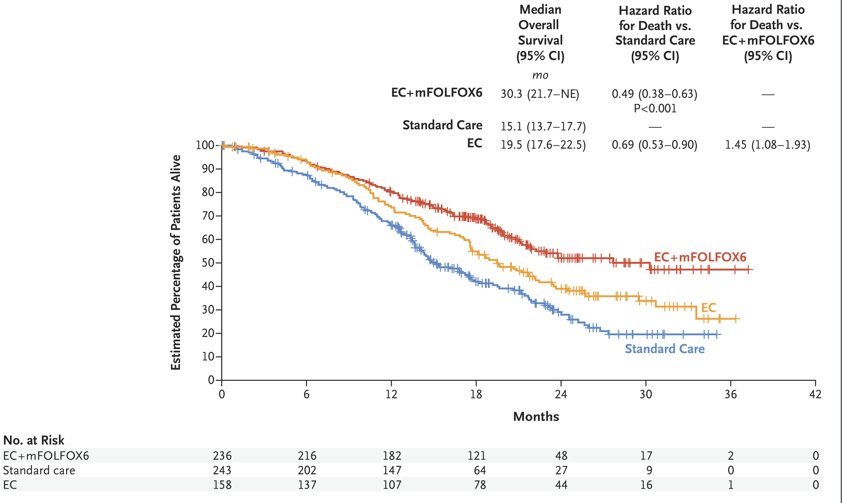
Slide 11
FOLFOX+Encorafenib/Cetuximab doubles OS in BRAF V600E mCRC
Notes:
Elez E, Yoshino T, Shen L, Lonardi S, Van Cutsem E, Eng C, Kim TW, Wasan HS, Desai J, Ciardiello F, Yaeger R, Maughan TS, Morris VK, Wu C, Usari T, Laliberte R, Dychter SS, Zhang X, Tabernero J, Kopetz S; BREAKWATER Trial Investigators. Encorafenib, Cetuximab, and mFOLFOX6 in BRAF-Mutated Colorectal Cancer. N Engl J Med. 2025 Jun 26;392(24):2425-2437. doi: 10.1056/NEJMoa2501912. Epub 2025 May 30. PMID: 40444708; PMCID: PMC12197837.

Slide 52
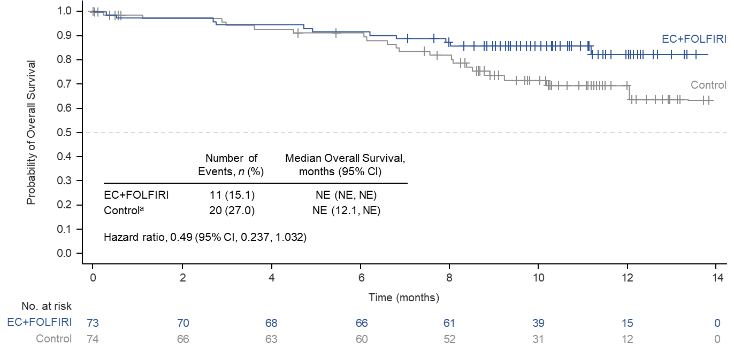
Overall Survival
Data are immature but showed a trend for OS improvement with EC + FOLFIRI vs control
ªFOLFIRI ± bevacizumab.
EC, encorafenib plus cetuximab; FOLFIRI, fluorouracil/leucovorin/irinotecan; NE, not estimable.
Notes:
Added P=0.0000454 after HR

Slide 53
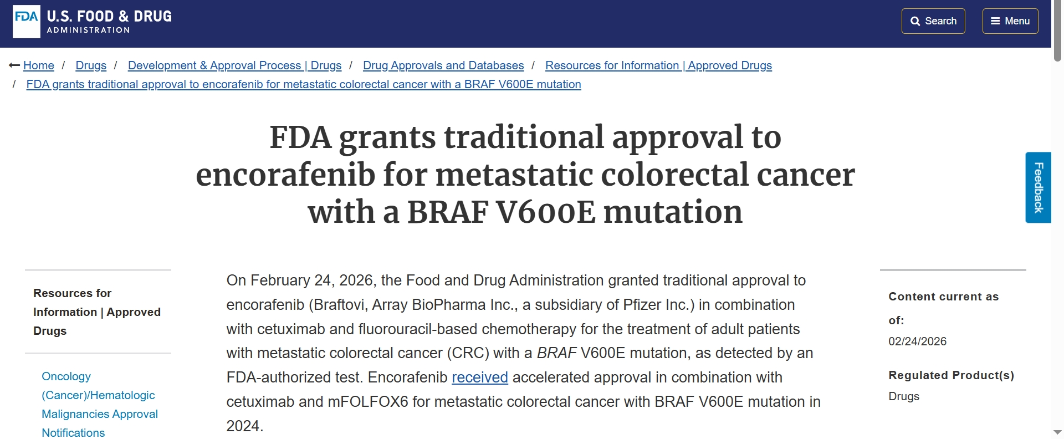

Slide 54
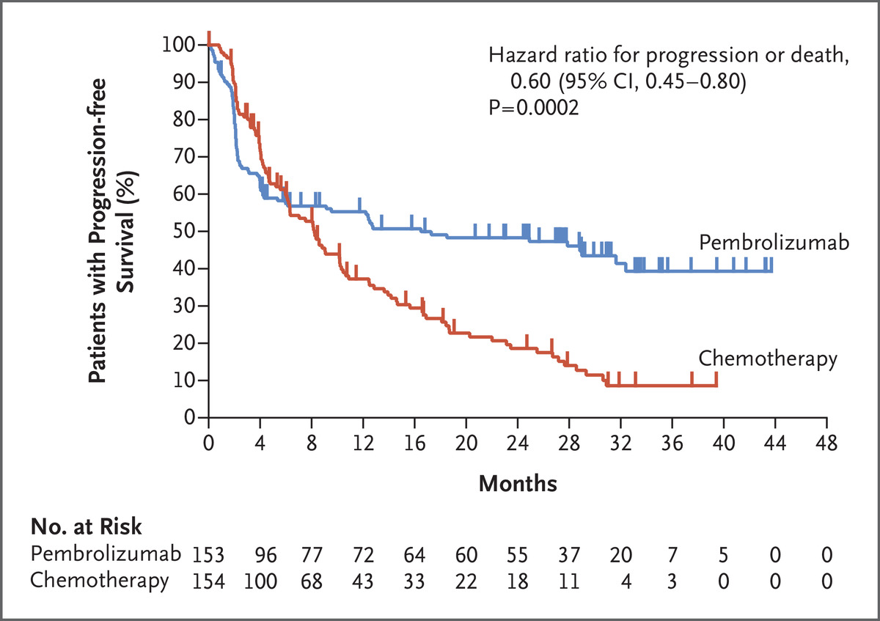

KEYNOTE 177: Pembrolizumab improves Progression-free Survival in dMMR Metastatic CRC
ORR 43.8% pembrolizumab group vs 33.1% chemo group;
CR 11% pembro vs 4% chemo
T André et al. N Engl J Med 2020;383:2207-2218.
Notes:
Figure 1. Progression-free Survival in Patients with MSI-H–dMMR Metastatic Colorectal Cancer. Shown are Kaplan–Meier estimates of progression-free survival among patients with microsatellite-instability–high (MSI-H) or mismatch-repair–deficient (dMMR) colorectal cancer. The analysis was performed in the intention-to-treat population. Tick marks represent data censored at the time of the last imaging assessment. Progression-free survival was assessed according to the Response Evaluation Criteria in Solid Tumors (RECIST), version 1.1, by independent central reviewers who were unaware of the group assignments. The P value shown met the prespecified statistical criterion (P=0.0117) for superiority of pembrolizumab over chemotherapy.

Slide 55
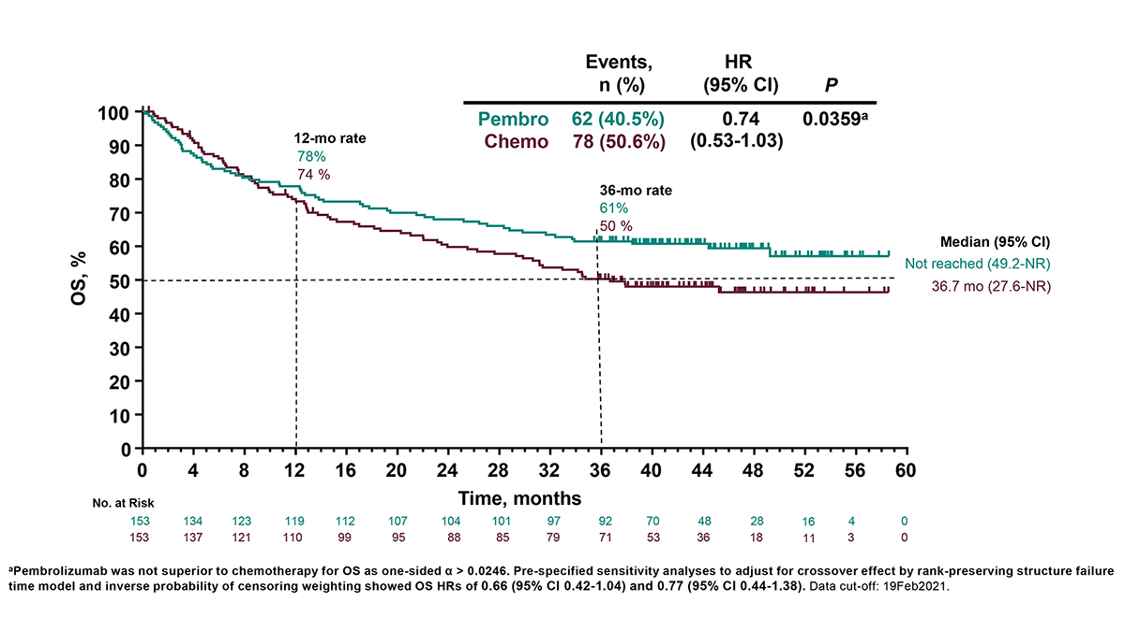

Slide 56
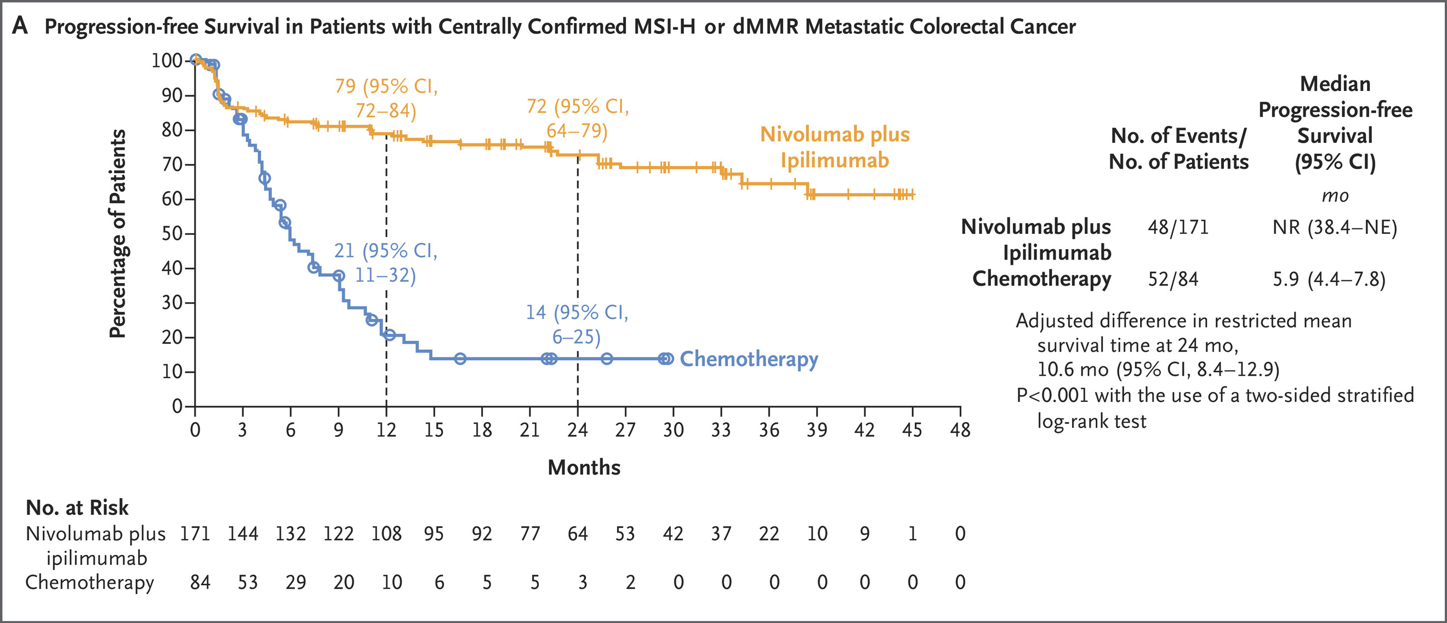
Dual PD-1 and CTLA-4 Checkpoint inhibitor immunotherapy
improves outcomes in DMMR/MSI-H CRC

Slide 57
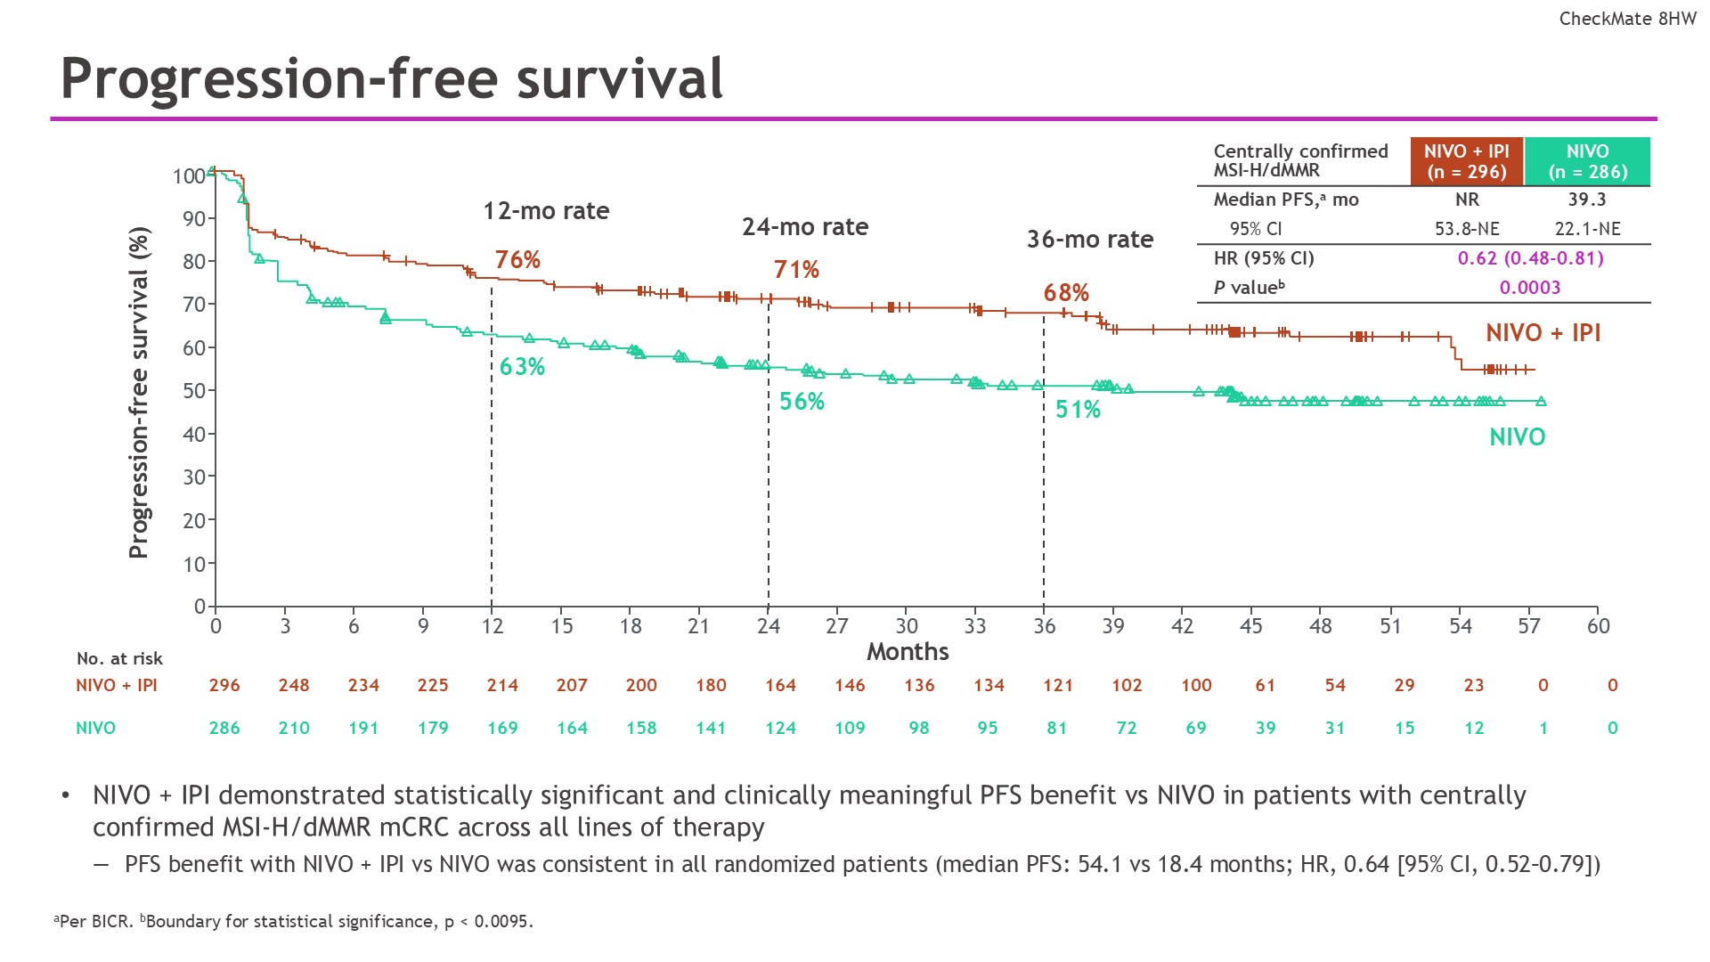
Progression-free survival
Combination IO > single agent
Content of this presentation is the property of the author, licensed by ASCO. Permission required for reuse.

Slide 58
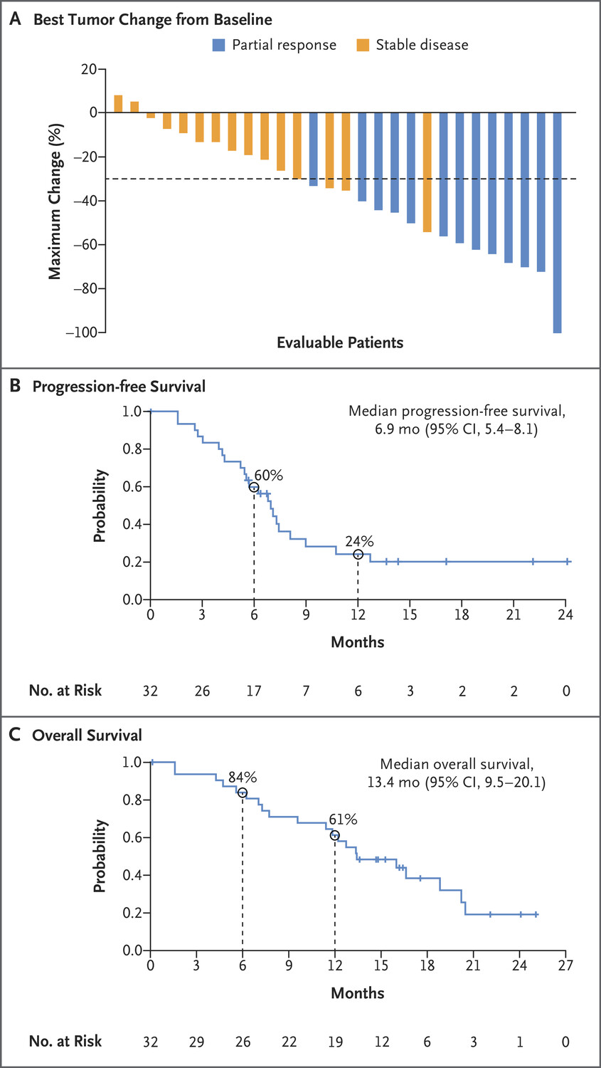
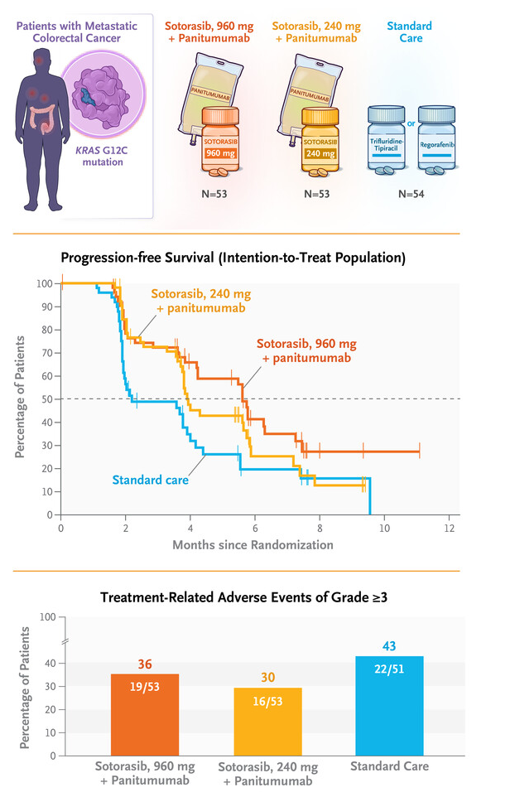
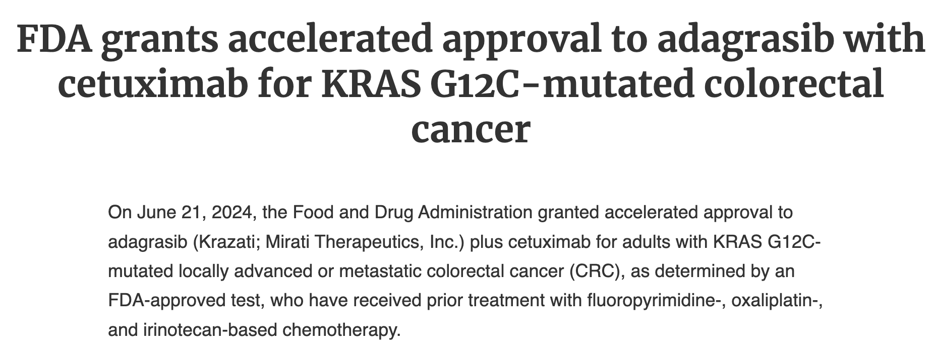
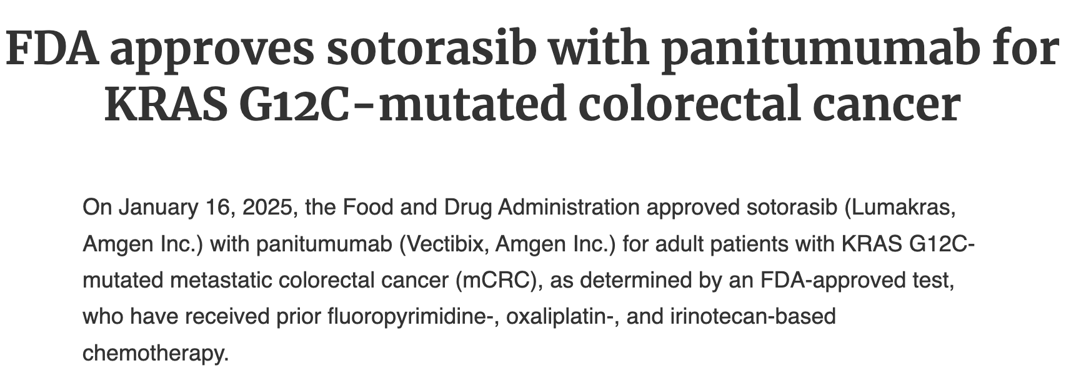
Targeted therapies in later lines: KRASG12C
Targeting KRASG12C and EGFR
Sotorasib + Panitumumab (left)
Adagrasib + Cetuximab (right)

Slide 59
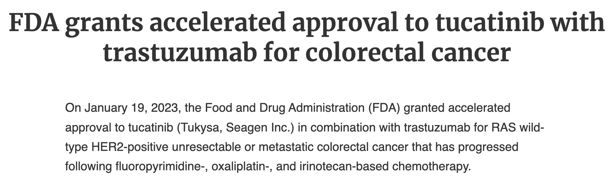
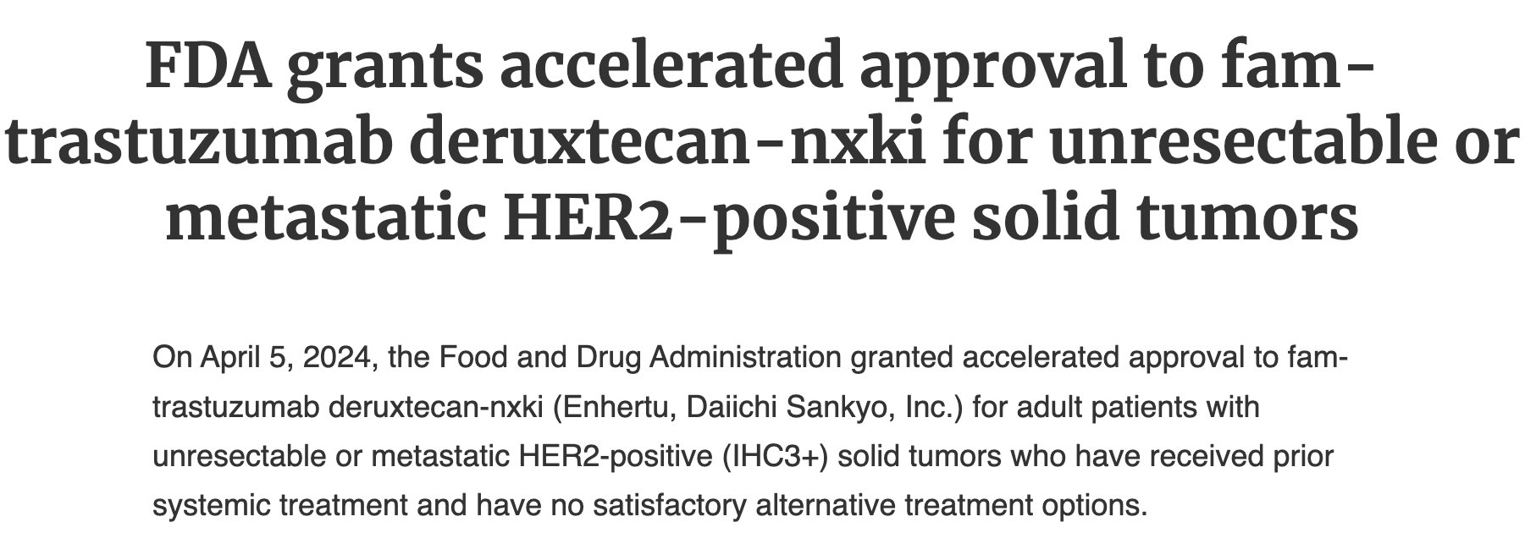
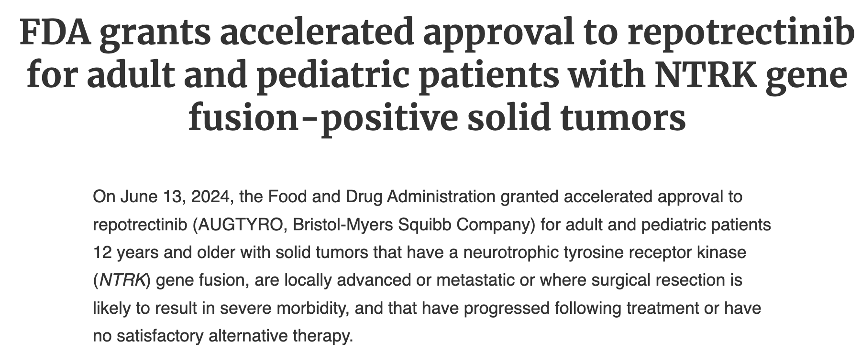
More targets, more approvals
HER2/ERBB2 therapies
  MOUNTAINEER: Trastuzumab/Tucatinib, ORR: 38% PFS 8m, OS 24m
  DESTINY-CRC01: Trastuzumab-Deruxtecan ORR 45% PFS 7m, OS 15m
NTRK Fusion (tumor agnostic)
  Larotrectnib
  Repotrectinib

Slide 60
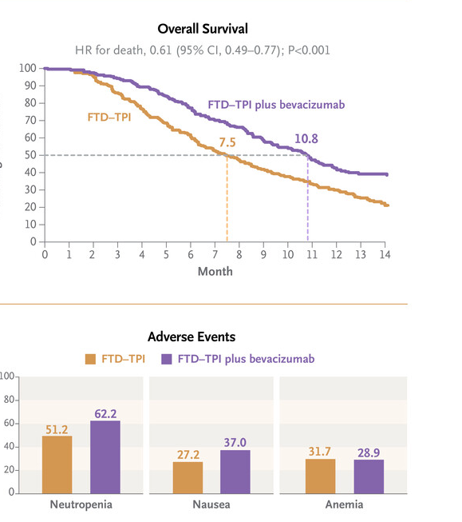
Subsequent lines of therapy (3L+ after FOLFOX/FOLFIRI)
Trifluridine/Tipiracil (Lonsurf) + Bevacizumab (SUNLIGHT): monitor for cytopenias
Fruquintinib (FRESCO): VEGF TKI; monitor BP and hand foot syndrome
Regorafenib (CORRECT): VEGF TKI; monitor BP and hand foot syndrome

Slide 61
Supportive care
Nausea: Zofran (Ondansetron), Compazine/Promethazine. Olanzapine, dexamethasone
Diarrhea: Loperamide/Lomotil
HFS/Palmar plantar erythrodysesthesia: Urea 20% and Diclofenac (Voltaren)
Painful peripheral neuropathy: duloxetine NOT Gabapentin
Constipation/bulky symptoms from rectal mass/high ostomy output: Consult Dietician (stool consistency)
  Low fiber diet

Slide 62
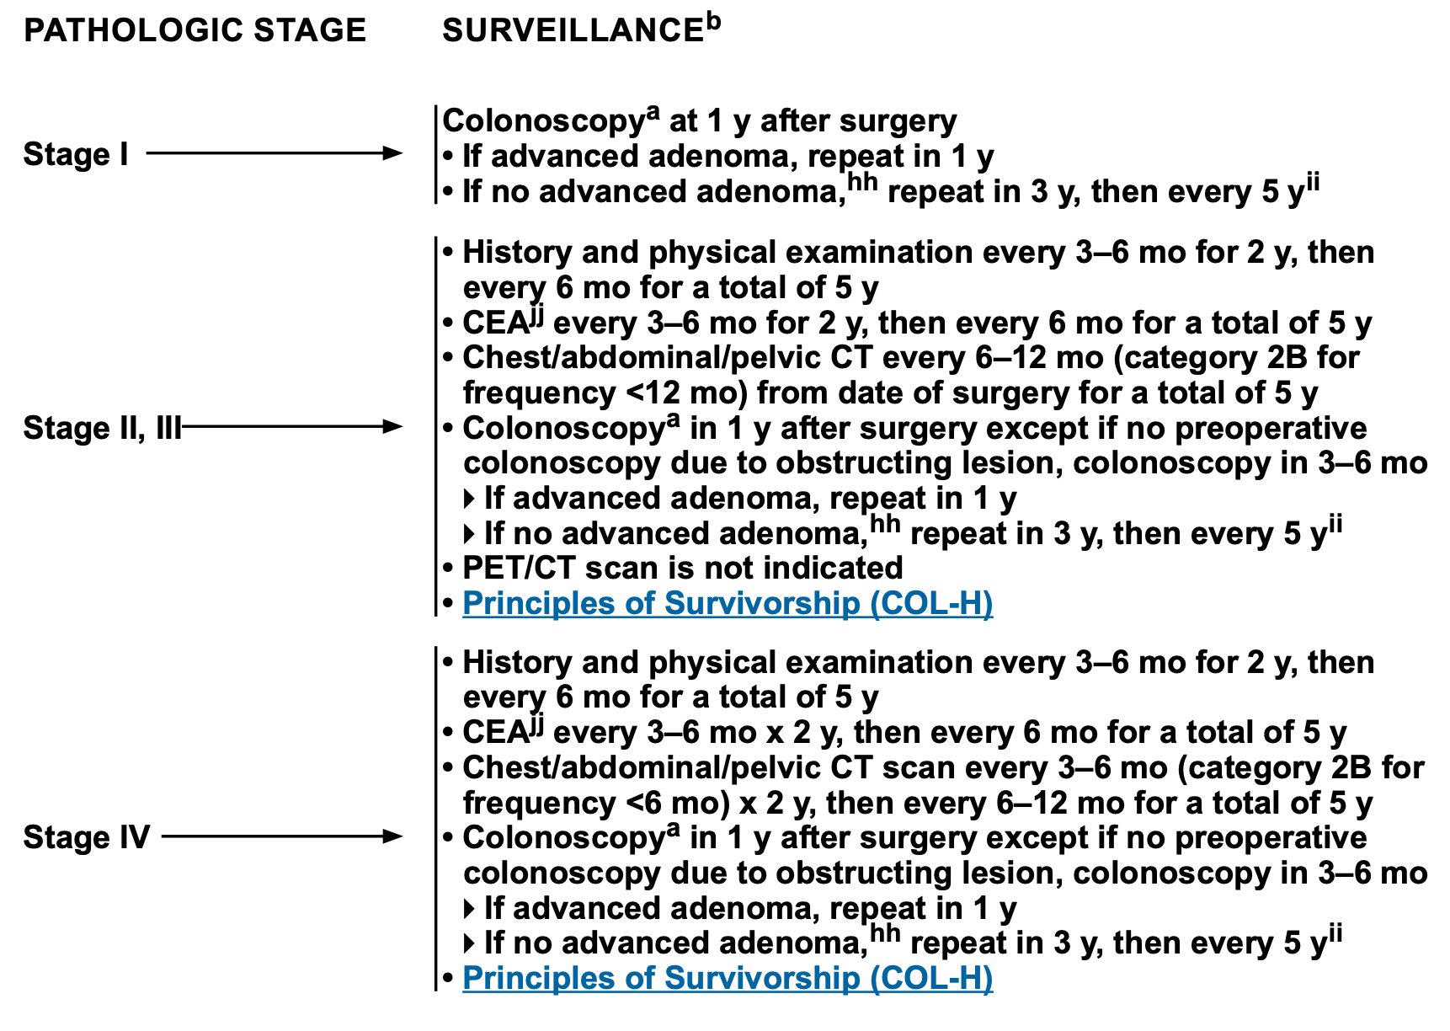
Surveillance

Slide 63
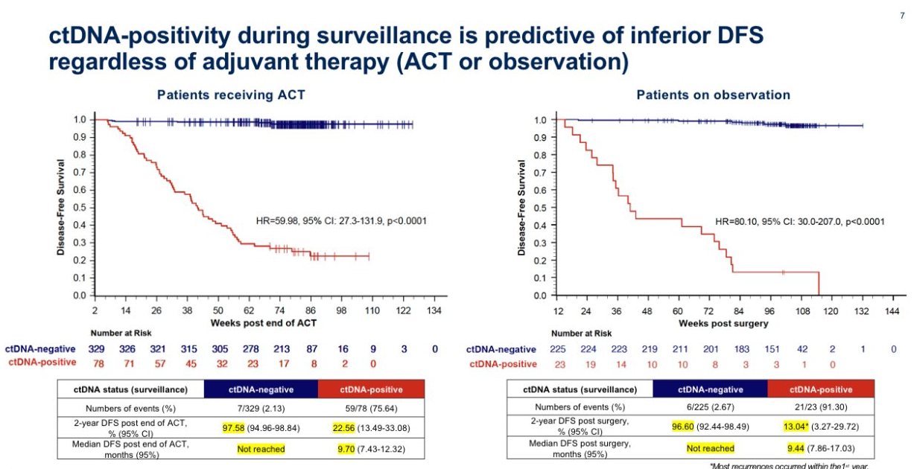
ctDNA: Predicting recurrence after definitive intent surgery

Slide 64
Take Home Points
All colorectal cancer should be MMR tested
Surgery for early-stage disease; adjuvant therapy for high-risk Stage II/Stage III
Adjuvant therapy: 3 months CAPOX/6 months of FOLFOX or 6 months of capecitabine in frailer patients
Oligometastatic disease can treated with definitive intent combining surgery, chemo and local therapy
For stage IV, 5FU doublet therapy-based therapy for PMMR colon cancer (FOLFOX/FOLFIRI)
Biomarker testing and sidedness impact therapy options especially in BRAFV600E patients
Checkpoint inhibitor immunotherapy 1L in dMMR/MSI-H

