Slide 1
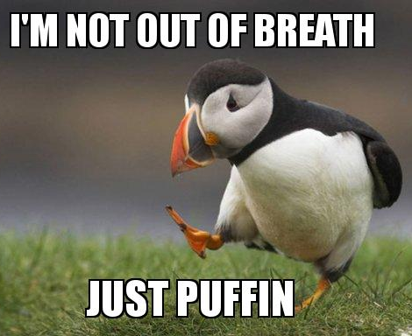
Dyspnea
Kaelin Bernier
Chief Resident
Intern Bootcamp

Slide 2
CC: Shortness of breath; acute hypoxia
Objectives
How to evaluate a patient
How to build a differential
Based on differential, order workup and treat

Slide 3
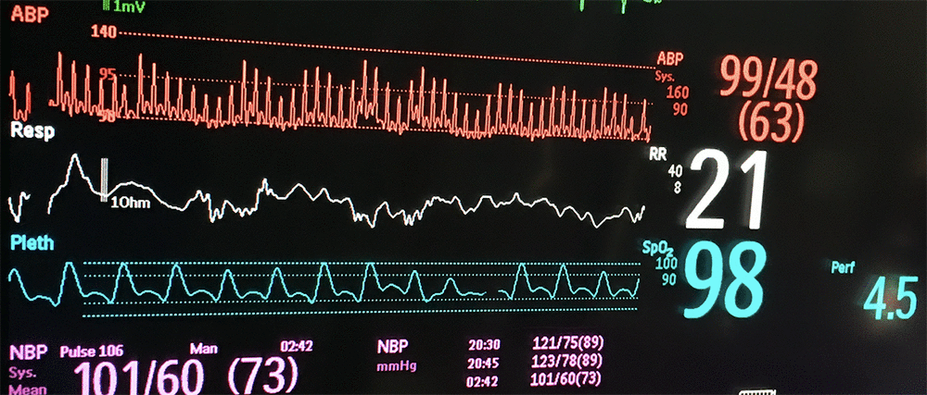
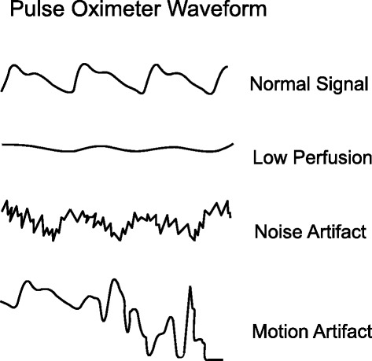
Evaluation
FIRST | Vitals Severity (ie is pt at risk for requiring intubation- using accessory muscles, cyanosis, rhonchi, obtunded) Is pt DNR/DNI? Recheck pulse ox and waveform
FIRST

Slide 4
Evaluation
HPI qs | Baseline/home O2 requirements What is patient’s baseline functional status- how far can they walk before getting short of breath normally How quickly and how much have we had to uptitrate O2? Infectious symptoms? Any recent hospitalizations or abx use? Any hx immunocompromised state? Pulm/cardiac review (COPD, asthma, PE, CHF, afib, recent CXR and TTE) Are fluids running? Aspiration events? Or mentation that may place pt at higher risk for aspiration Is patient on DVT prophylaxis? Or compliant with home AC if indicated? Is patient on tele? If so have there been any events? Has patient received any treatments (ie breathing treatments, diuretics?) and have symptoms improved?

Slide 5
Evaluation
PE | Respiratory effort- comfortable or sitting at side of bed tripoding? Or desatting just with conversation? When desatting, how long does it take to recover? Wheezing? Crackles? Evidence of fluid overload? BL LE edema, JVP?

Slide 6
Illness Script for acute dyspnea- BREATHE
Bacterial pneumonia or other infections
Reactive airway disease (asthma/copd)
Embolism (PE)
Acute coronary syndrome/arrhythmias/airway obstruction (aspiration, anaphylaxis)/anemia
Tension PTX/ cardiac tamponade
Heart failure or other causes of volume overload/pleural effusions
Everything else (heart structure- severe as or mr, pfos, pulm htn, hps, osa, ohs, ild, lung mass, sedative medications, neuromsk disorders that decrease breathing strength)

Slide 7
Tests
Tests | ABG CXR CTA chest BNP EKG Trop TTE CBC LA Infectious workup: blood cx, sputum cx, procal, cocci screen
Tests

Slide 8
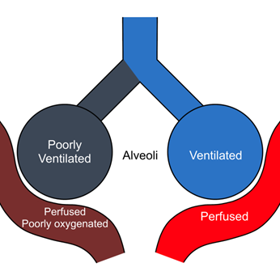
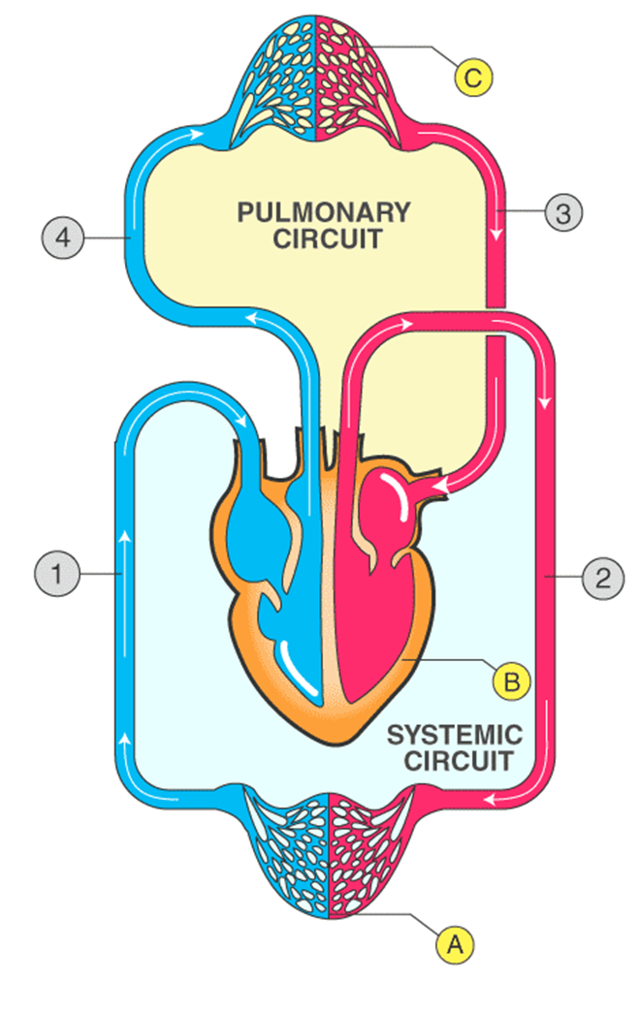
ABG
Can evaluate for
Hypercapnia (elevated pCO2 and resp acidosis if not compensated)
7.25 // 86 // 22
Overbreathing (resp alk)
7.48 // 28 // 22
Fatiguing and not compensating (normal/high pCO2 when expected low, ie not able to breath fast/take deep breaths)
7.34 // 48 // 105 // 20
PFR (PaO2:FiO2)
PaO2 105 on 50% (.5) FiO2-> PFR 210
Normal 400-500 at sea level
A-a gradient (alveolar-arterial)
PA (FiO2 x Patm – PH2O) - (pCO2/.8) which at RA sea level ~ 105
Normal 10-20 ( or ~ < [age/4] + 4)
Elevated VQ mismatch/shunting
Normal with hypoxemia from hypoventilation (elevated PCO2) or low barometric pressure (high elevation)

Slide 9
Treatment
Tx | Titrate supp O2 to keep spO2 92-96% or >88% (if copd) Steroids: ie iv solumedrol , prednisone CHF/volume overload: diuretics PNA: abx Aspiration: elevated head of bed, swallow eval, npo PTX: pulm consult for chest tube/needle decompression If asthma/copd exac- steroids, breathing tx, can consider 2gm Mg May need to consider HFNC, NPPV, intubation in which case alert MICU If pt with chronic dyspnea and normal spO2 but is tachypneic and workup unrevealing, consider air hunger and give iv morphine 1-2mg q2h sq prn

Slide 10
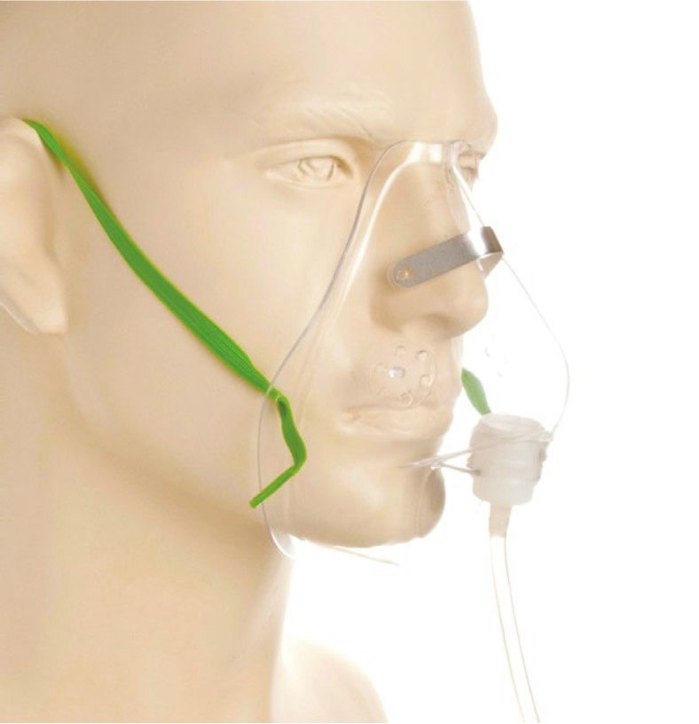
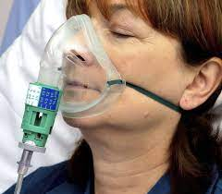
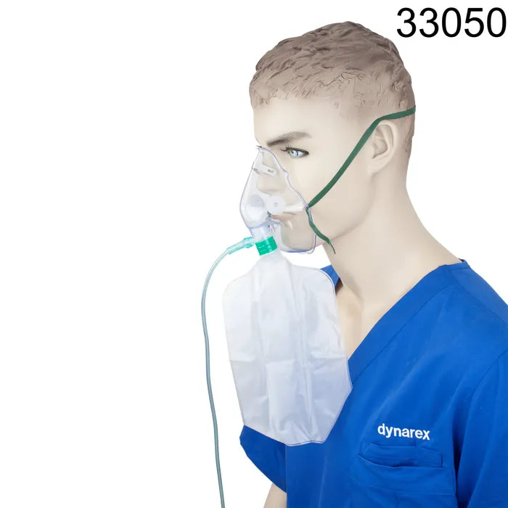
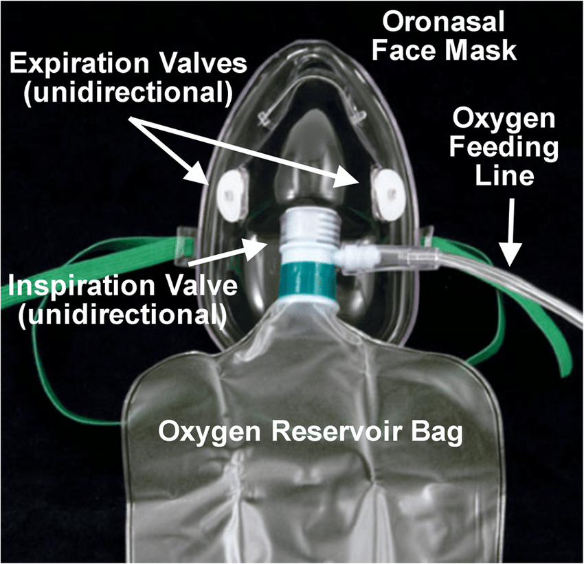
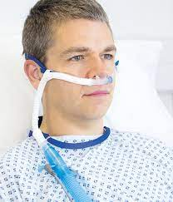
Supplemental Oxygen
Low flow oxygen devices
Device | Flow Rate | FiO2 | Note
Nasal cannula | 1-6L/min | 1L = 24 4L= 36 2L = 28 5L = 40 3L = 32 6L = 44 | May be humidified if not run at <5L/min which is why trach collar pts are on 6L O2
Simple mask | 6-10L/min | 35-60% | Never use at flow rate <5L/min to prevent rebreathing of CO2 Lateral perforations allow exhaled CO2 to escape
High flow oxygen devices
Venturi mask | 4-12L/min | 24-50% | Indicated for precise titration of FiO2; helpful if cf hypercapnia Uses graduated dial set to desired FiO2/ colored adapters which deliver desired FiO2
Non rebreather | 10-15L/min | 60%-90% | Indicated for high % FiO2; incorporates use of reservoir bag Flow rate must be sufficient to keep reservoir bag inflate 1/3-1/2 at all times One way flap prevents retention of CO2 during expiration
High flow | Up to 60L/min | Up to 100% | Heated, humidified air Reduced anatomical dead space; delivery of PEEP (~5); constant FiO2

Slide 11
Case 1:
65 yo male PMHx DMT2, HFrEF (EF 30%), COPD GOLD C, active tobacco use disorder (50+ pyh), CAD s/p PCI 2011, afib on Eliquis, CVA 2015 w minor residual speech deficits
Presenting with shortness of breath x 1 week
Says has associated productive cough with thick yellow sputum
Maybe subjective fevers? No chills, no hemoptysis
No recent hospitalizations or abx use
Compliant with Rx
Denying orthopnea, BL LE edema, weight gain
Denying chest pain or palpitations; no LH/dizziness/syncope;
VS: afebrile, spO2 93% on 2L, RR 16, HR 109, BP 134/95
On physical exam, patient sitting side of bed answering questions without issue, wet cough, HR tachy but regular and no murmurs, lungs with minor crackles and wheezes bilateral bases, thick neck but does not appear to have JVD, +1 BL LE edema,

Slide 12
Case 1
B | acterial pneumonia/ other infection
R | eactive airway disease (COPD, asthma)
E | mbolism (PE)
A | cute coronary syndrome (ACS)/ Arrhythmia/ Airway obstruction (aspiration, anaphylaxis)
T | ension pneumothorax/ cardiac Tamponade
H | eart failure or other causes of volume overload/ pleural effusions
E | verything else (heart structure disease ie severe AS/MR/PFO, pulm htn, OSA, OHS, ILD, lung mass, sedative Rx, neuromsk disorders)

Slide 13
Case 1
B | acterial pneumonia/ other infection | CBC, viral studies, covid/flu/rsv, procal, cocci screen, blood cx, sputum cx, CXR
R | eactive airway disease (COPD, asthma) | Clinical diagnosis
E | mbolism (PE) | CTA chest indicated?
A | cute coronary syndrome (ACS)/ Arrhythmia/ Airway obstruction (aspiration, anaphylaxis) | Trop, ekg, tele monitoring / evidence of obstruction? / hx aspiration events?
T | ension pneumothorax / cardiac Tamponade | CXR
H | eart failure or other causes of volume overload/ pleural effusions | BNP, CXR, TTE
E | verything else (heart structure disease ie severe AS/MR/PFO, pulm htn, OSA, OHS, ILD, lung mass, sedative Rx, neuromsk disorders)

Slide 14
Case 1
WBC 13K, Hgb 14
Rapid flu/rsv/covid neg
Procal 2 (H)
Upper resp viral panel, sputum cx, blood cx collected, results pending
Trop 12-> 11, EKG NSR 108
BNP 350, prior 410 6 mos ago
Still need TTE?

Slide 15
Case 1: PNA, COPD exac.
Pneumonia
Abx:
CAP: CTX + azithro x 5dd
MRSA: vancomycin, linezolid (x7dd)
Pseudomonas: cefepime, zosyn, meropenem
RFs: hospitalization w iv abx in past 3 mos, hx prior infection/colonization, immunosuppression
Steroids?
Severe CAP: PFR<300 with FiO2 >50 on NRB/HFNC: hydrocort 200 qd x 4-7dd to reduce inflammatory response and progression to ARDS; worsens outcomes if 2/2 influenza/fungal
Tests: blood cx, sputum cx, procal, MRSA screen, viral studies (flu/rsv/covid/upper resp panel), cocci screen, strep pneumo ag, legionella ag,
COPD exacerbation
Duonebs (albuterol-ipratroprium) q4-q6h sched; Albuterol q2h prn
Prednisone 40mg vs solumedrol 60-125mg bid x5-14dd
Abx? If increased sputum purulence and/or req vent support; can typically get away with CAP coverage
Titrate to keep spO2 88-92%
NPPV (CPAP for hypoxia, BiPAP for hypercarbia)

Slide 16
Case 2:
67 yo male PMHx HTN, COPD GOLD 2A, OSA not on CPAP, hx of provoked DVT (2018) 2/2 MVA previously on Eliquis, ETOH use disorder cb recurrent pancreatitis
Presenting with shortness of breath x 1 month but worsened over past couple of days
Dyspnea worse with exertion
Endorsing chest pressure and intermittent non-productive cough
Denying fevers, chills, hospitalizations or abx use
Compliant with Rx, on trelegy inhaler which has not been helping dyspnea
Denying orthopnea, BL LE edema, weight gain
Denying palpitations; no LH/dizziness/syncope;
VS: afebrile, spO2 93% on 2L, RR 16, HR 109, BP 134/95
On physical exam, patient sitting side of bed answering questions without issue,, HR tachy but regular and no murmurs, lungs CTAB, no JVD or BL LE edema

Slide 17
Case 2
B | acterial pneumonia/ other infection
R | eactive airway disease (COPD, asthma)
E | mbolism (PE)
A | cute coronary syndrome (ACS)/ Arrhythmia/ Airway obstruction (aspiration, anaphylaxis)
T | ension pneumothorax/ cardiac Tamponade
H | eart failure or other causes of volume overload/ pleural effusions
E | verything else (heart structure disease ie severe AS/MR/PFO, pulm htn, OSA, OHS, ILD, lung mass, sedative Rx, neuromsk disorders)

Slide 18
Case 2
B | acterial pneumonia/ other infection | CBC, viral studies, covid/flu/rsv, procal, cocci screen, blood cx, sputum cx, CXR
R | eactive airway disease (COPD, asthma) | Clinical diagnosis
E | mbolism (PE) | CTA chest indicated? D dimer?
A | cute coronary syndrome (ACS)/ Arrhythmia/ Airway obstruction (aspiration, anaphylaxis) | Trop, ekg, tele monitoring / evidence of obstruction? / hx aspiration events?
T | ension pneumothorax/ cardiac Tamponade | CXR
H | eart failure or other causes of volume overload/ pleural effusions | BNP, CXR, TTE
E | verything else (heart structure disease ie severe AS/MR/PFO, pulm htn, OSA, OHS, ILD, lung mass, sedative Rx, neuromsk disorders)

Slide 19
Case 2
WBC 6.5K, Hgb 13.5
Rapid flu/rsv/covid neg
Procal .03 (N)
Upper resp viral panel, sputum cx, blood cx collected, results pending
Trop 26->26, EKG NSR 112
BNP 602 (no prior to compare)
D dimer 1338

Slide 20
Case 2: Pulmonary embolism
Pulmonary embolism
High risk/Massive: sBP<90 or drop sBP baseline by 40 x 15min +
thrombolytics, embolectomy
Submassive: HDS but may have abnormal biomarkers (trop, BNP), evidence of RV dysfunction
AC: hep gtt, lovenox, DOAC, warfarin
Generally avoid excessive ivf (worsens dilated RV) and intubation (increased positive pressure can decrease preload and compress RV)
PERT (PE response team): 602-201-4442
Well’s score (<2 low, >6 high)→ probability of PE and whether to pursue further testing
PESI (PE severity index) score→ helps to determine severity of PE
Labs: BNP, trop, D-dimer (if low risk and ddimer<500 excludes, if int risk and ddimer<500, can also exclude; if high risk, low ddimer does not exclude; falsely high w increased age, obesity, smoking, inflammatory states, renal insufficiency)
Imaging: CTA, VQ, BL LE duplex
TTE: assess for RV dysfunction (EF, RVSP, RAP, McConnell’s sign, TR)

Slide 21
Case 3
42 yo female PMHx DMT2, HFrEF (EF 45%), COPD, polysubstance use disorder (meth, MJ), ETOH use disorder w hx withdrawal
Presenting due to ETOH withdrawal
Noted to have supp O2 requirements
Poor historian, unwilling to participate, mumbles to all questions
VS: afebrile, spO2 desatted to 86% on RA, titrated to 92% on 2L, RR 18, HR 112, BP 154/95
On physical exam, patient laying in bed, agitated, intermittently answering questions; HR tachy but regular and no murmurs; lungs coarse breath sounds BL bases, no wheezing; no JVD or BL LE edema

Slide 22
Case 3
B | acterial pneumonia/ other infection
R | eactive airway disease (COPD, asthma)
E | mbolism (PE)
A | cute coronary syndrome (ACS)/ Arrhythmia/ Airway obstruction (aspiration, anaphylaxis)
T | ension pneumothorax/ cardiac Tamponade
H | eart failure or other causes of volume overload/ pleural effusions
E | verything else (heart structure disease ie severe AS/MR/PFO, pulm htn, OSA, OHS, ILD, lung mass, sedative Rx, neuromsk disorders)

Slide 23
Case 3
B | acterial pneumonia/ other infection | CBC, viral studies, covid/flu/rsv, procal, cocci screen, blood cx, sputum cx, CXR
R | eactive airway disease (COPD, asthma) | less likely
E | mbolism (PE) | CTA chest indicated?
A | cute coronary syndrome (ACS)/ Arrhythmia/ Airway obstruction (aspiration, anaphylaxis) | Trop, ekg, tele monitoring / evidence of obstruction? / hx aspiration events?
T | ension pneumothorax/ cardiac Tamponade | CXR
H | eart failure or other causes of volume overload/ pleural effusions | BNP, CXR
E | verything else (heart structure disease ie severe AS/MR/PFO, pulm htn, OSA, OHS, ILD, lung mass, sedative Rx, neuromsk disorders)

Slide 24
Case 3
WBC 8K, Hgb 12
Rapid flu/rsv/covid neg
Procal .01 (H)
Upper resp viral panel, sputum cx, blood cx collected, results pending
Trop 16->14, EKG NSR 110
BNP 180

Slide 25
Case 3: aspiration
Aspiration pneumonia
RFs: reduced consciousness, dysphagia, UGI disorders, protracted emesis, LV TF/NGT, intubation, trach, increased age
Abrupt onset, low grade fever, crackle/wheezes, CXR dependent pulm segments
Abx? Usually not indicated unless cf bacterial infection; persistent/worsening resp impairment; reevaluate for need. CAP regimen x 5dd
Anaerobic coverage? Per IDSA/ATS if lung abscess/empyema
unasyn / CTX + flagyl/ zosyn / mero
Supportive care: OG suctioning, HOB 30 degrees, SLP consult

Slide 26
Case 4:
Pt is a 42 yo M PMHx COPD w known severe emphysema, prior tob use 50+ pyh
Presenting with productive cough, nausea, vomiting, and dyspnea x couple of days
Says has associated productive cough with thick yellow sputum
Denying fevers, chills, hemoptysis
No recent hospitalizations or abx use
Compliant with Rx
Denying orthopnea, BL LE edema, weight gain
Denying chest pain or palpitations; no LH/dizziness/syncope;
VS: afebrile, spO2 94% on 4L, RR 16, HR 115, BP 128/86
On physical exam, patient sitting side of bed answering questions without issue, lungs coarse breath sounds bilaterally, heart sinus tachy and no murmurs, no jvd or BL LE edema

Slide 27
Case 4
B | acterial pneumonia/ other infection
R | eactive airway disease (COPD, asthma)
E | mbolism (PE)
A | cute coronary syndrome (ACS)/ Arrhythmia/ Airway obstruction (aspiration, anaphylaxis)
T | ension pneumothorax/ cardiac Tamponade
H | eart failure or other causes of volume overload/ pleural effusions
E | verything else (heart structure disease ie severe AS/MR/PFO, pulm htn, OSA, OHS, ILD, lung mass, sedative Rx, neuromsk disorders)

Slide 28
Case 4
B | acterial pneumonia/ other infection | CBC, viral studies, covid/flu/rsv, procal, cocci screen, blood cx, sputum cx, CXR
R | eactive airway disease (COPD, asthma) | Clinical diagnosis
E | mbolism (PE) | would consider CTA if CXR unrevealing
A | cute coronary syndrome (ACS)/ Arrhythmia/ Airway obstruction (aspiration, anaphylaxis) | Trop, ekg, tele monitoring / evidence of obstruction? / hx aspiration events?
T | ension pneumothorax/ cardiac Tamponade | CXR
H | eart failure or other causes of volume overload/ pleural effusions | BNP, CXR
E | verything else (heart structure disease ie severe AS/MR/PFO, pulm htn, OSA, OHS, ILD, lung mass, sedative Rx, neuromsk disorders)

Slide 29
Case 4
WBC 3K, Hgb 12
Rapid flu/rsv/covid neg
Procal neg
Upper resp viral panel, sputum cx, blood cx collected, results pending
Trop 12-> 11, EKG NSR 116
BNP 90

Slide 30
Case 4: Pneumothorax
Pneumothorax
Primary spontaneous PTX (PSP): without precipitating external events and no clinical lung disease ; these are the tall, thin young males
Secondary spontaneous PTX (SSP): complication of underlying lung disease
Traumatic: iatrogenic (thoracentesis, lung bx, mech vent), non-iatrogenic
RFs for SSP: COPD/emphysema (50-70%, usually rupture of apical bleb/bullae), ILD, malignancy, TB, sarcoid, CF
Stable vs unstable (RR>24, HR>120, RA spO2<90, ability to speak whole sentences, HDS)
Small (<2cm at apex) vs large (>2cm at apex)
If small and stable, and asymptomatic/minimal sx, may observe w supp/o2
Chest tube thoracostomy/needle decompression
Avoid HFNC/NPPV, CPT

Slide 31
Case 5:
42 yo female PMHx NICM (EF 15%), severe MR, polysubstance use history (tobacco 25+ pyh and methamphetamine quit 6 mos ago) , housing instability
Presenting with shortness of breath x 8 days
Says has associated nonproductive cough
Denying fevers, chills, no hemoptysis
No recent hospitalizations or abx use
Says dyspnea worse with exertion and laying down; has noticed worsening BL LE edema
Has been out of medications for past couple of months
Denying chest pain or palpitations; no LH/dizziness/syncope;
VS: afebrile, spO2 93% on 4L, RR 20, HR 112, BP 145/85
On physical exam, patient sitting side of bed answering questions without issue, HR tachy but regular and systolic murmur, lungs with crackles BL bases but no wheezing, + JVD, +3 BL LE edema

Slide 32
Case 5
B | acterial pneumonia/ other infection
R | eactive airway disease (COPD, asthma)
E | mbolism (PE)
A | cute coronary syndrome (ACS)/ Arrhythmia/ Airway obstruction (aspiration, anaphylaxis)
T | ension pneumothorax/ cardiac Tamponade
H | eart failure or other causes of volume overload/ pleural effusions
E | verything else (heart structure disease ie severe AS/MR/PFO, pulm htn, OSA, OHS, ILD, lung mass, sedative Rx, neuromsk disorders)

Slide 33
Case 5
B | acterial pneumonia/ other infection | CBC, viral studies, covid/flu/rsv, procal, cocci screen, blood cx, sputum cx, CXR
R | eactive airway disease (COPD, asthma) | Clinical diagnosis
E | mbolism (PE) | CTA chest indicated? D dimer?
A | cute coronary syndrome (ACS)/ Arrhythmia/ Airway obstruction (aspiration, anaphylaxis) | Trop, ekg, tele monitoring / evidence of obstruction? / hx aspiration events?
T | ension pneumothorax/ cardiac Tamponade | CXR
H | eart failure or other causes of volume overload/ pleural effusions | BNP, CXR, TTE
E | verything else (heart structure disease ie severe AS/MR/PFO, pulm htn, OSA, OHS, ILD, lung mass, sedative Rx, neuromsk disorders)

Slide 34
Case 5
WBC 8K, Hgb 13.5
Rapid flu/rsv/covid neg
Procal .1 (N)
Upper resp viral panel, sputum cx, blood cx collected, results pending
Trop 26->31->29, EKG NSR 108
BNP 4007
TTE?

Slide 35
Case 5: Pleural effusions
Pleural effusions
Thoracentesis?
Indication: new effusion of unclear etiology; NOT indicated when clinically obvious CHF w typical features (ie BL pleural effusions and pulm edema)
Diagnostic vs therapeutic
Cell count and cell diff, total protein, LDH, glucose, cholesterol, cx, cytology, pH
Lights (Pl:S prot>5, Pl:S LDH>.6,, or Pl LDH>2/3 ULN), PFO2 (pl fl chol>40, pl fl LDH>.6 ULN), PFO3 (pl fl >3, pl chol >55, pl LDH>2/3 ULN)– req chest tube
Generally 1.5L safe to avoid re-expansion pulm edema
Complicated parapneumonic effusion/empyema: pH<7.2, glucose<2.2, LDH>1000 (complicated), if frank pus (empyema)
If considering thora, would involve academic pulm
Volume removal
Diuretics: generally at least double home dose
HD/CRRT
TIPS consideration if recurrent hepatic hydrothorax

Slide 36
Types of respiratory failure
Hypoxemic- failure of O2 exchange | Hypoventilation | Drug overdose, chest wall trauma, muscle weakness, stroke or brain tumor involving respiratory center, OHS
 | Diffusion limitation | Scarring/abnormally thickened blood/gas barrier ie pulm fibrosis or ILD
 | Shunt | Responds poorly to increased FiO2 Anatomic: pulm AVMs/intracardiac shunt Physiologic: severe PNA w ARDS
 | V/Q mismatch | Mismatch ventilation and blood flow impairs uptake/elimination of gas by lung
 | High altitude | Low partial pressure of O2, normal A-a gradient
Hypercapnic/ ventilatory- failure to exchange or remove CO2 | Central hypoventilation Neuromuscular disease Obstruction (COPD, asthma, OHS)
Peri-operative – increased atelectasis due to low functional residual capacity | Post-operative analgesia Obesity, ascites Pre-operative tobacco smoking Excessive airway secretions Undiagnosed OSA Anesthetic and analgesic medication effect
Shock | Goal is to stabilize gas exchange to help unload respiratory muscles, lower their O2 consumption, and compensate for severe acidosis

