Slide 1
AHD UTIs Lecture
04 August 2026
Aishan Shi, MD

Slide 2
Questions addressed in the next 10 min
How should urinary specimens be collected?
What’s the definition of a UTI?
What’s the duration of treatment of uUTI vs cUTI?
Which antimicrobials should be used for uUTI vs cUTI?
When should ASB be screened for and treated?
What is the management approach for recurrent UTIs?
Should candida in the urine be treated, and if so, how?
Should staph aureus in the urine be treated, and if so, how?

Slide 3
Specimen Collection
Patent urinates into the urinal jug, medical staff pours urine into specimen cup and leaves it on the counter, lab collects the specimen cup in 30 minutes to run it.
Patient urinates into a specimen cup, medical staff transfers urine from specimen cup to the collection tube within 10 minutes, lab collects the urine collection tube within 2 hours and runs the sample.
Patient urinates into a specimen cup, lab collects the specimen cup, runs the UA, leaves the rest of the specimen in the cup to refrigerate for 24 hours, then starts the culture after 24 hours.
1. How should urinary specimens be collected?

Slide 4
Urine specimens from catheters
Catheter should be exchanged before specimen is collected.
  Foley catheters
  Suprapubic catheters
  Nephrostomy tubes
Specimen should not be collected from the bag, but rather from the sampling port after proper disinfection of the port site.
1. How should urinary specimens be collected?

Slide 5
Nuances to consider for urine testing
Urine culture is still gold standard.
Pre-treatment with antimicrobials or chronic suppressive antimicrobials can decrease the count of bacteria. This may require asking lab to work up low colony counts in the appropriate populations (transplant).
Urine from ileal conduits/ “urostomies” are often colonized with enteric organisms.
PCR tests of the urine should NOT be used to diagnose UTI, as these pick up multiple organisms (too sensitive) that are often part of flora (not specific).
PCR tests also do not provide susceptibilities, only an empiric antibiogram.
The only PCR test that would be useful in the setting of urinary tract infection is MTB-PCR for the appropriate patient (disseminated TB).
1. How should urinary specimens be collected?

Slide 6
Summary of Specimen Collection
Question how the specimen was collected by the patient.
Specimen needs to be handled properly to preserve specimen quality and avoid overgrowth of flora.
Self-collection/”clean-catch” specimen quality is variable.
Straight catheter specimen is probably better but invasive. If patient cannot provide a reliable self-collection specimen, straight catheter specimen is needed.
Indwelling catheters should be exchanged BEFORE urine specimen is collected.
Avoid contamination as much as possible.
1. How should urinary specimens be collected?

Slide 7
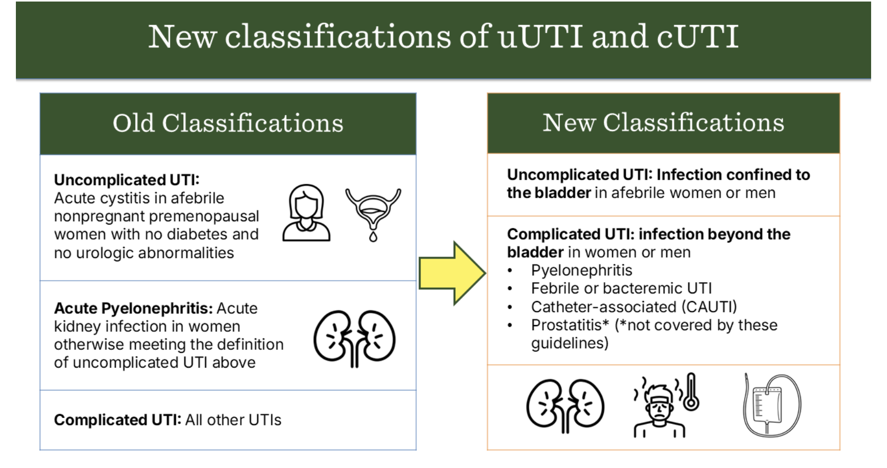
IDSA 2025 Guidelines on cUTI
2. What’s the definition of a UTI?

Slide 8
Management of uUTI
Oral antimicrobials with good bioavailability, duration 3-7 days (depending on anatomy, if choice is beta lactam, and if organism if more resistant or PsA):
  TMP-SMX (please dose appropriately, target dose 1-2 DS BID)
  Ciprofloxacin
  Levofloxacin
  Amoxicillin
  Amoxicillin/clavulanate
  Cephalexin
  Cefadroxil
Other oral antimicrobials for uUTI:
  Nitrofurantoin
  Fosfomycin (for E coli, if otherwise pan-R and susceptibility confirmed to fosfomycin)
Consider higher dosing:
  Cefdinir: 25% bioavailability
  Cefuroxime: 37% bioavailability, though 90% urinary excretion
  Cefpodoxime: 46% bioavailability though 80% urinary excretion
3. What’s the duration of treatment of uUTI vs cUTI?
4. Which antimicrobials should be used for uUTI vs cUTI?

Slide 9
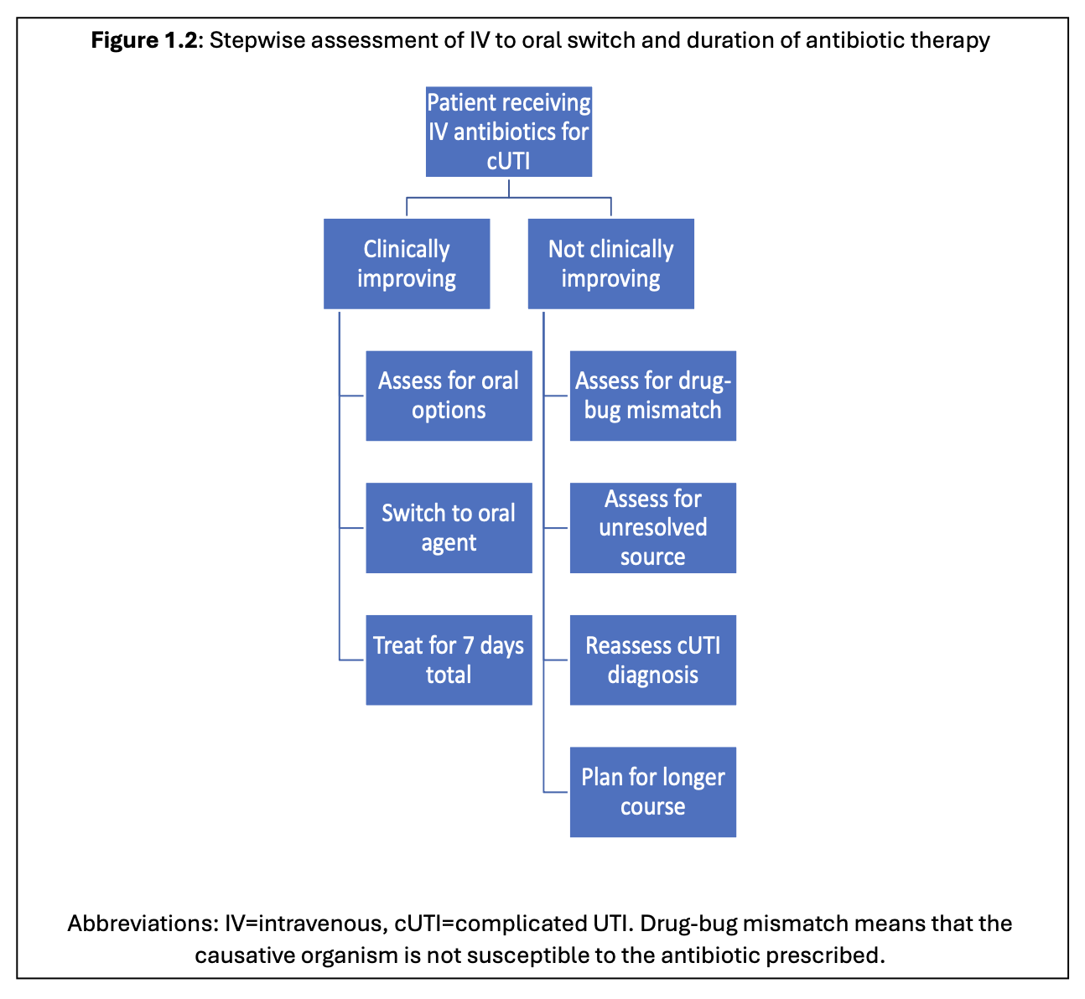
IDSA 2025 Guidelines on cUTI
3. What’s the duration of treatment of uUTI vs cUTI?
4. Which antimicrobials should be used for uUTI vs cUTI?

Slide 10
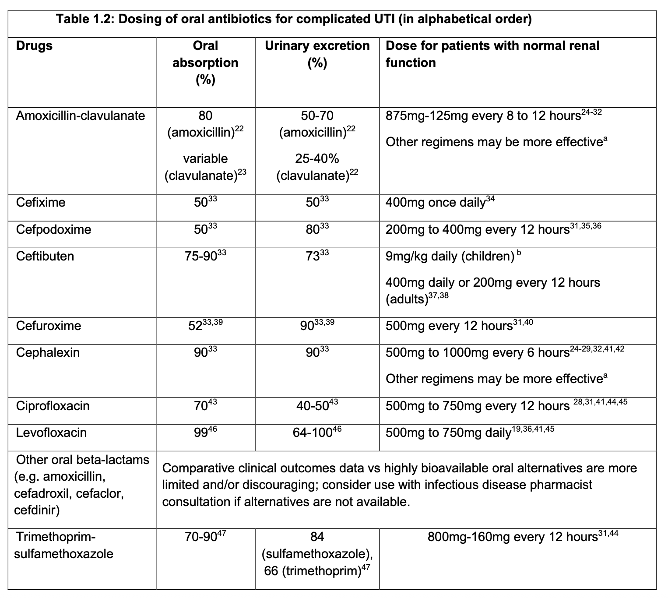

Slide 11
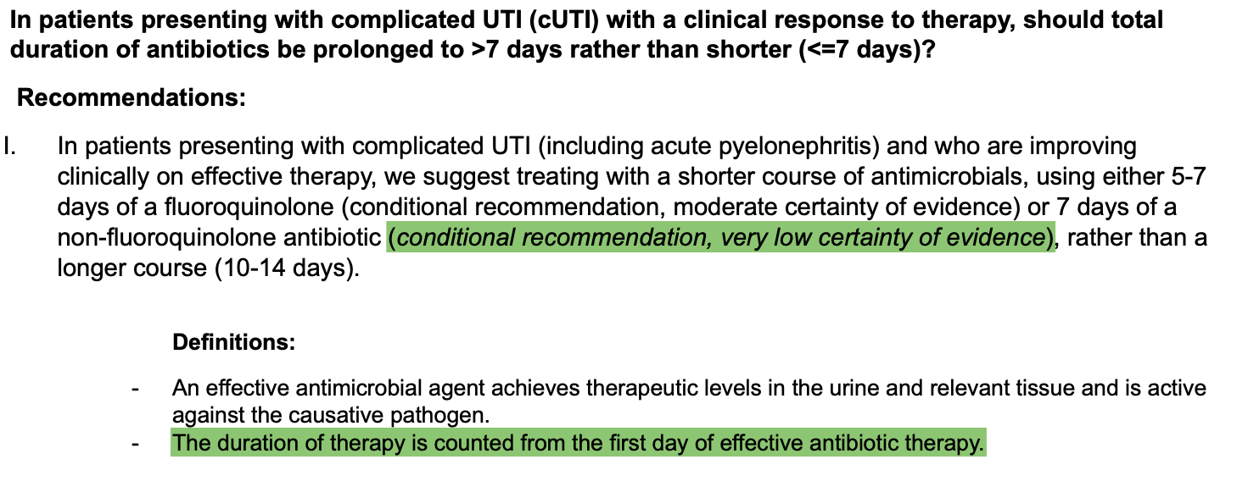
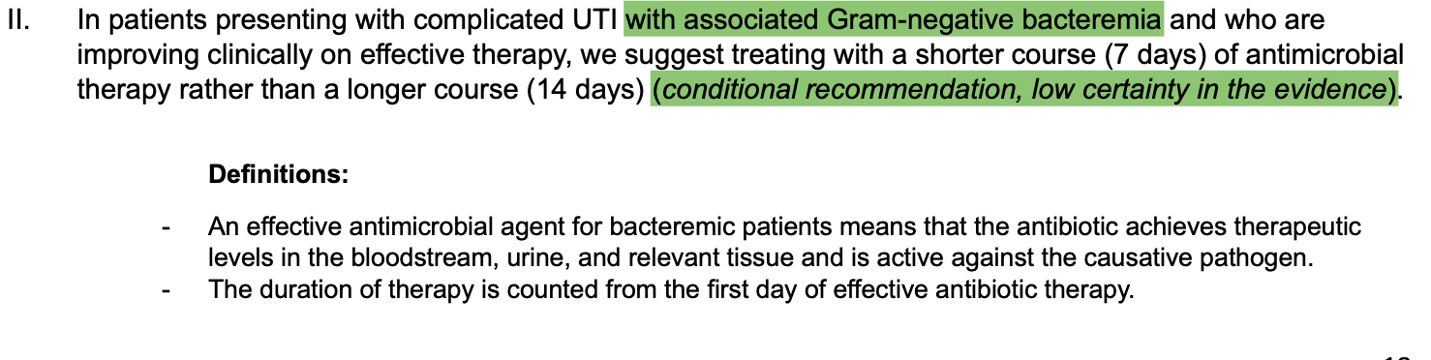
IDSA 2025 Guidelines on cUTI
7-day treatment course
7-day treatment course
3. What’s the duration of treatment of uUTI vs cUTI?
4. Which antimicrobials should be used for uUTI vs cUTI?

Slide 12
Asymptomatic bacteriuria
At least 50-70% of urine cultures are ordered inappropriately.
About 25%-50% of antimicrobial days for UTI are actually unnecessary treatment of ASB.
Increased antimicrobial use, increased fluid administration, increased Na intake.
Screening in patients with indwelling catheters who are asymptomatic leads to inappropriate exchanges of catheters.
Patients often are told by providers they have UTIs when they don’t have symptoms, leading them to tell future providers that they have recurrent UTIs.
Screen in pregnant patients and prior to urological procedure with anticipated mucosal injury.
Treat in pregnant patients, 1 dose before a urologic procedure with anticipated mucosal injury, and if found in the first month after kidney transplant.
5. When should ASB be screened for and treated?

Slide 13
Options for Recurrent UTIs (2 in 6 mo, 3 in 12 mo)
Local estrogen therapy – many studies show benefit in lowering symptomatic UTI rates and meta-analysis of 5 RCTs showed RR 0.42
Increased fluid intake – RCTs show reduced UTIs in premenopausal women; risk of fluid overload in CKD, CHF, cirrhosis patients
Methenamine Hippurate – ALTAR trial in 2022 showed noninferiority to low dose antimicrobial suppression in women; but SINBA trail in 2006 showed no benefit in patients with SCI
Chronic suppressive antimicrobials – effective up to a time, then there is risk of resistance, side effects, c diff
Probiotics – mixed results on studies
D-mannose – no high quality RCTs
Cranberry – Nov. 2023 Cochrane Review update added 26 studies (total 50), found that it reduces risk for recurrent UTI in women, children, and UTI associated with procedure, but not in elderly or with neurogenic bladder
6. What is the management approach for recurrent UTIs?

Slide 14
Candiduria (IDSA 2016 Candidiasis guidelines)
Asymptomatic candiduria – do not treat unless neutropenic (consider candidemia) or urological procedure (treat before and after)
Symptomatic cystitis – can treat, options are fluconazole x 14 days, ampho deoxycholate 1-7 days, or flucytosine 7-10 days, or ampho deoxycholate bladder irrigation; remove catheters
Ascending pyelonephritis – similar treatment; can consider mica
Fungal ball – treat and obtain surgical consult
7. Should candida in the urine be treated, and if so, how?

Slide 15
Staph aureus bacteriuria
Staph aureus is NOT a urine pathogen.
Coagulase negative staphs (staph saprophyticus) can be a cause of urinary tract infection.
Presence of staph aureus in the urine is often due to hematogenous seeding (from bacteremia) so blood cultures and a primary source of infection should be evaluated.
Staph aureus bacteriuria can be skin contaminant in a patient with chronic indwelling catheters, suprapubic catheters, nephrostomy tubes, etc., but this is a diagnosis of exclusion.
8. Should staph aureus in the urine be treated, and if so, how?

Slide 16
Summary
UTIs are symptomatic. Patient needs to have a real change from chronic baseline.
UTIs are treated for 3-5 days for uncomplicated cases, 7-10 days for complicated cases.
Do not screen for or treat asymptomatic bacteriuria except in 2.5 appropriate clinical situations. Don’t treat ASB even when it’s an MDR and/or when there is a catheter.
For non-specific clinical presentations, everything else should be ruled out before consideration of UTI as a cause.
Specimen collection is important. Always ask the patient how it was done.
Do not culture old catheters.
If patient does not have the mobility to provide a urine specimen, it needs to be collected as a straight catheterized specimen.
Take a thorough history about symptoms, antimicrobial use, improvement with treatment, etc.
In order to rule in recurrent UTI, you first have to rule out recurrent ASB.
Candiduria is usually colonization. If real UTI, treatment is with fluconazole or ampho deoxycholate.
Staph aureus bacteriuria is neither asymptomatic bacteriuria nor UTI; it should provoke workup for staph aureus bacteremia. (SA ASB --> ?SAB)

