Slide 1



Acute Leukemia
Matthew Ulrickson, MD
Banner MD Anderson Cancer Center
September 1, 2026

Slide 2

Objectives
Identify and select immediate management for acute leukemia complications including tumor lysis syndrome, leukostasis, and disseminated intravascular coagulation (DIC).
Order and interpret the correct initial laboratory studies including a complete blood count with differential, peripheral blood smear, DIC panel, and comprehensive metabolic panel.
Differentiate between Acute Myeloid Leukemia (AML), Acute Promyelocytic Leukemia (APL), and Acute Lymphoblastic Leukemia (ALL) based on pathologic features and ancillary testing.
Understand the impact of flow cytometry, cytogenetics, and molecular testing (eg. FLT3, NPM1, BCR-ABL1) for diagnosis, risk stratification, and treatment.
Select appropriate transfusion strategies for initial management of the patient with acute leukemia
Outline the conceptual differences between induction, consolidation, and maintenance therapy as well as the role of hematopoietic stem cell transplantation.

Slide 3

Case 1
32yo resident presents with sore throat and fever
Cervical adenopathy is present on exam
CBC: 35>35%<35k

Slide 4
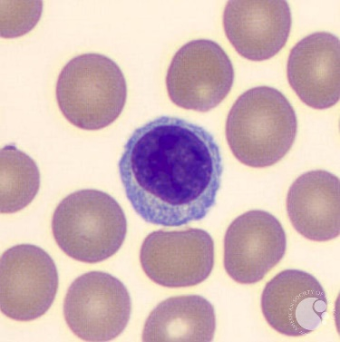
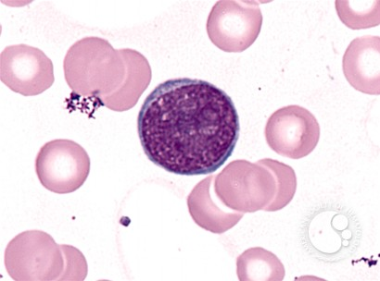
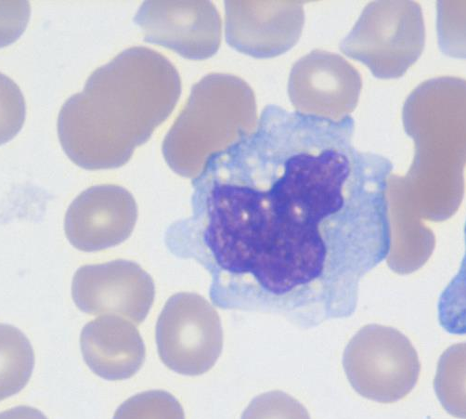
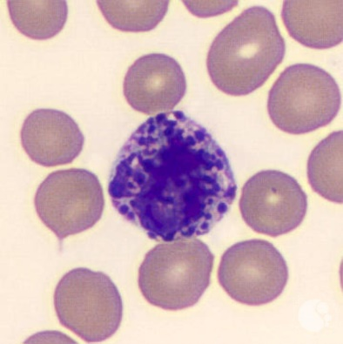
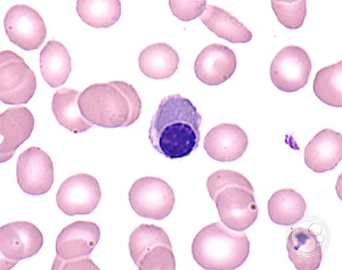

Which of the following is a blast?
92% Other
4% Lymph
4% Neutrophils
A
B
C
D
E
Image courtesy of Peter Maslak
Notes:
A. Lymphocyte B. Blast C. Mononucleosis D. Basophil E. Nucleated RBC

Slide 5
Peripheral Smear
92% Blasts
4% Lymph
4% Neutrophils
He was diagnosed with Ph+ Acute Lymphoblastic Leukemia
Addition of which of the following medications to Induction chemotherapy is recommended?
  A. Ruxolitinib
  B. Gilteritinib
  C. Ponatinib
  D. Rituximab
  E. Blinatumomab
Blast
Image courtesy of Peter Maslak

Slide 6
Case 2
52yo man develops intermittent fevers x 2 weeks
Later, chest pain, dyspnea on exertion, followed by marked fatigue.
No other B symptoms and no bruising or bleeding
No other PMHx
1 full brother, 1 full sister
Exam: Temp 37.3, HR 117, BP 107/54, RR 24
Conjunctival rim pallor noted, tachycardic with systolic murmur present at the apex. No LAD or HSM

Slide 7
Initial testing
CBC: 6.9>2.6<79 MCV 100

Slide 8
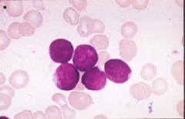
Initial testing
CBC: 6.9>2.6<139 MCV 100
    32% neutrophils, 6% bands, 2% lymphocytes, 1% monocytes, 1% metamyelocytes, 1% myelocytes and 53% ‘other’ cells.
Peripheral smear
  Atypical immature cell population with high N:C ratio, nucleoli
Reticulocyte 0.3%; absolute 2000/µl
Cr 0.8, total bilirubin 0.4, LDH 392, albumin 3.7, AST 45, ALT 145,

Slide 9
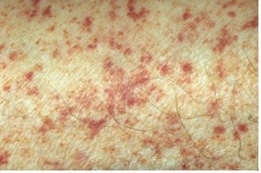
Clinical Symptoms of AML
Bone Marrow Failure (Cytopenias)
    Anemia - dyspnea, pallor, chest pain
    Neutropenia - infections
    Thrombocytopenia - bleeding, petechiae
Coagulopathy
  esp APL, Acute myelomonocytic leukemia
Tissue invasion

Slide 10
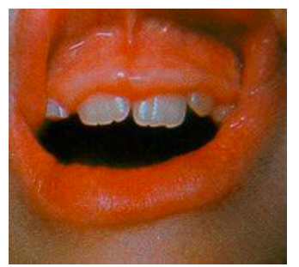
Tissue Invasion in AML (Myeloid Sarcoma = AML)
Associated with high WBC, monocytic subtypes, CD56+
Can Involve
  spleen
  gums
  perianal
  skin
  renal
  lung

Slide 11
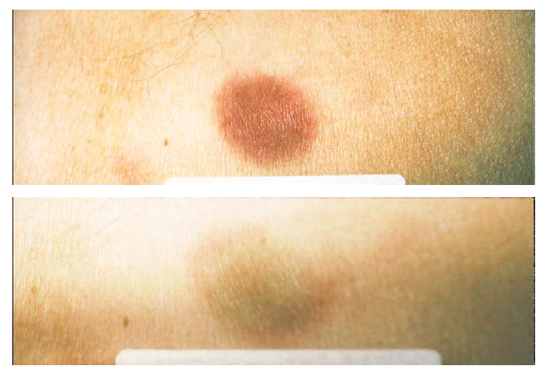
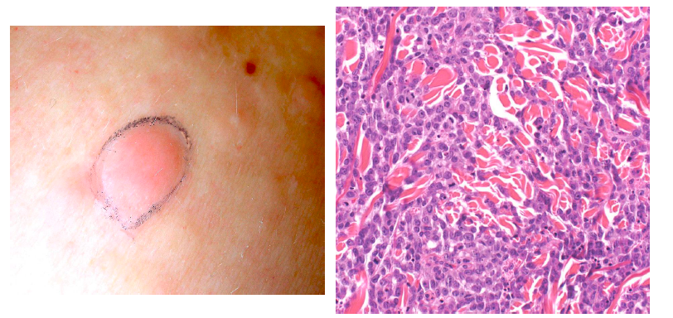
Leukemia CUTIS/Chloroma
Sauter and Jacky NEJM 1998. 338:969

Slide 12
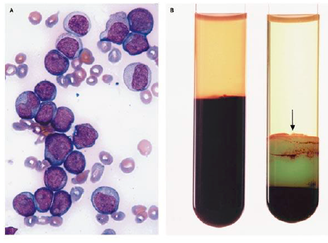
High Circulating Blasts
Hypoglycemia
Hypoxia
Hyperkalemia
Elevated Lactate
Mauro MJ NEJM 2003. 349:767
Pseudo:
Normal
AML

Slide 13
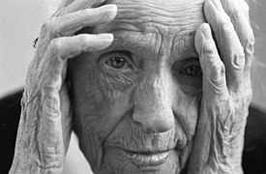

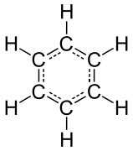
Risk Factors for AML
Increasing Age
  Median age at dx = 68yo (34% of pts >75yo)
Prior chemotherapy or radiation (5-10yr latency)
  Topoisomerase II inhibitors and alkylating agents
Prior hematologic disorder such as MDS, MPN
  Clonal hematopoiesis (mutations) slight predisposition
Benzene exposure
Most have no apparent cause
Robin Müller

Slide 14
Evaluation of patient with AML
Initial triage
  History and Physical
  CBC with differential (look at the peripheral smear)
  BMP, LFTs, uric acid, ABO type and screen
  PT, PTT, fibrinogen

Slide 15
Evaluation of patient with AML
Initial triage
  History and Physical
  CBC with differential (look at the peripheral smear)
  BMP, LFTs, uric acid, ABO type and screen
  PT, PTT, fibrinogen
Diagnosis
  Bone marrow biopsy
  FISH and cytogenetics, flow cytometry
  Molecular: NGS (next generation sequencing) panel
    (can be sent on PB if circulating blasts)
  If circulating blasts, send peripheral blood for flow cytometry (STAT) to make dx

Slide 16
Evaluation of patient with AML
Initial triage
  History and Physical
  CBC with differential (look at the peripheral smear)
  BMP, LFTs, uric acid, ABO type and screen
  PT, PTT, fibrinogen
Diagnosis
  Bone marrow biopsy
  FISH and cytogenetics, flow cytometry
  Molecular: NGS molecular panel (can be sent on PB too)
  If circulating blasts, send peripheral blood for flow cytometry (STAT) to make dx
Plan ahead
  HLA typing
  Identify siblings and brief health history, CMV serostatus (IgG)
  Consideration of future fertility

Slide 17
Immediate Emergency?
Leukostasis
Pulmonary or neurological symptoms related to increased serum viscosity
  Which of the following patients is most likely to have leukostasis?
    A. CML with WBC of 300k
    B. ALL with WBC of 180k
    C. CLL with WBC of 500k
    D. AML with WBC of 120k
    E. Cdiff with WBC of 70k

Slide 18
Immediate Emergency?
Leukostasis
Pulmonary or neurological symptoms related to increased serum viscosity
  Which of the following patients is most likely to have leukostasis?
    A. CML with WBC of 300k
    B. ALL with WBC of 180k
    C. CLL with WBC of 500k
    D. AML with WBC of 120k
    E. Cdiff with WBC of 70k

Slide 19
Immediate Emergency?
Leukostasis
Pulmonary or neurological symptoms related to increased serum viscosity
  Can occur
    when myeloid blast count >50-100k
    When lymphoid blast count >400k
    rare in CLL, CML
  Leukapheresis does not have significant clinical benefit at new dx Acute leukemia (start chemo instead)

Slide 20
Immediate Emergency?
Leukostasis
Pulmonary or neurological symptoms related to increased serum viscosity
  Can occur
    when myeloid blast count >50-100k
    When lymphoid blast count >400k
    rare in CLL, CML
DIC (esp APL and monocytic)
  Aggressive product replacement
Initial treatment can trigger SIRS
Tumor lysis syndrome

Slide 21
Chemo may transiently worsen initial leukemia symptoms
If a patient presents with leukemia –related symptoms, initial start of cytotoxic therapy can cause a transient flare of symptoms from lysis of disease
  O2 requirement increase
  SIRS response/hypotension
  Increased transfusion need for DIC
  Tumor lysis abnormalities exacerbated

Slide 22
How soon to treat the others?
Sekeres et al Blood 2009. 113:38
  No increase in mortality when treatment started within 5 days for patients >60yo.
  In younger, earlier the better
Obtain necessary diagnostic information prior to selecting regimen (NGS)
  Echocardiogram
  Central line (anthracycline is vascular irritant, extravasation toxicity)

Slide 23
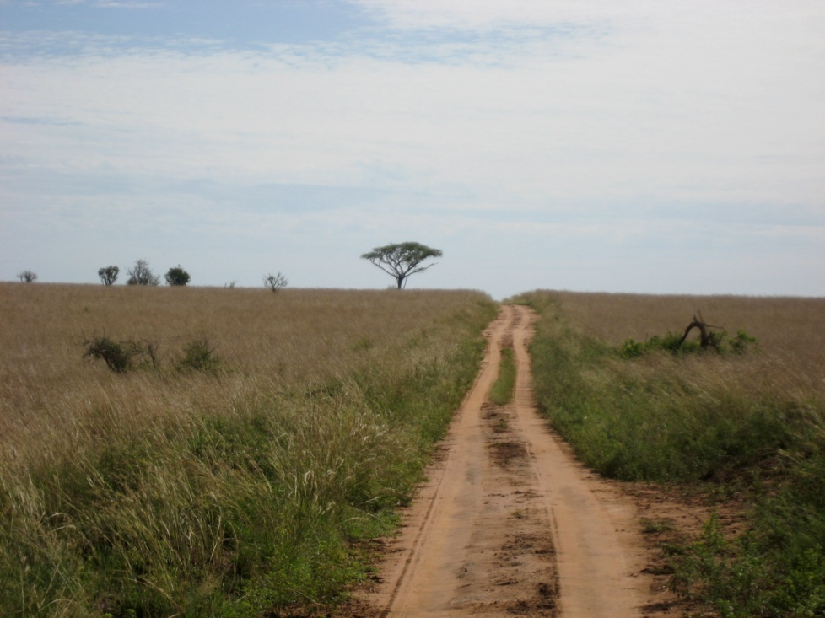
Day 1
Day 1 = first day of chemotherapy
  Knowing how long since last chemo lets us anticipate and interpret
  Most AML cycles take ~28 days for recovery
  GCSF not used for count recovery in AML during induction, ok in ALL and sometimes used for AML in consolidation

Slide 24
7+3
Induction
  Anthracycline (3 days)
    Daunorubicin 60-90mg/m2 better than 45mg
    Idarubicin 10-12mg/m2
  Cytarabine (ara-C) - 7 days continuous infusion
    100mg/m2 better than 200mg/m2
Berman et al. Blood 1991. 77:1666
Ohtake et al. Blood 2011. 117:2358
Rowe et al. Blood 2004. 103:479
Wiernik et al. Blood 1992. 79:313

Slide 25
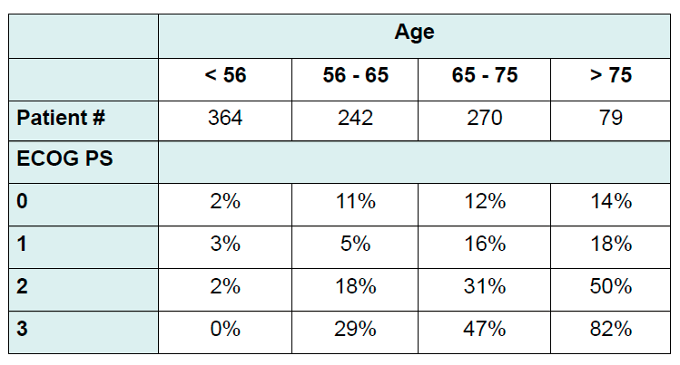
Mortality from 7+3 induction at 30 days
Appelbaum et al. Blood 2006. 107:3481

Slide 26
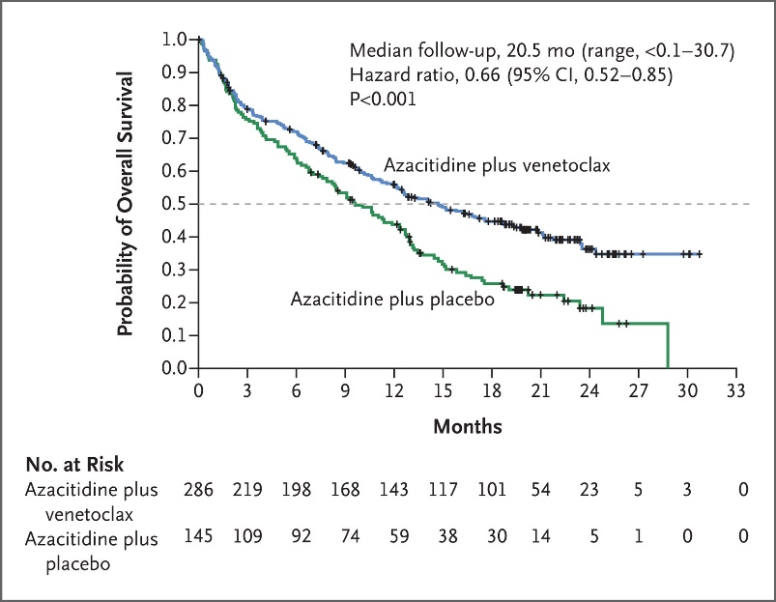
Hypomethylating agents with venetoclax in AML
>75yo and/or ineligible for induction chemotherapy
Venetoclax plus azacitidine or decitabine (HMA)
  Most patients do not receive 28 days venetoclax
Median age 76yo, poor risk cytogenetics in most
67% = CR (37%) or CRi (30%)
Median overall survival 14.7m vs 9.6m in control arm (HMA alone)
7% death within 30 days unrelated to AML
DiNardo, et al. NEJM 2020; 383:617-629

Slide 27
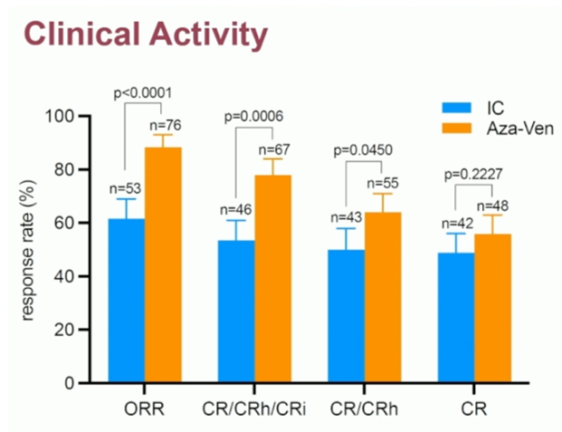
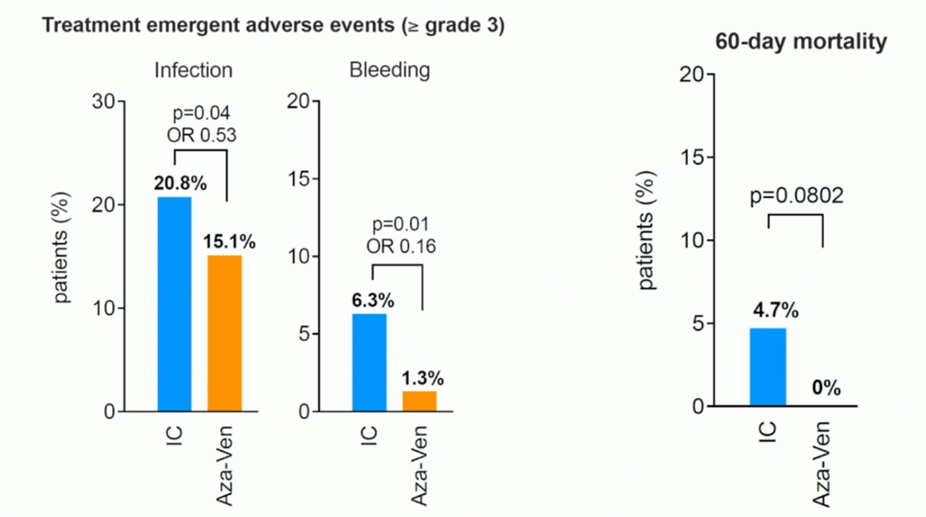
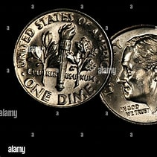
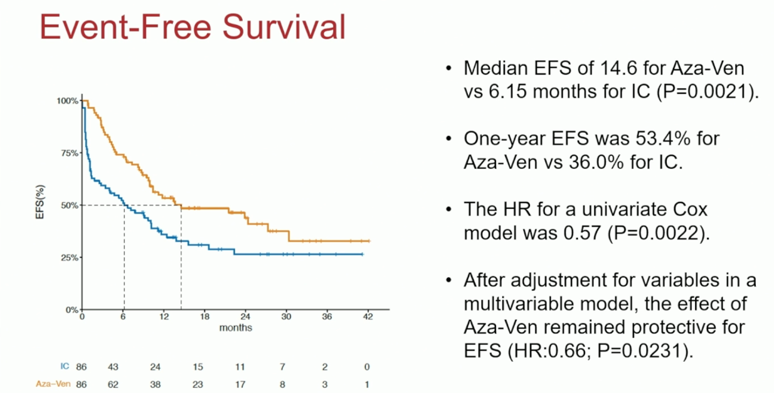
A new paradigm?
Fathi, A et al. ASH 2025

Slide 28
How to make a diagnosis
The pathology results begin to return
Things to send on a marrow (or peripheral blood if circulating blasts):
Flow cytometry
FISH
Karyotype
NGS (next generation sequencing) myeloid molecular panel
>20% blasts in PB or BM usually required

Slide 29
On target
Mutations help optimally treat AML
Current targeted medicines available:
  FLT3 + = midostaurin, gilteritinib, quizartinib
  IDH2 + = enasidenib
  IDH1 + = ivosidenib, olutasidenib
  CD33 = gemtuzumab ozogomicin (GO)
  NPM1m, KMT2Ar = zitomenib, revumenib
Stein, EM et al. Blood. 2017 Aug 10;130(6):722-731. Enasidenib in mutant IDH2 relapsed or refractory acute myeloid leukemia.
Stone, RM et al. N Engl J Med. 2017 Aug 3;377(5):454-464.
Midostaurin plus Chemotherapy for Acute Myeloid Leukemia with a FLT3 Mutation.

Slide 30
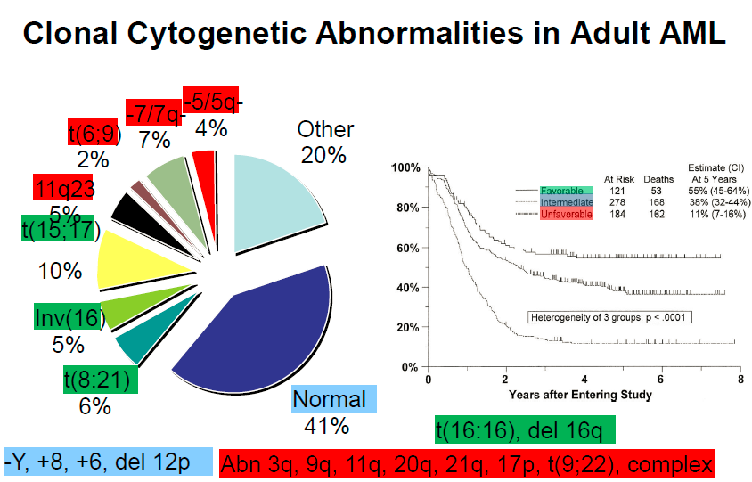
Slovak et al. Blood 2000. 96:4075

Slide 31
So what is next?
Need to achieve complete remission (CR)
  <5% blasts by morphology AND Plt >100k and ANC >1.0
  Day 14 marrow tells us some, but only part of CR definition
  CR is one of the best predictors of OS for individual patient
If not in CR - next line therapy
  Minimal residual disease = CR, but with detectable disease by flow/FISH/molecular
If in CR - not done yet…

Slide 32
AML in CR1
Consolidation with Cytarabine x 3-4 cycles
  Burnett et al JCO suggests total of 4 (3 consolidation) is just as good as 5
Hematopoietic Stem Cell Transplant (HCT)
This document is a facsimile from an official text (law, regulation, etc.) published in the Journal officiel de la République Française, the official gazette of the French Republic.

Slide 33
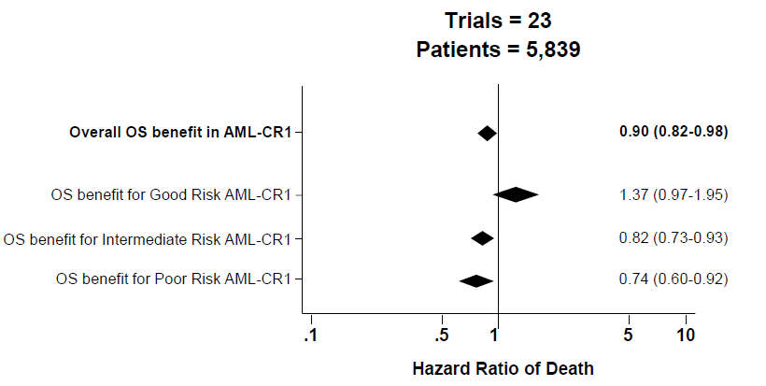
Meta-analysis of RCTs of HCT for AML in CR1
Koreth et al. JAMA 2009. 301:2349

Slide 34
Indications for Allogeneic SCT in AML
Primary Induction Failure (Primary Refractory)
Second (CR2) or later remission
Relapsed disease
CR1
  Intermediate risk
  Adverse risk cytogenetics
  Secondary AML (MDS, prior chemotherapy)
  Persistent MRD detectable

Slide 35
Our Patient
Enters a complete remission after induction
Completes 3 additional cycles of consolidation
Currently remains in remission, back at work, with regular follow up

Slide 36
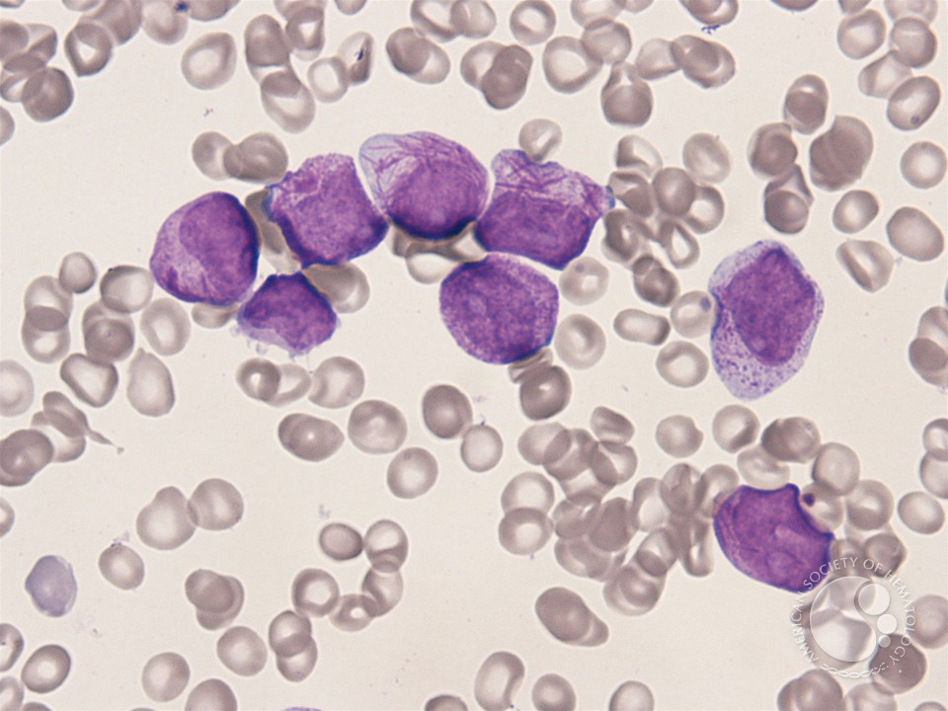
Case 3
44yo woman presents to the ED with bleeding gums and a non-blanching erythematous rash. Labs as follow:
CBC: WBC 1.9>7.2<5
INR 2.6 PTT 48 Fibrinogen 93
Peripheral smear is below.
Which of the following medications do you recommend?
  A. Doxycycline
  B. ATRA
  C. PCC
  D. Dasatinib
  E. Aminocaproic Acid

Slide 37
Case 3
44yo woman presents to the ED with bleeding gums and a non-blanching erythematous rash. Labs as follow:
CBC: WBC 1.9>7.2<5
INR 2.6 PTT 48 Fibrinogen 93
Peripheral smear is below.
Which of the following medications do you recommend?
  A. Doxycycline
  B. ATRA (Tretinoin)
  C. PCC
  D. Dasatinib
  E. Aminocaproic Acid

Slide 38
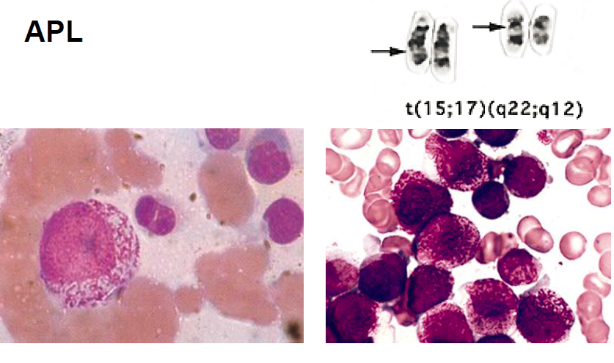
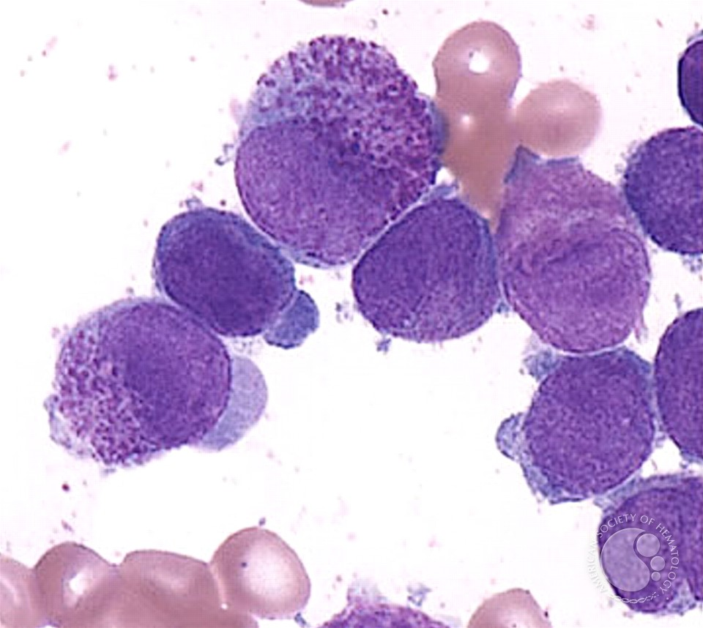
Acute Promyelocytic Leukemia (APL)

Slide 39
Aggressive early care for APL
Early mortality (within days of diagnosis) ~5-10%
  Bleeding
  Bleeding
  Intracranial bleeding
Start ATRA as soon as suspected
  If wrong, no harm done (as long as HCG negative)
  Do not wait for testing results to start but send t(15;17)
Long-term cure rate >95%
  ATRA/Arsenic
Aggressive blood product transfusion to decrease bleeding risk (cryo, plt)
Treatment at experienced centers significantly decreases risk of death during induction (~30% to <5%)
ATRA = All trans retinoic acid

Slide 40
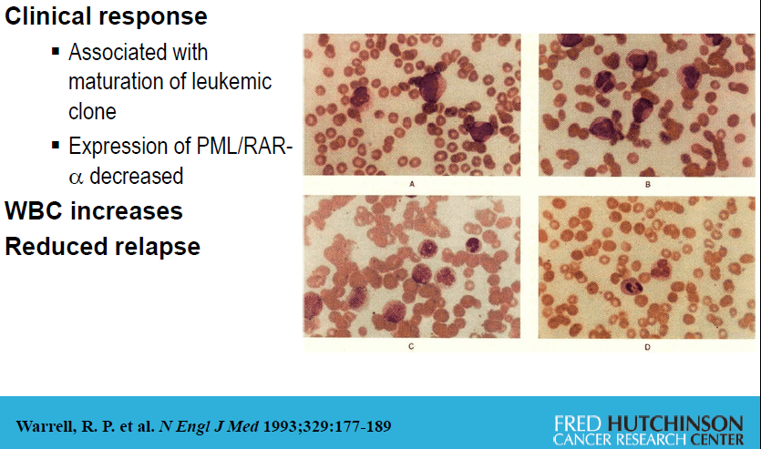
All-Trans Retinoic Acid
Tretinoin

Slide 41
Differentiation Syndrome
First described with ATRA
  Effusions, edema, AKI, fever
  Associated with rising WBC
  If WBC >10k, consider hydroxyurea (or chemo if higher)
Now known to occur with IDH inhibitors, FLT3 inhibitors and menin inhibitors
Acute leukemia is a disease of failure to differentiate

Slide 42
Day 28 marrow in APL
FISH and molecular (PCR) testing with persistent positivity at day 28 does not have prognostic implications in APL

Slide 43

Questions and Thanks
Matthew.ulrickson@bannerhealth.com

Slide 44
Acute lymphoblastic leukemia/lymphoma (ALL)
Peak age at diagnosis 7yo
  (23% of all pediatric cancer diagnoses)
But diagnosis possible throughout life
No major risk factors
  rare secondary ALL (such as from CML)
Must administer intrathecal chemotherapy
  Without this – 50% have CNS relapse
    With IT chemo - ~5% CNS relapse
Can also involve testicles – important to evaluate with testicular u/s as other ‘sanctuary site’

Slide 45
Presentation of ALL
Cytopenias from bone marrow involvement
  Bleeding, fevers, weight loss, bone pain
Circulating blasts
Mediastinal mass (especially T-ALL, 25% of adult ALL)
May have adenopathy, hepatosplenomegaly

Slide 46
Back to Philly
ALL can also have the Philadelphia Chromosome t(9;22)
  Respond to Imatininb/Dasatinib/Nilotininb/Ponatinib
    So always use these in Ph+ ALL

Slide 47
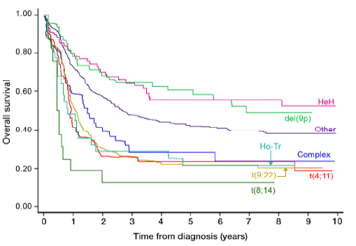
Survival by Cytogenetic Subgroup:
MRC UKALL XII/ECOG 2993
High Hyperdiploid
(51-65 csomes)
Ho-Tr = Low Hypodiploid (30-39), near triploid (60-78)
Moorman AV. et al. Blood 2007. 109:3189
Notes:
15-65yo
T4;11 = MLL
Ho-Tr = low hypodiploid (30-39 chromosomes), near triploid (60-78 chromosomes)
HeH = high hyperdiploid (51-65 chromosomes)
If between 60-65 chromosomes, specific pathologic interpretation based on pattern and initial literature description
Complex (5 or more without established tnslc)

Slide 48
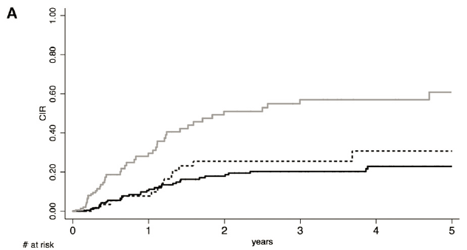
Measurable residual disease (MRD) and risk of relapse
Presence of Minimal Residual Disease (MRD) is the best current prognostic feature, guiding SCT vs no SCT
MRD assessed at week 6; GRAALL 2003 protocol
>10⁻⁴
<10⁻⁴
negative
Beldjord Blood 2014 and Bruggemann Blood 2006. 107:1116

Slide 49
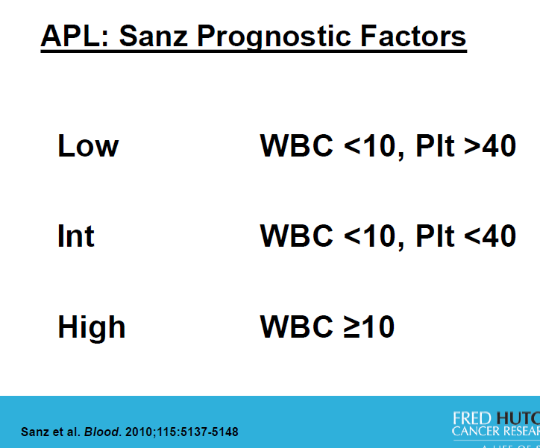

Slide 50
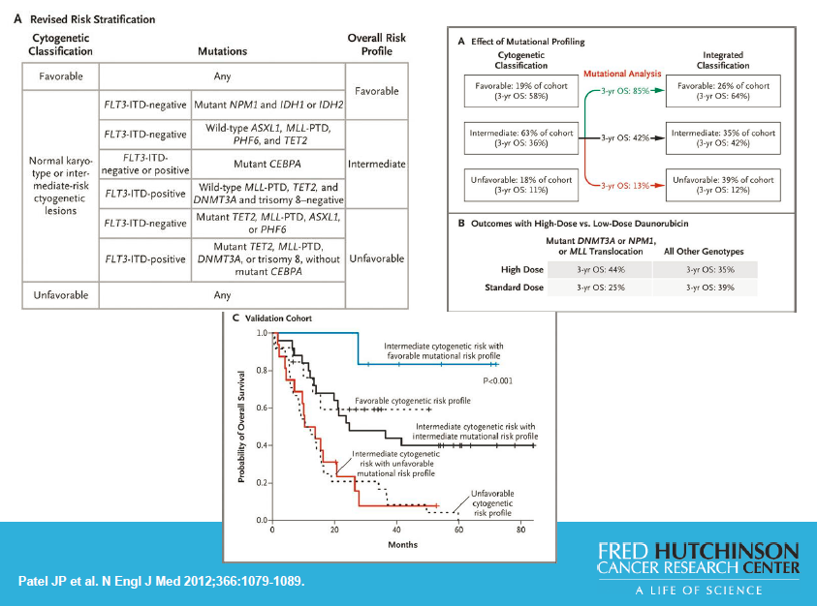

Slide 51
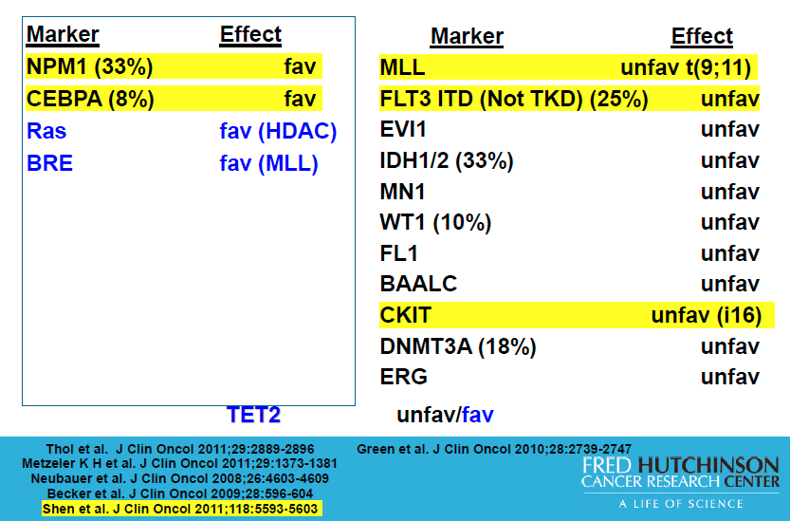
Molecular Markers and Prognosis in AML

Slide 52
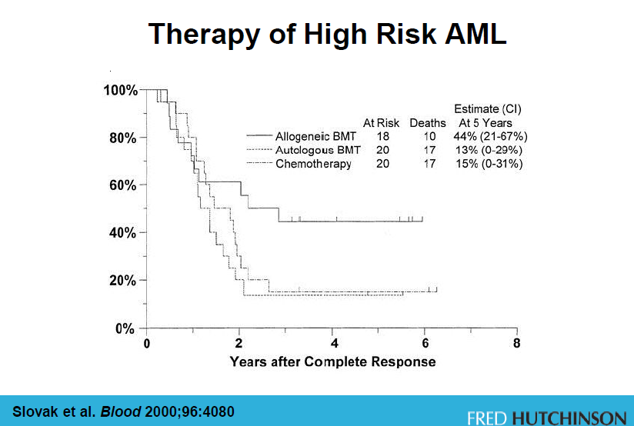

Slide 53
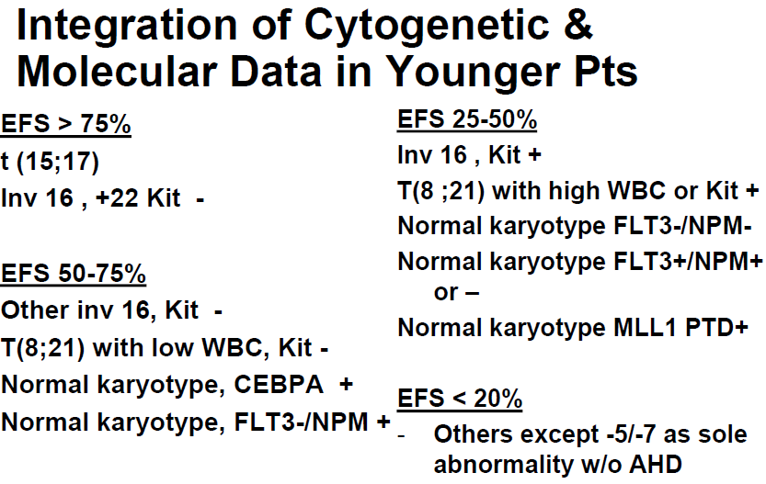
v

Slide 54
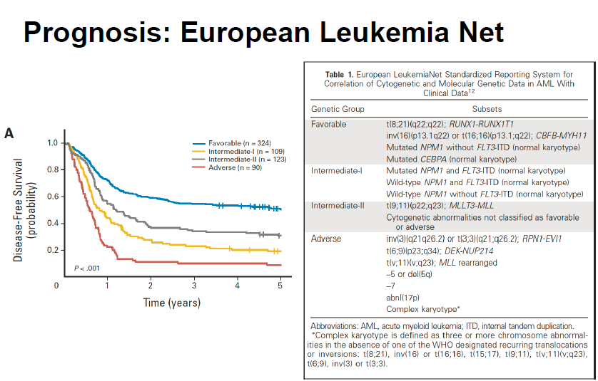
Mrozek et al. JCO 2012 _______

Slide 55
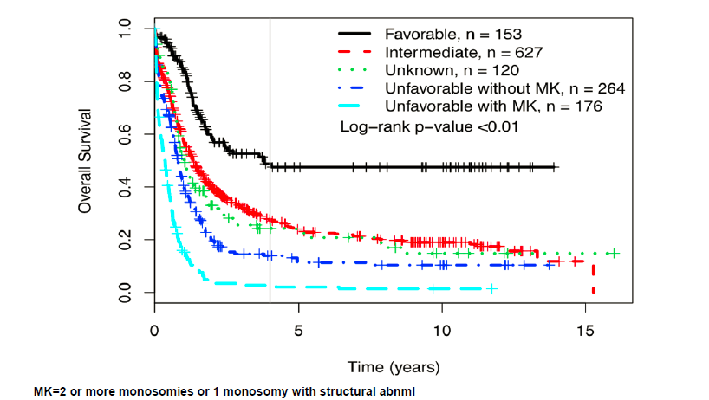
Cytogenetics and Survival in AML
Medeiros et al. Blood 2010. 116:2224

Slide 56
What to do with the rest?
Cytogenetic changes without clear prognostic information
Standard-risk patients that respond in nonstandard manner
Risk stratification in UK ALL XII (adverse features)
  Ph+
  >35yo
  WBC >30k B cell or >100k for T cell
  More than 4 weeks for cytologic CR (MRD)
Presence of Minimal Residual Disease (MRD) is the best current prognostic feature, guiding SCT vs no SCT
Moorman AV. Et al. Blood 2007. 109:3189

Slide 57
Differentiate AML vs ALL
Rarely, can see Auer Rods
  Only in myeloid blasts
Flow cytometry
Cytogenetics - t(8;21), inv16, → AML
  t(9:22) → ALL
  t(15;17) → APL

Slide 58
AML vs ALL with flow cytometry (or IHC)
Myeloid | B-cell (lymphoid) | T-cell (lymphoid)
CD13 | CD10 | CD2
CD33 | CD19 | CD3
MPO | CD20 | CD4
 | CD22 | CD5
 | Surface Ig | CD7
 |  | CD8
CD34 marks these cells as immature blasts (rare exceptions of CD34-negative blasts) The same marker as for HPC

Slide 59
AML in the elderly
Increased resistance to chemotherapy (MDR1 expression)
More likely to have unfavorable cytogenetics
More likely secondary to MDS
More comorbidities
Appelbaum et al. Blood 2006. 107:3481

Slide 60
Our Patient
Enters a complete remission
Completes 3 additional cycles of consolidation
Currently remains in remission, back at work, with regular follow up
But what if the disease comes back?

Slide 61
When is enough?
Estey Blood 1996
  206 pts, median age 56yo
  Received chemotherapy for relapsed/refractory AML and did not go to transplant (1991-1994)
First Salvage (n = 206) | 68% Conventional 32% investigational (topotecan, 2Cda, taxol) | CR rate 23%
Second Salvage (n = 93) | 43% conventional 57% investigational | CR rate 11%
Third Salvage (n=40) |  | CR rate 10%
Fourth salvage (n=17) |  | CR rate 6%

Slide 62
Duration of CR1 and likelihood of response
Treatment | Likelihood of CR
CR1 >2yrs, 1st salvage n=15 | 73% (45-92%)
CR1 1-2yrs, 1st salvage n=30 | 47% (28-66%)
CR1 <1yr or no CR, 1st salvage n=160 | 14% (8-21%)
CR1 <1yr or no CR1 2nd - 4th salvage n= 58 (96 tx) | 0% (0-4%)

