Slide 1
Multiple Sclerosis
For Medicine Residents
Nida K. Laurin, MD
December 2, 2025

Slide 2
Objectives
Define multiple sclerosis epidemiology and clinical course of this disease.
Describe new 2024 McDonald MS diagnostic criteria.
Describe common CSF findings in MS.
Describe the types of clinical presentation in MS.
Describe the treatment for an acute MS exacerbation and disease modifying therapies.

Slide 3
Epidemiology
MS is the most common, progressive neurological disease to affect young and middle-aged adults.
Immune-mediated, prevalence 50-300/100,000;
  in US - appr. 900,000 total;
  world-wide 2.8 mln;.
  5,000 -10,000 pediatric patients.
Genetic (HLA-DR15,16; non-HLA, >200 genes), epigenetic and environmental factors (EBV, vit D, smoking, obesity, hygiene); Caucasians (but in US, same in AA), F:M - 3:1, age 20-55 yo, 30% risk in monozygotic twin, 3-5% risk in offspring
Natural history variable, 10-15% “benign course”, 5% malignant course with severe disability within 5-7 y.
Shortens life expectancy

Slide 4
Clinical disease course classification
“Traditional” classification: relapsing-remitting, secondary progressive, primary progressive, CIS, RIS
Relapsing-remitting phase:
  Episodes of inflammatory demyelination and remyelination
  Active symptomatic (clinical attacks) or asymptomatic (MRI); with stepwise increase in disability
  Inactive
Progressive phase:
  Progressive axonal loss or dysfunction with minimal inflammation
  Active symptomatic or asymptomatic, with insidious and stepwise disability progression
  Inactive with insidious disability progression
Based on previous attacks
  None - primary progressive MS
  One - single attack progressive MS
  Multiple - secondary progressive MS

Slide 5
New ICD-10 MS codes G35
G35.A Relapsing-remitting multiple sclerosis
G35.B Primary progressive multiple sclerosis
G35.B0 …… unspecified
G35.B1 Active primary progressive multiple sclerosis
G35.B2 Non-active primary progressive multiple sclerosis
G35.C Secondary progressive multiple sclerosis
G35.C0 …… unspecified
G35.C1 Active secondary progressive multiple sclerosis
G35.C2 Non-active secondary progressive multiple sclerosis
G35.D Multiple sclerosis, unspecified

Slide 6
Question
19 yo Hispanic F, overweight, with history of migraines comes to ED complaining of dizziness. It started 1 week ago as blurred vision which progressed into double vision and dizziness. She can’t drive or read; her balance is worse. She has headache and nausea but no fever. No recent travel, no substance use. On exam – horizontal Ny either direction, can’t tandem. CBC, CMP, UA normal, head CT normal. What is possible diagnosis and next step?
Migraine with aura, in status; treat with IV fluids and “migraine cocktail”, follow up with PCP
Pseudotumor cerebri/idiopathic intracranial hypertension; treat headache, schedule LP for opening pressure
BPPV, treat with meclizine, refer to vestibular therapy
Cerebellar lesion; treat headache and nausea, order MRI brain wo/w contrast

Slide 7
Answer
19 yo Hispanic F, overweight, with history of migraines comes to ED complaining of dizziness. It started 1 week ago as blurred vision which progressed into double vision and dizziness. She can’t drive or read; her balance is worse. She has headache and nausea but no fever. No recent travel, no substance use. On exam – horizontal Ny either direction, can’t tandem. CBC, CMP, UA normal, head CT normal. What is possible diagnosis and next step?
Migraine with aura, in status; treat with IV fluids and “migraine cocktail”, follow up with PCP
Pseudotumor cerebri/idiopathic intracranial hypertension; treat headache, schedule LP for opening pressure
BPPV, treat with meclizine, refer to vestibular therapy
Cerebellar lesion; treat headache and nausea, order MRI brain wo/w contrast

Slide 8
Clinical presentation
New neurologic signs and symptoms, recurrence or worsening of old problems, lasting longer than 24 hrs (an attack)
Symptoms develop over several hours to days or weeks, followed by improvement with complete or incomplete recovery over several months
Frequency of relapses 1-3/y for first 5-10 y
Natural course: historically, 50% will develop secondary progression in 10-15 y from onset, sometimes still have relapses (progressive-relapsing or active secondary); recent data suggest if treatment initiated early, only 10-20% will transition to progression in 10 y.
Prodrome? Increased frequency of medical visits for appr. 5 years prior to first neurological symptoms

Slide 9
Clinical MS symptoms
Sensory symptoms: tingling, burning, loss of sensation to touch and pain, loss of positional sensation/vibration
Central (tracts), due to lesions in big hemispheres, brainstem or C, T, (L) spinal cord
Motor – upper MN (tract lesions): weakness, clumsiness
Muscle tone – increases with time (flexors UE, extensors LE)
Reflexes – brisk, expanded reflex zones, ankle clonus
Pathologic reflexes – Babinski, Hoffman
Coordination: ataxia of extremities, gait, “rubral” tremor/titubation
Cerebellum, brainstem
Could be secondary due to weakness or loss of sensation

Slide 10
Clinical MS symptoms
Vision
Loss, gradual (hours-days), painful, with color desaturation due to retrobulbar optic nerve inflammation – normal fundoscopy!
Diplopia/INO due to lesion of motor nerve nuclei or MLF
Hearing – very uncommon
Autonomic function
Bladder: incontinence, retention
Sexual, multifactorial
Bowel: constipation, incontinence
In advanced stages -
  Cardiovascular (BP fluctuation)
  Pulmonary (muscle weakness)
  Thermoregulation

Slide 11
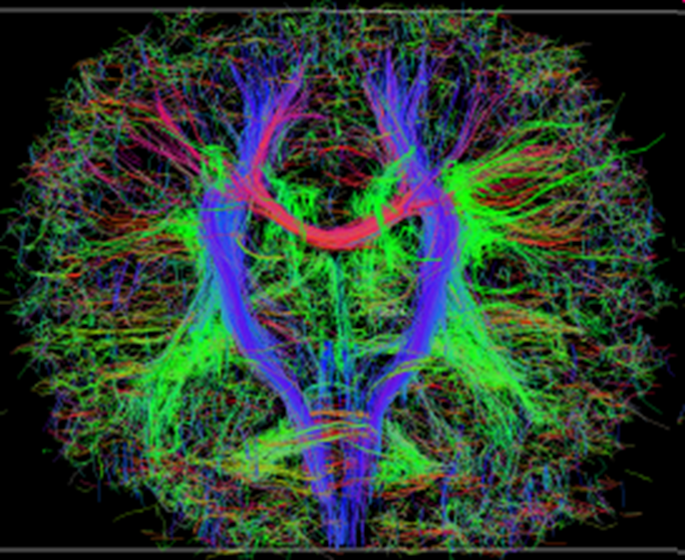
Clinical MS symptoms
Cognition, mood disorders and fatigue
Cortical lesions, thalamic atrophy
Inter-hemispheric tracts
Inflammatory dysregulation
Approximately 70% of patients have cognitive impairment by formal testing
Mood d/o very common, especially anxiety, depression and bipolar disorder
50% of patients are unemployed by 10 years

Slide 12
Case cont.
Brain MRI showed enhancing lesion in cerebellar peduncle and 2 small ovoid lesions in periventricular and subcortical areas in frontal lobes. Can this patient be diagnosed with MS? Do we need any additional testing?

Slide 13
2024 McDonald diagnostic criteria
No need for dissemination in time: 2024 criteria move away from the notion that you need evidence that MS is affecting areas of the central nervous system at different times to make a diagnosis
Expands the number of topographies used to establish dissemination in space. In addition to the historical topographies (juxtacortical, periventricular, infratentorial, spinal cord), the optic nerve now represents a 5th topography (use of OCT!)
Adds the central vein sign (CVS, ≥6), as well as paramagnetic rim lesions (PRLs, ≥1 ) on brain MRI
Incorporates kappa free light chains (κ-FLC) as an alternative to oligoclonal bands (OCBs) in cerebrospinal fluid (cheaper, objective, quick)
Allows to make a diagnosis of MS in individuals with no symptoms (RIS)
A primary concern is overdiagnosis. The increased sensitivity of the criteria means that more people may be diagnosed with MS.

Slide 14
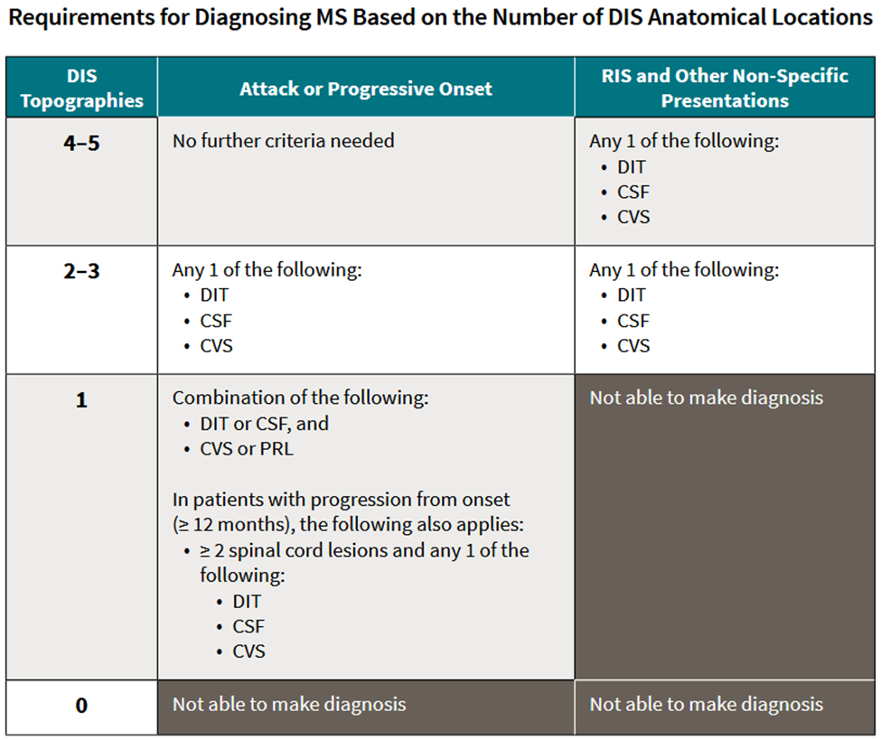
2024 McDonald diagnostic criteria

Slide 15
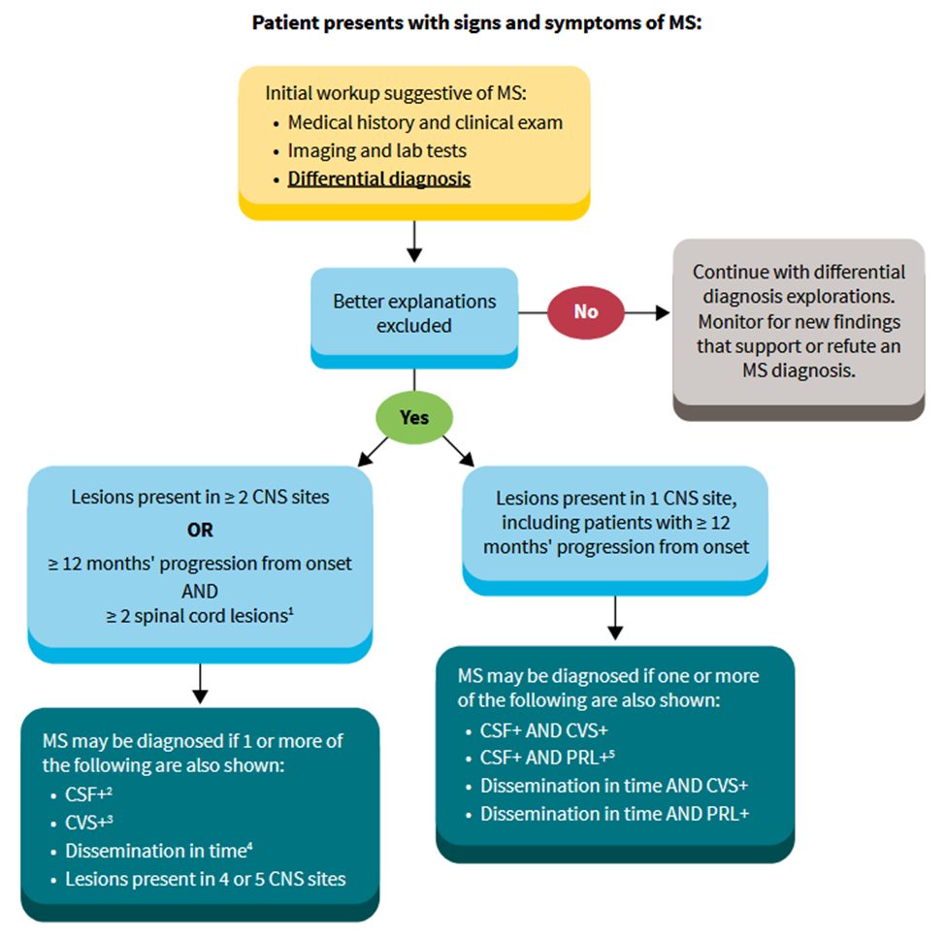

Slide 16
Diagnostic tests
MRI - Brain and spine
(T2/FLAIR, T1, Gad+)
  T1 FLAIR, 3D Gad, T2/FLAIR Gad

Slide 17
T2/FLAIR sagittal and axial

Slide 18
Brain T2 and T1 axial with Gad

Slide 19
C-spine STIR and T2 axial

Slide 20
Diagnostic tests
  CSF for
  IgG index (normal <0.66) and synthesis rate (normal -9.9 to +3.3) elevated – may correlate with severity of inflammation
  Oligoclonal bands present (>2) – must be unique to spinal fluid, takes time to develop, could be negative in 20%, especially early on
    OR Kappa Light Chains (? lab cut-off), higher levels correlate with activity
  Normal white blood cell count (or <50, lymph%)
  Normal protein (15-40; or < 100/dL)
  Evoked potential studies (VEP, SSEP)
  Blood work to rule out other conditions: CBC, CMP, ANA complete panel, RF, vit B12 and Folate, CRP/ESR, HTLV-1/2, HIV, ACE, copper
  OCT for optic neuritis, NF-L and other CSF/blood biomarkers for activity

Slide 21
Differential diagnosis
SLE
Sjogren’s disease
Lyme/neuroborreliosis
CNS vasculitis
Cerebrovascular disease
Syphilis
HIV and HTLV-1 complications
Neurosarcoidosis
Vit B12, vit E, copper deficiency
Mitochondrial disorders (CADASIL)
Postinfectious inflammatory disease (ADEM)
Paraneoplastic disease, NMDA encephalitis
NMO and MOGAD
Behcet's disease
Compressive lesions of the spinal cord (herniated disc, tumor, AVM)

Slide 22
MS Treatment
Acute
  Methylprednisolone 1000mg IV for 3-5 days, can be repeated
  Oral equivalent (prednisone 50mg 25 tablets per day, or dexamethasone 4mg 47 tabs or 6mg 31 tab, or compounded methylprednisolone 250mg 4 capsules a day for 3-5 days )
  ACTH (Acthar gel) 80 units daily sq for 10 days, sometimes longer
  PLEX – 1-1.5 volume every other day for 5 to 8 courses
  For steroids: premedicate with H2 blockers/PPI, may need benzodiazepines
  Do not treat “pseudo-exacerbation”/recrudescence of old symptoms with steroids!

Slide 23
Question
28 yo female with 5-year history of MS is seen in clinic. She has been doing well on ocrelizumab IV therapy. She recently learned she is pregnant, 8 weeks of gestation. Which of the following best describes current understanding of risk from ocrelizumab during pregnancy and breastfeeding?
1. current evidence suggest ocrelizumab doesn’t cross placenta during the first trimester and does not pose a known risk during breastfeeding
2. ocrelizumab is associated with teratogenicity, and pregnancy should be terminated, but only in women older that 35y of age
3. ocrelizumab is concentrated in breast milk and should not be used after delivery if patient plans to nurse, or she should not breastfeed
4. ocrelizumab should be stopped 12 months before conception and not restarted until no longer breastfeeding

Slide 24
Answer
28 yo female with 5-year history of MS is seen in clinic. She has been doing well on ocrelizumab IV therapy. She recently learned she is pregnant, 8 weeks of gestation. Which of the following best describes current understanding of risk from ocrelizumab during pregnancy and breastfeeding?
1. current evidence suggest ocrelizumab doesn’t cross placenta during the first trimester and does not pose a known risk during breastfeeding
2. ocrelizumab is associated with teratogenicity, and pregnancy should be terminated, but only in women older that 35y of age
3. ocrelizumab is concentrated in breast milk and should not be used after delivery if patient plans to nurse, or she should not breastfeed
4. ocrelizumab should be stopped 12 months before conception and not restarted until no longer breastfeeding

Slide 25
Disease modifying therapies
Interferon-β SQ or IM: Avonex and Plegridy 1a, Betaseron/Extavia 1b, Rebif 1a
Glatiramer Acetate SQ: Copaxone, Glatopa and other generics
Mitoxantrone (Novantrone) IV – not generally used anymore
S1P Receptor antagonists PO: Fingolimod (Gilenya and generics), Siponimod (Mayzent), Ozanimod (Zeposia), Ponesimod (Ponvory)
Teriflunomide (Aubagio and generics) PO
Fumarates PO: Dimethyl Fumarate (Tecfidera and generics), Diroximel Fumarate (Vumerity), Monomethyl Fumarate (Bafiertam)
Cladribine (Mavenclad) PO
Monoclonal Antibodies
Anti-integrin: Natalizumab (Tysabri) IV
CD52: Alemtuzumab (Lemtrada) IV
CD20: Ocrelizumab (Ocrevus IV and Zunovo SQ), Ofatumumab (Kesimpta) SQ, Ublituximab (Briumvi) IV;
Rituximab (Rituxan and biosimilars) IV - not approved but used for MS, MOGAD and NMO

Slide 26
Older drugs (injectable/IV)
Interferon-β SQ or IM
  Avonex, Plegridy, Rebif 1a
  Betaseron/Extavia 1b
  Increases anti-inflammatory and decreases pro-inflammatory cytokine production
  Safe in pregnancy/breastfeeding
  SE: depression, low WBC, liver function
Glatiramer Acetate SQ
  Copaxone/Glatopa and other generics
  Rebalances Th1/Th2 type helper responses
  Safe in pregnancy/breastfeeding
  SE: injection reaction, skin lipoatrophy
Mitoxantrone (Novantrone) IV – not used anymore due to cardiotoxicity and secondary malignancies (leukemia), “blue drug”. For secondary progressive MS.
  Antineoplastic agent, inhibits B cell, T cell, and macrophage proliferation and impairs antigen presentation, as well as the secretion of IFN-γ, TNF-α, and IL-2.

Slide 27
Oral medications
S1P receptor antagonists
Blocks egress of lymphocytes from lymphoid tissue
Non-selective; first dose monitoring (brady), eye exam before and 3-4 month after initiation
Fingolimod (Gilenya) 0.5mg once daily; available as generic
Selective S1P1/S1P5 receptor agonist (brain and lymphocytes), no first dose monitoring (unless cardiac history), titration mitigates first-dose cardiac effect;
Siponimod (Mayzent) 2mg or lower dose once daily; needs genetic testing (CYP2C9 genotype, contraindicated in *3/*3) prior to administration
Ozanimod (Zeposia) 0.92mg capsules once daily after titration, lesser drop in Lymph count, also approved for Ulcerative Colitis
Ponesimod (Ponvory) 20mg capsules once daily after titration; Lymphs recover in 1-2 weeks, higher liver toxicity but no monitoring recommended
SE: Same class warnings for all; cardiac precautions and contraindications; EKG, VZV, eye exam only if pre-existing eye problems, interaction with certain meds (CYP2C8, MAO-I), viral infections, cryptococcal infections/meningitis, macular edema, bradycardia, hypertension, PRES, severe increase in disability after discontinuation, not to be used with pregnancy/lactation

Slide 28
Oral medications
Fumarates
Increases intracellular accumulation of Nrf2, leading to anti-inflammatory and antioxidant effects, change in gene expression
Dimethyl Fumarate (Tecfidera and generics) 240mg twice daily (titration) –metabolized to active ingredient MMF
Diroximel Fumarate (Vumerity) 462mg (administered as two 231 mg capsules) twice daily; metabolized to active ingredient MMF, larger molecule with lower concentration of irritant, less GI side effects than Tecfidera
Monomethyl fumarate (Bafiertam) 190 mg, administered as two 95 mg capsules bid Active ingredient, no need to metabolize, less GI side effects
SE: GI side effects first 1-2 months for DMF and DRF; flushing, less if taken with food, ASA to help minimize flushing; Lymphopenia - monitor q6 months, risk for PML with prolonged lymphopenia; liver toxicity was seen in post-marketing

Slide 29
Oral medications
Teriflunomide (Aubagio and generics) PO 7mg or 14mg once daily
Reversible inhibitor of the mitochondrial enzyme DHODH which inhibits de novo pyrimidine DNA synthesis and prevents proliferation of activated T and B
SE: boxed warning on liver toxicity (was seen with leflunomide) and teratogenicity (animals); initial monitoring of liver function; hair loss, skin rash, can be removed over 11 days with activated charcoal or cholestyramine (accelerated elimination procedure).
Cladribine (Mavenclad) PO 10 mg tab, weight based 4 short courses over 2 y., followed by 2 years of monitoring.
Antimetabolite, disrupts cellular metabolism by inhibiting DNA synthesis and repair, leading to apoptosis, mainly in lymphocytes
SE: boxed warning about increased risk for malignancy (but proven to be safe) and fetal harm, monitor lymphocytes

Slide 30
Monoclonal antibodies
Natalizumab (Tysabri and biosimilar Tyruko)) IV every 4 weeks (ext.dos.int. 5-6 wks)
Anti-α4- integrin mAb, inhibits migration of lymphocytes to CNS
SE: PML dependent on prior exposure to immunosuppression, JCV status and treatment duration; elevated WBC, rebound of disease after d/c
Alemtuzumab (Lemtrada) IV 5 days + 3 days (+ 3days)
Anti-CD52 mAb, depletes T and B lymphocytes followed by homeostatic repopulation
SE: autoimmune thyroiditis, nephropathy, ITP, acalculous cholecystitis, stroke/cranial artery dissection, herpes infection; needs 4 y of monthly labs
Ocrelizumab (Ocrevus) IV every 6 months after titration, or SQ infusion Zunovo
Anti-CD20 mAb, depletes B cells
SE: warning of increased risk of breast cancer but no increase in cancer risk or other SE seen in trial extension; decrease in IgG/IgM with continuous use increases risk of serious infections (1%), few cases of PML, mostly carry-over from Tysabri or Gilenya
Ublituximab (Briumvi) IV every 6 months after titration
Ofatumumab (Kesimpta) SQ monthly after loading

Slide 31
Treatment strategies
Escalation
Initial medication of lower efficacy (but more safety)
Requires treatment response – close monitoring for disease activity
Concern: missed opportunity for early treatment
Induction
Initial medication of higher efficacy (but riskier), maintenance therapy with safer agent or additional re-treatment with high potency drug
Meet treatment response criteria sooner
Immune reconstitution
Concern: overtreating some patients
Clinical experience: Treating earlier with high efficacy therapies decreases risk of disability progression

Slide 32
Lifestyle modification
Smoking cessation
Vitamin D3 supplementation
Healthy diet, no special MS diets!
Minimize salt intake (?)
Weight loss
Regular exercises

Slide 33
Symptomatic management
Fatigue
sleep eval, thyroid/other chronic cond. evaluation; modafinil/armodafinil, amantadine
Muscle weakness and spasticity
PT, baclofen/tizanidine/benzodiazepines, ITB pump, botulinum toxins, braces
Imbalance/Gait disorder
PT, walking aids, Bioness/WalkAid FES, dalfampridine (Ampyra)
Pain and paresthesias
PT, pain modulators (TCA, SNRI, gabapentinoids, antiepileptics)
Impaired vision
Bladder/bowel/sexual dysfunction
Depression and anxiety, pseudobulbar affect
Cognitive dysfunction
Speech impairment and dysphagia
Tremor and ataxia
Encephalopathy/seizures

