Slide 1
Transplantation
Amandeep Khurana
Transplant Nephrologist
Southwest Kidney Institute

Slide 2
Learning Objectives
1. Describe the benefit to patients who obtain a well-timed renal transplant before the need for initiation of dialysis.
2. List the immunosuppression drugs required for successful transplantation and know the side effects of each of these medications.
3. Understand the diagnosis, the pathophysiology, and the management of patients with acute cell-mediated rejection and antibody mediated rejection.

Slide 3
You have been on dialysis for 3 years, a cadaver transplant is offered to you. Do you accept?
No, because I’m used to dialysis now
Yes, because I dislike dialysis
Yes, because I’ll live longer

Slide 4
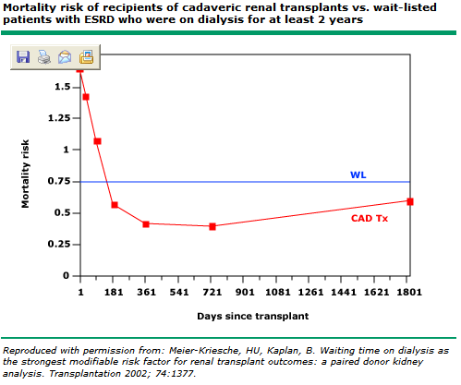

Slide 5
If you were getting a transplant, at what point would you like to get it?
No dialysis
HD x 6 months
HD x 1 yr
HD x 5 yr

Slide 6
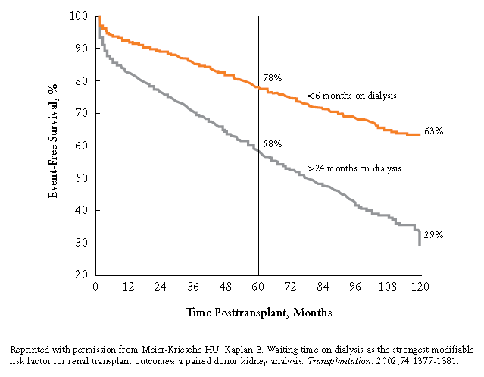

Slide 7
If your life expectancy was 6 months, and you were offered a transplant, would you accept?
Yes
No

Slide 9
If you were given the option between taking a living donor kidney versus a deceased donor kidney, which one would you pick?
Living donor
Deceased donor
Doesn’t matter
Dialysis

Slide 10
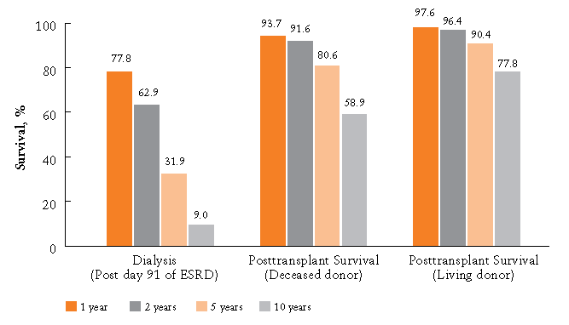

Slide 11
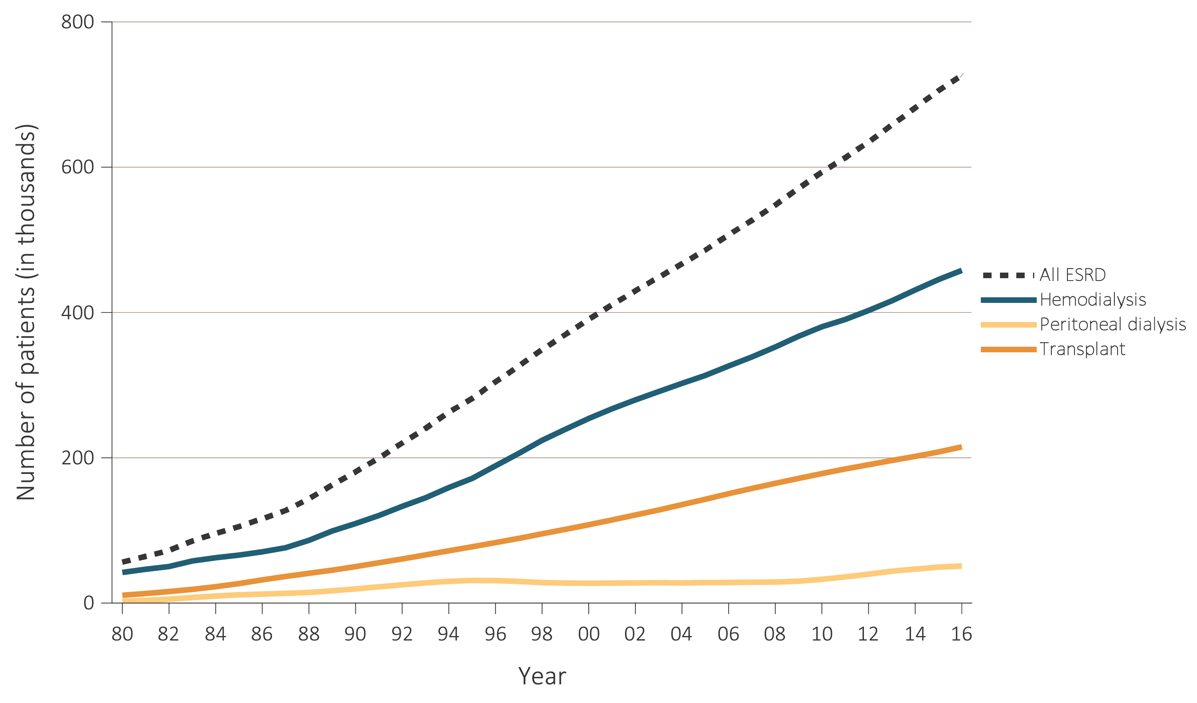
Trends in the number of ESRD prevalent cases, by modality, in the U.S. population,
1980-2016
Data Source: Reference Table D1 and special analyses, USRDS ESRD Database. Abbreviation: ESRD, end-stage renal disease. Persons with “Uncertain Dialysis” were included in the “All ESRD” total, but are not represented separately.

Slide 12
The average annual total (medicare) expenditure for an HD patient is 90K. What’s the average for a transplant patient?
100K
75K
50K
35K
10K

Slide 13
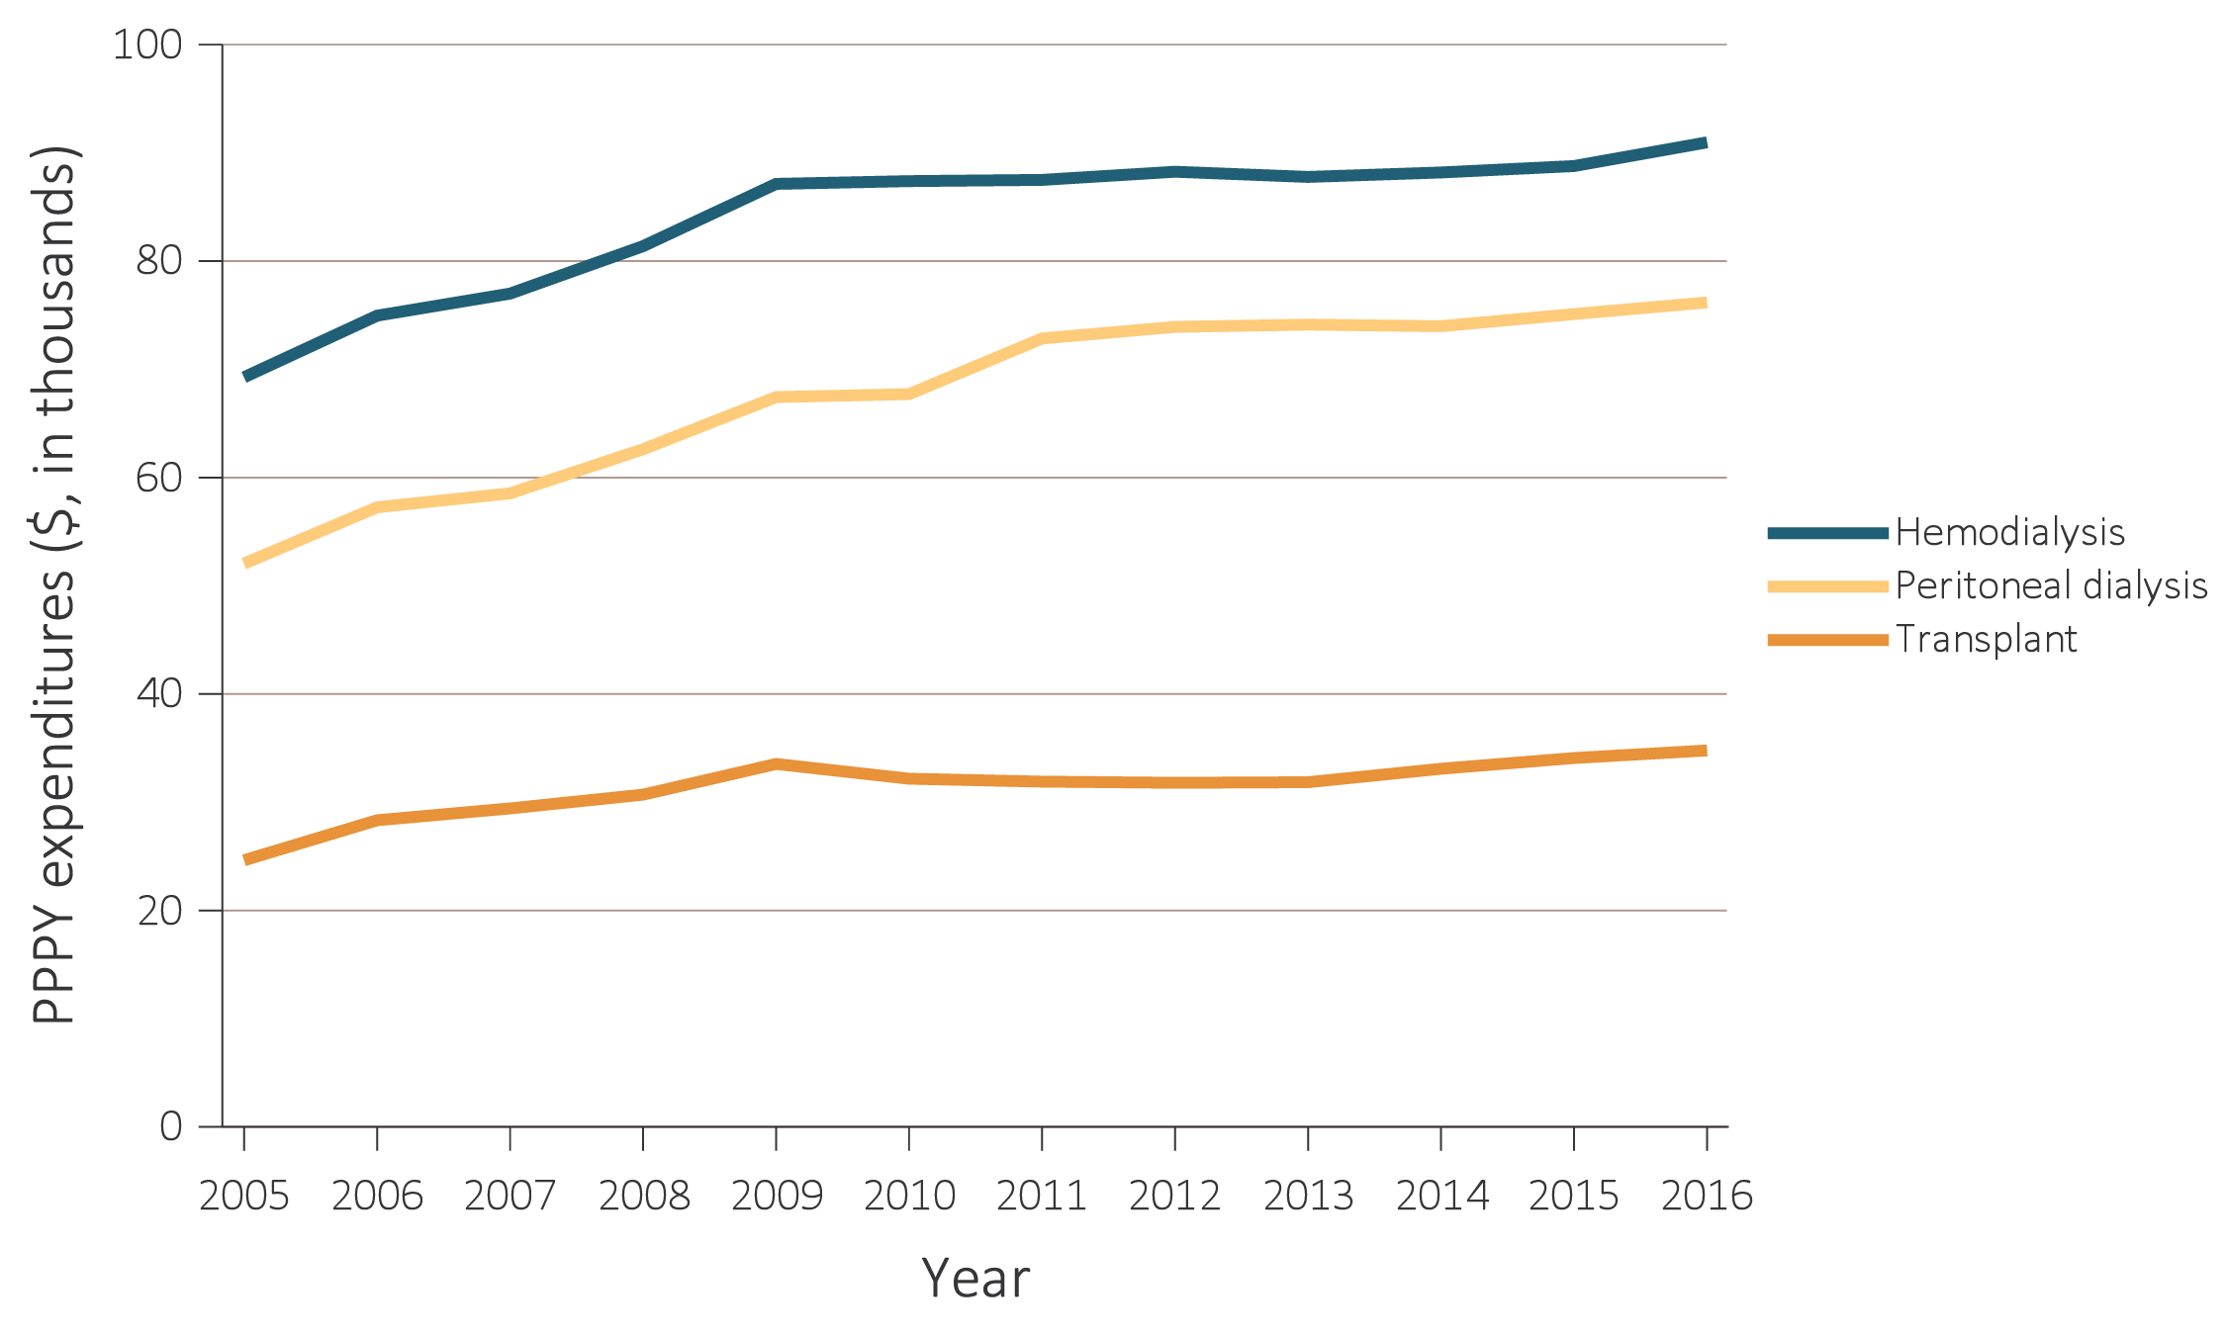
Total Medicare ESRD expenditures per person per year, by modality, 2004-2016
Data Source: USRDS ESRD Database; Reference Tables K.7, K.8, & K.9. Period prevalent ESRD patients; includes all claims with Medicare as primary payer only. Abbreviations: ESRD, end-stage renal disease; PPPY, per person per year.

Slide 14
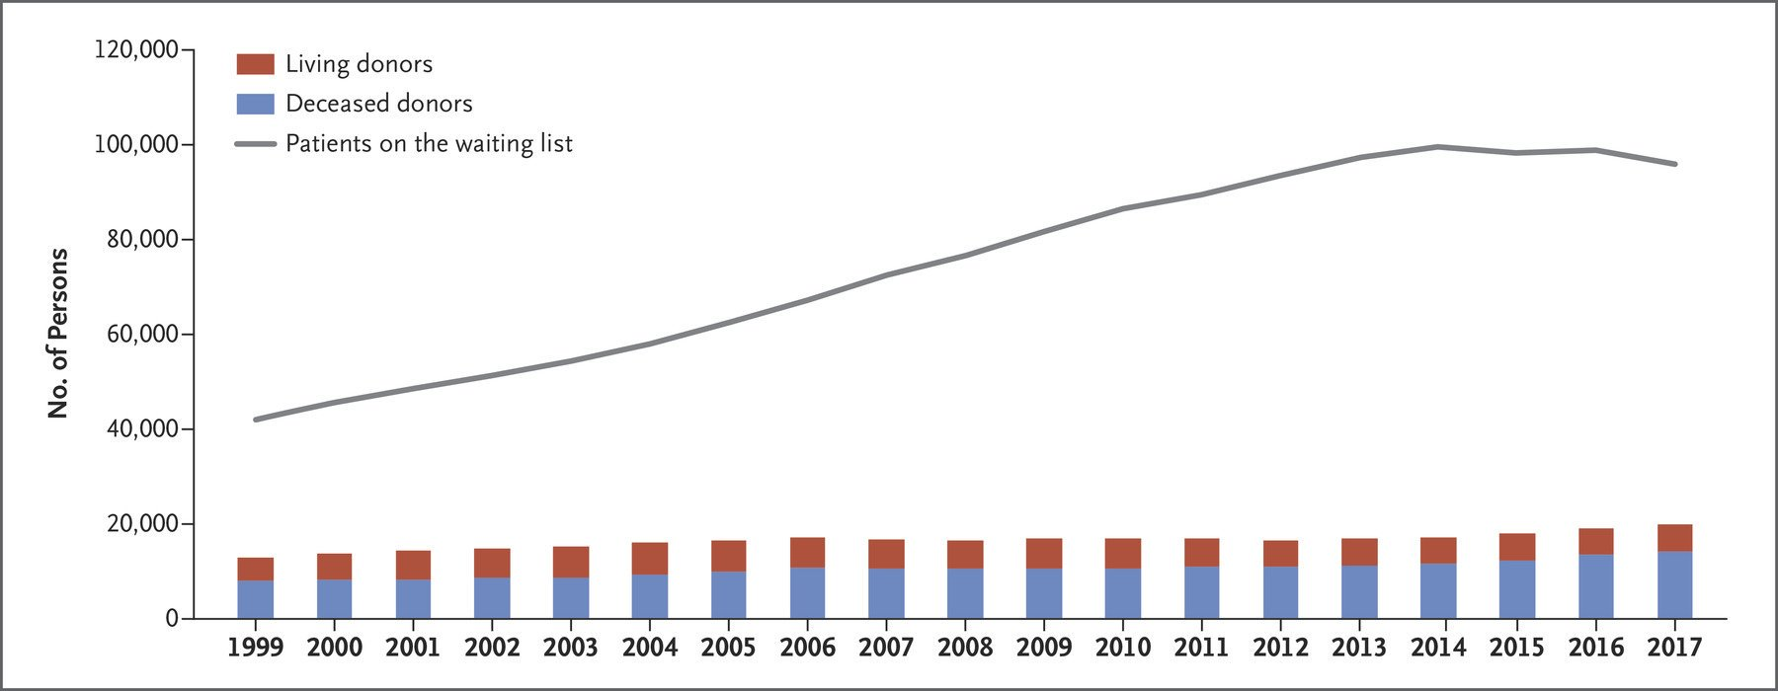

Slide 15
Which organ has the longest wait time?
Liver
Heart
Lung
Kidney

Slide 16
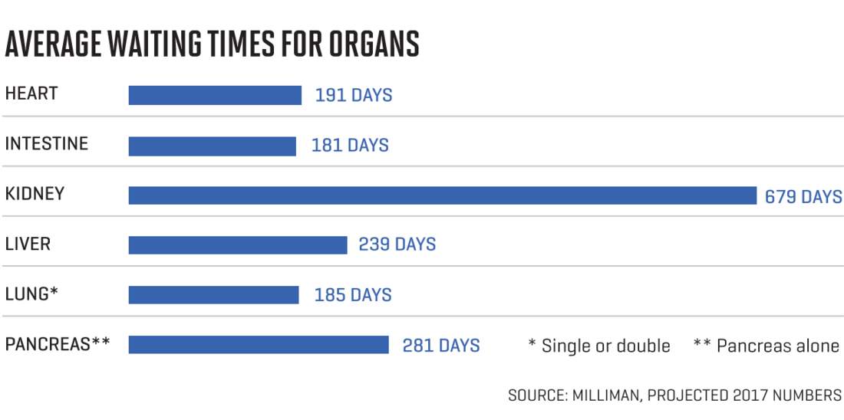

Slide 17
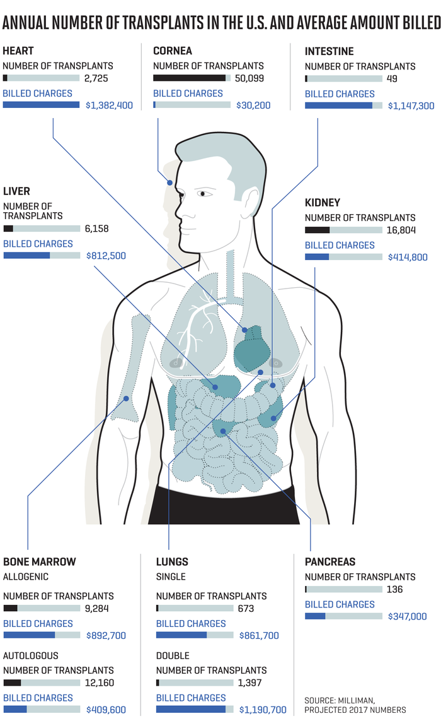

Slide 18
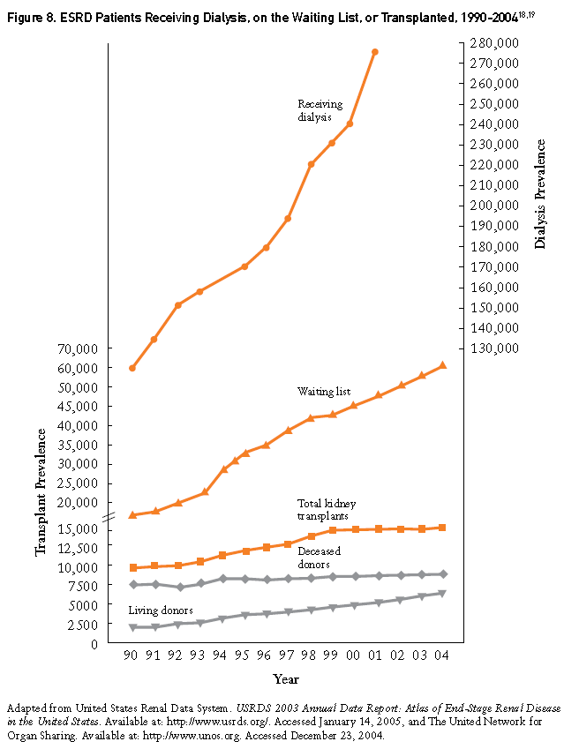

Slide 19
The KDPI is simply a mapping of the KDRI, a measure of relative risk, to a cumulative percentage scale. The KDPI is
calculated to the nearest integer percentage value and ranges from 0% to 100%.

Slide 20
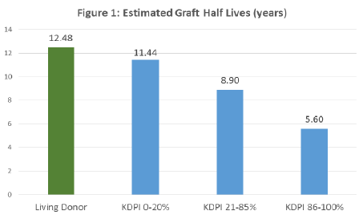

Slide 22
You have the option of remaining on HD or taking a 80% KDPI kidney…..which one would you pick?
HD
80% KDPI kidney
Either

Slide 23
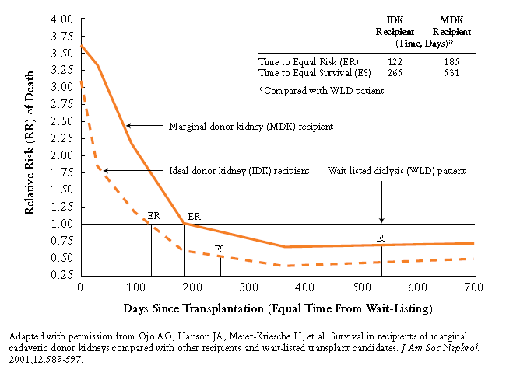

Slide 24
Transplant Immunology for
non-transplant nephrologists

Slide 25
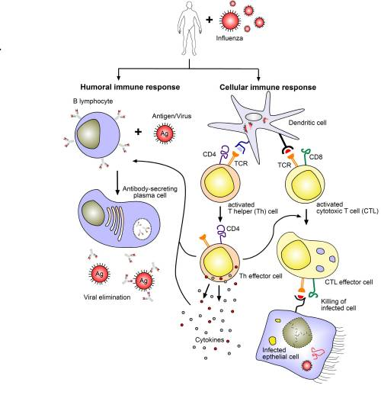

Slide 26
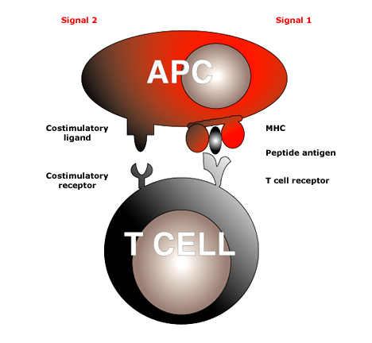
STEP 1 = Ag + APC meets T cell
antigen
Notes:
T cells require two separate signals before activation occurs. The first signal is antigen specific and is provided by the interaction of T cell receptor with peptide antigen presented within the antigen binding groove of MHC molecules. The second (costimulatory signal) is provided by the interaction of T cell surface molecules with their ligands on antigen-presenting cells. The provision of signal 1 in the absence of signal 2 may lead to T cell inactivation or anergy, or to failure of a Th1 response with promotion of a Th2 response.

Slide 27
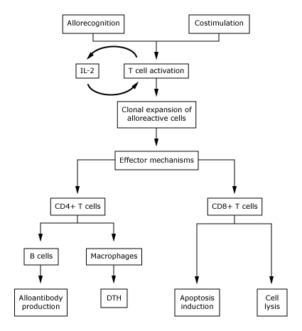
STEP 2 = T cell activation

Slide 28
STEP 3 = Acute Rejection
  Acute Humoral rejection: B
  Acute Cellular rejection: T

Slide 29
How can you diagnose acute rejection?
Rising Cr
Pain over transplant site
Elevated donor specific antibodies
Elevated cell free DNA
Biopsy

Slide 30
STEP 3 = Acute Humoral rejection: B

Slide 31
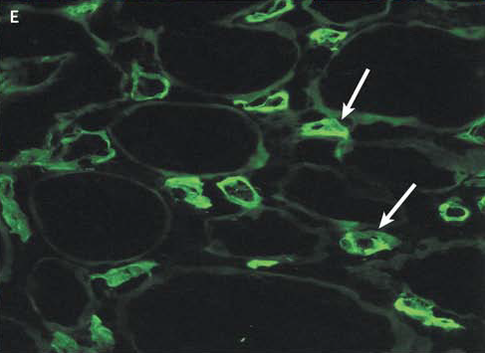
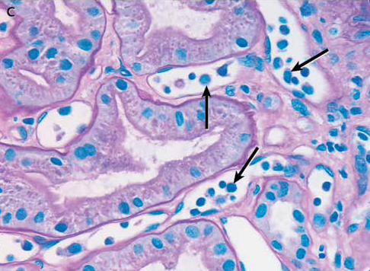
STEP 3 = Acute Humoral rejection: B

Slide 32
Haas M et al. The Banff 2017 Kidney Meeting Report: Revised diagnostic criteria for chronic active T cell-mediated rejection, antibody-mediated rejection, and prospects for integrative endpoints for next-generation clinical trials. Am J Transplant. 2018 Feb;18(2):293-307. doi: 10.1111/ajt.14625.

Slide 33
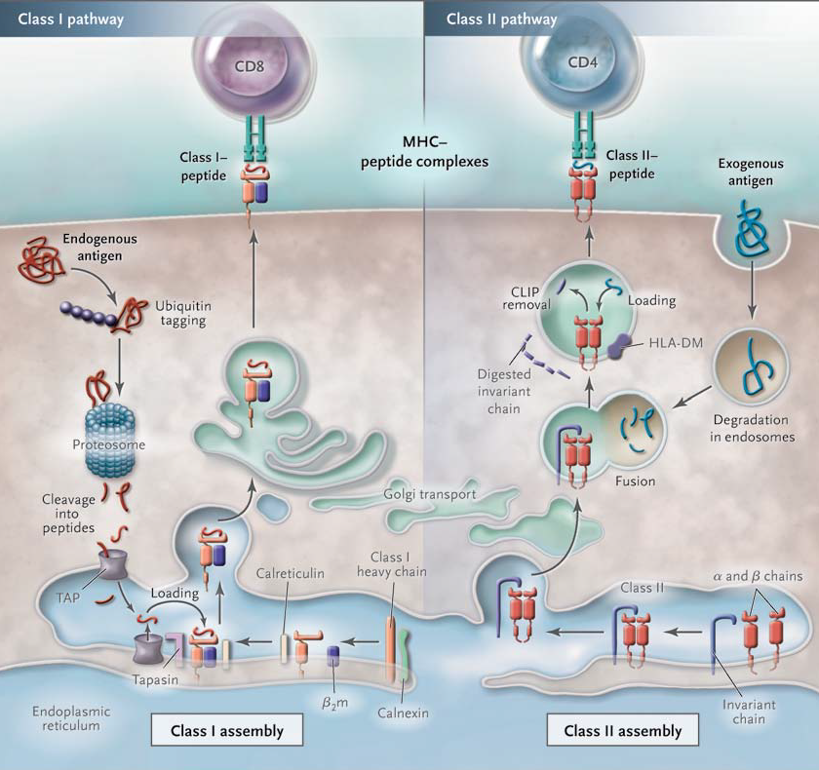

Slide 34
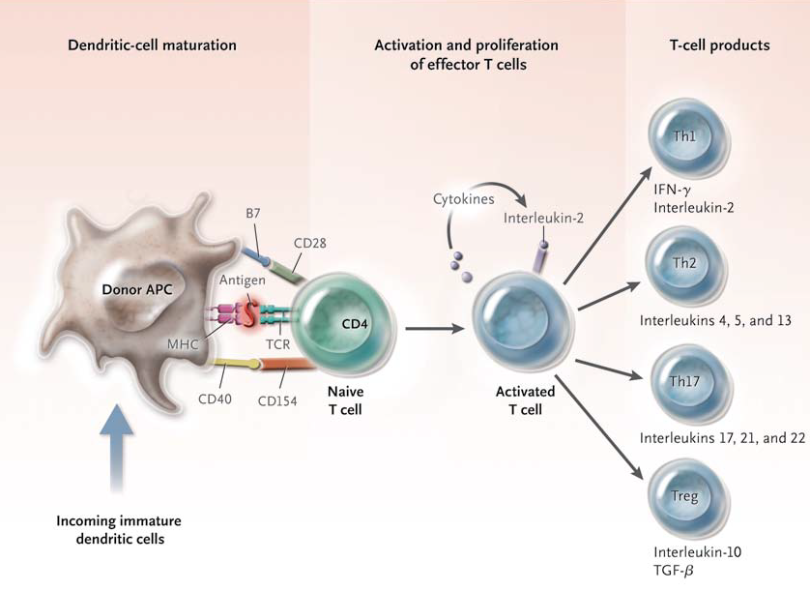

Slide 35
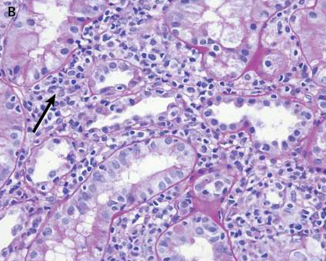

Slide 36
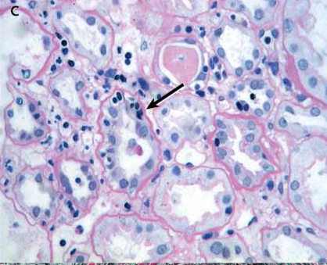

Slide 37
Haas M et al. The Banff 2017 Kidney Meeting Report: Revised diagnostic criteria for chronic active T cell-mediated rejection, antibody-mediated rejection, and prospects for integrative endpoints for next-generation clinical trials. Am J Transplant. 2018 Feb;18(2):293-307. doi: 10.1111/ajt.14625.

Slide 38
STEP 1 = Ag + APC meets T cell
antigen
Notes:
T cells require two separate signals before activation occurs. The first signal is antigen specific and is provided by the interaction of T cell receptor with peptide antigen presented within the antigen binding groove of MHC molecules. The second (costimulatory signal) is provided by the interaction of T cell surface molecules with their ligands on antigen-presenting cells. The provision of signal 1 in the absence of signal 2 may lead to T cell inactivation or anergy, or to failure of a Th1 response with promotion of a Th2 response.

Slide 39
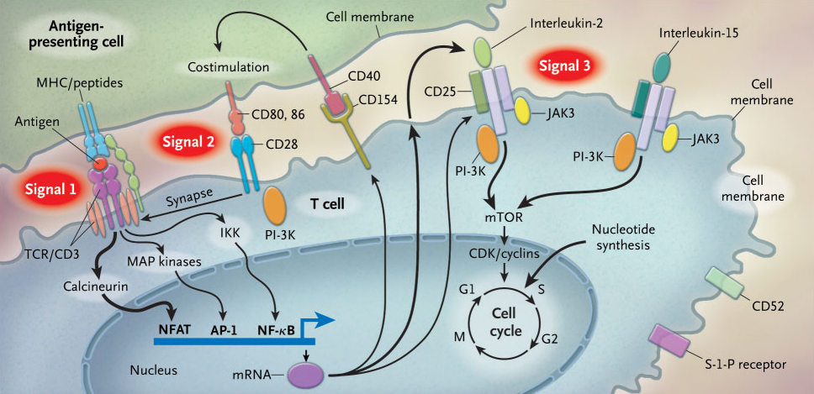

Slide 40
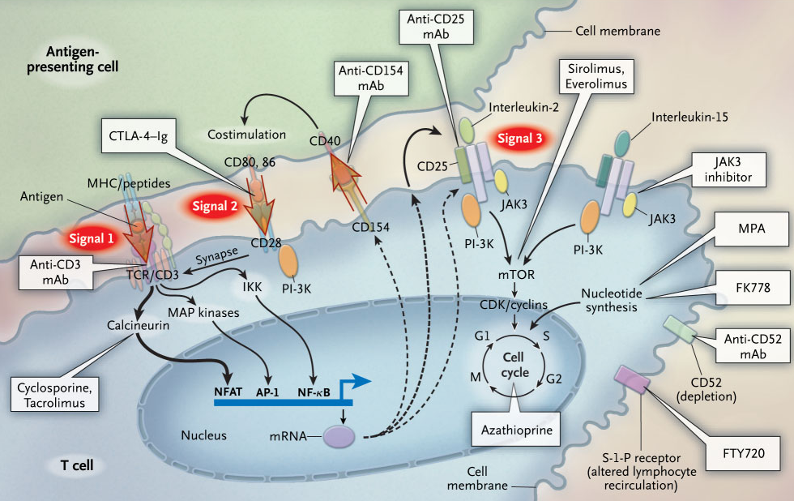

Slide 41
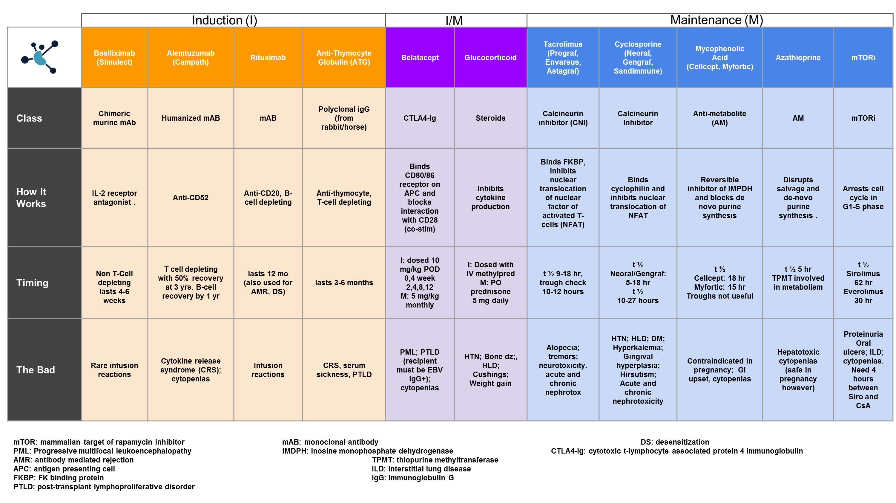

Slide 42
Patient develops skin irritation and congestion after exposure to rabbits. Which drugs can she not get?
Basiliximab
Alemtuzumab
Methylprednisolone
Thymoglobulin
Tacrolimus

Slide 43
Thymoglobulin
Polyclonal Ab preparation made by immunization of rabbits with human thymocytes
“depleting antibody”
Targets a variety of T cell subsets
Also causes expansion of CD4+;CD25+;FOXP3+ T cells (Tregs)

Slide 44
Dose and Administration
Dose 1.5mg/kg/day for 4-6 days
Targets CD3 counts less than 10 cells/cu mm
Cytokine release syndrome common with 1st and 2d dose
Acetaminophen and daily steroid dose given an hr prior to infusion
Given over 4-6 hrs
Administered through central line to avoid thrombophlebitis
Can be administered through peripheral line by adding hydrocortisone 20 mg and 1000 units of heparin

Slide 45
Adverse Effects
Chills/fever and arthralgias
Serum sickness
Thrombocytopenia
Leukopenia
Infections – CMV
Lymphoma

Slide 46
Basiliximab (Simulect)and Daclizumab (Zenapax)
Humanised anti CD25 monoclonal Ab
Targeted against the α chain of the IL-2 receptor
IL-2 mediated responses are blocked
Designed to prevent but not treat episodes of acute rejection
Low immunogenicity

Slide 47
Alemtuzumab (Campath)
Humanised monoclonal Ab against cell surface glycoprotein CD52
Approved for use in CLL
Profound, rapid and effective depletion of lymphoid T cells
May take months to return to pretransplantation levels

Slide 48
Drugs that interact with CNIs
Induce P450 → Decrease CNI levels
Inhibit P-450 → Increase CNI levels
Rifampin
Barbiturates
Phenytoin
Carbamazepine
Corticosteroids
St John’s wort
Verapamil
Diltiazem
Amlodipine
Fluconazole/Itraconazole
Voriconazole/Ketoconazole
Protease inhibitors (Ritonavir)

Slide 50
What is Delayed Graft function (DGF)
Delayed Graft Function (DGF)
Need for RRT within the first week after renal transplantation
Incidence of DGF in DDRT varies between 23-50% (USRDS)
Incidence of DGF following LDKTx usually less than 10%

Slide 51
Risk factors for DGF – Donor factors
Risk Factors for DGF – Donor
Kidneys from DCD donors
Inotropic support of the donor
Age > 55 yrs
Marginal kidneys from diabetic or hypertensive donors
Cold Ischemia Time

Slide 52
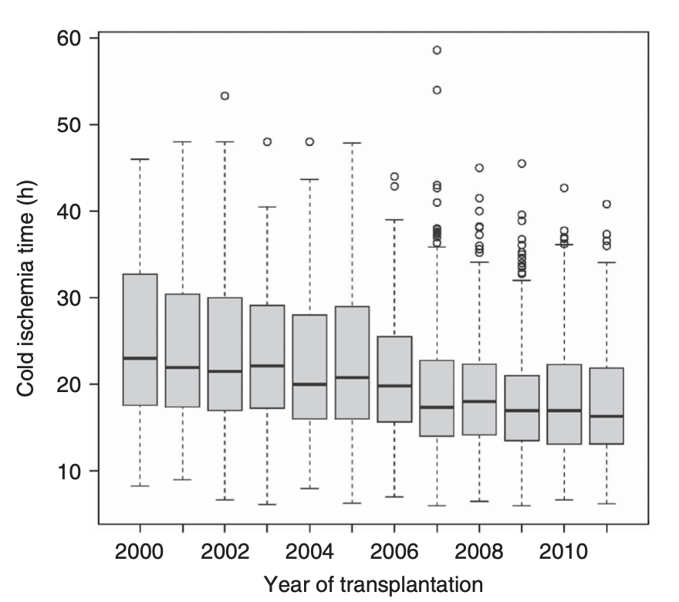
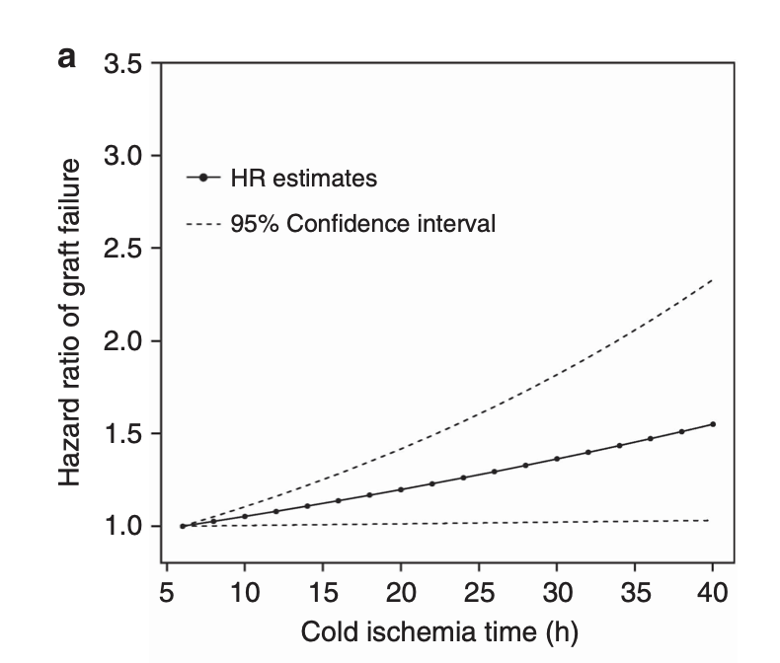
Cold Ischemia Time in Kidney Transplantation
Debout et al; KI 2014
Notes:
This was a retrospective French study. You can see the decrease in CIT over the years. And they also found a correlation between CIT and risk of graft failure.

Slide 53
Risk Factors for DGF – Recipient
Recipient hypovolemia
HD with UF within 24 hrs before Tx
Number of previous transplants
Lower mean perioperative diastolic BP
Higher PRA

Slide 54
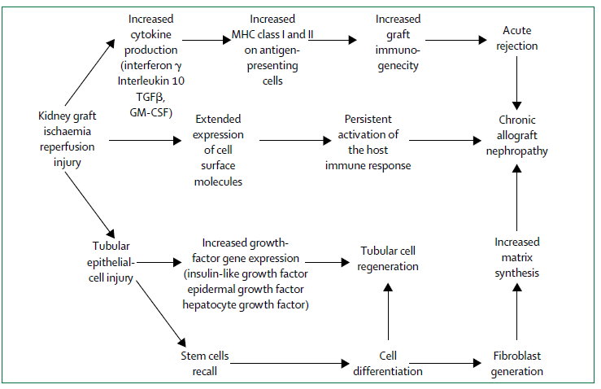
Molecular Mechanisms of DGF

Slide 55
Does DGF lead to (pick all options that apply)
Decreased patient survival
Acute rejection
Worse renal function
All of the above

Slide 56
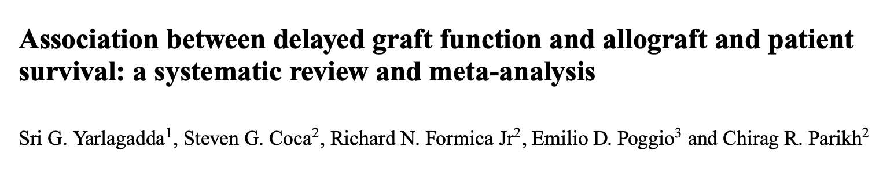
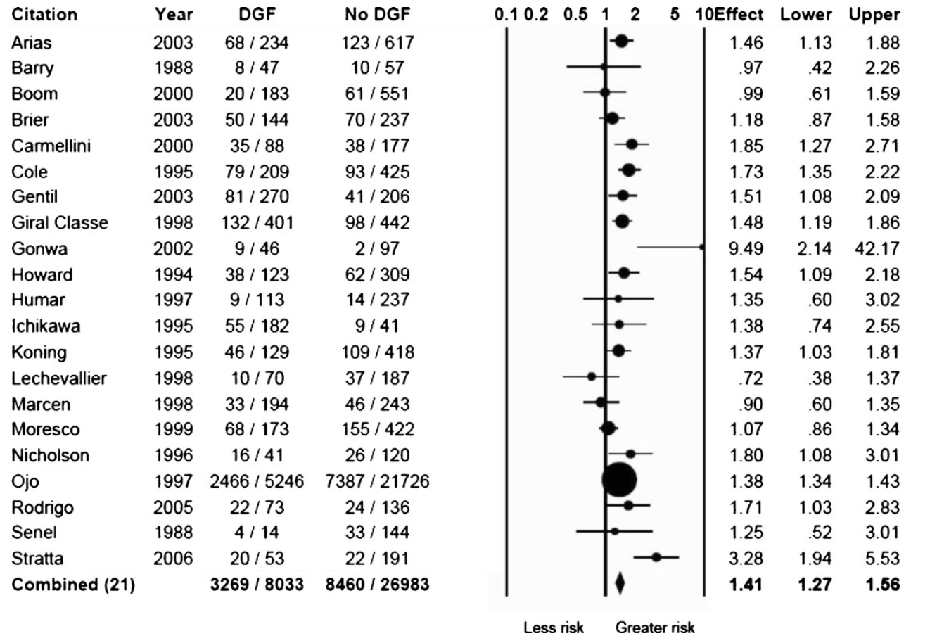
Relative risk of DGF on graft loss
NDT 2009

Slide 57
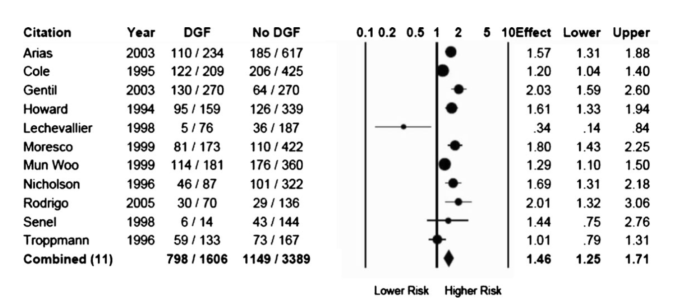
Relative risk of acute rejection with DGF
Yarlagadda et al; NDT 2009

Slide 58
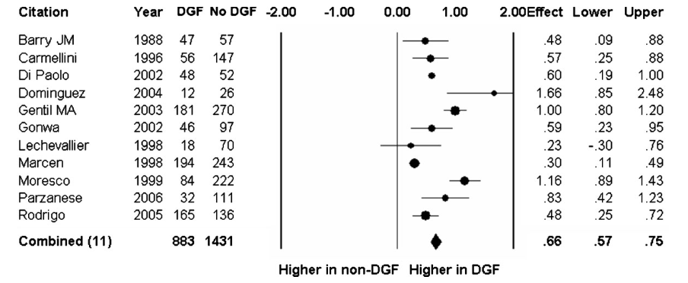
DGF and impact on Renal Function (creatinine)
Yarlagadda et al; NDT 2009

Slide 59
Maintenance
Cellcept 1g BID
Prograf
Steroid free

Slide 60
How do you treat ACR Banff IIa? Pick all options that apply
FK
MMF
Steroids
Thymoglobulin
Plasmapheresis
IVIG

Slide 61
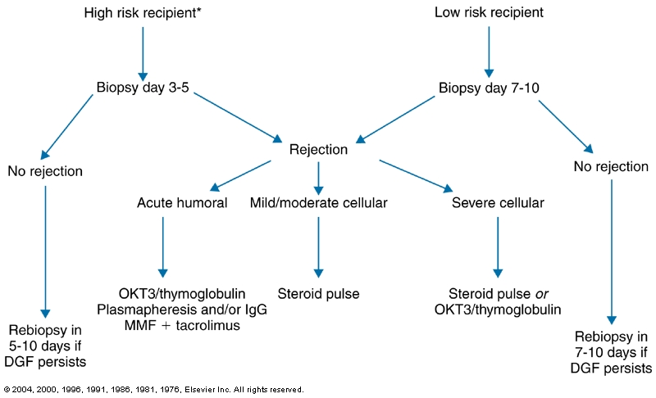

Slide 62
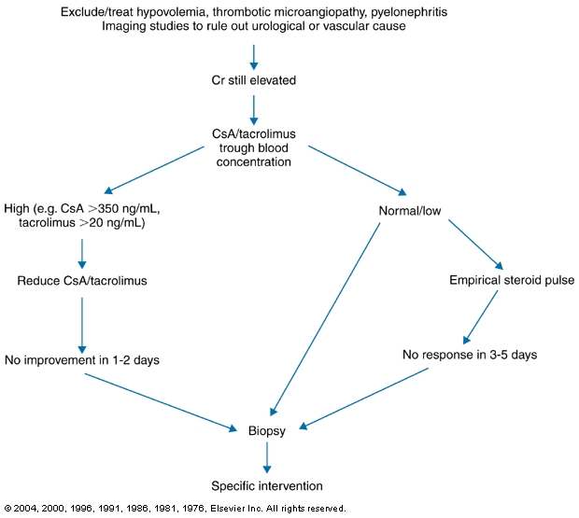

Slide 63
After 10 years of a living kidney transplant, how many are still functioning?
20
38
58
77
98

Slide 66
Hariharan S, Israni AK, Danovitch G. Long-Term Survival after Kidney Transplantation. N Engl J Med. 2021 Aug 19;385(8):729

Slide 67
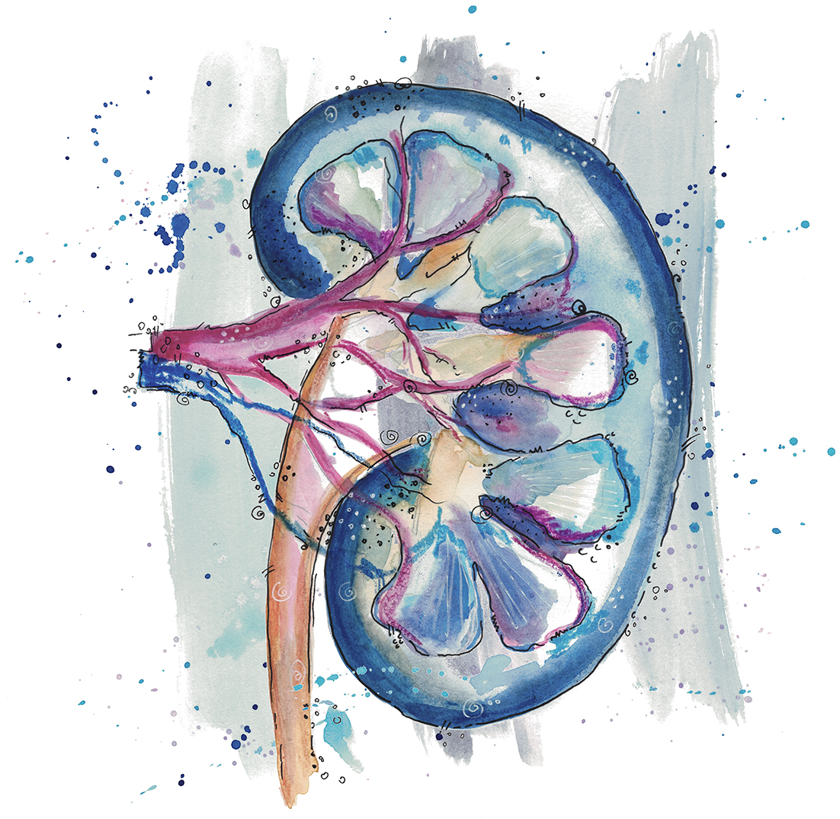
Questions?
Dominique Couck

Slide 68
