Slide 1
Hyper & HYPOnatremia
Dr. Mohit Agarwal

Slide 2
Learning Objectives
  Hyper and Hyponatremia:
  1. Describe the evaluation and management of the patient who presents with symptomatic severe hyponatremia.
  2. Describe the evaluation of a patient who presents with asymptomatic hyponatremia of unknown duration.
  3. Know the differential diagnosis for hyperosmotic hyponatremia, isosmotic hyponatremia, and hypoosmotic hyponatremia.
  4. Describe the evaluation and management of a patient with hypervolemic hypoosmotic hyponatremia, euvolemic hypoosmotic hyponatremia, and hypovolemic hypoosmotic hyponatremia.
  5. In a patient with hypernatremia, calculate a free water deficit, describe the type of fluid and rate of fluid per hour IV to correct the deficit. Know the safe parameters of correction to avoid complications such as osmotic demyelination

Slide 3
HYPONATREMIA
A water disorder
Dr. Mohit Agarwal

Slide 4
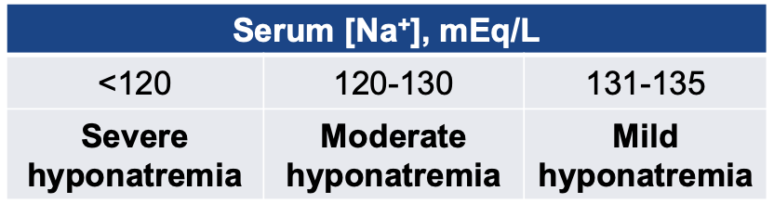
Hyponatremia: Definition
Commonly defined as serum sodium concentration ([Na+]) <135 mEq/L, but cut-off values vary
Generally considered a disorder of water rather than a disorder of sodium
Normal processes allow daily excretion of up to 10 L H2O
In most cases of hyponatremia, some impairment of water excretion is present
    Dilution from increased water retention
    Depletion from electrolyte losses in excess of water loss

Slide 5
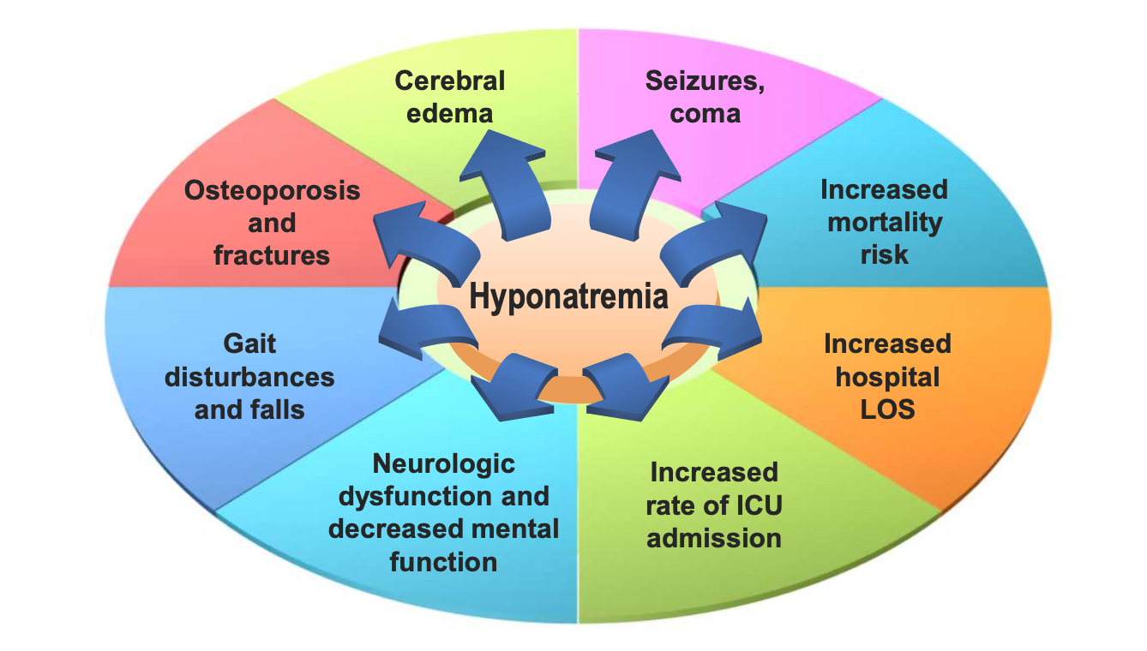
Consequences of Hyponatremia

Slide 6
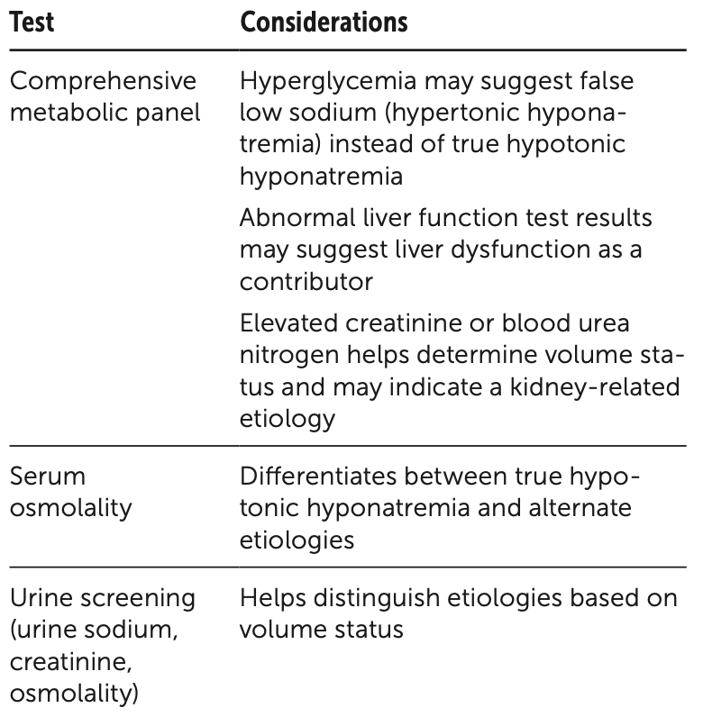
Laboratory Testing to Evaluate for Hyponatremia

Slide 7
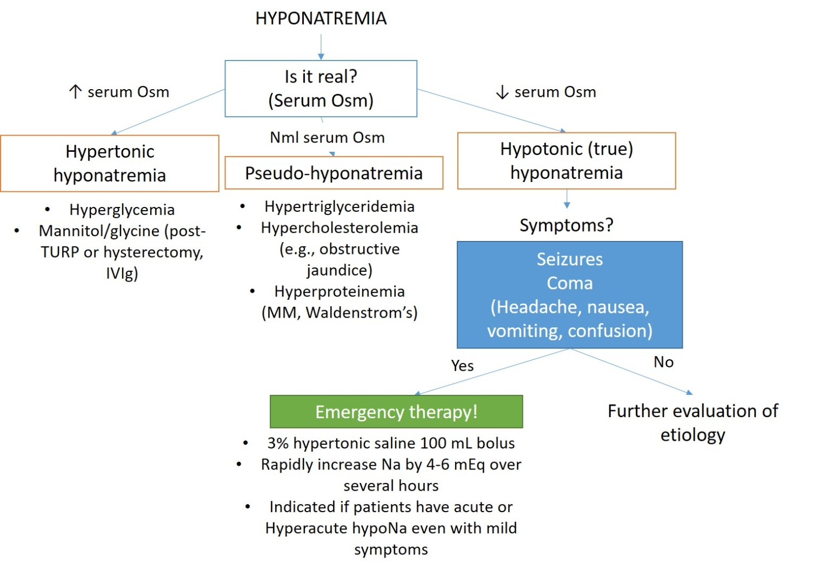
Is it Real?

Slide 8
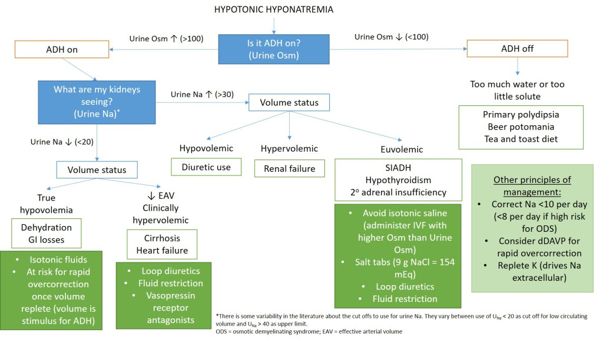
hyponatremia flowchart

Slide 9
Case
  A woman undergoes intrauterine surgery. 5% mannitol (iso-osmotic 275 mosm/kg) is used as the irrigant. Immediately after surgery the PNa is found to be 116 mEq/L, and irrigant absorption is suspected.
  • Posm measured 280 mosm/l.
  • Posm calculated 240 mosm/l.
  • Osmolal gap 40 mosm/l.

Slide 10
Case
  What is the cause of this patient’s hyponatremia?
  A. This is true hyponatremia from the absorbed mannitol pulling
  water from the intracellular space to extracellular space (like
  hyperglycemia)
  B. This is true hyponatremia from absorbed mannitol that does not contain Na
  C. This is pseudohyponatremia from absorbed mannitol
  D. This is true hyponatremia from mannitol metabolism to glucose
  causing hyperglycemia

Slide 11
Case
  Hyponatremia Without Hypo-Osmolality (osmolal gap present)
  Calculate serum osmolality: PNa x 2 + glucose/18 + BUN/2.8 (both in mg/dl)
  • Pseudo-hyponatremia due to an increase in plasma SOLIDS (marked hyperlipidemia or hyperproteinemia (Waldenstrom or MM))
    Can get hyperproteinemia transiently from IgG infusion
  • True hyponatremia due to exogenous solutes (NOT pseudo)
    HYPERTONIC Mannitol – pulls water from intracellular to extracellular space – transient
    IgG infusion (contain sucrose or maltose) – large amounts in infusion can pull water from intracellular to extracellular space
    Absorbed irrigants: ISOTONIC mannitol, glycine, or sorbitol

Slide 12
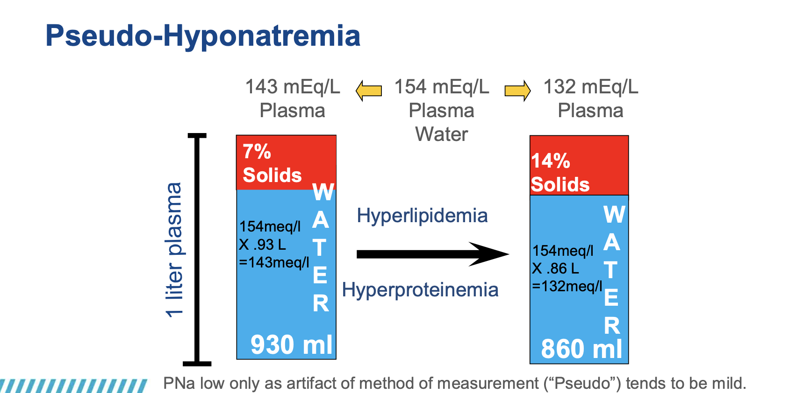
Pseudo-Hyponatremia

Slide 13
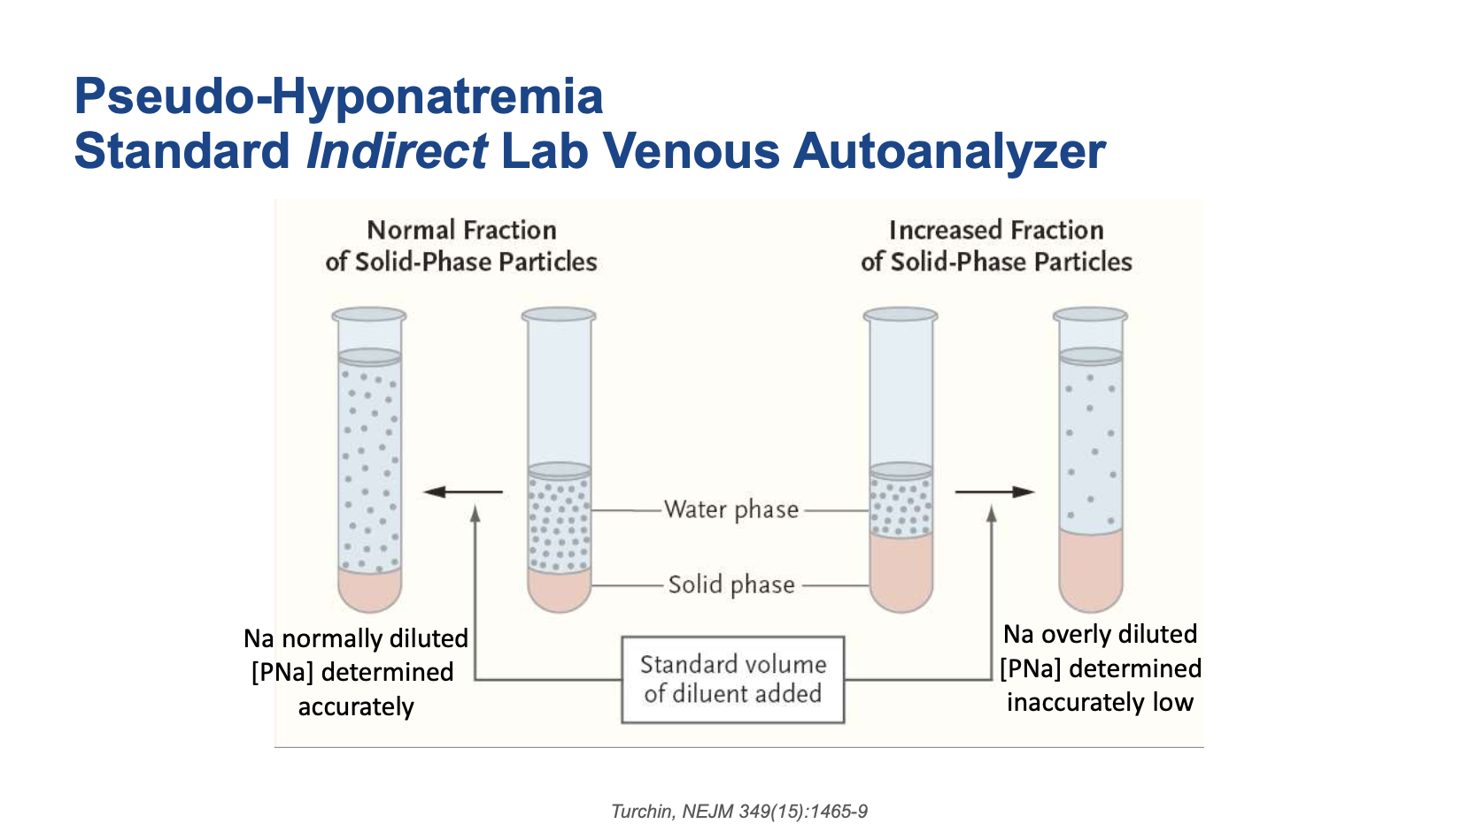
Pseudo-Hyponatremia

Slide 14
Case
  True vs. “Pseudo-Hyponatremia
  Direct vs. Indirect Potentiometry (ABG analysis)
  • Pseudo-hyponatremia is a “condition” related to Indirect Potentiometry (most laboratory auto-analyzers)
  • Direct Potentiometry uses an undiluted specimen (blood gas machine)
      • If you suspect pseudohypoNa, get blood gas “Direct” measurement
  • Pseudohyponatremia
      • PNa low by lab autoanalyzer Indirect but
      • PNa normal ABG Direct potentiometry
  • True hyponatremia
      • PNa low by both Indirect and Direct potentiometry
      • True hyponatremia but not hypo-osmolar

Slide 15
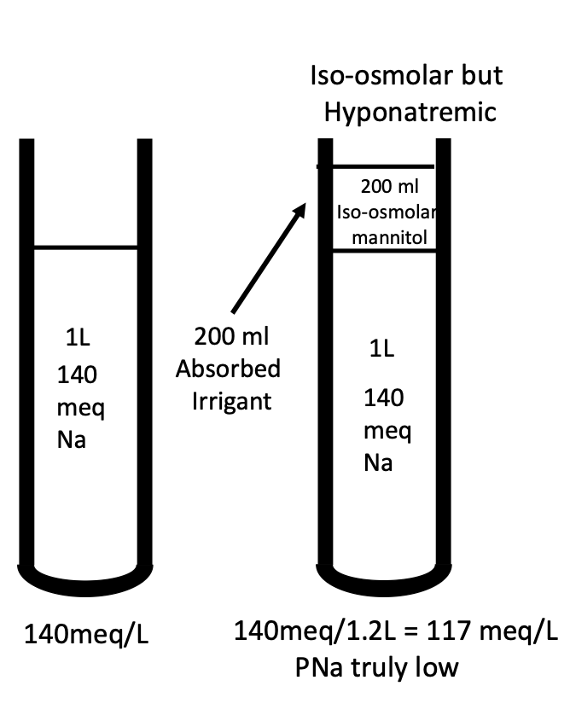
“True” Hyponatremia
Post-TURP/Uteroscopy Syndrome
  • Absorption of irrigant fluid with non-Na solutes
  • Bloody vascular operations need visualization
  • Requires large volume fluid irrigation and cautery
  • Cautery with saline could electrocute pt
  • Need iso-osmolar but non-conductive “irrigant” containing typically mannitol, glycine, sorbitol (get hemolysis with water)

Slide 16
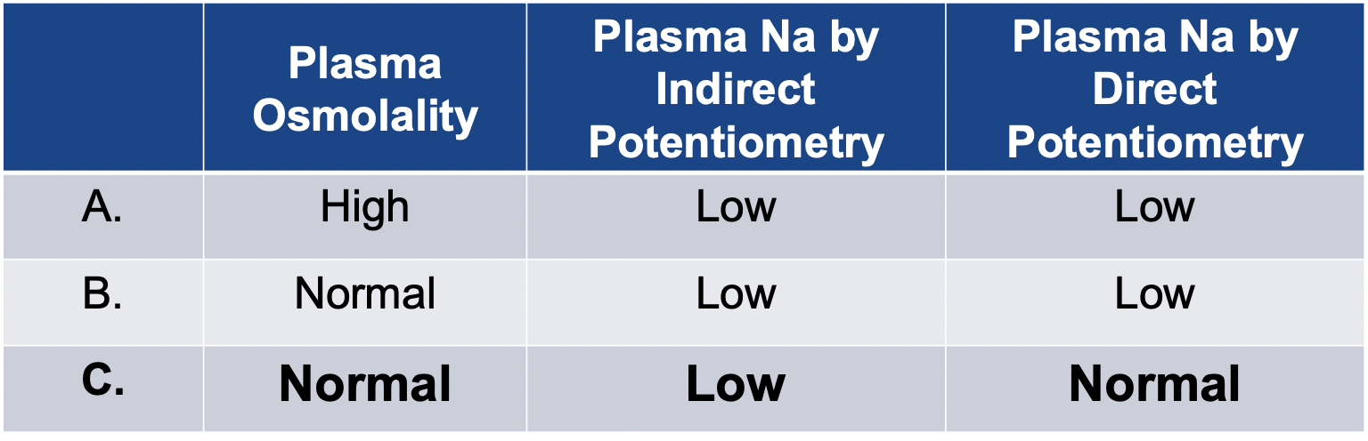
Pseudo-Hyponatremia
laboratory measurement methods are affected by large molecules like lipids or proteins, which displace water in the blood sample and lead to an artifactually low sodium reading while osmolality remains normal.

Slide 17
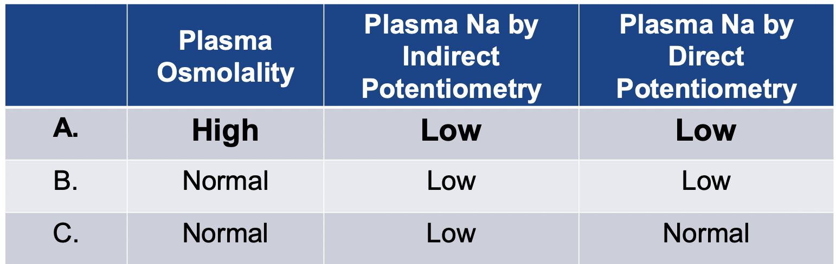
Hyperglycemia: True Hyponatremia
(No osmlolal gap because BG is in the equation)

Slide 18
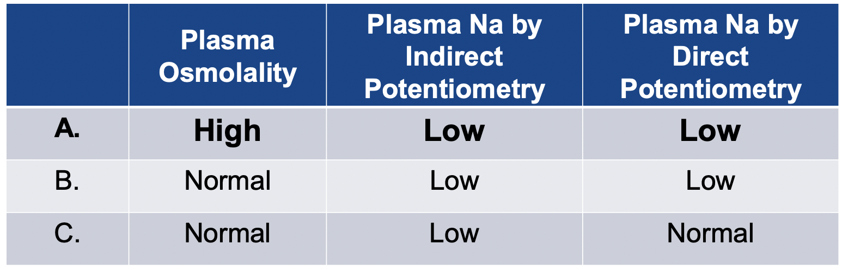
Hypertonic Mannitol, Hypertonic Sucrose, and Maltose found in Ig infusion (All can cause osmotic nephrosis)
All True Hyponatremia

Slide 19
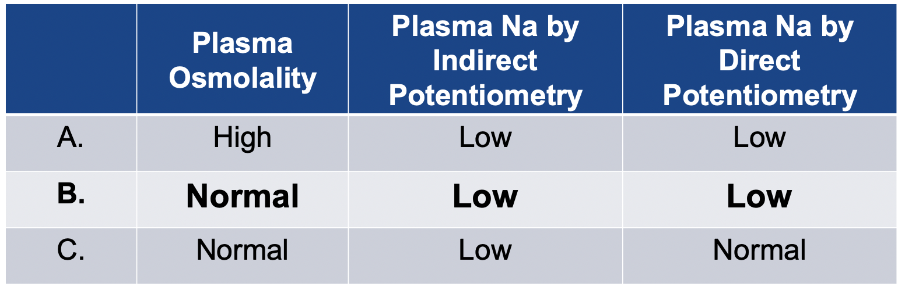
Absorbed Iso-Osmolar Irrigant

Slide 20
Case– Answer
  Question What is the cause of this patient’s hyponatremia?
  This is true hyponatremia from the absorbed mannitol pulling water from the intracellular space to extracellular space
  This is true hyponatremia from absorbed mannitol that does not contain Na
  This is Pseudohyponatremia from absorbed mannitol
  This is true hyponatremia from mannitol metabolism to glucose causing hyperglycemia

Slide 21
Case
  • An 18-yr-old woman is brought to the ER after she had a seizure at a dance party. She was drinking beer according to her friends.
  • She complained of a headache, became confused, and then seized.
  • EMT gave her an amp of D50 and then transported her to the hospital.
  • In the ER, her PNa was found to be 110 meq/L, and she was
  obtunded.

Slide 22
Case: Other Labs
  • Na 110 mEq/l, K 4.0 mEq/l, Cl 74 mEq/l, HCO3 16 mEq/l
  • BUN 8 mg/dl, creatinine 0.6 mg/dl
  • BG 350 mg/dl, lactate 8 mmol/l, Anion gap 20, uric acid 2.0
  • Serum osmolality 240 mosm/kg
  • Urine osmolality 780 mosm/kg, Urine Na 124 mEq/l

Slide 23
Case: Question
  Her severe hyponatremia is most consistent with?
  A. Beer drinker’s potomania
  B. SIADH
  C. Hyperglycemia with DKA
  D. Thiazide abuse
  E. Hypoadrenalism

Slide 24
Case: Explanation
  A. “Beer drinker’s potomania” and “Tea and toast” hyponatremia
      • Disorders of ↑ water intake and ↓ solute intake
      • Water excretion requires osms: Na, K, and urea
      • Beer and Tea & toast are only carbohydrates → CO2 + H2O
      • Low solute – limits water excretion
      • Solute issue not a urinary dilution issue. Urine should be dilute.
      (here 780 mosm/kg).
  B. SIADH
  C. Hyperglycemia with DKA
  D. Thiazide abuse
  E. Hypoadrenalism

Slide 25
Case: Explanation
  A. Beer drinker’s potomania
  B. SIADH
      • Not a disease of healthy 18-year-olds?
      • SIADH is a disease of patients often on medications or with cancer?
  C. Hyperglycemia with DKA
  D. Thiazide abuse
  E. Hypoadrenalism

Slide 26
Case: Explanation
  A. Beer drinker’s potomania
  B. SIADH
  C. Hyperglycemia with DKA
      • Serum should be hyperosmolar (Posm only 240)
      • BG would have to be ~ 2000 mg/dl to get PNa down to 110 mEq/l
      • This patient has a lactic acidosis not ketoacidosis
  D. Thiazide abuse
  E. Hypoadrenalism

Slide 27
Case: Explanation
  A. Beer drinker’s potomania
  B. SIADH
  C. Hyperglycemia with DKA
  D. Thiazide abuse
      • Usually alkalotic and azotemic and hypokalemic
      • Uric acid usually high not low
  E. Hypoadrenalism

Slide 28
Case: Explanation
  A. Beer drinker’s potomania
  B. SIADH
  C. Hyperglycemia with DKA
  D. Thiazide abuse
  E. Hypoadrenalism
      • Should be hypoglycemic and hyperkalemic

Slide 29
Case: Answer
  A. Beer drinker’s potomania
  B. SIADH – Euvolemia
      • PNa and Posm low
      • Uosm high
      • UNa high (“high” meaning not low)
      • Uric acid low
  A. Hyperglycemia with DKA
  B. Thiazide abuse
  C. Hypoadrenalism

Slide 30
Ecstasy-Induced Hyponatremia
  • Hyponatremia most common and most severe complication
  • Women >> Men
  • High mortality rate
  • Often only a single dose
  • N, V, MS changes, Sz, cardiac arrest
  • Brainstem herniation from acute cerebral edema

Slide 31
Ecstasy-Induced Hyponatremia
  • Raves encourage high water intake to prevent dehydration
  • ADH (non-osmotic) levels are high
  • [PNa] exacerbated by high water intake
  • Very similar to marathon drinkers hyponatremia
  • Best examples of acute severe hyponatremia
  • High ADH levels stress, pain, etc.
  • Water stations everywhere, ENCOURAGED TO DRINK
  • Treat BOTH the same
  • 3% Saline 100-150 cc bolus, repeat based on response up to 300 ml total

Slide 32
3% Hypertonic Saline Bolus Therapy
  • 1 ml 3% NaCl per/kg will increase the PNa by ~1 mEq/L
  In a 75 Kg patient, 150 mL of 3% bolus will increase sodium by ~ 2
  • Recommendations vary from bolus 100-150 ml

Slide 33
Case: Question 2
  After receiving 200 ml of 3% NS, she became more alert, PNa 116 mEq/l. Suddenly 4 hours later, she becomes polyuric, Uosm now 75 mosm/l.
  Do you:
  A. Replace urine with D5W?
  B. Replace urine with D5W and give DDAVP?
  C. Do nothing more?
  D. Call Nephrology?

Slide 34
Case Take-Home Points
  • This hyponatremia is SEVERE, ACUTE, and therefore SYMPTOMATIC.
  • Requires immediate increase in [PNa] with 3% NS as bolus.
  • It is rare to see such severe symptomatic hyponatremia and KNOW confidently that it is acute.
      • Ecstasy use and marathon runners
  • Complete brain adaptation to hyponatremia takes 36-48 hours.
  • Osmotic demyelination is a disease of CHRONIC hyponatremia.
  • PNa increase in ACUTE hyponatremia has “no” risk of osmotic demyelination.
  • Could comfortably do NOTHING here (after 3%).
  • Pre-menopausal women are more likely to:
      • develop hypoNa in general
      • be symptomatic in general
      • have a bad outcome worse outcome for any [PNa]

Slide 35
Case: Question 2 Answer
  After receiving 200 ml of 3% NS, she became more alert, PNa 116 mEq/l. Suddenly 4 hours later, she becomes polyuric, Uosm now 75 mosm/l.
  Do you:
  A. Replace urine with D5W?
  B. Replace urine with D5W and give DDAVP?
  C. Do nothing more?
  D. Call Nephrology?

Slide 36
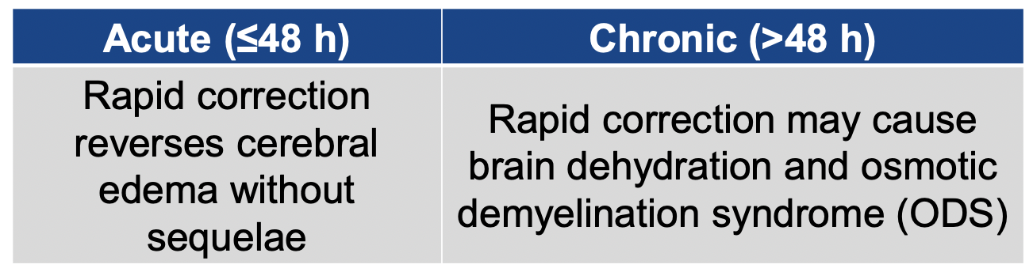
Treating Acute vs. Chronic Hyponatremia

Slide 37
Consensus Conference on Rx of Acute Hyponatremia in Marathon Runners
  Recommended Therapy:
  • In the field: 3% saline 100 ml over 10 minutes, repeated x 2 if needed
  • In hospital: 3% saline 100 ml or 1 ml/kg bolus followed by 100
  ml/hr or 1-2 ml/kg/hr

Slide 38
Therapeutic Hypernatremia for
Cerebral Edema
  • 30 ml bolus of 23.4% saline (equivalent to 234 ml 3% saline)
  • Change in Serum Na = 5 mEq/L
  • Reversed clinical signs of brain herniation in most cases
  • Decreased intracranial pressure by 40%

Slide 39
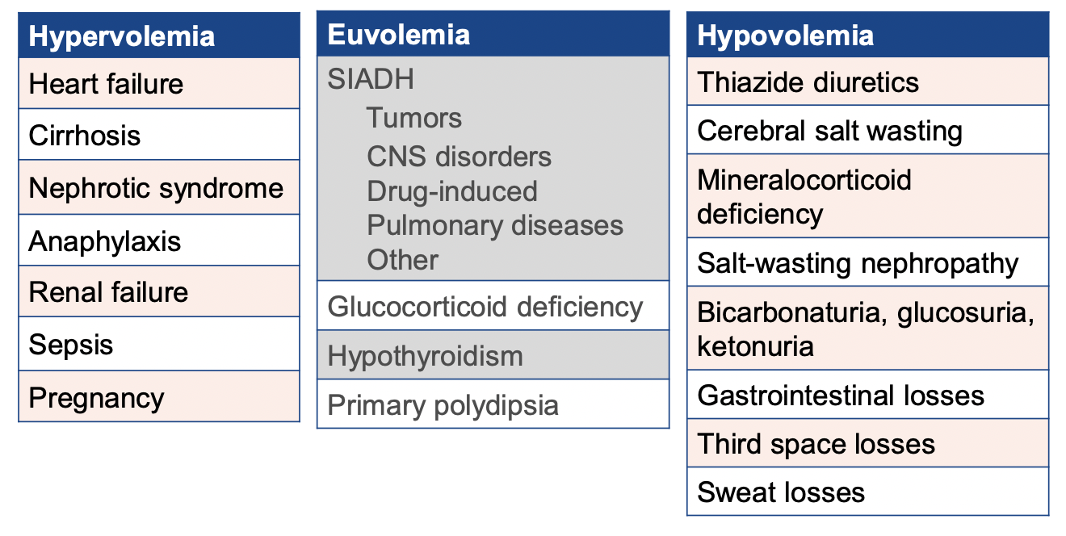
Etiologies of Hypo-Osmolar Hyponatremia

Slide 40
SIADH: Diagnosis
  • High urine osmolality in setting of inappropriately low serum osmolality
  • Urinary [Na+] >40 mEq/L with normal sodium intake
  • Clinical euvolemia
      • No signs of ECF volume depletion (orthostasis, tachycardia, decreased skin turgor, dry mucous membranes)
      • No clinical signs of excessive volume of ECF (edema, ascites)
  • Normal hepatic, renal, cardiac function
  • Normal thyroid and adrenal function
  • No recent diuretic agent use

Slide 41
SIADH: Pathophysiology
  • Caused by excessive levels of AVP as a result of disease, drug-induced pituitary release of AVP, or ectopic production of AVP
  • AVP secretion not suppressed appropriately when plasma osmolality falls below the osmotic threshold
  • The inability to suppress AVP secretion
  results in:
      • Impaired renal water excretion
      • Increased total body water
      • Hyponatremia
      • “Dilute serum, nondilute urine”

Slide 42
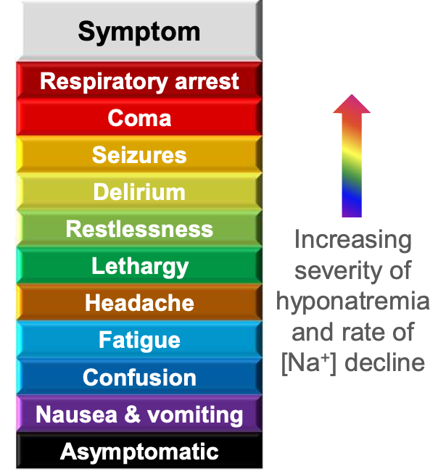
Symptoms Correlate with Severity and Rate of Decline in Serum [Na⁺]
  • Asymptomatic presentation common
  • May present with mild, nonspecific symptoms
  • Degree of symptomatology is surrogate for duration of hyponatremia
  • Symptomatic but less impaired: usually CHRONIC
  • Life-threatening: usually ACUTE
  • Symptoms from underlying disease process also common

Slide 43
Treatment Overview
  • Most important treatment factors
      • Severity of neurologic symptoms
      • Volume status
      • Acute vs. chronic
      • Identify likely cause of hyponatremia
  • Principles to guide treatment
      • Weigh risks and benefits
          • Neurologic consequences can follow both failure to promptly treat and excessively rapid rate of correction
          • Even modest improvement in serum [Na+] have survival benefits
      • Monitor serum [Na+] frequently
      • Address underlying disease and stop offending medications

Slide 44
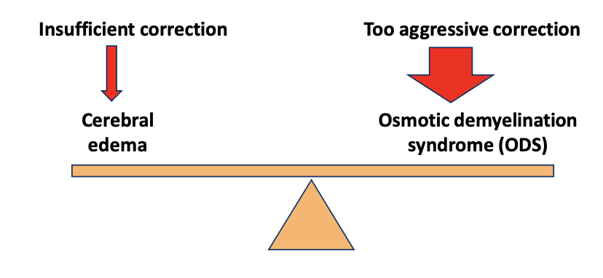
Correct Serum [Na+] to Safe Level at Safe Rate
  Sodium correction should be limited to 8 mEq per L over 24 hours in patients with chronic hyponatremia who are at increased risk of osmotic demyelination syndrome.
  For patients without risk factors, sodium correction should be limited to 12 mEq per L over 24 hours and 18 mEq per L over 48 hours to minimize the risk of osmotic demyelination syndrome.

Slide 45
Risk Factors for
Osmotic Demyelination Syndrome (ODS)
  • Chronic hyponatremia
  • Serum Na <105 mEq/L
  • Hypokalemia
  • Alcoholism and malnutrition
  • Liver disease (case reports of CPM with correction <10 mEq/L per 24 hours)
  • Hypoxemia

Slide 46
Therapeutic Goals
  • 6 mEq/L in 24 hours is “enough” for the most severe symptoms
  • How much is “too much”
  • 10 mEq/L/day in high risk groups
  • 18 mEq/L/2 days
  • How much is “just right”
  • Not too little and not too much
  • Enough margin for error
  • SUGGESTION: 6 mEq/L/day

Slide 47
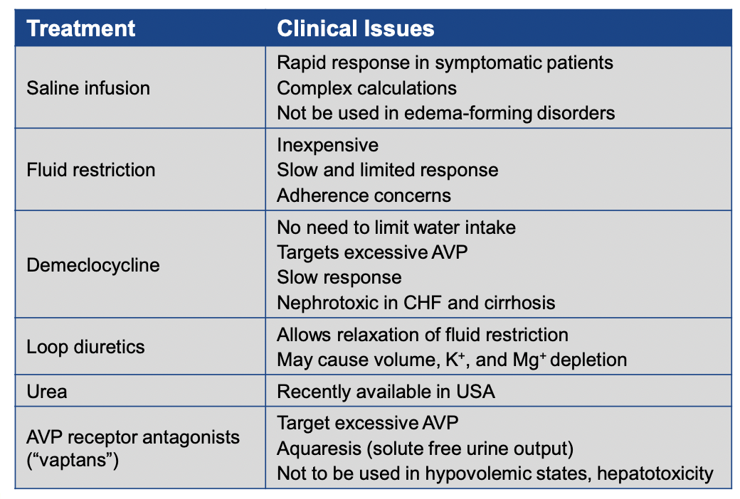
Treatments for Hyponatremia

Slide 48
Fluid Restriction
  • Fluid restriction very patient-specific
  • Standard procedure: restrict fluid to ~0.8 L/d
  • Slow rate of improvement
  • Poor patient adherence
  • Predictors of failure
    • High urine osmolality (>500 mOsm/kg H2O)
    • Urine [Na+] and [K+] > serum [Na+]
    • 24-hr urine output <1,500 mL/d
    • Increase in serum [Na+] <2 mEq/L in 24 hr

Slide 49
Fluid Restriction
  • Fluid restriction does not always work.
  • Fluid restriction in patients with SIADH slowly corrects hyponatremia by only 1–2 mEq/L/d, even when severe (<500 ml/d).
  • Fluid restriction is poorly tolerated because of increased thirst, with subsequent poor compliance.

Slide 50
Salt Tabs
  • Starting dose as 1 g of sodium chloride three times per day.
  • Can be increased further
  • Can be followed by 20 mg of furosemide once or twice daily

Slide 51
Loop Diuretics and Saline Infusion
  Effort to increase net renal free water excretion:
  • Loop diuretics generally lead to diuresis with urine sodium concentration of ~70 mEq/L.
  • If hourly urine volume is replaced with half the equivalent volume of normal saline (154 mEq/L), then the sodium loss induced by the diuretic is quantitatively replaced together with 50% of the water loss.
  • Technique effectively induces a net solvent excretion of 50% of the urine volume.
  • Require careful monitoring and is labor intensive.
  • May not be effective with renal failure and may require colloid expansion as well to get a diuresis.

Slide 52
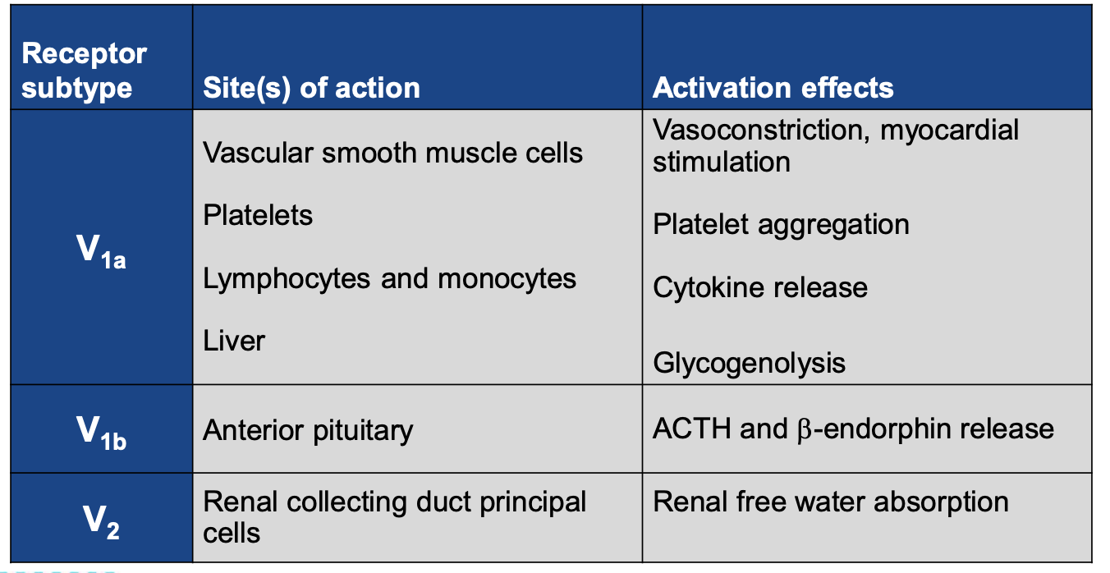
Receptor-Mediated Effects of AVP
Verbalis JG. J Mol Endocrinol. 2002;29(1):1-9

Slide 53
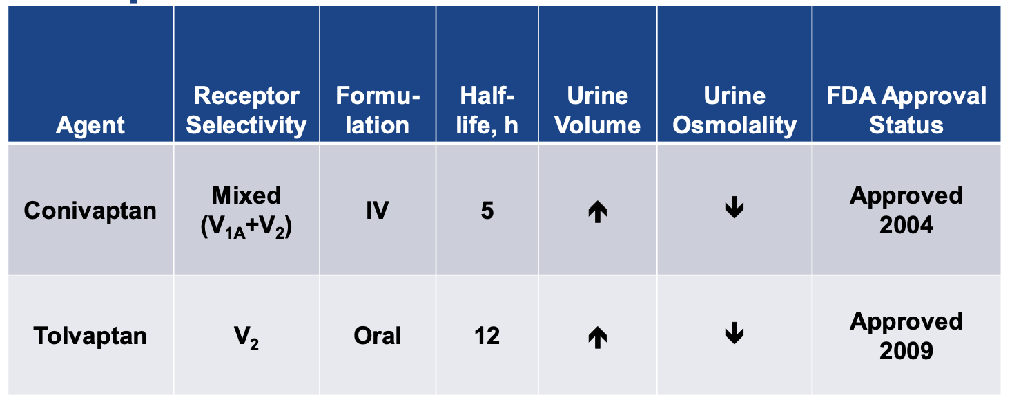
The Vaptans: Overview

Slide 54
The Vaptans: Dosing
Conivaptan
  • Loading dose: 20 mg IV over 30 min
  • Maintenance infusion 20-40mg over 24 hr (if desired)
  • May be administered for additional 1 to 4 days
  • To minimize risk of vascular irritation:
  • Administer through large veins
  • Change infusion site every 24 hr

Slide 55
The Vaptans: Dosing
Tolvaptan
  • Should be initiated and reinitiated only in a hospital
  • Initial oral dose of 15 mg administered once daily without regard to meals
  • Increase to 30 mg once daily after at least 24 hr
  • Maximum dose 60 mg daily
  • Avoid fluid restriction during first 24 hr of therapy

Slide 56
The Vaptans: Precautions
  • Caution use with CYP3A4 and PGP inhibitors
  • Do not use in hypovolemic patients
  • Use with caution in patients with hepatic or renal impairment
  • Use limited to 30 days
  • Recommend frequent monitoring of serum [Na+] and volume
  • Do not administer to anuric patients, as no benefit expected
  • Due to potential increased risk of GI bleeding in patients with cirrhosis, use only when need to treat outweighs risk*
  • Post-vaptan tx, check [Na+] every 4-6 hr first day
  • Avoid fluid restriction during first 24 hr of tx
  *Applies to tolvaptan only.

Slide 57
Potent inhibitors of CYP3A4 include
  CAMP
  C: Calcium Channel Blockers: diltiazem, verapamil (Amlodipine OK)
  C: Citrus: grapefruit
  C: Cyclosporine
  A: Azoles: itraconazole, ketoconazole
  M: Macrolides: clarithromycin, erythromycin (Azithromycin OK)
  P: Protease Inhibitors like ritonavir, Paxlovid

Slide 58
Urea
  • Induces osmotic excretion of free water without associated electrolyte depletion
  • In SIADH, diminishes natriuresis in association with increased medullary urea content
  • Recommended by European Practice Guideline
  • Dose is typically 15-30 gram per day or dose of 0.25-0.50g/Kg
  • Used for >30 years
  • Thus far, no cases of osmotic demyelination in the literature (possible protective effect of urea)
  • Available in USA: “Ure-Na” which is lemon-lime flavor

Slide 59
3% Hypertonic Saline infusion Therapy
  • 1 ml 3% NaCl per/kg will increase the PNa by ~1 mEq/L
  In an 80 Kg patient, 20 mL/hour infusion of 3% NaCl should increase sodium by ~ 6 mEq/L over 24 hours
  Caveats
  • Greater increase if urine is dilute
  • Smaller increase if urine [Na+] very high

Slide 60
3% Hypertonic Saline infusion Therapy
  • Peripheral vein is ok
  • No reported cases of extravasation injury of venous sclerosis
  • Mandate for central vein was based on experience with
  concentrated glucose
  • Standard pharmacy text no longer requires central vein

Slide 61
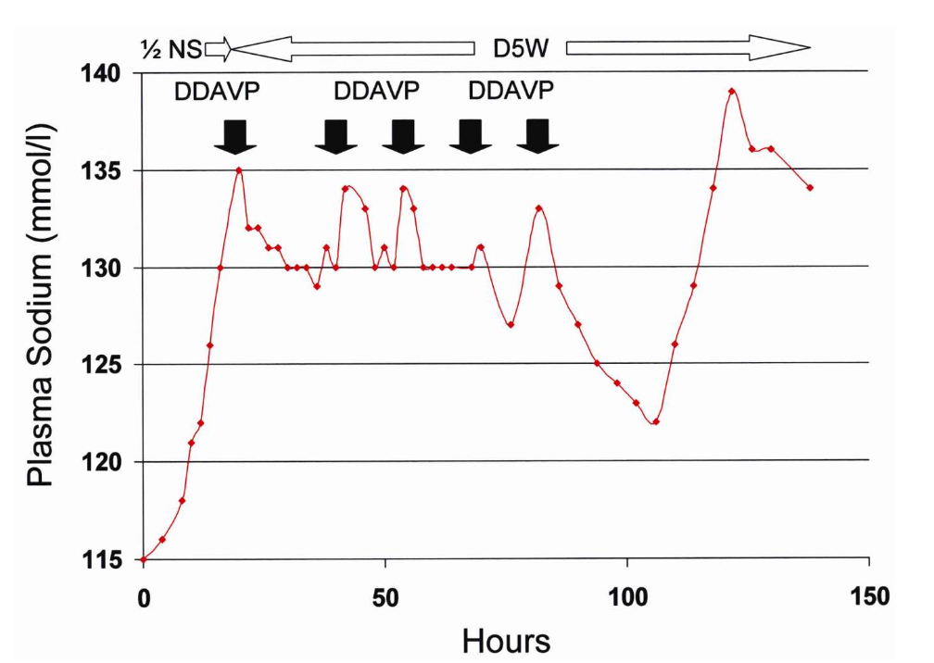
DDAVP to Reverse Overcorrection
Perianayagam A, Sterns RH, CJASN 3:331-336, 2008

Slide 62
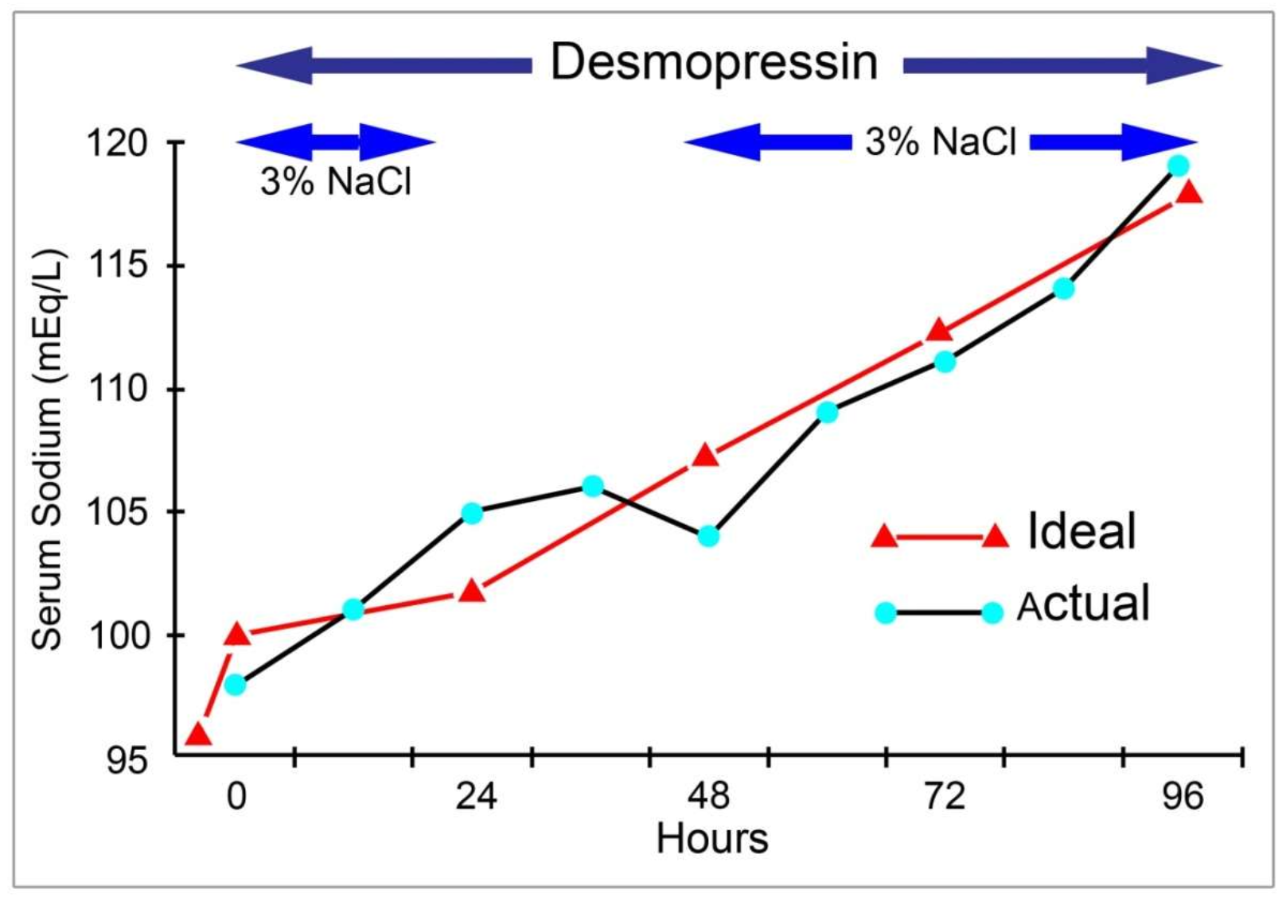
Pro-Active Strategy:
Combined Rx with DDAVP and 3% NaCl
Sterns, Am J Kidney Dis. 2010 Oct;56(4):774-9

Slide 63
Worry: Reversibly Impaired Water Excretion
Unintended Overcorrection
  • Urine osmolality falls to <100 mOsm/kg
  • Urine output increases to >500 ml/hr
  • Serum Na increases by >2.5 mEq/L/hr
  Replace urinary free water loss with oral hydration or 5% dextrose infused at 3 mL per kg per hour, with or without 2 mcg of desmopressin every 8 hours

Slide 64
Worry: States of Reversibly Impaired Water Excretion
  • Hypovolemia
  • Thiazide diuretics
  • Drug-induced SIADH
  • Stress-induced SIADH
  • Hypoxia
  • Cortisol deficiency
  These states share the risk of over-rapid correction of
  serum sodium and should be approached with caution.

Slide 65
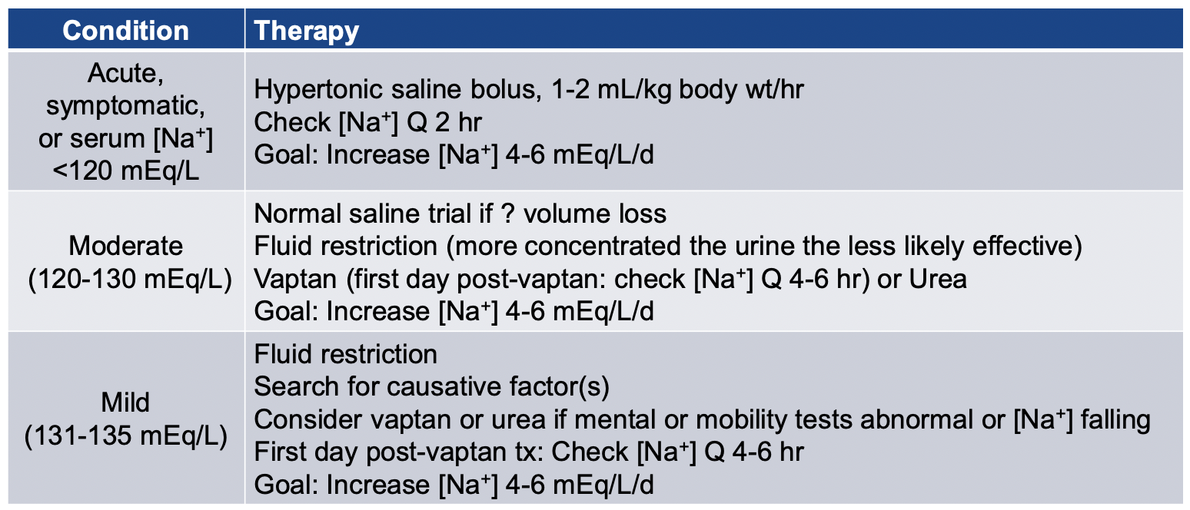
Summary: Therapies for Hyponatremia

Slide 66
Thanks!

Slide 67
Hypernatremia
A water disorder
Dr. Mohit Agarwal

Slide 68
dysnatremias are actually disorders of water homeostasis.
Hypernatremia is all about water. A more accurate term for hypernatremia might be “hypoaquaremia,” because it literally means a state in which there is too little water in the intravascular space and, as a consequence, in the intracellular space.

Slide 69
Hyper (High) natremia and Hypo (Low) natremia:
Water deficiency and water excess
Water Excess
Balanced Water
Na 130
Water Deficiency
Na 140
Na 150

Slide 70
Classifications of hypernatremia
  Serum sodium concentration
Mild 146–150 mmol/L
Moderate 151–155 mmol/L
Severe > 155 mmol/L
  Time of development (cutoff 48 hours)
Acute
Chronic
  Clinical assessment of volume status
Euvolemic
Hypovolemic
Hypervolemic

Slide 71
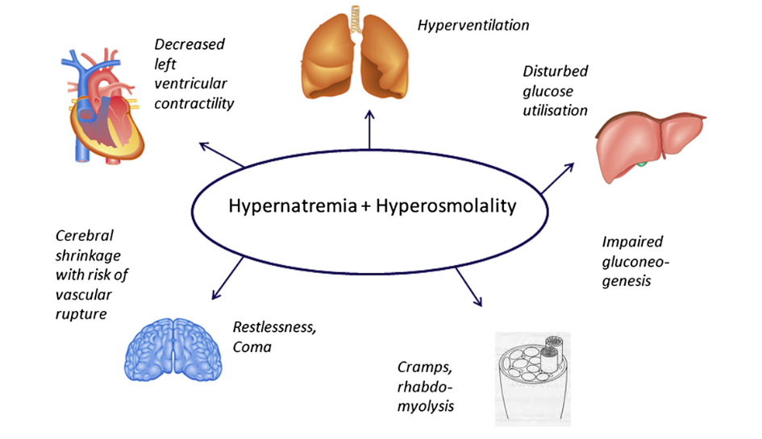
Consequences of hypernatremia
Lindner G, Funk GC. Hypernatremia in critically ill patients. J Crit Care. 2013 Apr;28(2):216.e11-20.
The major symptoms of hypernatremia are neurologic and include altered mental status, weakness, neuromuscular irritability, focal neurologic deficits, and occasionally coma or seizure.

Slide 72
symptoms of hypernatremia
  The severity of the symptoms depends on the amount of time it takes for the condition to develop.
  Acute hypernatremia: more severe symptoms.
Anorexia, restlessness, nausea and vomiting, altered mental status, lethargy or irritability, twitching, ataxia, hyperreflexia, stupor, and/or coma.
  Chronic Hypernatremia: gives the adaptive mechanisms (uptake of myoinositol) of the brain a chance to adjust and typically is better tolerated and less symptomatic
Patients complain of thirst and often have signs of volume depletion.

Slide 73
Pathogenetic Mechanisms of Hypernatremia
Condition | Serum Sodium | Example
Pure Water Loss | Na -------------------------- ↓Total Body Water | Diabetes Insipidus
Sodium & Water Loss | ↓ Na -------------------------- ↓↓ Total Body Water | Osmotic Diuresis
Sodium Gain | ↑ Na -------------------------- Total Body Water | Hypertonic Bicarbonate infusion

Slide 74
Treatment goals for hypernatremia
Stop ongoing water loss by treating the underlying cause and to correct the water deficit.
Water replacement is essential in a patient who is hypovolemic.
The amount of fluid deficit can be calculated by the equation:
water deficit = Body Weight in kg x TBW Factor x ([plasma Na+] − 140)/140
TBW factor:
0.6 male
0.5 female
0.45 elderly

Slide 75
Case
  A 70 kg male was found down in the parking lot in the summer heat. Sodium is 150. What is the approximate free water deficit ?
  A. 1 L
  B. 2 L
  C. 3 L
  D. 4 L
  E. 5 L

Slide 76
Calculating Water Deficit in Hypernatremia due to Pure Water Loss
Serum Na 150, Normal Na 140, 70 kg Male
Total Body Water Deficit =
Body Weight in kg x 0.6 x [150 -140]/140
70 x 0.6 x [0.071] = 3 L
Serum Na 150, Normal Na 140, 70 kg Female
Total Body Water Deficit =
Body Weight in kg x 0.5 x [150 -140]/140
70 x 0.5 x [0.071] = 2.5 L
Simpler Formula
Total Body Water Deficit = 4 mL/ excess Na+ in mEq/kg
= 4 x (150-140) x 70
= 4 X 10 X 70
= 2800 mL
= 2.8 L

Slide 77
TREATMENT GOALS FOR HYPERNATREMIA
Water deficit should be corrected over 48–72 hours depending on severity and presentation.
When calculating the rate of water replacement, ongoing losses should be taken into account,
Plasma Na+ concentration should be reduced by 0.5 mmol/L per hour and by no more than 12 mmol/L over the first 24 hours.
The fluid should be replaced by an oral route if possible, but if the patient is unconscious, has an altered mental status, or is vomiting, the IV route is preferred with 5% dextrose in water or 0.45% saline solution.

Slide 78
MANAGEMENT OF Chronic HYPERNATREMIA
Chronic (> 48 hours or unknown)
Slow correction
Decrease in [Na+] < 0.5 mmol/L/hr
Target goal of sodium: 6-11 mmol/L/day
More recent evidence suggests that hypernatremia in adults can be corrected at a rate of 12 mEq per L over 24 hours.

Slide 79
Management of chronic hypernatremia
- if your target correction is 9, free water rate will be 1.5x Wt (kg) in mL per hour. e. g. in a 66 kg person, D5W at 100 mL/hour or Free water flushes at 200 mL Q2 hrs.
Hypernatremic patients who are hypovolemic will require isotonic fluids to expand the extracellular fluid volume.
Frequent sodium checks

Slide 80
MANAGEMENT OF ACUTE HYPERNATREMIA
Acute (< 48 hours)
Rapid correction
Decrease in [Na+] 1-2 mmol/L/hr,
Target goal of sodium: 145 mmol/L within 24 hours

Slide 81
Management of ACUTE hypernatremia
- D5W IV @ 3-6 mL/kg/hr, up to a max of 666 mL/hr
sodium checks every 1 to 3 hours until Serum Na is < 145
Once Serum Na has reached 145, reduce rate to 1 mL/kg/hr and continued until Serum Na is 140

Slide 82
Thanks!

Slide 83
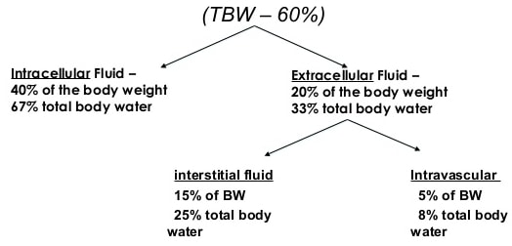
dysnatremias are actually disorders of water homeostasis.
Water distributes throughout all body compartments, two thirds in the intracellular and one third in the extracellular compartment.
Three quarters of the water in the extracellular compartment is located in the interstitial space, and one quarter is in the intravascular space.

Slide 84
dysnatremias are actually disorders of water homeostasis.
Water is lost (or gained) in the same proportions as it is distributed throughout all body compartments.
Pure water loss does not affect plasma volume status or hemodynamics significantly until very late because of the normal distribution of water throughout all body compartments. For example, for every 1 L of water deficit, only approximately 80 mL is lost from the intravascular (plasma) compartment.

Slide 85
Euvolemia (pure water loss = water deficit)
↓↓total body water, total body Na+ unchanged
Extrarenal losses
  Respiratory (tachycardia)
  Dermal (sweating, fever)
Renal losses
  Central diabetes insipidus (neurogenic)
    Post-traumatic
    Caused by tumors, cysts, histiocytosis, tuberculosis, sarcoidosis
    Idiopathic
    Caused by aneurysms, meningitis, encephalitis, Guillain-Barré syndrome
    Caused by ethanol ingestion (transient)
  Nephrogenic diabetes insipidus
    Congenital
    Acquired
      Caused by renal disease (e.g., medullary cystic disease)
      Caused by hypercalcemia or hypokalemia
      Caused by drugs (lithium, demeclocycline, foscarnet, methoxyflurane, amphotericin B, vasopressin V2 receptor antagonists)
Other
  Inability to gain access to fluids
  Hypodipsia or adipsia
Reset osmostat (essential hypernatremia)

Slide 86
Diabetes Insipidus (DI)
Inability of kidney to concentrate the urine
Excessive excretion of dilute urine (5-20L/day)
Increased thirst response.
Polyuria, enuresis, and/or nocturia
Signs of dehydration and hypernatremia do not develop unless fluid intake becomes restricted.
Central DI.
  impaired anti-diuretic hormone secretion from the posterior pituitary. Often occurs after pituitary surgery or following head trauma
Nephrogenic DI
  impaired response of the renal tubules to anti-diuretic hormone

Slide 87
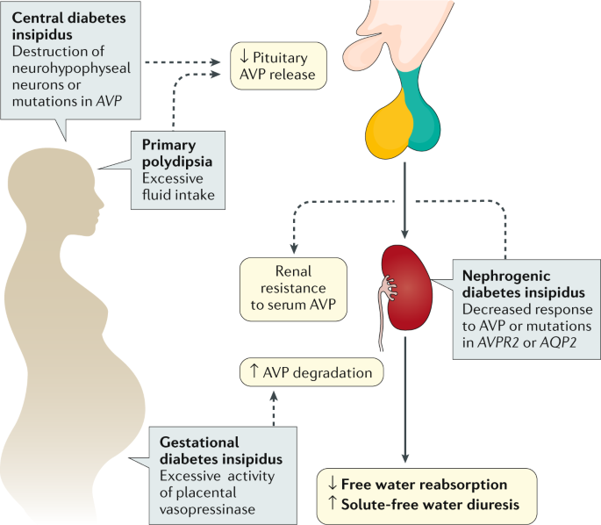
Diabetes Insipidus (DI)
Christ-Crain, M., Bichet, D.G., Fenske, W.K. et al. Diabetes insipidus. Nat Rev Dis Primers 5, 54 (2019)

Slide 88
Diabetes Insipidus (DI)
Patients will present with symptoms of polyuria (+compensatory polydipsia). Diagnosis of DI can be confirmed by doing a water deprivation test, whereby the patient is deprived of fluids for up to eight hours (or 5% loss of body weight), following which desmopressin is given
Normal:
Urine Osmolality already high before desmopressin test
Central DI.
  Urine Osmolality increases after desmopressin test
  MRI may be useful in visualizing the pituitary and hypothalamus to demonstrate abnormalities.
Nephrogenic DI
Urine Osmolality does not increase after desmopressin test

Slide 89
Treatment of Central Diabetes Insipidus (DI)
Treatment of uncomplicated central DI comprises replacement of AVP with the synthetic analog DDAVP by either IV or SC route, nasal inhalation, or oral tablet for symptomatic relief.
Decrease in urine flow is dose dependent and may vary based on the severity of symptoms.
Chlorpropamide can treat patients with central DI who have excessive thirst. It is rarely used. Chlorpropamide is contraindicated in pregnancy because of uncertain teratogenicity.

Slide 90
Treatment of Nephrogenic Diabetes Insipidus (DI)
Nephrogenic DI cannot be effectively treated with DDAVP as a result of end-organ insensitivity.
Thiazide diuretics with amiloride and a low-sodium diet are recommended to reduce the symptoms.
Indomethacin can also be effective in some patients.

Slide 91
Gestational Diabetes Insipidus (DI)
Gestational DI is often transient but may be severe until weeks after the delivery.
The deficiency of AVP during pregnancy largely results from the increased production of an N-terminal aminopeptidase produced by the placenta that metabolizes AVP.
These patients often have subclinical deficiency of AVP secretion in the nonpregnant state.

Slide 92
Hypovolemia (hypotonic fluid loss = combined water and sodium deficit)
↓↓total body water, ↓total body Na+
Extrarenal losses
  Gastrointestinal losses
    Vomiting
    Nasogastric drainage
    Enterocutaneous fistula
    Diarrhea
    Use of osmotic cathartic agents (e.g., lactulose)
  Dermal (cutaneous causes)
    Burns
    Excessive sweating
Renal losses
  Osmotic diuresis (mannitol, glucose, urea)
  Loop diuretics
  Postobstructive diuresis
  Polyuric phase of acute tubular necrosis
  Intrinsic renal disease
Others

Slide 93
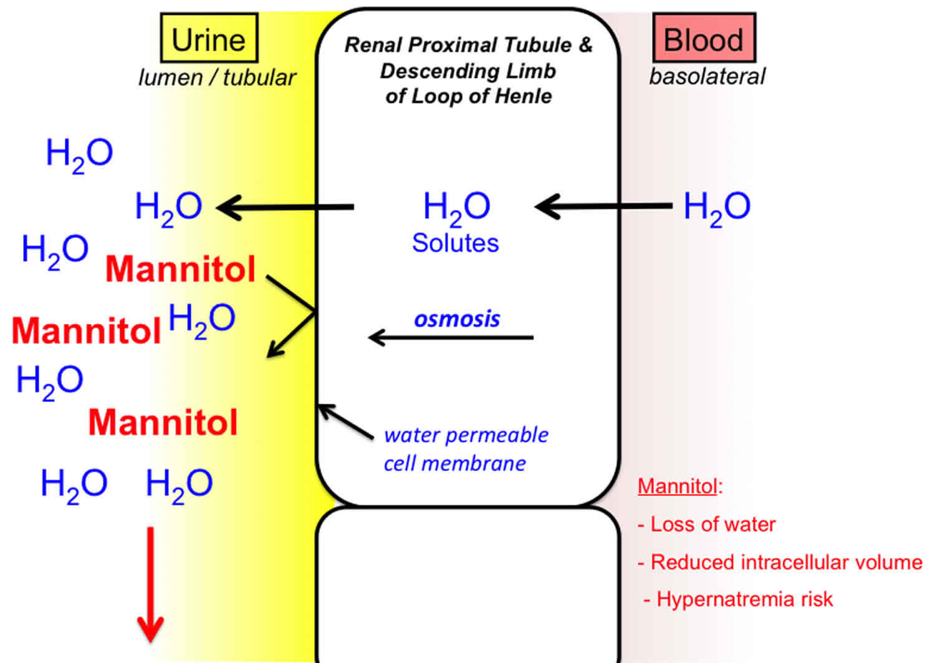
Osmotic diuresis
Osmotic diuresis is increased urination due to the presence of certain substances in the fluid filtered by the kidneys. This fluid eventually becomes urine.
The process of osmosis created by these substances cause additional water to come into the urine, increasing its amount.
https://healthjade.com/osmotic-diuresis/

Slide 94
Hypertonic sodium gain (hypervolemia)
variable total body water (↓/unchanged/↑), ↑↑total body Na+
Hypertonic saline (e.g, 3% normal saline) or NaHCO3 administration
Infants or comatose patients receiving hypertonic feeding
Ingestion of sodium chloride
Ingestion of seawater
Sodium chloride-rich emetics
Hypertonic saline enemas
Intrauterine injection of hypertonic saline
Hypertonic sodium chloride infusion
Hypertonic dialysis
Primary hyperaldosteronism
Cushing’s syndrome
Mineralocorticoid excess

Slide 95
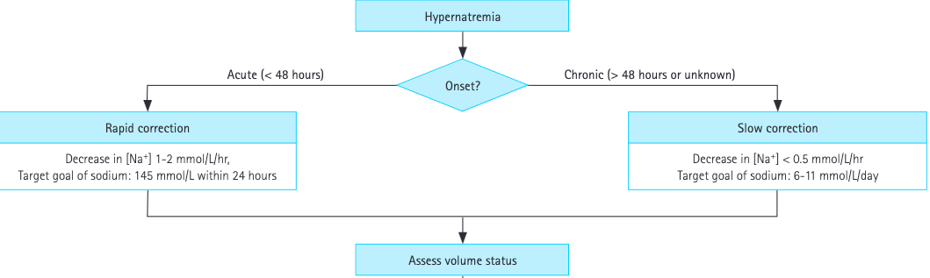
Management of Hypernatremia
Yun G, Baek SH, Kim S. Evaluation and management of hypernatremia in adults: clinical perspectives. Korean J Intern Med. 2023 May;38(3):290-302.

Slide 96
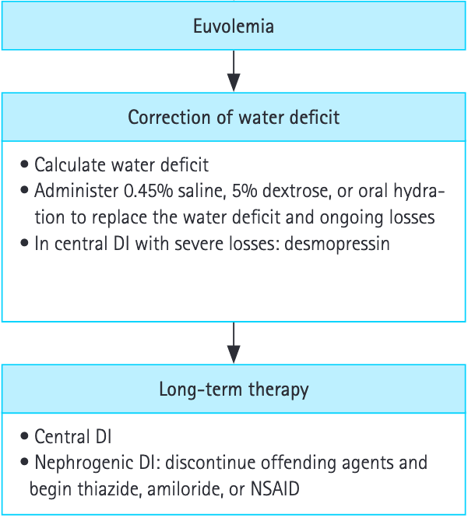
Management of Hypernatremia
Yun G, Baek SH, Kim S. Evaluation and management of hypernatremia in adults: clinical perspectives. Korean J Intern Med. 2023 May;38(3):290-302.

Slide 97
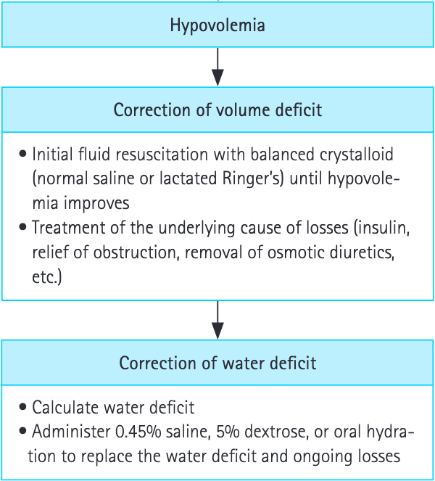
Management of Hypernatremia
Yun G, Baek SH, Kim S. Evaluation and management of hypernatremia in adults: clinical perspectives. Korean J Intern Med. 2023 May;38(3):290-302.

Slide 98
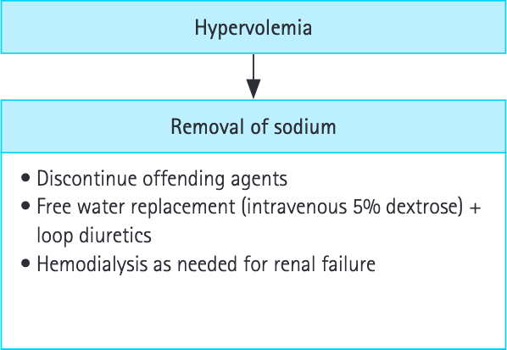
Management of Hypernatremia
Yun G, Baek SH, Kim S. Evaluation and management of hypernatremia in adults: clinical perspectives. Korean J Intern Med. 2023 May;38(3):290-302.

