Slide 1
Pancreas Cancer
Resident Didactics 2026

Slide 2
Objectives
Review the epidemiology of pancreas cancer and its incidence
Summarize risk factors for pancreatic cancer
Provide an overview of inherited PDAC risk
Explore PDAC biology
Define the resectability of PDAC and standard perioperative therapy
Differentiate between treatment options for resectable, borderline resectable, and locally advanced PDAC
Review chemo and targeted therapy approaches for metastatic PDAC
Discuss novel approaches of targeting KRAS in PDAC

Slide 3
Epidemiology and Increasing Incidence
Pancreas cancer is expected to be #2 leading cause of cancer death by 2030
Annual incidence increasing by 1% per year
Globally, PDAC ranks 12th in terms of incidence but sixth in mortality, accounting for 2.6% of all cancer cases and 4.8% of cancer deaths worldwide
PDAC continues to rise, particularly among younger adults (younger than 50 years)

Slide 4
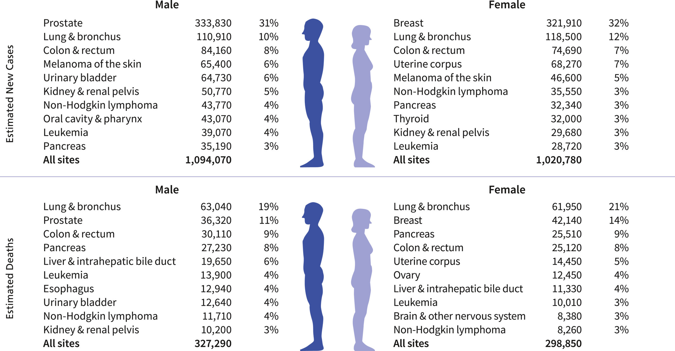
Cancer statistics, 2026
CA A Cancer J Clinicians, Volume: 76, Issue: 1, First published: 13 January 2026, DOI: (10.3322/caac.70043)
Notes:
Leading cancer types of estimated new cancer cases and deaths by sex, United States, 2026. Estimates are rounded to the nearest 10 and cases exclude basal cell and squamous cell skin cancers and in situ carcinoma except urinary bladder. Percentages may not sum to totals because of rounding. Rank is based on modeled projections and may differ from the most recent observed data.
IF THIS IMAGE HAS BEEN PROVIDED BY OR IS OWNED BY A THIRD PARTY, AS INDICATED IN THE CAPTION LINE, THEN FURTHER PERMISSION MAY BE NEEDED BEFORE ANY FURTHER USE. PLEASE CONTACT WILEY'S PERMISSIONS DEPARTMENT ON PERMISSIONS@WILEY.COM OR USE THE RIGHTSLINK SERVICE BY CLICKING ON THE 'REQUEST PERMISSIONS' LINK ACCOMPANYING THIS ARTICLE. WILEY OR AUTHOR OWNED IMAGES MAY BE USED FOR NON-COMMERCIAL PURPOSES, SUBJECT TO PROPER CITATION OF THE ARTICLE, AUTHOR, AND PUBLISHER.

Slide 5
Pancreatic cancer is an unmet need: Survival outcomes are uniquely poor
5 yr OS is “13% overall”
Three-fold increase in 5-yr relative survival for people diagnosed with pancreatic cancer, from 4% in the mid-1990s to 13% in 2015–2021, is partly an artifact of an increased number of incidentally detected Well differentiated pancreatic NETs (from 4% to 10%) that have much higher survival (72%) than more common ductal adenocarcinomas (8%)

Slide 6
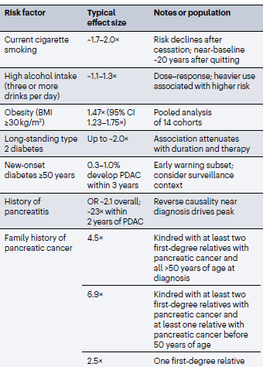
Risk Factors
Age
Family History
Smoking
Diabetes
Excessive Alcohol consumption > 3 drinks per day
Chronic Pancreatitis
Ashkenazi Jewish Heritage

Slide 7
Risk Factors
Most important non-modifiable risk factor is age: 80% of cases occurring in individuals aged 60–80 years

Slide 8
Risk Factors: Smoking
Cigarette smoking is the strongest modifiable risk factor, responsible for 25% of all PDAC cases
Current smokers: relative risk between 2 and 5, with a clear, strong dose–response relationship between amount smoked and risk
Smoking interacts synergistically w/ other risk factors, including diabetes, family hx, & h/o pancreatitis
In individuals w/ family history of PDAC, smoking amplifies risk by 3.7X; accelerates disease onset by 10–20 years
Smoking status has been linked to worse overall survival outcomes

Slide 9
Risk factors: Diabetes
Bidirectional causality
50% of PDAC patients have Diabetes as a comorbidity
>75% of cases, diabetes diagnosis precedes that of PDAC by less than 24 months
New-onset diabetes especially >50 years old is an early manifestation of underlying malignancy
  1% of individuals in this group will develop PDAC within 3 years

Slide 10
Risk Factors: Family history
Approximately 5%–10% of PDAC cases occur in individuals with a first-degree or second-degree blood relative affected by PDAC
Proportion increases to 38% when third-degree and more distant relatives are included

Slide 11
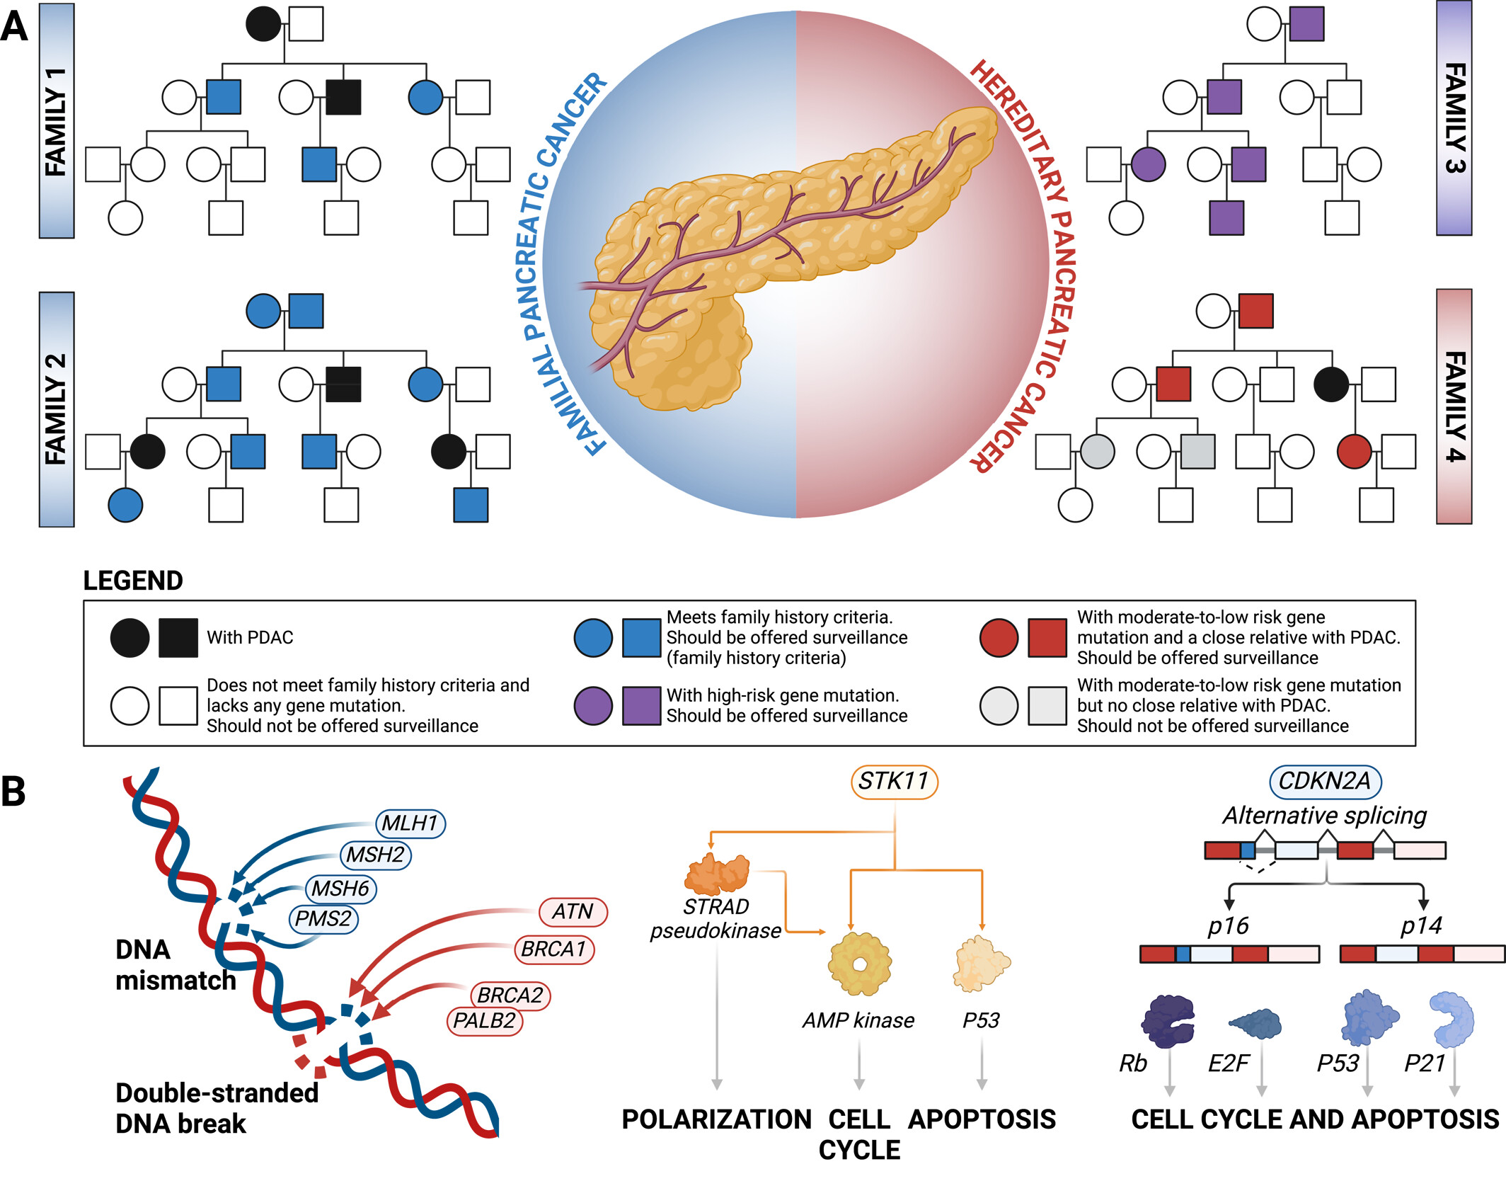
Inherited PDAC
15% of PDAC cases attributable to inherited predisposition
Germline pathogenic variant in cancer susceptibility gene = hereditary pancreatic cancer (HPC)

Slide 12
Inherited PDAC
NCCN guidelines recommend comprehensive germline genetic testing for all patients newly diagnosed with PDAC
Familial pancreatic cancer (FPC) characterized by a familial predisposition to PDAC
  clustering in families w/o identifiable germline pathogenic variant, suggesting polygenic or environmental influences that place immediate relatives at a higher risk of developing PDAC

Slide 13
Pancreatic Cancer Screening: Who to screen?
Individuals with a family history of pancreatic cancer (at least two affected relatives who are first-degree relatives to each other, of whom at least one is a first-degree relative to the individual considered for surveillance; or at least three affected relatives on the same side of the family, of whom at least one is a first-degree relative to the individual considered for surveillance
Those with a germline pathogenic variant in a high-risk gene (STK11 or CDKN2A), regardless of family history
Those with both a germline pathogenic variant in a low-to-moderate risk gene (BRCA2, BRCA1, PALB2, ATM, MLH1, MSH2, or MSH6) and with at least one first-degree blood relative affected by PDAC

Slide 14
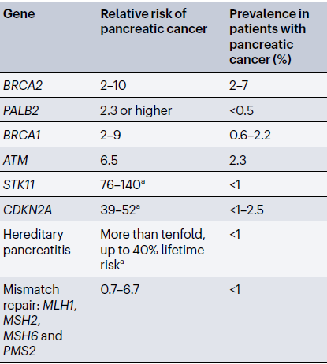

Slide 15
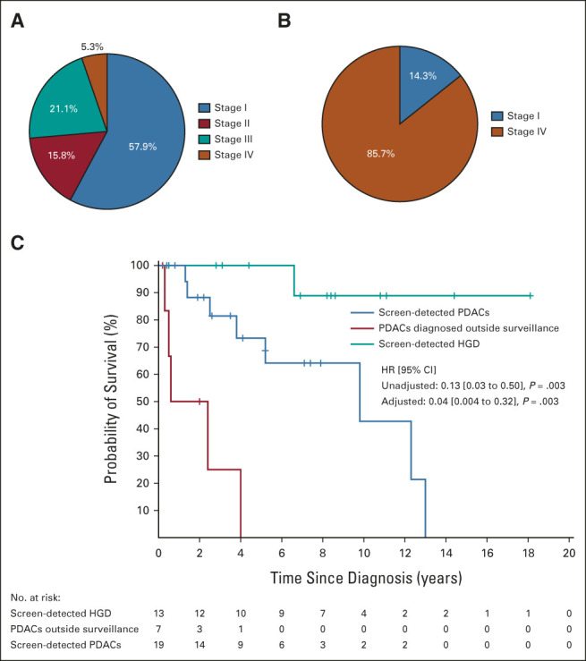
Surveillance/Screening in High-risk individuals
CAPS5 study: surveillance enables early detection
-nearly 80% of cases diagnosed at stage I in surveilled individuals, compared with 85% diagnosed at stage IV among those not under surveillance
EUS and MRI

Slide 16
Screening/Surveillance in individuals with family history or germline pathogenic variant
Earlier stage diagnoses significantly improves patient outcomes because these cancers are resectable in >90% of cases, with 5-year survival rates exceeding 60%
Most significant benefit appears to be among individuals with pathogenic germline variants, particularly CDKN2A carriers, who account for the majority of cancers detected through surveillance

Slide 17
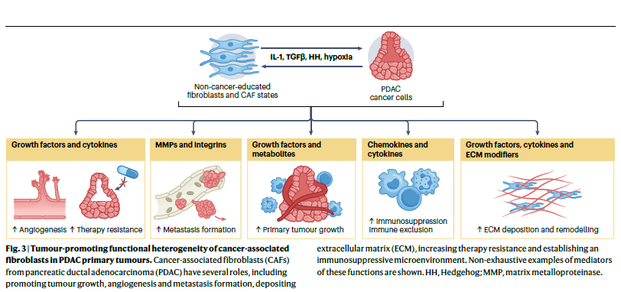
Histology and tumor biology: tumor microenvironment (TME)
TME: heterogeneous cellular network of cancer cells, immune cells, fibroblasts, extracellular matrix components, stroma
Immunosuppressive: myeloid-derived suppressor cells, tumor-associated macrophages, tumor-associated neutrophils, and regulatory T cells
Stroma: physical and biochemical barrier, limiting cell infiltration and fostering tumor cell survival

Slide 18
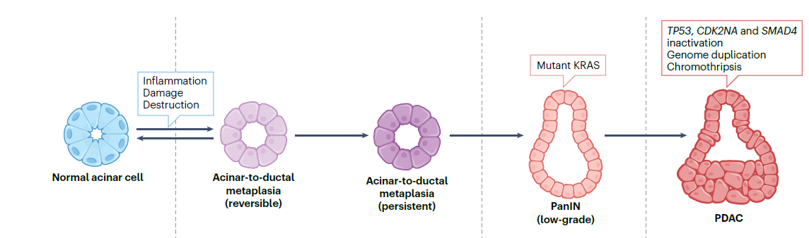
PDAC Tumor biology
Most common precursors of PDAC are pancreatic intraepithelial neoplasias (PanINs)
Other precusors: intraductal papillary mucinous neoplasms (IPMNs) and mucinous cystic neoplasms (MCNs)
Key driver: acquisition of activating mutations in the KRAS oncogene → accumulate inactivating mutations in tumor suppressor genes(CDKN2A, TP53, and SMAD4) → malignant transformation
Classical subtype: Better survival better differentiated
Basal subtype: Worse OS with FOLFIRINOX

Slide 19
PDAC Tumor biology
Key driver: acquisition of activating mutations in the KRAS oncogene → accumulate inactivating mutations in tumor suppressor genes(CDKN2A, TP53, and SMAD4) → malignant transformation
Classical subtype: Better survival better differentiated
Basal subtype: Worse OS with FOLFIRINOX

Slide 20
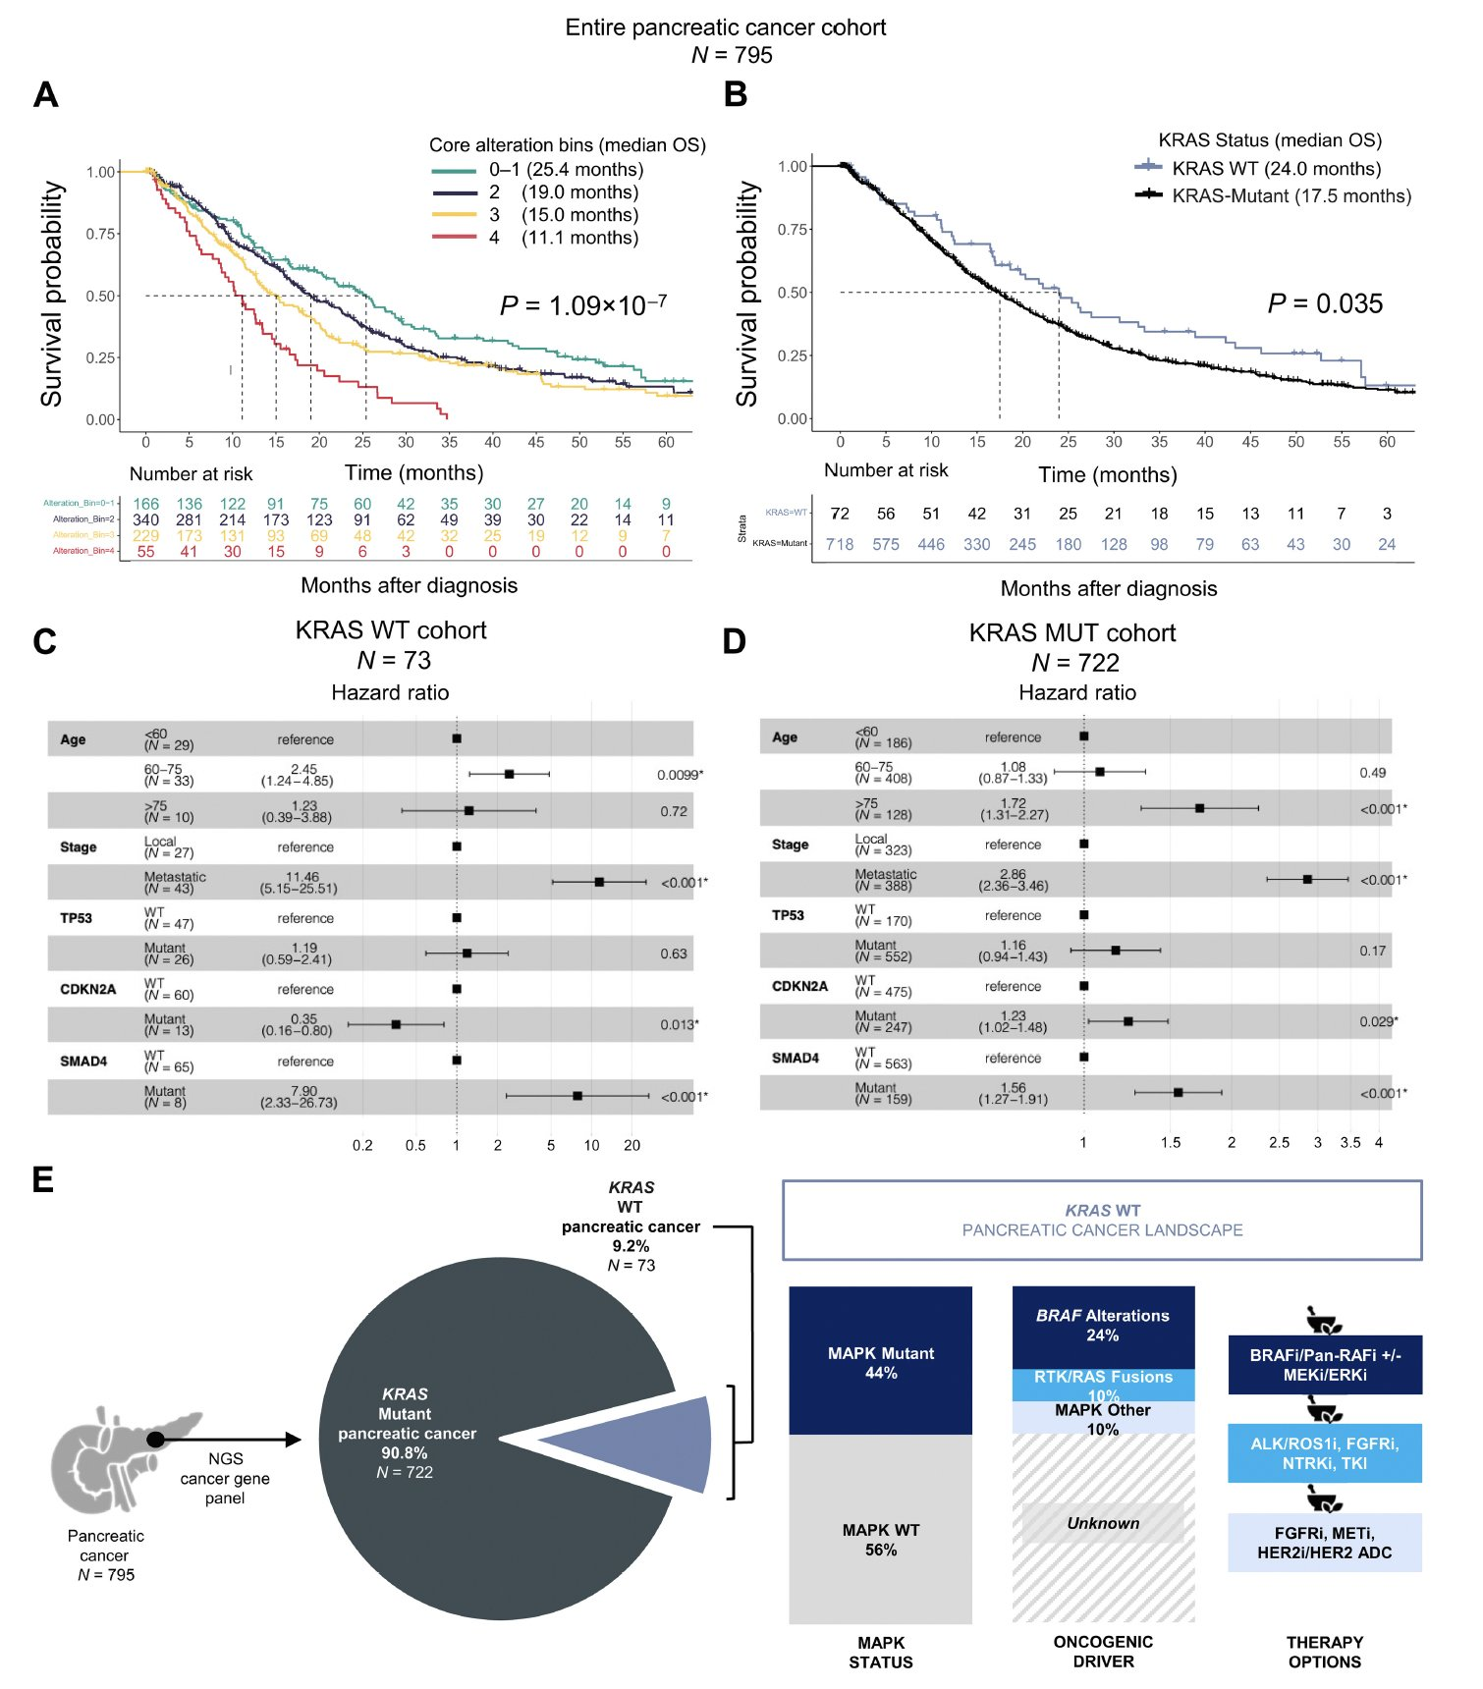
Molecular characteristics: KRAS addicted

Slide 21
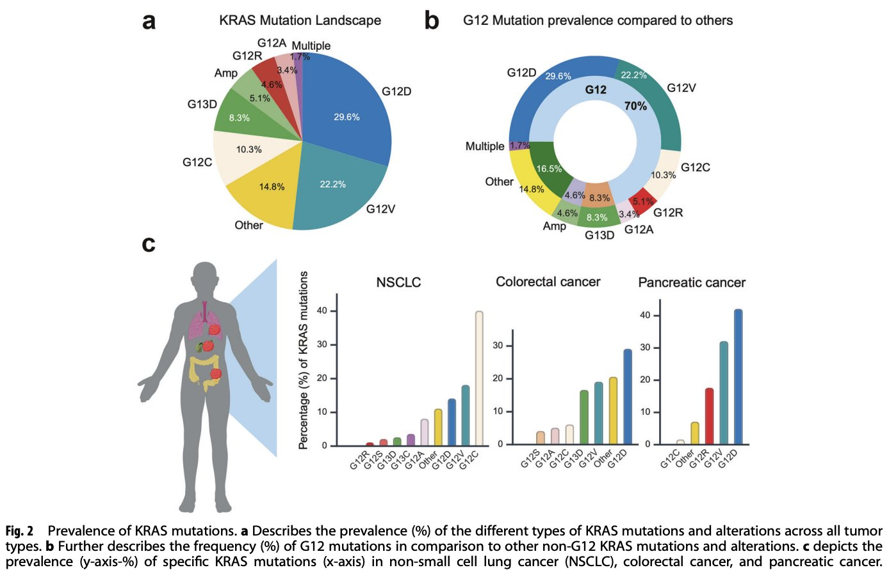
Notes:
Choucair, K., Imtiaz, H., Uddin, M.H. et al. Targeting KRAS mutations: orchestrating cancer evolution and therapeutic challenges. Sig Transduct Target Ther 10, 385 (2025). https://doi.org/10.1038/s41392-025-02473-8

Slide 22
KRAS WT = Better Survival

Slide 23
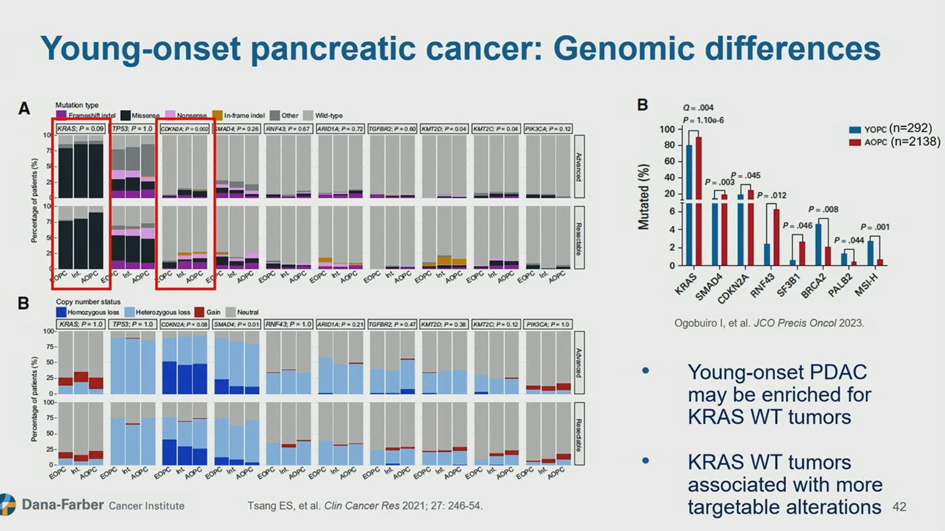
Improved OS in YOPC w/ KRAS WT
(19 vs 10%)
Fewer TP53 & more NRG1 and MET fusions
YOPC: more DMMR/MSI-H, BRCA2, and PALB2-mutant tumors, fewer SMAD4-, RNF43-, CDKN2A-, and SF3B1-mutant tumors
Notes:
Patients with YOPC had higher proportions of mismatch repair–deficient/microsatellite instability-high, BRCA2-mutant, and PALB2-mutant tumors compared with patients with AOPC, but fewer SMAD4-, RNF43-, CDKN2A-, and SF3B1-mutant tumors
In the KRAS wild-type subset (n = 227), YOPC tumors demonstrated fewer TP53 mutations and were more likely driven by NRG1 and MET fusions
Ifeanyichukwu Ogobuiro et al.
Multiomic Characterization Reveals a Distinct Molecular Landscape in Young-Onset Pancreatic Cancer. JCO Precis Oncol 7, e2300152(2023).DOI:10.1200/PO.23.00152

Slide 24
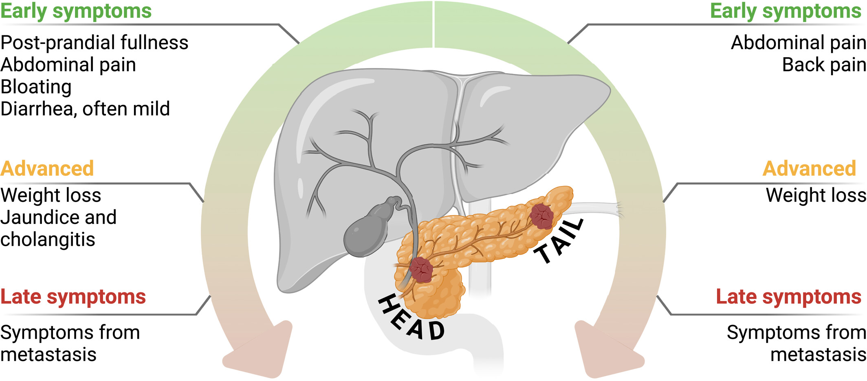
Clinical presentation
Mean age of Diagnosis is 71

Slide 25
Tissue is the issue
EUS for tissue sampling and establishment of definitive pathologic diagnosis
Core biopsies are preferred for diagnosis and NGS
EUS allows for TNM staging and assessment of vasculature

Slide 26
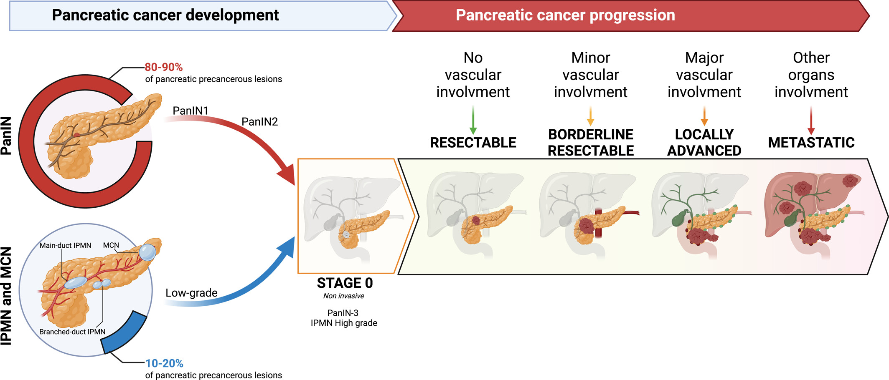
Staging

Slide 27
Staging: Assessment of resectability requires adequate imaging
Triple phase CT pancreas protocol w/w/o contrast
Consider MRI for liver metastases
PET can help distinguish between benign and malignant distant lesion and can help with response assessment

Slide 28
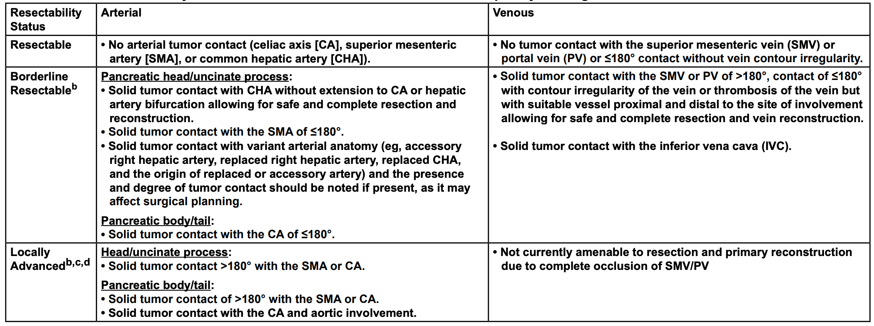
Vascular Anatomy defines borderline resectable and resectable

Slide 29
Biological (un)resectability: it may be technically resectable…
Fundamental biology of a systemic disease: metastatic disease established by the time of diagnosis (Haeno Cell 2012)
Elevated CA 19-9
Large tumor size
Extensive Adenopathy
Proximity to critical structures
Indeterminate lung lesions → PET? Biopsy
Indeterminate liver lesions → MRI
Indeterminate peritoneal lesions → Diagnostic laparoscopy
Notes:
Haeno H, Gonen M, Davis MB, Herman JM, Iacobuzio-Donahue CA, Michor F. Computational modeling of pancreatic cancer reveals kinetics of metastasis suggesting optimum treatment strategies. Cell. 2012 Jan 20;148(1-2):362-75. doi: 10.1016/j.cell.2011.11.060. PMID: 22265421; PMCID: PMC3289413.

Slide 30
Resection and outcomes
Surgical resection, combined with systemic therapy, remains the only potentially curative treatment modality for PDAC
Only 15% of patients are eligible for surgery at diagnosis
Most relapse within 2 years

Slide 31
Resectable PDAC:
Upfront resection with adjuvant therapy or neoadjuvant therapy are both options for resectable PDAC
High risk disease is considered an indication for neoadjuvant therapy (Large, LN+, elevated CA 19-9)
The standard of care for resectable PDAC is surgery plus six months of perioperative therapy

Slide 32
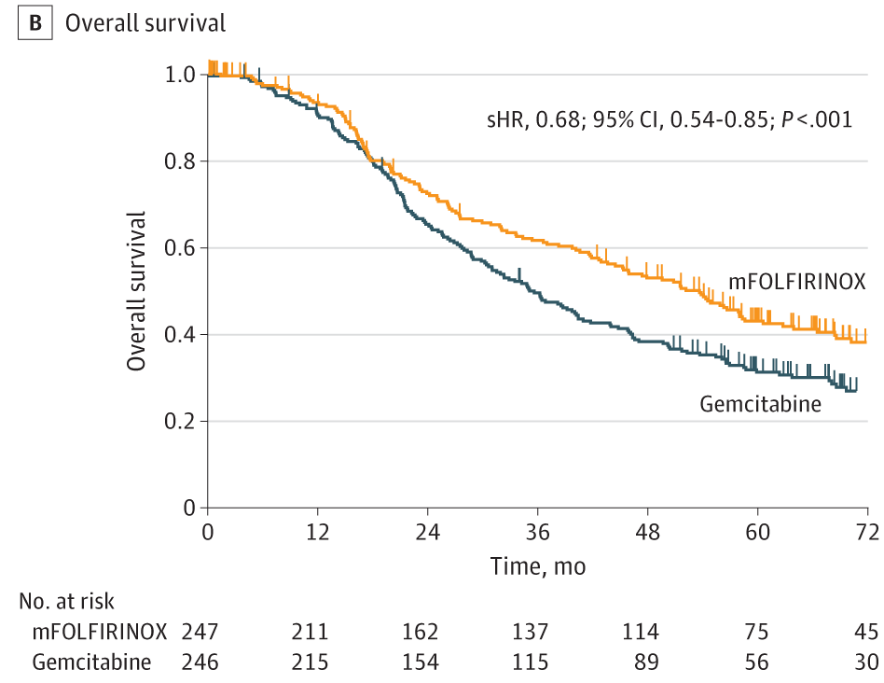
Surgery and adjuvant chemo (ACT)
Outcomes dismal after surgical resection alone
Survival benefit of 6 months of ACT established
  Gemcitabine (CONKO-001)
  Gemcitabine/Capecitabine (ESPAC-4)
  mFOLFIRINOX (PRODIGE 24)
5-year DFS rate: 26.1% mFFX vs 19.0% gem
median OS: 53.5 months mFFX vs 35.5 months gem (HR 0.68; P = .001)
5-year OS rate: 43.2% mFFX vs 31.4% gem
Conroy JAMA Oncol 2022
Notes:
Conroy T, Castan F, Lopez A, Turpin A, Ben Abdelghani M, Wei AC, Mitry E, Biagi JJ, Evesque L, Artru P, Lecomte T, Assenat E, Bauguion L, Ychou M, Bouché O, Monard L, Lambert A, Hammel P; Canadian Cancer Trials Group and the Unicancer-GI–PRODIGE Group. Five-Year Outcomes of FOLFIRINOX vs Gemcitabine as Adjuvant Therapy for Pancreatic Cancer: A Randomized Clinical Trial. JAMA Oncol. 2022 Nov 1;8(11):1571-1578. doi: 10.1001/jamaoncol.2022.3829. Erratum in: JAMA Oncol. 2023 Jan 1;9(1):151. doi: 10.1001/jamaoncol.2022.6629. PMID: 36048453; PMCID: PMC9437831.

Slide 33
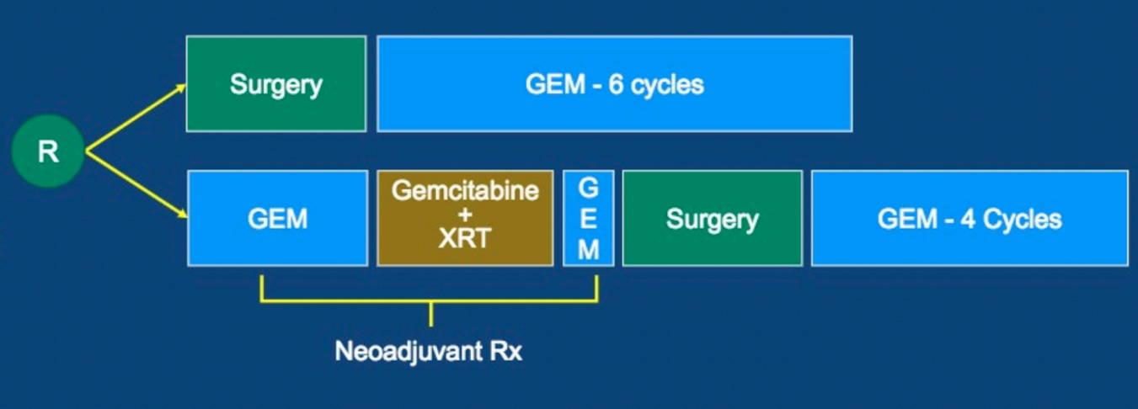
How did we get to neoadjuvant? PREOPANC-1
Dutch trial N=246 resectable or borderline disease → upfront surgery vs neoadjuvant chemo + RT (15 Fx 2.4 Gy + gemcitabine, preceded and followed by a cycle of gemcitabine)
Both arms received adjuvant gemcitabine: 6 cycles in surgery arm and 4 cycles in neoadjuvant arm
Versteijne JCO 2022
Notes:
Versteijne E, van Dam JL, Suker M, Janssen QP, Groothuis K, Akkermans-Vogelaar JM, Besselink MG, Bonsing BA, Buijsen J, Busch OR, Creemers GM, van Dam RM, Eskens FALM, Festen S, de Groot JWB, Groot Koerkamp B, de Hingh IH, Homs MYV, van Hooft JE, Kerver ED, Luelmo SAC, Neelis KJ, Nuyttens J, Paardekooper GMRM, Patijn GA, van der Sangen MJC, de Vos-Geelen J, Wilmink JW, Zwinderman AH, Punt CJ, van Tienhoven G, van Eijck CHJ; Dutch Pancreatic Cancer Group. Neoadjuvant Chemoradiotherapy Versus Upfront Surgery for Resectable and Borderline Resectable Pancreatic Cancer: Long-Term Results of the Dutch Randomized PREOPANC Trial. J Clin Oncol. 2022 Apr 10;40(11):1220-1230. doi: 10.1200/JCO.21.02233. Epub 2022 Jan 27. PMID: 35084987.

Slide 34
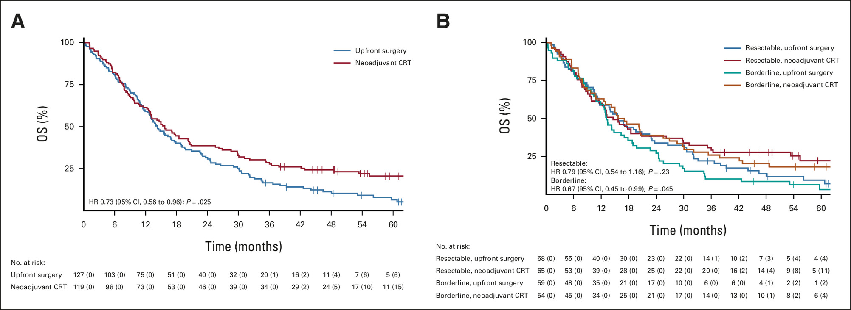
NAT improved mOS: 15.7 m vs 14.3 m, HR 0.73, P = 0.025.
5-year OS: 20.5% NAT vs 6.5% upfront surgery
Versteijne JCO 2022

Slide 35
Why neoadjuvant therapy? Patient-centered individualized therapy
Primum non nocere: avoid futile surgery
Upfront pancreatic resection morbid; prevents chemotherapy receipt in 25-40% of patients (Merkow Ann Surg 2014, Paiella Ann Surg Oncol 2024)
Neoadjuvant guarantees receipt of chemotherapy → improved OS
Test/Address individual tumor biology and incorporate response assessment
Treat micrometastatic disease
Chemotherapy before surgery usually better tolerated, more likely to complete therapeutic sequence
Prehab: Preoperative therapy provides observation time to manage comorbidities and optimize patient fitness for successful surgery recovery
Notes:
Merkow RP, Bilimoria KY, Tomlinson JS, Paruch JL, Fleming JB, Talamonti MS, Ko CY, Bentrem DJ. Postoperative complications reduce adjuvant chemotherapy use in resectable pancreatic cancer. Ann Surg. 2014 Aug;260(2):372-7. doi: 10.1097/SLA.0000000000000378. PMID: 24374509.
Bakens MJ, van der Geest LG, van Putten M, van Laarhoven HW, Creemers GJ, Besselink MG, Lemmens VE, de Hingh IH; Dutch Pancreatic Cancer Group. The use of adjuvant chemotherapy for pancreatic cancer varies widely between hospitals: a nationwide population-based analysis. Cancer Med. 2016 Oct;5(10):2825-2831. doi: 10.1002/cam4.921. Epub 2016 Sep 27. PMID: 27671746; PMCID: PMC5083735.
Paiella S, Malleo G, Lionetto G, Cattelani A, Casciani F, Secchettin E, De Pastena M, Bassi C, Salvia R. Adjuvant Therapy After Upfront Resection of Resectable Pancreatic Cancer: Patterns of Omission and Use-A Prospective Real-Life Study. Ann Surg Oncol. 2024 May;31(5):2892-2901. doi: 10.1245/s10434-024-14951-4. Epub 2024 Jan 29. PMID: 38286884; PMCID: PMC10997715.

Slide 36
Resectable Trials
Trial | Year | Arms | Control | Overall results | Limitations
PREOPANC-1 | 2020 | Preop Gem RT | Upfront Surgery | OS benefit w/ ChemoRT; 5 y OS 20.5% vs 6.5% | post op gem; mixed population of R and BR
SWOG1505 | 2021 | 1) Preop FFX 2) Preop Gem/Nab | None | 1º endpoint not met, 2 yr OS 47% | Noncomparative
JASPAC-04 | 2023 | 1) Preop S1 RT 2) Preop S1/Gem | None | Arms met efficacy, 2YR OS % ⬆️ w/ S1/Gem (72.4 vs 66.7%) | Noncomparative, S1, n=103
NEONAX | 2023 | Preop Gem/Nab | Upfront Surgery | preop mOS 25.5 vs 16.7m upfront surgery, preop ⬆️ R0 | Noncomparative, 1º Efficacy not met, 18m RFS 33.3% vs 44.1%
NORPACT-1 | 2024 | Preop FFX | Upfront Surgery | 18m OS worse w/ preop FFX (60 vs 73%) | Toxicity, FFX dose, gem post op
JSAP-05/Prep-02 | 2025 | Preop Gem/S1 | Upfront Surgery | mOS better w/ preop chemo (37 vs 26.6.) | S1-based regimen
PANACHE01-PRODIGE48 | 2025 | 1)Preop mFFX 2)Preop FOLFOX | Upfront Surgery | 1 year EFS ⬆️ 51.4% FFX vs. 38.7% surgery | Noncomparative
CASSANDRA | 2025 | 1)Preop PAXG 2) preop mFFX | None | 3 Yr EFS ⬆️ w/ PAXG: 31% vs 13% | Immature OS
CISPD-1 | 2025 | Preop Gem/nab→ mFFX | Upfront surgery | Preop Chemo better EFS | Single center, Gem Cap post op
Notes:
Reni M, Balzano G, Zanon S, Zerbi A, Rimassa L, Castoldi R, Pinelli D, Mosconi S, Doglioni C, Chiaravalli M, Pircher C, Arcidiacono PG, Torri V, Maggiora P, Ceraulo D, Falconi M, Gianni L. Safety and efficacy of preoperative or postoperative chemotherapy for resectable pancreatic adenocarcinoma (PACT-15): a randomised, open-label, phase 2-3 trial. Lancet Gastroenterol Hepatol. 2018 Jun;3(6):413-423. doi: 10.1016/S2468-1253(18)30081-5. Epub 2018 Apr 4. PMID: 29625841.
Goetze TO, Reichart A, Bankstahl US, Pauligk C, Loose M, Kraus TW, Elshafei M, Bechstein WO, Trojan J, Behrend M, Homann N, Venerito M, Bohle W, Varvenne M, Bolling C, Behringer DM, Kratz-Albers K, Siegler GM, Hozaeel W, Al-Batran SE. Adjuvant Gemcitabine Versus Neoadjuvant/Adjuvant FOLFIRINOX in Resectable Pancreatic Cancer: The Randomized Multicenter Phase II NEPAFOX Trial. Ann Surg Oncol. 2024 Jun;31(6):4073-4083. doi: 10.1245/s10434-024-15011-7. Epub 2024 Mar 8. PMID: 38459418; PMCID: PMC11076394.

Slide 37
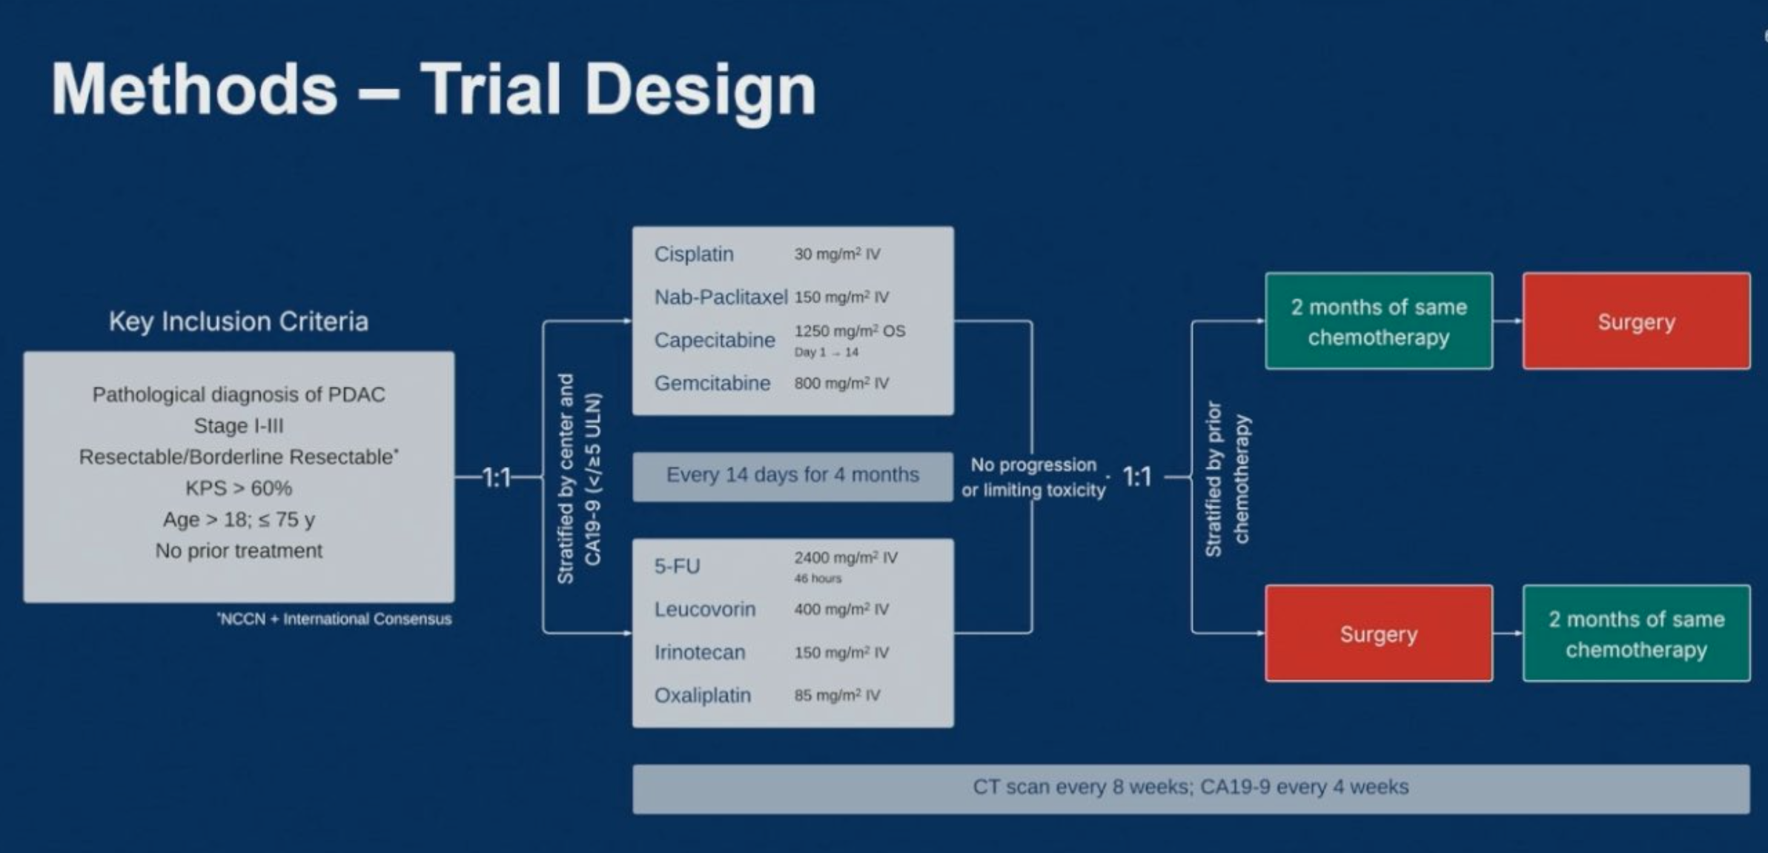
CASSANDRA: Can we improve on FFX?
Reni Presented at ASCO 2025

Slide 38
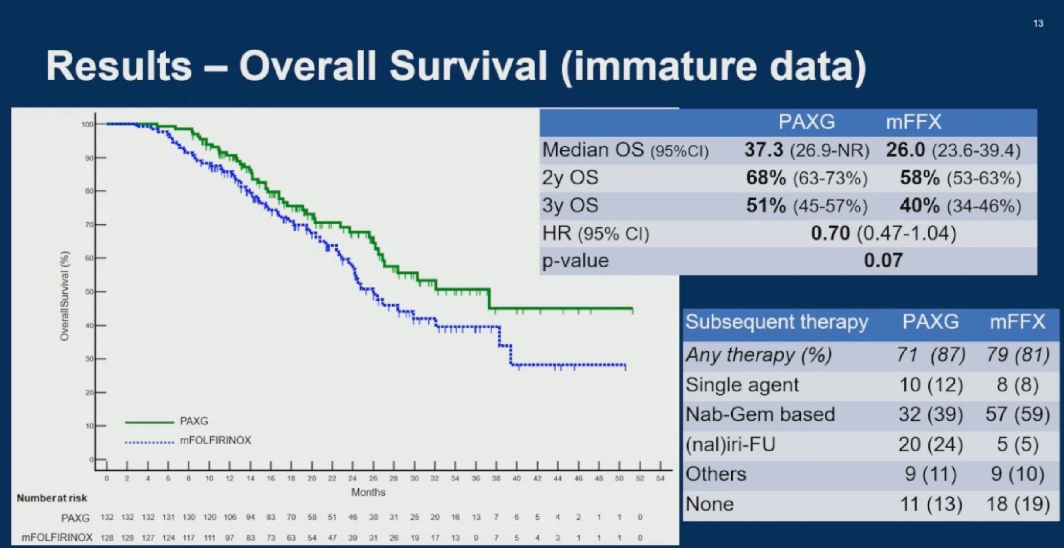
Reni Presented at ASCO 2025

Slide 39
Borderline resectable
Trial | Year | Arms | Control | Overall results | Limitations
Korean Radiation Oncology Grp | 2018 | Preop ChemoRT | Postop ChemoRT | Preop chemoRT superior OS | Gem single agent
PREOPANC-1 | 2020 | Preop ChemoRT | Upfront surgery | ChemoRT OS Benefit | Gem single agent
ALLIANCE A021501 | 2022 | Preop mFFX +hypoFx RT | Preop mFFX | R0 worse w/ RT, FFX standard | Randomization timing, RT QA
ESPAC5 | 2023 | 1) Preop Gem/Cap 2)Preop FFX 3)Preop ChemoRT | Upfront Surgery | OS superior w/ pooled preop arms | Not powered to compare, R0 resection rate not improved
GABARNANCE | 2024 | Preop Chemo | Preop ChemoRT | No OS benefit w/ chemo | chemoRT OS benefit
PANDAS-PRODIGE-44 | 2024 | Preop Chemo and CapeRT | Preop Chemo | No difference R0
PREOPANC-2 | 2025 | Preop FFX | Preop Gem RT | No OS difference | FFX more toxic

Slide 40
How often does futile surgery occur with upfront resection vs how many progress on neoadjuvant?
Futile surgery occurs in approximately 18.9%-25.3% of patients in upfront resectable disease (Crippa JAMA Surg 2024, Marcinak J Surg Oncol 2024)
Following NAT, pooled resection rates in metanalysis
  Resectable 77.4%
  Borderline resectable 60.6%
  Locally advanced 22.2%
Failure to undergo resection following NAT in S1505: 28.4% (Cloyd)
Notes:
Crippa S, Malleo G, Mazzaferro V, Langella S, Ricci C, Casciani F, Belfiori G, Galati S, D'Ambra V, Lionetto G, Ferrero A, Casadei R, Ercolani G, Salvia R, Falconi M, Cucchetti A. Futility of Up-Front Resection for Anatomically Resectable Pancreatic Cancer. JAMA Surg. 2024 Oct 1;159(10):1139-1147. doi: 10.1001/jamasurg.2024.2485. PMID: 39046713; PMCID: PMC11270270.
Marcinak CT, Ahmed KS, LoConte NK, Praska CE, Varley PR, Weber SM, Abbott DE, Ronnekleiv-Kelly SM, Kratz JD, Lubner SJ, Minter RM, Zafar SN. Understanding futility in pancreaticoduodenectomy: Insights from a national cohort. J Surg Oncol. 2024 Sep;130(3):462-475. doi: 10.1002/jso.27773. Epub 2024 Jul 31. PMID: 39082628.
Brown ZJ, Heh V, Labiner HE, Brock GN, Ejaz A, Dillhoff M, Tsung A, Pawlik TM, Cloyd JM. Surgical resection rates after neoadjuvant therapy for localized pancreatic ductal adenocarcinoma: meta-analysis. Br J Surg. 2022 Dec 13;110(1):34-42. doi: 10.1093/bjs/znac354. PMID: 36346716.
Cloyd JM, Colby S, Guthrie KA, Lowy AM, Chiorean EG, Philip P, Sohal D, Ahmad S. Failure to Undergo Resection Following Neoadjuvant Therapy for Resectable Pancreatic Cancer: A Secondary Analysis of SWOG S1505. J Natl Compr Canc Netw. 2024 Apr 29;22(4):e237099. doi: 10.6004/jnccn.2023.7099. PMID: 38688309.

Slide 41
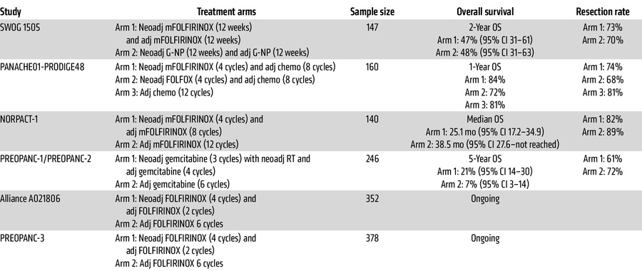
Trials in the FFX Era
J Clin Invest DOI: 10.1172/JCI191944
Notes:
Bryant JM, Ruffolo L, Soares K, Hoffe S, Lowy AM. Evolving concepts in adjuvant/neoadjuvant therapy for resectable pancreas cancer. J Clin Invest. 2025 Jul 15;135(14):e191944. doi: 10.1172/JCI191944. PMID: 40662364; PMCID: PMC12259248.

Slide 42
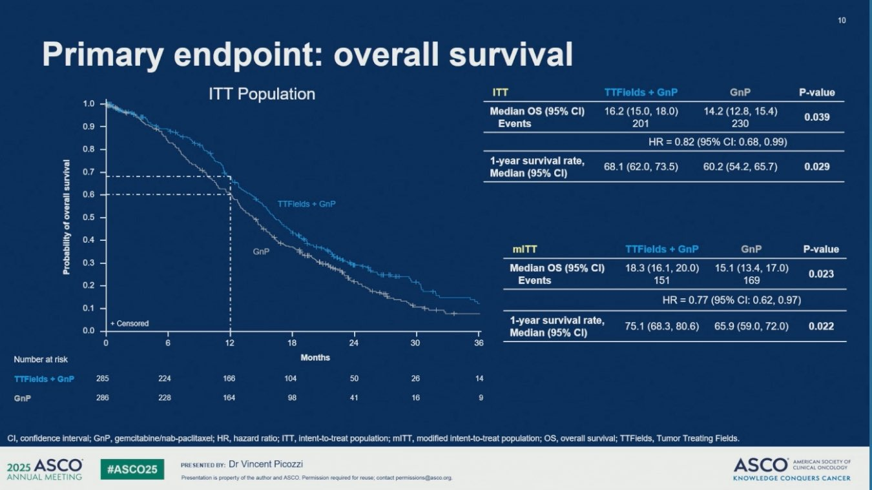
Locally Advanced Disease
Trials heterogeneous
Rule of thumb: combination chemo for 6 months upfront
Benefit of RT: LAP7 trial negative
Tumor treatment fields are an option
Radiation useful for pain

Slide 43
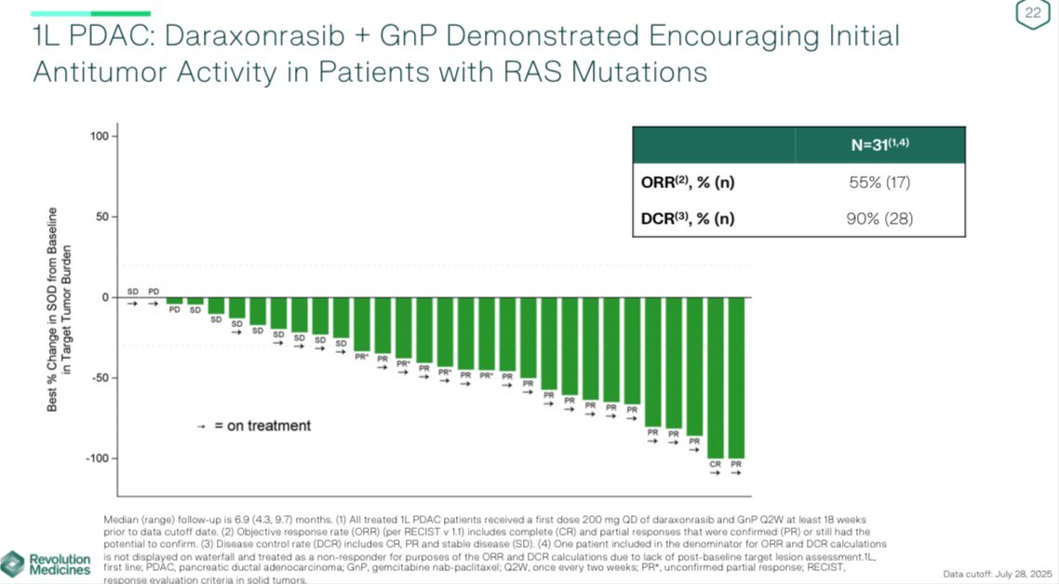
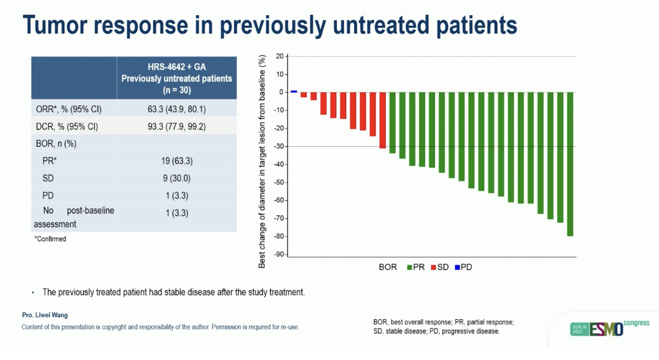
On the horizon: how can we improve?
We are waiting for more data from ALLIANCE and PREOPANC-3
ESPAC-6 (NCT05314998) prospective use of RNA transcriptomics to select ACT
Phase 1 neoadjuvant ELI-002 7P + chemo + anti-PD1 in R/BR PDAC
Personalized mRNA neoatigen vaccines
Adjuvant/Perioperative targeted therapy: RMC 6236 (Daxrasonrasib) and HRS-4642 ORR 55-63%
Revolution Medicines press release 2025
Wang ESMO 2025
Notes:
Rojas LA, Sethna Z, Soares KC, Olcese C, Pang N, Patterson E, Lihm J, Ceglia N, Guasp P, Chu A, Yu R, Chandra AK, Waters T, Ruan J, Amisaki M, Zebboudj A, Odgerel Z, Payne G, Derhovanessian E, Müller F, Rhee I, Yadav M, Dobrin A, Sadelain M, Łuksza M, Cohen N, Tang L, Basturk O, Gönen M, Katz S, Do RK, Epstein AS, Momtaz P, Park W, Sugarman R, Varghese AM, Won E, Desai A, Wei AC, D'Angelica MI, Kingham TP, Mellman I, Merghoub T, Wolchok JD, Sahin U, Türeci Ö, Greenbaum BD, Jarnagin WR, Drebin J, O'Reilly EM, Balachandran VP. Personalized RNA neoantigen vaccines stimulate T cells in pancreatic cancer. Nature. 2023 Jun;618(7963):144-150. doi: 10.1038/s41586-023-06063-y. Epub 2023 May 10. PMID: 37165196; PMCID: PMC10171177.

Slide 44
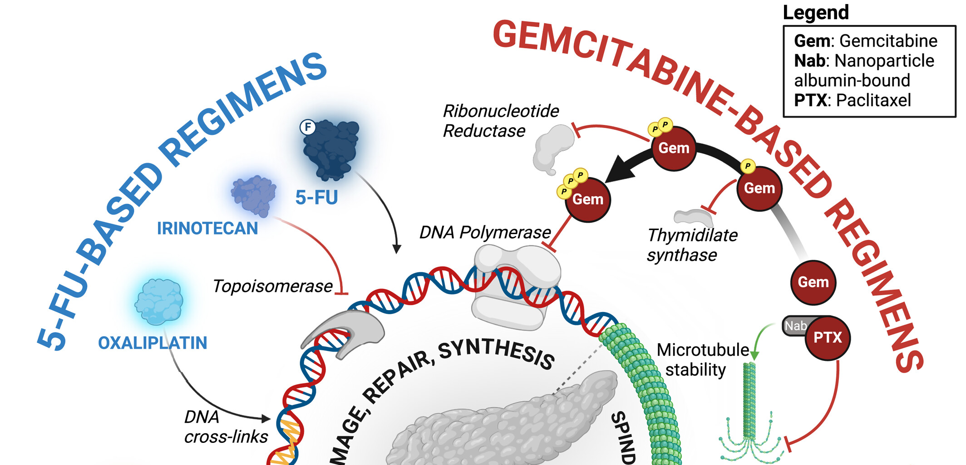
Metastatic disease: Advancements in systemic therapy

Slide 45
Timeline of FDA approved therapies for PDAC
1997
Gemcitabine survival benefit
2007
Gemcitabine Erlotinib (survival benefit of 10 days; lessons in how not to design trials)
2011
PRODIGE-4: FOLFIRINOX superior to gemcitabine (mOS 11.1 months)
2013
MPACT: Gemcitabine Nab-Paclitaxel (mOS 8.5 months)
2019
POLO: Olaparib maintenance in BRCA
2023
NAPOLI-3: NALIRIFOX: mOS 11.1 months

Slide 46
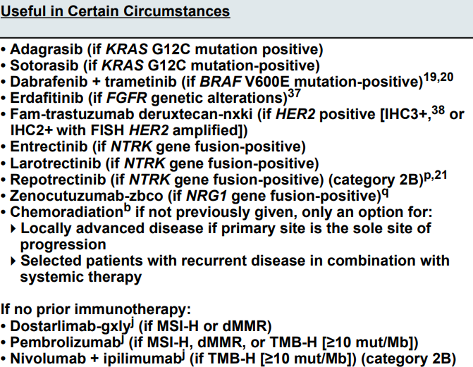

Slide 47
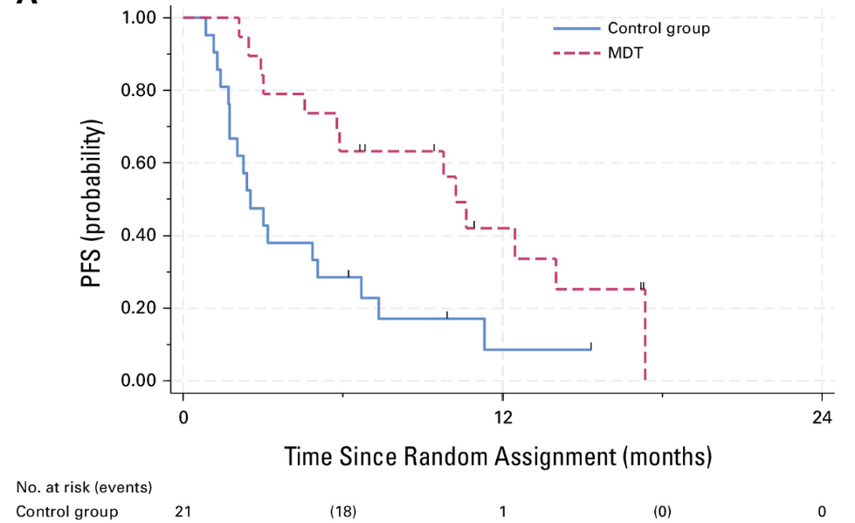
EXTEND trial
For carefully selected patients with limited sites of metastatic involvement of PDAC, the addition of locoregional intervention to systemic treatment may provide PFS benefit

Slide 48
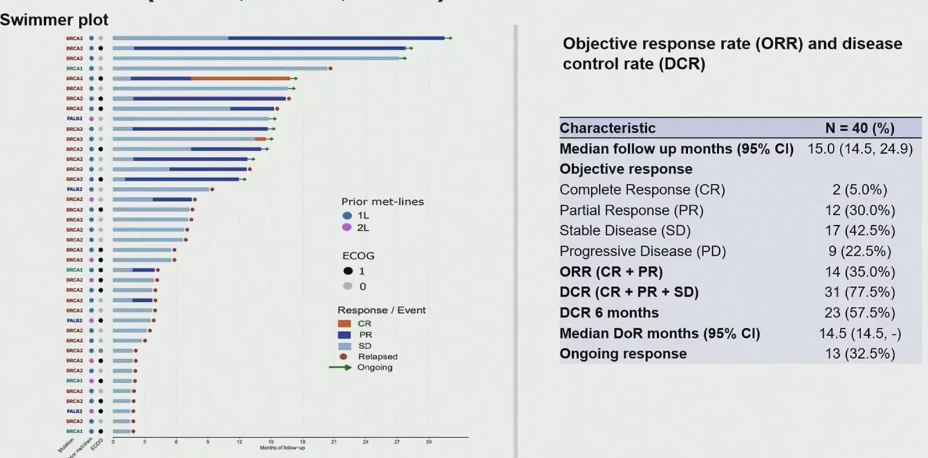
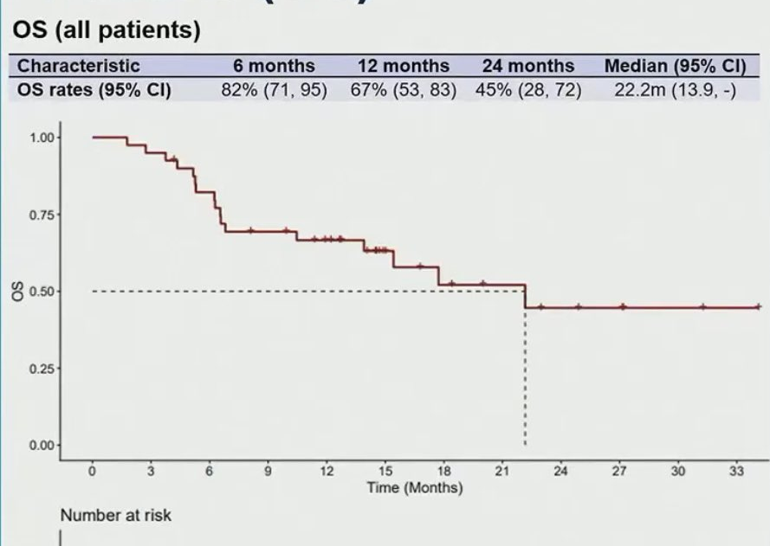
Targeting HRD
“BRCA”ness
BRCA1, BRCA2, PALB2 benefit from platinum induction therapy
If no progression after 4 months of platinum therapy
Data for maintenance PARP: Olaparib+/IO, Rucaparib
Durvalumab + Olaparib

Slide 49
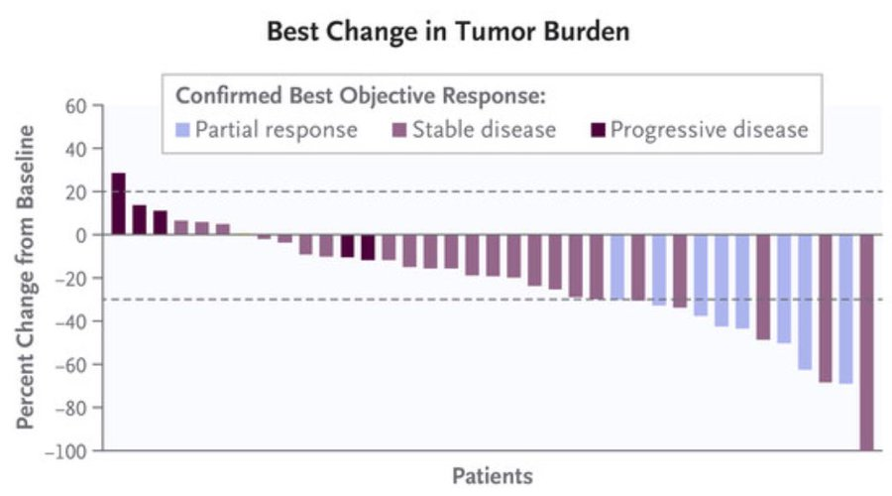
Targeting KRAS G12C OFF: Sotorasib in CodeBreaK100

Slide 50
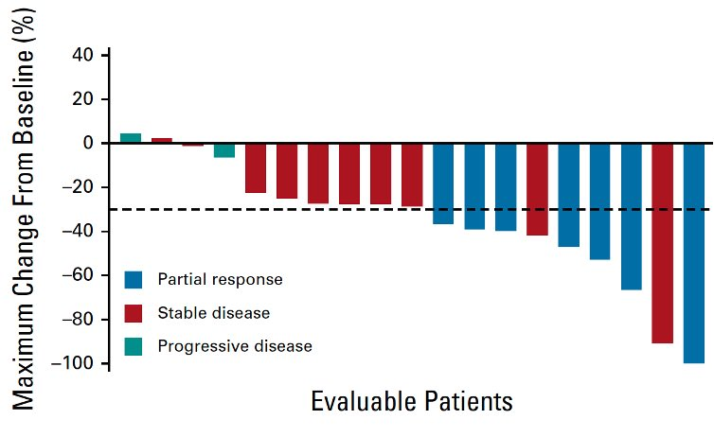
KRYSTAL-1: Adagrasib
Adagrasib G12C off inhibitor
ORR 33% in PDAC

Slide 51
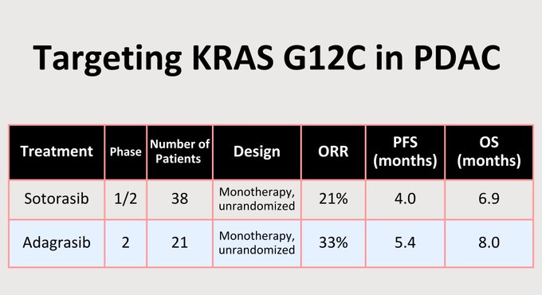
Different side effects, half life lives, and CNS penetration

Slide 52
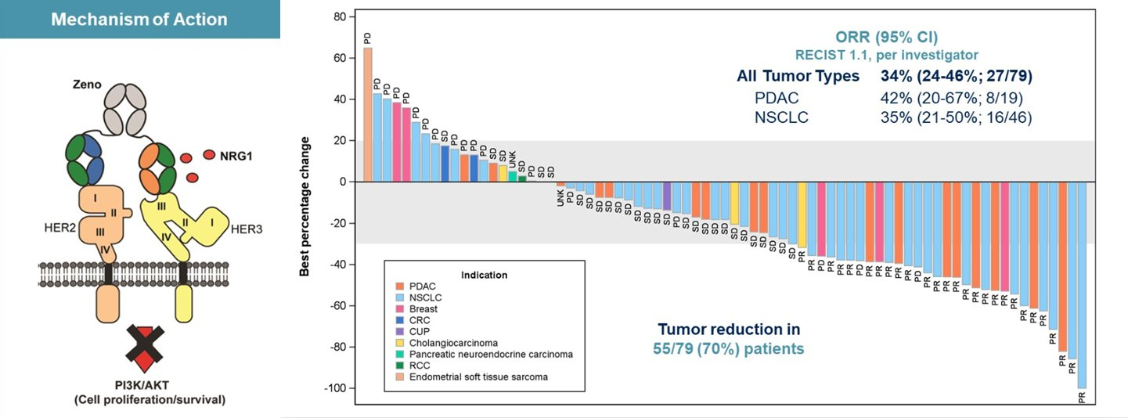
NRG Fusion+ Zenocutuzumab

Slide 53
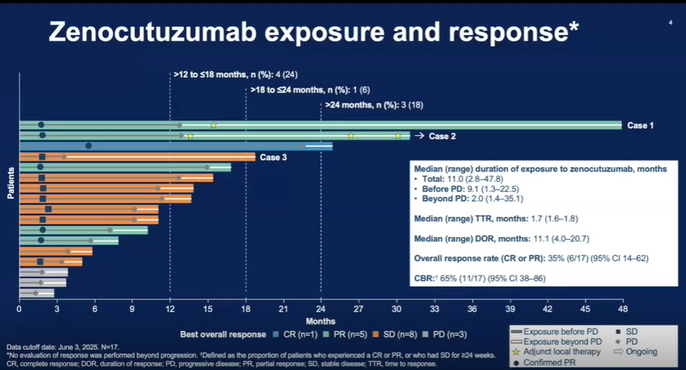

Slide 54
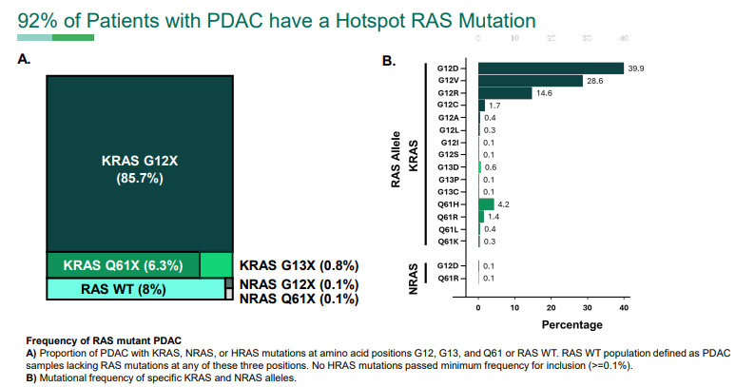
KRAS in Pancreas Cancer
KRAS is a critical driver of tumor initiation, pancreatic intraepithelial neoplasms
Notes:
Shubham Pant et al.
Frequency and incidence of oncogenic RAS mutations in patients with metastatic pancreatic ductal adenocarcinoma: Derived from the real-world evidence database Foundation Medicine Insights.. J Clin Oncol 43, 777-777(2025).
DOI:10.1200/JCO.2025.43.4_suppl.777

Slide 55
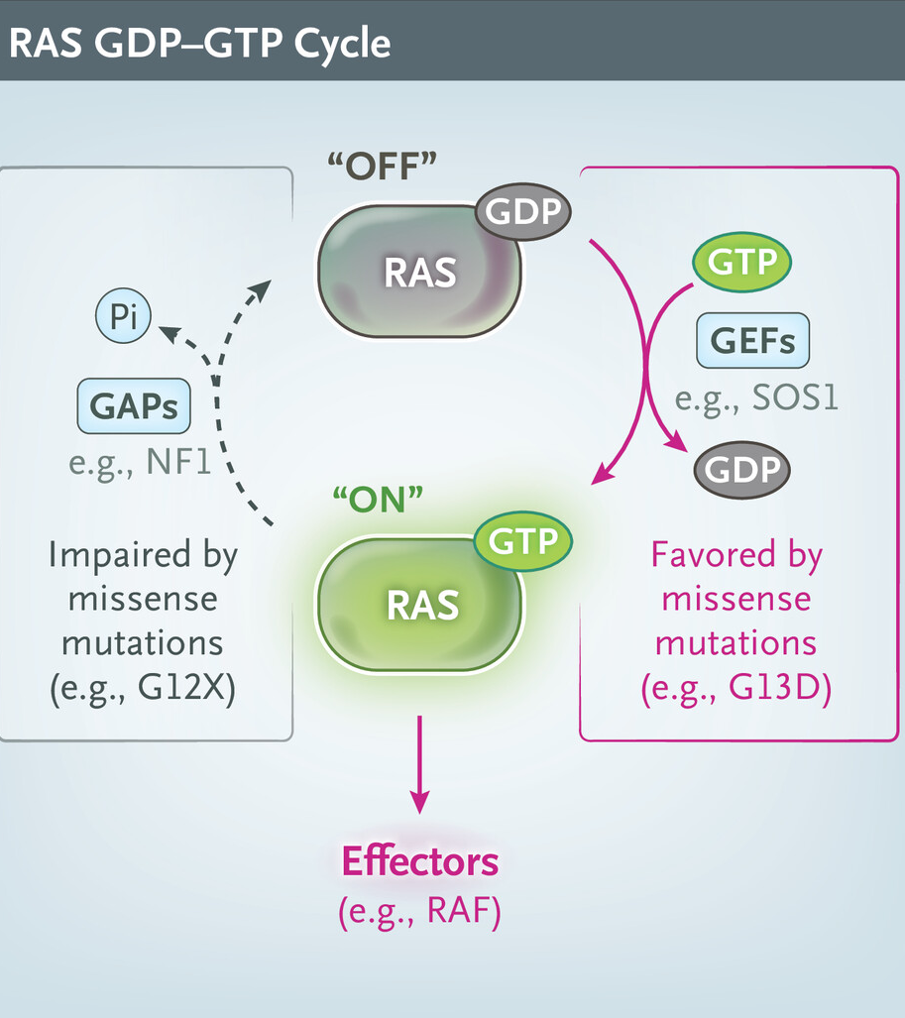
Drugging the undruggable
KRAS encodes a small GTPase that cycles between inactive GDP-bound (OFF) and active GTP-bound (ON) states
GTP binds to RAS at low picomolar concentrations → small molecule untenable
Surface topology of RAS lacked well-defined pockets amenable to design of small molecules with sufficient affinity and selectivity

Slide 56
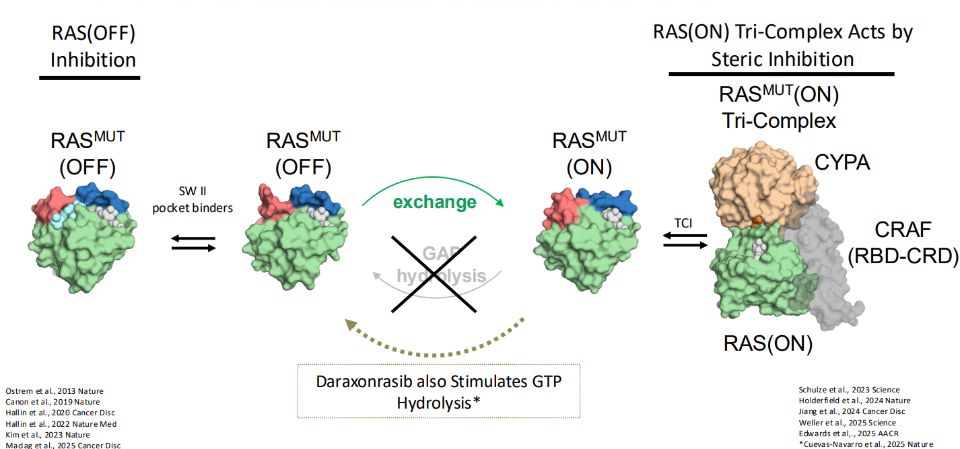
RAS Targeting strategies: OFF vs ON

Slide 57
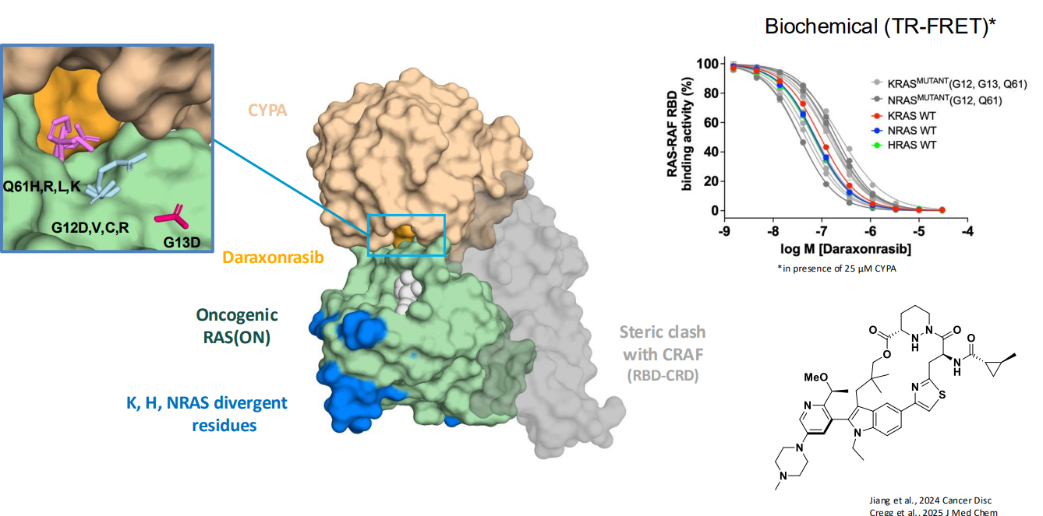
Daraxonrasib (RMC 6236): RAS(ON) Multi-selective, noncovalent, Tri-Complex Inhibitor

Slide 58
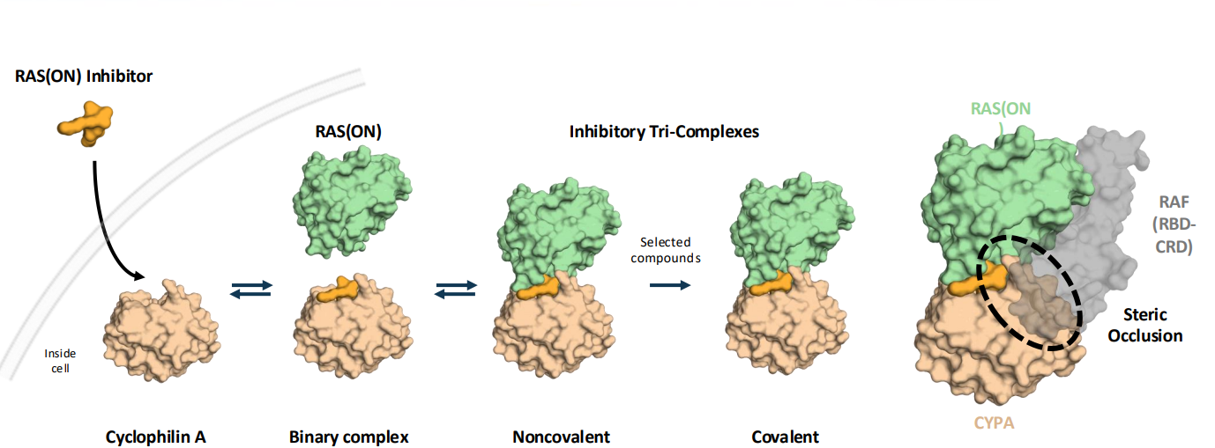
Daraxonrasib: RAS(ON) Molecular Glue

Slide 59
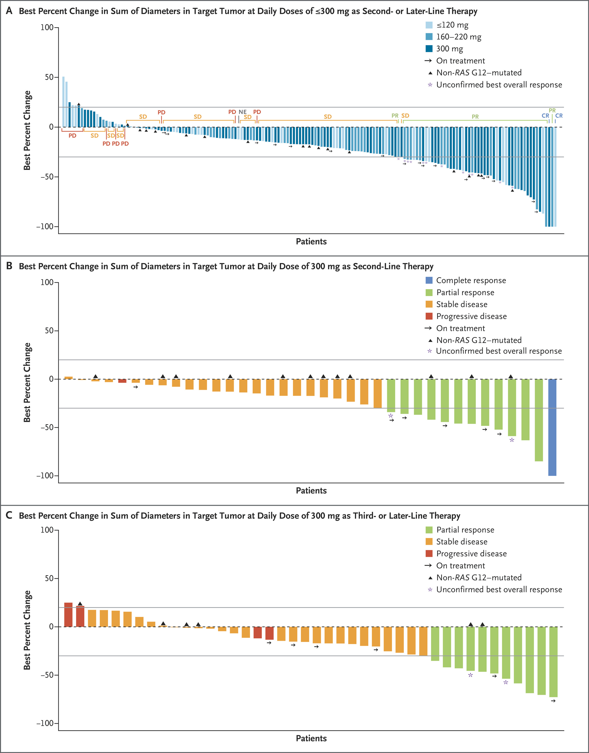
Phase I and II trials showed promising responses
Notes:
Wolpin BM, Park W, Garrido-Laguna I, Spira A, Starodub A, Sommerhalder D, Punekar SR, Barve M, Pelster M, Herzberg B, Azad NS, Hecht JR, Ou SHI, Lin T, Kar S, Tao L, Vora R, Hegde A, Aung K, Hong DS; RMC-6236-001 Investigators. Daraxonrasib in Previously Treated Advanced RAS-Mutated Pancreatic Cancer. N Engl J Med. 2026 May 7;394(18):1790-1802. doi: 10.1056/NEJMoa2505783. PMID: 42090791.

Slide 60
Daraxonrasib demonstrates antitumor activity despite heavy pretreatment

Slide 61
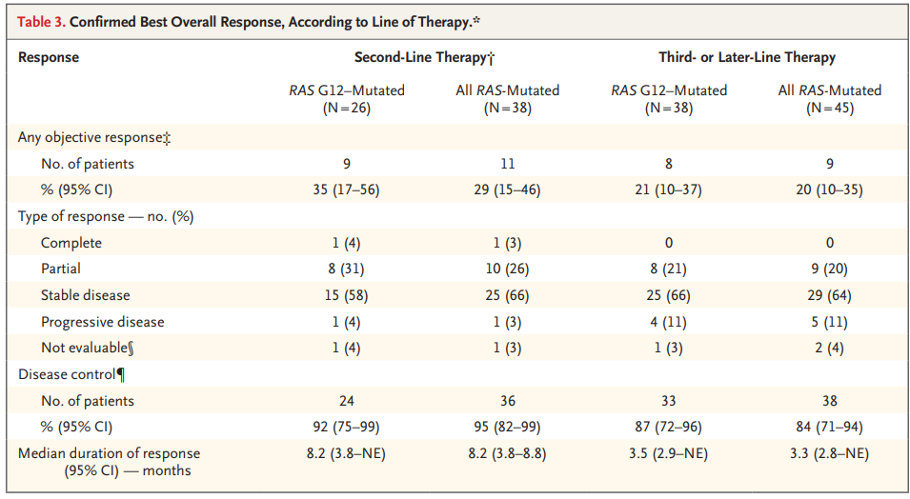
Daraxonrasib elicits high disease control rate

Slide 62
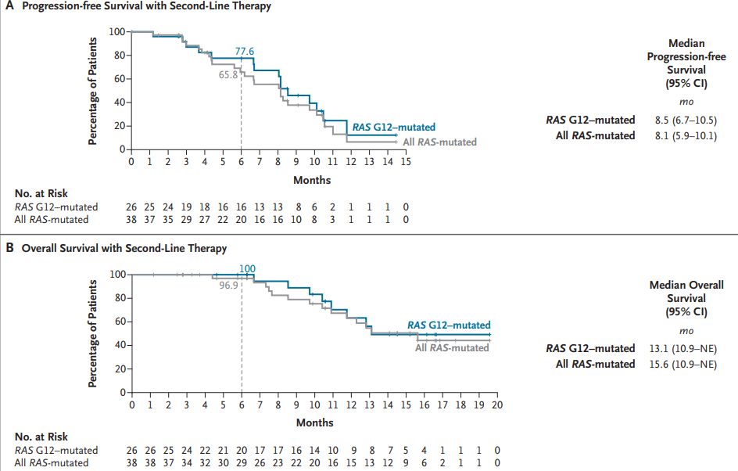
Daraxonrasib conferred survival benefit in 2L that exceeds historical 1L standard

Slide 63
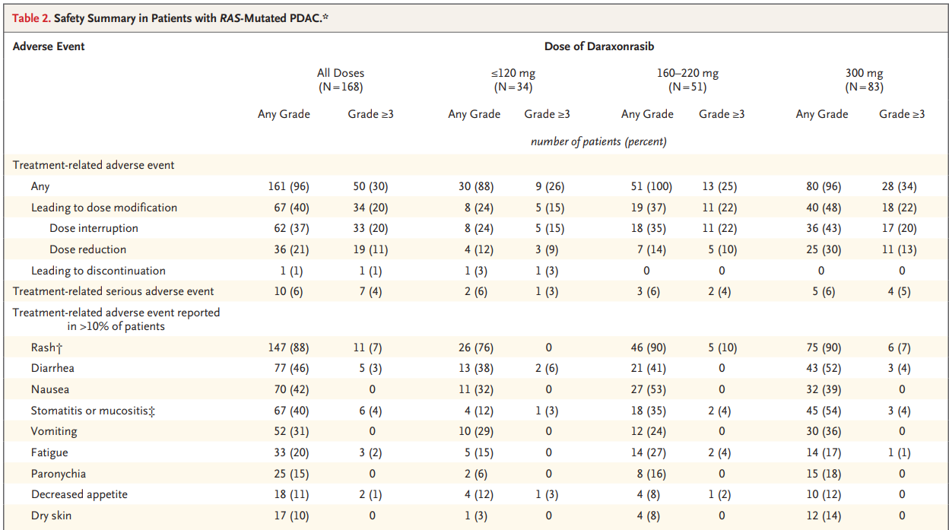
Treatment associated with G3 AEs in 1/3 of patients

Slide 64
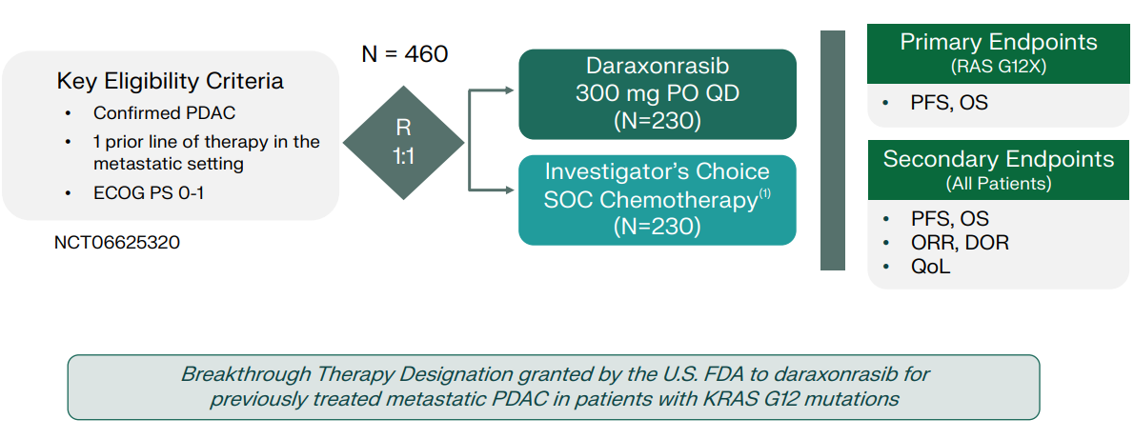
RASolute 302: 2L metastatic PDAC

Slide 65
Updates on outcomes
Press release: Daraxonrasib demonstrated a median OS of 13.2 months versus 6.7 months for chemotherapy, with a hazard ratio of 0.40 (p < 0.0001).
FDA submission being reviewed
FDA has permitted expanded access
Final data to be presented at ASCO
Next steps: Testing in the adjuvant setting and in the first line setting in combination with chemotherapy

Slide 66
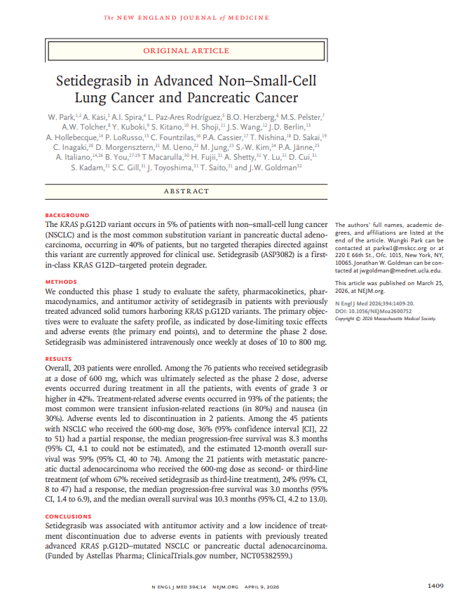
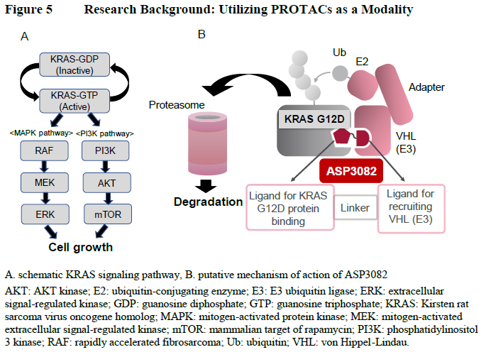
Setidegrasib: KRASG12D degrader

Slide 67
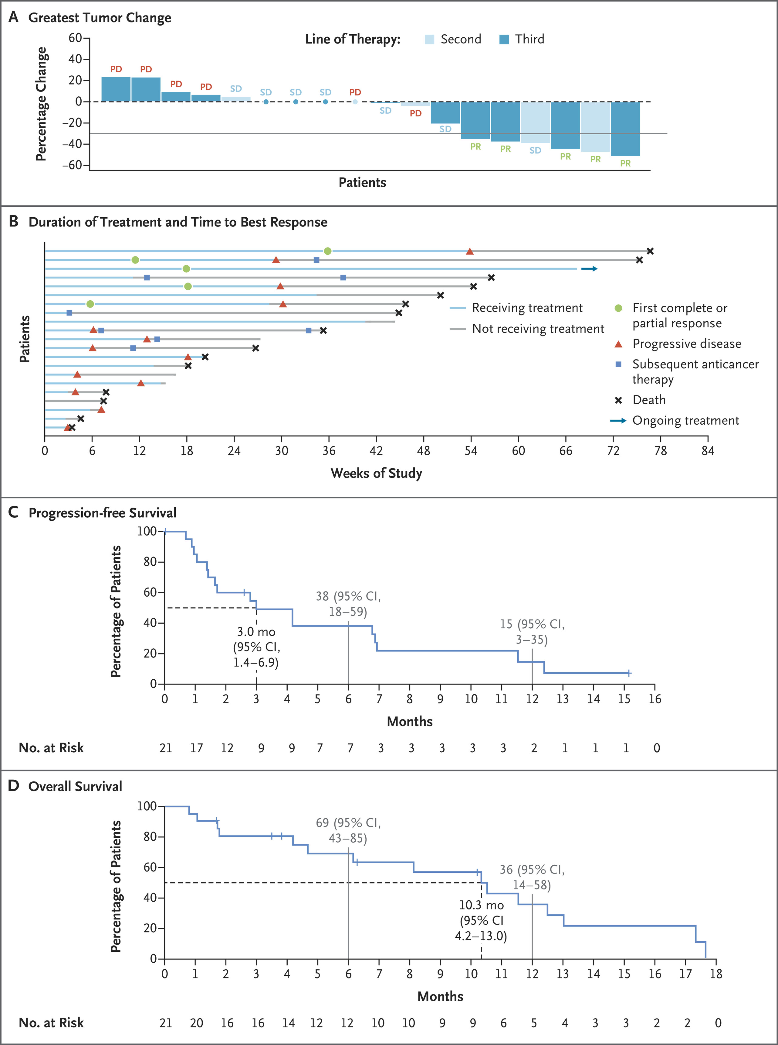

Slide 69
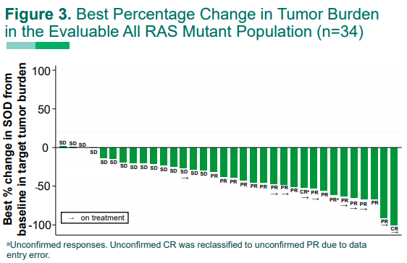
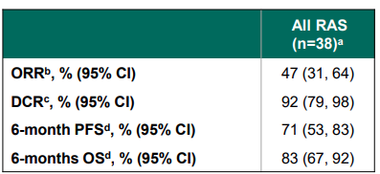
Daraxonrasib Monotherapy in 1L PDAC

Slide 70
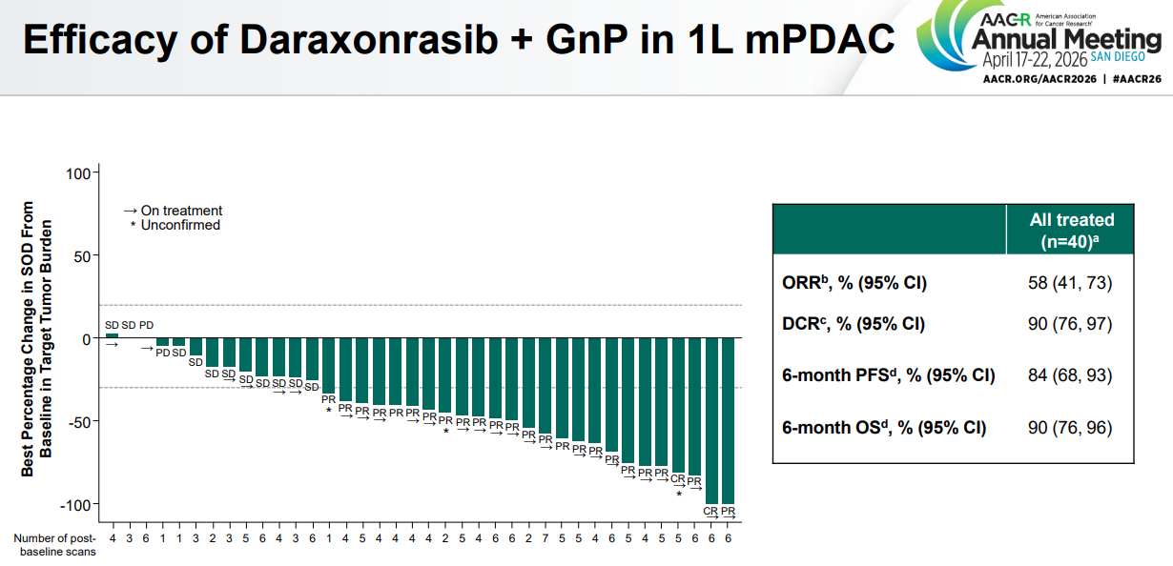

Slide 71
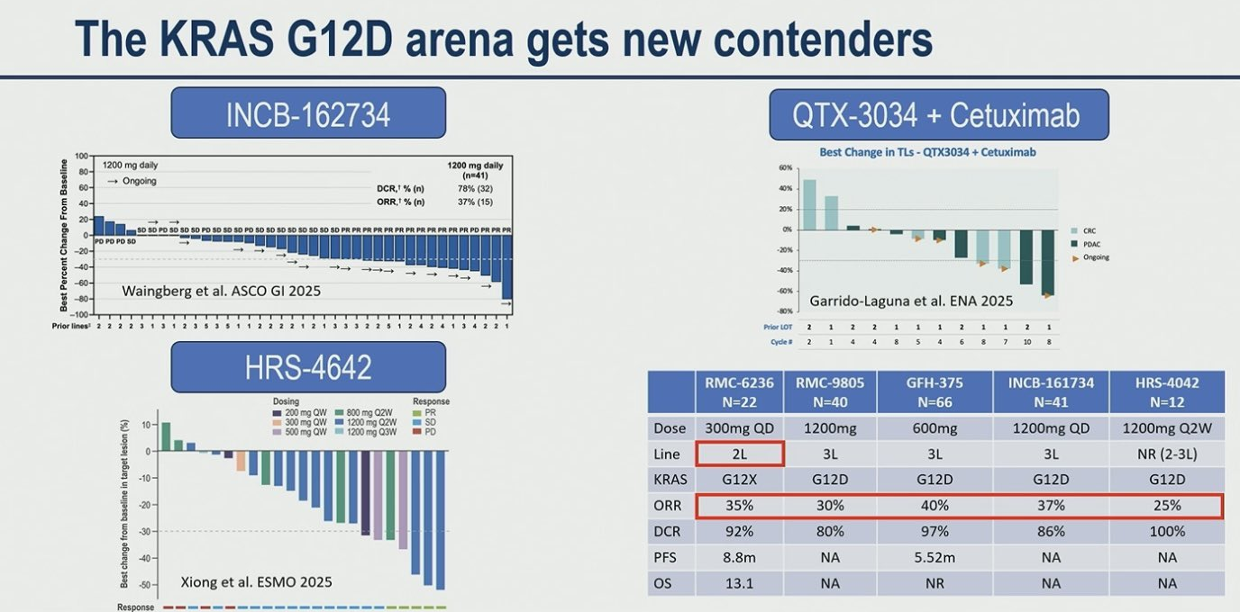

Slide 72
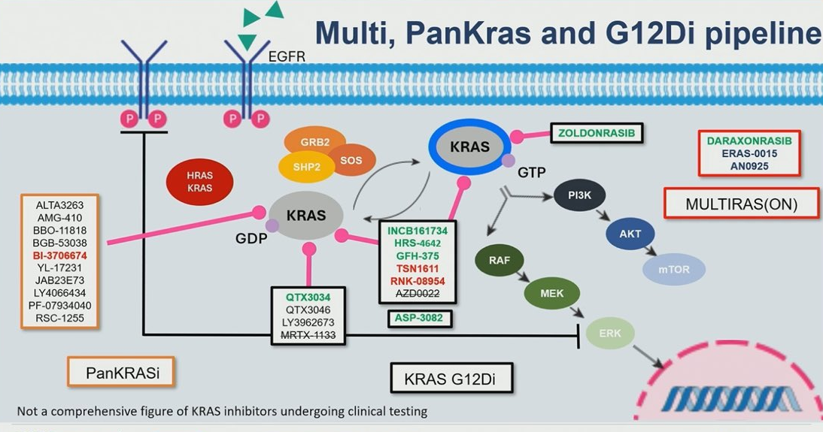

Slide 73


Slide 74


