Slide 1
Oncology in the Genomics Era
Name: Sarah Labib
MS4, University of Arizona College of Medicine, Phoenix
Rotation: IM Sub-Internship
Date: May 26, 2026

Slide 2
Disclosures
I have no financial conflicts of interest to report.
Although I am open to offers.

Slide 3
Objectives
By the end of this presentation, you should be able to:
Appreciate the ways in which genomics is utilized in oncology.
Distinguish between germline and somatic genetic testing and understand the clinical significance of each in oncology.
Describe the prevalence of genomic testing in oncology.
Define cascade genetic testing and its role in cancer prevention.
Identify barriers to genomic testing.
Review strategies to improve patient genomic literacy.
Discuss the pros and cons of universal genetic testing.
Understand how universal genomic testing impacts guideline-concordant cancer care.
Highlight opportunities for physicians and other clinicians to support patient and family outcomes.
Notes:
Here are some learning objectives. I originally gave this talk as part of a heme/onc elective one year ago. I have changed it quite a bit and tried to make it applicable for IM, so hopefully no matter what area of IM you are training for or practicing in, you can take something away from this.

Slide 4

Introduction
A Missed Opportunity: Maria’s Story
Patient: Maria G, a 48-year-old Spanish-speaking woman
Setting: Busy safety-net hospital serving predominantly underserved population
Presentation: Diagnosed with stage III colorectal cancer after presenting with rectal bleeding
Tumor testing: MSI-High, loss of MLH1/PMS2 by IHC, BRAF wild-type
At diagnosis, Maria communicates through a telephone interpreter, but the family history is not fully captured or documented in the EMR.
Her father had colon cancer at the age of 52.
Her aunt had endometrial cancer in her 40s.
Maria has a younger brother, age 46, an older sister, age 51, and two daughters age 28 and 24.
Due to limited staffing and time pressures, the oncology team is unaware of this history.
Maria undergoes surgical resection of her tumor followed by adjuvant chemotherapy with FOLFOX and is told to return in 6 months for surveillance.
Notes:
I would like to start by presenting a case:
Here we have Maria G, a 48-year old Spanish-speaking female presenting to her local safety-net hospital with symptoms of rectal bleeding. After further workup, she is diagnosed with stage III colorectal cancer.
Guardant testing of tumor tissue reveals MSI-H, loss of MLH1/PMS2, and wild-type BRAF. (I know many of you already see where this is going).
She has a fairly strong family history of cancer, but due to time and resource restraints, she is not really asked about it and it is not documented.
She is referred to oncology. She undergoes surgical resection of her tumor followed by adjuvant chemotherapy.
She is told to return in 6 months for surveillance.
She has 2 siblings and 2 adult daughters.

Slide 5
What went wrong here?
Notes:
Answers:
Family history is very strong and indicates some sort of hereditary cancer syndrome
Some cancers are preventable or could be caught early with screening, and Maria has many family members who could benefit from knowing if they are at an increased risk of developing cancer

Slide 6

Advancements in Genetic and Genomic Sequencing in Oncology
Integration of cancer genomics into clinical practice has enabled precision oncology
Treatment decisions are increasingly guided by the molecular and genetic profile of each patient’s tumor. (Avci et al, Berger et al)
Advances and cost reductions have made somatic tumor genomic profiling and germline testing routine components of cancer care.
Genomic profiling helps to:
  Refine cancer subtype classification
  Identify patients likely to benefit from targeted therapies
  Detect biomarkers predictive of treatment response or prognosis
  Screen for heritable germline variants influencing cancer risk (Chakravarty et al)
Notes:
In the past 20 years or so, we have widely expanded our knowledge of genetics and seen massive advancements in DNA sequencing technology. Thanks to these rapid advancements and cost reductions in sequencing, we can now routinely profile hundreds of genes, which wasn’t feasible just a few years ago.
This has had a huge impact on medicine as a whole, but especially oncology, where genomic sequencing technology has allowed us to look beyond traditional tumor histology to underlying genetic alterations driving cancer.
We have shifted from a “one-size-fits-all” model to precision medicine, meaning our treatments are increasingly customized to each patient’s unique tumor profile, improving outcomes and minimizing unnecessary toxicity.
This profiling also helps identify inherited cancer risk, enabling earlier interventions for patients and their families.

Slide 7
Types of Genomic Testing in Oncology
Feature | Germline Testing | Somatic (Tumor) Testing
Source | Blood or saliva | Tumor tissue or liquid biopsy
Origin | Inherited from parents | Acquired mutations in cancer cells
Clinical Utility | Guides risk assessment, preventive strategies, and family cascade testing | Informs selection of targeted therapies and treatment resistance mechanisms
Heritability | Can be passed on to biological relatives | Not inherited
Notes:
This is review for most of you, but I would like to provide a basic overview of the two main types of genetic testing utilized in the field of oncology. For the sake of simplicity, I will not discuss other kinds of genetic tests and biomarkers used for screening and surveillance such as circulating tumor DNA and liquid biopsy, but as many of you know very well, this is also a HUGE area of research and development, and there is a lot of exciting things to come in the future of cancer screening and early identification. This slide outlines the distinct but complementary roles of germline and somatic genetic testing in oncology.
Starting with germline testing:
This type of testing looks for inherited pathogenic variants—mutations present in every cell of the body—that are passed down through families. These mutations can signal a hereditary cancer syndrome, like BRCA1/2 or FAP.
Germline results inform not only the patient's care, but also risk-reducing strategies such as prophylactic surgeries, enhanced screening, and lifestyle modifications.
Equally important, germline testing enables family counseling and cascade testing, helping to identify relatives who may benefit from surveillance or preventive interventions.
They can also guide treatment decisions—for example, PARP inhibitors are particularly effective in BRCA1/2 carriers across multiple cancers.
Somatic testing, or tumor genomic profiling identifies acquired, tumor-specific mutations that arise during cancer development but are not inherited. These can guide the use of targeted therapies, help with prognosis, and may even indicate clinical trial eligibility (as most of you know really well).
Some somatic results—like BRCA1/2 or MMR gene mutations—can also suggest an underlying germline mutation, particularly when there is a relevant family history.
So while germline and somatic tests answer different questions, both are critical to comprehensive cancer care, and they often intersect in clinical decision-making.

Slide 8
Why it Matters
The Evidence: Matched Targeted Therapy Works
PFS benefit: A Cochrane systematic review and meta-analysis (30 RCTs, 7,393 patients) found NGS-guided matched targeted therapy (MTT) reduces disease progression risk by 30–40% vs. standard of care (Kazmi et al., Cochrane 2025)
The ROME Trial (Marchetti 2025): Guided therapy in advanced solid tumors (N=400) significantly improved ORR (17.5% vs. 10%, P=0.03) and PFS (HR 0.66, P=0.0002)
Pancreatic cancer: Patients who received germline-informed therapy had dramatically improved OS (HR 0.09); GGT rates at Roswell Park increased from 16.5% (2017) to 57.6% (2024) (O'Connor et al., JCO Precis Oncol 2026)
The Gap: Testing ≠ Treatment
17% of cancer patients harbor actionable germline variants — but only 3.2% actually received genotype-directed therapy (Stadler et al., JCO 2021)
Only 6.8% of cancer patients in the US received any germline testing (2013–2021), with persistent racial/ethnic disparities (Kurian et al., JAMA 2023)
Bottom Line: Genomic testing identifies actionable targets that improve survival- but only if results reach patients and inform treatment decisions
Notes:
This study published last year looking at nearly 10,000 patients and showed a 21% reduction in the risk of death when we match therapy to genomics. The ROME trial published just last year in 2025 backed this up, showing almost a doubling of response rates in advanced solid tumors.
But look at the bottom bullet. This is why you, as Internal Medicine residents, matter. 17% of patients have actionable mutations sitting right there in their code, but less than 4% actually get the drugs targeted to them. There is a massive execution gap in oncology right now, and identifying these mutations early is how we fix it

Slide 9
Why it Matters
Genomics Enables Cancer Prevention & Cascade Testing
Risk-Reducing Interventions for BRCA1/2 Carriers
Bilateral Mastectomy (RRBM):
  Reduces breast cancer incidence by ~94% (Gandhi et al., JCO 2026; Willert et al. 2025)
  Meta-analysis (6 studies, 6,135 carriers): Associated with 63% lower overall mortality (aHR 0.37) and 86% lower breast cancer-specific mortality (aHR 0.14) (O'Reilly et al., JAMA Surg 2026)
  Note: Intensive imaging surveillance yields comparable breast cancer-specific survival (Gandhi et al., JCO 2026)
Salpingo-Oophorectomy (RRSO):
  Reduces ovarian/tubal/peritoneal cancer risk by ~80% (meta-analysis HR 0.21)
  Reduces all-cause mortality by 68% (aHR 0.32); BRCA1: HR 0.28, BRCA2: HR 0.43 (Kotsopoulos et al., JAMA Oncol 2024)
Combined Impact: RRSO + RRM is cost-effective in >96% of simulations for BRCA1 carriers and >89% for BRCA2 carriers (Wei et al., JAMA Netw Open 2024)
Cascade Testing Multiplies the Impact
Only 41% of at-risk relatives complete genetic testing (Frey et al., JCO 2022)
Direct clinician contact nearly doubles uptake vs. patient-mediated contact (63% vs. 35%)
Among those testing positive via cascade testing: 72% completed recommended screening and 40% underwent risk-reducing surgery within 2 years (Frey et al., Cancer 2022)
Notes:
Genomics isn’t just for treating advanced cancer; it’s our strongest tool for prevention. Prophylactic surgeries in BRCA carriers drop cancer incidence and mortality massively. We are talking about preventing up to 900 cancers per 1,000 carriers.
But we can't offer these surgeries if we don't know who has the mutation. That brings us to cascade testing- testing the family members of our positive patients. Right now, left to their own devices, fewer than half of relatives get tested. But look at the Frey 2022 data: when a clinician directly contacts or provides resources for the family, uptake leaps from 35% to 63%. When we intervene, those family members get screened, they get their surgeries, and we save lives before a patient ever has to step foot into an oncology clinic.

Slide 10
Maria’s tumor was MSI-H BRAF Wild-Type. How does this affect your management?
What are you thinking about?
Notes:
That’s what we saw in Maria’s case: her MSI-H, BRAF wild-type tumor, combined with her family history, strongly suggested Lynch syndrome, but germline testing was not done initially.

Slide 11

Maria’s Story Continues: A Preventable Diagnosis
During a visit to her PCP, Maria’s 28-year-old daughter asks if she could be at risk. The PCP, unaware of the family history and constrained by time and available resources, explains that more information would be needed to make that determination.
Notes:
While seeing her PCP, Maria’s older daughter asks the oncologist if she is at risk of getting cancer. She does not receive a clear answer and is not offered genetic counseling or testing.

Slide 12
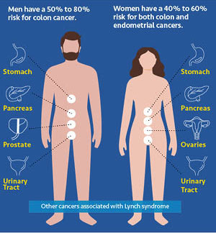
5 years later…
Maria’s daughter, now 33, presents with abnormal uterine bleeding and is diagnosed with endometrial cancer.
This triggers genetic evaluation, revealing a pathogenic MLH1 mutation, confirming Lynch syndrome.
Maria also receives germline genetic testing and is found to have the same mutation.
Notes:
Unfortunately, 5 years later she presents with symptoms of endometrial cancer. Genetic testing in this family is finally prompted and reveals a germline MLH1 mutation, consistent with Lynch syndrome.

Slide 13

Hereditary Cancer Syndromes
Syndrome | Gene(s) | Hallmark Features / Associated Cancers
HBOC | BRCA1, BRCA2 | Increased risk of breast, ovarian, prostate, and pancreatic cancers.
Lynch Syndrome | MLH1, MSH2, MSH6, PMS2, EPCAM | Colorectal (highest risk), endometrial, ovarian, gastric, and upper tract urothelial cancers.
Li-Fraumeni | TP53 | Early-onset soft tissue sarcomas, osteosarcomas, premenopausal breast cancer, brain tumors, adrenocortical carcinoma, and leukemias.
FAP | APC | Hundreds to thousands of adenomatous colorectal polyps; carries a near 100% lifetime risk of colorectal cancer if left untreated.
Peutz-Jeghers | STK11 | Gastrointestinal hamartomatous polyps and distinctive mucocutaneous hyperpigmentation (melanotic macules); increased risk of GI, breast, and pancreatic cancers.
Cowden Syndrome | PTEN | Macrocephaly, multiple benign hamartomas, and mucocutaneous lesions; significantly elevated risk of breast, thyroid, and endometrial cancers.
Notes:
This slide gives an overview of some of the most important hereditary cancer syndromes that providers should be aware of—especially as we talk about germline testing and cascade testing. I have noted all your high yield exam facts about each of these syndromes.
We know that approximately 5-10 percent of all cancers are caused by inherited pathogenic variants. If you’re surprised by that number, I was too. These are passed down through families and, when identified, can dramatically change how we manage both the patient and their at-risk relatives.
The two syndromes you are most likely to encounter are HBOC and Lynch syndrome.
The big takeaway here is that many of these conditions are clinically actionable, meaning that if you identify it early, there are things you can actually do about it that can change patient outcomes!

Slide 14
High Yield ABIM Pearls
About 5-10% of all cancers are attributable to inherited cancer syndromes
Lynch Syndrome accounts for about 3% of all new colorectal cancer cases.
Universal MMR/IHC testing is recommended for all newly diagnosed colorectal and endometrial cancers.
MSI-H + BRAF wild-type strongly points to Lynch Syndrome, whereas a BRAF mutant is more likely to be a sporadic colon cancer (due to MLH1 promoter hypermethylation).
Most hereditary cancer syndromes are autosomal dominant.
Many of these syndromes are clinically actionable. If we identify them early, we can intervene with enhanced surveillance, preventive surgeries, or treatment modifications.
Direct clinician contact is one of the most effective ways to increase genetic testing rates- both for patients and their family members
Management is gene-specific (and sometimes mutation specific); not all Lynch cases are treated the same

Slide 15
Now that Maria and her daughter have been diagnosed with Lynch Syndrome, what are the next steps?
Now that Maria and her daughter have been diagnosed with Lynch Syndrome, what are the next steps?

Slide 16
Lynch Syndrome: Prevention and Management
Cascade testing is recommended for first-degree relatives of individuals with confirmed Lynch syndrome.
Colorectal Cancer- gene specific management
  Genes & CRC risk: MLH1/MSH2 highest risk; MSH6/PMS2 lower and later onset
  Colonoscopy:
    MLH1/MSH2: start age 20–25, repeat every 1–2 years
    MSH6: start age 30–35, repeat every 1–3 years
    PMS2: start age 30–35, repeat every 1–3 years
  Aspirin chemoprevention may reduce colorectal cancer risk; evidence emerging for other Lynch-associated cancers (Dal Buono et al).
Endometrial and ovarian cancer
  Educate on symptoms (abnormal uterine bleeding)
  Consider endometrial biopsy every 1–2 years starting age 30–35
  Risk-reducing hysterectomy ± BSO can be considered (MLH1/MSH2: age ~40)
Upper GI surveillance: EGD starting age 30–40, repeat every 2–4 years; test and treat H. pylori
Notes:
So here are the guidelines for Lynch syndrome, and take note of these because these things can show up on exams.
Once Lynch syndrome is diagnosed in a patient, one of the most critical next steps is to offer genetic testing to their first-degree relatives—siblings, children, and parents—because they have a 50% chance of carrying the same mutation.
For individuals who test positive, early and intensive surveillance is key to preventing cancer or detecting it at a more treatable stage.
Colorectal cancer is the most well-established cancer associated with Lynch syndrome, with over 80% developing it. It is important to note that management of Lynch Syndrome is gene-specific (and sometimes even mutation specific)
Generally speaking, Lynch patients should begin colonoscopy every 1 to 2 years, starting at age 20 to 25, or even earlier when the youngest case in the family occurs earlier.
There’s also growing evidence for aspirin chemoprevention, which has been shown to reduce colorectal cancer risk in people with Lynch syndrome. Emerging research suggests it MIGHT also help reduce the risk of other Lynch-related cancers, though the evidence is strongest for colorectal cancer.
For gynecologic cancers, such as endometrial and ovarian, annual education about symptoms and, in some cases, annual endometrial sampling and transvaginal ultrasound starting at age 30–35 is recommended.
However, the most effective preventive strategy for gynecologic cancers in Lynch syndrome is risk-reducing surgery—specifically, prophylactic hysterectomy and bilateral salpingo-oophorectomy after childbearing is complete.

Slide 17
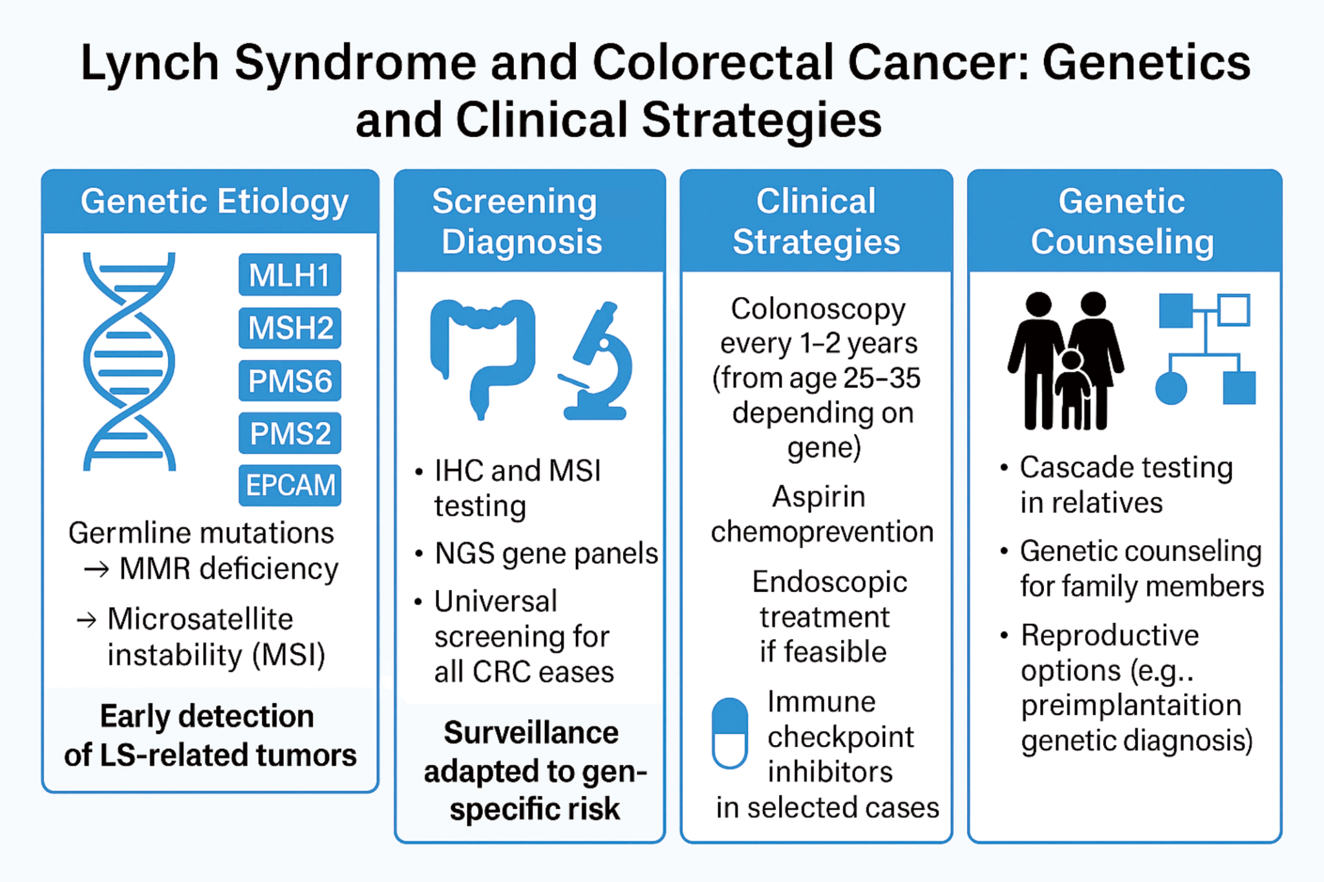
Notes:
This is a more visual presentation of Lynch Syndrome Guidelines.

Slide 18

Maria’s daughter: “If I had known I was at risk, I would have had surgery to prevent it.”
Notes:
This brings us back to Maria’s daughter, who said:
“If I had known I was at risk, I would have had surgery to prevent it.”
This quote underscores what’s at stake. If genetic risk had been identified earlier, she could have taken preventive steps that might have avoided her cancer altogether.

Slide 19
Guidelines for Other Hereditary Cancer Syndromes
HEREDITARY BREAST & OVARIAN CANCER (HBOC) — BRCA1/2
Breast surveillance:
  Age 25–29: annual breast MRI (preferred over mammogram due to radiation risk)
  Age 30–75: annual mammogram + breast MRI
  Clinical breast exam every 6–12 months starting at age 25
Ovarian risk reduction:
  Risk-reducing salpingo-oophorectomy (RRSO): BRCA1 age 35–40; BRCA2 age 40–45
  No effective ovarian cancer screening exists; RRSO reduces ovarian cancer risk by ~81%
  OCPs reduce ovarian cancer risk in carriers not yet undergoing RRSO
Other screening: prostate (BRCA2 especially — PSA at age 40), pancreatic cancer screening if family history, consider melanoma screening (BRCA2)
Risk-reducing mastectomy is an option; discuss with patient
LI-FRAUMENI SYNDROME
Surveillance (modified "Toronto Protocol"):
  Annual whole-body MRI (+ brain MRI) starting in childhood
  Breast MRI starting age 20 (mammogram added at 30); discuss risk-reducing mastectomy
  Colonoscopy + upper endoscopy every 2–5 years starting age 25
  Comprehensive physical exam every 6–12 months
  Annual dermatologic exam
Avoid radiation when possible (therapeutic RT and unnecessary diagnostic radiation) — mastectomy preferred over lumpectomy + RT for breast cancer
Pediatric: whole-body MRI + brain MRI annually from infancy; abdominal ultrasound every 3–4 months for adrenocortical carcinoma
Notes:
I won’t go over this in too much detail, but here is an overview of guidelines to manage other common hereditary cancer syndromes. Feel free to refer to NCCN guidelines. The big take-home point is that hereditary cancers are often clinically actionable and we have a role to play

Slide 20
Cascade Testing: A Key Tool for Cancer Prevention
What is Cascade Testing?
Systematic genetic counseling and testing offered to patients’ relatives (probands) identified with pathogenic/likely pathogenic germline variants.
Why Does it Matter?
Identifies at-risk family members who may carry the same mutation,
Enables targeted risk assessment, surveillance, and preventive measures (Wilke et al).
High Impact for Underserved Populations
Reaches relatives in minority, low-income, uninsured, rural, or non-English-speaking communities (Levine et al).
Despite these benefits, uptake remains low in underserved populations due to:
limited access to genetic services
language and cultural differences
healthcare mistrust
financial constraints
To close the gap, we need culturally tailored outreach, community engagement, and system-level infrastructure to support cascade testing in all populations!
Notes:
I mentioned cascade testing before, so what exactly is it? Cascade testing is a targeted approach where genetic counseling and testing are offered to blood relatives of patients who have been found to carry pathogenic or likely pathogenic germline mutations linked to hereditary cancer syndromes. It’s a kind of domino effect. This method helps identify family members who might also carry the mutation, allowing us to assess their cancer risk and implement surveillance or preventive strategies early.
This approach is particularly valuable for populations that face significant system-level barriers—such as racial and ethnic minorities, people with lower socioeconomic status, uninsured or underinsured patientsIn fact, studies find that compared to population-wide screening, cascade testing is more cost-effective and practical (Levine et al).
However, uptake of cascade testing remains disappointingly low in these underserved populations, due to many barriers we will discuss later.. Studies show that even when financial obstacles are reduced, minorities and lower-income groups are still less likely to complete cascade testing (Kassem et al).

Slide 21
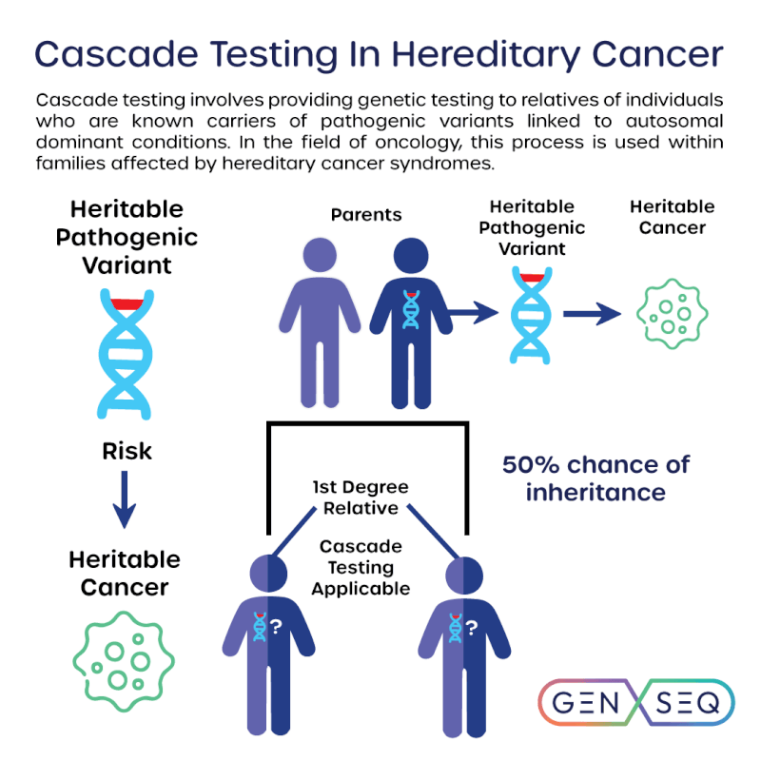
Notes:
This slide shows a family tree for an autosomal dominant condition such as Lynch syndrome and the risk of inheriting such a condition.

Slide 22
Current Guidelines

Slide 23

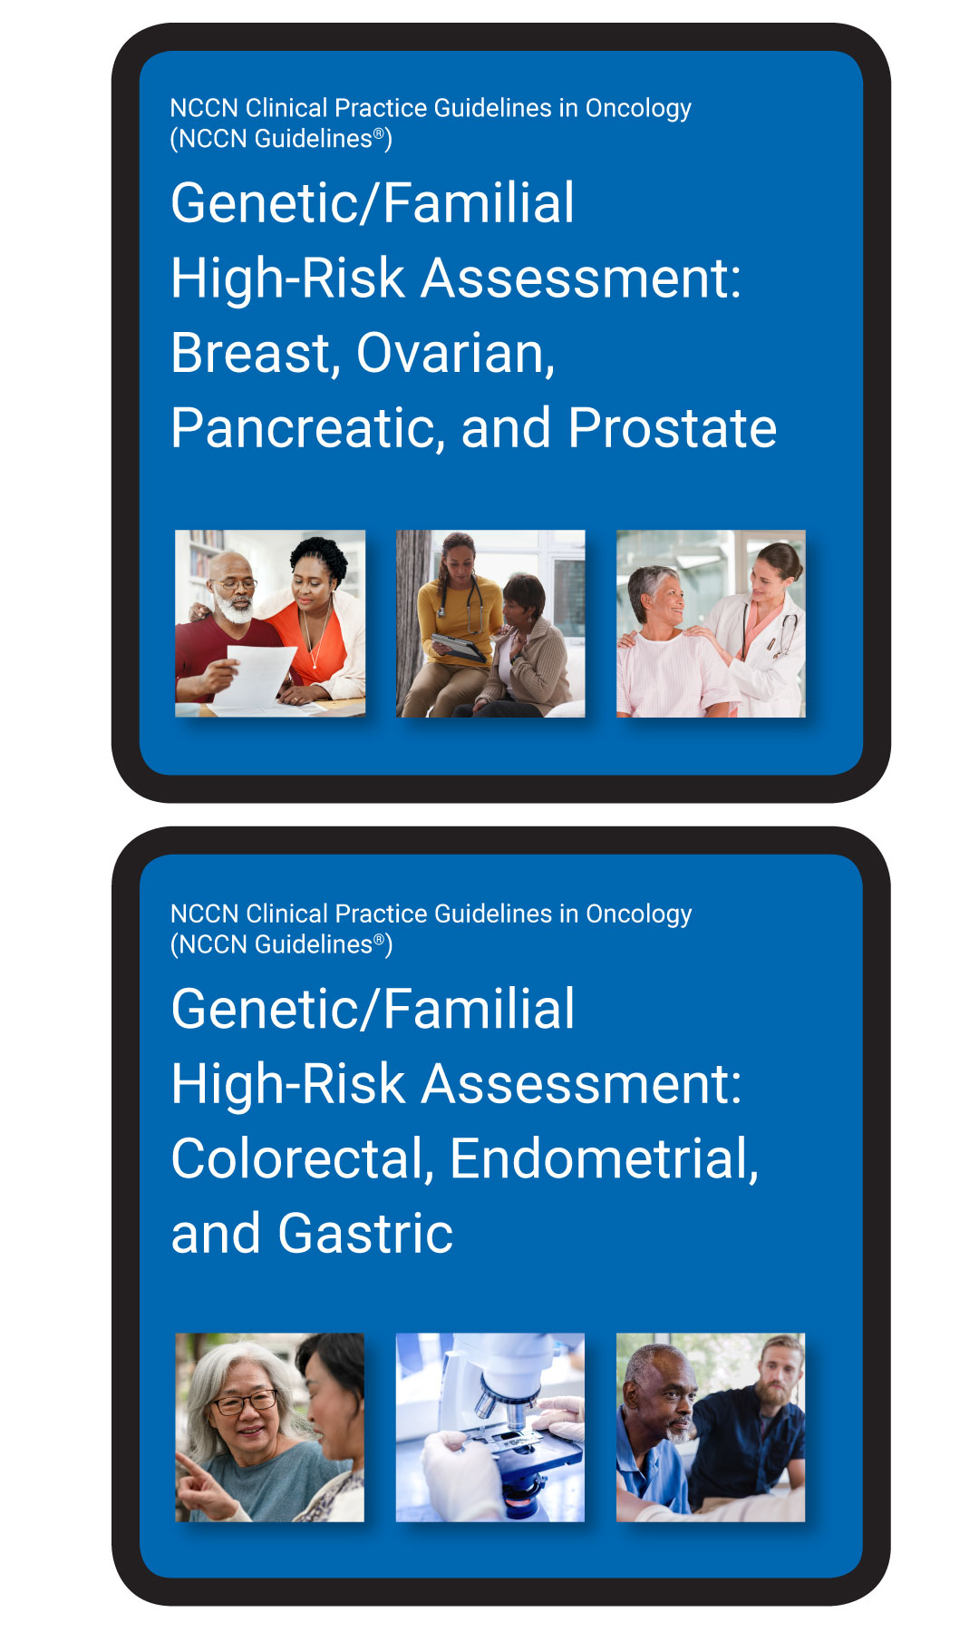
Germline Genetic Testing: Current Guidelines
ASCO Guidelines (2024): Germline Genetic Testing (Tung 2024)
The Golden Rule: Tumor testing ≠Germline testing. Tumor profiling misses 8%–10% of germline pathogenic variants.
Who to Test & How:
  Take a 3-generation history: 1st & 2nd-degree relatives (cancer types, ages, ethnicity).
  Automatic testing: Some cancers (e.g., ovarian, pancreatic) warrant testing regardless of family history.
  Reflex testing: If a pathogenic/likely pathogenic (P/LP) variant is found on tumor profiling, order germline testing to confirm if it's heritable.
Panel Selection:* Use multigene panels (now standard to capture high- & moderate-penetrance genes).
Next Steps: Strongly recommend Genetic Counseling to interpret positive/VUS results and facilitate family cascade testing.
Notes:
I know that hearing guidelines is getting old and dry, but I’ll quickly walk through the key things to remember for germline testing. The first and most important point is what I call the golden rule: tumor testing is not the same as germline testing. A negative tumor sequencing panel does not exclude a hereditary cancer syndrome. In fact, studies show that tumor profiling can miss roughly 8–10% of pathogenic germline variants. Therefore, if a patient meets criteria for germline testing, you should order germline testing regardless of tumor sequencing results.
The second key point is that family history still matters. We should obtain a three-generation family history when possible, including first- and second-degree relatives, cancer types, ages at diagnosis, and ancestry. However, remember that family history is imperfect and often unknown or incomplete, which is one reason guideline-based approaches may miss patients with actionable mutations.
There are also certain cancers where germline testing should be strongly considered regardless of family history, including ovarian and pancreatic cancer.
Another practical pearl is reflex testing. If tumor sequencing identifies a pathogenic variant in a hereditary cancer gene—such as BRCA1, BRCA2, PALB2, or one of the Lynch syndrome genes—that finding may represent an inherited mutation. Germline testing should be done.
NCCN now generally favors multigene panel testing over single-gene strategies.
Finally, a genetic test result is only useful if it is interpreted correctly. Positive results—and especially variants of uncertain significance, or VUS—often require genetics expertise. Referral to genetic counseling is vital.

Slide 24
Current Guidelines for Somatic (Tumor) Testing
ASCO Recommendations for Somatic (Tumor) Genomic Testing (Chakravarty et al)
When to Test
Multigene panel testing is preferred for patients with metastatic or advanced solid tumors
Especially when biomarker-linked therapies are FDA- or EMA-approved
Testing should be performed in certified laboratories and results integrated with clinical context
When to Add Germline Testing
If a pathogenic variant in a cancer susceptibility gene (such as MLH1) is found on tumor testing, confirmatory germline testing is indicated
Germline testing for therapy-linked alterations should not be limited by family history or traditional criteria
  Recent data suggest that up to 63% of Lynch syndrome carriers may be missed if testing is restricted to those with suggestive personal or family history, supporting consideration of population-based germline testing to improve equity in detection (Park et al).
Notes:
With regards to tumor testing, guidelines recommend multigene tumor sequencing for patients with metastatic or advanced solid tumors, especially when results may identify approved targeted therapies.
ASCO also notes that germline testing for clinically relevant alterations should not be restricted by family history alone. Studies suggest that up to 63% of Lynch syndrome carriers may be missed using traditional testing criteria, highlighting the need for broader approaches to hereditary cancer detection.

Slide 25
High Yield Exam Points
Tumor testing→ targeted therapy; germline testing→ risk-reduction
Take a 3-generation family history — the single most important screening tool for hereditary cancer syndromes
Refer to genetics when: cancer diagnosed young (<50), multiple primaries, clustering of related cancers, Ashkenazi Jewish ancestry, or known familial variant
Cascade testing of at-risk relatives is critical once a pathogenic variant is identified
Universal tumor testing for Lynch syndrome (MSI/IHC) is now standard of care for all CRCs and endometrial cancers
BRCA carriers and Lynch syndrome patients benefit from PARP inhibitors and immunotherapy (anti-PD-1), respectively, when they develop cancer- knowing germline status changes treatment

Slide 26
Practice
A 37-year-old woman presents with irregular menses. Endometrial biopsy reveals endometrial adenocarcinoma. Her father was diagnosed with colorectal cancer at age 32, and her paternal grandmother died of ovarian cancer at age 55. She has two healthy adult siblings. She has no other significant past medical history.
What is the next best step in evaluation?
A) Referral for genetic counseling and germline testing for Lynch syndrome
B) MSI/IHC testing of the endometrial tumor
C) BRAF V600E mutation testing of the tumor
D) Treat the endometrial cancer and reassure the patient that this is likely sporadic
E) Recommend screening colonoscopy for the patient every 1–2 years

Slide 27
Practice
A 37-year-old woman presents with irregular menses. Endometrial biopsy reveals endometrial adenocarcinoma. Her father was diagnosed with colorectal cancer at age 32, and her paternal grandmother died of ovarian cancer at age 55. She has two healthy adult siblings. She has no other significant past medical history.
What is the next best step in evaluation?
A) Referral for genetic counseling and germline testing for Lynch syndrome
B) MSI/IHC testing of the endometrial tumor
C) BRAF V600E mutation testing of the tumor
D) Treat the endometrial cancer and reassure the patient that this is likely sporadic
E) Recommend screening colonoscopy for the patient every 1–2 years
Notes:
Correct Answer: B) MSI/IHC testing of the endometrial tumor
Explanation:
Current guidelines recommend universal tumor testing with microsatellite instability (MSI) and/or immunohistochemistry (IHC) for mismatch repair (MMR) proteins on all newly diagnosed endometrial cancers, regardless of age or family history. This is the appropriate first step before proceeding to germline genetic testing.
Why not A? Germline genetic testing is appropriate but should generally follow tumor-based screening. If MSI/IHC is abnormal (MSI-high or loss of MMR protein expression), this strengthens the indication for genetic counseling and germline testing. Universal tumor testing is the recommended initial step.
Why not C? BRAF V600E testing is used in the workup of colorectal cancers with MLH1 loss to help distinguish sporadic (BRAF-mutated) tumors from Lynch syndrome. It is not part of the standard endometrial cancer Lynch syndrome workup.
Why not D? A young woman with endometrial cancer and a strong family history of Lynch-associated cancers (early-onset CRC, ovarian cancer) should not be reassured without further evaluation. This presentation is highly suspicious for a hereditary cancer syndrome.
Why not E? While Lynch syndrome carriers do require intensive colonoscopic surveillance, recommending a screening schedule is premature before a diagnosis of Lynch syndrome has been established through appropriate testing.
Key Teaching Points:
Universal MSI/IHC testing is now standard of care for all endometrial and colorectal cancers.
Lynch syndrome is caused by germline pathogenic variants in MMR genes (MLH1, MSH2, MSH6, PMS2) or EPCAM deletions.
The Amsterdam II and revised Bethesda criteria are historical tools; universal tumor testing has largely replaced criteria-based screening.
Lynch syndrome carries increased risk for colorectal, endometrial, ovarian, gastric, urothelial, and other cancers.

Slide 28
Practice
A 42-year-old woman presents to establish care after recently relocating. She reports a history of endometrial cancer diagnosed at age 38, treated with total abdominal hysterectomy and bilateral salpingo-oophorectomy. She has no other significant past medical history. Family history is notable for a paternal uncle diagnosed with colon cancer at age 50 and a paternal grandmother who died of "abdominal cancer" at age 55. She does not smoke or drink alcohol. Physical examination is unremarkable.
Pathology from her hysterectomy specimen is obtained and reveals a grade 2 endometrioid adenocarcinoma. Immunohistochemistry demonstrates loss of MSH2 and MSH6 protein expression with intact MLH1 and PMS2 staining.
Which of the following is the most appropriate next step in management?
A) Reassurance that this is a sporadic finding and routine cancer screening
B) BRAF V600E mutation testing of the tumor
C) MLH1 promoter methylation analysis of the tumor
D) Referral for genetic counseling and germline testing for Lynch Syndrome
E) Empiric initiation of annual colonoscopy
Notes:
Correct Answer: D
Explanation:
This patient's tumor demonstrates loss of MSH2 and MSH6 expression on immunohistochemistry, which is highly suggestive of Lynch syndrome (hereditary nonpolyposis colorectal cancer syndrome). Unlike loss of MLH1/PMS2 — which can occur sporadically due to MLH1 promoter hypermethylation — loss of MSH2/MSH6 is rarely a sporadic event and strongly suggests a germline mismatch repair gene mutation. The appropriate next step is referral for genetic counseling and confirmatory germline testing.
Why the other answers are incorrect:
(A) Reassurance — Loss of MSH2/MSH6 in a young patient with a suggestive family history should not be dismissed. This pattern has a high positive predictive value for Lynch syndrome.
(B) BRAF V600E testing — BRAF V600E testing is used to help distinguish sporadic from hereditary cases when there is loss of MLH1/PMS2, because BRAF V600E mutations are associated with sporadic MLH1 promoter methylation. It is not indicated when MSH2/MSH6 is lost.
(C) MLH1 promoter methylation analysis — This test is relevant when MLH1/PMS2 expression is lost, to determine whether the loss is due to sporadic promoter hypermethylation or a germline MLH1 mutation. It has no role in the workup of MSH2/MSH6 loss.
(E) Empiric colonoscopy without further workup — While enhanced surveillance (including colonoscopy every 1–2 years) is indeed recommended for confirmed Lynch syndrome carriers, initiating surveillance without first confirming the diagnosis through germline testing is premature. Germline testing identifies the specific mutation, enables cascade testing of at-risk family members, and guides the full spectrum of cancer surveillance recommendations.
Teaching Points:
Universal tumor screening for mismatch repair (MMR) deficiency via immunohistochemistry or microsatellite instability testing is recommended for all colorectal and endometrial cancers.
The pattern of MMR protein loss on immunohistochemistry guides the subsequent workup:
Loss of MLH1/PMS2 → Check BRAF V600E and/or MLH1 promoter methylation to rule out sporadic cause before proceeding to germline testing.
Loss of MSH2/MSH6 or isolated loss of MSH6 or PMS2 → Proceed directly to germline testing, as these patterns are rarely sporadic.
Lynch syndrome carries increased lifetime risks for colorectal, endometrial, ovarian, gastric, urothelial, and other cancers. Identifying a germline mutation allows cascade testing of relatives and implementation of risk-reducing strategies.
Somatic tumor genomic profiling can identify mutations that suggest hereditary syndromes, but confirmatory germline testing in a certified laboratory is always required.

Slide 29
Practice
A 42-year-old woman presents to establish care after recently relocating. She reports a history of endometrial cancer diagnosed at age 38, treated with total abdominal hysterectomy and bilateral salpingo-oophorectomy. She has no other significant past medical history. Family history is notable for a paternal uncle diagnosed with colon cancer at age 50 and a paternal grandmother who died of "abdominal cancer" at age 55. She does not smoke or drink alcohol. Physical examination is unremarkable.
Pathology from her hysterectomy specimen is obtained and reveals a grade 2 endometrioid adenocarcinoma. Immunohistochemistry demonstrates loss of MSH2 and MSH6 protein expression with intact MLH1 and PMS2 staining.
Which of the following is the most appropriate next step in management?
A) Reassurance that this is a sporadic finding and routine cancer screening
B) BRAF V600E mutation testing of the tumor
C) MLH1 promoter methylation analysis of the tumor
D) Referral for genetic counseling and germline testing for Lynch Syndrome
E) Empiric initiation of annual colonoscopy
Notes:
Correct Answer: D
Explanation:
This patient's tumor demonstrates loss of MSH2 and MSH6 expression on immunohistochemistry, which is highly suggestive of Lynch syndrome (hereditary nonpolyposis colorectal cancer syndrome). Unlike loss of MLH1/PMS2 — which can occur sporadically due to MLH1 promoter hypermethylation — loss of MSH2/MSH6 is rarely a sporadic event and strongly suggests a germline mismatch repair gene mutation. The appropriate next step is referral for genetic counseling and confirmatory germline testing.
Why the other answers are incorrect:
(A) Reassurance — Loss of MSH2/MSH6 in a young patient with a suggestive family history should not be dismissed. This pattern has a high positive predictive value for Lynch syndrome.
(B) BRAF V600E testing — BRAF V600E testing is used to help distinguish sporadic from hereditary cases when there is loss of MLH1/PMS2, because BRAF V600E mutations are associated with sporadic MLH1 promoter methylation. It is not indicated when MSH2/MSH6 is lost.
(C) MLH1 promoter methylation analysis — This test is relevant when MLH1/PMS2 expression is lost, to determine whether the loss is due to sporadic promoter hypermethylation or a germline MLH1 mutation. It has no role in the workup of MSH2/MSH6 loss.
(E) Empiric colonoscopy without further workup — While enhanced surveillance (including colonoscopy every 1–2 years) is indeed recommended for confirmed Lynch syndrome carriers, initiating surveillance without first confirming the diagnosis through germline testing is premature. Germline testing identifies the specific mutation, enables cascade testing of at-risk family members, and guides the full spectrum of cancer surveillance recommendations.
Teaching Points:
Universal tumor screening for mismatch repair (MMR) deficiency via immunohistochemistry or microsatellite instability testing is recommended for all colorectal and endometrial cancers.
The pattern of MMR protein loss on immunohistochemistry guides the subsequent workup:
Loss of MLH1/PMS2 → Check BRAF V600E and/or MLH1 promoter methylation to rule out sporadic cause before proceeding to germline testing.
Loss of MSH2/MSH6 or isolated loss of MSH6 or PMS2 → Proceed directly to germline testing, as these patterns are rarely sporadic.
Lynch syndrome carries increased lifetime risks for colorectal, endometrial, ovarian, gastric, urothelial, and other cancers. Identifying a germline mutation allows cascade testing of relatives and implementation of risk-reducing strategies.
Somatic tumor genomic profiling can identify mutations that suggest hereditary syndromes, but confirmatory germline testing in a certified laboratory is always required.

Slide 30
Key Points
Universal MSI/IHC testing is now standard of care for all endometrial and colorectal cancers.
Lynch syndrome is caused by germline pathogenic variants in MMR genes (MLH1, MSH2, MSH6, PMS2) or EPCAM deletions.
MSI-H + BRAF wild-type strongly points to Lynch Syndrome. If it were BRAF mutant, it would likely be a sporadic colon cancer (due to MLH1 promoter hypermethylation).
The Amsterdam II and revised Bethesda criteria are historical tools; universal tumor testing has largely replaced criteria-based screening.
Lynch syndrome carries increased risk for colorectal, endometrial, ovarian, gastric, urothelial, and other cancers.
BRAF V600E testing is only appropriate for colorectal cancers, not endometrial cancers.
NCCN guidelines note that regardless of tumor test results, genetic evaluation is recommended if the patient is under age 50 at diagnosis.

Slide 31
Where We Stand: Current Data

Slide 32
Where We Stand: Prevalence of Genomic Testing
Overall, only about 6.8% of cancer patients in the US receive germline genetic testing (Kurian et al)
Testing rates vary widely by cancer type:
The Advanced Setting (Somatic/Tumor Testing)
The Flatiron Health Cohort (N = 63,294, 2018–2022): A massive U.S. study revealed that the majority of patients with advanced or metastatic cancer still did not undergo tumor genomic testing.
The Timing Paradox (New Point): A separate Flatiron analysis found that among patients who underwent NGS and subsequently died, a concerning proportion received their first NGS results within 3 months of death or even after death, highlighting a subset of late, clinically futile testing.
Male Breast Cancer | 50%
Ovarian Cancer | 38.6%
Female Breast Cancer | 26%
Pancreatic and Colorectal Cancers | 5.6%
Prostate Cancer | 1%
Lung Cancer | 0.3%
Bottom Line: We need to test more, test smarter, and test earlier
Notes:
So how are we doing as a field in adhering to genetic testing guidelines?
Not very good.
Overall, only about 7% of cancer patients receive germline genetic testing. This varies a lot by cancer type. I think widespread public knowledge of BRCA has made genetic testing for breast cancer pretty common, but as you can see, people with lung cancer rarely receive germline testing. This is unfortunate considering that lung cancer has such a high mortality rate in the US. We should not assume all lung cancer is due to smoking.
Now, you might think, 'Well, maybe we aren't doing great with germline testing, but surely we are testing the actual tumors of patients with advanced, metastatic disease to find targeted treatments?'
Unfortunately, the data shows a similar gap. A massive U.S. cohort study looked at over 63,000 advanced or metastatic cancer patients between 2018 and 2022found that even in advanced stages—where matching a drug to a tumor mutation is a primary line of defense—the majority of patients still never underwent somatic tumor testing.
And here is the critical warning for us as internal medicine clinicians: A separate analysis from that study looked at the subset of patients who did get NGS testing and eventually passed away. They found a deeply concerning trend: a significant proportion of these patients received their first NGS results within 3 months of their death, or in some cases, after they had already died.
Genomic testing takes time to process—often weeks. If we wait to order NGS until a patient is in the ICU, or end-stage and failing multiple lines of therapy, the test becomes clinically futile. It adds cost without changing management. If we are going to use genomics to guide therapy, we have to order it early in the disease course, not as a last-resort Hail Mary when a patient is actively dying
As internal medicine residents, whether you go into primary care or oncology, recognizing this deficit is the first step. We have to be the ones ordering and advocate-testing for these patients.

Slide 33
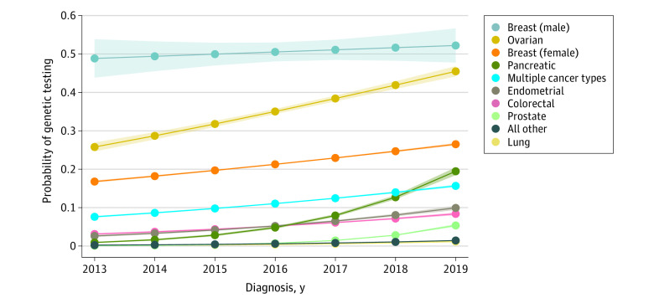
Prevalence of Genomic Testing in Cancer Patients
Kurian AW, Abrahamse P, Furgal A, et al. Germline Genetic Testing After Cancer Diagnosis. JAMA. 2023;330(1):43-51. doi:10.1001/jama.2023.9526
Notes:
This graph shows the rates of germline testing for different types of cancer. As you can see, the good news is that testing has continued to increase over time. The bad news is that the rate is still pretty, well, abysmal.

Slide 34
Disparities in Testing
Race/ethnicity: Compared to non-Hispanic White patients, germline testing rates were significantly lower for Black (OR 0.58), Hispanic (OR 0.62), and Asian (OR 0.71) patients, with no improvement over time. For somatic NGS, Black and Hispanic patients experienced significantly longer time to testing across multiple cancer types. Non-White patients also had higher VUS-only rates (Black 39%, Asian 40% vs. White 24.9%), a gap that widened over time. Kurian et al Hage et al
Socioeconomic status: Patients with low SES were less likely to undergo NGS in metastatic breast cancer, NSCLC, and CRC.
Insurance: Medicaid and Medicare patients experienced significantly longer time to NGS testing across all tumor types. The 2018 Medicare National Coverage Determination increased NGS access but did not eliminate disparities. (Sheinson et al 2021)
Post-test disparities: Even among patients who tested positive for pathogenic variants, non-White patients- particularly Black patients- were less likely to complete recommended genetic counseling (63% vs. 73.7% for White patients). (Liu et al 2022)
Research and Data Inequity: Minorities underrepresented in genomic research (Chakravarty et al), leading to more Variants of Uncertain Significance (VUS) and fewer actionable results
Notes:
Unsurprisingly, disparities exist throughout the cancer genomics pathway. Black, Hispanic, and Asian patients are less likely to receive germline testing and often experience delays in somatic NGS. Lower socioeconomic status and public insurance are also associated with reduced access to testing. Even after a positive result, minority patients are less likely to complete recommended genetic counseling. These inequities are compounded by the underrepresentation of diverse populations in genomic research, contributing to higher rates of variants of uncertain significance and fewer actionable results."

Slide 35
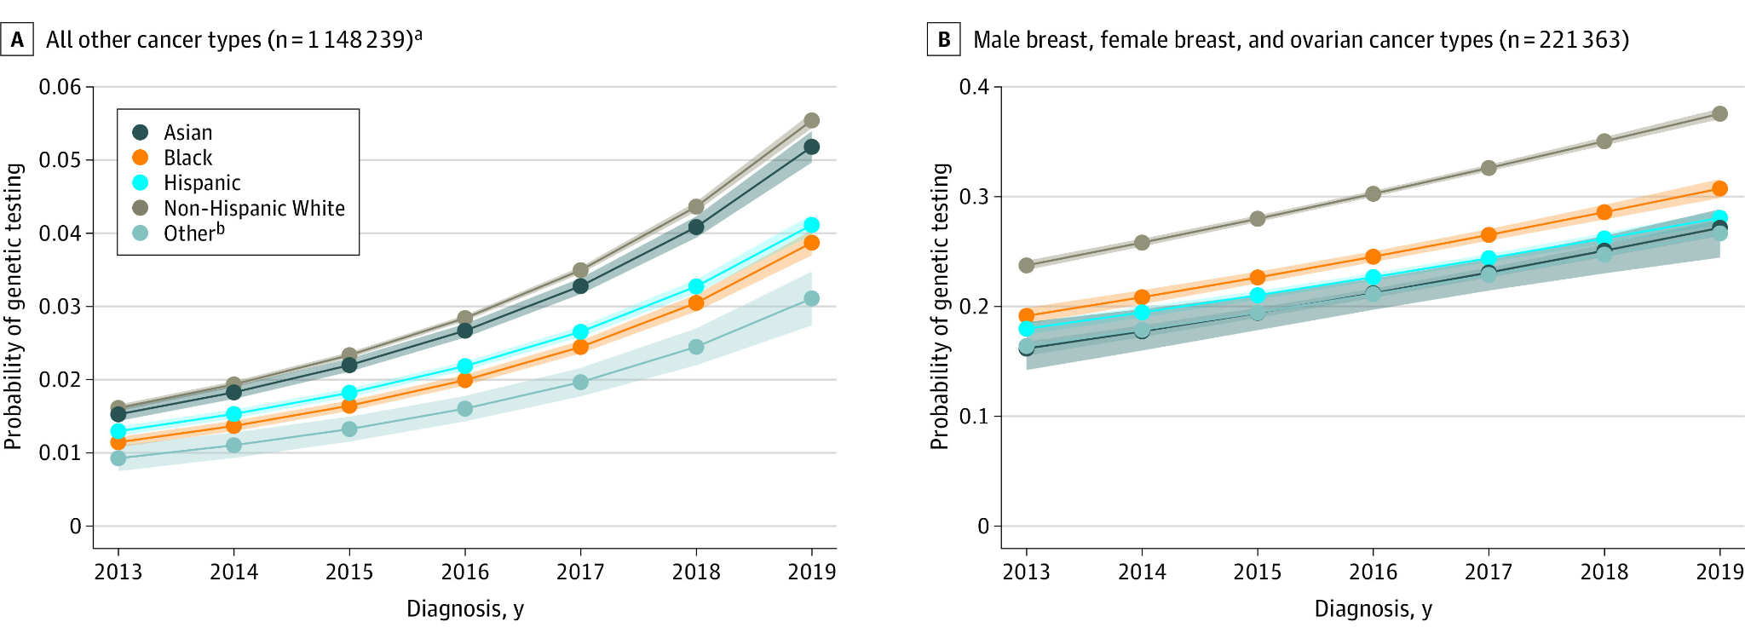
Notes:
This graph shows the probability of genetic testing in oncology patients separated by race. As you can see, there are pretty tremendous racial disparities.

Slide 36
Barriers to Genomic Testing

Slide 37
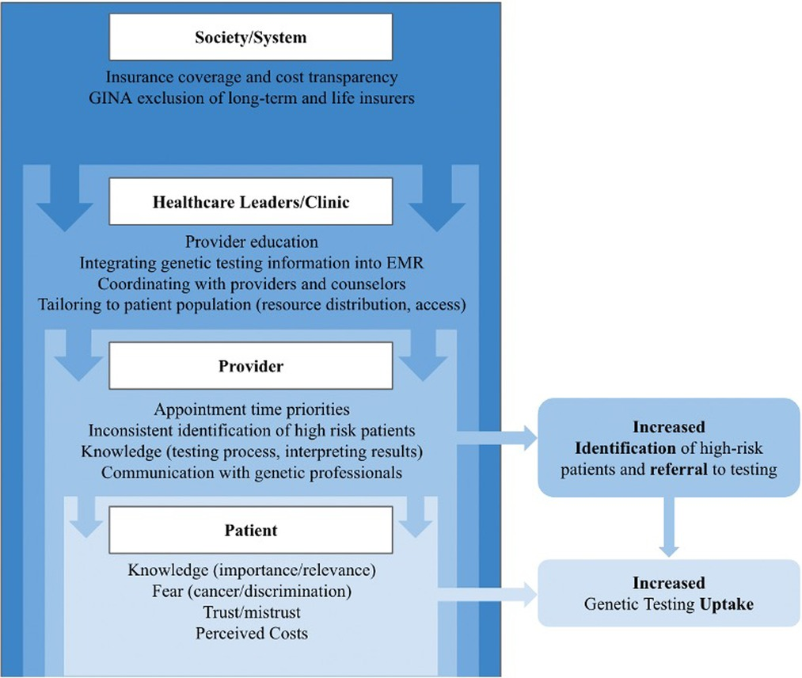
Barriers to Genetic Testing
Barriers to genetic testing can be split into 3 categories:
Patient-level
Provider-level
System-level
Dusic EJ, Theoryn T, Wang C, Swisher EM, Bowen DJ; EDGE Study Team. Barriers, interventions, and recommendations: Improving the genetic testing landscape. Front Digit Health. 2022;4:961128. Published 2022 Nov 1. doi:10.3389/fdgth.2022.961128
Notes:
We can generally think of barriers to widespread adoption of genetic testing as falling into 3 categories, although there is definitely overlap: barriers that occur at the patient level, at the provider level, and at the system level.

Slide 38
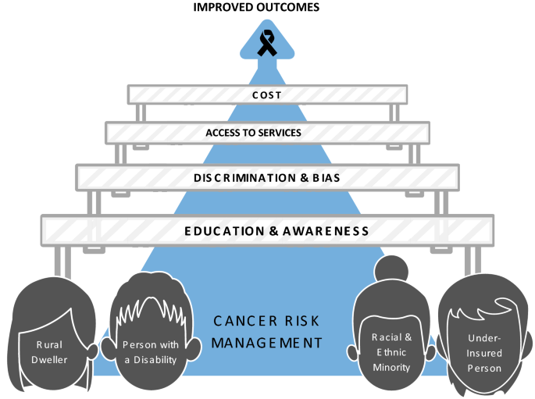
Patient-Level Barriers
Low genetic literacy and misunderstanding of results
Only ~50% feel they have enough knowledge to make informed decisions. ((Blanchette et al, Bartley et al))
Mistrust & Stigma
Historical and ongoing inequities fuel mistrust in the healthcare system. Concerns about discrimination, confidentiality, and stigma discourage engagement with genetic services (Matalon et al, Kamaraju et al).
Cost and Insurance Challenges
High out-of-pocket costs and inconsistent insurance coverage (Tung et al, Chakravarty et al).
Psychological Concerns
Fear, anxiety, stigma, and worries about family implications (Smith-Uffen et al).
GINA protects against genetic discrimination in health insurance and employment, but does NOT cover life, disability, or long-term care insurance, nor employers with 15 employees (GINA 2008; ACMG 2022)
Logistical Barriers
Transportation challenges, time off work, and lack of nearby testing centers (Bellaiche et al, Matalon et al)
Reid S, Spalluto LB, Lang K, Weidner A, Pal T. An overview of genetic services delivery for hereditary breast cancer. Breast Cancer Res Treat. 2022;191(3):491-500. doi:10.1007/s10549-021-06478-z
Notes:
Patients face several key barriers to accessing genomic testing and cascade testing in oncology.
Beyond systemic disparities, patients face several individual barriers to genetic testing. Many have limited genetic literacy and may not fully understand their results. Mistrust of the healthcare system, concerns about discrimination, cost, and insurance coverage can also discourage participation. Patients may experience anxiety about the implications for themselves and their families, and practical challenges such as transportation, time off work, and limited access to testing services can further reduce uptake.
Another important note is that GINA does not cover like, disability, or long-term care insurance- if you think a patient might have a hereditary cancer syndrome, consider counseling them to do these things before receiving testing

Slide 39

Provider-Level Barriers
Limited Genomics Knowledge & Confidence
Many physicians report low confidence in interpreting somatic and germline results (Kaminski et al, Shirrardeh et al)
Barriers more pronounced outside academic centers
Perceived Low Clinical Utility
Skepticism when results don’t inform treatment or lack outcome data
Limits routine adoption (Ferreira-Gonzalez et al).
Test Complexity & Interpretation Challenges
Difficulties with test selection, multigene panels, and VUS interpretation
Especially challenging in community settings (Schaibley et al).
Limited Access to Genetics Expertise
Shortage of cancer genetics-trained providers
Inadequate support for counseling and cascade testing (ASCO, Society of Surgical Oncology).
Insurance & Cost Concerns
Frequent delays due to prior authorizations and inconsistent coverage
Worry over patient financial burden
Notes:
Providers face important barriers as well. Many report limited confidence in interpreting genomic test results, particularly outside academic centers. The complexity of test selection, multigene panels, and variants of uncertain significance can make implementation challenging. Limited access to genetics specialists, concerns about clinical utility, and insurance-related delays and costs further reduce the routine use of genomic testing in clinical practice.

Slide 40
System-Level Barriers
Insurance coverage and reimbursement complexity
Inconsistent and restrictive payer policies, frequent requirements for prior authorization, and lack of coverage for certain tests or laboratories (Szamreta et al., Chakravarty et al).
Health system infrastructure limitations
Lack of integrated electronic medical record (EMR) systems.
Delays in test turnaround time and lack of standardized result reporting (O’Shea et al).
Workforce shortages and access disparities
Shortage of genetics professionals, particularly in rural and underserved areas (Matalon et al, Ferreira-Gonzalez et al).
Sociocultural and equity barriers
Racial and ethnic minorities experience greater obstacles to care, are more likely to be uninsured, and are at higher risk of fragmented or poor-quality care, which directly limits access to genomic testing and follow-up services. (Liu et al)
Sustainability of counseling models
As testing indications expand, traditional pre- and post-test counseling models are not scalable, especially in resource-limited settings
Notes:
Many of these systemic barriers overlap and intersect, but at the health-system level, access to genomic testing is limited by insurance and reimbursement challenges, fragmented infrastructure, and shortages of genetics professionals. These barriers disproportionately affect underserved populations and contribute to delays in testing and follow-up care. As genomic testing becomes more widespread, traditional genetic counseling models are also becoming increasingly difficult to sustain and scale.

Slide 41
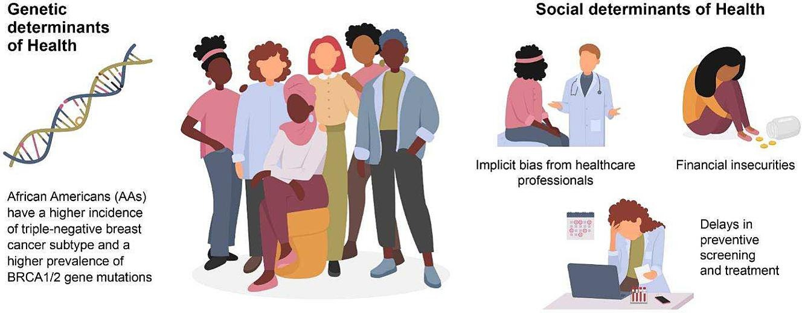
Kamaraju S, Conroy M, Harris A, et al. Challenges to genetic testing for germline mutations associated with breast cancer among African Americans. Cancer Treat Rev. 2024;124:102695. doi:10.1016/j.ctrv.2024.102695

Slide 42
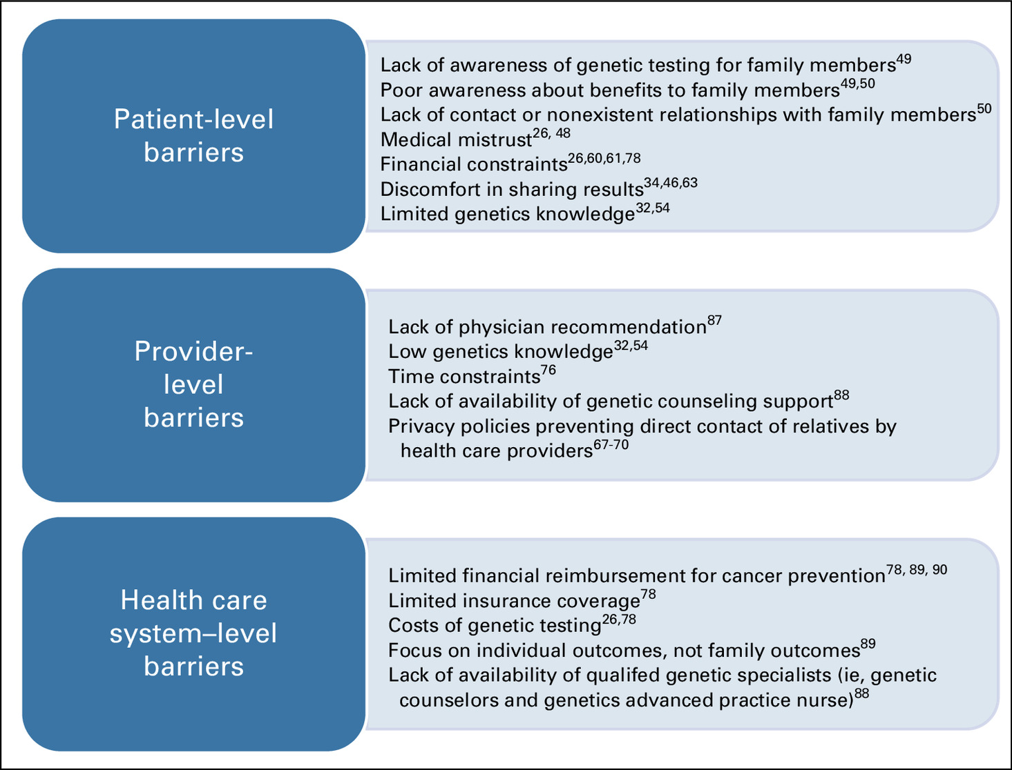
Reflect:
What barriers did we see in Maria’s case and what might be some ways to address them?
Think about the barriers we saw in Maria’s case
Whitaker KD, Obeid E, Daly MB, Hall MJ. Cascade Genetic Testing for Hereditary Cancer Risk: An Underutilized Tool for Cancer Prevention. JCO Precis Oncol. 2021;5:1387-1396. doi:10.1200/PO.21.00163

Slide 43
Genomic Literacy
What Is Genomic Literacy? The ability to understand, interpret, and use information about genetic/genomic testing, including implications for personal and family health.
The Problem
Many patients confuse germline (inherited) with somatic (tumor-specific) testing — even after education, ~1/3 of patients cannot correctly distinguish the two (Johnson et al., Cancer 2019)
Oncologists themselves have poor-to-moderate genomic literacy, with challenges tempering patient expectations and deciding what to disclose (Shirdarreh et al., Oncologist 2021)
Low literacy is linked to misunderstanding results, poor uptake of recommended interventions, and increased distress (Tung et al., JCO 2024; Bedrosian et al., JCO 2024)
Contributing barriers: older age, lower education, lack of genetic counseling or clear communication
Maria's daughter asked if she was at risk but received no clear answers.
Higher Genomic Literacy Supports
Informed consent and shared decision-making (ASCO, NCCN)
Greater intention to pursue genetic testing (Pausilli et al., Patient Educ Couns 2026)
Increased uptake of cascade testing — yet only 41% of at-risk relatives currently complete testing (Frey et al., JCO 2022)
Scalable tools (chatbots, videos, telephone counseling) show promise in bridging the gap
Notes:
This slide highlights the importance of patient genomic literacy—specifically, a patient’s ability to understand and apply genetic testing information in the context of their own care and their family's health.
A major challenge is that many patients confuse germline testing, which detects inherited mutations, with somatic testing, which identifies tumor-specific changes. This confusion can lead to fear, anxiety, and hesitation to pursue testing or follow through on recommended actions.
Studies show that low genomic literacy is associated with misunderstanding test results, poor recall, and reduced uptake of interventions like surveillance, prophylactic surgery, or therapy changes. In some cases, it can even result in inappropriate clinical decisions or increased psychological distress. (Yu et al, Tung et al, Blanchette et al)
Barriers contributing to low literacy include many of the same factors contributing to low overall health literacy- lower educational attainment, older age, and lack of access to clear communication or professional genetic counseling.
On the flip side, patients with higher genomic literacy are more likely to make informed decisions, participate in shared decision-making, and communicate genetic risk effectively with family members—making them more likely to engage in cascade testing (Bedrosian et al, Pedrazzani et al)
Improving patient genomic literacy is a critical component of equitable, effective oncology care.

Slide 44
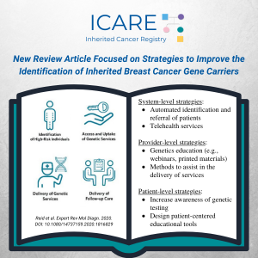
Evidence-Based Strategies to Improve Genomic Literacy
The most effective strategies are culturally tailored & language-appropriate.
Culturally and linguistically appropriate educational materials, including digital platforms
  Must be available in the patient’s preferred language & adapted for cultural relevance (Matalon et al).
Telehealth genetic counseling and telephone-based interventions
  Facilitated cascade testing using telephone counseling and mailed saliva kits increase uptake and satisfaction, minimize distress, and is a low-cost, scalable approach for reaching underserved populations (Frey et al).
Peer and family support interventions and community-based education
  Leveraging trusted local figures or family networks can help overcome mistrust and improve communication about genetic risk and cascade testing (Levine et al).
Notes:
This slide focuses on evidence-based strategies that have been shown to improve uptake of genetic counseling and testing—especially in underserved and historically marginalized populations.
The most effective approaches are multi-level, combining several elements:
First, we need culturally tailored, language-appropriate education.
Second, telehealth and remote genetic counseling have proven to be highly impactful.
Interventions like telephone-based counseling and mailed saliva kits for genetic testing are:
Low-cost
Scalable
And have been shown to increase uptake and satisfaction while minimizing psychological distress. This is especially important for patients in rural or under-resourced areas with limited access to on-site genetic counselors.
(Frey et al)
Third, we can’t underestimate the value of community-based education and peer or family support.
Working through trusted messengers—whether they are community health workers, religious leaders, or even family members—helps build trust and improve communication about genetic risk.

Slide 45
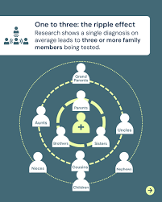
Strategies to Improve Cascade Testing
Direct relative contact by healthcare professionals
Direct outreach (phone, letter, email) by clinical teams significantly boosts uptake of cascade testing. (Frey et al).
Facilitated cascade testing programs
Clinician-supported models using mailed saliva kits, phone counseling, and proactive outreach. (Frey et al).
Educational interventions and resources
Culturally tailored materials, decision aids, and community education improve genomic literacy among patients and providers. (Passero et al, Levine et al).
Digital platforms
Online tools reduce logistical barriers and enable scalable, low-cost outreach to at-risk relatives. (Caswell-Jin et al).
Provider education and guideline adherence
Clinicians must be familiar with eligibility criteria, resources, and best practices to implement timely cascade testing. (ACOG Committee on Gynecologic Practice).
Effective strategies must address individual (e.g., fear), interpersonal (e.g., family dynamics), and systemic (e.g., cost, access) obstacles.
Requires multidisciplinary and policy support. (Passero et al, Levine et al, Wilke et al)
Notes:
This slide outlines evidence-based strategies that have been shown to increase the uptake of cascade genetic testing, particularly among underserved populations. These strategies target key barriers at the individual, interpersonal, provider, and system levels.
1. Direct relative contact by healthcare professionals is the most important
Research shows that when clinical teams directly contact relatives—by phone, letter, or email—the likelihood that those family members pursue genetic counseling and testing increases significantly.
This is especially effective when the outreach comes from a trusted provider (Frey et al)
2. Facilitated cascade testing programs, educational interventions including digital platforms, and provider education about guidelines and adherence are also critical.
These models remove barriers by offering mail-in saliva kits, telephone-based counseling, and structured outreach to at-risk family members.
They are low-cost, reduce logistical burden, and have high patient satisfaction. (Frey et al)
3. Educational interventions and resources, including online platforms, and provider education on guidelines and management are also critical.

Slide 46
Strategies to Address Provider and System-Level Barriers
Streamlined, point-of-care genetic testing workflows (Bedrosian et al, Kurian et al)
  Imagine if the EMR automatically alerted the clinician of Maria’s red flags for Lynch Syndrome to prompt germline testing!
Alternative models for genetic counseling and informed consent (Bedrosian et al, Kurian et al)
  Use of telehealth, clinician-ordered testing, and targeted educational materials to deliver essential elements of informed consent and patient education.
Provider education and decision support (Matalon et al, Conner et al)
  Enhancing provider knowledge through continuing education, clinical decision support tools, large-provider networks, and clear guidelines on test selection and interpretation.
System-level interventions to reduce disparities (Tung et al)
  Standardized referral pathways, electronic health record prompts, and policies
Integrated, multidisciplinary care models (Tung et al, Bednar et al)
  Embedding genetics professionals within oncology teams and fostering interdisciplinary collaboration
Notes:
This slide highlights key structural interventions that can help close the gap between genomic testing guidelines and real-world implementation—especially in busy, resource-limited settings like the one where Maria was treated.
First, we need streamlined, point-of-care testing workflows. Imagine if Maria’s electronic medical record (EMR) had automatically flagged her tumor results—MSI-high and BRAF wild-type—and prompted the oncologist to refer her for germline testing.
Studies show that embedding automated clinical decision tools into EMRs significantly increases testing uptake. (Bedrosian et al, Kurian et al)
Second, alternative models for genetic counseling and informed consent are essential. When access to genetic counselors is limited—which is common in rural or safety-net hospitals—clinician-ordered testing supported by telehealth, targeted educational materials, and streamlined consent processes can be effective.
These models ensure patients still receive the essential information they need, even when a counselor isn’t available in real time.(Bedrosian et al, Kurian et al)

Slide 47
Real World Impact of Genetic Testing Programs

Slide 48
Potential Benefits of Universal Testing
Guideline-Based Testing Misses Actionable Variants
1 in 8 unselected cancer patients (13.3%) harbor a pathogenic germline variant (PGV); 6.4% had clinically actionable findings missed by guideline-directed testing (Samadder et al., JAMA Oncol 2021)
In community oncology, >50% of PGVs would have been missed by NCCN criteria, with higher VUS rates in Black/African-American patients (UNITY Trial, ASCO 2025)
49% of BRCA1/2 carriers in the Geisinger screening program lacked a family history that would have triggered testing (Savatt et al., JAMA Netw Open 2025)
Direct Therapeutic Impact
28% of patients with high-penetrance PGVs had treatment modifications, including targeted therapy (e.g., PARP inhibitors) or clinical trial enrollment (Samadder et al.)
PARP inhibitors are now FDA-approved across breast, ovarian, pancreatic, and prostate cancers for germline BRCA1/2 carriers
Minimal Psychological Harm
Population screening shows no significant long-term differences in depression, anxiety, distress, or quality of life (Cannon et al., Clin Genet 2023)
Notes:
So why don’t we just test everyone. Universal genetic testing programs may be a great way to bridge the gaps in oncology. Universal germline testing in oncology captures a substantial number of actionable variants that guideline-based testing misses. Studies show up to 13% of unselected cancer patients carry a pathogenic germline variant, and many would not meet current testing criteria, even those with BRCA mutations lacking a family history. Importantly, these findings directly change management—about a quarter of patients have treatment modifications or clinical trial eligibility based on results. Despite concerns, population screening studies show no meaningful long-term psychological harm, supporting broader implementation.

Slide 49
Potential Harms of Universal Genomic Testing
Psychological Distress
Pathogenic findings can cause distress and anxiety; VUS results may generate confusion due to uncertain clinical significance (Tung et al., JCO 2024; Hampel Yurgelun, JCO 2022)
However, large studies show 92%–96% of patients exhibit low distress after multigene panel testing, and distress diminishes over time (Culver et al., Cancer 2021; Solomon et al., Genet Med 2026)
Misinterpretation of Results
Clinicians without genetics training may misinterpret VUS or moderate-penetrance findings, leading to unnecessary surveillance, risk-reducing interventions, or prophylactic surgeries (Tung et al., JCO 2024)
Family and Social Implications
Hereditary findings create obligations for cascade testing and disclosure to relatives, with potential for familial conflict, guilt, or distress (Hampel Yurgelun, JCO 2022)
Privacy and Discrimination Concerns
GINA protects against genetic discrimination in health insurance and employment, but does NOT cover life, disability, or long-term care insurance, nor employers with 15 employees (GINA 2008; ACMG 2022)
Resource and Access Strain
Increased demand for genetic counseling and result interpretation may strain systems and widen care inequities; Black/African-American patients have significantly higher VUS rates (50% vs. 36%), compounding interpretive challenges (UNITY Trial, ASCO 2025)
Notes:
However, Universal testing is not without challenges. Positive results and especially VUS findings can cause anxiety and confusion, although most studies show low long-term distress. There is also a risk of misinterpreting results, particularly when genetics expertise is limited. Hereditary findings can create difficult family conversations, privacy concerns remain despite GINA protections, and expanding testing may further strain genetic counseling resources and worsen existing disparities in variant interpretation.

Slide 50
Putting it to Practice

Slide 51

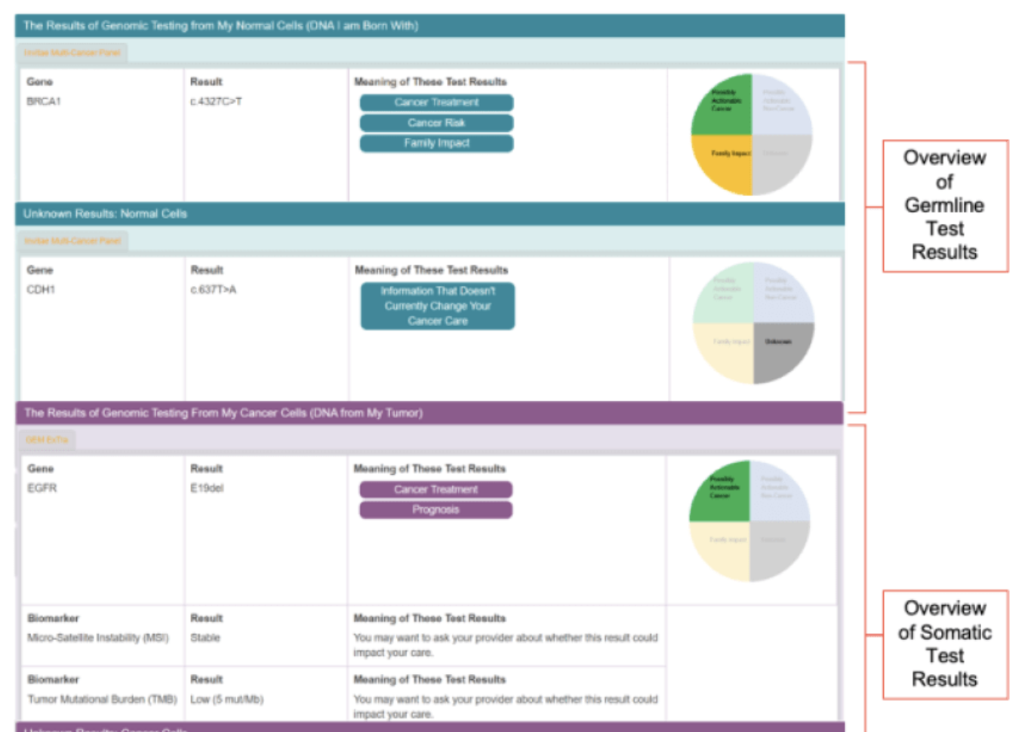
HOPE-Genomics RCT
Objective: Evaluate a web-based educational tool to improve patient understanding of genomic testing results and support informed decision-making in cancer care.
Intervention: HOPE-Genomics is an interactive, patient-facing platform that delivers:
  Personalized explanations of germline and somatic test results
  Educational modules to enhance genomic literacy
  Tools for family sharing and promoting cascade testing
Study Design:
  Patients randomized to standard care vs. HOPE-Genomics platform
  Measures: Genomic comprehension, patient engagement, and communication of results
Eligibility:
  Adult patients with actionable germline or somatic findings
  English, Spanish, or Mandarin-speaking
Results: TBD!!!
For more information: https://www.cityofhope.org/hope-genomics
Notes:
Now you guys get to know why this topic is special to me. While I was at City of Hope in Duarte I had the opportunity to work on a lot of projects related to cancer genomics and precision medicine, including multiple projects aimed at enhancing patient genomic literacy and increasing rates of cascade testing.
One of our biggest projects was a NIH funded RCT of a digital patient-facing educational platform called “HOPE-Genomics”. This online tool provided patients with education on basic genetic concepts and then their personalized test results- this includes both somatic and germline test results.
About the study: Patients were randomized to receive their results either through the tool + genetic counseling or with genetic counseling alone (standard of care). Patients were given surveys asking about their knowledge of genetics, genetic testing, and their understanding of their own test results at baseline and multiple time points following use of the tool.
About the tool: The tool was extremely interactive. It contained educational videos, links to educational materials, graphics, and more. Patients received their personalized genetic test results with buttons that told them “What this means for me”, “What this mutation means for my family” etc.
Results: Recruitment just ended recently so I do not have that data for you but stay tuned! (I can also provide anecdotal data from speaking to patients)
I can click the link to give them a view of the tool if asked. I can also talk about my involvement in working with GCs to write the patient facing language.

Slide 52

Healthcare utilization among individuals diagnosed with Lynch Syndrome through a universal germline genetic testing program.
Reference: Hampel, H., Solomon, I., Garcia, M., Luong, M., Labib, S., Bonner, J. D., ... & Gray, S. W. (2023). Healthcare utilization among individuals diagnosed with lynch syndrome through a universal germline genetic testing program.
Objective: Evaluate how universal germline genetic testing (GT) impacts healthcare utilization in individuals diagnosed with Lynch Syndrome
Design: Retrospective EHR analysis of 10,814 patients who underwent universal GT; utilization assessed 1–29 months before and after testing, categorized as LS-related vs. unrelated per NCCN guidelines
Key Findings
80/10,814 (0.74%) had pathogenic/likely pathogenic variants in LS genes (MLH1, MSH2, MSH6, PMS2, EPCAM)
86% (n = 69) had cancer; 45% had LS-associated cancers
52% of LS patients had procedures, imaging, and/or therapy potentially related to their LS diagnosis
Rates of colonoscopy, EGD, and HBSO were all higher after GT
17% (n = 12) of cancer patients with LS received immune checkpoint inhibitor therapy
Clinical Implications
Universal GT identifies LS carriers who then receive guideline-concordant surveillance and treatment
Findings support that universal testing translates into actionable clinical care — not just diagnosis
Limitations
Informatics approach cannot distinguish therapeutic vs. prophylactic intent (e.g., HBSO)
Prior GT and motivations for procedures not captured in codified EHR data
Notes:
I also got to be part of a study at City of Hope examining the impact of universal genetic testing. This study asked an important question: once we identify Lynch syndrome through universal germline testing, does it actually change patient care?
Among more than 10,000 patients tested, Lynch syndrome carriers had increased rates of guideline-recommended surveillance procedures after testing, including colonoscopy and upper endoscopy. Over half underwent interventions potentially related to their diagnosis, and some patients received immunotherapy guided by their genetic findings.
The key takeaway is that universal genetic testing did not simply generate diagnoses—it led to changes in surveillance and treatment that were consistent with Lynch syndrome management guidelines.

Slide 53
Healthcare utilization among individuals diagnosed with hereditary breast-ovarian cancer syndrome through a universal germline genetic testing program.
Reference: Hampel, H., Solomon, I., Garcia, M., Luong, M., Labib, S., Bonner, J. D., ... & Gray, S. W. (2023). Healthcare utilization among individuals diagnosed with HBOC syndrome through a universal germline genetic testing program.
Objective: Evaluate how universal germline genetic testing (GT) impacts healthcare utilization in individuals diagnosed with hereditary breast and ovarian cancer syndrome (HBOC).
Design: Retrospective EHR analysis of 10,814 patients who underwent universal GT; utilization assessed 1–29 months before and after testing, categorized as HBOC-related vs. unrelated per NCCN guidelines
Key Findings
217/10,814 (2.0%) had pathogenic BRCA1/2 variants — nearly 3× the LS detection rate (0.74%)
84% (n = 182) had cancer; 64% had HBOC-associated tumors
83% of all BRCA1/2 carriers received possibly related care; 86% among cancer patients
28% (n = 51) of cancer patients received PARP inhibitor therapy
67% of unaffected carriers also received related care (e.g., breast MRI, surveillance)
Utilization of breast MRI, mastectomy, and BSO mostly occurred prior to GT, likely for staging/treatment
Clinical Implications
Higher carrier prevalence and therapeutic actionability (PARP inhibitors) compared to LS
Even unaffected carriers received guideline-concordant surveillance, though some may have had prior awareness of BRCA status
Limitations
Cannot distinguish therapeutic vs. prophylactic intent (e.g., mastectomy, BSO)
Prior GT and motivations not captured in codified EHR data; text mining or chart review needed
Notes:
This was a similar study, but looked at BRCA1/2. This study found that BRCA1/2 pathogenic variants were identified in about 2% of patients undergoing universal testing—nearly three times the detection rate seen for Lynch syndrome.
Importantly, most carriers received care related to their genetic diagnosis, and more than one-quarter of affected patients received PARP inhibitor therapy. Even unaffected carriers underwent enhanced surveillance, such as breast MRI screening.
The main takeaway is that universal testing identified clinically actionable BRCA1/2 carriers and was associated with both treatment changes and risk-reduction strategies, supporting the real-world utility of population-based genetic testing.

Slide 54
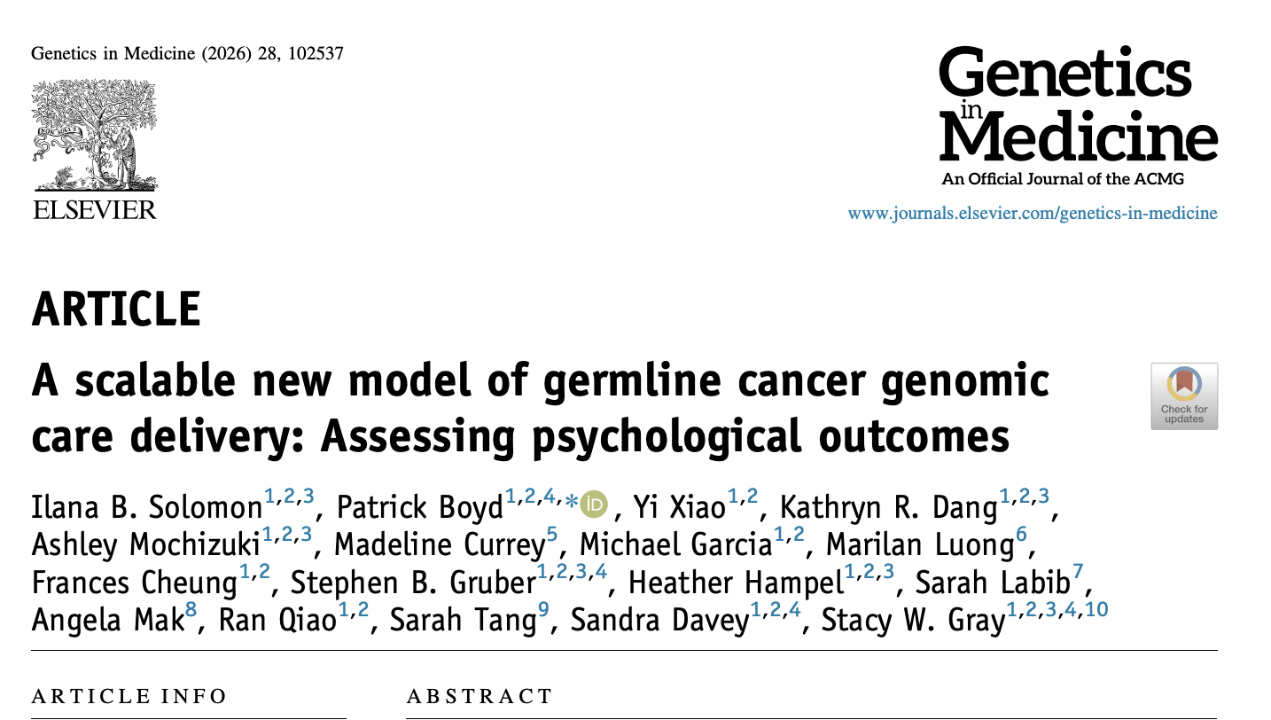
A scalable new model of germline cancer genomic care delivery: Assessing psychological outcomes
Can universal germline testing be offered safely without pretest genetic counseling?
Design: Prospective survey of unselected patients at a comprehensive cancer center (City of Hope) who underwent universal GT (154 cancer + 59 non-cancer genes) without pretest counseling. Detrimental psychological impact (DPI) assessed using the Feelings About Genomic Testing Results (FAbGTR) instrument at 2 weeks and 6 months post-disclosure.
Key Findings (n = 846)
96% exhibited low overall DPI
Low negativity (95.6%), low uncertainty (94.0%), low privacy concerns (95.6%)
55.6% reported high positivity about testing
DPI significantly diminished over time in those with positive (pathogenic) results
Patients with cancer had higher negativity and uncertainty than unaffected individuals
The ~4% Who Struggled
A small subset exhibited high distress and uncertainty
Among those with higher distress, the majority had pathogenic/likely pathogenic variants
Higher uncertainty was most common in patients with cancer + VUS
Take-Home Message
Eliminating pretest counseling does not cause widespread psychological harm — supports scalability of universal testing
Targeted post-test support for the ~4% at-risk subset may be more efficient than universal pretest counseling
Need for tools to prospectively identify vulnerable patients as universal testing programs expand
Notes:
This study, which was published addressed a common concern about universal genetic testing: whether pretest genetic counseling is required to prevent psychological harm.
Among more than 800 patients who underwent testing without pretest counseling, 96% reported low psychological distress, and distress generally decreased over time, even among those with pathogenic results.
Only a small subset—about 4%—experienced significant distress or uncertainty, most often patients with cancer who received a pathogenic variant or VUS result.
The key takeaway is that universal testing appears psychologically safe for most patients, suggesting that targeted post-test support may be a more scalable approach than requiring pretest counseling for everyone."

Slide 55
Next Steps for Maria and Opportunities for Improvement
Now that her daughter has been identified, germline testing of all her first-degree relatives (and Maria’s), including Maria’s younger daughter and two siblings.
Preventative measures such as screening colonoscopy if found to have Lynch syndrome.
What could have helped Maria and her family?
Interpreter-assisted family history documentation
On-site or telehealth genetic counseling
EMR-based alerts for germline testing in MSI-H/BRAF-wild-type tumors
  Delayed testing in Maria’s case led to the development of cancer in her daughter that might have been preventable
Provider education + patient-facing genomic literacy tools
Maybe: Implementation of universal genetic testing program?
Notes:
So, as the nuns in the sound of music would say, How do you solve a problem like Maria? Now that Maria's daughter has been identified as having Lynch syndrome, cascade testing should be offered to first-degree relatives, including Maria's other daughter and siblings. Relatives found to carry the variant can undergo preventive surveillance, such as regular colonoscopy screening.
This case also highlights several opportunities for improvement, including better family history collection with interpreter support, access to genetic counseling, EMR prompts for appropriate germline testing, and improved provider and patient education.
Most importantly, earlier identification of Lynch syndrome may have allowed preventive surveillance before Maria's daughter developed cancer, illustrating the potential value of broader and more systematic genetic testing approaches.

Slide 56
Key Takeaways
Genomic testing has changed the landscape of oncology, allowing for targeted and personalized care
Both germline and somatic testing greatly inform cancer care and change patient outcomes
Barriers to genomic testing occur at the patient, provider, and system-level
Addressing barriers such as genomic literacy impacts patient uptake of genetic testing, cascade family testing, and receipt of guideline-concordant care
Widespread genomic testing programs improve identification of patients with actionable genetic mutations and increase guideline-concordant prevention and care
Clinicians are central to bridging knowledge gaps and improving outcomes

Slide 57
Questions?

Slide 58
References
Avci CB, Bagca BG, Shademan B, Takanlou LS, Takanlou MS, Nourazarian A. Precision oncology: Using cancer genomics for targeted therapy advancements. Biochim Biophys Acta Rev Cancer. 2025;1880(1):189250. doi:10.1016/j.bbcan.2024.189250
Berger MF, Mardis ER. The emerging clinical relevance of genomics in cancer medicine. Nat Rev Clin Oncol. 2018;15(6):353-365. doi:10.1038/s41571-018-0002-6
Chakravarty D, Solit DB. Clinical cancer genomic profiling. Nat Rev Genet. 2021;22(8):483-501. doi:10.1038/s41576-021-00338-8
Chakravarty D, Johnson A, Sklar J, et al. Somatic Genomic Testing in Patients With Metastatic or Advanced Cancer: ASCO Provisional Clinical Opinion [published correction appears in J Clin Oncol. 2022 Jun 20;40(18):2068. doi: 10.1200/JCO.22.01144.]. J Clin Oncol. 2022;40(11):1231-1258. doi:10.1200/JCO.21.02767
Tung N, Ricker C, Messersmith H, et al. Selection of Germline Genetic Testing Panels in Patients With Cancer: ASCO Guideline. J Clin Oncol. 2024;42(21):2599-2615. doi:10.1200/JCO.24.00662
Kurian AW, Abrahamse P, Furgal A, et al. Germline Genetic Testing After Cancer Diagnosis. JAMA. 2023;330(1):43-51. doi:10.1001/jama.2023.9526
Konstantinopoulos PA, Norquist B, Lacchetti C, et al. Germline and Somatic Tumor Testing in Epithelial Ovarian Cancer: ASCO Guideline. J Clin Oncol. 2020;38(11):1222-1245. doi:10.1200/JCO.19.02960
Garutti M, Foffano L, Mazzeo R, et al. Hereditary Cancer Syndromes: A Comprehensive Review with a Visual Tool. Genes (Basel). 2023;14(5):1025. Published 2023 Apr 30. doi:10.3390/genes14051025
Win AK, Jenkins MA, Dowty JG, et al. Prevalence and Penetrance of Major Genes and Polygenes for Colorectal Cancer. Cancer Epidemiol Biomarkers Prev. 2017;26(3):404-412. doi:10.1158/1055-9965.EPI-16-0693
Huang M, Hunter T, Fein LA, et al. Lost opportunities for mismatch repair (MMR) screening among minority women with endometrial cancer. Sci Rep. 2021;11(1):11712. Published 2021 Jun 3. doi:10.1038/s41598-021-91053-1
Giardiello FM, Allen JI, Axilbund JE, et al. Guidelines on genetic evaluation and management of Lynch syndrome: a consensus statement by the US Multi-Society Task Force on colorectal cancer. Gastroenterology. 2014;147(2):502-526. doi:10.1053/j.gastro.2014.04.001
Dal Buono A, Puccini A, Franchellucci G, et al. Lynch Syndrome: From Multidisciplinary Management to Precision Prevention. Cancers (Basel). 2024;16(5):849. Published 2024 Feb 20. doi:10.3390/cancers16050849
Park J, Karnati H, Rustgi SD, Hur C, Kong XF, Kastrinos F. Impact of population screening for Lynch syndrome insights from the All of Us data. Nat Commun. 2025;16(1):523. Published 2025 Jan 9. doi:10.1038/s41467-024-52562-5
Syngal S, Brand RE, Church JM, et al. ACG clinical guideline: Genetic testing and management of hereditary gastrointestinal cancer syndromes. Am J Gastroenterol. 2015;110(2):223-263. doi:10.1038/ajg.2014.435
Blanchette PS, Spreafico A, Miller FA, et al. Genomic testing in cancer: patient knowledge, attitudes, and expectations. Cancer. 2014;120(19):3066-3073. doi:10.1002/cncr.28807
Bartley N, Best M, Jacobs C, et al. Cancer patients' views and understanding of genome sequencing: a qualitative study. J Med Genet. 2020;57(10):671-676. doi:10.1136/jmedgenet-2019-106410
Shirdarreh M, Aziza O, Pezo RC, Jerzak KJ, Warner E. Patients' and Oncologists' Knowledge and Expectations Regarding Tumor Multigene Next-Generation Sequencing: A Narrative Review. Oncologist. 2021;26(8):e1359-e1371. doi:10.1002/onco.13783

Slide 59
References
Kaminski, Allysen, et al. "Barriers to next-generation sequencing despite increased utilization: US physician survey results." (2021): e18754-e18754.
Szamreta, Elizabeth A., et al. "Barriers to BRCA, HRD, and HRRm testing despite increased utilization: US physician survey results." (2022): 380-380.
Ferreira-Gonzalez A, Ko G, Fusco N, et al. Barriers and facilitators to next-generation sequencing use in United States oncology settings: a systematic review. Future Oncol. 2024;20(35):2765-2777. doi:10.1080/14796694.2024.2390821
Matalon DR, Zepeda-Mendoza CJ, Aarabi M, et al. Clinical, technical, and environmental biases influencing equitable access to clinical genetics/genomics testing: A points to consider statement of the American College of Medical Genetics and Genomics (ACMG). Genet Med. 2023;25(6):100812. doi:10.1016/j.gim.2023.100812
Ghaloul-Gonzalez L, Parker LS, Davis JM, Vockley J. Genomic sequencing: the case for equity of care in the era of personalized medicine. Pediatr Res. 2025;97(4):1393-1398. doi:10.1038/s41390-025-03869-6
Meernik C, Raveendran Y, Kolarova M, et al. Racial and ethnic disparities in genomic testing among lung cancer patients: a systematic review. J Natl Cancer Inst. 2024;116(6):812-828. doi:10.1093/jnci/djae026
Liu YL, Maio A, Kemel Y, et al. Disparities in cancer genetics care by race/ethnicity among pan-cancer patients with pathogenic germline variants. Cancer. 2022;128(21):3870-3879. doi:10.1002/cncr.34434
Bellaiche MMJ, Fan W, Walbert HJ, et al. Disparity in Access to Oncology Precision Care: A Geospatial Analysis of Driving Distances to Genetic Counselors in the U.S. Front Oncol. 2021;11:689927. Published 2021 Jun 16. doi:10.3389/fonc.2021.689927
Hage Chehade C, Jo Y, Gebrael G, et al. Trends and Disparities in Next-Generation Sequencing in Metastatic Prostate and Urothelial Cancers. JAMA Netw Open. 2024;7(7):e2423186. Published 2024 Jul 1. doi:10.1001/jamanetworkopen.2024.23186
Tawfik SM, Elhosseiny AA, Galal AA, et al. Health inequity in genomic personalized medicine in underrepresented populations: a look at the current evidence. Funct Integr Genomics. 2023;23(1):54. Published 2023 Jan 31. doi:10.1007/s10142-023-00979-4
Schaibley VM, Ramos IN, Woosley RL, Curry S, Hays S, Ramos KS. Limited Genomics Training Among Physicians Remains a Barrier to Genomics-Based Implementation of Precision Medicine. Front Med (Lausanne). 2022;9:757212. Published 2022 Mar 18. doi:10.3389/fmed.2022.757212
O'Shea R, Taylor N, Crook A, et al. Health system interventions to integrate genetic testing in routine oncology services: A systematic review. PLoS One. 2021;16(5):e0250379. Published 2021 May 19. doi:10.1371/journal.pone.0250379
Pedrazzani C, Ming C, Bürki N, et al. Genetic Literacy and Communication of Genetic Information in Families Concerned with Hereditary Breast and Ovarian Cancer: A Cross-Study Comparison in Two Countries and within a Timeframe of More Than 10 Years. Cancers (Basel). 2021;13(24):6254. Published 2021 Dec 13. doi:10.3390/cancers13246254
Wilke RN, Bednar EM, Pirzadeh-Miller S, et al. Cascade genetic testing: an underutilized pathway to equitable cancer care?. Fam Cancer. 2024;23(2):141-145. doi:10.1007/s10689-024-00367-2
Levine R, Kahn RM, Perez L, et al. Cascade genetic testing for hereditary cancer syndromes: a review of barriers and breakthroughs. Fam Cancer. 2024;23(2):111-120. doi:10.1007/s10689-024-00373-4

Slide 60
References
Kassem NM, Althouse SK, Monahan PO, et al. Racial disparities in cascade testing for cancer predisposition genes. Prev Med. 2023;172:107539. doi:10.1016/j.ypmed.2023.107539
Wagner IM, Xuan Z, Lu H, Wang C. Racial Disparities in Accessing Care along the Continuum of Cancer Genetic Service Delivery. Cancer Epidemiol Biomarkers Prev. 2024;33(1):55-62. doi:10.1158/1055-9965.EPI-23-0596
Passero LE, Roberts MC. Challenges and opportunities for Lynch syndrome cascade testing in the United States. Fam Cancer. 2024;23(2):147-154. doi:10.1007/s10689-024-00374-3
Frey MK, Kahn RM, Chapman-Davis E, et al. Prospective Feasibility Trial of a Novel Strategy of Facilitated Cascade Genetic Testing Using Telephone Counseling. J Clin Oncol. 2020;38(13):1389-1397. doi:10.1200/JCO.19.02005
Frey MK, Ahsan MD, Badiner N, et al. What happens in the long term: Uptake of cancer surveillance and prevention strategies among at-risk relatives with pathogenic variants detected via cascade testing. Cancer. 2022;128(24):4241-4250. doi:10.1002/cncr.34482
Frey MK, Ahsan MD, Bergeron H, et al. Cascade Testing for Hereditary Cancer Syndromes: Should We Move Toward Direct Relative Contact? A Systematic Review and Meta-Analysis. J Clin Oncol. 2022;40(35):4129-4143. doi:10.1200/JCO.22.00303
Cohen ASA, Berrios CD, Zion TN, et al. Genomic Answers for Kids: Toward more equitable access to genomic testing for rare diseases in rural populations. Am J Hum Genet. 2024;111(5):825-832. doi:10.1016/j.ajhg.2024.03.016
Caswell-Jin JL, Zimmer AD, Stedden W, Kingham KE, Zhou AY, Kurian AW. Cascade Genetic Testing of Relatives for Hereditary Cancer Risk: Results of an Online Initiative. J Natl Cancer Inst. 2019;111(1):95-98. doi:10.1093/jnci/djy147
Committee on Gynecologic Practice. ACOG Committee Opinion No. 727: Cascade Testing: Testing Women for Known Hereditary Genetic Mutations Associated With Cancer. Obstet Gynecol. 2018;131(1):e31-e34. doi:10.1097/AOG.0000000000002457
O'Connor TN, Schultz E, Horowitz M, et al. Increasing Use of Germline Genetic Testing in Pancreatic Ductal Adenocarcinoma and Relationship to Clinical Outcome: A Single-Institution Study. JCO Precis Oncol. 2026;10(4):e2501088. doi:10.1200/PO-25-01088

Slide 61
References
ACOG Committee Opinion No. 727 Summary: Cascade Testing: Testing Women For Known Hereditary Genetic Mutations Associated With Cancer. Obstet Gynecol. 2018;131(1):194-195. doi:10.1097/AOG.0000000000002451
Bedrosian I, Somerfield MR, Achatz MI, et al. Germline Testing in Patients With Breast Cancer: ASCO-Society of Surgical Oncology Guideline. J Clin Oncol. 2024;42(5):584-604. doi:10.1200/JCO.23.02225
Nangalia J, Campbell PJ. Genome Sequencing during a Patient's Journey through Cancer. N Engl J Med. 2019;381(22):2145-2156. doi:10.1056/NEJMra1910138
Hampel H, Yurgelun MB. Point/Counterpoint: Is It Time for Universal Germline Genetic Testing for All GI Cancers?. J Clin Oncol. 2022;40(24):2681-2692. doi:10.1200/JCO.21.02764
Tischler J, Crew KD, Chung WK. Cases in Precision Medicine: The Role of Tumor and Germline Genetic Testing in Breast Cancer Management. Ann Intern Med. 2019;171(12):925-930. doi:10.7326/M18-2417
Yu EY, Rumble RB, Agarwal N, et al. Germline and Somatic Genomic Testing for Metastatic Prostate Cancer: ASCO Guideline. J Clin Oncol. 2025;43(6):748-758. doi:10.1200/JCO-24-02608
Conner S, Theoryn T, Dusic E, et al. Primary care provider practices, attitudes, and confidence with hereditary cancer risk assessment and testing: A mixed methods study. Genet Med. 2025;27(4):101307. doi:10.1016/j.gim.2024.101307
Bednar EM, Nitecki R, Krause KJ, Rauh-Hain JA. Interventions to improve delivery of cancer genetics services in the United States: A scoping review. Genet Med. 2022;24(6):1176-1186. doi:10.1016/j.gim.2022.03.002
Samadder NJ, Riegert-Johnson D, Boardman L, et al. Comparison of Universal Genetic Testing vs Guideline-Directed Targeted Testing for Patients With Hereditary Cancer Syndrome. JAMA Oncol. 2021;7(2):230-237. doi:10.1001/jamaoncol.2020.6252
Brand R, Borazanci E, Speare V, et al. Prospective study of germline genetic testing in incident cases of pancreatic adenocarcinoma. Cancer. 2018;124(17):3520-3527. doi:10.1002/cncr.31628
Savatt JM, Kelly MA, Sturm AC, et al. Genomic Screening at a Single Health System. JAMA Netw Open. 2025;8(3):e250917. doi:10.1001/jamanetworkopen.2025.0917
Cannon A, McMillan O, Kelley WV, et al. Medical and psychosocial outcomes of state-funded population genomic screening. Clinical Genetics. 2023;104(4):434-442. doi:10.1111/cge.14394
Solomon IB, Boyd P, Xiao Y, et al. A scalable new model of germline cancer genomic care delivery: Assessing psychological outcomes. Genet Med. Published online February 12, 2026. doi:10.1016/j.gim.2026.102537
Solomon, Ilana and Luong, Marilan and Currey, Madeline and Labib, Sarah and Tang, Sarah and Martinez, Justin and Suarez, Cassiel and Qiao, Ran and Mak, Angela and Cheung, Frances and Manookian, Rachelle and Xiao, Yi and Garcia, Michael and Seshadri, Amarnath and Jinadu, Jay and Kim, Minsub and Martinez, Robert and White, Philip and Martinez, Fortino and Rout, Ramesh and Sharifara, Ali and Zhou, Coco and Boyd, Patrick and Davey, Sandra and Gray, Stacy W., Rationale and Study Design for a Randomized Clinical Trial of HOPE-Genomics, a Web-Based Intervention to Improve Cancer Patients’ Understanding of Genomic Testing Results. Available at SSRN: https://ssrn.com/abstract=5671057 or http://dx.doi.org/10.2139/ssrn.5671057
O’Reilly C, McGarry JL, Zaborowski AM, et al. Risk-Reducing Bilateral Mastectomy and Mortality in Carriers of BRCA1 and BRCA2 Variants: A Systematic Review and Meta-Analysis. JAMA Surg. 2026;161(3):260–267. doi:10.1001/jamasurg.2025.5929
Wei X, Sun L, Slade E, et al. Cost-Effectiveness of Gene-Specific Prevention Strategies for Ovarian and Breast Cancer. JAMA Netw Open. 2024;7(2):e2355324. doi:10.1001/jamanetworkopen.2023.55324
Kazmi F, Shrestha N, Liu TF, Foord T, Heesen P, Booth S, Dodwell D, Lord S, Yeoh K-W, Blagden SP. Next‐generation sequencing for guiding matched targeted therapies in people with relapsed or metastatic cancer. Cochrane Database of Systematic Reviews 2025, Issue 3. Art. No.: CD014872. DOI: 10.1002/14651858.CD014872.pub2. Accessed 16 May 2026.
Marchetti P, Curigliano G, Biffoni M, et al. Genomically matched therapy in advanced solid tumors: the randomized phase 2 ROME trial. Nat Med. 2025;31(10):3514-3523. doi:10.1038/s41591-025-03918-x
National Comprehensive Cancer Network. Genetic/Familial High-Risk Assessment: Breast, Ovarian, Pancreatic, and Prostate. Updated February 19, 2026. Accessed May 16, 2026. NCCN Guidelines

Slide 62
Thank you!

