Slide 1

Liver Disease
A primer for a common clinical scenario on the wards
Intern Bootcamp 7/20/23
Erin Biringen MD PGY3
(PPT adapted from Elizabeth Rowland 2021)

Slide 2
Objectives
Review liver anatomy and liver function
Review the spectrum of liver disease including cirrhosis
Identify the main etiologies of liver disease & how to start evaluation
Discuss the pathophysiology of complications of cirrhosis, the clinical and lab findings, and their initial management
Provide a note template for decompensated cirrhosis
Terminology matters! Review the basic definitions of acute liver failure, alcohol associated hepatitis, acute on chronic liver failure, and hepatorenal syndrome
Identify resources to strengthen clinical knowledge regarding liver disease

Slide 3
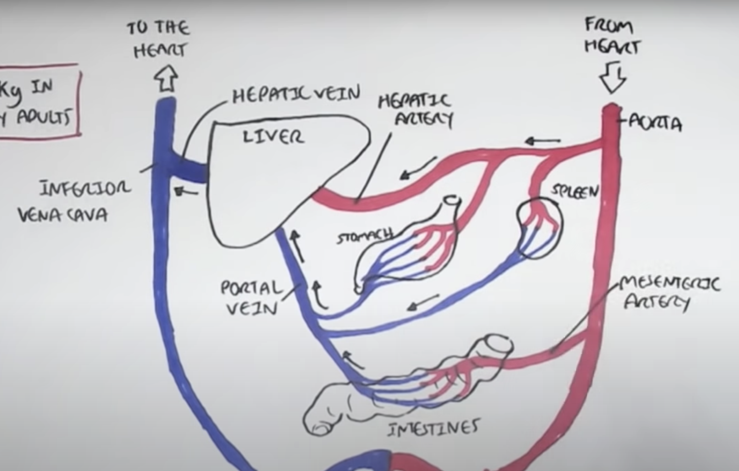
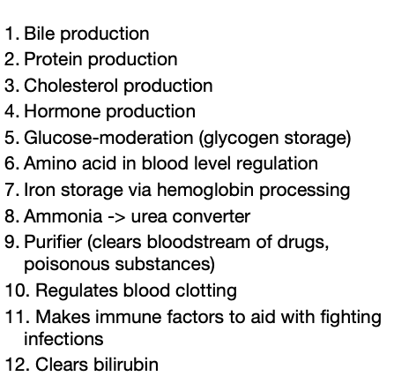
Anatomy & Liver Function
Notes:
2 sources of blood flow:
1. Hepatic artery:
1. Oxygenated 2. Supplies 25-30% of blood flow. Has much more O2 content than portal vein, so they contribute roughly equal amounts of O2.
2. Hepatic portal vein
1. Nutrient rich blood 2. Supplies 70-75% of its blood. Contributes roughly same amount of O2.

Slide 4
Spectrum of Liver Disease
Cirrhosis = irreversible fibrosis + impaired synthetic liver function (+/- complications)
  Low plt, incr INR, low albumin
  Normal to high-normal LFTs (not a marker of liver function)
  Gold standard: biopsy
  Can use FibroScan
  Imaging potentially useful (”cirrhotic morphology” could support suspected dx)

Slide 5
Etiologies of Chronic Liver Disease & Cirrhosis
Viral hepatitis (B, C: chronic)
Wilson’s
Hemochromatosis
A1-AT Def, Autoimmune
PSC
PBC
EtOH
NASH/NAFLD MASLD (metabolic dysfunction-associated steatotic liver disease 6/2023)
Something else (ex right heart failure)

Slide 6
Chronic Liver Disease & Cirrhosis Etiology Labs
Hepatitis serologies (incl HAV, HBV, HCV)
Serum ceruloplasmin
A1AT level
Iron panel & Ferritin, HFE genotyping
ANA
ANCA
Anti-smooth muscle
AMA
PETH (phosphatidylethanol – tests for etoh 3-4 weeks)
Lipid panel, A1C
*Not all are diagnostic or gold-standard but help start initial evaluation. Further imaging, biopsy may be needed for definitive diagnosis

Slide 7
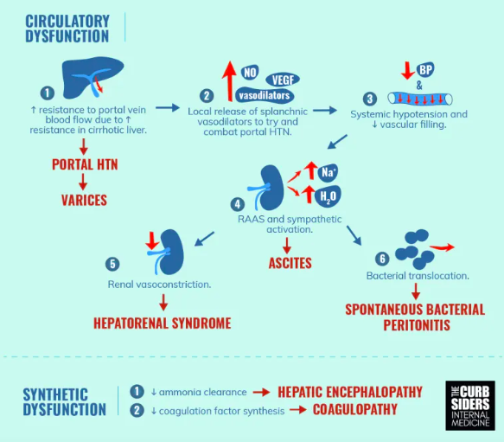
Decompensated Cirrhosis
: Physiology
Variceal bleeding
Ascites
Hepatic encephalopathy
+ resulting complications
Notes:
We can view decompensation of cirrhosis as a combination of circulatory dysfunction and synthetic dysfunction.
Much of decopmensation arises from portal hypertension. With fibrotic hepatic sinusoids there is increased resistance to portal blood flow. This causes increased pressure to collatorals and ultimately varices (can be gastric, esophageal, and also splenic)
With the increased resistance to blood flow we get a compensatory response of splanchnic vasodilation to balance portal hypertension, this results in hypotension and decreased vascular filling
The hypotension activates our RAAS system – holding on to sodium and water to try to increased systemic BP but really just results in ascites and decreased effective arterial blood volume, which then puts us at risk for HRS as the kidney tries to now compensate by way of vasoconstriction

Slide 8
Decompensated Cirrhosis: Evaluation
Why are they decompensated?
  Bleeding, infection, sedating medications, drugs/alcohol, HCC, portal vein thrombus
Exam
  Jaundice, spider angiomata, scleral icterus, fetor hepaticus, palmar erythema, Terrys nails
  Bleeding?
  Abdominal pain, caput medusae, ascites, edema – shifting dullness vs fluid wave → ultrasound for paracentesis
  Mental status/asterixis
Labs (etiology known)
  CBC, CMP, INR (eval synthetic function – plt, INR, bili, albumin, NOT AST/ALT)
  Diagnostic paracentesis - fluid studies: protein, albumin, cell count
  Blood cultures, +/- UA
  Drug screen, PETH
Imaging
  RUQ Duplex US

Slide 9
Decompensated Cirrhosis: Further Considerations & Management
Volume: Ascites or euvolemic? Frequent paracenteses?
Diuretic regimen (start w/ spiro 100, lasix 40)
should be on 2g Na (fluid restrict if hypoNa) diet
New ascites needs paracentesis to r/o SBP – not a clinical dx, may not be septic
First para try small vol for dx, next can be LVP (albumin 6-8g/L fluid removed if > 4-5L)
SAAG > 1.1 portal hypertension

Slide 10
Decompensated Cirrhosis: Further Considerations & Management
Varices: Concern for active bleed? CTX (SBP prophy 1g x7d), octreotide (somatostatin analog, decreases splanchnic blood flow to reduce variceal pressure), PPI (?ulcer), 2 large bore IV, call GI!
Last EGD? Varices or ulcers? Portal hypertensive gastropathy?
History of variceal bleed?
New cirrhotic should have baseline screening EGD.
On NSBB? (lowers portal pressure)
Is TIPS on the table?
HE: Mentation issues/change in sleep/wake cycle? What precipitated HE? (infection, meds, over-diuresis, bleed)
Lactulose (mentation), rectal if somnolent (or ICU?), rifaximin, zinc
4 grades sleep/wake disturbance → coma

Slide 11
Decompensated Cirrhosis: Further Considerations & Management
PVT/PHTN: portal vein patent on imaging? Other thromboses noted? Discuss AC if indicated.
SAAG > 1.1 ascites due to PHTN
SBP: Hx of? On prophylaxis? Last para w/ ANC? Cipro for prophy, could also use bactrim.
- Tx with CTX x 5d, albumin day 1 and 3
*other considerations for SBP prophy.
S: SBP hx
B: GIB
P: low protein ascites (<1.5) +
Re: renal dysfunction Cr > 1.2, BUN > 25)
Na < 130
L: liver dysfunction (Bili > 3, CP 9)
Coags: Plt, INR
HCC: Q6 month screening
Health maintenance: vaccinations, high protein diet, no alcohol
Transplant: Discussed with hep? Active evaluation? Barriers? Make sure connected w/ hep clinic
Scoring:
MELD-Na: 90-day mortality (update at least weekly, can be falsely high if on HD)
Child-Pugh Score: estimates cirrhosis severity
Notes:
. cirrhotics (and acute on chronic liver failure) is a hyper and hypocoagulable state – weigh AC and transfusion considerations

Slide 12
Note Template ..Cirrhosis
#Decompensated etoh/MASLD/etc cirrhosis (or #acute on chronic liver failure) MELD-Na __ on 6/4/23
Volume:
Varices:
HE:
PVT:
SBP:
Coags:
HCC:
Health maintenance:
Transplant:

Slide 13
Terminology matters!
Acute liver failure:
  No known liver disease at baseline + illness/insult within 26 weeks + INR >1.5 + HE, should be in ICU with emergent hep consult for transplant eval
Acute liver injury:
  High AST and ALT, even in 1000s, not meeting above criteria, +/- existing liver disease
Acute on chronic liver failure:
  Acute decompensation of known chronic liver disease (cirrhosis, alcohol assoc hepatitis, etc) with evidence of multi-organ failure → ICU, pressors. High 5-7 day mortality. AASLD guidelines pending
Alcohol-associated hepatitis
  Jaundice within 8 weeks, ongoing etoh use >6 months, <60d abstinence
  AST/ALT > 1.5-2, both < 400
  Tbili > 3
  Can have the same stigmata, complications, and even initial imaging as cirrhosis
  Use Maddreys DF for severity – steroids or not?
  If severe can manifest as acute on chronic liver failure
Hepatorenal syndrome (AKI variety)
  Cirrhosis + AKI after all causes for AKI have been ruled out + failure of albumin challenge (usually with HoTN, decreasing urine output, ascites, hypoNa)
  Midodrine, octreotide → pressors for renal perfusion

Slide 14
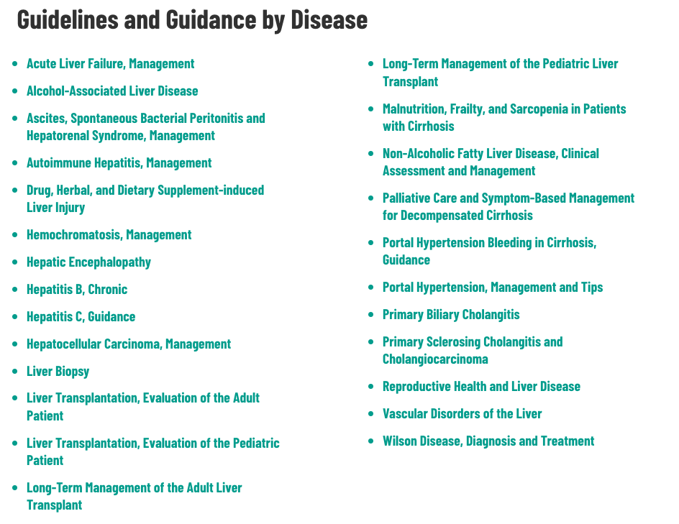
Suggested Resources
Podcasts
Curbsiders
Ep 100: Cirrhosis: Initial Evaluation and Management
Ep 101: Cirrhosis: Medications, Decompensation, Complications
Ep 142: Cirrhosis TIPS for acute Complications
Ep 145: Hepatorenal Syndrome vs AKI
Ep 398: Inpatient Cirrhosis Management
Run the List
Ep 85: Approach to Abnormal LFTs
Ep 86: Alcohol-Associated Liver Disease
Ep 87: Cirrhosis
Ep 88: Acute Liver Failure
JAMA Clinical Reviews
Management of Cirrhosis in 2023 5/9/23
Clinical Liver Disease
Identifying the patient with acute-on-chronic liver failure 8/4/22
Internet Book of Critical Care (also a website, great for MICU months)
Hepatorenal Syndrome 8/16/21
Acute on Chronic Liver Failure (website)
MDCalc
MELD-Na
Maddreys DF
Lille Score
Childs-Pugh
https://www.aasld.org/practice-guidelines

