Slide 1
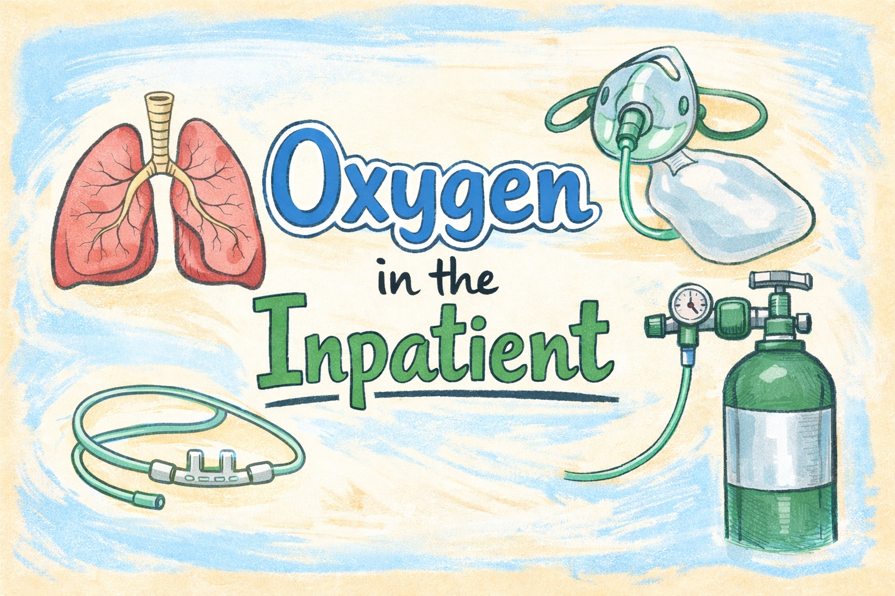
Ralph Mohty MD MPH

Slide 2
Learning Objectives
Hypoxia vs dysoxia vs hypoxemia
Causes of hypoxemia
DO2 & VO2
Oxygen delivery devices

Slide 3
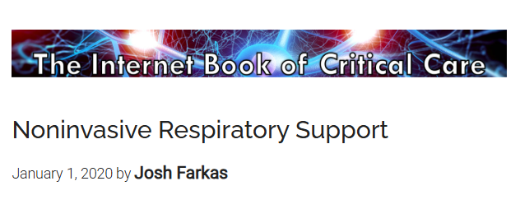

Notes:
https://partone.litfl.com/supplemental-oxygen.html

Slide 4
Hypoxemia
Hypoxia
Low blood oxygen content
PaO₂, SpO₂, SaO₂
Low oxygen delivery
Shock

Slide 5
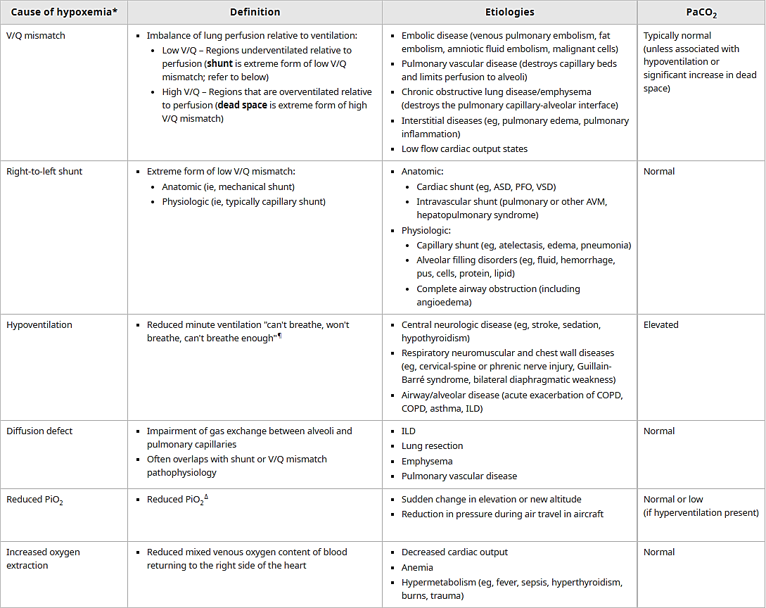

Slide 6
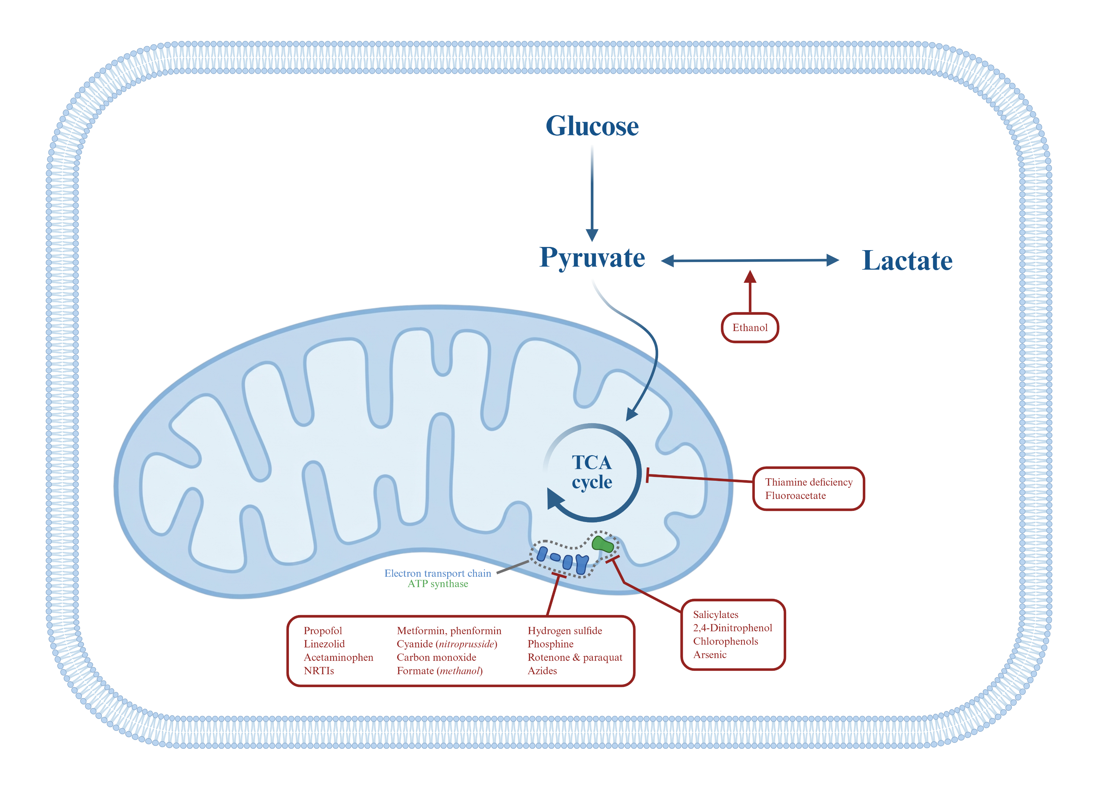
Dysoxia

Slide 7
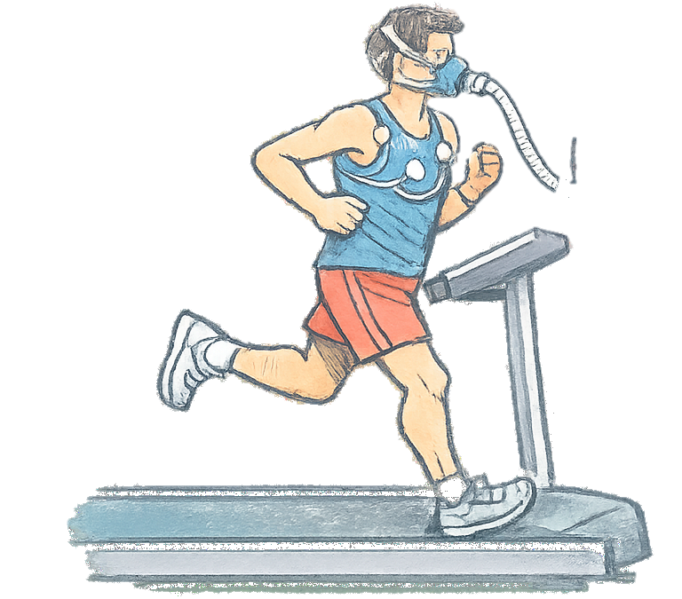
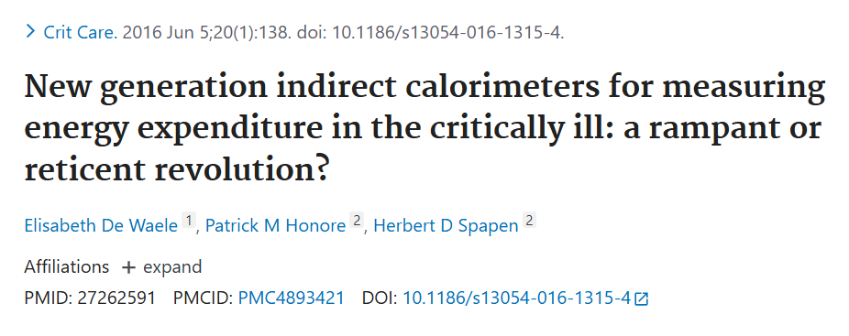
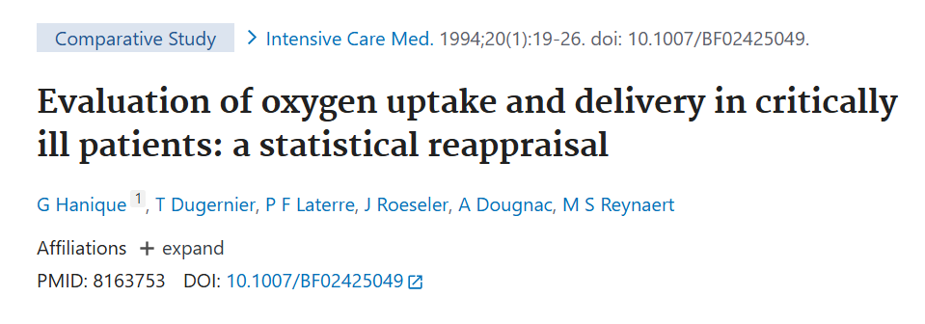
DO₂ – VO₂ matching
$$\text{D}{\text{O}}_{\text{2}}=Cardiac Output∙\left(\left(1.39\frac{mL O_{2}}{Hgb molecule}\right)\left(S_{a}O_{2}\right)\left(Hgb\right)+\left(0.003\frac{mL O_{2}}{mmHg}\right)\left(P_{a}O_{2}\right)\right)$$
$$VO_{2} can be estimated or measured$$
Notes:
Bartlett RH. Physiology of Gas Exchange During ECMO for Respiratory Failure. J Intensive Care Med. 2017;32(4):243-248. doi:10.1177/0885066616641383

Slide 8
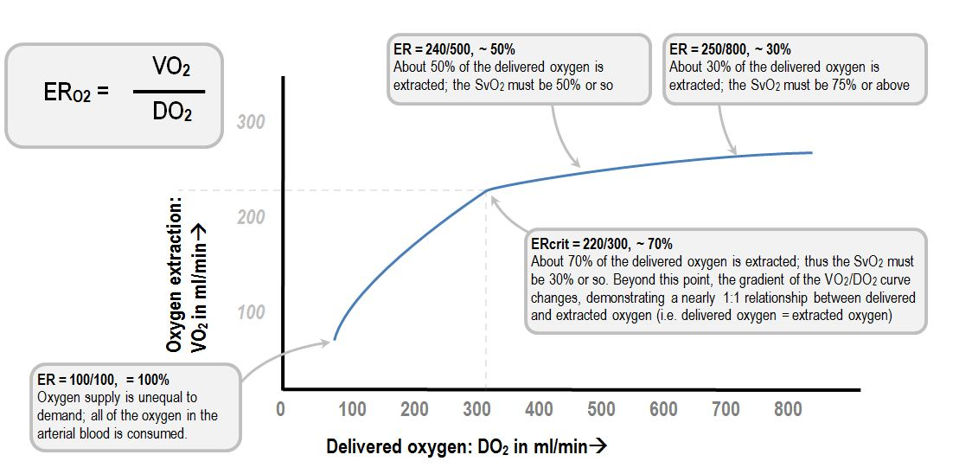
DO₂ – VO₂ matching
Notes:
Bartlett RH. Physiology of Gas Exchange During ECMO for Respiratory Failure. J Intensive Care Med. 2017;32(4):243-248. doi:10.1177/0885066616641383

Slide 9
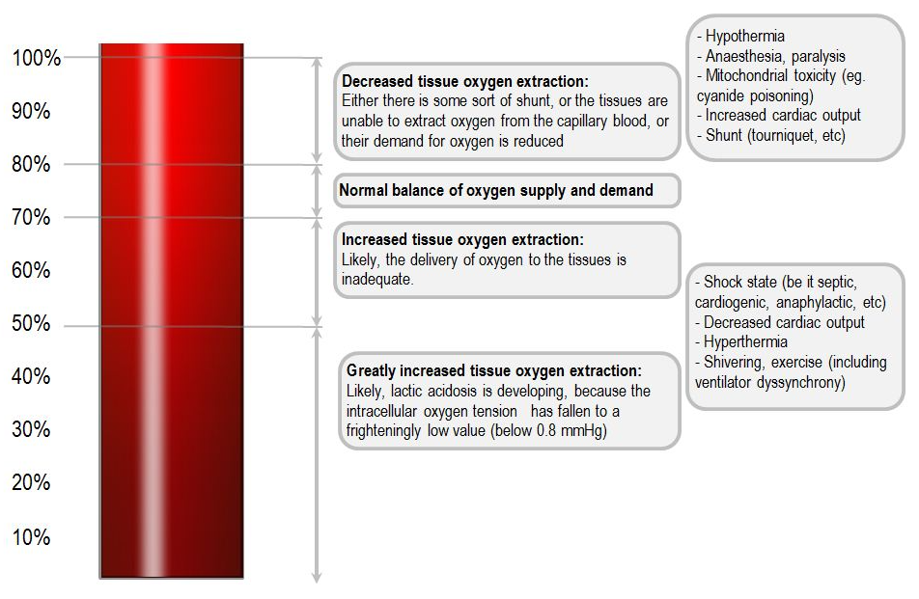
DO₂ – VO₂ matching
Notes:
Bartlett RH. Physiology of Gas Exchange During ECMO for Respiratory Failure. J Intensive Care Med. 2017;32(4):243-248. doi:10.1177/0885066616641383

Slide 10
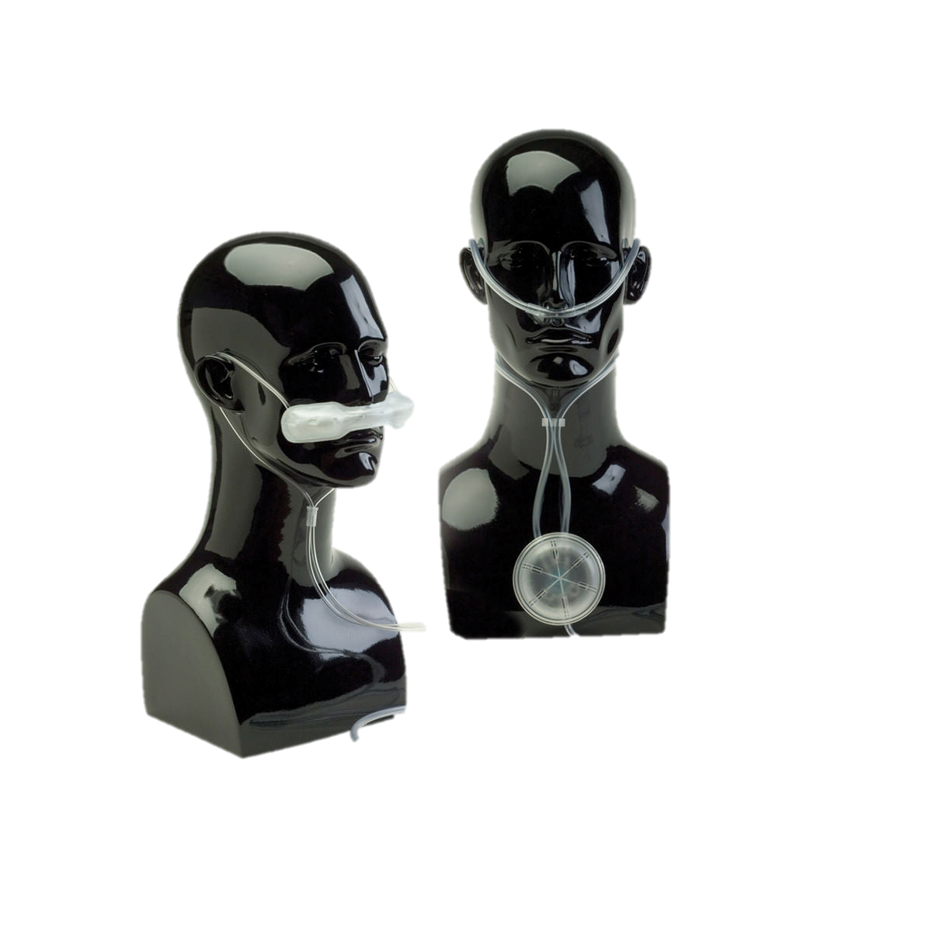
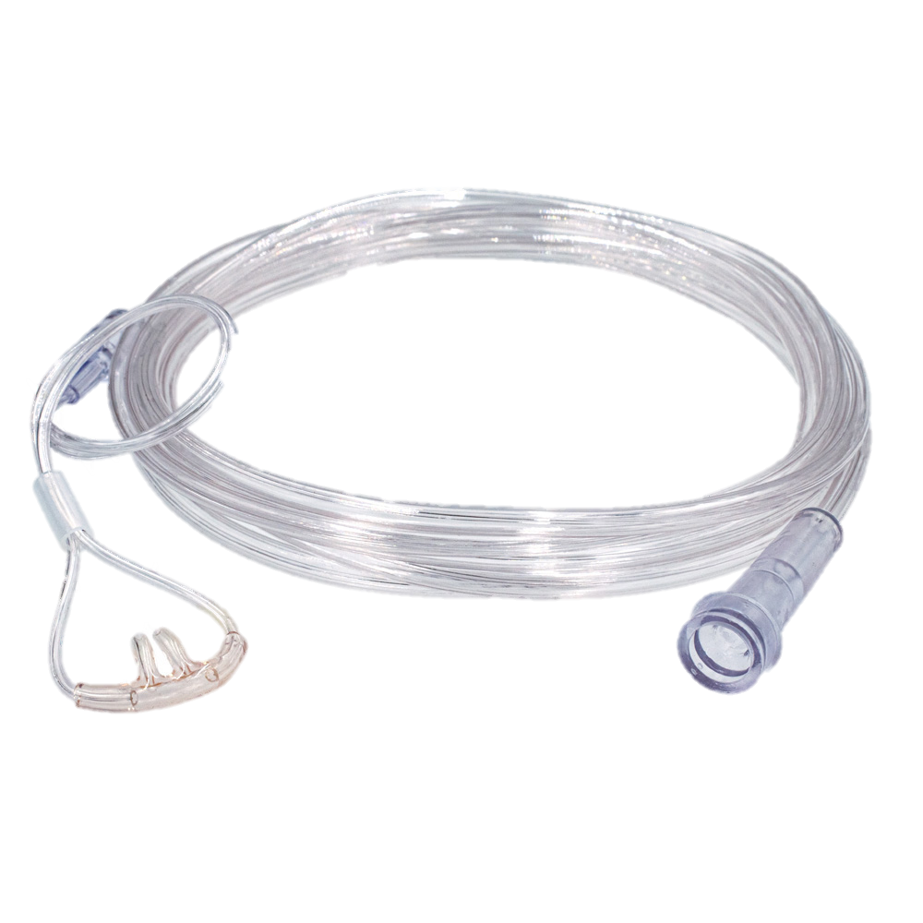
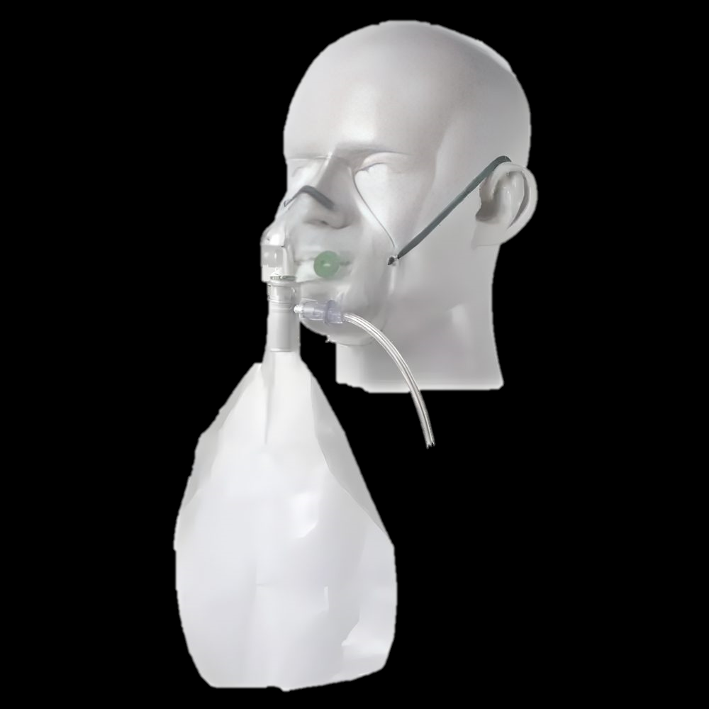
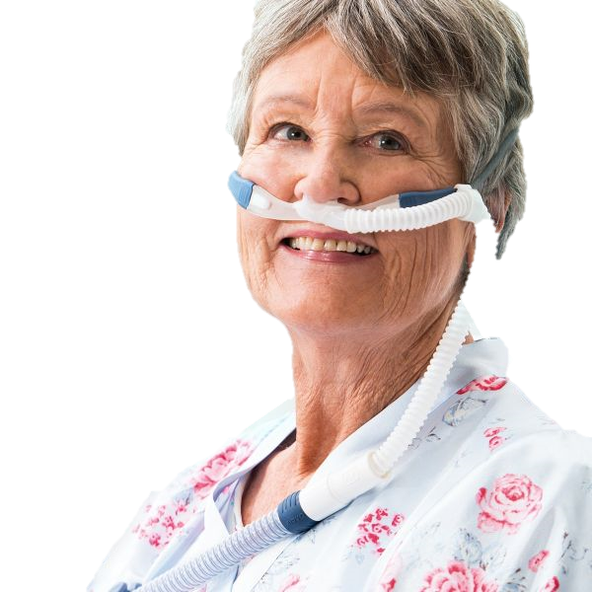
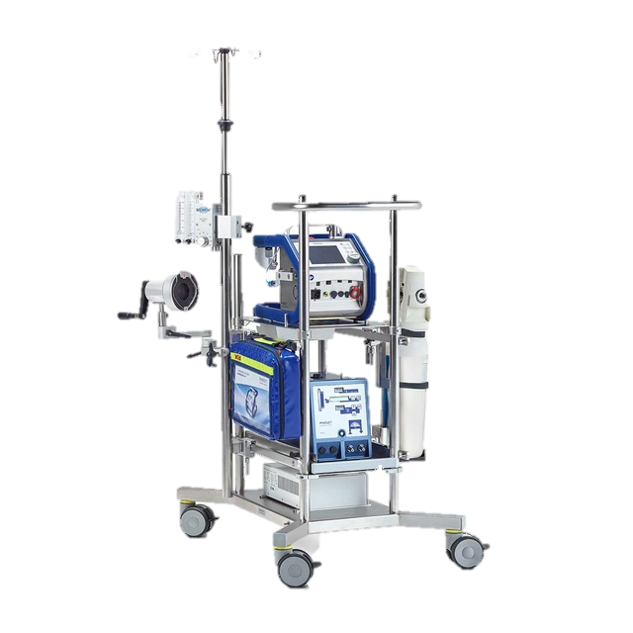
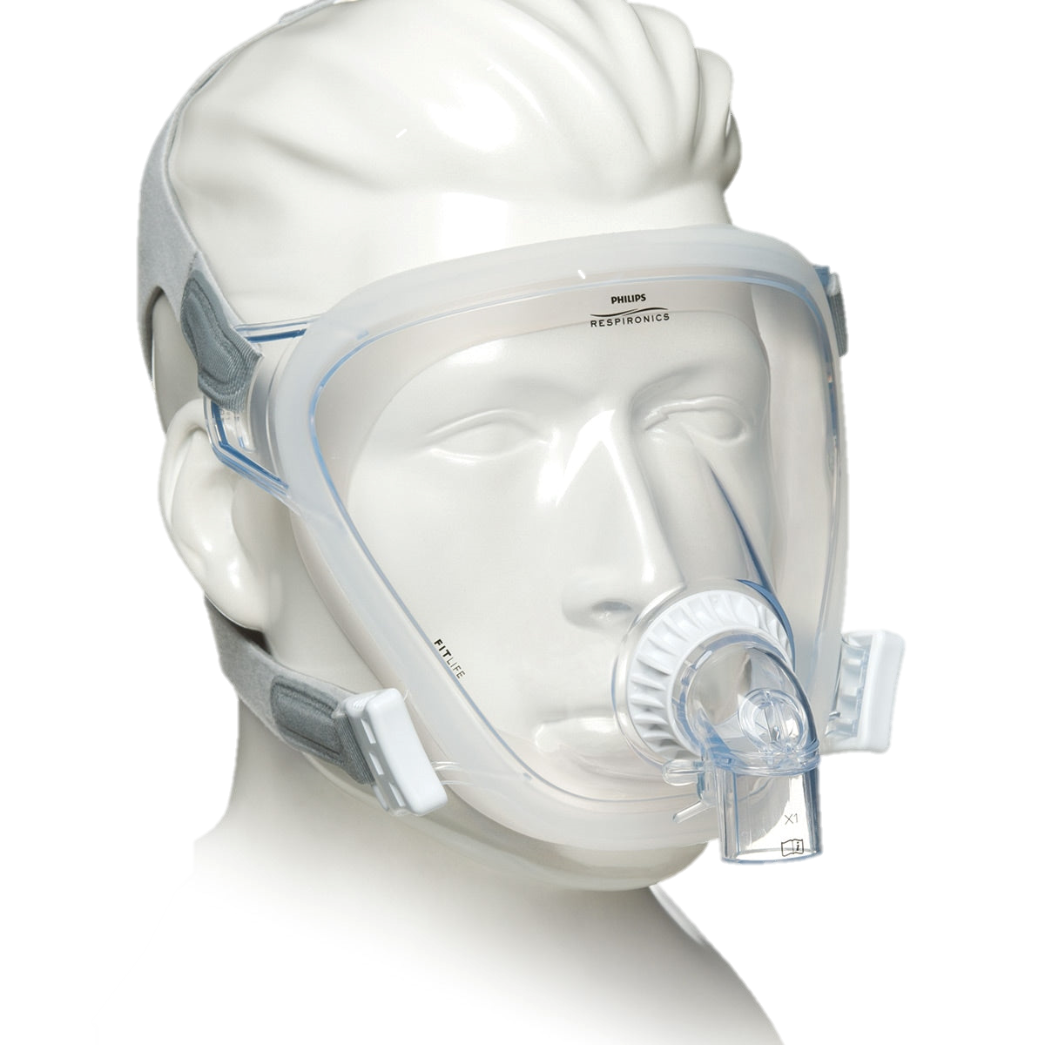
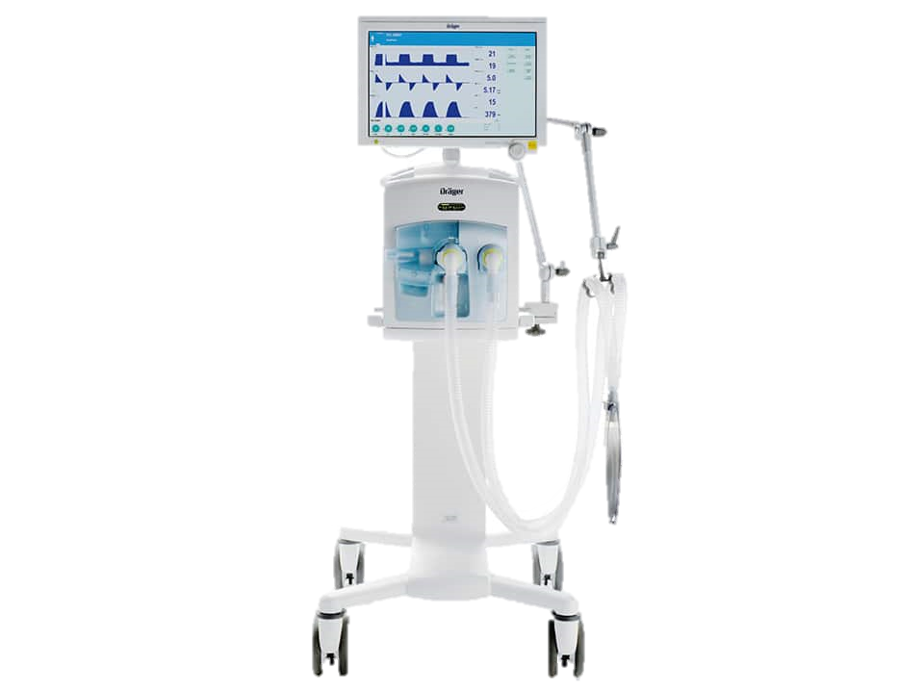
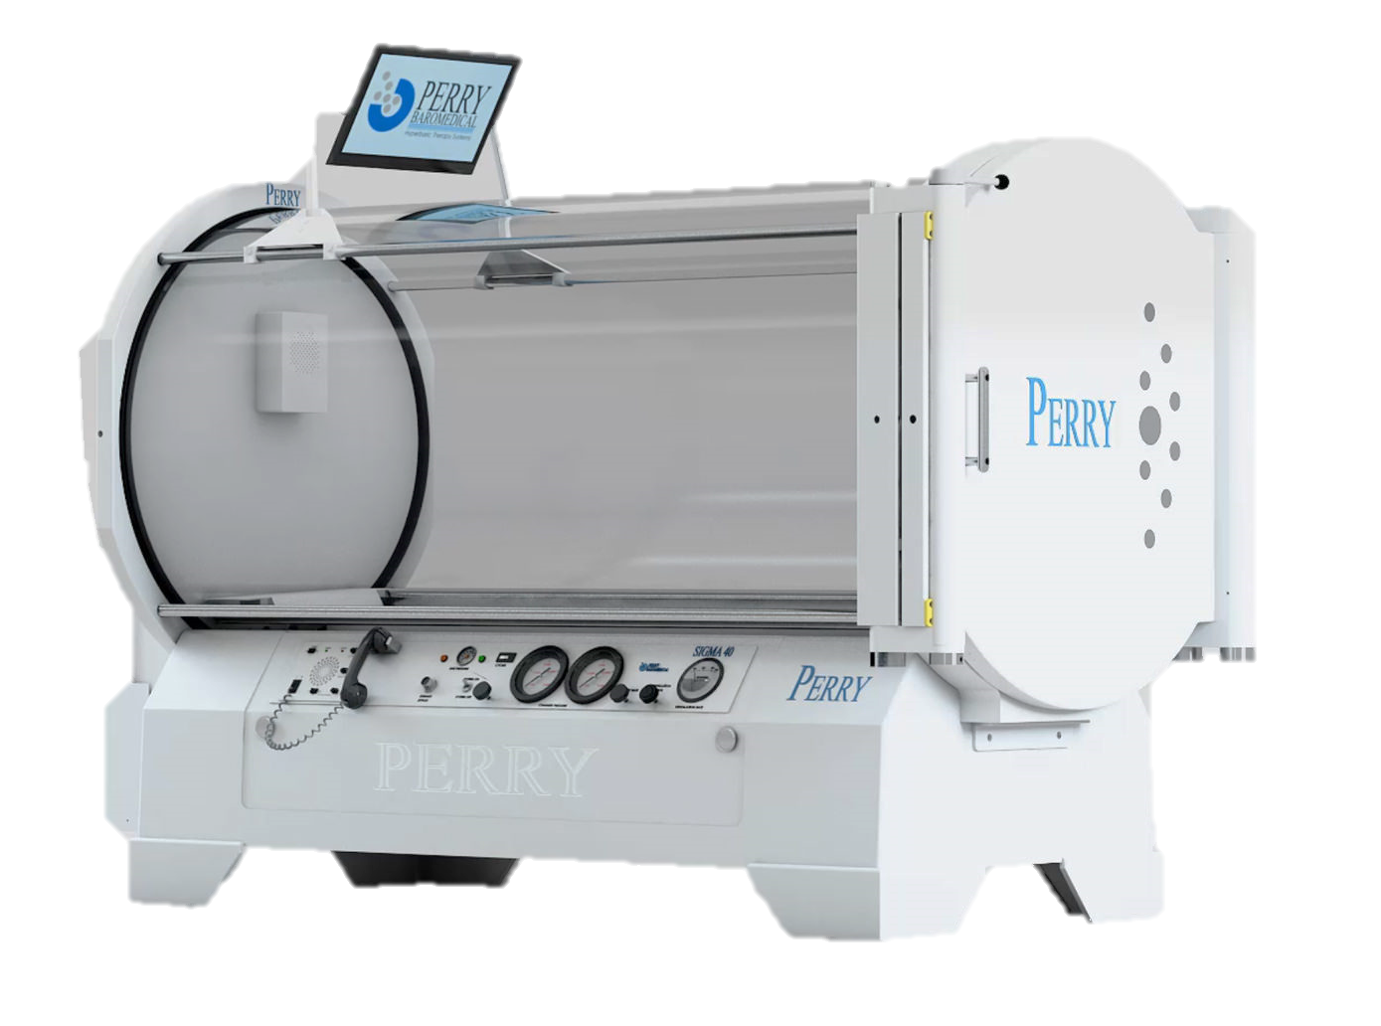

Slide 11
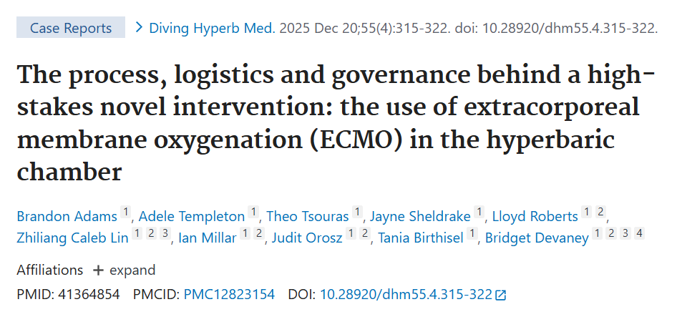
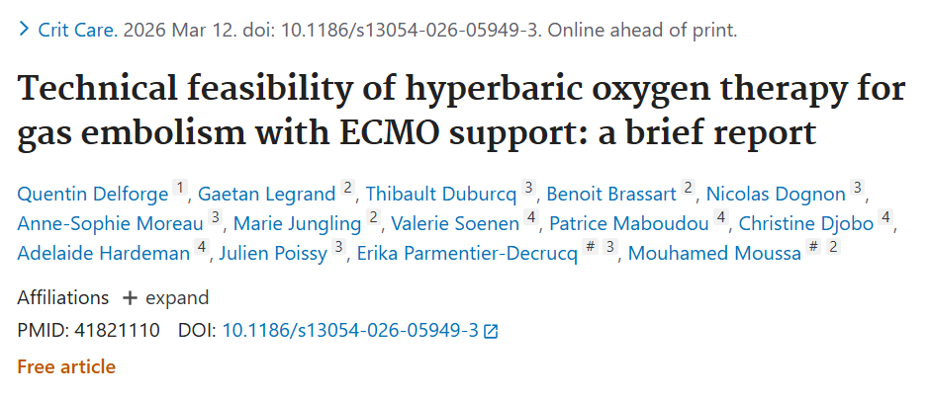

Slide 12
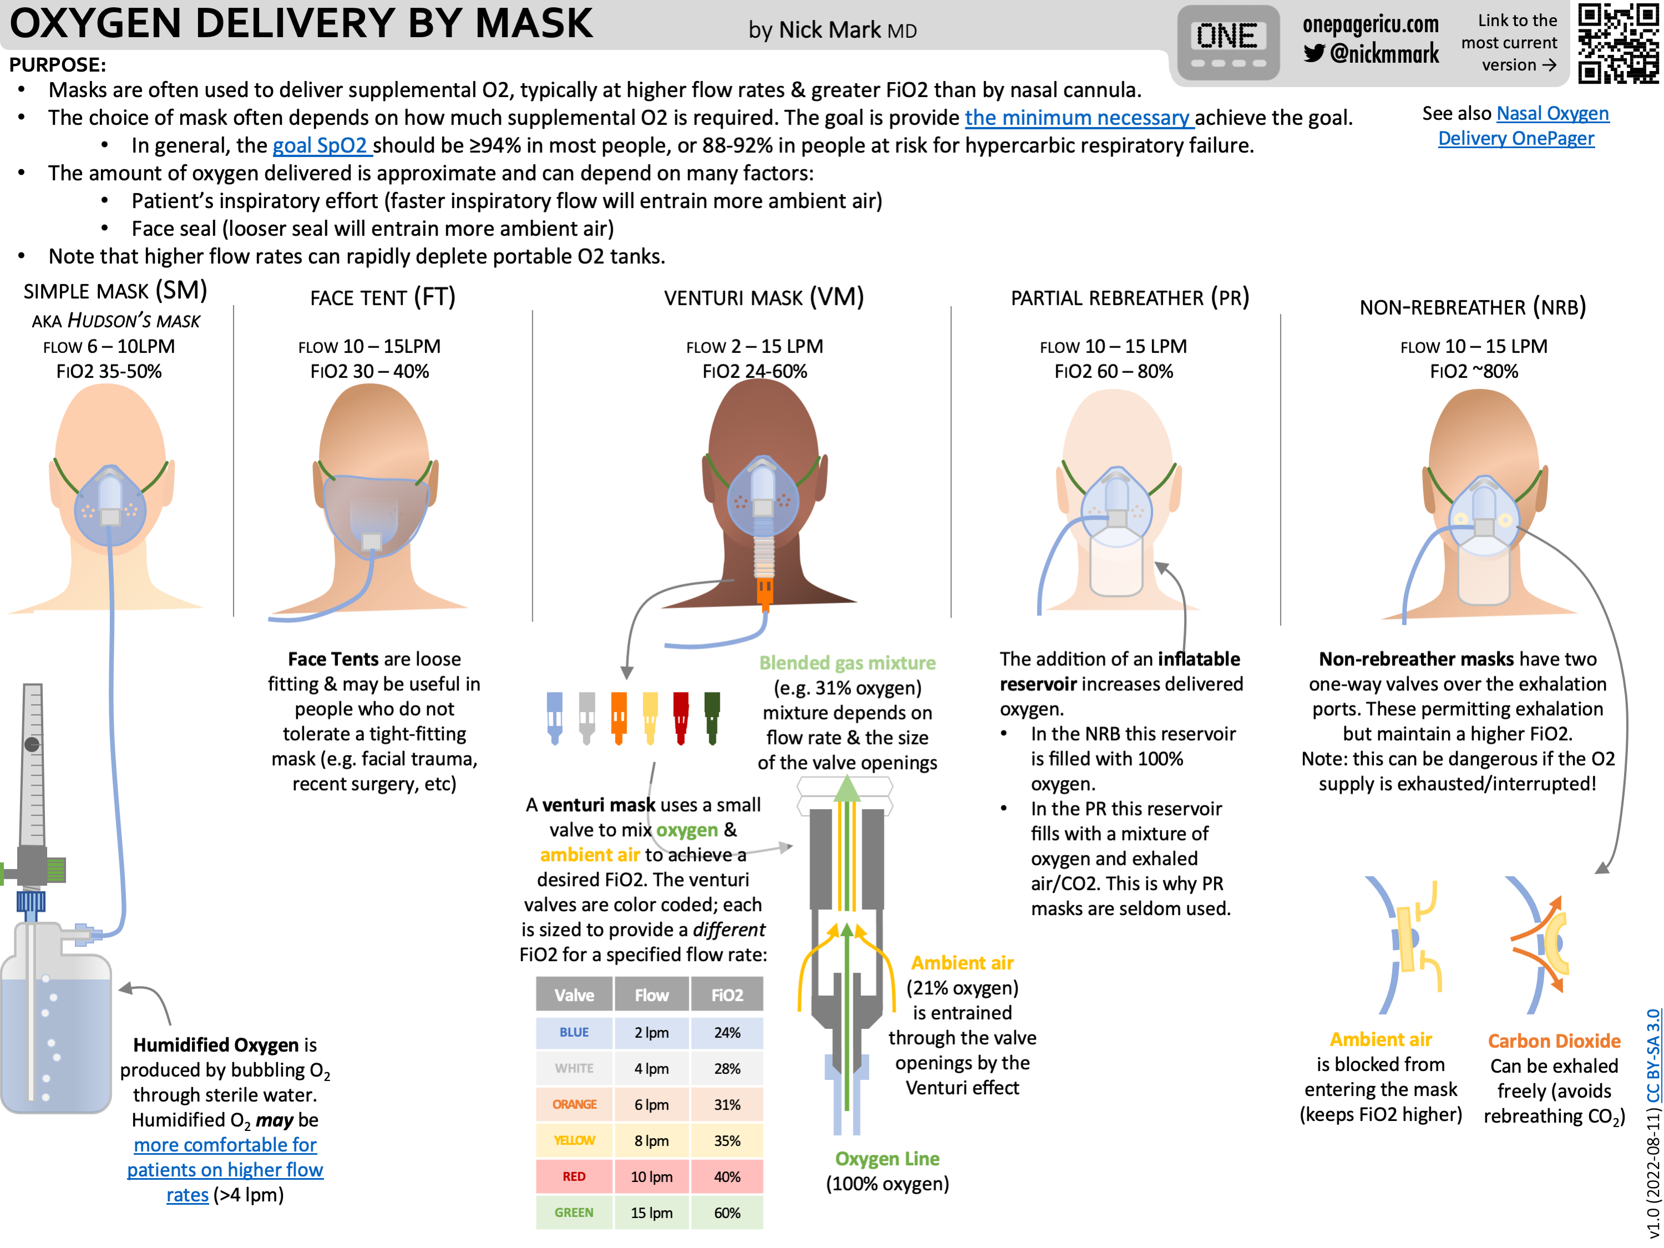

Slide 13
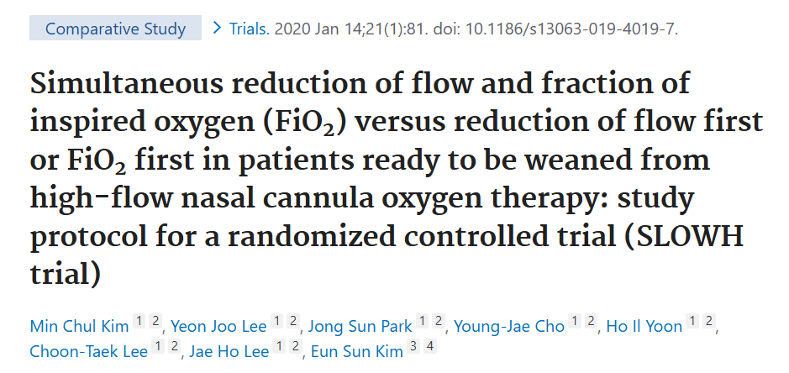
Weaning HFNC?

