Slide 1
Inpatient diabetes management ahd july 2026
Kendall novoa-Takara, MD
Notes:
Only had time to do 4 cases, could omit case one as it was too easy—they demonstrated that they got the basics. Would omit case 6 but could do it if there was time.
Consider mixing up the answers so that it isn’t a preponderance of choice D
I think it was good to have discussion about individual answer choices for them to review

Slide 2
Learning Objectives:
State the importance of inpatient glycemic control
State the glucose targets for hospitalized adults
Be familiar with the general principles of insulin therapy
Use preferred insulin regimens for hospitalized patients: basal, bolus and correction insulin
Calculate of initial doses of basal/ bolus insulin and adjustment of insulin regimen
Use Banner SC insulin order sets
Manage insulin when patients are NPO, on tube feeds, on steroids
Manage Hypoglycemia
Use of insulin pumps in hospital

Slide 3
HYPOGLYCEMIA AND HYPERGLYCEMIA HAVE CONSEQUENCES
HYPOGLYCEMIA
HYPERGLYCEMIA
Longer length of stay
higher medical costs
Increased risk of mortality
Higher infection rates
Increased length of stay

Slide 4
OUR BLOOD SUGAR CONTROL IS BEING MONITORED
CMS/MEDICARE
SOCIETY OF HOSPITAL MEDICINE
Monitoring AND data reporting to public
Penalties for severe hypoglycemia and severe hyperglycemia
Starts 2026
BUMCP voluntarily participates
Benchmarking with other academic and community hospitals
Performance had been in lowest quartile
Steadily making improvements
Still too much hypo- and hyper-glycemia

Slide 5
Good glycemic management in the hospital is a team effort
BUT providers must write the orders!

Slide 6
INSULIN TERMINOLOGY
Basal insulin: long-acting insulin required at all times in patients with Type 1 diabetes (and most patients with Type 2 diabetes) to maintain euglycemia (and suppress ketonemia) when NPO (hepatic gluconeogenesis can serve as a continuous source of blood glucose)
Nutritional insulin: scheduled short-acting insulin given with a meal, to prevent the glycemic spike that occurs due to carbohydrate ingestion (given even when the pre-meal blood sugar is in the normal range). Also refers to the scheduled insulin given to cover the carbohydrate load from tube feeds or parenteral nutrition
Correction insulin: (aka SSI) short-acting insulin meant to lower high blood sugars given in addition to scheduled nutritional insulin, also given to treat hyperglycemia in NPO patients
Total daily dose: ALL insulin given in a 24-hour period (scheduled glargine and lispro AND SSI)

Slide 7
Inpatient Blood sugar targets/definitions
Target BS 100-180
Hypoglycemia BG<70 mg/dL
Severe hypoglycemia BG<40 mg/dL
Hyperglycemia BG>180 mg/dL
Severe hyperglycemia BG>299 mg/dL

Slide 8
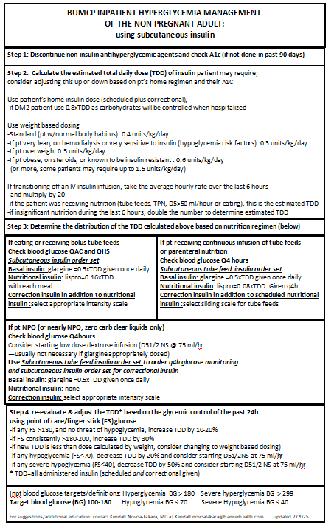

Slide 9
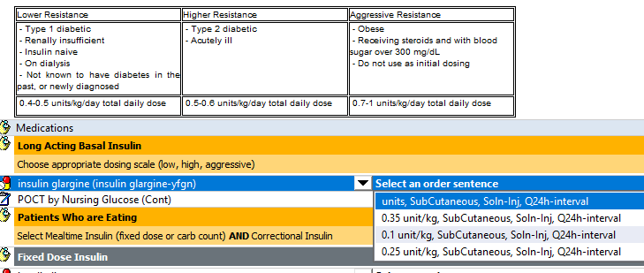
Ordering basal insulin
USING POWER PLAN
Insulin doses calculated by weight
Provider chooses
0.1=lower resistance
0.25-=higher resistance
0.35=aggressive
Can adjust dose before signing if wanting to use another dose
PROVIDER CAN ORDER OUTSIDE OF POWER PLAN
Power plan provides other important orders: diet, BG checks, ssi scales, hypoglycemia protocol

Slide 10
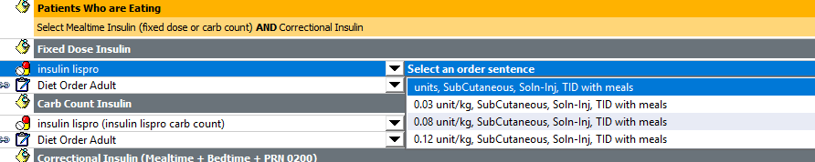
Ordering nutritional insulin
USING POWER PLAN
Insulin doses calculated by weight=TDD below if using basal insulin ordered in power plan*
0.03=lower resistance (TDD 0.2 units/kg)*
0.08-=higher resistance (TDD 0.5 units/kg*
0.12=aggressive (TDD 0.7 unit/kg)*
If you want a different dose than the one calculated, you can change dose after clicking on ‘orders for signature’ and before ‘sign’
CAN ORDER OUTSIDE OF POWER PLAN
Order outside of power plan

Slide 11

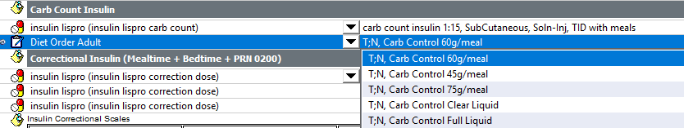
Ordering a diet in the power plan
SELECT A DIET
Recommended starting is 60 g for heavier patients/males
45 g for lighter patients/female
DO NOT ORDER 30 g diet!!!
Did you know you can order carb control liquid diets here?
DO NOT USE CARB CONTROL DIETS FOR CF PATIENTS-they should get high protein, high calorie diets!

Slide 12
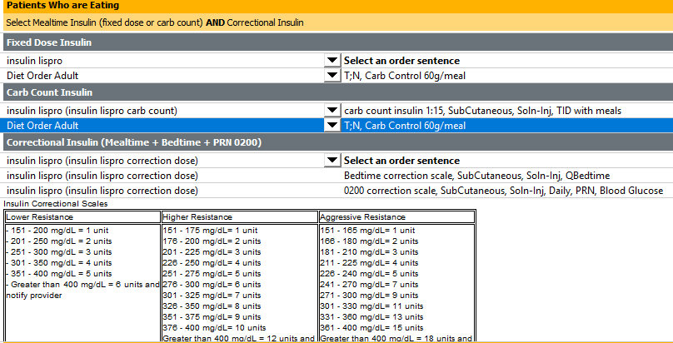


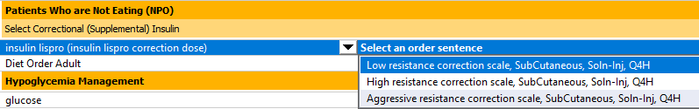
Ordering correctional insulin
Select intensity of correctional insulin (SSI)
Option for bedtime correctional insulin which starts at a higher glucose level (200+)

Slide 13
DIABETES EDUCATION CONSULTS
Newly diagnosed diabetes
New insulin starts or change in home regimen
Poorly-controlled diabetes with A1c>9
Complex patients (DKA, transplant, etc.)
Insulin pump patients
Order in Cerner

Slide 14
Case 1
70-year-old male with DM 2, HTN, CAD, is transferred out of the ICU overnight after undergoing emergent open cholecystectomy 3 days ago for a perforated gallbladder. Wt. 200 kg. A1c 15
For the past 24 hours
regular diet and has been eating >50% of his meals
got glargine 10 units, and lispro 5 units tid.
ALL blood sugars > 300 and has gotten 30 units of correctional insulin. TDD=55.
home regimen: metformin 1000 mg po bid, 70/30 insulin 20 units in the am and 10 units in the pm (TDD 30 units)
In addition to carb control diet 60 grams and ac/hs fingersticks, which of the following would be best to treat his diabetes?
A. glargine 10 units, lispro 5 units tid ac, aggressive resistance sliding scale insulin
B. glargine 27 units, lispro 9 units tid ac, aggressive resistance sliding scale insulin
C. glargine 36 units, lispro 12 units tid ac, aggressive resistance sliding scale insulin
D. glargine 50 units, lispro 16 units tid ac, aggressive resistance sliding scale insulin

Slide 15
Case 1—two good answers: c and d
DM 2, eating well, Was on scheduled glargine 10 units daily, and lispro 5 units tid. In the past 24 hours, all FS>300 and has gotten 30 units of correctional insulin. TDD yesterday=55. His weight is 200 kg. His A1c is 15. Home insulin TDD 30 units
In addition to stopping metformin, ordering carb-controlled diet 60 grams and ac/hs fingersticks, which of the following would be best to treat his diabetes?
C. glargine 36 units, lispro 12 units tid ac, aggressive resistance sliding scale insulin(TDD 72 reflects 30% increase to what was given day before)
D. glargine 50 units, lispro 16 units tid ac, aggressive resistance sliding scale insulin (weight based TDD 100 )

Slide 16
Case 1
DM 2, eating well, Was on scheduled glargine 10 units daily, and lispro 5 units tid. All FS>300 and has gotten 30 units of correctional insulin. TDD yesterday=55. Weight is 200 kg. His A1c is 15.
In addition to stopping metformin, carb-controlled diet 60 grams and ac/hs fingersticks, which of the following would be best to treat his diabetes?
glargine 10 units, lispro 5 units tid ac, aggressive resistance sliding scale insulin
--no change to prescribed TDD 30
--patient needs more insulin. 30 units is LESS than the TDD (55) received yesterday
--if you are concerned that is too much, remember…patient got the 55 units yesterday and DID NOT HAVE HYPOGYCEMIA!
--since ALL BG >300, should go up by 30% of the TDD

Slide 17
Case 1
DM 2, eating well, Was on scheduled glargine 10 units daily, and lispro 5 units tid. All FS>300 and has gotten 30 units of correctional insulin. TDD yesterday=55. Weight is 200 kg. His A1c is 15.
In addition to stopping metformin, carb-controlled diet 60 grams and ac/hs fingersticks, which of the following would be best to treat his diabetes?
B. glargine 27 units, lispro 8 units tid ac, aggressive resistance sliding scale insulin
--the TDD of this regimen is 51 which is double (or 100% more) compared to yesterday’s scheduled dose of 25 units
--increased to what was scheduled, but he got 55 units yesterday so if that didn’t control BS yesterday, won’t control BS today
-- Adjust your insulin dosing using TDD

Slide 18
Case 1
DM 2, eating well, Was on scheduled glargine 10 units daily, and lispro 5 units tid. In the past 24 hours, all FS>300 and has gotten 30 units of correctional insulin. TDD yesterday=55. His weight is 200 kg. His A1c is 15. Home insulin TDD 30 units
In addition to stopping metformin, ordering carb-controlled diet 60 grams and ac/hs fingersticks, which of the following would be best to treat his diabetes?
C. glargine 36 units, lispro 12 units tid ac, aggressive resistance sliding scale insulin
-- Increase insulin dose by 30% because all BS>300
--TDD 72 reflects 30% increase to what was given day before: 55x1.3=71.5
--units of insulin appropriately distributed
--aggressive resistance ssi is fine as pt appears to be insulin resistant

Slide 19
Case 1
DM 2, eating well, Was on scheduled glargine 10 units daily, and lispro 5 units tid. In the past 24 hours, all FS>300 and has gotten 30 units of correctional insulin. TDD yesterday=55. His weight is 200 kg. His A1c is 15. Home insulin TDD 30 units
In addition to stopping metformin, ordering carb-controlled diet 60 grams and ac/hs fingersticks, which of the following would be best to treat his diabetes?
D. glargine 50 units, lispro 16 units tid ac, aggressive resistance sliding scale insulin
--this is probably the BETTER answer
--weight based TDD 100: 200 kg x 0.5=100 units
--when BG poorly controlled (FS>300) you have a choice to go up on TDD by 30% OR to go to weight based dosing
--remember that 0.5 units/kg is a STARTING point and that some patients may use at much at 1 unit/kg of insulin if very insulin resistant

Slide 20
ADJUSTING INSULIN DOSES (STANDARD)
Always calculate the total daily dose (TDD)= all scheduled insulin and any sliding scale given
Calculate new total daily dose in the following manner:
  10% if no hypoglycemia and some BS in the 100s and some in 200s
  20% if all BS>200
  30% if all BS>300
Consider weight based dosing if all BS>200
  0.3 units/kg/day if very lean, on HD, or very sensitive to insulin
  0..4 units/kg/day if normal body weight and habitus
  0.5 units/kd/day if obese, on steroids, or known to be insulin resistant

Slide 21
Case 2
60-year-old female DM2, HTN, obesity, recurrent UTIs, COPD, chronic hypoxic respiratory failure requiring 2 L O₂ NC at home, is admitted for a COPD exacerbation. She was started on treatment for COPD exacerbation which includes solumedrol 125 mg bid. Wt 80 kg. A1c 8.0
home regimen: metformin 1000 mg po bid, glargine 40 units, and semaglutide 2mg SQ weekly.
Started on glargine 20 units qd and lispro 7 units tid ac, high resistance correctional insulin, and a carb-controlled 60-gram diet.
She is eating well.
Blood sugars 160-350 (lowest sugar was am fasting) and she has received 24 units of correctional insulin.
Total insulin given in 24 hours=20 glargine+ 21 nutritional + 24 correctional=65 units
Which of the following orders would be best to treat her diabetes?
Glargine 20 units, NPH 9 units in am, lispro 7 units tid ac, aggressive resistance correctional insulin
Glargine 25 units, lispro 8 units tid ac, high resistance correctional insulin
Glargine 20 units, lispro 13 units tid ac, aggressive resistance correctional insulin
D. Glargine 24 units, lispro 18 units tid ac, aggressive resistance correctional insulin

Slide 22
Case 2—best answer is d
Home regimen metformin, semaglutide, and glargine 40 units daily. On SOLUMEDROL Scheduled glargine 20 units qd and lispro 7 units tid ac, high resistance correctional insulin, and a carb-controlled 60-gram diet, pt eating well. A1c 8. Weight 80kg. Fingersticks 160-350 (lowest sugar was am fasting) and she has received 24 units of correctional insulin. Total insulin given in 24 hours=65 units
Which of the following orders would be best to treat her diabetes?
D. Glargine 24 units, lispro 18 units tid ac, aggressive resistance correctional insulin

Slide 23
Case 2
Home regimen metformin, semaglutide, and glargine 40 units daily. On SOLUMEDROL Scheduled glargine 20 units qd and lispro 7 units tid ac, high resistance correctional insulin, and a carb-controlled 60-gram diet, pt eating well. A1c 8. Weight 80kg. Fingersticks 160-350 (lowest sugar was am fasting) and she has received 24 units of correctional insulin. Total insulin given in 24 hours=65 units
Which of the following orders would be best to treat her diabetes?
Glargine 20 units, NPH 9 unit sin am, lispro 7 units tid ac, aggressive resistance correctional insulin
--TDD 50 which is yesterday’s TDD + 9 units (20% increase of yesterday’s TDD) given as NPH
--Adding AM NPH is a great strategy BUT….
--this TDD is LESS than the 65 units she got yesterday
--because BS elevated, some >200 would recommend going up by at LEAST 20% of TDD (65x 1.2=78 units)
--if using NPH I would put the change in new TDD-yesterday’s scheduled all in NPH: glargine 20 units, NPH (78-41) 37 units, lispro 7 units tid ac or you could split it between NPH and increasing meal time insulin
--if standard steroid distribution: insulin should be changed to 30% basal, 70% nutritional/3 per meal
--aggressive sliding scale is the appropriate sliding scale for those on steroids

Slide 24
Case 2
Home regimen metformin, semaglutide, and glargine 40 units daily. On SOLUMEDROL Scheduled glargine 20 units qd and lispro 7 units tid ac, high resistance correctional insulin, and a carb-controlled 60-gram diet, pt eating well. A1c 8. Weight 80kg. Fingersticks 160-350 (lowest sugar was am fasting) and she has received 24 units of correctional insulin. Total insulin given in 24 hours=65 units
Which of the following orders would be best to treat her diabetes?
B. Glargine 25 units, lispro 8 units tid ac, high resistance correctional insulin
--new TDD 49, scheduled insulin dosing went up by 20%
--BUT new TDD is still less than what was given yesterday BECAUSE THE TDD WASN’T USED TO CALCULATE THE INCREASE
--when actual TDD (all scheduled basal and nutritional insulin plus ssi) is used, the new TDD=65 x 1.2=78
--need to redistribute dosing to 30% basal, 70% nutritional/3 per meal

Slide 25
Case 2
Home regimen metformin, semaglutide, and glargine 40 units daily. On SOLUMEDROL Scheduled glargine 20 units qd and lispro 7 units tid ac, high resistance correctional insulin, and a carb-controlled 60-gram diet, pt eating well. A1c 8. Weight 80kg. Fingersticks 160-350 (lowest sugar was am fasting) and she has received 24 units of correctional insulin. Total insulin given in 24 hours=65 units
Which of the following orders would be best to treat her diabetes?
C. Glargine 20 units, lispro 13 units tid ac, aggressive resistance correctional insulin
--TDD of this regimen is 59 units: 20+13+13+13=59
--When starting steroids, you can use 1.5x home TDD for a starting insulin dose: 40 x 1.5=60
--this is a significant increase over yesterday’s 41 units of scheduled insulin
--However, TDD yesterday was 65 units
--new TDD should be yesterday’s 65 x 1.2=78 units
--redistribute insulin: 30% basal and 70%/3 per meal

Slide 26
Case 2—best answer is d
Home regimen metformin, semaglutide, and glargine 40 units daily. On SOLUMEDROL Scheduled glargine 20 units qd and lispro 7 units tid ac, high resistance correctional insulin, and a carb-controlled 60-gram diet, pt eating well. A1c 8. Weight 80kg. Fingersticks 160-350 (lowest sugar was am fasting) and she has received 24 units of correctional insulin. Total insulin given in 24 hours=65 units
Which of the following orders would be best to treat her diabetes?
D. Glargine 24 units, lispro 18 units tid ac, aggressive resistance correctional insulin
--YESTERDAY’S TDD 65 x 1.2=78 UNITS AND CHANGE DISTRIBUTION TO 30% BASAL AND 70%/3 NUTRITIONAL
--note that the basal dose goes down as fasting BG is usually the best of the day; it is once you start eating that the hyperglycemia worsens
--my quick short cut is to dose 25%/25%/25%/25%

Slide 27
Insulin dosing with steroid uSE
Corticosteroids affect carbohydrate metabolism and lead to more exaggerated post prandial hyperglycemia
Consider changing the ratio from 50% TDD basal/50% TDD nutritional (with meals) to 30% basal and 70% nutritional. *THIS WILL REQUIRE CUSTOM GLARGINE AND LISPRO DOSING—POWER PLAN WILL NOT CALCULATE THIS FOR YOU**
Consider using the aggressive resistance correctional scale found in the Subcutaneous Insulin order set
Recommended starting dose if pt to receive for several days: dexamethasone>2 mg/day, hydrocortisone>50 mg/day, or prednisone>15 mg/day = 1.5 x TDD
For high dose glucocorticoids i.e. methylprednisolone 500-1000mg consider adding NPH 0.4 units/kg 15 min before receiving steroid, no change to regular insulin dosing
*You may also consider change diet to 45gm CHO (shared decision making with patient)
If you are not gaining control in 2-3 days, consider an endocrinology consult
Effect of steroids on blood glucose typically wears off 24-48 hours after discontinuation

Slide 28
Case 3
70-year-old patient with DM2, HTN, osteoporosis is admitted for a R femoral neck fracture after a GLF in the IHOP parking lot across the street.
She took home glargine 80 units yesterday am and was npo due to surgery yesterday and today, missed carb control dinner, had a late snack, having symptomatic hypoglycemia FS 39
In addition to following the hypoglycemia protocol and stopping metformin, which of the following orders would be best for the covering night provider to order?
A. Glargine 40 units in the morning, low resistance sliding scale, D5 ½ NS 80 cc/hour
B. Glargine 20 units in the morning, lispro 7 units tid, high resistance sliding scale, D5 ½ NS 80 cc/hour
C. Glargine 40 units to start in the morning, lispro 13 units tid, high resistance sliding scale
D. Glargine 80 units to start in the morning, low resistance sliding scale

Slide 29
Case 3—best answer is b
Patient with DM2, 80 kg, took home glargine 80 units yesterday am and was npo due to surgery yesterday and today, missed carb control dinner, had a late snack, having symptomatic hypoglycemia FS 39
In addition to following the hypoglycemia protocol, which of the following orders would be best for the covering night provider to order?
B. Glargine 20 units in the morning, lispro 7 units tid, high resistance sliding scale, D5 ½ NS 80 cc/hour

Slide 30
Case 3
Patient with DM2, 80 kg, took home glargine 80 units yesterday am and was npo due to surgery, missed carb control dinner, had a late snack, having symptomatic hypoglycemia FS 39
In addition to following the hypoglycemia protocol, which of the following orders would be best for the covering night provider to order?
Glargine 40 units in the morning, low resistance sliding scale, D5 ½ NS 80 cc/hour
--TDD 40
--reduced glargine but no nutritional, ALL insulin is still dosed as BASAL
--still at risk for over basalization
--glargine still active, consider adding dextrose to IVF

Slide 31
Case 3—best answer is b
Patient with DM2, 80 kg, took home glargine 80 units yesterday am and was npo due to surgery yesterday and today, missed carb control dinner, had a late snack, having symptomatic hypoglycemia FS 39
In addition to following the hypoglycemia protocol, which of the following orders would be best for the covering night provider to order?
B. Glargine 20 units in the morning, lispro 7 units tid, high resistance sliding scale, D5 ½ NS 80 cc/hour
--this is SEVERE HYPOGLYCEMIA: REDUCE TDD BY 50% AND REDISTRIBUTE
--yesterday’s TDD was 80 units, need to decrease by 50%: 80x 0.50=40 units→ glargine 20 units, lispro 7 units tid ac
--PT WAS OVER BASALIZED TAKING 1 U of PER kg AND NOW ON CARB CONTROL DIET
--added dextrose containing IVF because the glargine given yesterday hasn’t completely worn off
**just because patients take a regimen like this at home, doesn’t mean you continue it in the hospital. We make patients npo all the time, so the risk of hypoglycemia is real. Patients may like this sort of regimen outpatient as it is one shot and done but the long acting insulin, when given this way, is no longer being used as BASAL insulin—it is being used as BASAL AND NUTRITIONAL.

Slide 32
Case 3
Patient with DM2, 80 kg, took home glargine 80 units yesterday am and was npo due to surgery, missed carb control dinner, had a late snack, having symptomatic hypoglycemia FS 39
In addition to following the hypoglycemia protocol, which of the following orders would be best for the covering night provider to order?
C. Glargine 40 units to start in the morning, lispro 13 units tid, high resistance sliding scale
--TDD is still 79 (40+39=79)
--Still too much insulin
--still at risk for more hypoglycemia as glargine hasn’t worn off, order dextrose containing fluid
--above suggested regimen close to what SHOULD have been ordered on admission, but would have considered decreasing dose by 20% as we carb control diets (64 units→23 units glargine, 7 units lispro tid ac)

Slide 33
Case 3
Patient with DM2, 80 kg, took home glargine 80 units yesterday am and was npo due to surgery, missed carb control dinner, had a late snack, having symptomatic hypoglycemia FS 39
In addition to following the hypoglycemia protocol, which of the following orders would be best for the covering night provider to order?
D. Glargine 80 units to start in the morning, low resistance sliding scale
--TDD 80, no change
--Still at risk for hypoglycemia: hospital diet will be carb controlled, may not be eating well post op
--this is OVERBASALIZATION, patient is at risk for RECURRENT hypoglycemia as pt could be made npo, could have poor po intake due to n/v from anesthesia or ileus, or carb control diet we give is significantly different than what is consumed at home
--patient is STILL at risk for hypoglycemia as glargine hasn’t worn off, start dextrose containing fluids

Slide 34
Case 3
Patient with DM2, 80 kg, took home glargine 80 units yesterday am and was npo due to surgery, missed carb control dinner, had a late snack, having symptomatic hypoglycemia FS 39
In addition to following the hypoglycemia protocol, which of the following orders would be best for the covering night provider to order?
WHY NOT STOP INSULIN ENTIRELY AND LEAVE FOR DAY TEAM?
--If no insulin ordered and patient begins eating, likely to have hyperglycemia then we are chasing blood sugars (reactive)
--having to ‘chase’ blood glucose will be worse if NO basal is ordered
--Ordering decreased dose of insulin allows us to be proactive

Slide 35
Preventing hypoglycemia
Consider decreasing prescribed hospital insulin to 70-80% of home insulin dose or redistributing into basal/bolus as most patients are OVERBASALIZED
OVERBASALIZATION=attempting to lower mealtime related hyperglycemia by increasing basal insulin
When I admit patients on 100% long acting insulin, I decrease total daily dose by 20% and then convert to basal (50%) bolus (50% divided by 3 for meal dose)
Patients should be on carb-controlled diets in the hospital
Avoid being too strict on carbs/meal, 60 grams of carbs/meal is the recommended amount for patients with higher weight/male or 45 grams lower weight/female

Slide 36
Responding to hypoglycemia
Use hypoglycemia protocol if not started already
EVALUATE THE CAUSE→INSULIN USE, NUTRITION, NPO STATUS, CKD/ESRD, CIRRHOSIS
if any episodes of hypoglycemia (FS<70), decrease TDD by 20% and consider starting D51/2NS at 75 ml/hr
if any episodes of severe hypoglycemia (FS<40), decrease TDD by 50% and consider starting D51/2 NS at 75 ml/hr
Adjust insulin doses to reflect 50% basal 50% nutritional (in divided doses)
Patients who are not diabetic and not taking insulin, may require a dextrose containing infusion to keep BS>80, particularly those with advanced liver or renal disease
*****CROSS COVER/NOCTURNIST SHOULD NOT DEFER TO PRIMARY TEAM*****

Slide 37
Case 4
85-year-old patient with DM2, HTN, CAD, history of stroke with L hemiparesis is admitted with aspiration pneumonia. The patient was eating a regular diabetic diet at home and that has been continued in the hospital. Weight 60 kg.
- Failed swallow eval, now npo and on tube feeds
- Getting glargine 15 units daily and lispro 5 units tid ac
- BS 180-300, and she has only gotten 1 dose of correctional insulin ,TDD of 35 units.
- Nurse said that there was some confusion because the time of fingerstick didn’t match with the time for correctional administration.
How should her orders be adjusted to gain better control of her blood sugars?
Continue glargine 15 units daily and manually order lispro 5 units 0600, 1200, and 1800, continue high resistance sliding scale
Glargine 21 units daily and lispro 7 units tid ac, continue high resistance sliding scale
Glargine 15 units daily, lispro 4 units q6 hours
Glargine 21 units daily, lispro 3 units q4 hours, continue high resistance sliding scale

Slide 38
Case 4—BEST ANSWER IS D
Taking glargine 15 units daily and lispro 5 units tid ac with high resistance sliding scale. TF at goal. Her blood sugars have been 180-300 , she got 1 dose of correctional insulin TDD of 35 units. Confusion because the time of fingerstick didn’t match with the time for correctional administration.
How should her orders be adjusted to gain better control of her blood sugars?
D. Glargine 21 units daily, lispro 3 units q4 hours, continue high resistance sliding scale

Slide 39
Case 4
Taking glargine 15 units daily and lispro 5 units tid ac with high resistance sliding scale. TF at goal. Her blood sugars have been 180-300 , she got 1 dose of correctional insulin TDD of 35 units. Confusion because the time of fingerstick didn’t match with the time for correctional administration.
How should her orders be adjusted to gain better control of her blood sugars?
Continue glargine 15 units daily and manually order lispro 5 units 0600, 1200, and 1800, continue high resistance sliding scale
--the new proposed TDD of 30 is yesterday’s TDD
--sugars will not be controlled because we are giving LESS insulin than yesterday
--the basal insulin of 15 units is 50% of the total and the proposed nutritional is 50%, so that division is correct
--proposed lispro is still tid BUT Lispro only lasts 4 hours so we must dose SIX time a day
--we could use Q6H (four times a day) dosing IF we were using regular insulin

Slide 40
Case 4
Taking glargine 15 units daily and lispro 5 units tid ac with high resistance sliding scale. TF at goal. Her blood sugars have been 180-300 , she got 1 dose of correctional insulin TDD of 35 units. Confusion because the time of fingerstick didn’t match with the time for correctional administration.
How should her orders be adjusted to gain better control of her blood sugars?
B. Glargine 21 units daily and lispro 7 units tid ac, continue high resistance sliding scale
--New TDD is 42 units: 35 x1.2=42 units
--the basal insulin of 21 units is 50% of the total and the proposed nutritional is 50%, so that division is correct
--lispro only lasts 4 hours, feeds are continuous so there will be coverage gaps
--nutritional insulin should be given in 6 doses: 21/6=3 units (approx.) Q4H

Slide 41
Case 4
Taking glargine 15 units daily and lispro 5 units tid ac with high resistance sliding scale. TF at goal. Her blood sugars have been 180-300 , she got 1 dose of correctional insulin TDD of 35 units. Confusion because the time of fingerstick didn’t match with the time for correctional administration.
How should her orders be adjusted to gain better control of her blood sugars?
C. Glargine 15 units daily, lispro 4 units q6 hours
--increase insulin TTx1.1=TDD 39
--can probably be more aggressive with dosing, would go up by 20% as most BS >200
--lispro only lasts 4 hours, so change lispro dosing to q4 hours (6 times a day)
--q6 is ok if using regular insulin

Slide 42
Case 4—BEST ANSWER IS D
Taking glargine 15 units daily and lispro 5 units tid ac with high resistance sliding scale. TF at goal. Her blood sugars have been 180-300 , she got 1 dose of correctional insulin TDD of 35 units. Confusion because the time of fingerstick didn’t match with the time for correctional administration.
How should her orders be adjusted to gain better control of her blood sugars?
D. Glargine 21 units daily, lispro 3 units q4 hours, continue high resistance sliding scale
--Increase insulin TDD(35) x 1.2 = 42.
--50% BASAL =21 UNITS
--divide the other 50% by 6 due to continuous TF: 21/6=3.5 so we will use 3 units q4 hours
--fix the fingersticks (more on that later)

Slide 43
Managing the patient on continuous tf or tpn
Check FS q4 hours (because we are using lispro)
Give basal insulin (glargine) 50% of TDD
Give nutritional insulin q4 hours (yes, this is 6 times a day) 50% TDD divided by 6=0.083% of TDD
Correctional insulin is given q4 hours in addition to nutritional insulin
Typically use high or aggressive resistance correctional insulin
Regular insulin can be added to TPN, discuss with nutrition if this is right for your patient
Use the subcutaneous tube feed order set

Slide 44
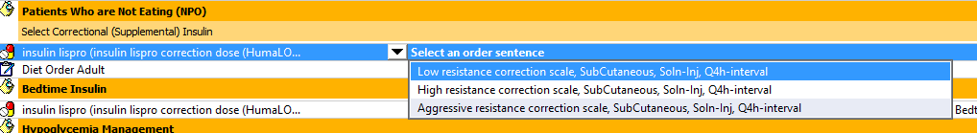
do not use the subcutaneous insulin order set for continuous tf or tpn
In the fine print says POCT Q4 if npo.
THIS ORDER SET DOESN’T REALLY GIVE A GOOD OPTION FOR SCHEDULED LISPRO Q4 HOURS BECAUSE BS CHECK IS QID AND THE CORRECTION IS Q4H

Slide 45
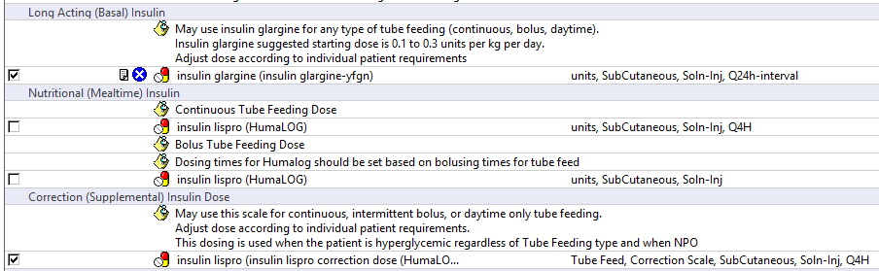
Subcutaneous tube feed insulin-for continuous and bolus NOT for nocturnal TF—may also be used for pt on tpn

Slide 46
Managing the patient on nocturnal tf
If a patient is receiving nocturnal tube feeds, consider giving NPH when the TF infusion starts
OR doses of lispro Q4 hours to cover the duration of infusion (e.g., if 8-hour infusion dose at T=0hr and 4 hr)
There is no specific order set for nocturnal tube feeds
Use the subcutaneous insulin order set to place all orders (blood glucose monitoring, hypoglycemia protocol, etc.)
NPH or lispro are ordered separately
If your patient is eating and on nocturnal tube feeds, insulin dosing is more complicated—consider an endocrinology consult

Slide 47
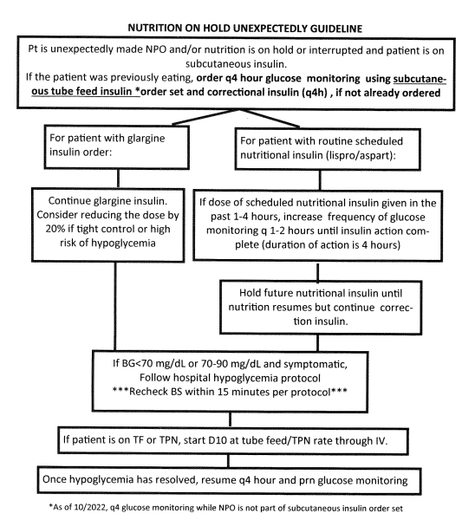
THIS IS NOT PART OF ANY ORDERSET
Consider starting D10 IV

Slide 48
Insulin pumps
Patients who are alert and understand their pumps may continue to use them in the hospital
IF patient is NOT alert/able to manage own pump, remove pump and start on basal and nutritional insulin
Use Insulin Pump-Patient’s Own order set
Pt may use CGM to dose insulin—you must write conditional order
In general do not stop the pump without consulting endocrine
Consult endocrinology and diabetes education for all patients using insulin pumps

Slide 49
CARBOHYDRATE COUNTING
Patients use an insulin-to-carb ratio to calculate their nutritional insulin dose
All carb-controlled diet orders will have the carbs listed on the meal tray ticket
Example: insulin-to-carb ration 1:10 means that 1 unit of insulin is given for every 10 grams of carbohydrate
This can be ordered using the appropriate section in the Subcutaneous Insulin order set

Slide 50
PATIENTS WITH TYPE 1 DIABETES REQUIRE SOME SCHEDULED INSULIN AT ALL TIMES

Slide 51
NEVER GIVE LISPRO MORE OFTEN THEN EVERY 4 HOURS DUE TO DOSE STACKING AND RISK OF HYPOGLYCEMIA

Slide 52
SYSTEMS IN PLACE TO ASSIST: CERNER POP UP
Alerts fire ONCE for a specific provider in a day
Positions: Physician, NP and PA
Relationships: Admitting, attending, house staff, physician asst
High blood sugar alert and low blood sugar alert are separate
High blood sugar alert fires if 3 BS>180 were detected in the past 24 hours
Low blood sugars alert fires if BS<70 in past 24 hours

Slide 53

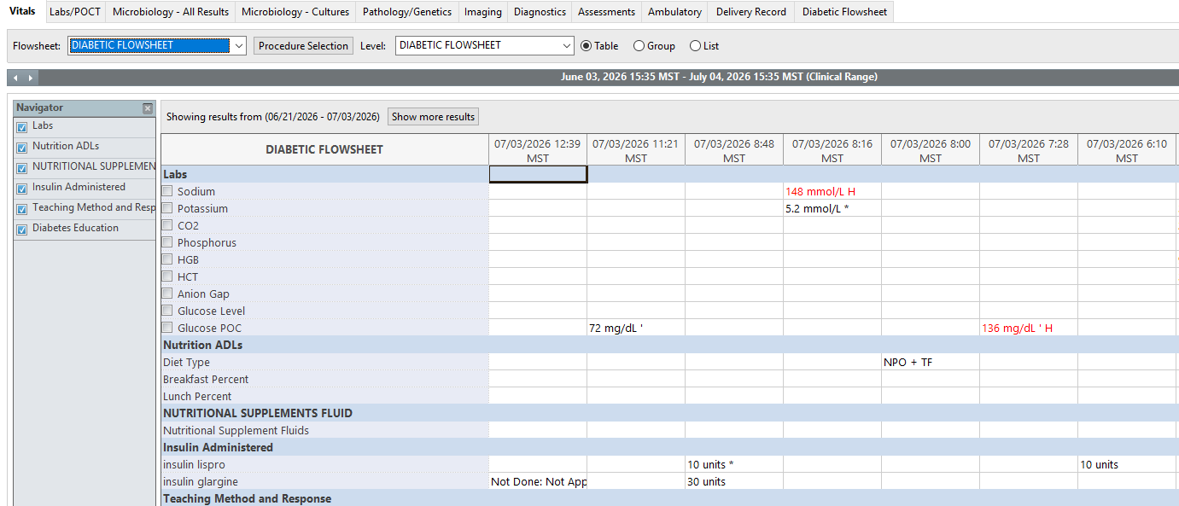
Use the Diabetic flow sheet

Slide 54
Consulting endocrinology
Place order in Cerner
Provider to provider communication must occur
Pager 602-201-7629 24/7

Slide 55
Tips for success Part 1
Put patient on carb control diet: 60gm higher weight/male, 45gram lower weight/female
Pick your starting insulin doses judiciously—you can calculate it yourself or use the order set
Refer back to previous admissions to see what they were taking
DO NOT OVERBASALIZE—just because the patient was doing at home, doesn’t mean it is right. Convert that dose to basal bolus using 80% of home TDD
Using basal bolus (50% basal plus 50% nutritional) is preferred
If insulin naïve and you want to start a little bit of hs basal alone or ssi, that is OK –if I started that way, I add nutritional insulin once my TDD is higher than 6-10 units, but would definitely use once ≥20 to avoid over basalization
Steroids: 30% basal, 70% divided into 3 meal time doses PLUS aggressive sliding scale, you’ll probably need to increase your TDD (higher) while patient is on steroids (or for back of the envelope math: 25/25/25/25)

Slide 56
TIPS FOR SUCCES PART 2
Don’t ignore patient if they say they determine their dose by carb counting—consult endocrine if needed
All type 1 diabetics must have basal insulin on board at all times, even when npo, use fluids with dextrose if needed to prevent hypoglycemia
Review finger stick blood sugars EVERYDAY and make adjustments
Adjust based on yesterday’s TDD=ALL insulin given (basal, nutritional and correctional) and go UP or DOWN appropriately
I prefer glargine at night (order as Qbedtime NOT daily)—can give dose of NPH in am if plan to increase glargine dose significantly to provide coverage until new dose given
Calculate total daily dose (TDD) given and new total daily dose. When this is not done, the NEW order for an uncontrolled hyperglycemic patient may give less insulin than the patient got the previous day. WHY? BECAUSE THE SSI UNITS MAY NOT BE TAKEN INTO ACCOUNT.

Slide 57
TIPS FOR SUCCES PART 3
If BS very high and dose is still less than weight based, consider going to weight-based dosing
Do not give lispro more often than Q4 hours, doses may stack and result in hypoglycemia
Use the same time interval to calculate TDD—I personally like 6 am to 6 am
Patient npo? Consider decreasing glargine if you suspect overbasalized. On continuous TF or TPN that had to be stopped? Start D10 IV
Use the Diabetic Flow Sheet—if nursing is entering data correctly, you’ll be able to see the FS, diet, how much patient is eating, how much of what insulin was given when
Order an A1c is one hasn’t been done in past 90 days

Slide 58
TIPS FOR SUCCES PART 4
Call your diabetic educator extraordinaire EARLY IN WEEK-they are here Mon-Fri (light staffing on Thur/Fri)
Forget to adjust your insulin earlier in the day?—go ahead and make the changes…better late than not at all
IF YOU GET CALLED FOR LOW OR HIGH BLOOD SUGARS, EVALUATE AND MAKE ADJUSTMENTS…EVEN IF YOU ARE NIGHT COVERAGE
TALK to nursing if doses aren’t being given correctly
BS>180? MAKE ADJUSTMENTS! ***this will be key to improve SHM/Medicare metrics!!!! Why not grab the low hanging fruit? There will always be people who are hard to control or brittle, so take care of the sugars that are easy to manage
Get endocrine consults on insulin pump patients and those that are hard to manage

Slide 59

Special thanks to
Dr. natty

