Slide 1

Colon Cancer Screening
Internal Medicine Residency – Oncology Lecture Series
5/12/2026
Adam Welu, MD
Gastroenterology Fellow, PGY4

Slide 2
Learning Objectives
Review basics of colorectal cancer pathology
Identify high-risk patients for colon cancer screening
Discuss prior major evidence and research supporting colorectal cancer screening
Review recommendations for colorectal cancer screening in average risk patients
Understand available modalities for colorectal screening
Discuss future directions for colorectal cancer screening

Slide 3
Case
45-year-old healthy male asks about colon cancer screening. He reports no family history of CRC or advanced polyps.
When would you recommend starting CRC screening?
What modality do you recommend?
Notes:
We will start with a brief case to get us thinking about the basics in a very likely encountered scenario
45-year-old healthy male asks about colon cancer screening. He reports no family history of CRC or advanced polyps.
When would you recommend to start screening for colorectal cancer? Now? Age 50? Is he overdue?
What modality are you going to recommend for this patient? Do you recommend colonoscopy? Stool-based test? Or let patient choose?

Slide 4
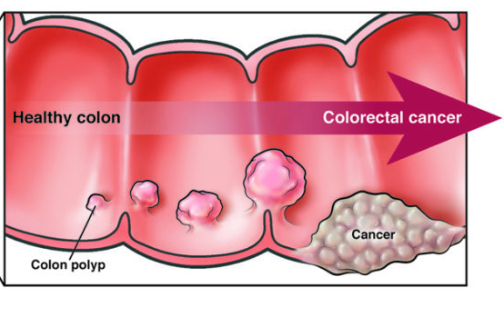
Background
Most colon cancers develop through a preceding adenoma.
Timeline of progression to cancer is variable
  26 years for diminutive adenoma (smaller than 5mm)
  9 years for tubulovillous adenoma
  8 years for small adenoma
  5 years for large adenoma
  4 years for villous adenoma
Chen, CD., Yen, MF., Wang, WM. et al. A case–cohort study for the disease natural history of adenoma–carcinoma and de novo carcinoma and surveillance of colon and rectum after polypectomy: implication for efficacy of colonoscopy. Br J Cancer 88, 1866–1873 (2003). https://doi.org/10.1038/sj.bjc.6601007
Notes:
Background
Colon cancer typically develops through clear progression from polyp or adenoma until final stage of carcinoma (which accounts for 70-85% of colon cancers)
The timeline of progression to cancer is variable, but overall → colon cancer takes a LONG time to develop
#s from slide
It’s not important for IM and those of you not going into GI to worry about the specific adenoma types. This is just to illustrate that even some of the more serious adenomas still take a pretty long time to turn into cancer

Slide 5
Colon Cancer Risk Factors
Age
Family history of CRC or advanced adenoma
IBD
Hereditary syndromes (FAP, MAP, Lynch)
Obesity
Tobacco use
Alcohol
Processed meats
Sedentary
Notes:
Can you guys name any risk factors for me?
Age is the single most important risk factor for the vast majority of the population
Family history is a very important non-modifiable risk factor -> easily screened for by taking a family history
However, slightly more difficult is that many patients will not know if they have a family history of an advanced adenoma
If there is a concern, the patient should be asked to confirm with their relative the diagnosis.
In general, if polyp type is unknown – it is assumed to NOT be an advanced polyp
There are other specific populations with non-modifiable risk factors such as patients with IBD and hereditary colon cancer syndromes
The rest are modifiable risk factors - so obesity, sedentary lifestyle, drinking, smoking, and eating processed meats
Notes:
Advanced polyps
Advanced adenoma
Adenoma size ≥1 cm
Adenoma with high-grade dysplasia
Adenoma with villous elements
Advanced serrated lesion
Sessile serrated polyp (SSP) ≥1 cm
Traditional serrated adenoma ≥1 cm
SSP with cytologic dysplasia
Unknown polyp type
If an FDR had a polyp but the patient does not know if it was an advanced polyp, the patient should be encouraged to contact the relative, if possible, to confirm the polyp's histologic findings and size.
If this information cannot be obtained, assume that the polyp was not an advanced polyp.

Slide 6
Who are High-Risk Patients?
FHx of 1 first-degree relative with CRC or advanced polyp at age <60
FHx of 2 or more second-degree relatives with CRC/advanced polyp at any age
  Initiate screening at age 40 or 10 years prior to youngest affected relative, then interval colonoscopy at least every 5 years
Consider genetics evaluation for patients with higher familiar CRC burden
Patients with IBD or hereditary syndrome should already be followed by a gastroenterologist
Notes:
Who do we define as a high-risk patient?
- FH of 1 first-degree relative with CRC or advanced polyp at age <60
- FH of 2 or more second-degree relatives with CRC/AA at any age
On average, a family history of CRC is believed to be associated with approximately a 2-fold increase in CRC risk, though the exact magnitude depends on the age of the individual at risk, age at diagnosis of the relative(s), degree of familial relation between the individual and relative(s), and number of affected relative(s)
For these high-risk individuals: Initiate screening at age 40 or 10 years prior to youngest affected relative, then interval colonoscopy every 5 years
A single second degree relative with colon cancer = average risk
Notes:
FDR = parents, siblings, children
SDR = grandparents, aunts/uncles

Slide 7
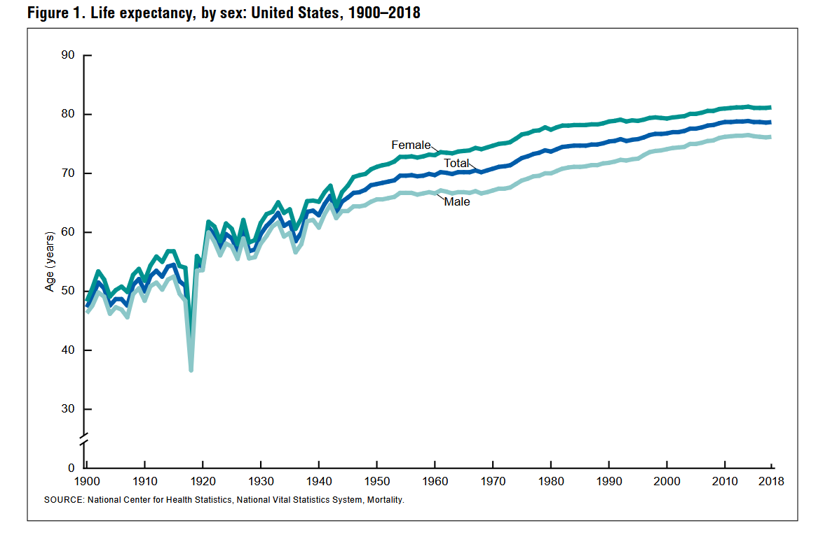
Brief History Lesson
Notes:
Let’s take a step back and quickly review the history of colon cancer screening and how we got to where we are today
This is a graph of life expectancy in the US
As you can see people started to live longer in the 1960s
Due to scientific/medical advances (diabetes/heart disease)
- Before this most patients simply weren’t living long enough where colon cancer screening would be useful on a population scale & there really weren’t any useful screening modalities

Slide 8
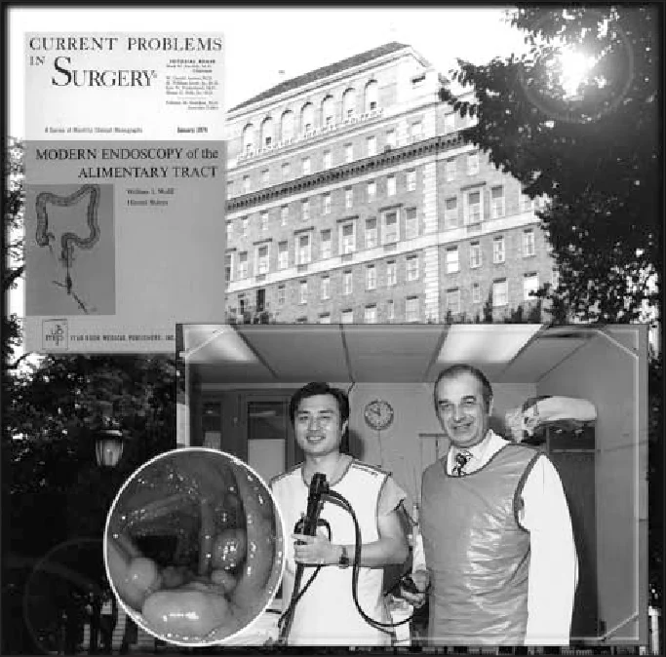
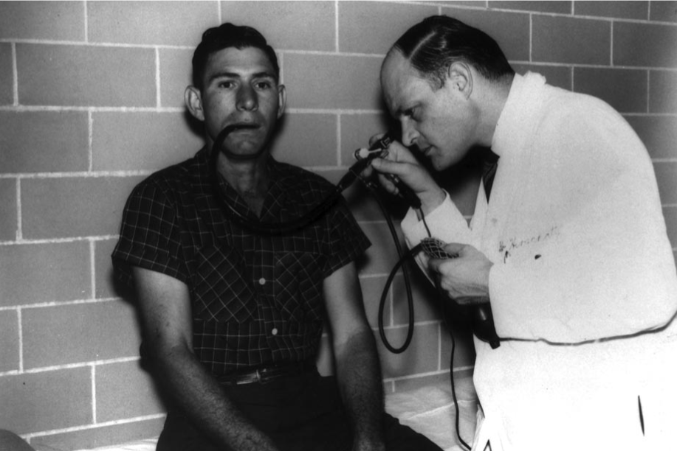
Notes:
Simultaneously, there was the introduction of fiberoptic endoscope by Dr. Basil Hirschowitz at University of Michigan in the 1950s. He initially tested the first prototype on himself…. Here is a picture of him using it on a patient with remarkable tolerance
And then the first colonoscopy was performed in 1969 by Dr. William Wolff in NY (at Beth Israel)

Slide 9
Screening Recommendations
1978
ACS endorses CRC screening w/ FOBT or sigmoidoscopy – based on no evidence
1997
First screening recommendation for sigmoidoscopy (USPSTF)
2000
Screening colonoscopy recommended over sigmoidoscopy (by ACG, Lieberman et al)
2002
Screening colonoscopy recommended by USPSTF
Notes:
But interestingly, we didn’t previously have an RCT to support colonoscopy for CRC screening
In the 2010s RCTs supporting benefit of flexible sigmoidoscopy
And then finally in 2022…

Slide 10
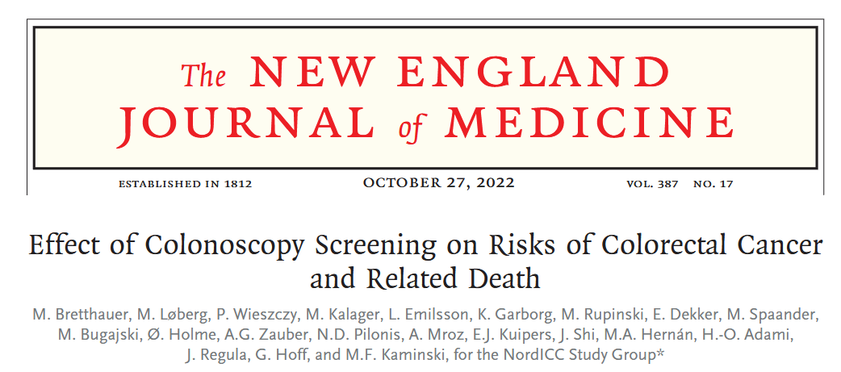
NordICC Trial 2022
Notes:
Multinational study (Poland, Norway, Sweden, and Netherlands) with 85K participants
Compared invitation to screen vs no invitation

Slide 11
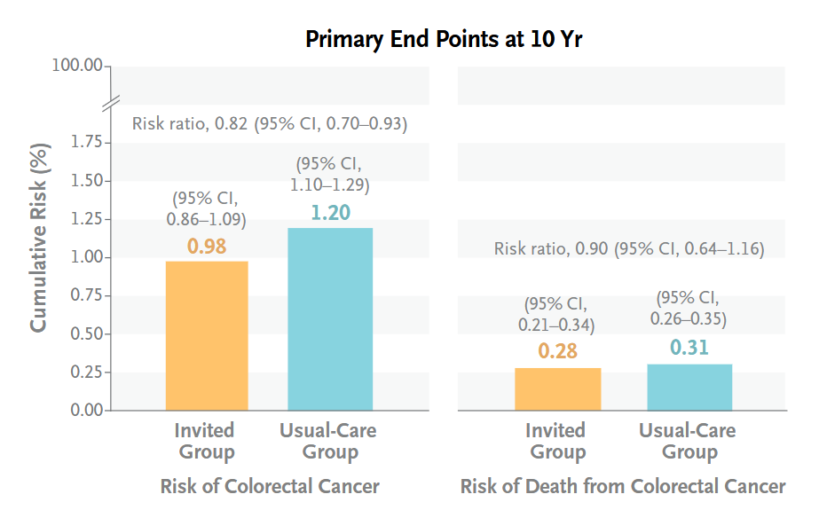
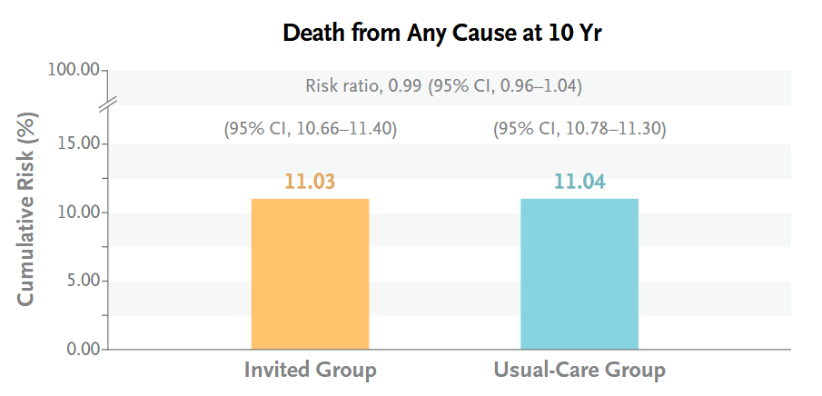
Notes:
- Risk of colorectal cancer at 10 years was lower among participants who were invited to undergo screening colonoscopy than among those who were assigned to no screening
- No survival benefit at 10 years (which should not be unexpected given what we now from earlier about the pathologic timeline for CRC)

Slide 12
Colon Cancer Incidence
Third most common type of cancer, fourth in the US
2nd leading cause of death from cancer worldwide
Approximately 4% of individuals will develop colon cancer in their lifetime
Notes:
Where are we now?
Colon cancer is the 3rd most common cancer worldwide, 4th in the US
2nd leading cause of death from cancer worldwide
~4% of individuals will develop colon cancer in the their lifetime (So about 1:20)

Slide 13
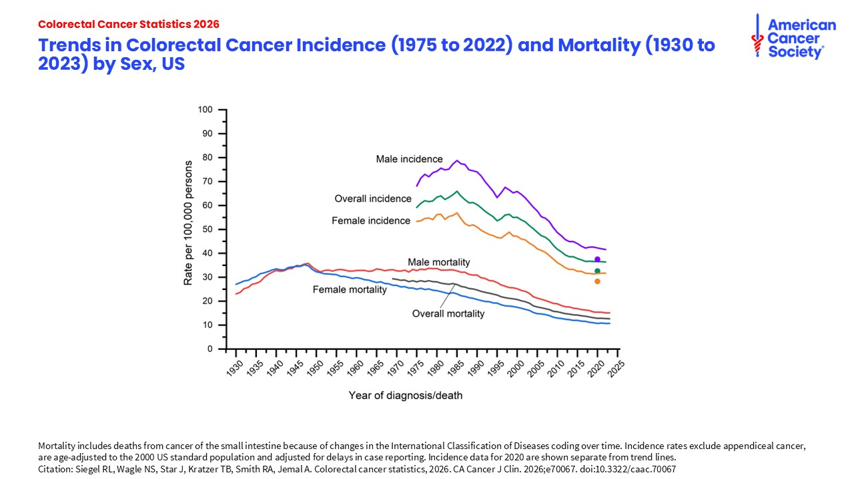
Siegel RL, Wagle NS, Star J, Kratzer TB, Smith RA, Jemal A. Colorectal cancer statistics, 2026. CA Cancer J Clin. 2026;e70067. doi:10..33222/caac.70067
Notes:
So overall we are doing well.
Top lines: colorectal cancer incidence rate decreased by 45%, from its peak in 1985 (66.2 per 100,000) to 2022 (36.4 per 100,000),
This is likely driven by changes in risk factor patterns such as declines in smoking, increased use of ASA/NSAIDs, and certainly do to increased screening uptake (Remember we have evidence that shows that colon cancer screening reduces incidence)
Bottom lines: Colorectal cancer death rate also decreased by 57% from 1970 (29.2 per 100,000) to 2023 (12.7 per 100,000), driven by declines in incidence, earlier detection, and improvements in treatment.

Slide 14
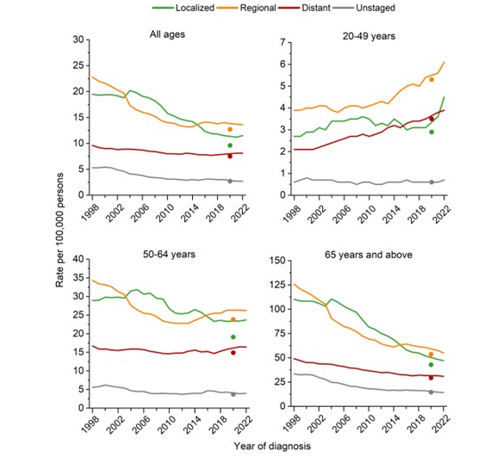
Siegel RL, Wagle NS, Star J, Kratzer TB, Smith RA, Jemal A. Colorectal cancer statistics, 2026. CA Cancer J Clin. 2026;e70067. doi:10..33222/caac.70067
Notes:
However, there was a noted increased incidence of colorectal cancer incidence among adults younger than 65
Top right: incidence increased by 3% per year for ages 20-49 particularly over the past 5-10 years. 0.4% per year for ages 50-64 during 2013-2022, largely driven by advanced stage (regional and distant stage) disease.
And this obviously was very concerning

Slide 15
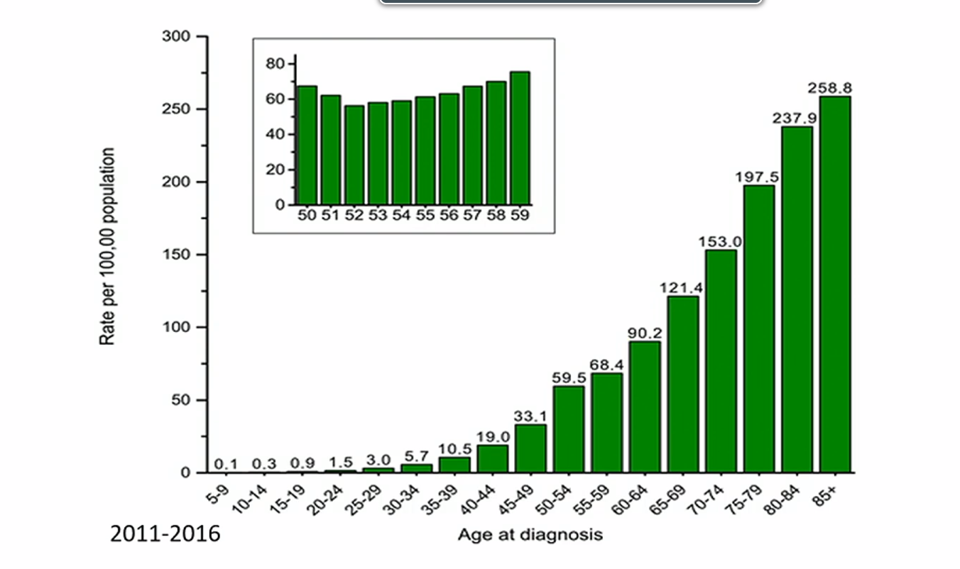
Siegel R et al. CA: a cancer journal for clinicians; 70:145-164
Notes:
This is cancer data broken down by age at diagnosis over 5-year increments
As you can see from the graph, the power of age as a risk factor for CRC
With the increasing rate in younger patients with CRC, then the question was – when should we start screening?
Most modeling studies suggest that when the incidence rate exceeds 30/100,000 screening is both effective for patients and cost-effective
So this is why it makes since to drop the screening age

Slide 16
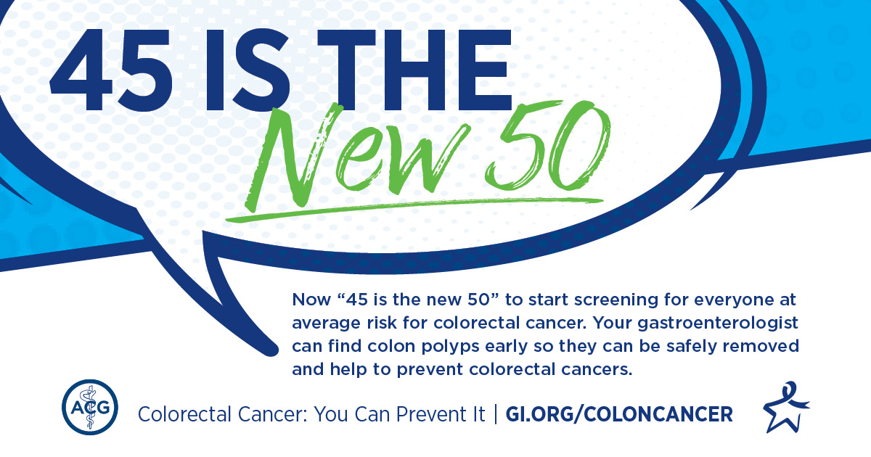
When should you start screening for CRC?
Notes:
So, because of the noted change in incidence data, in 2021, nearly all major societies (ACG, USPSTF, American Cancer Society, MSTF) had changed their guidelines to start screening for colon cancer at age 45
***only holdout ACP

Slide 17
But WHY is incidence increasing in younger adults?
Obesity
Changes in microbiome
Inflammation
Environmental exposures
Notes:
So why is the incidence increased in younger adults?
The population is primarily Gen X, and Y - what is different about this group?
No clear answer but a few hypotheses
Obesity has been shown consistently to be important risk factor. And there have been increased rates of childhood/early-onset obesity which has correlation with earlier onset of cancer
Another theory is changes in microbiome – very theoretical at this point. Increased used of antibiotics in childhood, antibiotics in food chain given to animals we are eating is altering our microbiomes then affecting cancer development
Changes in food industry with increased used of chemicals which can increase inflammation
Demonstrated association with areas with increased air and water pollution with increased cancer rates

Slide 18
Screening Modalities
Invasive:
  Colonoscopy
  Flexible sigmoidoscopy*
Non-invasive (2-step)
  FIT
  mtsDNA stool (Cologuard)
  CT colonography
Notes:
Invasive options include colonoscopy and flex sig
Non-invasive options include stool tests with FIT or multi-target stool DNA (mtsDNA) aka Cologuard, and CT colonography
FIT test uses antibodies directed at globin of Hgb to detect microscopic amounts of blood in stool
mtsDNA (multitarget stool) detects both blood and mutated DNA from cancerous or precancerous cells
Note that non-invasive tests operate as a pre-test, and all high-quality programs have need for colonoscopy if the pre-test is positive, so these are essential 2-step tests potentially
With flex sig: if adenomas are found, referral for a colonoscopy is required so not commonly done except in rare situations

Slide 19
Screening Modalities
Modality | Sensitivity CRC | Sensitivity AA | Specificity
Colonoscopy | 96% | 95% | 90%
FIT | 74% | 24% | 96%
mtsDNA | 92% | 42% | 87%
Notes:
So lets compare how good these tests are:
Colonoscopy is the most frequently used → it is highly sensitive for both colorectal cancer and advanced adenomas
The 2 other most tests – the FIT and mtsDNA -> they have good sensitivity for CRC but not very good for advanced adenoma
And this is why it is so crucial to be completing these tests at regular intervals

Slide 20
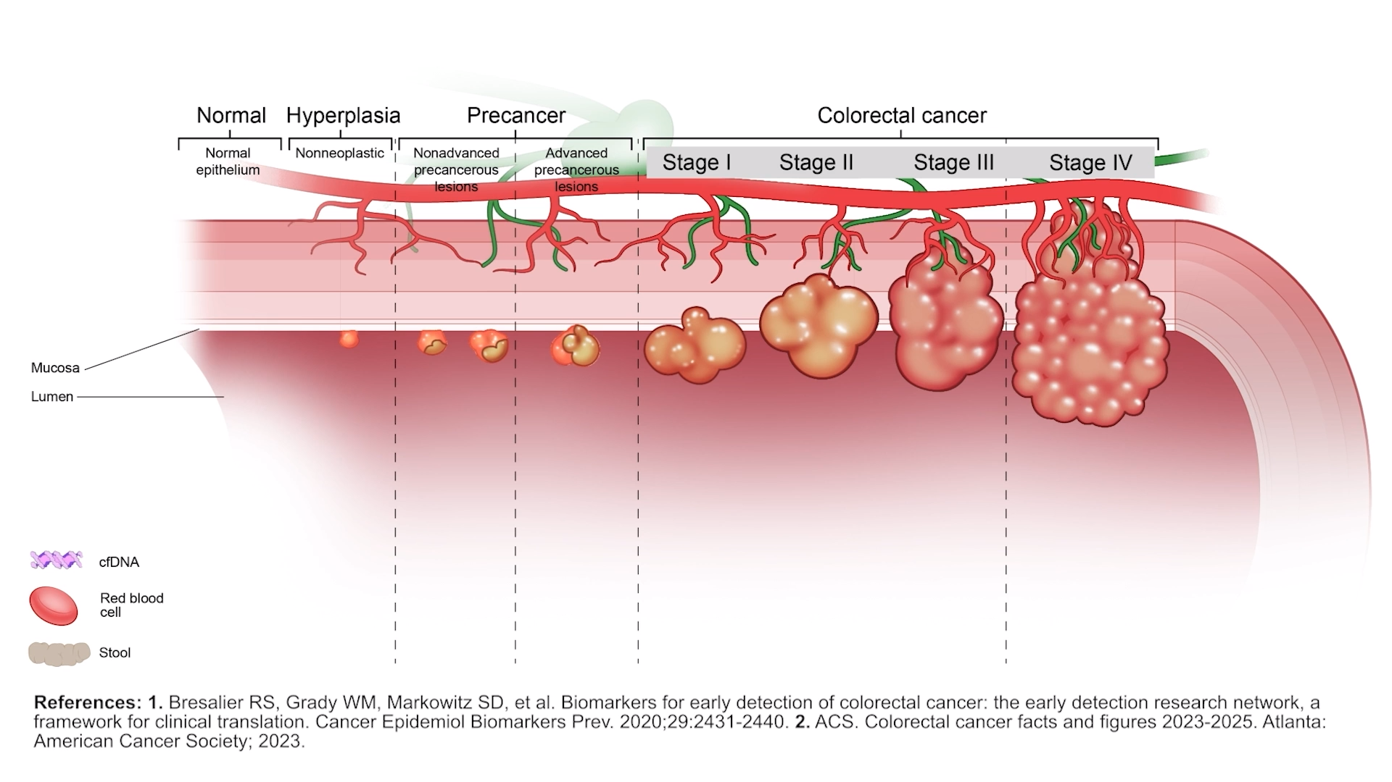
Notes:
FIT: can detect early and advanced cancer
mtsDNA: can detect large adenoma, early and advanced cancer
Colonoscopy has the advantage of detecting polyps much earlier is their lifecycle

Slide 21
Screening Intervals
Colonoscopy – every 10 years. If polyps → CRC surveillance
FIT – annual
mtsDNA (Cologuard) – every 3 years

Slide 22
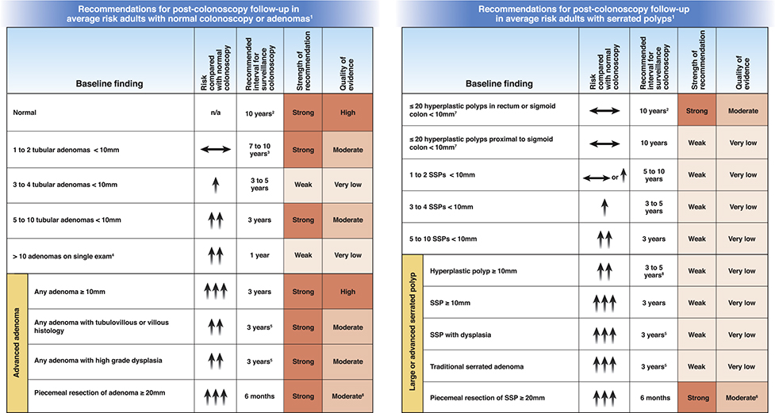
Notes:
And then based on colonoscopy results, your GI doc can decide subsequent screening intervals based on number, type, and size of polyps

Slide 23
Case – when to stop screening?
78 year old female with history of osteoarthritis and HTN with no prior colon cancer screening.
78 year old male with history of ESRD on HD, CAD, T2DM, COPD, Parkinson’s with 3 prior negative colonoscopies at age 50, 60, and 70.
Notes:
Okay so far we have discussed colon cancer risk factors, high risk patients, when to start screening, and options for screening.
Now – when do we stop screening?
2 patient examples
How would you counsel these 2 patients on their colon cancer screening?
Note this means STOP screening -> If you do a FIT you really should be willing to do a colonoscopy

Slide 24
Age to Stop CRC Screening
Screen up to age 75
Individualize for ages 75-85
Stop screening after age 85
Notes:
When discussing with patients it is important to remember that the benefits of polypectomy are delayed 7-10 years, so can use life expectancy of <10 years as a cutoff for when to discontinue CRC screening

Slide 25
When to stop screening?
After age 75 use a pragmatic approach
If unsure, can discuss with colleagues
No reliable/useful clinical calculators (yet)
Important to use clinical judgement and shared-decision making
Document reasoning
Notes:
Consider what is most likely to cause mortality for my patient?
Elderly individuals likely more susceptible to adverse effects and risks of undergoing screening than younger patients

Slide 26
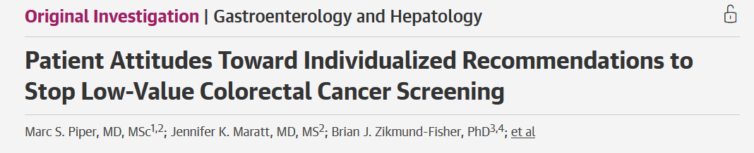
"If you personally had serious health problems that were likely to shorten your life and your doctor did not think screening would be of much benefit … how comfortable would you be with not getting any more screening colonoscopies?"
Many patients (29%) were not comfortable with cessation of low value CRC screening
Factors that increased comfort with cessation: higher trust in physician, higher perceived health status, and higher barriers to screening
Notes:
Note this may discussing cessation my difficult for some patients
Study at Michigan VA
- Survey asked "If you personally had serious health problems that were likely to shorten your life and your doctor did not think screening would be of much benefit … how comfortable would you be with not getting any more screening colonoscopies?"
Study showed that many patients (29%) were not comfortable with cessation of low value CRC screening
Factors that increased comfort with cessation: higher trust in physician, higher perceived health status, and higher barriers to screening

Slide 27

Adherence is Crucial!
Need to complete testing
Timely follow up of abnormal tests
Repeat tests at appropriate intervals
Despite options for CRC screening – all typically covered by insurance/Medicare – only ~68% are up to date
Notes:
- So 1 in 3 people in US are not up to date on CRC screening
Adherence is often the “Achilles heel” of CRC screening programs
Most significant negative risk factors are lack of health insurance and/or regular PCP

Slide 28
Adherence for Non-invasive tests
Test offered
Test completed
Test positive
Test negative
Colonoscopy offered
Colonoscopy completed
Repeat test offered
<50%
60-80%
20-65%
Notes:
We often do a good job of offering tests (which has been streamlined with templates built into EMR) and we feel good that we did our job, however, much remains in actually reducing colon cancer incidence and mortality
Test needs to be completed and appropriately followed up
Positive test indicates 2-4x higher risk and need to have subsequent colonoscopy
And negative tests need to be completed at appropriate interval as well
Data indicates that 60-80% of people who are offered a test, complete the test
And often <50% of people with positive screening test actually complete colonoscopy within recommend interval of 6 months
Repeat test rate is anywhere from 20-65%
So how do we improve our screening programs?

Slide 29
Organized Screening Program Improves Adherence
Kaiser Permanente Northern California
Screening before vs after implemented proactive outreach program from 2000 to 2015
 | Before | After | Absolute Change
Adherence | 38% | 82% | +44%
CRC Incidence | 95 per 100K | 71 per 100k | -24%
CRC Mortality | 30 per 100K | 14 per 100K | -52%
Levin TR, Corley DA, Jensen CD, et al. Effects of Organized Colorectal Cancer Screening on Cancer Incidence and Mortality in a Large Community-Based Population. Gastroenterology. 2018;155(5):1383-1391.e5. doi:10.1053/j.gastro.2018.07.017
Notes:
We know that we have ways to increase adherence
Implement several tools for CRC screening
direct-to-patient annual FIT outreach
each year FIT kits mailed if without a record of a colonoscopy within 10 years or a sigmoidoscopy within 5 years
Positive FIT initiated automatic reminder by PCP/GI to schedule colonoscopy (combo of calls, secure messaging, mail)

Slide 30

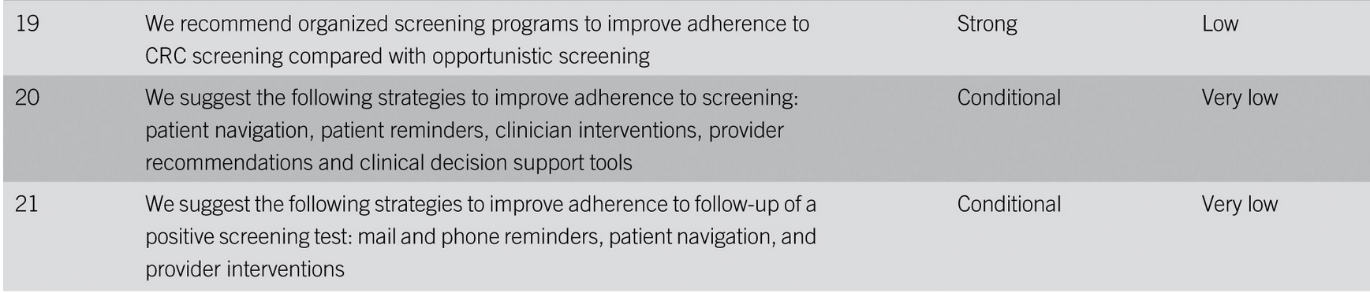
Organized Screening Programs
Notes:
Now included in ACG Guidelines from 2021 to implement an organized screening program with interventions such as patient navigators, patient reminders, clinician reminders and decision support tools

Slide 31
Why not colonoscopy for all?
Low adherence in real-world
Large upfront cost
Invasive
Limited resources
Requires high-quality colonoscopy (high ADR)
Notes:
- A question that often comes up with options for colon cancer screening – is why not colonoscopy for all?
Several important factors
Is there enough GI doctors for everyone to get colonoscopy?

Slide 32

Barriers to CRC Screening
Social determinants of health:
  Access issues
  Disparities in income, education, insurance,
  Geography
  Race and immigration status
Patient level barriers:
  Trust
  Logistics (need ride, miss day of work, childcare and/or elder care)
  Cultural barriers
  Perception

Slide 33

Future is coming soon….
Blood-based CRC screening
Guardant SHIELD – cfDNA BBT
Patients 45-84 years old
83.1% sensitivity, 89.6% specificity for CRC detection
AA detection of 13.2%
Notes:
So I think we all can realize that the “ideal” screening test should be noninvasive, have high sensitivity and specificity, be safe, readily available, convenient, and inexpensive
Lots of interest in developing blood test for colon cancer screening which would be so much simpler than colonoscopy or stool tests
Guardant SHIELD was FDA approved July 2024 and now also has Medicare coverage as of May 2025
Their studies suggest that blood tests after improved adherence compared to stool-based tests
Studied in patients 45-84 years old
Pretty impressive sensitivity for CRC, less so for advanced adenoma

Slide 34
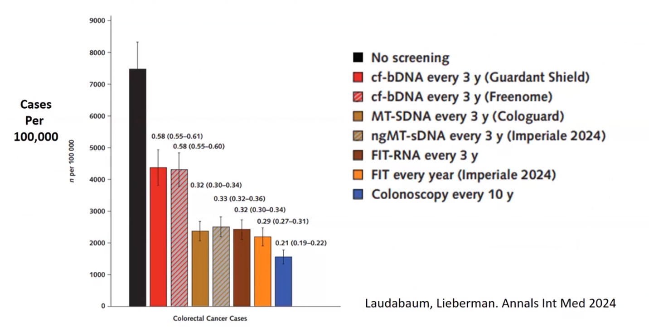
Better than no screening
Inferior to other tests
Notes:
Data from colon cancer cases comparing Shield vs no screening vs other available tests
It is better than no screening, but current stool tests and colonoscopy are better than blood tests
- Also currently quite expensive (with out-of-pocket cost around $1500) though it is covered by Medicare and increasingly covered by private insurance

Slide 35
Summary
CRC screening reduces cancer and saves lives
Adherence is key!
Risk stratify patients into high-risk vs average risk
CRC screening for all patients age 45-75
Individualize decision for patients >75
Stop screening after age 85
Screening options primarily include stool (FIT, Cologuard mtsDNA) and colonoscopy
Blood tests for CRC screening are here (SHIELD) and more to come

Slide 36

Questions?
Contact: adam.welu@bannerhealth.com
  adam.welu@va.gov

