Slide 1
Metabolic dysfunction associated steatotic liver disease (MASLD)
Ma Ai Thanda Han, MD, FACP
Transplant Hepatologist & Gastroenterologist
University of Arizona College of Medicine-Phoenix
Division of Gastroenterology and Hepatology
Banner University Medical Center
maaithanda.han2@bannerhealth.com; hanm@arizona.edu

Slide 2
Disclosure
Nothing to disclose

Slide 3
Outline
Background
Risk factors to develop MASLD
Who to screen from general population?
How to stratify risk among MASLD
Management
Life-Style Intervention
Current Therapies
Who are the at-risk patients among patients with MASLD?

Slide 4
Background
MASLD is the most common cause of chronic liver disease and elevated liver enzymes
>80 million individuals affected in US and increasing annually
MASLD is one of the leading causes of cirrhosis
MASH and ALD -the most common cause of LT among without HCC
MASH – the leading cause of Liver transplant with HCC
Most rapidly increasing indication for Liver transplant
Chalasani N HEPATOLOGY, VOL. 67, NO. 1, 2018
Younossi Z et al Clin Gastroenterol Hepatol, 2020.
Adam et al JAMA. 2020;323(12):1175-1183.
Wong RJ, Singal AK et. al. JAMA Netw Open. 2020;3(2):e1920294.
Notes:
The criteria are based on evidence of hepatic steatosis, in addition to one of the following three criteria, namely overweight/obesity, presence of type 2 diabetes mellitus, or evidence of metabolic dysregulation.

Slide 5

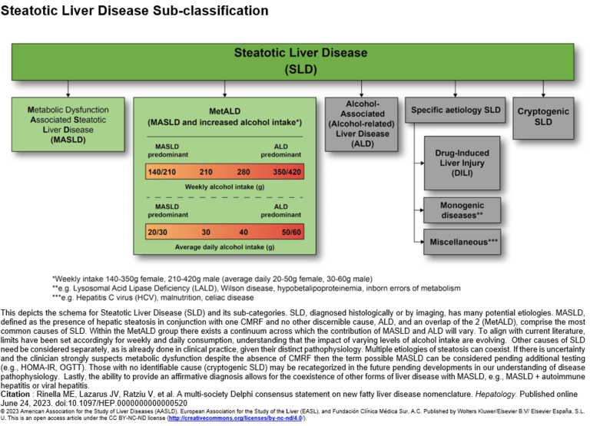
New Nomenclature –Steatotic Liver Disease (SLD)

Slide 6
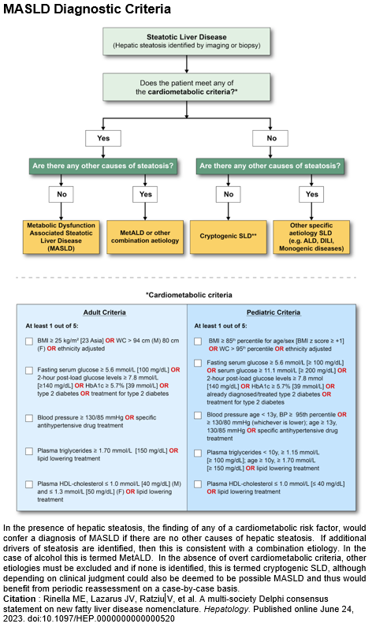
Metabolic Dysfunction Associated Steatotic Liver Disease (MASLD)

Slide 7
Question 1:
A 52-year-old woman is evaluated for chronically elevated ALT and AST discovered on routine labs. She does not drink alcohol. BMI is 33 kg/m². Medical history includes diabetes mellitus, hypertension and dyslipidemia. Which of the following is the strongest independent risk factor for developing MASLD and progressive liver fibrosis?
A. Female sex
B. Hypertension
C. Type 2 diabetes mellitus
D. Hypertriglyceridemia
E. Moderate alcohol intake
C

Slide 8
Rick Factors (High Risk) MASLD
Morbid Obesity (BMI≥35)
Obesity
70%
Race
Hispanic, SE Asia >Caucasian>>African American: 45-50%
PCOS
80-90% in bariatric surgery patients
T2DM
70%
Metabolic syndrome
Central obese, Hyperglycemia, HTN, Dyslipidemia: 53%
Dyslipidemia
High TG, low HDL: 50%
15-55%
Non- Asian > 25 kg/ m ²
Asian- >23 kg/m ²
Lean NAFLD
Associated with metabolic syndrome (6.8-10.8%) – older, male
Chalasani N HEPATOLOGY, VOL. 67, NO. 1, 2018
AGA clinical practice update: Lean NAFLD: Gastroenterology 2022 –In press
Notes:
Prevalence
NCEP ATP III
Central obesity (WC >102 m male, >88 cm female); Fasting glucose >110 mg/dl, HTN >130/85 mmHg, TG >150 mg/dl, HDL <45 mg/dl male, <50 mg/dl female

Slide 9
What is the potential causes
Metabolic
Environment
Food – Fructose, Saturated & Trans fat (Processed/Ultra processed food)
Alcohol
Drug & Toxin
Genetic, Epigenetic, Ethnic, virus etc.
Hispanic, SE Asia >Caucasian>>African American
Obesity/Overweight
High blood pressure (Hypertension)
Hyperlipidemia
Diabetes/Insulin resistance
Genetic- PNPLA3

Slide 10
Answer 1: C
Type 2 diabetes mellitus is the strongest and most consistent risk factor for MASLD and progression to steatohepatitis and advanced fibrosis.
Obesity, dyslipidemia, and hypertension are components of metabolic syndrome, diabetes confers the highest risk of fibrosis progression and liver-related mortality.
Female sex is not an independent risk factor
Moderate alcohol intake excludes MASLD by definition.

Slide 11
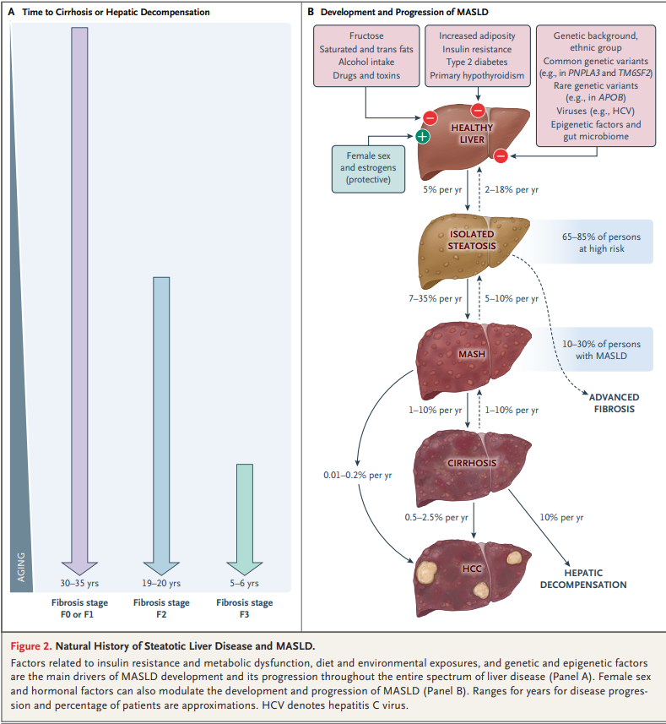
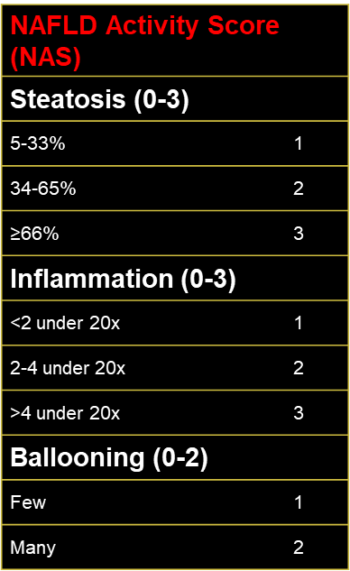
Natural History & Disease Spectrum
No fibrosis | Stage 0
Portal fibrosis | Stage I
Peri-portal fibrosis | Stage II
Bridging fibrosis | Stage III
Cirrhosis | Stage IV
G. Targher et.al NEJM.2025-08-14 393(7): 683-698
Notes:
Factors related to insulin resistance and metabolic dysfunction, diet and environmental exposures, and genetic and epigenetic factors are the main drivers of MASLD development and its progression throughout the entire spectrum of liver disease (Panel A). Female sex and hormonal factors can also modulate the development and progression of MASLD (Panel B). Ranges for years for disease progression and percentage of patients are approximations. HCV denotes hepatitis C virus.

Slide 12
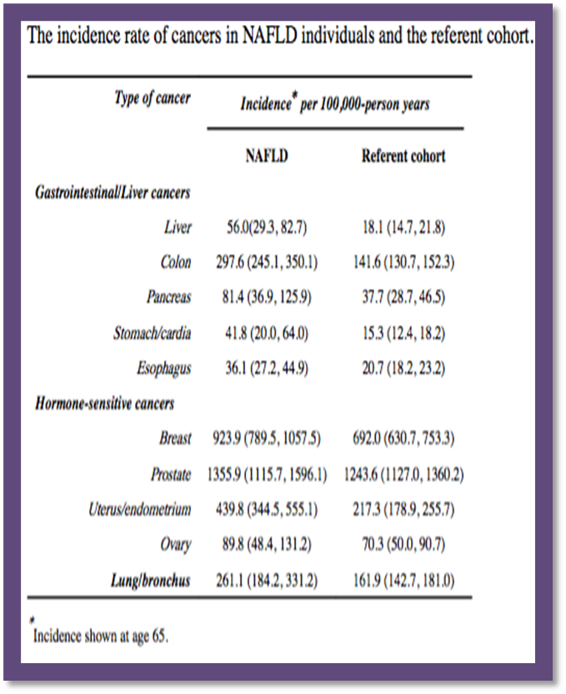
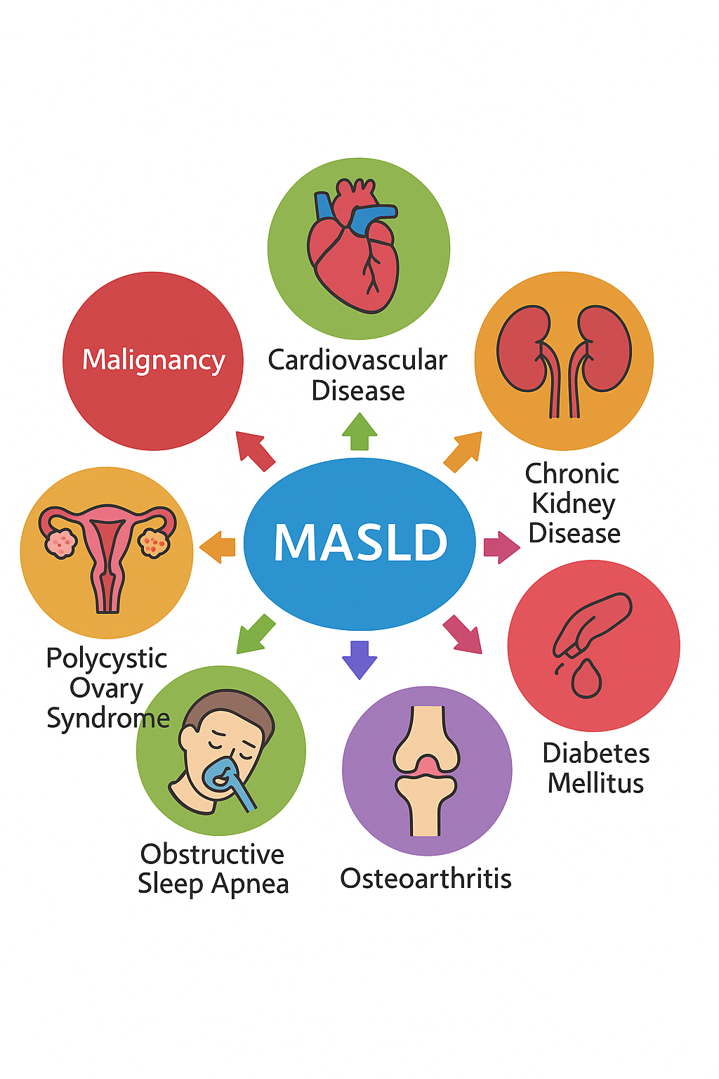
MASLD related Disease

Slide 13
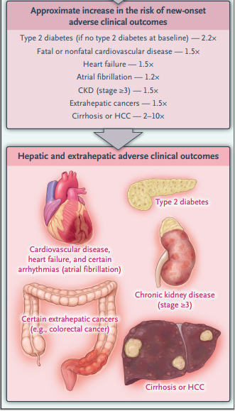
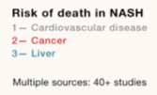
Extrahepatic Disease Outcomes
Loomba et.al Cell 184, May 13, 2021
G. Targher et.al NEJM.2025-08-14 393(7): 683-698

Slide 14
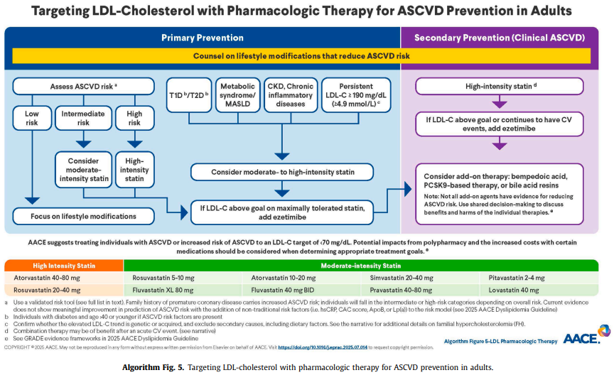
Hyperlipidemia
Statin -safe | CV Risk reduction across spectrum including compensated cirrhosis
Statin | -Limited data on decompensated cirrhosis -use with Careful monitoring in Pts with high CV risk
Hypertriglyceridemia | Lifestyle Supplement with Omega-3 fatty acids, icosapent ethyl, or fibrates
Rinella, Mary E. el.al Hepatology. 2023;77:1797–1835.
S.B. Patel, L.M. Belalcazar, S. Afreen et al Endocrine Practice xxx (xxxx) xxx in press

Slide 15
Alcohol use & MASLD
Alcohol use | Disease progression
Mild Female- up to 20 g/day Male – up to 30 g/day | Associated with less improvement in steatosis, AST and lower odds of NASH resolution
Moderate Female – 21-39 g/day Male – 31-59 g/day | Increase probability of advanced fibrosis
Heavy Female ≥ 40 g/day Male ≥ 60 g/day | Accelerates liver injury, fibrosis
Obesity & alcohol use – | Synergistically increased risk of Liver injury, cirrhosis & death from liver
Daily Alcohol use | Increase risk for extrahepatic malignancy & HCC
Rinella, Mary E. el.al Hepatology. 2023;77:1797–1835.

Slide 16
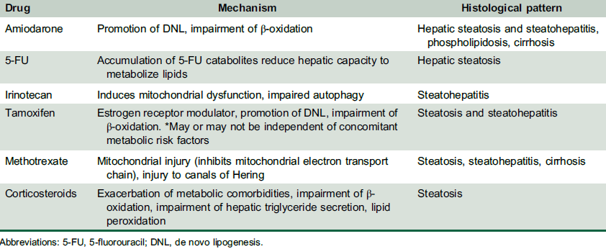
Drugs links to macro-vesicular steatosis or steatohepatitis
Rinella, Mary E. el.al Hepatology. 2023;77:1797–1835.

Slide 17
Question 2
A 60 YOF with diabetes mellitus, hypertension who comes to primary care office for regular medical check up. On examination, her BMI 33 kg/m2, the rest of the examination are negative. Her medications include Glyburide and lisinopril. Lab include AST 90 IU/L, ALT 110 IU/L, Alkaline phosphatase 210 IU/L, bilirubin 0.5, platelet 150K. Ultrasound showed bright liver. SMA 1:20, IgG 1010, AMA negative. Hepatitis A, B and C serologies were negative.
What is the next investigation ?
Check Fibrosure
Calculate FIB 4 score
CT scan abdomen
MRI abdomen
B

Slide 18
Question 3
A 60 YOF with diabetes mellitus, hypertension who comes to primary care office for regular medical check up. On examination, her BMI 33 kg/m2, the rest of the examination are negative. Her medications include Glyburide and lisinopril. Lab include AST 90 IU/L, ALT 110 IU/L, Alkaline phosphatase 210 IU/L, platelet 150K. Ultrasound showed bright liver. SMA 1:20, IgG 1010, AMA negative. Hepatitis A, B and C serologies were negative. FIB4 score 3.43.
What is the next step ?
Refer to hepatology clinic
CT scan abdomen
MRI abdomen
Liver biopsy
A

Slide 19
Who is the high-risk patient?

Slide 20
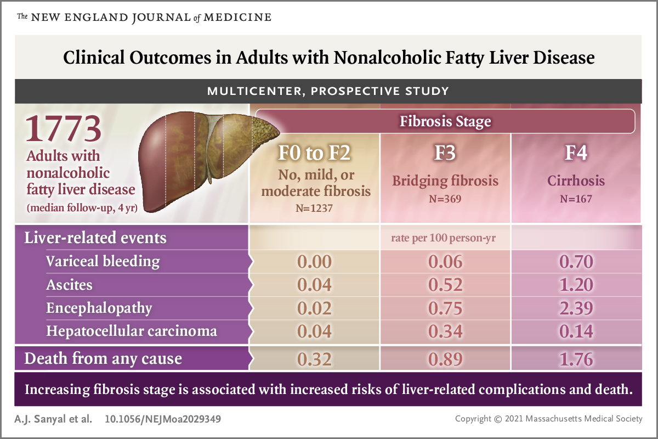

Slide 21
Incidence of Events based on Fibrosis Stages
 | F4 Rate/100-person year | F3 Rate/100-person year | F0-2 Rate/100-person year
All cause mortality | 1.76 | 0.89 | 0.32
Any decompensation event | 2.69 | 0.99 | 0.05
MELD>15 | 2.33 | 0.87 | 0.57
CAD | 0.81 | 0.93 | 0.8
Hypertension | 14.49 | 12.17 | 6.5
eGFR<60ml/min | 4.49 | 2.97 | 2.17
Type 2 DM | 7.53 | 6.24 | 4.45
Sanyal et.al. N Engl J Med. 2021 Oct 21;385(17):1559-1569

Slide 22
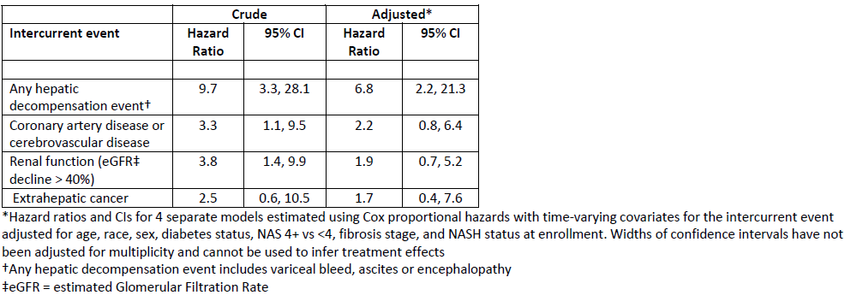
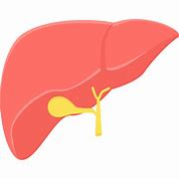

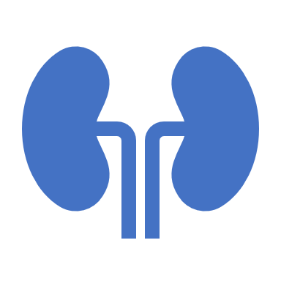
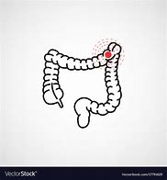
Association between first occurrence of selected intercurrent event and all-cause mortality
Hepatic decompensation (HR 6.8)
CVA/CAD (HR 2.2)
eGFR decline >40% (HR 1.9)
Extra-hepatic cancer (HR 2.5)
Sanyal et.al. N Engl J Med. 2021 Oct 21;385(17):1559-1569

Slide 23
“At-Risk” MASH
Patients with NASH & F2-4 fibrosis
  Higher risk for liver related events and mortality
Rinella, Mary E. et.al AASLD Practice Guidance on the clinical assessment and management of nonalcoholic fatty liver disease. Hepatology (): March 17, 2023. | DOI: 10.1097/HEP.0000000000000323

Slide 24
Who should be screened for clinically significant fibrosis?

Slide 25
Screen for Clinically significant fibrosis F≥ 2
Prevalence of advanced fibrosis in background population 0.9-2%
Screen for advanced fibrosis in high-risk population | Prevalence of advanced fibrosis %
T2DM | 6-19
Obesity with metabolic complications | 4-33
NAFLD with moderate alcohol use (>20g/day-female, 30g/day-male) | 17
1st degree relative of a patient with cirrhosis due to NAFLD/NASH | 18
Rinella, Mary E. et.al AASLD Practice Guidance on the clinical assessment and management of nonalcoholic fatty liver disease. Hepatology (): March 17, 2023. | DOI: 10.1097/HEP.0000000000000323
Notes:
Avoid complete alcohol consumption in patients with significant fibrosis F≥ 2

Slide 26
How to stratify risk
Who needs to be referred to Hepatology Clinic?

Slide 27
Staging of NAFLD - Fibrosis
Invasive staging (Gold Standard)
Non Invasive Tests (NIT) staging

Slide 28
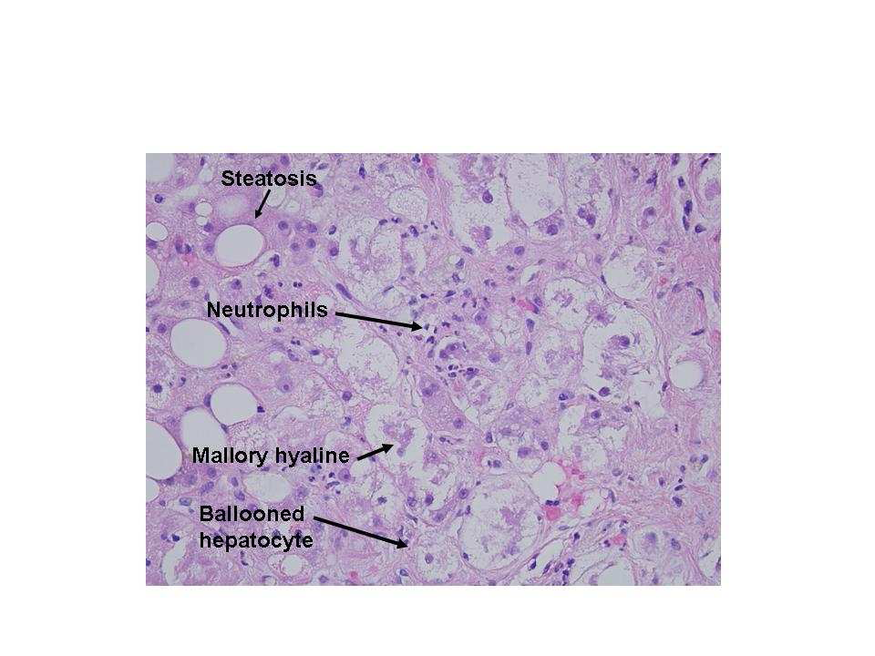
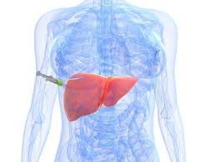
Invasive: Liver biopsy
Liver Biopsy
Gold standard –
    Clinical – staging, differentiate/detect concomitant disease
    End points of phase 3 clinical trials
Limitations –
  Invasive
  Small risk of complications
  Risk of sampling error or variability
  Low acceptance by patients
  Inconvenience for monitoring of disease status
  Cost
Bedossa P Hepatology 2003;38:1449-57.
Siddiqui MS Hepatology 2018;67:2001-2012.

Slide 29
Non invasive Tests (NIT) for staging
Biomarkers
VTCE
Shear Wave Elastography
SWE
Imaging
Simple
MRE
Complex

Slide 30
Simple NIT biomarkers
Score | Formula
FIB4 | Age x AST (IU/l)/platelet count (x10⁹/litre)x √ALT (IU/l).
NFS (NAFLD fibrosis score) | 1.675+0.0373age (years)+0.0943BMI (kg/m2)+1.133impaired fasting glycaemia or diabetes (yes1⁄41, no1⁄40)+0.993AST/ALT ratio 0.0133platelet (31x9/litre) 0.663albumin (g/dl)

Slide 31
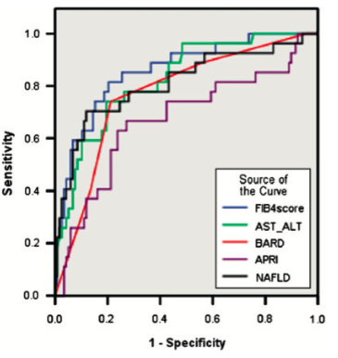
Accuracy of simple NIT biomarkers
(no/Mild vs advanced fibrosis)
No/Mild Fibrosis F0-2
Indeterminate
?
Advanced Fibrosis F3-4
TESTS | CUT-OFF
FIB4 | <1.3
AST/ALT | <0.8
NSF | <-1.455
TESTS | CUT-OFF
FIB4 | >2.67
AST/ALT | >1
NSF | >0.676
FIB4 0.86
AST/ALT 0.83
NSF 0.81
BARD 0.77
Indeterminate stage?
McPherson S Gut. 2010 Sep;59(9):1265-9
Shah. Clin Gastroenterol Hepatol. 2009;7:1104
Notes:
To accurately diagnosed advanced fibrosis
145 patients (82 male (61%), mean age 51612 years) were included. The mean body mass index was 3565 kg/m2. 73 subjects (50%) had diabetes. 93 patients (64%) had non-alcoholic steatohepatitis.

Slide 32
Complex Tests

Slide 33
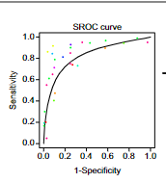

Test |  | Data
ELF (Enhanced Liver Fibrosis panel) To assess ≥F3 | DS= -7.412+(ln(HA)*0.681)+(ln(P3NP)*0.775)+ (ln(TIMP1)*0.494) HA=Hyaluronic acid P3NP=Pro-collagen 3 TIMP1=Tissue Inhibitor of matrix metalloproteinase 1
Sensitivity of >0.90 for excluding fibrosis at threshold of 7.7
Specificity of 0.90 for advanced and significant fibrosis ,thresholds of 10.18 (sensitivity: 0.57) and 9.86 (sensitivity: 0.55)
Vali et al. J.Hepatol. 2020, 73, 252–262 Boyle J Hep Reports. 2019 Jul 4;1(3):188-198
Daniels SJ. Hepatology. 2019 Mar;69(3):1075-1086

Slide 34
Imaging
Liver Stiffness Measurement

Slide 35
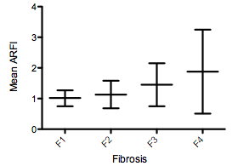
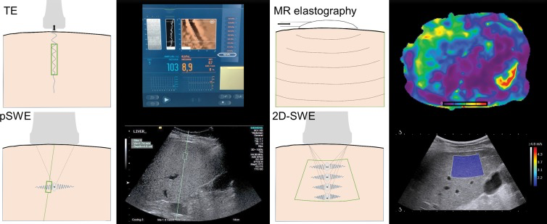
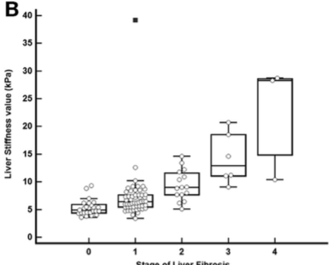
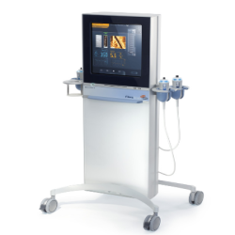
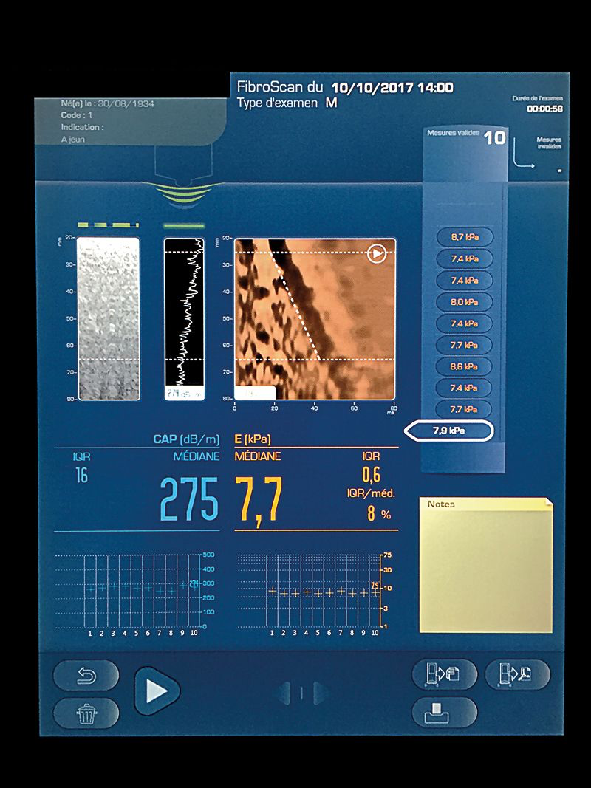
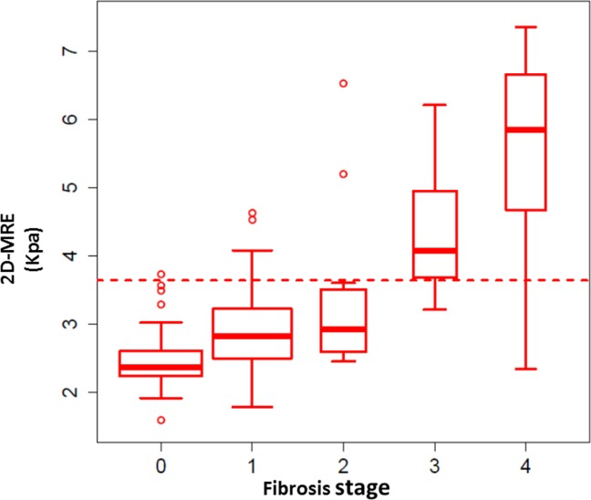
Technique |  | Data
Acoustic Radiation Force Impulse (ARFI) | High intensity acoustic beam to tissue Monitor tissue displacement response
Shear Wave Elastography (SWE) | Shear waves generated from acoustic pulse at 5 different tissue depth levels
Tranisent Elastography (TE) | Shear waves propagates through liver parenchyma Limit: obese, ascites, inflammation, congestion, post prandial
Magnetic Resonance Elastography (MRE) | Most accurate NIT Costly No point of care access
Fibrosis | m/s | AUROC
≥F2 | 1.32 | 0.77
≥F3 | 1.53 | 0.84
F4 | 2.04 | 0.84
Fibrosis | kPa | AUROC
≥F1 | 6.3 | 0.82
≥F2 | 7.6 | 0.87
≥F3 | 9 | 0.95
Fibrosis Stage | Youden’s Threshold (kPa) | AUROC
F0-F1 vs > F2 | 8.2 | 0.77
F0-F2 vs F3 | 9.7 | 0.71
F0-F3 vs F4 | 13.6 | 0.89
Fibrosis | kPa | AUROC
≥F1 | 3.02 | 0.838
≥F2 | 3.58 | 0.856
≥F3 | 3.64 | 0.924
Cassinotto C et al.Hepatology: 2016 Jun;63(6):1817-27, Lee H et al. Clin Gastroenterol Hepatol 2020 May 22;S1542-3565(20)30693-5
Eddowes PJ Gastroenterology. 2019 May;156(6):1717-1730
Loomba.el.al Hepatology, 2014:60-1920

Slide 36
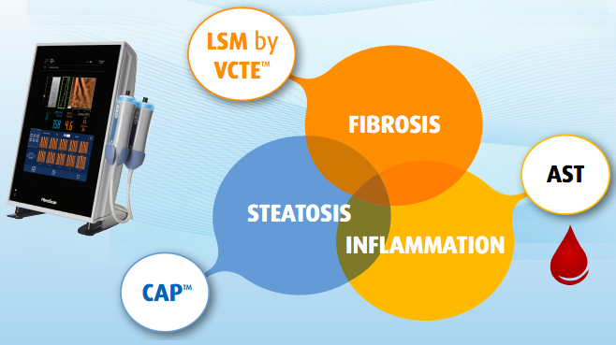

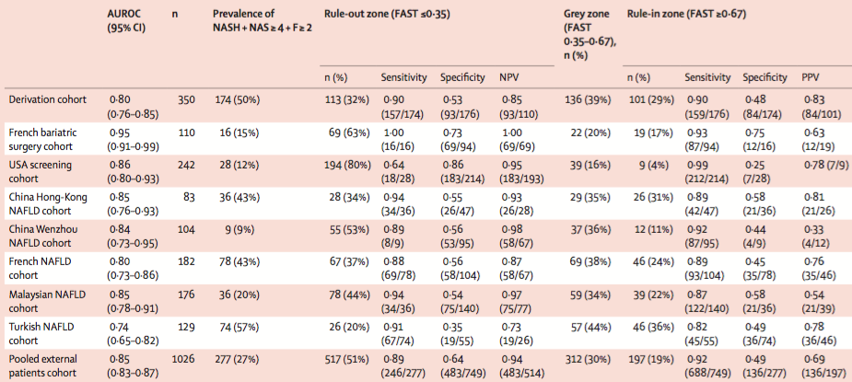
FAST (Fibroscan-AST)
Main outcome=NASH+NAS≥4+F≥2
Newsome et.atl Lancet Gastroenterol Hepatol. 2020 Feb 3
^{Epub ahead of print}
Notes:
Between March 20, 2014, and Jan 17, 2017, 350 patients with suspected NAFLD attending liver clinics in England were prospectively enrolled.
Main outcome=NASH(FLIP defination)+NAS≥4+F≥2
350 patients undergoing a biopsy for suspicion of NAFLD, FAST demonstrated an AUROC of .80 while in a pooled external validation cohort of 1026 patients the AUROC was 0.85

Slide 37
Narrow Indeterminate Zone
No/Mild Fibrosis F0-2
Indeterminate
?
Advanced Fibrosis F3-4
Sequential NITs Test
No/Mild Fibrosis F0-2
Indeterminate
?
Advanced Fibrosis F3-4

Slide 38
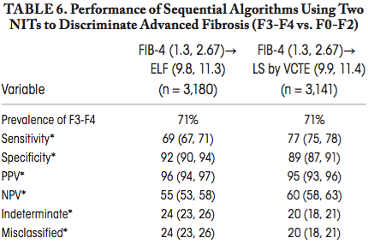
Sequential NITs to Reduce Indeterminate Zone
Single tests
(either NFS, FIB4,ELF, VTE)
Up to 50% indeterminate
Anstee.et. al. Hepatology. 2019;70:1521.
Notes:
Study of baseline data from STELLAR trials (N = 3202) to determine performance of sequential combinations of noninvasive tests in diagnosing F3/F4 liver fibrosis
Phase 3 trial selonsertib

Slide 39
Algorithm for Clinical Practice

Slide 40
Answer 2
A 60 YOF with diabetes mellitus, hypertension who comes to primary care office for regular medical check up. On examination, her BMI 33 kg/m2, the rest of the examination are negative. Her medications include Glyburide and lisinopril. Lab include AST 90 IU/L, ALT 110 IU/L, Alkaline phosphatase 210 IU/L, bilirubin 0.5, platelet 150K. Ultrasound showed bright liver. SMA 1:20, IgG 1010, AMA negative. Hepatitis A, B and C serologies were negative.
What is the next investigation ?
Check Fibrosure
Calculate FIB 4 score
CT scan abdomen
MRI abdomen
Risk stratification is important
FIB4 3.43 which is >1.3
B

Slide 41
Answer 3
A 60 YOF with diabetes mellitus, hypertension who comes to primary care office for regular medical check up. On examination, her BMI 33 kg/m2, the rest of the examination are negative. Her medications include Glyburide and lisinopril. Lab include AST 90 IU/L, ALT 110 IU/L, Alkaline phosphatase 210 IU/L, platelet 150K. Ultrasound showed bright liver. SMA 1:20, IgG 1010, AMA negative. Hepatitis A, B and C serologies were negative.
What is the next step ?
Refer to hepatology clinic
CT scan abdomen
MRI abdomen
Liver biopsy
FIB4 3.43 which is >1.3 → refer to Hepatology clinic
A

Slide 42
Management
Life-style Modification
Weight loss Management
Liver Targeted Therapy

Slide 43
Question -4
A 55 YOM with BMI 35 kg/m2, hypertension who was found to have elevated liver enzymes. Lab include AST 90 IU/L, ALT 110 IU/L, Alkaline phosphatase 210 IU/L, platelet 150K. Ultrasound showed bright liver. The investigation for elevated liver test include. SMA 1:20, IgG 1010, AMA negative. Ferritin 600, % saturation iron 25%, Hepatitis A, B and C serologies were negative. Ultrasound showed increased echogenicity of liver. Which of the following interventions is most strongly associated with histologic improvement in steatohepatitis and fibrosis?
A. Low-carbohydrate diet without weight loss
B. Aerobic exercise without weight loss
C. Vitamin supplementation
D. Weight loss of ≥10% of body weight
E. Intermittent fasting alone
D

Slide 44
Life-style Intervention
5% weight loss →improve hepatic steatosis
7% weight loss → improve MASH
10% weight loss → improve fibrosis
12-70%of pts Achieve
9-12%
9-10%
Lean NAFLD
3-5% weight loss, exercise, avoid Fructose
Romero-Gómez M, et al. J Hepatol. 2017Oct;67(4):829-846
Vilar-Gomez E et al. Gastroenterology.2015 Aug;149(2):367-78.35
AGA clinical practice update: Lean NAFLD: Gastroenterology 2022 –In press

Slide 45
Answer 4 : D Weight loss of ≥10% of body weight
Sustained ≥10% weight loss is associated with:
Resolution of steatohepatitis
Improvement in fibrosis
Reduction in liver-related outcomes
Exercise and dietary changes are beneficial, but magnitude of weight loss is the key determinant of histologic improvement. Vitamin supplementation alone has not shown consistent benefit.

Slide 46
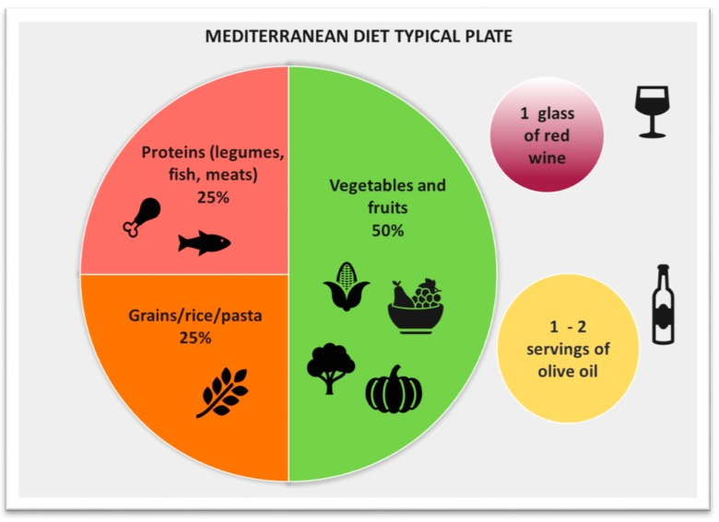
Dietary Changes
Daily Calories
1200-1600 calories
Lipids
20-30% of daily calories
Rich in MUFA and PUFA
Proteins
1.5 g/kg/day
Rich in plant-based protein
Carbohydrates
<45-65% of daily calories with decreased simple sugar
Low CHO diet
Improves liver fat metabolism
Mediterranean diet
Improves steatosis, IR, even without weight loss
Reduce CV events, metabolic syndrome
Coffee (caffeinated, filtered)
≥3 cups/day-decrease mortality
Alcohol consumption
Reduce or abstinence
Reduce fibrosis
Limit ≤2 drinks/d for female, ≤3 drinks/d for male
Limit 20g/d for female, 30 g/d for male
Vlad Ratziu 1, et al. Transplantation. 2019 Jan;103(1):28-38. Romero-Gómez M, et al. J Hepatol. 2017Oct;67(4):829-846.Torres M et al. Nutrients. 2019 Dec; 11(12): 2971.
Notes:
Mediterranean diet-high consumption of monounsaturated fatty acids primar- ily from olives and olive oil, fruit, cereals, whole grain cereals, and low-fat dairy products with infrequent consumption of red meat
The beneficial cytoprotective effects of coffee depends not only on caffeine but also on diterpens and chlorogenic compounds.

Slide 47
Question 5:
A 49-year-old woman with obesity (BMI 36 kg/m²), type 2 diabetes, and biopsy-proven MASLD with steatohepatitis (F2 fibrosis) who is at the clinic for follow up. What is the most beneficial therapy ?
Phlebotomy
Semaglutide & Weight loss
Pioglitazone
Prednisone
B

Slide 48
Therapies for mASLD/MASH
Medical and Surgical/Endoscopic Therapies

Slide 49
FDA Approved Medicine- non cirrhosis (F2-3)
Resmetirom (Rezdiffra)
Semaglutide (Wegovy)

Slide 50
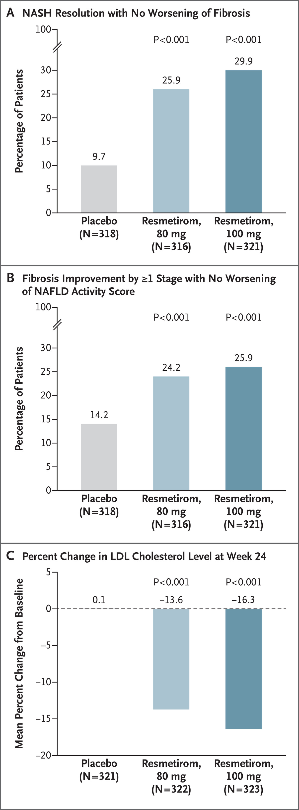
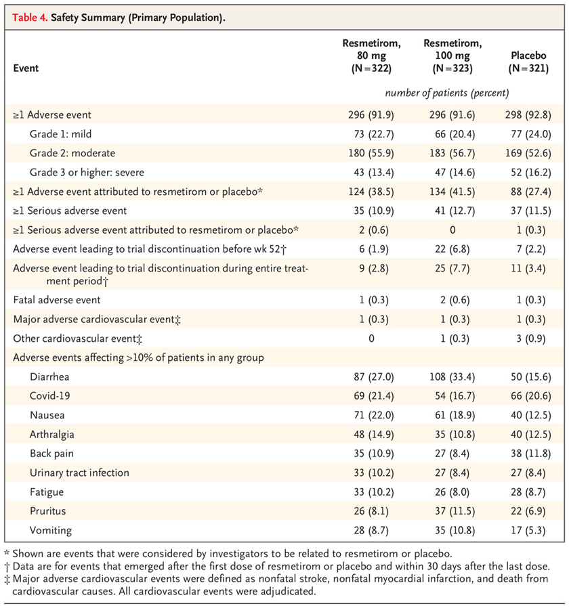

Resmetirom (Rezdiffra)
Thyroid Hormone Receptor Beta Agonist (THR-β)–selective agonist
Phase 3, double-blind, randomized, placebo-controlled trial at 245 sites in 15 countries- 966 patients with MASH with F1B, F2, F3)
SA Harrison et al. N Engl J Med 2024;390:497-509.
Notes:
In NASH, THR-β function in the liver is impaired, which leads to a reduction in mitochondrial function and β-oxidation of fatty acids in association with an increase in fibrosis.
Figure 1. Primary and Key Secondary End Points. The two primary end points at week 52 were resolution of nonalcoholic steatohepatitis (NASH) with no worsening of fibrosis (Panel A), and an improvement (reduction) in fibrosis by at least one stage with no worsening of the nonalcoholic fatty liver disease (NAFLD) activity score (Panel B). The key secondary end point was the percent change from baseline in the low-density lipoprotein (LDL) cholesterol level at week 24 (Panel C). The NAFLD activity score is assessed on a scale of 0 to 8, with higher scores indicating more severe disease; the components of this measure are steatosis (assessed on a scale of 0 to 3), lobular inflammation (assessed on a scale of 0 to 3), and hepatocellular ballooning (assessed on a scale of 0 to 2). NASH resolution was defined as achievement of a hepatocellular ballooning score of 0, a lobular inflammation score of 0 or 1, and a reduction in the NAFLD activity score by at least 2 points. Fibrosis stages range from F0 (no fibrosis) to F4 (cirrhosis). A total of 11 patients had a delay in their week 52 biopsy due to coronavirus disease 2019–related closure of the biopsy site or related reasons and were removed from the primary analysis population for liver-biopsy analyses.

Slide 51
Indication & Dosage
REZDIFFRA is indicated in conjunction with diet and exercise for the treatment of adults with noncirrhotic nonalcoholic steatohepatitis (NASH) with moderate to advanced liver fibrosis (consistent with stages F2 to F3 fibrosis)
• The recommended dosage of REZDIFFRA is based on actual body weight
<100 kg, 80 mg orally once daily
≥ 100 kg, 100 mg orally once daily
No Contraindications
Major side effect – Diarrhea and Nausea

Slide 52
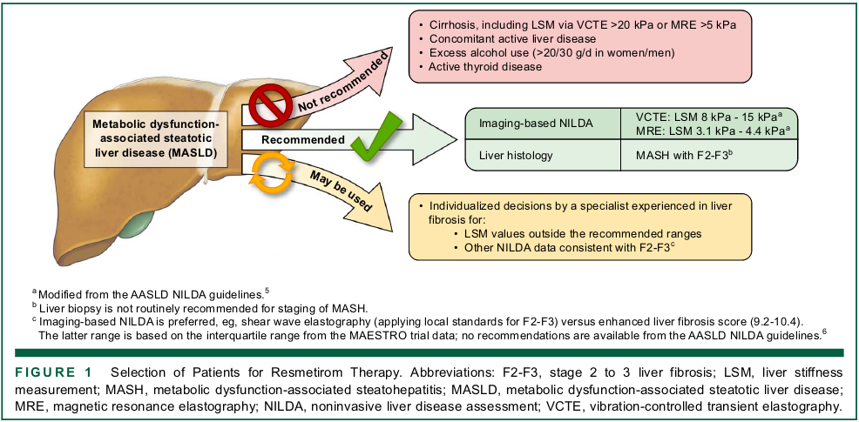
Whom To Treat
Nonquantitative imaging evidence of hepatic steatosis (eg, ultrasonographic evidence) in persons with at least 1 cardiometabolic risk factor and F2-F3
MAESTRO-NASH Trial-
  screened with VCTE and those with LSM > 8.5 kPa in whom liver histology demonstrated MASH with F2-F3 were enrolled
  Median (IQR) LSM by VCTE was 12 kPa (10-15 kPa) and the mean LSM by MRE was 3.5 kPa
  Median (IQR) of ELF (Enhanced Liver Fibrosis score) fibrosis score was 9.7 (9.2-10.4)
Ultimately, it is the prescriber’s prerogative and responsibility to adjudícate a patient’s fibrosis status.
Chen et. Al. AASLD MASLD GUIDANCE UPDATE: RESMETIROM. Hepatology. 2024 Oct 18 doi: 10.1097/HEP.0000000000001112

Slide 53
Warnings & Precautions
Hepatotoxicity –
  1 patient (DI-AIH) –resolved with discontinuation
  Monitor hepatotoxic → discontinue
Gall bladder related adverse reactions
  Cholelithiasis, acute cholecystitis, obstructive pancreatitis (gall stones) observed more often treated group.
  If happens, interrupt treatment until the event is resolved
Drug interaction
Renal impairment
  Mild to moderate renal impairment – dose the same as normal
  Not studies in severe renal impairment
Hepatic impairment –
  avoid – decompensated cirrhosis Child Pugh B or C
  No dosage adjustment in Child Pugh A

Slide 54
Drug Interaction
Clinically Significant Interactions Affecting Rezdiffra
Strong or Moderate CYP2C8 Inhibitors: Resmetirom is a CYP2C8 substrate. Concomitant use with strong CYP2C8 inhibitors (e.g., gemfibrozil) is not recommended.
Reduce Rezdiffra dosage if used concomitantly with a moderate CYP2C8 inhibitor (e.g., clopidogrel).
Organic Anion-Transporting Polypeptides (OATP) 1B1 and OATP1B3 Inhibitors: Resmetirom is an OATP1B1 and OATP1B3 substrate. Concomitant use with OATP1B1 or OATP1B3 inhibitors (e.g., cyclosporine) is not recommended.
Clinically Significant Interactions Affecting Other Drugs
Statins
  Limit daily rosuvastatin and simvastatin dosage to 20 mg
  Limit daily pravastatin and atorvastatin dosage to 40 mg
CYP2C8 Substrates: Resmetirom is a weak CYP2C8 inhibitor. Monitor patients more frequently for substrate-related adverse reactions if Rezdiffra is co-administered with CYP2C8 substrates where minimal concentration changes may lead to serious adverse reactions.

Slide 55
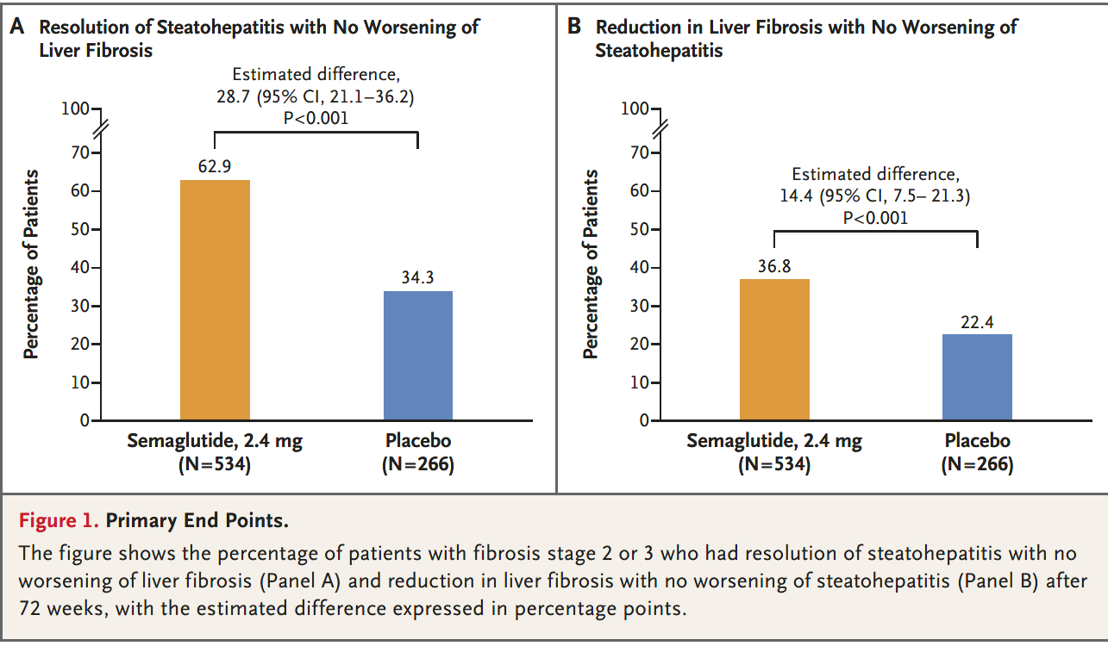
Phase 3 Essence Trial – Semaglutide in Metabolic Dysfunction-Associated Steatohepatitis
Sanyal AJ et. al. N Engl J Med. 2025 Apr 30. doi: 10.1056/NEJMoa2413258

Slide 56
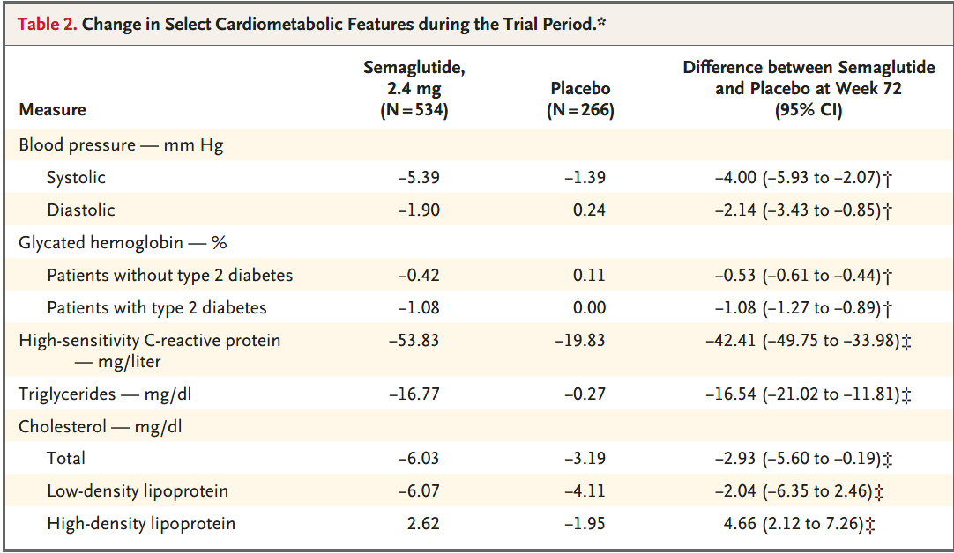
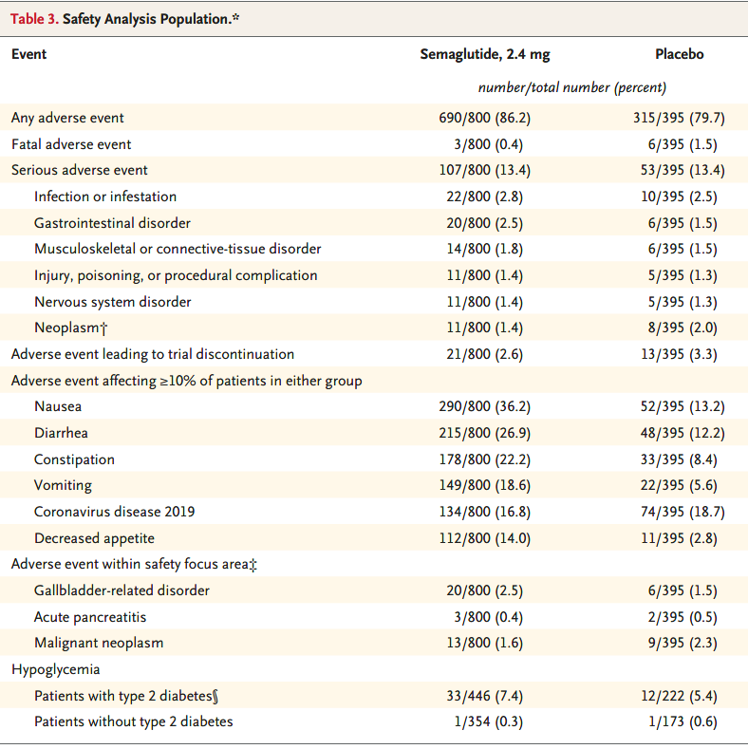
Phase 3 Essence Trial – Semaglutide in Metabolic Dysfunction-Associated Steatohepatitis
Sanyal AJ et. al. N Engl J Med. 2025 Apr 30. doi: 10.1056/NEJMoa2413258
Notes:
Reduced HbA1C, insulin resistance, plasma lipd level

Slide 57
Contraindication & Caution
Contraindication
Caution
Medullary Thyroid Cancer
MEN-2
Hypersensitivity to Semaglutide
History of Pancreatitis
Gall stones
DM retinopathy
Cause Pancreatitis
Aspiration risk with surgery and procedure

Slide 58
Obese MASLD

Slide 59
Weight Loss Therapies
Pharmacotherapy
GLP-1 RA (Liraglutide)
Others- orlistat, Phentermine, Natrexone/Bupropion
Endoscopic Bariatric
Gastric Balloon
Sleeve Gastroplasty
Bariatric Surgery
Rou-en-Y Gastric by-pass
Sleeve Gastroplasty
DMR (duodenal mucosal resurfacing)
Gastric emptying
Duodenal-jejunal bypass sleeves
Liraglutide
Semaglutide
Tirzepatide
Mean 8-13% total body wt loss

Slide 60
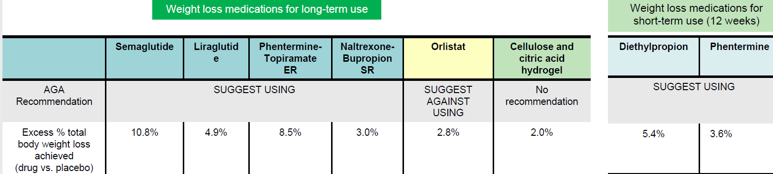
Pharmacotherapy for weight loss – general population
No studies in Chronic Liver disease
Minimal hepatic metabolism (dose adjust in Child B, avoid in Child C)
Monitor BP & HR
No data on Chronic liver disease (studies exclude patients with liver disease)
avoid in seizure, uncontrolled hypertension
Meta-analysis 7 studies in NAFLD & NASH
Mean BMI difference -1.97, ALT difference -1.41, not liver fibrosis score
Hepatology, VOL . 73, NO. 5, 2021
AGA guideline-pharmacotherapy
for obesity. Gastroenterology. 2022 Nov;163(5):1198-1225
Notes:
Orlistat- reversible inhibitor of gastric and pancreatic lipase and acts by directly blocking absorption of about 30% of dietary triglycerides (120 mg 3 times per day with meal)
Phentermine is a hypothalamic adrenergic agonist that stimulates the sympathetic nervous system, resulting in decreased appetite and increased resting Energy expenditure.

Slide 61
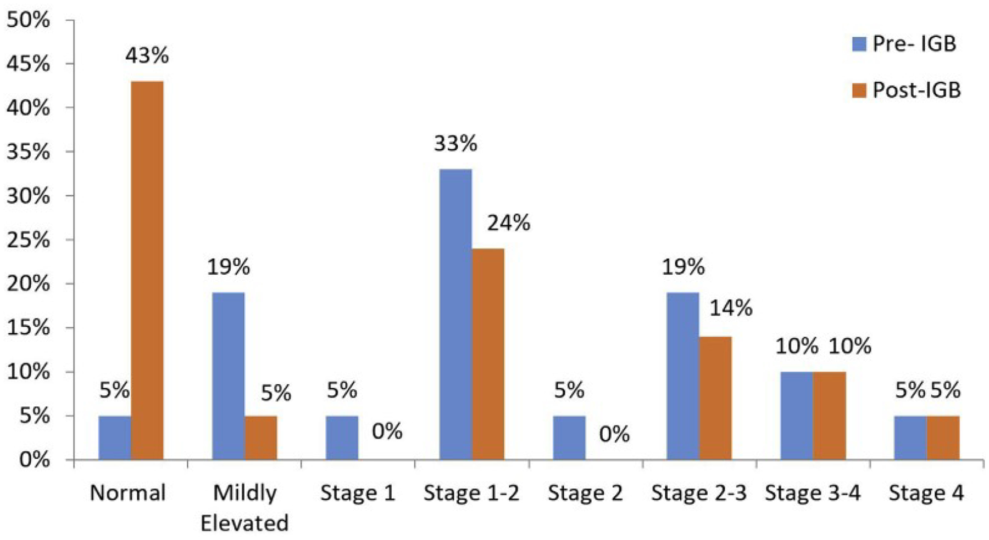
Intragastric Gastric Balloon Placement induces Significant Metabolic & Histologic Improvement in patients with NASH
Half of patients reached endpoints approved by the FDA for NASH resolution and fibrosis improvement
Fibrosis, measured by magnetic resonance elastography, improved by 1.5 stages in half of the patients
Bazerbachi et.al. Clin Gastroenterol Hepatol. 2021 January ; 19(1): 146–154.e4.
Notes:
Twenty-one patients with early hepatic fibrosis
Six months after IGB
NAS improved in 18 of 20 patients (90%), with a median decrease of 3 points (range, 1–4 points); 16 of 20 patients (80%) had improvements of 2 points or more. Fibrosis improved by 1.17 stages in 15% of patients, and MRE-detected fibrosis improved by 1.5 stages in 10 of 20 patients (50%).

Slide 62
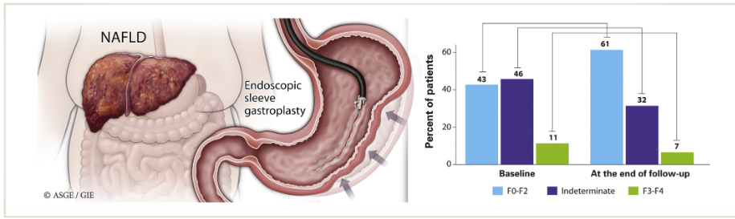
Endoscopic Sleeve Gastroplasty
Twenty-four patients (20%) improved their risk of hepatic fibrosis from F3-F4 or indeterminate to F0-F2 using NFS
Mean total body weight loss was 15.5% (95% confidence interval, 13.3%-17.8%)
Patients’ hepatic steatosis index score improved significantly, decreasing by 4 points per year (P for trend, <.001)
Patients’ NAFLD fibrosis score improved significantly, decreasing by 0.3 point per year (P for trend, .034).
Hajifathalian et.al Gastrointest Endosc. 2021 May;93(5):1110-1118.
Notes:
One hundred eighteen patients with obesity and NAFLD underwent ESG and were followed for 2 years.
NAFLD were identified using hepatic steatosis index (HSI) model

Slide 63
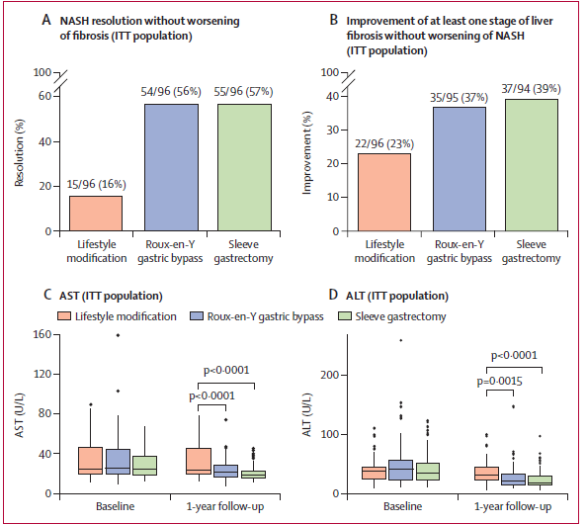
Bariatric–metabolic surgery versus lifestyle intervention plus best medical care in non-alcoholic steatohepatitis (BRAVES): a multicentre, open-label, randomised trial
Randomly assigned 288 (67%) participants with biopsy-proven NASH to
  lifestyle modification plus best medical care (n=96 [33%]),
  Roux-en-Y gastric bypass (n=96 [33%]), or sleeve gastrectomy (n=96 [33%]).
Verrastro O et.al. Lancet. 2023 Apr 20:S0140-6736(23)00634-7.
Notes:
multicentre, open-label, randomised trial at three major hospitals in Rome, Italy. 25–70 years with obesity (BMI 30–55 kg/m²), with or without type 2 diabetes, with histologically confirmed NASH.
primary endpoint of the study was histological resolution of NASH without worsening of fibrosis at 1-year follow-up.

Slide 64
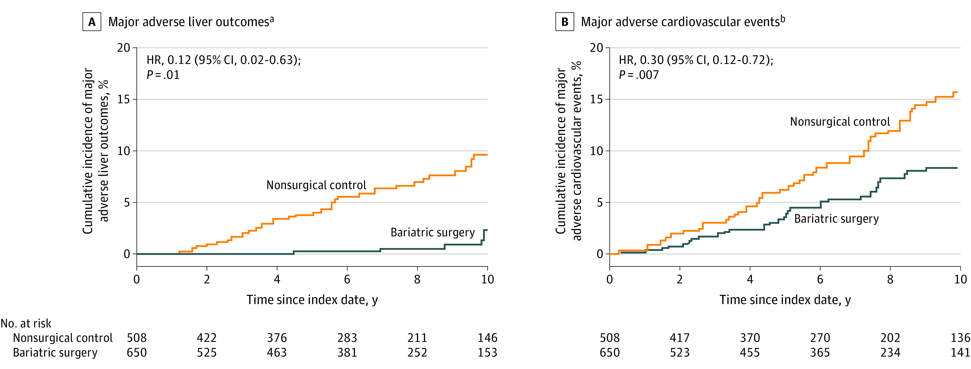
Surgical Procedures and Long-term Effectiveness in MASH Disease and Obesity Risk (SPLENDOR)
Cumulative Incidence Estimates for Major Adverse Liver Outcomes (MALO) & MACE
MALO (progression to clinical or histological cirrhosis, development of hepatocellular carcinoma, liver transplantation, or liver-related mortality)
MACE (a composite of coronary artery events, cerebrovascular events, heart failure, or cardiovascular death)
Aminian A et.al JAMA. 2021 Nov 23;326(20):2031-2042
Notes:
1158 adult patients with obesity were identified who fulfilled enrollment criteria, including confirmed histological diagnosis of NASH and presence of liver fibrosis (histological stages 1-3)

Slide 65
Summary of potential impact of available medications on patients with NAFLD
Medication | FDA indication | Patient Population | Clinical benefit | Potential side effects | Cardiac benefit
Vitamin E (800 IU daily PO) | N/A | NASH without T2DM or cirrhosis | Improves Steatosis ? NASH resolution | Hemorrhagic stroke, Risk of prostate cancer | No
Pioglitazone (30-45 mg daily PO) | T2DM | NASH with & without T2DM | Improves steatosis NASH resolution ? Fibrosis improvement Insulin sensitivity – prevent DM CV risk reduction & stroke prevention | Weight gain Risk of Ht failure exacerbation Bone loss (post menopausal) | Yes
Rinella, Mary E. et.al AASLD Practice Guidance on the clinical assessment and management of nonalcoholic fatty liver disease. Hepatology (): March 17, 2023. | DOI: 10.1097/HEP.0000000000000323

Slide 66
Medication | FDA indication | Patient Population | Clinical benefit | Potential side effects | Cardiac benefit
Liraglutide (1.8mg SC daily – DM) (0.6-3 mg SC daily – Obesity) | T2DM Obesity | NASH without cirrhosis | Improves Steatosis Insulin sensitivity Weight loss CV risk reduction Slow progression of renal disease | GI, Gallstones (related to wt loss) Pancreatitis | Yes
Semaglutide (0.4 mg SC daily, 0.25-2.4 mg SC weekly) | T2DM Obesity | NASH without cirrhosis | Improve steatosis NASH resolution May slow fibrosis progression Improve Insulin sensitivity Weight loss Improve CV & renal outcome Stroke prevention | GI, Gallstones (related to wt loss) Pancreatitis | Yes
Tirzepatide | T2DM | T2DM or obesity with NAFLD | Reduces steatosis (image) Improve insulin sensitivity Weight loss | GI, Gallstones (related to wt loss) Pancreatitis | Unknown
Rinella, Mary E. et.al AASLD Practice Guidance on the clinical assessment and management of nonalcoholic fatty liver disease. Hepatology (): March 17, 2023. | DOI: 10.1097/HEP.0000000000000323

Slide 67
Medication | FDA indication | Patient Population | Clinical benefit | Potential side effects | Cardiac benefit
SGLT-2i | T2DM | T2DM and NAFLD | Improves Steatosis (image) Improve insulin sensitivity Improve V & renal outcomes Benefit in Heart failure Modest weight loss | GU yeast infection Volume depletion Bone loss | Yes
Rinella, Mary E. et.al AASLD Practice Guidance on the clinical assessment and management of nonalcoholic fatty liver disease. Hepatology (): March 17, 2023. | DOI: 10.1097/HEP.0000000000000323

Slide 68
MASLD Multidisciplinary Care Model
Rinella, Mary E. et.al AASLD Practice Guidance on the clinical assessment and management of nonalcoholic fatty liver disease. Hepatology (): March 17, 2023. | DOI: 10.1097/HEP.0000000000000323

Slide 69
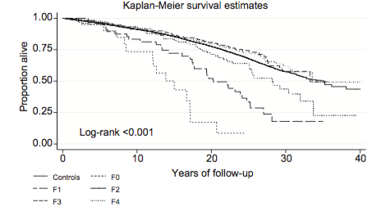
Take Home Message
Obese
Fatty
Liver
DM
metabolic
PCOS
F2
F4
F3
Stage
(Bx, NITs)
DM- GLP-1, SGLT2
Weight loss Tx
(Drug, endoscope/bariatric)
Biopsy
Therapies
Combined
FIB4>2.67
NFS>0.676
ELF
Pro C
Resolution of MASH
Resmetirom
Semiglutide
Improvement of Fibrosis ≥1
Resmetirom
Semiglutide
VTCE>13
MRE>4

Slide 70
Thank you!

