Slide 1
Multiple Myeloma
Sunil Tulpule

Slide 2
Pertinent Disclosures
Consultant: Genmab, Genentech, Sanofi

Slide 3
Objectives
Diagnosing Myeloma
Differentiating between MGUS, Smoldering Myeloma, Solitary Plasmacytoma and Symptomatic Myeloma
Review Treatments
Review Adverse Effects of Treatments

Slide 4
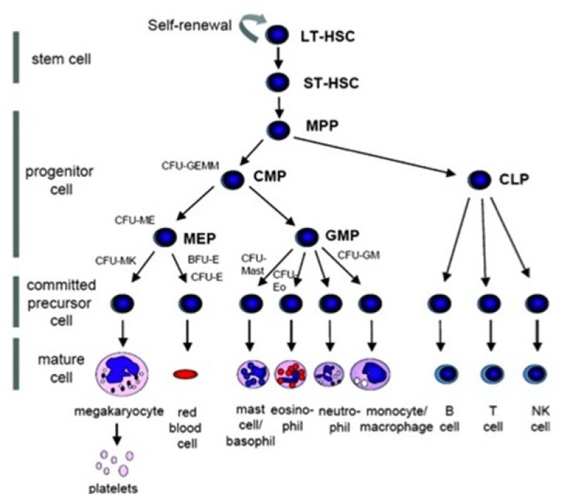

Slide 5
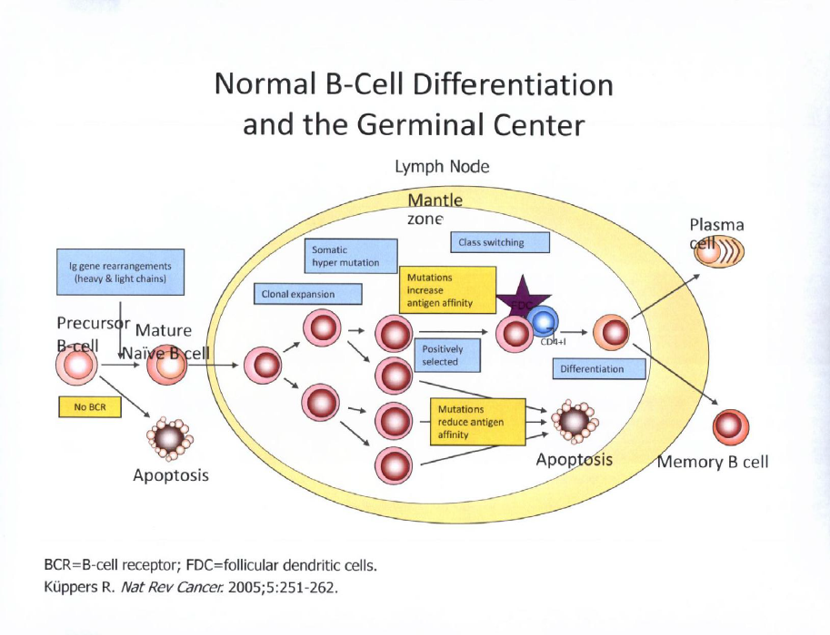

Slide 6
Case 1
A 74 year-old male with hypertension, diabetes mellitus and chronic kidney disease is admitted with community acquired pneumonia
CBC w diff shows acute on chronic normocytic anemia with hgb 8 g/dL (baseline 10 g/dL), leukocytosis WBC 15,000/uL (neutrophil predominant) and acute thrombocytopenia 100,000/uL
CMP shows AKI on CKD with creatinine 4.0 , gfr is 15. Total protein is 7 g/dL and Albumin is 2.5 g/dL. Creatinine is normal
CT CAP without contrast shows RLL pneumonia and is otherwise normal

Slide 7
Case 1
SPEP/IT shows an IgG kappa m spike 0.3 g/dL. Serum kappa FLCs are 15 mg/L, lambda 10 mg/L, kappa/lambda 1.50 (normal)
Pathology of bone marrow aspirate/biopsy shows 5-10% clonal plasma cells
Pathology of kidney biopsy shows Kimmelstiel-Wilson lesions and focal nodular glomerulosclerosis
Skeletal survey is negative

Slide 8
Case 1
What is the next best step?
Plan to start chemotherapy inpatient
Outpatient observation
Plasmapheresis
Start Steroids
None of the above

Slide 9
Epidemiology & Basics
Plasma cell malignancy → monoclonal immunoglobulin production
Median age: ~65–70 years
More common in men, African Americans
Precursor states: MGUS → smoldering myeloma → symptomatic myeloma

Slide 10
MGUS
Serum M Protein < 3 g/dL
< 10 % clonal plasma cells in bone marrow
No Myeloma Defining Events

Slide 11
Smoldering
M-protein > 3 g/dL (serum) or > 500 mg/24-h (urine)
> 10-60% clonal plasma cells in BM
No Myeloma Defining Events
Revised Risk Stratification
  High-Risk: > 2
  Intermediate-Risk: 1
  Low-Risk: 0
Factors:
BMPC > 20%
M-spike > 2.0 g/dL
FLC ratio > 20

Slide 12
Case 2
A 55 year-old male presents with acute encephalopathy
CBC w diff shows normocytic anemia with hgb 6.5 g/dL and is otherwise normal
CMP shows AKI and Calcium 14 mg/dL
CT head is negative

Slide 13
Case 2
What is the best next step?
MRI Brain
Administer Bisphosphonate
Transfuse to keep hgb above 7 g/dL
B and C
None of the Above

Slide 14
Multiple Myeloma
Underlying plasma cell proliferative disorder AND
1 or more myeloma defining events including either:
  > 1 CRAB feature(s) OR
  > 1 Biomarker Driven
    SLiM

Slide 15
“CRAB“ Criteria
Calcium > 11 g/dL or > 1 mg/dL above ULN
Renal Insufficiency (creatinine clearance < 40 mL/min or Creatinine > 2
  Most commonly due to cast nephropathy
Anemia (Hgb < 10 g/dL or 2 g/dL less than LLN)
Bone disease (> 1 lytic lesion by CT or MRI)
  Skeletal survey is insufficient

Slide 16
Biomarker Driven “SLiM”
> 60% clonal plasma cells in bone marrow
  Sixty
Serum FLC ratio involved to uninvolved > 100
  Light Chains
> 1 focal lesion by MRI > 5 mm
  MRI

Slide 17
Diagnostic Workup
CBC, CMP, uric acid level, LDH
  Peripheral Smear “Rouleaux”
SPEP/UPEP with immunofixation
Serum free light chains
Quantitative Immunoglobulins
Beta-2 microglobulin
Bone marrow biopsy with FISH and clonality
Imaging
  Whole Body PET-CT
  Whole Body low-dose CT
  Whole Body MRI

Slide 18
ISS Staging System
Uses beta-2 macroglobulin and Albumin
  β2 Microglobulin > 2.5 is adverse prognostic factor
Stage 1: Albumin > 3.5 g/dL, β2 Microglobulin < 3.5 mg/L
Stage 2: Albumin < 3.5 g/dL, β2 Microglobulin 3.5-5.5 mg/L
Stage 3: β2 Microglobulin > 5.5

Slide 19
R-ISS Staging System
Uses Beta-2 macroglobulin, Albumin, LDH and FISH
Stage 1: ISS stage 1 and normal LDH and FISH
Stage 2: Not R-ISS Stage 1 or Stage 3
Stage 3: ISS stage 3 plus either High LDH or t(4;14), t(14;16), 17p

Slide 20
Treatment Paradigm
Autologous SCT Eligible:
  Induction → Auto pbSCT → Maintenance → Relapse
  No OS difference but increased duration of remission
SCT Ineligible:
  Induction → Continuous Treatment → Relapse

Slide 21
First-Line Treatment
Triplet Therapy:
  subq weekly Bortezomib + PO Lenalidomide + weekly Dexamethasone (VRd)
Quad Therapy:
  Addition of anti-CD38 mAb
  Daratumumab (Dara-VRd)
  Isatuximab (Isa-VRd)
Supportive Meds:
  Bisphosphonates, Prophylaxis, IVIG

Slide 22
VRd
Velcade (Bortezomib)
  Weekly subq injection
  Proteasome Inhibitor
  Risk of Herpes Reactivation (ppx ACV, Valacyclovir, Famciclovir)
  Long-term cardiotoxicity
  Peripheral Neuropathy
Revlimid (Lenalidomide)
  PO
  Requires REMS
  Thrombogenic (ppx Aspirin or Anticoagulation)
  Risk of secondary hematologic malignancy
  Rash, Diarrhea
Weekly Dexamethasone 20 or 40 mg

Slide 23
Anti-CD30 mAbs
Daratumumab
  IV or subq weekly x 8 → q2w x 8 → monthly
  Type and Screen prior to starting
    Can cause positive Indirect Coomb’s Test
  IgG (keep in mind with subsequent SPEP/ITs)
  Infusion Reactions (needs premedications)
Isatuximab
  IV or subq
  Can cause positive Indirect Coomb’s Test

Slide 24
4-6 cycles of Dara-VRd
  Restage (BMBx, PET-CT)
  Minimal Residual Disease Analysis
    Tracks Clones found on initial bone marrow biopsy
Followed by Transplant or Continuous Therapy
  If Continuous Therapy, discontinue Bortezomib after total 6-8 cycles
    Stopped due to risk of neuropathy, cardiotoxicity
  Continue Dara-Rd until progression or toxicity

Slide 25
Autologous SCT
Consolidative after Induction Remission
Collection of Peripheral Blood Stem Cells
  Filgrastim, Plerixafor
  These stem cells are stored
High-Dose Chemotherapy
  Typically Melphalan for Myeloma
Infusion of Collected pb stem cells
  Go back to BM

Slide 26
Maintenance Therapy
3 months Post-Transplant:
  Standard Risk: Lenalidomide maintenance
  High-Risk:
    If del(17p) or other high-risk features: VRd maintenance
    If t(4;14): Bortezomib maintenance
    Dara-Rd
      PFS benefit, increased MRD negativity
Monitor with MRD Analysis

Slide 27
Relapsed/Refractory Disease
Multiple novel agents:
  Immunomodulators: Pomalidomide
  Proteasome inhibitors: Carfilzomib, Ixazomib
  Monoclonals: Daratumumab or Isatuximab (anti-CD38), Elotuzumab (SLAMF7)
  Bispecifics
    Teclistamab and Elranatamab (CD3 x BCMA)
    Talquetamab (CD3 x GPRC5D)
  CAR T-cell Therapy
    Ciltacabtagene autoleucel and Idecabtagene vicleucel (BCMA-directed)

Slide 28
Other Therapies
Venetoclax + Dexamethasone for t(11;14)
Belantamab mafodotin (ADC)
Pembrolizumab, Nivolumab
Selinexor
Chemotherapy (CyBorD, VTD-PACE)
  CyBorD can be given inpatient for newly diagnosed disease requiring urgent treatment

Slide 29
Case 2 cont
Pathology of bone marrow biopsy shows 80% clonal plasma cells
SPEP/IT shows IgA kappa m spike 3.5 g/dL. Serum kappa FLCs 400 mg/L, lambda < 0.05, kappa/lambda cannot be calculated
Whole Body CT shows multiple lytic lesions without fracture

Slide 30
Case 2 cont
What is the next best step?
Initiate Plasmapheresis
Start Chemotherapy
Start Bisphosphonate after OMFS clearance
All of the Above
None of the Above

Slide 31
MGUS
Watch and Wait
0.25 – 1% risk of progression per year
Labs every 6-12 months

Slide 32
Smoldering Myeloma
Low-Risk: Watch and Wait
  Labs 3-4x per year
High-Risk
  Daratumumab monotherapy
  AQUILA trial showed lower risk of progression to active myeloma or death with higher OS

Slide 33
Case 3
A 44 year-old male presents with acute low back pain
CT L-spine and MR L-spine show a 5 cm vertebral mass with associated pathologic fracture
Pathology of the mass shows Plasma Cell Neoplasm

Slide 34
Case 3
What is the next best step?
Consult Neurosurgery
Consult Radiation Oncology
Start Dexamethasone
Obtain a bone marrow biopsy
All of the above

Slide 35
Solitary Plasmacytoma
Biopsy-proven solitary lesion of bone or soft tissue with evidence of clonal plasma cells
Normal skeletal surgery or MRI (or CT) of spine and pelvis (except for the primary solitary lesion)
Absence of Myeloma Defining Events
Normal bone marrow with no evidence of clonal plasma cells
Treatment: XRT +/- surgical resection

Slide 36
Solitary Plasmacytoma with Minimal Marrow Involvement
Clonal BM plasma cells < 10%
Regarded as active symptomatic myeloma
Systemic Therapy should be considered
Obtain FISH testing on plasmacytoma biopsy if clonal cells absent/inadequate in marrow

Slide 37
Oncologic Emergencies
Malignant Cord Compression
  Dexamethasone 10 mg IV once followed by 4 mg every 6 hours
  STAT Neurosurgery consult
  If no plan for surgery → XRT
Hypercalcemia of Malignancy
  Poor prognostic factor
  Start IV fluids and Bisphosphonate

Slide 38
Key Points
MGUS: m-spike < 3 g/dL and < 10% BMPCs
Smoldering: m-spike > 3 g/dL and 10-60% clonal BMPCs
SLiM CRAB
Dara-VRd → Auto → maintenance Lenalidomide
Bortezomib (Velcade): Shingles ppx
Lenalidomide (Revlimid): VTE ppx

Slide 39
Thank you!

