Slide 1
Brain Death/
Death by Neurologic Criteria
Mai Kau Yang, MD
Assistant Professor of Clinical Neurology
Division of Neurocritical Care
9 December 2025

Slide 2
Objectives
Understand the criteria for brain death testing
Explain the cerebral anatomy associated with consciousness
Identify the prerequisites for brain death testing
Perform motor and brainstem examination required for determination of brain death
Describe and localize brainstem reflexes
Perform apnea testing
Identify and interpret ancillary testing for the determination of brain death

Slide 3
Examination Requirements
Required 1 exam
More accurate: 2 exams
Pediatrics: 2 exams at least 12 hours apart
State/institution dependent requirements

Slide 4
1968 Harvard Committee
Permanent Coma
Loss of brainstem reflexes
Inability to breathe in setting of adequate stimulus

Slide 5
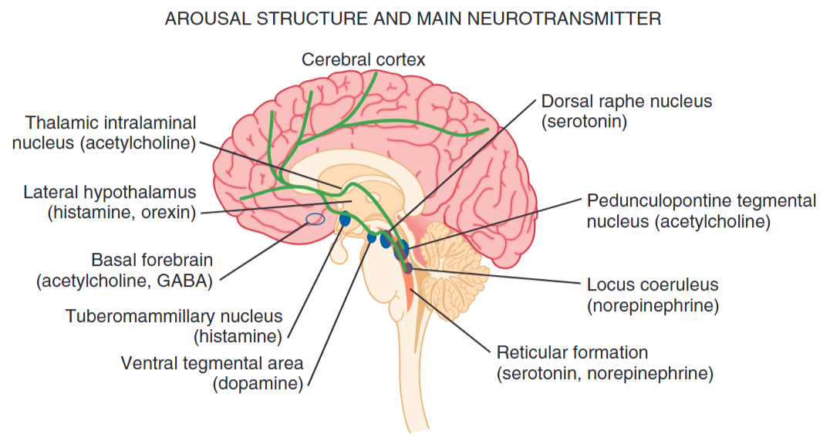
Reticular Activating System
Predictor of permanent comatose state
Critical Care Medicine: Principles of Diagnosis and Management in the Adult

Slide 6
Brain Death Testing
Prerequisites
Physical examination
Apnea testing
Ancillary testing

Slide 7
Prerequisites
Catastrophic brain injury
Temperature >36C: suppress brain function including areflexia and apnea; alter the pharmacokinetics and metabolism of medications
Blood pressure: SBP >100 or MAP >75 or no less than 2 SD below age-appropriate norms; IV fluids or vasopressors
Absence of drugs or metabolic derangements
  Tox: depressants, document if not contributing to examination
  Drugs: normal hepatic and renal function – wait 5 half-lives; or serum levels below normal therapeutic range; TOF for recent neuromuscular blockade; Pentobarbital <5ug/mL or below lower limit of detection
  Electrolytes: Sodium
  pH disturbances

Slide 8
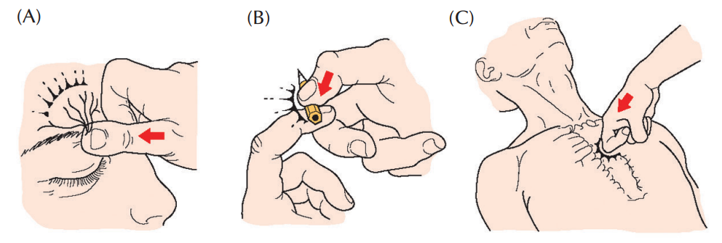
Physical Examination
Motor response: absence of cerebrally mediated motor response
  Spinal mediated motor responses may still be presence and do not invalidate BD/DNC
Plum and Posner's Diagnosis and Treatment of Stupor and Coma, Fifth Edition
Notes:
In deep coma, OCR may be absent/not as robust
. If uncertain, ancillary testing

Slide 9
Physical Examination
  Motor response: absence of cerebrally mediated motor response (axial, appendageal)
    Spinal mediated motor responses may still be presence and do not invalidate BD/DNC
  Cranial nerve: pupillary, OCR/caloric, corneal, cough, gag
Notes:
In deep coma, OCR may be absent/not as robust

Slide 10
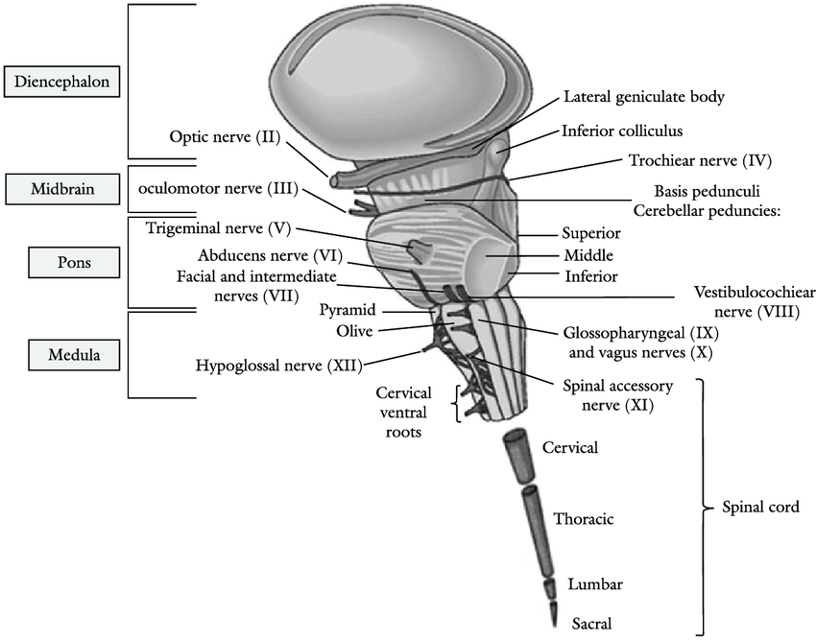

Slide 11
Reflex | Afferent | Efferent | Brainstem
Pupillary | CN II | CN III | Midbrain
Corneal | CN V | CN VII | Pons
VOR | CN VIII | CN III, IV, & VI | Midbrain and Pons
Gag | CN IX | CN X | Medulla
Cough | CN X | CN X | Medulla

Slide 12
Confounders
High cervical cord injuries
Neuromuscular disorders, sensory neuropathies
Anopthalmia, scleral edema, chemosis
Notes:
Perform ancillary testing

Slide 13
Apnea Testing
Must be hemodynamically stable; possible compromise during testing
Adults: once; children: twice (once after each exam)
Oxygenation catheter over trachea, resuscitation bag with PEEP valve, tracheal insufflation
ABG (if able, place arterial line)
  ABG: pH 7.35-7.45 and PaCO2 35-45 or at patient baseline
  Preoxygenatate: PaO2 >200 mmHg
8-10 minutes of apnea testing
PaCO2: Adults >60 or >20 over baseline if chronically hypercapnic, pH <7.3
ECMO: decrease sweep
Notes:
(medullary chemoreceptors for respiration)
(chemoreceptors become less responsive if chronically hypercarbic)

Slide 14
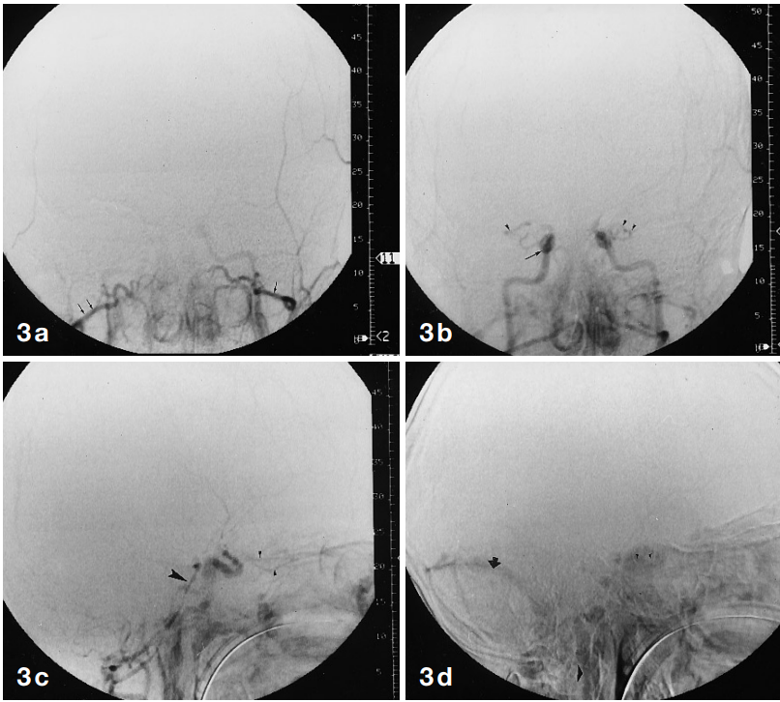
Ancillary testing
DSA (4-vessel catheter angiography)
Braun et al. Neuroradiology (1997) 39: 404-405

Slide 15
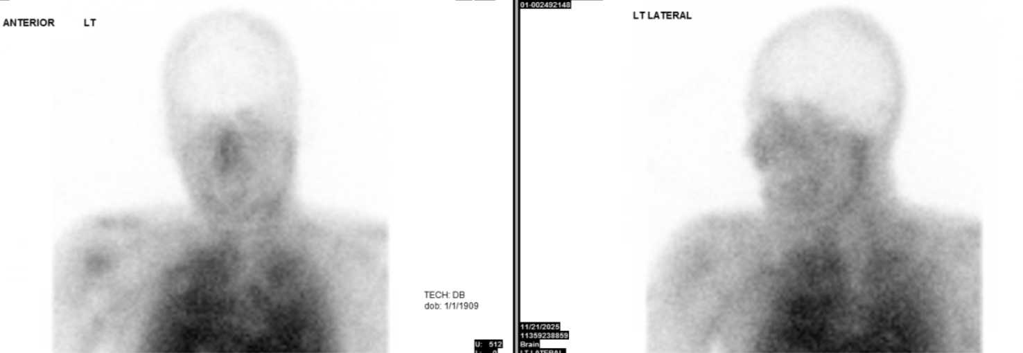
Ancillary testing
DSA (4-vessel catheter angiography)
Radionuclide perfusion scintigraphy

Slide 16
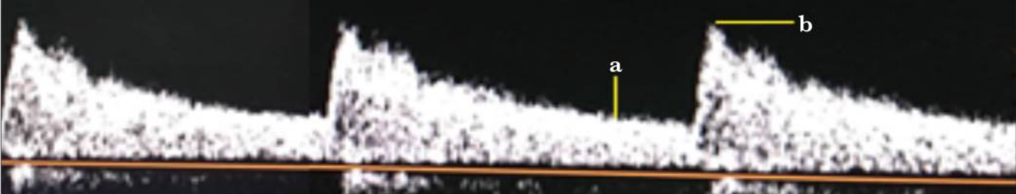
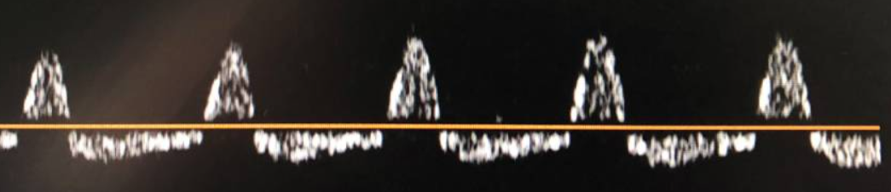
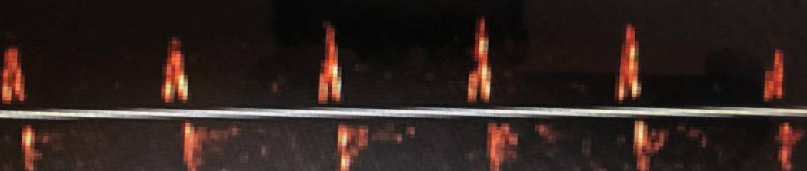
Ancillary testing
DSA (4-vessel catheter angiography)
Radionuclide perfusion scintigraphy
Transcranial doppler: oscillating flow, systolic spikes

Slide 17
Ancillary testing
DSA (4-vessel catheter angiography)
Radionuclide perfusion scintigraphy
Transcranial doppler: oscillating flow, systolic spikes
Electroencephalogram (EEG): does not provide information about brainstem activity; electrical activity in ICU
CT and MR angiography: lack of validation, false positives

Slide 18
Ancillary testing
DSA (4-vessel catheter angiography)
Radionuclide perfusion scintigraphy
Transcranial doppler: oscillating flow, systolic spikes
Electroencephalogram (EEG): does not provide information about brainstem activity; electrical activity in ICU
CT and MR angiography: lack of validation, false positives

Slide 19
Determination of Death by Neurologic Criteria
Prerequisites: temperature >36C, absence of metabolic derangements or CNS depressants, SBP >100
Physical examination: absence of brainstem reflexes and centrally mediated motor movements
Apnea testing: pH <7.3, PaCO2 >60 or >20 from baseline
Ancillary testing: DSA, radionucleotide scintigraphy, TCD

Slide 20
Questions

