Slide 1
PULMONARY HYPERTENSION

Slide 2
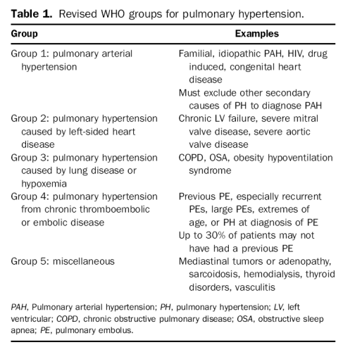
Groups

Slide 3
Diagnosis
Often overlooked
Dyspnea on exertion and fatigue
Other symptoms: COPD + Heart failure symptoms
CV exam: JVD, prominent a wave, widen split S2, tricuspid regurgitation.
→ hepatomegaly, ascites, peripheral edema
ECHO:
Estimate the PA pressure
RV size and function
Once PH is suspected. Further testing …
RHC/LHC
Resting Mean PA Pressure > 25mmHg,= PA
V/Q scan
Overnight pulse oximetry
Group 1 lab test: HIV, LFTs, rheumatologic evaluation
6 min walk test for baseline prior to treatment
Notes:
Fever//Roth's spots// Osler's nodes// Murmur//Janeway lesions// Anemia// Nail hemorrhage (splinter hemorrhages)// Emboli

Slide 4
echocardiogram

Slide 5
Treatment
Notes:
Bosentan (Tracleer): a pill taken twice a day to help reduce pressure in your lungs, enable you to exercise more, and slow down the disease. You must have blood tests every month to check your liver, because this medicine may harm the liver. If a liver problem develops, your liver should return to normal if you stop the medicine or take a lower dose. You should avoid pregnancy while on this medicine because it can harm an unborn child.
Epoprostenol (Flolan): an IV (intravenous line) medicine that you receive non-stop. It requires a permanent IV catheter inserted into a vein and a portable pump. This medicine is usually given to patients with more serious illness. It can help to lessen your symptoms, enable you to exercise more, and reduce blood pressure in your lungs. It may prolong life. Some side effects may occur, such as headache, diarrhea, facial redness (flushing), jaw pain, muscle pain, and infection at the catheter site.
Treprostinil (Remodulin): a shot (injection) into the fatty tissue on your belly. A pump the size of a pager is worn on the belt. The benefits of this medicine are similar to those of epoprostenol. The most common side effect is pain where the medicine goes into the skin. Infection is much less common with this medicine.
Calcium channel blockers: a pill to help relax narrowed blood vessels in the lungs. This medicine works only for a small number of patients.

Slide 7
MKSAP High Yield
Pulmonary hypertension = resting mean pulmonary artery pressure of > 25 mm Hg
Majority of PH → caused by left-sided heart disease and hypoxic respiratory disorders.
Echocardiography is a useful initial tool in the evaluation of PH, but it may may underestimate pulmonary artery pressures, right heart catheterization should be considered after a normal echocardiogram if high suspicion.
Treat the underlying disease in groups 2-5.
Advanced therapy for pulmonary hypertension with vasodilators is reserved or PAH (group 1) as the are not effective and may be harmful in groups 2-5.
VQ scan is first line imaging for CTEPH – sensitive indicator.

Slide 8
MKSAP High Yield
PAH (Group 1) is associated with other conditions, including connective tissue diseases, portal hypertension, HIV, illicit drug use (meth), toxin exposure, and congenital heart disease.
In PAH → right heart catheterization is required to confirm pulmonary hemodynamics with nitric oxide.
The use of targeted vascular therapies have improved survival rates.
Supportive measures (diuretic therapy, supplemental oxygen), anticoagulation, digoxin, and exercise training should be considered.

Slide 9
Value
“Don’t routinely offer pharmacologic treatment with advanced vasoactive agents approved only for the management of pulmonary arterial hypertension to patients with pulmonary hypertension resulting from left heart disease or hypoxemic lung diseases (Groups II or III pulmonary hypertension).”
Choosing Wisely – CHEST and ATS 2013

