Slide 1
Healthcare in a Changing Ecosystem
Cordel Fuher, PGY 3
UACOMP IM Residency

Slide 2
Disclosures
No financial disclosures
Breathe air, drink water, eat food
Pregnant wife
Sister lives on the coast
Grandparents with chronic medical conditions

Slide 3
Objectives
Overview of climate change
Adverse impacts of climate change on the health of patients/populations
Adverse impacts of the healthcare industry on the climate
Planned & possible responses for the field of healthcare to address the above
Science
Public Health
Local
Healthcare
Strategies

Slide 4
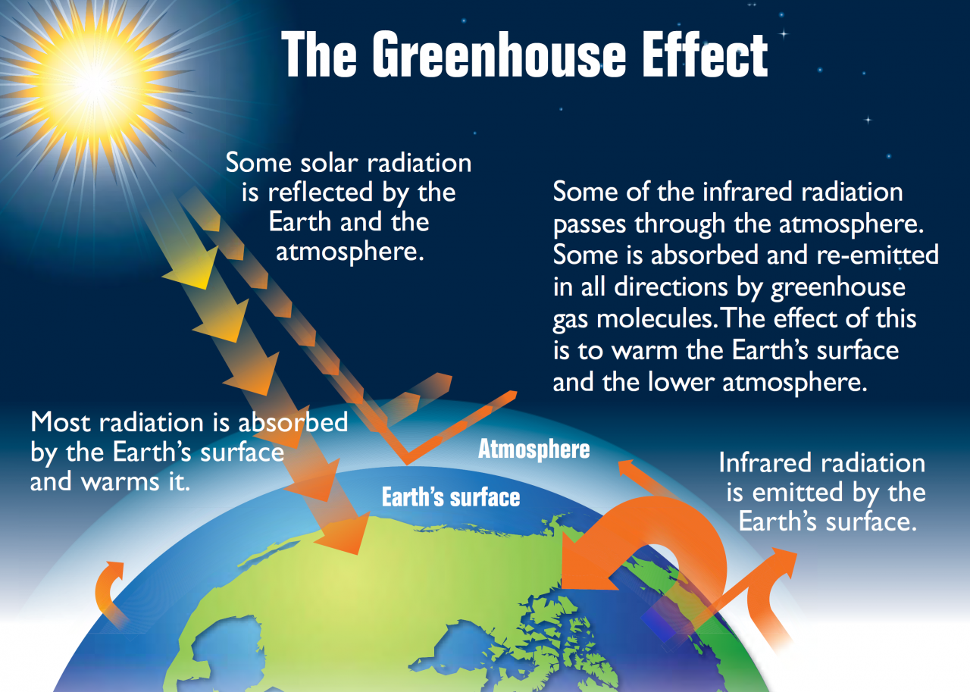
Anthroponosis
Causes
Fossil fuels & emissions
Carbon dioxide, methane, fluorocarbons
Aerosols
Pollution (air, land, water)
Resource utilization
Farming & livestock
Effects
Global warming & altered ecosystems
Severe weather
Poisoning, particles
Resource scarcity
EPA
Science
Public Health
Local
Healthcare
Strategies

Slide 5
Impact of Climate Change on Health
Weather
Air pollution
Water pollution
Plastics, fine particles
Disease vector habitat shifts
Science
Public Health
Local
Healthcare
Strategies

Slide 6
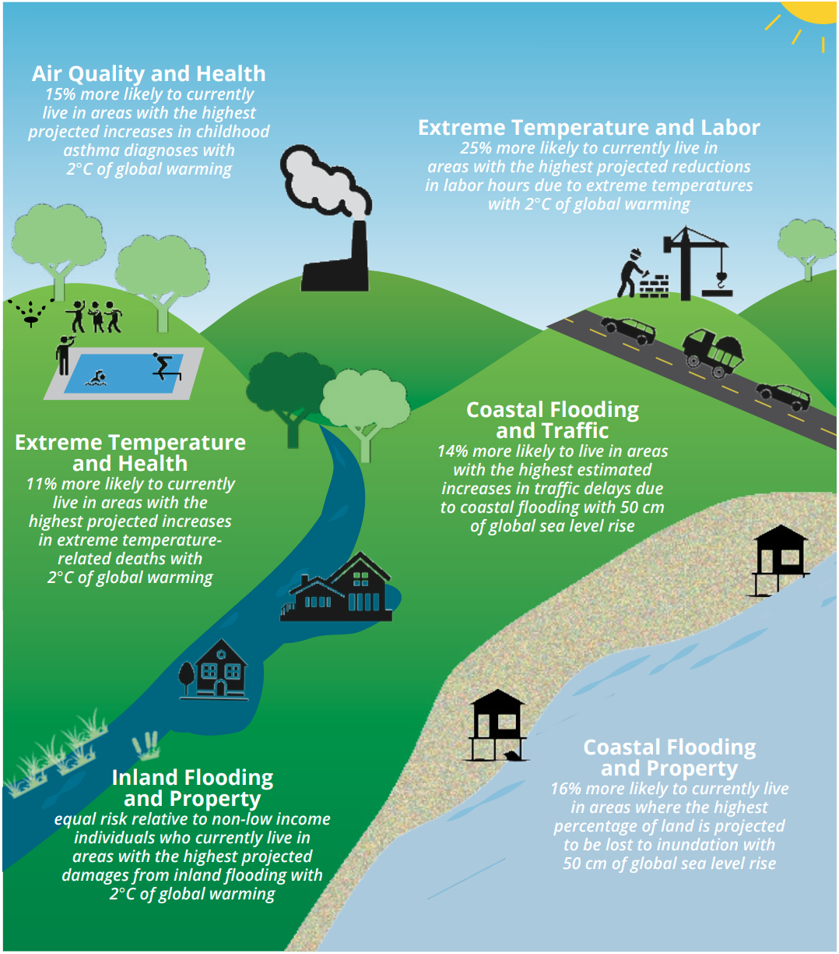
Disproportionate Impact of Climate Change on Health
Weather
Air pollution
Water pollution
Plastics, fine particles
Disease vector habitat shifts
EPA
Science
Public Health
Local
Healthcare
Strategies

Slide 7
Disproportionate Impact of Climate Change on Health
Impoverished
Unhoused
Elderly
Less formal education
Pregnant
Chronically ill, disability
Certain occupations
EPA
Science
Public Health
Local
Healthcare
Strategies

Slide 8
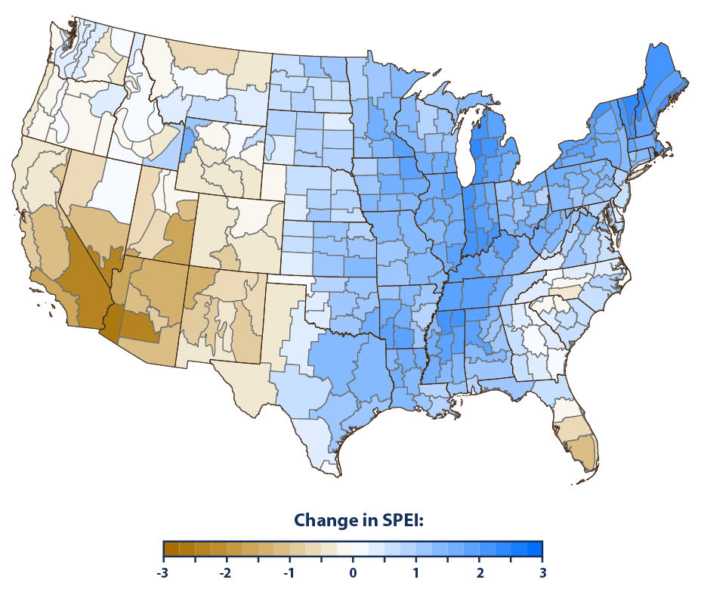
Impact of Climate Change on Health (continued)
Weather
Heat waves
Droughts
Flooding, rising oceans
Extreme weather events
Wildfires
EPA
Science
Public Health
Local
Healthcare
Strategies

Slide 9
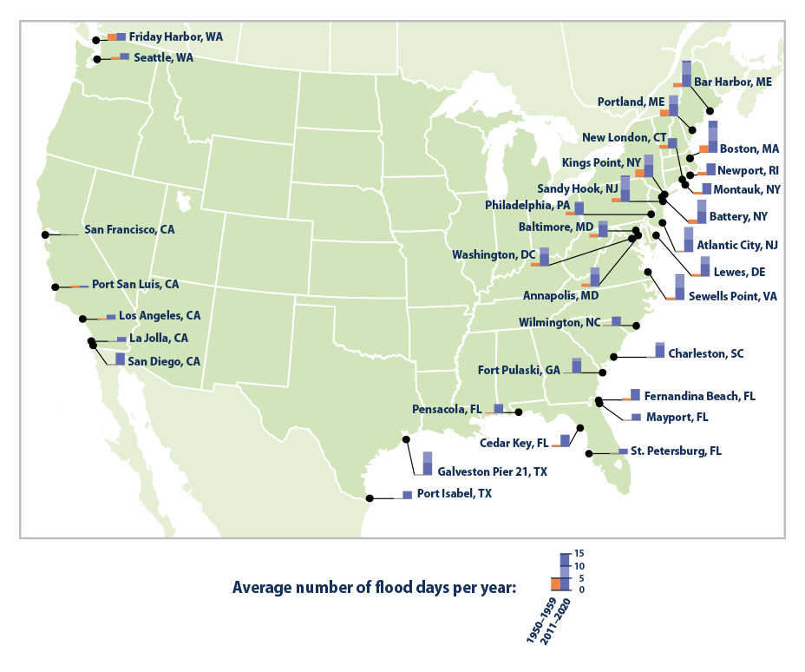
Impact of Climate Change on Health (continued)
Weather
Heat waves
Droughts
Flooding, rising oceans
Extreme weather events
Wildfires
EPA
Science
Public Health
Local
Healthcare
Strategies

Slide 10
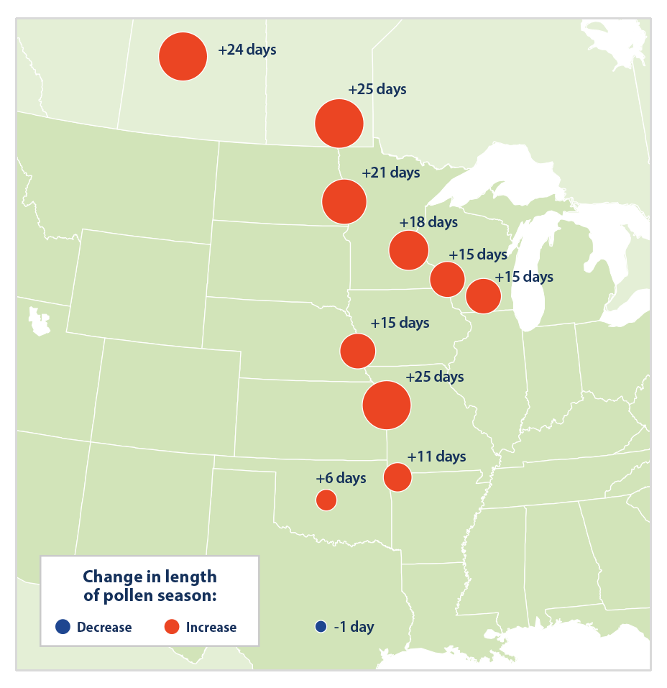
Impact of Climate Change on Health (continued)
Weather
Change in growing season
Crop yield
Allergies
Ragweed
EPA
Science
Public Health
Local
Healthcare
Strategies

Slide 11
Impact of Climate Change on Health (continued)
Air pollution
Water pollution
Agriculture
Pesticides
Plastics, fine particles
Science
Public Health
Local
Healthcare
Strategies

Slide 12
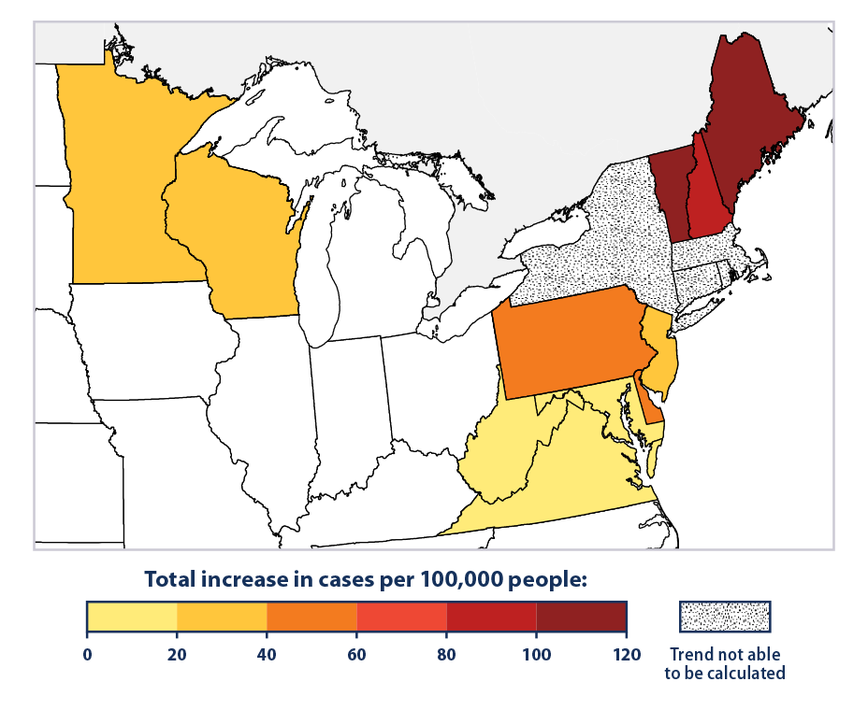
Impact of Climate Change on Health (continued)
Disease vector habitat shifts
Lyme disease
West Nile virus
Zika virus
Chikungunya virus
EPA
Science
Public Health
Local
Healthcare
Strategies

Slide 13
Impact of Climate Change on Health (continued)
Displacement
Resource scarcity
Famine, drought
Climate refugees
Science
Public Health
Local
Healthcare
Strategies

Slide 14
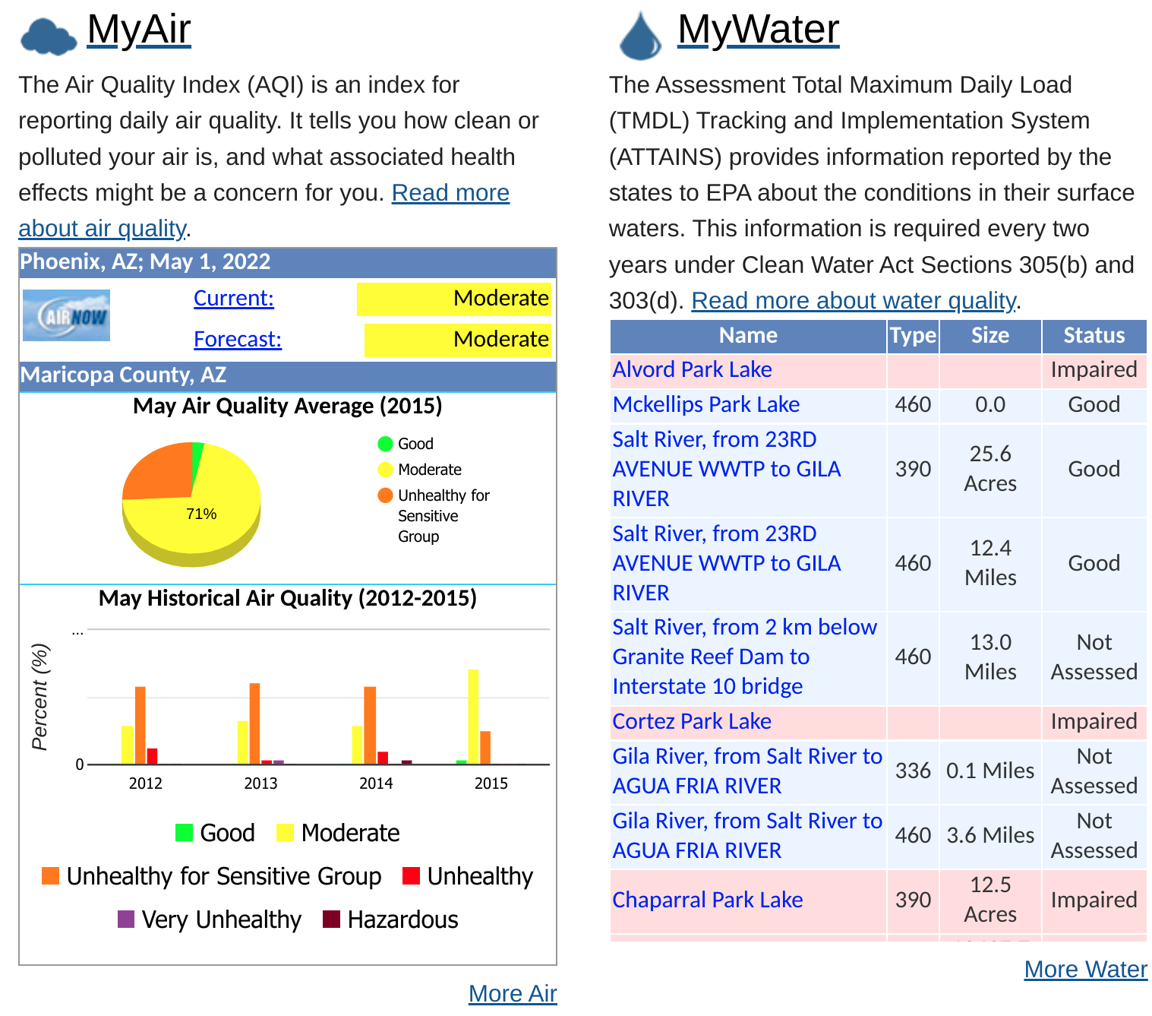
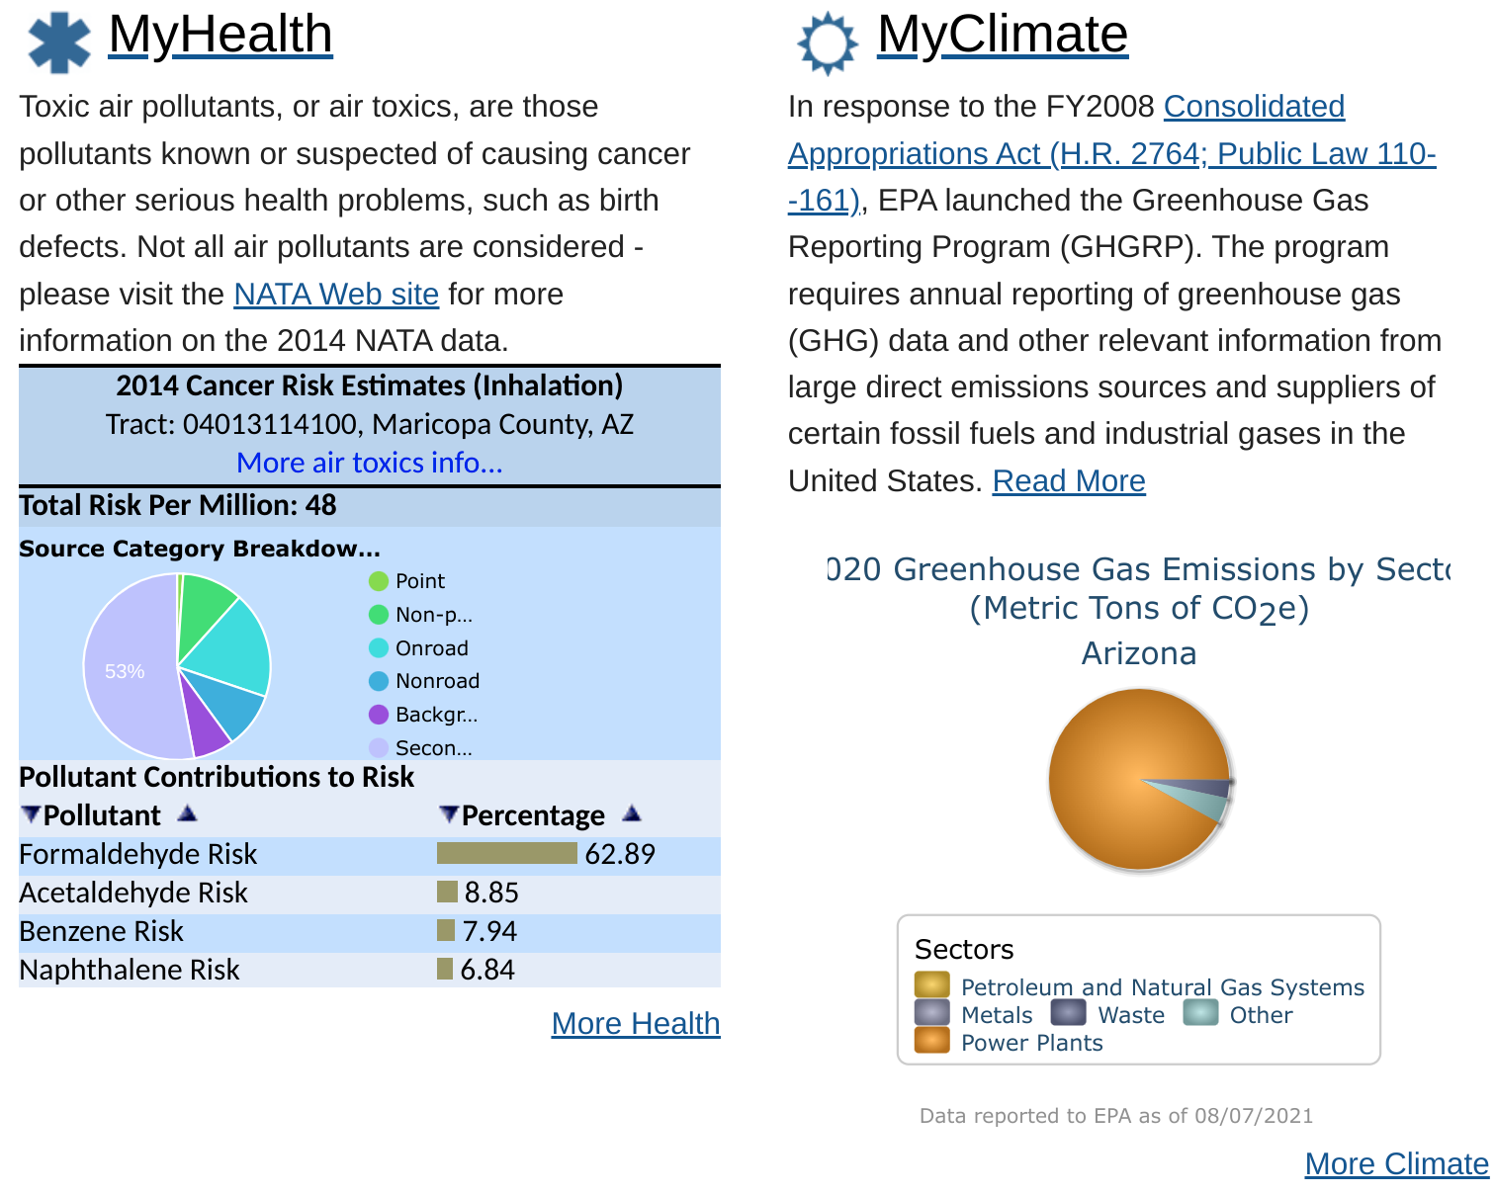
Local Impacts of Climate Change on Health
EPA MyEnvironment
Science
Public Health
Local
Healthcare
Strategies

Slide 15
Local Impacts of Climate Change on Health
American Lung Association State of the Air - Maricopa Report Card
ALA State of the Air
Science
Public Health
Local
Healthcare
Strategies

Slide 16
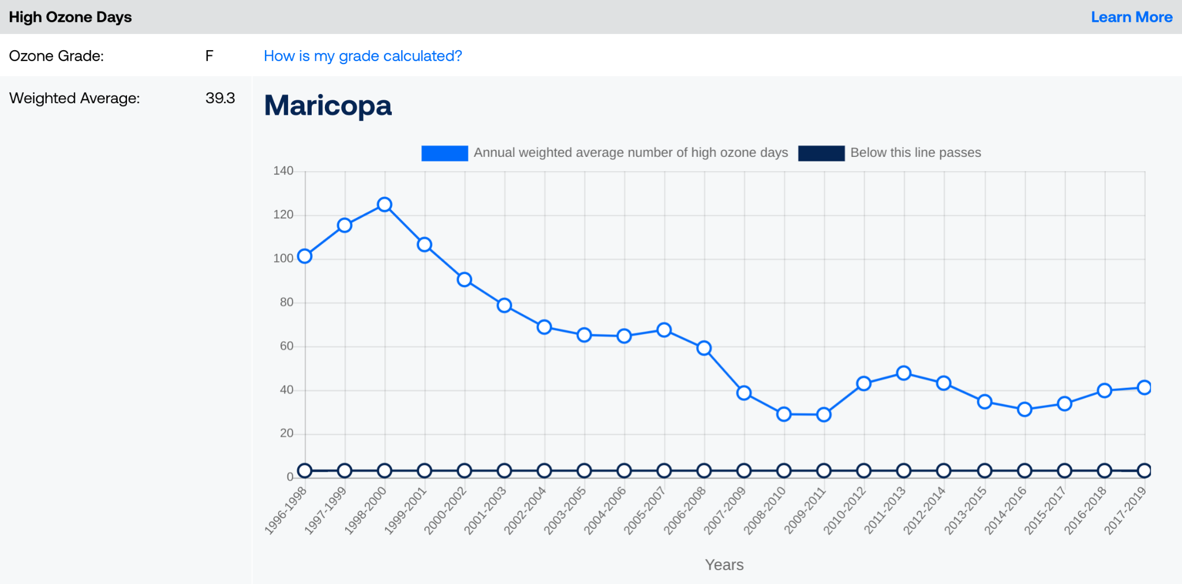
Local Impacts of Climate Change on Health
American Lung Association State of the Air - Maricopa Report Card
ALA State of the Air
Science
Public Health
Local
Healthcare
Strategies

Slide 17
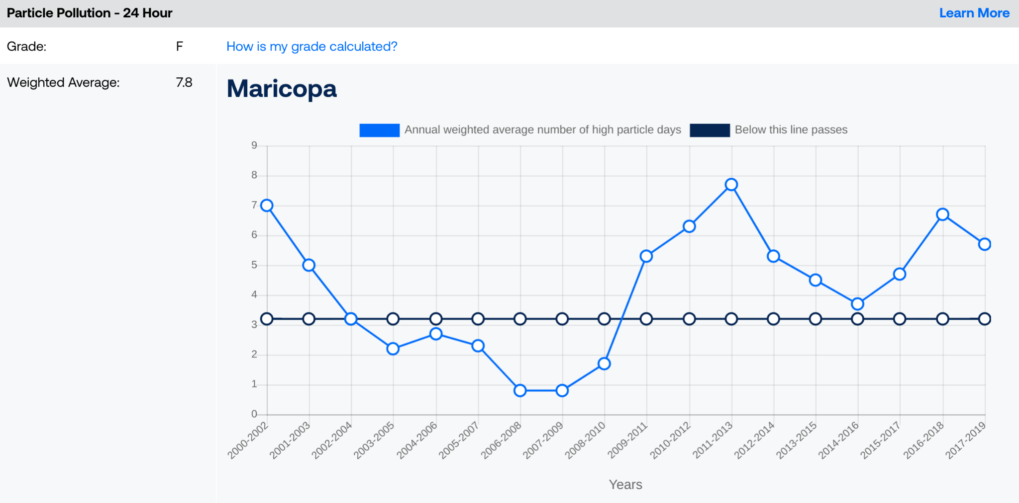
Local Impacts of Climate Change on Health
American Lung Association State of the Air - Maricopa Report Card
ALA State of the Air
Science
Public Health
Local
Healthcare
Strategies

Slide 18
Impact of Healthcare on the Climate
Waste & incinerators
Sterilizers, disinfectants
Pollution
Medication production
Anesthetics
Emissions
Science
Public Health
Local
Healthcare
Strategies

Slide 19
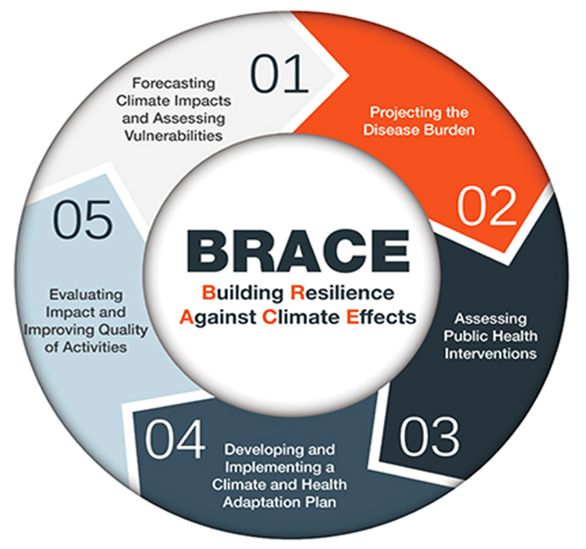
Adaptive Strategies to Address Impacts Climate Change
Local
AZ Department of Environmental Quality
Urban Canopy
Solar panel parking
EPA working on Navajo Nation Uranium mines cleanup
National
EPA Climate Adaptation Plan
BRACE framework for local community actions
EPA Office of Environmental Justice
National Environmental Justice Advisory Council
Indiginous Peoples Work Group
White House Environmental Justice Advisory Council
EPA
Science
Public Health
Local
Healthcare
Strategies

Slide 20
Healthcare Industry Strategies to Address Climate Change
Green energy, rooftop solar
Sustainable materials
Minimize waste, recycle, compost
Green chemistry for drug/chemical production
Sevoflurane for inhaled anesthetics
Encourage vegetarian diet (or at least diminish meat intake), organic foods
Evisits
Recommend safe products, use recycled products
Water conservation, water safety
Early warning systems for extreme heat & other weather events
Counselling
Advocacy
Science
Public Health
Local
Healthcare
Strategies

Slide 21
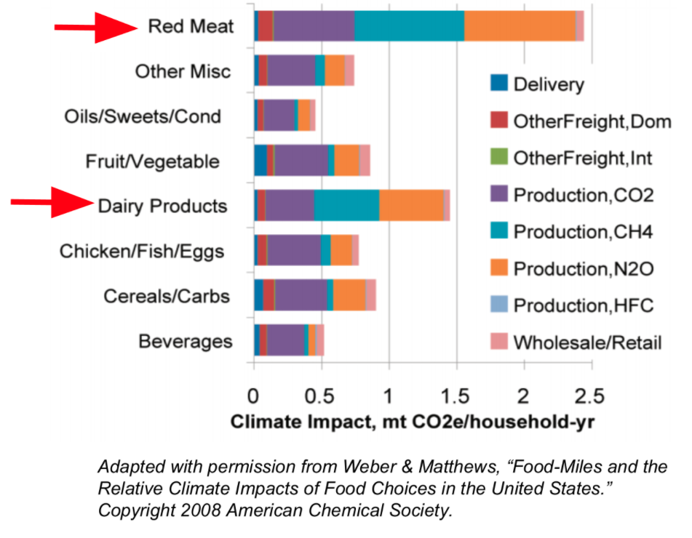
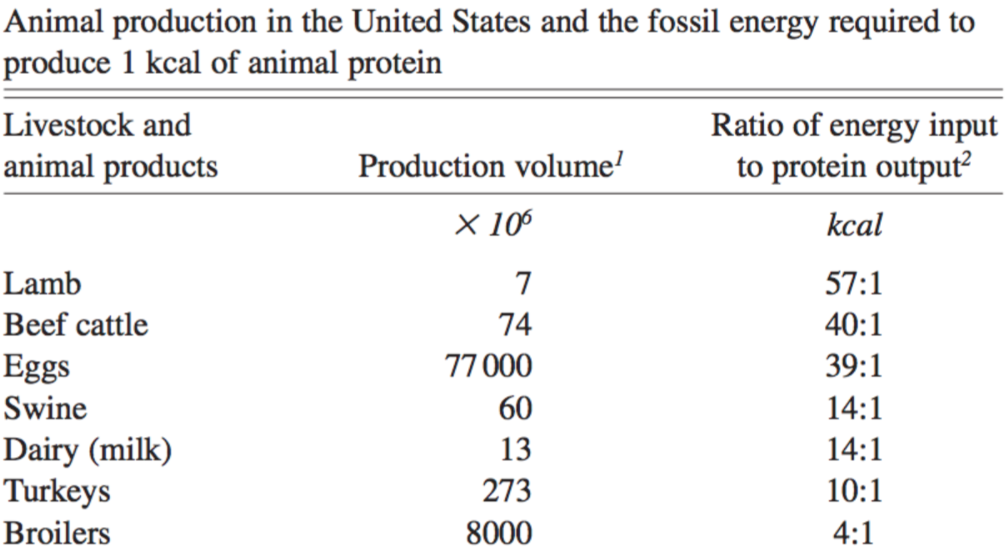
Healthcare Industry Strategies to Address Climate Change
U.S. Department of Agriculture
Science
Public Health
Local
Healthcare
Strategies

Slide 22
Physicians
Physicians for Social Responsibility (PSR)
Shared the Nobel Prize in 1985 for their work on nuclear disarmament
Added action on climate change as their second policy position (out of two)
American College of Physicians
Science
Public Health
Local
Healthcare
Strategies

Slide 23
References
Environmental Protection Agency. epa.gov
Intergovernmental Panel on Climate Change (IPCC).
Crowley RA; Health and Public Policy Committee of the American College of Physicians. Climate Change and Health: A Position Paper of the American College of Physicians. Ann Intern Med. 2016 May 3;164(9):608-10.
Crowley RA; Health and Public Policy Committee of the American College of Physicians. Climate Change and Health: A Position Paper of the American College of Physicians. Ann Intern Med. 2016 May 3;164(9):608-10.
U.S. Global Change Research Program (USGCRP). The Impacts of Climate Change on Human Health in the United States: A Scientific Assessment. April 2016.
Schraufnagel DE, Balmes JR, Cowl CT, et al. Air Pollution and Noncommunicable Diseases: A Review by the Forum of International Respiratory Societies' Environmental Committee, Part 2: Air Pollution and Organ Systems. Chest. 2019;155(2):417-426.
Yasny JS, White J. Environmental implications of anesthetic gases. Anesth Prog. 2012;59(4):154-158.
Aung S, Vittinghoff E, Marcus GM. Pandemic-Related Pollution Decline and ST-Segment‒Elevation Myocardial Infarctions. J Am Heart Assoc. 2022 Apr 5;11(7):e024605.
American Lung Association. State of the Air. 2022 May.
U.S. Department of Agriculture. usda.gov
Tilman, Clark. Global Diets Link Environmental Sustainability and Human Health. Nature. 2014.
Groundswell Report. World Bank. 2016.

