Slide 1

Glomerular Diseases Part II: Nephritic Syndromes
Elise J Barney, DO
Nephrologist
Associate Clinical Professor, University of Arizona College of Medicine
BUMC Internal Medicine RESIDENCY ACADEMIC HALF-DAY
October 14, 2025

Slide 2
Learning Objectives
Diagram the classic clinical presentations, laboratory findings, and associated systemic diseases (if any) of the following syndromes:
    Immune-Complex GN
    Anti-Glomerular Basement Membrane (GBM) Disease
    Pauci-Immune Glomerulonephritis (ANCA positive)
    Hereditary nephritis
    Lupus nephritis
Subcategorize which GNs present with hypocomplementemia and distinguish which complement (C3 versus C4) is low in each.
Describe the clinical presentation of rapidly progressive glomerulonephritis (RPGN) and formulate a differential diagnosis based on the clinical and pathological findings.

Slide 3
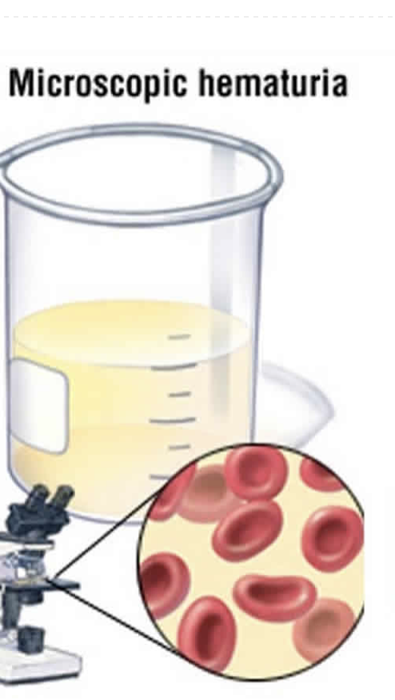
Microhematuria: Definition
RBC > 3 per HPF on 2 or more separate properly-collected urinalyses

Slide 4
Which of the following would indicate a non-glomerular source of hematuria?
Hypertension
Proteinuria of 2000 mg on 24-hour urine
Bright red blood at the end of urinary stream
Negative urological workup
RBC casts

Slide 5
Answer
C. Bright red blood at the end of urinary stream

Slide 6
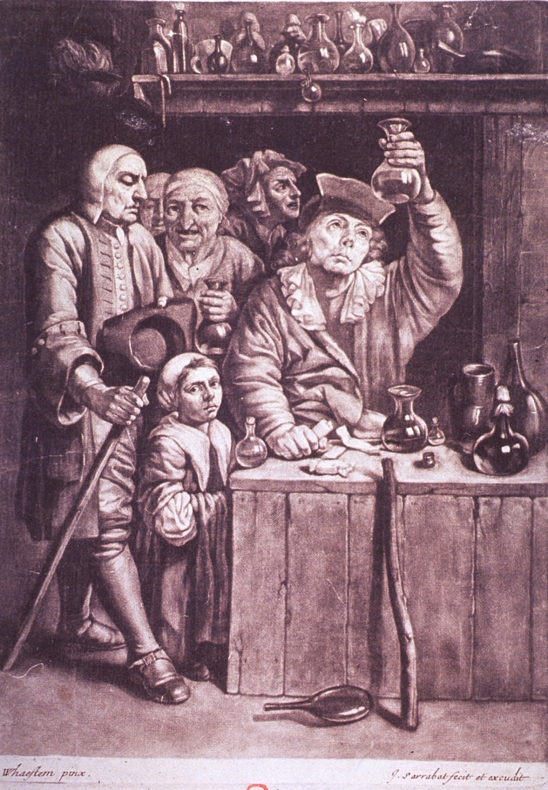
Glomerular Hematuria
Dysmorphic RBCs
RBC casts
Proteinuria > 500mg
Decline in GFR
Hypertension
Absence of clots or terminal hematuria
Negative urological workup
Notes:
AUA definition of microhematuria: https://www.auanet.org/education/hematuria.cfm
“Nephritic” syndrome = sub-nephrotic proteinuria + microhematuria

Slide 7

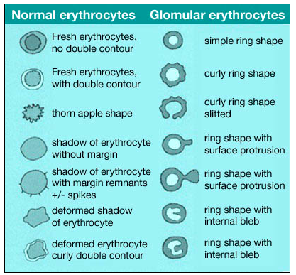
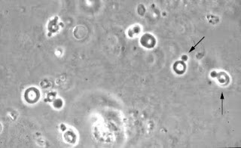
Dysmorphic RBCs

Slide 8
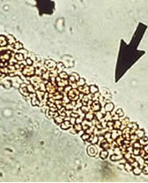
RBC Cast

Slide 9
Diagnostic Evaluation: Glomerular Disease
Spin urine and look under microscope
Quantify proteinuria
Perform serological workup
  Primary vs Secondary (systemic)
Renal ultrasound for morphology
Renal biopsy
Serological Evaluation
C3, C4, CH50
Hepatitis B, C panel
ANA with reflex
ANCA
Anti-GBM Ab
Anti-PLA2 Ab
SPEP/UPEP
HgA1c
Streptozyme, blood cultures

Slide 10
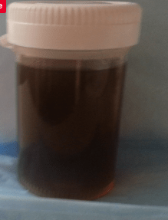
Sub-nephrotic Glomerulonephritis:
“Nephritic Syndrome”
Sub-nephrotic proteinuria < 3.5 grams / day
Glomerular hematuria
  Micro
  Macro – dark urine, gross hematuria
  Active urinary sediment
Hypertension
Elevated BUN/Creatinine

Slide 11
Causes of Sub-nephrotic
Glomerulonephritis (GN)
Immune-complex GNs
Lupus Nephritis
Hereditary Nephritis (Alport’s)
  Hereditary defect of type IV collagen
Anti-GBM Antibody (Ab) Disease
  Autoimmune disease, antibodies against alpha-3 chain of type IV collagen
Pauci-immune GNs / Small vessel vasculitis
  Granulomatosis with polyangiitis (GPA)
  Microscopic polyangiitis (MPA)
  Negative immunofluorescence on pathology
Others: HUS, HSP, EGPA – 40% +ANCA

Slide 12
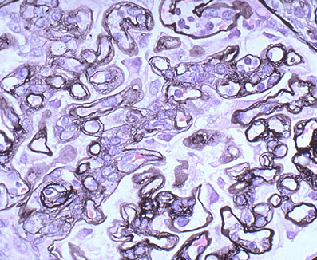
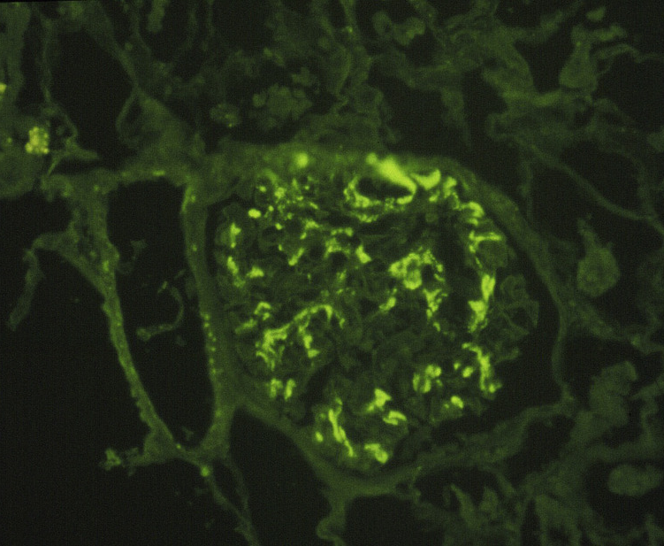
Immune-Complex GNs

Slide 13
Which of the following is NOT associated with IgA nephropathy?
A. Crohn’s disease
B. Liver disease
C. Celiac disease
D. Rheumatoid arthritis
E. Ankylosing spondylitis

Slide 14
Which of the following is NOT associated with IgA nephropathy?
A. Crohn’s disease
B. Liver disease
C. Celiac disease
D. Rheumatoid arthritis
E. Ankylosing spondylitis

Slide 15
IgA Nephropathy
Most common GN in the world
Male > female, 2nd to 3rd decade of life
Clinical presentations are varied and progression typically slow.
  Temporal relationship with URI/tonsillitis
  50 % Macrohematuria
Associations / Secondary Causes
  Liver disease
  Celiac disease
  Crohn’s disease
  Reiter syndrome, Ankylosing spondylitis
  HSP = systemic vasculitis + IgA, children
Treatment limited to ACE/ARB

Slide 16
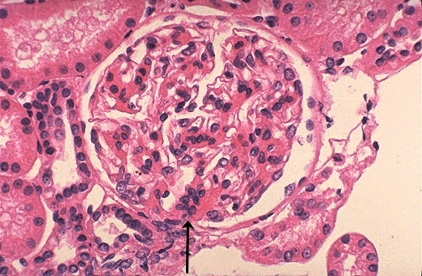
IgA Nephropathy Pathology
Defect in IgA1-producing cells, leading to galactose deficient IgA1
Antibodies form against galactose-deficient IgA1 (Gd-IgA1) → immune complexes which accumulate in glomerular mesangium
Mesangial proliferation and matrix expansion on LM
Deposits of IgA (often accompanied by C3 and IgG) in the mesangium on IF

Slide 17
Membranoproliferative Glomerulonephritis (MPGN)
AKA Mesangiocapillary GN
Immune-complex and/or complement protein deposition in the mesangium and subendothelium of the capillaries with GBM double contouring and “tram-track” appearance
Notes:
IF is IGAN
LM is MPGN

Slide 18
Membranoproliferative GN (MPGN)
Clinical: sub-nephrotic > nephrotic
Low serum C3
Causes
  Infections: HBV, HCV, infectious endocarditis, chronic bacterial or parasitic infections
  Auto-immune disease: SLE, Sjogrens, RA
  Dysproteinemias, inherited mutations in complement-regulating proteins

Slide 19
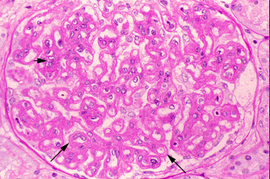
The Membranoproliferative Pattern of Injury
Describes a general pattern of injury of variety of diseases that share common pathogenetic mechanism
Typical LM features mesangial hypercellularity, endocapillary proliferation & capillary wall double contours, ie “tram tracks”
Deposition of immunoglobulins, complement or both in mesangium & capillary walls
Notes:
Light micrograph showing thickening of all capillary walls with double contours (long arrows) from capillary remodeling and focal areas of cellular proliferation (short arrow).
The double-contour or tram-track appearance represents interposition of mesangial cell elements with new glomerular basement membrane synthesis.

Slide 20
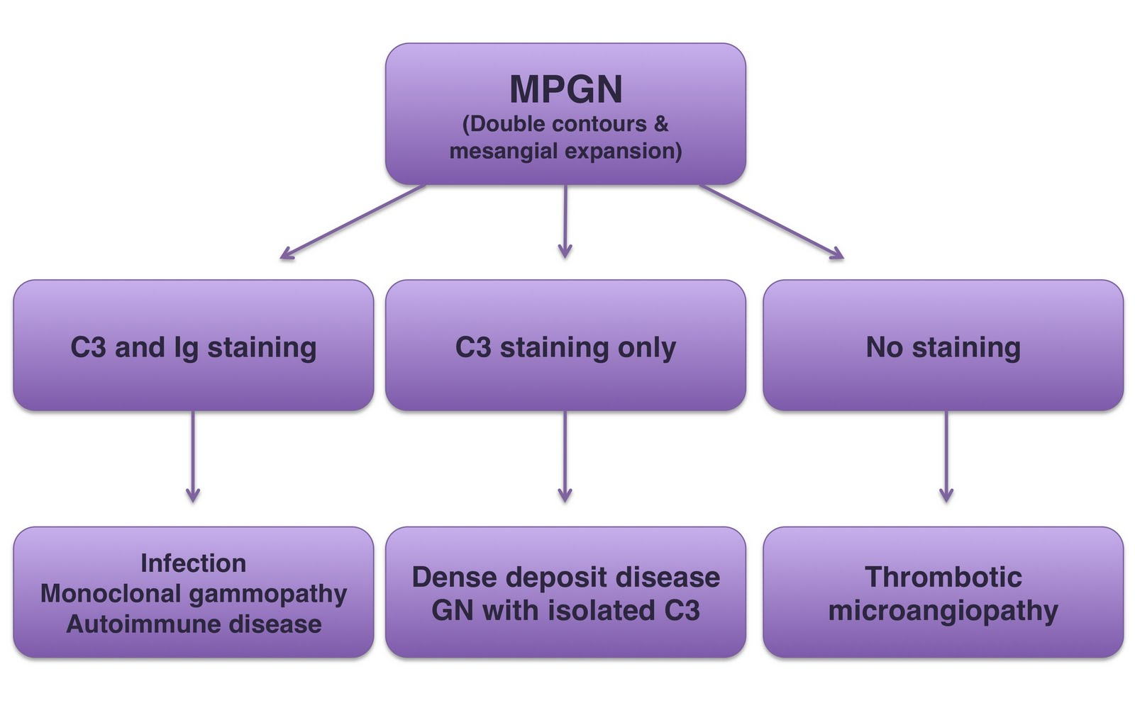
MPGN Classification

Slide 21
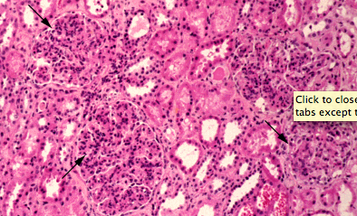
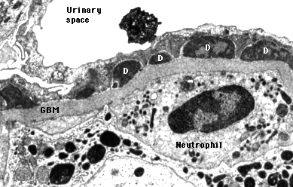
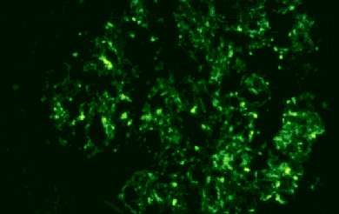
Infection-Related / PSGN
PSGN on decline in developed countries
  97 % cases occur in regions of the world with poor socioeconomic status
  In developed countries, no longer a strong association with pharyngitis, rather skin-related
  Mainly affects children, seasonal pattern
  1-8 weeks POST-infection
Staph, gram (-) bact, viral infections more common in adults → GN develops DURING active infection
Low C3
Notes:
Images from UTD.com, Courtesy of Helmut Rennke, MD.

Slide 22
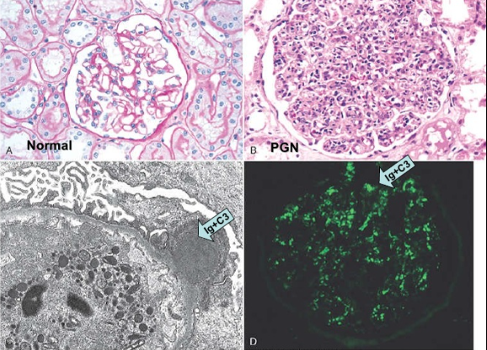
Infection-Related / Post-Strep Glomerulonephritis Pathology
  Circulating immune complexes
  LM: Hypercellular glomeruli, intracapillary WBC/neutrophils
  EM: Electron-dense, glomerular subepithelial immune-complex deposits ("humps")
  IF: + IgG, C3 epithelial w/coarse granular glom wall/mesangial deposits AKA “starry sky” pattern

Slide 23
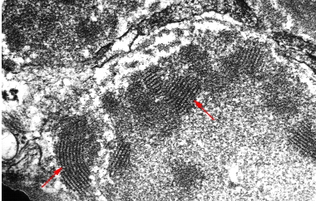
Mixed Cryoglobulinemia
Production of circulating IG that precipitate on cooling
IG complexes deposit in glomeruli + arterioles → bind complement → proliferative response
  Sub-endothelial deposits on electron microscopy= “fingerprinting”
Renal disease occurs in ~ 40 %
Low serum C4 > C3 and (+) RF
Associations
  Type I: Myeloma, Waldenstrom macroglobulinemia
  Type II: Infections such as HCV, HBV
  Type III: Collagen-vascular diseases, lymphoproliferative diseases, HCV
Notes:
Courtesy of Helmut Rennke, MD.

Slide 24
Lupus Nephritis (LN)
Renal disease results from deposition of circulating immune complexes → complement cascade activation → comp-mediated damage, leukocyte infiltration, cytokine release
Anti-dsDNA correlates best with renal disease
Low C4 > C3

Slide 25
ISN / Renal Pathology Society Classification of Lupus Nephritis (2004)
Class | Renal Pathology
I | Minimal mesangial LN
II | Mesangial proliferative LN
III | Focal LN (< 50 % glomeruli)
IV | Diffuse LN (> 50 % glomeruli)
V | Membranous LN
VI | Advanced sclerosing LN (> 90% globally sclerosed glomeruli)

Slide 26
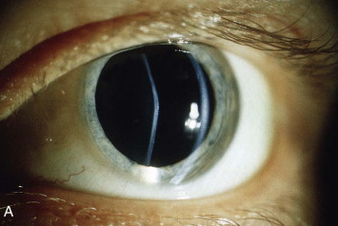
IM Board Question
A 26-year-old man is seen for pre-employment physical. He has no complaints. On ROS, he admits to a few episodes of gross hematuria for which he did not seek medical attention.
On physical examination, his BP is 159/88. His BMI is 21. He appears well except for a conical protrusion of the lens noted on ophthalmic exam pictured below.

Slide 27
Question Continued
What is the most likely diagnosis?
A. Anti-GBM antibody disease
B. IgA Nephropathy
C. Hereditary nephritis
D. HSP

Slide 28
Answer
What is the most likely diagnosis?
A. Anti-GBM antibody disease
B. IgA Nephropathy
C. Hereditary nephritis
D. HSP

Slide 29
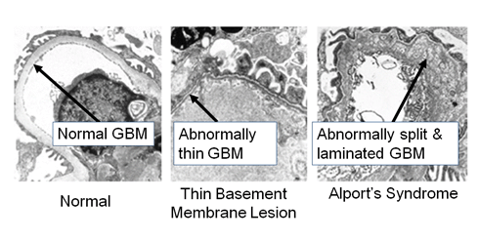
Hereditary Nephritis:
“Alport’s Syndrome”
X-linked, either AR or AD
Mutation in COL4A5 gene on X chromosome encoding α−5 chain of type IV collagen found in GBM
Clinical presentation: young man with asymptomatic persistent microhematuria
Progression to ESRD typically by age 35
Other Clinical Characteristics
Sensorineural deafness
Anterior lenticonus
Retinopathy
Leiomyomatosis

Slide 30
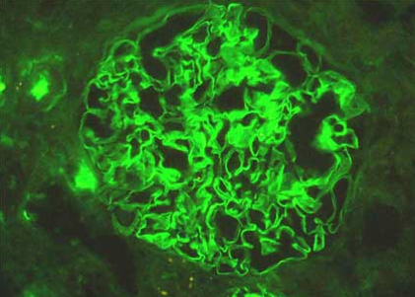
Anti-GBM Disease
Circulating antibodies to GBM with IgG deposits
Renal disease + pulmonary hemorrhage = Goodpasture Syndrome (30-40% pts)
Age/Gender predilection
  20-30 yo men > women
  60-70 yo women > men
Diagnosis
  Renal bx: Linear IgG staining on IF
  (+) Anti-GBM Ab
Treatment
  Plasmapheresis, steroids, Cytoxan
Notes:
Men have higher incidence pulm hemorrhage and the older women renal limited disease.
Test for ANCA, 1/3 ANCA (+) as well

Slide 31
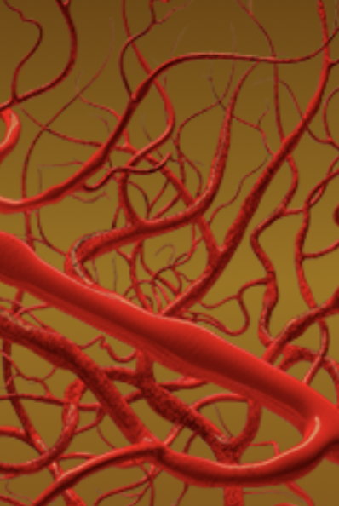
Pauci-Immune GN
Misnomer – classic renal autoimmune disease
Most common cause of RPGN
Presents between ages of 45-65 yrs
1 year mortality ~ 80% without treatment
Triggers: 20% genetic / 80% exposures
  Infectious: Parvovirus B19, Staph aureus
  Drugs: Hydralazine, Minocycline, Cefotaxime, Ant-TNF, Phenytoin, PTU
  Environmental: Silica; Pesticides; Hydrocarbons in paint, diesel; Farms with cattle/pigs; Construction fumes/materials
ANCA (+) vasculitis ~ 90 %
  Granulomatosis with Polyangiitis (GPA)
  Microscopic Polyangiitis (MPA)
  Renal-limited ANCA (+) vasculitis – 80% are MPO-ANCA (+)
  Eosinophilic Granulomatosis with Polyangiitis (EGPA or Churg-Strauss)
ANCA (-) vasculitis ~ 10 %
Notes:
With aggressive immunosuppression, however, the 5-year survival is up to 75%. Relapse common = 40%. Overall, 25% of patients progress → ESRD.
Renal-limited ANCA vasculitis is considered part of the spectrum of GPA and MPA.
REF: Syed R, Rehman A, Valecha G, El-Sayegh S. Pauci-Immune Crescentic Glomerulonephritis: An ANCA-Associated Vasculitis. BioMed Research International. 2015;2015:402826.

Slide 32
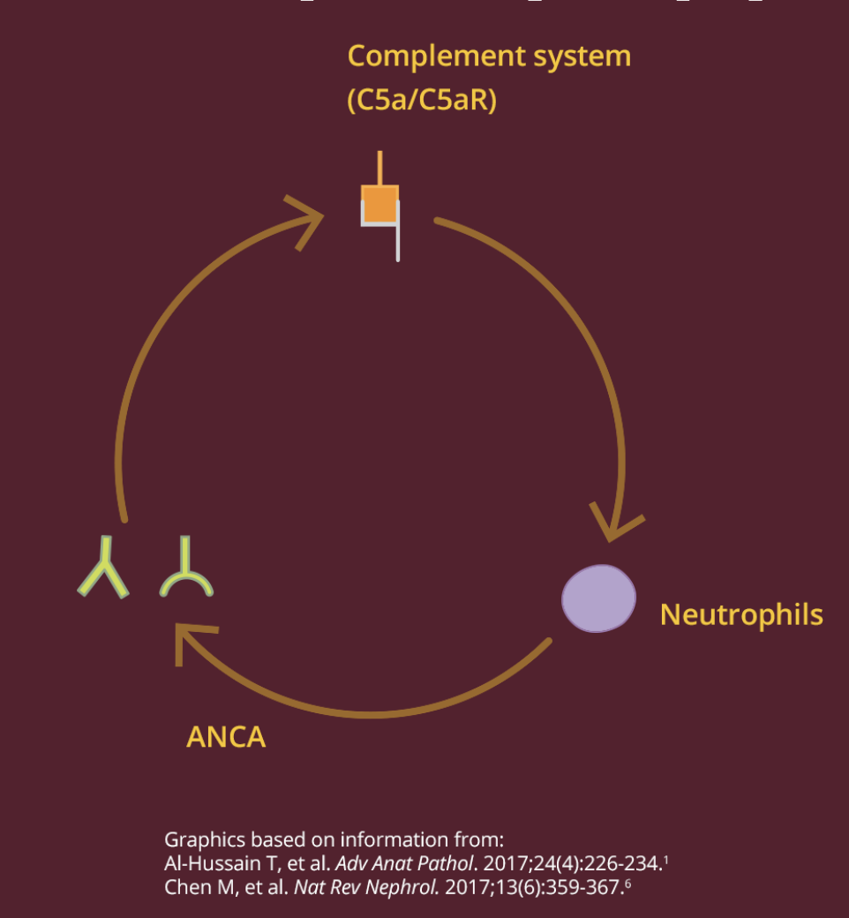
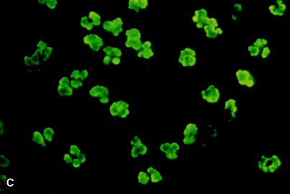
ANCA-Associated Vasculitis Pathophysiology
Loss of immune tolerance and ANCA development
Neutrophil priming -> PR3 and MPO on neutrophil surface enable ANCA to bind → generation of C5a complement fragment
Terminal activation of neutrophils -> C5a binds to C5aR on neutrophils → neutrophil release destructive mediators (ROS, cytokines, NET) → inflammation / destruction vascular tissue
Distinct histological pattern on IF
  < 2+ glomerular Ig and complement staining
Notes:
Neutrophils are primed by a combo of factors, including the inflammatory milieu of cytokines produced in response to an infection or another event.
Alternative complement pathway

Slide 33
Question: Mix and Match
  Match the most common ANCA staining with the pauci-immune GN.
  Granulomatosis with Polyangiitis (GPA)
  Microscopic Polyangiitis (MPA)
  Renal-limited ANCA (+) vasculitis
  Eosinophilic Granulomatosis with Polyangiitis (EGPA)
  p-ANCA (MPO Ab)
  c-ANCA (PR3 Ab)

Slide 34
Answer
  Granulomatosis with Polyangiitis (GPA) - c-ANCA
  Microscopic Polyangiitis (MPA) - p-ANCA
  Renal-limited ANCA (+) vasculitis - p-ANCA
  Eosinophilic Granulomatosis with Polyangiitis - p-ANCA > c-ANCA

Slide 35
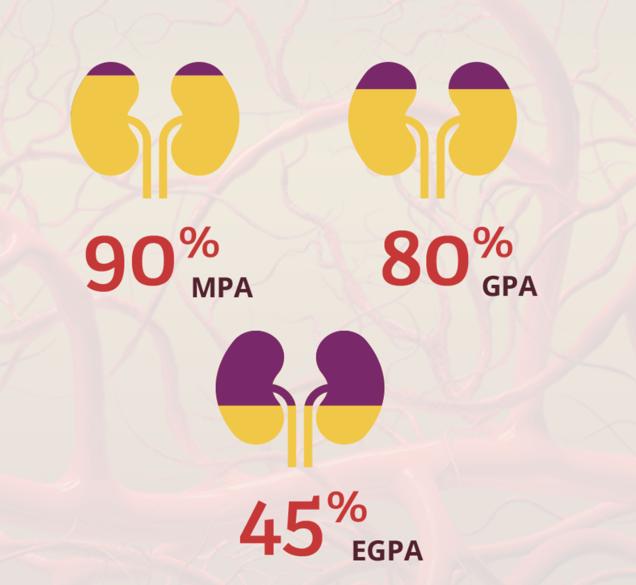
Frequency of Renal Involvement by Sub-type

Slide 36
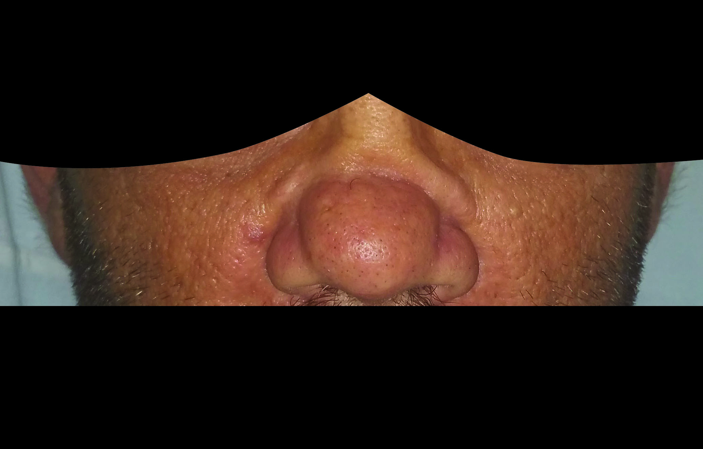
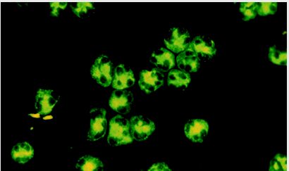
Granulomatosis with Polyangiitis (GPA)
cANCA cytoplasm staining for PR3 antibodies
Granulomatous inflammation and extensive extra-renal involvement→ upper respiratory tract, ENT, & lung (oral ulcers, nasal discharge, uveitis, sinusitis, pulmonary infiltrates)
Higher relapse rate than pANCA phenotype
Microbial factors implicated – + S aureus nares
? Genetic factors – more common in whites, older
Notes:
More common in cooler climates.
Interestingly, a number of pathogens such as S. aureus , Ross River virus, and Entamoeba histolytica have sequences similar to cPR3 peptide, thus making them capable of generating
the autoimmune response.

Slide 37
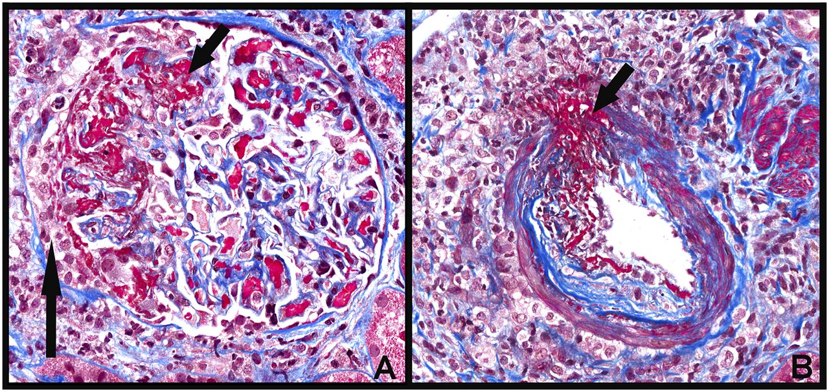
Microscopic Polyangiitis (MPA)
pANCA perinuclear staining for MPO-antibodies
Worse renal prognosis than cANCA phenotype
Similar clinical picture to GPA but without significant respiratory tract involvement
Non-specific sx fatigue, fever, anorexia,
weight loss
~ 50% patients: Leukocytoclastic angiitis,
urticaria, livedo reticularis & other skin lesions
Notes:
More common in warmer climates.
Sx same as GPA but without resp sx as much.

Slide 38
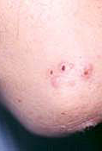
Eosinophilic Granulomatosis with Polyangiitis (EGPA)
pANCA (+) > cANCA
Eosinophilia, asthma, and atopy
  +/- elevated serum IgE levels
Episodic cough and and pulm infiltrates years prior to systemic disease
Tender subcutaneous nodules (granulomas) on the extensor surfaces of the arm (50-67%)
Peripheral neuropathy, usually mononeuritis multiplex (75%)
Milder than GPA and MPA

Slide 39
ANCA Vasculitis: Treatment
Steroids
Cyclophosphamide
Rituxan
Plasmapheresis in severe / dialysis-dependent AKI

Slide 40
Rapidly Progressive GN (RPGN)
NOT a specific disease
  Clinical & histological entity indicating severe glomerular damage
Clinical definition: rapidly progressive renal failure (weeks to months) secondary to acute glomerulonephritis
Pathological definition: glomerular extracapillary proliferation
  Hallmark: “Crescents” typically > 50% gloms
  AKA “Crescentic GN”

Slide 41
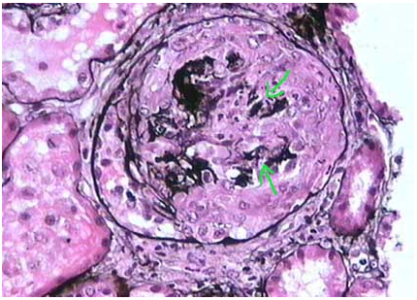
Glomerular Crescent
Either partially or completely filling up Bowman’s space
Composed of proliferating parietal epithelial cells, podocytes, macrophages, and fibroblasts
Stimulated by entry of fibrin and other plasma proteins from the capillary lumens following the rupture of the GBM
Extracapillary proliferation within a glomerulus
Notes:
Compressed tuft, in the center of the glomerulus, by a dense circumferential cellular proliferation that occupies the entire Bowman’s space. The arrows indicate rupture of capillary walls, a frequently associated phenomenon to the crescent. (Methenamine-silver, X300).

Slide 42
Question
Which of the following is NOT a cause of RPGN?
Pauci-immune GN
IgA nephropathy
Anti-GBM Ab disease
Renal amyloid

Slide 43
Answer
Which of the following is NOT a cause of RPGN?
Pauci-immune GN
IgA nephropathy
Anti-GBM Ab disease
Renal amyloid

Slide 44
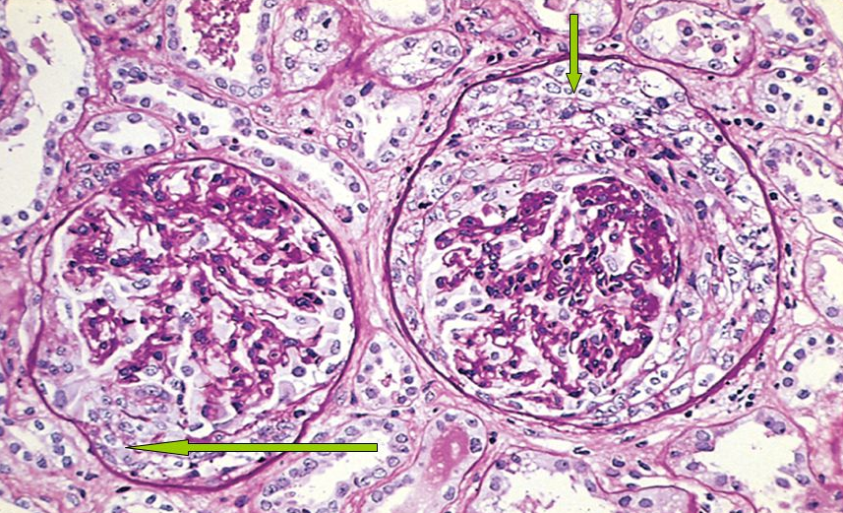
RPGN Causes
Pauci-immune GN (80%) = #1 Cause
  96 % are ANCA (+)
Anti-GBM Ab disease
Immune-complex GNs
Notes:
Anti-GBM disease accounts for 10-20% RPGNs.
Brenner’s the Kidney.
Syed R, Rehman A, Valecha G, El-Sayegh S. Pauci-Immune Crescentic Glomerulonephritis: An ANCA-Associated Vasculitis. BioMed Research International. 2015;2015:402826.

Slide 45
Hypocomplementemic GNs
Glomerulonephritis | C3 | C4
MPGN
Infection-related and Post-Strep GN
Mixed cryoglobulinemia
Lupus nephritis

Slide 46
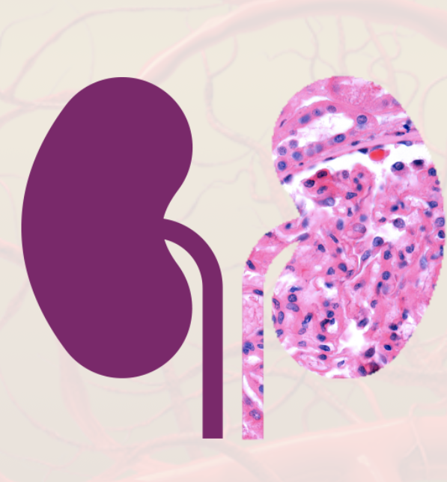

Questions?
Contact: ejbarney@arizona.edu

Slide 47
References
1. www.auanet.org, Microhematuria. American Urological Association
2. Chapter 277: Glomerular Diseases. Harrison’s Internal Medicine 17th edition. Pages 1786-1790.
3. Crescentic Glomerulonephritis. www.kidneypathology.com
4. Heidet L and Gubler MC. The Renal Lesions of Alport Syndrome. JASN 2009 vol. 20 no. 6: 1210-1215.
5. Brenner’s The Kidney, Chapter 2, Anatomy of the Kidney, Chapter 26, Renal and Systemic Manifestations of Glomerular Disease, Chapter 30, Primary Glomerular Disease and Chapter 31, Secondary Glomerular Disease
6. Berden A, Ferrario F, et al. F. Ferrario, A. Vanzati, and F. Pagni. Pathology of ANCA-Associated Vasculitis,. J Am Soc Nephrology 2010; 21: 1628–1636.
7. Jennette C and Nachman P. ANCA Glomerulonephritis and Vasculitis. CJASN October 2017, 12 (10) 1680-1691.
8. Syed R, Rehman A, Valecha G, El-Sayegh S. Pauci-Immune Crescentic Glomerulonephritis: An ANCA-Associated Vasculitis. BioMed Research International. 2015;2015:402826.
9. C. A. Stegeman, et al. Association of chronic nasal carriage of Staphylococcus aureus and higher relapse rates in Wegener granulomatosis. Annals of Internal Medicine, vol. 120, no. 1, pp. 12–17, 1994.

