Slide 1
Thrombocytopenia
Sunil Tulpule

Slide 2
Disclosures
Consultant, Kyowa Kirin

Slide 3
Objectives
Define Thrombocytopenia
Evaluating Thrombocytopenia
  Ruling out Emergent Causes
  Decreased Production versus Increased Destruction verses Sequestration
Treatment of Underlying Causes
Transfusion Parameters

Slide 4
Case 1
A 39 year-old male without any medical history presents for an annual follow-up visit. He doesn’t have any complaints and doesn’t take any medications. He does not smoke or drink alcohol. Prior labs have been normal. CBC w diff shows new thrombocytopenia with platelet count 80,000/uL and is otherwise normal. CMP is normal. Which of the following is the next best step?
Obtain anti-platelet antibodies
Repeat a platelet count in a heparinized or citrated tube
Bone Marrow Biopsy
Review the peripheral smear

Slide 5
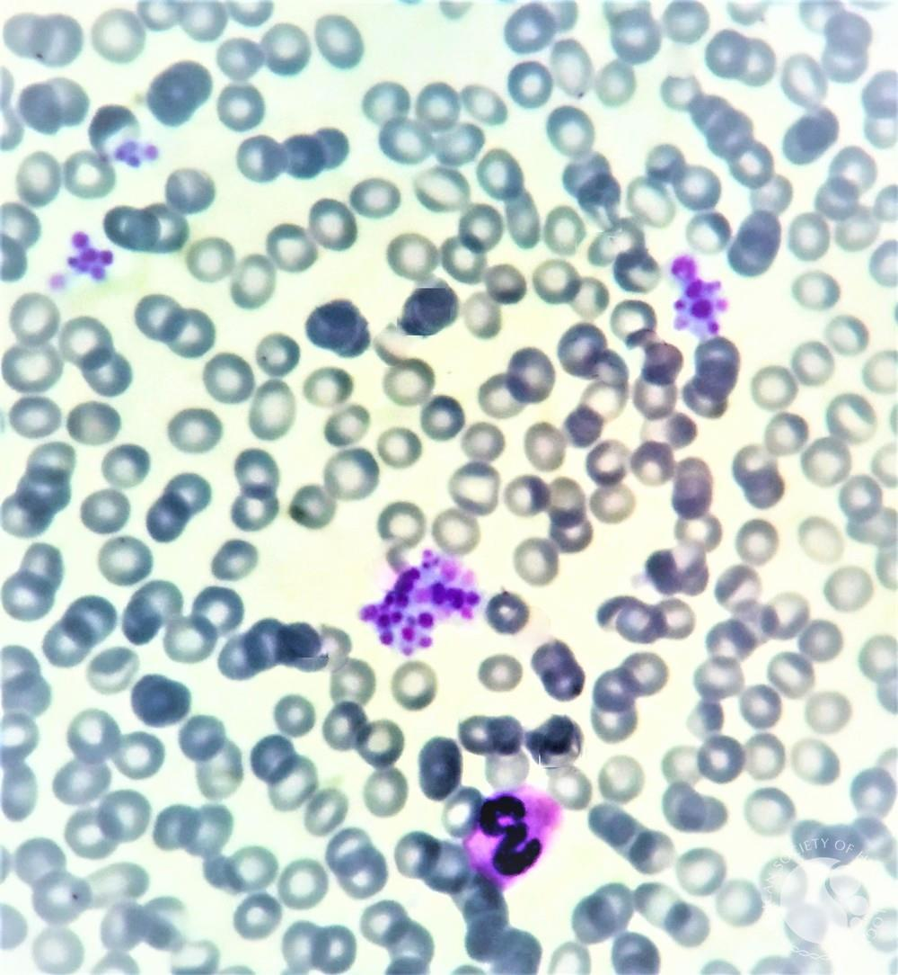
Case 1
Pseudothrombocytopenia
  Peripheral smear shows clumped platelets
  Repeat a platelet count in a heparinized or citrated tube
Courtesy, American Society of Hematology Image Bank

Slide 6
Thrombocytopenia
Platelet count < 150,000/uL
Platelet-type bleeding typically involves skin or mucous membranes
  Petechiae, Ecchymosis, Epistaxis, Menorrhagia and GI Bleed
Deep muscle hematomas and hemarthrosis typically seen with defects in fluid hemostatic system

Slide 7
Clinical Manifestations
Bleeding
  < 75,000 – 100,000: Increased bleeding with surgery, trauma
  < 20,000: Increased spontaneous mucocutaneous bleeding
  < 10,000: Increased risk of spontaneous intracerebral hemorrhage
Thrombosis:
  Heparin-Induced Thrombocytopenia (HITTS): Thrombosis, Large Vein & Arteries
  Thrombotic Microangiopathy (TTP, HUS, aHUS): Thrombosis, Small Arteries, CNS, Renal, Cardiac

Slide 8
Etiologies
Decreased Bone Marrow Production
Hemodilution
Sequestration (understand pathophysiology)
Increased Consumption (TMA’s)
Increased Destruction or Clearance (immune mechanisms)
Pseudothrombocytopenia (clumps on smear)

Slide 9
Thrombopoietin
Major Hematopoietic Growth Factor influencing platelet production
Made in liver and kidneys
Production is constant
Binds to Myeloproliferative Leukaemia Virus Oncogene (MPL) receptor on Promegakaryocytes, Megakaryocytes and Platelets
Gain of function TPO gene mutation → increased platelets
Gain of function MPL gene mutation → increased platelets
Loss of function MPL gene mutation → decreased platelets
  Congenital Amegakaryocytic Thrombocytopenia

Slide 10
Decreased Production
Congenital:
  Inherited Platelet Disorders
  MYH9 Thrombocytopenias (e.g. May-Hegglin Anomaly)
  Mediterranean Macrothrombocytopenia (GP1ba)
  RUNX1 mutations
  Paris-Trousseau Thrombocytopenia
  Velocardiofacial/DiGeorge Syndrome (del CH22)
  Congenital Amegakaryocytic Thrombocytopenia
  Thrombocytopenia with Absent Radii (TAR)
  Wiscott-Aldrich Syndrome
  Bernard-Soulier Syndrome

Slide 11
Decreased Production
Acquired:
  Disorders of bone marrow production
  Leukemias
  Aplastic Anemia
  Lymphomas
  Myeloma
  Infiltrative BM disorders
  Fanconi Anemia
  Congenital Infection
  Medications
Notes:
Fanconi- defect in DNA repair

Slide 12
Hemodilution
Post-operative
Cardiopulmonary Bypass
  Decreases then followed by reactive thrombocytosis
Pregnancy in 3rd Trimester:
  Blood volume increases by 30%
  Platelet count decreases by 10 – 20%

Slide 13
Sequestration
Hypersplenism (including liver disease)
  Congested or inflamed spleen enlarges (normal adult spleen is 11 cm)
  Normally spleen has 30% of platelets (can be up to 90%)
  Associated with liver disease, portal hypertension, congestive splenomegaly in heart failure (Banti’s Syndrome), Felty Syndrome in RA, Malaria, CML, Kala-Azar (Leishmaniasis)
Kasabach-Merritt Syndrome
  Giant Cavernous Hemangioma
  Disorder of both sequestration and consumption due to microvascular DIC

Slide 14
Increased Consumption
DIC: acute and chronic
Sepsis from any cause
Cardiovascular Disease:
  Cardiopulmonary Bypass, ECMO, Calcified Aortic Valve Disease, Artificial Heart Valves, Heydes Syndrome (loss of VWF multimers with platelet consumption), paravalvular leak
Vasculitis: SLE, GPA
Thrombotic Microangiopathy: TTP, HUS, aHUS, Medications (Gemcitabine, Ticlodipine, Cyclosporine)
  Intravascular Consumption and Destruction of RBCs → Archetype Schistocytes

Slide 15
Case 2
A 44 year-old female presents with confusion x 1 hour. She is found to have an acute ischemic CVA and an AKI. CBC w diff shows normocytic anemia with hemoglobin concentration 7 g/dL, normal WBC and diff and thrombocytopenia with platelet count 6,000/uL. Urine pregnancy test is negative. What is the next best step?
Repeat a platelet count in a heparinized or citrated tube
Administer tPA for acute ischemic CVA
Stat LDH, Haptoglobin, Review of Peripheral Smear
Transfuse platelets
SPEP/IFE, serum free light chains to rule out myeloma

Slide 16
Case 2
Labs show hemolysis and peripheral smear shows 3+ schistocytes. What is the next best step?
Start Steroids
Insert a dialysis catheter
Obtain an ADAMTS 13 level and check stool for Shiga Toxin
Start Plasmapheresis
All of the above

Slide 17
TTP (Moschowitz Syndrome)
Acute disorder with abnormalities in multiple organ systems and evidence of MAHA and Thrombocytopenia
Untreated: 80% mortality
  Plasmapheresis decreases mortality to 20 – 30%
Less than 2% patients die today (when they die it’s due to microvessel thromboses in heart causing MI’s)
Classic Pentad:
  MAHA
  Thrombocytopenia
  Renal Insufficiency or Abnormalities
  Neurologic Abnormalities that can be fluctuating
  Fever
Most common sx at presentation are nonspecific: abdominal pain, N/V, weakness

Slide 18
TTP
Mechanism: VWF cleaving protein ADAMTS13 (a disintegrin and metalloprotease Thrombospodin repeats #13), aka VWF-cleaving protease
  Hyaline Thrombi occlude arterioles and are predominantly comprised of VWF and Platelets
  Idiopathic Acquired, usually associated with Antibody to ADAMTS13 (87 – 90%)
Congenital: Upshaw-Schulman Syndrome (10 – 13%)
  Hereditary deficiency of ADAMTS13

Slide 19
TTP
Management:
  Plasmapheresis initially with immunosuppression (steroids)
    +/- Caplacizumab
    +/- anti-CD20 therapy
    Cyclophosphamide
  In pregnancy: PLEX +/- steroids
  Caplacizumab inhibits VWF-platelet interaction
  Upshaw-Schulman Syndrome: Plasma Infusion or Recombinant ADAMTS13 (if available)

Slide 20
Hemolytic Uremic Syndrome
Presents with bloody diarrhea and renal failure
Mostly effects children
Verotoxin-producing e. coli 0157:H7, 0104:H4 strains (Shiga toxin I & II producing e. coli STEC) produce shigella toxin (measure by stool PCR)
Food contamination: Hamburger meat, Spinach, Fresh Fruit, etc.
E. coli LPS and STEC toxin from Shigella stimulates cytokines
  Leads to Renal Inflammation and Injury
Treat Infection and Plasmapheresis
  If just diarrhea, supportive care
50% of patients have permanent renal failure and end up on dialysis
25% mortality without plasmapheresis
Notes:
Lipopolysaccharide (LPS), Shiga Toxin producing E. coli (STEC)

Slide 21
Atypical HUS
Renal Failure with or without MAHA
Due to complement protein defects:
  Loss of function of Factor H, I, Membrane Complement Protein (MCP), Thrombomodulin (TM)
    CD46 membrane cofactor protein
  Gain of Function of C3 and Factor B
Diagnosis made by exclusion
  Exclude: HELLP in Pregnancy, Cancer, Hemolysis in Lupus
  Treat with anti-C5 therapy:
    Monoclonal Antibody Eculizumab or Ravulizumab (long-acting)
      In Pregnancy Eculizumab (increased dose and frequency)

Slide 22
Approach to Patient with TMA
Initiate Plasmapheresis x 5 days
Send labs for ADAMTS13, Shiga Toxin PCR in stool
Exclude other causes of TMA (HELLP, Cancer Meds, APLS, SLE)
Upon receipt of lab results, start treatment
  Low ADAMTS13 → PLEX for TTP
    Caplacizumab
  Positive Shiga Toxin → Continue PLEX for HUS
  Both Negative → Stop PLEX and Start Eculizumab

Slide 23
Other TMAs
HELLP Syndrome (form of preeclampsia): deliver baby
  True HELLP syndrome resolves with delivery of baby
  If hemolysis doesn’t resolve, explore other causes of TMA
CAPS
Medications:
  Ticlodipine, Clopidogrel
  Quinine, Cyclosporine, Tacrolimus, Cocaine
  Gemcitabine, Mitomycin C, Interferon
TMA-associated with Bone Marrow Transplant:
  Vaso-occlusive disorder related to PAI-1 expression with fibrosis
  Within 150 days of BMT

Slide 24
Case 3
A 24 year-old female psychiatry PGY-2 presents with petechiae x 2 weeks. She had covid 1 month ago. She rarely drinks alcohol and doesn’t take any medications. Vital signs are normal. CBC w diff shows isolated thrombocytopenia with platelet count 30,000/uL and is otherwise normal. CMP is normal. Repeat platelet count in a citrated tube and review of peripheral smear confirms thrombocytopenia without any other suspicious findings. What is the next best step?
Send to the ED
Evaluate for hemolysis, hematologic malignancies, viral causes, autoimmune disorders and obtain an abdominal ultrasound
Type and Screen for platelet transfusion
Counsel re: alcohol cessation and repeat labs in 4-6 months

Slide 25
Increased Platelet Destruction
ITP
Idiopathic
Alloimmune Syndrome
Drug-induced Thrombocytopenia
Heparin-induced Thrombocytopenia
Other immune: HIV, H. pylori, Hepatitis C
Collagen Vascular Disease, SLE, Thyroiditis, Common Variable Hypogammaglobulinemia

Slide 26
ITP
Antibodies bind to platelet surface (e.g. α2β3, GP1bα) → activation
  Leads to splenic and hepatic clearance
  IgG antibodies mediated by integrins are cleared by Spleen
  GPIb antibodies (IgG or IgM) → platelet activation and deacetylation
    Cleared by Ashwell-Morell receptor in liver
Peak incidence in childhood (2 – 10 years) and adult women
Childhood ITP M=F whereas in adults females predominate 3:1
Characteristic presentation is sudden-onset bruising/petechiae in an otherwise well person
History of viral illness or immunization 1 – 3 weeks prior to presentation in acute ITP (mainly childhood ITP)
Notes:
In 1961 Carl Moore and his hematology fellow William Harrington at WashU in St. Louis injected themselves with serum from a patient with ITP. Harrington nearly died. They demonstrated that the patient’s blood contained a substance that induced reversible profound thrombocytopenia.

Slide 27
ITP
Diagnosis:
  Of exclusion
  Antecedent infectious illness ~60%
  Physical exam remarkable for only purpura
  Peripheral smear with thrombocytopenia and normal to large platelets (in high turnover states)
  Bone Marrow shows Megakaryocytes
  60% will have increased IgG or IgM on platelet surface

Slide 28
ITP
Tests:
  CBC w diff (review peripheral smear)
  Retics, ESR, LDH, Haptoglobin, Direct Bilirubin
  DAT
  SPEP/IFE, Serum FLCs, Quantitative Immunoglobulins
  Hepatitis C Antibody, HIV serology
  Serologies for SLE and related disorders
  H. pylori antibody
  Flow cytometry of peripheral blood looking for clonality
  If Rituximab or Splenectomy is considered: CT CAP and Bone Marrow Biopsy

Slide 29
ITP
Treatment:
  Primary Treatment:
    Steroids: Dexamethasone x 4 days every 14 days for 6 cycles
    IVIG
  Secondary Treatment:
    Splenectomy: 60 – 70% response rate for 25+ years
    Rituximab: 60% response rate; 25% CR at 5 years
    TPO Analogs:
      Romiplostim subq: 13-year safety record
      Eltrombopag PO: 11-year safety record
    Fostamatinib: Splenic TKI
  Tertiary Treatment (no longer needed)
    Immunosuppressive agents: Azathioprine, Cyclophosphamide + Prednisone
    Danazol
    Anti-D Antigen Therapy

Slide 30
TPO Mimetics
Not associated with increased risk of Thrombosis in ITP
Romiplostim
  IgG Fc fragment to which four 14-a.a. TPO peptides are attached that activate TPO receptor (a “peptibody”)
  Indications:
    Chronic ITP with insufficient response to first-line therapy
    Severe thrombocytopenia with increased bleeding or at risk of increased bleeding
  1 mcg/kg subq weekly (dose-adjusted to keep platelet count > 50k)
  AE’s:
    Reversible increase in reticulin
    Thrombosis (doesn’t correlate with platelet count)
    Increased blasts in MDS
    Transient rebound thrombocytopenia when stopped

Slide 31
TPO Mimetics
Eltrombopag:
  Oral Nonpeptide TPO Receptor Agonist (small molecule agonist of C-MPL receptor)
  Indications:
    Chronic ITP (similar to Romiplostim)
    Thrombocytopenia due to Chronic Hepatitis C to allow initiation and maintenance of Interferon treatment
    Severe Aplastic Anemia when immune suppression fails (in non-BMT candidates)
  Start at 50 mg PO daily
    If Asian or Hepatic Insufficiency, start at 25 mg PO daily
    Increase to 75 mg PO daily (max dose)
    Dose-adjust based on platelet response

Slide 32
Eltrombopag cont.
Take on an empty stomach (without antacids) or with a low-calcium meal
  Calcium inhibits absorption
AE’s:
  Nausea/Vomiting
  Menorrhagia
  Myalgia
  Rare Hepatotoxicity (need frequent early monitoring q2w until stable dose, then monthly)
In Aplastic Anemia, all three cell lines improve with Eltrombopag
  MPL on stem cells are stimulated by Eltrombopag

Slide 33
TPO Mimetics
Avatrombopag
  Oral Nonpeptide TPO receptor agonist
  4x more potent than Eltrombopag in healthy volunteers
  Indication:
    Thrombocytopenia due to chronic liver disease in patients scheduled to undergo a procedure
    Refractory ITP
  Start 10-13 days prior to procedure
  Take on empty stomach without antacids
  AE’s:
    Nausea, Abdominal pain, fever, fatigue, headache, peripheral edema, thromboembolism
Lusutrombopeg:
  For thrombocytopenia in adults with chronic liver disease who are scheduled to undergo a medical or dental procedure

Slide 34
Differential Dx of Acute Thrombocytopenia
Condition | PT | aPTT | D-Dimer | Platelets | Peripheral Smear
ITP | Normal | Normal | Negative | Decreased | +/-
TTP | Normal | Normal | Negative | Decreased | +++
HUS | Normal | Normal | Negative | Decreased | +++
aHUS | Normal/Abnormal | Normal/Abnormal | Negative or Positive | Decreased | ++/-
DIC | Abnormal | Normal/Abnormal | Positive | Decreased | +/-

Slide 35
Alloimmune Thrombocytopenias
Neonatal Alloimmune Thrombocytopenia (NAIT)
Post-Transfusion Purpura
Passive Alloimmune Thrombocytopenia
Transplant-Associated Alloimmune Thrombocytopenia
Platelet-Transfusion Refractoriness

Slide 36
Neonatal Autoimmune Thrombocytopenia
Fetal Platelet Antigen rear Maternal Antibodies that transfer across placenta and induce Thrombocytopenia
  HPA-1a is the most common antigen
Cranial ultrasound to rule out ICH
Treatment for Baby:
  IVIG 1 g/kg if platelet count < 20,000 or Transfusion with Mother’s Washed Platelets

Slide 37
Post-Transfusion Purpura
Elderly females form high-titer anti-HPA-1a anti-GPIIb/IIIa Alloantibodies that destroy autologous platelets
5 – 10 days after transfusion
Treatment: IVIG

Slide 38
Passive Alloimmune Thrombocytopenia (PAT)
Rare disorder
Donor platelets contain alloantibody to recipient’s platelets
  The transfused alloantibody binds rapidly to the recipient’s platelets which are subsequently removed by the RES
  HPA-1a and HPA-5b have been implicated
Occurs within hours of transfusion of plasma or RBCs
Thrombocytopenia usually lasts less than 1 week
  Implicated donor should not donate blood products in the future

Slide 39
Transplant-Associated Alloimmune Thrombocytopenia
Seen in previously heavily transfused patient (i.e. BMT) who becomes refractory to random platelet transfusion
Due to residual host lymphocytes
Platelet Transfusion Refractoriness
Heavily transfused patient
Transfuse HLA-matched Platelets

Slide 40
Drug-Induced Thrombocytopenias
Mechanisms:
  Hapten Mechanism
    Drug binds to platelets and antibodies reared to drug-platelet complex (e.g. many penicillins and cephalosporins)
    Antibody-drug complex is cleared from circulation by splenic macrophages
  Immune Complex Mechanism
    Antibody reacts to drug and forms a complex → immune complex binds to platelet
    Complement binds and is platelet-activated or lysted (i.e. quinine)
  Auto-Antibody Mechanism
    Drug rears Antibody; Antibody attacks Platelets
      e.g. Heparin-PF4 Antibodies (Fcγ2 receptor)
    Tirofiban, Eptifibatide
      Integrilin-antibody to drug-integrin complex acts like a platelet-activating agent
  Immunogenic Drug-Platelet Complex
    Rears antibody that then binds drug
    Platelets cleared from circulation by macrophages in spleen by Fc receptors

Slide 41
Case 4
A 65 year-old male with hypertension and diabetes mellitus presents with STEMI and undergoes emergent PCI. CBC with diff on arrival shows anemia with hemoglobin 10.5 g/dL, neutrophil-predominant leukocytosis with WBC 13,000/uL and thrombocytopenia with platelet count 130,000/uL. 3 days later his CBC shows stable anemia and worsening thrombocytopenia with platelet count 100,000/uL. He is asymptomatic. What is the next best step?
Obtain HIT antibodies and Serotonin Release Assay
Transfuse platelets
Stop antiplatelet therapy
Evaluate for other causes of thrombocytopenia

Slide 42
HIT and HITT
Occurs in 1-3% of patients getting UFH and 0.5-1% getting LMWH
Defined as 50% decrease in platelet count anywhere from 3-30 days after exposure
  Usually 5-10 days after exposure
First manifestation is Thrombocytopenia
  Median platelet count is 60,000/uL
70% or more patients get Venous or Arterial Thrombosis
  Most are subclinical and need duplex ultrasound of all 4 extremities

Slide 43
HIT and HITT
Pathogenesis
  UFH binds to Platelets and releases Platelet Factor 4 (PF4) that binds to Glycosaminoglycan (GAG)
  PF4 also binds to GAG on ECM, displacing Antithrombin (AT)
  UFH administration displaces PF4 → Large UFH-PF4 complexes
  1-3% of patients rear an antibody to UFH-PF4 complex
  This antibody (HIT Antibody) binds to platelet via Fc receptor (Fcγ2 receptor on platelets)
  HIT Antibody binding triggers Platelet Activation and Procoagulant State
  Caused by autoantibodies to PF4 (stored in platelet alpha granules) complexed with heparin
    Mechanism of thrombocytopenia is removal of IgG-coated platelets by macrophages of the RES

Slide 44
HIT and HITT
Clinical Criteria:
  One or more of the following:
    Thrombocytopenia
    Thrombosis (venous, arterial or microvascular)
    Necrotizing skin lesions at injection sites
    Acute Anaphylactoid Reactions
  Appropriate timing of heparin exposure
  Absence of more compelling explanation
Pathologic:
  Positive Platelet Activation Assay
  Positive Anti-PF4/Heparin IgG Assay
  Positive Serotonin Release Assay

Slide 45
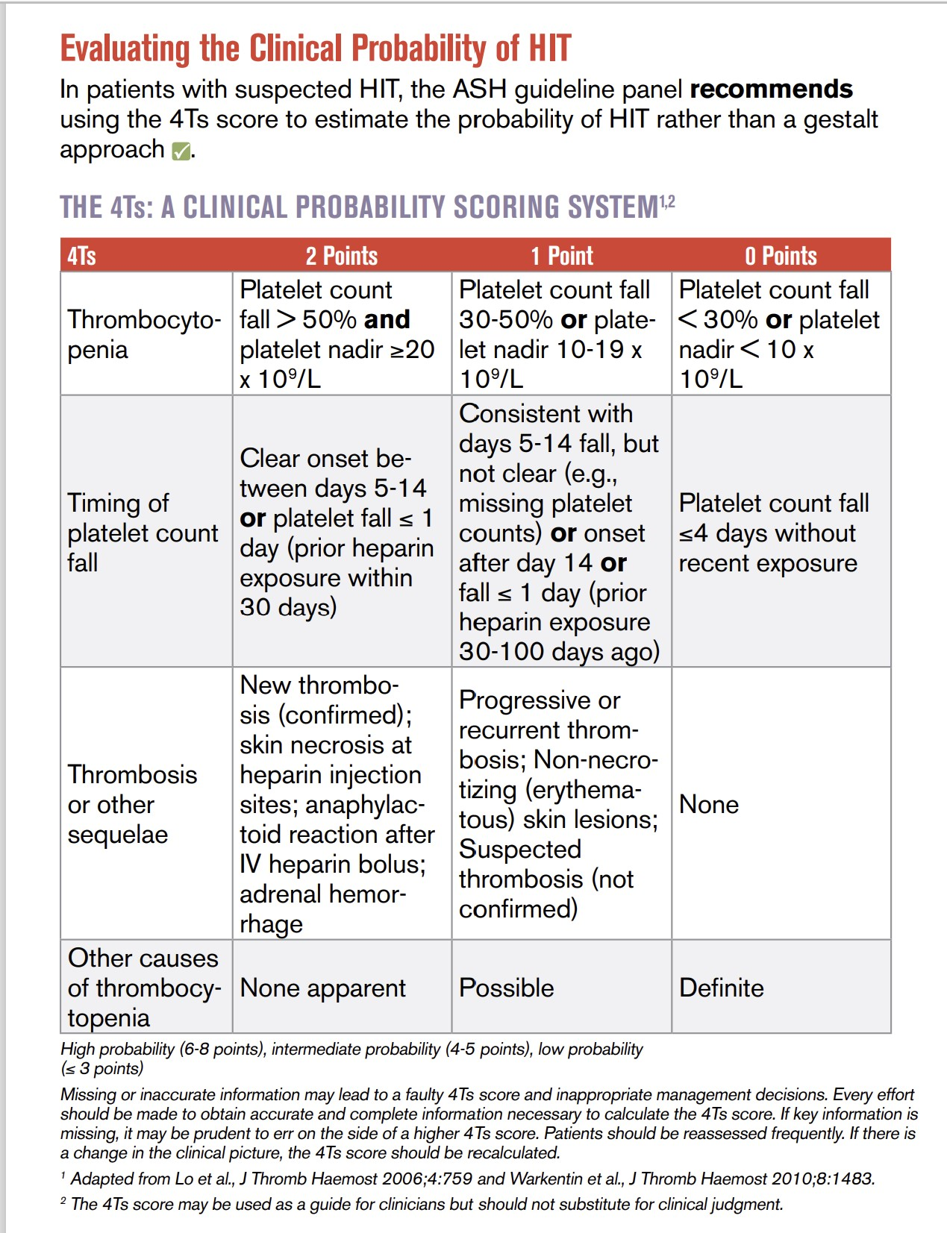
ASH VTE Guidelines 2018

Slide 46
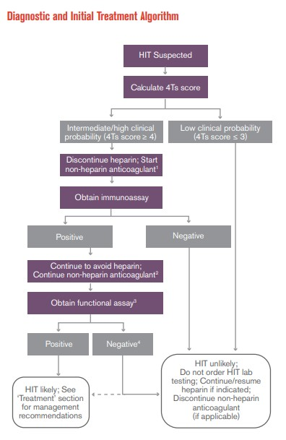
ASH VTE Guidelines 2018

Slide 47
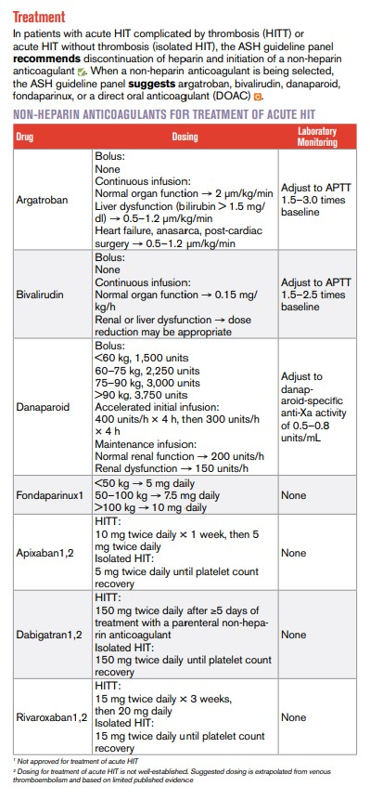
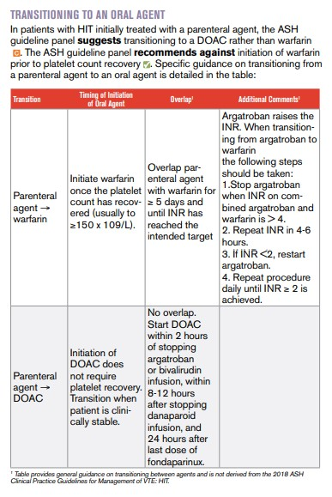
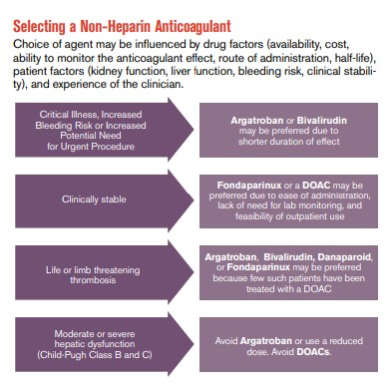
ASH VTE Guidelines 2018

Slide 48
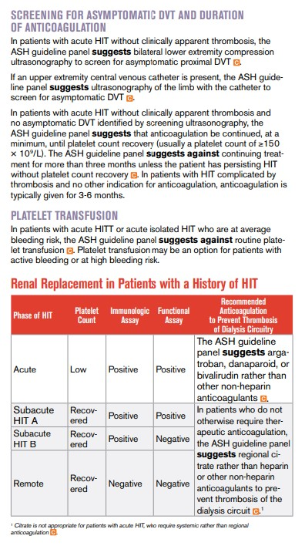
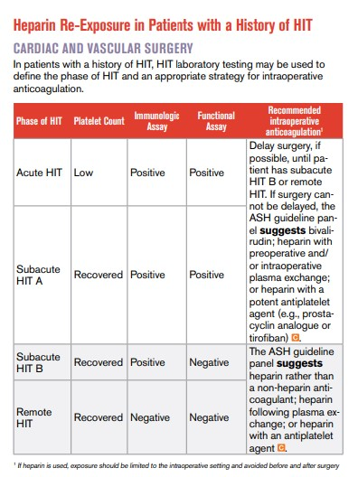
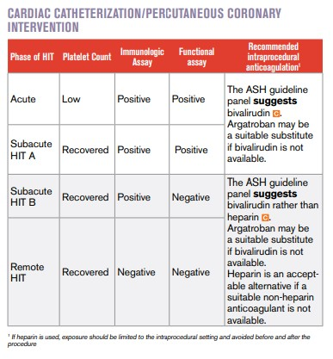
ASH VTE Guidelines 2018

Slide 49
Management of HIT/HITT
Stop UFH/LMWH
Warfarin is Contraindicated because of Acquired Protein C Deficiency (activated coagulation state)
Anticoagulate with Direct Thrombin Inhibitor (Argatroban if renal dysfunction)
  Retrospective studies suggest acute HIT can be treated with Rivaroxaban
Determine if occult thrombosis to ascertain duration of anticoagulation
Transition to an oral anticoagulant
  Overlap Direct Thrombin Anticoagulant with Warfarin for 5 days
    Start Warfarin when platelets > 150, then continue warfarin monotherapy for at-least 4 weeks

Slide 50
Thrombocytopenia in Hospitalized Patients
Infections
Medications (antibiotics, heparin)
DIC
Medical Disorders: SLE, Liver Disease, Splenomegaly, etc.
Hematologic Disorders

Slide 51
DIC
Condition in which thromboses form throughout body, blocking small vessels
  Imbalance between procoagulant and anticoagulant pathways
Relatively common causes:
  Sepsis (protein C deficiency), Surgery, Malignancy, Trauma, Pregnancy Complications
Less common causes:
  HIT, Prothrombin Complex Concentrate, Acute Hepatic Necrosis, Pancreatitis
Criteria: Thrombocytopenia, Elevated D-dimer and Abnormal PT/PTT
  Hypofibrinogenemia is not diagnostic
    Transfuse Cryoprecipitate to keep fibrinogen above 100 (or 150 if bleeding)

Slide 52
Treatment of DIC
Transfuse Platelets as needed
Transfuse Cryoprecipitate as needed
  Each unit of Cryo will increase Fibrinogen by 10 mg/dL
  Keep Fibrinogen above 100 (150 if bleeding)
Do not administer Tranexamic Acid or Aminocaproid Acid for bleeding

Slide 53
Practical Approach to Thrombocytopenia
Review of Peripheral Blood Smear
  Pseudothrombocytopenia (clumping)
    Repeat testing in Citrated or Heparinized tube
  Schistocytes
    TTP/HUS
      Hemolysis
      ADAMTS13 level
Medications
  Recent or Prior Heparin Exposure – HIT (4-T score)
    Anti-PF4 antibodies, SRA
Viral Studies – HIV, Hepatitis, EBV, CMV
Abdominal Ultrasound
  Cirrhosis, Portal Hypertension, Splenomegaly
Family History
Hospitalized patients – Infection, Infection, Infection!
  DIC – D-dimer, Coags (PT, PTT)
  Fibrinogen level is normal/elevated in most cases
ITP – Diagnosis of Exclusion

Slide 54
Transfusion Parameters
Contraindications for Platelet Transfusions:
  TTP, aHUS
  HIT/HITT
  ITP (relative): can transfuse under the cover of dual immune suppression
No bleeding: > 10,000/uL
Bleeding, Perioperatively or Peripartum: > 50,000/uL
  Operator Dependent for Lumbar Punctures (? 20,000/uL)
Intracranial Bleeding, Neurosurgical Procedures: > 100,000/uL

Slide 55
Questions?

