Slide 1
Heart failure basics
Fadi Khoury, MD
PGY-3
This Photo by Unknown Author is licensed under CC BY-NC-ND

Slide 2
What is heart failure?
Clinically diagnosed condition for which you need to have both:
Current or prior symptoms of HF(dyspnea, fluid overload etc.)
Abnormal Echo findings
Just incidental abnormal echo findings like EF ~ 30% without any current or prior history
of HF symptoms would be called Systolic Dysfunction but not Heart Failure

Slide 3
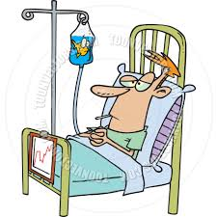
How many HF admissions per year in the country
Average of 57 million HF admissions per year in United States
This Photo by Unknown Author is licensed under CC BY-NC

Slide 4
Types of heart failure
2 types:
Systolic and Diastolic
HFrEF EF<40%
Impaired squeeze function of ventricles
HFpEF EF>50%
More common, impaired filling pattern with a stiff ventricle
Normal EF 55-70%

Slide 5
classification
2 Types of Classification
Functional and Anatomical
These 2 stages do not fit actual HF diagnosis
NYHA Functional Status
I: No limitations in normal physical activity
II: Mild symptoms only in normal activity
III: Marked symptoms during daily activities, asymptomatic only at rest
IV: Severe limitations, symptoms even at rest
ACCF/AHA Stages
A – at risk for HF
B – structural disease but no symptoms
C – structural disease + prior/current symptoms
D – refractory HF

Slide 6
CASE #1
A 68 yo M with CAD, ICM s/p AICD, HTN, DM2, HLD presents to the hospital with progressive SOB x 2 weeks and weight gain 3.3 kg (7.3 lb). Two nights ago, he awoke with sudden-onset dyspnea that was relieved with ambulation. He has not had chest pain. Medical history is significant for myocardial infarction 8 years ago. He also has a history of left ventricular dysfunction but has been previously well compensated. His medications are metformin, furosemide, lisinopril, aspirin, metoprolol, and rosuvastatin.
What is the next appropriate step:
A. Transthoracic echocardiogram
B. Immediate Cardiology Consultation
C. Physical Exam
D. Chest XRAY

Slide 7
Answer: C! HF is a CLINICAL diagnosis

Slide 8
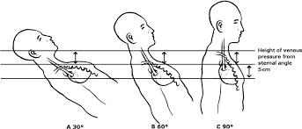
Clinical presentation
History(usually spreading out over days to weeks):
dyspnea, paroxysmal nocturnal dyspnea, orthopnea(how many pillows have been using lately to sleep at night, sleeping in bed or on chair), edema, weight gain, pain from hepatic congestion, and abdominal discomfort due to distention from ascites, early satiety
For HFrEF patients fatigue, weakness that is most pronounced with exertion
Physical exam:
3 major manifestations of volume overload: +/- Murmurs/S3
1.JVD = Reported in CM of H2O,abnormal when >9cmH2O2.
2. Peripheral edema
3. Wet Crackles(different from dry pulm. Fibrosis crackles) or wheeze (cardiac wheeze); Could be hypoxic or not

Slide 9
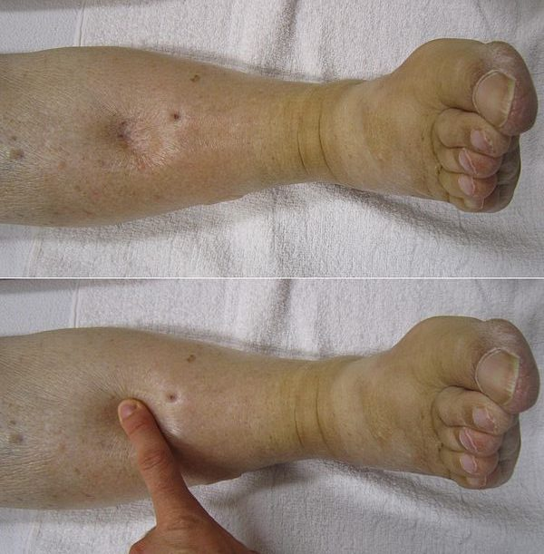
Pitting edema
Fresh/New pitting edema: soft and squishy
Chronic venous stasis edema: pigmented skin(Stasis dermatitis), hard, firm, have to press really hard for it to pit
This Photo by Unknown Author is licensed under CC BY-SA-NC

Slide 10
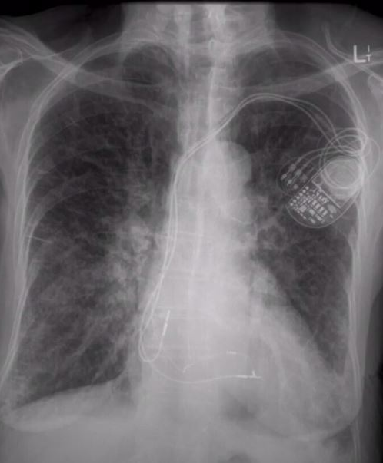
CASE #2
Laboratory studies are significant for a serum creatinine level of 1.9 mg/dL (168 µmol/L), a serum potassium level of 4.5 mEq/L (4.5 mmol/L), and a serum sodium level of 139 mEq/L (139 mmol/L). BNP 2,321. Troponin <0.10.
Chest Xray was done.
Findings?

Slide 11
Pleural Effusions
Kerley B lines
Cephalization (can see blood vessels)
Full hilum, pulmonary edema
Increased cardiac thoracic ratio

Slide 12
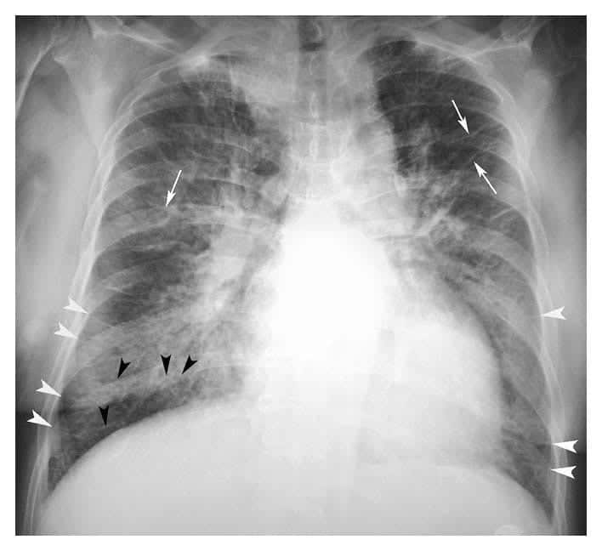
Cardiogenic vs non-cardiogenic pulmonary edema
This Photo by Unknown Author is licensed under CC BY-SA-NC
This Photo by Unknown Author is licensed under CC BY-SA

Slide 13
Kerley A lines are linear opacities extending from the periphery to the hila caused by distention of anastomotic channels between peripheral and central lymphatics
Kerley B lines are small, horizontal, peripheral straight lines demonstrated at the lung bases that represent thickened interlobular septa on CXR. They represent edema of the interlobular septa and though not specific, they frequently imply left ventricular failure

Slide 14
Conditions that are common triggers for hf exacerbation
Medication non-compliance(Ran out of prescriptions, didn’t feel like taking it, was feeling good so thought they can stop meds now) or diet non-compliance
Atrial fibrillation
Acute ACS
Alcohol use
Thyrotoxicosis
Wet Beri Beri, B1 deficiency in alcoholics
Pregnancy
Worsening of underlying cardiac disease
Infection/sepsis

Slide 15
diagnosis
Difference between
BNP NT-proBNP
- Biologically active hormone. - Not a biologically active hormone
Shorter half life. - Longer half life
Normal level <100pg/mL. - Normal level
Used at the VA hospital. - Used at Banner
- more valuable as stays in the body for longer so can detect earlier forms of heart failure(is more sensitive) + ARNi meds can effect BNP levels but not touch NT-proBNP
Both of their diagnostic and prognostic abilities are largely similar
For <75yrs: <125pg/mL
1. Labs: CBC, UA, CMP, BNP, fasting lipids, TSH, electrolytes (including Mg), trop
2. EKG
3. Chest X ray
4. TTE(if none in record or prior echo >6months old or suspected ACS to r/o wall motion abnormalities or resistant to current diuretic management)
5. Also keep looking for cause/triggering factor for the heart failure exacerbation, so getting troponins(to rule out ACS), EKG(if suspecting arrhythmia as triggering factor for HF)
For >75yrs:<450pg/mL
BNP(Brain natriuretic peptide)(worse the BNP more severe the heart failure; Obesity can underestimate BNP levels but not normalize them; we usually do not trend them, it should be a 1X order)

Slide 16
CASE #3
What is the next appropriate step?
A. Double home dose of furosemide
B. Start intravenous furosemide
C. Dopamine infusion
D. Dialysis
E. Discontinue home metoprolol

Slide 17
Correct answer: B Furosemide IV
Start IV furosemide, usually considered to be 2X home dose
For example: 20 of IV Lasix = 40 of PO Lasix
Frequency: 2 to 3 times per day
Why IV? Increased intestinal edema leads to decreased absorption of PO medications including furosemide
Dialysis not indicated at this time as patient is likely to make urine
Dopamine not needed as not currently in cardiogenic shock
Betablockers can be continued in acute heart failure exacerbations if HR and BP can tolerate and patient was taking before. Avoid initially starting new BB in the setting of new onset heart failure.

Slide 18
management
Diastolic heart failure
Risk factor modification, +/- diuretics, +/- BB
Bisoprolol
Carvedilol
Metoprolol (long acting=succinate is the one shown to improve mortality and is part of GDMT but when we initiate someone on metoprolol inpatient we prefer tartarate as is shorter acting and easy to titrate, once a dose set for pt. can switch to succinate and discharge
Systolic heart failure
Risk factor modification
ACEI/ARB
Beta blockers BONUS QUESTION: what 3 BB are indicated?
Aldosterone antagonists (ex: spironolactone)
ARNI (sacubitril/valsartan aka “entresto”)
SGLT-2 inhibitors(Empaglifozin)
AA- hydralazine-isosorbide
+/- statin
START THERAPIES BEFORE THEY ARE DISCHARGED!! Titrate gradually….

Slide 19
GDMT(Goal Directed Medical Therapy)
ACE inhibitor/ARB or ARNI(Entresto)
Beta-blockers(Metoprolol succinate/carvidelol/bisoprolol)
MRA(Mineralocorticoid receptor antagonist)-Spironolactone
SGLT 2 inhibitors- Empaglifozin,canaglifozin
This year’s guidelines in April 2022 included SGLT-2 inhibitors
Make sure patient gets discharged on these medications, if not need to have a good reason.

Slide 20
What Lasix dose to begin with when patient hospitalized
Double of home dose for patients taking diuretics at home
If Lasix naïve typically starting with 40mg IV daily or BID depending on severity of fluid overload and response(which could be assessed pretty quickly, within a 1-2 hours)
Maximum Lasix dose is 500mg/day

Slide 21
Conversion of doses from po to iv
Diuretic equivalents
For eg: Lasix :40mg IV Lasix would be double of 40mg PO Lasix(because IV Lasix is twice as potent as PO Lasix)
3 High efficacy diuretics:
Furosemide(when given IV effect is instantaneous, within 2-5 min, so if UO not upto goal within a couple of hours can increase the dose)
(Oral onset of action 20-40min)
Bumetanide(40 X more potent than furosemide)
Torasemide(3 x more potent than furosemide)
Oral bioavailability(not IV bioavailability)
Torasemide(>80%)>Bumetanide(>80%)>Furosemide(~50%)
40mg IV of furosemide is approx. equivalent to 15-20mg of torasemide, is equivalent to 1mg of bumetanide

Slide 22
What is the difference between IV Lasix drip and IV Lasix pushes
Continuous infusion is started when borderline low BP, not enough BP margin to tolerate IV pushes
Continuous infusion can be titrated for a set BP or urine output goal
Usually in refractory HF cases who have been resistant to other modes of therapy or cardiogenic shock patient on ionotrope support(still volume overloaded, so we need to get rid of excess fluid from body)
Continuous infusion has been proven to be a little more superior in terms of efficacy and lower rates of ototoxicity(as compared to IV push therapy) of the same dose of drug
Continuous IV infusion also has a better diuretic effect in advanced CKD patients
After starting the Lasix drip if there is no UO in 4 hours, stop the drip(nothing out and we gave the patient more volume with the drip)

Slide 23
What is the most accurate way to assess HF (aka fluid status)?
A. TTE (Transthoracic echocardiogram)
B. Continuous monitoring with Swan catheter
C. Physical exam
D. Right heart catheterization
E. Serial BNPs

Slide 24
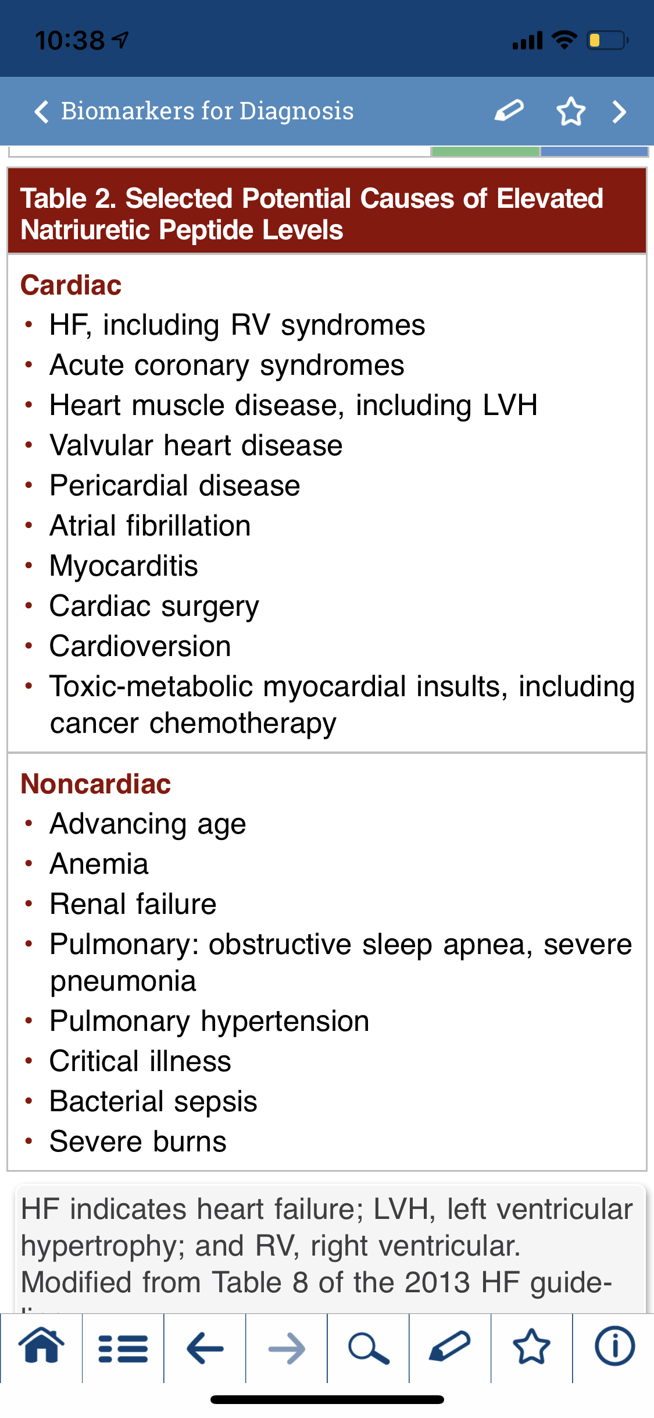
Answer C: Physical Exam!
Many causes of an elevated BNP
Invasive monitoring did not improve outcomes
ESCAPE trial (2005)
Take home message: pulmonary arterial catheter use to guide therapy in HF does NOT improve survival AND increases adverse events
Indicated when clinical assessment not able to be done

Slide 25
Poor Prognostic Factors
Clinical:
Higher NYHA class
SBP <100
Moderate to severe mitral regurgitation
Laboratory:
Hyponatremia
Renal insufficiency
EKG/ECHO:
Sever LV dysfunction
QRS > 120msec
Associated Conditions:
Anemia
A-fib
Diabetes mellitus

Slide 26
Common Clinical Scenario:
Patient admitted for HF exacerbation, already on Lasix IV pushes BID
You are on nights and are paged about his BP being soft, was 130/90 before, now 100/70

Slide 27
Bp dropping
90/70

Slide 28
BP still dropping
80/40
This Photo by Unknown Author is licensed under CC BY-NC-ND

Slide 29
Intern to the rescue
This Photo by Unknown Author is licensed under CC BY-NC

Slide 30
Examine bedside
Patient Confused + Cold extremities

Slide 31
Cardiogenic shock
Call ICU for an Ionotrope drip(Milrinone/Dobutamine) while they continue diuresis with probably IV continuous Lasix drip
This Photo by Unknown Author is licensed under CC BY-NC

Slide 32
CASE #4
A 75-year-old woman is hospitalized for a 3-week history of progressive exertional dyspnea, increasing peripheral edema, and mental status changes. For the past 4 nights, she has been sleeping in a recliner instead of her bed. She reports no chest pain. She has a 6-year history of ischemic cardiomyopathy, for which she takes low-dose aspirin, furosemide, carvedilol, lisinopril, digoxin, spironolactone, and as-needed metolazone.
On physical examination, the patient is afebrile, blood pressure is 84/52 mm Hg, pulse rate is 118/min, and respiration rate is 28/min. Oxygen saturation is 95% breathing ambient air. She is confused. Jugular venous distention is present. Cardiac examination reveals an S₃. There is ascites on abdominal examination. The extremities are cool, and there is lower extremity edema to the knees.
Labs are: ALT 172, AST 163, Creatinine 2.9, Potassium 4.7, Sodium 132
ECG: no acute changes. Previous ECHO shows EF 20%.

Slide 33
What is the next appropriate step in her management?
A. Start IV furosemide
B. Increase digoxin
C. Normal saline bolus 30cc/kg
D. Start dobutamine
E. CT head without contrast

Slide 34
Correct answer: D start dobutamine
The most appropriate initial treatment of this patient with cardiogenic shock is to start dobutamine.
Cardiogenic shock is defined by persistent symptomatic hypotension and end-organ dysfunction.
Cardiogenic shock secondary to progressive heart failure is generally treated with an inotropic agent, such as dobutamine or milrinone.
In this case, dobutamine would be a better option than milrinone, even in the setting of relative tachycardia, because milrinone is excreted through the kidneys and could build to a toxic level given her current kidney function.

Slide 35
What ward should the Case 3 patient be admitted to?
A. Observation
B. Med/Surg
C. Telemetry
D. ICU
E. Psychiatry

Slide 36
Correct Answer D: ICU
Patients in cardiogenic shock (or any shock) should be admitted to the ICU initially for aggressive therapy and monitoring
If the patient recovers but continues to require inotropic therapy for an extended period of time, they may come out of the ICU on a stable dose with slow titration off with cardiology guidance

Slide 37
CASE #5
68 yo F admitted for acute heart failure exacerbation after 2 weeks of weight gain, dyspnea, and orthopnea. Her baseline EF if 35-40%. Home furosemide is 80mg BID. She was started on furosemide 80mg IV TID and was net negative 120cc of urine in the last 24 hours. She remains dyspneic at rest and cannot lay flat. She denies chest pain but reports significant swelling that has not improved. BP 127/85, HR 88, O2 94% on 2L NC. She is currently on a 2L fluid restriction. What is the next appropriate step in her management?
A. Increase furosemide to QID
B. Transthoracic echocardiogram
C. Give metolazone prior to furosemide dose
D. Start inotropic support
E. Increase fluid restriction to 1.2L per day

Slide 38
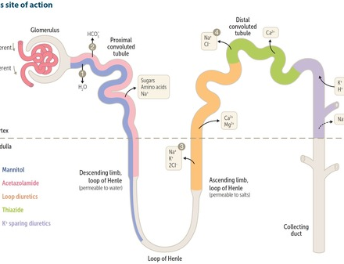
Correct answer: start metolazone
Addition of metolazone 30 minutes prior to the first Lasix dose can increase the urine output
Metolazone belongs to the thiazide like diuretic category
Has a strong additive effect when used in combination with Lasix

Slide 39
Common Adverse effects of diuretics
Hypokalemia(if on home Lasix, discharge patient on some KCL 10-20mEQ daily/every other day)
Hypomagnesemia
Hypocalcemia(Loops lose calcium in urine)
Dehydration, orthostatic hypotension
Ototoxicity (associated with either high doses or normal doses with kidney dysfunction)
Hyperuricemia when on chronic diuretics(careful with gout patients)
Contraction Alkalosis

Slide 40
To dos of classic heart failure admission
Diuretic regimen(most commonly start with IV Lasix 40mg BID, could vary in diuretic naïve patients)
GDMT(Goal directed Medical Therapy): Beta blocker(conti. If prior h/o HF, don’t initiate during acute exacerbation if first time HF diagnosis) + ACE inhibitor/ARB + Spironolactone/Aldactone
Daily weights(to monitor response to treatment)
Strict Is&Os
Supplemental oxygen as needed
Low sodium fluid restricted diet, start liberalizing diet close to discharge so you can adjust outpatient diuretic regimen accordingly
Telemetry monitoring(high risk of fatal arrhythmias during acute exacerbation)
Daily labs, electrolytes, K>4(important because losing lots of K through diuresis), Mg>2
Treat any precipitating factor

Slide 41
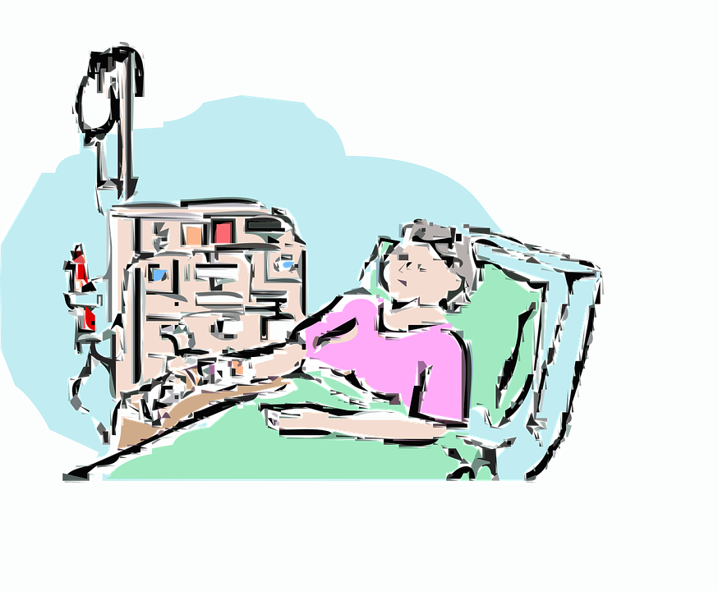
HF exacerbation in ESRD/DIALYSIS DEPENDENT PATIENTS
Presents similarly with fluid overload
But most of these patients anuric, so diuretics won’t work
Call Nephrology to set up Dialysis soon(usually run more frequent sessions initially and then go back to home dialysis schedule)

Slide 42
Iron Deficiency and Heart Failure
Affirm-AHF trial: randomized 1132 pts who were hospitalized with acute HF and iron deficiency (ferritin <100ng/mL or transferrin sat <20%) to IV iron or placebo. Those who received IV iron had fewer hospitalizations over the course of the 52 week trail (RR 0.7, 95% CI 0.58-0.94), CV mortality was similar. Similar studies have shown improvement in NYHA class, 6 min walk, and LV function.
We prefer intravenous iron replacement given limited available evidence on the efficacy of oral iron supplementation and concerns about possible reduced oral iron absorption in HF.

Slide 43
Iron Dosing
Iron Sucrose
200mg EVERY OTHER DAY x 5 total doses (1000mg total)
Drawbacks:
patients often don't stay in hospital long enough to get all doses - outpatient hematology clinic can be utilized to finishing dosing schedule
Ferric carboxymaltose was used in AFFIRM-AHF but is not on formulary here
Consider giving iron in HF patients with ferritin <100, transferrin sat < 20%, with or without anemia

Slide 44
Switch back to po Lasix before discharge

Slide 45
Patient education
Helps prevent subsequent rehospitalizations
Helps them be a part of their management plan, take some ownership of their own health
Patients should be told to be aware of their breathing status, check if they are coughing more, clothes or shoes getting tighter
measure weight at home
Importance of being compliant with their medication and their low salt diet(high salt will make them thirsty and make them drink more water)
Severe heart failure patients should limit their home everyday fluid consumption to <2L(6-8 cups of water)
Call their PCP/cardiologist if they gain >2lbs a day or >5lbs a week, having difficulty laying down flat, worsening dyspnea, wheezing, worse swelling, running out of prescription

Slide 46
QUESTIONS?

