Slide 1
Code Status Conversations in Serious Illness
Ralph Mendez, MD
Giovanni Sassano, MD
Nehan Sher, MD

Slide 2
Learning Objectives
Describe an approach to code status conversations in patients with serious illness
Use empathic communication skills when discussing code status with patients and families
Apply the SPIKES framework to serious illness conversations

Slide 3
Code Status Options
Full code
DNR/DNI
DNR/OK to intubate
OK for compressions/DNI
Do Not Escalate/NoET
Selective: No CPR but OK for:
    BiPAP?
    Cardioversion?
    Pressors?
Sher N, Habib N, Etzioni S, Glassberg M. Making Decisions about Serious Illness: What Is Code Status? Am J Respir Crit Care Med. 2022 Mar 15;205(6):P11-P12.

Slide 4
Why does this matter anyway?
There are ≈292,000 adult in-hospital cardiac arrests and 15, 200 pediatric in-hospital events in the United States each year.
In one survey study of Internal Medicine residents admitting patients with treatment-resistant advanced cancer:
      Nearly all residents felt CPR would be unhelpful
      Yet fewer than half were likely to discuss an estimate of prognosis and the value of CPR with the patient
      Only 30% were likely to offer a recommendation on CPR
      69% of residents who were unwilling to offer a recommendation stated that deference to patient autonomy prevented them from providing guidance
      Only a minority was satisfied with end-of-life discussions
Holmberg MJ, Ross CE, Fitzmaurice GM, Chan PS, Duval-Arnould J, Grossestreuer AV, Yankama T, Donnino MW, Andersen LW; American Heart Association’s Get With The Guidelines–Resuscitation Investigators. Annual Incidence of Adult and Pediatric In-Hospital Cardiac Arrest in the United States. Circ Cardiovasc Qual Outcomes. 2019 Jul 9;12(7):e005580.
Einstein DJ, Einstein KL, Mathew P. Dying for Advice: Code Status Discussions between Resident Physicians and Patients with Advanced Cancer--A National Survey. J Palliat Med. 2015 Jun;18(6):535-41.

Slide 5
Two Kinds of Code Status Discussions
Routine, on admission
Triggered by clinical change

Slide 6

Either way, a code status conversation is not a menu of options! It’s a serious-illness conversation that ends with a medically appropriate recommendation.

Slide 7
Routine Code Status Discussion on Admission
Low-risk patient: normalize the topic, define it clearly, then invite the patient in
1
Normalize & contextualize
2
Provide a basic definition
3
Hand the conversation to them
“I have one more topic that I discuss with every patient I admit, regardless of how healthy or sick they are. Some people have strong preferences, and I want to be sure we respect yours.”
“This is about your code status, or resuscitation orders—directions for what the medical team should or should not do if you unexpectedly became critically ill and your heart stopped.”
“What have you heard about the terms code status or resuscitation orders?”
Best placed near the end of the admission conversation, after the plan and expectations are clear.
Use explicit language. Avoid euphemisms such as “doing everything.”
Listen for prior knowledge, clear preferences, emotional reactions, and readiness to continue.
AVOID
“Do you want us to do everything?”
It does not explain what is at stake and can unintentionally frame limits as “less care.”
Notes:
Normalize, define, and invite the patient into the discussion
Explain CPR, respond to emotions, and close the loop

Slide 8
Explain CPR, Respond, and Close the Loop
Present CPR as a package—not a menu—then pause, support, document, and revisit
CPR is a package of interventions
Pause, respond, and reassure
“If your heart were not pumping blood, we may attempt CPR to restore life. This can include:”
Empathize: “I know this can be upsetting to discuss.”
Reassure: “I do not think it is likely we will face this during this admission.”
Explore: “Some people would accept all of these treatments for a chance of recovery; others would not. What matters most to you?”
1
Chest compressions
Pushing firmly on the chest to circulate blood
2
Electrical shocks
Trying to restore an effective heart rhythm
When more context is needed
Close the loop
3
Intubation + ventilator
• Thank the patient
• Confirm the selected order
• Document the discussion
• Revisit as the clinical picture evolves
A breathing tube and machine support
“Overall, about 1 in 7 patients survive the hospitalization after in-hospital CPR.”
“CPR does not always lead to survival or recovery, which is why I ask everyone.”
Tailor prognostic detail to the patient, diagnosis, and local data.
“As we learn more, I may ask to revisit this with you.”
Clarify separately when appropriate: intubation for progressive respiratory failure without cardiac arrest has different indications and outcomes than CPR after arrest.

Slide 9
Identify the Surrogate Early
“If you became too sick to make decisions for yourself, who would you trust to speak for you?”
Clarify that the surrogate decision-maker’s job would not be to decide what they personally want, but to relay to the team what they think the patient would want
Surrogates can feel like they are deciding life or death, so reframe their role as representing the patient’s voice.

Slide 10
Routine Code Status Discussion On Admission
Normalize
Define
Invite the patient into the discussion
Explain CPR
Respond to emotions
Close the loop
“There is no urgency to this, take your time to make a decision. Every patient who comes into the hospital is FULL CODE by DEFAULT, unless they tell us otherwise. That means that if their heart were to stop they would receive compressions and if they stopped being able to breathe we would put them on the ventilator. If you change your mind about your code status, you can let us know.”

Slide 11
Code Status Discussion With Serious Clinical Change
Assess the illness → explore the patient’s goals → distinguish intubation from CPR → explain likely efficacy → make a recommendation
Use SPIKES to break bad news of the clinical change
Use NURSE to address the emotions

Slide 12
Case
Michael Evans is a 60-year-old male with COPD and CHF. He came to the hospital with worsening dyspnea and cough. A CT scan was obtained to rule out PE. It showed no PE but showed a new lung mass concerning for cancer. He is being treated for a COPD exacerbation and currently requires 4L NC O₂. He is awake, has decision-making capacity, and is improving with treatment. He has never completed an advance directive and has no documented code status. After a discussion with the care team, he opts to be full code.
He lives at home alone. His son Josh is the surrogate decision maker. He was independent before this admission. He values being at home, communicating with family, and maintaining independence. He has recovered from previous COPD exacerbations.
The next day, Mr. Michael Evans vomits and aspirates while on the medical floor. He has worsening respiratory distress. His O2 requirement increases from 4 L to 15 L Non-rebreather. He also develops worsening abdominal pain. A stat CT abdomen shows widespread metastatic cancer and likely malignant small bowel obstruction. The medical team is concerned that his respiratory failure may continue to worsen, intubation is unlikely to return him to his previous independent life, and CPR would be extremely unlikely to result in meaningful recovery. He no longer has decision-making capacity because of encephalopathy. Josh says: “He told you he wanted everything. You must put him on the ventilator and save him.”

Slide 13
Demonstration

Slide 14

Notes:
Debrief
What did the physician do poorly?
What did the patient likely hear?
What was missing before asking about code status?
Was emotion addressed?
Was there a recommendation?
A patient’s answer is only meaningful if they understand the medical situation, the treatment, the likely outcome, and how it connects to their goals

Slide 15
‘Do you want us to do everything?’
What do patients think we are asking?
  Do you want the medical team to continue treating you?
  Do you want to live?
  Are you willing to fight?
Many patients feel they lack the experience to make a decision even after they have been provided with information
Patients may default to maximum intervention as a way to compensate for uncertainty.
A shared decision-making approach can be a way support the patient in making a decision.
Research reveals that merely eliciting preference around interventions such as CPR and intubation is inadequate to promote shared decision making.
https://thischangedmypractice.com/matters-of-the-heeart/

Slide 16
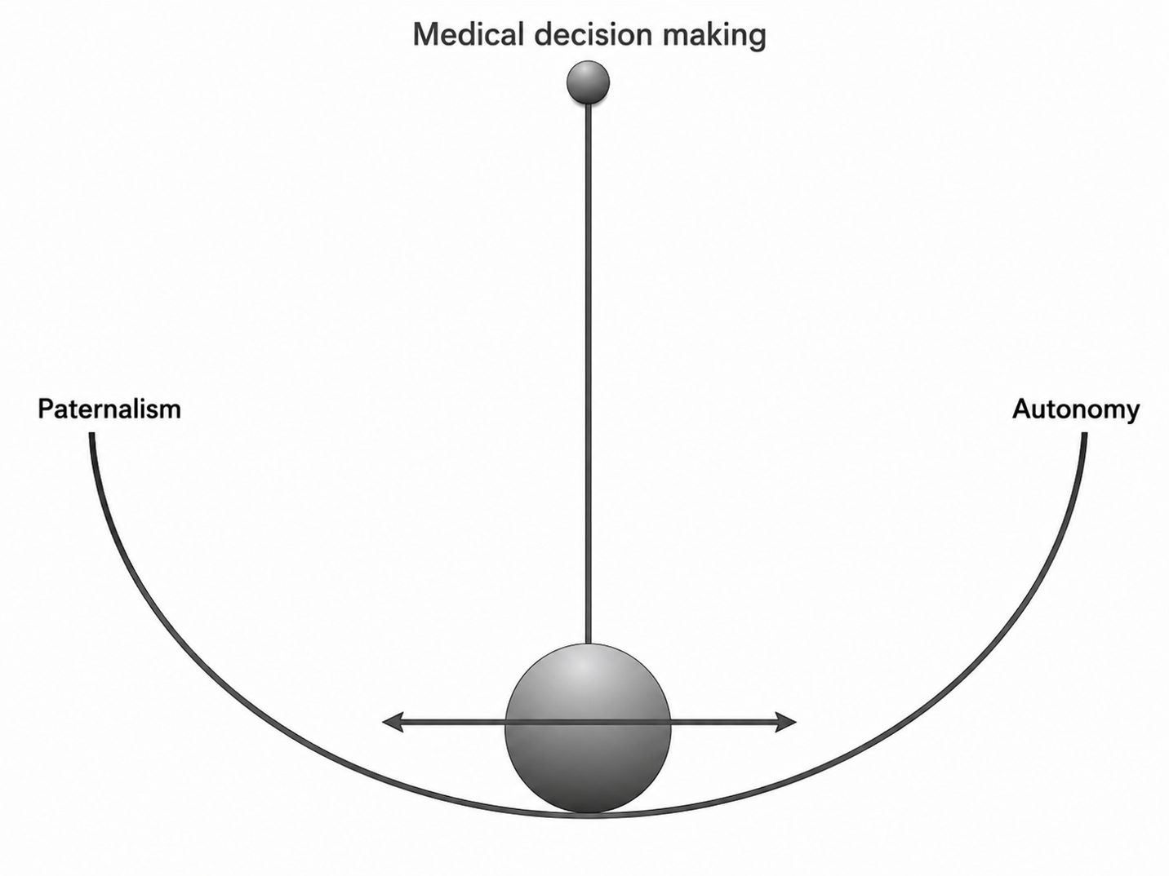

Slide 17
The Core Clinical Questions
Before discussing code status, ask yourself:
  Why might this patient code?
  Is resuscitation likely to reverse the problem?
  What is the chance of surviving to discharge?
  What condition would the patient likely survive in?
  Would that outcome fit the patient’s goals?

Slide 18
Frameworks for Difficult Conversations Requiring Decision-Making
SPIKES: A Framework for Breaking Bad News
S — Setting
Private, seated, include family/surrogate if appropriate.
P — Perception
“What is your understanding of what’s happening?”
I — Invitation
“Would it be okay if we talked about what we would do if things got worse?”
K — Knowledge
Explain the illness, possible deterioration, intubation, CPR.
E — Emotion
Respond before moving on.
S — Strategy/Summary
Connect goals to treatment and make a recommendation.
REMAP: A Framework for Goals-of-Care Conversations
R — Reframe: Explain how the medical situation has changed and why the current approach may no longer work.
E — Expect emotion: Pause, recognize the emotional response, and respond with empathy.
M — Map out patient goals: Explore what matters most, acceptable outcomes, and what the patient is willing to undergo.
A — Align with goals: Show that you understand the patient’s values and connect your medical judgment to those priorities.
P — Propose a plan: Recommend treatments that are most likely to achieve the patient’s goals.

Slide 19
SPIKES for Code Status Conversations in Serious Illness
S — Setting
Create privacy, sit down, include the appropriate family or surrogate, and minimize interruptions.
P — Perception
Assess the patient’s understanding of both the illness and code status.
“What is your understanding of what is happening with your health?”
“What have you heard about code status or resuscitation?”
I — Invitation
Ask permission to discuss possible deterioration and emergency treatments.
“Would it be okay if we talked about what we would do if your condition became worse?”
K — Knowledge
Explain the serious illness, the ways the patient might deteriorate, and the treatments that could be considered. Discuss intubation separately from cardiac arrest. Explain that CPR is attempted after the heart stops and may include chest compressions, shocks, medications, intubation, and mechanical ventilation. Describe the likely patient-specific outcomes.
E — Emotion and Empathy
Pause and respond to fear, sadness, anger, or uncertainty before continuing.
“I can see this is difficult to think about.”
“It sounds like you are worried that we may stop treating you.”
S — Strategy and Summary
Explore the patient’s goals and acceptable outcomes, connect those goals to the likely benefits and burdens of treatment, and make a clear medical recommendation about code status.
“Based on what you have told me and what I know about your illness, I recommend…”
Clarify what treatments will continue, check understanding, summarize the decision, and document the plan.

Slide 20
Code Status Differences
Routine admission | Serious illness / clinical decline
“We ask everyone this.” | “I’m worried your condition could worsen.”
Full code may be medically reasonable | CPR/intubation may not achieve patient’s goals
Goal is to document preferences | Goal is informed, goal-concordant decision-making
Less prognostic detail needed | Prognosis and recommendation are essential

Slide 21
S: Setting
Private, seated, include family/surrogate if appropriate.

Slide 22
P: Perception
“I want to talk about something important because your breathing has become more serious. We are treating your pneumonia, but I’m worried that despite treatment, your lungs may get worse.”
“Before we talk about specific treatments, can you tell me what you understand about what is happening?”
Avoid “What is your code status?” in a clinical deterioration
Useful questions:
      “What are you hoping this treatment will help you get back to?”
      “Have you seen someone go through ICU care or a ventilator before?”

Slide 23
I : Invitation
Ask permission to discuss possible deterioration and emergency treatments.
“Would it be okay if we talked about what we could do if your condition became worse?”

Slide 24
K: Knowledge
Discuss intubation before CPR because patients can reasonably choose DNR but okay for intubation for a reversible respiratory problem.
Example language:
  “If your breathing worsens from pneumonia, one treatment we might consider is a breathing tube and ventilator. Sometimes this is used for a short time while we treat the infection.”
  “Because your body is already very weak, I worry there is a chance you might not recover enough to come off the ventilator.”

Slide 25
Transition to CPR
After discussing illness and possible intubation, move to CPR
  “There is another situation that is different. I want to talk about what we would do if your heart stopped.”
Avoid euphemisms.
  “If your heart stopped, that means you had died. CPR is our attempt to restart the heart.”
Be clear and gentle. Moderate-to-strong associations between perceived physician empathy and patient trust
Wu Q, Jin Z, Wang P. The Relationship Between the Physician-Patient Relationship, Physician Empathy, and Patient Trust. J Gen Intern Med. 2022 May;37(6):1388-1393.

Slide 26
Explain CPR as a Package
CPR may include:
    Forceful chest compressions
    Electrical shocks
    Medications
    Intubation and mechanical ventilation
    ICU care afterward if circulation returns
CPR is a package of emergency interventions after death has occurred

Slide 27
CPR Outcomes
“CPR can sometimes restart the heart, but it does not always lead to survival or recovery. Across hospitalized patients, only a minority survive to leave the hospital after CPR. In someone already seriously ill, the chance of returning to their prior life may be much lower.”
“Given your severe lung disease and current infection, I worry CPR would be very unlikely to get you back to the life you told me matters to you.”

Slide 28



What does the public think?
At least 1/2 estimated CPR success rate >75% in all situations
For 95%, TV was the main source of information about CPR
90% wanted to receive CPR
Bandolin NS, Huang W, Beckett L, et al. Perspectives of emergency department attendees on outcomes of resuscitation efforts: origins and impact on cardiopulmonary resuscitation preference.Emergency Medicine Journal 2020;37:611-616.

Slide 29

What does the data show about cardiac arrest survival?

Slide 30


Cardiac Arrest Survival Outcomes
Arrest location | Survival to hospital discharge | Favorable neurologic outcome
EMS-treated OHCA | 10.5% | 8.2%
IHCA | 23.6% | 79.2%

Slide 31
Outcomes of cardiac arrest with multiple comorbidities
A meta-analysis has shown that the presence of heart failure, end-stage renal disease, metastatic cancer and COPD were each associated with decreased survival to hospital discharge
Andrew E, Nehme Z, Bernard S, Smith K. The influence of comorbidity on survival and long-term outcomes after out-of-hospital cardiac arrest. Resuscitation. 2017 Jan 1;110:42-7.

Slide 32

Long-term survival after 10 years in patients surviving initial hospital stay s/p OHCA is 62-64%
Prognostic factors for long-term survival:
    younger age
    bystander CPR
    absence of diastolic dysfunction
    functional status at hospital discharge
    initial cardiac arrest rhythm
    post–cardiac arrest care at a tertiary referral hospital
Amacher SA, Bohren C, Blatter R, et al. Long-term Survival After Out-of-Hospital Cardiac Arrest: A Systematic Review and Meta-analysis. JAMA Cardiol. 2022;7(6):633–643. doi:10.1001/jamacardio.2022.0795

Slide 33

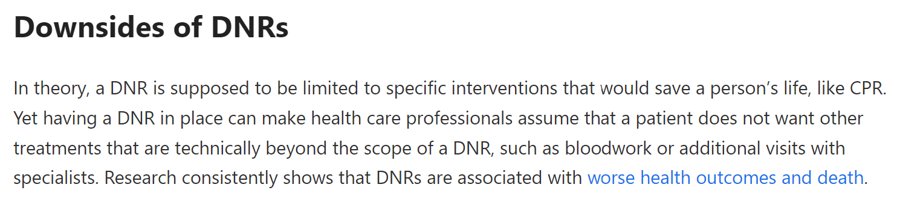

Layperson perspectives on DNR orders

Slide 34
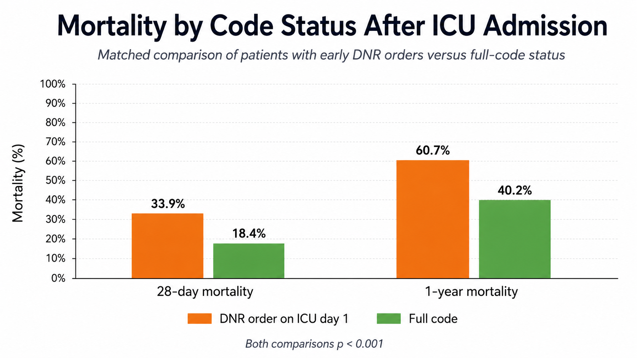
Mortality remained higher among patients with an early DNR order
Notes:
In this study, we sought to measure the effect of pre-ICU admission DNR order on mortality, adjusted for the severity of the disease and lifesaving interventions.

Slide 35



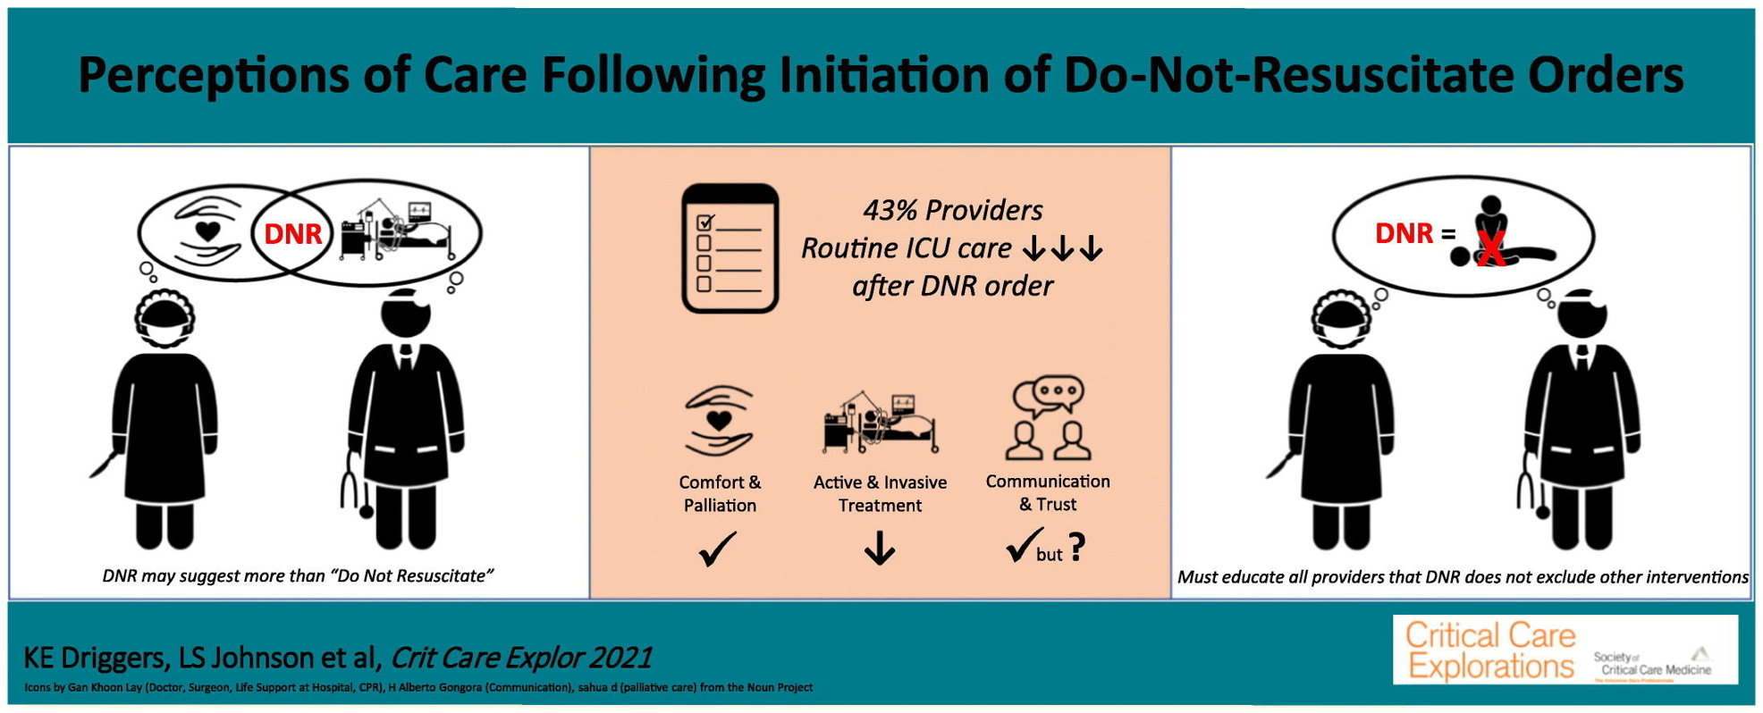
Bias in DNR/DNI Status
Patients with a DNR order may receive less aggressive interventions in circumstances that do not involve cardiopulmonary arrest, which can lead to suboptimal care
Both surgical and ICU staff believe care decreases after DNR order initiation (43%)
Chen JL, Sosnov J, Lessard D, et al. Impact of do-not-resuscitation orders on quality of care performance measures in patients hospitalized with acute heart failure. Am Heart J. 2008;156:78–84.
Richardson DK, Zive D, Daya M, et al. The impact of early do not resuscitate (DNR) orders on patient care and outcomes following resuscitation from out of hospital cardiac arrest. Resuscitation. 2013;84:483–7.
Stevenson EK, Mehter HM, Walkey AJ, et al. Association between do not resuscitate/do not intubate status and resident physician decision-making. A national survey. Ann Am Thorac Soc. 2017;14:536–42. a

Slide 36
DNR Does Not Mean “Do Not Treat”
“A DNR order only applies if your heart stops. All your other treatments continue as they were.”
Treatments that may continue:
        Antibiotics
        BiPAP/high-flow oxygen
        ICU transfer
        Vasopressors
        Procedures
        Intubation

Slide 37
General Principles of CPR
CPR is intended for patients whose hearts are the first thing to fail, not the last thing
CPR should be a bridge
Code status should not affect pre-arrest care
Code status does not equate to a plan of care
    That is a larger conversation and can include limit-setting of other interventions, including dialysis etc
    Address general scope of interventions possible before arrest
Cui J, et al. Integrating palliative care in the ICU: A case study. Ann Intern Med Clin Cases. 2022;1(10):CC66-70. doi:10.7326/aimcc.2022.0174

Slide 38
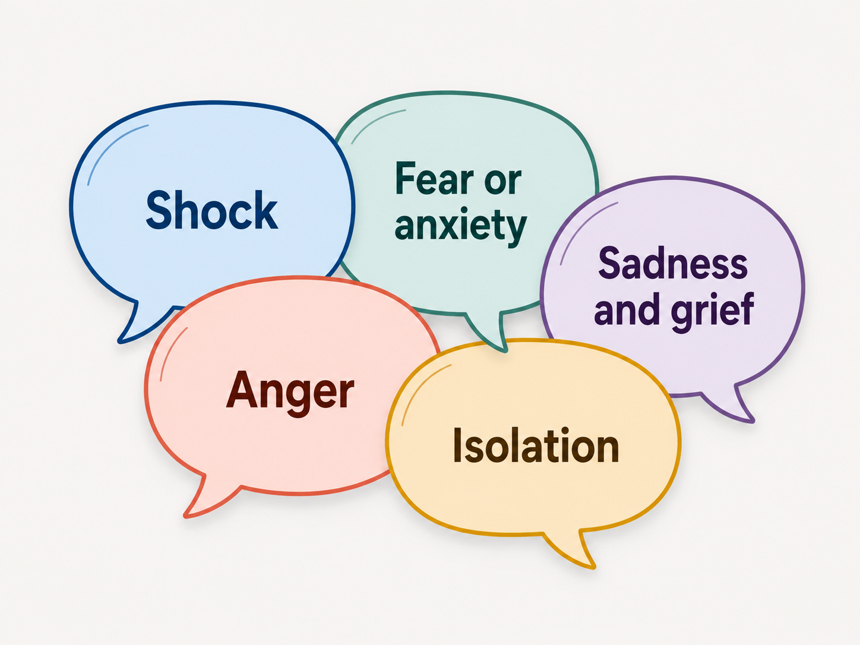
E: Emotions

Slide 39
Use NURSE
Name: “This is scary.”
Understand: “Anyone would feel overwhelmed.”
Respect: “I can see how much you love her.”
Support: “We will keep taking care of her.”
Explore: “Tell me what’s worrying you the most right now.”
Notes:
It’s not helpful to counter emotion with more physiology.

Slide 40
Wish and Worry
The Wish: Acknowledges mutual hopes, desires, or the limits of control (e.g., "I wish we could reverse this illness")
The Worry: Clearly names the specific danger, behavior, or negative impact that needs attention (e.g., "I worry that your body is getting too weak to handle this treatment")
    “I wish CPR could return you to the life you have now. I worry that, given how sick you are, it would be unlikely to help you leave the hospital or communicate with your family.”
    “I wish CPR could give you more meaningful time with your family. I worry that, in your current condition, it would not help you recover to the life you have told me is important.”
https://www.palliativecareswo.ca/docs/Communication-Support-Tools-Framework.pdf

Slide 41
S: Summarize/Strategize
(Check with your attending then…) Make a Recommendation!
“Based on what you have told me-that being awake, communicating with your family, and getting home matter most-I recommend that we continue aggressive treatment for the pneumonia. If your breathing worsens, a short trial of the ventilator may be reasonable. But if your heart stops despite those treatments, I would recommend that we do not do CPR, because I do not think it would help you recover to the life you value.”
Patients often value a medical recommendation, especially in high-stakes decisions

Slide 42
Recommendation-Making Practice
• The patient asks for a recommendation.
• You have a trusting relationship with the patient
• There are limited options, and you feel strongly that there is a best course of action.
• The decision is relatively low stakes. For example, you might recommend that the patients talk with their health care agent about their goals and values. “I recommend that you sit down and talk with your son about what is most important to you if you were to get sicker.”
Jacobsen J, Blinderman C, Alexander Cole C ...
“I'd Recommend …” How to Incorporate Your Recommendation Into Shared Decision Making for Patients With Serious Illness
Journal of Pain and Symptom Management, 2018; 55, 1224-1230

Slide 43
Demonstration 2

Slide 44
Debrief
Notes:
What did the physician do differently?
What made the patient feel heard?
How did the physician avoid “do everything”?
Where did SPIKES show up?
What language would you use in your own practice?

Slide 45
Practical Framework
Code Status in Serious Illness
Explain why the conversation is happening now
Ask what the patient understands
Identify surrogate
Discuss intubation first when relevant
Explore values and acceptable outcomes
Discuss CPR clearly
Make a recommendation and summarize

Slide 46
Common Pitfalls
“Do you want everything done?”
“Do you want us to save you?”
“Do you want chest compressions?”
Giving a procedure menu without prognosis
Asking the family what they want instead of what the patient would want
Treating DNR as equivalent to comfort care
Avoiding a recommendation

Slide 47
Take-Home Points
Code status conversations are serious illness conversations.
Start with an understanding of the illness and patient’s goals, not procedures.
Discuss intubation and CPR separately.
Respond to emotion before giving more information.
Make a recommendation based on the patient’s goals and the likely effectiveness of treatment.

Slide 48
Thank You

Slide 53
Practical points
Introduce NURSE and REMAP
Statistics, add how many deaths
-------------------------------------------------
Cases-time left, something changes and theres less time, cancer with post-obstructive pneumonia
Full code reasonable, reversible, not advanced age, copd, lung mass,
Then clinical shift, new scans show mets and worsening respiratory failure senior does that

Slide 54
Code Status Options
Full code
DNR/DNI
DNR/OK to intubate
OK for compressions/DNI
Do Not Escalate/NoET
Selective: No CPR but OK for:
    BPAP?
    Cardioversion?
    Pressors?
Sher N, Habib N, Etzioni S, Glassberg M. Making Decisions about Serious Illness: What Is Code Status? Am J Respir Crit Care Med. 2022 Mar 15;205(6):P11-P12.

Slide 55
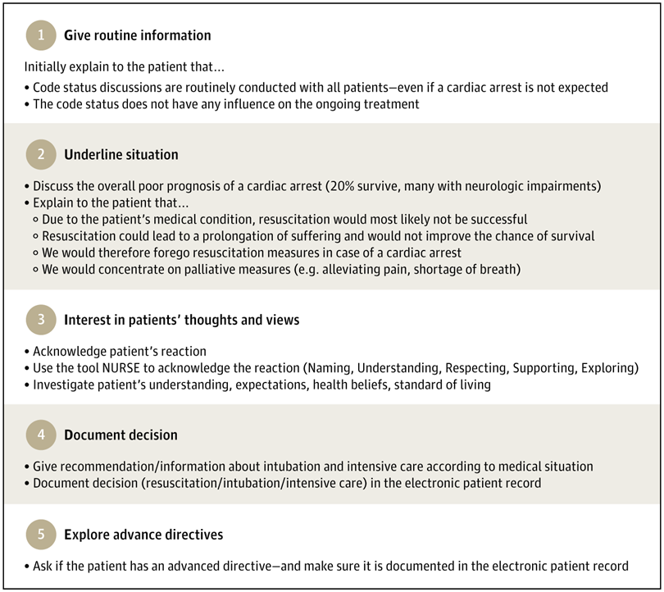
Arpagaus A, Arpagaus L, Becker C, et al. Checklist-Guided Code Status Discussions in Patients for Whom Cardiopulmonary Resuscitation Is Considered Futile: An Analysis of a Randomized Clinical Trial. JAMA Netw Open. 2025;8(9):e2533638.

Slide 56
Summary
Do not begin by asking patients to choose a code status.
First understand the illness, the patient’s values, and the outcomes they would consider acceptable.
Do not present CPR as a neutral menu item when it is unlikely to achieve the patient’s goals.
DNR addresses what happens during cardiac arrest; it does not mean stopping appropriate treatment.

Slide 57
SPIKES
S — Setting
Private, seated, include family/surrogate if appropriate.
P — Perception
“What is your understanding of what’s happening?”
I — Invitation
“Would it be okay if we talked about what we would do if things got worse?”
K — Knowledge
Explain the illness, possible deterioration, intubation, CPR.
E — Emotion
Respond before moving on.
S — Strategy/Summary
Connect goals to treatment and make a recommendation.
Notes:
SPIKES as the Structure

