Slide 1

Aortic Valve Disease
Jake Hillyer, MD
Cardiology Fellow, PGY4/5

Slide 2
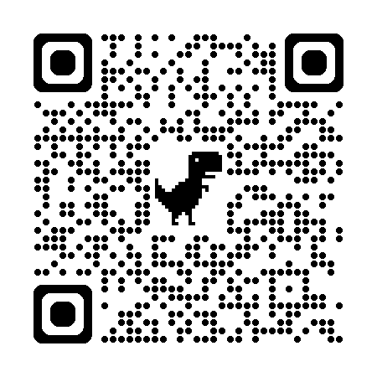
Disclosures
None

Slide 3
Learning objectives
List several causes of aortic stenosis and describe the physical exam findings of aortic stenosis.
Define severe aortic stenosis by valve area and gradient. Describe pseudostenosis and how it is diagnosed.
Describe the Class I indications for aortic valve replacement. What is the indication for TAVR rather than SAVR?
List several causes for acute and chronic aortic regurgitation and describe the physical examination findings and treatment of aortic regurgitation.
Describe the Class I indications for aortic valve replacement in aortic valve regurgitation.

Slide 4
Learning objectives
List several causes of aortic stenosis and describe the physical exam findings of aortic stenosis.
Define severe aortic stenosis by valve area and gradient. Describe pseudostenosis and how it is diagnosed.
Describe the Class I indications for aortic valve replacement. What is the indication for TAVR rather than SAVR?
List several causes for acute and chronic aortic regurgitation and describe the physical examination findings and treatment of aortic regurgitation.
Describe the Class I indications for aortic valve replacement in aortic valve regurgitation.

Slide 5
Case 1
  A 67-year-old man with hypertension, hyperlipidemia and benign prostatic hyperplasia presents to the emergency department with new-onset NYHA IV dyspnea and peripheral edema. He is unable to lie flat at night or bend over to tie his shoes without severe dyspnea. He denies any chest pain or syncopal episodes.
  Medications include lisinopril 5mg QD, HCTZ 25mg QD and tamsulosin 0.4mg QD. NKDA. No FH of premature CAD. He denies tobacco, ETOH or illicit drug use. He worked a desk job in finance prior to retiring two years ago and lives a sedentary lifestyle.
  BP 145/87, HR 75, SpO2 97%, RR 16
  Exam:
  Gen: Obese Elderly Man
  Neck: JVD with HJR
  Lungs: crackles and dullness at B/L bases
  Heart: late peaking crescendo-decrescendo systolic murmur at the RSB
  Extremities: 2+ peripheral edema

Slide 6
Question 1
Which of the following characteristics is/are associated with increased mortality in patients with aortic stenosis?
A) Angina
B) Syncope
C) Heart Failure Symptoms
D) LVEF <60%
E) Global Longitudinal Strain <14.7%
F) BNP x3 the ULN
G) All of the above

Slide 7
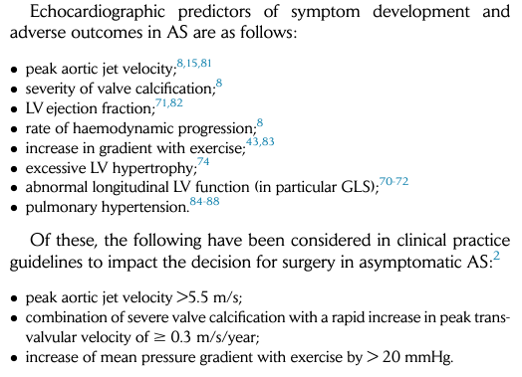
Question 1
Which of the following characteristics is/are associated with increased mortality in patients with aortic stenosis?
A) Angina
B) Syncope
C) Heart Failure Symptoms
D) LVEF <60%
E) Global Longitudinal Strain <14.7%
F) BNP x3 the ULN
G) All of the above
Notes:
So at the end of the day, why do we care about aortic stenosis and why do we spend so much time tracking symptoms?

Slide 8
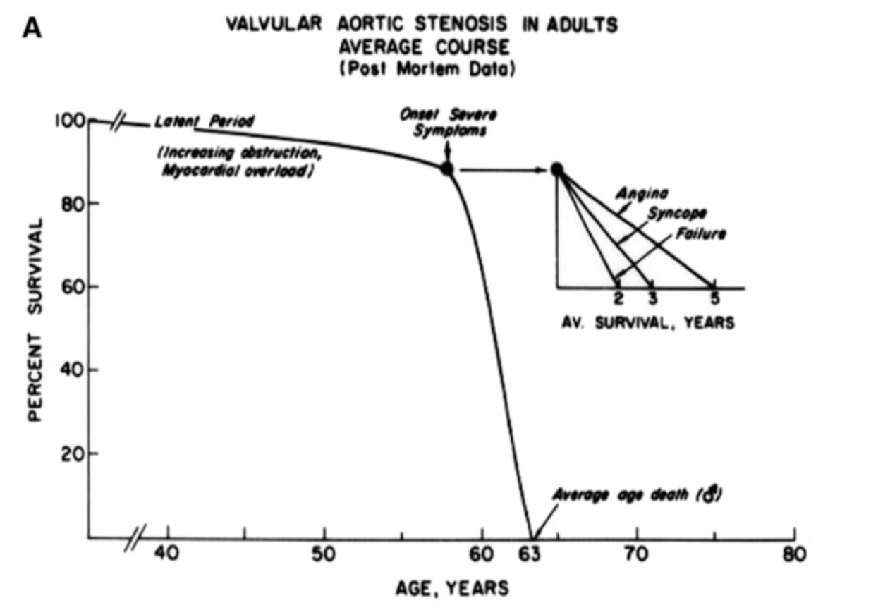
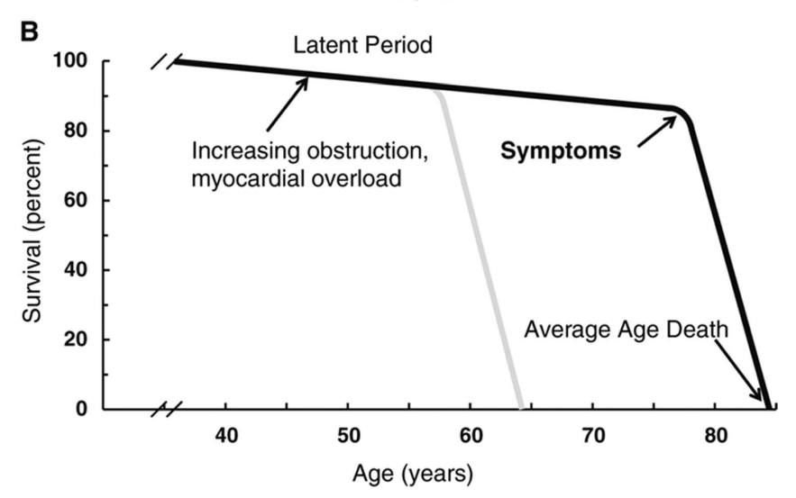
Aortic Stenosis – Natural History
75% of symptomatic patients will die within 3 years of symptom onset without AVR
AVA decreases 0.1cm² per year on average
Ross J Jr, Braunwald E. Aortic stenosis. Circulation. 1968;38(1 Suppl):61–7.
Carabello. Circ Res. 2013; 113:179–185

Slide 9
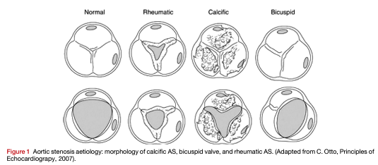
Aortic Stenosis - Etiologies
Calcific
  Most common, especially in those >75 years of age.
  Calcification of central/basal parts of cusp.
Rheumatic
  Rare in USA/Europe, higher prevalence globally.
  Will usually involve MV as well.
  Fusion of commissures.
Bicuspid
  More common in young patients <65 years of age
  Right-Left Cusp fusion 80% of cases.
  Other variants:
    Unicuspid
    Quadracuspid
Notes:
The most common causes of valvular AS are:
Calcific stenosis of a tricuspid valve (usually in the elderly age >75)
bicuspid aortic valve with superimposed calcific changes (more common in younger patients age <65)
Rheumatic valve disease (rare in US but prevalent worldwide)
Other
Congenital aortic stenosis owing to a unicuspid aortic valve is rare in adults with usually marked dysmorphic features including severe thickening and calcification and associated with significant concomitant aortic regurgitation
Sequelae of Infective endocarditis, chronic inflammatory disease (eg SLE, RA, Paget’s disease of bone)
HTN, metabolic syndrome, high cholesterol
Figure 1: Aortic stenosis aetiology: morphology of calcific AS, bicuspid valve, and rheumatic AS..

Slide 10
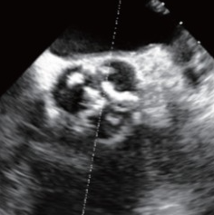
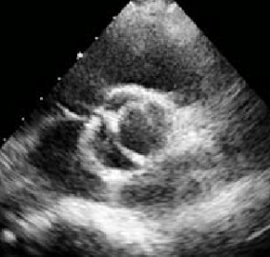
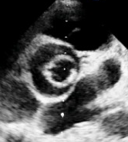
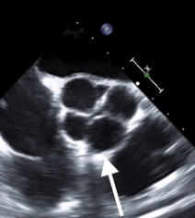
Aortic Stenosis - Etiologies
Calcific
Bicuspid
Unicuspid
Quadricuspid

Slide 11
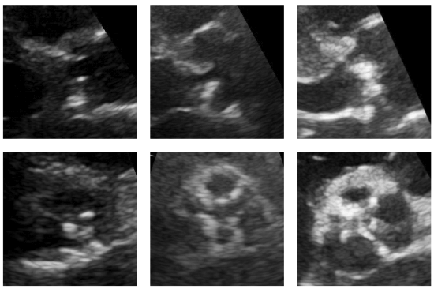
Aortic Stenosis - Etiologies
Mild
Severe
PLAX
PSAX
Notes:
Calcification of a tricuspid aortic valve is most prominent in the central and basal parts of each cusp while commissural fusion is absent, resulting in a stellate-shaped systolic orifice.
The severity of valve calcification can be graded semi-quantitatively, as mild (left - few areas of dense echogenicity with little acoustic shadowing), moderate (middle - multiple larger areas of dense echogenicity), or severe (right - extensive thickening and increased echogenicity with a prominent acoustic shadow).

Slide 12
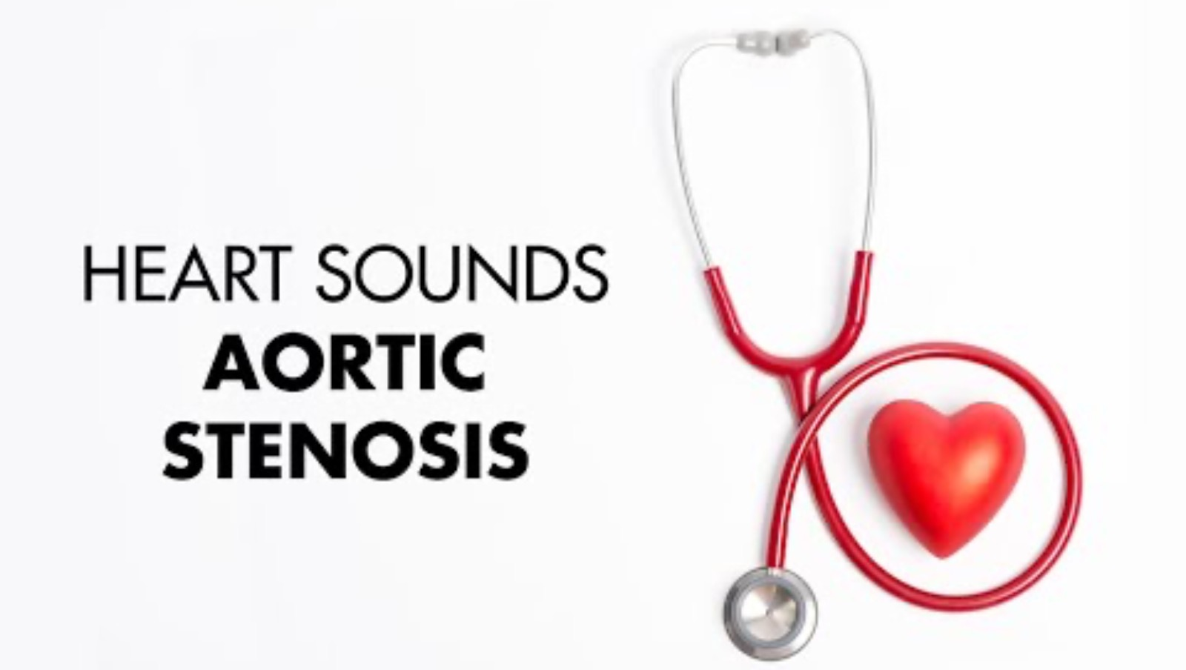
Aortic Stenosis – Physical Exam
Murmur: Mid-systolic, crescendo-decrescendo
Location: RUSB
Radiation: Right clavicle, carotids, apex
Associated findings:
  Enlarged nondisplaced apical impulse
  S4
Severe stenosis findings:
  Decreased/absent A2
  High-pitched, late peaking murmur
  Diminished/delayed carotid upstroke
  Radiation of murmur to both clavicles and carotids
Notes:
More severe aortic stenosis results in a murmur that peaks later in systole because the narrowed valve orifice creates a greater obstruction to left ventricular outflow, requiring more time for the ventricle to generate enough pressure to overcome the resistance and reach peak flow. Same goes for carotid upstrokes

Slide 13
Learning objectives
List several causes of aortic stenosis and describe the physical exam findings of aortic stenosis.
Define severe aortic stenosis by valve area and gradient. Describe pseudostenosis and how it is diagnosed.
Describe the Class I indications for aortic valve replacement. What is the indication for TAVR rather than SAVR?
List several causes for acute and chronic aortic regurgitation and describe the physical examination findings and treatment of aortic regurgitation.
Describe the Class I indications for aortic valve replacement in aortic valve regurgitation.

Slide 14
Learning objectives
List several causes of aortic stenosis and describe the physical exam findings of aortic stenosis.
Define severe aortic stenosis by valve area and gradient. Describe pseudostenosis and how it is diagnosed.
Describe the Class I indications for aortic valve replacement. What is the indication for TAVR rather than SAVR?
List several causes for acute and chronic aortic regurgitation and describe the physical examination findings and treatment of aortic regurgitation.
Describe the Class I indications for aortic valve replacement in aortic valve regurgitation.

Slide 15
Question 2
What medical treatment options exist to delay progression of aortic stenosis?
High intensity statins
ACE inhibitors
Beta blockers
All of the above
None of the above

Slide 16
Question 2
What medical treatment options exist to delay progression of aortic stenosis?
High intensity statins
ACE inhibitors
Beta blockers
All of the above
None of the above
Structural problems generally require a structural intervention

Slide 17
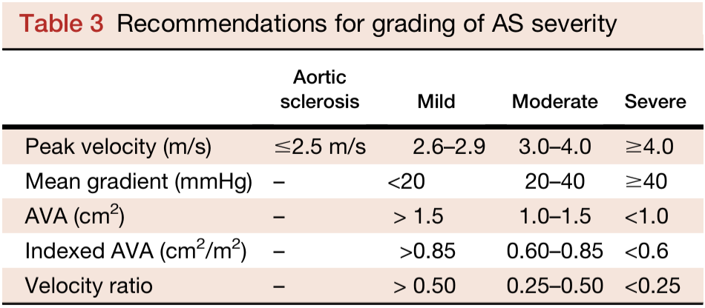
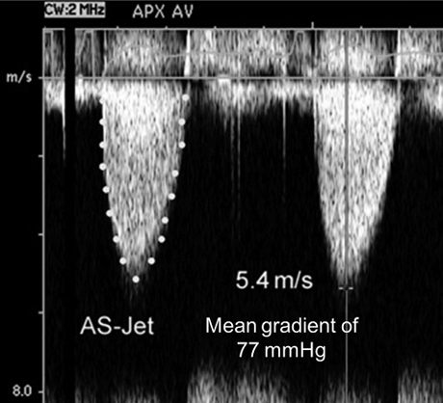
Aortic Stenosis – Grading Severity
Continuous wave doppler of AV
Know severe cut-offs for medicine boards!

Slide 18
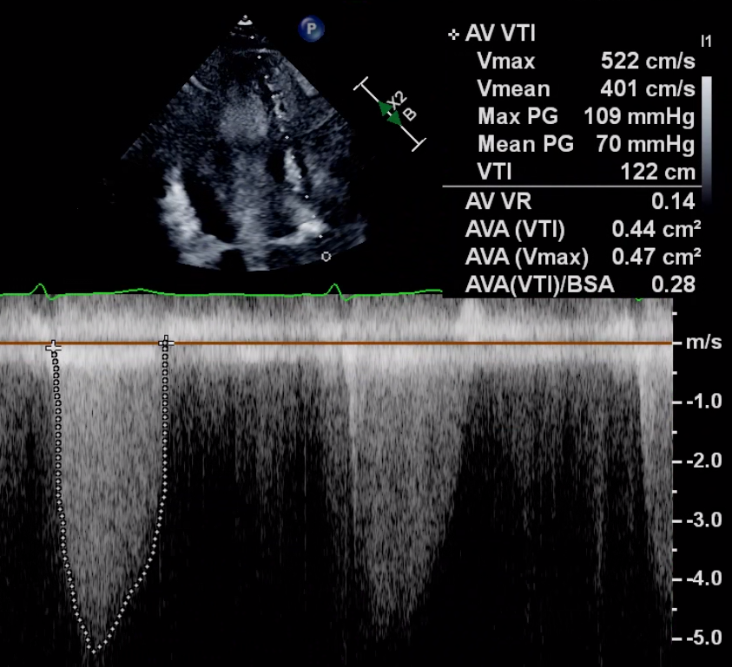
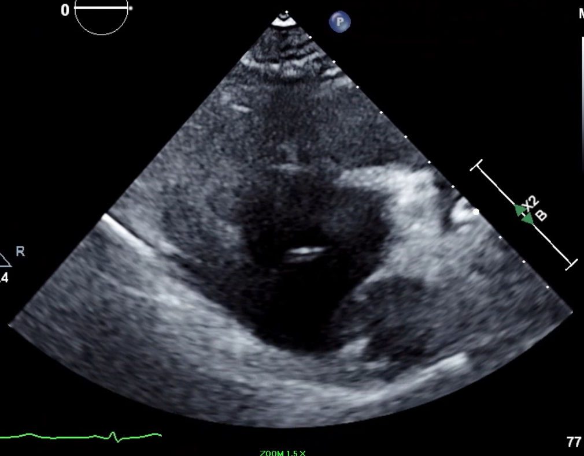
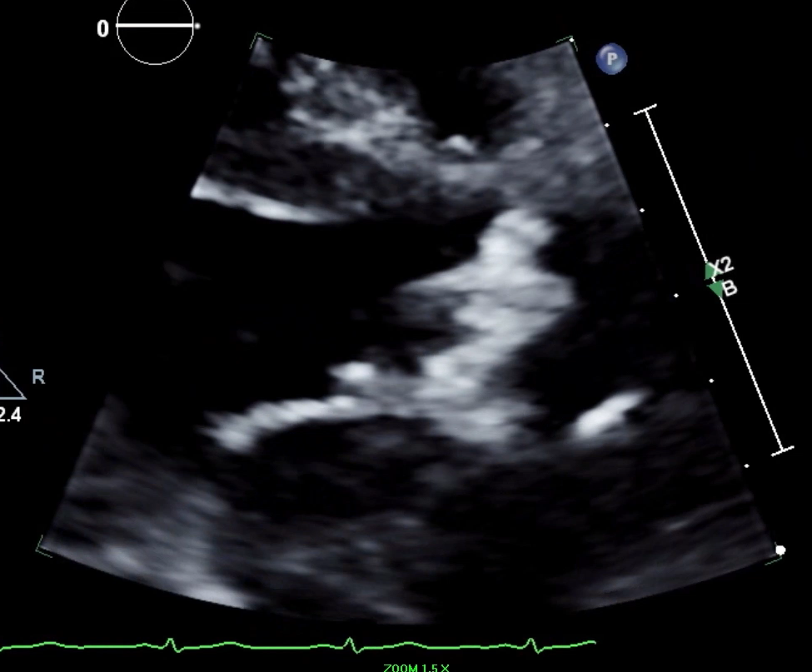
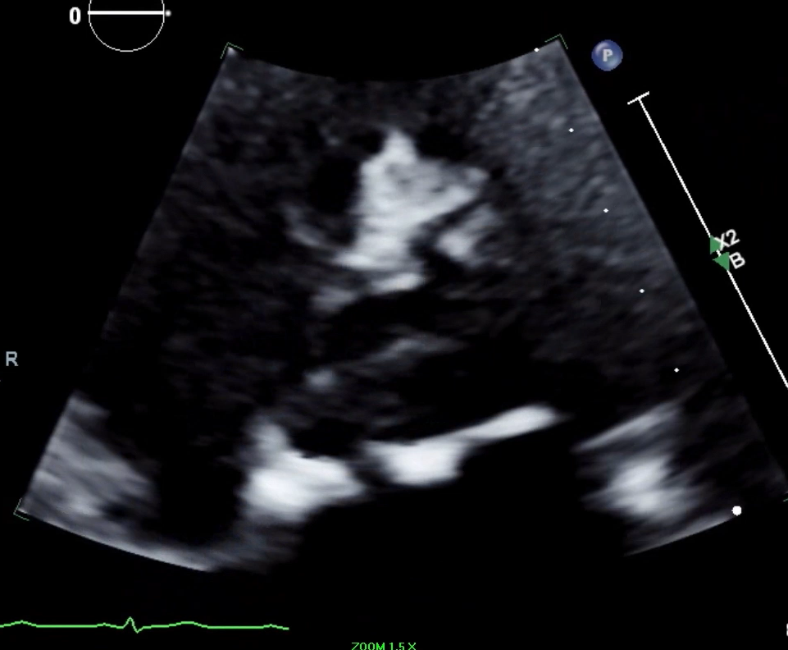
Case 1
Severe Aortic Stenosis
Notes:
Why is a diagnosis of severe symptomatic aortic stenosis important? Because it guides workup and treatment!

Slide 19
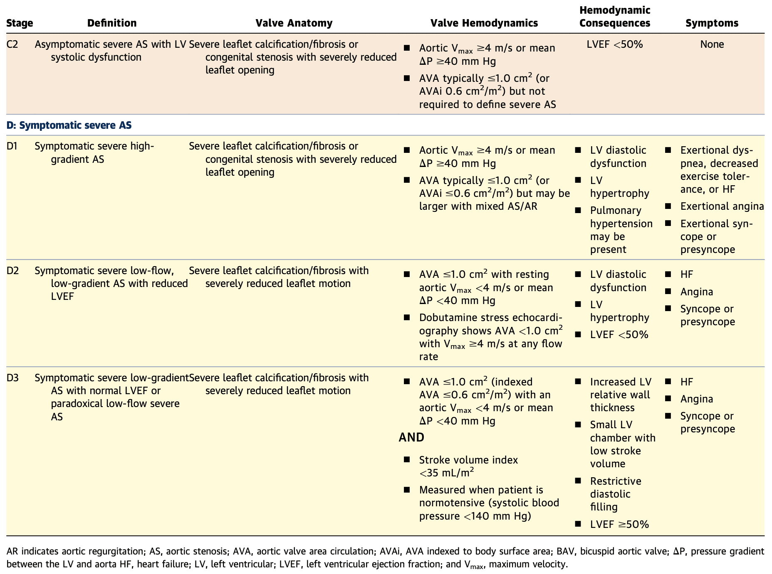
Go to surgery
Stage A = at risk
Stage B = mild to moderate
Go to surgery
Additional workup needed
Additional workup needed
Notes:
Stage A examples: bicuspid valve or other congenital anomaly, aortic valve sclerosis (i.e., thickening)
Stage B examples: mild-moderate calcification/fibrosis, of a bicuspid or trileaflet valve with some reduction in systolic motion or rheumatic changes with commissural fusion
Stage C1 examples: Severe leaflet calcification/fibrosis or congenital stenosis with severely reduced leaflet opening
***Patients with symptoms provoked by exercise testing should be considered symptomatic, even if the clinical history is equivocal.***
exercise testing is avoided in symptomatic patients with AS because of ahigh risk of complications, including syncope, ventricular tachycardia, and death

Slide 20
What is “pseudostenosis”?
Go to surgery
Additional workup needed
Additional workup needed
Notes:
Pseudostenosis is an apparent severe aortic stenosis on echocardiography or catheterization that is actually due to low cardiac output, rather than true fixed obstruction of the valve.
Dobutamine echocardiography or dobutamine cardiac catheterization is needed to distinguish true aortic stenosis from pseudostenosis. In pseudostenosis, dobutamine increases cardiac output and the opening forces on the aortic valve, causing the valve area to increase out of the severe range. With low-flow, low-gradient aortic stenosis, the calculated valve area remains in the severe range with dobutamine administration, and the aortic valve gradient and velocity increase with increased stroke volume.
Patients with paradoxical low-flow, low-gradient aortic stenosis have low stroke volume (<35 mL/m²) resulting from a combination of small LV size and high aortic impedance to flow (e.g., hypertension) or other causes of low cardiac output (e.g., atrial fibrillation, pulmonary hypertension). Determination of lesion severity in paradoxical aortic stenosis requires consideration of the hemodynamics, valve morphology (e.g., degree of calcification), presence of LV hypertrophy, and clinical presentation of the patient. In patients with suspected low-flow, low-gradient severe aortic stenosis with normal or reduced left ventricular ejection fraction, measurement of aortic valve calcium score by CT is reasonable to further define severity.

Slide 21

D2: Low flow, Low Gradient with Reduced EF
Definition:
  Effective AVA <1.0 cm²
  Mean aortic transvalvular pressure gradient <40 mmHg
  LV EF <50%
  SVi < 35 mL/m²
Next step in workup?
Notes:
Low flow, low gradient with reduced EF occurs when systolic dysfunction with reduced SV co-exists with severe AS.

Slide 22
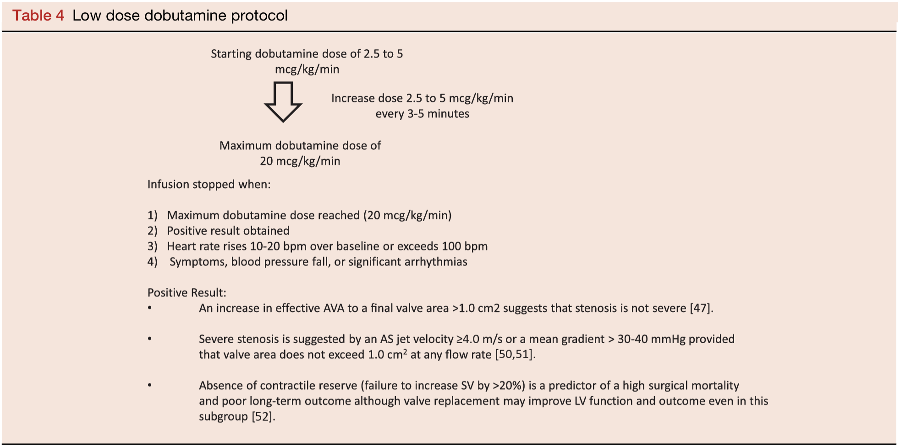
Dobutamine stress echo!
Positive result:
Pseudo: AVA increases to >1.0 cm²
True:
AVA stays < 1.0 cm²
AND
AS jet ≥4.0 m/s or mean gradient >30-40mmHg
Contractile reserve: >20% increase in SV from baseline
Notes:
Dobutamine stress-echocardiography provides information on the changes in aortic velocity, mean gradient, and valve area as flow rate increases, and also provides a measure of the contractile response to dobutamine and presence of flow reserve, measured by the change in ejection fraction and increase in SV. These data may be helpful to differentiate two clinical situations:
Severe AS causing LV systolic dysfunction (i.e. true severe AS): the transaortic velocity is flow dependent; so, LV failure can lead to a patient with severe AS having an apparently moderate transaortic peak velocity and mean pressure gradient associated with a small EOA. In this situation, aortic valve replacement will relieve afterload and may allow the LV ejection fraction to increase towards normal
Moderate AS (i.e. pseudosevere AS) with another cause of LV dysfunction (e.g. myocardial infarct or a primary cardiomyopathy): The EOA is then low because the LV does not generate sufficient energy to overcome the inertia required to open the aortic valve to its maximum possible extent. In this situation, aortic valve replacement may not lead to a significant improvement in LV systolic function. Valve replacement has not been shown to be of benefit in this group and medical heart failure treatment is recommended. Thus, this diagnostic distinction has important clinical relevance.
The protocol for dobutamine stress echocardiography for evaluation of AS severity in the setting of LV dysfunction uses a low-dose protocol, starting at 2.5 or 5 mg/kg/min with an incremental increase in the infusion every 3–5 min to a maximum dose of 10–20 mg/kg/min.
There is a risk of arrhythmia so there must be medical supervision and high doses of dobutamine should be avoided.
The infusion should be stopped as soon as a positive result is obtained (>20% increase in SV from baseline or an increase in AS jet velocity $4.0 m/s or a mean gradient $30–40 mmHg provided that valve area does not exceed 1.0 cm2 at any flow rate) or when the heart rate begins to rise more than 10–20 bpm over baseline or exceeds 100 bpm, on the assumption that the maximum inotropic effect has been reached.
Doppler data are recorded at each stage including LVOT velocity recorded from the apical approach. AS jet velocity is recorded from the window that yields the highest velocity signal but some laboratories prefer to use comparative changes from an apical window to facilitate rapid data acquisition. The LVOT diameter is measured at baseline and the same diameter is used to calculate the continuity equation valve area at each stage
Positive result:
An increase in effective AVA to a final valve area >1.0 cm2 suggests that stenosis is not severe
>20% increase in SV from baseline suggests presence of contractile reserve
Severe stenosis is suggested by an AS jet velocity ≥4.0 m/s or a mean gradient >30–40 mmHg provided that valve area does not exceed 1.0 cm2 at any flow rate
Absence of contractile reserve (failure to increase SV by > 20%) is a predictor of a high surgical mortality and poor long-term outcome although valve replacement may improve LV function and outcome even in this subgroup

Slide 23
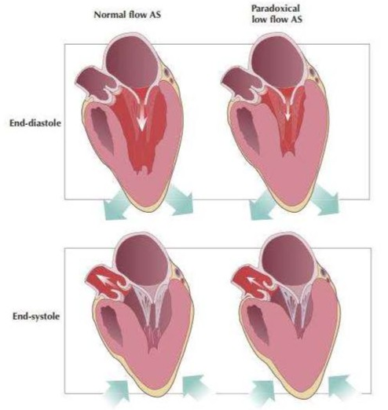
D3: Low flow, Low Gradient with Preserved EF (“Paradoxical AS”)
Seen most often in patients with small, hypertrophied LVs with restricted diastolic filling and reduced stroke volume (rather than impaired contractility)
Exacerbating factors
  Measurement error (e.g., underestimation of LVOT area)
  Severe HTN during exam
CT calcium score may be helpful here
Notes:
The guidelines explain that the low-flow state is typically due to a small, hypertrophied left ventricle with increased relative wall thickness, restrictive diastolic filling, and reduced stroke volume, rather than impaired contractility. This pattern is most often seen in elderly patients with hypertension, diabetes, or other conditions leading to concentric LV remodeling and diastolic dysfunction

Slide 24
Learning objectives
List several causes of aortic stenosis and describe the physical exam findings of aortic stenosis.
Define severe aortic stenosis by valve area and gradient. Describe pseudostenosis and how it is diagnosed.
Describe the Class I indications for aortic valve replacement. What is the indication for TAVR rather than SAVR?
List several causes for acute and chronic aortic regurgitation and describe the physical examination findings and treatment of aortic regurgitation.
Describe the Class I indications for aortic valve replacement in aortic valve regurgitation.

Slide 25
Learning objectives
List several causes of aortic stenosis and describe the physical exam findings of aortic stenosis.
Define severe aortic stenosis by valve area and gradient. Describe pseudostenosis and how it is diagnosed.
Describe the Class I indications for aortic valve replacement. What is the indication for TAVR rather than SAVR?
List several causes for acute and chronic aortic regurgitation and describe the physical examination findings and treatment of aortic regurgitation.
Describe the Class I indications for aortic valve replacement in aortic valve regurgitation.

Slide 26
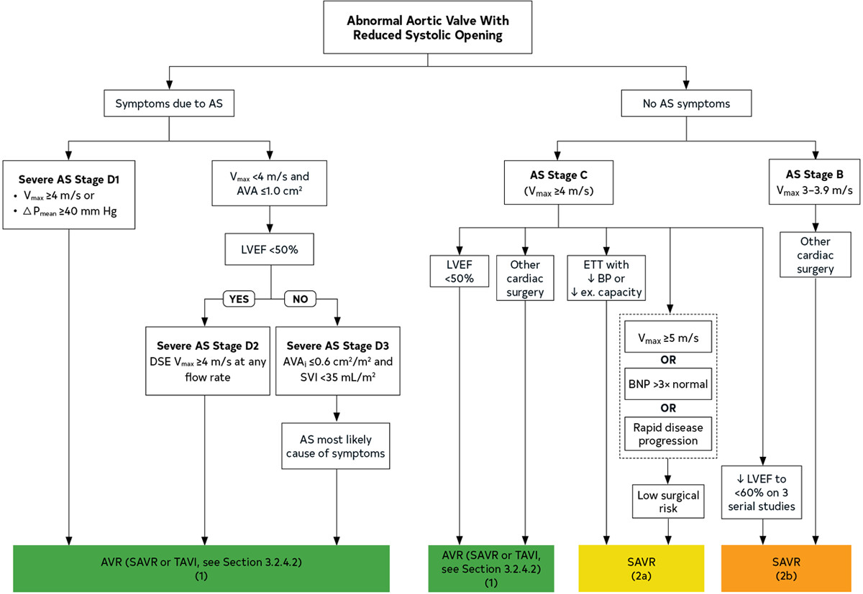
Aortic Stenosis - Treatment
Notes:
Mechanical valves = 20-30 years
Bioprosthetic valves = 10-20 years

Slide 27
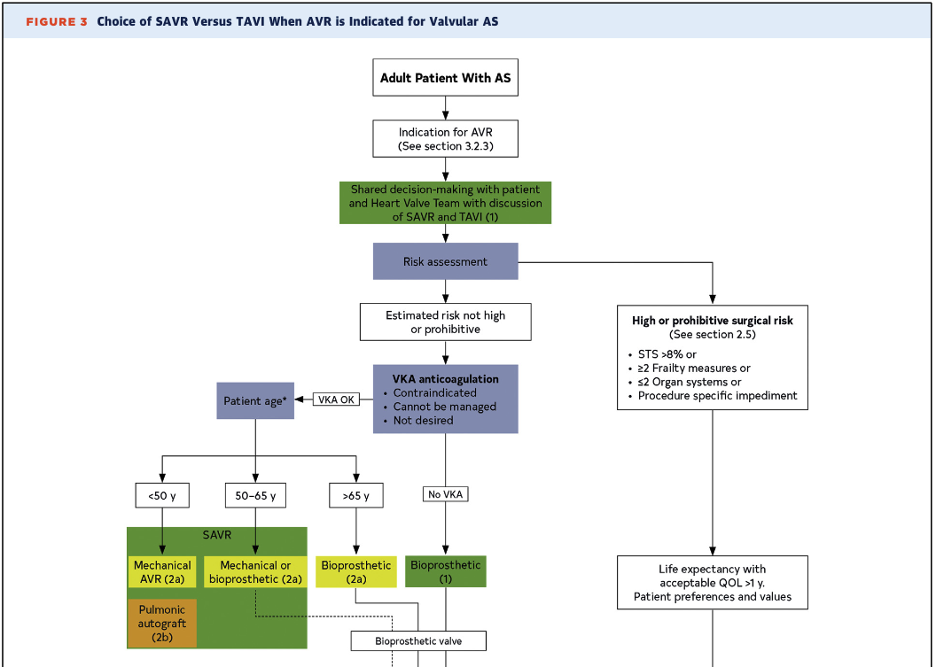
SAVR or TAVI?
Notes:
STS = society of thoracic surgeons
Mechanical valves = 20-30 years
Bioprosthetic valves = 10-20 years

Slide 28
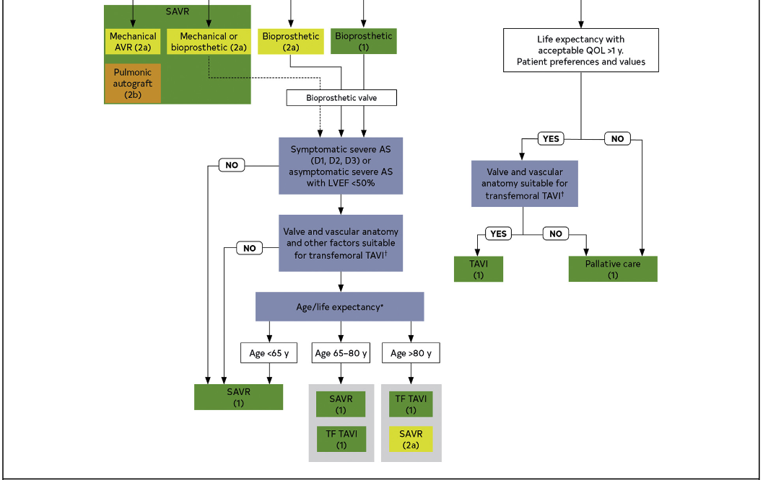
SAVR or TAVI?
Notes:
†Placement of a transcatheter valve requires vascular anatomy that allows transfemoral delivery and the absence of aortic root dilation that would require surgical replacement. Valvular anatomy must be suitable for placement of the speciﬁc prosthetic valve, including annulus size and shape, leaﬂet number and calciﬁcation, and coronary ostial height.
All patients with mechanical aortic valve replacements require lifelong anticoagulation with a vitamin K antagonist (VKA), typically warfarin, targeting an INR of 2.0–3.0.
For bioprosthetic aortic valves, the ACC/AHA guidelines state that routine lifelong anticoagulation is not required unless there is another indication (e.g., atrial fibrillation). However, short-term anticoagulation with warfarin (VKA) for 3–6 months postoperatively may be considered to reduce early thromboembolic risk until the valve is endothelialized, especially in patients with additional risk factors. After this period, antiplatelet therapy (aspirin) is often used.

Slide 29
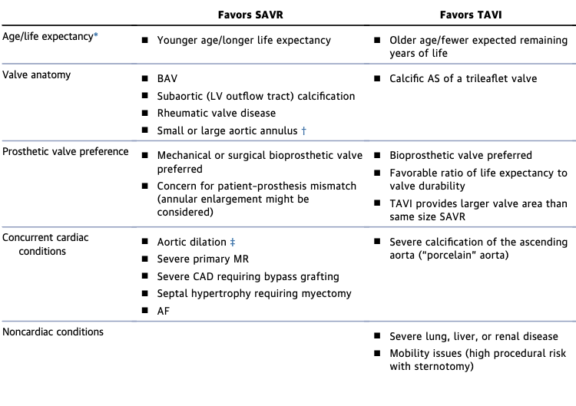
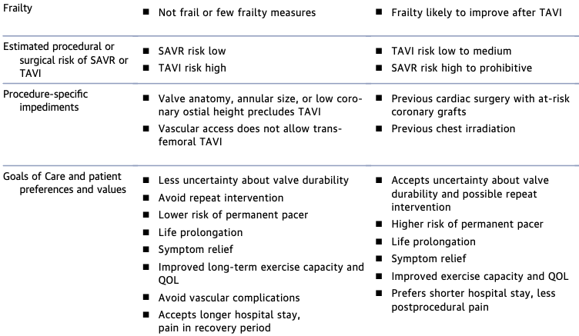
SAVR or TAVI?
Notes:
Generally speaking, patients who are younger and who have concomitant anatomical considerations such as bicuspid valve, root dilation, other valve disease (e.g., MR), CAD requiring bypass are better candidates for SAVR
Whereas those who are older who are more frail and higher surgical risks without additional surgery considerations will probably be better candidates for TAVI

Slide 30
In General
SAVR is good for:
Young (<65)
Spry
Complex valve anatomy (e.g., BAV, Rheumatic valve dz)
Concurrent CV disease (e.g. aortic dilation, MR, mvCAD)
Low surgical risk (STS)
TAVI is good for:
Old (>80)
Frail
Straight-forward valve anatomy
Little/no concurrent CV disease
High surgical risk

Slide 31
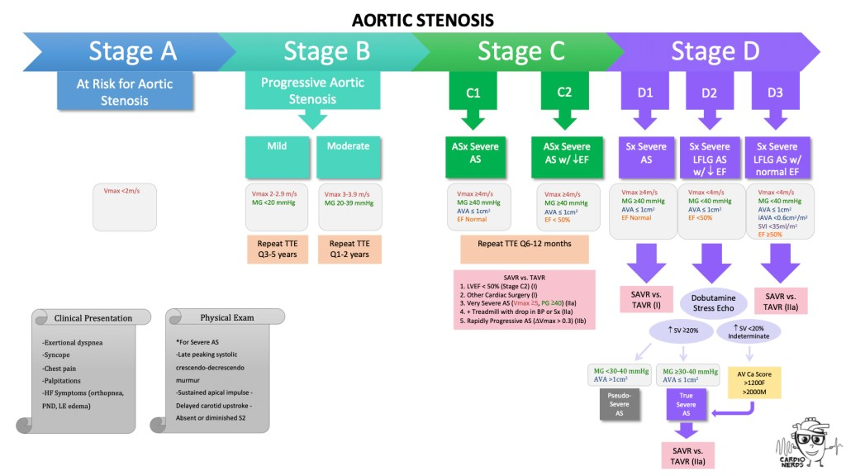

Slide 32
Learning objectives
List several causes of aortic stenosis and describe the physical exam findings of aortic stenosis.
Define severe aortic stenosis by valve area and gradient. Describe pseudostenosis and how it is diagnosed.
Describe the Class I indications for aortic valve replacement. What is the indication for TAVR rather than SAVR?
List several causes for acute and chronic aortic regurgitation and describe the physical examination findings and treatment of aortic regurgitation.
Describe the Class I indications for aortic valve replacement in aortic valve regurgitation.

Slide 33
Learning objectives
List several causes of aortic stenosis and describe the physical exam findings of aortic stenosis.
Define severe aortic stenosis by valve area and gradient. Describe pseudostenosis and how it is diagnosed.
Describe the Class I indications for aortic valve replacement. What is the indication for TAVR rather than SAVR?
List several causes for acute and chronic aortic regurgitation and describe the physical examination findings and treatment of aortic regurgitation.
Describe the Class I indications for aortic valve replacement in aortic valve regurgitation.

Slide 34
Case 2
A 40-year-old houseless man with history of MRSA wound infection is seen in the ED.
He is hemodynamically tenuous with BP 100/35, HR 105, Temp 39C and SpO2 88% on RA. LA is 4 and NT-pro BNP is 8000. He is started on broad-spectrum antibiotics.
You are a master at POCUS and eager to show off your skills to your attending. Your lung exam shows numerous B-lines and your cardiac exam shows...

Slide 35
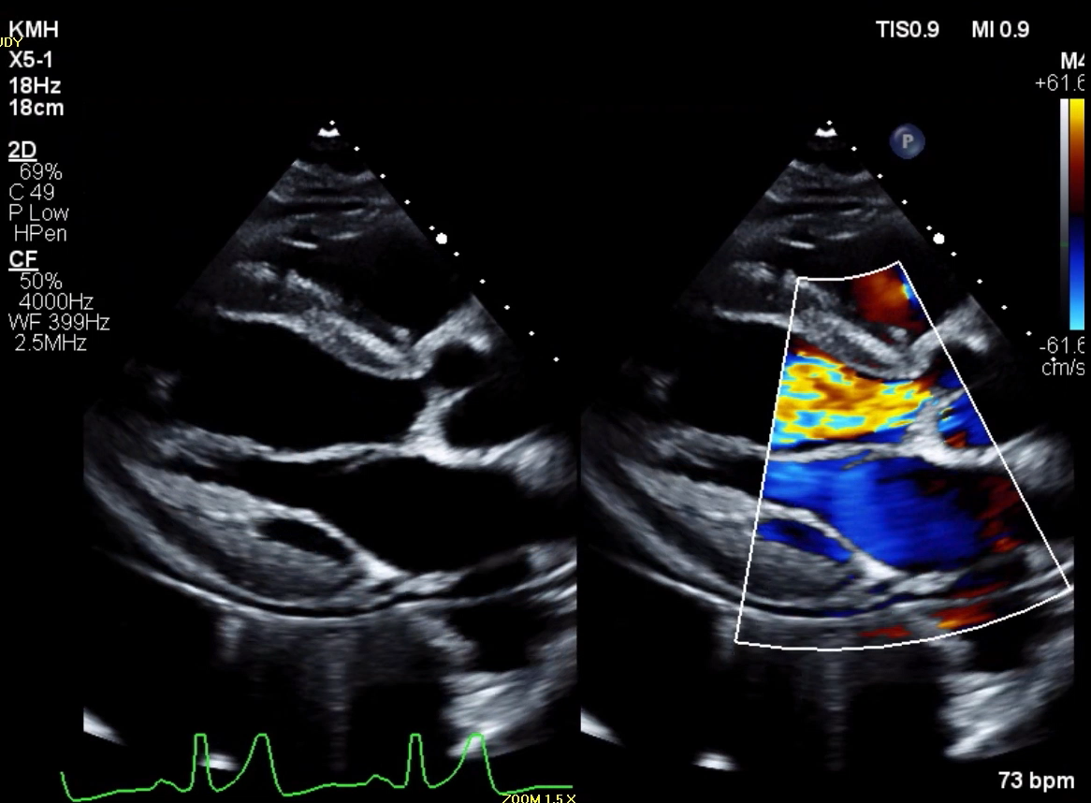

Slide 36
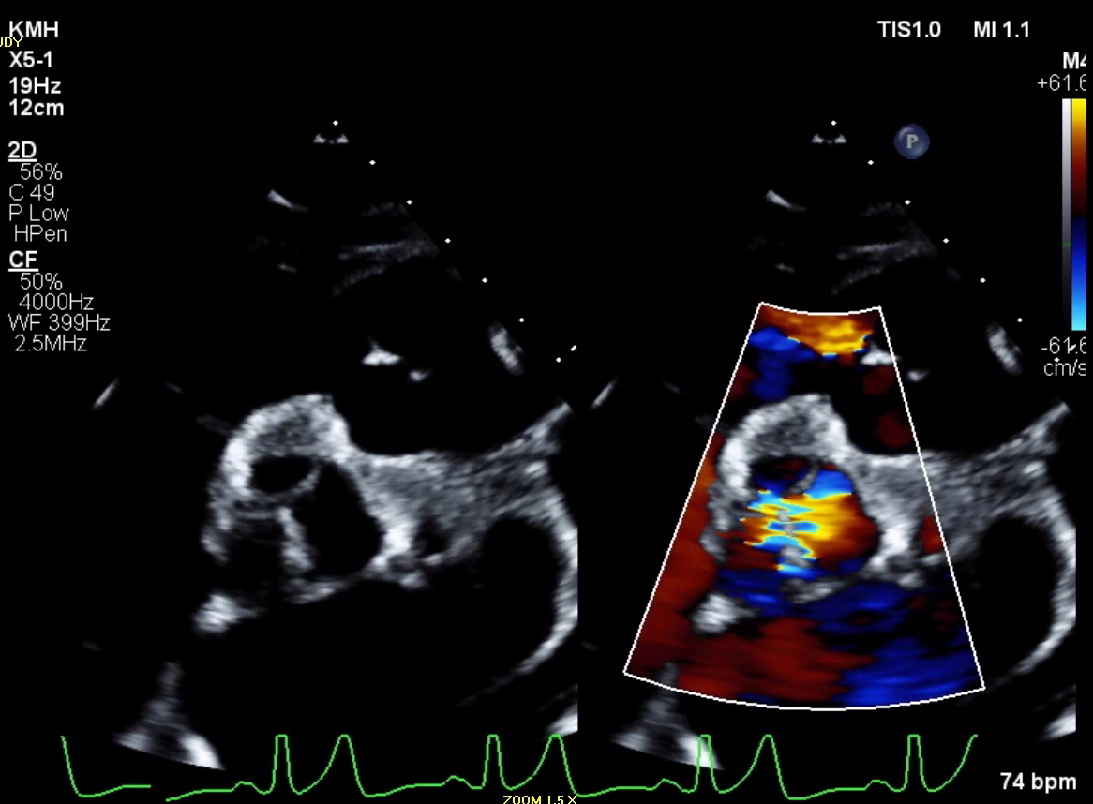

Slide 37
Question 3
What do you expect to hear on exam?
A) High pitched holodiastolic murmur
B) Late peaking systolic murmur
C) Diastolic rumble at the apex
D) Soft S1

Slide 38
Question 3
What do you expect to hear on exam?
A) High pitched holodiastolic murmur – Chronic AR, generally there is no murmur or a faint diastolic murmur
B) Late peaking systolic murmur - AS
C) Diastolic rumble at the apex - MS
D) Soft S1 -> Acute AR due to premature closure of mitral valve
What do you do next?
Notes:
The first heart sound (S1) is soft in acute aortic regurgitation because early closure of the mitral valve occurs due to the rapid rise in left ventricular diastolic pressure from the regurgitant aortic flow, which reduces the pressure gradient and velocity of mitral leaflet closure.

Slide 39
Acute Aortic Regurgitation
  Emergent Surgery
Notes:
Hx of Takotsubo CMP with EF 35% (9/2022)

Slide 40
Acute Aortic Regurgitation
  Medical therapy ~75% mortality
  Surgical treatment ~25% mortality
Rigolin VH et al. 2009.

Slide 41
Acute Aortic Regurgitation
Etiology: Endocarditis, dissection, transcatheter procedure or blunt trauma
Pathophysiology: Rapid regurgitation of blood into a normal sized LV that has not adapted leads to a large increase in LVEDP -> non-compliant LV -> low cardiac output -> pulmonary edema.
Beta-blockers, IABP, Impella and ECMO worsen the problem
Notes:
Beta-blockers are contraindicated because they blunt the compensatory tachycardia that is critical for maintaining cardiac output in acute AR. Blocking this response can precipitate severe hypotension and compromise perfusion
IABP is contraindicated because diastolic balloon inflation increases aortic diastolic pressure, thereby increasing the regurgitant volume into the left ventricle and worsening AR. This can lead to further hemodynamic instability
Impella and other percutaneous LV assist devices reduce LV pressures and volumes, but in the context of acute AR, they do not address the underlying regurgitant flow and may not provide adequate forward output, potentially worsening cardiac performance.
VA-ECMO without LV venting increases LV systolic and diastolic pressures, exacerbating regurgitant flow and LV overload, which can worsen pulmonary edema and compromise systemic perfusion

Slide 42
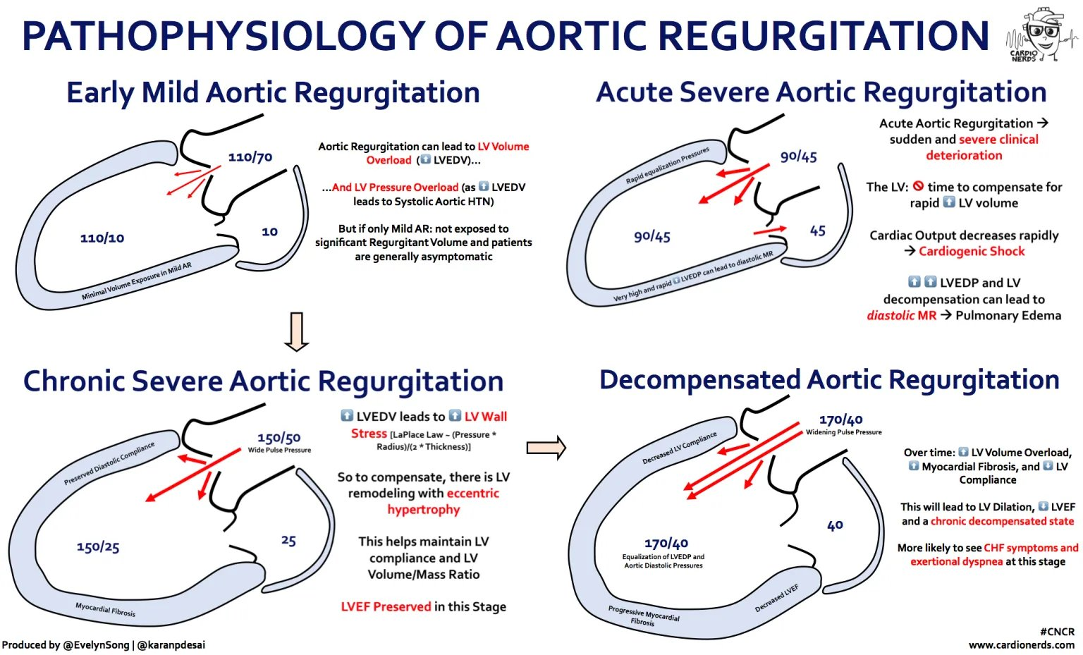
Acute Aortic Regurgitation

Slide 43
Acute Aortic Regurgitation
  Emergent Surgery
Notes:
Hx of Takotsubo CMP with EF 35% (9/2022)

Slide 44
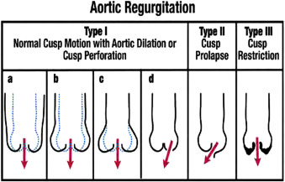
Chronic Aortic Regurgitation
Prevalence in the US is between 4.9% to 10%.
More common in men than women, increases with age.
Etiology:
  Primary Valve disorder
    Bicuspid
    Calcific
    Infective Endocarditis
    Rheumatic (worldwide)
  Aortic Root disorder
    Bicuspid
    Marfan
    Ehlers-Danlos
    HTN
    Degenerative

Slide 45
Chronic Aortic Regurgitation

Slide 46
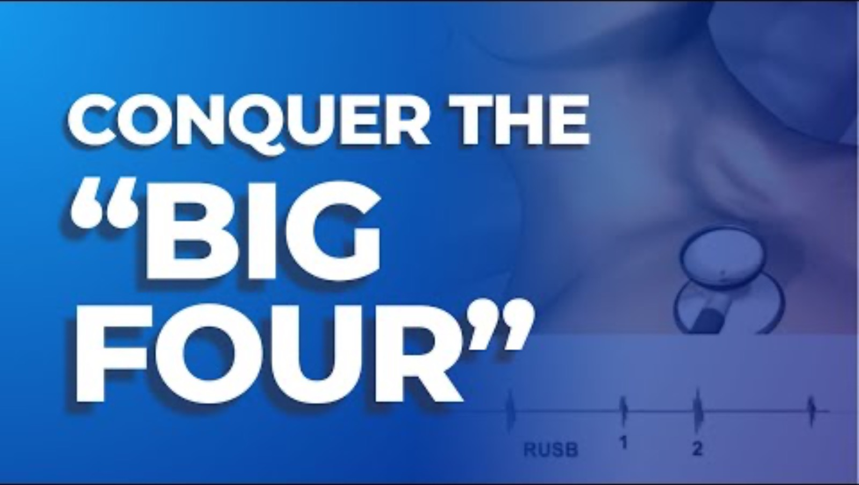
Aortic Regurgitation – Physical Exam
Murmur: Diastolic decrescendo
Location: LLSB (valvular) or RLSB (dilated aorta)
Radiation: None
Associated findings:
  Enlarged, displaced apical impulse
  S3 or S4
  Increased pulse pressure
  Bounding carotid & peripheral pulses
Pitfalls:
  Acute: severity may be masked by tachycardia and short duration of murmur
  Chronic: severity difficult to assess by auscultation

Slide 47
Learning objectives
List several causes of aortic stenosis and describe the physical exam findings of aortic stenosis.
Define severe aortic stenosis by valve area and gradient. Describe pseudostenosis and how it is diagnosed.
Describe the Class I indications for aortic valve replacement. What is the indication for TAVR rather than SAVR?
List several causes for acute and chronic aortic regurgitation and describe the physical examination findings and treatment of aortic regurgitation.
Describe the Class I indications for aortic valve replacement in aortic valve regurgitation.

Slide 48
Learning objectives
List several causes of aortic stenosis and describe the physical exam findings of aortic stenosis.
Define severe aortic stenosis by valve area and gradient. Describe pseudostenosis and how it is diagnosed.
Describe the Class I indications for aortic valve replacement. What is the indication for TAVR rather than SAVR?
List several causes for acute and chronic aortic regurgitation and describe the physical examination findings and treatment of aortic regurgitation.
Describe the Class I indications for aortic valve replacement in aortic valve regurgitation.

Slide 49
Question 4
A 45-year-old woman with a history of infective endocarditis presents to the hospital for new onset dyspnea. She denies any recent dental procedures or IVDU.
BP 120/40, HR 95 BPM, afebrile and normal respirations/saturations.
Exam: Early diastolic murmur, Austin-Flint murmur, Waterhammer pulse, Corrigan’s Sign and Quincke’s pulse
TTE demonstrates severe AR, LVEF 40%, LVIDs 55mm and no vegetations.
What is the best next step for this patient?
A) Start beta-blocker
B) Call interventional cardiology for IABP
C) Call structural cardiology for inpatient TAVR
D) Call CTS for SAVR

Slide 50
Question 4
A 45-year-old woman with a history of infective endocarditis presents to the hospital for new onset dyspnea. She denies any recent dental procedures or IVDU.
BP 120/40, HR 95 BPM, afebrile and normal respirations/saturations.
Exam: Early diastolic murmur, Austin-Flint murmur, Waterhammer pulse, Corrigan’s Sign and Quincke’s pulse
TTE demonstrates severe AR, LVEF 40%, LVIDs 55mm and no vegetations.
What is the best next step for this patient?
A) Start beta-blocker
B) Call interventional cardiology for IABP
C) Call structural cardiology for inpatient TAVR
D) Call CTS for SAVR

Slide 51
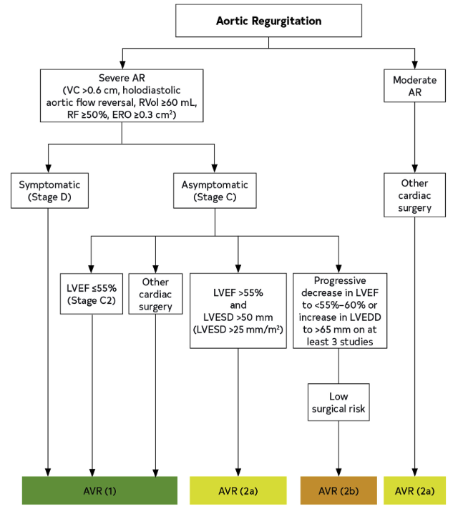
Aortic Regurgitation - Treatment
Notes:
Rvol = regurgitant volume
RF = regurgitant fraction
ERO = effective regurgitant orifice
VC = vena contracta
The vena contracta (VC) is the narrowest point of a regurgitant blood jet, while the effective regurgitant orifice area (EROA) is the area of that jet at the vena contracta, representing the effective size of the leak

Slide 52
Learning objectives
List several causes of aortic stenosis and describe the physical exam findings of aortic stenosis.
Define severe aortic stenosis by valve area and gradient. Describe pseudostenosis and how it is diagnosed.
Describe the Class I indications for aortic valve replacement. What is the indication for TAVR rather than SAVR?
List several causes for acute and chronic aortic regurgitation and describe the physical examination findings and treatment of aortic regurgitation.
Describe the Class I indications for aortic valve replacement in aortic valve regurgitation.

Slide 53
Questions?
Thank you!

Slide 54
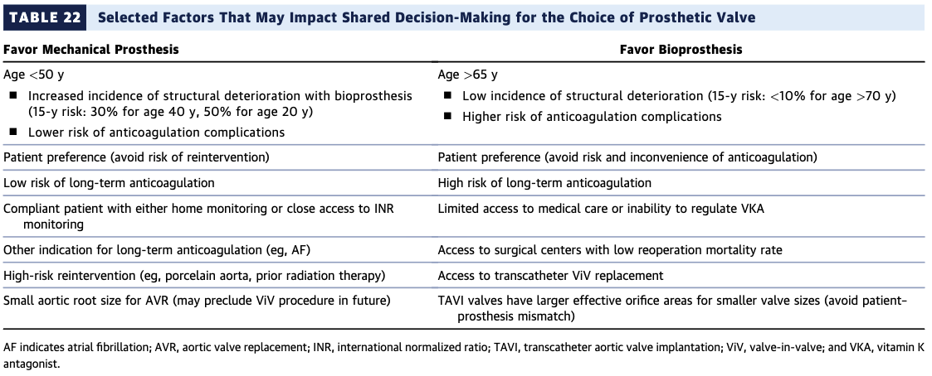
…mechanical or bioprosthetic?

Slide 55
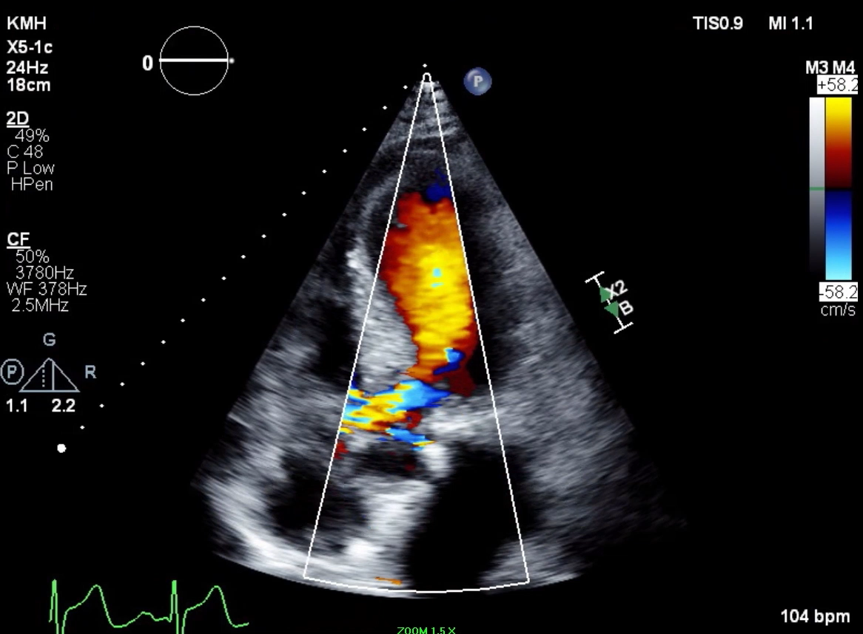
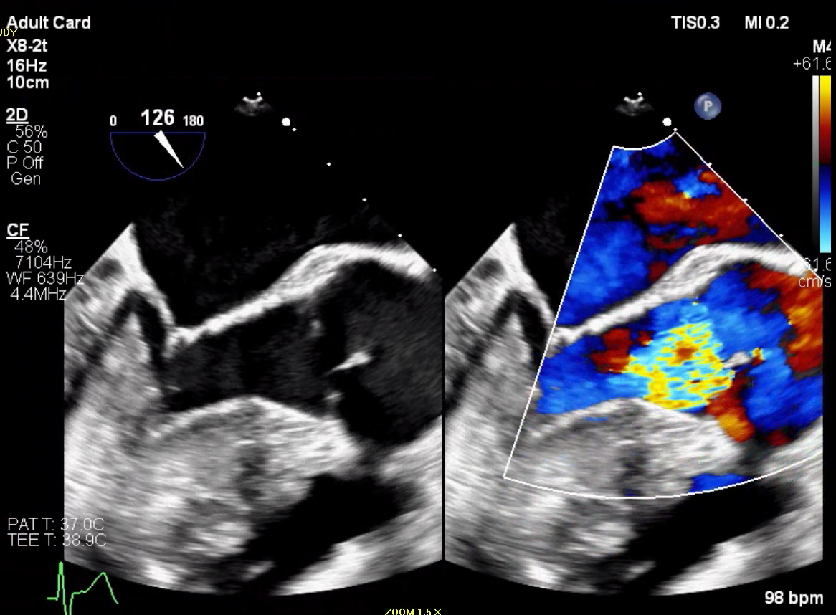

Slide 56
Question 3
A 54-year-old woman with bicuspid AS presents to the internal medicine clinic after a recent uncomplicated bioprosthetic SAVR. Her last CT of the chest shows a 4.4cm ascending thoracic aortic aneurysm. She is asymptomatic.
What additional testing, screening and treatment is necessary?
A) Antibiotic prophylaxis for routine dental cleanings
B) Screening TTE of 1st degree relatives
C) Periodic screening of her thoracic aortic aneurysm
D) All of the above
E) None of the above

Slide 57
Question 3
A 54-year-old woman with bicuspid AS presents to the internal medicine clinic after a recent uncomplicated bioprosthetic SAVR. Her last CT of the chest shows a 4.4cm ascending thoracic aortic aneurysm. She is asymptomatic.
What additional testing, screening and treatment is necessary?
A) Antibiotic prophylaxis for routine dental cleanings Class IIa
B) Screening TTE of 1st degree relatives Class I (BAV + TAA), Class IIa (BAV)
C) Periodic screening of her thoracic aortic aneurysm Class I
D) All of the above
E) None of the above

Slide 58
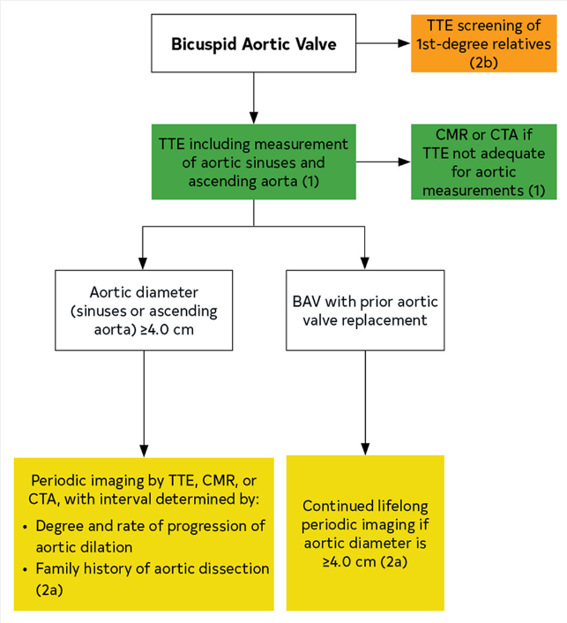
Bicuspid Aortic Valve
Indications for aortic root replacement in BAV:
≥5.5 cm Class I
5-5.4 cm Class IIa, if risk factors
5-5.4 cm Class IIb, if no risk factors
≥4.5 cm Class IIa, if another surgical indication
Risk factors:
FH of dissection, growth rate ≥0.3cm/year, coarctation, root phenotype

Slide 59
Question 5
A 45-year-old woman with previous infective endocarditis presents to the hospital for new onset dyspnea. She denies any recent dental procedures or IVDU.
BP 120/40, HR 95 BPM and normal respirations/saturations.
Exam: Early diastolic murmur, Austin-Flint murmur, Waterhammer pulse, Corrigan’s Sign and Quincke’s pulse.
TTE demonstrated moderately reduced LV systolic function with LVEF 40%, severe AR, and LV end systolic diameter 55mm.
What ACC/AHA stage is this patient’s valve disease?
A) Stage A
B) Stage B
C) Stage C1
D) Stage C2
E) Stage D

Slide 60
Question 5
A 45-year-old woman with previous infective endocarditis presents to the hospital for new onset dyspnea. She denies any recent dental procedures or IVDU.
BP 120/40, HR 95 BPM and normal respirations/saturations.
Exam: Early diastolic murmur, Austin-Flint murmur, Waterhammer pulse, Corrigan’s Sign and Quincke’s pulse.
TTE demonstrated moderately reduced LV systolic function with LVEF 40%, severe AR, and LV end systolic diameter 55mm.
What ACC/AHA stage is this patient’s valve disease?
A) Stage A
B) Stage B
C) Stage C1
D) Stage C2
E) Stage D

Slide 61
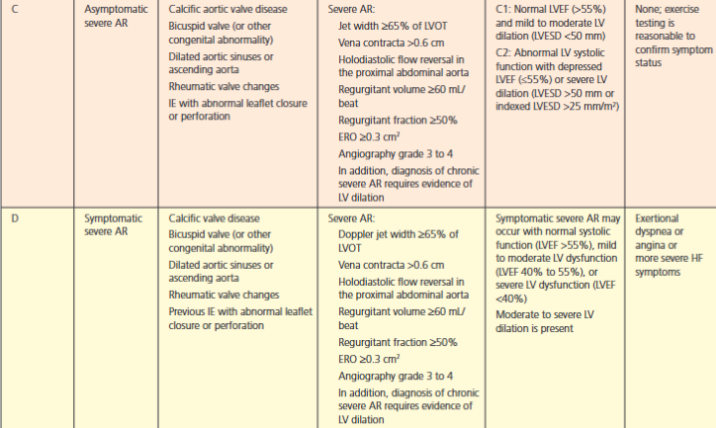
Chronic Aortic Regurgitation
Stage A = at risk
Stage B = mild to moderate
Notes:
Hx of Takotsubo CMP with EF 35% (9/2022)

Slide 62
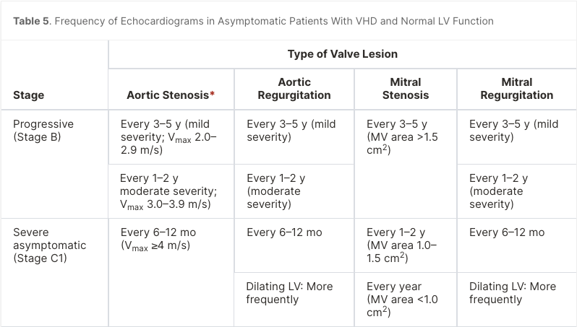

Slide 63
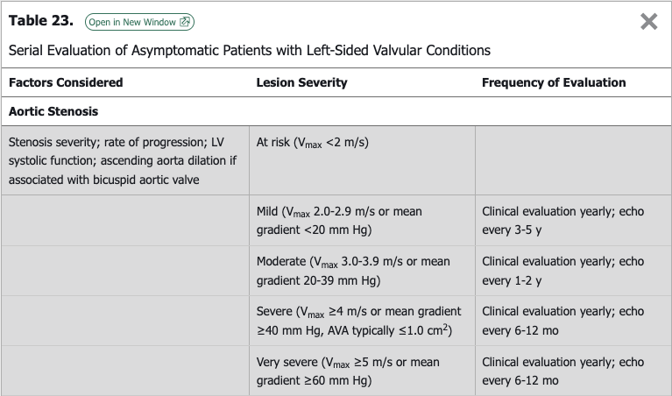

Slide 64
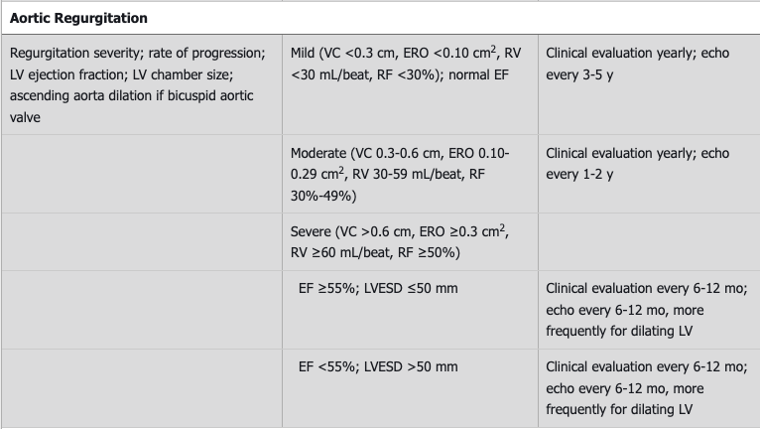

Slide 65
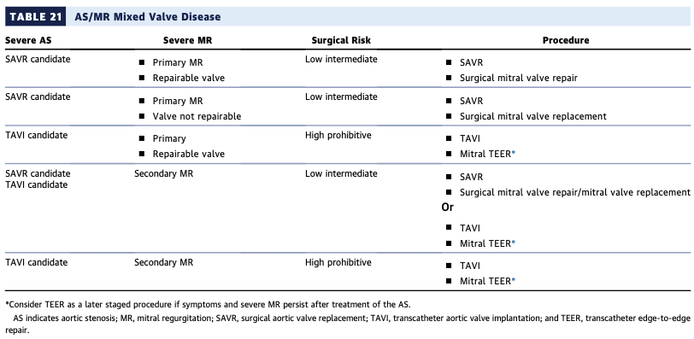

Slide 66
