Slide 1
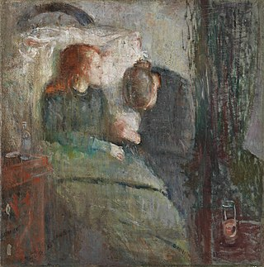
Tuberculosis
Edvard Munch “The Sick Child” 1885-86
Ron Galbraith MD
August 10, 2026
Notes:
1882 Dr Robert Koch announced the discovery of Mycobacterium tuberculosis, 1600-1800 in Europe, Tb caused 25% of all deaths; it is still considered the most lethal of infectious diseases worldwide; late 1800s/early 1900s people came to Tucson and Phoenix for santoriums
https://www.cdc.gov/tb/worldtbday/history.htm
https://www.azcentral.com/story/travel/arizona/road-trips/2020/05/11/arizona-tuberculosis-history-sunnyslope-sanatoriums-doc-holliday/3101543001/ ~1910s Tucson > Phoenix
https://www.arizonahighways.com/classroom/tuberculosis-and-tourism

Slide 2
Learning Objectives
1. Differentiate between tuberculosis infection and disease
2. Identify the most significant risk factors for converting from latent to active tuberculosis
3. Describe the most common clinical manifestations for TB disease in an adult in the US
4. Compare and contrast the different laboratory tests for tuberculosis infection and disease
5. Compare and contrast NMT (MAC) with TB
6. List a typical treatment course for LTBI and active pulmonary tuberculosis
7. Examine other aspects of management – isolation, drug resistance and adverse drug effects
Notes:
Just describe the blueprint: a couple cases throughout, micro/path/epi, diagnosis and treatment; touch on infection/disease vs latent/active terminology

Slide 3
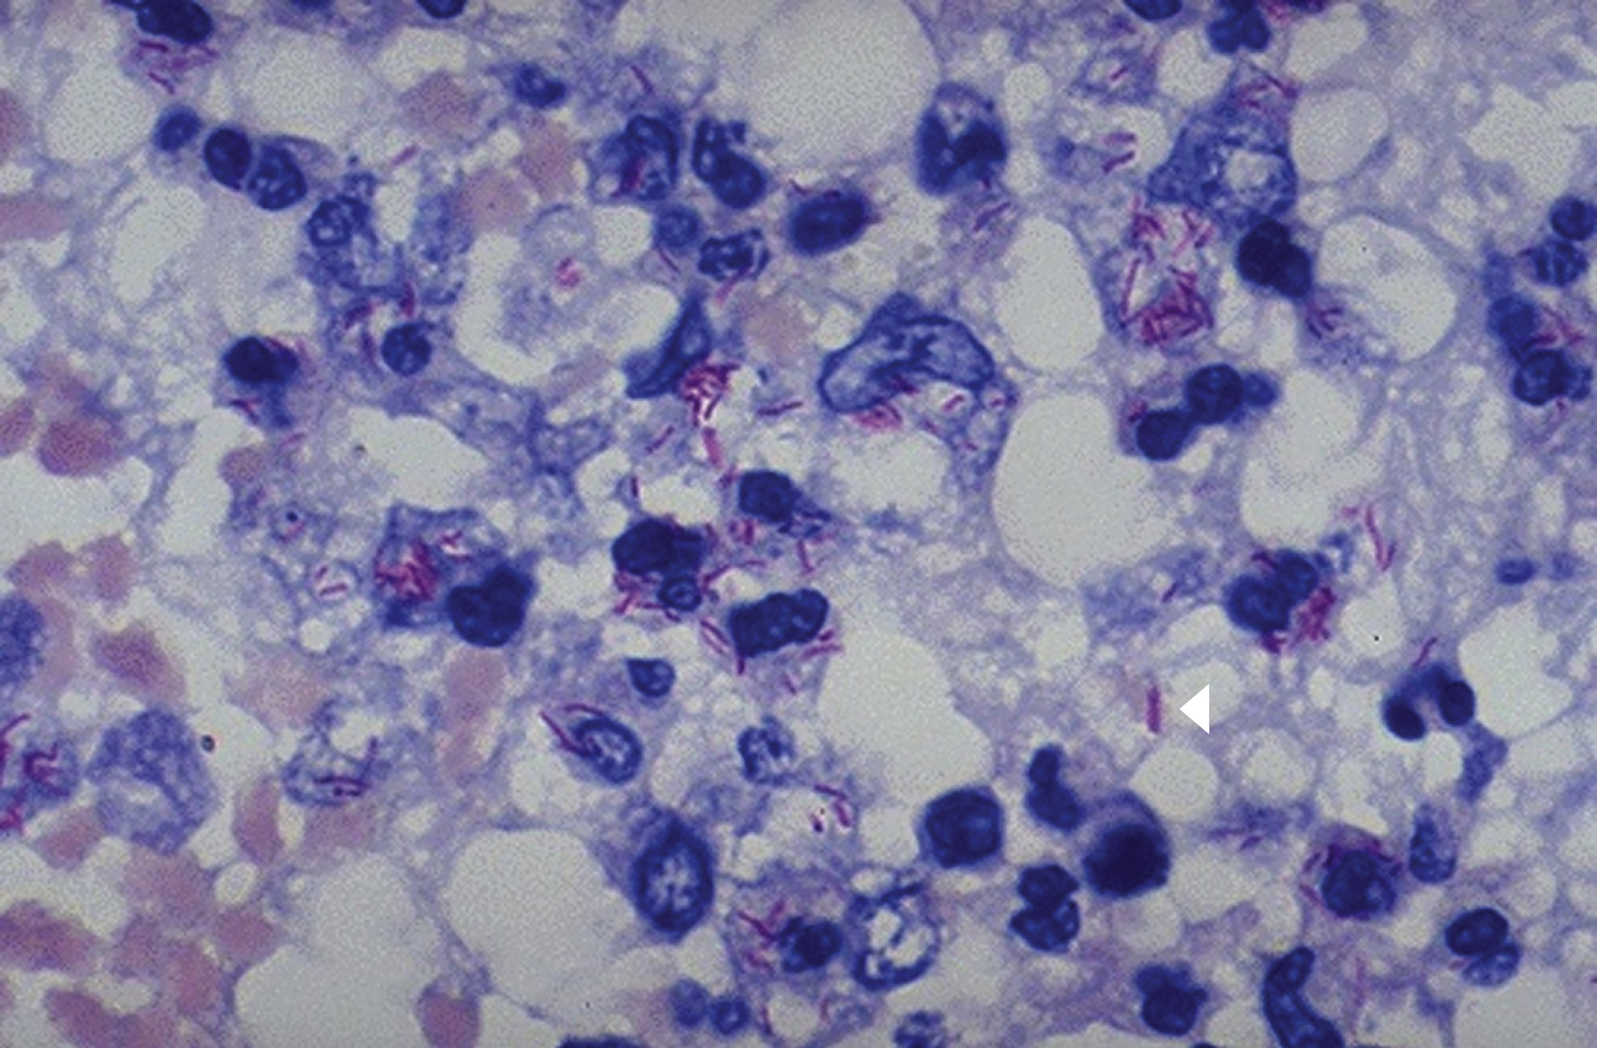
Mycobacterium tuberculosis (Mtb)is a unique bacteria
Mtb complex is a bacteria with unique characteristics
  High lipid content in cell wall / unique growth requirements => AFB stain/culture
  Slow growth => chronic, long duration of treatment
  Two stages
    Transmission/infection
    Progression from infection to disease
      “latent tb”
Robbins and Cotran Atlas of Pathology
Notes:
High lipid content in cell wass => gram staining doesn’t work
Unique growth requirements => special culture media needs to be used
Slow growth: 3- 8 weeks for visible growth; more typical bacteria would grow overnight, Tb has a 20h generational time vs 20m for Ecoli
Spread by inhalation of droplet nuclei into midlung zone
Progression from infection to disease in 5-10% of infected

Slide 4
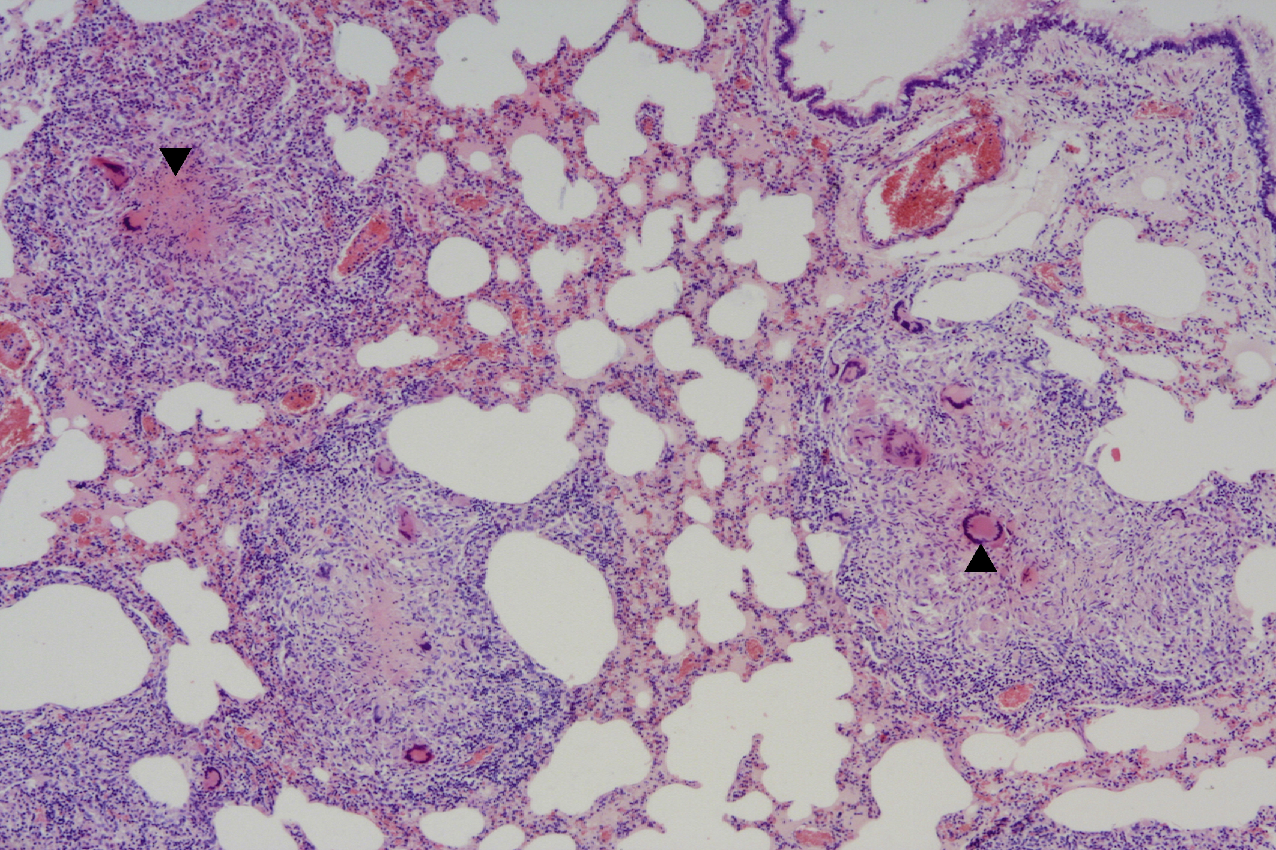
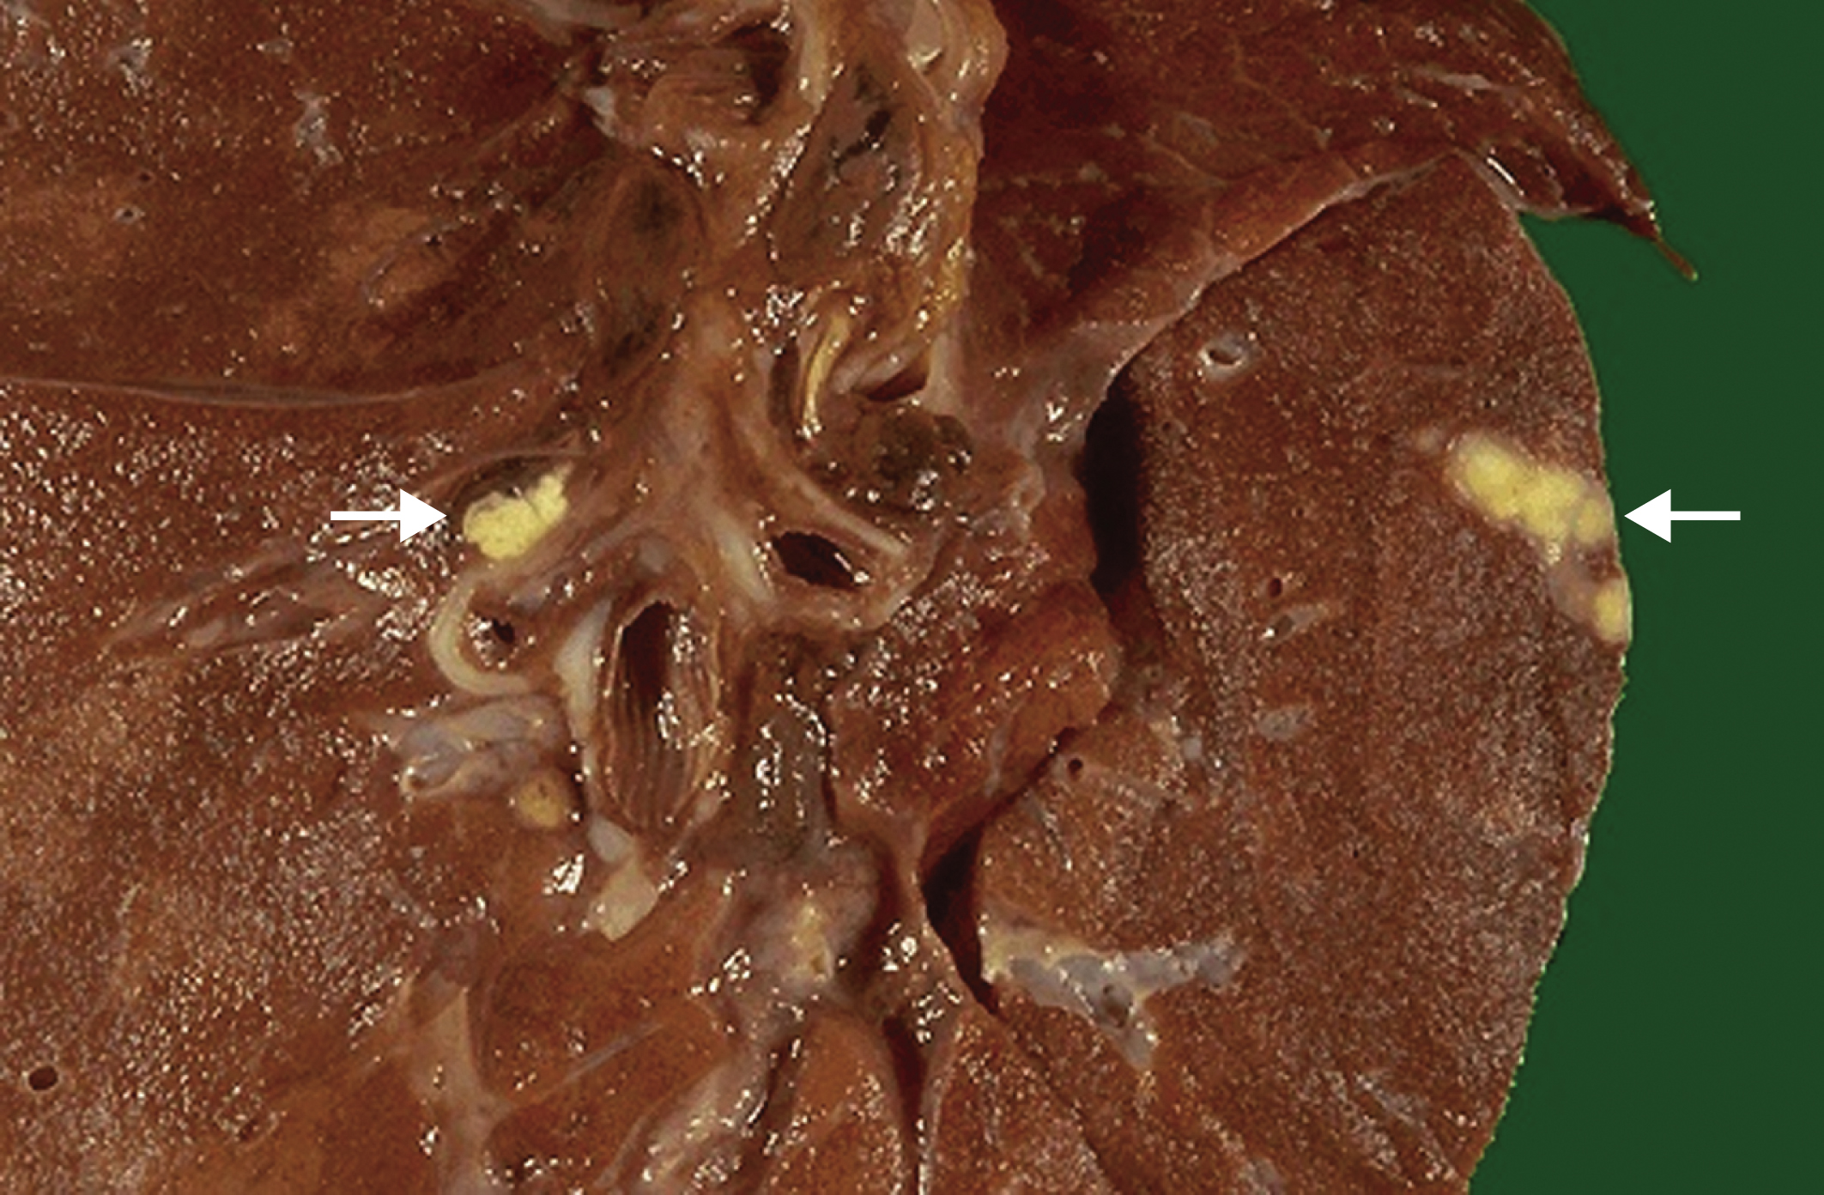
What is latent tuberculosis?
Inhaled mtb
(immediate) clearance
Primary (immediate) disease
Latent infection (= granulomatous containment)
90-95% never reactivates
5-10% reactivation disease
Before containment, tb may spread to different areas of the body, especially apical-posterior lungs
Robbins and Cotran Atlas of Pathology
Notes:
After primary infection, 10% develop primary tuberculosis as active disease but this is much more common in children in areas with high tb prevalence so I just have 1 slide on this
Of the 5-10% of infected individuals who develop active disease, about 50% of them will do so within the first 2-3y following infection

Slide 5
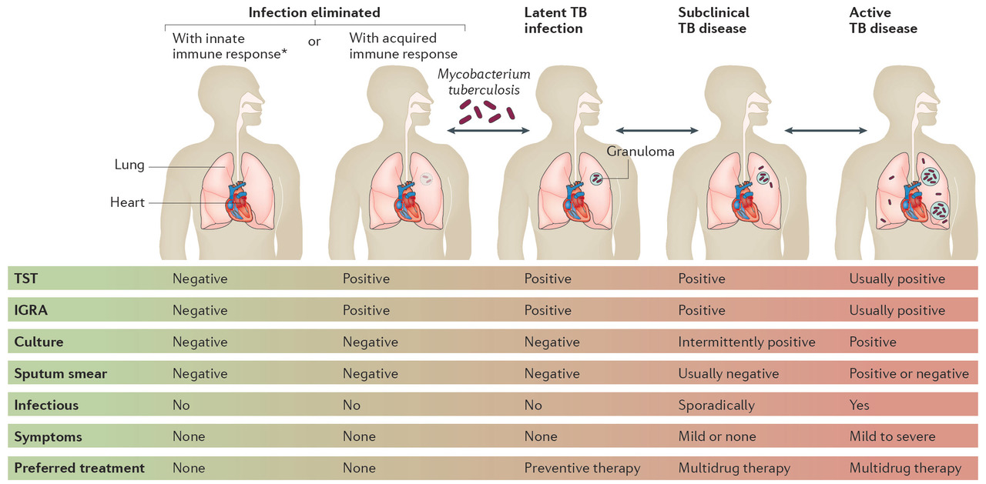
Spectrum of tb infection/disease
Pai “The Spectrum of Tuberculosis and Why It Matters”
Notes:
TBI = tuberculosis infection > LTBI

Slide 6
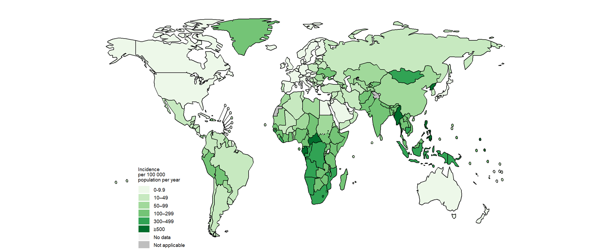
TBI in the world and US
Prevalence of TBI
  25% of world population (WHO)
  5% of US population (CDC, NHANES 2011-2012)
  More than 80% of cases in US result from longstanding untreated TBI
Most countries don’t screen LBTI
  High risk of reinfection
  Higher risk of causing resistance
WHO 2023 – Tb incidence by country
World Health Organization
Notes:
Low prevalence in most of Americas/Europe; worst in Africa and SE Asia; very little in US, Canada, Western Europe, Australia and New Zealand
most of the world does not check for TBI and wouldn’t treat TBI because they drug resistance is more of a concern and it is more widespread (high risk of reinfection, cat’s out of the bag)
1.7 billion infected world wide, 6-13million in US, 9.3-20.5% foreign born vs 0.6-2.8% us born
2021 WHO Global TB report it remains the leading cause of mortality among infectious diseases

Slide 7
Recommendations for LTBI screening
General population
  CDC and USPSTF recommend testing people who are at increased risk for TB infection or disease-progression
High risk TB infection | High risk TB disease if infected
Known tb exposure | Recently infected within 2y
Born > time in country where tb is common | HIV
Shelters, prisons> jails, health care | Immunosuppressives
 | CKD/HD
 | Low weight / Silicosis / leukemia / head & neck ca
Table 7: CDC Latent tuberculosis infection, A guide for primary health care providers
Notes:
US strategy is to screen those at high risk for ltbi and for progression to active tb and to treat
Treatment substantially reduces risk that LTBI will progress to tb disease (estimated 90% efficacy – http://www.cdc.gov/tb/education/FAQforproviders.htm)
Navy started TST 1948 of all recruits – (seminal data in US about tb is from Navy)
48. Hanzel, "Tuberculosis Control in the United States Navy"; G. W. Comstock, "Frost Revisited: The Modern Epidemiology of Tuberculosis," American Journal of Epidemiology 101, no. 5 (1975): 363-382; G. W. Comstock, L. B. Edwards, and V. T. Livesay, "Tuberculosis Morbidity in the US Navy: Its Distribution and Decline," American Review of Respiratory Disease 110, no. 5 (1974): 572-580; L. B. Edwards , F. A. Acquaviva, and V. T. Livesay, "Identification of Tuberculous Infected. Dual Tests and Density of Reaction," American Review of Respiratory Disease 108, no. 6 (1973): 1334-1339; L. B. Edwards , F. A. Acquaviva, V. T. Livesay, F. W. Cross, and C. E. Palmer, "An Atlas of Sensitivity to Tuberculin, PPD-B, and Histoplasmin in the United States," American Review of Respiratory Disease 99, no. 4 supplement (1969): 1-132; L. B. Edwards and C. E. Palmer, Part II. Tuberculous Infection. Tuberculosis (Cambridge, MA: Harvard University Press, 1969), 123-204; C. E. Palmer and L. B. Edwards, "Identifying the Tuberculous Infected. The Dual-Test Technique," Journal of the American Medical Association 205, no. 3 (1968): 167-169.
*low body weight means <90% of ideal body weight; so someone who is 6’ tall would weigh 154 lb

Slide 8
Case 1
70 Caucasian man with alcohol use disorder, HTN/HL, CAD s/p MI, CHF, afib, COPD on home oxygen, from Arizona has screening QuantiFERON screens done at VA, which is positive.
Apart from a tour of duty in Vietnam in 1969, he has not left the US, no known exposure to tuberculosis. He is not on immunosuppression. His med list includes digoxin and apixaban.
HIV test is negative, CXR is normal. He is referred to you for management of LTBI.

Slide 9
Case 1
What would you recommend?
A) start rifampin x4 months
B) stop apixaban, start warfarin and rifampin x4mo
C) start INH x9mo
D) no treatment for LTBI

Slide 10
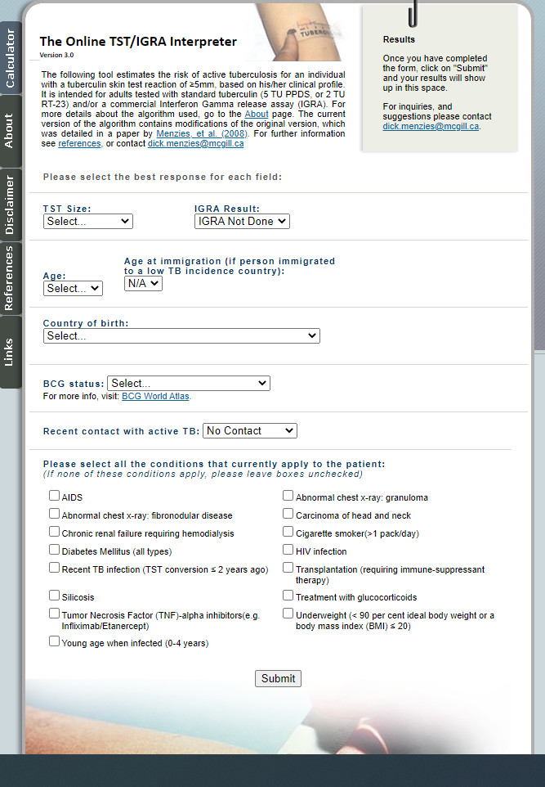
Online risk calculator
example: Caucasian from AZ
 | 50y (risk to age 80) | 70y (risk to age 80)
No recent contact | 2.94% | 2.4%
Conversion within 2y | 4.21% | 2.4%
1PPD+ Smoker | 7.35% | 2.45%
Close contact | 7.64% | 5.68%
DM | 8.23% | 2.74%
Steroids | 14.41% | 4.8%
Infliximab/etanercept | 15.73% | 5.24%
Hemodialysis | 54.45% | 17.15%
Transplant | 100% | 46.06%
AIDS | 100% | 100%
http://www.tstin3d.com/en/calc.html
Notes:
Of note, calculator reports risk of hospitalization for significant inh-induced hepatitis is 2.4%, for hospitalization 0.6% in 50yo; 5% and 2.4% for hospitalization for 70 yo

Slide 11
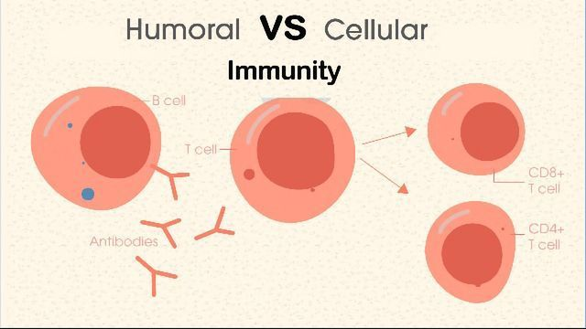
Available TB screening tests
Tb infection typically leads to development of delayed hypersensitivity (T-cell mediated immunity)
1. skin: Tuberculin skin test (TST) – tuberculin positivity appears 3-9 weeks after infection
  1890 the reaction was first described by Koch
  PPD, Mantoux test
2. whole blood = Interferon gamma release assay (IGRA)
  Measures the immune response (interferon gamma) to TB proteins in whole blood
  T-Spot and Quantiferon
Important points
  both typically remain positive after successful treatment
  neither can rule out active tuberculosis
    28.8% false negative for extrapulmonary tb (Kim, 2018)
  neither will be sensitive in patients with limited cell mediated immunity
Notes:
(https://www.quantiferon.com/wp-content/uploads/2017/05/PROM-10157_FAQs-Health-Professionals-Rev001v02.pdf)

Slide 12
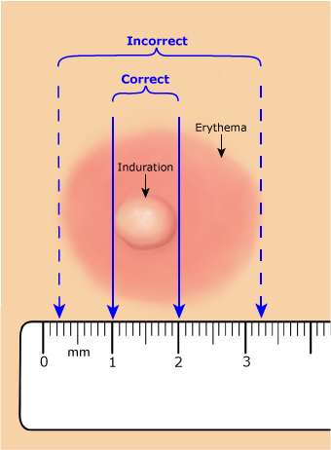
Tuberculin skin test (TST)
5+ mm | 10+ mm | 15+ mm
HIV | Recent (<5y) immigrants from non-low prevalence countries | No known risk factors
Recent contact | IVDU
Fibrotic changes on cxr | High risk congregate settings
immunosuppression | Afb lab worker
 | Silicosis, dm, esrd, gastrectomy, <10% IBW, smokers, etoh, h&n and liquid cancer
CDC – interactive core curriculum on tuberculosis
Notes:
Still a recommended screening test but is being replaced by IGRAs because of more difficult logistics, interpretation, and because the BCG false positives

Slide 13
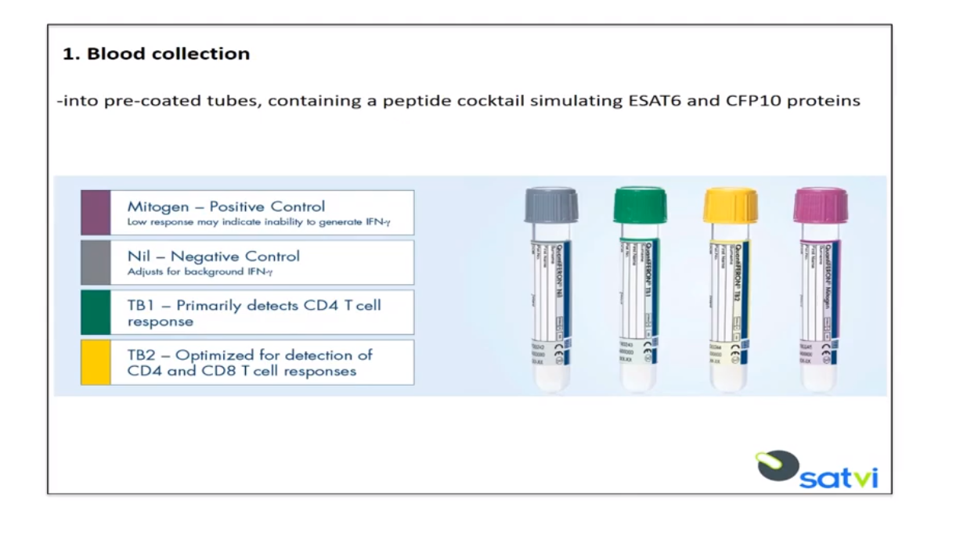
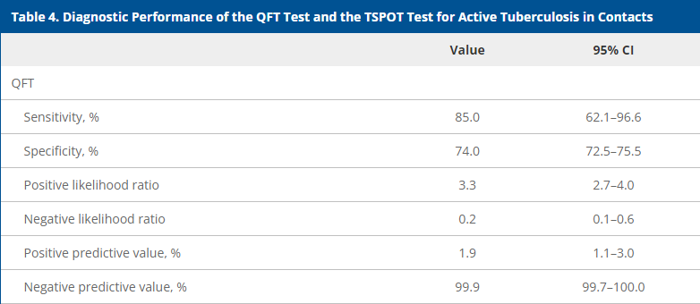
Quantiferon
Zellweger et al.
No gold standard for diagnosing LTBI
Cut off <0.35 is set to maximize NPV
Quantiferon is NOT how you diagnosis active disease
https://www.youtube.com/watch?v=sxNt6vfRU-M
Notes:
Whole blood is drawn and incubates in these tubes for 16-24h
Test performance not so simple; what we really care about is the development of active tuberculosis

Slide 14
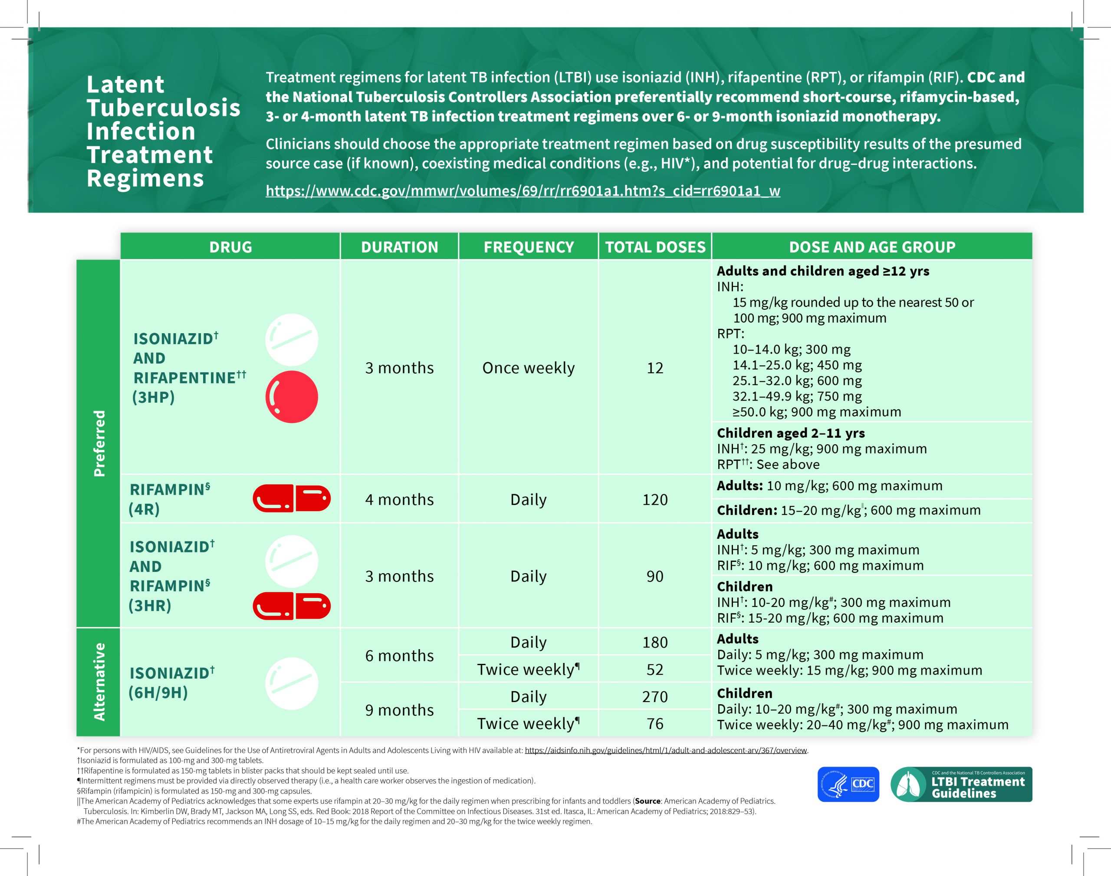
Recommended regimens for LTBI treatment
Notes:
2020 CDC changed to recommending rifamycin-based regimens
INH with more hepatotoxicity and decreased completion rates

Slide 15
Recommended monitoring for LTBI treatment
Patient education, clinical monitoring, laboratory testing
Monthly visits
Labs
  Per CDC, baseline LFTs are not routinely indicated; if any risk factors, check at baseline and then monthly
  At Maricopa County Department of Health, typical practice is
    Baseline CBC/CMP on all adults, then again in 1mo
    After that, as needed
If concern for adverse reaction, stop

Slide 16
Case 1 review
What would you recommend?
A) start rifampin x4 months
B) stop apixaban, start warfarin and rifampin x4mo
C) start INH x9mo
D) no treatment for LTBI

Slide 17
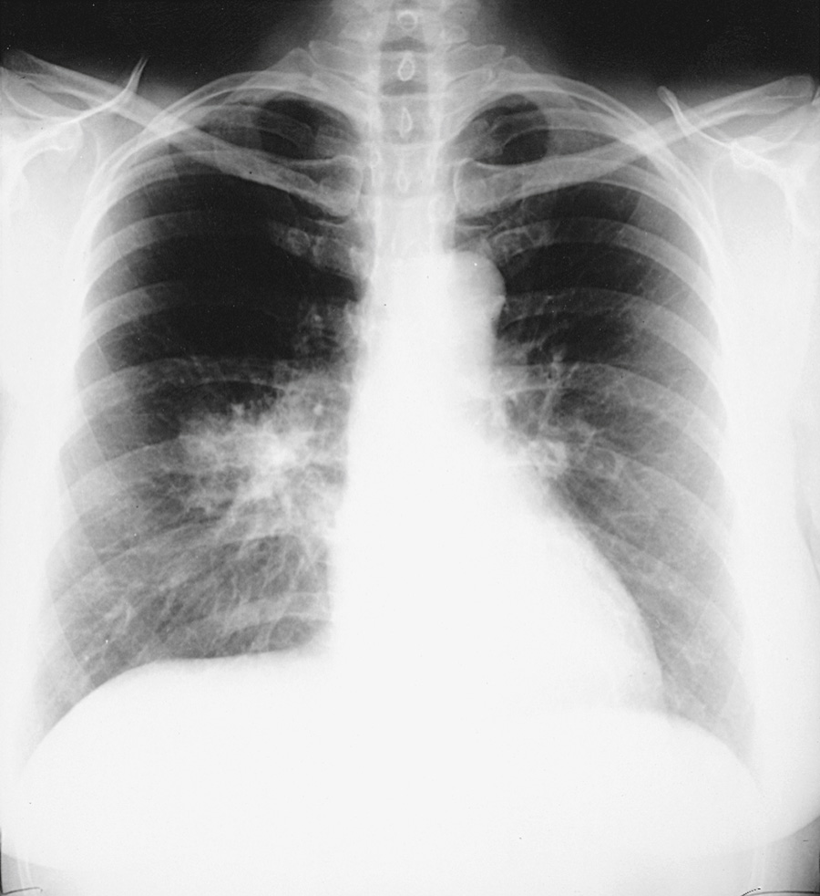
Primary tuberculosis infection
Primary tb infection
  extremes of age, immunosuppressed
    70% fever
    2/3 hilar adenopathy
    1/3 pleural effusion
    1/3 mid-lower lung infiltrate
    Acta Tuberc Scand. 1957; 33(1-2):37
Mandell
Notes:
R hilar adenopathy and lower lobe opacity in 58W with primary tb

Slide 18
Post-Primary Pulmonary tuberculosis
Symptoms and Signs
  1/2 – 2/3 have cough, weight loss, and fatigue
  1/2 night sweats +/- fever
  1/3 chest pain/dyspnea
  1/4 hemoptysis
Notes:
“B-symptoms” term for Ann Arbor stating of lymphomas = fever, drenching night sweats, unintentional weight loss
Cough > 2 weeks
Post-primary is aka reactivation tb, can be asymptomatic for years; symptoms have been described retrospectively in case series
Uptodate article “clinical manifestations and complications of pulmonary tuberculosis
One study focusing on ambulatory patients found cough >2 weeks in 52% of patients, fever >2 weeks in 29% of patients (Miler et al, CID 2000. pmid 10671331

Slide 19
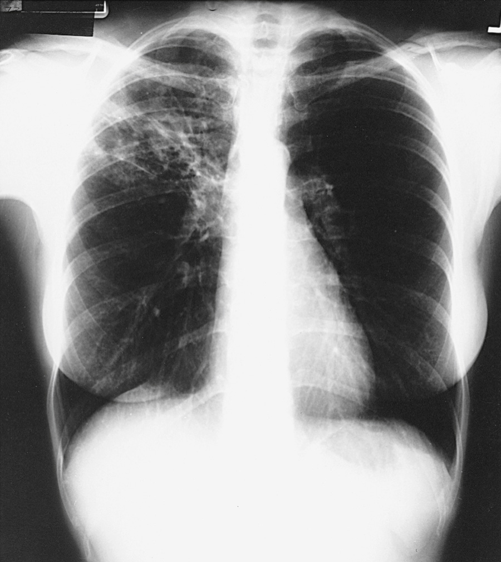
Post-Primary Pulmonary Tuberculosis
Radiographic findings
  Most patients with tb will have abnormalities on CXR, even in absence of respiratory symptoms
  70-90% involves apical and posterior segments of the upper lobes
  20-40% have cavities
  25% normal CXR
Mandell
Notes:
Post-primary tb is the same as reactivation tb
CT typically not indicated but can be helpful in certain situations

Slide 20
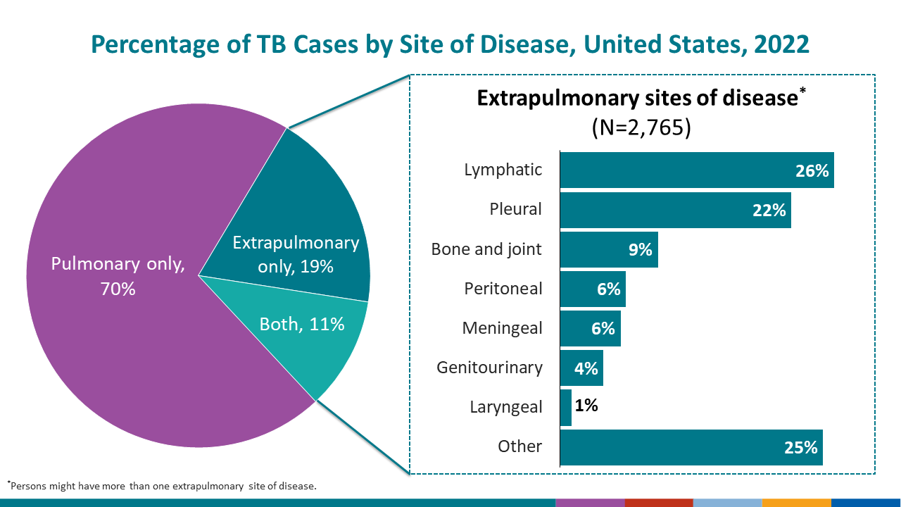
Extrapulmonary TB
Pulmonary TB accounts for 85% of reported TB cases worldwide
In US, ~30% of patients with TB have extrapulmonary disease, frequently concomitant pulmonary tb
More common with AIDS
“Miliary” tb was originally a pathologic then radiographic description, now describes any progressive disseminated hematogenous TB
Rolo et al. J Clin Tuberc Other Mycobact Dis 2023
Notes:
CDC table 19 reported tb in the us 2022 ,data & statistics, https://www.cdc.gov/tb/statistics/reports/2022/table19.htm

Slide 21
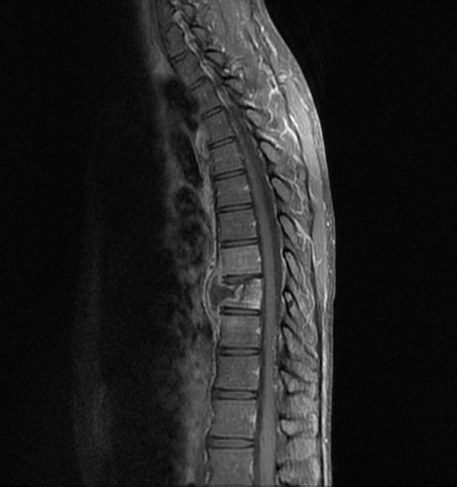
Extrapulmonary TB – clinical features
Location | Notes
Lymphadenitis | Isolated, chronic nontender LAD, cervical in 63-77% of cases
Pleurisy | Acute fever, cough and pleuritic chest pain; effusions unilateral +/- parenchymal disease, typically lymphocytic
Bone/joint | Spondylitis (Potts disease) is the most common, Lower T/upper L spine, anterior and “disc sparing”
CNS | Meningitis most common form in US, subacute presentation, + palsies, CSF is lymphocytic, -> treat!
Notes:
https://www.uptodate.com/contents/epidemiology-and-pathology-of-miliary-and-extrapulmonary-tuberculosis?search=extrapulmonary%20tuberculosis&source=search_result&selectedTitle=1~93&usage_type=default&display_rank=1

Slide 22
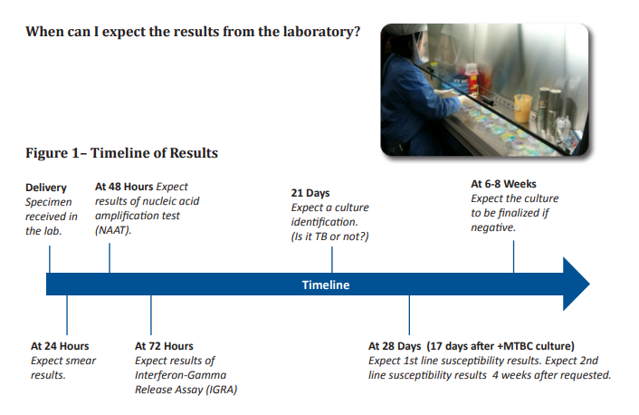
Laboratory testing available for pulmonary tb
AFB smear
NAAT = nucleic acid amplification test
AFB culture
Heartland National TB Center “A Clinician’s Guide to the TB Laboratory”
Notes:
#AFB smear: detects TB and NTM, used to infer infectiousness/source case and to monitor response to treatment, plan for isolation
#NAAT
Current CDC guidelines recommend NAAT testing on at least one respiratory specimen for patient with suspected pulmonary tb
Advantage is (1) ability to diagnose TB in smear negative patients before TB grows in culture (2) exclude TB with AFB smear positive sample due to NTM (3) also can identify rif resistance
#AFB cultures: identify viable organisms, monitor response to treatment, used for drug susceptibility testing and genotyping, 80% of initial specimens are reported as culture positive by day 21, held for 6-8 weeks

Slide 23
NAAT details
2020 WHO updated guidelines: tb NAAT tests have replaced smears as initial tests for pulmonary and CNS TB
Cepheid Xpert MTB/rif is FDA approved and available
Source | Sensitivity | Specificity
Sputum | 85% (81% for HIV) | 97-98%
Pleural Fluid | 38-61% | 96-99%
CSF | 87% | 88%
Synovial Fluid | 96% | 97%
Lymph node aspirate | 70% | 78%
Lymph node biopsy | 67% | 96%
Urine | 100% | 100%
WHO guidelines 2020
Notes:
CDC guidelines recommend NAAT to be performed on at least on respiratory specimen from each patient with s/s pulmonary tb

Slide 24
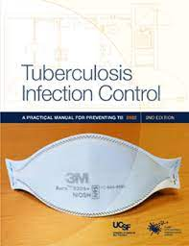
Infection Control
Airborne precautions for possible cases
Personal respiratory protection
  N95 or PAPR
  Surgical mask on patient
“clearing patient”
  Unknown if has tb
    3 AFB negative smears 8h apart
    Alternative diagnosis
  If diagnosed with TB
    2 weeks of RIPE
    3 consecutive AFB negative smears*
Notes:
Would you be okay with your mother sharing a room with the patient
You are clearing from having smear positive pulmonary tb

Slide 25
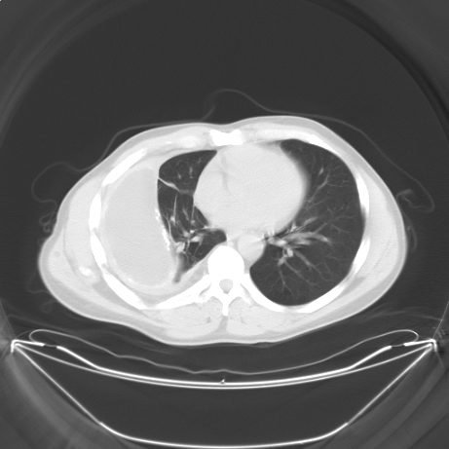
Case 2 – TB clinic
32 healthy woman originally from Guatemala presented to outside hospital with shortness of breath, seeing you in clinic post discharge.
She was found to have lymphocytic predominant pleural effusion, pleural fluid and pleural tissue biopsies done, path consistent with necrotizing granulomas, however no growth from any cultures after 3 weeks (including a bal), no evidence of malignancy.
She lives with her infant niece.

Slide 26
Case 2 – TB Clinic
What is your next step?
A. Send to hospital to be ruled out for tb
B. Start RIPE + vitamin B6
C. Wait until cultures are finalized
D. Send for repeat pleural tissue biopsy

Slide 27
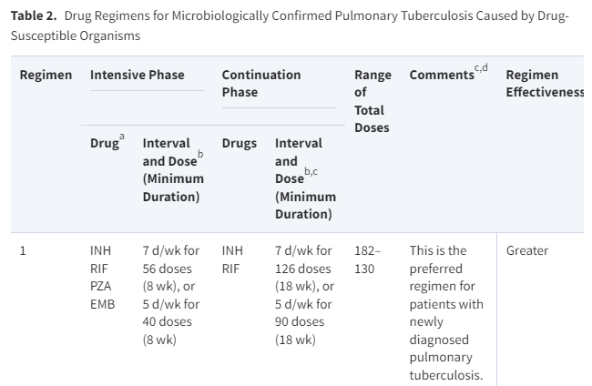
Typical treatment - DOT
Why 4 drugs? resistance
Each drug has a role
RIF achievement of relapse-free cure (sterilizing effect)
INH: rapid killing of multiplying bacteria
PZA: lets you complete treatment in 6mo if given for 2mo
EMB – there to protect RIF in case there is INH resistance
Phase | Treatment
Initiation phase | RIPE* x 2mo
Continuation phase | RI x 4-7mo
Executive Summary: ATS/CDC/IDSA guidelines drug susceptible tb, 2016
Notes:
In every population of TB there are naturally occurring drug resistance in small groups, eg natural INH resistance which could go on to develop drug resistance in setting of monotherapy
2022 4month rifapentine-moxifloxacin regimen as effective as standard 6mo treatment course – 8 weeks rifapentine, isoniazid, pza, moxi, followed by 9 weeks of rpt, inh, mox

Slide 28
Treatment – variations in duration
Scenario | Duration
Typical RIPE treatment | Total 6mo
Typical RIPE treatment with cavitary disease and positive sputum cultures after 2 mo of treatment | Total 9mo
Extrapulmonary | Typically 6-12mo
Drug resistance to standard regimen | Varies
Relapse rates
Cavitary and c2m+ 6%
Cavitary and c2m- 2.2%
Noncavitary and c2m+ 1.8%
Noncavitary and c2m- 0.6%
Other factors to consider: underweight, smoker, dm, hiv/immunosuppression, extensive disease
Chang et al. AJRCCM 2006 “Dosing schedules of 6-month regimens and relapse for pulmonary tuberculosis”

Slide 29
Treatment – brief review of drug resistance
Resistance | Alteration
INH monoresistance | RPE+quinolone x6mo
PZA monoresistance | RI x 9mo
RIF or multiple, (R/I resistance = MDR-TB) | Traditionally, have to add 3mo for every 1mo without rifampin MDR-TB – 5 drugs x 5-7mo, follow by 4 drugs x 15-21mo New regimen: BPAL +/- M x6mo
Notes:
Bedaquiline, pretomanid, linezolid, moxifloxacin

Slide 30
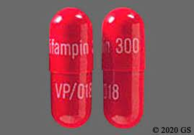
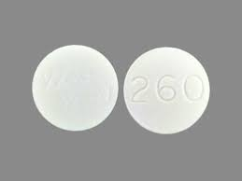
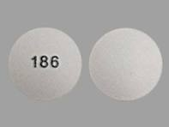
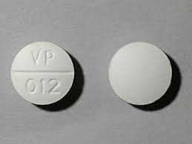
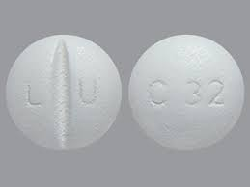
RIPE side effects
Rifampin=RIF
- hepatotoxicity ~0.6%
- DDIs (apixaban, OCPs, steroids…)
- makes body fluids red/orange
Isoniazid = INH
- hepatotoxicity: elevated ast/alt in 10-20%
- Hold if ast/alt >3x uln if symptomatic or >5x uln if asymptomatic
- clinical hepatitis <1%, peripheral neuropathy <1%, +B6
Pyrazinamide = PZA
- hepatotoxicity
- myalgias/arthralgias and gout flare
Ethambutol = EMB
- by far the safest, rarely optic neuritis
*rash/itch/gi issues/fatigue with all
CDC: Latent Tuberculosis Infection: A Guide for Primary Care Providers
Notes:
DDIs: also methodone, warfarin, amlodipine, haloperidol, tricyclic antidepressants, diazepam, phenytoin, protease inhibitors

Slide 31
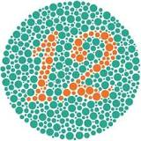
Treatment –typical monitoring for adverse effects
At Maricopa County Department of Health
- baseline CBC with diff, CMP, (also HIV and HgA1C)
- monthly CBC with diff, LFT
  INH/RIF rarely cause severe anemia/thrombocytopenia
- monthly Snellen and Ishihara while on EMB
- staff member reviews symptoms prior to observing DOT

Slide 32
Treatment: Drug induced hepatotoxicity
If bili >3 will typically discontinue all meds then sequentially rechallenge
transaminitis
cholestasis
Suspect PZA/INH, restart EMB/RIF, then INH, then +/- PZA
Suspect RIF, restart EMB, INH, PZA, then likely rifamycin

Slide 33
Review case 2
What is your next step?
A. Send to hospital to be ruled out for tb
B. Start RIPE + vitamin B6
C. Wait until cultures are finalized
D. Send for repeat pleural tissue biopsy

Slide 34
Case 3 – VA pulmonary clinic
- 72M with HTN/HL, CAD, and COPD reports increase in cough and weight loss x6mo
- CT chest reports patchy consolidation and ground glass opacities primarily in RML and lingula of left upper lobe
- ultimately, he has a bronchoscopy, after 7d, the AFB BAL cx grows AFB positive organisms
- he lives by himself

Slide 35
Case 3 – VA pulmonary clinic
What is your next step?
A. direct admit the patient to the hospital for airborne isolation while starting RIPE
B. refer to the Maricopa County Department of Health TB clinic to start RIPE as outpatient
C. Await further studies
D. start azithromycin, rifampin, and ethambutol

Slide 36
TB vs MAC (mycobacterium avium complex)
 | TB | MAC - pulmonary
Typical host | Risk factor for exposure to TB | Underlying anatomical lung issue (COPD)
imaging | Upper lobes (78% *) | middle lobes (77% **)
Micro diagnosis | AFB sputum, typically grows in 21d (pcr probes help diagnose early) | AFB sputum, typically grows in 10d
treatment | RIPE for 6-9mo | Azithromycin, rifampin, ethambutol for 1y after clear sputum cx, ½ of patients do not complete treatment
Of note, there is a wide variety of nontuberculous mycobacterium typically categorized as fast or slow growing, which cause a variety of infections, but most commonly pulmonary or skin and soft tissue infections
* Al-Tawfiq et al **Wittram et al

Slide 37
Take home points – diagnosis
Mycobacterium tuberculosis is a unique bacteria
  Atypical cell wall, slow growth, and two separate stages to causes disease
Tuberculosis infection (LTBI) now typically diagnosed by Quantiferon or T-spot test, major risk factors for conversion to disease are immunosuppression and ESRD, infection within 2y is also a risk
Among adults in the US, the most common presentation of tb is reactivation pulmonary tb, which is best diagnosed by CXR, afb sputum smear/cx and NAAT

Slide 38
Take home points - treatment
Recommended treatment regimens for latent tuberculosis infection are a rifampin alone for 4 months or in combination with INH for 3 months
Pulmonary MAC is the most common NTM, it is like TBs less contagious, less virulent but more difficult to treat cousin
Typical treatment for active tb is RIP(E) x 2 months, then R/I x4-7 months
The most common sides effects among first line TB agents is hepatotoxicity

Slide 39

Thank you

Slide 40
references
A Poulsen. Acta Tuberc Scand. Some clinical features of tuberculosis. 1957;33(1-2):37 PMID 13424392
Al-Tawfiq, Saadeh. Radiographic Manifestations of culture-positive pulmonary tuberculosis: cavitary or non-cavitary. Int J Tuberc Lung Dis. 2009 Mar; 13(3):367-70. PMID 19275798
CDC. Reported tuberculosis in the United States, 2021. Atlanta, GA: US Department of Health and Human Services, CDC; 2022. https://www.cdc.gov/tb/statistics/reports/2021/default.htm
CDC. Reported tuberculosis in the United States, 2022. https://www.cdc.gov/tb/statistics/reports/2022/table19.htm
CDC webcourse: https://www.cdc.gov/tb/webcourses/course/chapter3/3_testing_for_tb_disease_and_ltbi_3_mantoux_tuberculin_skin_test_interpreting_tst_reactions_chart.html
Chang et al. Dosing schedules of 6-month regimens and relapse for pulmonary tuberculosis. AJRCCM 2006 Nov 15; 174(10):1153-8. PMID 16908866
Hales et al. The association between symptoms and microbiologically defined response to tuberculosis treatment. Annals of the American Thoracic Society, 2013 Feb;10(1):18-25 PMID 23509328
Heartland National TB Center. “A Clinician’s Guide to the TB Laboratory”
Kim, Youn Jeong et al. Predictors for false-negative QuantiFERON-TB Gold assay results in patients with extrapulmonary tuberculosis. BMC Infectious Diseases, 2018. Article 457.

Slide 41
references
Nahid et al. Executive Summary: Official ATS/CDC/IDSA Clinical Practice Guidelines: Treatment of Drug Susceptible Tuberculosis. CID Volume 63, Issue 7, 1 Oactober 2016, pgs 853-867.
Uptodate Tuberculous lymphadenitis accessed 8/20/23
Uptodate Tuberculous pleural effusion accessed 8/20/23
Uptodate Central nervous system tuberculosis: an overview, accessed 8/20/23
WHO 1.1 TB incidence. https://www.who.int/teams/global-programme-on-tuberculosis-and-lung-health/tb-reports/global-tuberculosis-report-2024/tb-disease-burden/1-1-tb-incidence
Wittram, Weisbrod. Mycobacterium avium complete lung disease in immunocompetent patients: radiography-CT correlation. Br J Radiol. 2002 Apr;75(892):340-4. PMID 12000692
Zellweger et al. “Risk Assessment of Tuberculosis in Contacts by IGRAs” 2015 Tuberculosis Network European Trials Group Study

Slide 42
Feedback from lecture 8/10/26
- how was I on time? Can remove some LTBI stuff I think
- mention updates: BPALM and 4mo Rifapentine/moxi/inh/pza
- still need to improve MAC/NTM question and review, make an additional slide
- 45m, ideally 42m, each question takes about 1m for them to think, so like 3m per question => 9m

