Slide 1
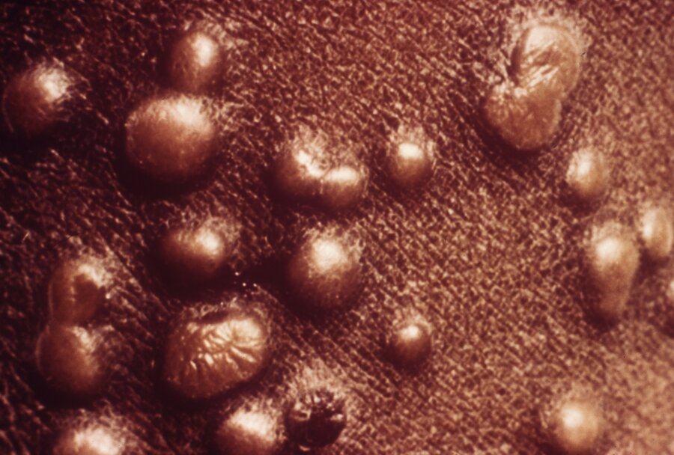
A 42-year-old patient is evaluated in the emergency department for a rash. Four days ago, they developed fever, malaise, and a headache; these symptoms resolved after 2 to 3 days and were followed by the rash, which started as small erythematous macules that developed into papules. The macules were initially on the oral mucosa and face and then developed on the trunk and extremities. The patient works for a government biocontainment laboratory and attended an international conference 14 days ago. They report no sexual contact in the past 2 years. They received all childhood vaccines.
On physical examination, temperature is 37.4 °C (99.3 °F), blood pressure is 124/82 mm Hg, pulse rate is 110/min, and respiration rate is 14/min. Rash is present on the patient's face, trunk, and extremities, including the palms and soles, as shown.
A few oropharyngeal lesions are seen. No conjunctival erythema or other lesions are present.
Which of the following is the most likely diagnosis?
1- Chickenpox
2- Mpox
3- Secondary syphilis
4- Shingles
5- Smallpox

Slide 2
Smallpox
The most likely diagnosis is smallpox (variola) (Option E). Smallpox begins with prodromal symptoms, including fever, malaise, headache, and back pain; symptoms typically start suddenly after an incubation period of about 10 to 14 days and last about 2 to 4 days. After the prodrome, skin lesions develop; they start as maculopapular and become vesicular and pustular, often with a central umbilication. Lesions tend to progress synchronously (same stage of maturation). Severe disease can manifest with bacteremia and pneumonia, which are associated with a high mortality rate. Patients in whom smallpox is suspected should be placed in an airborne infection isolation (negative-pressure) room with airborne and contact precautions. Vaccination should be offered to close contacts. Supportive care should be provided, and antiviral medications such as tecovirimat, cidofovir, and brincidofovir can be given to patients with severe disease. Because variola virus has no natural reservoir and exists only in limited laboratory stocks, use of this agent in a bioterrorism attack is a concern. Public health authorities should be notified because a significant outbreak can occur. This patient's possible exposure history, clinical time course, and synchronous rash are concerning for smallpox.

Slide 3
Varicella (chickenpox) (Option A) lesions can appear similar to smallpox rash but are usually in different stages of healing, whereas smallpox lesions tend to progress synchronously. In varicella, lesions on the palms and soles are rare; varicella lesions also tend to be smaller than smallpox lesions. Additionally, the prodromal period for varicella is often shorter (0-2 days); fever, headache, and muscle pains can occur in varicella but are much less severe than in smallpox. This patient's symptoms are more consistent with smallpox than varicella.
Mpox lesions (Option B) can appear similar to smallpox lesions. However, the most recent outbreak of mpox in the United States was predominantly sexually transmitted, and lesions in the genital region or other sites of sexual contact were the most typical presentation. Because this patient reports no sexual contact in the previous 2 years and they have epidemiologic risk factors (working in a biocontainment laboratory; attending a conference 2 weeks ago), this infection is less likely to be mpox.
Secondary syphilis (Option C) typically occurs within 4 to 8 weeks of primary syphilis. This patient reports no sexual contact in the previous 2 years, which makes secondary syphilis unlikely.
Herpes zoster (shingles) (Option D) typically causes a painful vesicular rash that follows a unilateral dermatomal distribution. Immunosuppressed patients and pregnant persons can have multiple dermatomes affected or disseminated disease. This patient's rash does not fit the description for herpes zoster, nor are they immunocompromised.

Slide 4
A 75-year-old man is evaluated for a 24-hour history of severe left knee pain. He has type 2 diabetes mellitus and well-controlled gout. Medications are metformin and allopurinol.
On physical examination, temperature is 37.8 °C (100.0 °F). The left knee is warm, swollen, and tender, and the overlying skin is erythematous. Aspiration is performed.
Analysis shows opaque fluid; extracellular negatively birefringent needle-shaped crystals are present. Gram stain is negative. Culture is pending.
Which of the following is the most appropriate treatment?
1- Canakinumab
2- Low-dose colchicine
3- Intra-articular methylprednisolone injection
4- Vancomycin
Synovial fluid studies:
Leukocyte count | 120,000/µL (120 × 10⁹/L) with 80% polymorphonuclear cells | H

Slide 5
Septic arthritis
Vancomycin (Option D) is appropriate for this patient who has acute monoarthritis that is concerning for the presence of infectious arthritis, considering the synovial fluid leukocyte count of 120,000/µL (120 × 10⁹/L) with a polymorphonuclear predominance. Gout and infectious arthritis typically present with pain, swelling, warmth, and erythema of the affected joint and can be accompanied by fever and constitutional symptoms; new-onset monoarthritis should always prompt urgent arthrocentesis to evaluate for infection. A negative Gram stain and the presence of crystals do not exclude infection, especially when the visualized crystals are extracellular. If infection is suspected, empiric antibiotics should be started immediately. The crystals seen in this patient's synovial fluid are extracellular, which is consistent with chronic gout but not diagnostic of an acute gout flare; intracellular crystals are typical during an acute flare. Additionally, the presence of infectious arthritis when the synovial fluid leukocyte count is greater than 100,000/µL (100 × 10⁹/L), as in this patient, has a positive likelihood ratio of 28. Without a positive Gram stain, initial empiric therapy includes coverage for gram-positive organisms (including increasingly prevalent methicillin-resistant Staphylococcus aureus) and gram-negative organisms if the patient is immunocompromised, is at risk for gonococcal infection, or has joint trauma. Vancomycin is appropriate empiric therapy in this patient who has no indications for coverage of gram-negative organisms. Therapy can be adjusted when results from cultures are available. Septic arthritis and acute gout can coexist as well, although rarely.

Slide 6
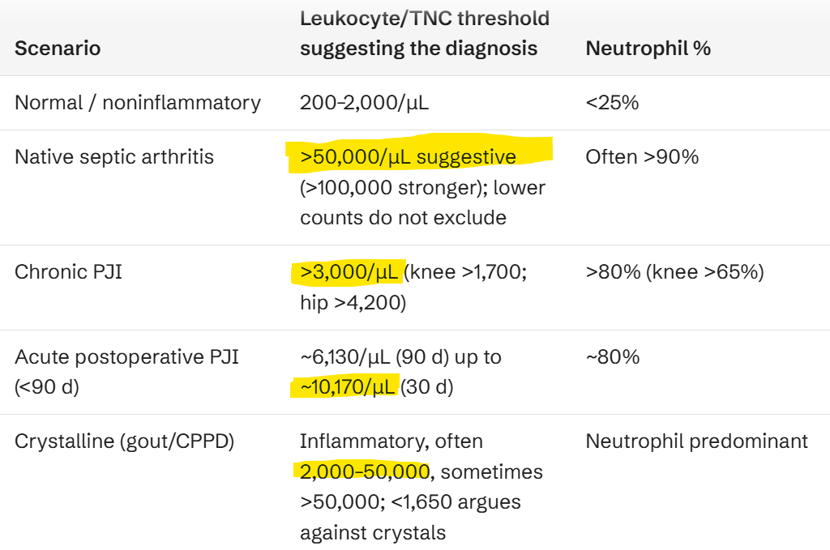
For patients with severe and refractory gout flares or with contraindications to other treatments, interleukin-1β inhibitors such as canakinumab (Option A) can be considered. However, these drugs will not be helpful in treating infectious arthritis and are therefore not the most appropriate choice in this patient whose presentation is concerning for infectious arthritis.
Low-dose colchicine (Option B) can be useful in treating acute crystalline arthritis but is not appropriate at this time because it will not treat infectious arthritis.
An intra-articular glucocorticoid injection with methylprednisolone (Option C) can treat an acute crystalline joint flare but may worsen infection. Injection is therefore inappropriate at this time because the cause of this patient's acute inflammatory monoarthritis has not been determined.

Slide 7
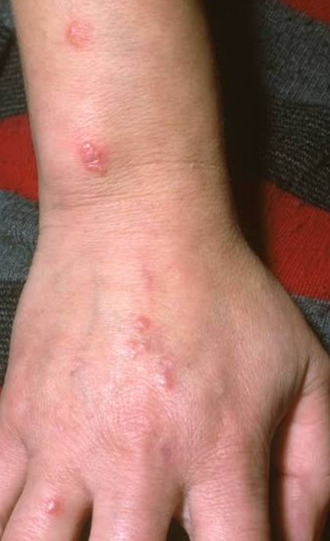
A 21-year-old man is evaluated in the hospital for a 4-day history of fever, fatigue, and left ankle swelling and pain. He also reports experiencing pain in his right wrist and several fingers of his right hand for the past 2 days. He takes no medications.
On physical examination, temperature is 38.3 °C (100.9 °F); remaining vital signs are normal. The examination reveals three vesiculopustular lesions over the dorsum of the right hand and tenosynovitis of the right wrist and left ankle. Fusiform enlargement of the second and third digits of the right hand is noted with pain elicited on movement. No anogenital abnormalities are noted.
Blood cultures are positive for Neisseria gonorrhoeae, and coinfection with Chlamydia trachomatis is ruled out.
Which of the following is the most appropriate antibiotic treatment for this patient?
1- Intravenous ceftriaxone
2- Intravenous ceftriaxone plus doxycycline
3- Oral ciprofloxacin
4- Oral doxycycline

Slide 8
Disseminated gonococcal infection
Intravenous ceftriaxone (Option A) is the most appropriate antibiotic treatment for this patient. He has a disseminated gonococcal infection (DGI) without concomitant Chlamydia trachomatis infection. Gonococcal infections occur more commonly in younger, sexually active persons. Risk factors for dissemination include deficiencies in a terminal complement, drugs that suppress activation of terminal complement (i.e., eculizumab, a monoclonal antibody to C5), pregnancy, and recent menstruation. DGI can present as an arthritis-dermatitis syndrome, a triad of 1- tenosynovitis, 2- dermatitis (usually painless pustular or vesiculopustular lesions), and 3- polyarthralgia without frank arthritis. Fever, chills, and malaise are common in this presentation, and inflammation of tendons of the wrists, fingers, ankles, and toes distinguishes this syndrome from other forms of infectious arthritis. DGI may also manifest as a purulent arthritis, usually without associated skin lesions or fever. Patients have acute onset of monoarthritis or oligoarthritis; the knees, wrists, and ankles are most commonly involved. When DGI is clinically suspected, microbiologic evaluation of samples from all mucosal sites (genital, rectal, pharyngeal) and disseminated sites (blood, synovial fluid, skin) should be pursued. Susceptibility testing should be performed on all gonococcal isolates. Patients with arthritis-dermatitis syndrome can be stepped down to a lower dose of ceftriaxone or an oral agent that the organism is susceptible to when clinical improvement is noted for 1 to 2 days, with a total antibiotic duration of at least 1 week. In addition to adequate joint drainage, at least 1 to 2 weeks of ceftriaxone therapy is typically administered for purulent arthritis.
Rule out concomitant Chlamydia trachomatis infection.

Slide 9
If infection with C. trachomatis has not been excluded in a patient with DGI, oral doxycycline should be administered with ceftriaxone (Option B). If concomitant infection is excluded, as in this patient, then ceftriaxone alone is recommended.
In patients with DGI-associated arthritis-dermatitis syndrome, initial ceftriaxone can be transitioned to an oral antibiotic (guided by antibiotic susceptibility testing) 1 to 2 days after significant improvement is noted. Second-line oral agents include cefixime, ciprofloxacin (Option C), doxycycline (Option D), and amoxicillin. If no susceptibility testing is available, then ceftriaxone should be continued.

Slide 10
A 28-year-old patient is evaluated in the emergency department for a 5-day history of fever, chills, and diffuse joint pain. Pain began bilaterally in the ankles and the wrists and has progressed to involve both knees and elbows. The patient also reports development of a rash over their trunk within the past 24 hours. They returned 7 days ago from a trip to Jamaica.
On physical examination, temperature is 39.5 °C (103.1 °F), blood pressure is 135/90 mm Hg, and pulse rate is 110/min; respiration rate is normal. Synovitis is noted bilaterally in the ankles and wrists. A patchy macular rash is present over the trunk.
Which of the following is the most likely diagnosis?
1- Chikungunya
2- Dengue fever
3- Reactive arthritis
4- Yellow fever
Laboratory studies:
Leukocyte count | 2800/µL (2.8 × 10⁹/L) | L
Platelet count | 90,000/µL (90 × 10⁹/L) | L
Alanine aminotransferase | 235 U/L | H
Aspartate aminotransferase | 190 U/L | H

Slide 11
Chikungunya
The most likely diagnosis is chikungunya virus infection (Option A). Chikungunya is transmitted by the mosquito vectors Aedes aegypti and Aedes albopictus. Outbreaks of infection have occurred in Africa, Asia, the Indian and Pacific Ocean islands, and the Caribbean. A live-attenuated chikungunya vaccine is available and is recommended for patients aged 18 years and older traveling to an area with a chikungunya outbreak. The incubation period is between 3 and 7 days, and primary symptoms include fever, malaise, and joint pain. Arthralgia is a predominant feature of chikungunya and is usually bilateral and symmetric, more often involving the distal than the proximal joints. Pain may be intense and disabling, and synovitis and joint effusion may be present on examination. Approximately 50% of patients will have a macular or maculopapular rash that usually starts on day 3 of illness, beginning on the limbs and trunk and potentially involving the face. Patients can have leukopenia, thrombocytopenia, and elevated aminotransferase levels. Severe disease is uncommon. Acute disease usually resolves spontaneously within 7 days, but patients can develop chronic arthritis months to years after infection, which can be debilitating.

Slide 12
Dengue fever (Option B) is carried by the same mosquitoes as chikungunya, and thus has a similar geographic distribution. Infected patients may be asymptomatic or have an acute febrile illness associated with frontal headache, retro-orbital pain, and myalgia; severe lumbosacral pain is characteristic. A transient maculopapular rash may be present. Arthritis is more severe and synovitis is more likely with chikungunya, whereas dengue can progress to hemorrhagic shock. Elevated CPK is commonly noted. This patient's symptoms are more consistent with chikungunya.
Reactive arthritis (Option C) arises after an infection, usually an enteric or genitourinary infection. Joint pain is usually an acute, asymmetric oligoarthritis, often affecting the knee. Reactive arthritis does not present with fever or rash.
Yellow fever (Option D) is an arthropod-borne infection also carried by the same mosquito species as chikungunya and dengue fever. Patients with yellow fever typically have fever, malaise, and headache; over the course of a few days, progression to acute hepatitis with nausea, vomiting, epigastric pain, and jaundice will occur. This patient's primary symptom of joint pain is not consistent with yellow fever, nor is yellow fever present in Jamaica.

Slide 13
An 18-year-old woman is evaluated for a 5-day history of fever, night sweats, sore throat and malaise. She is up to date with her vaccines and has no recent travel. Medical history is otherwise unremarkable, and she takes no medications.
On physical examination, temperature is 39.0 °C (102.2 °F), blood pressure is 137/84 mm Hg, pulse rate is 92/min, and respiration rate is 22/min. She is oriented and in no acute distress. Neck examination reveals bilateral tender lymphadenopathy. No tonsillar exudates are seen. No crackles are heard on lung examination. Abdominal palpation reveals splenomegaly.
A rapid heterophile antibody test is positive, and a rapid streptococcal antigen test is negative.
Laboratory studies:
Hemoglobin | 14.2 g/dL (142 g/L)
Leukocyte count | 12,500/µL (12.5 × 10⁹/L) with 75% lymphocytes; atypical lymphocytes seen | H
Platelet count | 315,000/μL (315 × 10⁹/L)
What is the most appropriate management?
1- Abdominal ultrasonography
2- Penicillin V
3- Prednisone
4- Supportive care

Slide 14
EBV
The most appropriate management is supportive care (Option D). This patient's clinical presentation, presence of cervical lymphadenopathy, splenomegaly, and lymphocytosis, including atypical lymphocytes, strongly suggest infectious mononucleosis.
Diagnosis is confirmed by the presence of heterophile antibodies (monospot test) or IgM to the Epstein-Barr virus (EBV) viral capsid antigen. Notably, the monospot test has a lower sensitivity in patients presenting during the first week of symptoms; these patients should undergo serologic testing for EBV and cytomegalovirus and have the monospot repeated later.
Infectious mononucleosis is managed with supportive care.
Additionally, it is recommended to avoid contact sports for 3-4 weeks due to the possibility of splenic rupture.

Slide 15
A 35-year-old man is evaluated in the emergency department for a 2-day history of a painful rash on the right side of his chest. He had chickenpox as a child. He takes no medications.
On physical examination, vital signs are normal. He is oriented and in no acute distress. A vesicular rash over the right T4 dermatome is observed.
Which of the following is the most appropriate serologic test to perform next?
1- Herpes simplex virus IgM and IgG
2- HIV-1/2 antigen/antibody combination immunoassay
3- Varicella-zoster virus IgM and IgG
4- No serologic testing

Slide 16
HIV screening in VZV
The most appropriate serologic test to perform next in this patient is HIV-1/2 antigen/antibody combination immunoassay (Option B). The patient has a classic dermatomal vesicular rash indicative of varicella-zoster virus (VZV). VZV is transmitted by inhalation and colonization of the respiratory tract, with subsequent viremic dissemination to skin, liver, spleen, and sensory ganglia (varicella). VZV establishes latency in the ganglia and can later reactivate, causing herpes zoster (shingles), especially in adults older than 60 years or immunosuppressed patients, such as those with HIV infection. Zoster is a disease of reactivation; patients have previously experienced VZV infection in the form of chickenpox. Zoster is less common in younger patients; however, HIV infection can predispose young patients to herpes zoster. As such, any young person who is diagnosed with shingles should undergo HIV testing.

Slide 17
Herpes simplex virus type 1 (HSV-1) infection is transmitted by oral-oral or oral-genital contact. HSV-1 is a common infection that typically causes gingivostomatitis in primary infection and herpes labialis with reactivation.
Herpes simplex virus type 2 (HSV-2) is sexually transmitted and typically causes genital and rectal ulcers. HSV-1 and HSV-2 typically do not cause dermatomal vesicular rashes. Because this patient's symptoms are not consistent with HSV infection, serologic testing for HSV IgM and IgG is not appropriate (Option A).
VZV IgM and IgG testing (Option C) is not appropriate in this patient. Most persons have been exposed to VZV, and a positive IgG serologic result does not aid in the diagnosis of herpes zoster. Obtaining a VZV IgM level during a suspected episode of shingles is also not indicated because shingles is a reactivation of a previous VZV infection; therefore, a positive VZV IgM level would not be expected. Shingles is usually diagnosed clinically; if confirmation is needed, VZV polymerase chain reaction testing of a lesion can be performed.

Slide 18
Question 1
You are evaluating a 54 year old female with history of uterine prolapse and multiple prior episodes of pyelonephritis and cystitis in the past. She presented 3 days prior with severe sepsis, supra-pubic pain, dysuria. Labs showed leukocytosis of 18,000, acute renal failure. Blood and urine cultures at the time grew Klebsiella pneumoniae susceptible to ceftriaxone, ciprofloxacin, and bactrim. She was initiated on ceftriaxone. She has since been afebrile for 48 hours, leukocytosis and renal function have normalized and she reports symptoms have resolved.
What is the next appropriate step in management?
A: Obtain transthoracic echocardiogram repeat blood cultures now to verify clearance
B: Treat with IV ceftriaxone for 14 days total for complicated bacteremia
C: Consult urology for recurrent pyelonephritis
D: Discharge on oral ciprofloxacin for a 7 day total course
E: Discharge on oral cefdinir for a 7 day total course
Notes:
D – discharging on oral antibiotics is safe in this scenario, oral fluoroquinolones and other similar highly oral bioavailable agents are preferred. Oral cefdinir (option E) is not one of these options and would not be recommended in this scenario.

Slide 19
Learning Point: Gram negative bacteremias
Follow up blood cultures typically not necessary unless patient has fevers or other concerns for non-resolution
Gram negative endocarditis is very rare, echocardiogram not typically warranted with a clear source
IV antibiotic therapy not warranted for the entire treatment course, allowing for earlier discharge in these populations
When transitioning to an oral regimen, consider oral bioavailability (ie TMP-SMX or fluoroquinolones)

Slide 20
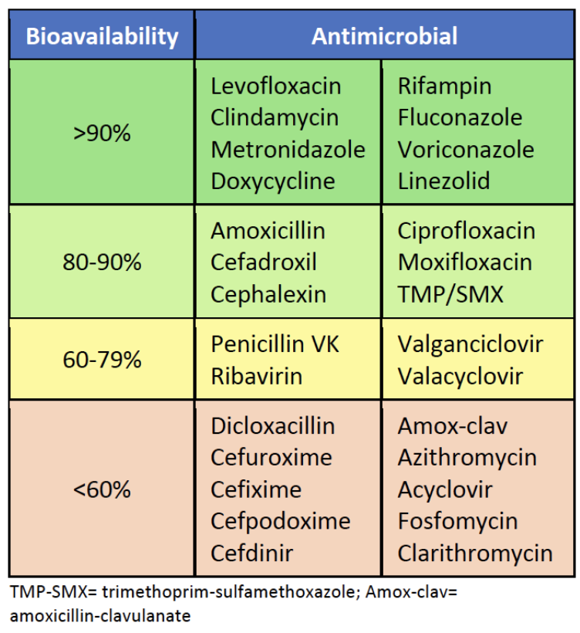
Oral Antibiotic Bioavailability
Notice fluoroquinolones including levofloxacin, ciprofloxacin
Notice differences in oral cephalosporins, first generation superior to third/fourth generation
Gilbert DN, Eliopoulos GM, Chambers HF, et al. The Sanford Guide to Antimicrobial Therapy 2019. Sperryville, VA. Antimicrobial, Inc.

Slide 21
Question 2
A 72-year-old male with a history of a bioprosthetic aortic valve replacement performed 3 years ago is admitted to the hospital with a 4-week history of fatigue, intermittent low-grade fevers, and a 10-pound weight loss. On physical examination, he has a new holosystolic murmur at the apex, trace peripheral edema, and several splinter hemorrhages under his fingernails. His initial workup reveals normocytic anemia, an elevated ESR and CRP, and microscopic hematuria. Three sets of blood cultures are drawn on admission before the initiation of empiric antibiotics. All three cultures grow Enterococcus faecalis after 24 hours. A transthoracic echocardiogram (TTE) is initially negative for vegetations or perivalvular complications.
Based on the modified Duke criteria, what is the most appropriate next step in the diagnostic workup for this patient's suspected enterococcal prosthetic valve endocarditis (PVE)?
A) Discontinue further diagnostic workup and initiate empiric IV Vancomycin and Gentamicin for 6 weeks, as the diagnosis is already confirmed by the positive blood cultures and clinical signs.
B) Order a cardiac Computed Tomography Angiogram (CTA) to better assess for perivalvular complications, given the high suspicion for PVE in a prosthetic valve patient.
C) Repeat the blood cultures in 48 hours to confirm clearance of bacteremia, and if negative, consider the diagnosis unlikely.
D) Proceed immediately with a transesophageal echocardiogram (TEE) to improve sensitivity for detecting vegetations and structural complications associated with PVE.
Notes:
D – When clinical suspicion of IE is high, TEE is often necessary for diagnosis

Slide 22
Key Point: Diagnosis of infective endocarditis
Initial diagnostic tests for suspected infective endocarditis include blood cultures and transthoracic echocardiogram (TTE)
Transesophageal echocardiography (TEE) is indicated when TTE is not diagnostic and clinical suspicion remains high
Chambers HF, Bayer AS. Native-valve infective endocarditis. N Engl J Med. 2020;383:567-576. PMID: 32757525 doi:10.1056/NEJMcp2000400

Slide 23
Question 3
A 55-year-old male with a history of intravenous drug use (IDU) presents with a 2-week history of high-grade fevers and rigors. Blood cultures grow Streptococcus mitis (a Viridans group strep) susceptible to penicillin. The patient is initiated on appropriate IV penicillin G therapy. On Day 3 of treatment, the patient remains febrile and suddenly develops acute dyspnea on exertion, diaphoresis, and a blood pressure of 90/60 mmHg. Physical exam reveals crackles bilaterally and a new, loud diastolic murmur over the aortic area. A STAT transthoracic echocardiogram (TTE) reveals a large, mobile vegetation (1.8 cm) on the native aortic valve with severe regurgitation and a left ventricular ejection fraction (LVEF) of 35%.
In the management of this patient with Viridans group infective endocarditis, what is the most appropriate next step?
A) Continue the current IV penicillin G regimen and add gentamicin for synergistic bactericidal effect.
B) Consult an interventional cardiologist for percutaneous vegetation removal due to the risk of embolization.
C) Increase the dose of penicillin G and switch the patient to the ICU for hemodynamic monitoring.
D) Immediately obtain an emergency consultation from the cardiothoracic surgical team.
Notes:
D – large vegetations require urgent surgical intervention

Slide 24
Learning Point: Surgical management of IE
Surgical management is required in infective endocarditis in the following circumstances:
  Severe valvular dysfunction resulting in symptomatic heart failure
  IE caused by fungal organisms or other highly resistant organisms
  Associated complications such as aortic abscess or heart block
  Persistent bacteremia
  Recurrent emboli after > 5 days of appropriate antibiotics
  Large (> 10 mm) vegetations

Slide 25
Antimicrobial Management of Native Valve IE
Dependent on the organism
Streptococcal Endocarditis
Penicillin or ceftriaxone for 4-6 weeks depending on MIC
Staph aureus
MSSA – nafcillin or cefazolin for 6 weeks
MRSA – Vancomycin or daptomycin for 6 weeks
Enterococcal
Ampicillin and ceftriaxone for 6 weeks generally better tolerated than ampicillin + gentamicin

Slide 26
Question 4
68 F admitted for evaluation of daily fevers, fatigue, unintentiaonl 12 lb weight loss over the past 5 weeks. She reports daily evening temperature spikes to 38.9 accompanied by night sweats and generalized stiffness in her shoulders and hips that is worse in the mornings. She denies headache, visual changes, jaw claudication, cough, dysuria or joint swelling. PMH is notable for essential hypertension on amlodipine. Lab findings as follows:
WBC: 11,200 80% PMNs, Hgb 10.2
Inflammatory Markers: ESR 104, CRP 78, ferritin 420
3 sets of blood cultures are all negative as is HIV, quant gold, and a viral hepatitis panel
Which of the following is most appropriate next step in management?
A: Empiric initiation of broad spectrum antibitoics
B: Bilateral temporal artery biopsy
C: Bone marrow aspiration and biopsy
D: Discontinue amlodipine and observe for 72 hours
E: Liver biopsy
Notes:
B

Slide 27
Non-infectious etiologies of fever
Vasculitis (Giant Cell arteritis/PMR in the prior question)
Neoplasm (leukemia, lymphoma, renal cell carcinoma, hepatocellular carcinoma, ovarian cancer)
Rheumatologic disease (adult-onset Still disease, polymyalgia rheumatica, systemic lupus erythematosus, giant cell arteritis)
Endocrine disorders (hyperthyroidism, subacute thyroiditis)
Genetic (familial Mediterranean fever, tumor necrosis factor receptor-1 associated periodic syndrome)
Miscellaneous (drug fever, factitious fever)

Slide 28
Question 5
You are evaluating a 37 year old female patient for potential discharge. She has been hospitalized for the past 2 days, presenting initially with fevers, chills, and right flank pain, found to have acute pyelonephritis on CT abdomen and pelvis. She has a history of a prior episode of pyelonephritis 1 year prior. She has improved on empiric ceftriaxone, Urine culture has grown a pan-susceptible E coli species. She has been afebrile without leukocytosis for 48 hours at this point. You are considering discharging her on a course of Trimethoprim-sulfamethoxazole. Prior to discharge, you are informed by the nurse that the microbiology lab called and reported 1 out of 2 of her blood cultures are growing a Micrococcus species.
What is the next step in management?
A: Call microbiology and request susceptibility of the Micrococcus organism
B: Start empiric linezolid
C: Start empiric vancomycin then call microbiology to request susceptibility
D: Discharge the patient as planned with 7 days of TMP-SMX and refer to urology outpatient
E: Repeat blood cultures and obtain transthoracic echocardiogram
Notes:
D – this represents contamination or pseudobacteremia

Slide 29
Learning Point: Pseudobacteremia
Isolation of organisms which normally live on the skin (colonize) including Bacillus (not anthracis) species, Corynebacterium, C acnes, Micrococcus or most coagulase negative staph species especially in only 1 set of blood cultures represents contamination
Important exceptions:
  Staph lugdunensis – a coagulase negative staph which is treated similarly to staph aureus
  Multiple sets of blood cultures positive in context of devices such as port-a-cath or other central lines, cardiac devices, etc

Slide 30
Question 6
A 52-year-old man with diabetes presents with 5 days of fever, right upper quadrant pain, and malaise. Blood cultures grow gram-positive cocci in chains, identified as Streptococcus anginosus. Which of the following clinical features is MOST characteristic of infections caused by the Streptococcus anginosus group?
A. High rate of penicillin resistance requiring vancomycin therapy
B. Strong association with colon cancer, warranting colonoscopy
C. Propensity for abscess formation in multiple organ systems
D. Predominant cause of community-acquired pneumonia
E. Frequent progression to toxic shock syndrome
Notes:
C – strep anginosus group has high propensity of pyogenic type infections

Slide 31
Learning Point: Strep anginosus group bacteremias
Strep anginosus, intermedius, constellatus class have special clinical significance in that they are strongly associated with pyogenic infections
Strep anginosus and other viridans group (sanguinis, mitis, oralis) more commonly cause infective endocarditis

Slide 32
Question 1
A 34-year-old woman is evaluated in the emergency department in January for headache, fever, and neck stiffness for the past day. Medical history is notable only for aseptic meningitis diagnosed 2 years ago, for which she reports a full recovery. She has not had recent travel, sick contacts, or animal exposures. She takes no medications.
On physical examination, the patient appears uncomfortable. Temperature is 38.1 °C (100.6 °F), blood pressure is 125/83 mm Hg, pulse rate is 100/min, and respiration rate is 16/min. Oxygen saturation is 98% breathing ambient air. She is alert, and cognition is intact. Mild nuchal rigidity is noted. The remainder of the examination is unremarkable.
Lumbar puncture is performed. CSF studies:
Gram stain of the cerebrospinal fluid is negative; culture is pending.
Which of the following is the most likely cause of this patient's illness?
  A. Enterovirus
  B. Herpes simplex virus type 2
  C. Lymphocytic choriomeningitis virus
  D. West Nile virus
Leukocyte count | 200/µL (200 × 10⁶/L) with 92% lymphocytes | H
Glucose | 78 mg/dL (4.3 mmol/L)
Opening pressure | 180 mm H₂O
Protein | 65 mg/dL (650 mg/L)

Slide 33
Question 1
A 34-year-old woman is evaluated in the emergency department in January for headache, fever, and neck stiffness for the past day. Medical history is notable only for aseptic meningitis diagnosed 2 years ago, for which she reports a full recovery. She has not had recent travel, sick contacts, or animal exposures. She takes no medications.
On physical examination, the patient appears uncomfortable. Temperature is 38.1 °C (100.6 °F), blood pressure is 125/83 mm Hg, pulse rate is 100/min, and respiration rate is 16/min. Oxygen saturation is 98% breathing ambient air. She is alert, and cognition is intact. Mild nuchal rigidity is noted. The remainder of the examination is unremarkable.
Lumbar puncture is performed. CSF studies:
Gram stain of the cerebrospinal fluid is negative; culture is pending.
Which of the following is the most likely cause of this patient's illness?
  A. Enterovirus
  B. Herpes simplex virus type 2
  C. Lymphocytic choriomeningitis virus
  D. West Nile virus
Leukocyte count | 200/µL (200 × 10⁶/L) with 92% lymphocytes | H
Glucose | 78 mg/dL (4.3 mmol/L)
Opening pressure | 180 mm H₂O
Protein | 65 mg/dL (650 mg/L)

Slide 34
Diagnose herpes simplex virus type 2 meningitis
Herpes simplex virus type 2 is the most common cause of recurrent aseptic/viral meningitis (recurrent benign lymphocytic meningitis or Mollaret meningitis)
  Aseptic meningitis refers to acute-onset community-acquired meningitis with negative cerebrospinal fluid (CSF) gram stain and culture results
  Lymphocytic pleocytosis, a normal glucose level, and mildly elevated protein level
Outcomes for HSV-2 meningitis are generally favorable without requiring acyclovir therapy, although therapy is often administered to patients requiring hospitalization
Notes:
The most likely cause of this patient's meningitis is herpes simplex virus type 2 (HSV-2) (Option B). The term aseptic meningitis refers to acute-onset community-acquired meningitis with negative cerebrospinal fluid (CSF) Gram stain and culture results and is typically caused by a viral infection. HSV-2 is a common cause of aseptic meningitis that can occur throughout the year. A distinguishing feature of HSV-2 meningitis is its propensity to occasionally recur (recurrent benign lymphocytic meningitis, also known as Mollaret meningitis). CSF findings include a lymphocytic pleocytosis, a normal glucose level, and a mildly elevated protein level. Oral or genital HSV lesions are not always present during an episode of meningitis. Diagnosis is supported by a positive HSV-2 polymerase chain reaction of the CSF. Outcomes are generally favorable without acyclovir therapy, although therapy is commonly administered to hospitalized patients. This patient has recurrent meningitis, and her CSF shows a negative Gram stain with other findings typical of viral meningitis; in this setting, HSV-2 is the most likely cause.

Slide 35
HSV type 1
Herpes simplex virus type 1 is the most common cause of sporadic encephalitis in the United States, presenting with fever, seizures, altered mental status, and focal neurologic deficits; prompt identification and treatment with intravenous acyclovir improves outcomes
Diagnosis is confirmed by HSV PCR of the CSF (98% sensitivity, 94% specificity)
  False-negative results have been reported; if HSV is suspected, a repeat PCR should be obtained within 1 week while continuing acyclovir therapy
Treat for 14-21 days

Slide 36
Other answers
A; Enteroviruses are the most common cause of viral meningitis, although they present seasonally (typically between May and November in North America); may be accompanied by pharyngitis, cough, and a maculopapular rash; this patient's presentation is outside of the typical seasonality for enteroviral meningitis; additionally, enteroviruses do not cause recurrent disease
C; Lymphocytic choriomeningitis virus is a cause of aseptic meningitis that is most commonly associated with rodent exposure; uncommon cause of viral meningitis and does not present with recurrent disease
D; West Nile virus (WNV) is a mosquito-borne virus that can cause meningitis or encephalitis between June and October in North America; recurrent nature and time of year make WNV unlikely

Slide 37
Question 2
A 60-year-old woman is evaluated in the emergency department for worsening headache, fever, and confusion that began yesterday. She was previously healthy and takes no medications.
On physical examination, she is not oriented to person, place, or time. Temperature is 39.1 °C (102.4 °F), blood pressure is 150/85 mm Hg, pulse rate is 115/min, and respiration rate is 19/min. Oxygen saturation is 97% with the patient breathing ambient air. Neck stiffness and photophobia are appreciated. Pupils are equal, round, and reactive to light and accommodation. The patient is unable to participate in motor and sensory examinations.
Blood cultures are obtained.
Which of the following is the most appropriate diagnostic test to perform next?
  A. CT of the head
  B. HIV testing
  C. Lumbar puncture
  D. MRI of the brain
Notes:
IDMCQ26026

Slide 38
Question 2
A 60-year-old woman is evaluated in the emergency department for worsening headache, fever, and confusion that began yesterday. She was previously healthy and takes no medications.
On physical examination, she is not oriented to person, place, or time. Temperature is 39.1 °C (102.4 °F), blood pressure is 150/85 mm Hg, pulse rate is 115/min, and respiration rate is 19/min. Oxygen saturation is 97% with the patient breathing ambient air. Neck stiffness and photophobia are appreciated. Pupils are equal, round, and reactive to light and accommodation. The patient is unable to participate in motor and sensory examinations.
Blood cultures are obtained.
Which of the following is the most appropriate diagnostic test to perform next?
  A. CT of the head
  B. HIV testing
  C. Lumbar puncture
  D. MRI of the brain

Slide 39
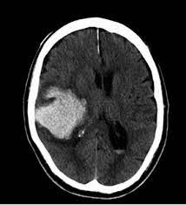
Recognize indications for head CT before performing a lumbar puncture in a patient with suspected bacterial meningitis
LP is crucial for diagnosis of meningitis, but in patients with elevated intracranial pressure, concern for brain herniation with withdrawal of CSF
Who needs a head CT prior to LP?
  Immunocompromised
  Hx of CNS infection
  New-onset seizure
  Papilledema
  Altered level of consciousness
  Focal neurologic deficit
Notes:
The most appropriate diagnostic test to perform next is CT of the head (Option A). The most commonly reported symptoms in patients with bacterial meningitis include headache, fever, neck stiffness, altered mental status, and nausea. Streptococcus pneumoniae and Neisseria meningitidis remain the most common causative organisms in adults; Listeria monocytogenes is an uncommon pathogen overall but is seen more often in persons older than 50 years and in those who are immunocompromised. In patients with suspected bacterial meningitis, definitive diagnosis is established with lumbar puncture (LP) with opening pressure measurement and cerebrospinal fluid (CSF) analysis (leukocyte count, glucose and protein levels, Gram stain and culture) and should be performed early in evaluation. To decrease risk of brain herniation, the Infectious Diseases Society of America recommends obtaining CT of the head before LP in adults with suspected bacterial meningitis if they have immunocompromise, new-onset seizures, altered mental status, history of central nervous system disease (e.g., mass lesions, stroke, focal infections), focal neurologic deficits, papilledema, or a delay in performance of diagnostic LP. Importantly, imaging should not delay initiation of dexamethasone and antibacterials before LP in patients with suspected bacterial meningitis. This patient's presentation is concerning for bacterial meningitis; expedited diagnosis and treatment are critical. Because she has altered mental status, she should undergo head CT before LP; dexamethasone and empiric antibiotics should also be administered now that blood cultures have been drawn.

Slide 40
Clinical manifestations of bacterial meningitis
Classic triad: fever, nuchal rigidity and altered mental status in 40%
95% will have 2 of 4: HA, fever, stiff neck, and altered mental status
Most common clinical features:
  Headache (84%)
  Fever >38˚C (74%)
  Stiff neck (74%)
  GCS <14 (71%)
  Nausea (62%)
[1] NEJM 2004; 351: 1849
[2] Lancet ID 2016; 16: 339
[3] Ann Intern Med 1998; 129: 862
Notes:
This data comes out of a large registry in the Netherlands – they had about 700 patients with acute bacterial meningitis and they assessed for symptoms; so don’t wait for you patient to have all 3 of these sxs before you do the LP, you will miss > 50% of your cases
If you patient has any combination of 2 of these 4 sxs, HA, fever, stiff neck and AMS, you need to be thinking about doing an LP; and if you’re thinking about doing an LP, you should do an LP

Slide 41
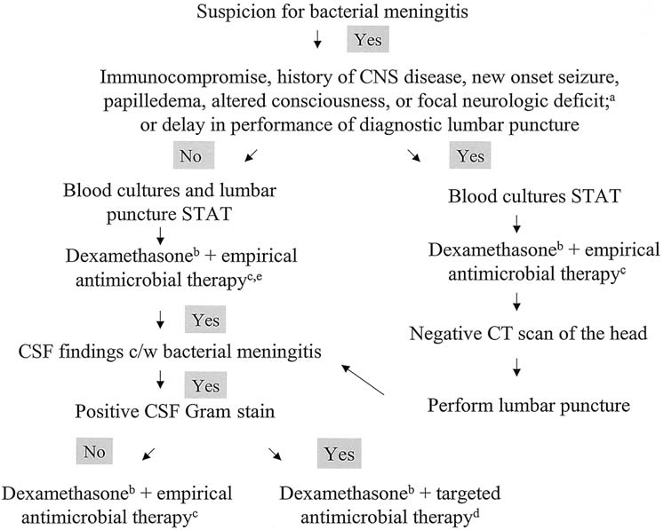
Notes:
50-90% of pts with bacterial meningitis have + blood cxs; CAP – blood cxs + in ~5-16% of pts

Slide 42
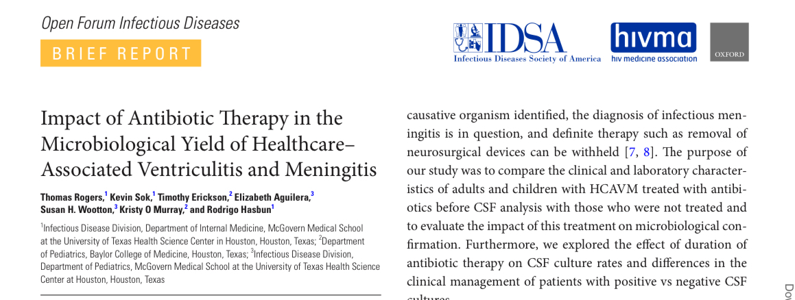
Antibiotic administration prior to LP
Antibiotic administration has minimal effects on chemistry and cytology findings
Antimicrobial therapy prior to LP decreases CSF culture sensitivity from 66.1% to 48.5%
  Blood cultures
  Multiplex PCR in CSF

Slide 43
Question 3
A 65-year-old woman is evaluated in the emergency department for a 1-day history of fever, chills, and diarrhea. Medical history is significant for diffuse large B-cell lymphoma, for which she is currently receiving chemotherapy. Her last dose was 1 week ago. She also has type 2 diabetes mellitus and takes metformin and atorvastatin.
On physical examination, temperature is 39.2 °C (102.6 °F), blood pressure is 110/74 mm Hg, pulse rate is 120/min, and respiration rate is 14/min. Oxygen saturation is 95% with the patient breathing ambient air. There is slight diffuse tenderness in the abdomen, with no rebound or guarding.
Chest radiograph shows no abnormalities.
Blood cultures, urinalysis, and urine cultures are obtained. Treatment is initiated with intravenous fluids.
Which of the following is the most appropriate management?
  A. Administer granulocyte colony-stimulating factor
  B. Begin piperacillin-tazobactam
  C. Begin vancomycin and cefepime
  D. Discharge home with levofloxacin and amoxicillin-clavulanate

Slide 44
Question 3
A 65-year-old woman is evaluated in the emergency department for a 1-day history of fever, chills, and diarrhea. Medical history is significant for diffuse large B-cell lymphoma, for which she is currently receiving chemotherapy. Her last dose was 1 week ago. She also has type 2 diabetes mellitus and takes metformin and atorvastatin.
On physical examination, temperature is 39.2 °C (102.6 °F), blood pressure is 110/74 mm Hg, pulse rate is 120/min, and respiration rate is 14/min. Oxygen saturation is 95% with the patient breathing ambient air. There is slight diffuse tenderness in the abdomen, with no rebound or guarding.
Chest radiograph shows no abnormalities.
Blood cultures, urinalysis, and urine cultures are obtained. Treatment is initiated with intravenous fluids.
Which of the following is the most appropriate management?
  A. Administer granulocyte colony-stimulating factor
  B. Begin piperacillin-tazobactam
  C. Begin vancomycin and cefepime
  D. Discharge home with levofloxacin and amoxicillin-clavulanate

Slide 45
Manage neutropenic fever
Single temperature of 101.0 °F (38.3 °C) or a sustained (for ≥1 hour) temperature of 100.4 °F (38.0 °C)
Serious infectious complications are more likely with increasing severity (absolute neutrophil count <500/µL [0.5 × 10⁹/L]) and longer duration of neutropenia
Signs and symptoms of infection/inflammation may be minimal or absent in the neutropenic patient
  Cellulitis with minimal to no erythema
  Pulmonary infection without discernable infiltrate
  Meningitis without CSF pleocytosis
  UTI without pyuria
Notes:
The most appropriate management for this patient with neutropenic fever is to begin piperacillin-tazobactam. Febrile neutropenia is defined as neutropenia accompanied by a single temperature of 101.0 °F (38.3 °C) or a sustained (for ≥1 hour) temperature of 100.4 °F (38.0 °C). It typically occurs 5 to 15 days after chemotherapy administration. Serious infectious complications are more likely with increasing severity (absolute neutrophil count <500/µL [0.5 × 10⁹/L]) and longer duration of neutropenia.

Slide 46
Management of neutropenic fever
Prompt initiation of an intravenous broad-spectrum antibiotic, such as cefepime or piperacillin-tazobactam, is required for patients with high-risk neutropenic fever
Empiric use of vancomycin in febrile neutropenia is limited to patients with hemodynamic instability or suspected antibiotic resistance, catheter-associated infection, skin or soft-tissue infection, or pneumonia
Persistent fever in the setting of prolonged neutropenia and adequate antibiotic coverage should prompt concern for a potential invasive fungal infection; the incidence of fungal infection (especially candidiasis or aspergillosis) increases in patients who experience more than 7 days of neutropenic fever
Notes:
Immediate institution of antibiotic therapy after obtaining blood cultures is crucial. Therapy consists of an intravenous antipseudomonal β-lactam agent such as cefepime or piperacillin/tazobactam. Other antimicrobials, such as fluoroquinolones or vancomycin, can be added if antimicrobial resistance is suspected or for managing patients with shock or pneumonia. Specific anaerobic therapy (clindamycin or metronidazole) is not generally needed unless an anaerobic source is suspected. This patient has high-risk febrile neutropenia because her absolute neutrophil count is less than 500/μL (0.5 × 10⁹/L). If there are no signs of antibiotic resistance, sepsis, pneumonia, or anaerobic infection, piperacillin-tazobactam is an appropriate choice for empiric antimicrobial coverage.

Slide 47
Question 4
A 34-year-old man comes to the emergency department due to 2 days of fever, chills, and drenching sweats. He has had no sore throat, cough, shortness of breath, chest pain, or dysuria. The patient has a history of Crohn disease and recently underwent abdominal surgery to remove a bowel stricture. The postoperative course was complicated by an enterocutaneous fistula, which has been treated over the past 6 weeks with antitumor necrosis factor therapy. This treatment has reduced the amount of drainage from the fistula. He has had no recent abdominal pain or diarrhea. The patient takes nothing by mouth and receives daily total parenteral nutrition. He has no other medical problems and does not use tobacco, alcohol, or illicit drugs.
Temperature is 38.3 C (101 F), blood pressure is 110/60 mm Hg, pulse is 112/min, and respirations are 18/min. The patient is ill-appearing and diaphoretic. The lungs are clear to auscultation. Cardiac examination reveals tachycardia but is otherwise unremarkable. The abdomen is soft and nontender with clear discharge from the infraumbilical fistula site. The right upper arm peripherally inserted central catheter site has no erythema or tenderness.
Leukocyte count is 18,000/mm³, and serum creatinine is 0.9 mg/dL. Chest x-ray reveals no infiltrates. Urinalysis is normal. Blood cultures are obtained, and empiric broad-spectrum intravenous antibiotics are initiated.
Within the next 24 hours, both sets of blood cultures grow budding yeast.
Which of the following is the most appropriate next step in management of this patient?
A. Change the catheter via guidewire and begin IV fluconazole
B. Keep the catheter and begin IV liposomal amphotericin B
C. Remove the catheter and await species identification of the yeast
D. Remove the catheter and begin IV caspofungin
E. Repeat blood cultures and continue broad-spectrum antibiotics
Notes:
Uworld

Slide 48
Question 4
A 34-year-old man comes to the emergency department due to 2 days of fever, chills, and drenching sweats. He has had no sore throat, cough, shortness of breath, chest pain, or dysuria. The patient has a history of Crohn disease and recently underwent abdominal surgery to remove a bowel stricture. The postoperative course was complicated by an enterocutaneous fistula, which has been treated over the past 6 weeks with antitumor necrosis factor therapy. This treatment has reduced the amount of drainage from the fistula. He has had no recent abdominal pain or diarrhea. The patient takes nothing by mouth and receives daily total parenteral nutrition. He has no other medical problems and does not use tobacco, alcohol, or illicit drugs.
Temperature is 38.3 C (101 F), blood pressure is 110/60 mm Hg, pulse is 112/min, and respirations are 18/min. The patient is ill-appearing and diaphoretic. The lungs are clear to auscultation. Cardiac examination reveals tachycardia but is otherwise unremarkable. The abdomen is soft and nontender with clear discharge from the infraumbilical fistula site. The right upper arm peripherally inserted central catheter site has no erythema or tenderness.
Leukocyte count is 18,000/mm³, and serum creatinine is 0.9 mg/dL. Chest x-ray reveals no infiltrates. Urinalysis is normal. Blood cultures are obtained, and empiric broad-spectrum intravenous antibiotics are initiated.
Within the next 24 hours, both sets of blood cultures grow budding yeast.
Which of the following is the most appropriate next step in management of this patient?
A. Change the catheter via guidewire and begin IV fluconazole
B. Keep the catheter and begin IV liposomal amphotericin B
C. Remove the catheter and await species identification of the yeast
D. Remove the catheter and begin IV caspofungin
E. Repeat blood cultures and continue broad-spectrum antibiotics
Notes:
Uworld

Slide 49
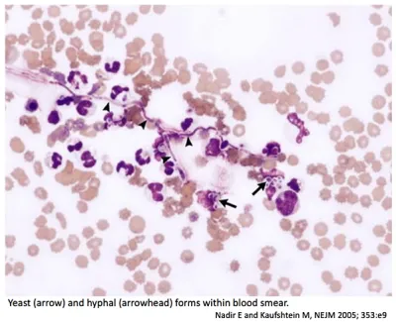
Management of candidemia
RFs for candidemia:
  Trauma and burn patients
  CVCs
  TPN
  Broad-spectrum abx
  High APACHE scores
  ARF
  Prior surgery (abdominal)
  GI tract perfs/anastamotic leaks
  Pancreatitis
  C. diff infections
Notes:
This patient with budding yeasts on blood cultures likely has candidemia, a common hospital-acquired infection that is frequently linked to central venous catheters, total parenteral nutrition, and immunocompromised states (eg, neutropenia). Clinical manifestations are myriad and range from mild fever to full-blown sepsis with or without end-organ involvement (eg, chorioretinitis, endocarditis, meningitis). Blood cultures are the gold standard for diagnosis, but sensitivity is low (~50%) so serum markers (eg, beta-D-glucan) and/or biopsy with histology are sometimes required.
Educational objective:
Candidemia is a common hospital-acquired infection and usually occurs in the setting of a central venous catheter, total parenteral nutrition, and/or an immunocompromised state (eg, neutropenia). The cornerstone of treatment is catheter removal and empiric antifungal therapy with an echinocandin (eg, caspofungin). Candida in blood cultures should never be considered a contaminant.

Slide 50
Management of candidemia
The cornerstone of treatment for candidemia is:
  Central venous catheter removal – catheter removal speeds clearance of candidemia and reduces mortality rates; it should be performed when feasible
  Empiric antifungal treatment – echinocandins such as caspofungin are first-line therapy due to excellent coverage against the most common infective species including Candida albicans, C glabrata, C tropicalis, C parapsilosis, and C krusei
Patients with candidemia should undergo ophthalmologic examination to evaluate for endophthalmitis
Candida in blood cultures should never be considered a contaminant
Notes:
In neutropenic patients, ophthalmologic exam should be deferred until the first week of neutrophil recovery; if endopthalmitis is present a prolonged course of an antifungal agent that achieves adequate intraocular concentration

Slide 51
Other answers:
A; fluconazole has excellent efficacy against C albicans, but does not adequately cover many strains of C glabrata and C krusei; changing the catheter via guidewire increases the risk of septic emboli and may result in inoculation of the new catheter
B; the catheter should be removed if possible; liposomal amphotericin B is considered a second-line agent for candidemia due to a greater risk of side effects (when compared to echinocandins)
C; catheter removal without antifungal treatment is associated with high mortality rates; treatment should not be delayed for species and susceptibility results
E; gram stain evidence of budding yeasts on blood cultures should never be considered a contaminant

Slide 52
Catheter management with blood stream infections
Removal recommended:
  Sepsis
  Hemodynamic instability
  Concomitant endocarditis or evidence of metastatic infection
  Presence of suppurative thrombophlebitis
  Presence of a propagating clot
  Persistent bacteremia after 72 hours of appropriate antimicrobial therapy
  Subcutaneously tunneled central venous catheter tunnel tract infection or subcutaneous port reservoir infection
Always remove the line:
  S. aureus
  Pseudomonas aeruginosa
  Drug-resistant GNRs
  Candida species
Consider catheter salvage therapy:
  CoNS
  Drug-susceptible Enterobacteriaceae (eg, E. coli, Klebsiella species, Enterobacter species)
Antibiotic lock therapy in addition to systemic antibiotics
Guidewire exchange = last resort!
Notes:
ALT refers to instillation of a concentrated antibiotic solution into the catheter lumen with the intention of achieving a drug level high enough to kill bacteria within the biofilm of the catheter.
Guidewire exchange of the catheter is a management approach of last resort (eg, only in patients for whom continued access is essential and alternative vascular access is absolutely impossible due to high risk for mechanical complications or bleeding during catheter reinsertion). These caveats are important since the new catheter is inserted into a likely infected tract, and removing the old catheter will seed the tract if not yet infected.

Slide 53
Question 5
A 66-year-old man is evaluated in the emergency department for a 1-month history of productive cough, fever, periodic night sweats, and 5-kg (11 lb) unintentional weight loss. He reports temporarily living in a shelter 9 months ago. He takes no medications.
On physical examination, temperature is 38.3 °C (101 °F) and respiration rate is 20/min; other vital signs are normal. Oxygen saturation is 94% with the patient breathing ambient air. Bilateral crackles are heard in the upper lobes.
Chest radiograph demonstrates bilateral patchy infiltrates in the upper lobes without cavitation.
Which of the following is the most appropriate next step in management?
A. Acid-fast bacilli smear and culture of sputum and nucleic acid amplification testing
B. CT of the chest
C. Interferon-γ release assay
D. Isoniazid and rifampin
Laboratory studies:
Leukocyte count | 11,200/µL (11.2 × 10⁹/L)

Slide 54
Question 5
A 66-year-old man is evaluated in the emergency department for a 1-month history of productive cough, fever, periodic night sweats, and 5-kg (11 lb) unintentional weight loss. He reports temporarily living in a shelter 9 months ago. He takes no medications.
On physical examination, temperature is 38.3 °C (101 °F) and respiration rate is 20/min; other vital signs are normal. Oxygen saturation is 94% with the patient breathing ambient air. Bilateral crackles are heard in the upper lobes.
Chest radiograph demonstrates bilateral patchy infiltrates in the upper lobes without cavitation.
Which of the following is the most appropriate next step in management?
A. Acid-fast bacilli smear and culture of sputum and nucleic acid amplification testing
B. CT of the chest
C. Interferon-γ release assay
D. Isoniazid and rifampin
Laboratory studies:
Leukocyte count | 11,200/µL (11.2 × 10⁹/L)

Slide 55
Diagnose active TB infection
Classic symptoms (productive cough, fever, night sweats, and unintentional weight loss occurring for >2 weeks) and a chest radiograph that suggest active pulmonary tuberculosis infection
3 separate sputum specimens should be obtained at least 8 hours apart; one specimen should be an early morning specimen
  When a sputum smear result is positive for AFB, NAAT for Mycobacterium tuberculosis can be used to verify the organism
Interferon-gamma release assay (IGRA) or tuberculin skin test (TST) is used to diagnose latent tuberculosis infection (LTBI)
  TST and IGRA are not indicated to diagnose active tuberculosis infection and are often negative in active tuberculosis infection

Slide 56
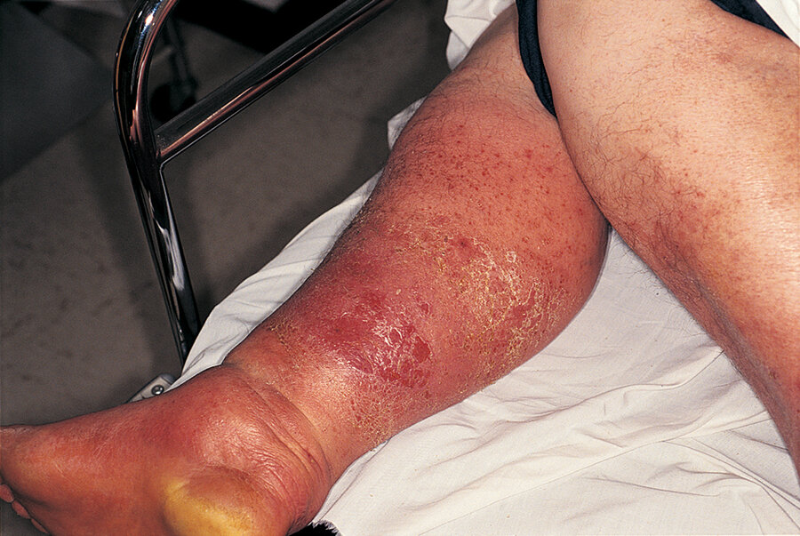
Question 6
A 55-year-old woman is evaluated in the emergency department for acute onset of fevers and chills and a 3-day history of progressively worsening right-lower-extremity pain, swelling, and erythema. She reports no antecedent trauma or water exposure. Medical history is noncontributory; she takes no medications and has no history of injection drug use.
On physical examination, temperature is 38.9 °C (102.0 °F), blood pressure is 108/62 mm Hg, and pulse rate is 105/min; other vital signs are normal. No focal areas of fluctuance or drainage are noted over the right lower extremity (shown).
Lower extremity ultrasound shows no evidence of abscess.
Which of the following is the most appropriate treatment?
  A. Intravenous cefazolin
  B. Intravenous vancomycin
  C. Oral cephalexin
  D. Oral trimethoprim-sulfamethoxazole

Slide 57
Question 6
A 55-year-old woman is evaluated in the emergency department for acute onset of fevers and chills and a 3-day history of progressively worsening right-lower-extremity pain, swelling, and erythema. She reports no antecedent trauma or water exposure. Medical history is noncontributory; she takes no medications and has no history of injection drug use.
On physical examination, temperature is 38.9 °C (102.0 °F), blood pressure is 108/62 mm Hg, and pulse rate is 105/min; other vital signs are normal. No focal areas of fluctuance or drainage are noted over the right lower extremity (shown).
Lower extremity ultrasound shows no evidence of abscess.
Which of the following is the most appropriate treatment?
  A. Intravenous cefazolin
  B. Intravenous vancomycin
  C. Oral cephalexin
  D. Oral trimethoprim-sulfamethoxazole

Slide 58
Treat moderate nonpurulent cellulitis
Patients with moderate nonpurulent cellulitis or erysipelas with systemic symptoms should receive empiric intravenous antibiotics (penicillin, ceftriaxone, cefazolin, clindamycin) targeting streptococci

Slide 59
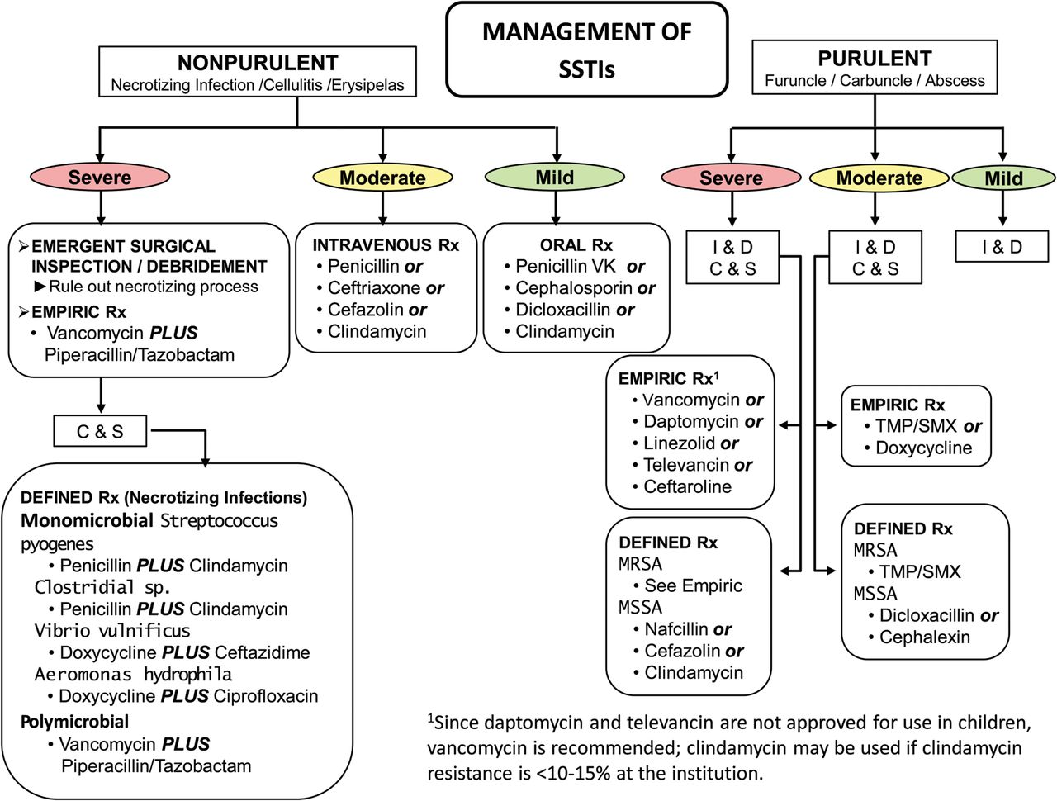

Notes:
Table 1. Strength of Recommendations and Quality of the
Evidence
Abbreviation: RCT, randomized controlled
trial.
Figure
1.Purulent skin and soft tissue infections (SSTIs). Mild
infection: for purulent SSTI, incision and drainage is indicated. Moderate infection:
patients with purulent infection with systemic signs of infection. Severe infection:
patients who have failed incision and drainage plus oral antibiotics or those with
systemic signs of infection such as temperature >38°C, tachycardia (heart rate
>90 beats per minute), tachypnea (respiratory rate >24 breaths per minute) or
abnormal white blood cell count (<12 000 or <400 cells/µL), or immunocompromised
patients. Nonpurulent SSTIs. Mild infection: typical cellulitis/erysipelas with no
focus of purulence. Moderate infection: typical cellulitis/erysipelas with systemic
signs of infection. Severe infection: patients who have failed oral antibiotic
treatment or those with systemic signs of infection (as defined above under purulent
infection), or those who are immunocompromised, or those with clinical signs of deeper
infection such as bullae, skin sloughing, hypotension, or evidence of organ
dysfunction. Two newer agents, tedizolid and dalbavancin, are also effective agents in
SSTIs, including those caused by methicillin-resistant Staphylococcus
aureus, and may be approved for this indication by June 2014.
Abbreviations: C & S, culture and sensitivity; I & D, incision and drainage;
MRSA, methicillin-resistant Staphylococcus aureus; MSSA,
methicillin-susceptible Staphylococcus aureus; Rx, treatment;
TMP/SMX, trimethoprim-sulfamethoxazole.
Figure
2.Algorithm for the management and treatment of surgical site
infections (SSIs). *For patients with type 1 (anaphylaxis or hives) allergy to
β-lactam antibiotics. If Gram stain not available, open and debride if purulent
drainage present. Where the rate of infection with methicillin-resistant Staphylococcus aureus infection is high, consider vancomycin,
daptomycin, or linezolid, pending results of culture and susceptibility tests. Adapted
and modied with permission from Dellinger et al [96]. Abbreviations: GI, gastrointestinal; MRSA,
methicillin-resistant Staphylococcus aureus; WBC, white blood cell
count.
Unless provided in the caption above, the following copyright applies to the content of this slide: © The Author 2014. Published by Oxford University Press on behalf of
the Infectious Diseases Society of America. All rights reserved. For Permissions, please
e-mail: journals.permissions@oup.com.

