Slide 1
SYSTEMIC LUPUS
CHANDANA KESHAVAMURTHY
3/17/2026

Slide 2
RHEUMATIC DISEASES ARE CLINICAL DIAGNOSES SUPPORTED BY THE PRESENCE OF ANTIBODIES
HISTORY IS THE SCALPEL OF RHEUMATOLOGISTS

Slide 3
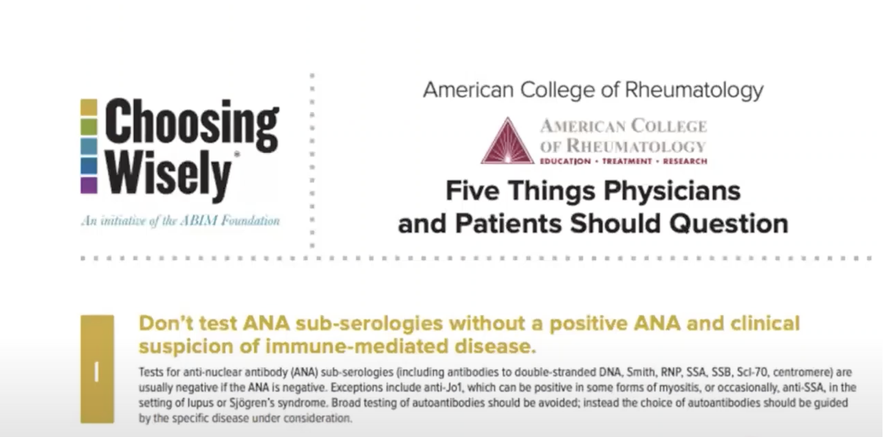

Slide 4
LEARNING OBJECTIVES
Epidemiology of systemic lupus
Understand the “ Positive ANA ” consult
Symptoms and signs of systemic lupus
Work up of systemic lupus
Comorbidities of systemic lupus

Slide 5
EPIDEMIOLOGY
Prevalence : 50/100,000 worldwide
Incidence : 5/100,000 per year worldwide

Slide 6
HIGHEST RISK POPULATION
Women in reproductive years, 9: 1 : female : male, post puberty and pre menopause
Highest prevalence in Non Caucasians, highest in African American women , highest risk than white women

Slide 7
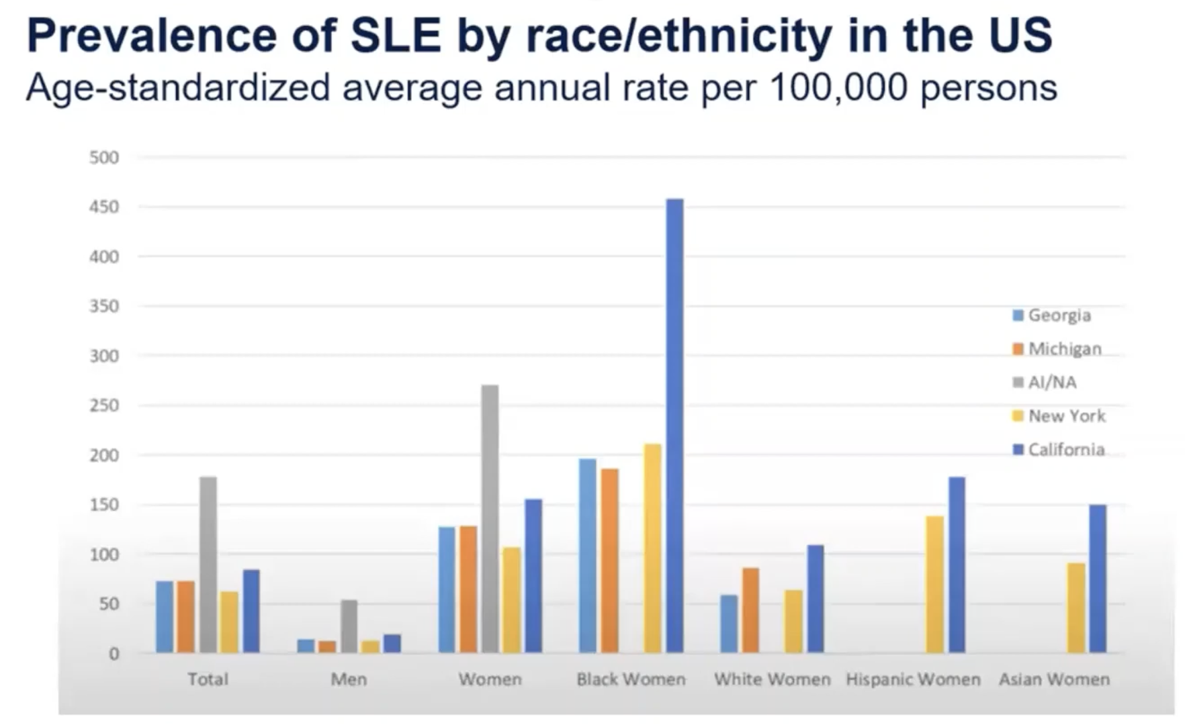
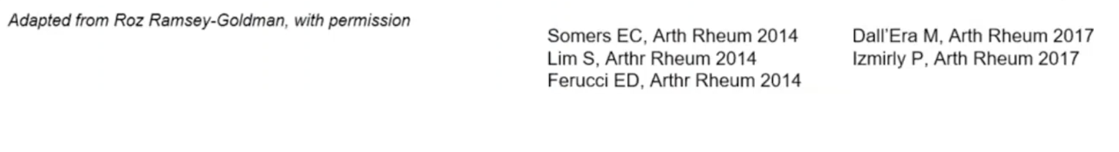
This is data from 5 Population based registries.
Total prevalence is higher in :
-American Indian and Alaskan native Indian population
-Women > men
-Black, Hispanic, American Indian, Alaskan native, Asian women > White women

Slide 8
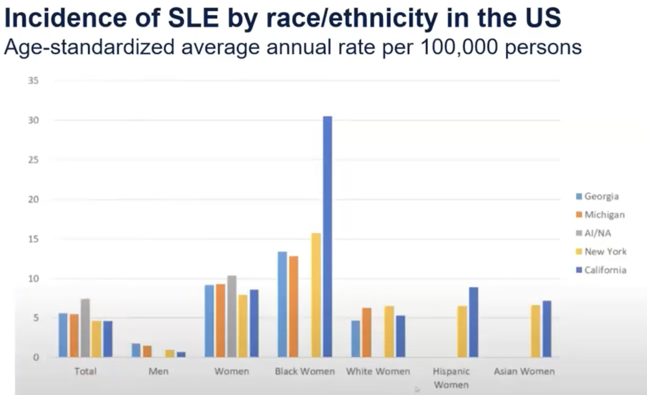
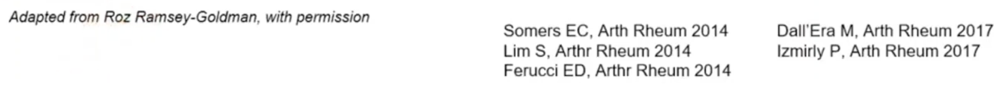
Women > more affected than Men
Colored women > more affected than White women

Slide 9
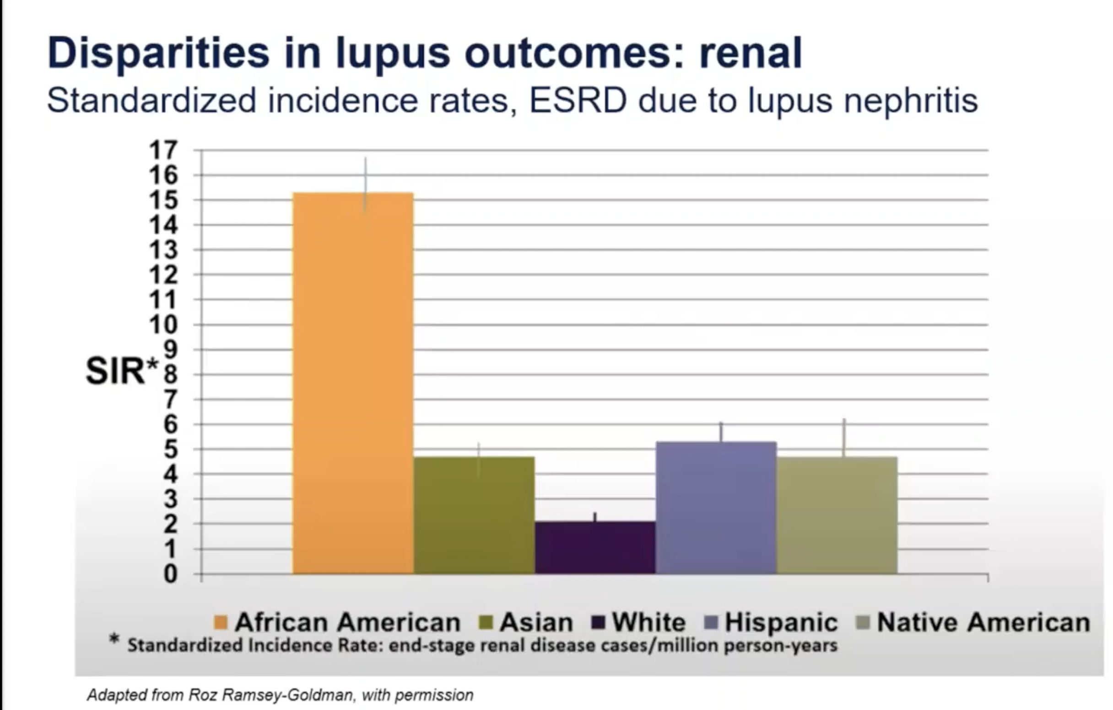
African Americans > higher incidence of Lupus Nephritis and also more risk of ESRD

Slide 10
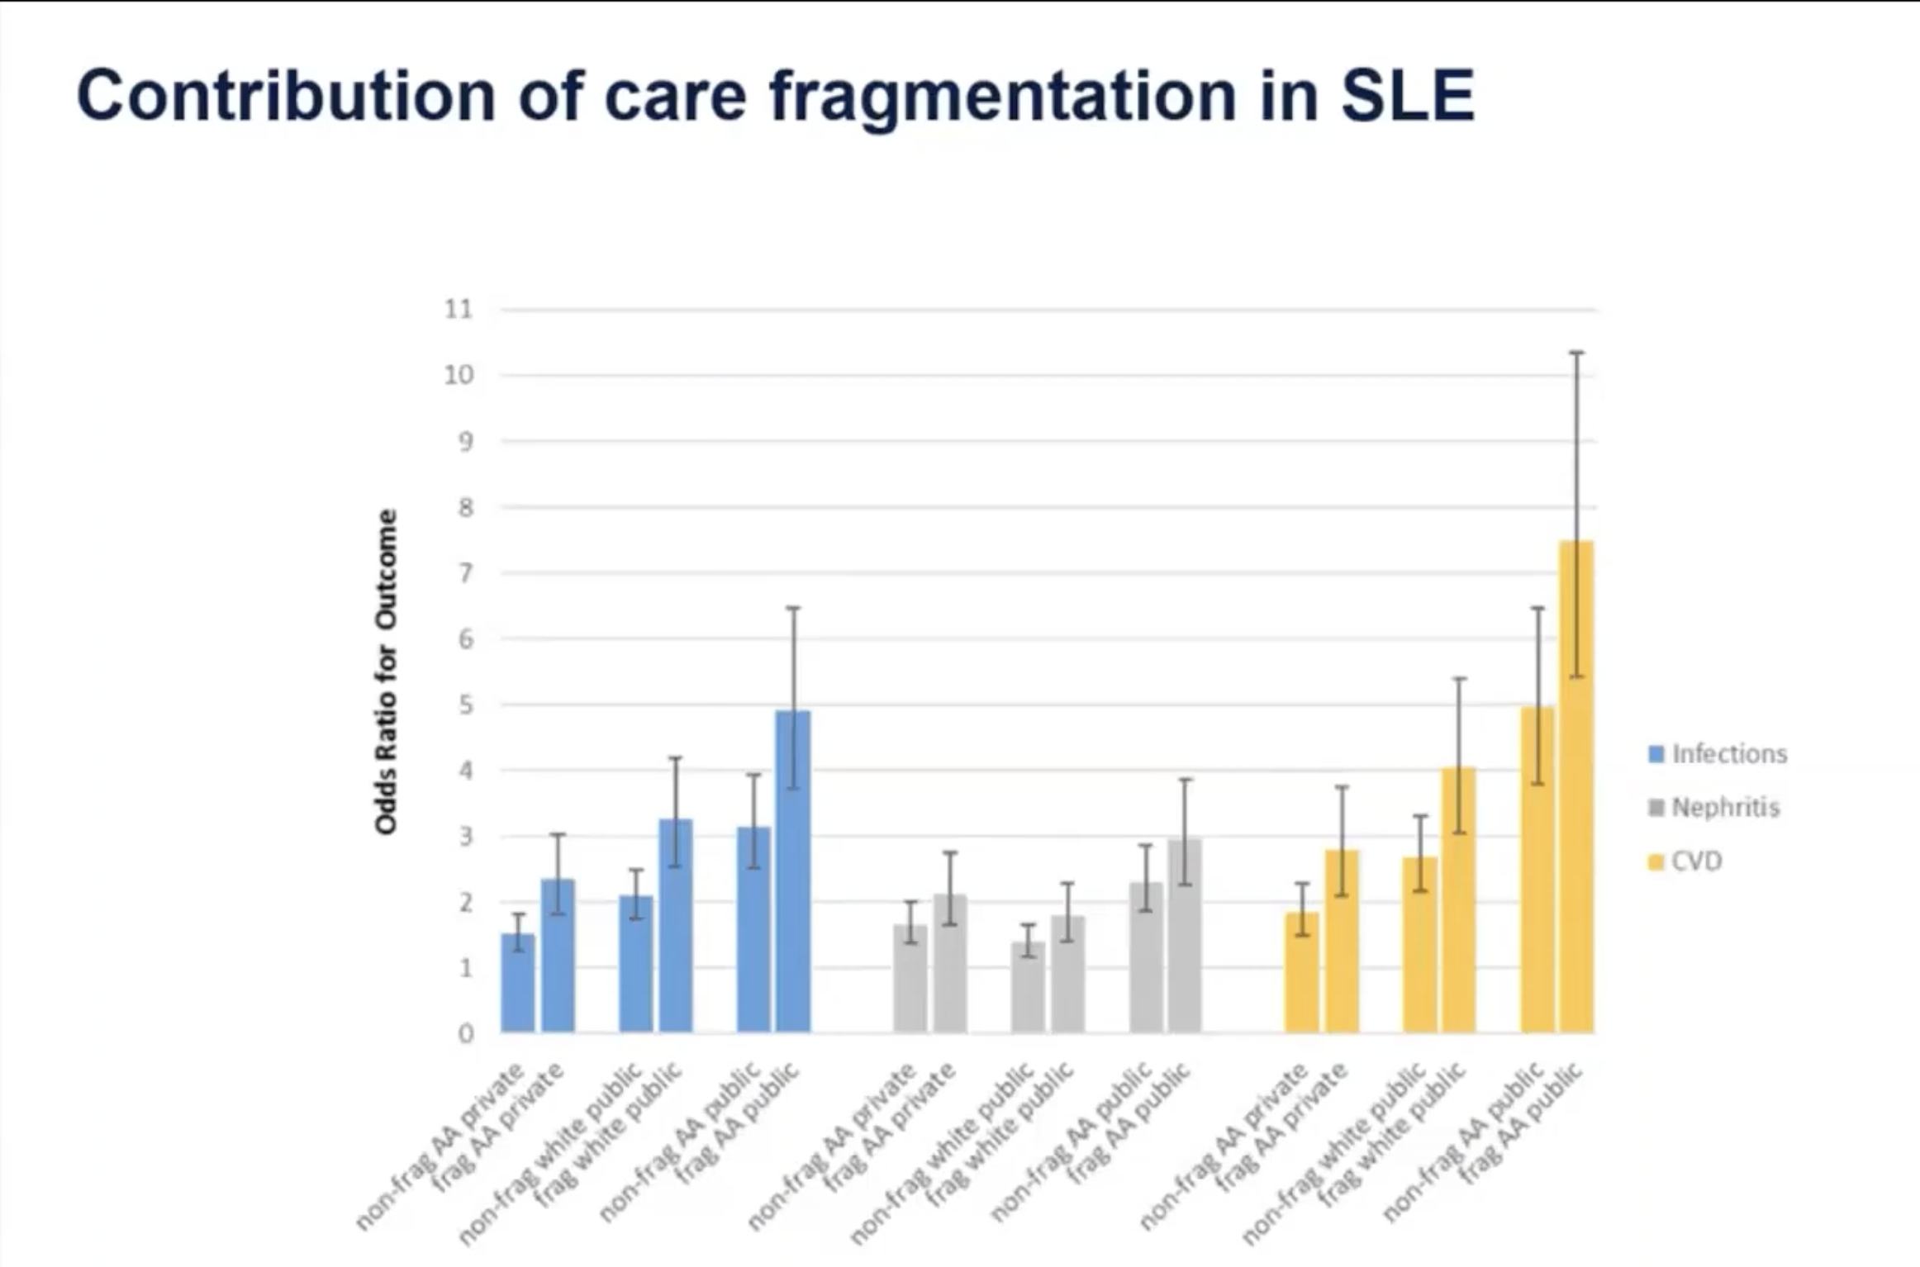
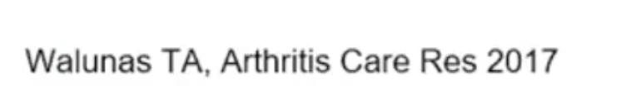
Care fragmentation-defined as getting care from 2 institutions
African Americans, even when they have private insurance, and when they get non fragmented care, they will have higher risk of complications
More fragmented the care becomes, higher is the risk!
Worse outcomes are in African Americans, with public insurance and fragmented care.
Risk is higher -
Serious Infections needing hospitalization
Lupus nephritis
CVD

Slide 11
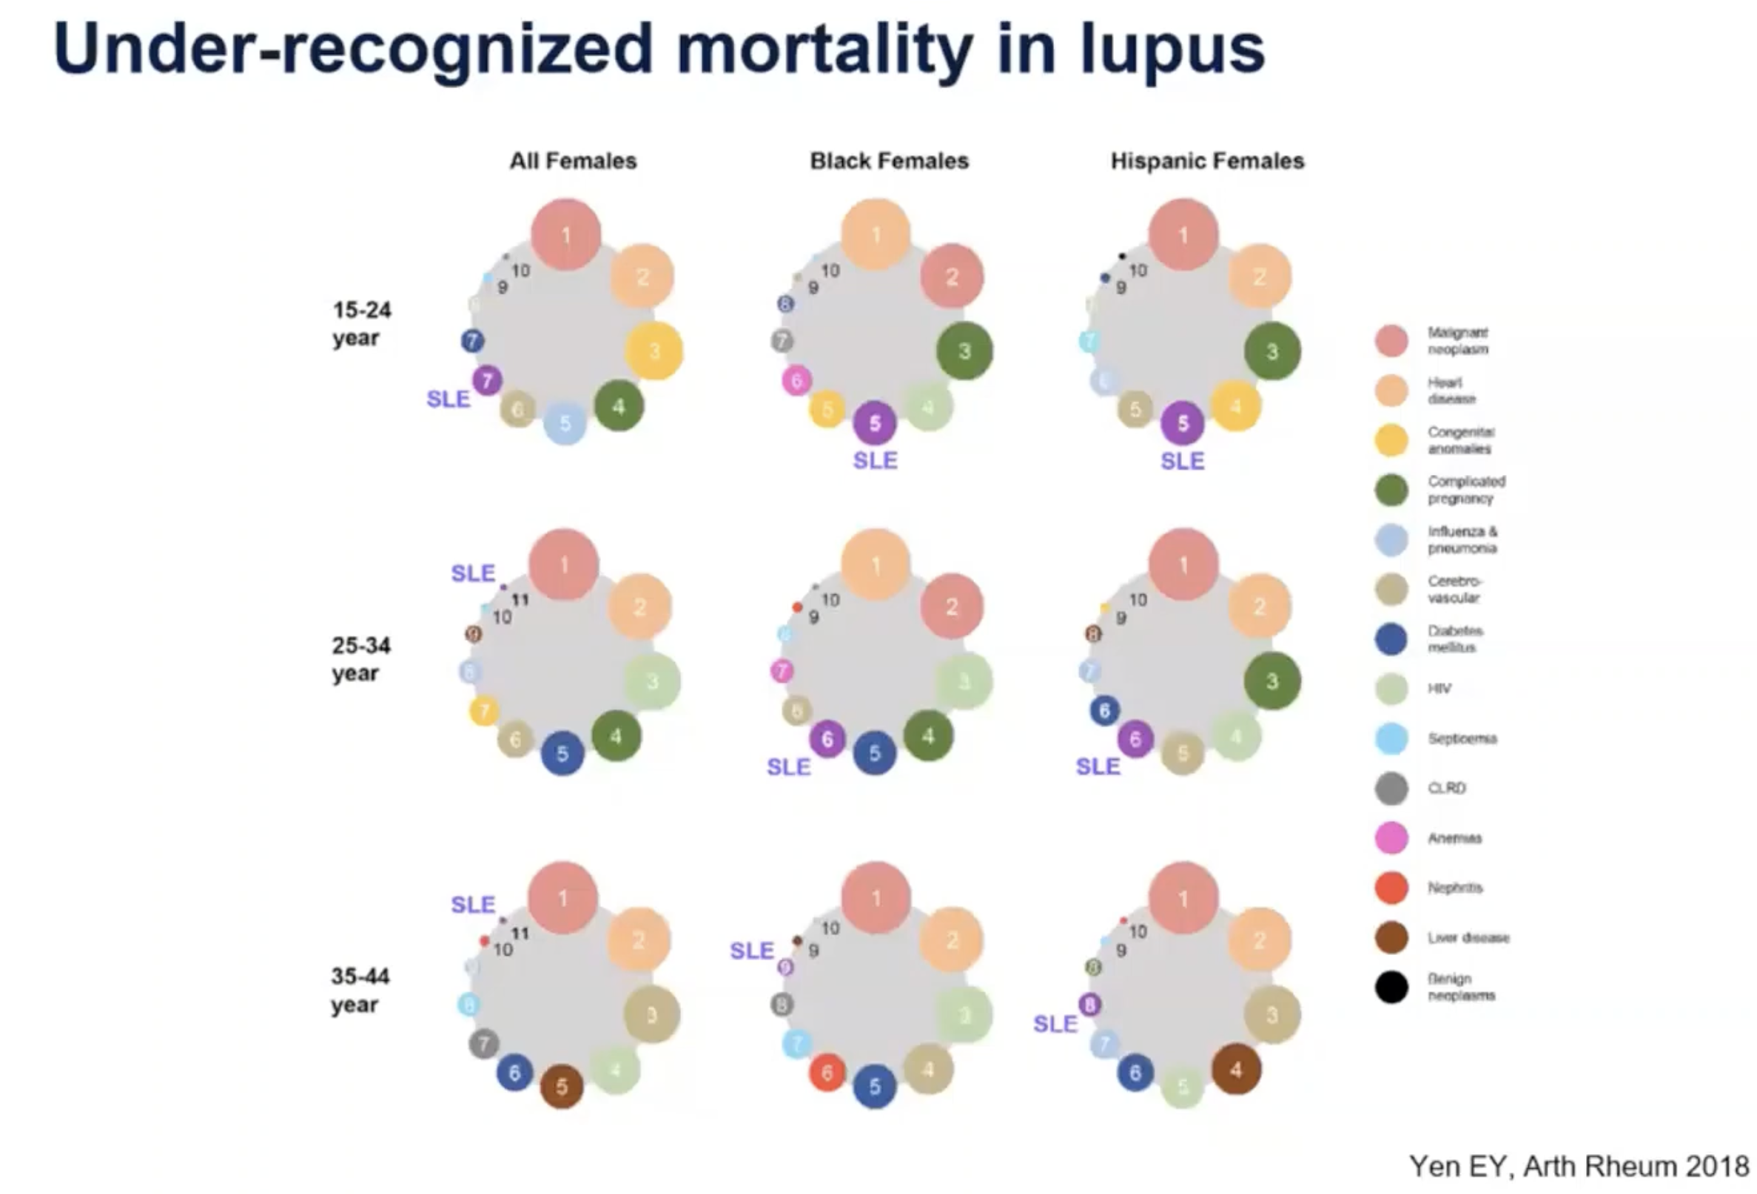
This is data extracted from National statistics data base.
What this shows is that – Lupus is a significant cause of death.
In young, black and Hispanic females , it is in-fact one of the leading causes of death.

Slide 12
WHY DO LUPUS PATIENTS DIE?
Cardiovascular risk
Active Lupus, high disease severity at diagnosis
Infection
Younger age at diagnosis
Male sex
Low socioeconomic status
Poor patient adherence
Inadequate patient support system
Limited patient education and of course ethnic disparities we already talked about.

Slide 13

POSITIVE ANA CONSULT : POTENTIAL AUTOIMMUNITY VS HEALTHY INDIVIDUAL
What should you know about Anti nuclear antibodies? These are antibodies that bind to components of the nucleus, eg RNA, DNA, protein nucleic acid complexes.
In reality these are natural antibodies. In our body, cells are constantly dying. They are undergoing apoptosis and they extrude internal contents to the outside world. These antibodies are actually trying to clean up the cellular debris and they are harmless.
But when there is break in self tolerance, they turn into pathogenic antibodies.

Slide 14
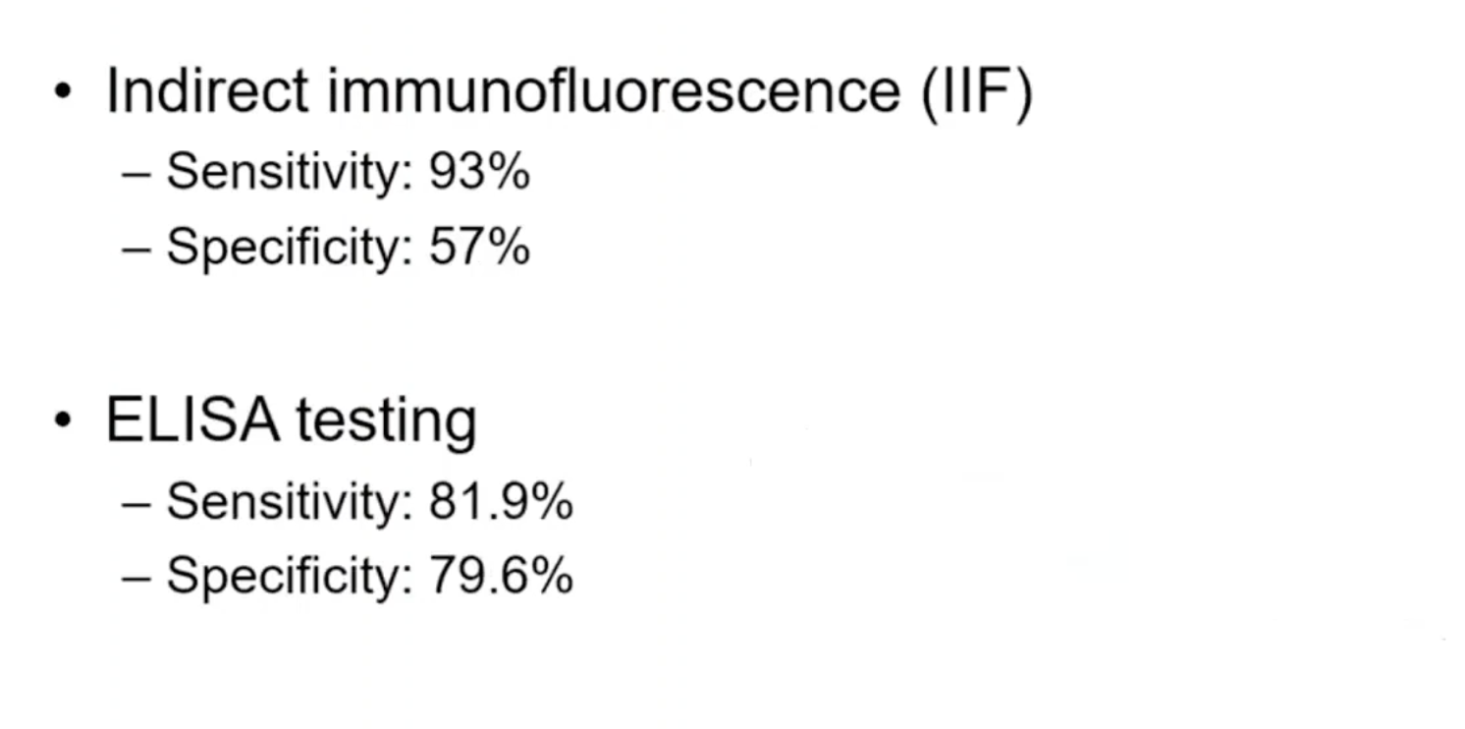

IN MOST LABS THERE ARE TWO WAYS “ANA” IS REPORTED
ANA is sensitive but not specific

Slide 15
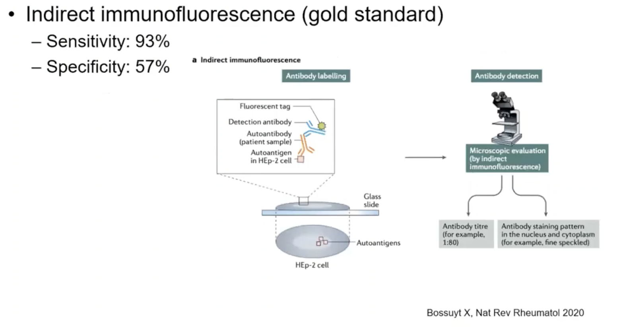
How is the IIFA ANA test performed?
Slides contain HEp-2 cells, which have large nuclei and abundant nuclear autoantigens.
The patient’s serum is applied to the slide. If antinuclear antibodies are present, they bind to nuclear antigens within the HEp-2 cells.
A fluorescently labeled secondary antibody (anti-human IgG) is then added.
This antibody binds to the patient antibodies and produces fluorescence under a microscope.
The test provides information about ANA staining pattern and titer.
Serial dilutions of the serum are performed to determine the ANA titer.

Slide 16
IIFA ANA test Limitations
Time-intensive
Operator dependent
Subjective interpretation of patterns and titers
Low specificity despite high sensitivity
HEp-2 cells are used because they express a broad range of nuclear and cytoplasmic antigens, making the test highly sensitive for autoimmune disease.

Slide 17
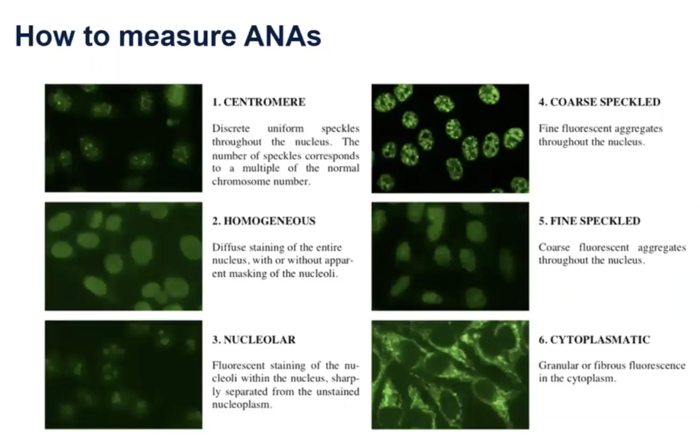


Slide 18
ENA – Extractable Nuclear Antigens
ENA refers to specific nuclear antigens that antibodies may target in autoimmune diseases.
These antigens are called “extractable” because historically they could be extracted from cell nuclei using saline solutions in the laboratory.
After a patient has a positive ANA, ENA testing helps identify the specific autoantibody present.
Common ENA antibodies and their disease associations
Anti-Ro (SSA) – seen in Sjögren's syndrome and Systemic Lupus Erythematosus
Anti-La (SSB) – associated with Sjögren's syndrome
Anti-Sm – highly specific for Systemic Lupus Erythematosus
Anti-RNP – seen in Mixed Connective Tissue Disease
Anti-Scl-70 (topoisomerase I) – associated with Systemic Sclerosis
Anti-Jo-1 – associated with Antisynthetase Syndrome and inflammatory myositis

Slide 19
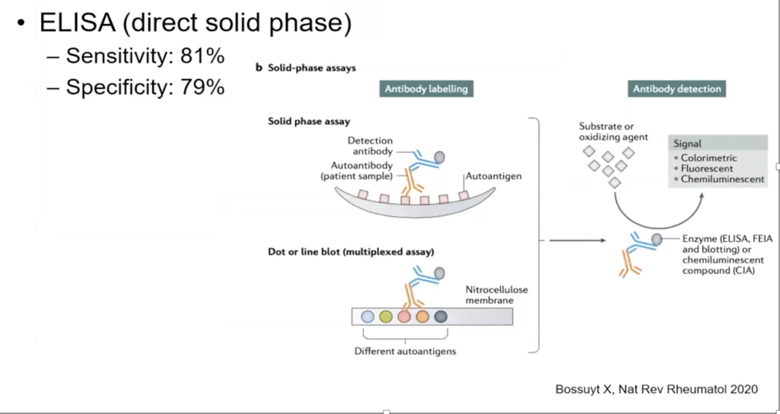
Uses a solid-phase surface (such as polystyrene plates or nitrocellulose membranes) that is coated with a mixture of nuclear autoantigens.
The patient’s serum is added. If autoantibodies are present, they bind to these antigens.
A detection antibody (anti-human IgG linked to an enzyme) is then added.
When the substrate is applied, the enzyme produces a color change, indicating the presence of antibodies.

Slide 20
ANA by ELISA
ELISA is easier and more automated, but it may miss antibodies detected by IIFA, which is why Indirect Immunofluorescence Assay on HEp-2 cells remains the gold standard screening test for ANA.

Slide 21
CASE 1
A 54 year old male comes to your clinic for a positive ANA. He first presented with a rash, which was then confirmed to be contact dermatitis as per a highly reliable dermatologist.
PMH includes hypothyroidism, hypertension
Family history of Rheumatoid arthritis

Slide 22
WHAT QUESTIONS WILL YOU ASK THE PATIENT?
Fevers
Oral ulcers
Sicca symptoms
Raynaud’s
Photosensitivity
Joint pain and stiffness
Pleurisy

Slide 23
WHEN YOU EXAMINE THIS PATIENT, WHAT WILL YOU BE LOOKING FOR?
Rashes-scalp, conchal bowls, face, hands, lower legs
Alopecia
Oral ulcers
Murmur, pericardial rub
Diminished breath sounds
Synovitis
Muscle strength

Slide 24
WHAT LAB TEST WILL YOU NOW ORDER?
Anti- scl 70
Anti- RNP
Anti-thyroglobulin
Anti-mitochondrial
Answer- anti-thyroglobulin antibodies

Slide 25
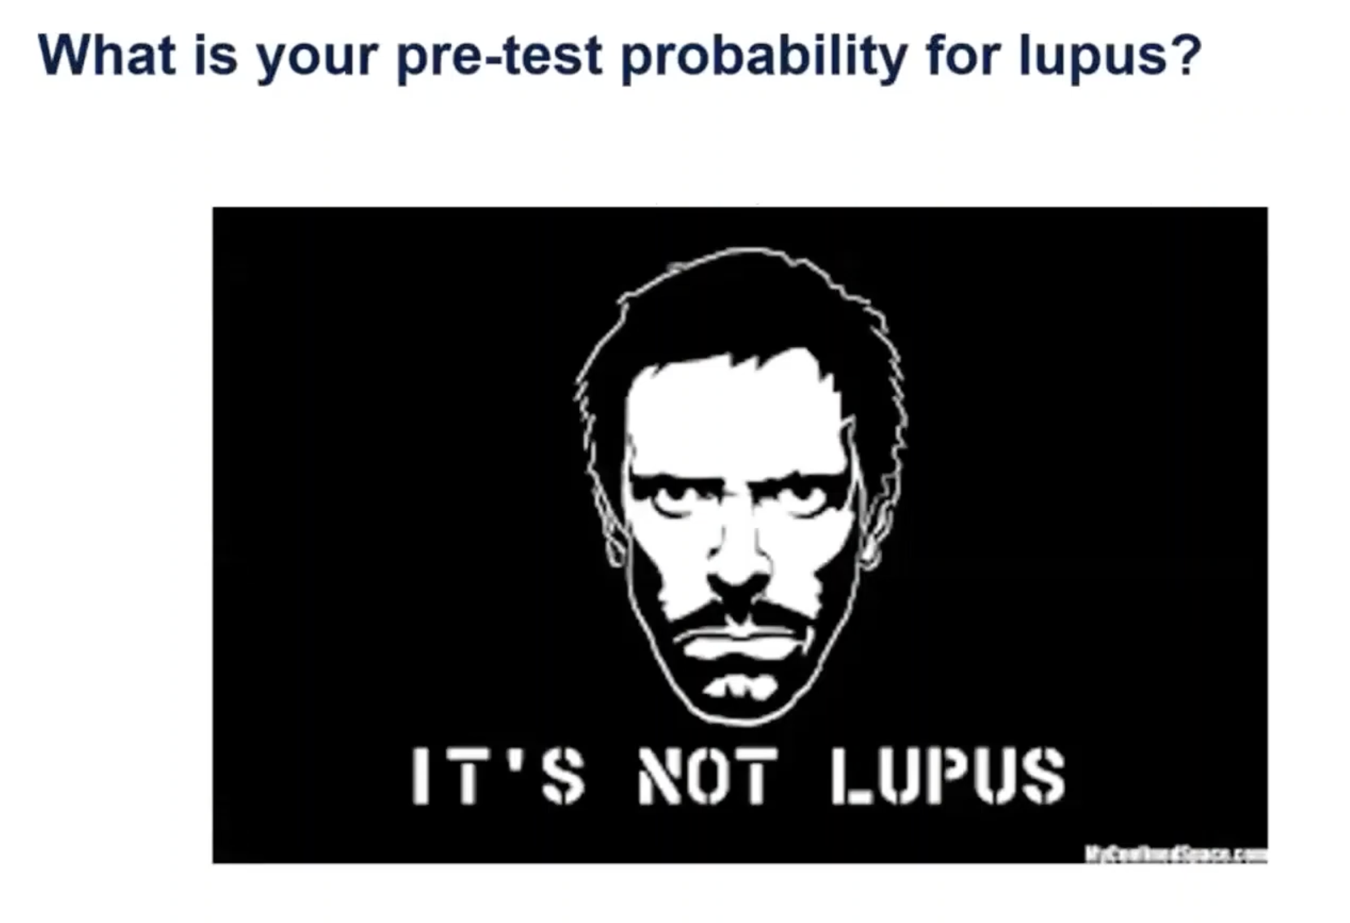

Slide 26
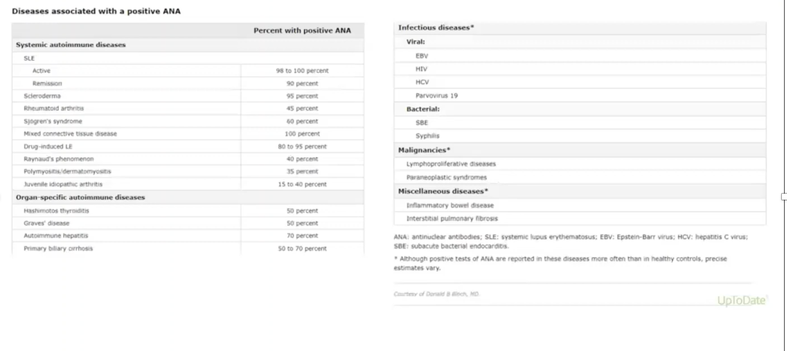

Slide 27
LETS DO A BIT STATS
How do you use likelihood ratio? Likelihood ratio x pretest odds= post
test odds.
Positive likelihood ratio : Higher is better. Meaning LR > 5 is a good test.
Negative likelihood ratio : Lower is better. Meaning LR< 0.2 is a good test
If LR is 1 – test cannot be used to predict

Slide 28
At an ANA cutoff of 1:80:
Sensitivity: 95% → detects most patients with Systemic Lupus Erythematosus
Specificity: 95%
From this we get likelihood ratios:
Positive LR( TP/FP )( Sensitivity/ 1- specificity) = 19 → a positive test increases the chance of disease
Negative LR( FN/TN )( 1- Sensitivity/ specificity) = 0.05 → a negative test strongly decreases the chance of disease

Slide 29
Now let’s make an assumption that the pre test probability of lupus before testing is 1%.
What the 1% really means
The 1% pre-test probability is an educational assumption representing a patient who has some symptoms suggestive of disease but not a high likelihood of Systemic Lupus Erythematosus.
It’s chosen because:
General population prevalence ≈ 0.1%
If a patient has some suggestive symptoms, the probability rises a bit.
We often use 1% as a reasonable low-suspicion scenario to demonstrate how test interpretation works.

Slide 30
What happens after the ANA result?
If ANA is NEGATIVE
Post-test odds( pretest odds X LR )( 0.01 X 0.05 =0.0005) become extremely small.
Meaning:
➡ Lupus is essentially ruled out
If ANA is POSITIVE
Post-test odds ( 0.01 X 19 )= 0.19 ≈ 1 in 5
Meaning:
➡ Still more likely the patient does NOT have lupus

Slide 31
CASE 2
32 year old female with
Pericarditis : chest pain worse when supine, EKG with diffuse ST elevation, PR depression, feeling better with NSAIDs and colchicine
Also has fatigue, recurrent roof of the mouth ulcers, fatigue, arthralgias with morning stiffness in the hands, and a photosensitive rash
On exam she has many tender joints on the MCPs of b/l hands
Labs : normal CBC,CMP, But ANA is 1: 80

Slide 32
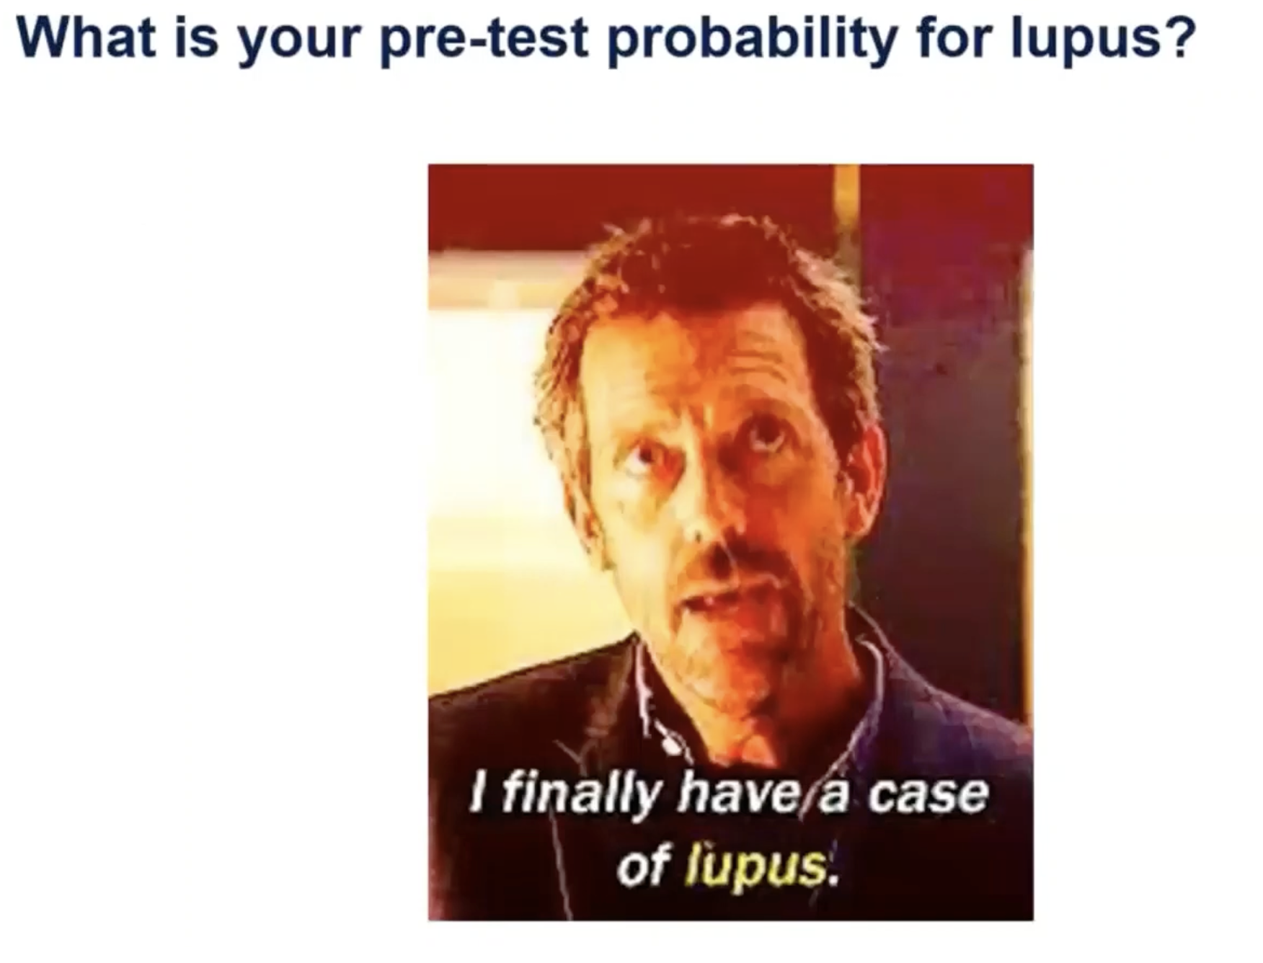

Slide 33
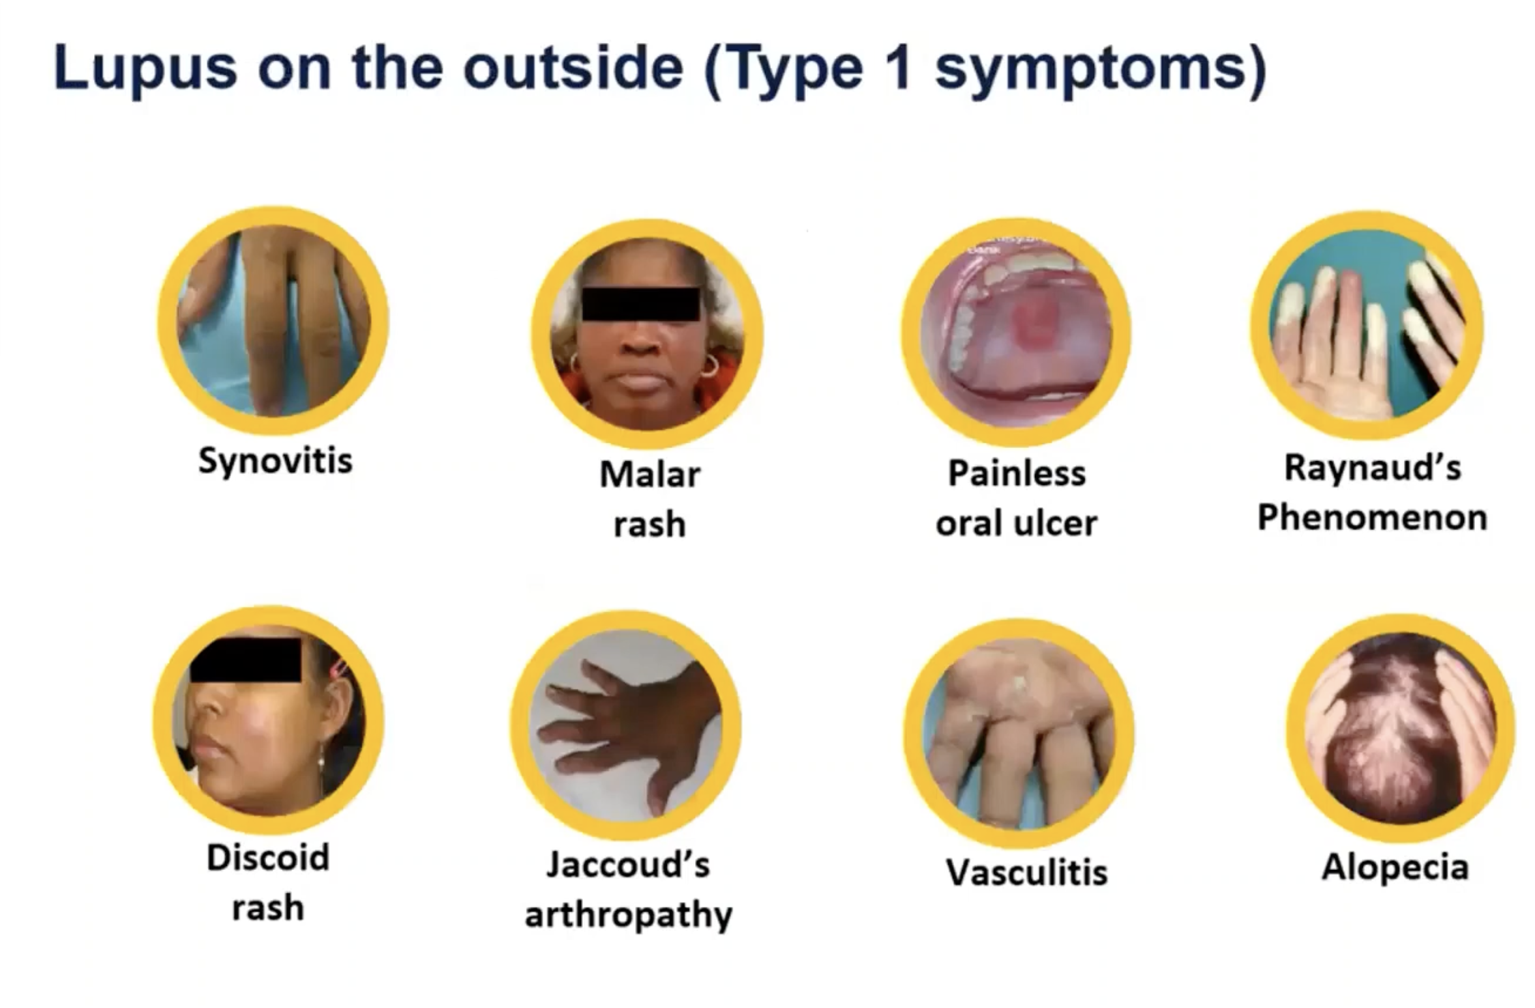

Slide 34
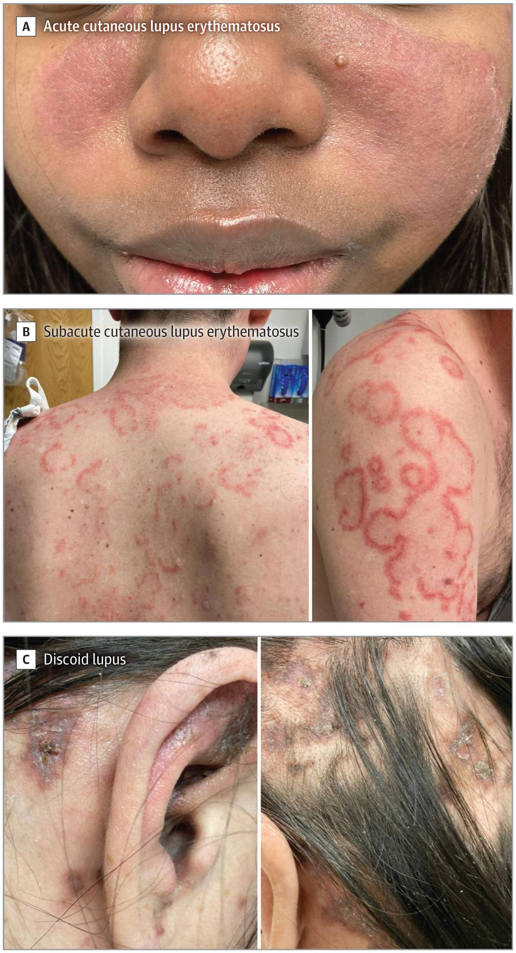
Acute cutaneous lupus erythematosus is defined as a maculopapular rash in a generalized or malar distribution (Figure A). Up to 50% of patients with SLE will have acute cutaneous lupus ery- thematosus sometime in their disease course.
Subacute cutane- ous lupus erythematosus is a photosensitive annular or papulosqua- mous rash that affects 10% to 15% of people with SLE (Figure B).
The most common chronic cutaneous lupus erythematosus, discoid lupus, is defined by well-demarcated, scaly, erythematous mac- ules or papules that evolve into indurated circular plaques, often affecting the head and neck.
Discoid lupus may be associated with permanent hair loss due to scarring

Slide 35
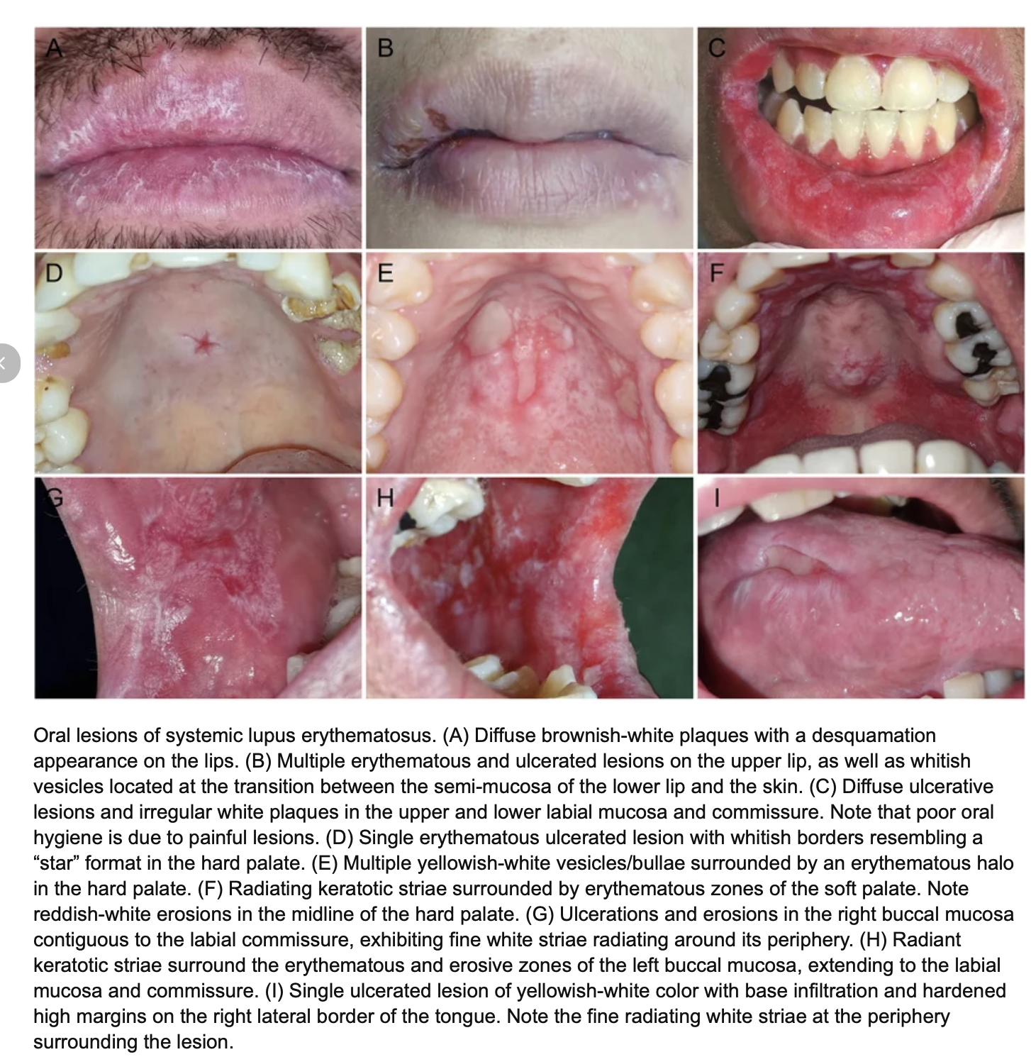

Slide 36
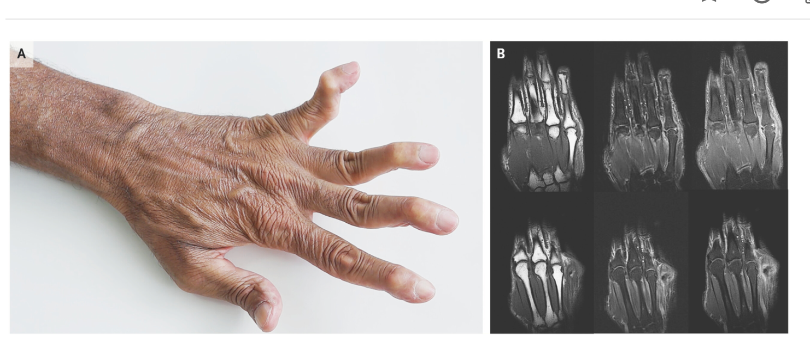
In Jaccoud’s arthropathy, the deformities result mainly from soft-tissue abnormalities, such as laxity of ligaments, fibrosis of the capsule, and muscular imbalance, rather than from destruction of the bone of joints, as occurs in rheumatoid arthritis. The mainstay of the management of Jaccoud’s arthropathy includes physical therapy and the use of orthotic devices

Slide 37
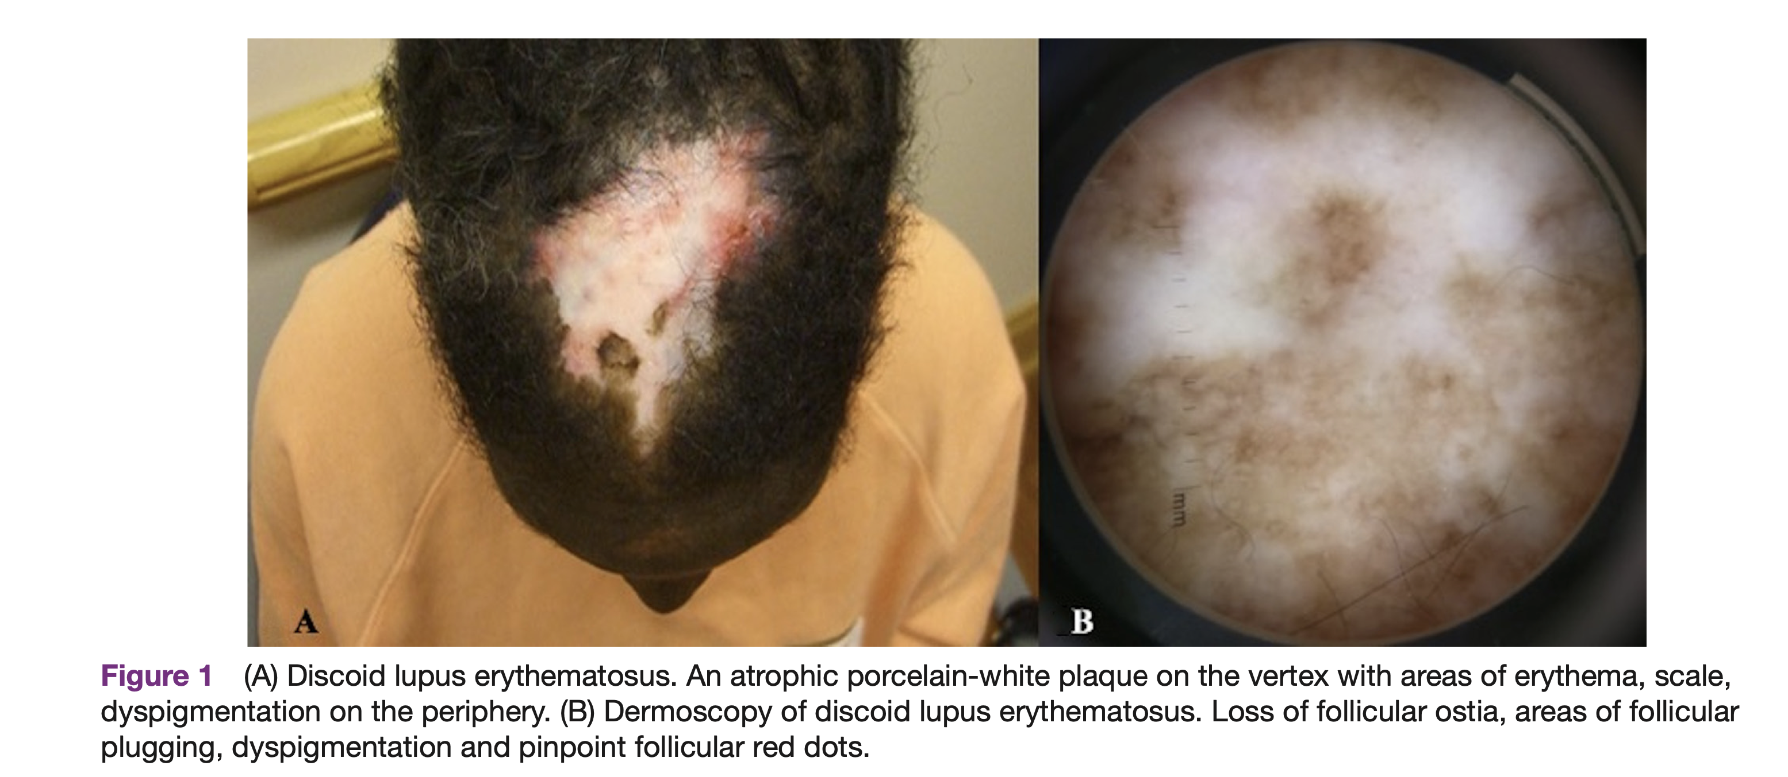

Slide 38
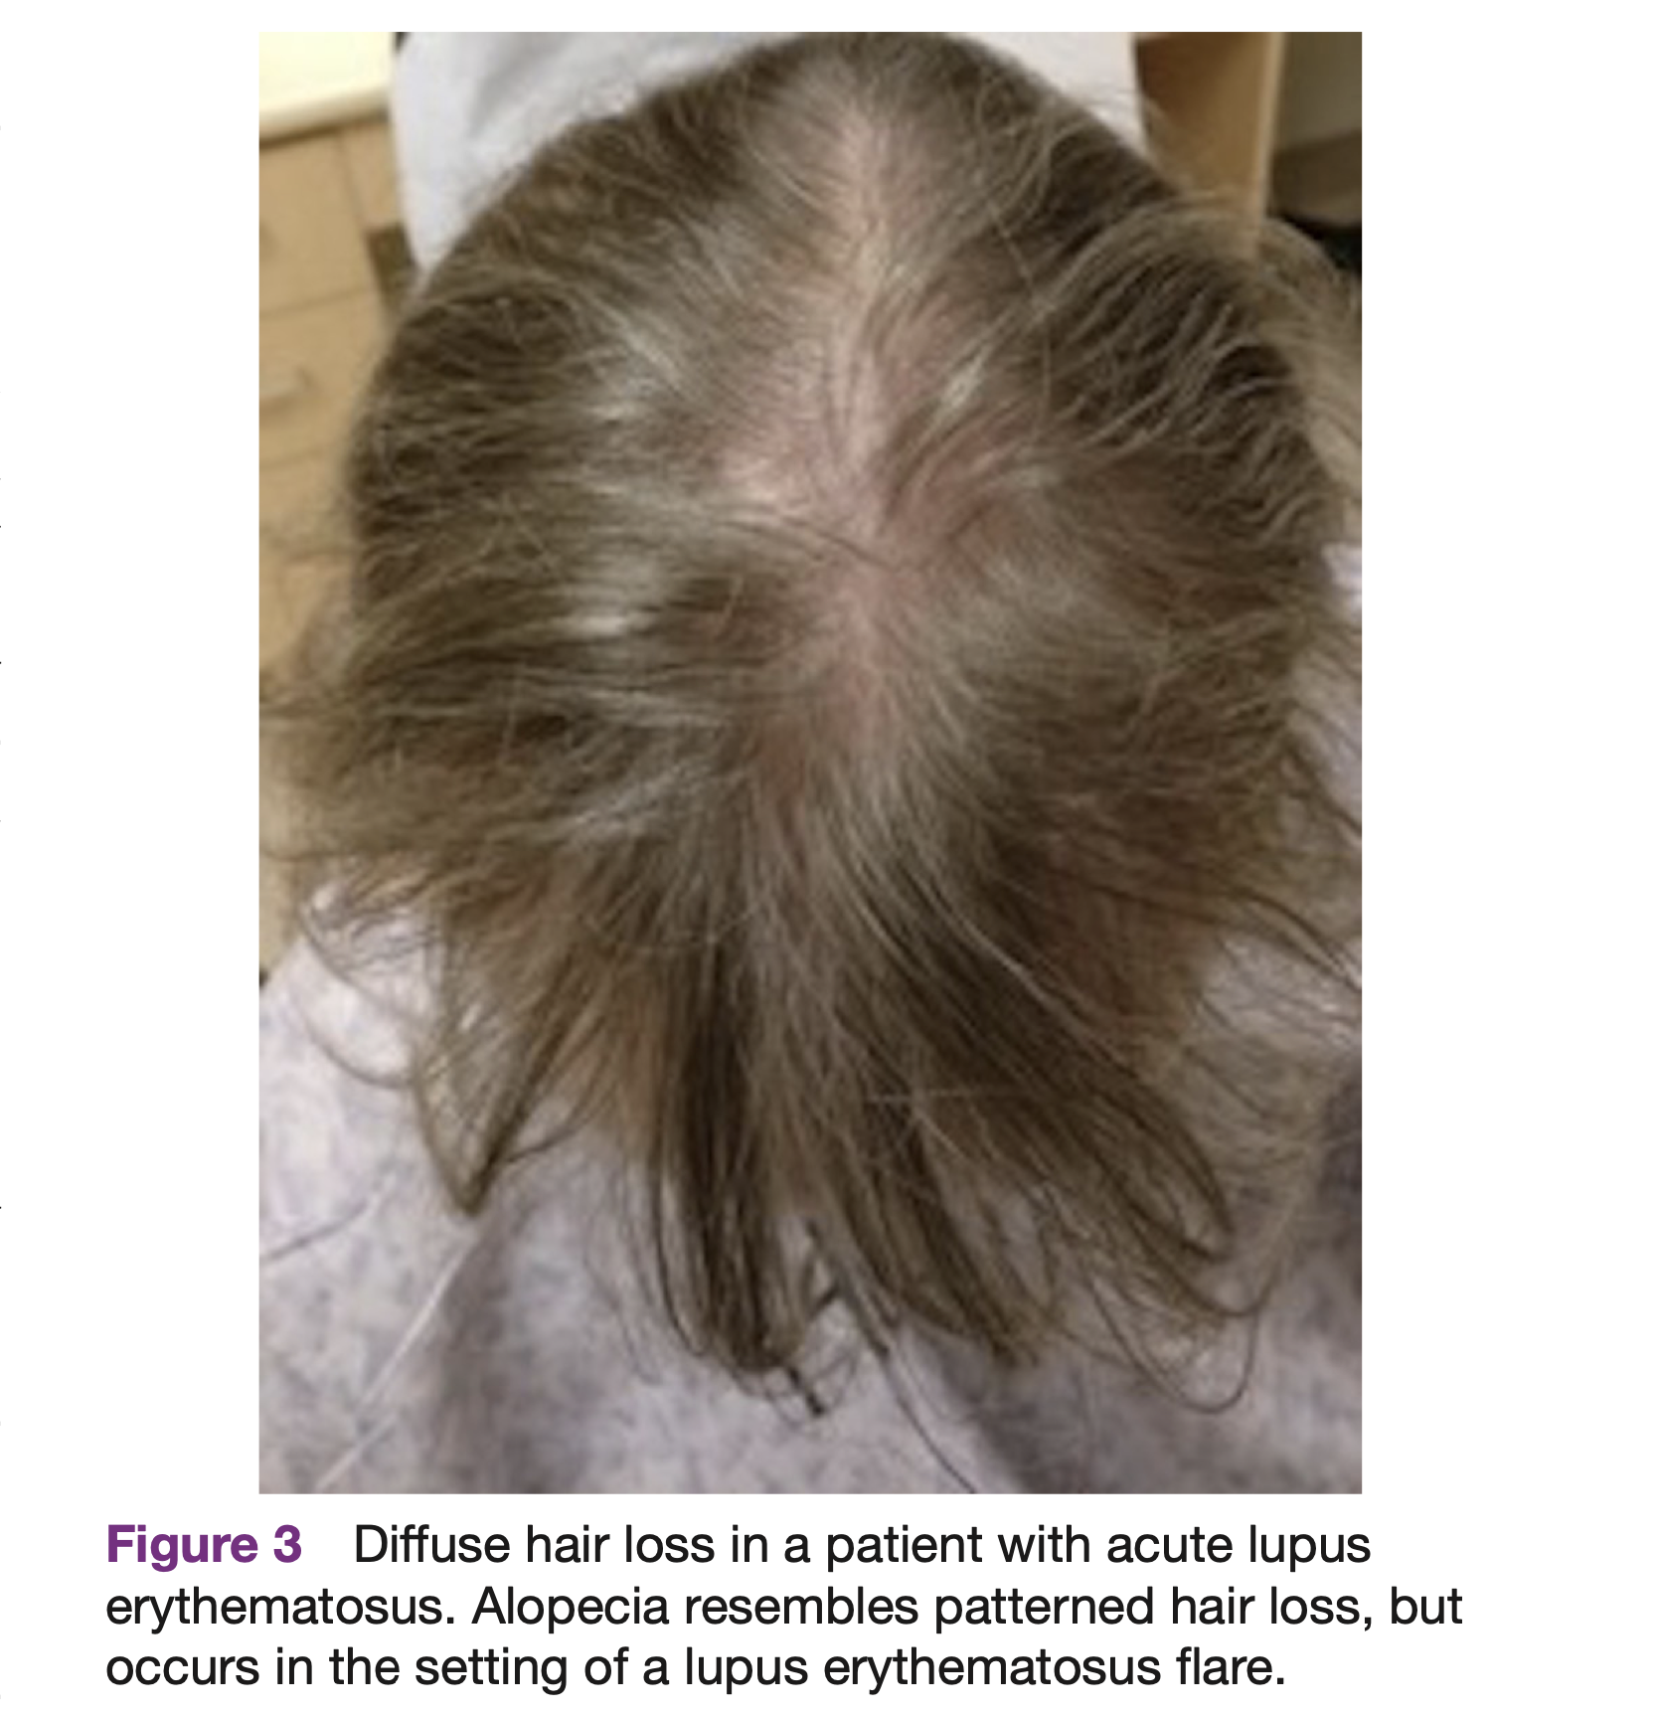

Slide 39
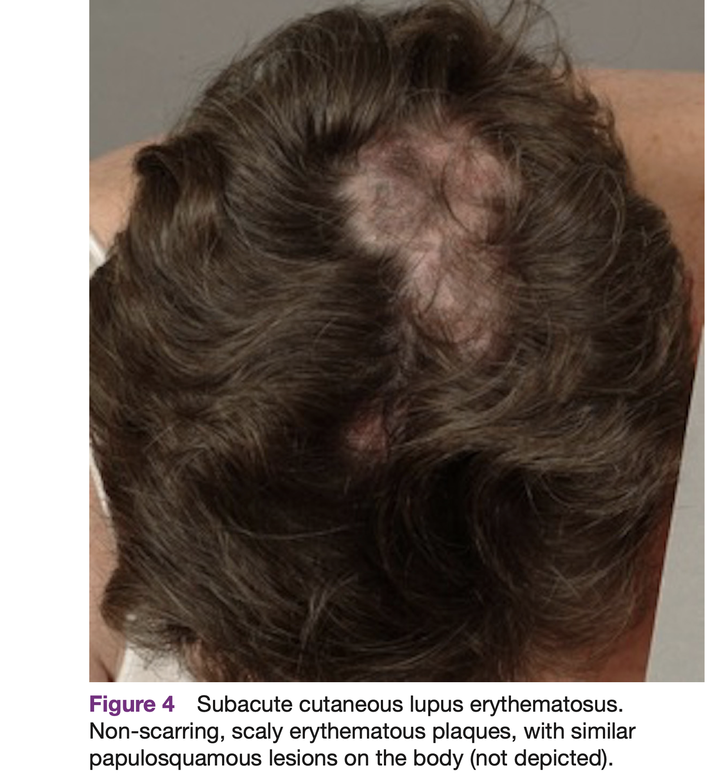

Slide 40
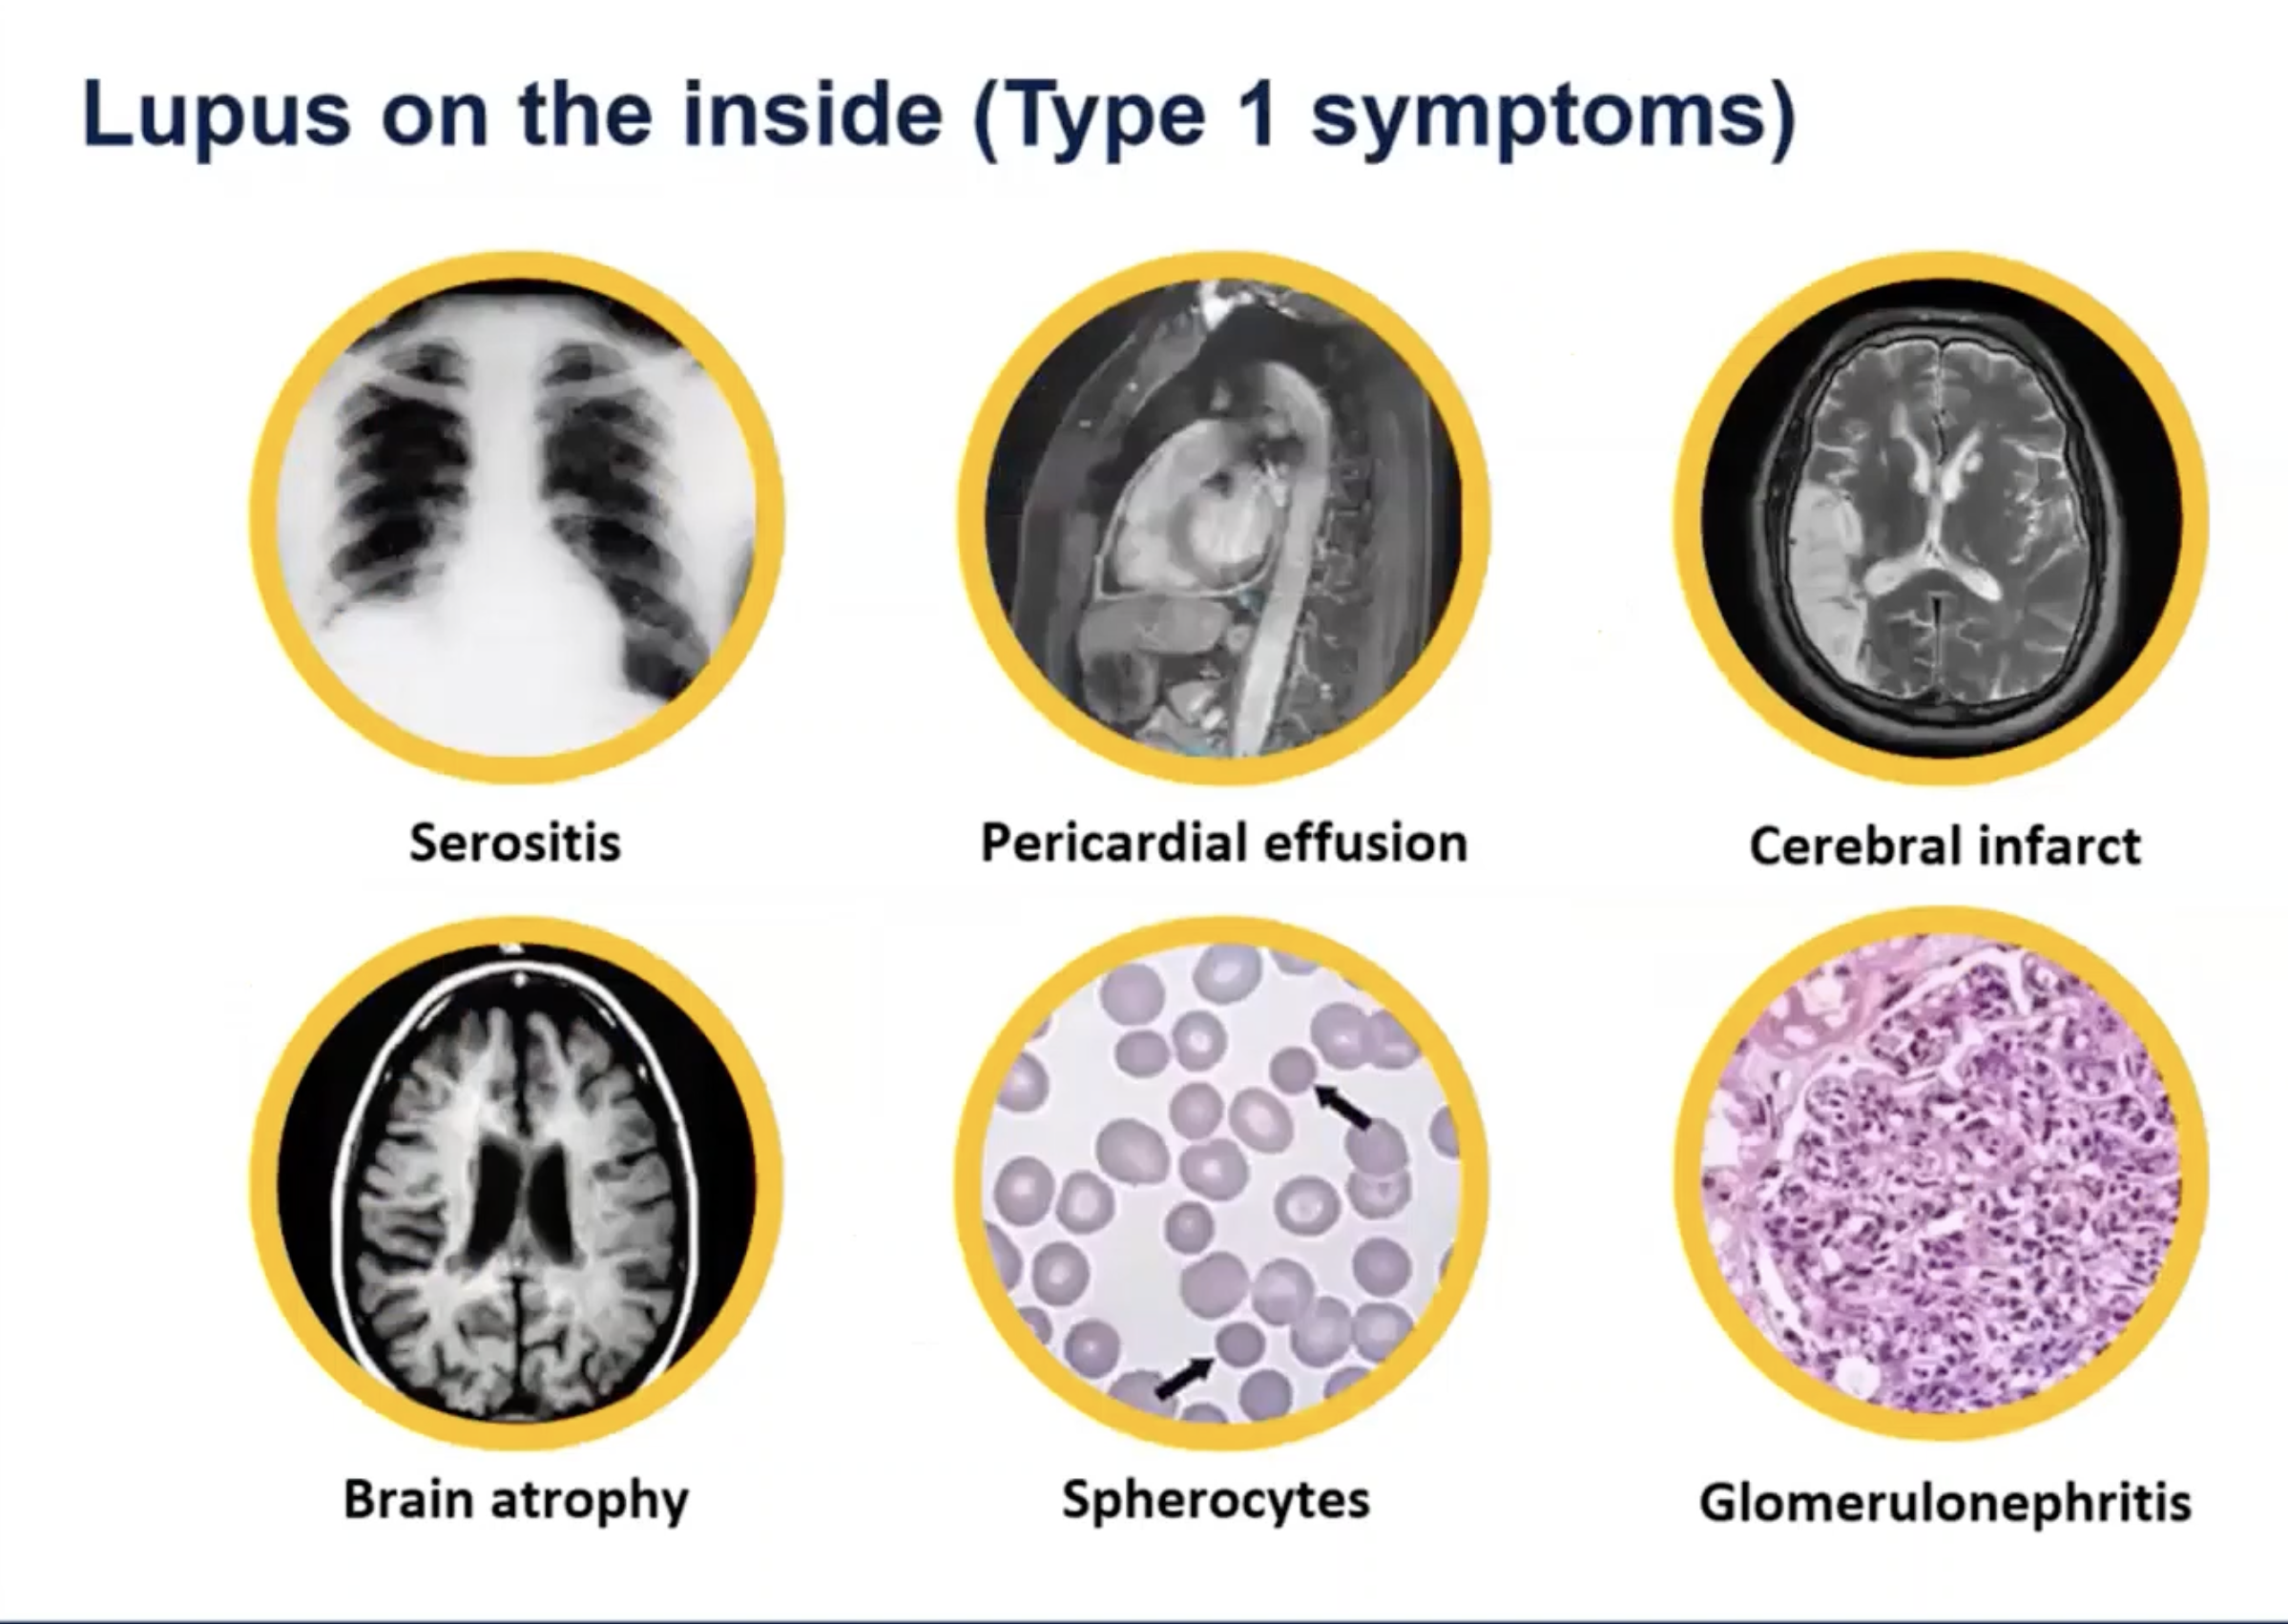

Slide 41



Slide 42
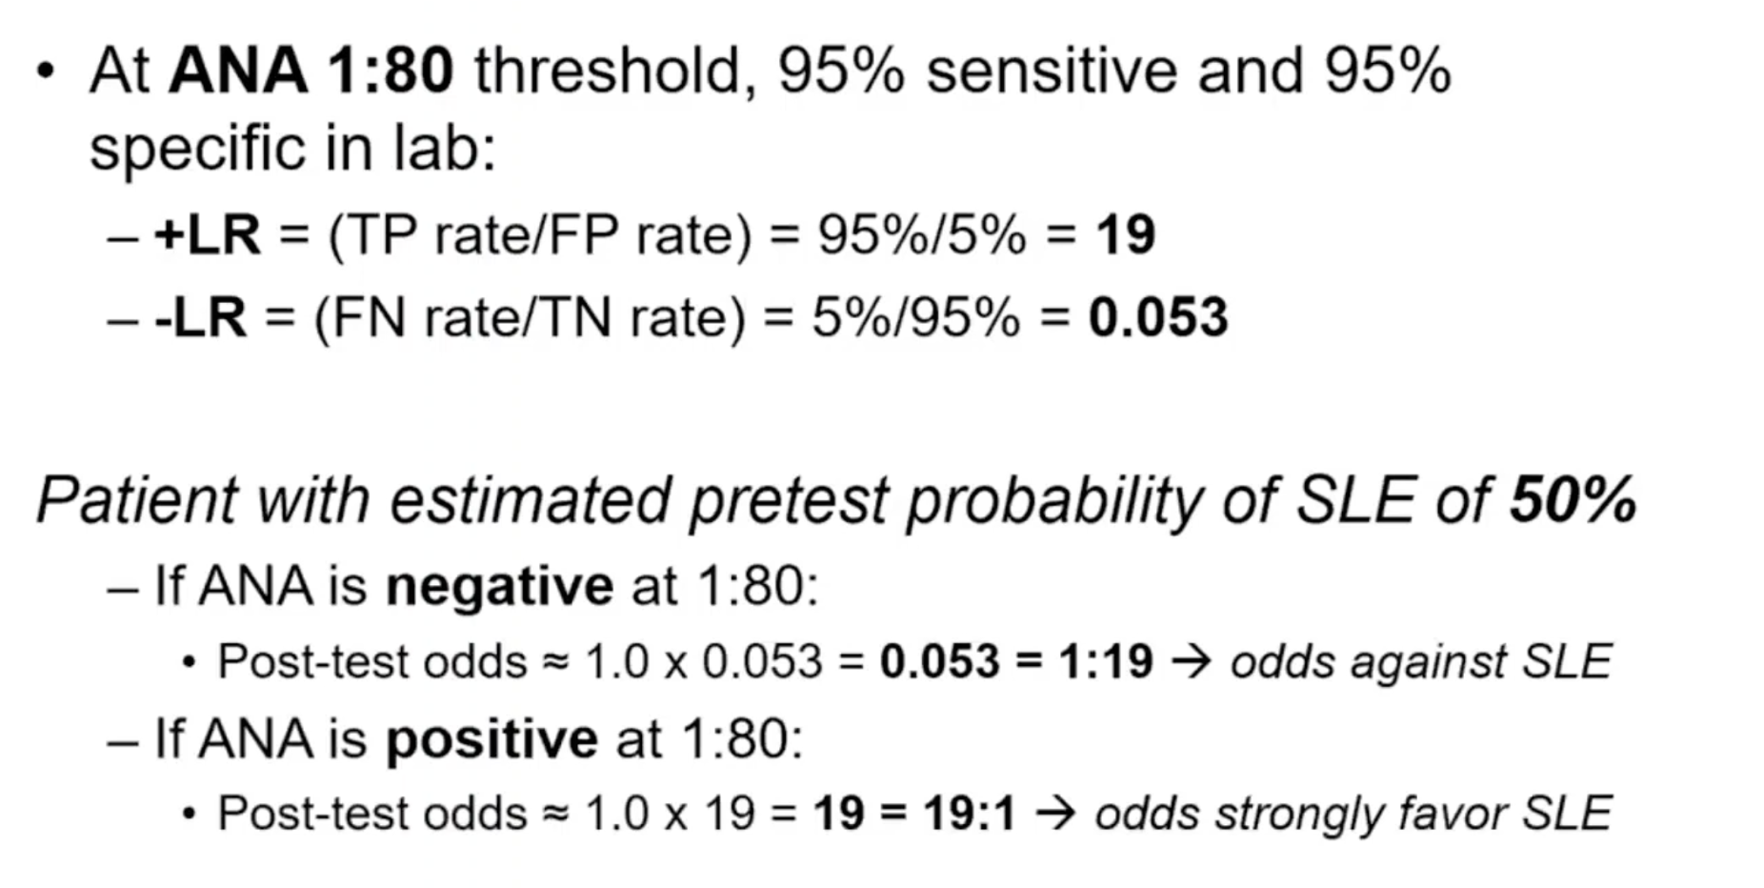

Slide 43
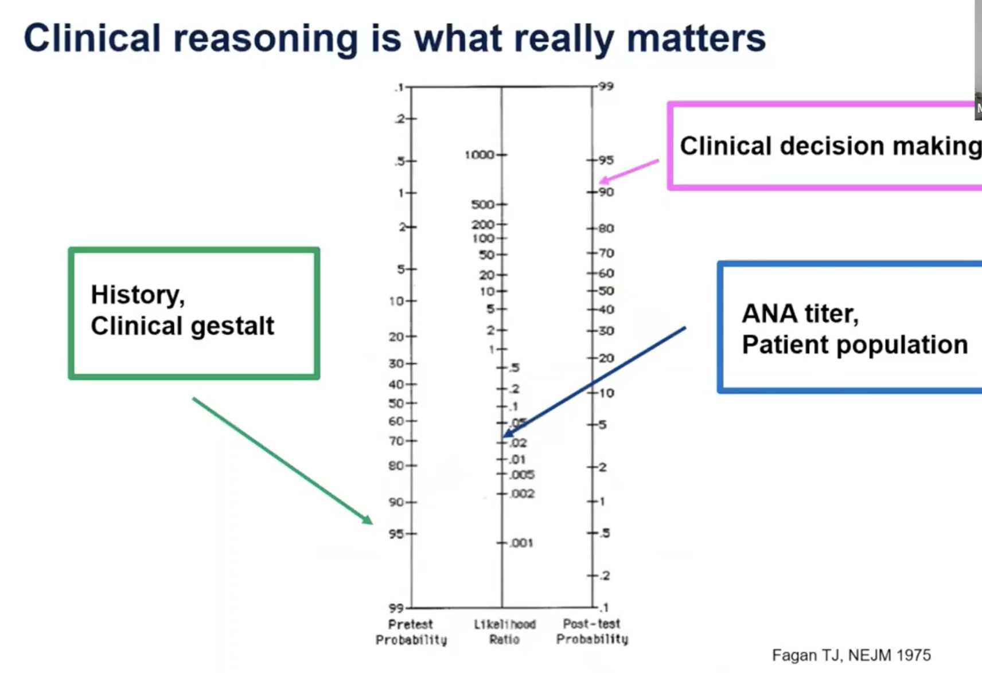

Slide 44

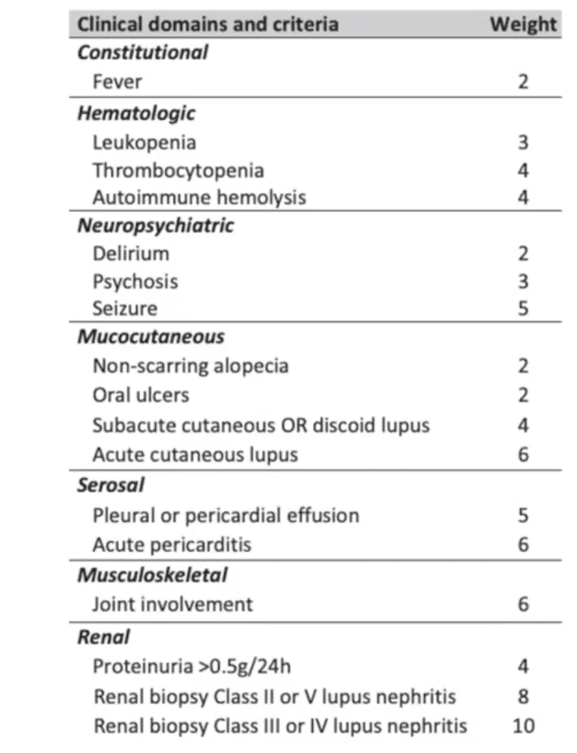
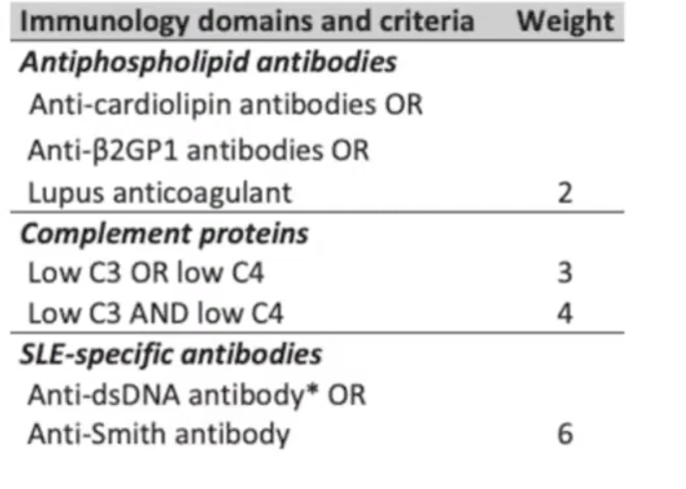
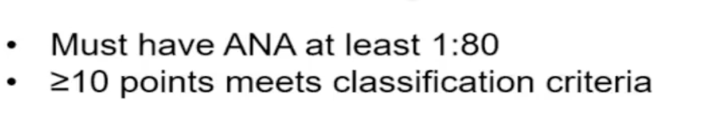


Slide 45
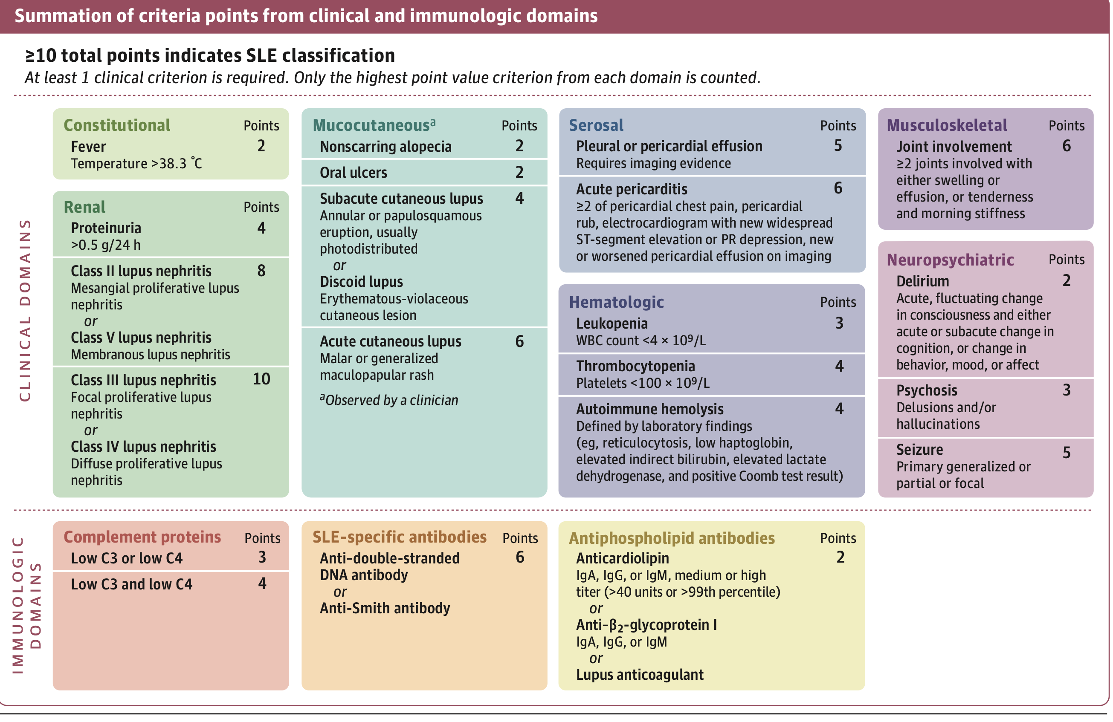

Slide 46
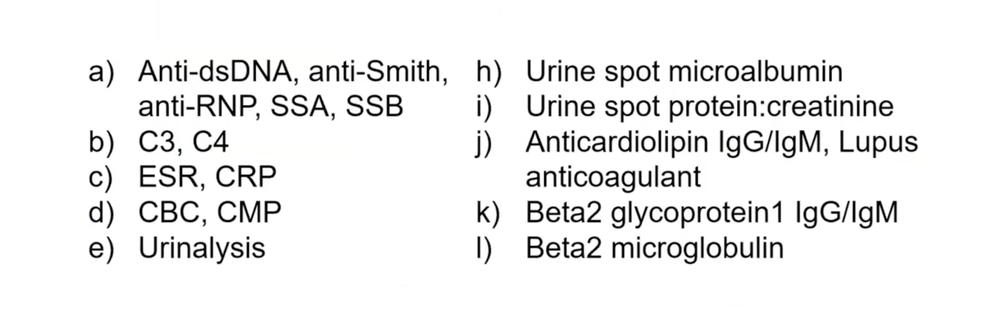
WHAT TESTS WILL YOU ORDER NEXT ?
EVERYTHING except h and l

Slide 47
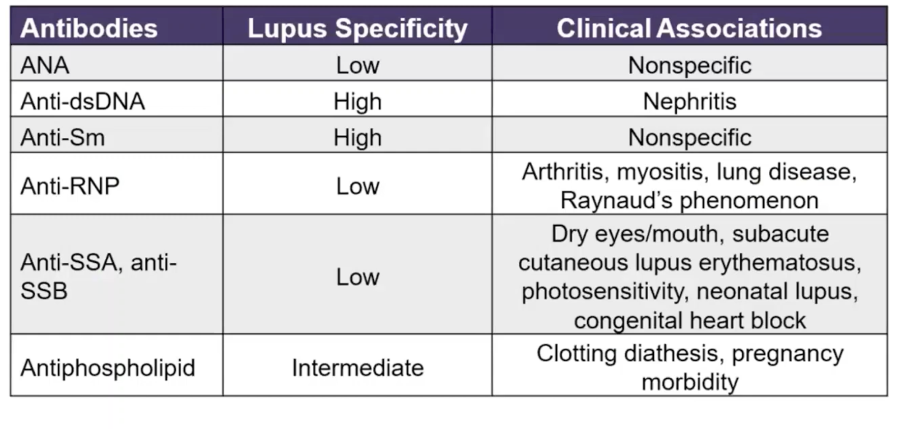
ROLE OF CERTAIN ANTIBODIES

Slide 48
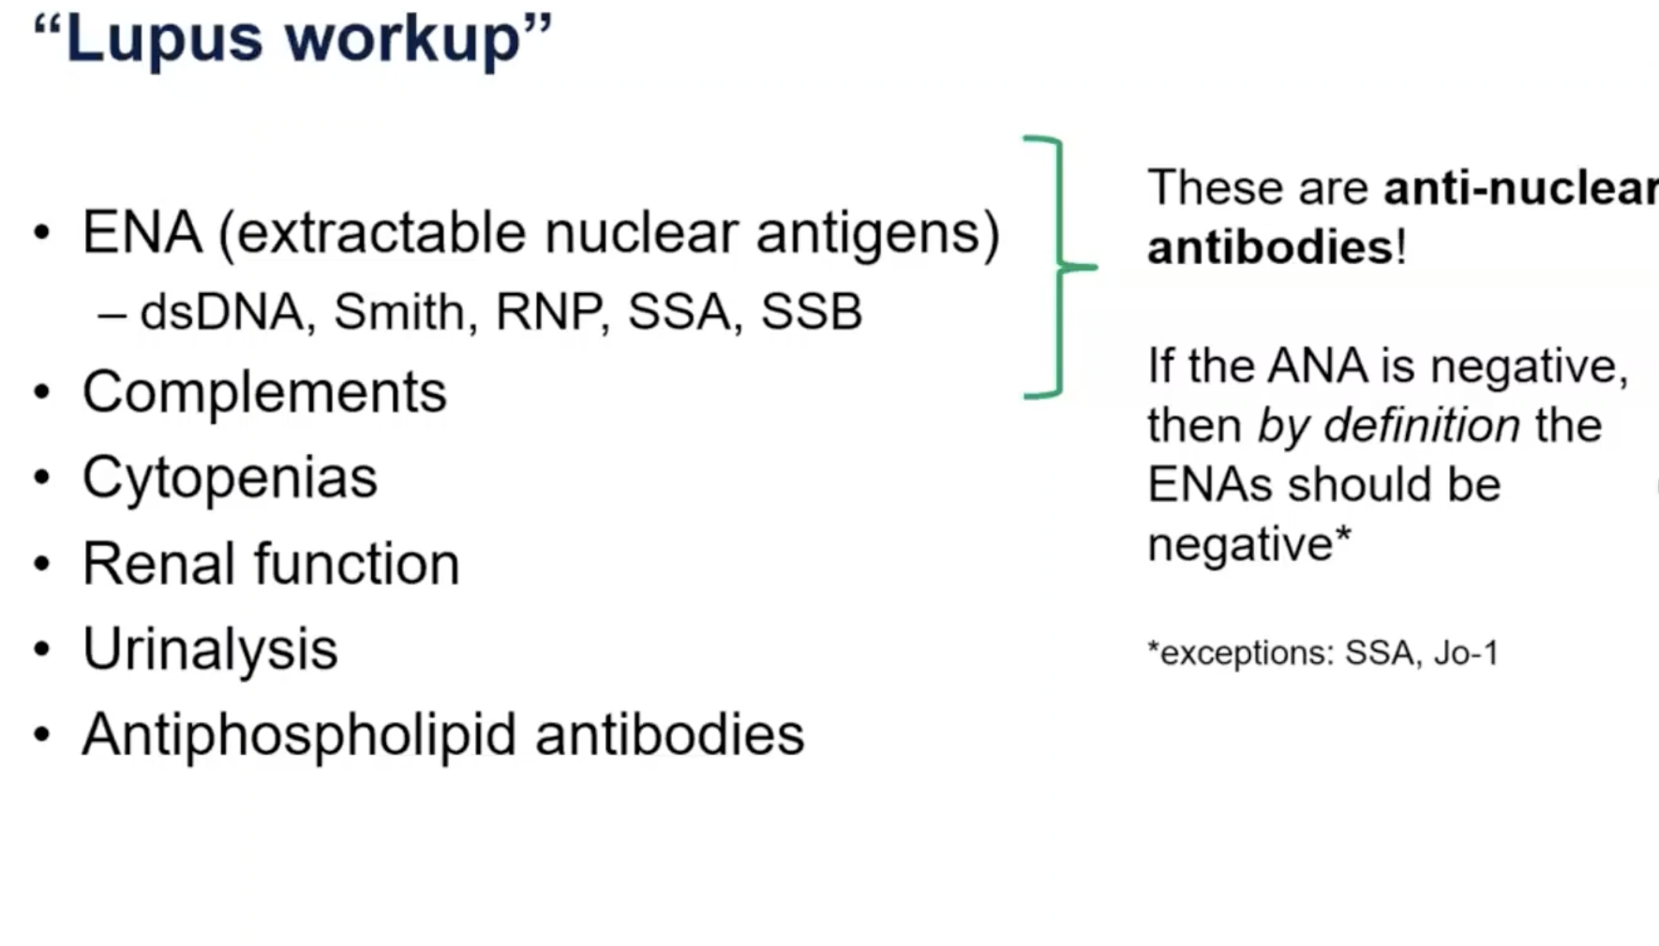

Slide 49
CASE 3
A 24 year old woman presents for a positive ANA 1: 2560, speckled pattern, she approached her PCP for evaluation of fatigue.
Her PCP checked vitamin D and suggested replacement and her fatigue resolved.
But ANA titre being very high, she is sent to Rheumatology for further management.
Past medical history : unremarkable
Family history : sister has Lupus

Slide 50
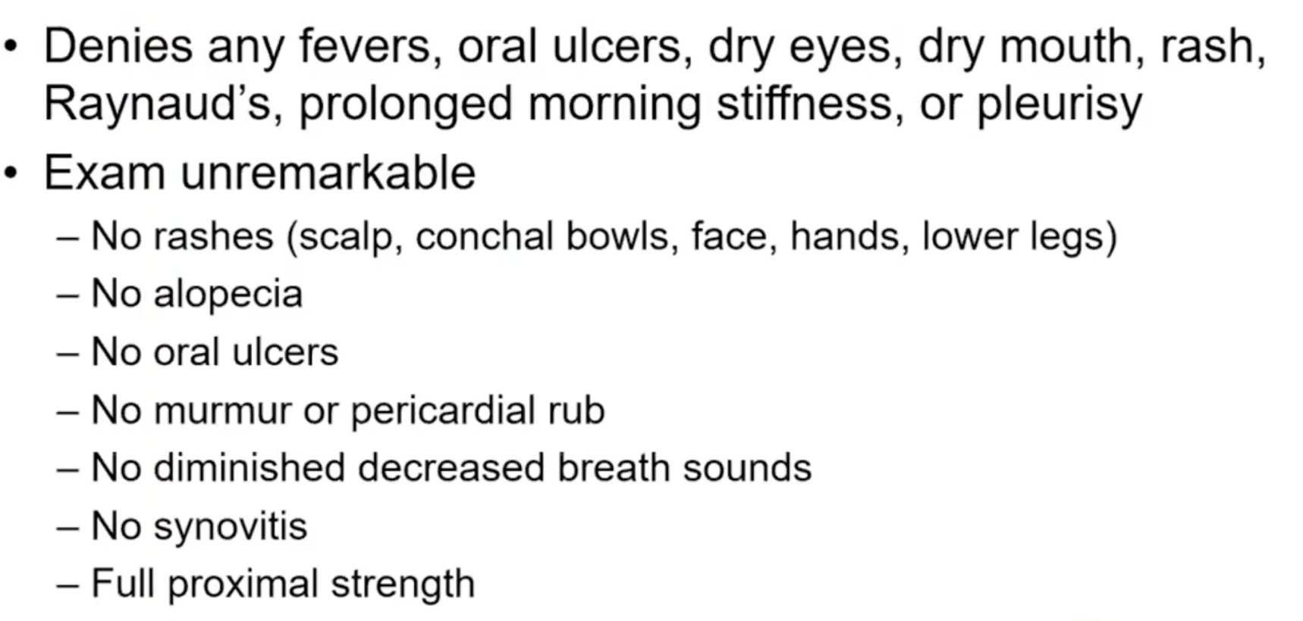

Slide 51
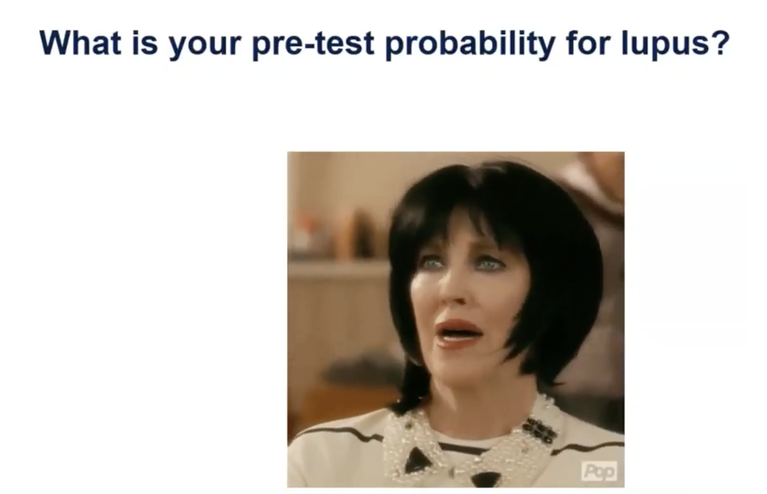

Slide 52
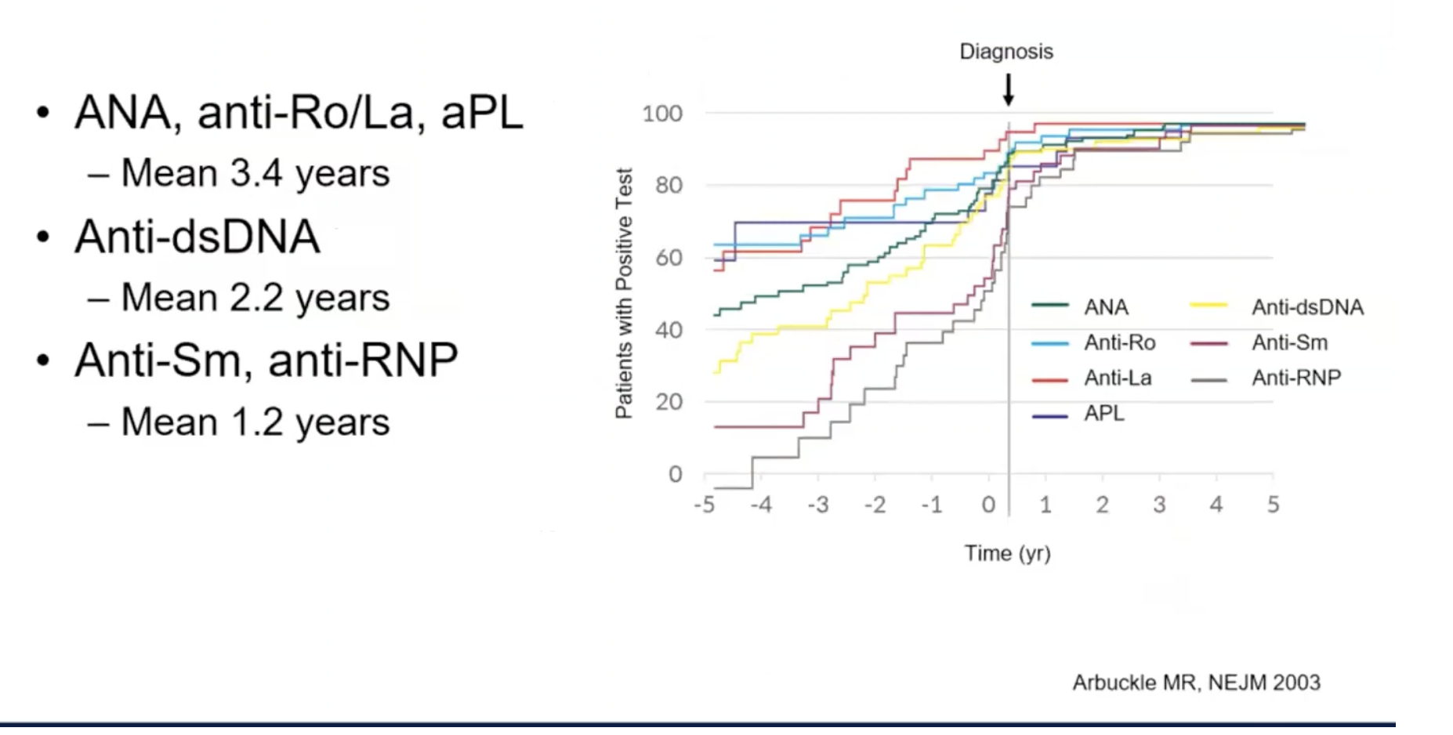
Michael R. Arbuckle study published in the The New England Journal of Medicine is a classic paper - about the preclinical phase of Systemic Lupus Erythematosus. The study used samples from the U.S. Department of Defense Serum Repository, which contains millions of stored serum samples from military personnel.

Slide 53
Lupus begins immunologically years before it becomes clinically apparent
Lupus does not start suddenly. Autoantibodies appear years before clinical lupus.
Autoantibodies can be detected years before symptoms appear.
Mean time before diagnosis is 3.3 years and in some cases they appeared up to 9 years earlier.

Slide 54
Antibodies appear in a predictable sequence
Early antibodies:
Antinuclear Antibody (ANA)
Anti-Ro (SSA)
Antiphospholipid antibodies
Later antibodies (closer to disease onset):
Anti–double-stranded DNA antibodies
Anti-Smith antibodies
This shows progressive epitope spreading before clinical disease
Number of antibodies increases over time
Early stage: 1 autoantibody
Closer to diagnosis: multiple antibodies
Indicates evolving immune dysregulation

Slide 55
Important clinical lesson
A positive ANA alone does not equal lupus.
Because antibodies may be present years before disease develops.
Concept of “preclinical lupus”
This study established the idea that lupus has a long silent autoimmune phase before clinical manifestations.

Slide 56
CASE 5
A 24 year old woman with Systemic Lupus presents for routine follow up.
Inflammatory arthritis, acute cutaneous lupus, fatigue, oral ulcers
ANA, Smith, RNP, SSA, LAC positive
Doing well on HCQ monotherapy

Slide 57
What should you focus on the visit today?
Photoprotection
Vaccination
Contraception
CV risk
APS primary prevention
Medication complications

Slide 58
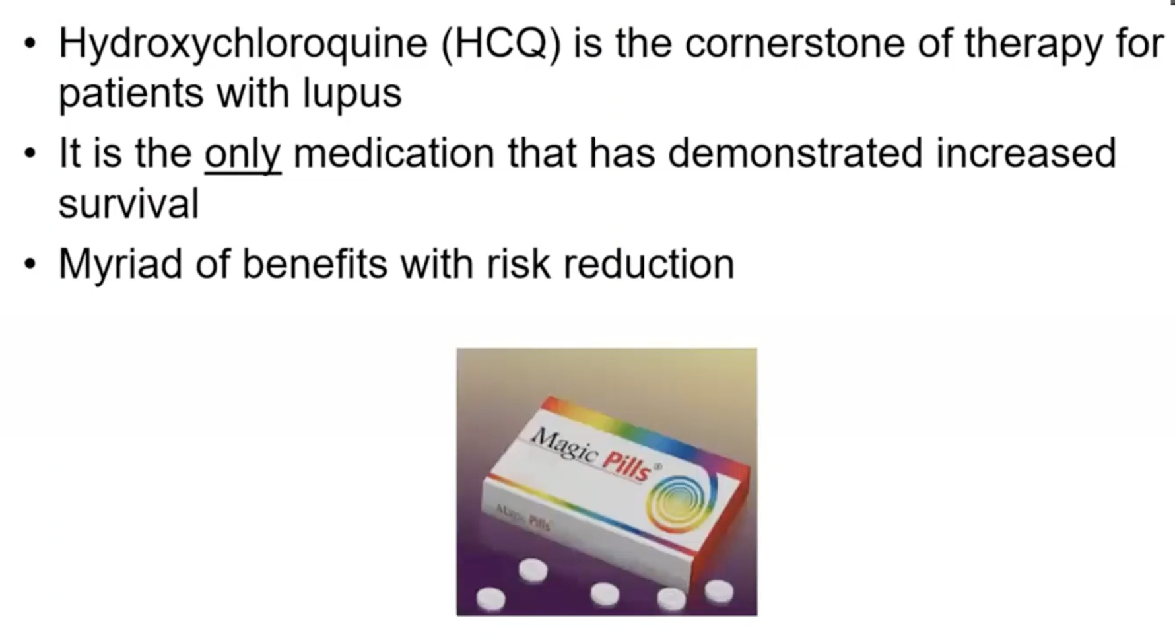
Hydroxychloroquine

Slide 59
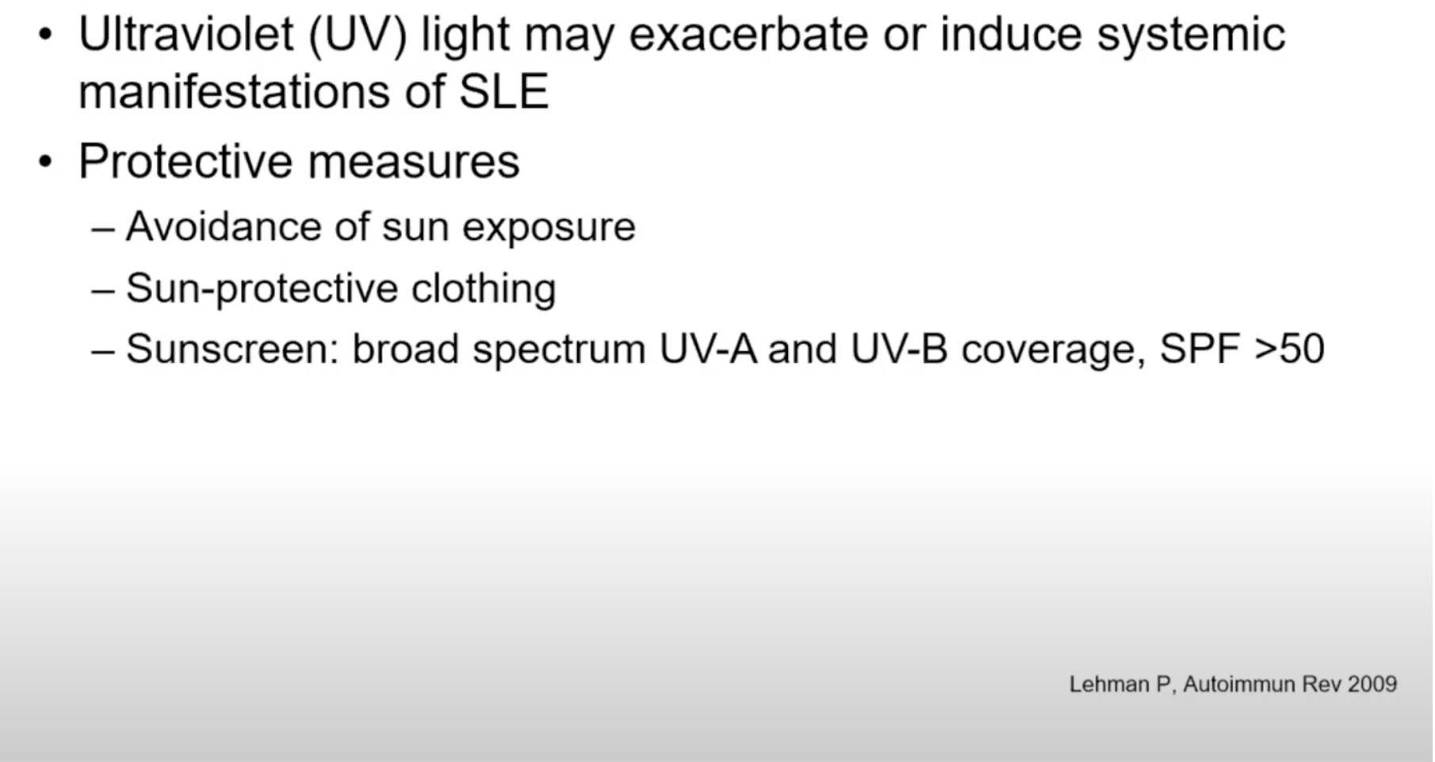
Photoprotection

Slide 60
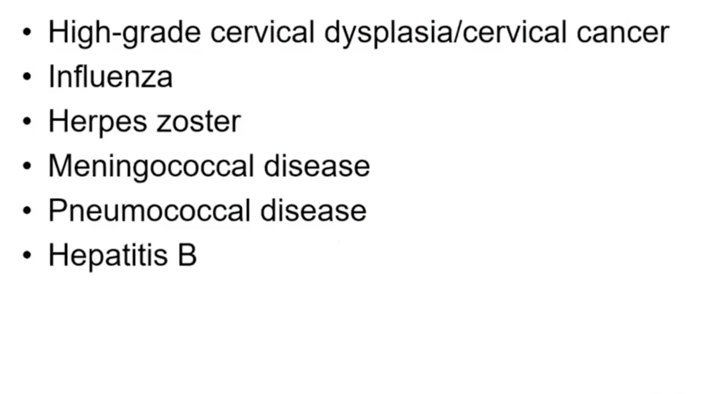
Update vaccines

Slide 61
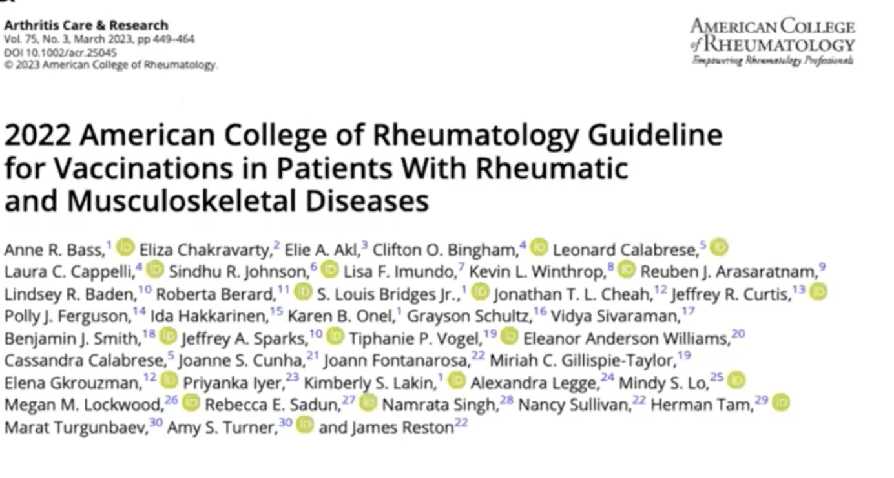

Slide 62
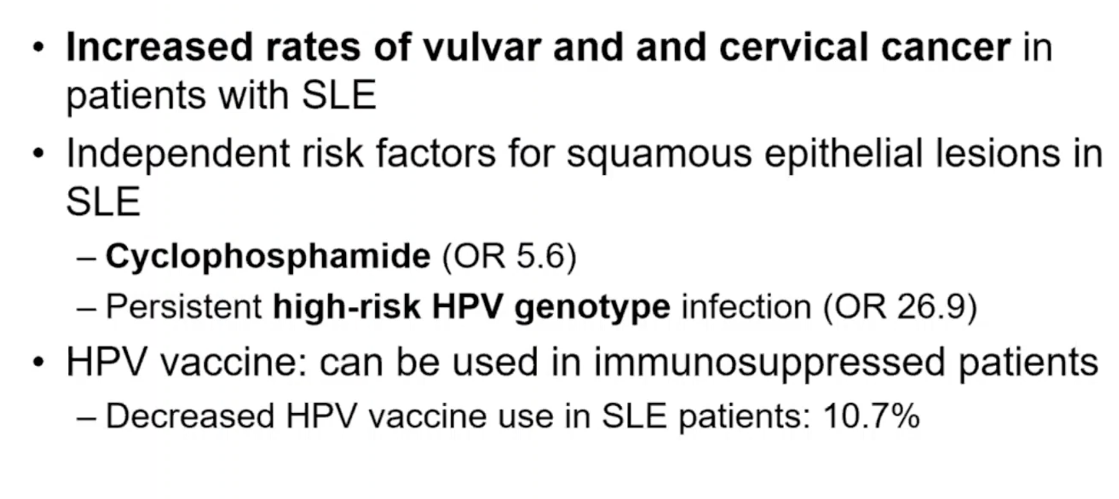
HPV in SYSTEMIC LUPUS AND CANCER RISK

Slide 63
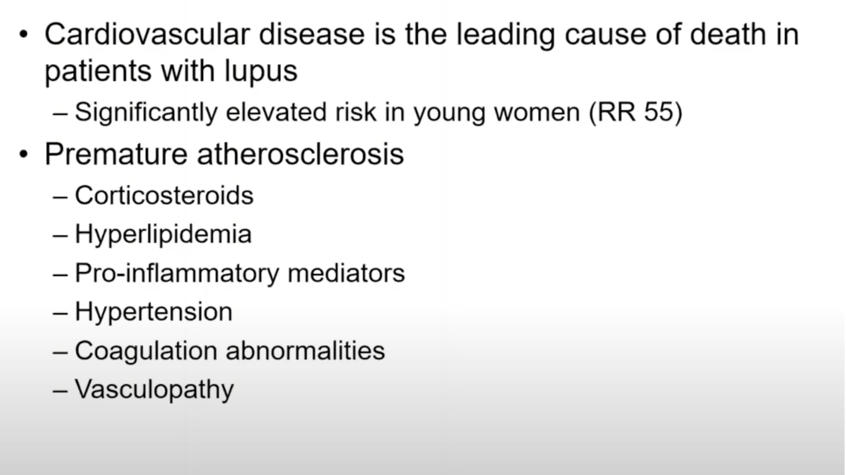
Cardiovascular risk in Lupus

Slide 64
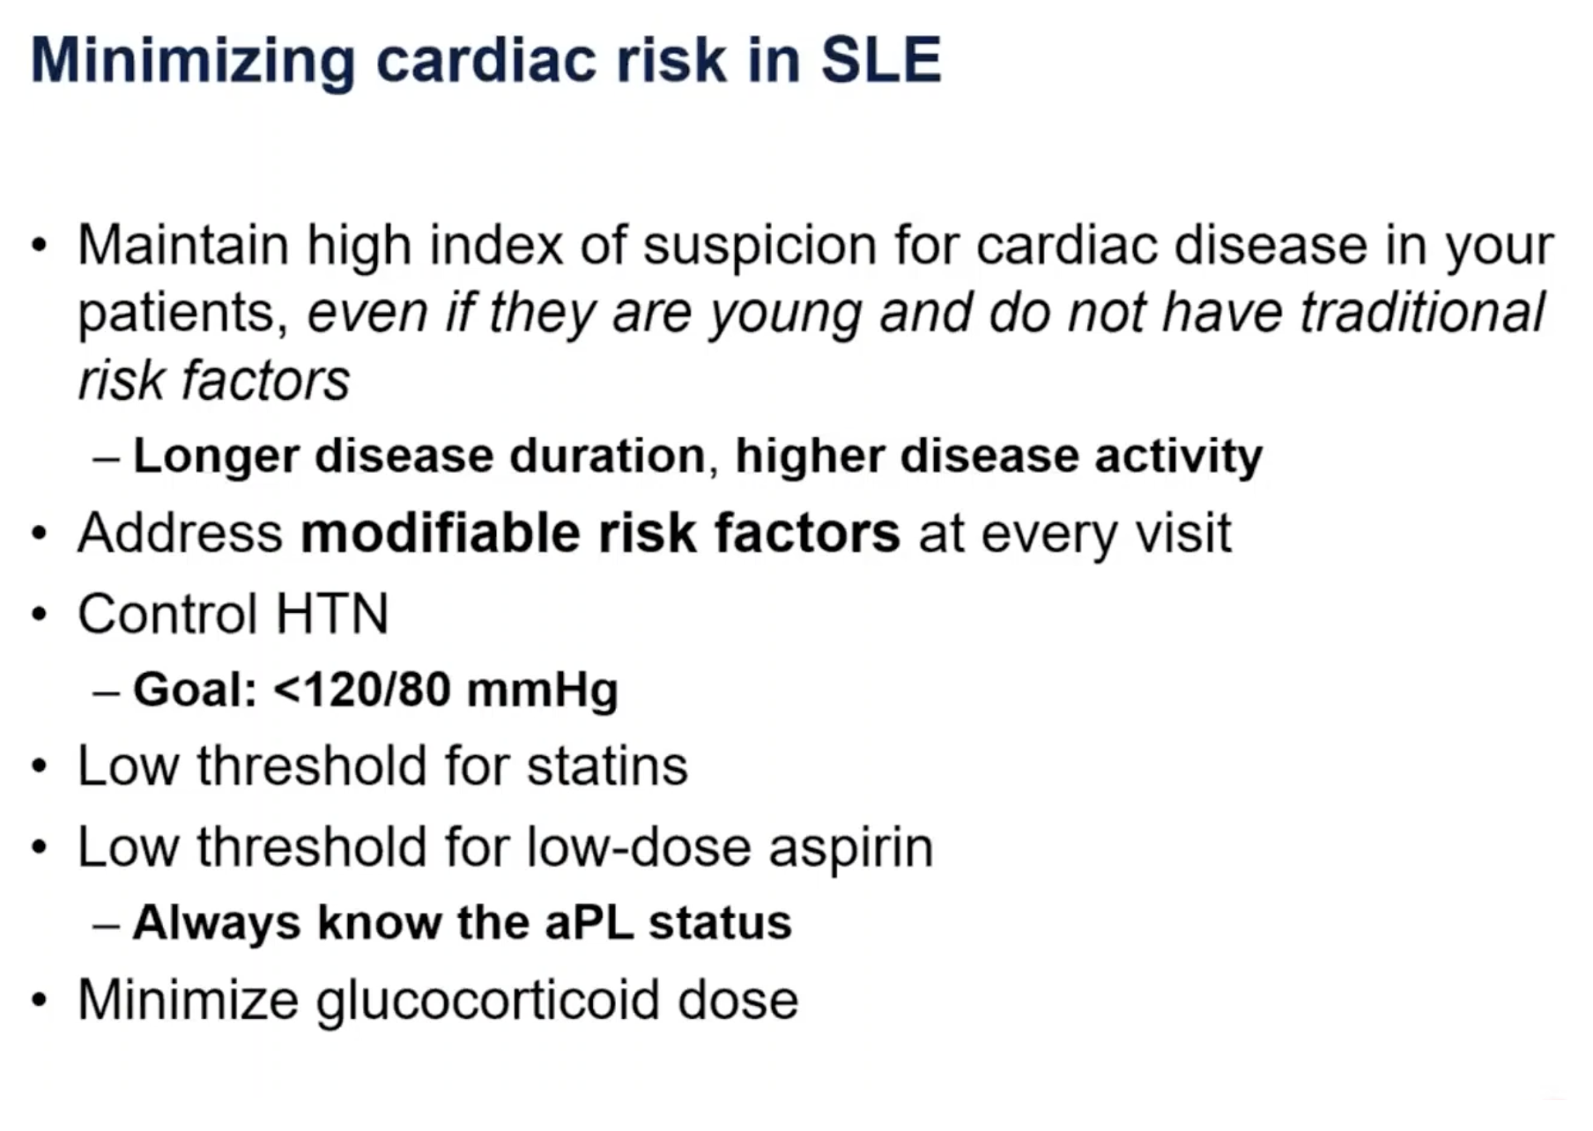

Slide 65
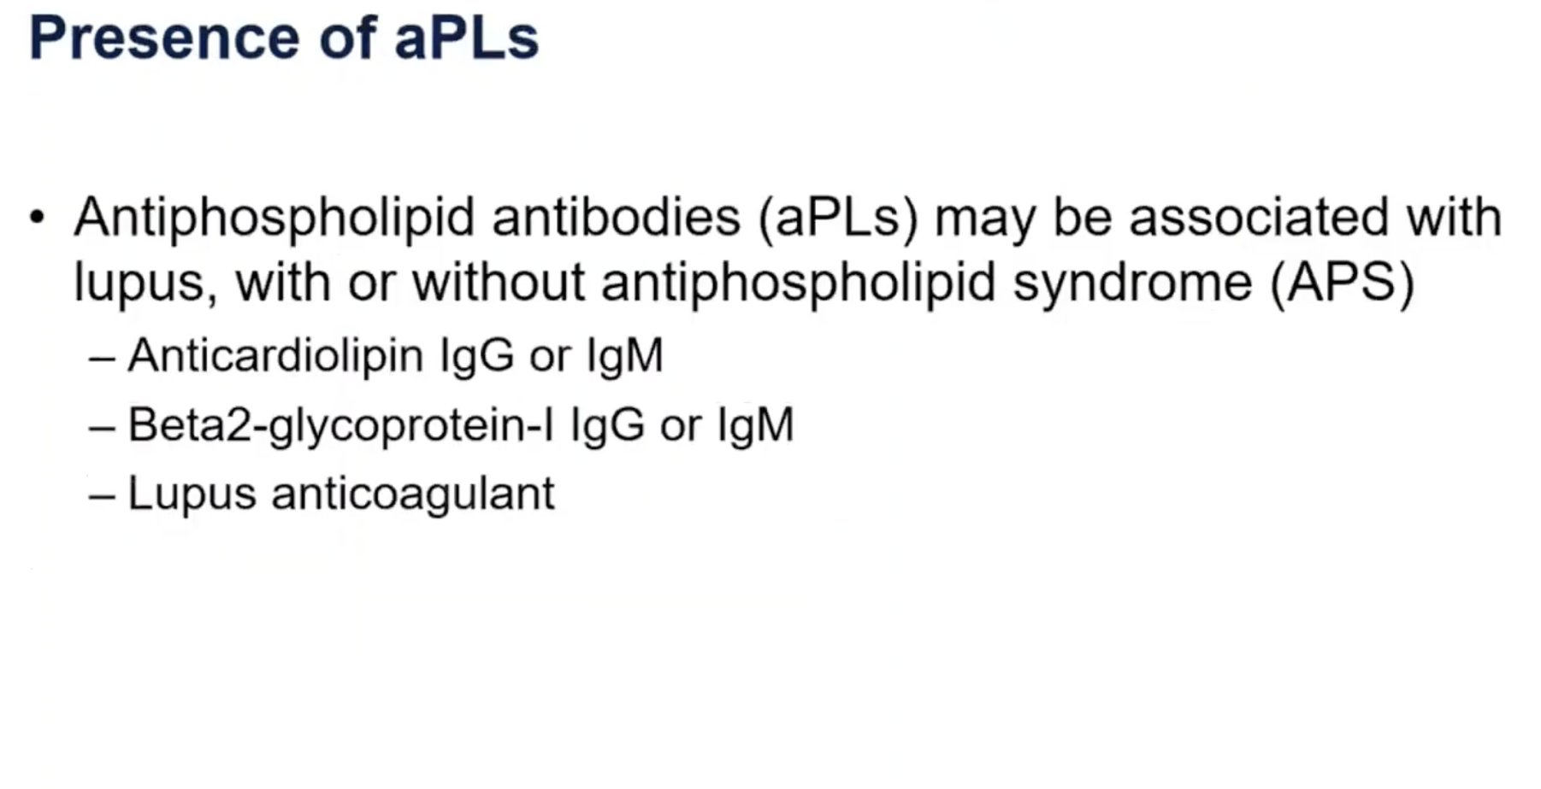

Slide 66
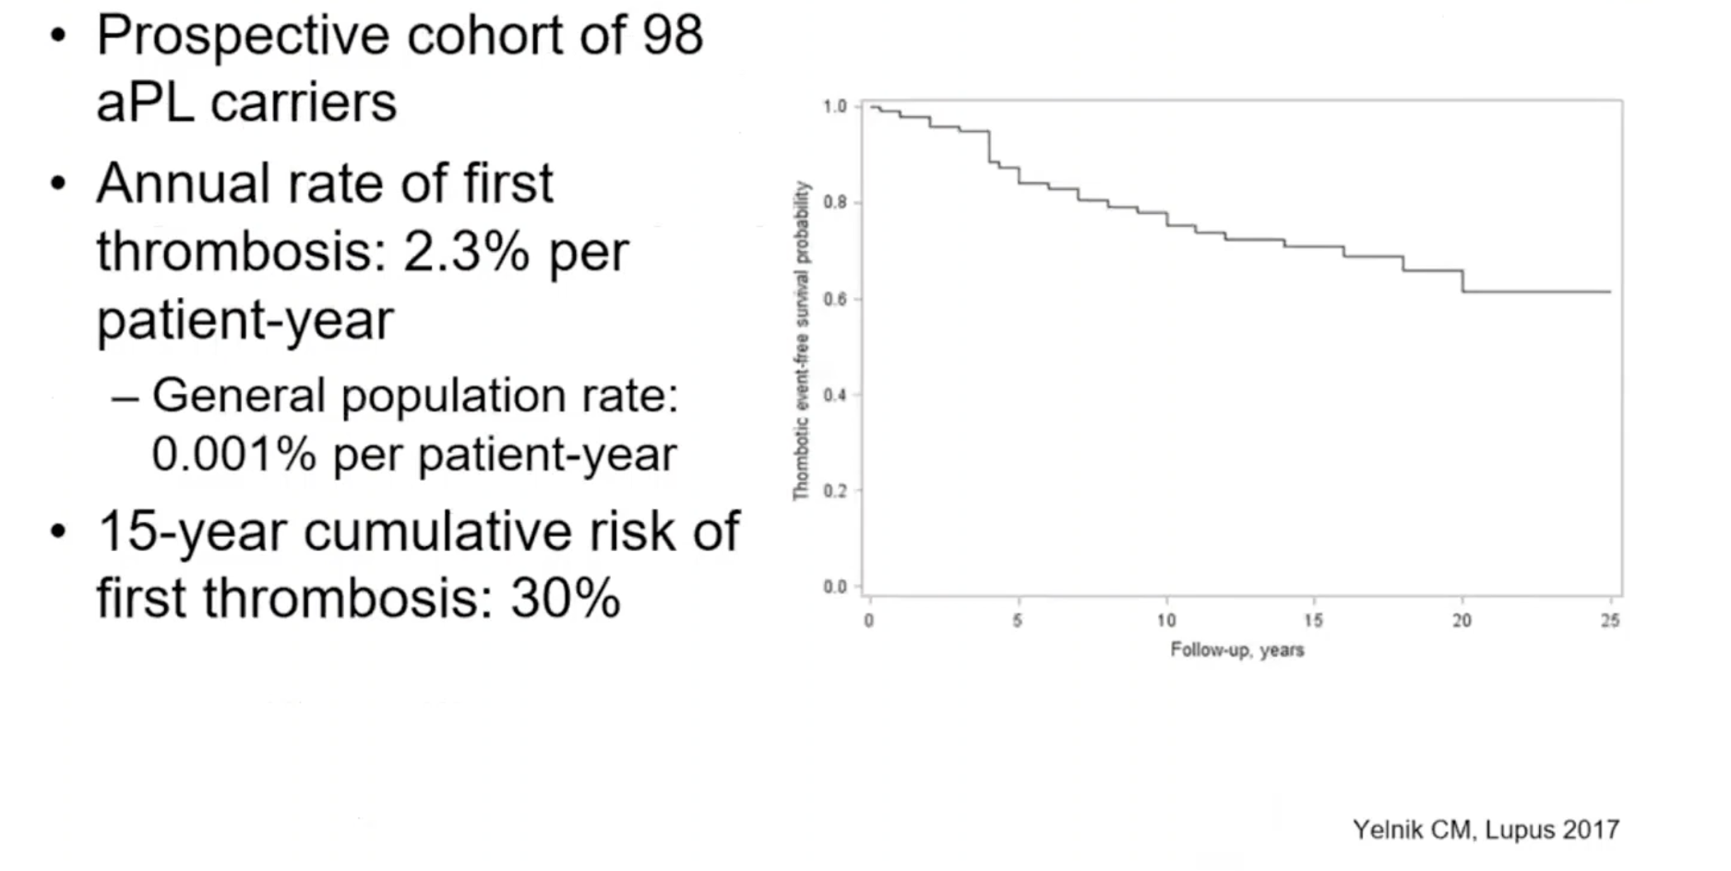

Slide 67
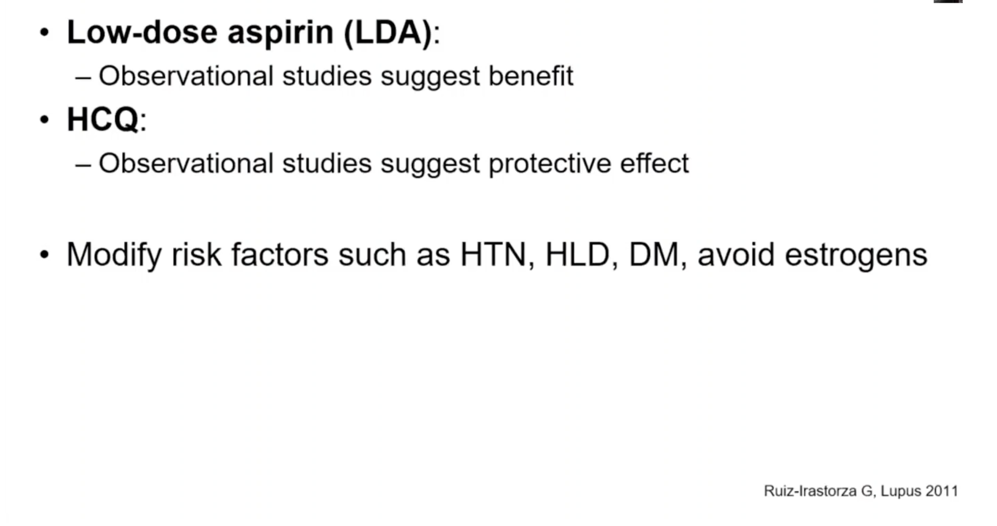

Slide 68
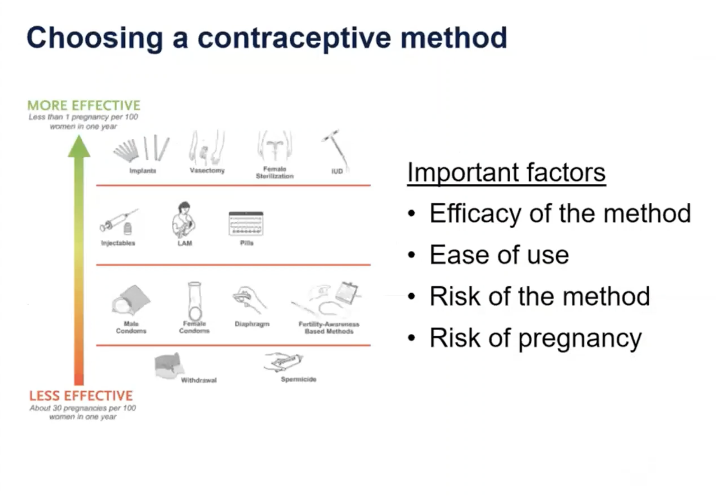

Slide 69
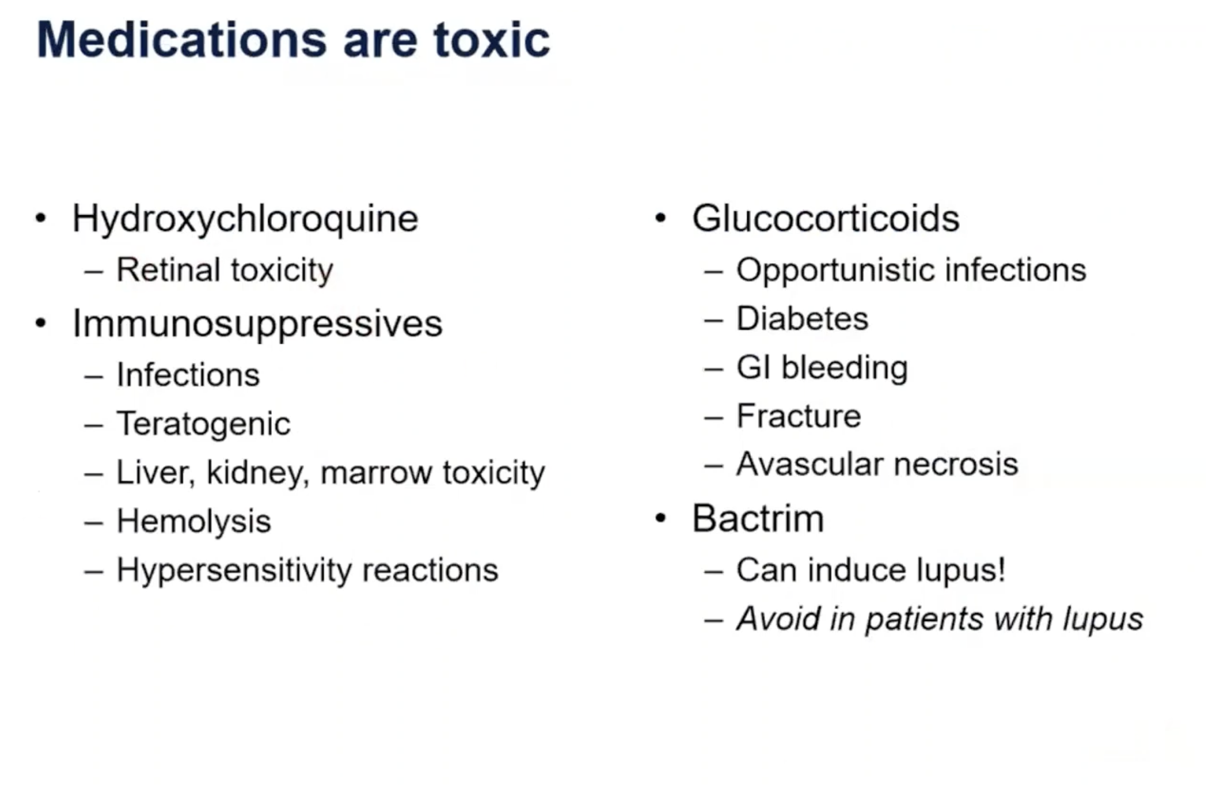

Slide 70
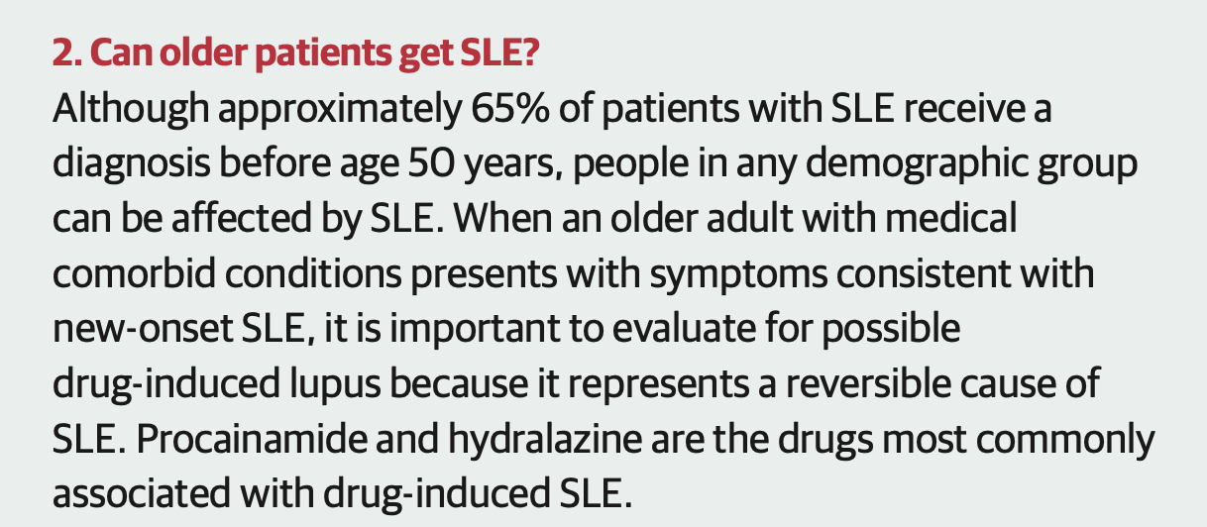

Slide 71
