Slide 1
Antimicrobial Stewardship
Michelle Potter, PharmD, BCIDP

Slide 2
Objectives
Define antimicrobial stewardship and describe common stewardship strategies
Explain the consequences of poor antimicrobial stewardship
List the four moments of antibiotic decision making
Describe the errors that are made in interpretation of microbiology results
Choose the appropriate antimicrobial durations for common infections

Slide 3
What is Antimicrobial Stewardship?

Slide 4
What is Antimicrobial Stewardship?
Multidisciplinary approach to optimizing antimicrobials to maximize patient outcomes and decrease antimicrobial resistance
Right drug
Right dose
Right route
Right duration
Timely de-escalation

Slide 5
Antimicrobial Stewardship Programs
Strategies
  Prospective audit and feedback
  Formulary restriction
  Guidelines and clinical pathways
  IV to PO conversion
  De-escalation of therapy
  Dose optimization
  Education

Slide 6
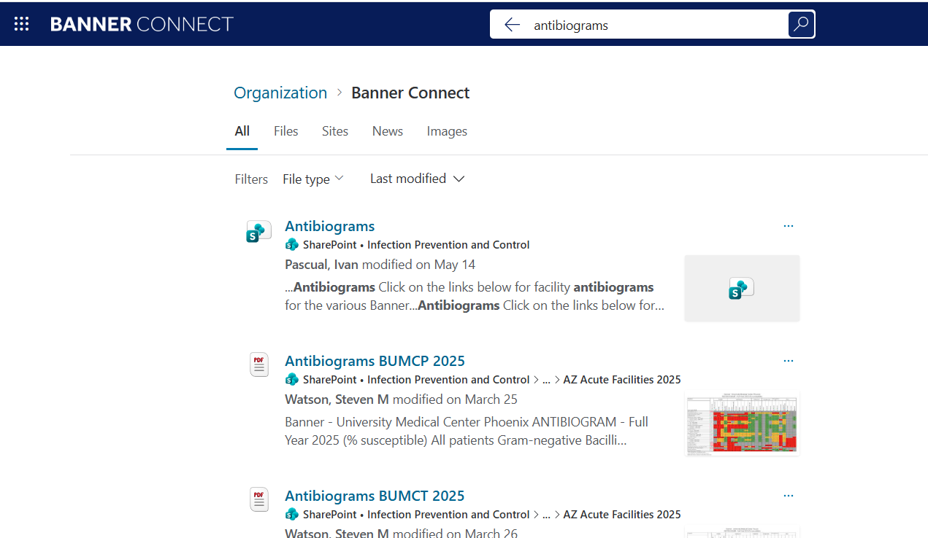
Banner General Stewardship Resources
OR on Banner Connect search bar: search “antibiograms”

Slide 7
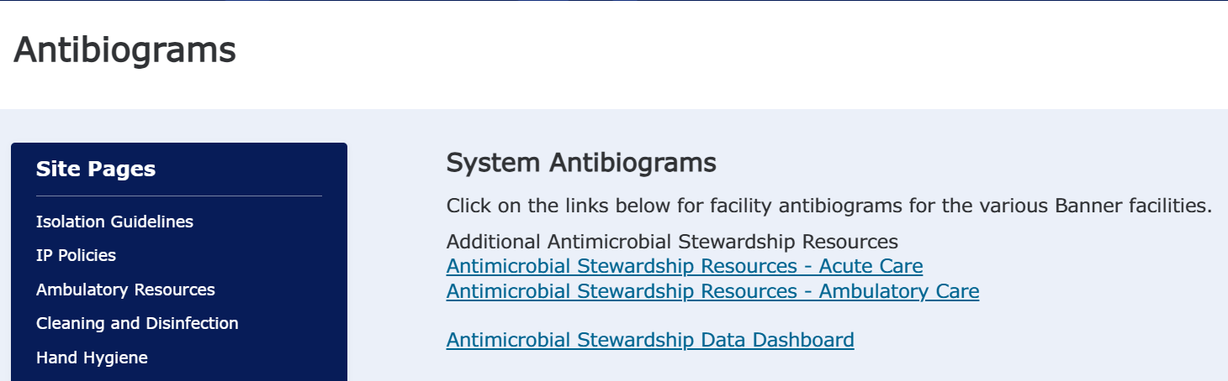
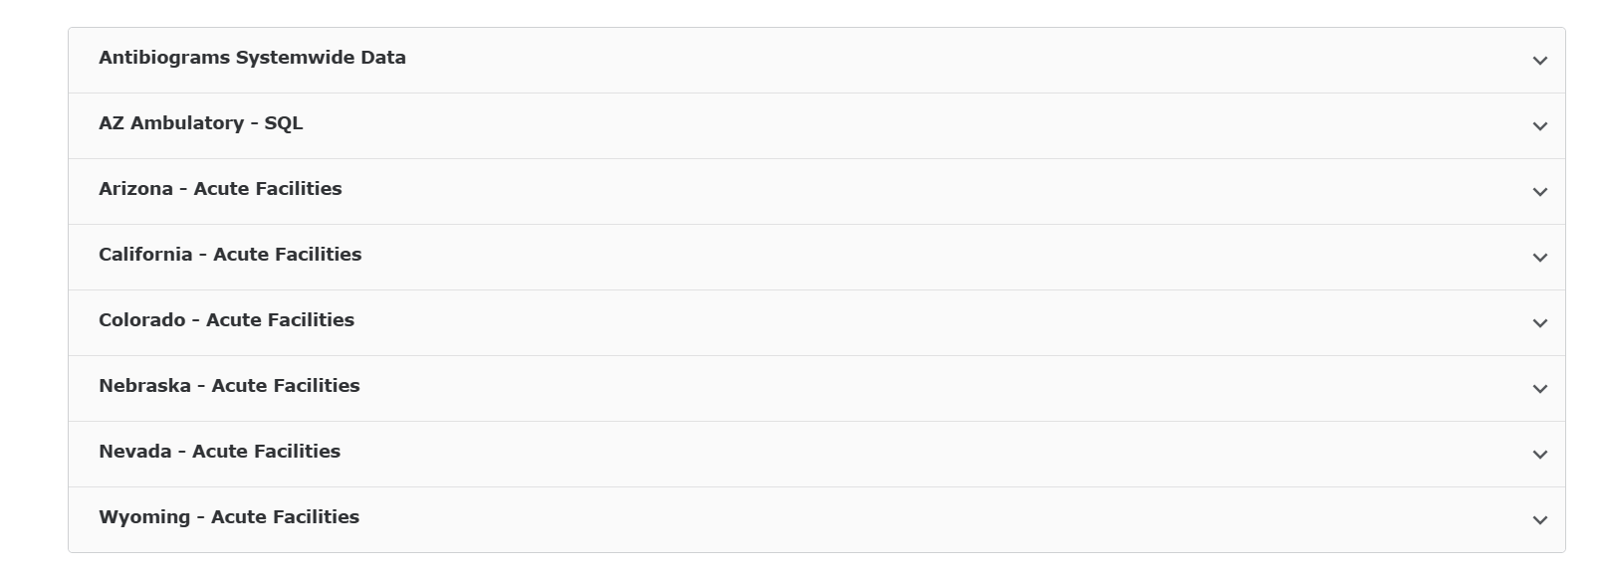
Banner Stewardship Resources

Slide 8
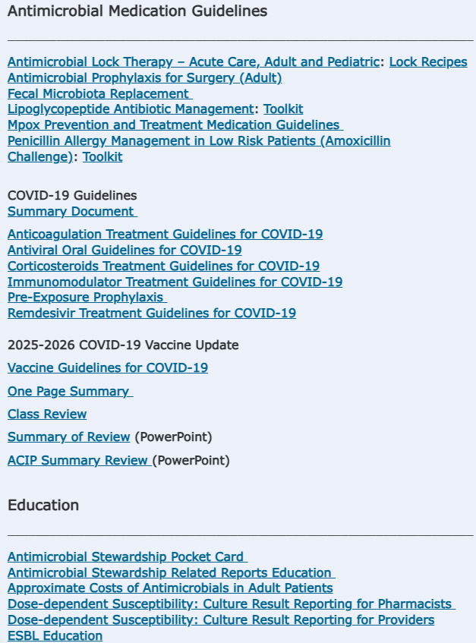
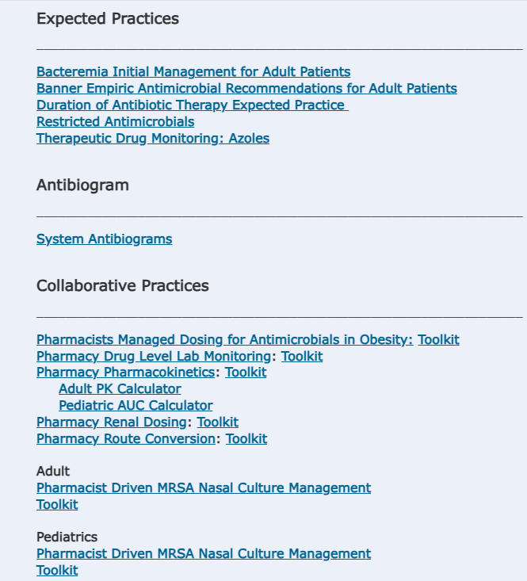
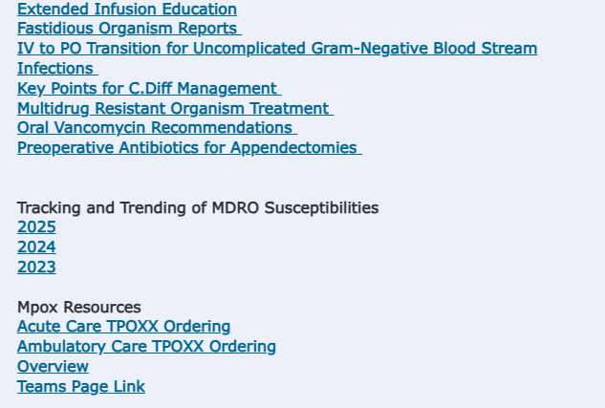
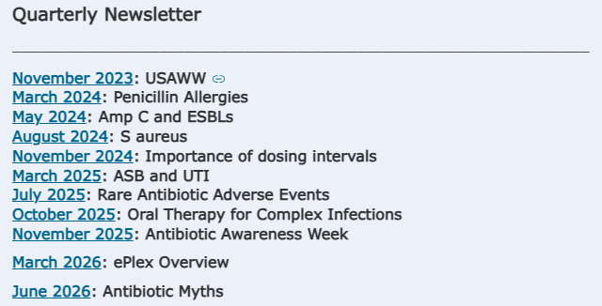
Banner Stewardship Resources

Slide 9
Multidisciplinary Approach
Antimicrobial stewardship requires a multidisciplinary approach
Everyone involved in patient care can contribute to antimicrobial stewardship
ID Physician
Hospital Administration
ID Pharmacist and Pharmacists
Information Technology Specialist
Infection Prevention
Antimicrobial Stewardship
Hospital Epidemiologist
Microbiology
Nursing
Primary Medical Provider(s)

Slide 10
Why Does stewardship Matter?

Slide 11
Consequences of Antibiotic Misuse
Inappropriate Antibiotic Use
Adverse Drug Events and Toxicity
C. difficile Infection
Antibiotic Resistant Pathogens
Excess Mortality and Costs
Notes:
Antibiotics are unlike any other drug, in that the use of the agent in one patient can compromise its effectiveness in another

Slide 12
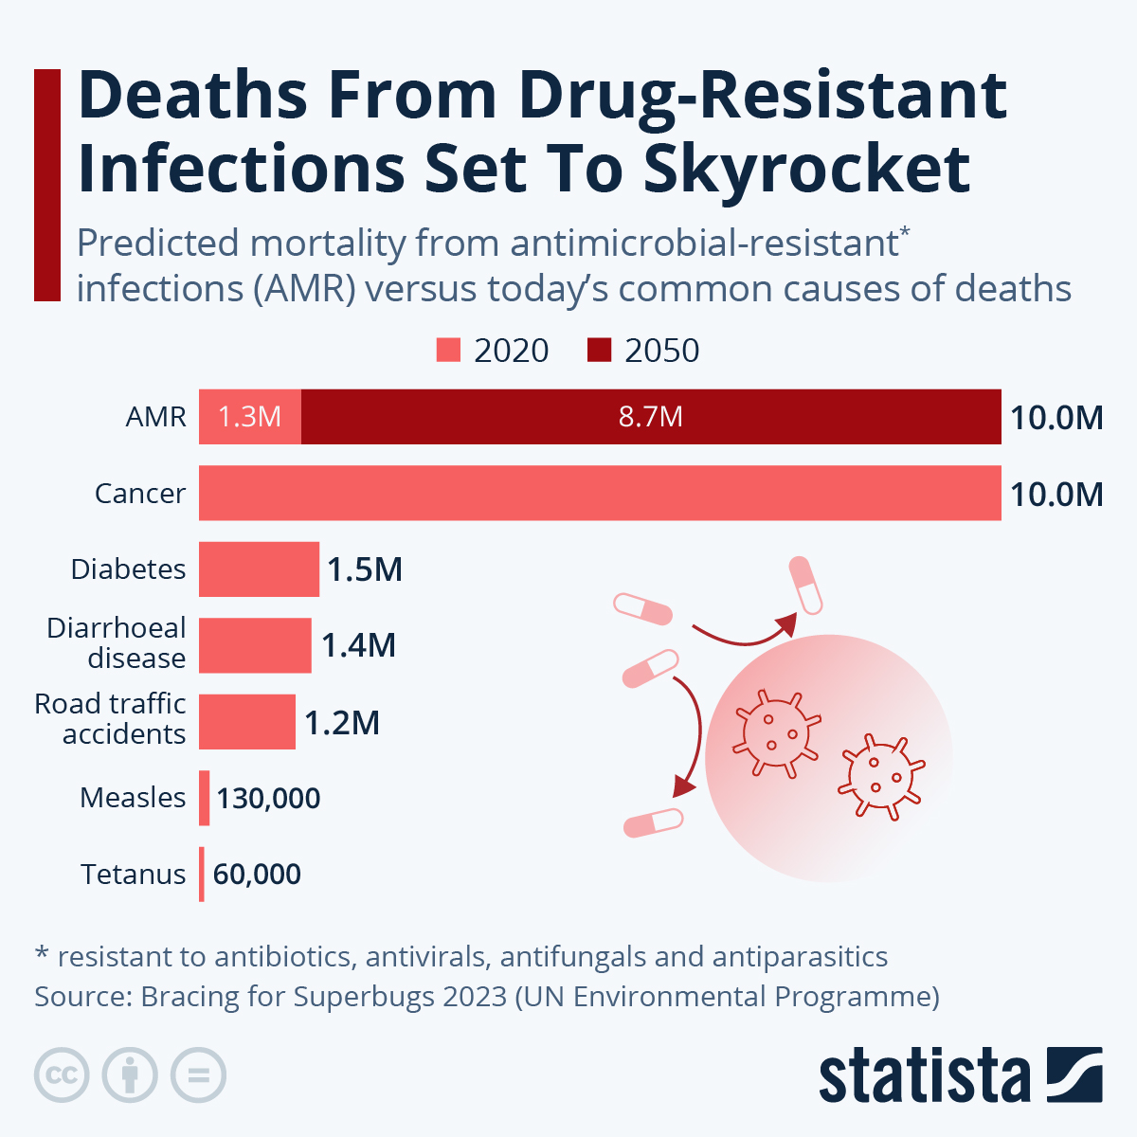
Antibiotic Resistance
https://www.statista.com/chart/3095/drug-resistant-infections/

Slide 13
Local Antibiotic Resistance
BUMCP Antibiogram
Organism | 2023 Antibiogram | 2024 Antibiogram | 2025 Antibiogram
Klebsiella pneumoniae non-urine | 10% CRE | 17% CRE | 23% CRE
AZ Banner Health Data

Slide 14
Carbapenem Use Increases Risk of Carbapenem Resistance
Single center study: changes to restricted antimicrobial policy due to ESBL outbreak
 | 1995 | 1996 | % Change
Cephalosporin Use (gm/month) | 5508 gm | 1106 gm | -80%
Imipenem Use (gm/month) | 197 gm | 474 gm | + 141%
Ceftazidime R Klebsiella (#) | 150 | 84 | -44%
Imipenem R Pseudomonas (#) | 67 | 113 | +69%
Rahal JJ et al. JAMA. 1998;280:1233-37.
Notes:
All cephalosporins restricted except CTX for meningitis/gonorrhea, cefotaxime for SBP, cefazolin for surgical prophy
Imi restricted except for ICUs for 72 hours

Slide 15
Improving Antibiotic Use Reduces Resistance
P < 0.01 for all increases
White et al. Clin Infect Dis. 1997;25:230-239.
Notes:
Houston teaching hospital: prior auth requiring ID physician approval for above IV abx
Also $800K in savings

Slide 16
Every Additional Day of Antibiotic Matters
7118 critically ill patients receiving antipseudomonal beta-lactams were evaluated
Every additional day of exposure to any antipseudomonal beta-lactam was associated with a 4% increase in risk of new resistance development
Teshome BF et al. Pharmacotherpay. 2019;39:261-70.
Notes:
BJH

Slide 17
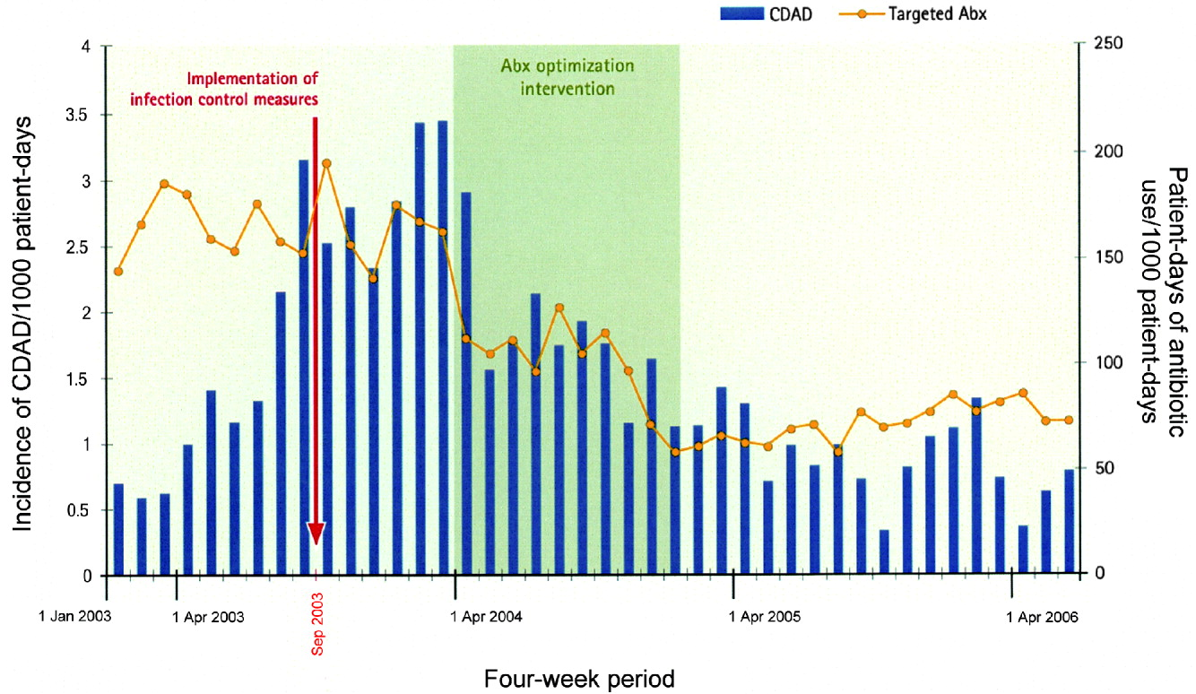
Improving Antibiotic Use Reduces C. difficile Rates
Valiquette et al. Clin Infect Dis 2007;45:S112
Notes:
Letters to all physicians/pharmacists, in-person education, pocket-sized abx guide of empiric treatment of common infxns, enforced by review/feedback. Targeted high CDI risk abx. 23% and 54% reduction in total and targeted abx consumption, CDI decreased by 60%

Slide 18
Improving Antibiotic Use Improves Infection Cure Rates
Fishman N et al. Am J Med. 2006;119:S53-S61
Notes:
University of Pennsylvania
Appropriate therapy: followed insitutition guidelines, allergies/renal dose adjustment/appropriate for discharge

Slide 19
Effects of Antimicrobial Stewardship
Improves Patient Outcomes
Decreases Antimicrobial Resistance
Decreases Adverse Effects
Decreases Costs
How we use antibiotics today or in one patient directly impacts how effective they will be tomorrow or in another patient; they are a shared resource
- Centers for Disease Control and Prevention

Slide 20
What Can We Do to Help?

Slide 21
Optimizing Antibiotics
Does this patient have an infection?
  Vs non-infectious causes/explanations
  Is it a bacterial infection?
  Colonization vs infection
De-escalation/optimization
  Site/type of infection
  Patient history
  Cultures and susceptibilities
  Other diagnostics (e.g. MRSA nares)
IV to PO
Duration plan
Notes:
Gram stain
48-72 hours de-escalation

Slide 22
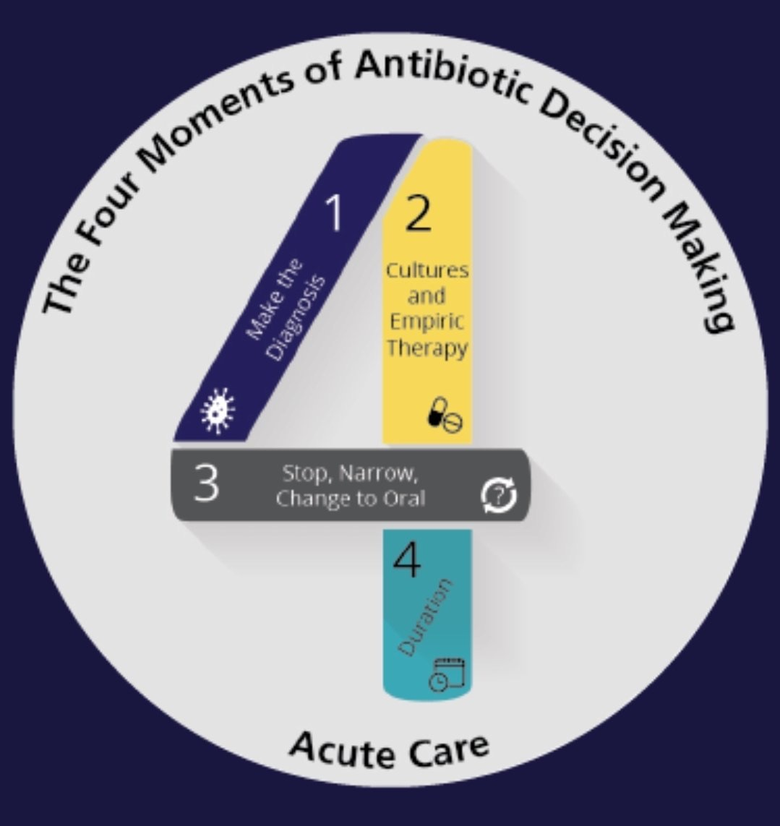
Optimizing Antibiotics

Slide 23
Interpreting Cultures/Susceptibilities

Slide 24
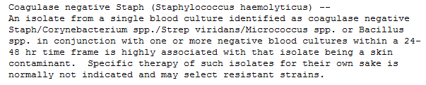
Is it a True Pathogen?
Contaminant, colonizer or true pathogen?
  Do they have symptoms of a UTI, pneumonia, etc?
How was the culture obtained?
  After urinary catheter exchange, or drawn from an old Foley?
  Wound swab vs debridement culture vs OR culture?

Slide 25
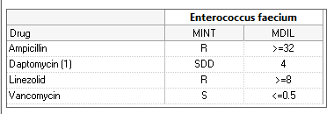
Interpreting Susceptibility Results
What do the numbers mean?
What does SDD mean?

Slide 26
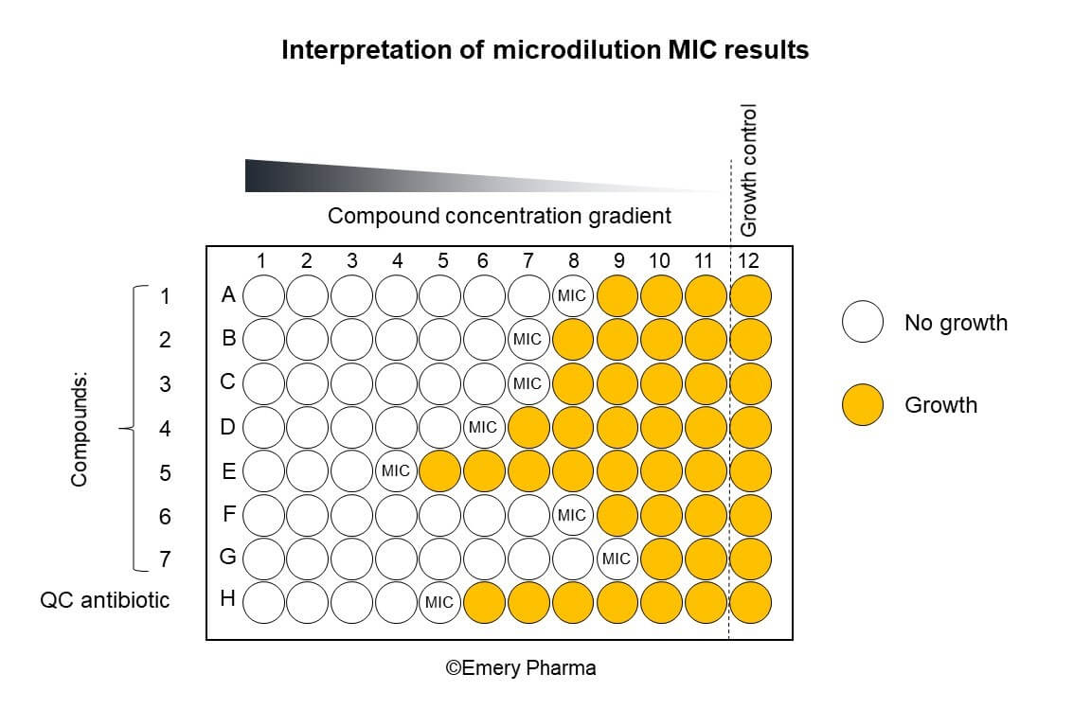
Susceptibilities
Minimum inhibitory concentration (MIC): Minimum concentration at which an antimicrobial agent inhibits the growth of the organism

Slide 27
Susceptibilities
Breakpoint: Determines whether an organism is susceptible or resistant to the antibiotic
  Example: MIC ≤ 4 mcg/mL = susceptible
Susceptible
High likelihood of clinical success
Intermediate
Buffer zone for error OR High likelihood of clinical success if exposure is enhanced by adjusting the dose regimen or if the antibiotic is concentrated at the site of infection
Susceptible Dose Dependent
High likelihood of clinical success if a higher dose is used
Resistant
Less likely to achieve clinical success

Slide 28
Banner Stewardship Resources: SDD

Slide 29
Susceptibilities
Which antibiotic would you choose to treat this infection?
Trach Aspirate: Pseudomonas aeruginosa
Sensitive MIC
Cefepime S 2
Levofloxacin S ≤1
Meropenem S ≤1
Tobramycin S ≤1
Piperacillin/tazobactam S 16

Slide 30
Susceptibilities
Which antibiotic would you choose to treat this infection?
Trach Aspirate: Pseudomonas aeruginosa
Sensitive MIC CLSI BP
Cefepime S 2 8
Levofloxacin S ≤1 1
Meropenem S ≤1 2
Tobramycin S ≤1 1
Piperacillin/tazobactam S 16 16

Slide 31
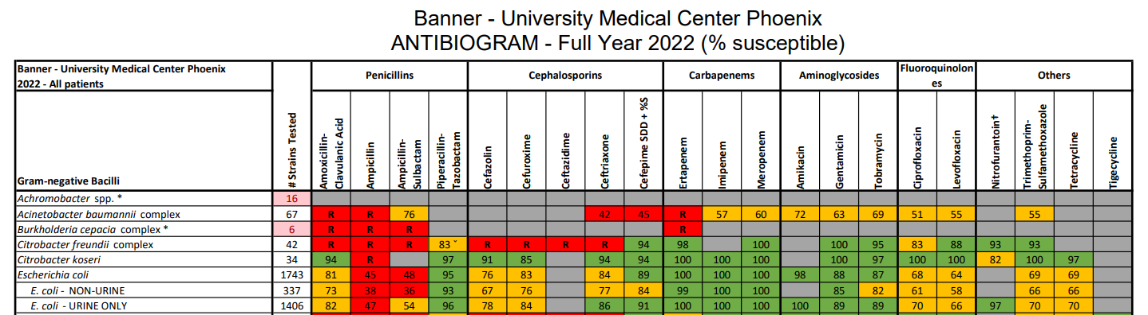
Antibiograms
What is an antibiogram?

Slide 32
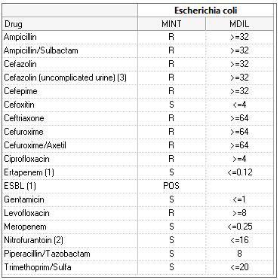
Case
GM is an 86-year-old female admitted for weakness after several days without A/C, found to have AKI. U/A was obtained in the ED, and patient was initiated on ceftriaxone because of pyuria. The culture results are shown below. GM denies urinary symptoms, and has been afebrile with a normal WBC.
What kind of resistance is seen here?
What changes would you make to the current antibiotics?

Slide 33
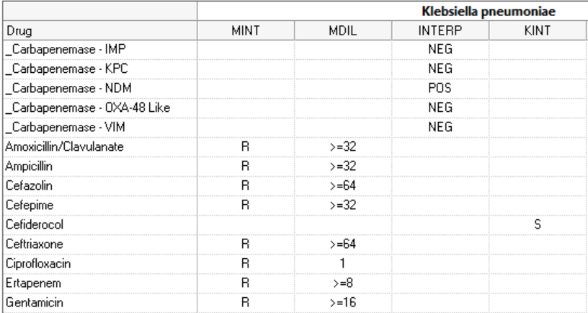
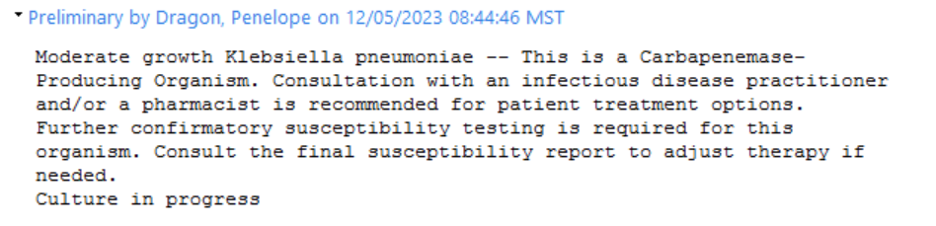
Interpreting Micro Comments

Slide 34
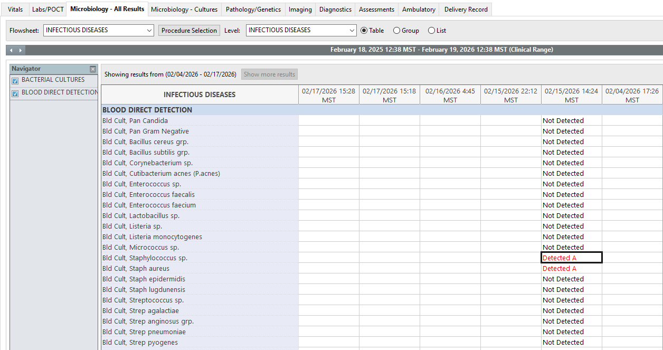
ePlex
Rapid diagnostic for blood cultures: results populate ~2 hours after positive blood culture gram stain

Slide 35
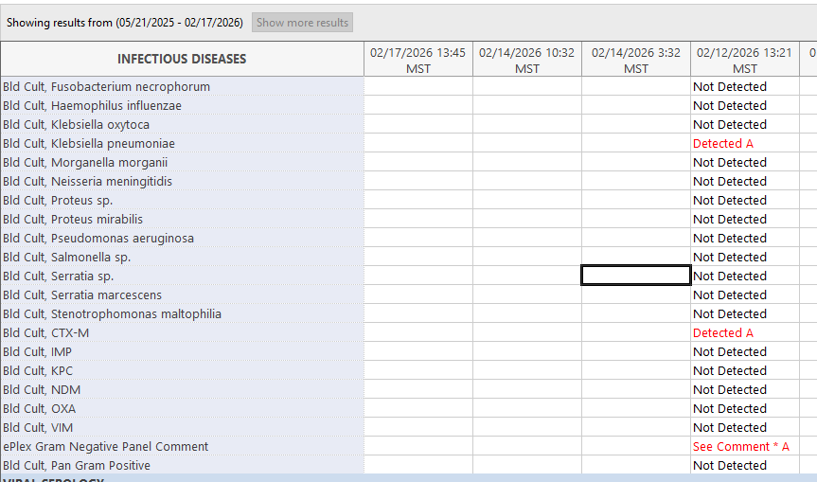
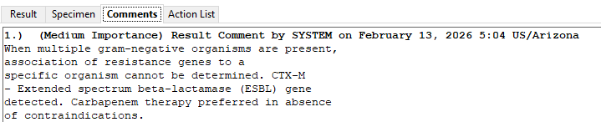
EPlex

Slide 36
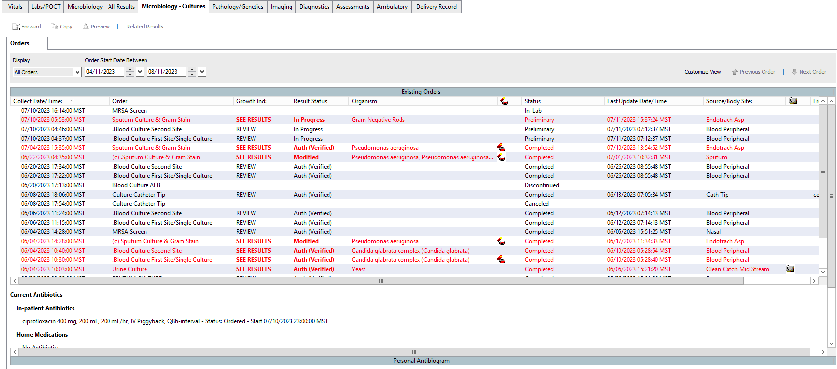
Cerner Feature: Personal Antibiogram

Slide 37
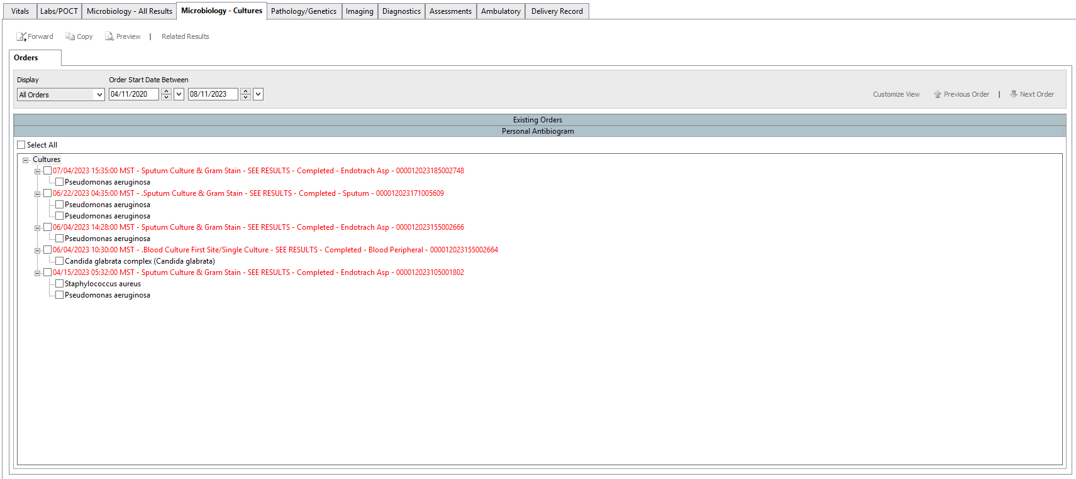
Cerner Feature: Personal Antibiogram

Slide 38
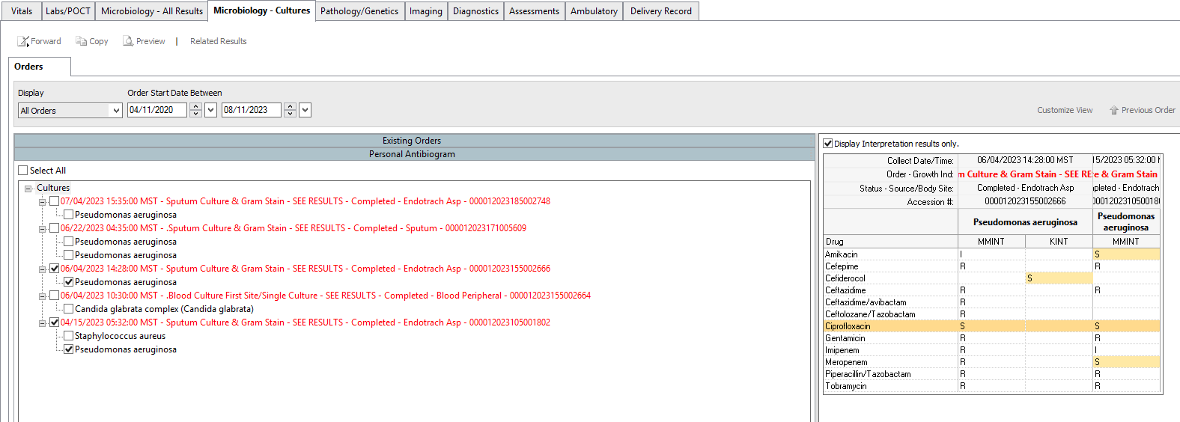
Cerner Feature: Personal Antibiogram

Slide 39
How to Request Additional Susceptibilities
If we are using an antimicrobial that we do not have susceptibilities for, susceptibilities should be confirmed via micro request
Micro extension: 3481
  With questions about whether an agent has been tested but just hidden
Lab communication in Cerner
  To request additional susceptibility testing
  Orders → Laboratory Communication
  Type of communication: Add On Test
  Under order comments: include date, culture, organism, and antibiotic requested
    E.g. “For sputum culture from 7/8 growing Staphylococcus aureus, please test linezolid susceptibilities”

Slide 40
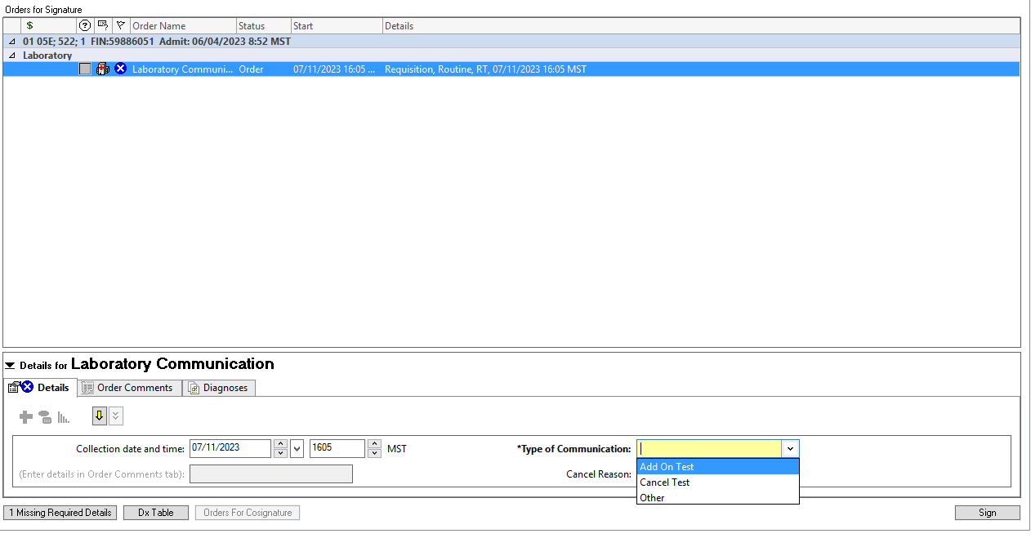
How to Request Additional Susceptibilities

Slide 41
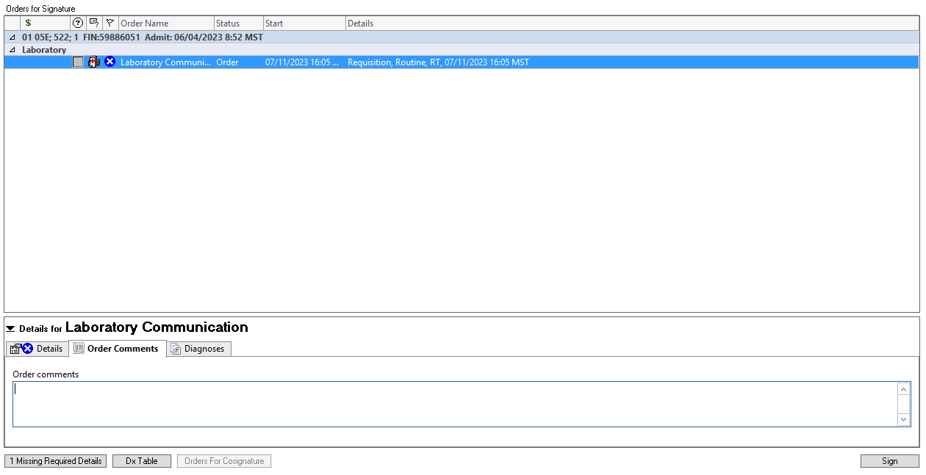
How to Request Additional Susceptibilities

Slide 42
IV to PO

Slide 43
IV to PO
Antimicrobials with excellent oral bioavailability:
  Azithromycin
  Clindamycin
  Doxycycline
  Fluconazole
  Fluoroquinolones
  Isavuconazole
  Linezolid
  Metronidazole
  Rifampin
  Trimethoprim-sulfamethoxazole
  Voriconazole
Infection treatable w/ PO
Gut works
USE PO!
Pt on orals
Notes:
Pharmacy CPA

Slide 44
Choosing the Route
Oral
Patient convenience
Facilitates discharge
Fewer IV-line-associated complications
More cost-effective
Intravenous
N/V/D precludes use of PO route
Poor oral bioavailability
Preferred for critically ill patients
Less data for efficacy in severe infections

Slide 45
IV to PO Protocol
Inclusions
On oral diet or tube feeds
On other oral medications
WBC normalizing, afebrile
Exclusions
NPO including meds or unable to tolerate PO meds (N/V)
Grade III or IV mucositis
GI obstruction, high stoma outputs and/or malabsorption syndrome
Serious or life-threatening illness (e.g. sepsis, pressors)
CNS infection, endocarditis, osteomyelitis, persistent febrile neutropenia

Slide 46
Duration

Slide 47
Banner Stewardship Resources: Duration

Slide 48
Duration: Shorter is Better
Many infections that have traditionally been treated with longer durations of antibiotics can now be treated with shorter courses based on new RCTs
Infection | Short Course | Longer Course | Result
CAP | 5 | 14 | Equal
HAP/VAP | 7-8 | 10-15 | Equal
Pyelonephritis | 5-7 | 10-14 | Equal
Gram-Negative Bacteremia | 7 | 14 | Equal
Intra-Abdominal Infection | 4 | 10 | Equal
SSTI | 5-6 | 10 | Equal
Neutropenic Fever | Afebrile x 72 hours | ANC > 500 | Equal
Metlay, et al. Clin Infect Dis. 2019;200:e45-e67.
Kalil AC, et al. Clin Infect Dis. 2016 Sep 1;63(5):e61-e111.
Eliakim-Raz N, et al. J Antimicrob Chemother. 2013;68:2183-91.
Yahav D, et al. Clin Infect Dis. 2019;69:1091-98.
Hepburn MJ, et al. Arch Intern Med. 2004;164:1669-74.
Moran GJ, et al. Lancet Infect Dis. 2014;14:696-705.
Sawyer RG, et al. N Engl J Med. 2015;375:1996-2005.
Aguilar-Guisado M, et al. Lancet Haematol. 2017;4:e573-e583.
bradspellberg.com/shorter-is-better

Slide 49
Duration
KS is a 38-year-old female with a PMH of depression, admitted for chills, flank pain, and dysuria. CT A/P with pyelonephritis, blood and urine cultures with pan-susceptible E. coli. Antibiotic course thus far has been vancomycin + piperacillin/tazobactam x3 days, now on ceftriaxone x2 days so far. How much longer would you continue antibiotics?

Slide 50
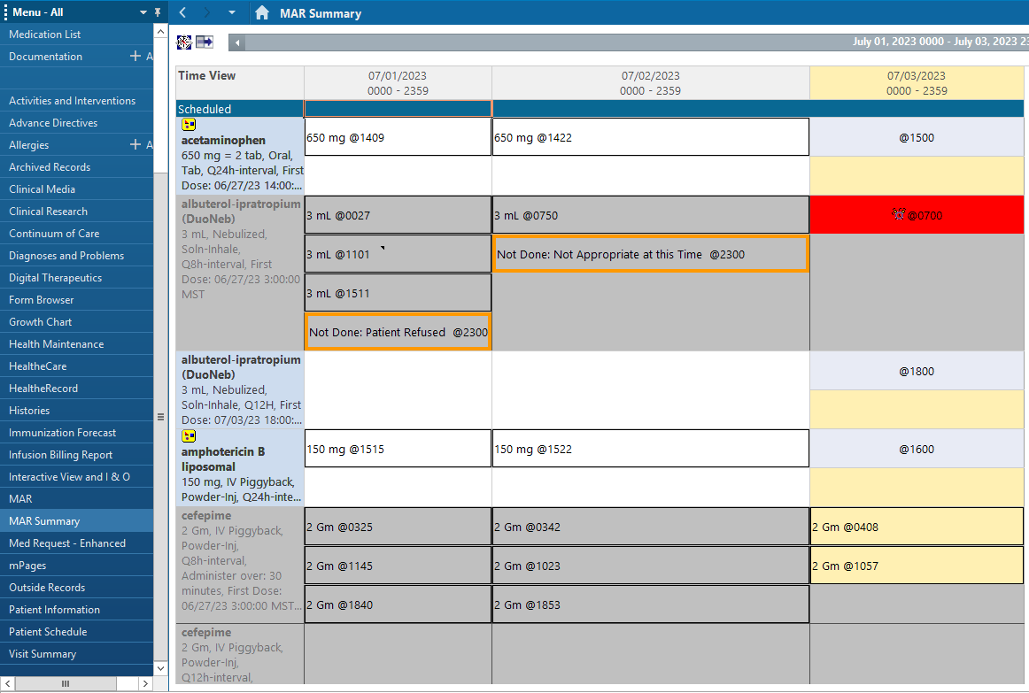
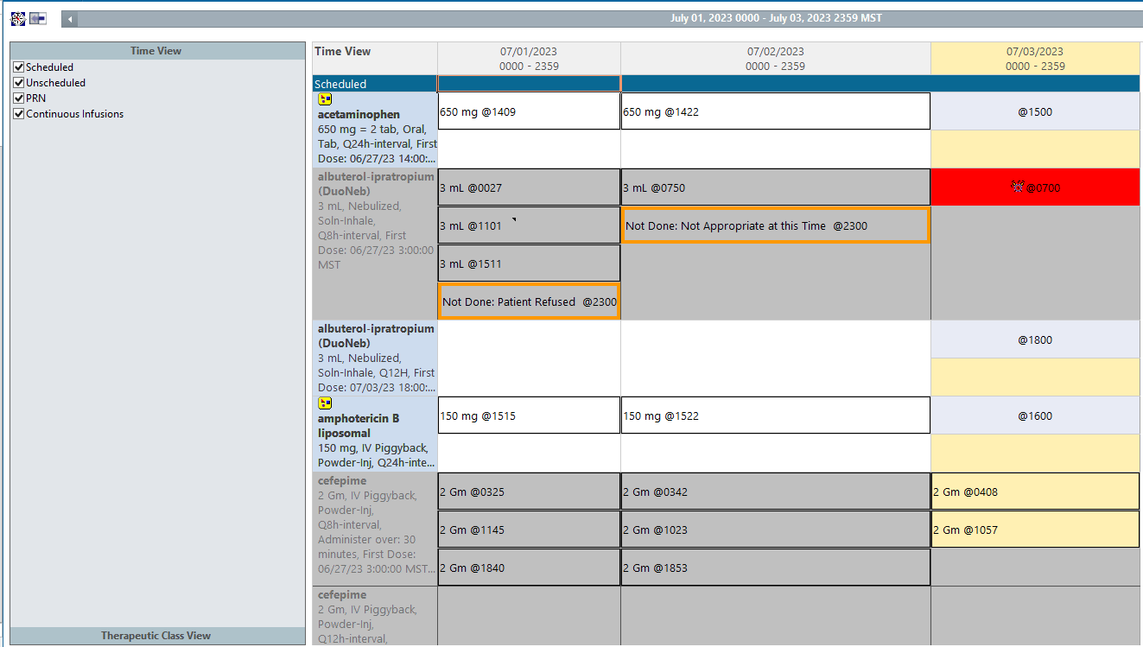
Duration: Cerner Views: Method 1
Include every day of effective antimicrobials
Include inpatient duration in discharge prescription durations

Slide 51
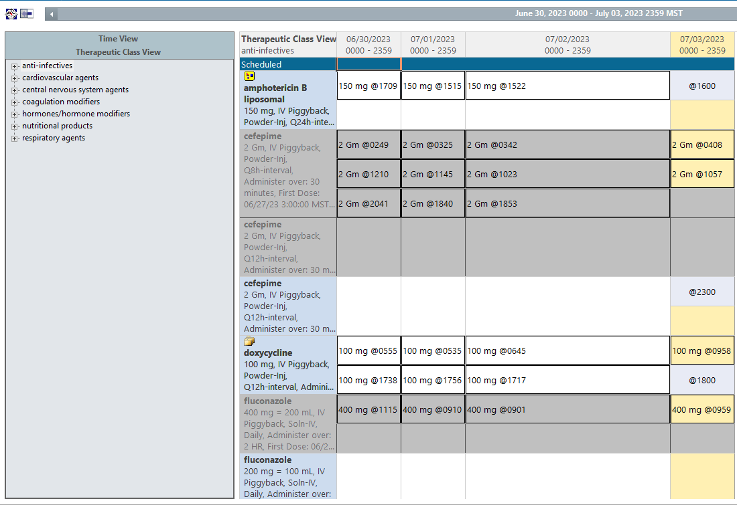
Duration: Cerner Views: Method 1
Sorts by antimicrobials only
Right click on top grey bar to change dates/see prior antimicrobials

Slide 52
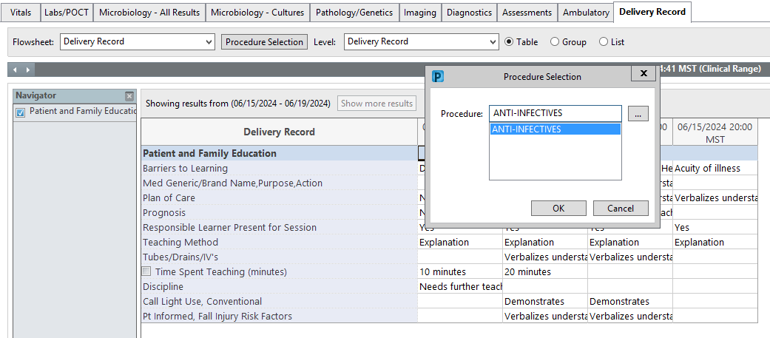
Duration: Cerner Views: Method 2
Delivery Record → Click on Procedure Selection → Type anti-infectives and press enter, then hit ok

Slide 53
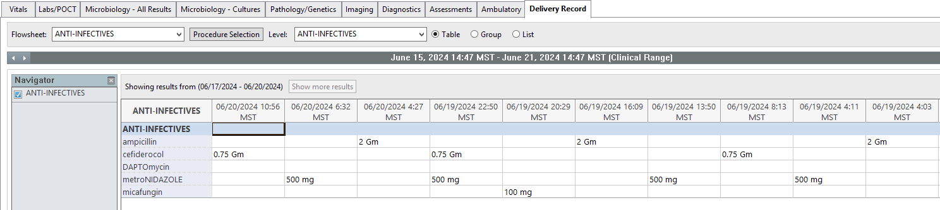
Duration: Cerner Views: Method 2
Right click on top grey bar to change dates/see prior antimicrobials

Slide 54
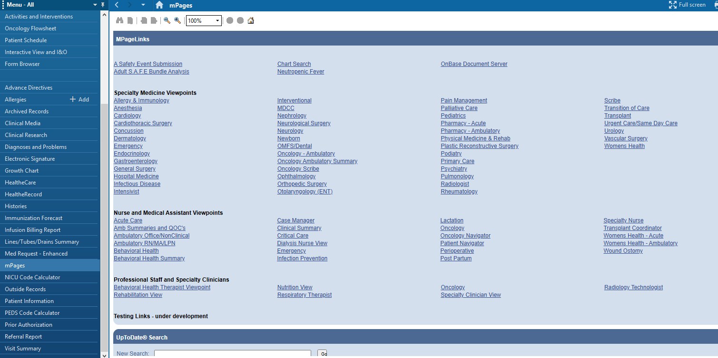
Duration: Cerner Views: Method 3

Slide 55
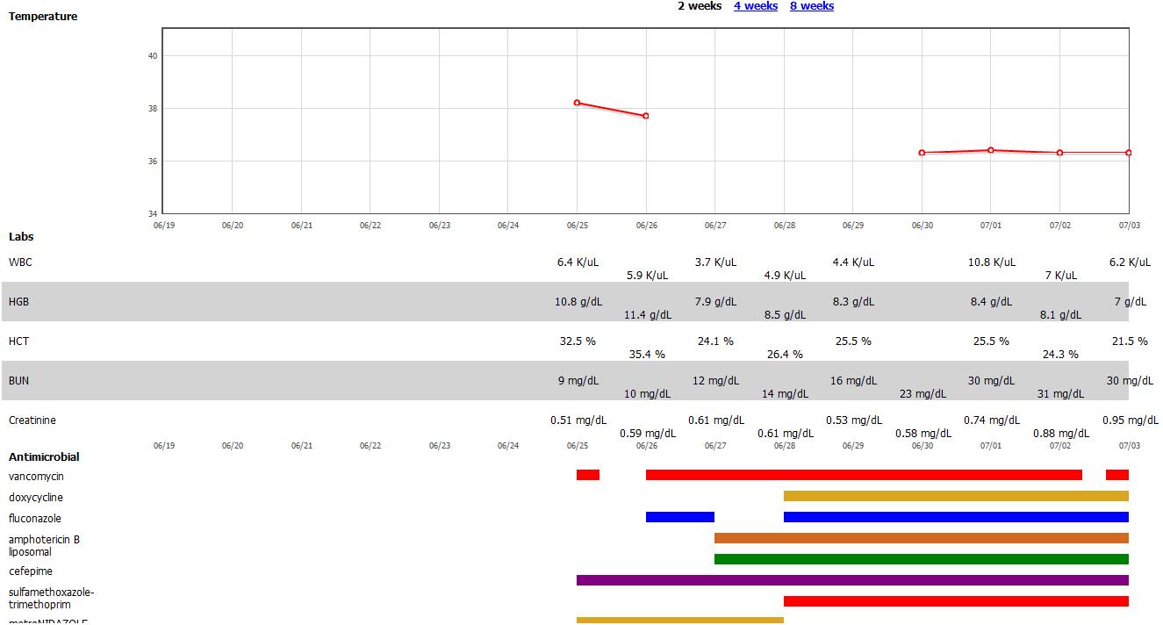
Duration: Cerner Views: Method 3

Slide 56
Optimizing Antibiotics
Does this patient have an infection?
  Vs non-infectious causes/explanations
  Is it a bacterial infection?
  Colonization vs infection
De-escalation/optimization
  Site/type of infection
  Patient history
  Cultures and susceptibilities
  Other diagnostics (e.g. MRSA nares)
IV to PO
Duration plan
Notes:
Asymptomatic bacteriuria
Foley

