Slide 1
Mini-Lectures
Wajih Askar, MD

Slide 2
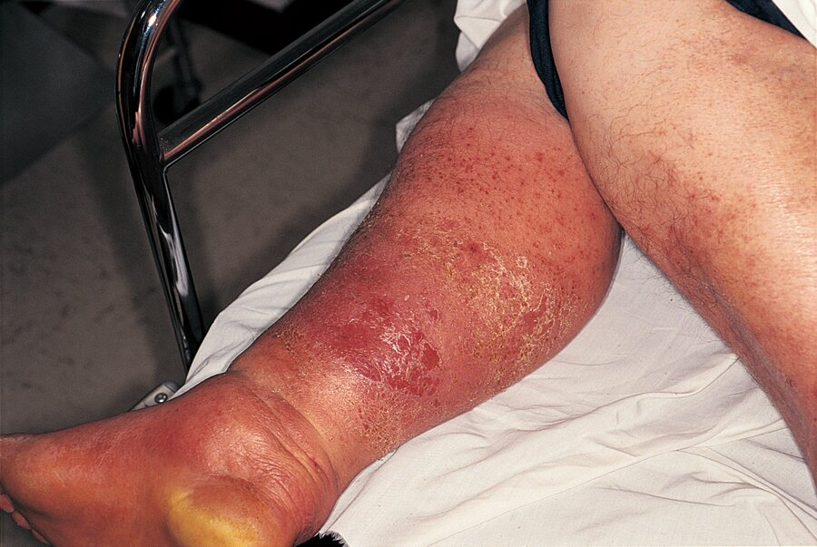
Case 1
A 56-year-old M is evaluated for fever, chills, and a rapidly spreading, warm, and painful skin condition. He is hemodynamically stable and lacks crepitus.
Which of the following is the most likely diagnosis?
1- Cellulitis
2- Deep Venous Thrombosis
3- Erythema migrans
4- Toxic shock syndrome

Slide 3
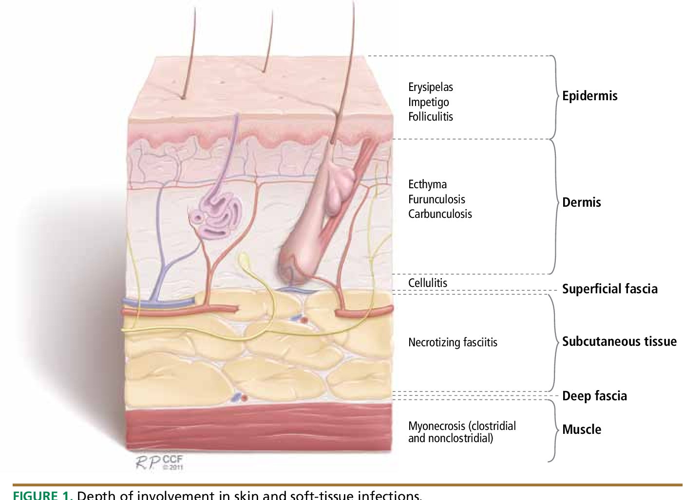
Cross-Section of the Skin

Slide 4
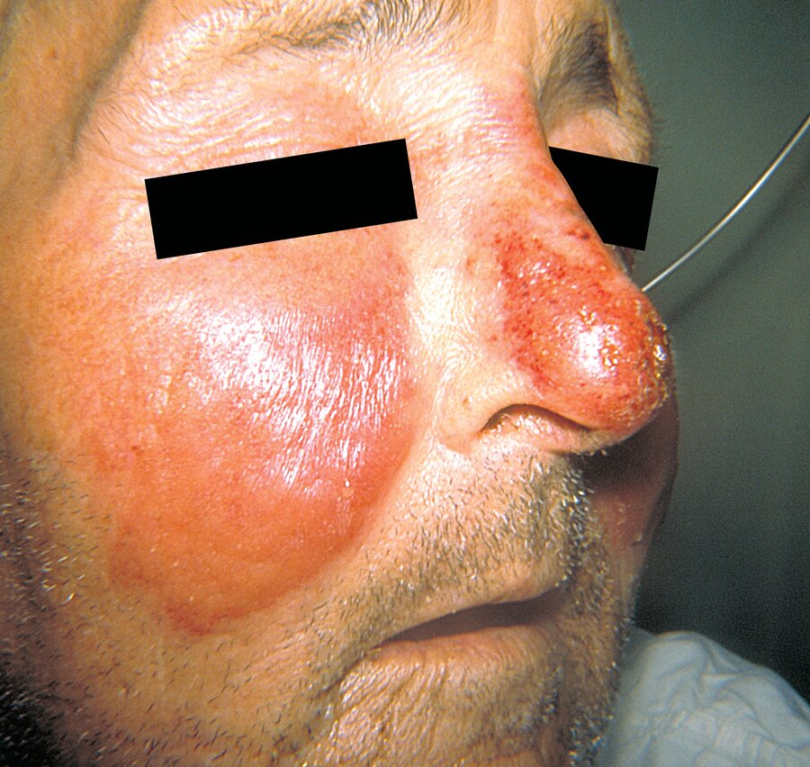
Definitions
Erysipelas: infection of the epidermis, upper dermis, and superficial lymphatics. Usually involving the face or lower extremities.
This infection is brightly erythematous and tender, with distinct elevated borders and associated fever, lymphangitis, and regional lymphadenopathy.

Slide 5
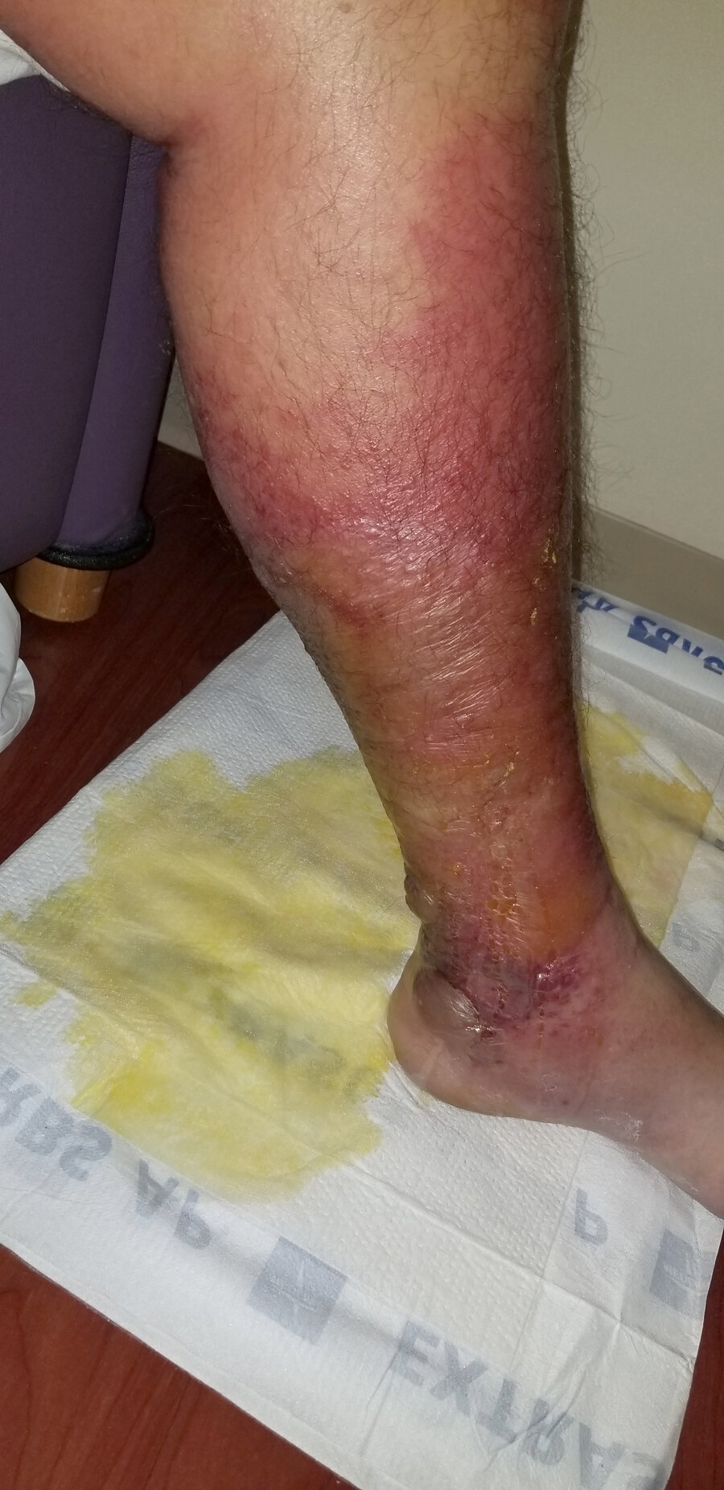
Definitions-cont’d
Cellulitis: infection involving the deeper dermis and subcutaneous fat tissue. Inflammatory signs of infection are similar to erysipelas, but the area of involvement is less well demarcated.

Slide 6
Epidemiology
Non-purulent infections are typically caused by β-hemolytic streptococci.
Purulent cellulitis and abscesses are typically caused by Staphylococcus aureus (including methicillin-resistant [MRSA] strains).
Think about MRSA:
1- Purulent cellulitis
2- Penetrating trauma
3- MRSA infection somewhere else
4- Positive MRSA nares screen.
5- IVDU
6- Immunocompromised host even in non-purulence cellulitis (neutropenia).

Slide 7
Case 2
A 33-year-old F is evaluated for redness over her right calf at the site of a scratch that occurred 2 days ago. She has otherwise been well and takes no medications.
On physical examination, vital signs are normal. Tender, poorly demarcated erythema measuring 4 × 3 cm is noted over the right lower leg. No purulence, induration, or fluctuance is present.
Which of the following is the most appropriate treatment?
1- Cephalexin
2- Doxycycline.
3- TMP/SMZ
4- IV Vancomycin

Slide 8
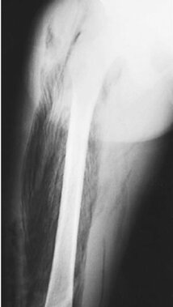
Case 3
A 38-year-old M is evaluated for a 2-day history of right arm pain, erythema, and fever following a traumatic injury to the arm 5 days ago.
Radiograph of the right arm is shown.
Which of the following is the most likely diagnosis?
1- Cellulitis
2- Necrotizing fasciitis
3- Osteomyelitis
4- Soft-tissue sarcoma

Slide 9
Epidemiology-cont’d
Necrotizing fasciitis infections are typically caused by polymicrobial (mixed aerobic–anaerobic microbes) or monomicrobial (group A streptococci, community-acquired MRSA).

Slide 10
Are Blood Cultures Necessary?
Blood cultures are positive in ~ 5% of patients with cellulitis, so they are NOT routinely indicated.
Blood cultures should be performed for those with:
1- Malignancy
2- Immunocompromised.
3- Severe systemic features.
4- Predisposing features (e.g., penetrating trauma, animal bite).

Slide 11
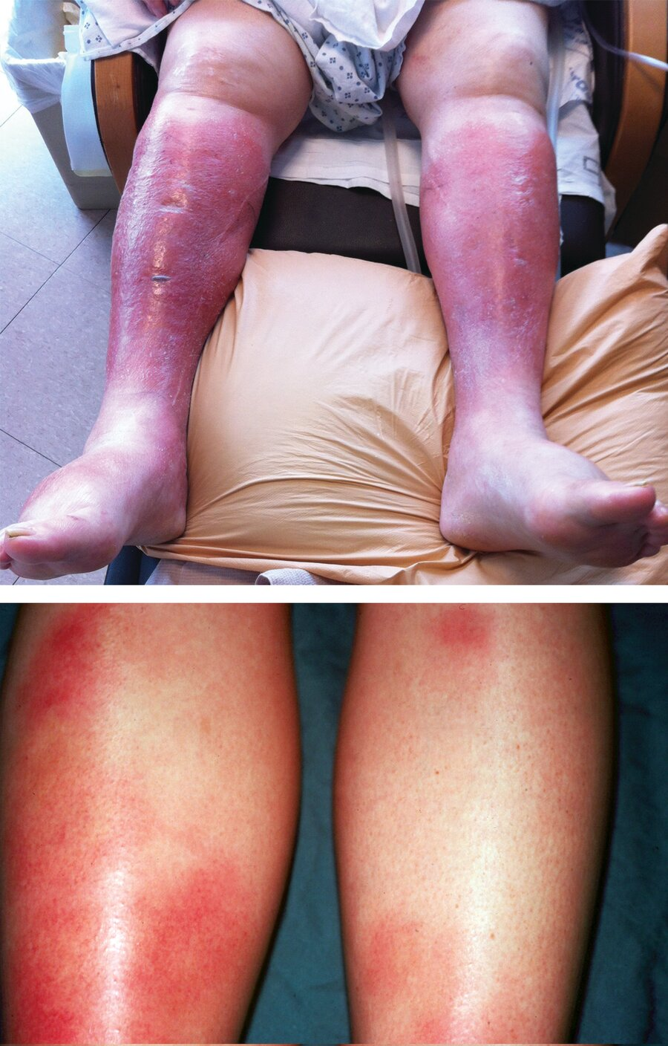
Cellulitis Mimics
Erythema nodosum: single or multiple tender nodules on extensor surfaces of the lower extremities.
Can be associated with Coccidiomycosis, TB, Viral Hepatitis (B/C), Brucella, Sarcoidosis, IBD, etc…
Chronic stasis dermatitis: erythematous, scaling, and eczematous patches or plaques associated with chronic venous insufficiency and chronic lower extremity edema, often bilateral.
Bilateral lower extremities cellulitis is rare.

Slide 12
Treatment
Infection | Treatment
Erysipelas or non-purulent cellulitis | Mild: PO penicillin, cephalexin, dicloxacillin, clindamycin Moderate: IV penicillin, ceftriaxone, cefazolin, clindamycin Severe: see Necrotizing fasciitis (Evaluate for tinea pedis and treat with topical clotrimazole-point of entry).
Furuncle, carbuncle, or abscess | Incision and drainage + anti-MRSA antibiotics (Bactrim or Doxycycline)
Necrotizing fasciitis | Emergent surgical assessment/debridement PLUS Empiric IV vancomycin (+/- Clindamycin) or Linezolid + piperacillin-tazobactam
 | Aeromonas hydrophila: skin laceration + swimming in fresh or brackish water in liver cirrhosis/immunocompromised host (IS). Surgical assessment/debridement + Ciprofloxacin/Doxycycline
 | Vibrio vulnificus: exposure to shellfish and seawater in liver cirrhosis/IS. Surgical assessment/debridement + Ceftriaxone/Doxycycline
Folliculitis | Staphylococcus aureus. Self-limited. Use topical mupirocin
 | Pseudomonas aeruginosa (i.e., hot tub folliculitis) Usually self-limited; PO ciprofloxacin in IS patients.

Slide 13
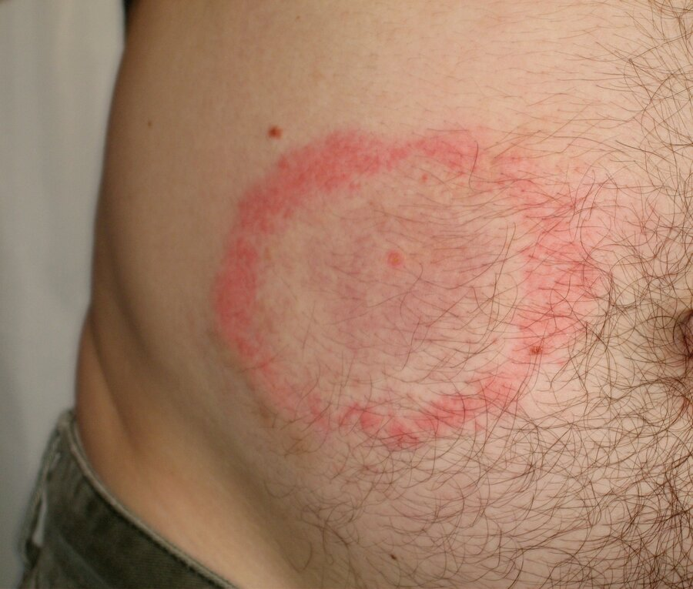
Case 4
A 58-year-old M from New Hampshire is evaluated for a rash on the right side of his abdomen that developed over the past 2 weeks.
Which of the following is most likely diagnosis?
1- Erythema migrans
2- Erythema nodosum
3- Leukocytoclastic vasculitis
4- Non-purulent cellulitis

Slide 14
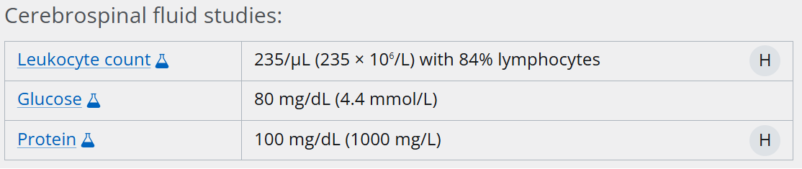
Case 5
A 24-year-old M is evaluated in the emergency department in October for a 10-day history of headaches, fever, and stiff neck. He reports hiking in the woods on Nantucket Island 2 months ago.
On physical examination, he is alert and oriented. Temperature is 38.3 °C (100.9 °F). Right-sided facial palsy is noted, and neck flexion elicits resistance and discomfort. No rash is present.
A lumbar puncture is performed.
Gram stain is negative, and cultures are pending.
Which of the following is the most likely cause of the patient's findings?
1- Borrelia burgdorferi
2- Enterovirus
3- Herpes simplex virus type 2
4- Varicella-zoster virus

Slide 15
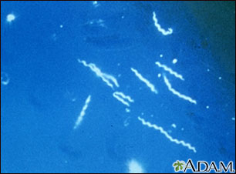
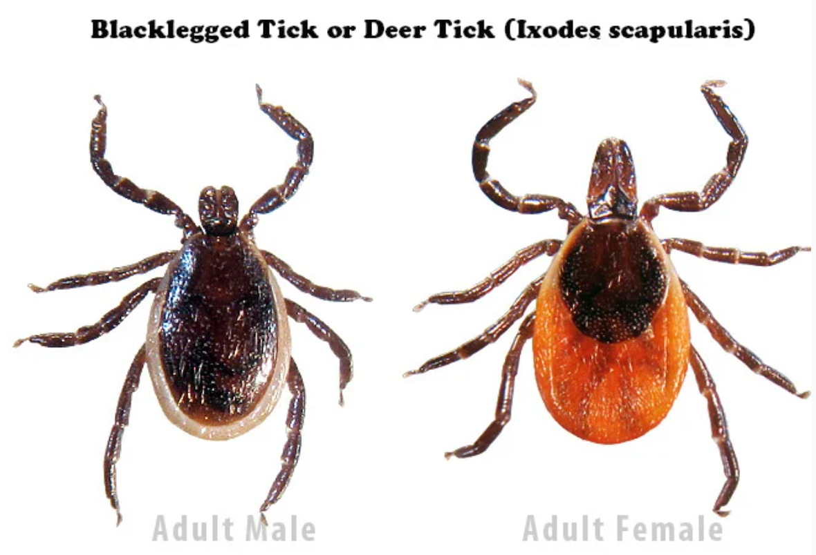
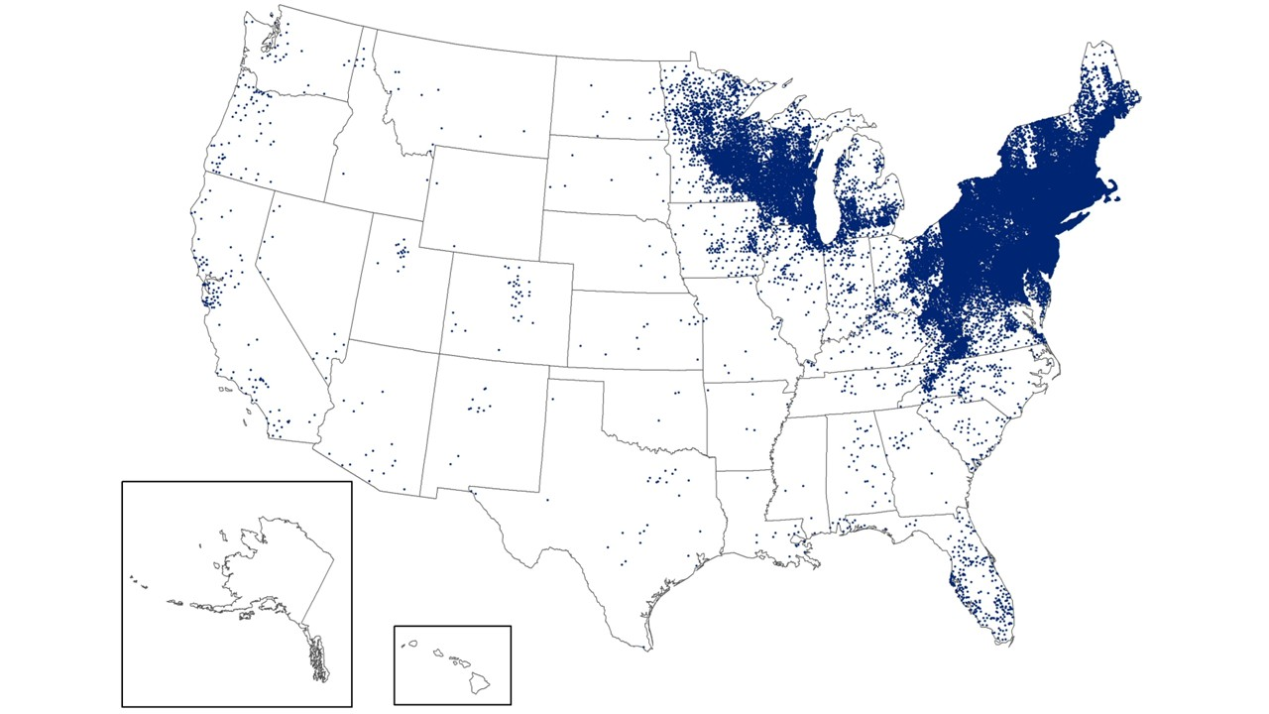
Lyme Disease
A tick-borne infection caused by the spirochete Borrelia burgdorferi.
Transmitted through an Ixodes scapularis (blacklegged deer tick) bite.
Lyme disease is the most common vector-borne infection in the United States.

Slide 16

Case 6
A 38-year-old F is evaluated in the ER for a 2-day history of new fatigue and exercise intolerance. She lives in New Hampshire and recalls removing a few ticks from her body over the past month. She has no other medical history and takes no medications.
On physical examination, temperature is 37.2 °C (99.0 °F), blood pressure is 100/60 mm Hg, pulse rate is 52/min, and respiration rate is 18/min. No rash is seen.
Lyme enzyme immunoassay is positive; Lyme IgM and IgG Western blots are positive.
ECG is shown.
Which of the following is the most appropriate treatment?
1- Ceftriaxone
2- Doxycycline
3- Left ventricular assisted device
4- Permanent pacemaker placement

Slide 17
Clinical Manifestations and Treatment-Lyme Disease
Lyme stage | Onset after infection | Clinical findings/testing | Antibiotics/Duration
Early localized | ≤4 wk | Erythema migrans (site of tick bite), fever, lymphadenopathy, myalgia. No lab testing indicated | Doxycycline 100 mg PO BID x10 days Amoxicillin 500 mg PO TID x14 days (pregnancy and peds). Cefuroxime 500 mg PO BID x14 days
Early disseminated | 2-6 wk | Multiple EM, Flu-like syndrome. No lab testing indicated (if EM present) | For early disseminated, CNVII palsy, 1st degree heart block (PR <300): Doxycycline 100 mg PO BID for 21 days. For meningitis, 1st degree heart block (PR >300), higher degree heart block, myopericarditis: Ceftriaxone 2 g IV daily for 14-21 days For arthritis: Doxycycline 100 mg PO BID for 28 days. If no improvement, consider a second course of IV Ceftriaxone 2-4 weeks.
 |  | Cardiac: Myocarditis Cardiac Heart Block 1st-3rd degree 2-tier serologic test.
 |  | Neuro: CNVII palsy, radiculitis Meningitis: “Rule of 7s” HA for >7 days, CSF with >70% mononuclear cells, and 7th CN palsy 2-tier serologic test.
Late disseminated | ≥6 mo | Arthritis, peripheral neuropathy, encephalopathy 2-tier serologic test

Slide 18
Case 7
A 38-year-old M is evaluated after removing a blacklegged deer tick from his upper left arm 12 hours ago. He lives in Rhode Island. He states that the tick was engorged and was likely present for more than 36 hours. He otherwise feels well, has no medical problems, and takes no medications.
On physical examination, vital signs are normal. The site of tick removal on his upper left arm shows no erythema, swelling, or tenderness.
Which of the following is the most appropriate next step?
1- Doxycycline for 10 days
2- Lyme serology
3- Single dose of Doxycycline
4- Observation only
Doxycycline 200 mg x1 for prophylaxis, if:
1- The tick can be reliably identified as a blacklegged tick in lyme-endemic area.
2- Antibiotics can be given within 72 hours of the bite.
3- The tick was attached for at least 36 hours.

Slide 19
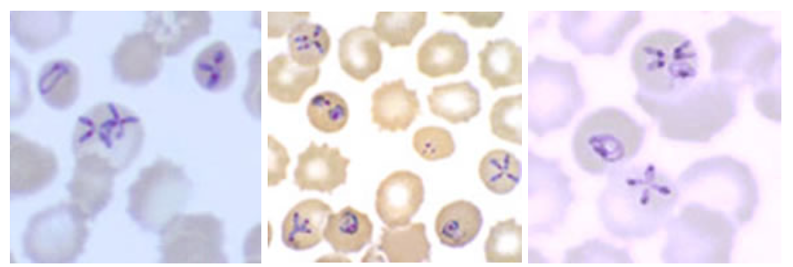
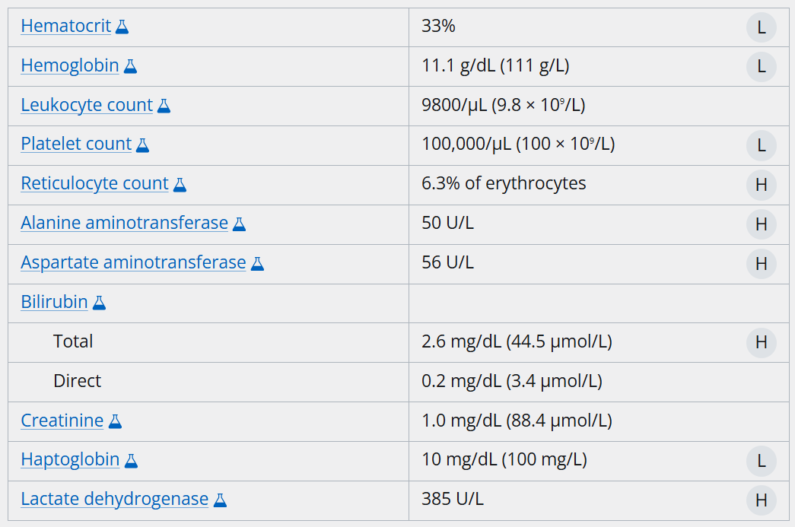
Case 8
A 28-year-old M is evaluated for a 3-day hx of fever, myalgia, and malaise. He also reports occasional headaches. He resides in Maine and reports no recent travel. Medical history is unremarkable, and he takes no medications.
On physical examination, temperature is 39.2 °C (102.6 °F), blood pressure is 120/70 mm Hg, pulse rate is 112/min, and respiration rate is 16/min. Palpation reveals a mildly enlarged liver. No lymphadenopathy or rash is present.
Direct antiglobulin test is negative for IgG and complement (C3).
Peripheral blood smear shows erythrocytes with occasional inclusions arranged in a tetrad resembling a Maltese cross.
Which of the following is the most likely diagnosis?
1- Babesiosis
2- Malaria
3- Thrombotic thrombocytopenic purpura
4- Warm autoimmune hemolytic anemia

Slide 20
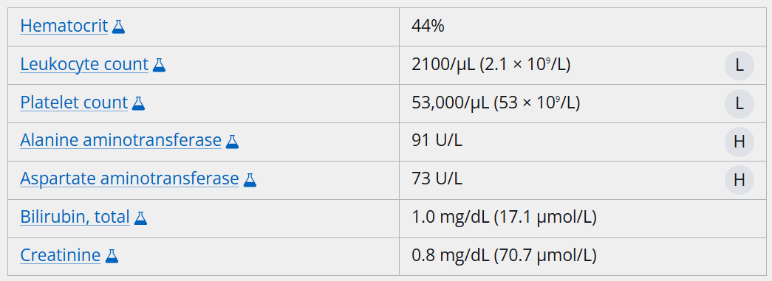
Case 9
A 48-year-old man is evaluated in May for a 1-week history of fever, headache, and myalgia. He lives in Kansas and reports no travel outside the area. He has no other medical problems and takes no medications.
On physical examination, temperature is 38.6 °C (101.5 °F). His other vital signs and the remainder of examination findings are normal.
Blood Gram stain and cultures are negative.
Which of the following is the most likely diagnosis?
1- Babesiosis
2- Borrelia miyamotoi infection
3- Ehrlichiosis
4- Lyme disease

Slide 21
Feature | Babesiosis | Anaplasmosis (HGA) Human Granulocytic Anaplasmosis (HGA) | Ehrlichiosis (HME) Human Monocytic Ehrlichiosis (HME
Organism | Babesia microti | Anaplasma phagocytophilum | Ehrlichia chaffeensis
Organism type | Protozoan | Obligate intracellular Gram-negative organism
Tick vector | Ixodes scapularis (deer/blacklegged tick) |  | Amblyomma americanum (Lone Star tick)
Geographic Distribution (US) | Northeast and upper Midwest |  | Southeast, south-central US
Cell Tropism | Erythrocytes (RBC) | Neutrophils/granulocytes | Monocytes/macrophages
Clinical Symptoms | Fever, fatigue, headache, myalgia, anorexia
Rash | Uncommon (if present, consider Lyme co-infection) | Uncommon | Up to ~30% of cases
Key lab findings | Hemolytic anemia, low PLTs, high LFTs | Low PLTs, Low WBC
Peripheral Smear Finding | Intraerythrocytic "Maltese cross" | Morulae in granulocytes/neutrophils | Morulae in monocytes (rarely seen)
Treatment | Atovaquone + Azithromycin Q(c)lindamycin + Quinine | Doxycycline

Slide 22
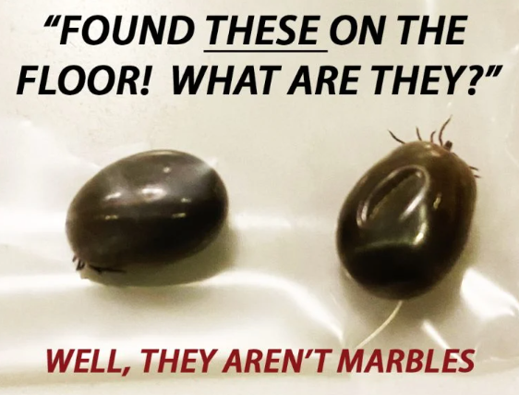
Questions?
>5 days engorged female blacklegged deer tick

