Slide 1
Question # 3
56 year old gentleman, never smoker, presents with progressive dyspnea and 20lb weight loss. Remains active and working full time.
CT Chest reveals multiple lung masses up to 4cm
PET/CT, MRI reveal multiple bone and liver masses, no brain mets.
CT guided bx of liver mass reveals adenocarcinoma, TTF1+
Testing reveals ALK mutation, no other actionable mutation, PDL1 testing 25%
What is your next step in treatment of this patient?
  A. Chemoimmunotherapy (Pemetrexed + Carbo + Pembrolizumab)
  B. Surgical evaluation
  C. Chemoradiotherapy to largest lung mets
  D. Alectanib
  E. Hospice

Slide 2
Systemic Therapy for Stage IV NSCLC
Things just got complicated….
Treatment is different depending on multiple factors: driver gene mutation, histology, PDL1 expression
  In general, if target mutation consider use targeted agent first (higher response rates)
    EGFR, ALK, BRAF targets
  If no target mutation use immunotherapy alone (if PDL1>50%) or in combination with chemotherapy
    PDL1 is not a perfect marker of responsiveness to immunotherapy
  Consider radiotherapy and aggressive treatment if isolated area of progression or oligometastic disease

Slide 3
Two Drug Combination in Stage IIIB/IV NSCLC
1.0
Cisplatin/Paclitaxel
Cisplatin/Gemcitabine
Cisplatin/Docetaxel
Carboplatin/Paclitaxel
0.8
0.6
Survival %
0.4
ECOG 1594
0.2
0.0
Months
0
5
10
15
20
25
30
Schiller JH et al. N Engl J Med. 2002;346:92-98.

Slide 4
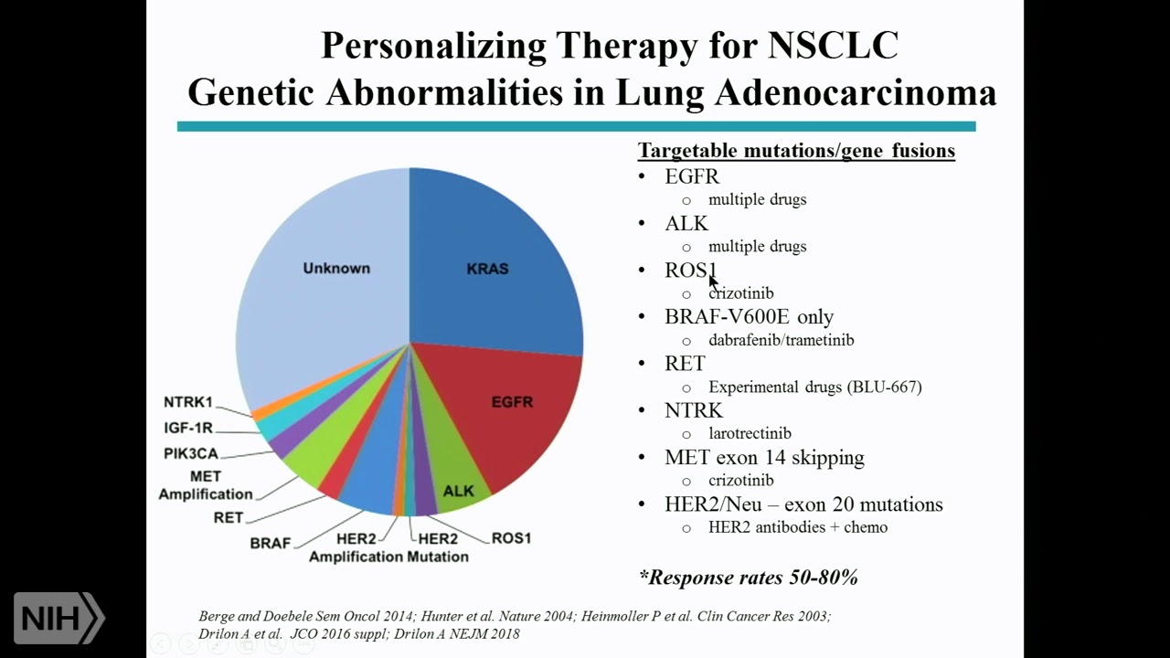

Slide 5
Systemic Tx for EGFR Positive Lung Cancer
Treated with EGFR targeted drugs (oral agents): Osimertinib, Erlotinib
Molecularly distinct subtype of lung cancer more common in younger, non-smoking, Asian patients
Most common to find in adenocarcinoma
~15% of lung cancers in U.S.
Much better prognosis (especially with treatment) with median survival 30-36 months
Response rates 60-70% with tx

Slide 6
Systemic Tx for ALK Positive Lung Cancer
Treated with ALK targeted drugs (oral agents): Alectinib, Brigatinib, Ceritinib, Crizotinib
At time of progression will switch to different agent
~5% of lung cancers in U.S.
Median survival with treatment on the order of 5-6 years
Response rates > 70%

Slide 7
Target Drugs for Specific Driver Mutations in NSCLC
EGFR mutation
  Exon 19 deletion or exon 21 L858R mutation: osimertinib (with chemo if fit)
  Exon 20 insertion mutation: amivantamab in combo with chemotherapy
  S7681, L861Q, G719X mutation: afatinib or osimertinib
ALK mutation: alectinib or brigatinib or lorlatinib
BRAF V600E mutation: dabrafenib + trametinib or encorafenib + binimetinib
ROS1 mutation: entrectinib or crizotinib or repotrectinib
NTRK1/2/3 gene fusion: larotrectinib or entrectinib
MET exon 14 skipping mutation: capmatinib or tepotinib
RET mutation: selpercatinib or pralsetinib
KRAS G12C mutation: 2nd line therapy with adagrasib or sotorasib
ERBB2 (Her2) mutation: 2nd line therapy with fam-trastuzumab deruxtecan

Slide 8
Systemic Tx for Stage IV NSCLC
(Squamous Cell Carcinoma)
If no contraindication to PDL1 Inhibitors then use chemotherapy with immunotherapy
  Carboplatin + Paclitaxel + Pembrolizumab
  Carboplatin + Abraxane (albumin bound paclitaxel) + Pembrolizumab
  Carboplatin + Paclitaxel + Cemiplimab
  Carboplatin + Paclitaxel + Nivolumab + Ipilimumab
Continue maintenance immunotherapy with PDL1 inhibitor (usually up to two years)
  Pembrolizumab
  Cemiplimab
  Durvalumab

Slide 9
Systemic Tx for Stage IV Non-Squamous Cell Carcinoma of the Lung (Adenocarcinoma, Large Cell)
If PDL1 > 50% then immunotherapy alone or immunotherapy + chemotherapy
  Pembrolizumab or Atezolizumab or Cemiplimab
  Pemetrexed + Carboplatin + Pembrolizumab
  Paclitaxel + Carboplatin + Bevacizumab + Atezolizumab
If PDL1 1-49% then immunotherapy + chemotherapy
  Pemetrexed + Carboplatin + Pembrolizumab
  Paclitaxel + Carboplatin + Bevacizumab + Atezolizumab
If PDL1 0 then immunotherapy + chemotherapy
  Pemetrexed + Carboplatin + Pembrolizumab
  Paclitaxel + Carboplatin + Bevacizumab + Atezolizumab
  Nivolumab + Ipilimumab

Slide 10
Oncology leading the pack in terms of “Precision Medicine”
Therapy of non-squamous NSCLC guided by gene testing of tumor for driver mutation. Targeted therapies given first if option.
Non-smokers tend to have fewer mutations and distinct signaling pathways mutated (EGFR, ALK)
Smokers tend to have wide array of mutations and multiple abnormal signaling pathways: more likely to respond to immunotherapy where many antigens represented on cell surface
Immunotherapy (PDL1 inhibitors) has largely replaced chemotherapy as backbone of treatment for non-driver mutation NSCLC

Slide 11
General Notes Regarding Oncologist Management of Advanced Lung Cancer
Maintenance therapy standard of care
  Immunotherapy (PDL1 Inhibitors) given for 1-2 years
  Pemetrexed or bevacizumab given as maintenance until progression
  Platinum chemotherapies given for 4-6 cycles (cisplatin or carboplatin not given beyond 6 cycles)
Treatment of advanced lung cancer is palliative
With new therapies and combination immunotherapies there are increasing number of long term survivors
“Playing for the tail of the curve”
  20-25% of individuals with metastatic kidney cancer and melanoma are cured with immunotherapies
  There are long term survivors and individuals with oligometastatic NSCLC who are cured

Slide 12
Small Cell Lung Cancer
Represents ~15% of lung cancer in the U.S.
Associated with history of heavy smoking (be suspicious of diagnosis without heavy smoking history)
Neuroendocrine tumor associated with rapid growth and early metastasis (cell doubling time of ~30-60 days)

Slide 13
Question # 4
64 year old veteran with 60 pack year history of smoking presents after having abnormal CXR prior to elective knee replacement surgery
CT C/A/P reveals 5cm RLL lung mass with hilar and mediastinal lad
MRI Head, Bone scan without distant mets
PFTs reveal mild emphysema with FEV1 of 3 liters, DLCO 80%
Bronchoscopy and bx of subcarinal lymph node with small cell carcinoma
What is the most appropriate next step in the management of this patient?
  A. Surgical resection of lung tumor with lymph node dissection
  B. Concurrent chemoradiation
  C. Prophylactic cranial radiation
  D. Immunotherapy (Pembrolizumab)
  E. Chemoimmunotherapy (Cisplatin + Etoposide + Pembrolizumab)

Slide 14
Small Cell Lung Cancer Staging
Limited Stage or Extensive Stage
  Limited Stage = Primary tumor and lymph node mets fit in a single radiotherapy port
  Extensive Stage = Spread outside chest and tumor cannot be contained in radiotherapy port
May use TNM for research / data collection
Generally stage I-III are limited stage

Slide 15
Limited Stage Small Cell Lung Cancer
Surgery usually only considered for small <5cm tumors that are node negative
Adjuvant PDL1 inhibitor (durvalumab) recently FDA approved for limited stage small cell after chemoradiotherapy completed
Generally treat with concurrent chemotherapy and radiation
  Treated with cisplatin + etoposide for 4 cycles
  Concurrent radiation (either 3 weeks bid or 5 weeks once daily)
With chemoradiation ~ 30-35% of patients can be cured
After treatment consider prophylactic cranial radiation (25Gy in ~ 10 fractions to whole brain)
  Many centers now opt for serial MRI imaging of brain every 3 months
Small cell lung cancer has high propensity to spread to brain ~40%

Slide 16
Extensive Stage Small Cell Lung Cancer
Small cell cancer usually presents with metastatic disease
Common sites of metastasis: bone, brain, liver, lung, adrenal
Tends to respond quickly to initial therapy and often with dramatic improvement
Response rates to initial chemoimmunotherapy ~ 70%

Slide 17
Treatment for Extensive Stage Small Cell Lung Cancer
Platinum based chemotherapy + immunotherapy
Carboplatin + Etoposide for 4-6 cycles and then maintenance immunotherapy
  Carboplatin + Etoposide + Atezolizumab (PDL1 inhibitor)
  Carboplatin + Etoposide + Durvalumab
If good response to therapy then may benefit from prophylactic cranial irradiation (many centers prefer close surveillance with serial brain MRIs)

Slide 18
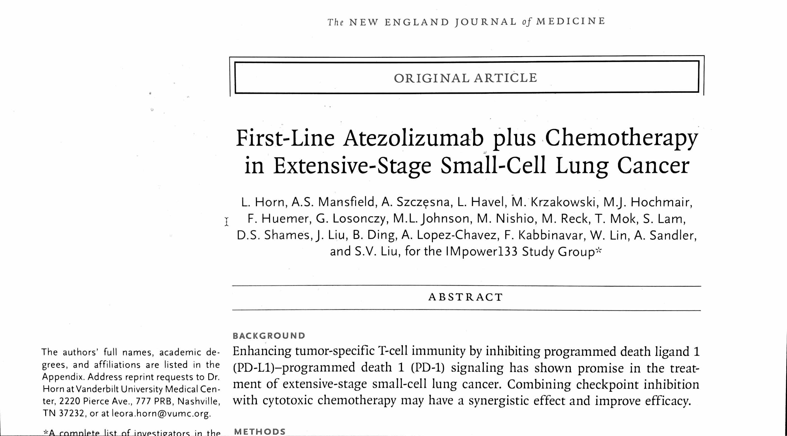
Addition of Atezolizumab to Chemotherapy First Breakthrough in Systemic Treatment for Small Cell Carcinoma in > 20 years

Slide 19
Question # 5
73 year old woman presents with 30 lb weight loss, severe dyspnea and hypercalcemia
On exam P105, RR22, 02 sat 90%, BMI 22, temporal wasting, diminished lung sounds on left, clubbing, no focal neurologic deficit
Staging CT C/A/P, MRI Head, bone scan with 9cm left lung mass, multiple bone and liver masses
CT guided biopsy of liver with squamous cell carcinoma
Patient using wheelchair because family states she is too weak to walk. Spends majority of day sleeping. Family reports she does not like coming to doctors.
What is the most appropriate next step in the care of this patient?
  A. Give oxygen and referral to hospice
  B. Chemoimmunotherapy (Carbo + Taxol + Pembrolizumab)
  C. Immunotherapy (Ipilimumab + Pembrolizumab)
  D. Give oxygen and send for EGFR testing
  E. Give oxygen and referral to radiation oncology to treat bulky lung tumor

Slide 20
Giving Chemotherapy is Not Always the Right Choice
Multiple studies in lung cancer demonstrating poor survival in patients with performance status of 3 or 4 (<3 months)
Chemotherapy in general takes 1-2 months to work
Chemotherapy in patients that are too weak or frail may cause harm and lead to earlier death
Standard of care is best supportive care and palliative care/hospice

Slide 21
What is the diagnosis?

Slide 22
Horner Syndrome
Clinical triad = miosis, ptosis, anhidrosis
Multiple possible etiologies but may be caused by apical lung cancer compressing sympathetic nerve roots (Pancoast Tumor)

Slide 23
What is the Diagnosis?

Slide 24
SVC Syndrome
Tumor compressing SVC causing increased venous pressure in head and upper extremities
Most common in small cell lung cancer and squamous cell carcinoma
Pembertons sign = raise arms and head becomes more plethoric and swollen

Slide 25
What is the diagnosis?

Slide 26
Hypertrophic Osteoarthropathy
Syndrome characterized by abnormal proliferation of bone and skin at distal extremities
Dramatic clubbing and periostosis of tubular bones (classically along tibia)
Often have severe pain along affected bony area
Lung cancer is the most common cause

Slide 27
Answers to Questions
Question # 1 = C. (Patient meets new criteria for low dose CT screening)
Question # 2 = E. (Stereotactic radiation potentially curative, PFTs too bad for surgery)
Question # 3 = D. (Treat with ALK targeted therapy which in this case is alectanib)
Question # 4 = B. (Treat limited stage small cell lung cancer with chemoradiation)
Question # 5 = A. (Referral to hospice, ECOG 4 and too frail for chemotherapy)

Slide 28
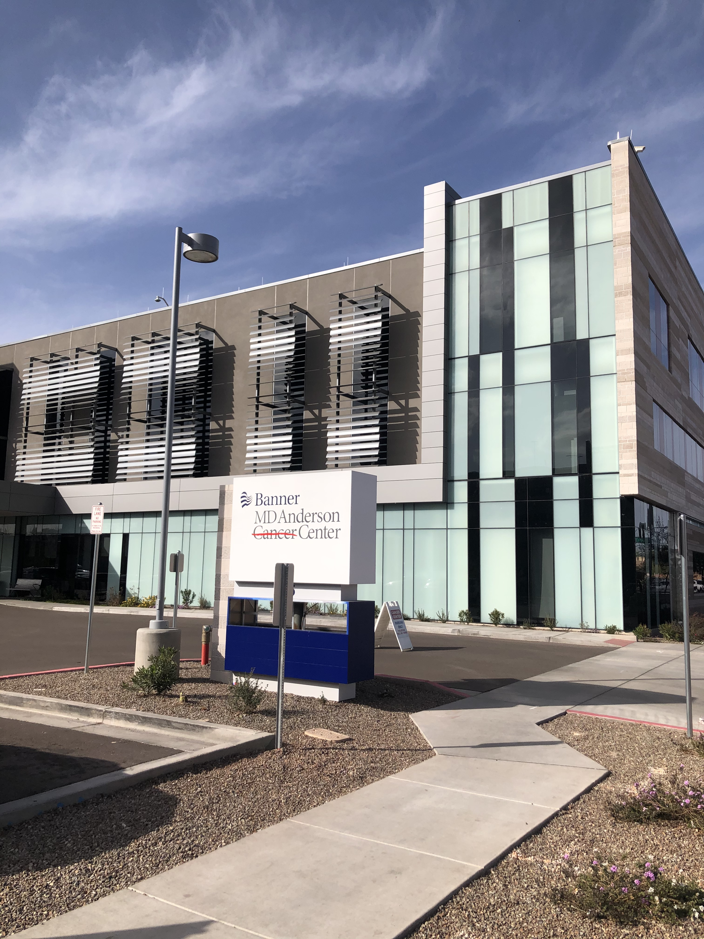
Banner MD Anderson
Central Phoenix Campus
David Paul, MD
Sucai Bi, MD
Todd Erickson, MD
Sunil Tulpule, MD
Smitha Sagaram, MD
John Roller, MD
Curtis Lacy, MD (Inpatient)
Melissa Yap, NP
Sara Lindebak, NP
Deesha Parmar, PA

