Slide 1
Cardiology Jeopardy
How Come?
Big
Red
Baby Makes Three
Twinkle Toes
Fragrant Twigs
$100
$100
$100
$100
$100
$200
$200
$200
$200
$200
$300
$300
$300
$300
$300
$400
$400
$400
$400
$400
$500
$500
$500
$500
$500

Slide 2
How Come? $100
This is the genetic inheritance pattern of hypertrophic cardiomyopathy.

Slide 3
Hypertrophic Cardiomyopathy (HCM)
What is autosomal dominant?
HOCM (70%) HNCM (30%)
Sarcomeric disease, myocardial fiber disarray
1:500-1000 persons

Slide 4
How Come? $200
Most people with HCM are asymptomatic with normal life expectancy.
These are three symptoms that a patient may have who develops symptoms from HCM.

Slide 5
Hypertrophic Cardiomyopathy
What are the following symptoms:
Heart failure
Palpitations/arrhythmia
Syncope
Sudden cardiac death

Slide 6
How Come? $300
These are two provocative maneuvers that can be done on physical examination that will increase the murmur of HOCM and help to distinguish it from the fixed murmur of aortic stenosis.

Slide 7
Hypertrophic Cardiomyopathy
What is Valsalva maneuver
and Sit to Stand?
(Both maneuvers decrease preload)

Slide 8
How Come? $400
These are five drugs that are contraindicated in HOCM because they make the dynamic obstruction WORSE.

Slide 9
Hypertrophic Cardiomyopathy
What are the following:
Preload reducers
  a. Diuretics
  b. Venous vasodilators (nitrates)
Inotropes (Increased contractility)
  a. Digoxin
  b. Dobutamine
Afterload reducers (Improves contractility)
  ACEI/ARB
  Dihydropyridine calcium channel blockers (amlodipine, nifedipine)
  Sodium nitroprusside
  Hydralazine
  Minoxidil

Slide 10
How Come? $500
These are three indications for placement of an intracardiac defibrillator for primary prevention of sudden cardiac death in a patient with HCM.

Slide 11
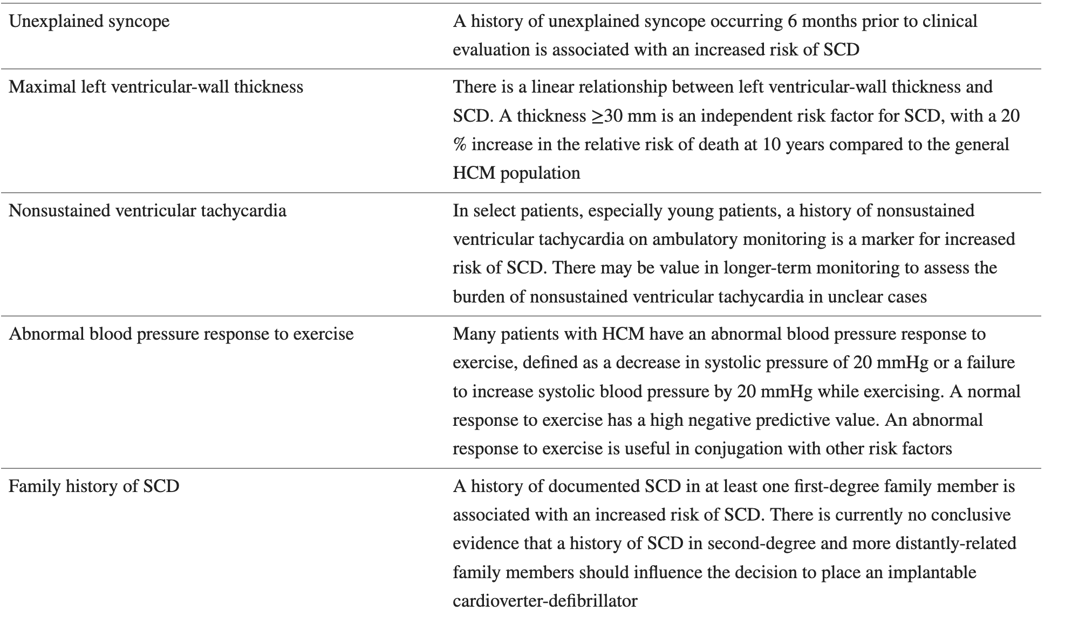
Hypertrophic Cardiomyopathy

Slide 12
Big Red: $100
Abdominal aortic aneurysm is often incidentally found on CT or ultrasound done for another reason. 75% of patients diagnosed are asymptomatic at the time of diagnosis.
This is recommendation for screening for AAA according to the USPSTF.

Slide 13
Abdominal Aortic Aneurysm
USPSTF recommends one-time screening with duplex ultrasound in men aged 65 to 75 years who have smoked at least 100 cigarettes in their lifetime.
AAA = AP diameter > 3.0 cm
Risk factors= Male sex (6:1), advanced age, smoking, atherosclerosis, hypertension and family history.

Slide 14
Big Red: $200
This is the Stanford classification for
aortic dissection.

Slide 15
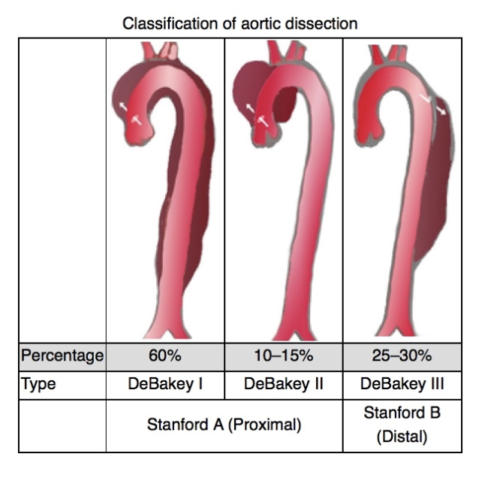
Aortic Dissection
What is type A and type B? (Stanford)
Type A =
Acute surgical emergency
Type B =
Medical management

Slide 16
Big Red: $300
Thoracic aortic aneurysms are defined as an increase in the thoracic aortic diameter of greater than 50% relative to the expected or normal dimension. TAAs occur at the level of the aortic root, ascending aorta, aortic arch or descending aorta.
In addition to atherosclerosis and trauma, these are 3 risk factors for thoracic aortic aneurysm.

Slide 17
Risk Factors for TAA
1. Connective tissue disorders
  Marfan syndrome
  Ehlers-Danlos syndrome type 4
  Loeys-Dietz syndrome
  Ankylosing spondylitis
2. Congenital disorders
a. Bicuspid aortic valve
b. Coarctation of the aorta
c. Turner syndrome
d. Familial TAA and aortic
dissection syndrome
3. Vasculitis
a. Takayasu arteritis
b. Giant cell arteritis
4. Infectious
a. Septic embolism
b. Syphilis
5. Atherosclerosis
6. Trauma

Slide 18
Big Red: $400
Aortic dissection is a potentially life-threatening emergency.
These are the three of the most common clinical presentations of aortic dissection that should prompt urgent evaluation.

Slide 19
Clinical Presentation of
Aortic Dissection
What is:
Severe pain of chest/abdomen/flanks “ripping or tearing” quality
  (>90% type A, 75% type B)
Hypertension (80-90%) >> shock*
(*16% with type A, 2.9% type B)
3. Neurologic deficit (9.5%)
4. Heart failure (7.6%)
5. Syncope (6.7%)
Journal of International Medical Research 2017, Vol. 45(2) 823–829, L. Zhao, et al. 2017

Slide 20
Big Red: $500
In addition to pain control,this is the appropriate medical treatment for a patient with aortic dissection including the goal blood pressure and heart rate.

Slide 21
Medical Treatment of
Aortic Dissection
What is an IV b-blocker (labetolol, propranolol, or esmolol) to decrease heart rate to 60-70 and systolic blood pressure <120 mm Hg first, then add arterial vasodilator to get MAP 60-75.
Research Reports in Clinical Cardiology; Diagnosis and clinical management of aortic dissection; Phillips B Harrington, et al Melby Division of Cardiothoracic Surgery, Department of Surgery, University of Alabama at Birmingham, Birmingham, AL, USA, 19 June 2014

Slide 22
Baby Makes Three: $100
These are the normal physiologic hemodynamic changes
in pregnancy. (CO, SVR, HR, BP)

Slide 23
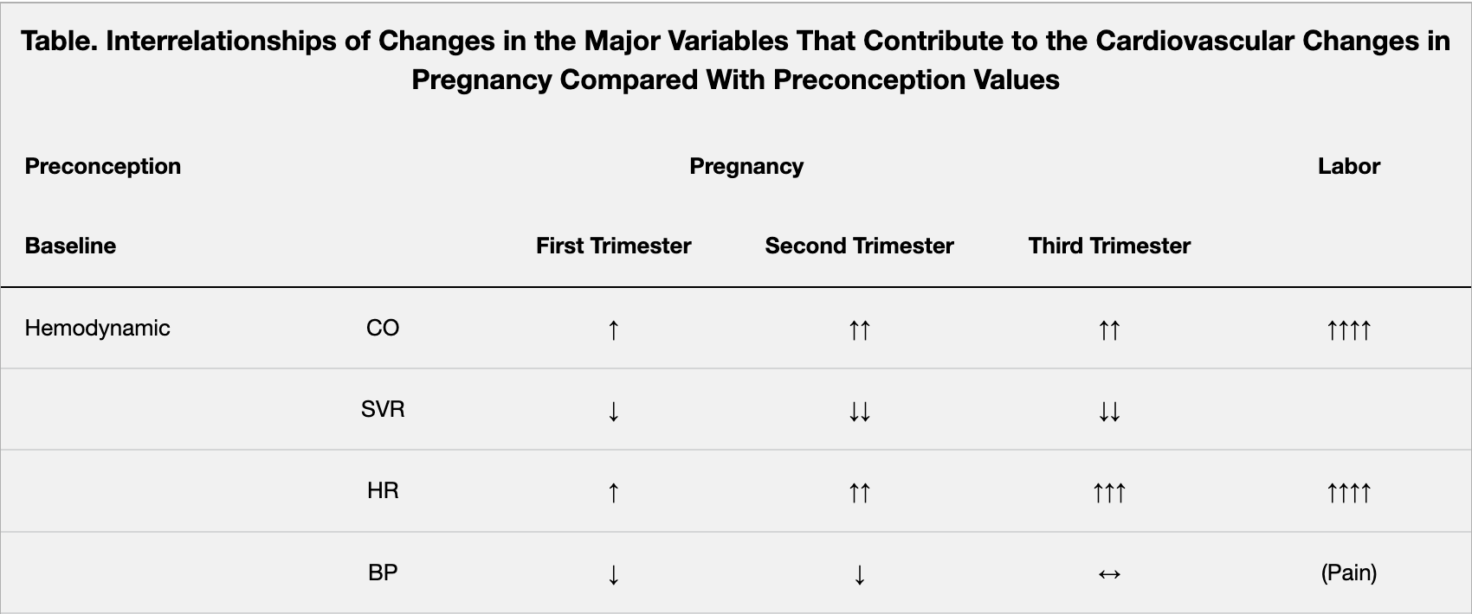
Normal Cardiovascular
Physiology in Pregnancy
What is Increase in CO and HR and Decrease in SVR and BP?
https://doi.org/10.1161/CIRCULATIONAHA.114.009029

Slide 24
Baby Makes Three: $200
According to the CDC, this is the percentage of cases of maternal mortality attributed to cardiovascular causes in the US.

Slide 25
Maternal Mortality in the United States
What is 33%?
The most recent CDC report on maternal mortality from May 2019 also identified cardiovascular conditions (including cardiomyopathy, myocardial infarction, and cerebrovascular accidents) as the cause for more than 33% of pregnancy-related deaths.
From 2003 to 2012 there was a 25% increase in the number of women entering pregnancy with preexisting heart disease. Most of these women have congenital heart disease or valvular heart disease.
Collier AY, Molina RL. Maternal Mortality in the United States: Updates on Trends, Causes, and Solutions. Neoreviews. 2019 Oct;20(10):e561-e574. doi: 10.1542/neo.20-10-e561. PMID: 31575778; PMCID: PMC7377107.
Notes:
However, the prevalence of cardiomyopathy and pulmonary hypertension increased significantly and demonstrated the highest in-hospital mortality, most often because of heart failure, arrhythmia, respiratory failure, shock, renal failure, and preeclampsia. (25)
It is unclear why the incidence of cardiomyopathy is increasing, but it could be associated with increases in maternal age, multifetal pregnancies, or improved recognition.

Slide 26
Baby Makes Three: $300
.
Women with this type of cardiac valvular lesion typically develop symptoms in pregnancy but women with this type of cardiac valvular lesion typically does well in pregnancy.

Slide 27
Valvular Disease in Pregnancy
What is women with obstructive valvular diseases develop symptoms in pregnancy and women with regurgitant valvular diseases do well in pregnancy?

Slide 28
Baby Makes Three: $400
This is the American College of Cardiology recommendation for the management of anticoagulation in pregnancy in a women who has a mechanical heart valve prosthesis.

Slide 29
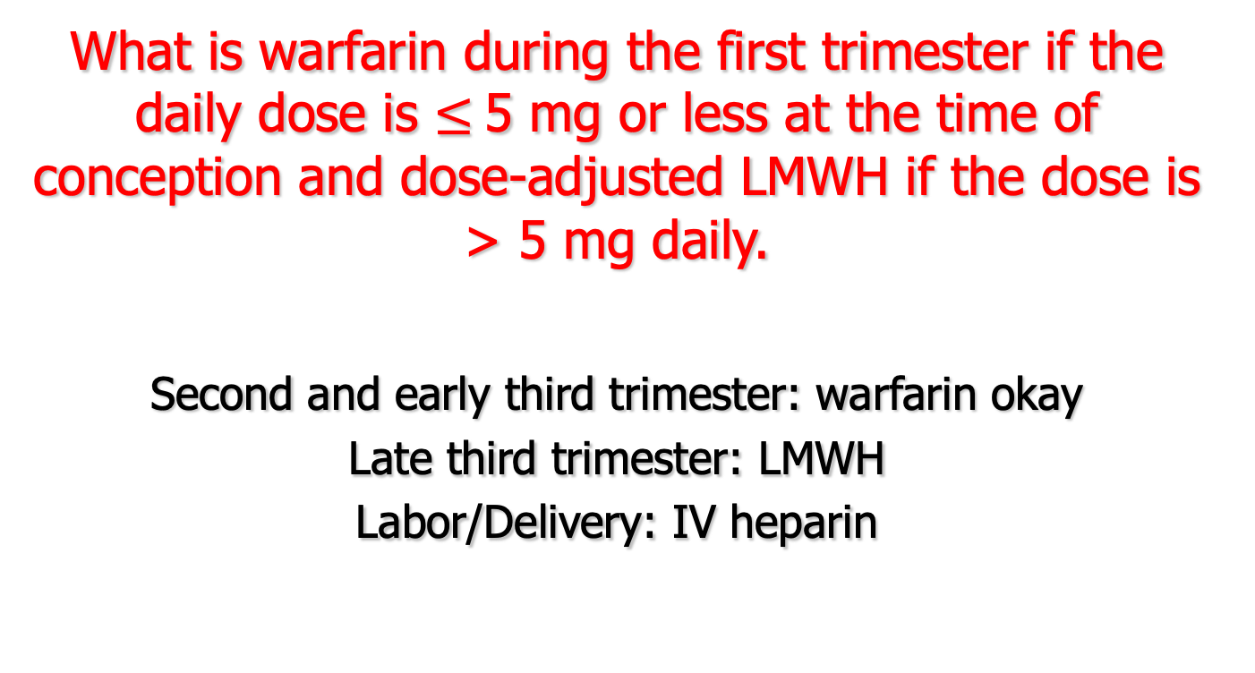
Management of Anticoagulation in Pregnancy
What is warfarin during the first trimester if the daily dose is $≤$5 mg or less at the time of conception and dose-adjusted LMWH if the dose is > 5 mg daily.
Second and early third trimester: warfarin okay
Late third trimester: LMWH
Labor/Delivery: IV heparin

Slide 30
Baby Makes Three: $500
These are 3 maternal cardiac contraindications to pregnancy.

Slide 31
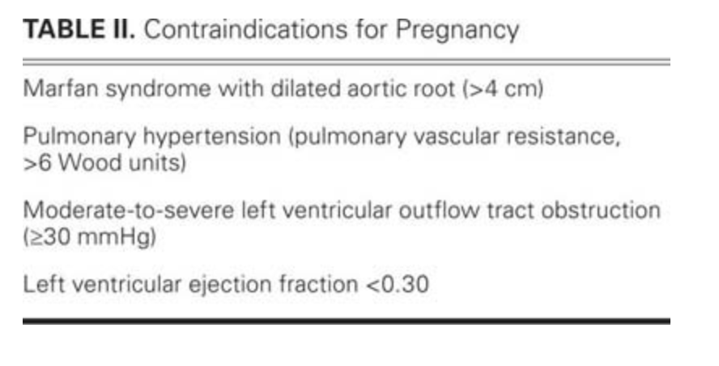
Maternal cardiac contraindications to pregnancy
Franklin WJ, Benton MK, Parekh DR. Cardiac disease in pregnancy. Tex Heart Inst J. 2011;38(2):151-3. PMID: 21494524; PMCID: PMC3066821.

Slide 32
Twinkle Toes- $100
According to the guidelines from the American Heart Association and the American College of Cardiology, this test can be used to screen for PAD in an asymptomatic person who is at increased risk.

Slide 33
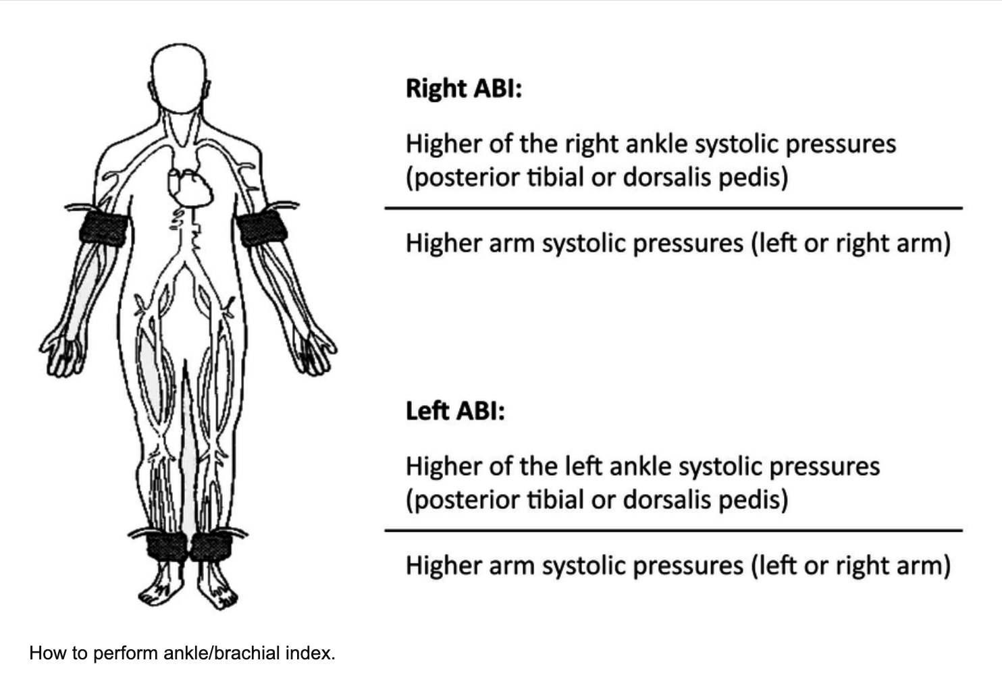
Diagnosis of PAD
What is an ankle-brachial index (ABI)?

Slide 34
Twinkle Toes- $200
This is the value range that is considered normal for an ankle brachial index test.

Slide 35
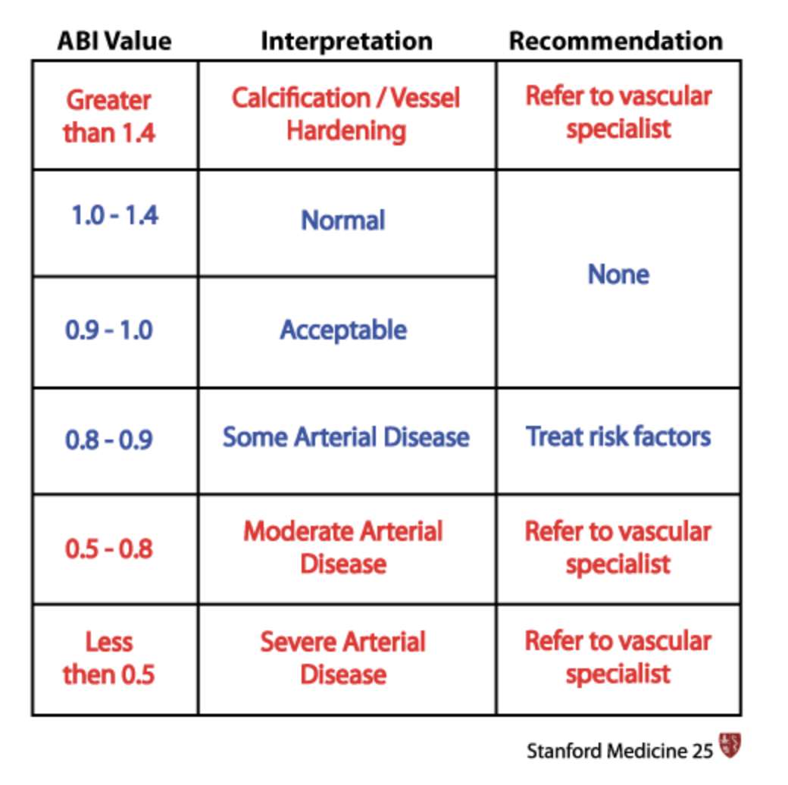
Ankle Brachial Index Test
What is 1.0-1.4?

Slide 36
Twinkle Toes- $300
Your 50-year-old male patient has symptoms of intermittent claudication in his left calf that starts after walking for about a block and improves with rest. He is a smoker and hypercholesterolemic.
You order an ABI test that returns as normal (1.1)
This is the test your order next to evaluate for PAD.

Slide 37
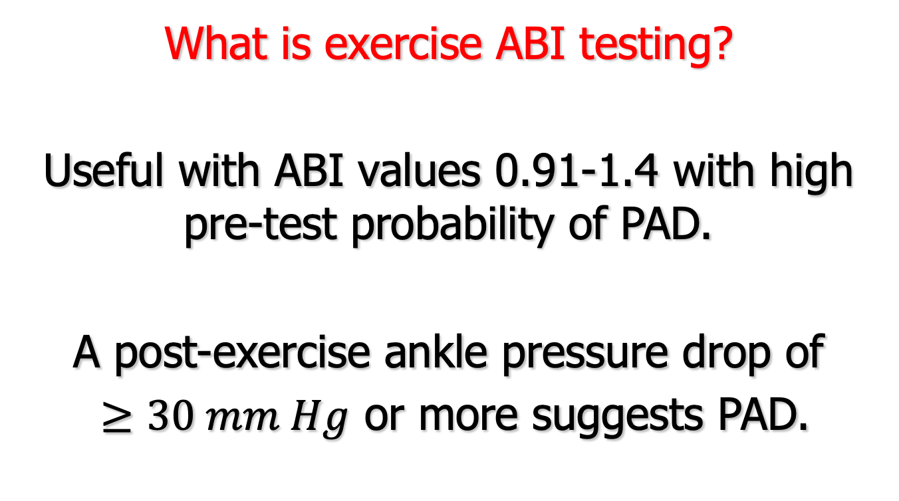
Symptoms of PAD in high-risk individual with normal ABI
What is exercise ABI testing?
Useful with ABI values 0.91-1.4 with high pre-test probability of PAD.
A post-exercise ankle pressure drop of
$≥30 mm Hg$ or more suggests PAD.

Slide 38
Twinkle Toes- $400
Your 50-year-old male patient has symptoms of intermittent claudication in his left calf that starts after walking for about a block and improves with rest. He is a smoker and hypercholesterolemic.
You order an ABI test that returns with a value of 1.41.
This is the test your order next to evaluate for PAD.

Slide 39
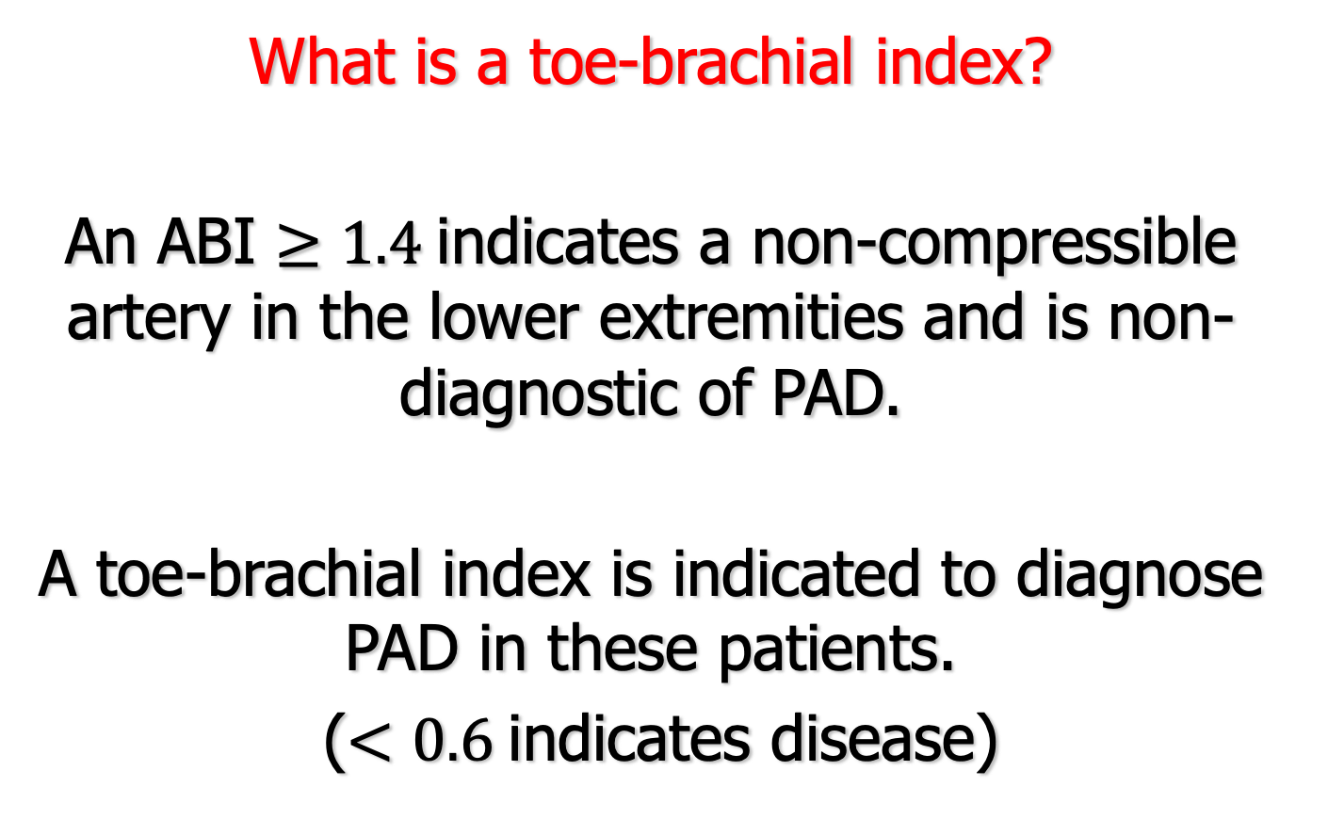
Elevated ABI in a patient at high-risk for PAD
What is a toe-brachial index?
An ABI $≥1.4$indicates a non-compressible artery in the lower extremities and is non-diagnostic of PAD.
A toe-brachial index is indicated to diagnose PAD in these patients.
($<0.6$indicates disease)

Slide 40
Twinkle Toes- $500
The drug, cilostazol, has been shown to improve pain-free walking distance and overall walking distance in patients with claudication. Clinical practice guidelines recommend a trial of cilostazol be considered in patients with claudication.
This is the mechanism of action of cilostazol and this is the black box warning.

Slide 41
Cilostazol
What is inhibition of phosphodiesterase III; such activity has been shown to decrease survival of patients with class III-IV CHF; contraindicated in patients with CHF of any severity?

Slide 42
Fragrant Twigs $100
You admit an 80-year-old woman from the ED who had a mechanical fall when she got tangled in her dog’s leash and broke her left hip. They have asked you to “clear” the patient for surgery.
What do you call this surgical repair in terms of timing?

Slide 43
Surgical Urgency in
Perioperative Risk Assessment
What is urgent with plan to take her to the OR within 24 hours for repair?
Emergent: < 6 hours
Urgent: 6-24 hours
Time-sensitive: 1-6 weeks
Elective: 1 year

Slide 44
Fragrant Twigs $200
According to the 2022 AHA/ACC Guidelines, THIS the ejection fraction of HFrEF,
THIS is the ejection fraction of HFpEF, and
THIS is HFmrEF. (the numbers and what it stands for)

Slide 45
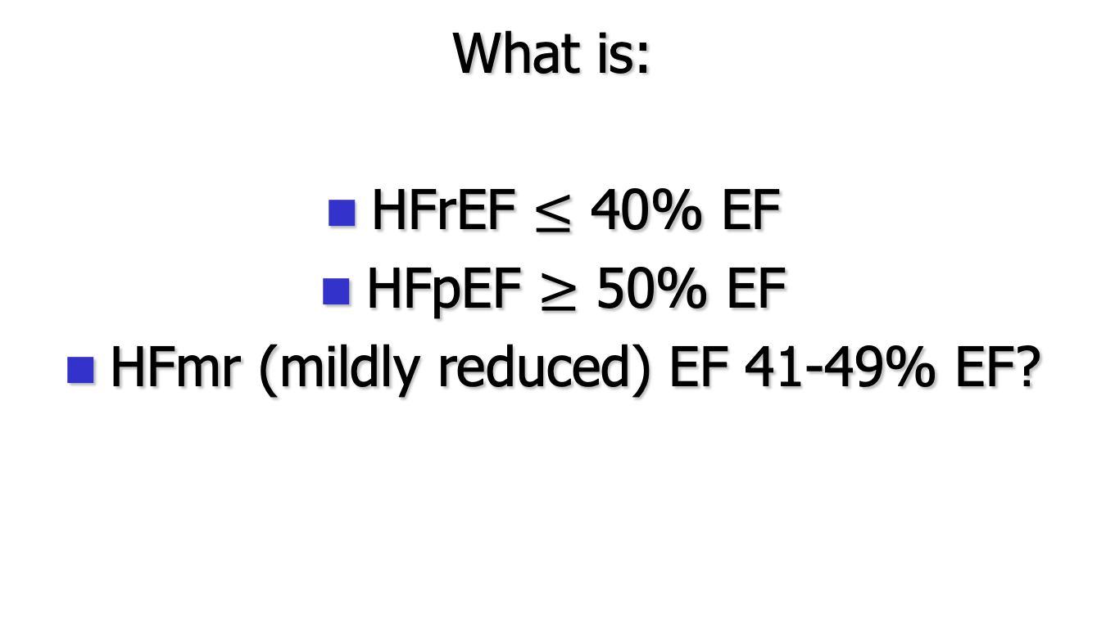
Heart Failure Classification
What is:
HFrEF $≤$ 40% EF
HFpEF $≥$ 50% EF
HFmr (mildly reduced) EF 41-49% EF?

Slide 46
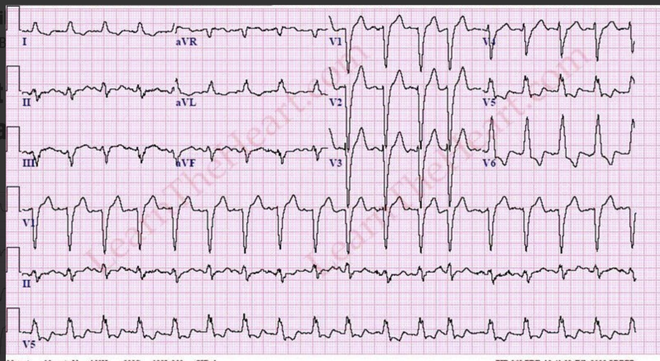
Fragrant Twigs $300
Your patient with class C heart failure (EF 25%) is on goal directed medical therapy and is still symptomatic with mild exertion. His ECG is shown.
THIS is the next treatment option available to improve his symptoms and mortality from HF.

Slide 47
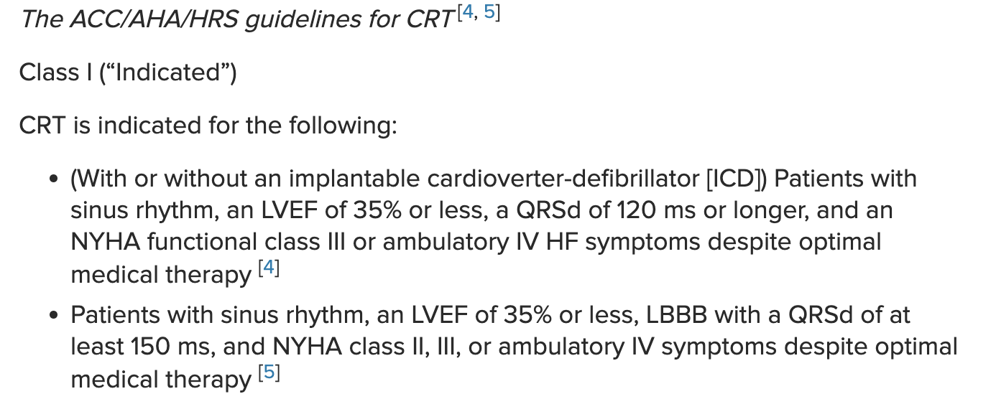
Indication for Cardiac Resynchronization in HFrEF
What is a biventricular pacemaker for cardiac resynchronization?

Slide 48
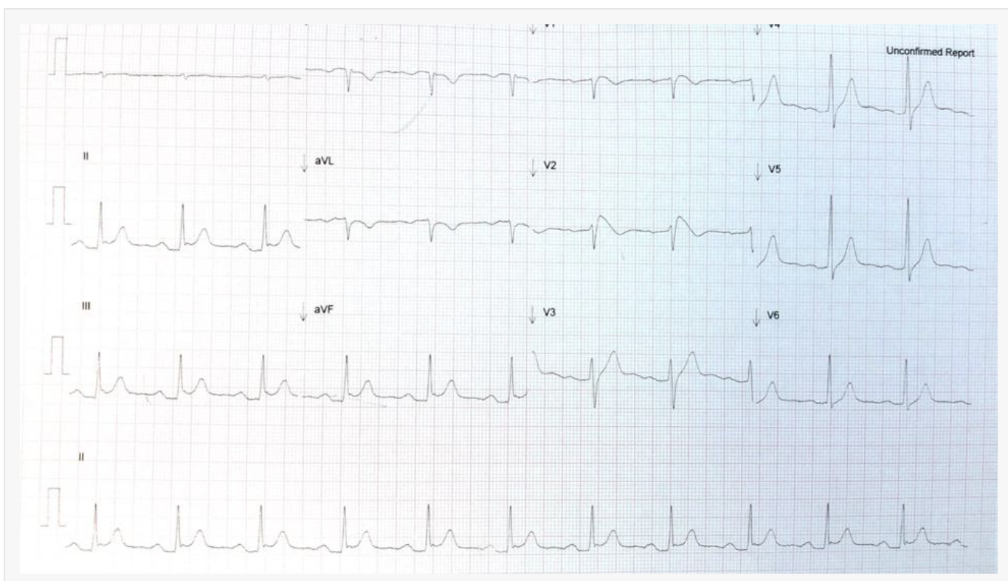
Fragrant Twigs $400
A 24-year-old man of Asian ancestry presents to the ED with syncope. His ECG is below. This is the likely cause of his syncope.

Slide 49
Brugada Syndrome
What is Brugada syndrome?
It is an inherited autosomal dominant Na+ channel abnormality. It is far more common in males (by factor of 8-10:1) where it is the second most common cause of death in those less than 40 years of age.
The true prevalence is difficult to estimate, as it is a dynamic ECG pattern, ie., it is not always present. It is usually associated with sudden death in those with structurally normal hearts.
Its prevalence is about 5/10000 of the population, being responsible for approximately 4% of all sudden cardiac deaths.
It has a high prevalence in South-East Asia and is the same disorder as the previously known Sudden Unexplained Nocturnal Death Syndrome(SUNDS)(2)

Slide 50
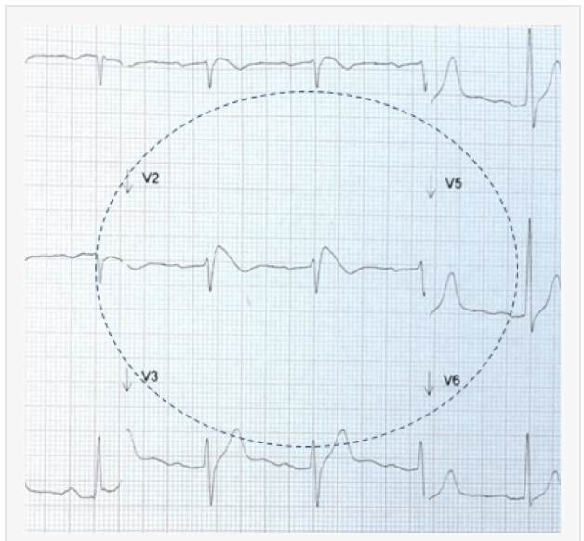
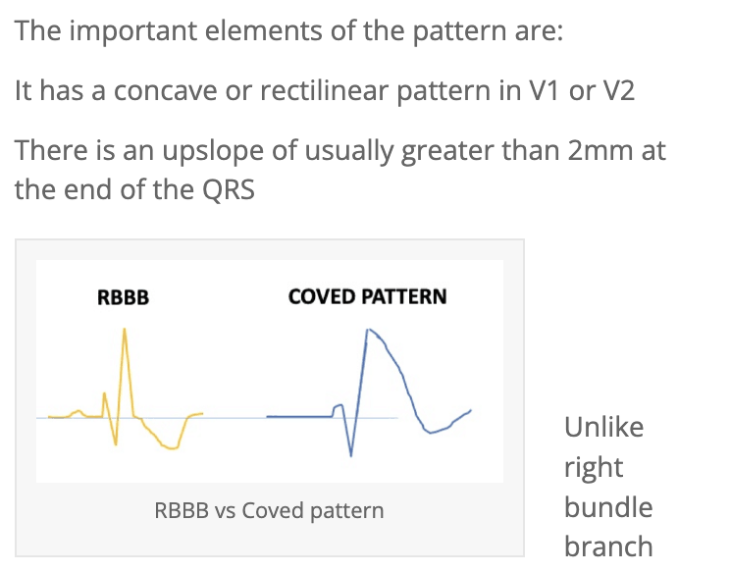
Brugada syndrome

Slide 51
Fragrant Twigs $500
A 60-year-old man of African ancestry presents to the hospital with symptoms of new onset heart failure. He is a regular cocaine user. His echocardiogram shows increased wall thickness of the LV. ECG reveals low voltage. A coronary angiogram reveals non-obstructive coronary disease.
THIS is the likely diagnosis.

Slide 52
Hereditary ATTR Amyloidosis
What is hereditary
ATTR amyloidosis?
Genetic mutation in TTR gene.
Occurs in 3.4% of black persons living in the US
Think of diagnosis with increased LV thickness and low voltage ECG.
Abnormal cardiac MR and diagnostic 99m-technetium pyrophosphate scintigraphy of heart
Tafamidis, protein stabilizer, reduces mortality

