Slide 1
Question 1
A 52-year-old patient is evaluated to discuss recent screening colonoscopy findings.
On physical examination, vital signs and other findings are normal.
One week ago, colonoscopy showed eight tubular adenomas that ranged between 3 mm and 6 mm in size. Polyps were sessile and were removed completely. Colonoscopy bowel preparation and withdrawal time were adequate.
Which of the following is the most appropriate management?
A. Colonoscopy in 1 year
B. Colonoscopy in 3 years
C. Colonoscopy in 5 years
D. Multitarget stool DNA testing in 1 year
E. Multitarget stool DNA testing in 3 years

Slide 2
Question 1
A 52-year-old patient is evaluated to discuss recent screening colonoscopy findings.
On physical examination, vital signs and other findings are normal.
One week ago, colonoscopy showed eight tubular adenomas that ranged between 3 mm and 6 mm in size. Polyps were sessile and were removed completely. Colonoscopy bowel preparation and withdrawal time were adequate.
Which of the following is the most appropriate management?
A. Colonoscopy in 1 year
B. Colonoscopy in 3 years
C. Colonoscopy in 5 years
D. Multitarget stool DNA testing in 1 year
E. Multitarget stool DNA testing in 3 years

Slide 3
Question 1
A 52-year-old patient is evaluated to discuss recent screening colonoscopy findings.
On physical examination, vital signs and other findings are normal.
One week ago, colonoscopy showed eight tubular adenomas that ranged between 3 mm and 6 mm in size. Polyps were sessile and were removed completely. Colonoscopy bowel preparation and withdrawal time were adequate.
Which of the following is the most appropriate management?
A. Colonoscopy in 1 year
B. Colonoscopy in 3 years
C. Colonoscopy in 5 years
D. Multitarget stool DNA testing in 1 year
E. Multitarget stool DNA testing in 3 years

Slide 4
Surveillance colonoscopy
Polyp surveillance intervals after screening colonoscopy depend on:
  number of polyps
  types of polyps
  polyp size
  histology results
Must also consider:
  the quality of the baseline colonoscopy (e.g., withdrawal time and quality of bowel preparation)
  whether polyps were completely resected or removed piecemeal

Slide 5
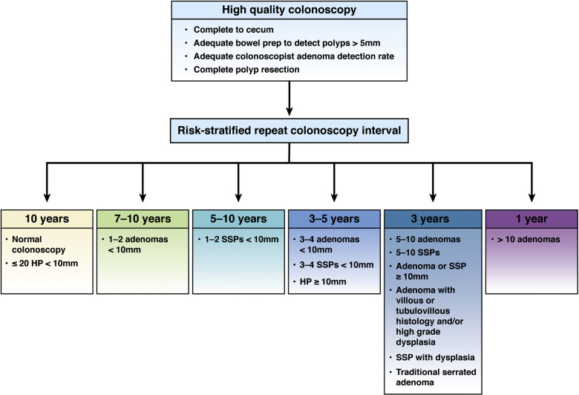

Slide 6
Surveillance for Colorectal Cancer After Screening or Polypectomy
Adenomatous Polyps | Interval to Next Colonoscopy
1-2 tubular adenomas <10 mm | 7-10 years
3-4 tubular adenomas <10 mm | 3-5 years
5-10 tubular adenomas <10 mm, adenoma ≥10 mm, any adenoma with villous or tubulovillous histology, and/or high-grade dysplasia | 3 years
>10 adenomasª on single examination | 1 year
Piecemeal resection of adenoma ≥20 mm | 6 months, then 1 year later, then 3 years after second examination
Serrated Polyps | Interval to Next Colonoscopy
≤20 HP in rectum or sigmoid colon <10 mm or ≤20 HP proximal to sigmoid colon <10 mm | 10 years
1-2 SSP <10 mm | 5-10 years
3-4 SSP <10 mm or HP ≥10 mm | 3-5 years
5-10 SSP <10 mm, SSP ≥10 mm, or SSP with dysplasia | 3 years
Serrated polyposis syndrome | 1-3 years
Traditional serrated adenoma | 3 years
Piecemeal resection of SSP ≥20 mm | 6 months

Slide 7
Question 2
A 54-year-old man is evaluated in the emergency department for a needlestick injury that occurred while at work. He is a respiratory therapist, and he sustained an injury to his left index finger while measuring a patient's arterial blood gas. The source patient was tested; her hepatitis B surface antigen (HBsAg) result is positive and hepatitis C and HIV results are negative. The respiratory therapist cleaned his injured finger with soap and water and reported immediately for evaluation. He previously received the hepatitis B vaccination series, with documented vaccine response (antibody to HBsAg [anti-HBs] ≥10 mU/mL). He takes no medications.
On physical examination, vital signs are normal. A distal left finger puncture injury is noted; the wound has clotted.
Which of the following is the most appropriate management for the respiratory therapist's exposure to hepatitis B?
A. Administer hepatitis B immune globulin
B. Administer hepatitis B vaccine
C. Check anti-HBs
D. No further management

Slide 8
Question 2
A 54-year-old man is evaluated in the emergency department for a needlestick injury that occurred while at work. He is a respiratory therapist, and he sustained an injury to his left index finger while measuring a patient's arterial blood gas. The source patient was tested; her hepatitis B surface antigen (HBsAg) result is positive and hepatitis C and HIV results are negative. The respiratory therapist cleaned his injured finger with soap and water and reported immediately for evaluation. He previously received the hepatitis B vaccination series, with documented vaccine response (antibody to HBsAg [anti-HBs] ≥10 mU/mL). He takes no medications.
On physical examination, vital signs are normal. A distal left finger puncture injury is noted; the wound has clotted.
Which of the following is the most appropriate management for the respiratory therapist's exposure to hepatitis B?
A. Administer hepatitis B immune globulin
B. Administer hepatitis B vaccine
C. Check anti-HBs
D. No further management

Slide 9
Manage potential hepatitis B exposure in a vaccinated patient
A person is considered immune to hepatitis B if they completed the hepatitis B vaccine series and were documented to have an antibody response to hepatitis B surface antigen (anti-HBs) of 10 mU/mL or greater 1 to 2 months after completion of the vaccine series
Notes:
Persons who have demonstrated immunity to hepatitis B virus (HBV) after vaccination do not require additional vaccination or immune globulin if they are exposed to HBV.
Hepatitis B vaccine response is determined by an antibody to hepatitis B surface antigen of 10 mU/mL or greater.

Slide 10
Postexposure Management of Health Care Personnel following Percutaneous or Mucosal Exposure to Hepatitis B
HCP Statusª | Source Patient HBsAg + or Status Unknown | Source Patient HBsAg −
Vaccine responder^{b} | No action needed | No action needed
Vaccine nonresponder^{c} after two complete series | HBIG^{d} × 2 separated by 1 month | No action needed
If vaccine response unknown, test HCP
Anti-HBs <10 mU/mL | HBIG^{d} × 1 Initiate revaccination Postvaccination serologic testing^{e} | Initiate revaccination Postvaccination serologic testing^{e}
Anti-HBs ≥10 mU/mL | No action needed | No action needed
Unvaccinated or incompletely vaccinated | HBIG^{d} × 1 Complete vaccination Postvaccination serologic testing^{e} | Complete vaccination Postvaccination serologic testing^{e}

Slide 11
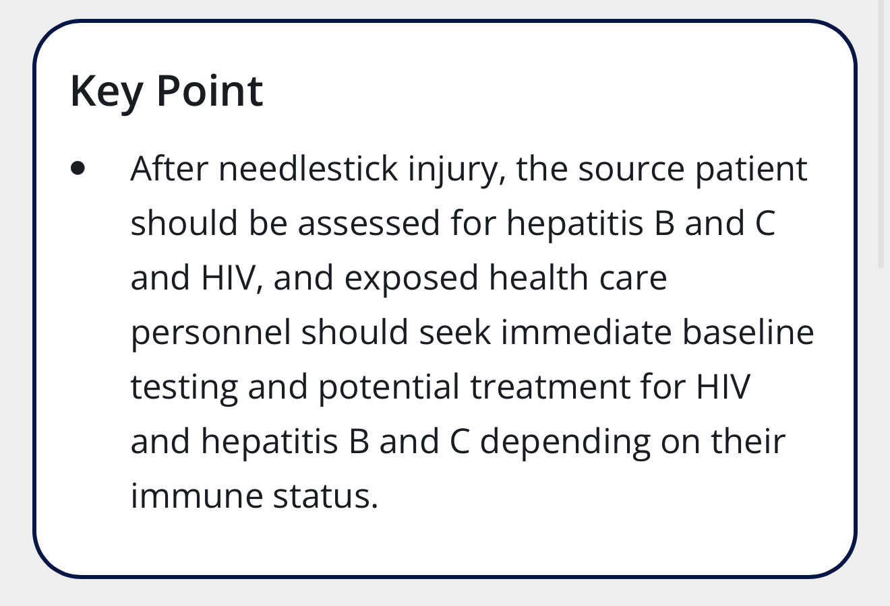

Slide 12
Needlestick injury
HCV
  Follow-up testing of HCP is indicated if the source patient is positive for HCV or status is unknown or if HCV RNA testing is unavailable
  An HCV RNA test at 3 to 6 weeks following exposure is recommended; if negative, a follow-up anti-HCV with reflex to HCV RNA at 4 to 6 months following exposure is advised
HIV
  PEP for HIV should be offered to all exposed HCPs when the source patient is positive or if the status of the source patient is unknown
  Therapy can be discontinued if the test returns negative unless acute HIV infection is a concern
  PEP should be initiated as soon as possible, preferably within a few hours. The preferred PEP regimen is given for 4 weeks
  Follow-up HIV testing

Slide 13
Question 3
A 28-year-old woman is evaluated for a 4-week history of three to four bloody bowel movements daily and associated lower abdominal cramping relieved by stool passage. She reports no fever, nausea, vomiting, or weight loss. She does not use NSAIDs and has no history of recent antibiotic use, travel, or sick contacts.
On physical examination, vital signs are normal. The abdomen is nondistended. There is mild left-sided abdominal tenderness to palpation without rebound or guarding. Anorectal examination reveals a small amount of bloody mucus.
Laboratory studies show normal complete blood count, C-reactive protein level, and stool pathogen panel.
Colonoscopy with biopsy confirms active mild left-sided ulcerative colitis.
Which of the following is the most appropriate treatment?
A. Infliximab
B. Mesalamine suppositories
C. Oral mesalamine and mesalamine enemas
D. Oral prednisone

Slide 14
Question 3
A 28-year-old woman is evaluated for a 4-week history of three to four bloody bowel movements daily and associated lower abdominal cramping relieved by stool passage. She reports no fever, nausea, vomiting, or weight loss. She does not use NSAIDs and has no history of recent antibiotic use, travel, or sick contacts.
On physical examination, vital signs are normal. The abdomen is nondistended. There is mild left-sided abdominal tenderness to palpation without rebound or guarding. Anorectal examination reveals a small amount of bloody mucus.
Laboratory studies show normal complete blood count, C-reactive protein level, and stool pathogen panel.
Colonoscopy with biopsy confirms active mild left-sided ulcerative colitis.
Which of the following is the most appropriate treatment?
A. Infliximab
B. Mesalamine suppositories
C. Oral mesalamine and mesalamine enemas
D. Oral prednisone

Slide 15
Treatment of UC
UC categorized into proctitis (involving the rectum only), left-sided colitis (inflammation that does not extend beyond the splenic flexure), and extensive colitis (inflammation extending beyond the splenic flexure)
Treatment depends on extent and severity
American College of Gastroenterology Clinical Guidelines recommend combined mesalamine therapy (oral and enemas) for induction of remission in mild to moderate left-sided UC, because it is superior to oral mesalamine alone

Slide 16
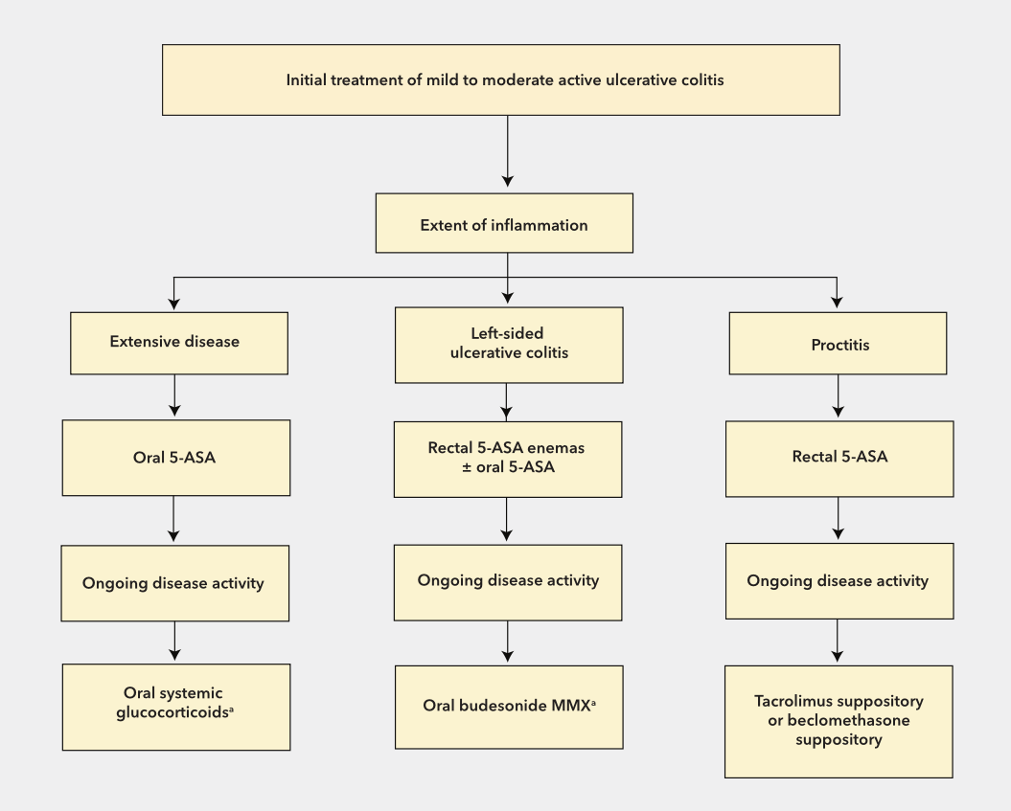
Treat mild left-sided ulcerative colitis

Slide 17
Question 4
A 72-year-old man is hospitalized after a fall resulting in a displaced femoral neck fracture. Orthopedic surgery recommends operative repair within the next 24 hours to reduce complications associated with prolonged immobilization.
The patient has a history of coronary artery disease with placement of a drug-eluting stent 2 years ago, hypertension, and hyperlipidemia. Current medications are aspirin, metoprolol, atorvastatin, and lisinopril.
Before the fall, he was able to climb 2 flights of stairs and walk several blocks without chest pain or dyspnea. He has had no recent angina, orthopnea, palpitations, or syncope.
Blood pressure is 132/78 mm Hg, pulse rate is 68/min, and oxygen saturation is 98% on room air. Cardiac examination is normal. ECG shows normal sinus rhythm without ischemic changes.
What is the most appropriate next step in management?
  A. Delay surgery for pharmacologic stress testing
  B. Delay surgery for coronary angiography
  C. Proceed with surgery without additional cardiac testing and continue perioperative beta-blocker therapy
  D. Initiate high-dose beta-blocker therapy immediately before surgery
  E. Delay surgery for transthoracic echocardiography

Slide 18
Question 4
A 72-year-old man is hospitalized after a fall resulting in a displaced femoral neck fracture. Orthopedic surgery recommends operative repair within the next 24 hours to reduce complications associated with prolonged immobilization.
The patient has a history of coronary artery disease with placement of a drug-eluting stent 2 years ago, hypertension, and hyperlipidemia. Current medications are aspirin, metoprolol, atorvastatin, and lisinopril.
Before the fall, he was able to climb 2 flights of stairs and walk several blocks without chest pain or dyspnea. He has had no recent angina, orthopnea, palpitations, or syncope.
Blood pressure is 132/78 mm Hg, pulse rate is 68/min, and oxygen saturation is 98% on room air. Cardiac examination is normal. ECG shows normal sinus rhythm without ischemic changes.
What is the most appropriate next step in management?
  A. Delay surgery for pharmacologic stress testing
  B. Delay surgery for coronary angiography
  C. Proceed with surgery without additional cardiac testing and continue perioperative beta-blocker therapy
  D. Initiate high-dose beta-blocker therapy immediately before surgery
  E. Delay surgery for transthoracic echocardiography

Slide 19
Cardiac risk stratification for NCS
This patient requires urgent noncardiac surgery (hip fracture repair); delaying repair of a hip fracture is associated with increased morbidity and mortality
He has:
  Stable coronary artery disease
  Prior coronary stenting more than 1 year ago
  Good functional capacity (>4 METs)
  No symptoms suggestive of active myocardial ischemia
  No evidence of decompensated heart failure
  No significant arrhythmia
  No evidence of severe symptomatic valvular disease
The key perioperative principle is:
  Urgent surgery should proceed without additional cardiac testing unless the patient has an active cardiac condition that would change immediate management
Examples of active cardiac conditions include:
  Acute coronary syndrome
  Decompensated heart failure
  Hemodynamically significant arrhythmias
  Severe symptomatic valvular disease

Slide 20
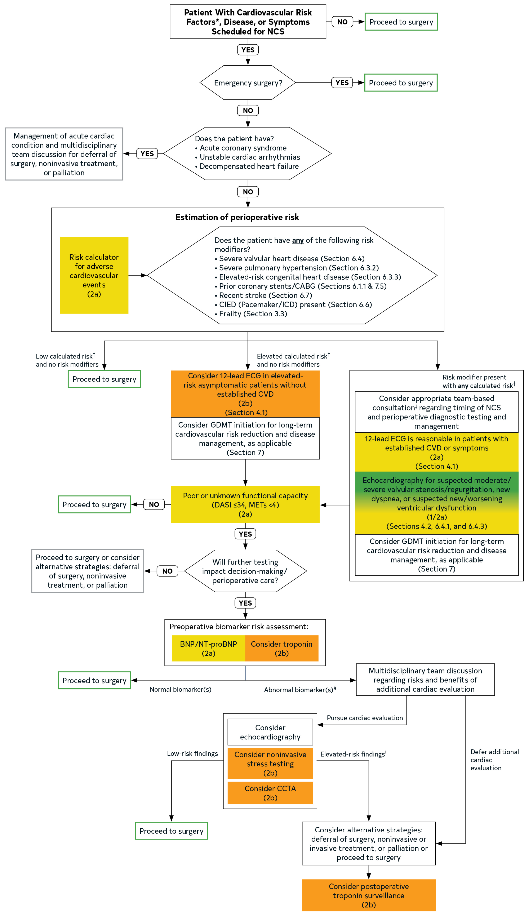
Notes:
2024, ACC/AHA joint guideline update

Slide 23
Key points
Patients with low cardiovascular risk (<1% risk for perioperative major adverse cardiac events [MACE]) and no risk modifiers may proceed to surgery, whereas patients with elevated risk (≥1% risk for perioperative MACE) or presence of risk modifiers should undergo an objective assessment of functional capacity.
Preoperative ECG is reasonable in patients with known cardiovascular disease, arrhythmia, structural heart disease, or symptoms of cardiovascular disease who are undergoing elevated-risk surgeries; it may also be considered for other asymptomatic patients undergoing elevated-risk procedures.
Preoperative ECG is not recommended for patients undergoing low-risk procedures.

Slide 24
Question 5
A 78-year-old man with metastatic prostate cancer is evaluated for worsening bone pain that is no longer responsive to nonpharmacologic and nonopioid therapy. He was recently admitted to hospice care. He also has stage G4 chronic kidney disease, hypertension, and depression. Medications are acetaminophen, amlodipine, and escitalopram.
On physical examination, the patient appears chronically ill. Vital signs are normal. There is tenderness over the midthoracic vertebrae, right humerus, and left femur.
Labs: Cr 2.5 mg/dL and estimated GFR 26 mL/min/1.73 m²
Which of the following is the most appropriate treatment for pain?
  A. Extended-release oxycodone
  B. Immediate-release hydromorphone
  C. Immediate-release morphine
  D. Immediate-release tramadol

Slide 25
Question 5
A 78-year-old man with metastatic prostate cancer is evaluated for worsening bone pain that is no longer responsive to nonpharmacologic and nonopioid therapy. He was recently admitted to hospice care. He also has stage G4 chronic kidney disease, hypertension, and depression. Medications are acetaminophen, amlodipine, and escitalopram.
On physical examination, the patient appears chronically ill. Vital signs are normal. There is tenderness over the midthoracic vertebrae, right humerus, and left femur.
Labs: Cr 2.5 mg/dL and estimated GFR 26 mL/min/1.73 m²
Which of the following is the most appropriate treatment for pain?
  A. Extended-release oxycodone
  B. Immediate-release hydromorphone
  C. Immediate-release morphine
  D. Immediate-release tramadol

Slide 26
Treat pain in a patient with advanced illness and kidney disease
When opioids are used for chronic pain, initiating treatment with a short-acting or immediate-release preparation, rather than a long-acting preparation, is preferred; allows for accurate determination of opioid requirements and reduces overdose risk
Other answers:
  A; should not start off with long-acting formulations
  C; morphine not recommended in patients with kidney disease, as metabolites may accumulate quickly leading to CNS and respiratory depression
  D; tramadol has marginal effectiveness, significant DDIs (esp. serotonergic meds), and wide variations in hepatic metabolism

Slide 27
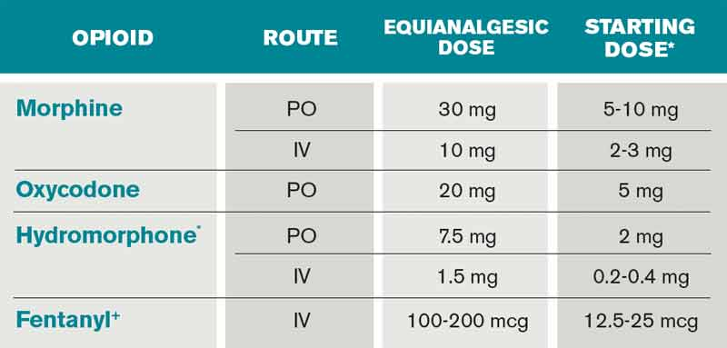
Opioid Dosing

Slide 28
Question 6
A 76-year-old woman is evaluated after two episodes of syncope over the past month. Both episodes occurred while seated and were preceded by lightheadedness. She denies chest pain, palpitations, or dyspnea.
Medical history is significant for hypertension and hyperlipidemia.
Medications include lisinopril and atorvastatin.
Physical examination is normal. Orthostatic vital signs are negative.
Laboratory studies, including CBC, CMP, and TSH, are normal.
ECG shows sinus bradycardia at 48/min.
A 14-day ambulatory monitor demonstrates multiple sinus pauses lasting up to 5.8 seconds that correlate with episodes of dizziness documented in the patient's symptom diary.
What is the most appropriate next step in management?
A. Begin metoprolol therapy
B. Implant a permanent pacemaker
C. Perform tilt-table testing
D. Refer for catheter ablation
E. Repeat ambulatory monitoring in 6 months

Slide 29
Question 6
A 76-year-old woman is evaluated after two episodes of syncope over the past month. Both episodes occurred while seated and were preceded by lightheadedness. She denies chest pain, palpitations, or dyspnea.
Medical history is significant for hypertension and hyperlipidemia.
Medications include lisinopril and atorvastatin.
Physical examination is normal. Orthostatic vital signs are negative.
Laboratory studies, including CBC, CMP, and TSH, are normal.
ECG shows sinus bradycardia at 48/min.
A 14-day ambulatory monitor demonstrates multiple sinus pauses lasting up to 5.8 seconds that correlate with episodes of dizziness documented in the patient's symptom diary.
What is the most appropriate next step in management?
A. Begin metoprolol therapy
B. Implant a permanent pacemaker
C. Perform tilt-table testing
D. Refer for catheter ablation
E. Repeat ambulatory monitoring in 6 months

Slide 30
2018 ACC/AHA/HRS Guideline on the Evaluation and Management of Patients With Bradycardia and Cardiac Conduction Delay: A Report of the American College of Cardiology/American Heart Association Task Force on Clinical Practice Guidelines and the Heart Rhythm Society
In sinus node dysfunction, there is no established minimum heart rate or pause duration where permanent pacing is recommended. Establishing temporal correlation between symptoms and bradycardia is important when determining whether permanent pacing is needed.

Slide 31
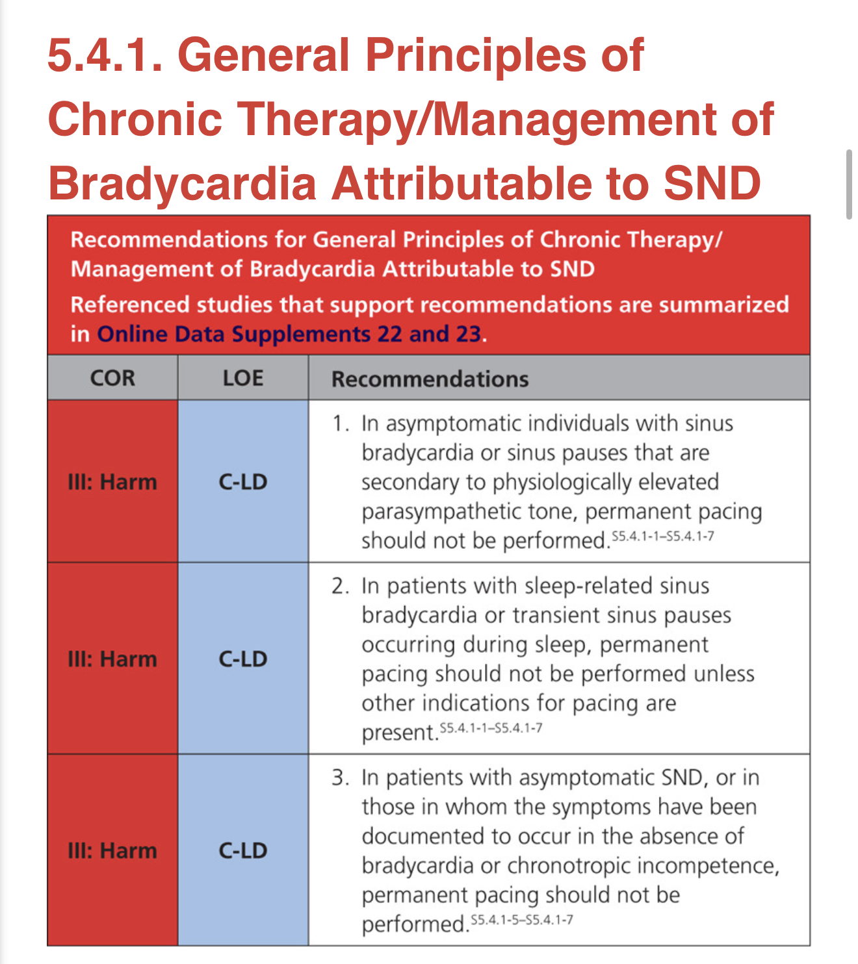

Slide 32
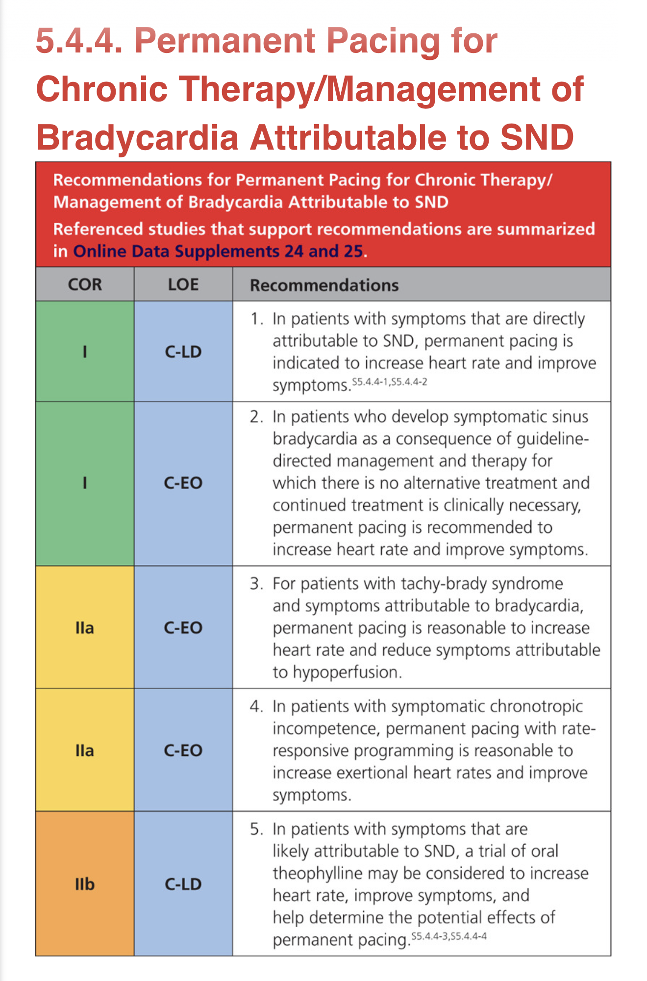

Slide 33
Question 7
A 48-year-old patient is evaluated for fatigue and generalized itching that worsens after showering. They are otherwise healthy and take no medications.
On physical examination, vital signs are normal. The spleen tip is palpable 1 cm below the left costal margin.
Labs:
Genetic testing is positive for the JAK2 V617F mutation.
In addition to daily aspirin, which of the following is the most appropriate treatment?
  Allogeneic hematopoietic stem cell transplantation
  Hydroxyurea
  Phlebotomy
  Ruxolitinib
Erythropoietin | 2 mU/mL (2 U/L) | L
Hematocrit | 56.5% | H
Hemoglobin | 19 g/dL (190 g/L) | H
Leukocyte count | 11,200/µL (11.2 × 10⁹/L) | H
Platelet count | 445,000/µL (445 × 10⁹/L)

Slide 34
Question 7
A 48-year-old patient is evaluated for fatigue and generalized itching that worsens after showering. They are otherwise healthy and take no medications.
On physical examination, vital signs are normal. The spleen tip is palpable 1 cm below the left costal margin.
Labs:
Genetic testing is positive for the JAK2 V617F mutation.
In addition to daily aspirin, which of the following is the most appropriate treatment?
  Allogeneic hematopoietic stem cell transplantation
  Hydroxyurea
  Phlebotomy
  Ruxolitinib
Erythropoietin | 2 mU/mL (2 U/L) | L
Hematocrit | 56.5% | H
Hemoglobin | 19 g/dL (190 g/L) | H
Leukocyte count | 11,200/µL (11.2 × 10⁹/L) | H
Platelet count | 445,000/µL (445 × 10⁹/L)
Notes:
This patient has erythrocytosis, a low erythropoietin level, and the JAK2 V617F mutation, establishing the diagnosis of PV. Aspirin should be started, and they should undergo phlebotomy.

Slide 35
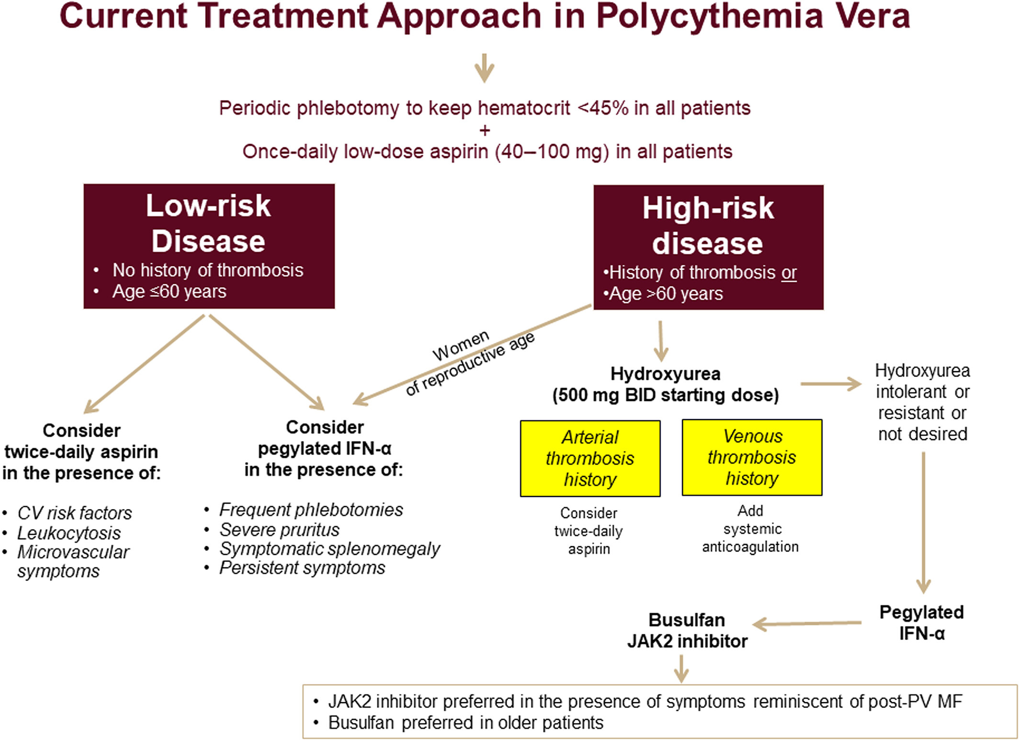

Slide 36
Manage low-risk polycythemia vera
PV is a clonal stem cell disorder characterized by the JAK2 V617F activating alteration in virtually all patients (97%) and an elevated hemoglobin level; thrombocytosis and neutrophilia are also common
A suppressed erythropoietin level is common in patients with JAK2-positive PV
Symptoms may include fatigue, headache, or itching, usually after a warm shower (aquagenic pruritus); some patients may be asymptomatic
Patients with PV have an increased risk for adverse cardiovascular events, including venous thrombosis, stroke, and myocardial infarction
Patients may also experience significant bleeding complications or develop acquired von Willebrand disease
Unless contraindicated, all patients with JAK2-positive PV should undergo phlebotomy to maintain a hematocrit level less than 45% and be treated with low-dose aspirin to reduce the risk of adverse cardiovascular events
Notes:
** with the diagnosis discovered incidentally on laboratory testing done for other reasons

Slide 37
Other answers
A; Allogeneic hematopoietic stem cell transplantation (HSCT) appropriate for select patients with acute myeloid and lymphocytic leukemias, aplastic anemia, and myelodysplastic syndrome; HSCT carries significant risk of serious complications and is generally reserved for patients with a poor prognosis; not indicated for treatment of PV
B; Hydroxyurea is a first-line cytoreductive therapy in select patients with PV and reduces the production of hematopoietic elements, resulting in a lower hemoglobin level and lower leukocyte and platelet counts; indicated in patients with high-risk PV, defined as those who are older than 60 years or have a history of thrombosis
D; The JAK1/JAK2 inhibitor ruxolitinib is another form of cytoreductive therapy effective in PV; 2nd line agent for patients who cannot tolerate hydroxyurea or who have hydroxyurea-resistant PV
Notes:
Cytoreductive therapy is also considered in patients at low risk with significant symptom burden or in those who require frequent phlebotomy, are unable to maintain a target hematocrit despite repeated phlebotomy, or do not tolerate phlebotomy. This patient is considered low risk and does not meet criteria for cytoreductive therapy.

Slide 38
Key points
All patients with polycythemia vera should be treated with low-dose aspirin and phlebotomy to achieve a target hematocrit of less than 45% to reduce the risk of cardiovascular events.
Patients with polycythemia vera who are older than 60 years or those who have a history of thromboses should receive cytoreductive therapy in addition to aspirin and phlebotomy.

Slide 39
Question 8
A 34-year-old woman is hospitalized for a 2-week history of severe abdominal pain.
On physical examination, vital signs are normal. Her abdomen is distended, and a 12-cm mass in the lower abdomen is noted.
Labs:
PET/CT scans show a large, bulky mesenteric mass and retroperitoneal adenopathy. Biopsy of the mass shows Burkitt lymphoma.
Which of the following is the most appropriate next step in management?
  High-flow intravenous fluids
  High-flow intravenous fluids and furosemide
  Immediate chemotherapy
  Sevelamer
Complete blood count | Normal
Creatinine | 1.1 mg/dL (97.2 µmol/L)
Potassium | 5.0 mEq/L (5.0 mmol/L)
Lactate dehydrogenase | 1250 U/L | H
Phosphorus | 5.2 mg/dL (1.7 mmol/L) | H
Urate | 8.5 mg/dL (0.5 mmol/L) | H

Slide 40
Question 8
A 34-year-old woman is hospitalized for a 2-week history of severe abdominal pain.
On physical examination, vital signs are normal. Her abdomen is distended, and a 12-cm mass in the lower abdomen is noted.
Labs:
PET/CT scans show a large, bulky mesenteric mass and retroperitoneal adenopathy. Biopsy of the mass shows Burkitt lymphoma.
Which of the following is the most appropriate next step in management?
  High-flow intravenous fluids
  High-flow intravenous fluids and furosemide
  Immediate chemotherapy
  Sevelamer
Complete blood count | Normal
Creatinine | 1.1 mg/dL (97.2 µmol/L)
Potassium | 5.0 mEq/L (5.0 mmol/L)
Lactate dehydrogenase | 1250 U/L | H
Phosphorus | 5.2 mg/dL (1.7 mmol/L) | H
Urate | 8.5 mg/dL (0.5 mmol/L) | H

Slide 41
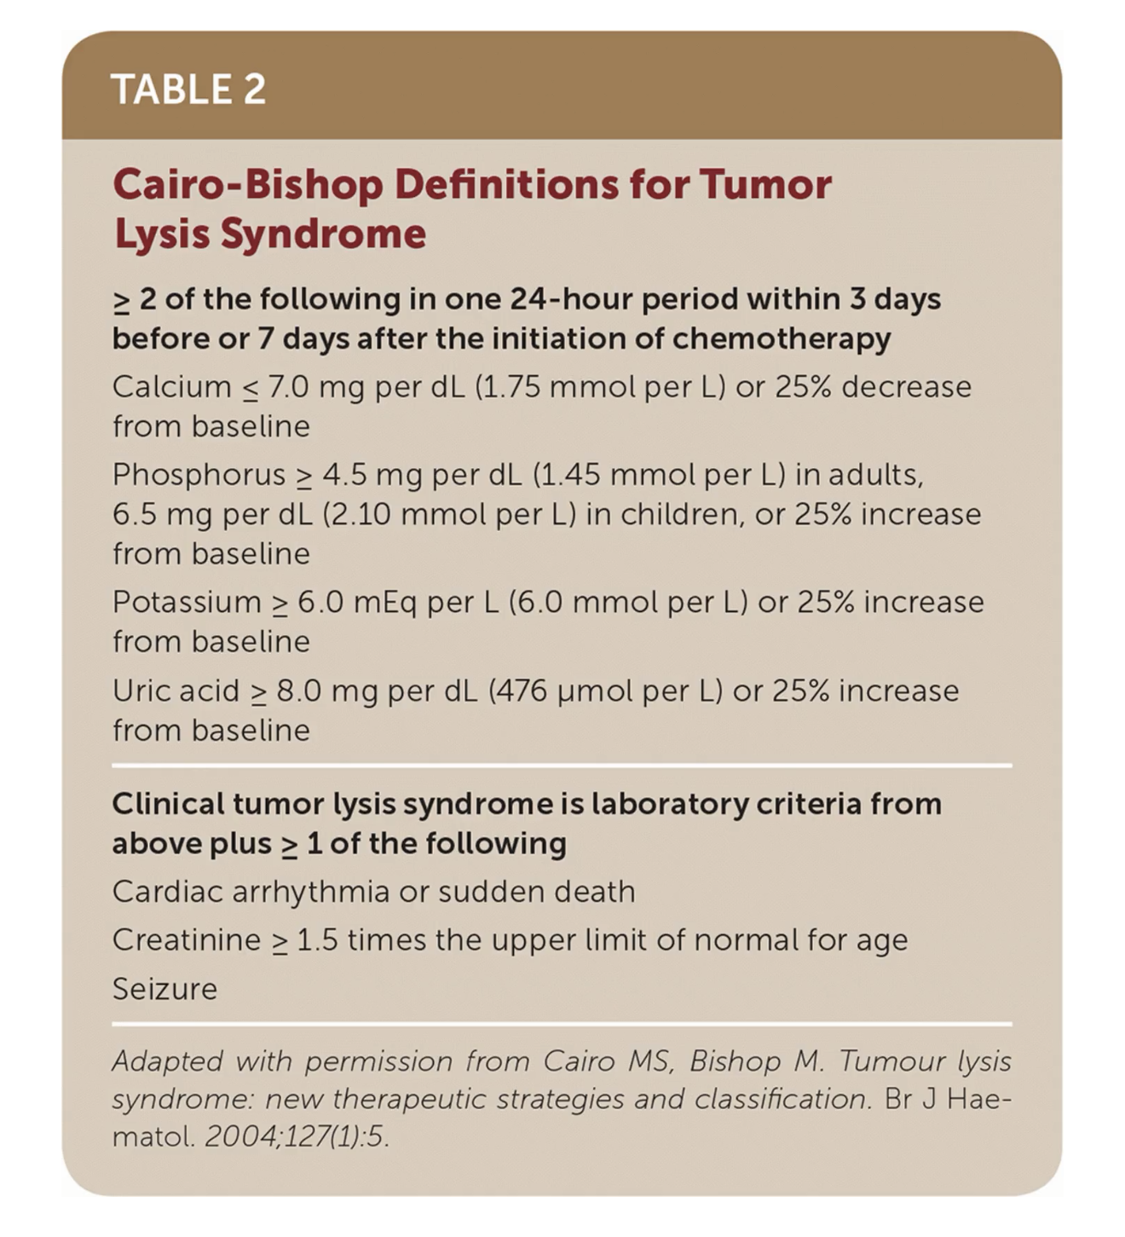
TLS
Massive tumor cell lysis
Can occur spontaneously or after chemotherapy initiation
  Burkitt’s lymphoma, DLBCL, ALL, CLL
Notes:
When it is spontaneous, tumor outgrows its blood supply, resulting in lysis of tumor cells; when it occurs after chemo initiation, the cell death is intentional but still causes lysis of tumor cells
The most appropriate next step in management is treatment of tumor lysis syndrome (TLS) with high-flow intravenous fluids (Option A). Patients with highly proliferative hematologic malignancies, such as acute leukemia and high-grade lymphomas, can develop TLS even before chemotherapy is started. TLS is caused when tumor cells release their contents into the bloodstream, either spontaneously or resulting from treatment, leading to hyperuricemia, hyperkalemia, hyperphosphatemia, and hypocalcemia. These electrolyte abnormalities can lead to acute kidney injury, cardiac arrhythmias, seizures, and death. Patients with tumors that pose a high risk for TLS should receive prophylaxis for TLS before starting chemotherapy. Treatment includes intravenous fluids and management of potassium, phosphorous, calcium, and urate levels. Urate levels can be lowered by using allopurinol or rasburicase. This patient's elevated serum potassium, urate, and phosphorous levels, along with kidney impairment, suggest spontaneous tumor lysis syndrome. Treatment with intravenous fluids should be started immediately. Therapy directed at urate levels, specifically rasburicase, should also be initiated.
Intravenous fluids and furosemide (Option B) would not be an appropriate intervention. Intravenous fluids are a key component of the treatment for TLS, but diuretic therapy should be used only if needed to maintain urine output or if volume overload develops. This patient has no preexisting cardiac or kidney disease and may not require diuretic therapy.
Immediate chemotherapy (Option C) should not be pursued until treatment is started for TLS in this patient who has laboratory evidence of TLS. Beginning chemotherapy before starting treatment for TLS could result in worsening of TLS, with resultant electrolyte abnormalities and kidney injury.
Sevelamer (Option D) is not indicated for this patient. Useful in the treatment of hyperphosphatemia in the setting of chronic kidney disease, sevelamer binds phosphate in the gastrointestinal tract before it can be absorbed. It has no role in the treatment of TLS, where the major phosphate load is generated from tumor cell lysis.
Patients with highly proliferative hematologic malignancies, such as acute leukemia and high-grade lymphomas, can develop tumor lysis syndrome even before starting chemotherapy.
In patients with malignancies at high risk for developing tumor lysis syndrome, prophylaxis should be started before initiating chemotherapy.

Slide 42
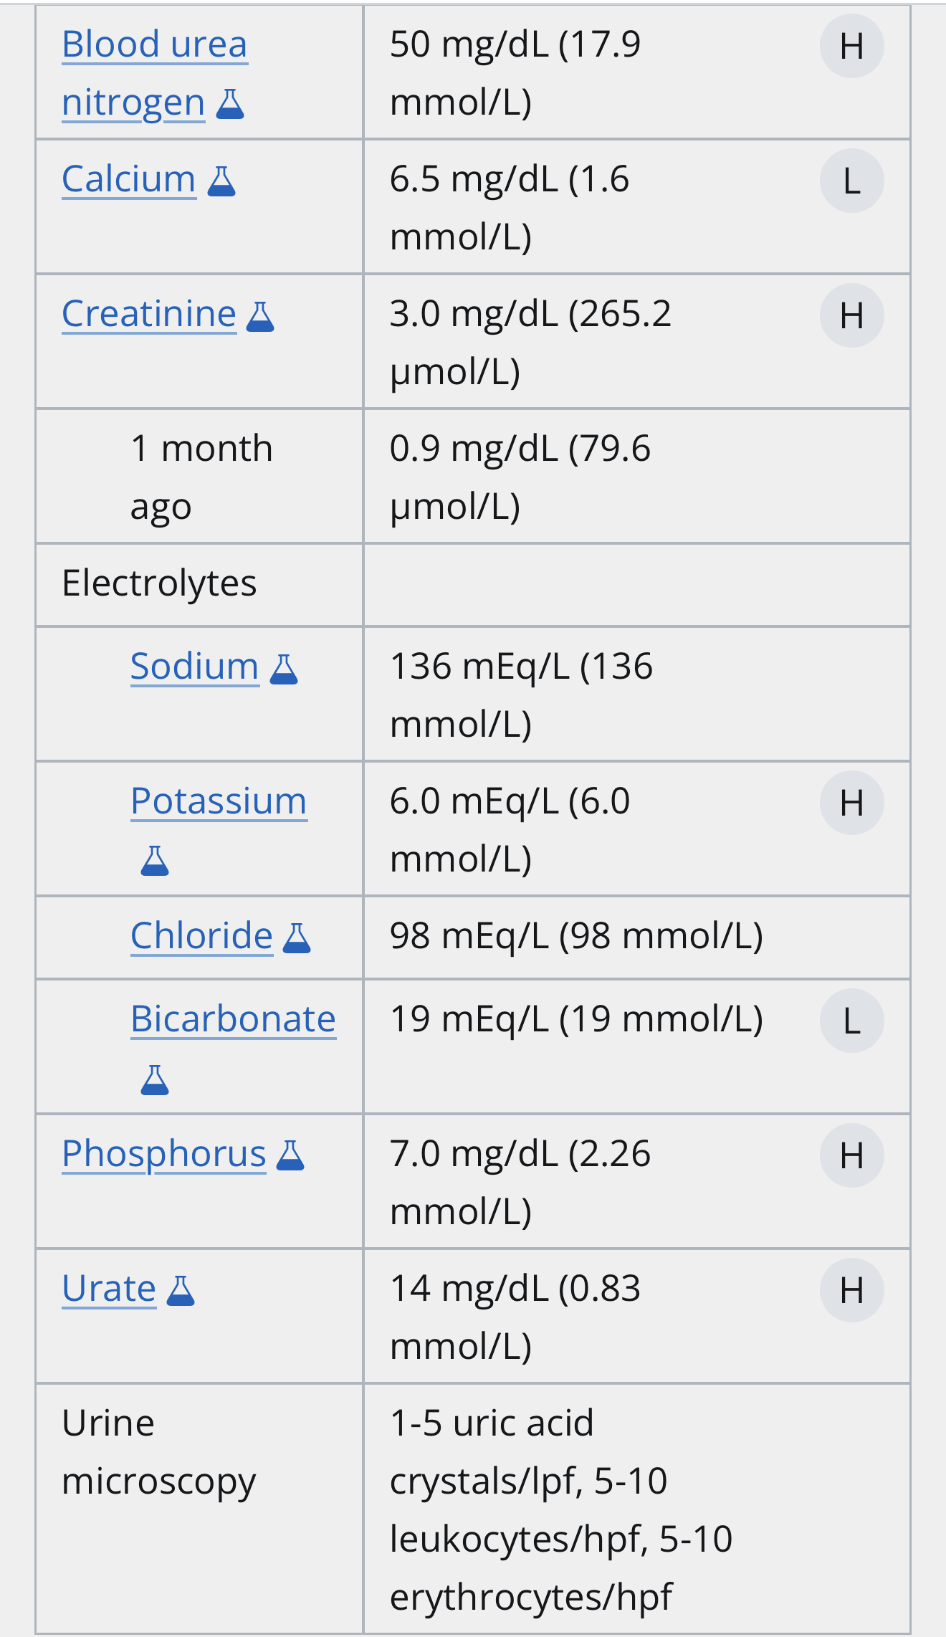
Question 9
A 60-year-old man is evaluated in the emergency department for acute kidney injury after presenting with a 5-day history of nausea, vomiting, and lethargy. One week ago, he received his first dose of chemotherapy for non-Hodgkin lymphoma.
On physical examination, vital signs are normal. The patient is drowsy but alert and oriented. There is no precordial rub on cardiac examination. Lungs are clear to auscultation bilaterally. Asterixis is not noted.
A 12-lead ECG reveals normal sinus rhythm and no ST-T wave changes.
Which of the following is the most appropriate treatment?
  Fomepizole
  Hemodialysis
  Plasma exchange
  Rasburicase

Slide 43
Question 9
A 60-year-old man is evaluated in the emergency department for acute kidney injury after presenting with a 5-day history of nausea, vomiting, and lethargy. One week ago, he received his first dose of chemotherapy for non-Hodgkin lymphoma.
On physical examination, vital signs are normal. The patient is drowsy but alert and oriented. There is no precordial rub on cardiac examination. Lungs are clear to auscultation bilaterally. Asterixis is not noted.
A 12-lead ECG reveals normal sinus rhythm and no ST-T wave changes.
Which of the following is the most appropriate treatment?
  Fomepizole
  Hemodialysis
  Plasma exchange
  Rasburicase

Slide 44
TLS prevention and Treatment
Prophylaxis
  Hydration: 0.9% NS (No potassium in IVF). Goal UOP 80-100 mL/hr (in high risk I usually start at 200cc/hr as long as no cardiac concerns)
  Allopurinol: allopurinol 300mg PO daily (or can use BID/TID)
  Check labs often - don’t just order them, make sure they result
Treatment (as above plus:)
Electrolyte abnormalities:
  Phosphate Binders (decrease GI absorption of phos)
  HyperK treatments
  Use caution prior to repleting for hypocalcemia
    remove automated electrolyte plans
    Ca x PO4 >60 increases risk of precipitation
  Severe cases may require hemodialysis.
  Loop diuretics can assist with uric acid excretion when patient no longer hypovolemic.
Do not suggest alkalinizing the urine
  (alkalinization makes uric acid more soluble – but phosphate less soluble, so may trigger precipitation esp when Ca x PO4 is >60mg/dL. With rasburicase available, alkalinization is rarely indicated)

Slide 45
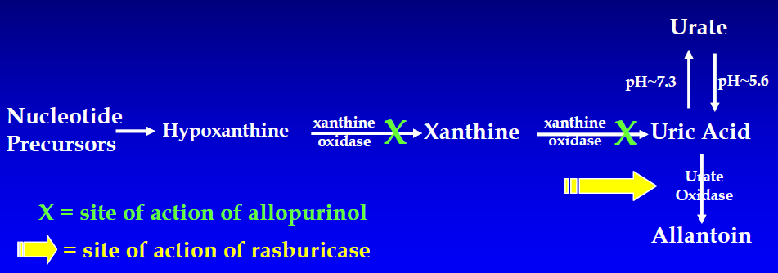

TLS Treatment
- Rasburicase: (recombinant urate oxidase enzyme) for selected high-risk patients (uric acid >10), treat with 3mg IV x 1
  may repeat after 8 hours in rare cases, esp if uric acid remains >8.5mg/dL
  Caution: agent can cause hemolysis in G6PD deficient patients.
Check level 3-6 hours after dose: Note well: Uric acid samples taken after administration of rasburicase must be collected in chilled heparin tubes, kept in ice, and run within 4 hours of collection as the enzyme will continue to be active within the tube and cause spuriously low results (Use RASBURICASE uric acid level order).
Aggressive IVF can often avoid need for rasburicase in borderline cases and increase value

Slide 46
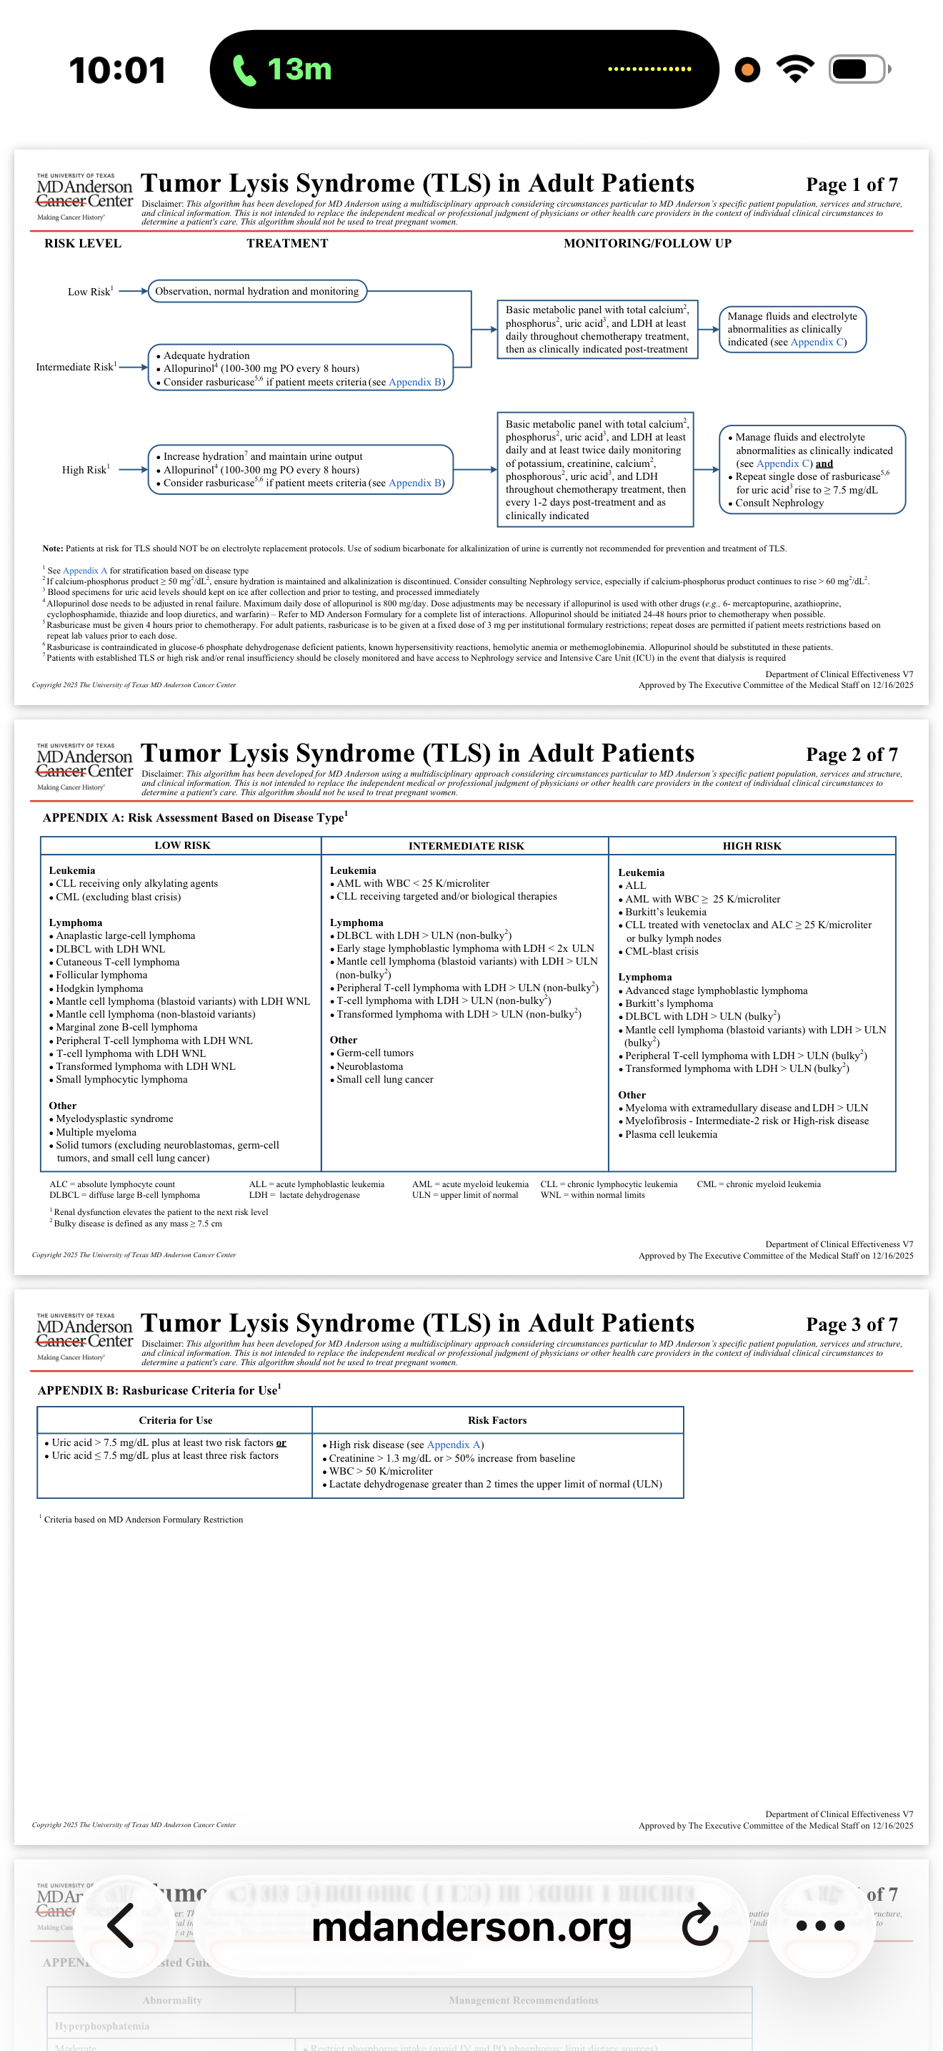

Slide 49
Question 10
A 74-year-old man reports having persistent diarrhea (characterized by three loose, watery, nonbloody stools per day), abdominal bloating, and intermittent cramping for the past 6 weeks. He has also had intermittent headaches, which are new for him. The symptoms began shortly after he returned from a trip to rural Mexico. While there, he drank bottled water, but he ate fresh fruit that might have been washed with water from the local well. He states that he does not have fevers or chills but that he has lost a few kilograms of body weight.
His vital signs are within normal limits. There is mild tenderness to palpation in his lower abdomen.
A stool sample is sent for diagnostic studies, and the Giardia antigen test returns positive.
Which one of the following treatments is most likely to be appropriate for this patient?
  A. Quinacrine
  B. Azithromycin
  C. Tinidazole
  D. Trimethoprim-sulfamethoxazole
  E. Ciprofloxacin
Notes:
Tx giardia lambia infection

Slide 50
Question 10
A 74-year-old man reports having persistent diarrhea (characterized by three loose, watery, nonbloody stools per day), abdominal bloating, and intermittent cramping for the past 6 weeks. He has also had intermittent headaches, which are new for him. The symptoms began shortly after he returned from a trip to rural Mexico. While there, he drank bottled water, but he ate fresh fruit that might have been washed with water from the local well. He states that he does not have fevers or chills but that he has lost a few kilograms of body weight.
His vital signs are within normal limits. There is mild tenderness to palpation in his lower abdomen.
A stool sample is sent for diagnostic studies, and the Giardia antigen test returns positive.
Which one of the following treatments is most likely to be appropriate for this patient?
  A. Quinacrine
  B. Azithromycin
  C. Tinidazole
  D. Trimethoprim-sulfamethoxazole
  E. Ciprofloxacin
Notes:
Tx giardia lambia infection

Slide 51
Treat giardia lamblia
Giardia duodenalis, also known as Giardia intestinalis and Giardia lamblia
Caused by the ingestion of Giardia Lamblia cysts found in contaminated water or food
Incubation period is 7 to 14 days, and illness can range from asymptomatic infection to chronic diarrhea
Common symptoms:
  diarrhea, abdominal cramps, bloating, foul-smelling stools, and flatulence
Chronic symptoms:
  anorexia, headaches, and weight loss.
Diagnosis of Giardia infection is made through direct examination of the stool for cysts or through antigen testing
First-line treatment for adults and most children consists of tinidazole or nitazoxanide.
Metronidazole, the former first-line agent, is now considered a second-line agent because of concerns about increasing rates of resistance

