Slide 1
USPSTF Cancer Prevention Jeopardy
At your cervix
No butts about it
Can’t we all just get a lung
Breast friends forever
To pee or not to pee
$100
$100
$100
$100
$100
$200
$200
$200
$200
$200
$300
$300
$300
$300
$300
$400
$400
$400
$400
$400
$500
$500
$500
$500
$500

Slide 2
At Your Cervix - $100
This is the pap follow up interval anytime you use cotesting with negative results.

Slide 3
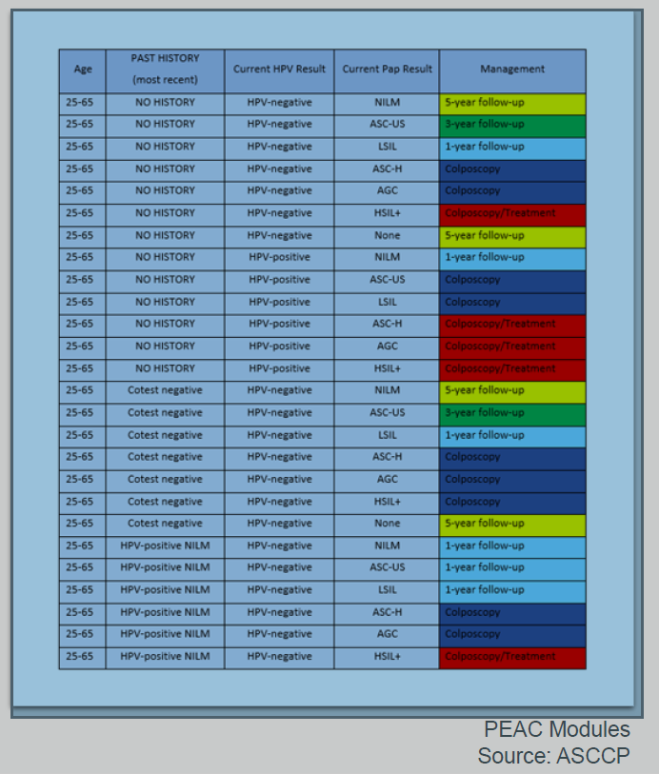
5 years
ASC-H, HSIL (high grade intraepithelial lesion), AGC (atypical glandular cells) → colposcopy
Neg cotesting→5 year follow up
Everything else → → →

Slide 4
At Your Cervix - $200
A 36-year-old female identifies as asexual and had her Gardasil vaccine series asks whether she should forgo screening for cervical cancer.
This is your recommendation.

Slide 5
Yes, pap still indicated.
Who should be screened for cervical cancer?
Age-appropriate people with a cervix
Transgender men
Women who have sex with women
Women who have never had sex
Women who have had a hysterectomy (if they have their cervix)

Slide 6

At Your Cervix - $300
These are the procedure(s) recommended for abnormal pap results to closely examine the cervix/vagina/vulva for signs of disease, and to test and treat abnormal lesions.

Slide 7
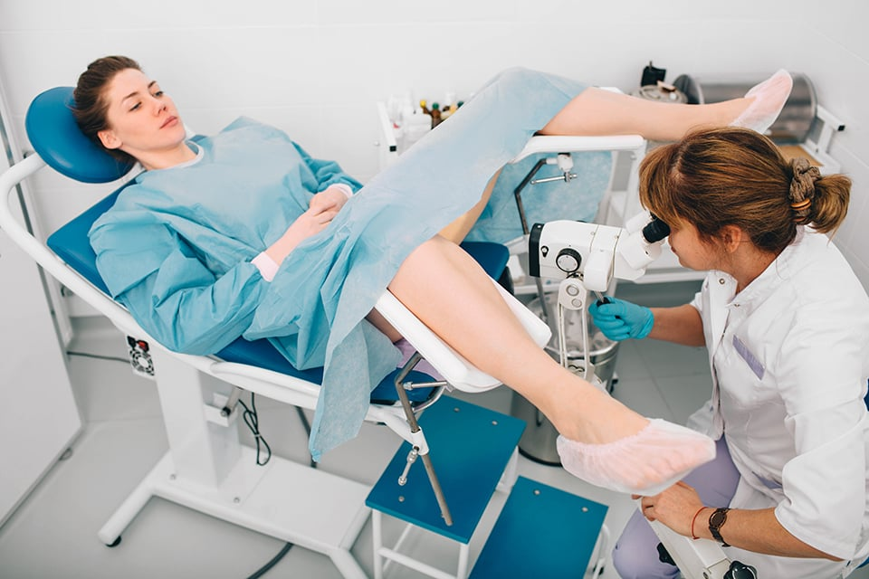
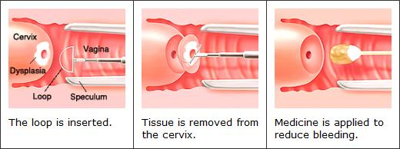
Colposcopy +/- LEEP
Colposcopy: examines the cervix/vagina/vulva
LEEP: Loop Electrosurgical Excision Procedure to remove abnormalities (for testing and treatment)

Slide 8

At Your Cervix - $400
A 68-year-old female presents to clinic and asks if she needs another pap.
She has had 2 negative cotests but had abnormal results (ASCUS) 15 years ago.
This is what you recommend.
(Apparently Fran Drescher is 68 years old FYI but I don’t think this is on boards.)

Slide 9
Stop screening.
Stop screening at age 65 only if:
No abnormal results in the past decade
Two negative primary HPV tests or cotests
OR
3 negative cytology in the past decade with most recent in last 5 years
Not immunocompromised
If abnormal results, continue screening until no abnormality for a decade

Slide 10

At Your Cervix - $500
A 24 year old female asks if she needs a pap today. Her last pap was 3 years ago and was normal.
This is what you recommend.

Slide 11
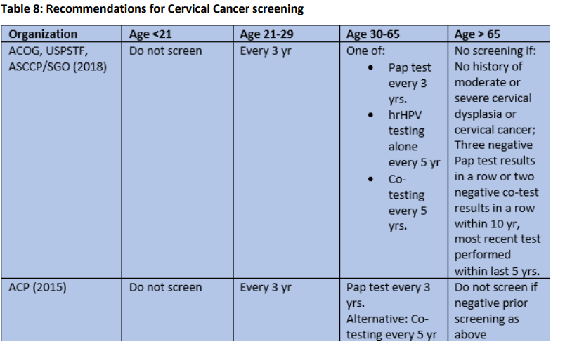
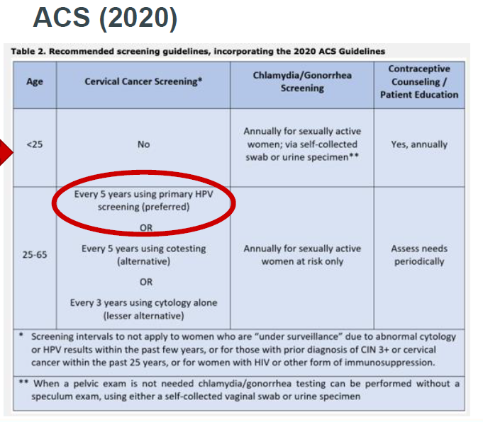
Controversy! (Free points)
Current guidelines:
Proposed guidelines:

Slide 12
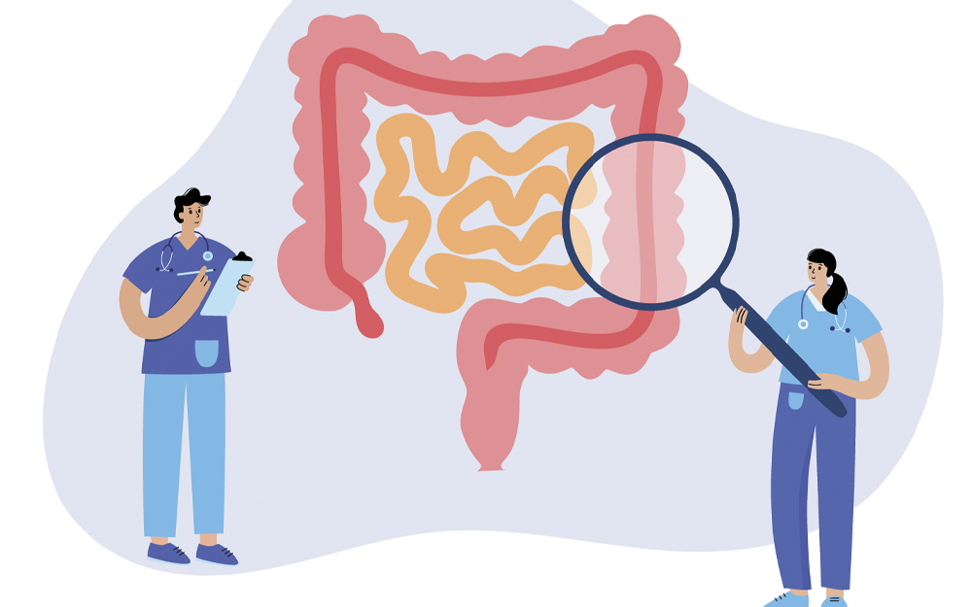
No Butts About It - $100
The USPSTF recommends screening for colorectal cancer starting at this age if there is no significant family history.

Slide 13
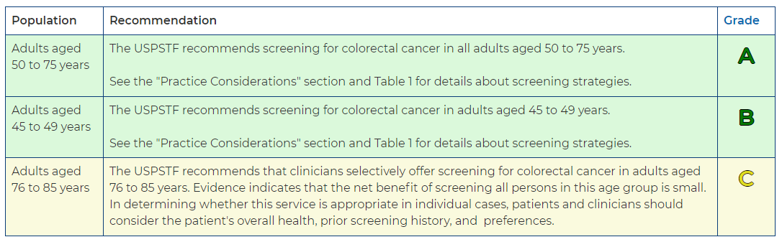
Age 45
Colorectal cancer screening

Slide 14

No Butts About It - $200
This is how often a Cologuard sDNA-FIT test should be repeated if negative and patient is of average risk.

Slide 15
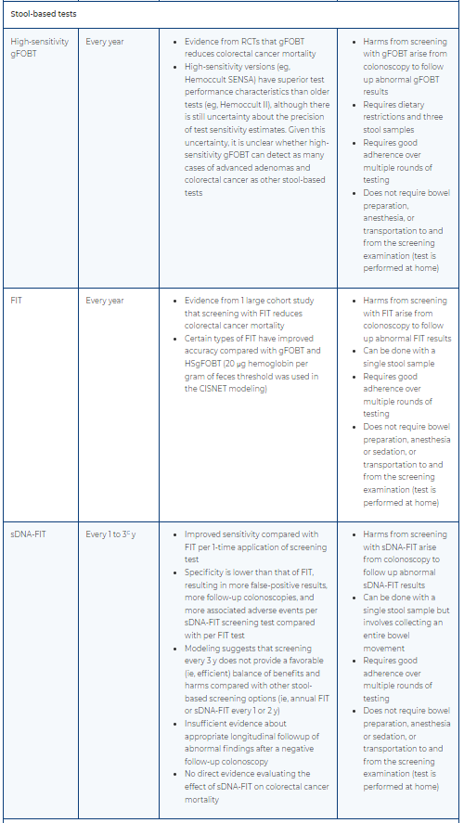
3 years
Frequency of Screening

Slide 16
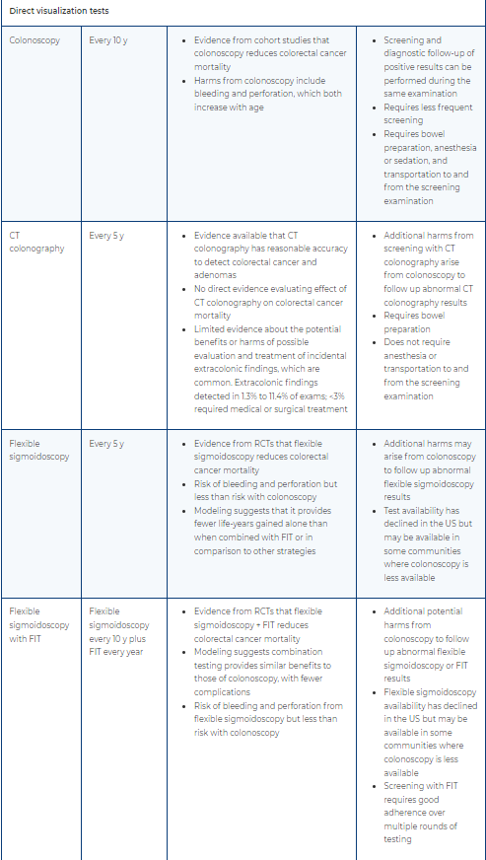
Frequency of Screening

Slide 17
No Butts About It - $300
This is the age to start screening a patient whose father was diagnosed with CRC at age 40.
USPSTF 2024

Slide 18
Age 30, then at least q5years
(10 years prior to first degree relative’s diagnosis OR 40yo, whichever is first)
Indications for enhanced screening — Specific aspects of the family history of CRC influence the age at which to begin screening and the frequency of screening.
Obtaining family history permits determination of the number of FDRs diagnosed with ANY of the following:
Colorectal cancer (CRC)
Documented advanced polyp with ANY of the following:
  Advanced adenoma
  Adenoma size ≥1 cm
  Adenoma with high-grade dysplasia
  Adenoma with villous elements
  Advanced serrated lesion
  Sessile serrated polyp (SSP) ≥1 cm
  Traditional serrated adenoma ≥1 cm
  SSP with cytologic dysplasia
We suggest using the information about first-degree relatives (FDRs) with ANY of the above to screen as follows, in keeping with the 2021 NCCN guidelines [38]:
One or more FDR diagnosed at any age – Begin screening at age 40 years, or 10 years before the FDR's diagnosis, whichever is earlier (or in the case of an advanced polyp, at the age of diagnosis of the advanced polyp if that is earlier). We suggest colonoscopy every five years. If the patient declines colonoscopy, annual fecal immunochemical testing (FIT) should be offered.

Slide 19
No Butts About It - $400
This is when we screen patients with IBD for colorectal cancer, and the preferred modality.
USPSTF 2024

Slide 20
8 years after onset with colonoscopy
High Risk Group - IBD
IBD- 8 years after symptom/disease onset
Colonoscopy preferred
USPSTF 2024

Slide 21
No Butts About It - $500
This is when we screen PSC patients for CRC.

Slide 22
Other High Risk Groups
PSC- at time of diagnosis
Family history of known genetic syndromes- require genetic counselling and early enhanced CRC screening
Adult survivors of pediatric cancer with h/o abdominal/pelvic/spine/total body radiation- consider 5 years after radiation or age 30 but no clear guidelines
USPSTF

Slide 23

Can’t We All Just Get A Lung - $100
This is the imaging technique we use to screen for lung cancer.
FYI this costume is on sale for $350

Slide 24
Low Dose CT
Single maximal inspiratory breath-hold with a scanning time under 25 seconds

Slide 25
Can’t We All Just Get A Lung - $200
This is how often to screen for lung cancer in patients who meet criteria.
USPSTF

Slide 26

Every year

Slide 27
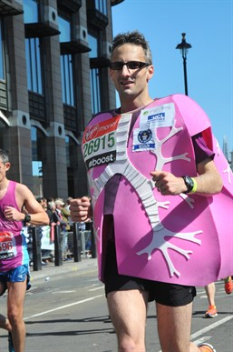
Can’t We All Just Get A Lung - $300
This is when to stop screening for lung cancer

Slide 28
Once:
81 years old
OR
has not smoked for 15 years
OR
limited life expectancy

Slide 29

Can’t We All Just Get A Lung - $400
The guy on the right has been smoking 1 pack per day for 10 years. He is 48 years old and states he will never quit smoking.
This is when he will likely be due for lung cancer screening.
(This costume is on sale for $380 FYI)

Slide 30
Age 58 (in 10 years)
Lung Cancer Screening
Adults aged 50 to 80 years
AND
20 pack-year smoking history
AND
currently smoke or have quit within the past 15 years

Slide 31
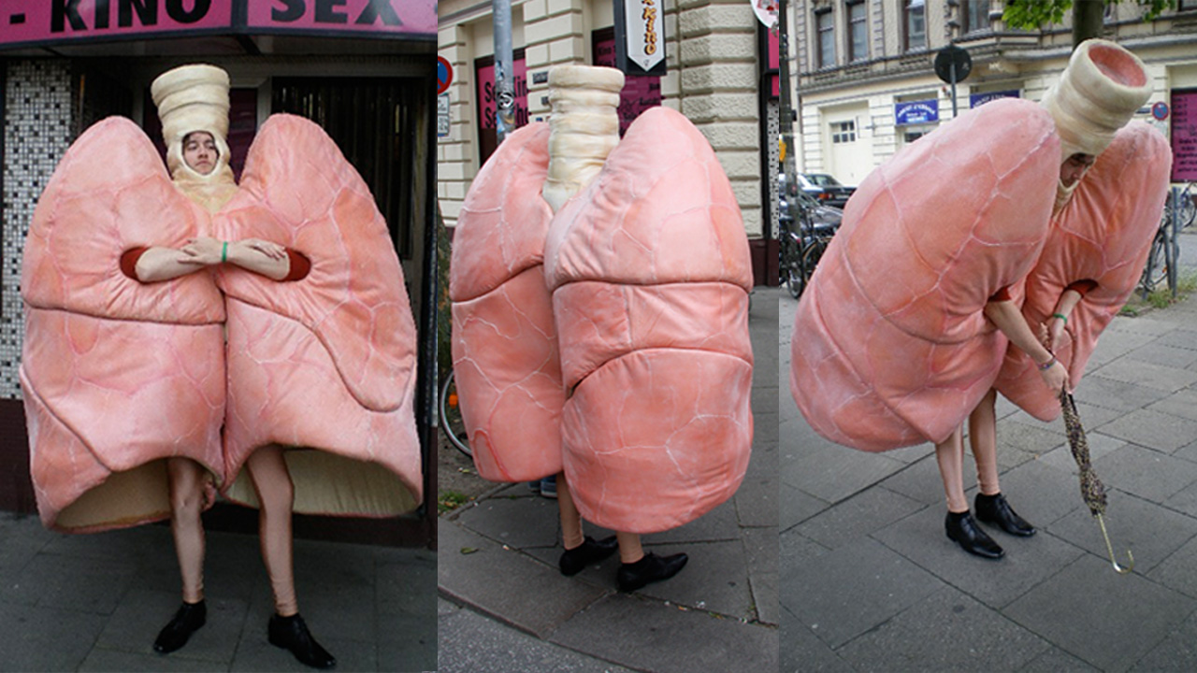
Can’t We All Just Get A Lung - $500
This is how much less radiation a low dose CT uses compared to a conventional CT.

Slide 32
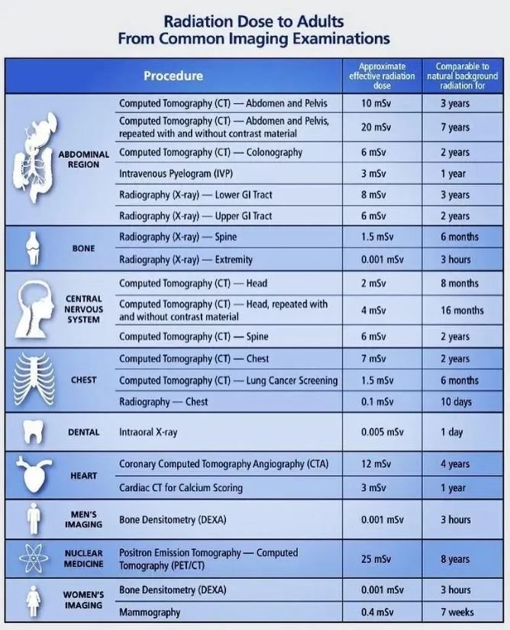
About 5x less
Source: Radiation Dose Chart (Adult) from Common Imaging Examinations (theradiologictechnologist.com)

Slide 33
Breast Friends Forever - $100
This is the age range there is clear benefit for screening for breast cancer (AKA is it a B grade recommendation from the USPSTF).

Slide 34
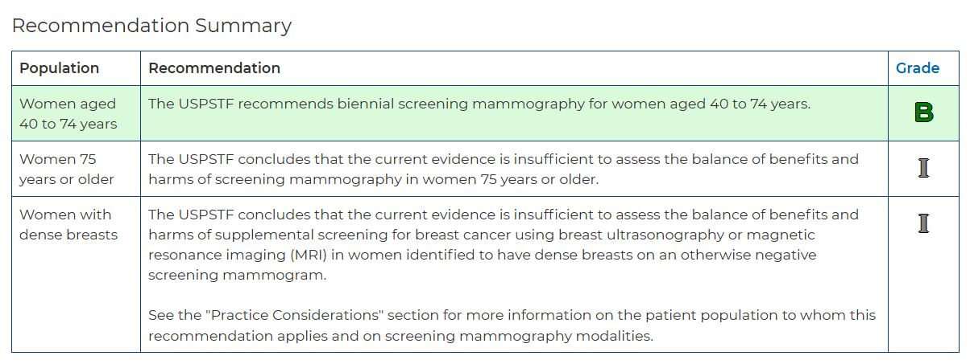
Age 40-74

Slide 35
Breast Friends Forever - $200
A 40 year old woman presents to your office to discuss breast cancer screening. This is the downside she is most at risk for.

Slide 36
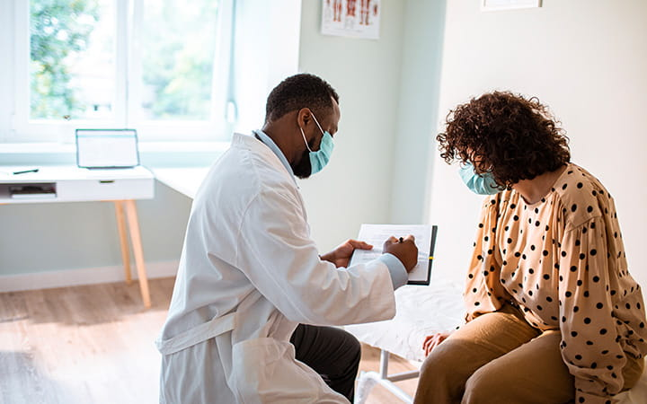
False positive
For patients starting mammography at age 40 or 50 years, the 10-year cumulative false-positive rates are 42% with biennial screening and 61% with annual screening. Such results may cause unnecessary biopsies and substantial patient anxiety. Overdiagnosis accounts for roughly 30% of all breast cancers diagnosed.
Patient trying to figure out what to do
My schedule getting backed up because this was scheduled as a 15 minute appointment

Slide 37
Breast Friends Forever - $300
This is the primary mode of screening for breast cancer recommended for women with dense breast tissue.

Slide 38
Mammogram

Slide 39
Breast Friends Forever - $400
This is the age range (hint: 1 decade) where screening for breast cancer is the most beneficial in terms of breast cancer death reduction.

Slide 40
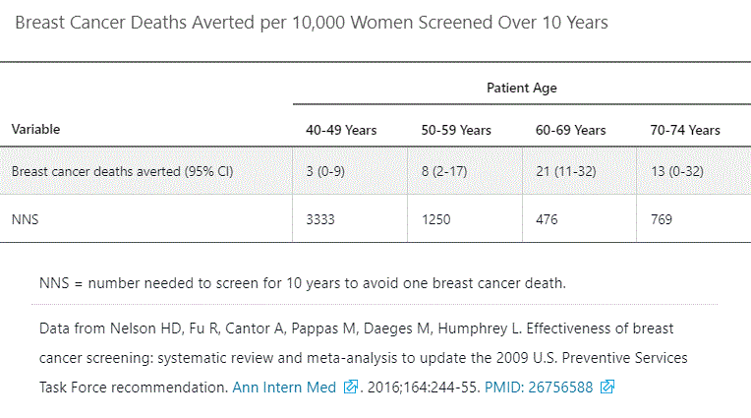
60-69 years old

Slide 41
Breast Friends Forever - $500
There is an American Cancer Society recommendation that is likely to be adopted by the USPSTF soon.
It recommends this mode of screening for patients at high risk of breast cancer.

Slide 42
Mammo + MRI
(qYear starting at age 30)
High-risk defined as those that
Have a lifetime risk of breast cancer of about 20% to 25% or greater
Have a known BRCA1 or BRCA2 gene mutation
Have a first-degree relative (parent, brother, sister, or child) with a BRCA1 or BRCA2 gene mutation, and have not had genetic testing themselves
Had radiation therapy to the chest when they were between the ages of 10 and 30 years
Have Li-Fraumeni syndrome, Cowden syndrome, or Bannayan-Riley-Ruvalcaba syndrome, or have first-degree relatives with one of these syndromes
Women who are at high risk: breast MRI and a mammogram every year, typically starting at age 30

Slide 43
To Pee or Not to Pee - $100
This is the age to begin discussing PSA screening with patients.

Slide 44
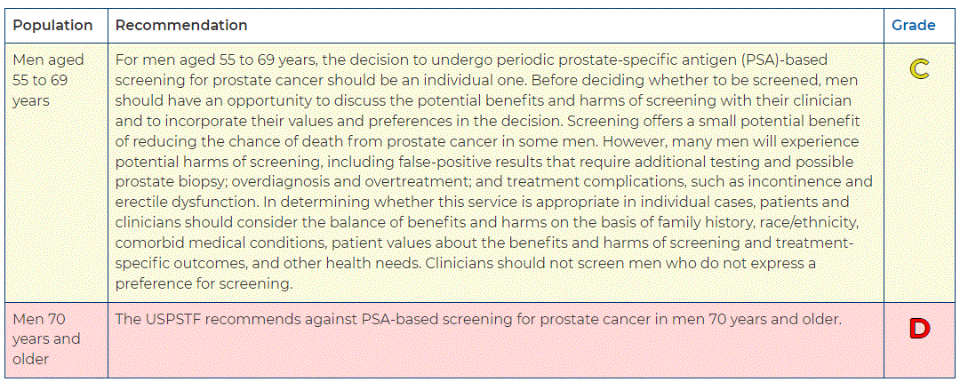
Age 55

Slide 45

To Pee or Not to Pee - $200
This is the age after which the USPSTF recommends against PSA-based screening.

Slide 46
Age 70

Slide 47
To Pee or Not to Pee - $300
This is the number needed to screen using PSA to save 1 life.

Slide 48
1000
Benefits of screening for men (in the recommended age range) include prevention of one prostate cancer–related death for every 1000 men screened for 10 years (NNS, 1000).

Slide 49
To Pee or Not to Pee - $400
This is the PSA concentration that most societies use as the cutoff to consider “abnormal.”

Slide 50
4 mcg/L
40 to 49 years – 0 to 2.5 ng/mL
50 to 59 years – 0 to 3.5 ng/mL
60 to 69 years – 0 to 4.5 ng/mL
70 to 79 years – 0 to 6.5 ng/mL
Resource: UTD

Slide 51
To Pee or Not to Pee - $500
This is the standard procedure for prostate biopsy.

Slide 52
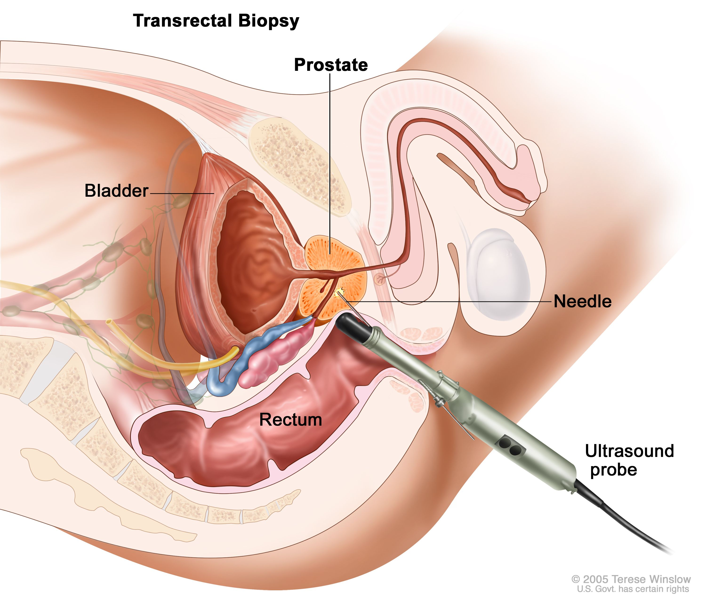
Transrectal ultrasound guided (TRUS)
Among men enrolled in the Prostate, Lung, Colorectal, and Ovarian Screening (PLCO) trial who underwent biopsy (negative biopsy result), the incidences of any complication, postbiopsy infection, and noninfectious complications were 2.0, 0.78, and 1.3 percent, respectively. (Pinsky, et al)
Give ppx antibiotics (usually a floroquinolone) for all patients.
Minor urinary or rectal bleeding or hematospermia is common after prostate biopsy, is generally self-limited, and only on rare occasion requires some form of intervention.

