Slide 1
Oncology AHD Review
May 26, 2026
Brenda Shinar, MD

Slide 2
Question 1.
A 35-year-old patient is evaluated at a follow up visit for a thyroid nodule that they incidentally found while dressing. They have no history of neck irradiation and no family history of thyroid cancer. Medical history is otherwise unremarkable, and they take no medications.
On physical examination, vital signs are normal. A left thyroid nodule, but no cervical lymphadenopathy, is palpable.
Laboratory studies:
TSH: 1.5 uU/mL (0.4-4.0 uU/mL)
An ultrasound of the thyroid reveals a 1 x 0.9 x 1.5 cm nodule on the left mid-thyroid that is hypoechoic and solid with irregular margins.
Which of the following is the most appropriate next step in management?
A. Fine needle aspiration biopsy
B. Surgical referral
C. Thyroid scintigraphy with radioactive iodine uptake
D. Ultrasonography in one year

Slide 3
Question 1.
A 35-year-old patient is evaluated at a follow up visit for a thyroid nodule that they incidentally found while dressing. They have no history of neck irradiation and no family history of thyroid cancer. Medical history is otherwise unremarkable, and they take no medications.
On physical examination, vital signs are normal. A left thyroid nodule, but no cervical lymphadenopathy, is palpable.
Laboratory studies:
TSH: 1.5 uU/mL (0.4-4.0 uU/mL)
An ultrasound of the thyroid reveals a 1 x 0.9 x 1.5 cm nodule on the left mid-thyroid that is hypoechoic and solid with irregular margins.
Which of the following is the most appropriate next step in management?
A. Fine needle aspiration biopsy
B. Surgical referral
C. Thyroid scintigraphy with radioactive iodine uptake
D. Ultrasonography in one year

Slide 4
Thyroid Nodule/Mass:
Get TSH and ultrasound with lymph node mapping
Risk Factors:
Radiation to Head/Neck
Smoking
Obesity
Men solitary nodule
Asian ethnicity
Family hx, Hereditary syndromes (MEN, Cowden, FAP)
Hashimoto’s
Low iodine diet (1924)
Ultrasound red flags:
Microcalcifications
Coarse/peripheral calcifications
Indistinct borders/local invasion/infiltrating or irregular margins
Lymphadenopathy
Taller (in AP diameter) than wide
Markedly hypoechoic
Intranodular hypervascularity

Slide 5
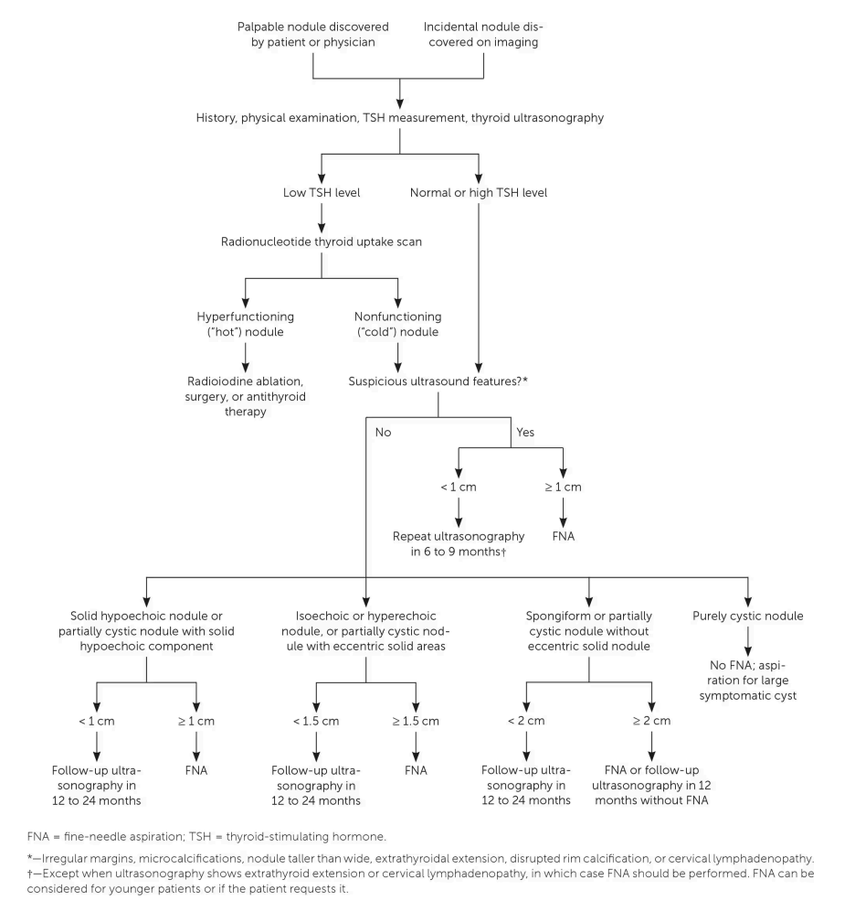
Practical Evaluation of Thyroid Nodule
American Family Physician. Ravi Kant, MD 2020;102(5):298-304.

Slide 6
Question 2.
A 40-year-old woman is evaluated for a 6-month history of palpitations and increased sweating, sleep disturbances and a lump on her neck. Medical history is unremarkable and she takes no medications.
On physical examination, blood pressure is 142/70 mm Hg, and pulse rate is 105/min; other vital signs are normal. No exophthalmos or lid lag is seen. A right thyroid nodule is palpable; the left thyroid gland is not enlarged. Aside from tachycardia, cardiopulmonary examination is unremarkable. The patient exhibits mild bilateral hand tremors. No edema is noted.
Laboratory studies:
Thyroid stimulating hormone: 0.1 uU/mL (L)
Free thyroxine: 3.1 ng/dL (H)
Total triiodothyronine: 210 ng/dL (H)
Thyrotropin receptor antibody: Negative
Which of the following is the most appropriate diagnostic test to perform next?
A. Thyroid Doppler ultrasonography
B. Thyroid peroxidase antibody measurement
C. Thyroid scintigraphy with radioactive iodine uptake
D. Total thyroxine measurement

Slide 7
Question 2.
A 40-year-old woman is evaluated for a 6-month history of palpitations and increased sweating, sleep disturbances and a lump on her neck. Medical history is unremarkable and she takes no medications.
On physical examination, blood pressure is 142/70 mm Hg, and pulse rate is 105/min; other vital signs are normal. No exophthalmos or lid lag is seen. A right thyroid nodule is palpable; the left thyroid gland is not enlarged. Aside from tachycardia, cardiopulmonary examination is unremarkable. The patient exhibits mild bilateral hand tremors. No edema is noted.
Laboratory studies:
Thyroid stimulating hormone: 0.1 uU/mL (L)
Free thyroxine: 3.1 ng/dL (H)
Total triiodothyronine: 210 ng/dL (H)
Thyrotropin receptor antibody: Negative
Which of the following is the most appropriate diagnostic test to perform next?
A. Thyroid Doppler ultrasonography
B. Thyroid peroxidase antibody measurement
C. Thyroid scintigraphy with radioactive iodine uptake
D. Total thyroxine measurement

Slide 8
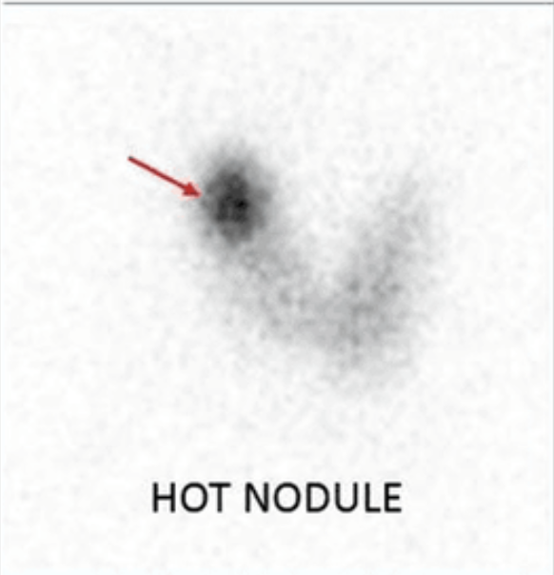
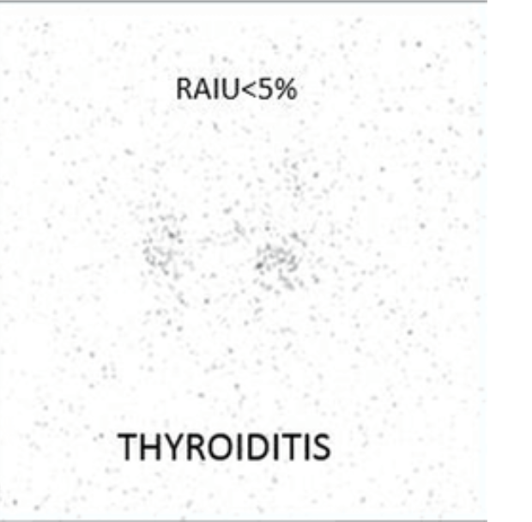
Diagnosis of Thyrotoxicosis
Differential Diagnosis:
Graves disease
Multinodular goiter
Thyroid adenoma
Thyroiditis (DeQuervain’s, Silent, Suppurative)
Hamburger thyrotoxicosis
Exogenous thyroid use
Secondary Hyperthyroidism (TSH hypersecretion)
Amiodarone induced
Struma ovarii
Thyroid cancer (metastatic follicular)
Evaluation:
TSH, free T4 and total (or free) T3
TSI antibodies
Thyroid uptake (number H or L)
Thyroid scintigraphy (picture)
Ultrasound with doppler if 3 & 4 contraindicated (pregnancy and breastfeeding)

Slide 9
Question 3.
A 45-year-old man is evaluated during a medical oncology consultation three weeks after undergoing a right hemicolectomy for adenocarcinoma of the ascending colon. Preoperative staging showed no evidence of metastatic disease. He has recovered well from surgery, has resumed regular activities, and is eating well.
Physical examination findings, including vital signs, are normal.
Laboratory study results are normal.
Pathology shows a poorly differentiated tumor penetrating the full thickness of the bowel wall with no positive lymph nodes.
Perineural and lymphovascular invasion are noted on pathology.
Immunohistochemical stains for mismatch repair proteins are negative for MLH1 and PMS2.
Which of the following is the most appropriate treatment?
A. Adjuvant chemotherapy with capecitabine
B. Adjuvant chemotherapy with capecitabine and oxaliplatin
C. Adjuvant chemotherapy with a PD-1 inhibitor
D. No further therapy

Slide 10
Question 3.
A 45-year-old man is evaluated during a medical oncology consultation three weeks after undergoing a right hemicolectomy for adenocarcinoma of the ascending colon. Preoperative staging showed no evidence of metastatic disease. He has recovered well from surgery, has resumed regular activities, and is eating well.
Physical examination findings, including vital signs, are normal.
Laboratory study results are normal.
Pathology shows a poorly differentiated tumor penetrating the full thickness of the bowel wall with no positive lymph nodes.
Perineural and lymphovascular invasion are noted on pathology.
Immunohistochemical stains for mismatch repair proteins are negative for MLH1 and PMS2.
Which of the following is the most appropriate treatment?
A. Adjuvant chemotherapy with capecitabine
B. Adjuvant chemotherapy with capecitabine and oxaliplatin
C. Adjuvant chemotherapy with a PD-1 inhibitor
D. No further therapy

Slide 11
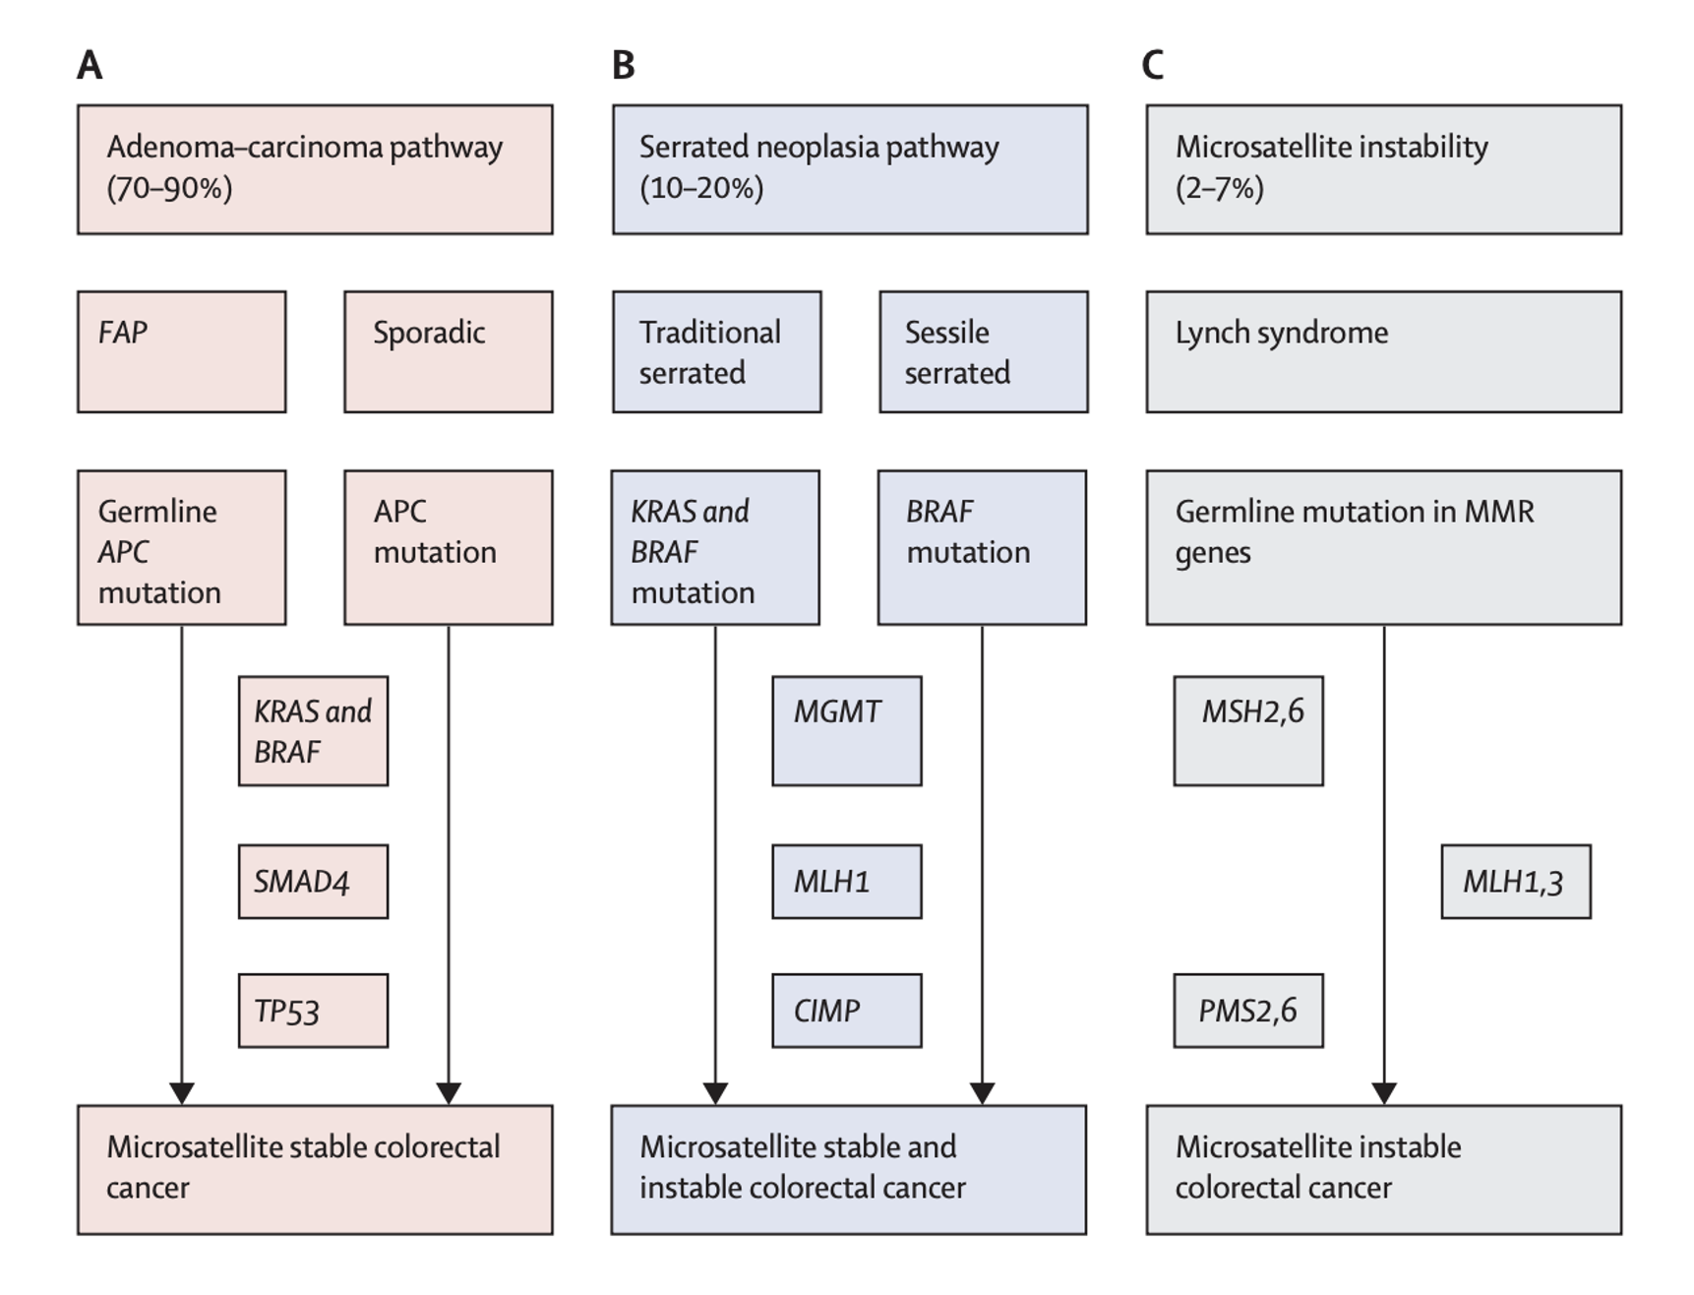
Colon Cancer: 3 buckets

Slide 12
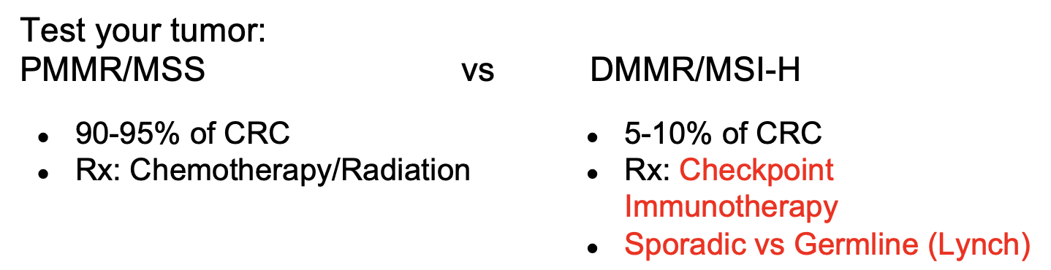
Colon cancer testing
Immunohistochemical stain: deficient mismatch repair (MMR) protein (dMMR) (versus proficient pMMR)
Next generation sequencing: Microsatellite instability (MSI)-H (versus microsatellite stable MSS)

Slide 13

Stage 2 Colon Cancer:
Indications for Adjuvant Chemotherapy (High risk)
Proficient MMR/ MSS PLUS
T4
High-grade
Lymphovascular invasion
Perineural invasion
Bowel Obstruction or Perforation
Inadequate lymph node sampling (<12)
Close/undetermined/positive margins

Slide 14
Question 4.
. A 50-year-old woman is evaluated after her first routine colonoscopy revealed a non-obstructing mass in the descending colon, just distal to the splenic flexure. The colonoscopy findings were otherwise unremarkable. Biopsy and immunohistochemistry testing revealed mismatch repair-proficient adenocarcinoma. She has no other medical problems and takes no medications.
Physical examination findings, including vital signs, are normal.
Serum carcinoembryonic antigen level is normal.
Which of the following is the most appropriate management?
A. Contrast-enhanced CT of the chest, abdomen, and pelvis
B. Molecular determination of the BRAF mutation status
C. Molecular determination of the KRAS and NRAS status
D. PET/CT

Slide 15
Question 4.
. A 50-year-old woman is evaluated after her first routine colonoscopy revealed a non-obstructing mass in the descending colon, just distal to the splenic flexure. The colonoscopy findings were otherwise unremarkable. Biopsy and immunohistochemistry testing revealed mismatch repair-proficient adenocarcinoma. She has no other medical problems and takes no medications.
Physical examination findings, including vital signs, are normal.
Serum carcinoembryonic antigen level is normal.
Which of the following is the most appropriate management?
A. Contrast-enhanced CT of the chest, abdomen, and pelvis
B. Molecular determination of the BRAF mutation status
C. Molecular determination of the KRAS and NRAS status
D. PET/CT

Slide 16
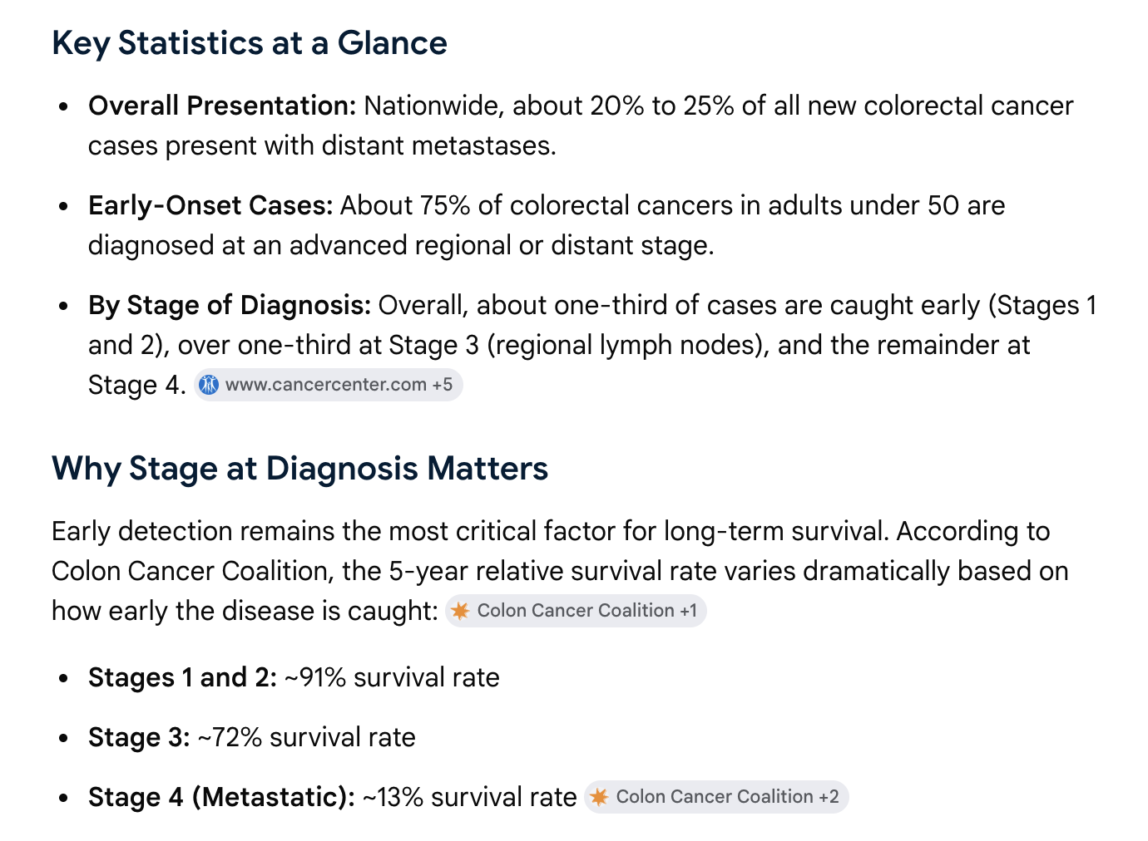
Staging of Colon Cancer for Metastases
CT scan of chest abdomen and pelvis with contrast
CEA tumor marker
Basic Laboratories
Complete colonoscopy
KRAS/BRAF testing for target therapy only if metastatic
PET/CT NOT used for staging colon cancer
FDG eliminated in bowel
Not sensitive for mucinous
tumors or lymph node
involvement

Slide 17
Question 5.
A 45-year-old woman is evaluated at a follow-up visit. Two months ago, abdominal hysterectomy and bilateral oophorectomy were performed for stage 1 endometrial cancer. Colorectal cancer was diagnosed in her father at age 59 years, and ovarian cancer was diagnosed in her paternal aunt at age 63 years.
On physical examination, vital signs and other findings are normal.
Results of laboratory studies are normal.
Previous immunohistochemistry of endometrial tumor showed loss of staining for MSH2 and MSH6. Genetic testing disclosed a pathogenic variant in the MSH6 gene.
Which of the following is the most appropriate testing to perform next?
A. Colonoscopy
B. Fecal immunochemistry testing
C. Upper endoscopy and colonoscopy
D. Upper endoscopy, colonoscopy, and small-bowel capsule endoscopy

Slide 18
Question 5.
A 45-year-old woman is evaluated at a follow-up visit. Two months ago, abdominal hysterectomy and bilateral oophorectomy were performed for stage 1 endometrial cancer. Colorectal cancer was diagnosed in her father at age 59 years, and ovarian cancer was diagnosed in her paternal aunt at age 63 years.
On physical examination, vital signs and other findings are normal.
Results of laboratory studies are normal.
Previous immunohistochemistry of endometrial tumor showed loss of staining for MSH2 and MSH6. Genetic testing disclosed a pathogenic variant in the MSH6 gene.
Which of the following is the most appropriate testing to perform next?
A. Colonoscopy
B. Fecal immunochemistry testing
C. Upper endoscopy and colonoscopy
D. Upper endoscopy, colonoscopy, and small-bowel capsule endoscopy

Slide 19
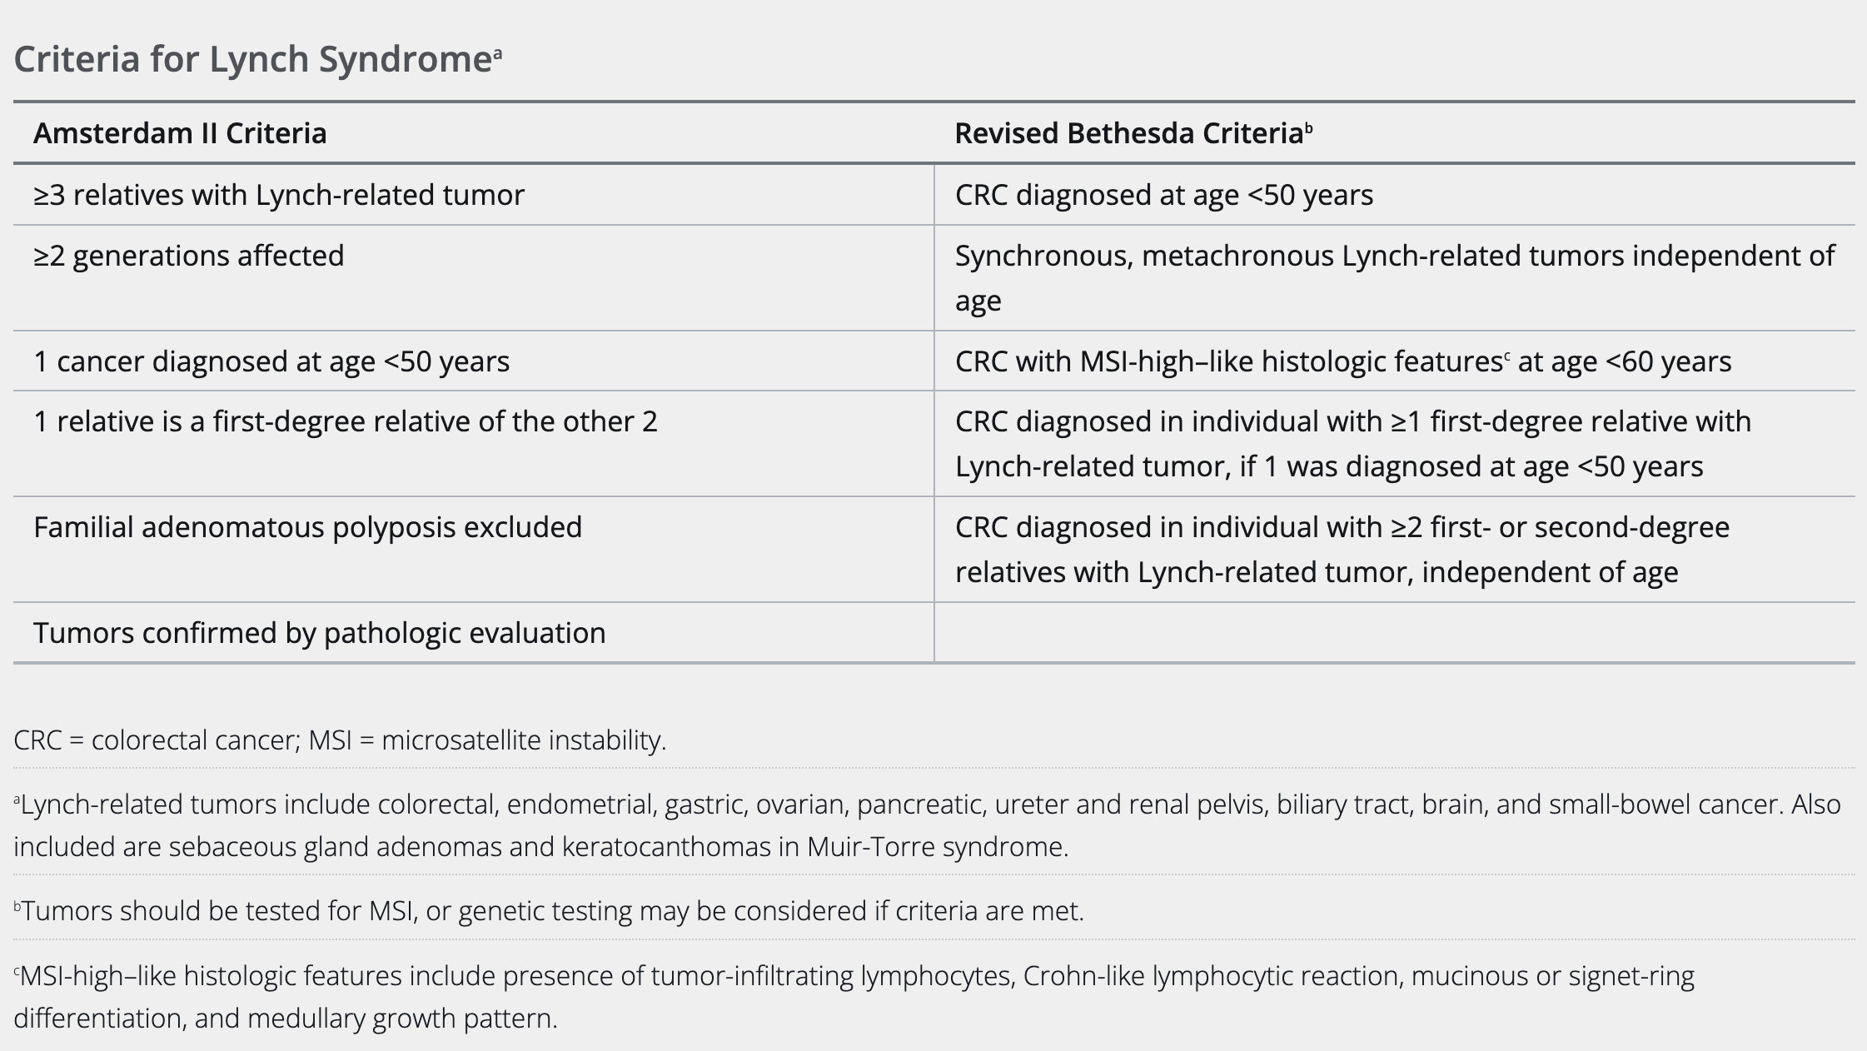
Lynch Syndrome Criteria
Notes:
Amsterdam criteria is not sensitive but is very specific. It may miss patients with Lynch syndrome. Revised Bethesda Criteria is very sensitive but not specific. The NCCN guidelines state that all colon cancers and endometrial cancers should be tested for mutations without reference to Amsterdam or Revised Bethesda Criteria.

Slide 20
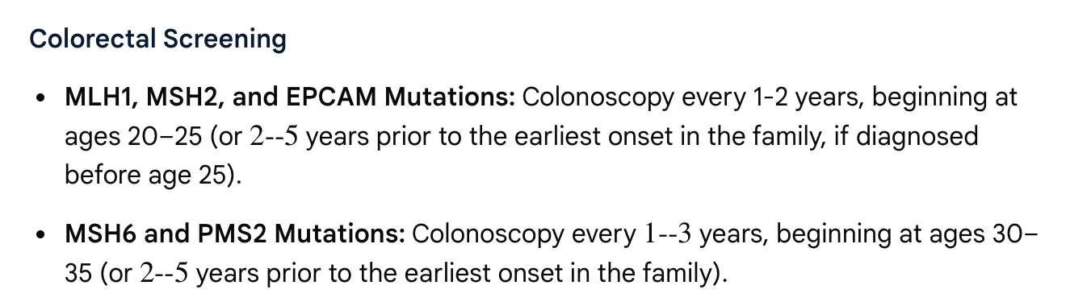
Screening for Patients with Lynch Syndrome

Slide 21
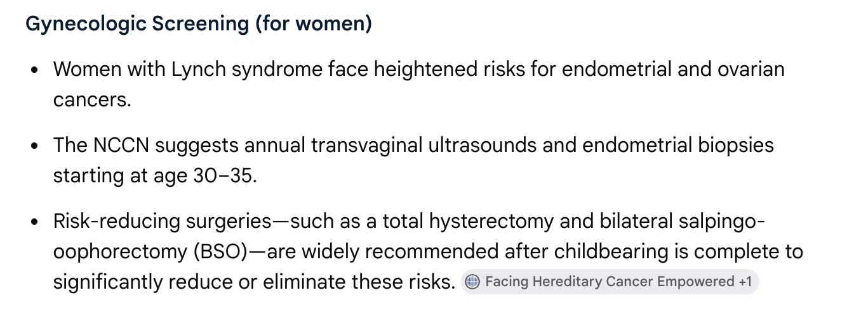
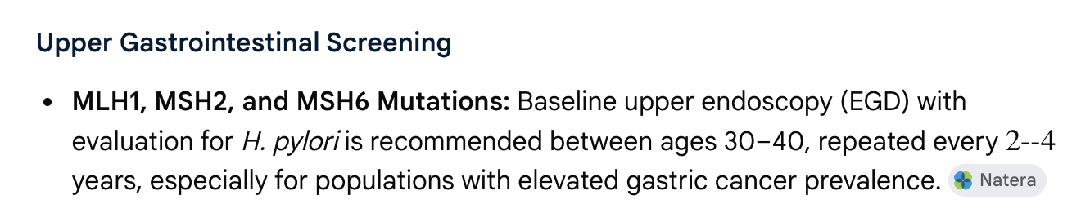
Screening for Patients with Lynch Syndrome

Slide 22
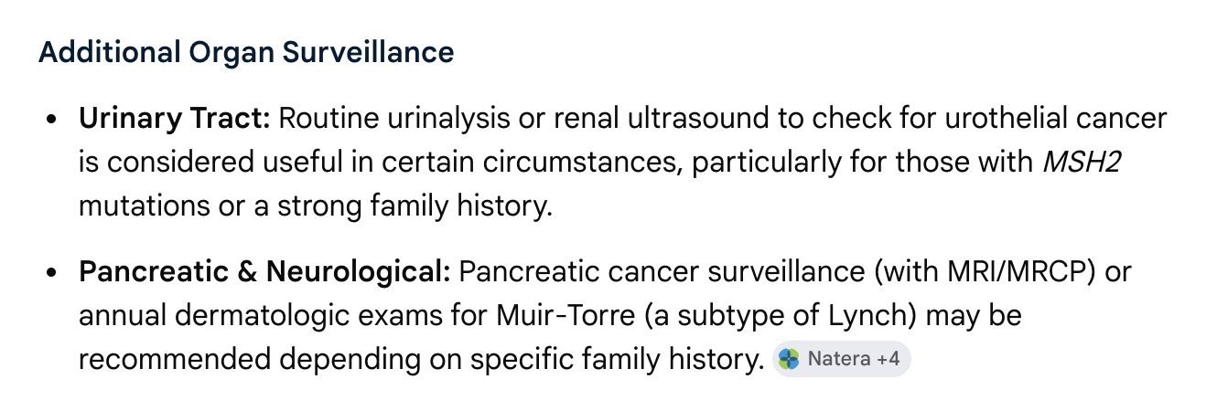
Screening for Patients with Lynch Syndrome

Slide 23
Question 6.
A 54-year-old woman is evaluated during a routine visit. She is asymptomatic. Her sister was diagnosed with pancreatic cancer at age 60 years. Her father died of pancreatic cancer at age 67 years.
On physical examination, vital sign and other findings are normal.
Which of the following is the most appropriate screening test to perform next?
A. Abdominal CT
B. CA 19-9 measurement
C. Endoscopic ultrasonography (EUS)
D. Transabdominal ultrasonography

Slide 24
Question 6.
A 54-year-old woman is evaluated during a routine visit. She is asymptomatic. Her sister was diagnosed with pancreatic cancer at age 60 years. Her father died of pancreatic cancer at age 67 years.
On physical examination, vital sign and other findings are normal.
Which of the following is the most appropriate screening test to perform next?
A. Abdominal CT
B. CA 19-9 measurement
C. Endoscopic ultrasonography (EUS)
D. Transabdominal ultrasonography
Notes:
\

Slide 25
CA 19-9: Lewis Antigen
Lewis Antigen-negative persons cannot make CA 19-9
White population: 5-10%
African-American/Non-white population: Up to 22%
Lewis negative phenotype may be as common as 20% in cancer patients compared to 8% in healthy individuals
A negative CA 19-9 does not rule out pancreatic cancer
Consider also ordering CEA and CA 125 markers
Benign causes of elevated CA 19-9:
Biliary obstruction
Bile duct inflammation
Benign liver disease

Slide 26
Pancreatic Cancer
Key Points:
All patients diagnosed with pancreatic adenocarcinoma should should undergo genetic testing
One First degree relative (FDR) with PDAC = 4x risk; Two FDR = 6x risk, and 3 FDR = 34 x risk
First year after type 2 DM diagnosis, 14-15x risk of pancreatic cancer compared to non-DM population
Screening in High-Risk Population
HR = Lifetime risk > or = 5%
3 or more relatives on same side of the family
Two affected relatives on same side of family, one FDR
Annual Screen method:
MRI (better for cystic lesions)
EUS (better for solid lesions and can undergo biopsy)
Start age 50 or 10 years before earliest diagnosed relative
Tonini V, Zanni M. Pancreatic cancer in 2025: Have we found a solution?
World J Gastroenterol 2025; 31(43): 111433

Slide 27
Question 7.
A 37-year-old patient is evaluated during a yearly office visit. Their father was diagnosed with colon cancer at age 57 years. The patient has no other family history of cancer and no medical conditions.
On physical examination, vital signs and other findings are normal.
Which of the following is the most appropriate colorectal cancer screening approach?
A. Colonoscopy at age 40 years
B. Colonoscopy at age 47 years
C. Multitarget stool DNA testing at age 40 years
D. Multitarget stool DNA testing at age 47 years

Slide 28
Question 7.
A 37-year-old patient is evaluated during a yearly office visit. Their father was diagnosed with colon cancer at age 57 years. The patient has no other family history of cancer and no medical conditions.
On physical examination, vital signs and other findings are normal.
Which of the following is the most appropriate colorectal cancer screening approach?
A. Colonoscopy at age 40 years
B. Colonoscopy at age 47 years
C. Multitarget stool DNA testing at age 40 years
D. Multitarget stool DNA testing at age 47 years

Slide 29
Colon Cancer: 3 buckets

Slide 30
Colon Cancer Risk:
Persons with increased risk:
FDR with CRC or advanced polyp <60 OR 2 or more SDR with CRC/advanced polyp at any age
FDR with CRC or advanced polyp dx over age 60
Personal history of CRC
Adults with Cystic Fibrosis
Persons with high risk:
Hereditary syndromes (FAP, Lynch)
Inflammatory bowel disease (IBD)
Risk Factors:
Age
Family history of CRC or advanced adenoma
IBD
Hereditary syndromes (FAP, Lynch)
Obesity
Tobacco use
Alcohol
Processed meats
Sedentary

Slide 31
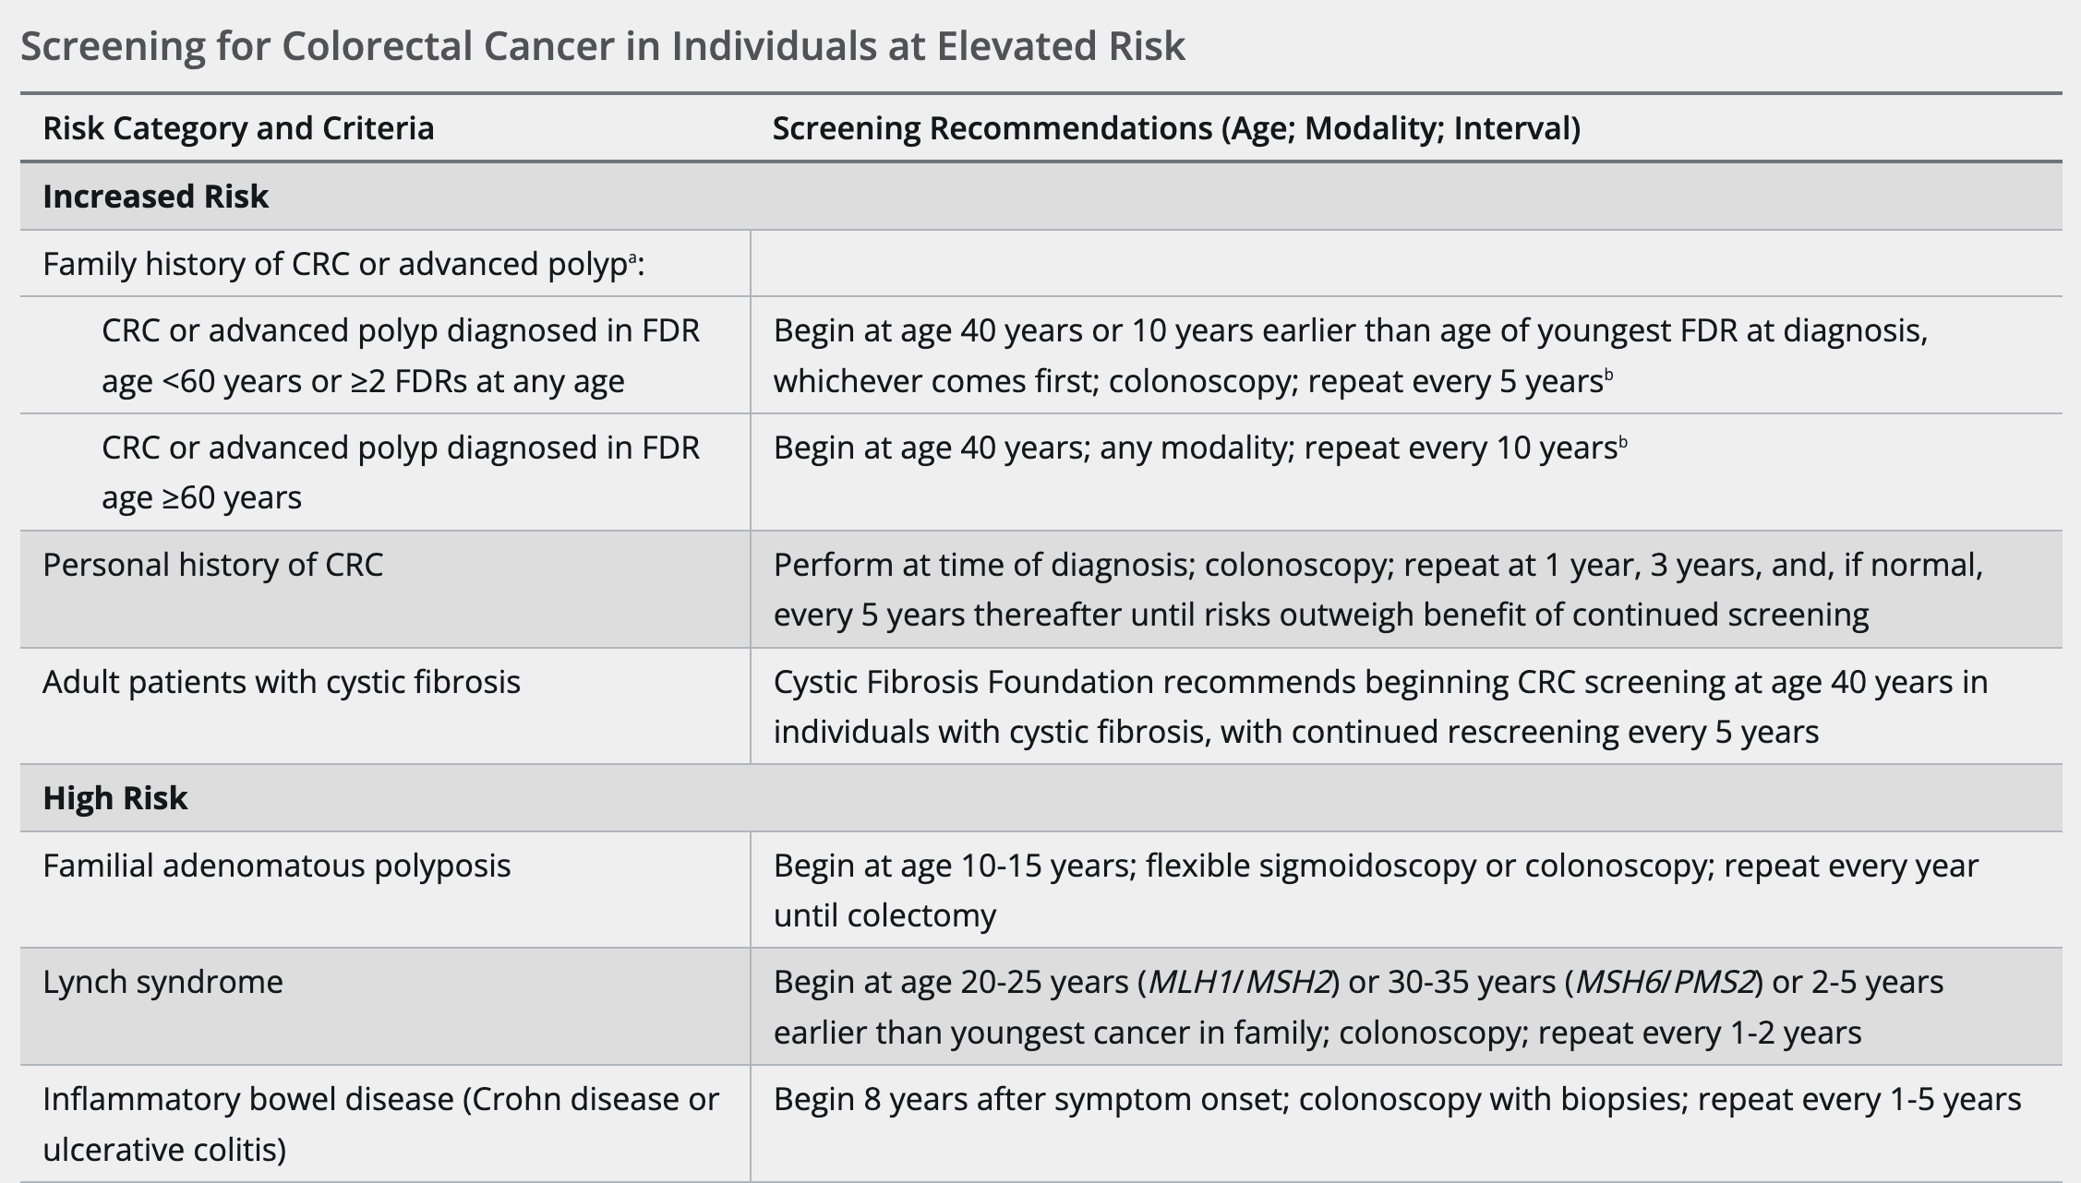

Slide 32
Question 8.
A 43-year-old woman is evaluated after testing positive for hepatitis B surface antigen on routine screening. She is asymptomatic. She recently emigrated from China. She does not have a family history of liver cancer. She has no other medical problems and takes no medications.
On physical examination, vital signs are normal.
Laboratory studies:
Complete blood count: Normal
Alanine aminotransferase: 22 U/L (Normal)
Hepatitis B surface antigen: Positive
Hepatitis B surface antibody: Negative
Hepatitis B e antigen: Negative
Hepatitis B e antibody: Positive
Hepatitis B virus DNA: 160 IU/ml
Her Fibrosis-4 score is low.
Abdominal ultrasound shows a normal-appearing liver and spleen without free fluid.
Which of the following is the most appropriate management?
A. Alpha-Fetoprotein measurement
B. Hepatitis B virus DNA and alanine aminotransferase monitoring
C. Tenofovir
D. Reassurance

Slide 33
Question 8.
A 43-year-old woman is evaluated after testing positive for hepatitis B surface antigen on routine screening. She is asymptomatic. She recently emigrated from China. She does not have a family history of liver cancer. She has no other medical problems and takes no medications.
On physical examination, vital signs are normal.
Laboratory studies:
Complete blood count: Normal
Alanine aminotransferase: 22 U/L (Normal)
Hepatitis B surface antigen: Positive
Hepatitis B surface antibody: Negative
Hepatitis B e antigen: Negative
Hepatitis B e antibody: Positive
Hepatitis B virus DNA: 160 IU/ml
Her Fibrosis-4 score is low.
Abdominal ultrasound shows a normal-appearing liver and spleen without free fluid.
Which of the following is the most appropriate management?
A. Alpha-Fetoprotein measurement
B. Hepatitis B virus DNA and alanine aminotransferase monitoring
C. Tenofovir
D. Reassurance

Slide 34
Chronic Hepatitis B: Four Phases
Immune Control (Inactive carrier):
The immune system successfully suppresses the virus, the disease is largely inactive, and patients are at low risk of progression (Hep B e Ag negative, LFTs normal, DNA low or neg)
(MONITOR Q 6 months)
Reactivation:
The virus mutates or the immune system weakens allowing the virus to multiply again and cause ongoing liver damage without HepBeAg being present (Hep B e Ag negative, LFTs elevated)
Immune Tolerant:
Often seen in individuals at birth; immune system does not attack the virus resulting in high viral load but no liver damage (Hep B e Ag positive, LFTs normal)
Immune Active:
The body recognizes the virus and
mounts and immune response causing
liver inflammation (Hep B e Ag positive, LFTs elevated)

Slide 35
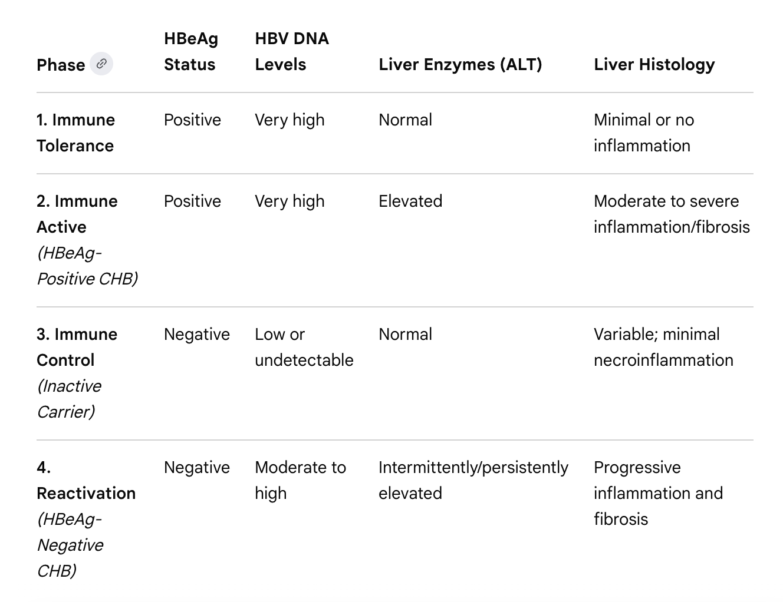
Chronic Hepatitis B Serologies

Slide 36
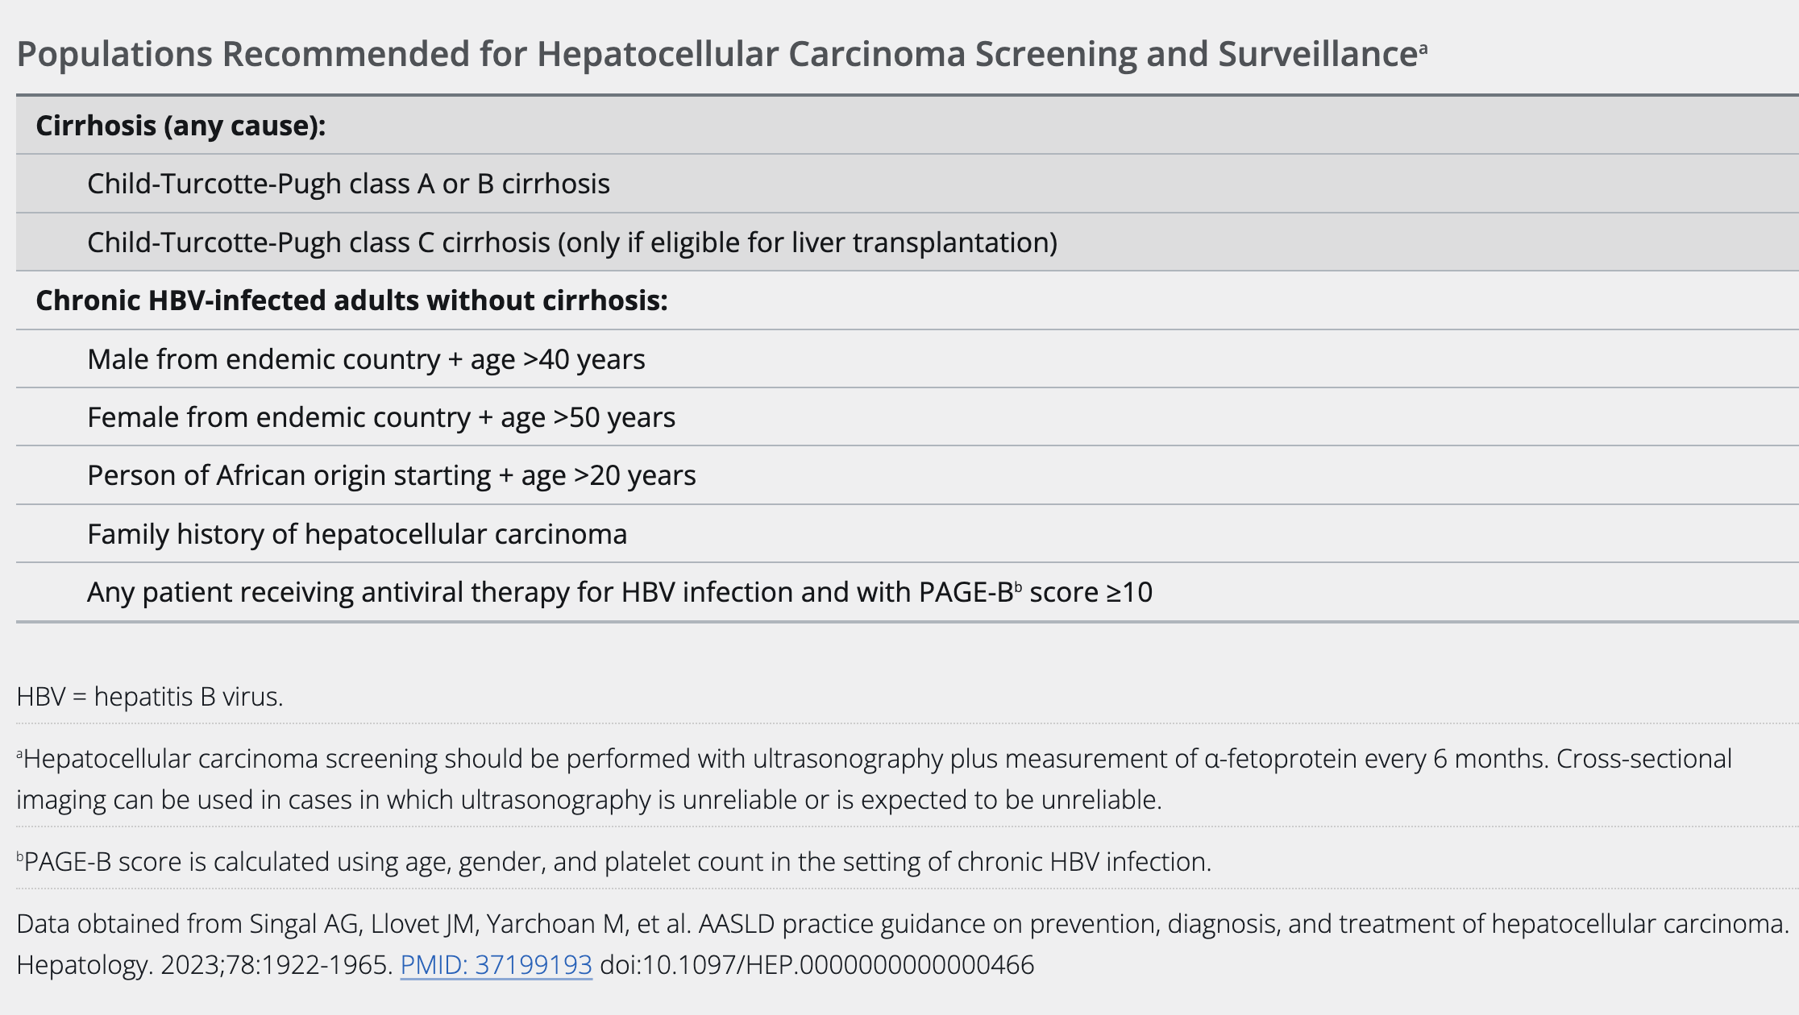
HCC Screening

Slide 37
Question 9.
A 55-year-old woman is evaluated for a recent diagnosis of lobular carcinoma in situ and atypical lobular hyperplasia. She wishes to discuss options to decrease her risk of breast cancer. The patient is postmenopausal. Medical history is significant for a left calf deep venous thrombosis at age 25 years concurrent with oral contraceptive use. She takes no medication.
On physical examination, vital signs are normal. A healed left upper breast incision is noted. The remainder of the examination is normal.
Which of the following is the most appropriate preventative measure for this patient?
A. Exemestane
B. High-dose vitamin D
C. Low-fat diet
D. Tamoxifen

Slide 38
Question 9.
A 55-year-old woman is evaluated for a recent diagnosis of lobular carcinoma in situ and atypical lobular hyperplasia. She wishes to discuss options to decrease her risk of breast cancer. The patient is postmenopausal. Medical history is significant for a left calf deep venous thrombosis at age 25 years concurrent with oral contraceptive use. She takes no medication.
On physical examination, vital signs are normal. A healed left upper breast incision is noted. The remainder of the examination is normal.
Which of the following is the most appropriate preventative measure for this patient?
A. Exemestane
B. High-dose vitamin D
C. Low-fat diet
D. Tamoxifen

Slide 39
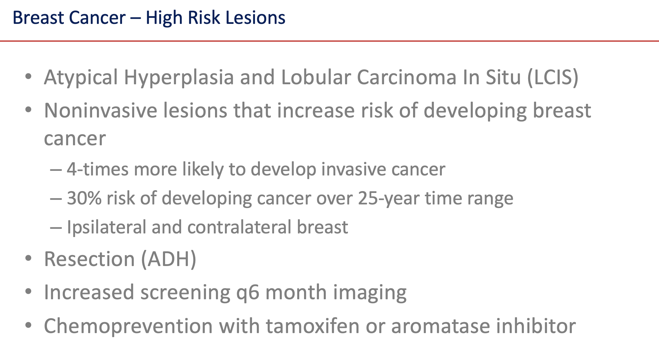
Notes:
Atypical ductal hyperplasia needs surgical resection to rule out carcinoma in situ (up to 30% upgraded) Lobular carcinoma in situ and Atypical lobular hyperplasia may not need resection.

Slide 40
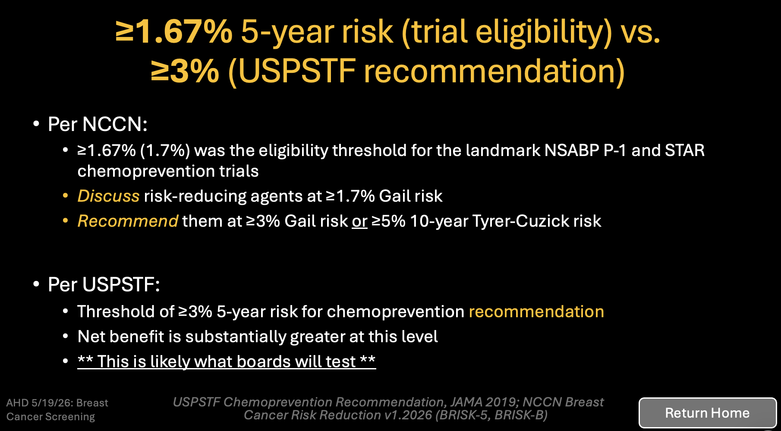

Slide 41
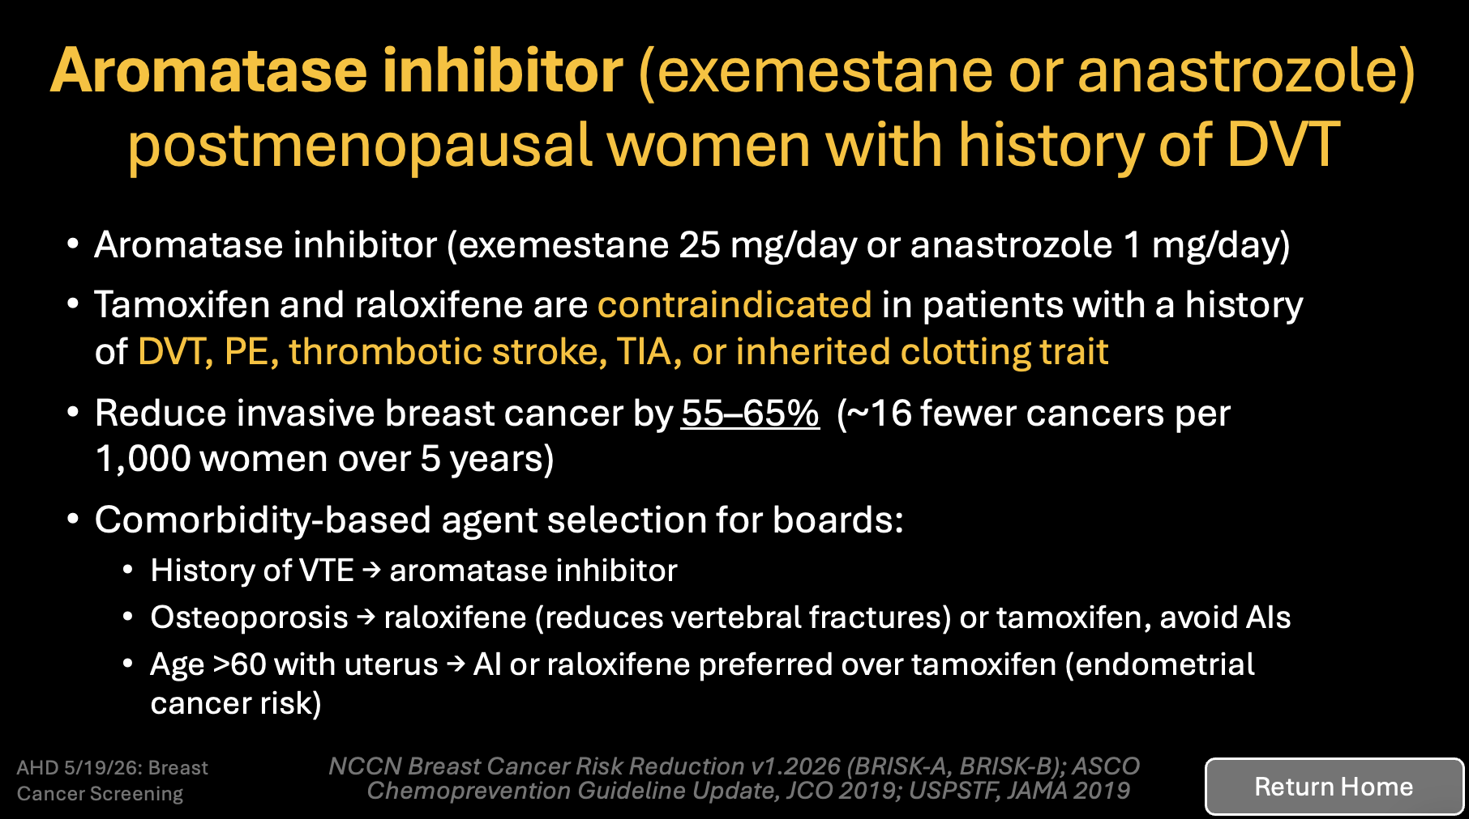

Slide 42
Other answers….
High Dose Vitamin D
https://www.cancer.gov/about-cancer/causes-prevention/risk/diet/vitamin-d-fact-sheet
Low Fat Diet
https://www.ccjm.org/content/89/11/643

Slide 43
Question 10.
A 26-year-old woman is evaluated after genetic testing revealed a pathogenic variant of BRCA1. She is asymptomatic. Breast cancer was diagnosed in her mother at age 32 years and in her maternal uncle at age 53 years. Her sister was diagnosed with ovarian cancer at age 37 years. Medical history is otherwise unremarkable, and she takes no medications
On physical examination, vital signs are normal.
The remainder of the examination, including breast examination, shows no abnormalities.
Results of laboratory studies are normal.
Which of the following is the most appropriate screening test to perform next?
A. Breast MRI with contrast
B. Breast ultrasonography
C. Mammography
D. No screening is currently indicated

Slide 44
Question 10.
A 26-year-old woman is evaluated after genetic testing revealed a pathogenic variant of BRCA1. She is asymptomatic. Breast cancer was diagnosed in her mother at age 32 years and in her maternal uncle at age 53 years. Her sister was diagnosed with ovarian cancer at age 37 years. Medical history is otherwise unremarkable, and she takes no medications
On physical examination, vital signs are normal.
The remainder of the examination, including breast examination, shows no abnormalities.
Results of laboratory studies are normal.
Which of the following is the most appropriate screening test to perform next?
A. Breast MRI with contrast
B. Breast ultrasonography
C. Mammography
D. No screening is currently indicated

Slide 45
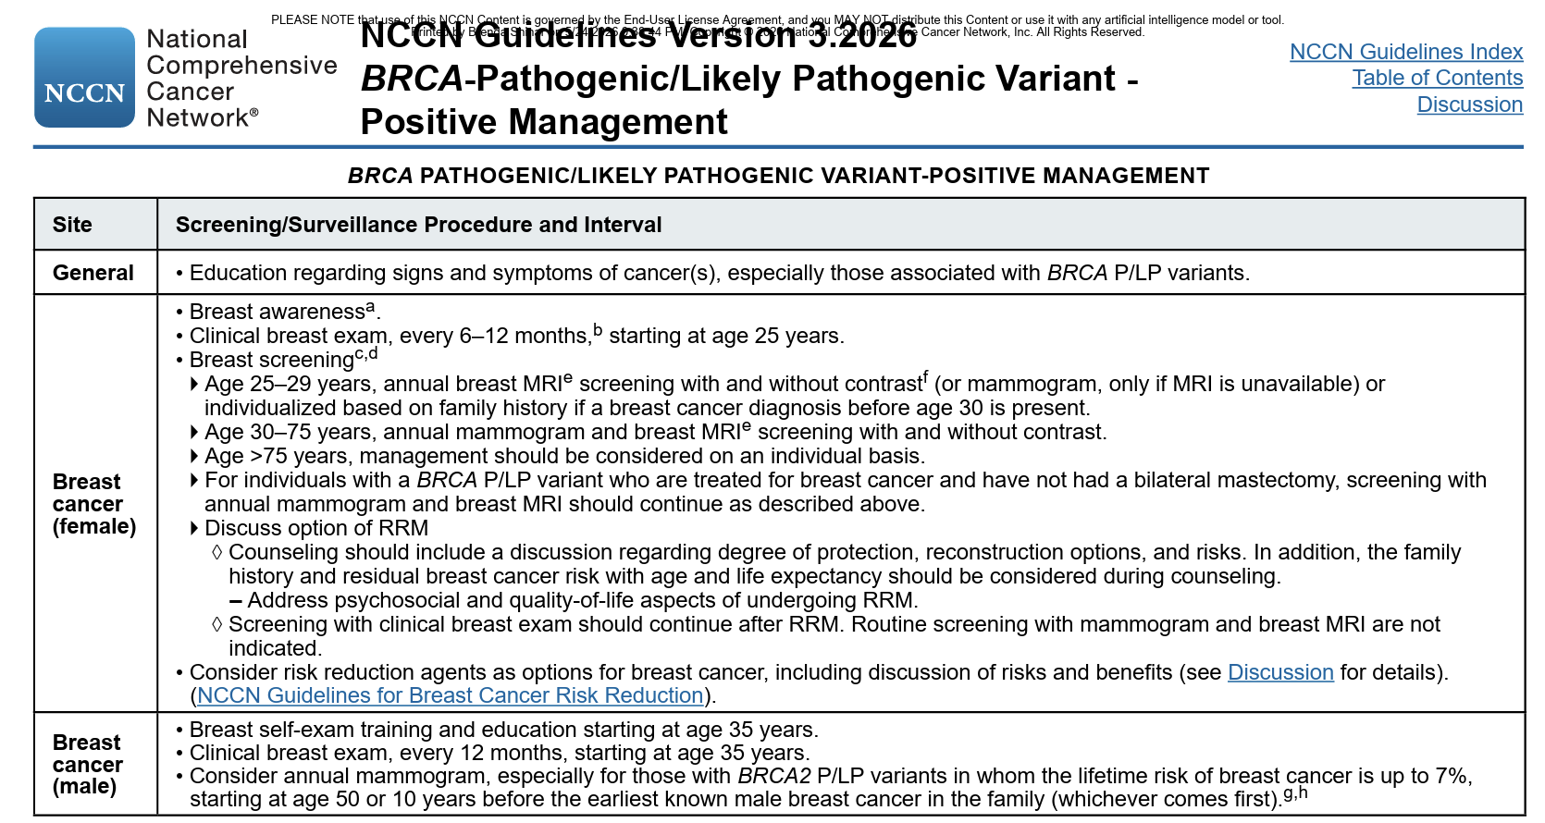
Screening BRCA Positive Patients

Slide 46
Question 11.
Mammogram reveals a BI-RADS category of 1; negative for any abnormality. Breast ultrasonography shows no abnormalities.
Which of the following is the most appropriate management?
A. Breast MRI
B. Referral to a breast surgeon for biopsy or excision
C. Repeat clinical breast examination in 6 weeks
D. No additional evaluation
A 42-year-old woman is evaluated because of a quarter-sized right breast mass that she first noticed two months ago. She does not have any other symptoms including breast pain or skin changes. She has no family history of breast or ovarian cancer.
On physical examination, vital signs are normal. A palpable 1.5 cm round, firm mass is noted in the right breast at the 2 o’clock position
There is no axillary lymphadenopathy. The remainder of the examination is normal.

Slide 47
Question 11.
Mammogram reveals a BI-RADS category of 1; negative for any abnormality. Breast ultrasonography shows no abnormalities.
Which of the following is the most appropriate management?
A. Breast MRI
B. Referral to a breast surgeon for biopsy or excision
C. Repeat clinical breast examination in 6 weeks
D. No additional evaluation
A 42-year-old woman is evaluated because of a quarter-sized right breast mass that she first noticed two months ago. She does not have any other symptoms including breast pain or skin changes. She has no family history of breast or ovarian cancer.
On physical examination, vital signs are normal. A palpable 1.5 cm round, firm mass is noted in the right breast at the 2 o’clock position
There is no axillary lymphadenopathy. The remainder of the examination is normal.

Slide 48
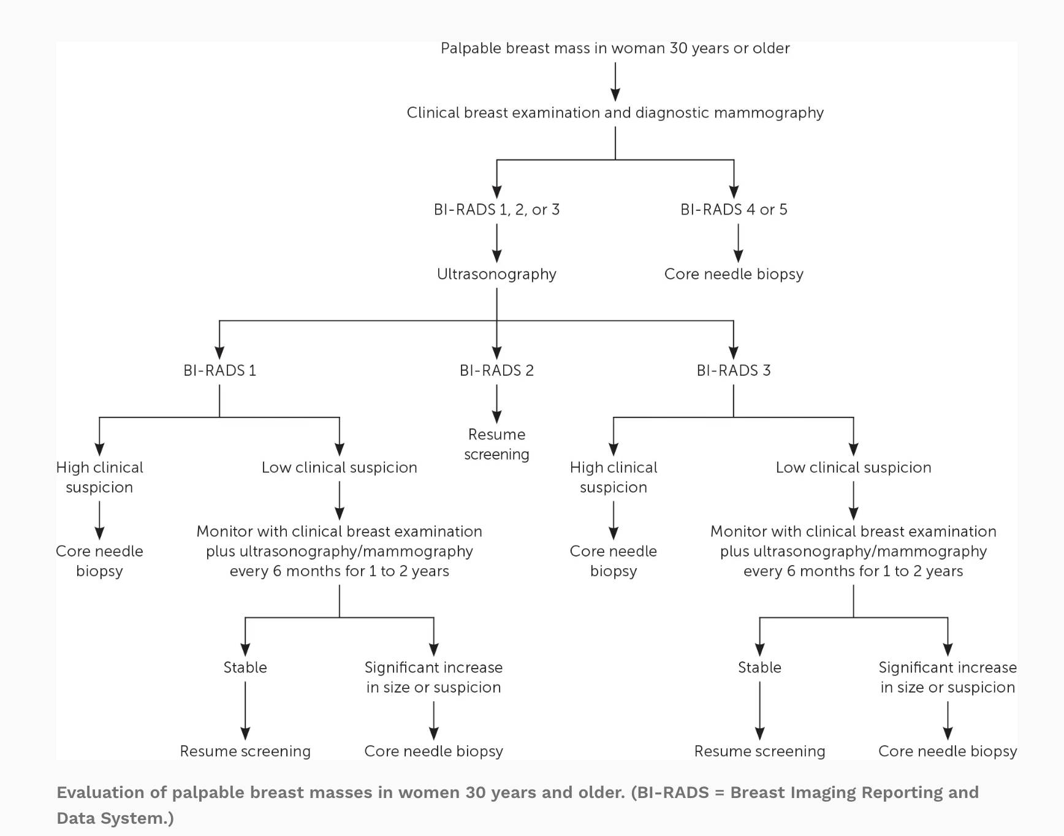
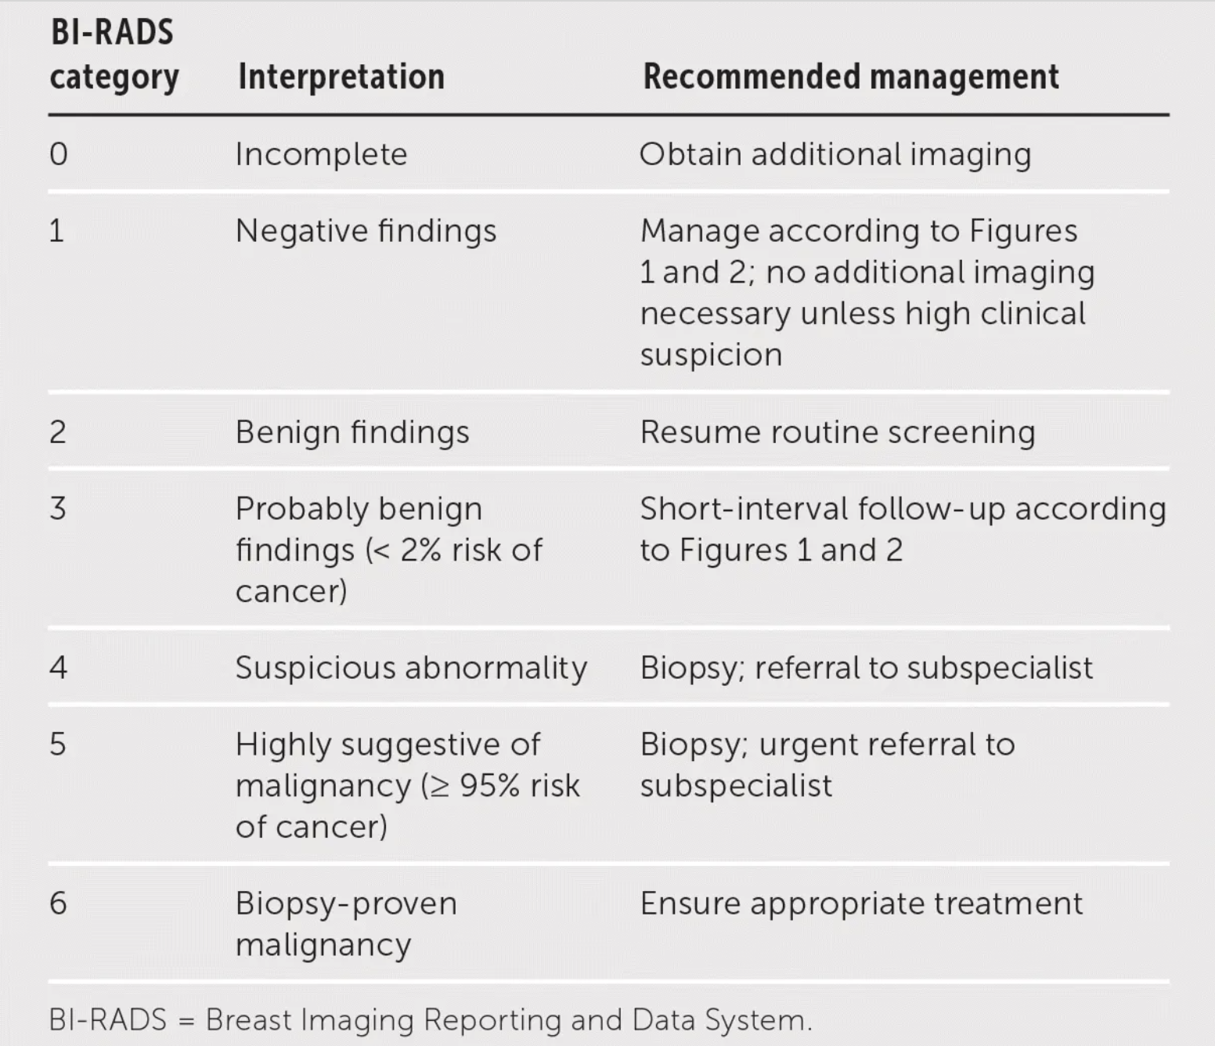
Evaluation of a Palpable Breast Lump

Slide 49
Question 12.
Calcium: Mildly elevated
Liver function testing: Normal
CT scan of the chest shows multiple scattered bilateral pulmonary masses measuring up to 3.2 cm and a 4-cm x 4-cm right breast mass. Spinal MRI reveals multiple lesions in the lumbar spine with no evidence of spinal cord compression.
Which of the following is the most appropriate diagnostic test to perform next?
A. Biopsy of a bone lesion
B. Biopsy of a lung lesion
C. Biopsy of the breast mass
D. Bone scan
A 74-year-old woman is evaluated for a 4-month history of worsening back pain and dyspnea on exertion. She has not experienced bladder or bowel incontinence or lower extremity weakness. She has a history of coronary artery disease and hypertension. Medications include aspirin, metoprolol tartrate, atorvastatin, and lisinopril.
On physical examination, vital signs are normal. A palpable 4 cm x 3 cm right breast mass is noted.
Laboratory studies:
Alkaline phosphatase: Mildly elevated

Slide 50
Question 12.
Calcium: Mildly elevated
Liver function testing: Normal
CT scan of the chest shows multiple scattered bilateral pulmonary masses measuring up to 3.2 cm and a 4-cm x 4-cm right breast mass. Spinal MRI reveals multiple lesions in the lumbar spine with no evidence of spinal cord compression.
Which of the following is the most appropriate diagnostic test to perform next?
A. Biopsy of a bone lesion
B. Biopsy of a lung lesion
C. Biopsy of the breast mass
D. Bone scan
A 74-year-old woman is evaluated for a 4-month history of worsening back pain and dyspnea on exertion. She has not experienced bladder or bowel incontinence or lower extremity weakness. She has a history of coronary artery disease and hypertension. Medications include aspirin, metoprolol tartrate, atorvastatin, and lisinopril.
On physical examination, vital signs are normal. A palpable 4 cm x 3 cm right breast mass is noted.
Laboratory studies:
Alkaline phosphatase: Mildly elevated

Slide 51
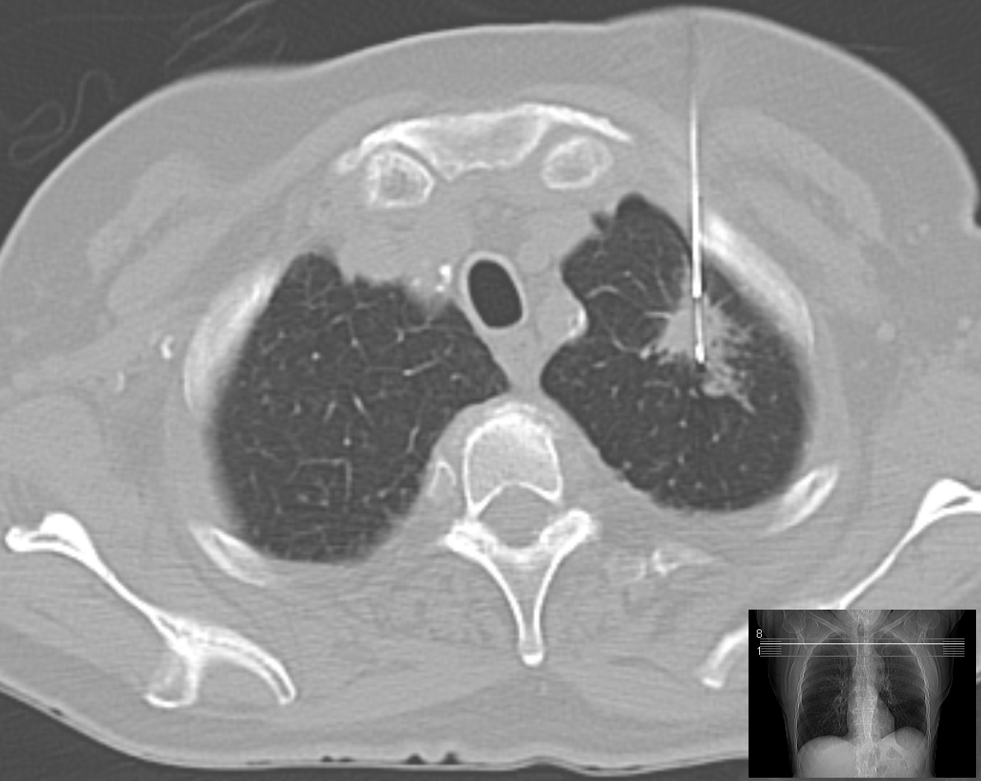
Metastatic Breast Cancer
The patient presents with signs of possible metastatic breast cancer
MUST biopsy the site that upstages the patient the MOST (in this patient- lung)
If the patient had previous diagnosis of breast cancer, MUST re-biopsy to determine receptor positivity (ER/PR, HER-2) which changes in up to 15% of patients
Bone biopsy is difficult to process for receptor (esp HER-2) and another site is preferred
Bone scan or PET/CT would be done to see if bone lesions are likely metastatic after the lung biopsy
This Photo by Unknown Author is licensed under CC BY-SA

Slide 52
Question 13.
A 65-year-old man is evaluated for hemoptysis. He has a 30-pack year smoking history but quit smoking 1 year ago. He takes no medications.
Vital signs and physical examination are normal.
CT scan of the chest shows a 3.5-cm spiculated mass in the right lower lobe and an enlarged hilar lymph node. There is no evidence of metastatic disease.
After further evaluation, surgery is performed and reveals a 3.2 cm, poorly differentiated adenocarcinoma with negative margins.
Two hilar lymph nodes are positive for metastatic adenocarcinoma, and negative mediastinal lymph nodes. Tumor genomic profiling, including EGFR, reveals no genetic alterations.
Which of the following is the most appropriate management?
A. Adjuvant chemoradiation
B. Adjuvant chemotherapy followed by pembrolizumab
C. Adjuvant radiation therapy
D. Observation

Slide 53
Question 13.
A 65-year-old man is evaluated for hemoptysis. He has a 30-pack year smoking history but quit smoking 1 year ago. He takes no medications.
Vital signs and physical examination are normal.
CT scan of the chest shows a 3.5-cm spiculated mass in the right lower lobe and an enlarged hilar lymph node. There is no evidence of metastatic disease.
After further evaluation, surgery is performed and reveals a 3.2 cm, poorly differentiate adenocarcinoma with negative margins.
Two hilar lymph nodes are positive for metastatic adenocarcinoma, and negative mediastinal lymph nodes. Tumor genomic profiling, including EGFR, reveals no genetic alterations.
Which of the following is the most appropriate management?
A. Adjuvant chemoradiation
B. Adjuvant chemotherapy followed by pembrolizumab
C. Adjuvant radiation therapy
D. Observation

Slide 54
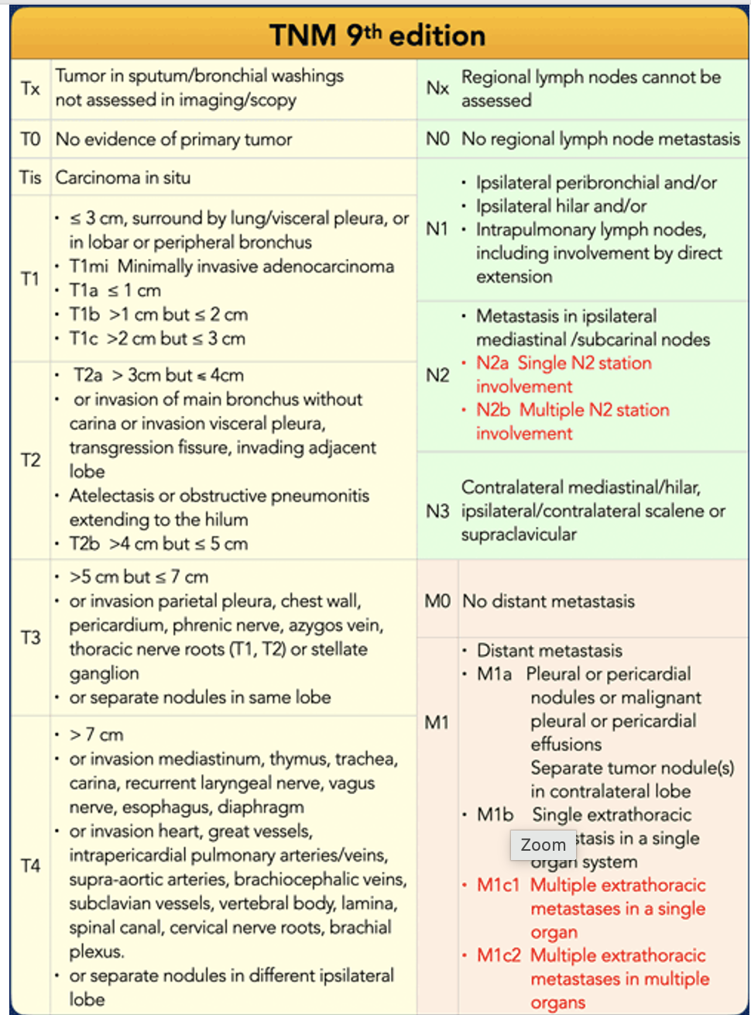
Notes:
3.5 cm spiculated mass in the right lower lobe with an enlarged hilar node

Slide 55
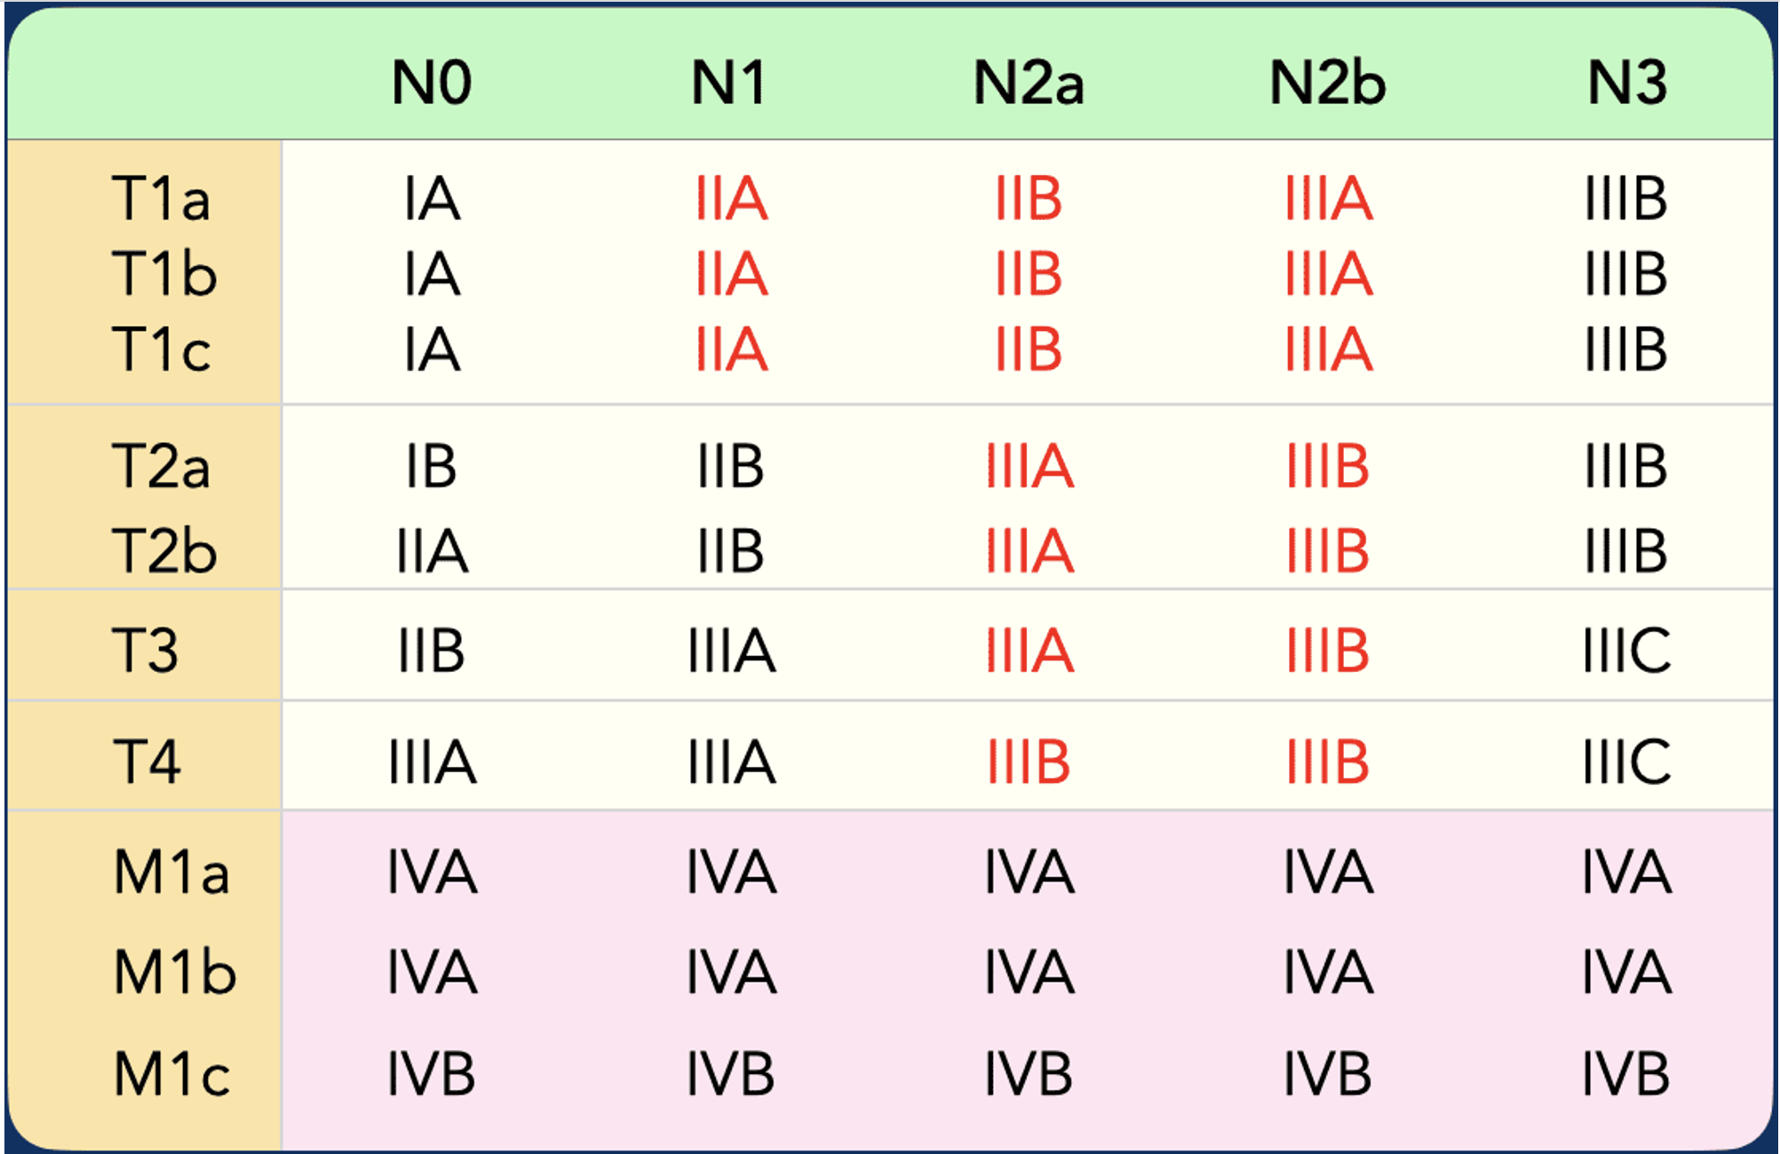

Slide 56
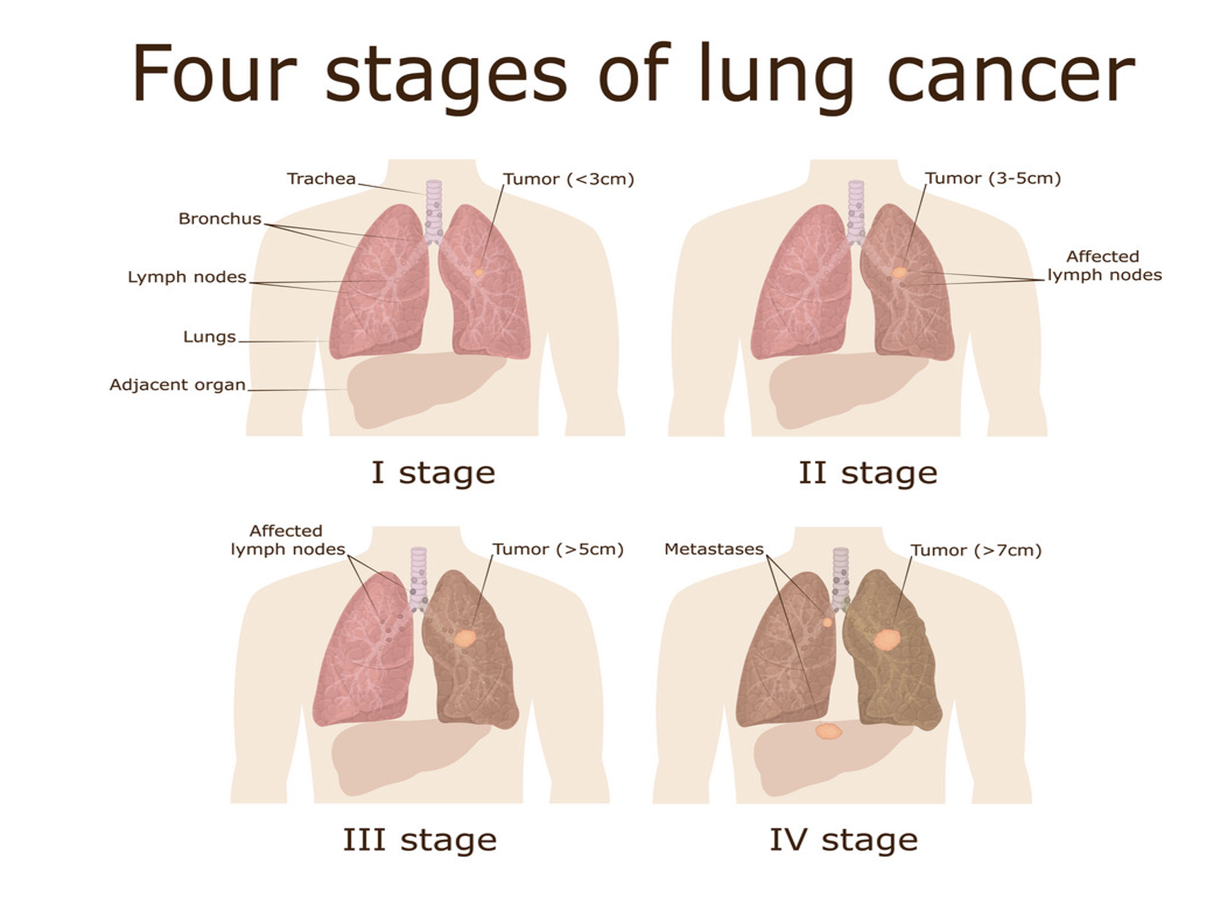
Cisplatin-based chemotherapy is recommended after surgery for stage IB to stage III NSCLC in patients without contraindications to chemotherapy. (5% increase in survival in 5 years)
In patients without an EGFR or ALK genetic mutation, the addition of immunotherapy after completing chemotherapy further improves outcomes.
KEYNOTE trial demonstrated 1 year of pembrolizumab significantly prolonged survival in patients who received prior adjuvant chemotherapy from 34.9 months to 58.7 months. Approved for IB-IIIA NSCLC

Slide 57
Question 14.
A 50-year-old man is evaluated for follow up 2 months after surgical resection of a localized melanoma of the right lower extremity. The depth of invasion by Breslow microstaging at excision was 0.6 mm, and the lesion was nonulcerated. He has no other medical problems and takes no medications. He performs daily skin self-examinations.
On physical examination, vital signs are normal.
The right lower extremity surgical site is clean, without evidence of infection. Results of laboratory studies are normal.
Which of the following is the most appropriate management?
A. Dermatologic evaluation every six months
B. Nivolumab and ipilimumab
C. PET/CT
D. Sentinal lymph node biopsy

Slide 58
Question 14.
A 50-year-old man is evaluated for follow up 2 months after surgical resection of a localized melanoma of the right lower extremity. The depth of invasion by Breslow microstaging at excision was 0.6 mm, and the lesion was nonulcerated. He has no other medical problems and takes no medications. He performs daily skin self-examinations.
On physical examination, vital signs are normal.
The right lower extremity surgical site is clean, without evidence of infection. Results of laboratory studies are normal.
Which of the following is the most appropriate management?
A. Dermatologic evaluation every six months
B. Nivolumab and ipilimumab
C. PET/CT
D. Sentinal lymph node biopsy

Slide 59

Melanoma Risk Factors
Male sex
Age > 50
Atypical moles/dysplastic nevi
Increased mole count
Fitzpatrick skin type 1 (red hair-blue eyes)
Multiple and/or blistering sun burns
Actinic keratosis
Non-melanoma skin cancer (BCC and SCC)
Immunosuppression
Solid organ transplant
HIV/AIDS
Hematologic malignancy
Genetic predisposition
Tanning bed use
Residence in sunnier climate/nearer to equator
Intermittent intense sun exposure
Chronic sun exposure

Slide 60
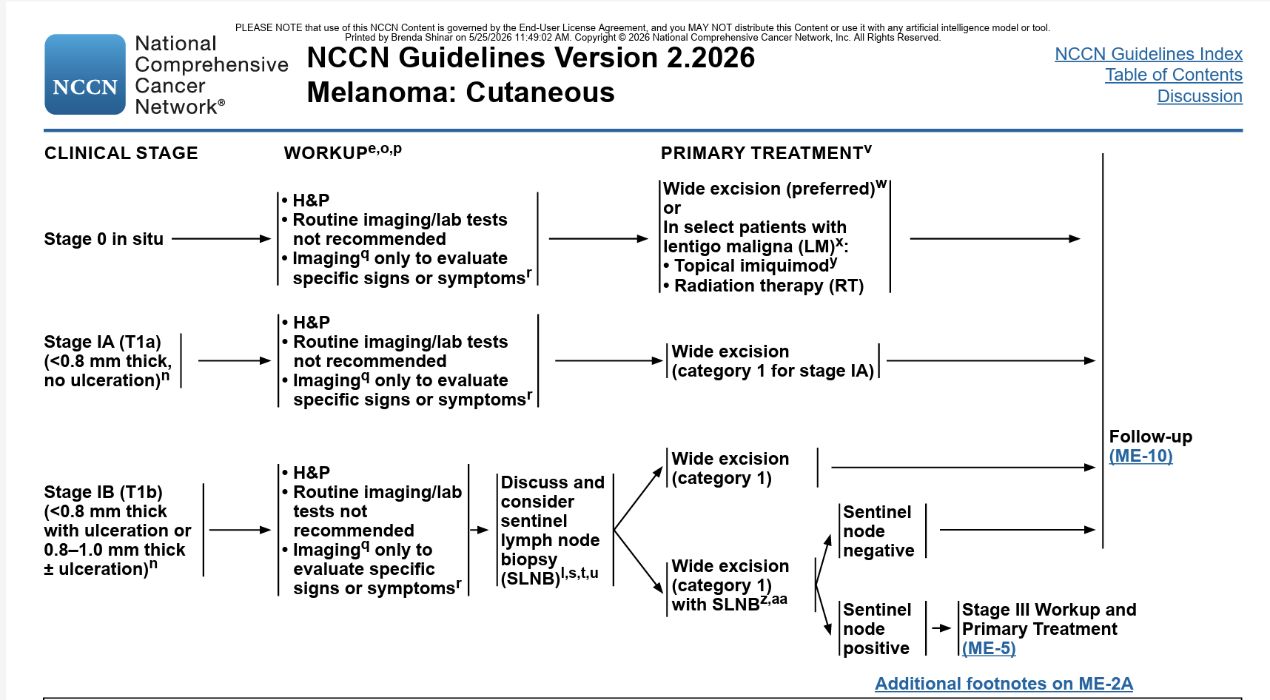
Sentinel lymph node biopsy should be considered if <0.8 mm thick WITH ulceration or 0.8-1.0 mm thick +/- ulceration
Follow up for stage 1A melanoma should be clinical exam with emphasis on skin and LN q 6-12 months for 5 years, then annually

Slide 61
Question 15.
A 60-year-old man is evaluated for a nodule in the left upper lung discovered on a chest radiograph because of a chronic cough. Five years ago, melanoma of the left upper extremity was surgically removed. The sentinel node biopsy at that time was negative, and he did not receive adjuvant therapy. The patient has gastroesophageal reflux disease, hypertension, and type 2 diabetes mellitus. Medications include omeprazole, empagliflozin, lisinopril, metformin, and simvastatin.
On physical examination, vital signs and other findings are normal.
Results of laboratory studies are normal.
A PET/CT scan shows uptake in the nodule in the left upper lung and no other evidence of disease.
Findings on biopsy of the lung lesion are consistent with BRAFV600E-mutation melanoma.
Which of the following is the most appropriate next treatment?
A. BRAF inhibitor plus MEK inhibitor
B. Immune checkpoint inhibitor
C. Interferon
D. Surgical resection

Slide 62
Question 15.
A 60-year-old man is evaluated for a nodule in the left upper lung discovered on a chest radiograph because of a chronic cough. Five years ago, melanoma of the left upper extremity was surgically removed. The sentinel node biopsy at that time was negative, and he did not receive adjuvant therapy. The patient has gastroesophageal reflux disease, hypertension, and type 2 diabetes mellitus. Medications include omeprazole, empagliflozin, lisinopril, metformin, and simvastatin.
On physical examination, vital signs and other findings are normal.
Results of laboratory studies are normal.
A PET/CT scan shows uptake in the nodule in the left upper lung and no other evidence of disease.
Findings on biopsy of the lung lesion are consistent with BRAFV600E-mutation melanoma.
Which of the following is the most appropriate next treatment?
A. BRAF inhibitor plus MEK inhibitor
B. Immune checkpoint inhibitor
C. Interferon
D. Surgical resection

Slide 63
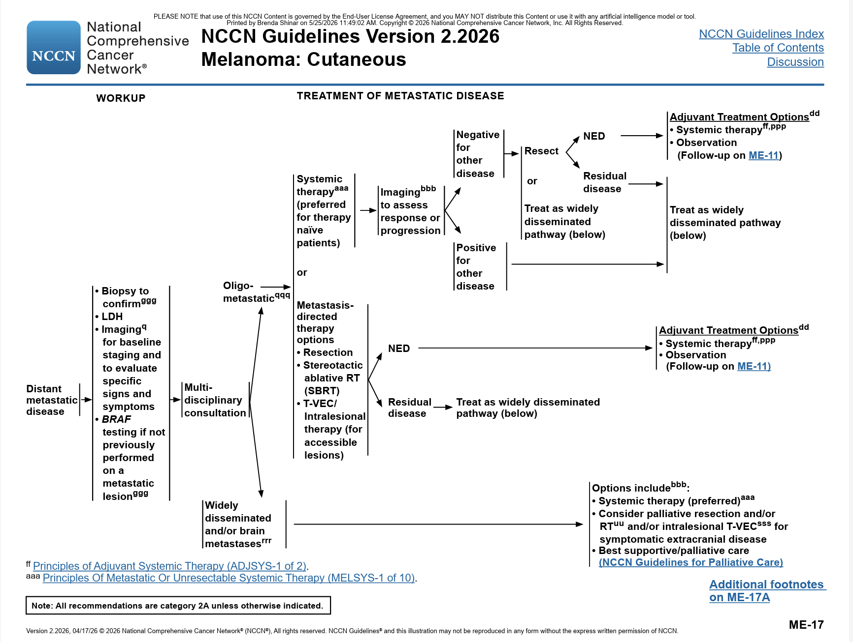


Oligo Metastatic Melanoma

Slide 64
Conclusions from Oncology Month
Prevent Cancer
Screen for Cancer-find it early
Take good family histories
Involve genetic counsellors
Be sun safe!

Slide 65
Thanks!
Do you have any questions?
youremail@freepik.com
+34 654 321 432
yourwebsite.com
Please keep this slide for attribution

