Slide 1
Rheumatology Test Review
March 31, 2026

Slide 2
Question 1.
A 62-year-old woman presents with a 4-day history of daily fevers with temperatures reaching up to 38.6 C (101.5 F). She reports associated fatigue, a 10-lb unintentional weight loss, and stiffness in her shoulders and hips, particularly in the morning. She denies cough, diarrhea, dysuria, rash, or recent travel. She smoked for 35 years and quit smoking one year ago. Review of systems otherwise negative
Physical examination is remarkable only for mild, diffuse tenderness upon palpation of the shoulders and reduced range of motion in the hips. There is tenderness in the MCPs of the hands bilaterally.
Laboratories:
CBC Hgb 10.5 g/dL (normal 12-16), WBC 9500/uL, platelets 350,000/uL
ESR: 95 mm/h (normal <30 mm/h)
CRP: 110 mg/L (normal <10 mg/L)
Blood cultures x 3: Negative
Chest x-ray: Normal
ANA, RF, Anti-CCP antibodies: Negative
HIV testing: negative
A CT scan of the abdomen and pelvis is negative for occult abscess or malignancy.
Which of the following is the most appropriate next step in the management of this patient?
A. Initiate broad-spectrum antibiotics
B. Perform a PET/CT scan
C. Initiate prednisone 20 mg po q day
D. Perform a transthoracic echocardiogram
E. Perform a temporal artery biopsy

Slide 3
Question 1.
ANSWER : C

Slide 4
FEW SALIENT POINTS on D/D
Polymyalgia rheumatica/PMR : The clinical picture presented and elevated inflammatory markers, in an elderly patient should make one think of PMR .
It is important not to miss late onset Rheumatoid arthritis which is an important mimicker. While RF,CCP should be ordered to diagnose or rule out seropositive RA, it is important to have seronegative RA on the differential. Symmetric small joint involvement points towards RA.
Malignancy is a big mimicker of PMR, hence when the patient does not respond rapidly to steroids, make sure an extensive malignancy screen is performed.
Myositis is often confused with PMR – normal muscle strength and normal CK, aldolase usually means no myositis.
Osteoarthritis is often confused with PMR, but normal inflammatory markers is the norm in OA.
Lastly Fibromyalgia, a pain syndrome should not be confused with Polymyalgia rheumatica.

Slide 5
SYMPTOMS OF PMR
Most common inflammatory rheumatic condition in patients > 50 years
Females > affected than males 3: 1
Always ask- onset of symptoms is over few days to weeks
Joint distribution : shoulder/neck bilaterally > hips
Morning stiffness > 30 to 45 minutes that resolves partially as day progresses.
Elevation of inflammatory markers is the norm.
Rapid resolution of symptoms within 48 years with initiation of prednisone is a key to diagnosis.

Slide 6
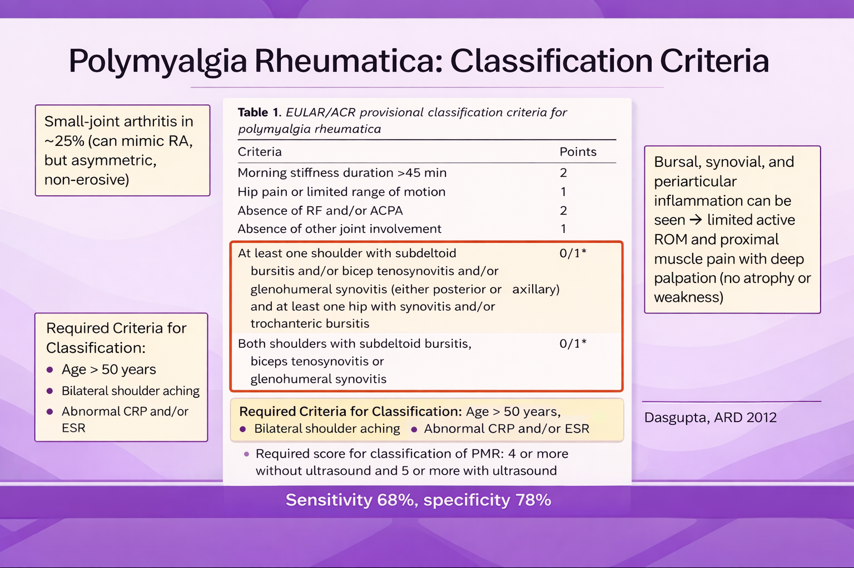

Slide 7
TIPS TO INTERPRET INFLAMMATORY MARKERS -FORMULAS
ESR : Age/2 in males. Age/2 + 10 in females
CRP mg/dl : Age/ 50 in males. Age/ 50 + 0.6 in females

Slide 8
TREATMENT
Prednisone 12.5 mg to 25 mg – follow up in 2 to 4 weeks, clinical and serologic resolution- taper gradually over several months.
If relapses, there is role for steroid sparing agent such as IL6 inhibitor.
Bone protection is extremely important due to age and steroid toxicity.

Slide 9
Question 2.
A 26-year-old man is evaluated for a 2-year history of back pain. He has morning stiffness lasting longer than 1 hour that improves with activity. He wakes up at 2 am in the morning with low back pain and stiffness. He reports alternating buttock pain. He does not like his desk job anymore since sitting for extended period of time has become almost impossible due to back discomfort.
On physical examination, vitals are normal. There is mild reduction of lumbar flexion and tenderness over the sacroiliac joints bilaterally. Results of the FABER (Flexion, Abduction, and External Rotation) are positive bilaterally.
Laboratory studies:
C-reactive protein 3.0 mg/dL (H)
Radiographs show normal lumbar vertebrae and bilateral sacroiliac joint sclerosis and erosions consistent with sacroiliitis.
Which of the following is the most appropriate treatment?
A. Acetaminophen
B. Adalimumab
C. Methotrexate
D. Naproxen

Slide 10
Question 2.
ANSWER : D

Slide 11
DEFINITION OF INFLAMMATORY BACK PAIN
Inflammatory back pain (IBP) is a condition of pain localized to the axial spine and sacroiliac joints that is chronic and is differentiated from mechanical back pain by a set of key diagnostic features :
Young age of onset (<40 years of age)
Insidious in onset
Lasting at least 3 months
Morning stiffness
Pain relieved by exercise or activity and worsened by rest

Slide 12
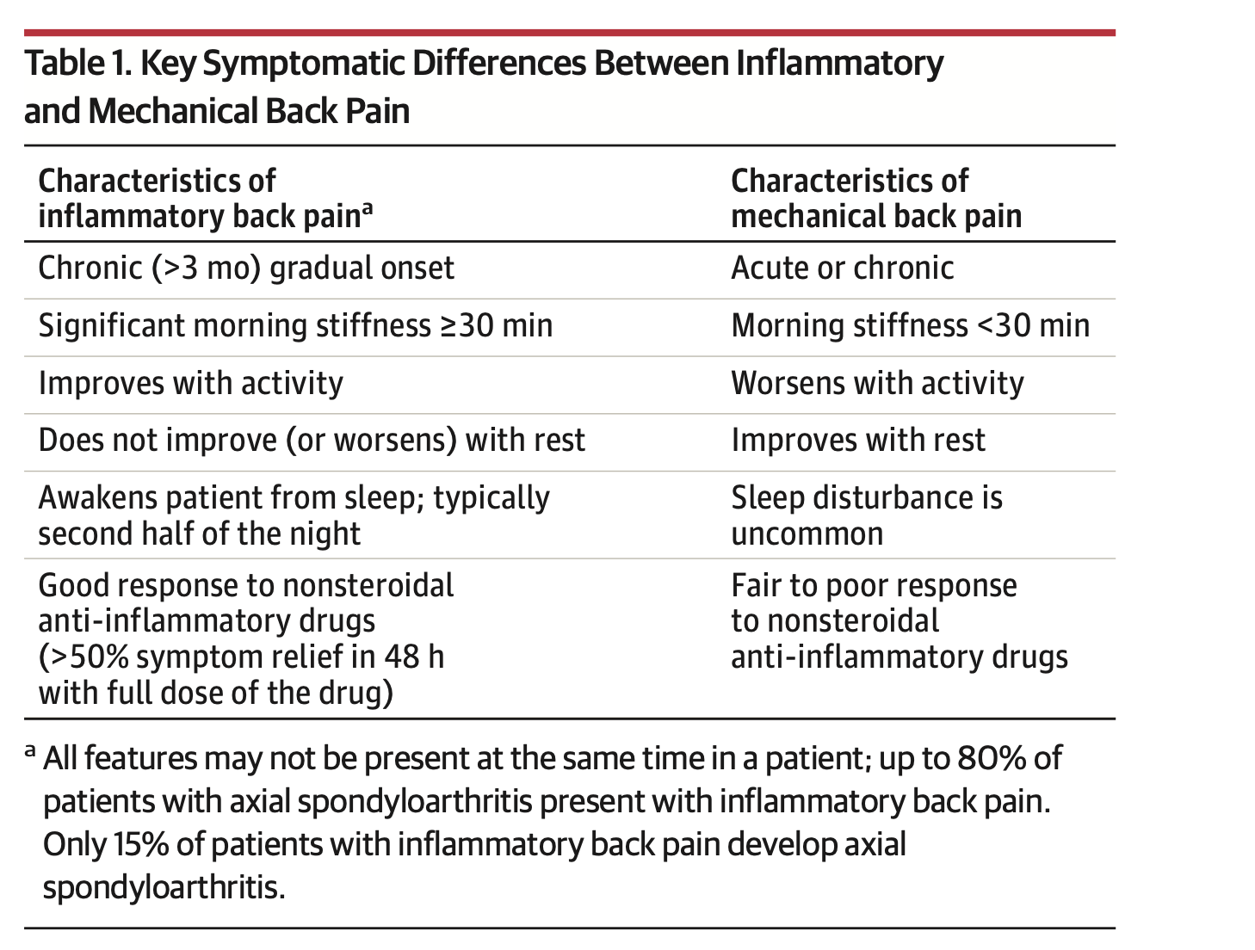

Slide 13
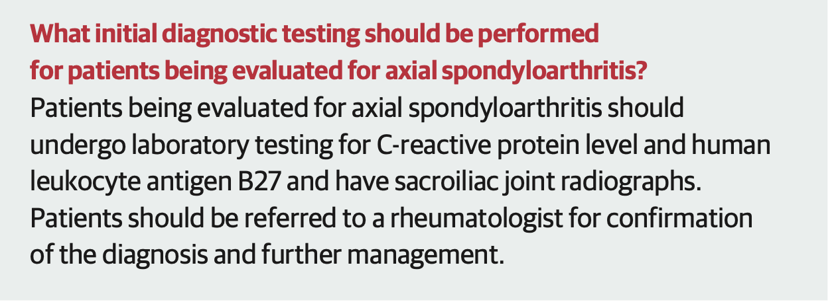

Slide 14
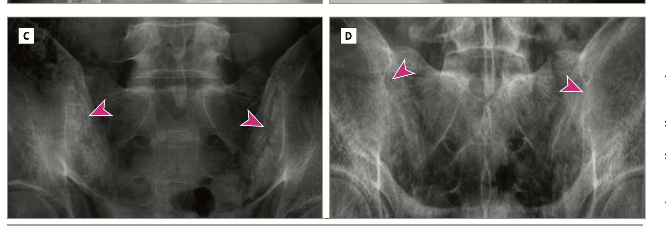
C, Erosions, narrowing, and partial fusion in the sacroiliac joints (arrowheads) (bilateral grade 3 sacroiliitis).
D, Complete ankylosis (fusion) of the sacroiliac joints (arrowheads) (bilateral grade 4 sacroiliitis).

Slide 15
What is the role of HLAB27 ?
Positive HLA-B27 test is not diagnostic of ankylosing spondylitis.
HLA-B27 is present in 70-90% of patients with axial spondyloarthritis (including ankylosing spondylitis).
Approximately 6% of the general US population is HLA-B27 positive, and only about 6% of HLA-B27-positive individuals develop axial spondyloarthritis.
The test has a sensitivity of only 50% and specificity of 90%, with a positive likelihood ratio of 3.1, making it insufficient for diagnosis on its own.

Slide 16
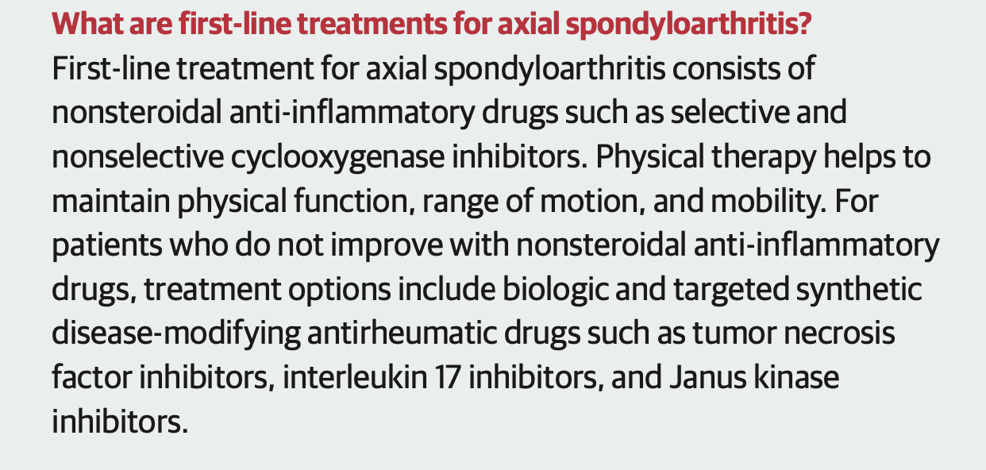

Slide 17
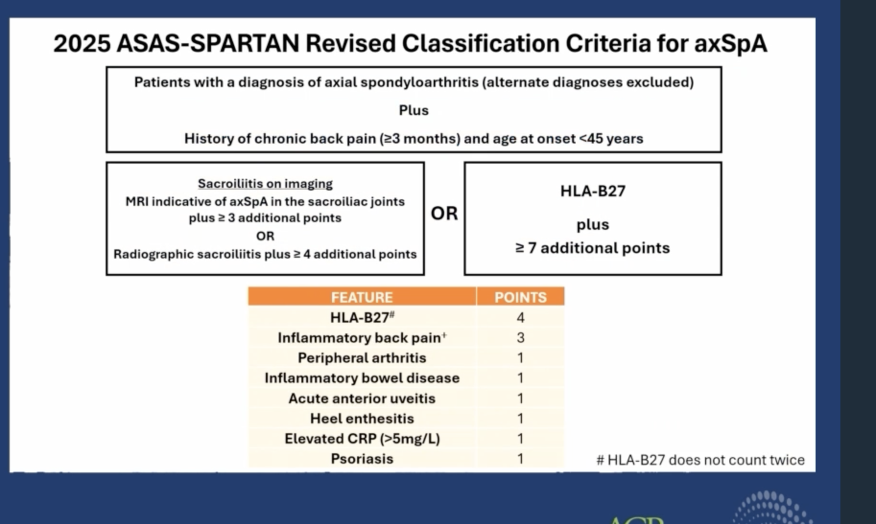
BONUS SLIDE

Slide 18
Question 3.
A 40-year-old woman, with no past medical history, comes to you for suspected Rheumatoid arthritis. She reports joint pain for 3 months affecting her fingers, wrists, knees, and feet, with joint stiffness and pain. Symptoms are worse in the mornings and improve with activity. She also reports a rash on the backs of her hands and forearms for 6 weeks. Progressively worsening fatigue for 6 months is another complaint.
Physical examination reveals tenderness in 3 proximal interphalangeal joints and 3 metacarpophalangeal joints, tenderness in bilateral wrists, and trace effusions in the knees and tenderness in the ankles. In addition, you notice erythematous patches over the dorsal aspect of the fingers between the joints, and there are erythematous papules on the dorsum of the hands. There is 1+ pitting edema on the lower extremities to the mid tibia bilaterally.
Laboratory results:
WBC count of 2.5, with 1.0 lymphocytes, hemoglobin (Hgb) of 11.5 g/dL (normal 12–15 g/dL), rest of CBC normal
Normal chemistries; urinalysis with 2+ protein and 1+ blood on dipstick
ESR of 66 (normal 0–20); CRP 7 mg/dL (normal 0–10 mg/dL).
Which of the following diagnostic tests is most likely to confirm the suspected diagnosis in this patient?
A. Serum RF and anti-cyclic citrullinated peptide (anti-CCP) antibody
B. MRI of the hand and wrist
C. Genetic testing for susceptibility alleles in the human leucocyte antigen (HLA)-DR4 locus
D.ANA with reflex profile and complement testing
E. Serum uric acid and synovial fluid crystal analysis from knee

Slide 19
Question 3.
Answer: D

Slide 20
IMPORTANT POINTS IN THIS CASE
Inflammatory arthritis is a pattern and not a diagnosis
Morning stiffness, symmetric small joint involvement, synovitis points to inflammatory arthritis, but this is not rheumatoid arthritis always.
Always look for extra-articular causes – In this case :
-rash in sun exposed areas
-cytopenias : anemia, leukopenia and lymphopenia
-proteinuria and hematuria, with peripheral edema
So something systemic is going on!

Slide 21
Think broadly…
Hence ordering RF,CCP is not wrong but think outside the box.
Skin is a window to systemic disease in Rheumatology.
Lab clues in her case : proteinuria and hematuria which should make you think of glomerular involvement, ESR out of proportion to CRP is common in Systemic lupus.

Slide 22
RA vs Lupus
Rheumatoid arthritis is a symmetrical polyarthritis predominantly affecting small joints of the hands, metacarpophalangeal and proximal interphalangeal joints, wrists, and feet with marked morning stiffness.
In contrast, Systemic lupus arthritis commonly affects the hands, wrists, and knees and can be initially asymmetric and migratory.
Radiographic joint erosions are typical of RA, but not characteristic of Systemic lupus.

Slide 23
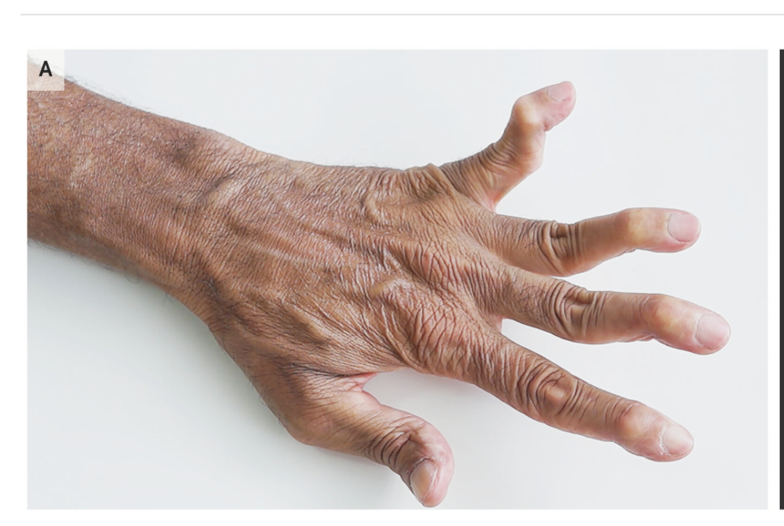
FUN FACTS
Rhupus = Rheumatoid arthritis and Systemic lupus
Jaccoud’s arthropathy is a reducible non-erosive joint deformity seen in patients with systemic lupus.

Slide 24
Question 4.
A 42-year-old woman presents to the rheumatology clinic with a 6-month history of progressive joint pain and stiffness. She reports pain and swelling in her right second and third fingers, left ankle, and right knee. The stiffness is worst in the morning, lasting approximately 90 minutes, and improves with activity. She has noticed that her right third finger appears "sausage-like" in appearance.
Past Medical History: The patient has a 10-year history of plaque psoriasis, primarily affecting her elbows, knees, and scalp, managed by her dermatologist with topical corticosteroids. She notes that her fingernails have become pitted and some have begun to separate from the nail beds over the past year.
Family History : Her father has psoriasis. No family history of rheumatoid arthritis or other autoimmune conditions.
Physical Examination:
Skin: Erythematous plaques with silvery scales on bilateral elbows and knees; smaller lesions in the scalp and behind the ears
Nails: Pitting of multiple fingernails bilaterally; onycholysis of the right third fingernail
Musculoskeletal:
Dactylitis of the right third finger with diffuse swelling
Synovitis of the right second and third proximal interphalangeal joints, left ankle, and right knee with warmth and tenderness
Tenderness at the left Achilles tendon insertion (enthesitis) Asymmetric joint involvement affecting 4 joints
Laboratory Studies:
Rheumatoid factor: Negative
Anti-CCP antibodies: Negative
ESR: 38 mm/hr (elevated)
CRP: 2.1 mg/dL (elevated)
Imaging:
Hand radiographs: Early erosive changes at the right second proximal interphalangeal joint with juxta-articular new bone formation
Foot radiographs: Soft tissue swelling without erosions
What is the most likely diagnosis?
A. Rheumatoid arthritis
B. Psoriatic arthritis
C. Parvovirus arthritis
D. Crystalline arthritis

Slide 25
Question 4.
ANSWER: B

Slide 26
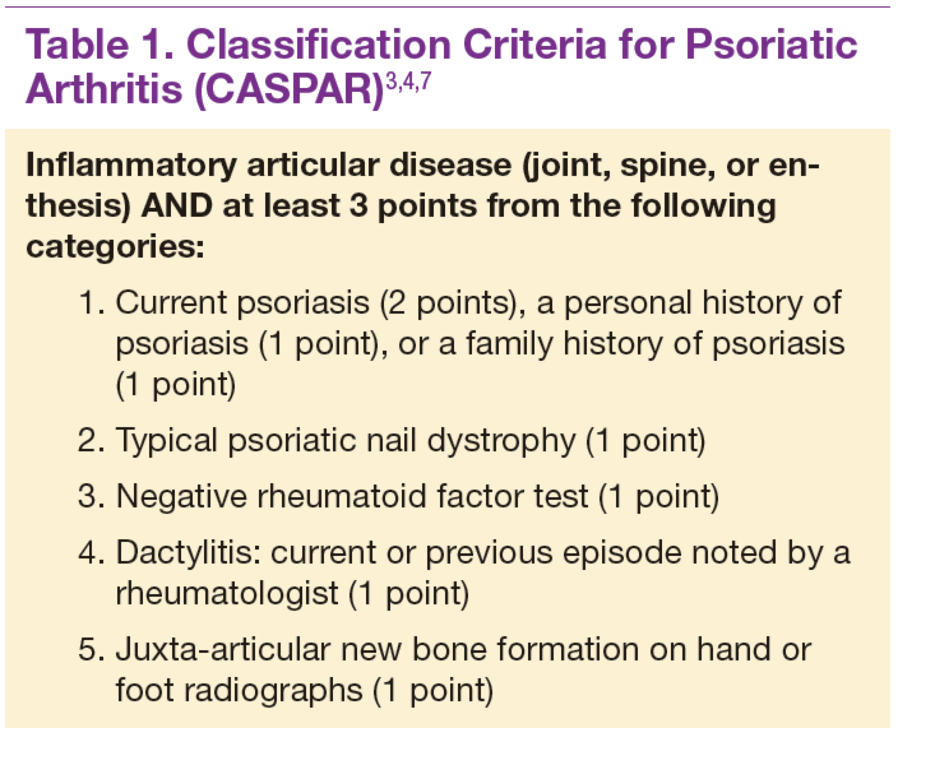

Slide 27
Psoriatic Arthritis
Knowing CASPAR criteria helps make a diagnosis of psoriatic arthritis : Inflammatory articular disease ( peripheral arthritis ) plus 5 points : current psoriasis (2 points), psoriatic nail dystrophy (1 point), negative rheumatoid factor (1 point), and dactylitis (1 point), Xray findings ( 1 point ).
The clinical presentation demonstrates the asymmetric oligoarticular subtype with characteristic features including dactylitis, enthesitis, and nail involvement.
The diagnosis is supported by the typical pattern of psoriasis preceding arthritis by several years, which occurs in approximately 85% of psoriatic arthritis cases.

Slide 28
RA vs Psoriatic
Key Differences from Rheumatoid Arthritis
Distribution patterns are your best friend for differentiation:
PsA: DIP involvement (>50% of cases), asymmetric "ray" pattern, spares the wrist relatively.
RA: Symmetric MCP/PIP involvement, DIP sparing, prominent wrist and ulnar styloid involvement.

Slide 29
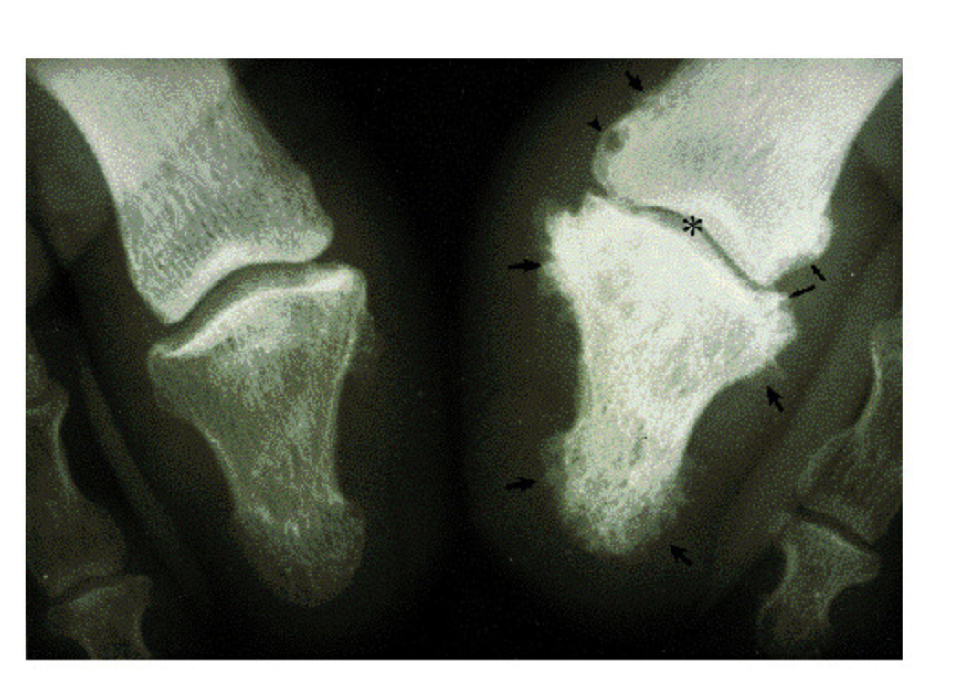
On the right toe, there is:
Diffuse soft tissue swelling that extends beyond just the joint (not limited to the joint capsule).
Narrowing of the interphalangeal joint space, suggesting cartilage loss.
Subchondral cysts and marginal erosions, indicating inflammatory joint damage.
New bone formation, including:
  Periosteal bone formation (along the outer surface of the bone)
  Endosteal bone formation, creating an “ivory phalanx” appearance (increased bone density within the phalanx)

Slide 30
Question 5.
You are seeing a 25-year-old woman presenting to your service with a high fever. She has no known medical conditions. For 2 months, she has fevers every day to 40 degrees Celsius. Fever is mostly in the late afternoon and at night and resolves by morning. Fever is associated with a maculopapular rash on the abdomen and extremities, polyarthralgias, sore throat, and headaches. She has leukocytosis 17,000/microl with neutrophilia up to 88%, thrombocytosis up to 452,000/microl. Antibiotics have not helped her; however, steroids up to 60 mg daily have benefited her, and she had no fevers or joint pains. But the moment she tapered steroids, all her symptoms came back with a vengeance, with unremitting high-grade fevers, worsening lethargy: no sick contacts, no travel, no exposure to pets.
She is in distress and slow to answer your questions, but has no focal neurologic findings.
Vitals: temperature 39.7°C (103.5°F), heart rate 115 beats/min, BP 100/70 mm Hg, respiratory rate 24/min, and oxygen saturation 97% on room air.
Her fever has been persistent during her hospital stay.
She has mild cervical adenopathy. She had a palpably enlarged liver 3 cm below the right costal margin and a palpable spleen tip.
Many joints are tender, and she has a faint pink macular rash over the chest, abdomen, and extremities.
Labs:
CBC: Hct 27%, WBC 3300/uL with normal differential, platelets 72,000/uL
Electrolytes: sodium (Na) 128 mEq/L, creatinine 1.1 mg/dL, rest normal
Serum transaminases: ALT 116 U/L (nl 10–50), AST 380 U/L (nl 10–40)
LDH 1028 U/L (nl 140–280), albumin 2.7 g/dL (nl 3.5–4.5)
Urinalysis: normal
ESR: 38 mm/h
Fibrinogen: 185 mg/dL (nl 200–400 mg/dL)
Triglycerides: 350 mg/dL
ANA: negative
RF: negative
Ferritin: 10,800 ng/mL
D-dimer: 5800 (nl <250 ug/L)
Interferon gamma release assay: negative
Blood cultures: negative at 48 h
Chest radiograph: normal
Which one of the following tests is most likely to establish the diagnosis?
A. Lumbar puncture for CSF analysis
B. Chest CT pulmonary embolus study
C. Skin biopsy with immunofluorescence
D. Genetic testing for perforin gene mutation
E. Bone marrow biopsy

Slide 31
Question 5.
ANSWER: E

Slide 32
Diagnosis : Macrophage activation syndrome secondary to Adult onset Still disease
Adult onset Still disease :
Quotidian fever > 39 degree Celsius
Evanescent, salmon-colored macular rash on the trunk and extremities, often coincident with fever spikes, typically in the late afternoon or evening.
Pharyngitis, polyarthralgia, lymphadenopathy, splenomegaly, and serositis.
Leucocyte elevations of the acute phase reactants (erythrocyte sedimentation rate and C-reactive protein), and dramatic increases in the serum ferritin level.
Lasting for > 2 weeks
Respond to prednisone

Slide 33
MAS vs HLH
Macrophage activation syndrome (MAS) is a life-threatening hyperinflammatory complication of rheumatic diseases including adult-onset Still's disease (AOSD) that is classified as secondary hemophagocytic lympho histiocytosis ( HLH )due to shared clinical and laboratory features.
Diagnostic Criteria
In patients with systemic juvenile idiopathic arthritis (which along with AOSD comprises Still's disease), MAS-HLH is defined by the presence of fever, a ferritin level exceeding 684 μg/L, and any two of the following: platelet count ≤181×10⁹/L, aspartate aminotransferase >48 U/L, fasting triglyceride level >1.76 mmol/L (156 mg/dL), and fibrinogen level ≤3.6 g/L. Notably, fibrinogen and platelet levels are often higher in MAS-HLH than in other forms of HLH because of the underlying inflammatory nature of the disease.
Prognosis
Mortality associated with MAS-HLH is approximately 10-15% among adults.
Central nervous system involvement may lead to irreversible neurologic damage, and severe pulmonary disease with high risk of death may develop, though optimal prevention and treatment strategies remain uncertain.

Slide 34
MAS Treatment
A common first-line approach involves high-dose glucocorticoid therapy, such as intravenous pulse methylprednisolone at 30 mg/kg/dose (maximum 1000 mg/dose) once daily for 3-5 days, followed by oral or intravenous glucocorticoids.
Cyclosporine can be added at 2-7 mg/kg/day (trough value 100-150 μg/L). Interleukin-1 blocking therapy is increasingly used, with anakinra administered at 2-10 mg/kg/day.
In patients with severe disease or CNS involvement despite glucocorticoid therapy and cyclosporine or anakinra (or both), one or a few moderate weekly doses of etoposide (50-100 mg/m²) can be effective.

Slide 35
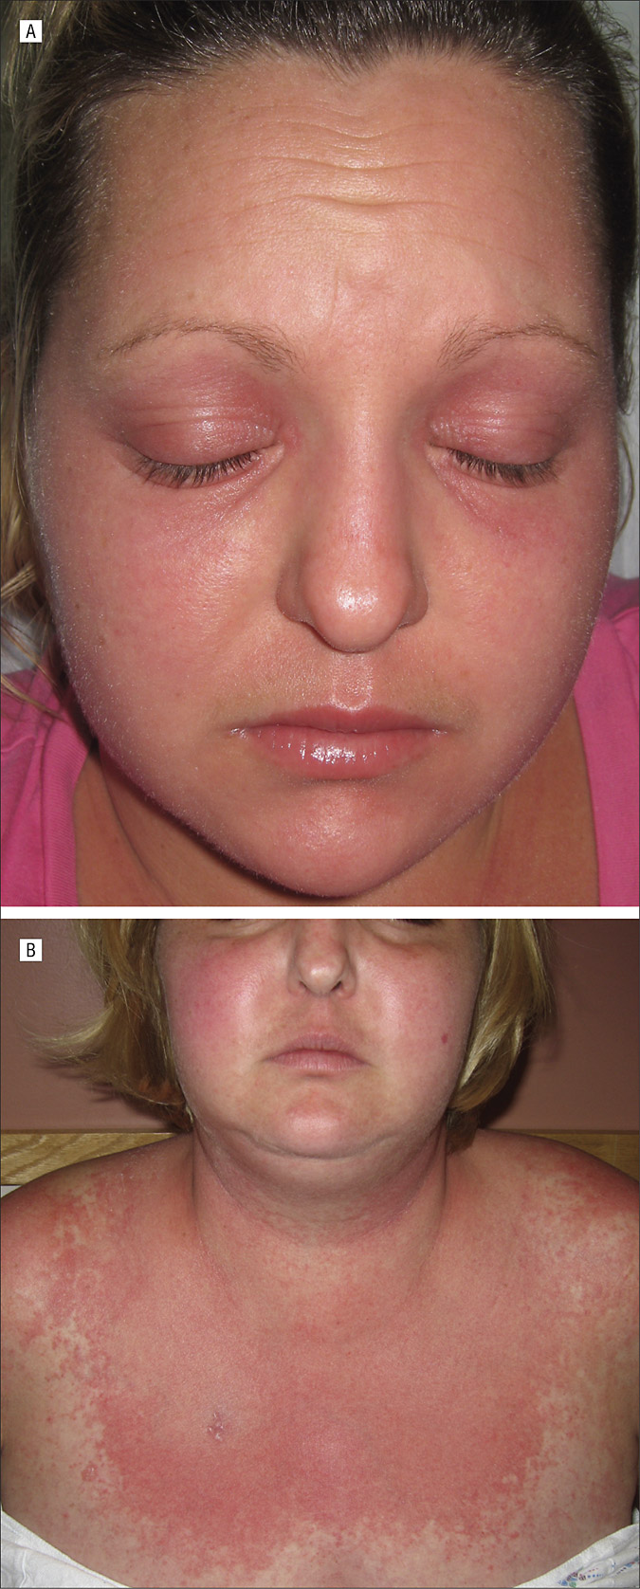
Question 6.
A 60-year-old woman presents to your clinic for evaluation of weakness and a new skin rash. Over the last several months, she has noted worsening weakness in her arms and legs with difficulty combing her hair and rising from a seated position.
Her rash has involved her chest and eyelids and is purplish in color. On examination, you note 4/5 proximal muscle weakness, heliotrope rash, and "V sign". You diagnose her with dermatomyositis, and subsequent laboratory testing reveals positive anti-TIF-1 gamma antibodies.
She has received a mammogram in the past year and had a Pap smear two years prior; both of these studies were normal.
She has never had a screening colonoscopy.
Which one of the following should you recommend for cancer screening at this time?
A. No additional screening necessary
B. Colonoscopy only
C. CT of chest, abdomen, pelvis, CA-125 blood test, pelvic ultrasound, and colonoscopy
D. CT of chest, abdomen, pelvis only

Slide 36
Question 6.
ANSWER: C

Slide 37
Understanding the Cancer Risk in Dermatomyositis
Patients with dermatomyositis (DM) face a significantly elevated risk of malignancy, with studies showing a 4.66-fold increased cancer risk compared to the general population.
This risk is particularly pronounced within 3 years before and after the diagnosis of dermatomyositis.
The temporal clustering of cancer diagnoses around the time of DM diagnosis is well-documented, with most malignancies occurring within the first year after diagnosis.

Slide 38
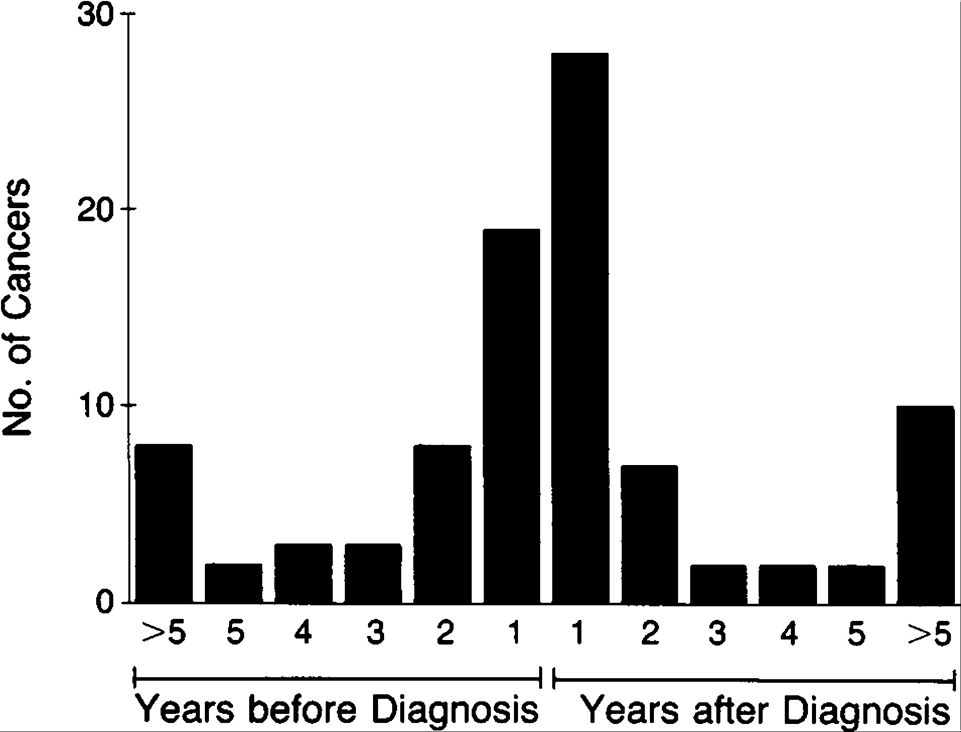

Slide 39
International Guidelines for Cancer Screening
The International Myositis Assessment and Clinical Studies Group (IMACS) published comprehensive guidelines in 2023 for cancer screening in idiopathic inflammatory myopathies.
These guidelines stratify patients into standard, moderate, or high risk based on:
IIM subtype
Autoantibody status
Clinical features

Slide 40
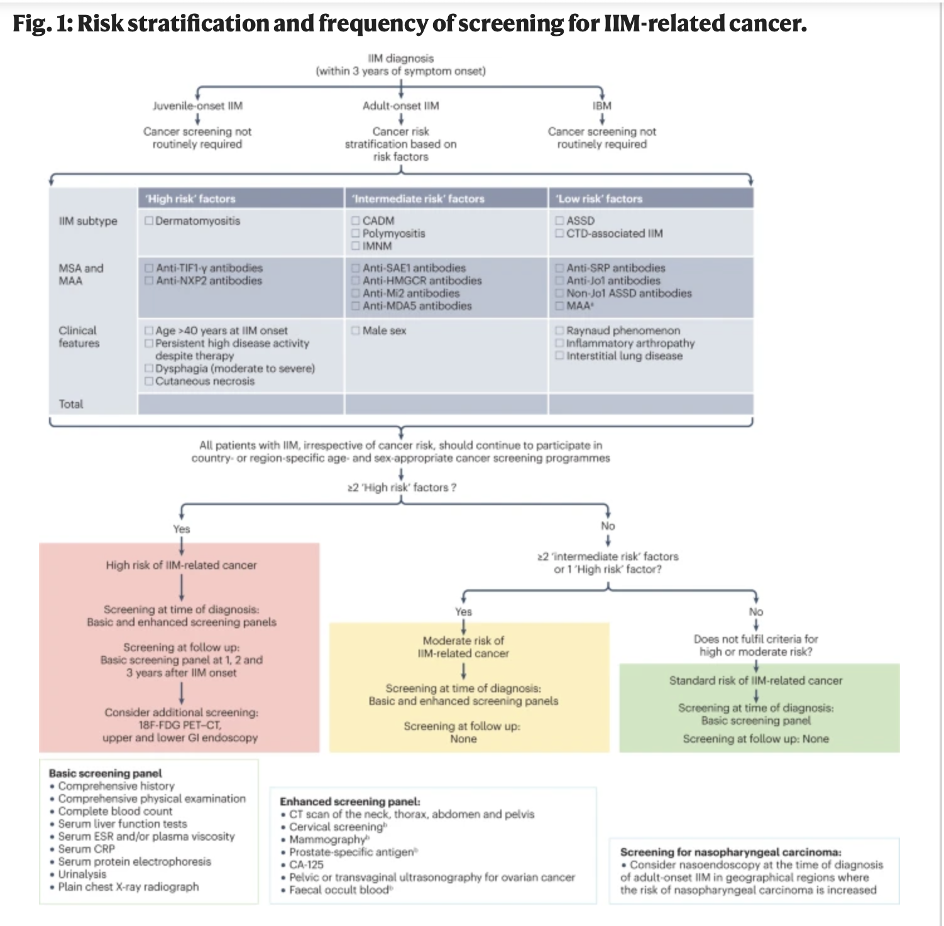

Slide 41
Risk Stratification: Why This Patient is High-Risk ?
This patient has multiple high-risk features that place her in the highest cancer risk category:
Anti-TIF-1γ antibody positivity: This is the strongest predictor of cancer-associated dermatomyositis, conferring a 9.37-fold increased cancer risk. Patients with anti-TIF-1γ antibodies have particularly elevated risks for ovarian cancer (standardized prevalence ratio 18.39) and breast cancer (standardized prevalence ratio 3.84).
Age 60 years: Older age (particularly >45 years) is an independent risk factor for malignancy in dermatomyositis.
Classic dermatomyositis with cutaneous manifestations: The presence of classic DM (rather than clinically amyopathic DM) increases cancer risk, with one study showing 9.9% of classic DM patients had malignancy within 2 years versus only 1.7% of clinically amyopathic DM patients.

Slide 42
Common malignancies in Dermatomyositis
Ovarian cancer (especially with anti-TIF-1γ)
Lung cancer
Breast cancer
Colorectal cancer
Gastric cancer
Pancreatic cancer
Nasopharyngeal cancer (particularly in Asian populations)
Lymphoma

Slide 43
Pearls
No additional screening is incorrect. This patient is at extremely high risk for occult malignancy, hence comprehensive screening needs to be done immediately.
Doing colonoscopy alone is grossly inappropriate for a high-risk dermatomyositis patient. Colorectal cancer is one of several malignancies associated with DM, but ovarian, lung, and breast cancers are equally or more concerning, particularly with anti-TIF-1γ positivity.
CT chest, abdomen and pelvis alone misses ovarian cancer screening and colon cancer screening.

Slide 44
Important message
Patients classified as high-risk (which includes this patient with anti-TIF-1γ positive dermatomyositis at age 60) should undergo enhanced cancer screening that includes :
CT imaging of chest, abdomen, and pelvis
Tumor markers (including CA-125 for ovarian cancer screening in women)
Pelvic ultrasound (particularly important given the high ovarian cancer risk with anti-TIF-1γ)
Age-appropriate screening updated to current recommendations

Slide 45
Clinical pearls
Timing is critical: Most dermatomyositis-associated cancers are diagnosed within 1 year of DM diagnosis, and cancers are often at advanced stages, contributing to mortality.
Anti-TIF-1γ is the strongest predictor: Among all myositis-specific antibodies, anti-TIF-1γ confers the highest cancer risk.
Enhanced screening saves lives: Myositis-associated cancers are often occult and asymptomatic at diagnosis. Enhanced screening with CT imaging has been shown to effectively identify underlying malignancies.
PET-CT may be considered: For very high-risk patients where initial enhanced screening is negative, whole-body PET-CT can be considered as it has shown good performance (AUC 0.87) for detecting occult malignancy.
Follow-up screening: The elevated cancer risk persists for 3 years, so continued surveillance is recommended during this period.

Slide 46
Question 7
A 54-year-old woman presents with progressive weakness and sensory changes.
Three weeks prior to your visit: left foot dorsiflexion weakness (“foot drop”).
One week later: distal right arm weakness with wrist drop and painful paresthesias in right hand. Then: painful burning in both feet and right foot weakness. She also complains of generalized fatigue and nonproductive cough.
Past Medical History:
No other pertinent medical problems.
History of recurrent sinusitis over past 6 months, treated with repeated courses of antibiotics (most recently fluoroquinolone).
Physical Exam:
Vital signs: normal
Mental status: normal
Cranial nerves: normal
Motor strength:
  Bilateral foot movements: 2/5
  Right upper extremity distally: 3/5
  Left upper extremity: 5/5
Reflexes:
  Achilles: absent
  Patella and upper extremities: normal
Sensory changes:
  Radial and ulnar distributions of right hand
  Lateral lower legs and dorsum of feet bilaterally
CBC: Hct 32%, WBC 11,200/uL (normal differential), platelets 456,000/uL
CMP: Creatinine 1.6 mg/dL, albumin 3.1 g/dL
Urine dipstick (office): positive for blood and protein
Inflammatory markers: ESR 80 mm/h, CRP 45 mg/L
Complement: C3 198 mg/dL, C4 42 mg/dL (both normal)
Serologies: ANA, RF, ANCA, ACE pending
Imaging: Chest x-ray: bilateral lung nodules
Which one of the following is the most likely diagnosis of this patient’s neuromuscular symptoms?
A. Guillain-Barré syndrome
B. Antibiotic-induced polyneuropathy
C. Vasculitic neuropathy
D. Idiopathic inflammatory myositis
E. SLE

Slide 47
Question 7.
ANSWER: C

Slide 48
Explanation and rationale
This case illustrates a presentation most consistent with “mononeuritis multiplex”, which is most often caused by a vasculitic neuropathy.
Features supporting vasculitic neuropathy:
  Progressive, asymmetric weakness in different myotomes
  Pain and altered sensation in individual nerve distributions
  History of recurrent sinus inflammation
  Abnormal chest x-ray with lung nodules
  Elevated inflammatory markers (ESR, CRP)
  Renal dysfunction and abnormal urine
This patient actually had ANCA-associated vasculitis/ GPA (Granulomatosis with Polyangiitis).
Immediate management: start high-dose glucocorticoids.

Slide 49
Differential considerations
SLE neuropathy:
  Can affect peripheral nervous system and cause nephropathy
  Sinus involvement, lung nodules, elevated WBC/platelets, and high complement levels make SLE less likely in this patient
Guillain-Barré syndrome (GBS):
  Classically presents as initially distal symmetric lower extremity weakness, ascending proximally
  Diffuse areflexia
  Motor deficits more common than sensory
  Often preceded by viral infection or immunization
Antibiotic-induced peripheral neuropathy:
  Rare complication
  Typically symmetric sensory neuropathy or diffuse small fiber neuropathy, primarily pain
  Fluoroquinolones most commonly implicated (also dapsone, linezolid, metronidazole, nitrofurantoin)

Slide 50
Why is it not
Idiopathic Inflammatory Myositis?
Pattern of Weakness:
  IIM typically causes symmetric, proximal muscle weakness (shoulders, hips) rather than asymmetric, distal weakness in multiple individual nerves (mononeuritis multiplex pattern).
  This patient has foot drop, wrist drop, and distal limb involvement, which is not characteristic of IIM.
Sensory Involvement:
  IIM is primarily a motor disorder; sensory symptoms are usually absent.
  This patient has painful paresthesias in the right hand and burning in the feet, suggesting peripheral nerve involvement, not myopathy.
Reflexes:
  Reflexes in IIM are generally preserved unless severe weakness is present.
  This patient has absent Achilles reflexes, consistent with peripheral neuropathy, not a primary muscle disease.
Timeline and Progression:
  IIM usually develops gradually over weeks to months, often bilaterally.
  This patient’s course is rapid, asymmetric, and sequential in different nerve distributions.

Slide 51
Why is it not
Idiopathic Inflammatory Myositis?
Laboratory Findings:
  IIM is usually associated with elevated creatine kinase (CK) and aldolase.
  No CK or aldolase elevation is mentioned here, and the pattern of renal and inflammatory labs points toward vasculitis rather than primary myositis.
Systemic Features:
  IIM often has skin findings (heliotrope rash, Gottron’s papules in dermatomyositis) or interstitial lung disease.
  This patient has sinusitis, lung nodules, renal involvement, which are more consistent with ANCA-associated vasculitis rather than idiopathic myositis.
Response to Distribution:
  IIM rarely causes mononeuritis-like patterns; asymmetric, distal, painful neuropathy points strongly toward vasculitic neuropathy.

Slide 52
Question 8.
A 29-year-old woman with SLE is admitted to the hospital with headache, confusion, and visual disturbance. Her mother reports she had one generalized seizure.
Past Medical History:
Diagnosed with SLE 1 month ago, manifested by fever, adenopathy, arthritis, rash, and nephritis.
Labs at diagnosis: positive ANA, elevated anti-dsDNA antibodies, low complements.
Antiphospholipid antibodies: negative for lupus anticoagulant; IgM anticardiolipin antibody 44 MPL units (nl <40); IgM anti-β2 glycoprotein I 33 MPL units (nl <30).
Kidney biopsy: diffuse proliferative glomerulonephritis.
Treatment started: prednisone 30 mg twice daily.
One week ago: first dose of IV cyclophosphamide (0.75 g/m²).
Current Medications:
Acetylsalicylic acid 81 mg
Furosemide 80 mg daily
Lisinopril 10 mg daily
Physical Examination :
Pulse: 90/min
Blood pressure: 188/105 mm Hg
Afebrile, mildly Cushingoid
Discoid lupus lesions: right ear, scalp, left upper arm
Cardiac: 2/6 systolic murmur (known)
Neurologic: somnolent, only knows name, does not follow commands well; moves all extremities equally; responds to painful stimuli; diffusely hyperreflexic; 3 beats of nonsustained clonus; negative Babinski
Other: unremarkable
CBC: Hct 33%, WBC 4600/uL (82% neutrophils), platelets 180,000/uL
Chemistries: normal electrolytes, glucose, calcium, magnesium
Creatinine: 1.7 mg/dL (same as 1 week ago)
Liver tests: normal except albumin 2.7 g/dL
Urinalysis: 2+ protein, 5–10 RBCs/HPF, 0–2 hyaline or granular casts/low PF
CSF: 2 mononuclear cells/uL, protein 66 mg/dL, normal glucose
MRI of the brain: radiologist reports posterior leukoencephalopathy
Which one of the following is the most important treatment for this patient?
A. Control BP
B. High dose IV solumedrol
C. Rituximab
D. Heparinization
E. Anticonvulsant therapy

Slide 53
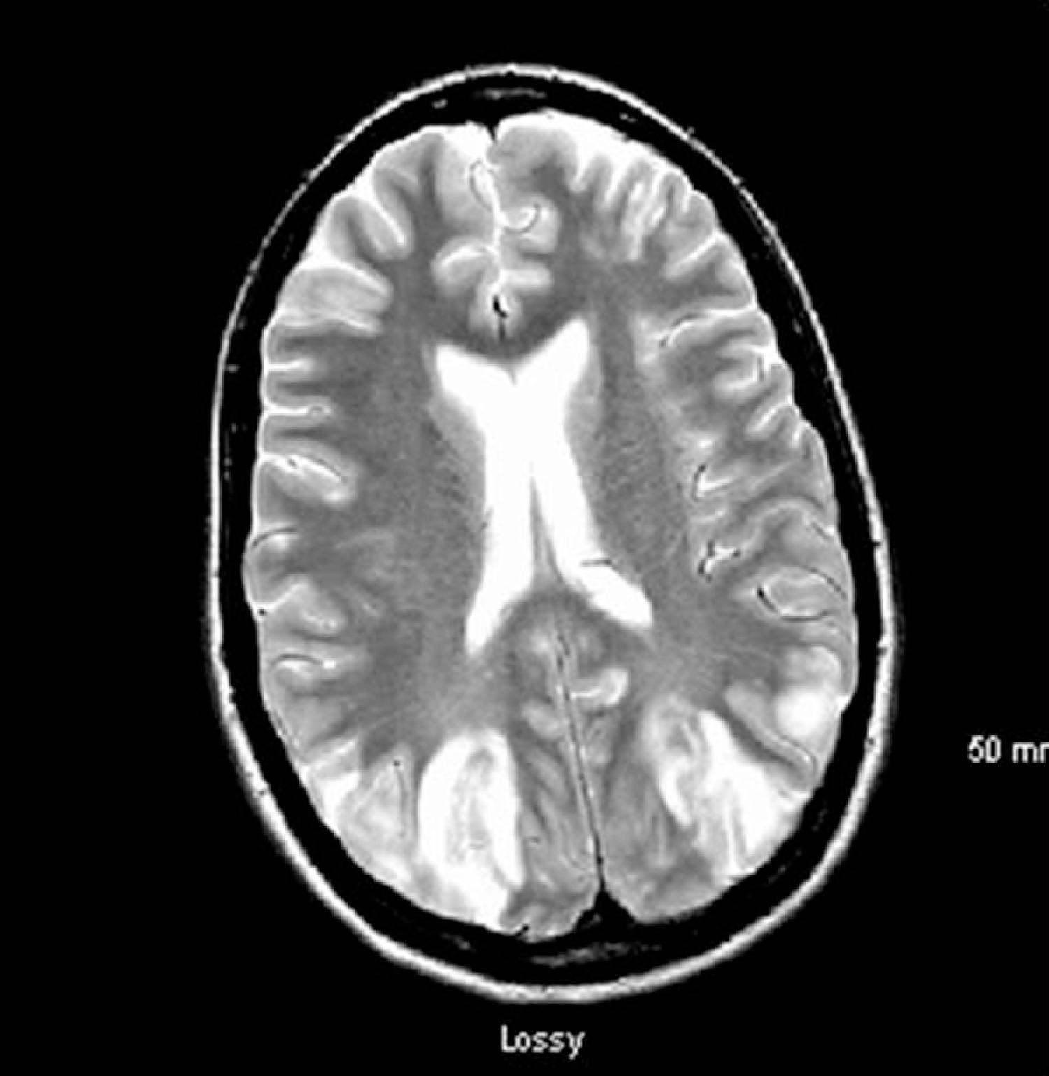
MRI of the brain: radiologist reports posterior leukoencephalopathy

Slide 54
Question 8.
Answer: A

Slide 55
Explanation/Rationale
Posterior leukoencephalopathy syndrome (PLS) / Posterior reversible encephalopathy syndrome (PRES):
  Important reversible secondary cause of neurologic dysfunction in SLE patients.
  Typical onset: seizures, accelerated hypertension, renal insufficiency, headache, visual disturbance, and confusion.
  Over 75% of patients developing PLS/PRES had recent initiation or escalation of immunosuppressive therapy (IV solumedrol, IV cyclophosphamide) within ~7 days before neurologic symptoms.
  MRI findings: majority have posterior circulation brain abnormalities, likely due to vasogenic edema.

Slide 56
Treatment
  Most important immediate therapy: control BP to <140/90 mm Hg.
  Giving more immunosuppression is contraindicated.
  Low titer antiphospholipid antibodies do not contribute to PLS/PRES, so anticoagulation is not indicated.
  Most patients achieve complete resolution of symptoms with BP control.
  Anticonvulsants are only indicated if seizures recur despite BP control.
  In this patient, switching from IV cyclophosphamide to mycophenolate mofetil may reduce relapse risk of PLS/PRES.

Slide 57
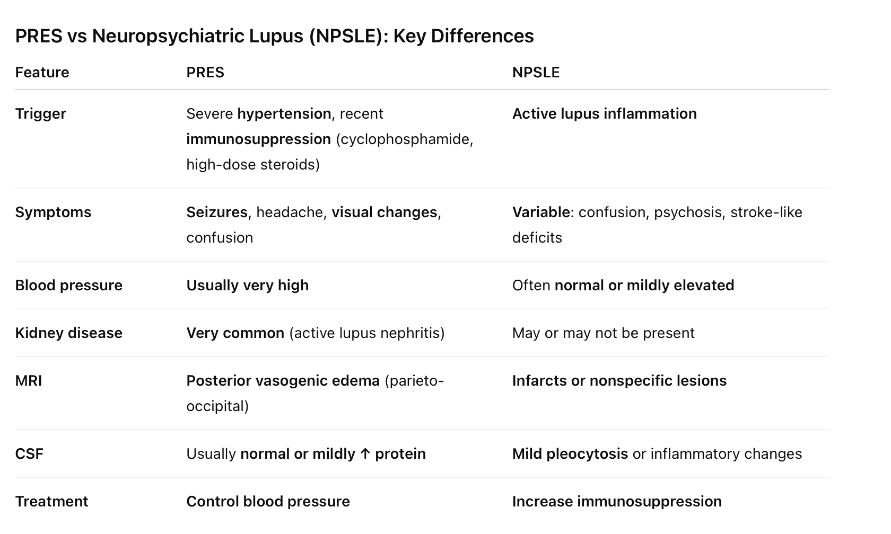
PRES vs
Neuropsychiatric Lupus

Slide 58
Question 9.
A 67-year-old woman presents with ocular and oral dryness of 5 years duration. She has a daily gritty sensation in her eyes and uses preservative-free eye drops three times daily to alleviate her symptoms. She wakes up at night with a dry mouth and must sip water in order to swallow crackers and other dry foods.
The patient has never noted enlargement of her salivary glands. She denies fevers, chills, unintentional weight loss, Raynaud's, inflammatory joint pain, photosensitivity, oral or nasal ulcerations, pleuritic chest pain, shortness of breath, or focal neurologic symptoms.
She has mild lower extremity edema which she treats with compression stockings and furosemide as needed. Of note, she has been using this medication over the last two weeks on a more regular basis. She is currently using prescription-strength retinoids topically at night to alleviate photoaging.
Physical Exam:
Reduced sublingual salivary pooling.
No major salivary gland tenderness or enlargement.
Saliva can be expressed from Stenson's ducts bilaterally.
Tongue is without fissuring or papillary atrophy.
No evidence of synovitis, rash, lymphadenopathy, abnormal breath sounds, or splenomegaly.
Objective Tests:
Unstimulated whole salivary flow: 0.2 mL/5-minutes
Schirmer's test: 1 mm of wetting in each eye after 5 minutes
Laboratory Findings:
ANA: 1:160 (homogenous staining)
Rheumatoid factor: negative
Anti-SSA antibody: negative
Anti-SSB antibody: negative
What should be the next step to complete a diagnostic evaluation for Sjögren's?
A. Perform salivary gland ultrasound
B. Send her to a cornea expert for a dry eye exam, to include ocular surface staining assessment with both fluorescein and lissamine green
C. Send for labial salivary gland biopsy
D. Order a send-out lab for early markers: salivary protein-1 (SP-1), carbonic anhydrase 6 (CA6), and parotid secretory protein (PSP)

Slide 59
Question 9.
ANSWER: C

Slide 60
Explanation/Rationale
This patient presents with symptoms of dryness and has low tear and saliva flow rates (by the stringent 2016 American College of Rheumatology [ACR]/European Alliance of Associations for Rheumatology [EULAR] criteria).
To differentiate dryness in the setting of Sjögren's disease (SjD) from other causes, it is imperative to establish that autoimmunity is driving the dryness.

Slide 61
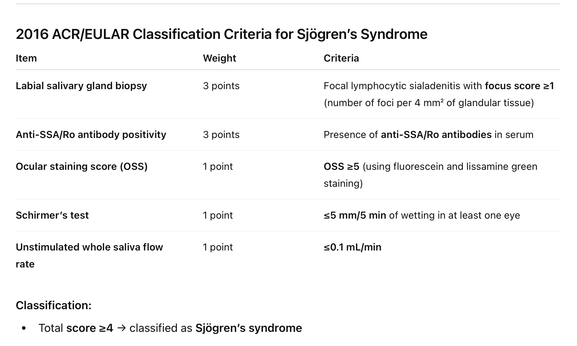
  Currently, labial salivary gland biopsy remains the gold standard for diagnosis of anti-SSA antibody negative Sjögren's patients.

Slide 62
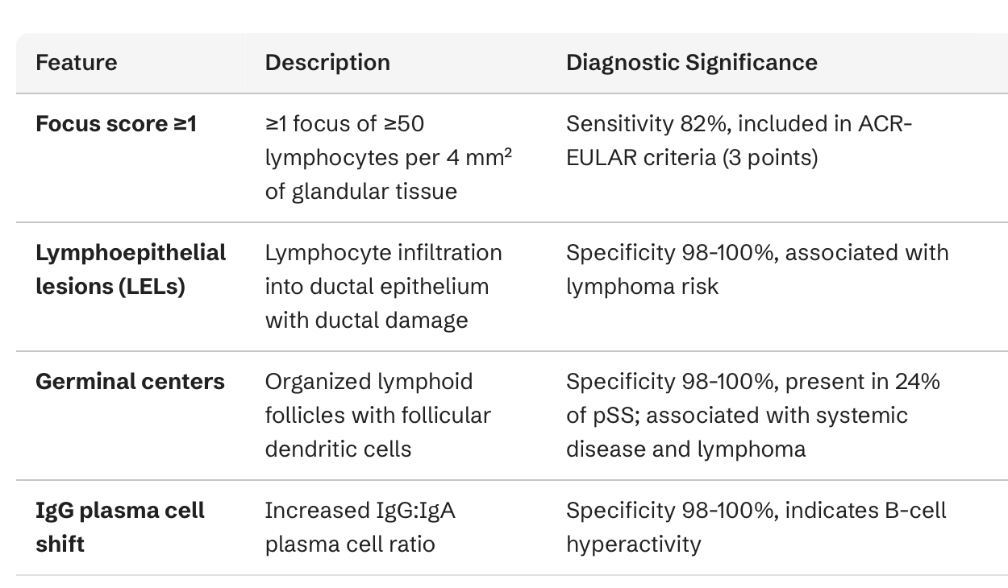
Findings of minor salivary gland biopsy : The characteristic finding is focal lymphocytic sialadenitis (FLS)—periductal aggregates of lymphocytes

Slide 63
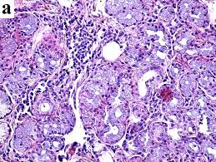
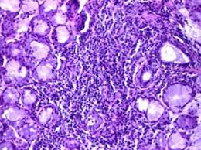
Focal lymphocytic sialadenitis: Dense aggregates of lymphocytes (focus) adjacent to salivary ducts and acini. A “focus” = ≥50 lymphocytes in a 4 mm² area.

Slide 64
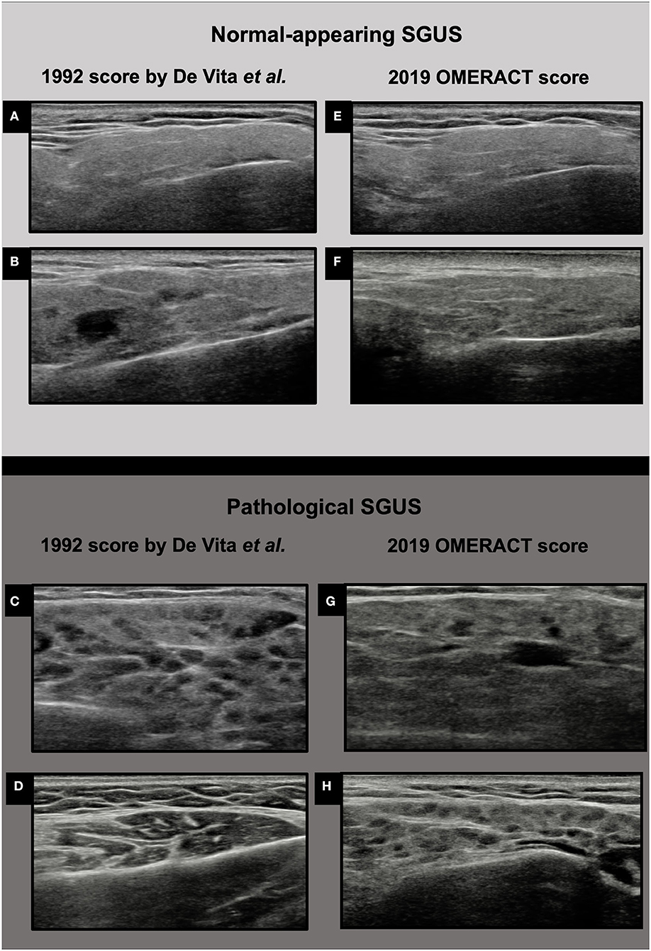
Salivary gland US
Patchy or “honeycomb-like” appearance of normally smooth gland tissue.
Small, multiple, rounded/oval dark spots → lymphocytic infiltration or tissue destruction.
Bright white lines or spots → fibrosis or fatty infiltration.
Gland edges difficult to distinguish from surrounding tissue.
Color Doppler shows increased blood flow in active inflammation.

Slide 65
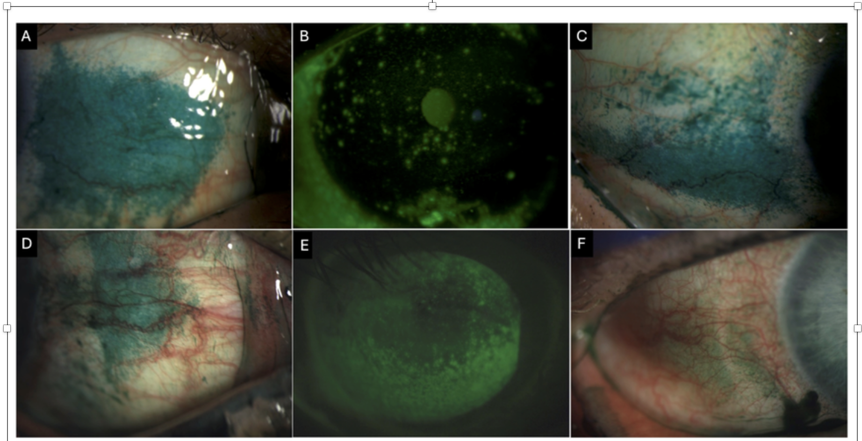
Lissamine green and fluorescein staining are used together to assess ocular surface damage in autoimmune dry eye—lissamine stains devitalized conjunctival cells, fluorescein stains corneal epithelial defects.
Conjunctival lissamine green staining
A,C,D
Corneal fluorescein staining
B,E

Slide 66
Question 10.
A 48-year-old woman with a past medical history of SLE for 10 years manifested by arthritis, photosensitivity, a discoid rash and leukopenia with positive ANA, anti-SSA, and negative ds-DNA and normal complements presents with acute right lower extremity swelling after a long plane ride one week ago. She is seeing you now in follow up. She denies a history of previous venous or arterial thrombosis. She has had one normal pregnancy.
A doppler ultrasound one week ago in the ED revealed a posterior tibial vein distal DVT. Her medications are prednisone 5 mg po q day, hydroxychloroquine 400 mg q day, calcium and vitamin D. Rivaroxaban was started for the acute thrombus one week ago.
On physical examination, vital signs are normal. The patient is obese, with mild mottling of the lower extremities that resolves with warming. She has mild alopecia and a healed discoid lupus lesion on the left ear. Her right lower extremity is swollen below the knee.
Laboratories:
WBC: 3800/uL
Hct: 40%
Platelets: 140,000/uL
Urinalysis: normal
PT/aPTT: normal
Doppler US: distal posterior tibial vein clot
Which of the following tests is most likely to be positive if you ordered it today?
A. Anticardiolipin antibody IgM
B. Anti-B2 glycoprotein 1 antibody IgG
C. Lupus anticoagulant
D. Factor V Leiden mutation
E. Elevated homocysteine

Slide 67
Question 10.
ANSWER: C

Slide 68
Key concepts
1. Thrombosis Risk in SLE
Provoked vs Unprovoked DVT:
  This patient’s DVT is provoked: long plane flight, obesity, smoking, SLE itself
  No history of recurrent thrombosis or pregnancy complications → low suspicion for primary thrombophilia
Laboratory Considerations:
  Lupus anticoagulant (LA): Can be falsely positive with DOACs (rivaroxaban)
  Anticardiolipin & anti-β2 glycoprotein I antibodies: Often negative in isolated provoked DVT
  Genetic thrombophilia: Factor V Leiden, prothrombin mutation, hyperhomocysteinemia → less likely
2. Cutaneous Clues
Cutis marmorata: mottled, blanchable skin that resolves with warming
  Often benign, not associated with hypercoagulability
Livedo reticularis: persistent, non-blanchable → raises suspicion for APS

Slide 69
Answer and rationale
Answer: C. Lupus anticoagulant
Patient is on a DOAC (rivaroxaban) → LA test can be falsely positive
No history of recurrent thrombosis or pregnancy complications → low pre-test probability for APS
Other thrombophilia tests likely negative given provoked nature of DVT
The DVT is considered provoked due to her risk factors of SLE, obesity, smoking, and immobility during a plane flight.
She has no prior history of clot or pregnancy complications and no family history of thrombosis.
Her PTT was normal prior to starting anticoagulation.

Slide 70
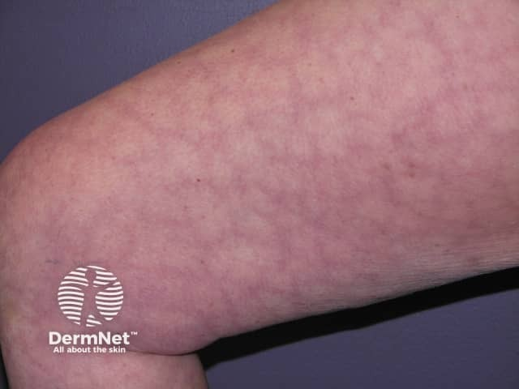
Cutis
Marmorata

Slide 71
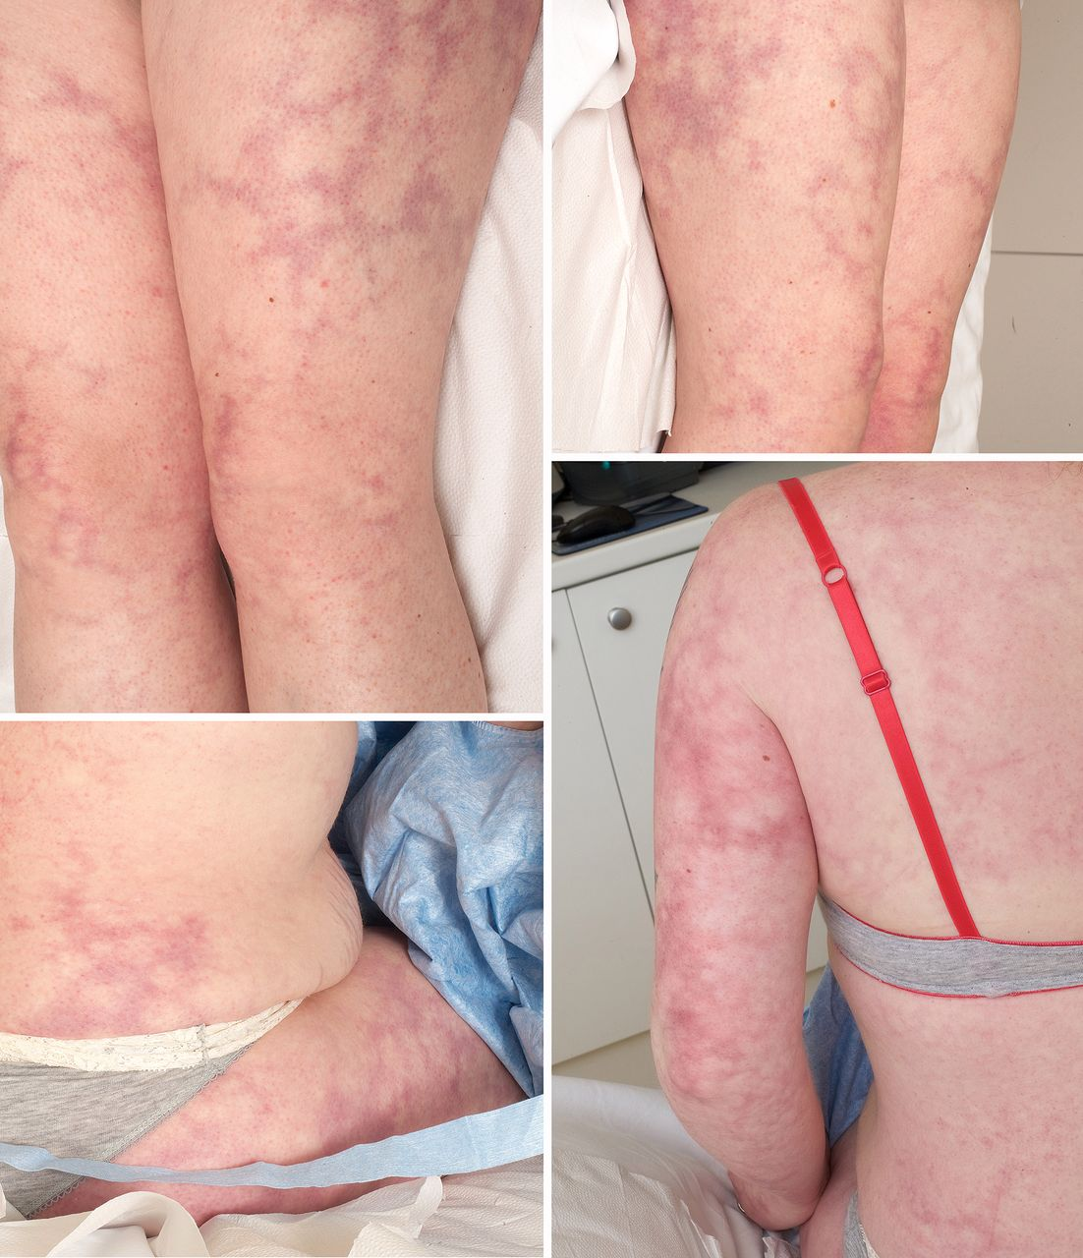
Livedo
Racemosa

Slide 72
High-Yield Pearls
DOACs interfere with lupus anticoagulant testing.
Provoked DVT in SLE without history of recurrent thrombosis or pregnancy morbidity generally does not indicate primary thrombophilia.
Cutis marmorata ≠ livedo reticularis → important dermatologic clue. Mottled skin that resolves with warming and rubbing the skin
APS antibodies (anticardiolipin, anti-β2-GPI) are usually checked after anticoagulation is paused for accuracy.

Slide 73
Question 11.
A 56-year-old patient presents for management of refractory gout. The patient experiences 3–4 acute flares per year, with increasing frequency and severity over the past 2 years despite allopurinol therapy at the maximally tolerated dose. Febuxostat was not tolerated. Comorbidities include stage G3a chronic kidney disease (eGFR 45–59 mL/min/1.73 m²), hypercholesterolemia, and hypertension. Current medications include atorvastatin, lisinopril, allopurinol, and colchicine.
Physical Examination:
Vital signs: within normal limits.
Tophi noted on the left elbow, right ear, multiple fingers, and left heel.
No active joint tenderness or swelling observed.
Laboratory Findings:
ESR: 15 mm/h (normal)
Serum creatinine: 1.4 mg/dL (elevated)
Serum urate: 9.0 mg/dL (elevated; target <6 mg/dL per ACR 2020 gout guidelines)
CBC: within normal limits
A decision is made to initiate pegloticase therapy
Which of the following adverse effects is most likely to limit therapy in this patient?
A. Cardiovascular toxicity
B. Immunogenicity
C. Interactions with atorvastatin
D. Interactions with lisinopril
E. Nephrotoxicity

Slide 74
Question 11.
ANSWER: B

Slide 75
LEARNING PEARL 1 : WHEN TO USE PEGLOTICASE?
Clinical Context:
  The patient has chronic tophaceous gout.
  He is refractory to one xanthine oxidase inhibitor (XOI) and intolerant to the second XOI.
  Serum urate goal:
    <5 mg/dL for tophaceous gout
    <6 mg/dL for non-tophaceous gout
  The patient’s serum urate remains elevated, putting him at risk for ongoing flares and persistent tophi.
Evidence-Based Guidelines:
  ACR 2020 recommendations: Escalate urate-lowering therapy with pegloticase in patients who cannot achieve target serum urate levels with conventional therapy and have debilitating tophi (Singh et al., Arthritis Rheumatol, 2020).
Clinical Implication:
  Without achieving target urate levels, flares will continue and tophi will not regress.
  Pegloticase is indicated to rapidly lower urate, reduce tophi burden, and prevent recurrent flares in this refractory scenario.

Slide 76
PEARL 2
For all patients with gout, including CKD stage 3, or higher, the first line therapy is allopurinol.
Maximal dose titration can be achieved even in this patient population.
Start low and titrate gently is the approach in this patient population.

Slide 77
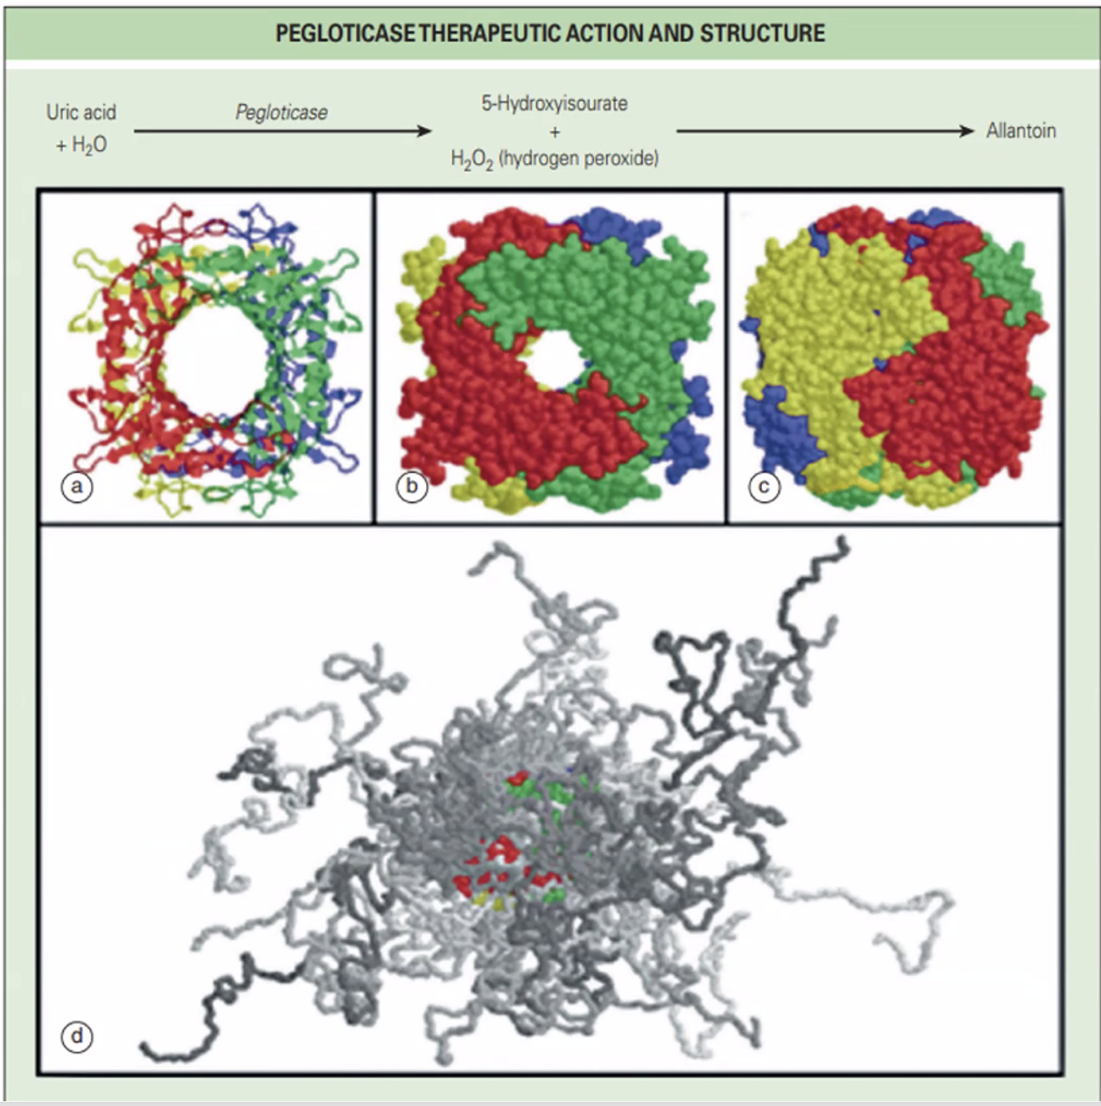
FUN PICTURE
THIS IS HOW
PEGLOTICASE LOOKS LIKE

Slide 78
Pegloticase
Mechanism of Action:
  Humans lack uricase, an enzyme that converts uric acid to the more soluble allantoin.
  Pegloticase is a recombinant mammalian uricase conjugated to polyethylene glycol (PEG).
  It converts urate to allantoin, effectively lowering serum urate levels.
Indications:
  Refractory gout not controlled with conventional urate-lowering therapy (ULT).
  Intolerance to oral ULT (e.g., allopurinol, febuxostat).
  Chronic symptomatic or tophaceous gout.
  Particularly useful for patients with draining or infected tophi requiring rapid urate reduction.
Efficacy:
  Clinical trials show significant reduction in tophi burden, prevention of recurrent flares, and dramatic lowering of serum uric acid, including in patients with CKD stage 3.
Administration:
Intravenous (IV) infusion every 2 weeks.
Therapy is usually short-term, followed by transition to oral urate-lowering therapy (ULT) once urate is controlled.

Slide 79
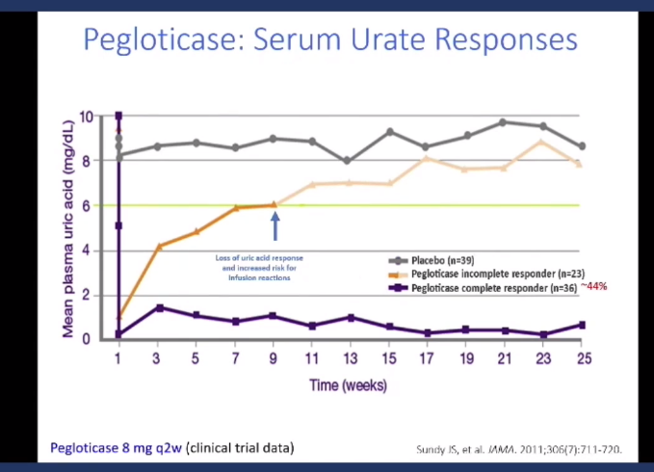

Slide 80
Safety, Monitoring and Practical considerations with Pegloticase
Risks and Adverse Events:
  Infusion reactions occur in ~25–30% of patients; may include anaphylaxis.
  Loss of efficacy occurs in ~50% due to development of anti-pegloticase antibodies.
  Hemolytic anemia and methemoglobinemia can occur in patients with G6PD deficiency; always screen for G6PD before initiation.
Mitigation Strategies:
  Premedication with antihistamines, acetaminophen, and corticosteroids is recommended to reduce infusion reactions.
  Background gout prophylaxis (colchicine or NSAID) should be continued, as pegloticase can trigger acute flares.
  Monitor serum uric acid prior to each infusion:
    After the initial doses, if serum uric acid >6 mg/dL, this suggests loss of efficacy due to antibody formation → discontinue therapy.

Slide 81
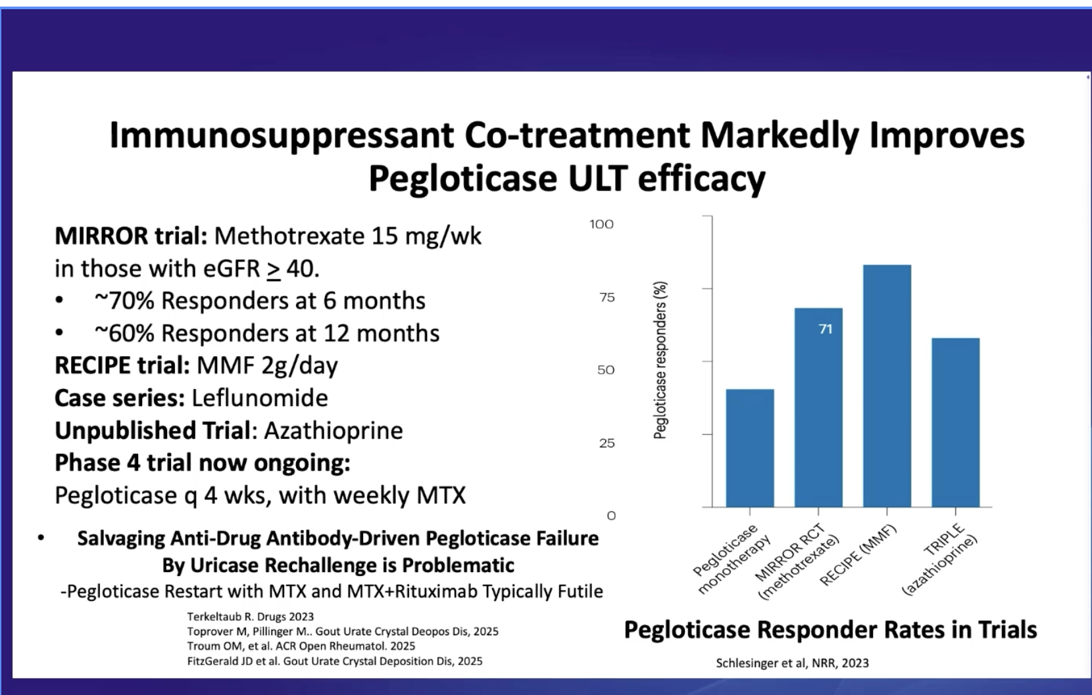

Slide 82
Question 12
An 82-year-old man presents with acute onset of right wrist pain, swelling, and warmth that began 2 days ago. He describes the pain as severe (9/10), constant, and worse with any movement. He denies trauma but notes he was recently hospitalized for pneumonia 2 weeks ago. Past medical history includes type 2 diabetes, chronic kidney disease (stage 3), and osteoarthritis.
Physical Examination:
Temperature: 37.8°C
Right wrist: marked swelling, warmth, erythema, tenderness, severely limited range of motion
No other joint involvement on examination
Left knee shows mild effusion (chronic, asymptomatic per patient)
Initial Laboratory Results:
WBC: 9,800/μL
CRP: 78 mg/L
ESR: 55 mm/hr
Creatinine: 1.8 mg/dL (baseline)
How does the joint distribution pattern help differentiate CPPD from primary osteoarthritis?
ANSWER CHOICES:
A. CPPD typically affects the distal interphalangeal (DIP) and proximal interphalangeal (PIP) joints, while primary osteoarthritis spares these joints
B. CPPD commonly involves the wrist, metacarpophalangeal (MCP) joints, and glenohumeral joint—sites that are typically spared in primary osteoarthritis
C. CPPD preferentially affects the first metatarsophalangeal (MTP) joint, while primary osteoarthritis does not
D. CPPD and primary osteoarthritis have identical joint distribution patterns and cannot be distinguished by location
E. CPPD typically affects weight-bearing joints only, while primary osteoarthritis affects both weight-bearing and non-weight-bearing joints

Slide 83
CORRECT ANSWER: B
CPPD commonly involves the wrist, metacarpophalangeal (MCP) joints, and glenohumeral joint—sites that are typically spared in primary osteoarthritis.

Slide 84
Pearl 1
What is the differential diagnosis ?
In an elderly patient with acute monoarticular arthritis, think of gout, CPPD, inflammatory arthritis flare.

Slide 85
Pearl 2 : synovial fluid aspiration
This is the gold standard.
Always rule out septic arthritis and ask for crystal analysis, ask for cell count and differential, gram stain, culture, compensated polarized light microscopy.
What does a typical synovial fluid analysis look like in CPPD ?
Cell count : 2000 to > 50,000 white cells/microl
Rhomboid shaped, weakly positively birefringent CPP crystals
Under a compensated polarized light microscopy with red filter,
Blue when parallel to polarizer axis
Yellow when perpendicular to polarizer axis
Look for mention of intracellular crystals rather than just extracellular crystals

Slide 86
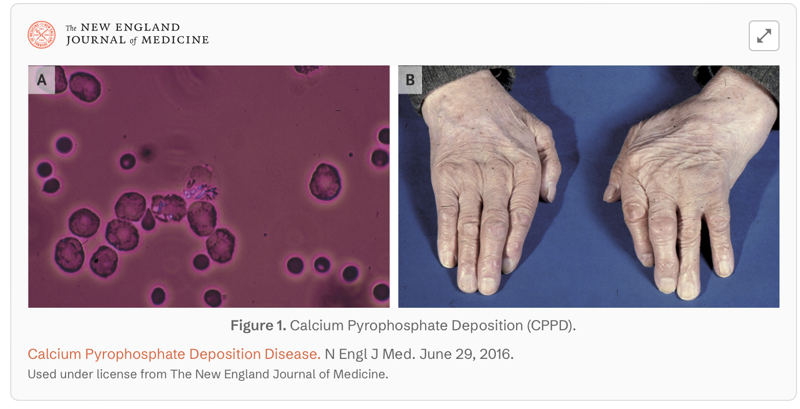

Slide 87
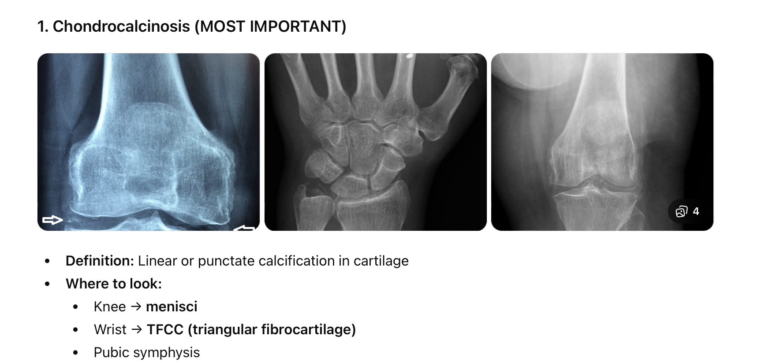
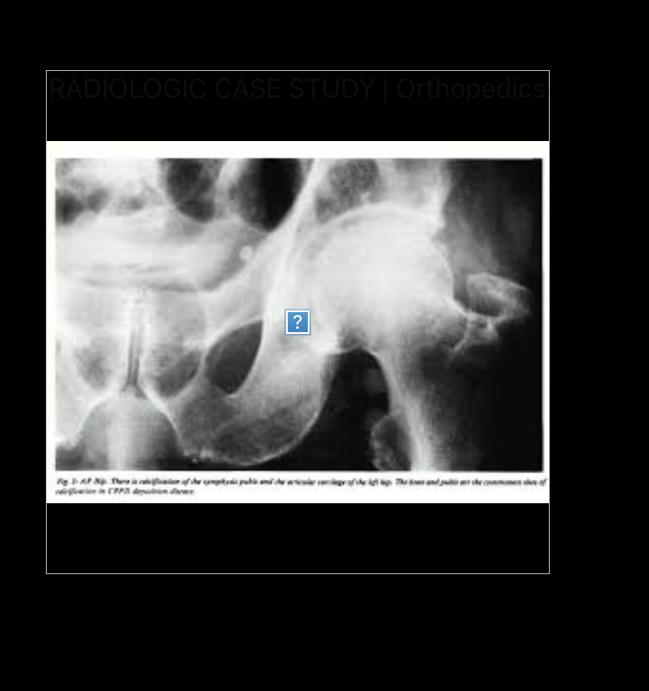
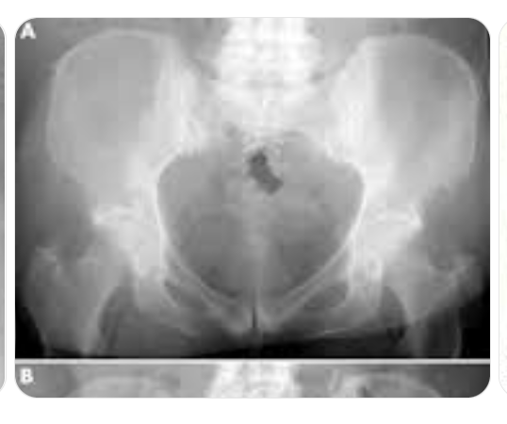

Slide 88
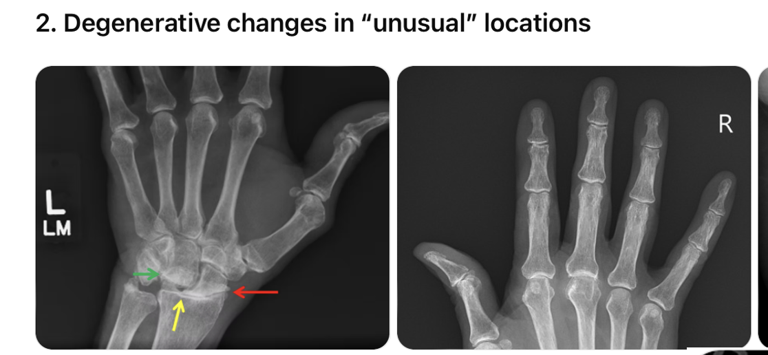
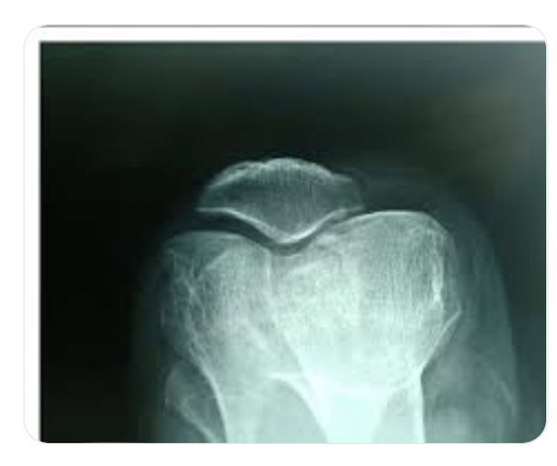
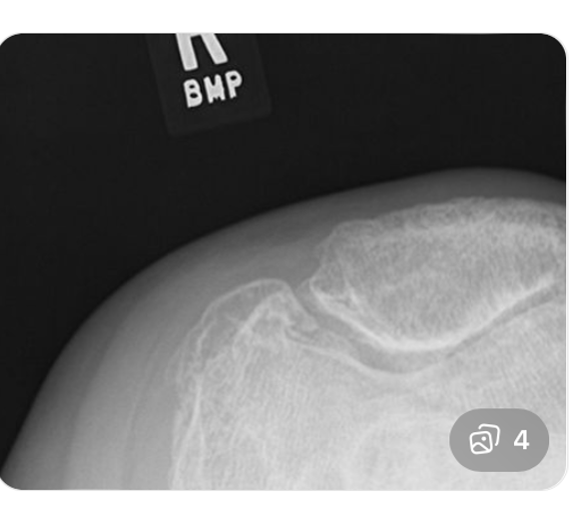
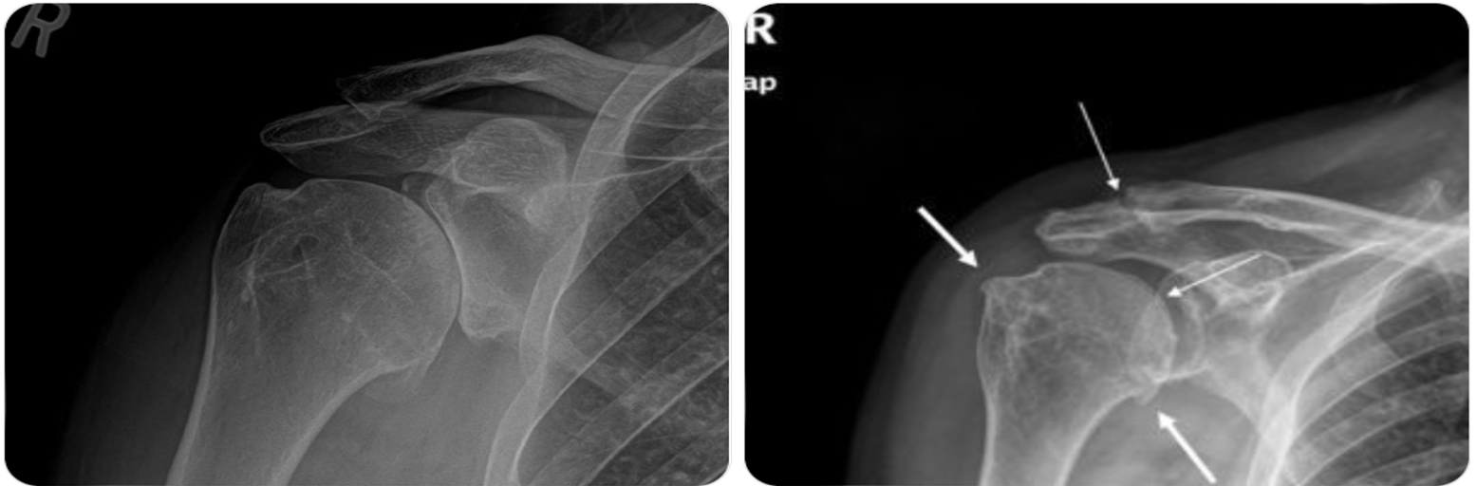

Slide 89
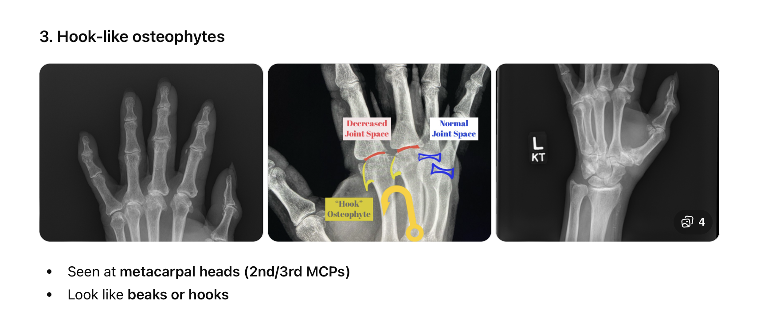

Slide 90
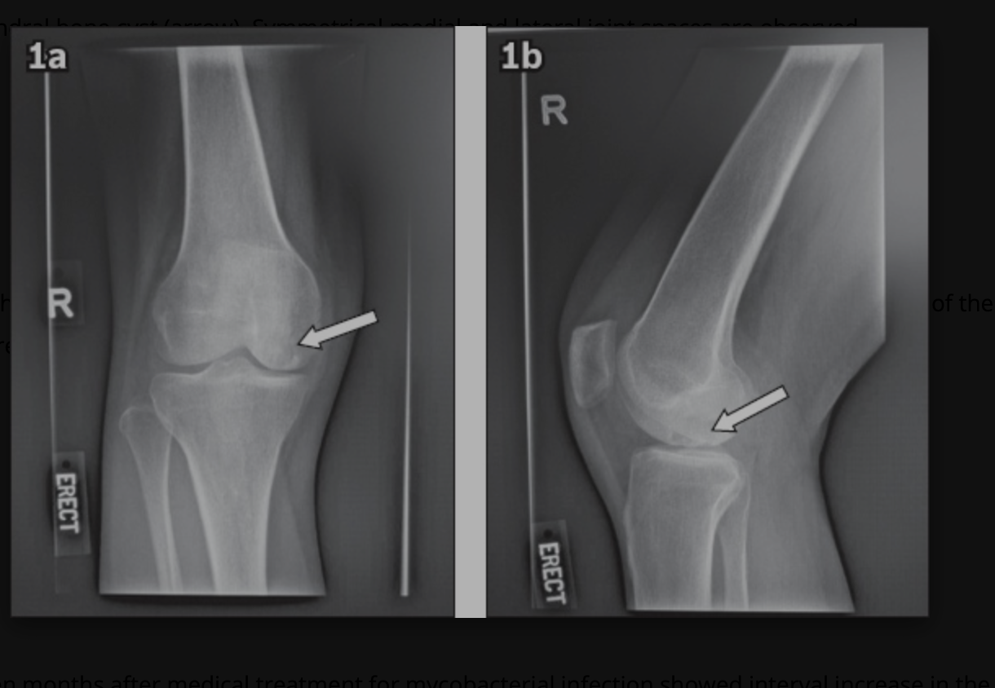
Subchondral cysts

Slide 91
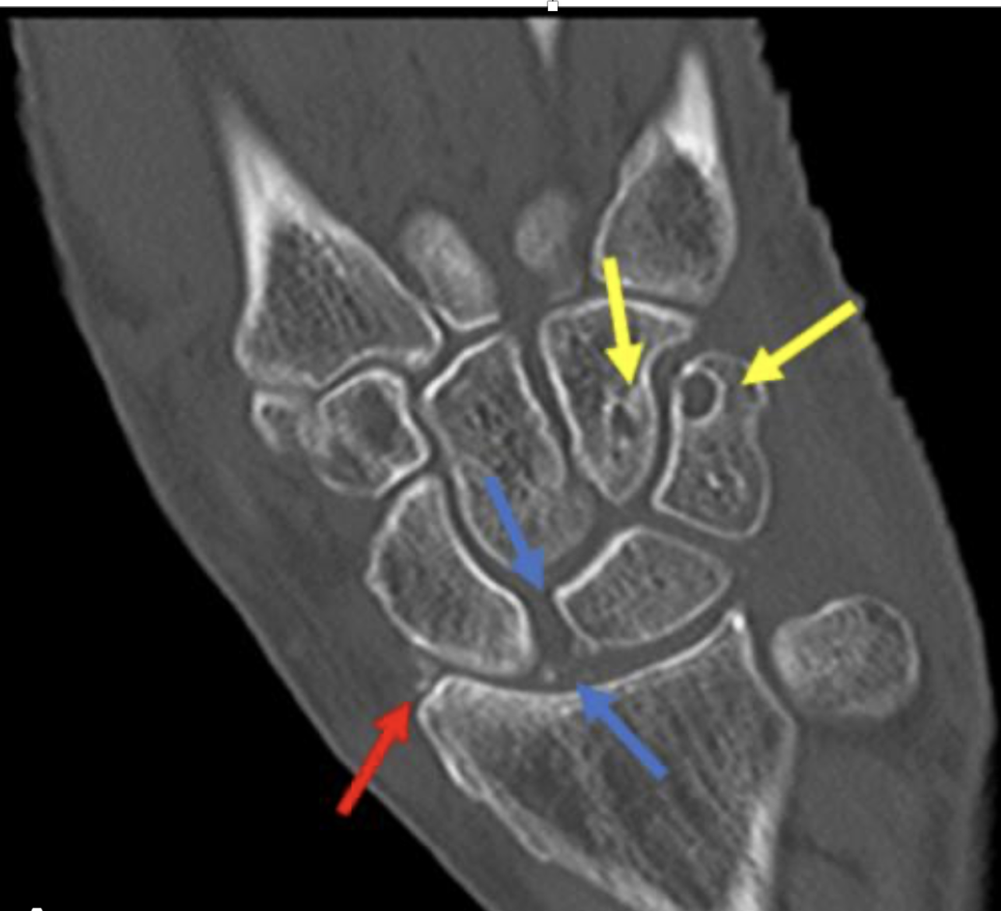
Subchondral
cysts

Slide 92
Role of other imaging modalities
MSUS : Hyperechoic linear deposits in hyaline or fibrocartilage; higher sensitivity (71-87%) than plain radiographs.
CT : Superior for detecting calcifications; useful when X-ray negative but clinical suspicion high
DECT: Can characterize calcium deposits and potentially differentiate CPP from other calcium crystals, though spatial resolution limitations exist.

Slide 93
Role of labs
  Screen for metabolic associations: calcium, phosphate, magnesium, alkaline phosphatase, parathyroid hormone, iron studies, ferritin

Slide 94
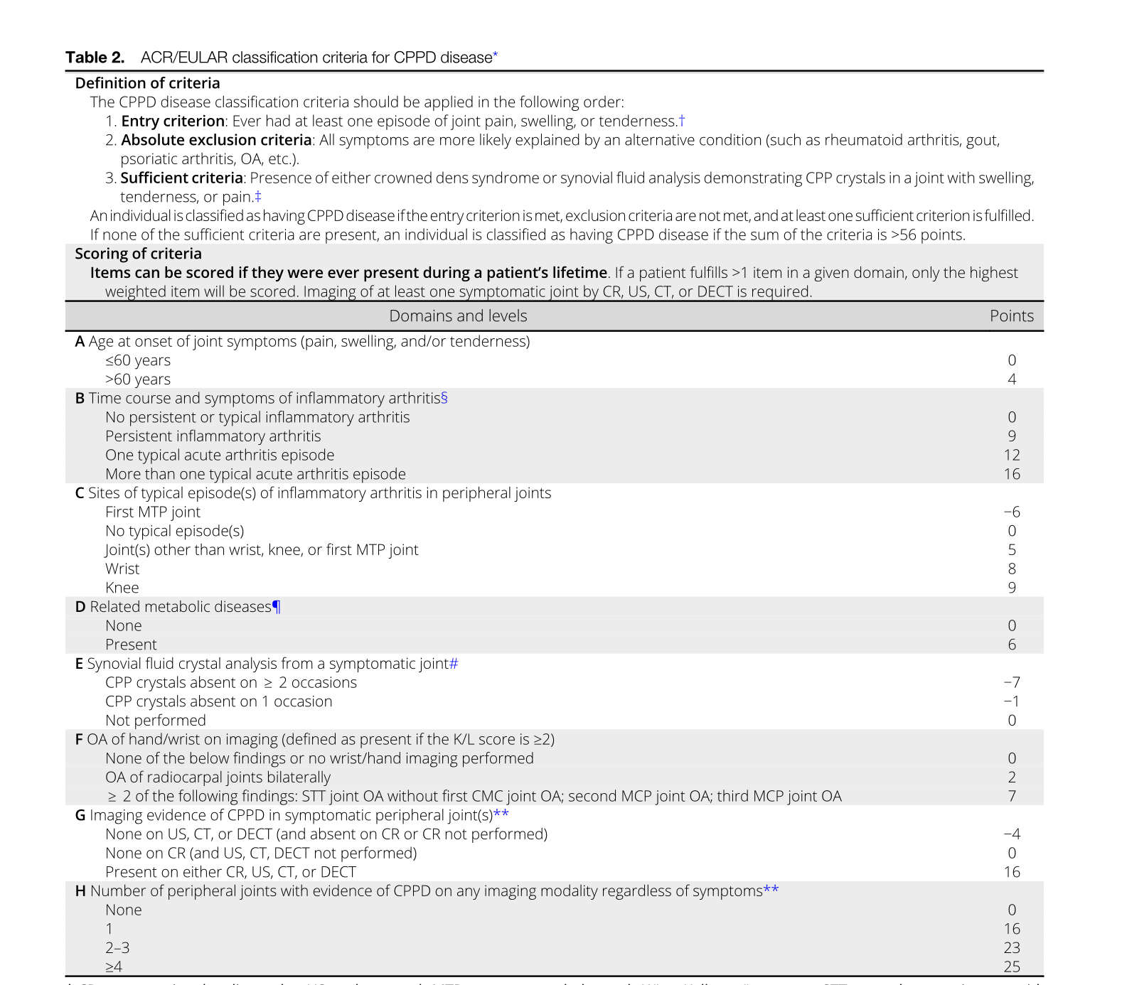

Slide 95
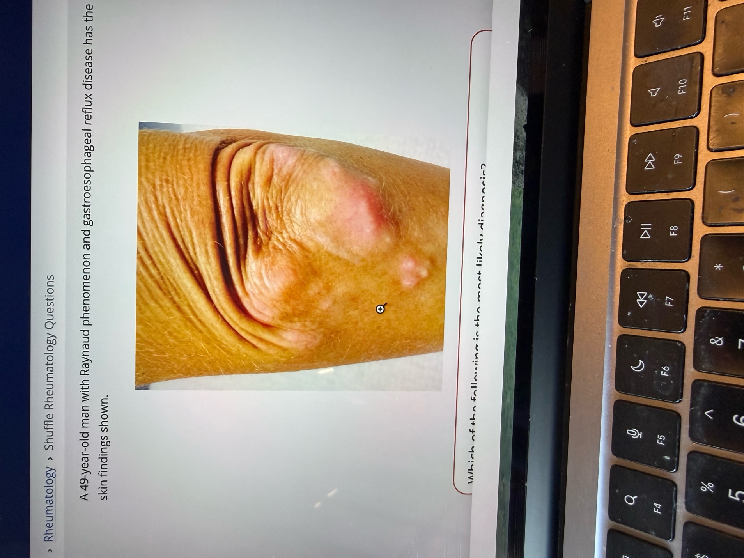
Question 13.
A 49-year-old man presents with Raynaud phenomenon and gastroesophageal reflux disease (GERD). On examination, he has a firm, whitish nodule over his left elbow. He denies joint pain or recent trauma.
Which of the following is the most likely diagnosis?
A. Limited cutaneous systemic sclerosis (CREST syndrome)
B. Molluscum contagiosum
C. Rheumatoid arthritis
D. Tophaceous gout

Slide 96
Question 13.
ANSWER: A

Slide 97
Pearls
CREST : is now Limited systemic sclerosis
Calcinosis cutis: Calcium deposits in skin/subcutaneous tissue, especially fingers, elbows, extensor surfaces
Raynaud phenomenon: Precedes other symptoms by 5-10 years (vs. 1-2 years in diffuse SSc)
Esophageal dysmotility: Lower esophageal dysfunction, GERD, dysphagia
Sclerodactyly: Skin thickening limited to fingers, hands, face, and distal forearms (does NOT extend proximal to elbows or above knees)
Telangiectasias: Mat-like telangiectasias on face, hands, mucous membranes
Commonly associated with anticentromere antibody ( on immunofluorescence, it is seen as discrete punctate nuclear staining at centromeres)
Common organ complication : Pulmonary arterial hypertension
Less ILD, scleroderma renal crisis, cardiac involvement
Best prognosis among SSc subtypes: 65% 20-year survival in ACA+ limited SSc

Slide 98
Calcinosis cutis –Develops 7.5 years after Systemic sclerosis diagnosis.
Most common sites: Fingers, hands, feet (pressure points, extensor surfaces)
Dystrophic calcification: Normal serum calcium/phosphate levels
Can be severely disabling: ulceration, infection, functional impairment

Slide 99
Other autoimmune conditions with calcinosis
Dermatomyositis/Polymyositis:
Juvenile dermatomyositis: 44-70% develop calcinosis (much higher than adult-onset)
Develops earlier in juvenile DM (2.9 years) vs. adult DM (7.8 years)
Extremities most common; head involvement rare but more likely in juvenile DM
Systemic Lupus Erythematosus :
Rare association with calcinosis cutis
Occurs after long-standing disease (>20 years mean)
Often clinically silent
Mixed Connective Tissue Disease (MCTD):
Calcinosis occurs in overlap syndromes
Associated with anti-U1 RNP antibodies

Slide 100
2013 ACR/EULAR Classification Criteria (score ≥9 = definite SSc):
Skin thickening proximal to MCPs = 9 points
Puffy fingers = 2 points
Fingertip lesions (digital ulcers or pitting scars) = 2-3 points
Telangiectasia = 2 points
Abnormal nailfold capillaries = 2 points
PAH or ILD = 2 points (maximum)
Raynaud phenomenon = 3 points
SSc-related autoantibodies (ACA, anti-Scl-70, anti-RNA pol III) = 3 points
Very Early Diagnosis (VEDOSS) Criteria:
Raynaud phenomenon + SSc-specific antibody + scleroderma pattern on nailfold capillaroscopy → 66% develop definite SSc at 5 years, 73% at 10 years
Adding puffy fingers increases risk to 94% at 5 years
Limited vs. Diffuse SSc - Temporal Pattern:
Limited SSc: Raynaud → 5-10 years → first non-Raynaud symptom
Diffuse SSc: Raynaud → <1 year → skin thickening/organ involvement

Slide 101
Pearl
Why not the others:
  B. Molluscum contagiosum: Usually presents as small, umbilicated papules, not firm nodules over elbows.
  C. Rheumatoid arthritis: Can cause subcutaneous nodules, but usually associated with joint pain, swelling, and deformities, not isolated calcinosis.
  D. Tophaceous gout: Typically occurs in patients with hyperuricemia, often on fingers, toes, and ears; associated with painful flares.

Slide 102
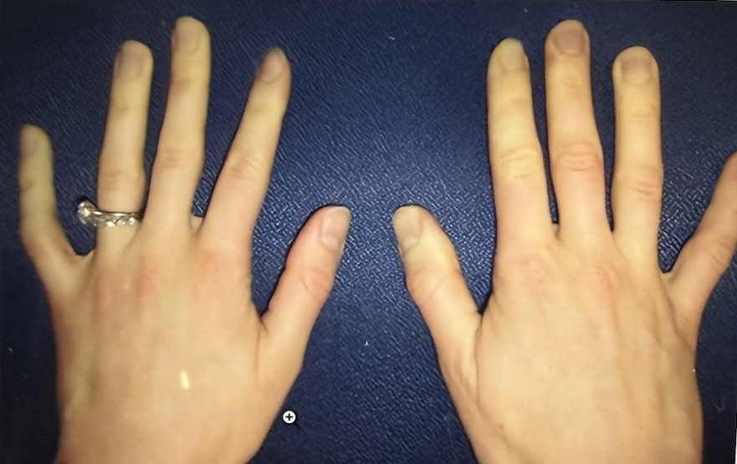
Question 14.
A 20-year-old woman experiences temperature-dependent episodic finger pain. She has no other medical problems.
Hand findings are shown:
Which of the following is the most likely diagnosis?
A. Acrocyanosis
B. Complex regional pain syndrome
C. Erythromelalgia
D. Primary Raynaud’s phenomenon

Slide 103
Question 14.
ANSWER: D

Slide 104
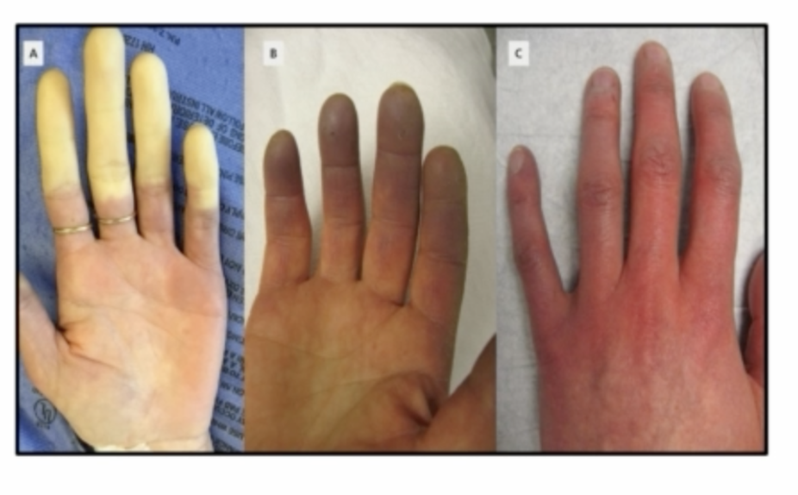

Slide 105
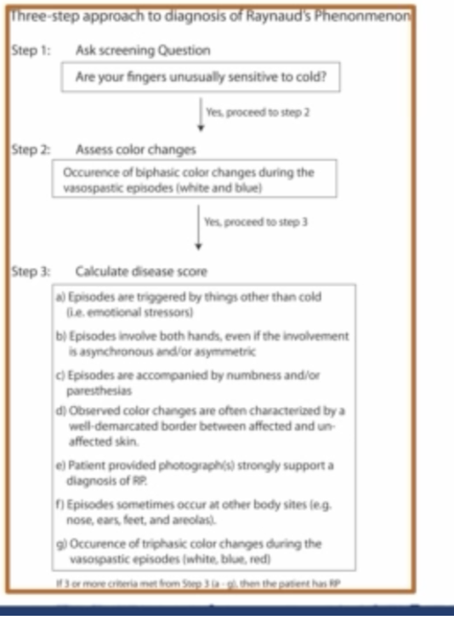

Slide 106
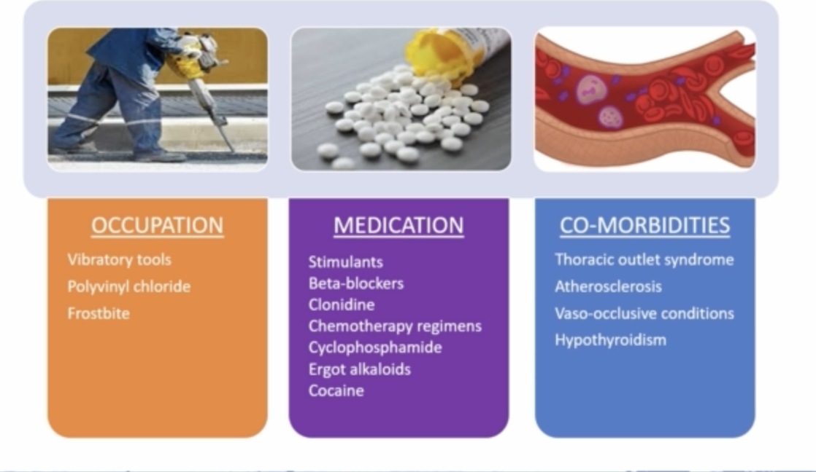
Always ask and assess

Slide 107
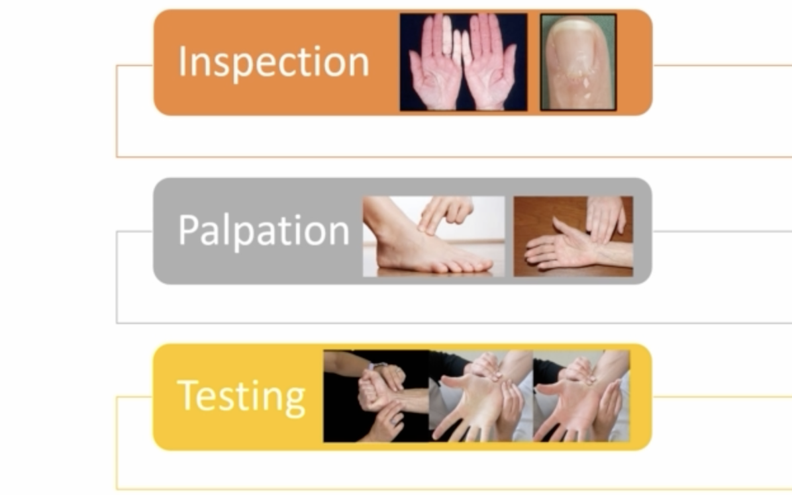
Color changes and nail fold cuticle changes,
Digital pitting, ulcers
Palpate for pulses
Do Allen’s test

Slide 108
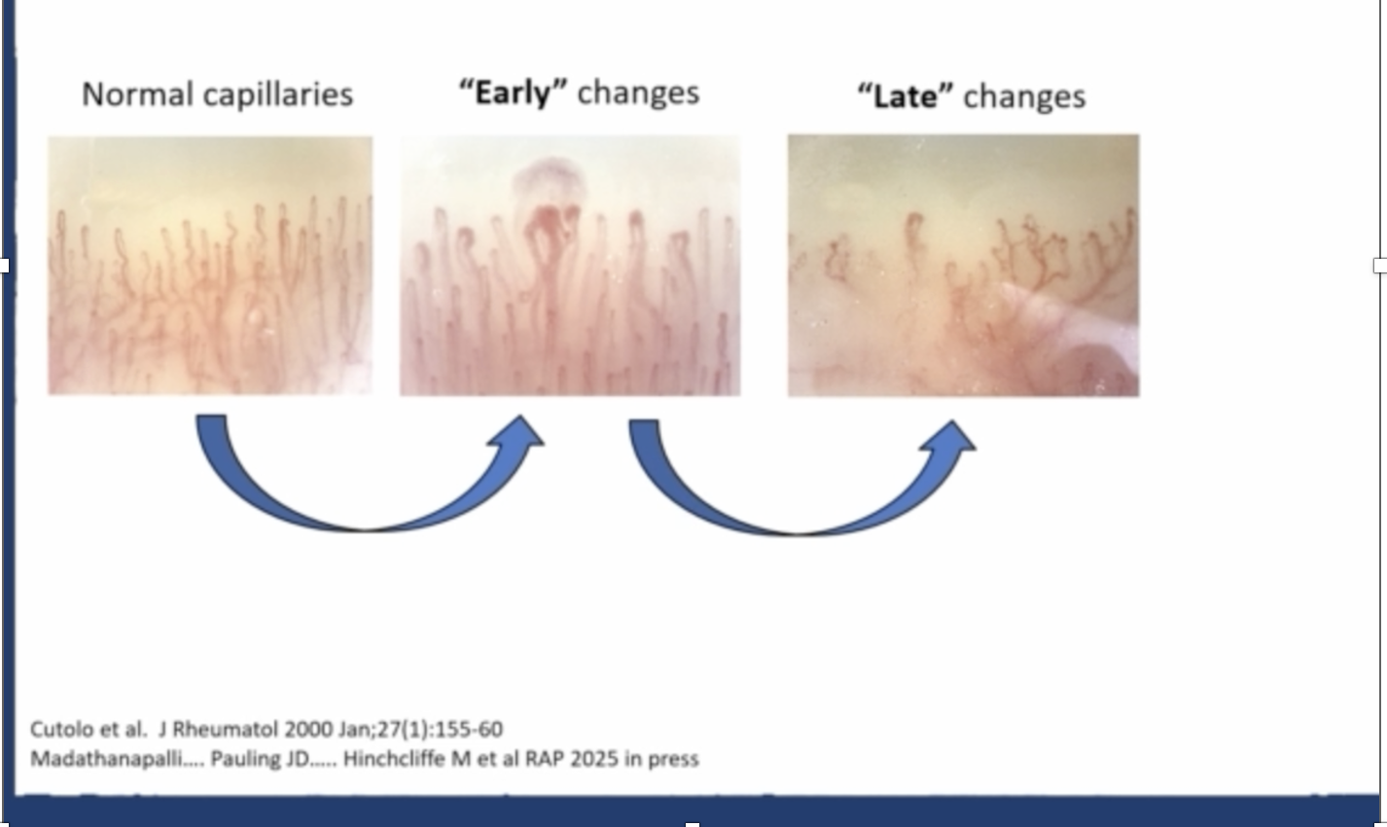
Raynaud’s is a progressive obliterative microangiopathy

Slide 109
Question 15.
A 27-year-old woman is evaluated for a 6-month history of progressive bilateral leg soreness when she walks more than two blocks; the soreness resolves with rest. The patient reports increased headaches and fatigue during the past 3 months, as well as increased lightheadedness and dizziness without syncope that began this past month. She has no medical problems and takes no medications.
On physical examination, blood pressure is 150/100 mm Hg in the right arm and pulse rate is 80/min; other vital signs are normal. There is tenderness to palpation over the right carotid artery.
Laboratory studies:
ESR: 52 mm/h (H)
C-reactive protein: 1.5 mg/dL (H)
Antinuclear antibody : Negative
Magnetic resonance angiogram shows edema and enhancement of the right carotid artery with moderate stenosis. Wall thickening and stenosis of the left renal artery are noted. Areas of stenosis and dilation of the bilateral femoral arteries with enhancement are observed.
Which of the following is the most likely diagnosis?
A. Fibromuscular dysplasia
B. Giant cell arteritis
C. Takayasu arteritis
D. Vascular Erlers-Danlos syndrome

Slide 110
Question 15
ANSWER: C

Slide 111
What is Takayasu’s arteritis?
It is also called Pulseless disease, aortic arch syndrome, non specific aorto-arteritis.
Most frequently seen in young women, 8: 1 female> male, peak age 15 to 30 years.
Common in Asian women – Japan/China/India/S E asia

Slide 112
There are 3 phases of progression
Phase 1 : pre pulseless, inflammatory period, characterized by systemic complaints, such as fever, arthralgias, weight loss
Phase 2 : vessel inflammation, dominated by vessel pain and tenderness
Phase 3 : fibrotic burnt out stage with bruits and ischemia
Patients can present in any phase or combination since the disease is chronic and recurrent.
Up to 10% present with no symptoms, and the incidental finding of unequal pulses/BPs, bruits, or hypertension prompts further evaluation.
There are no lab markers to make the diagnosis. There can be elevated ESR,CRP, anemia of chronic disease and thrombocytosis.

Slide 113
Diagnosis has to be clinical and supported by imaging
Check for bruits, decreased pulses, asymmetric blood pressures.
Limb claudication – due to involvement of subclavian and iliac arteries
If carotid and vertebral arteries are involved, there is presyncope, dizziness, headache, and carotidynia (tenderness with palpation over the carotid artery).
Pulmonary artery disease occurs in upto 70% of patients, with quarter having pulmonary hypertension.
Cardiac involvement with angina, myocardial infarction, heart failure, sudden death, and aortic valvular regurgitation occurs in up to 15% of patients.
Renovascular hypertension can occur from the involvement of the renal arteries.
Arthralgias (50%) and constitutional symptoms (40%) are common.

Slide 114
Gold standard : Angiography – but this is invasive.
MRA : preferred initial modality for the diagnosis. Less radiation
CTA is an option
FDG-PET also suggested
Ultrasound
There is usually no need to biopsy

Slide 115
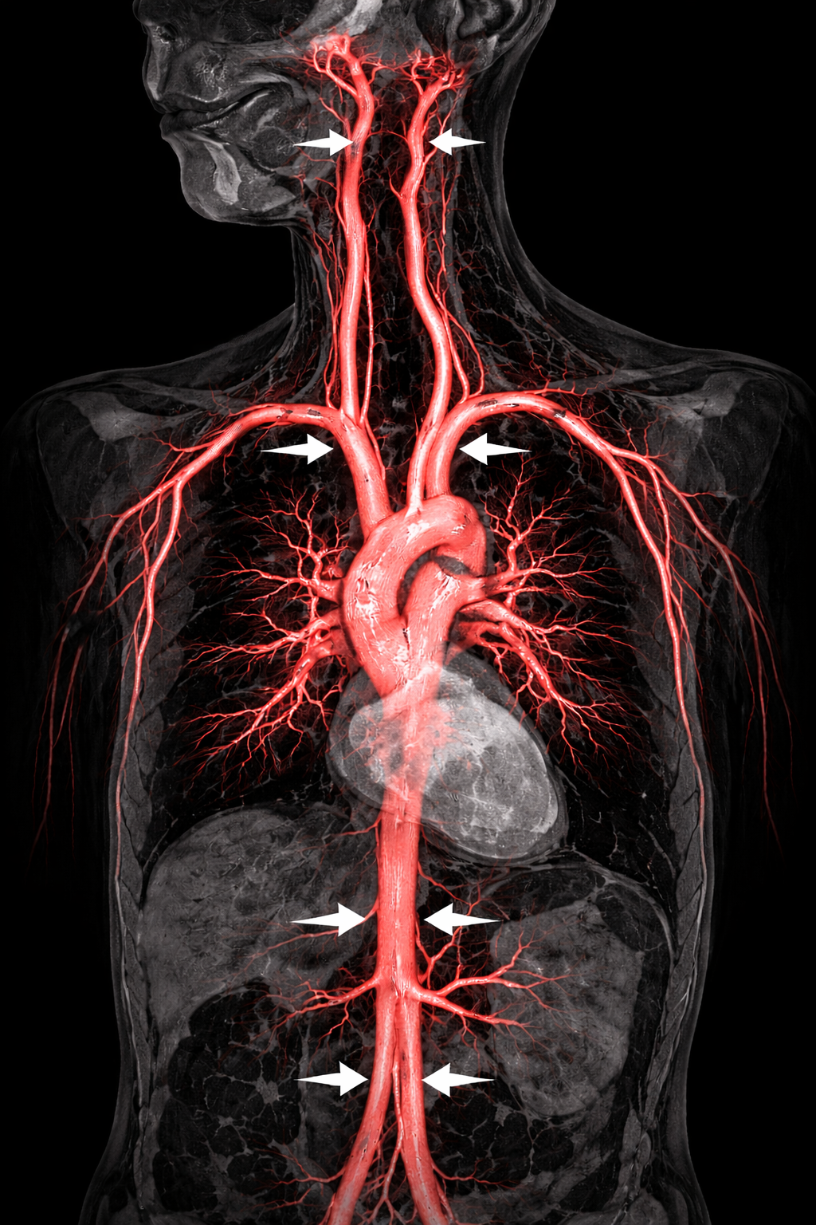
This is a picture of MRA
in a patient with TAK
Look at the arrows

Slide 116
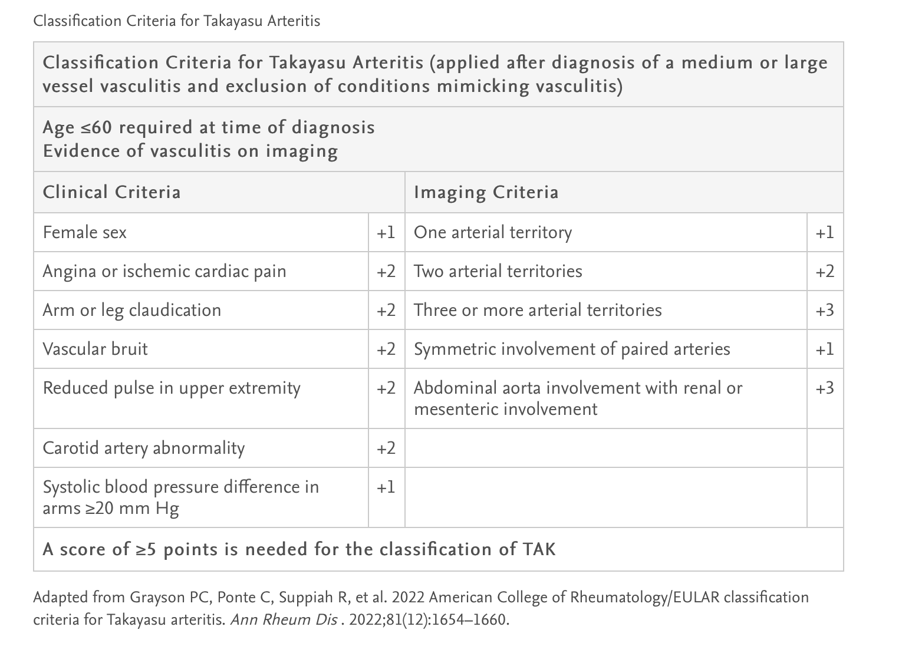

Slide 117
Question 16
A 30-year-old man is evaluated for sudden onset of severe pain, redness, and photophobia in his right eye associated with blurred vision and seeing halos around lights. He has had two similar episodes over the past year, one in each eye. He reports no other symptoms or medical problems and takes no medications.
On physical examination, the affected eye shows conjunctival injection, anterior chamber cells, and flare. Slit-lamp examination reveals keratic precipitates in the endothelium and anterior chamber cells. Joint examination is unremarkable.
Laboratory studies show normal complete blood counts, serum creatinine, and C-reactive protein levels, and urinalysis.
Which of the following is the most appropriate diagnostic test to perform next?
A. ANCA
B. Anti-cyclic citrullinated peptide antibodies
C. Antinuclear antibodies
D. HLA-B27

Slide 118
Question 17.
ANSWER: D

Slide 119
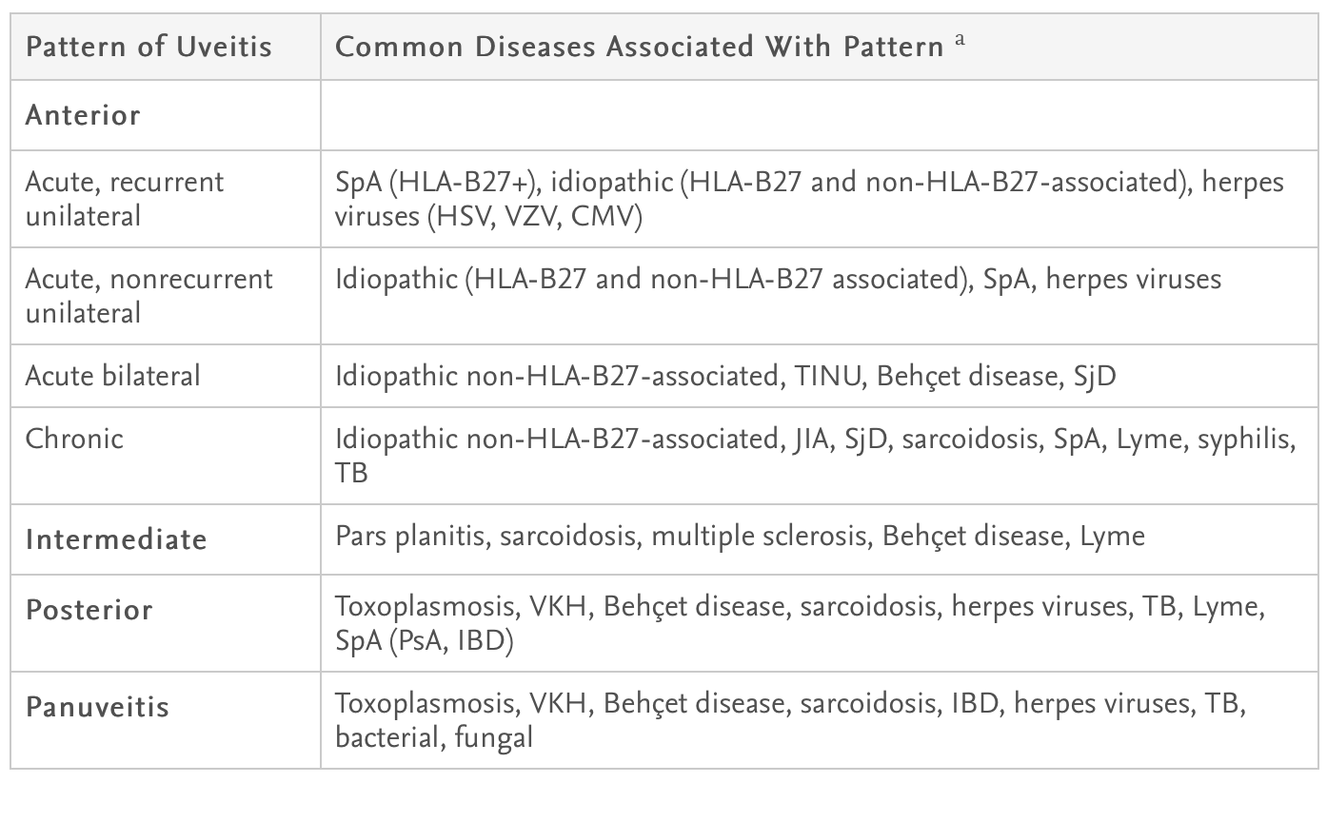
Types of uveitis

Slide 120
Anterior uveitis
Anterior uveitis : inflammation predominantly anterior to the lens of the eyes. It can be iritis or iridocyclitis.
It accounts for 50 to 80% of the cases of uveitis.
Causes : Idiopathic, HLA B27 associated, Sarcoidosis, Behcet’s disease, MS, Infections such as HSV, VZV, CMV, EBV, Syphilis, Lyme, Drugs such as bisphosphonates, rifabutin, cidofovir, sulfonamides, MEK and BRAF inhibitors, cancer immunotherapy agents, and trauma.

Slide 121
In the Western population, 50% of the cases of acute anterior uveitis is associated with HLAB27.
This group can be subdivided into : Isolated HLAB27 associated anterior uveitis and HLAB27 associated with spondylo-arthritis.
Patients with HLAB27 positive acute anterior uveitis are usually whites, younger, male sex, have an acute course, have many recurrences, develop hypopyon.

Slide 122
All forms of spondylo-arthritis can be associated with Uveitis
In ankylosing spondylitis and reactive arthritis, 90% are HLAB27 positive. They can have sudden onset anterior uveitis which is unilateral but alternating, has a recurrent course and resolves completely within several months.
In psoriatic arthritis and entero-pathic arthritis, 45 to 50% are HLAB27 positive, and present with classic acute anterior uveitis. In the ones that are HLAB27 negative, they have insidious onset bilateral, chronic uveitis which is anterior, intermediate or posterior.

Slide 123
Question 17.
A 55-year-old man is evaluated by his primary physician for a 2-day history of a swollen, tender, and red right great toe. Symptoms were initially severe and prevented him from walking. Similar episodes occurred twice in the past year and resolved spontaneously within a week. He presented to the ED yesterday and colchicine was initiated. He can now walk, but symptoms have not fully resolved. The patient is of Korean heritage. He has no other medical problems and takes no other medications.
On physical examination, vital signs are normal. Swelling, mild redness, warmth, and moderate tenderness of the right first metatarsophalangeal (MTP) joint are noted. The remainder of the examination is normal.
Laboratory studies from the Emergency Department:
ESR: 56 mm/h (H)
Leukocyte count: 12,000/uL (H)
Urate: 8.6 mg/dL
Ultrasound shows soft-tissue swelling over the right first MTP joint. A double contour sign is seen over the MTP head, without discrete fluid collection or bony changes.
Which of the following is the most appropriate next step in management?
A. Glucocorticoid intra-articular injection
B. HLA-B*58:01 testing
C. Initiation of allopurinol
D. Initiation of febuxostat

Slide 124
Question 17
ANSWER: B

Slide 125
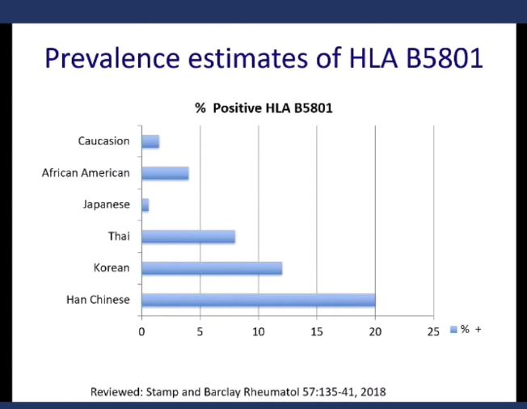

Slide 126
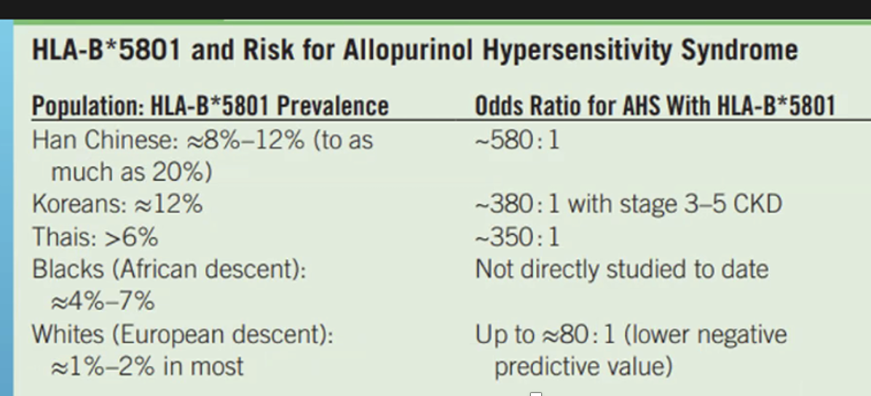
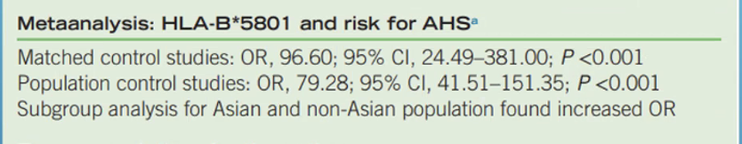

Slide 127



Slide 128


Slide 129
Question 18.
A 32-year-old man is evaluated for a recent diagnosis of rheumatoid arthritis. He has had a 4-month history of progressive bilateral hand pain. Medical history is otherwise unremarkable.
On physical examination, vital signs are normal. Joint examination shows swelling and tenderness in the wrists and second metacarpophalangeal joints bilaterally and tenderness in the third and fifth metacarpophalangeal joints bilaterally. No rash, lymphadenopathy, edema, or other joint tenderness or swelling is noted.
Laboratory studies reveal a normal complete blood count and comprehensive metabolic panel.
Which of the following is the most appropriate treatment?
A. Adalimumab
B. High dose prednisone
C. Methotrexate
D. Naproxen

Slide 130
Question 18.
ANSWER: C

Slide 131


Slide 132
ACR recommendations
Methotrexate (MTX) as First-Line DMARD for DMARD-Naive Patients with Moderate-to-High Disease Activity
1. Strong Recommendations for Methotrexate Monotherapy
Over hydroxychloroquine or sulfasalazine:
  MTX has strong evidence for disease-modifying efficacy.
  Hydroxychloroquine and sulfasalazine have low-certainty evidence.
  Concerns exist about long-term tolerability of sulfasalazine.
Over bDMARD or tsDMARD monotherapy:
  MTX monotherapy is strongly preferred for DMARD-naive patients.
  Most biologics are comparable in efficacy to MTX, except tocilizumab and JAK inhibitors.
Over methotrexate plus non-TNF inhibitor bDMARD or tsDMARD:
  Very low-certainty evidence for superiority of combination therapy.
  MTX monotherapy is strongly preferred due to lower risk and cost, and lack of proven added benefit.

Slide 133
2. Conditional Recommendations
Over sulfasalazine or hydroxychloroquine:
  MTX is conditionally recommended over leflunomide, since no direct head-to-head efficacy comparison exists.
Over dual or triple csDMARD therapy:
  MTX monotherapy is conditionally recommended due to:
    Lower medication burden and cost.
    Moderate-quality evidence that combination therapy may slightly improve disease activity.
    Some patients may prefer combination therapy for a higher probability of better response.
Over MTX plus TNF inhibitor:
  Conditional recommendation because:
    Most patients achieve treatment goals with MTX alone.
    TNF inhibitors have higher toxicity risk and cost.
    Some patients with poor prognostic factors may prefer combination therapy for faster or greater improvement.

Slide 134
3. Advantages of Methotrexate
Established efficacy and safety as first-line DMARD.
Greater dosing flexibility.
Lower cost compared to combination DMARDs and biologics.
Acts as an anchor DMARD in combination regimens.

Slide 135
Question 19.
A 54-year-old man is evaluated for a 1-month history of progressive dyspnea and pleuritic chest pain. He has rheumatoid arthritis treated with methotrexate.
Pulmonary examination reveals left-sided decreased breath sounds and dullness to percussion. Metacarpophalangeal joint deformities with ulnar deviation and subcutaneous nodules along the right ulna are noted.
A chest radiograph shows a left-sided pleural effusion.
Thoracentesis is performed.
Pleural fluid studies:
Leukocyte count: 1600/uL with 98% lymphocytes (H)
pH: 7.1 (L)
Glucose: 42 mg/dL (L)
Lactate dehydrogenase: 2310 U/L (H)
Protein, total: 5.2 g/dL (H)
Gram stain: Negative
Cytology: Negative

Slide 136
Which of the following is the most likely cause of the patient’s pleural effusion?
A. Bacterial pneumonia
B. Heart failure
C. Malignancy
D. Rheumatoid arthritis

Slide 137
Question 19.
ANSWER: D

Slide 138
Classic triad of RA-Pleural effusions :
Low glucose < 40 mg/dl due to defect in glucose transport across pleura
Low pH, < 7.2 – mimics infection
High LDH- cellular exudate with high protein

Slide 139
Rheumatoid pleuritis
Pleura is involved in the course of rheumatoid arthritis. 5% of patients with RA have a pleural effusion, 20% have pleuritic chest pain.
Rheumatoid pleurisy is seen mostly in male, > 10% of men and < 2% of women have rheumatoid pleural effusion.
Patients are older than 35 years.
Patients usually have subcutaneous nodules in many cases.
Arthritis is usually present for several years , very rarely it is the first manifestation
95% are RF positive
Asymptomatic or symptomatic with pleuritic chest pain, fever or both.
Some patients experience dyspnea secondary to the pleural fluid.
CXR reveals a small to moderate sized pleural effusion in most patients.
It can be bilateral in a quarter of patients
It can alternate from one side to the other or may come and go on the same side.
1/3rd patients can have other intrathoracic manifestations of rheumatoid disease.

Slide 140
Cell Count Evolution:
Early: neutrophil predominance (mimics empyema)
7-11 days later: lymphocyte predominance (as in this case - 98% lymphocytes)
Differential Diagnosis - Other Causes of Low Glucose/Low pH:
Complicated parapneumonic/empyema: positive Gram stain/culture, neutrophil predominant
Malignancy: positive cytology, usually not this low glucose
Tuberculosis : high ADA (>45 U/L), lymphocyte predominant

Slide 141
Why don’t other options fit?
A (Bacterial pneumonia): Negative Gram stain, lymphocyte (not neutrophil) predominant
B (Heart failure): Transudate, not exudate; normal glucose/pH
C (Malignancy): Negative cytology; glucose rarely this low

Slide 142
Question 20
A 28-year-old man is referred for possible vasculitis. He has a 2-week history of a painful purpuric skin rash affecting his fingertips, toes, and ears. He also has a few scattered ulcerative lesions on his lower extremities, both ears, and right great toe.
Past medical history is significant for previously treated hepatitis C. He saw his primary care physician 3 days ago who obtained laboratories and referred him for evaluation.
Physical examination shows a temperature 38°C, pulse 100 beats/minute, and BP 140/92 mm Hg. He is in distress because of pain. HEENT exam reveals painful, purpuric ulcerative lesions on both ears (see figure below). He has a septal perforation and poor dentition. He has a normal lung examination. Heart examination shows tachycardia with a 1/6 systolic murmur that has been present for several years per report. Extremity examination shows several painful, purpuric lesions on the fingertips and toes, some with early ulceration. He also has several large (3 cm) purpuric and ulcerative lesions on his lower extremities. The remainder of his examination is unremarkable.

Slide 143


Slide 144
Laboratory tests through primary care one week ago:
  CBC: Hct 33%, WBC 2800/cu mm with 11% neutrophils, platelets 436,000/cu mm
  Chemistries: normal
  Liver associated enzymes: normal except alkaline phosphatase 152 IU/L (nl 45–135)
  Albumin: 2.8 g/dL
  Urinalysis: normal
  RF: negative
  C3/C4: both elevated
  P-ANCA: 1:320
  C-ANCA: negative
  Hepatitis C load by PCR: negative
  ESR: 105 mm/h (nl 0–15)
  CRP: 24 mg/dL (nl 0–1)
  PTT: normal

Slide 145
Which of the following should be ordered next to establish the cause of this patient's symptoms?
a)Cryoglobulins
b)Transthoracic echocardiogram
c)Bone marrow biopsy
d)Urine toxicology screen
e) Abdominal angiogram

Slide 146
Answer: D

Slide 147
Cocaine induced vasculitis
Vasculitis is caused by Levamisole, which is used to cut cocaine to enhance the effects of cocaine. It is very hard to detect levamisole in any of our drug screen testing, we can only test cocaine. U tox has to be ordered very quickly since cocaine is cleared very quickly through the urine.
Vasculitis caused by the drug- mimics ANCA associated vasculitis. There is ENT, skin, kidney and lung involvement.
Very commonly there is midline destruction in the ENT pathway. Like nasal septal perforation.
Skin lesions can be necrotic.
Severe neutropenia and at times pancytopenia can be present
Antibodies : positive p-ANCA, high titre MPO, dual ANCA, dual MPO.PR3, cardiolipin antibodies, cold agglutinins, human neutrophil elastase antibodies can be present.

Slide 148
Treatment
Coccaine use needs to stop
Cytoxan and rituximab might be needed for severe manifestations

Slide 149
Why other choices are not correct?
Since this is a small vessel vasculitis, an abdominal angiogram would not be helpful.
Although the patient has a history of treated hepatitis C, cryoglobulinemia is an unlikely cause of the current symptoms since viral load is negative, urinalysis is normal, RF is negative, and complement levels are not depressed.
An echocardiogram is not indicated because the murmur is benign, longstanding, and unchanged.
A bone marrow biopsy would only be indicated if the leukocyte count failed to improve with abstinence from cocaine/levamisole.

