Slide 1
GASTROINTESTINAL INFECTIONS:
BACTERIAL AND VIRAL
CASES AND DISCUSSION
Justin Seroy, DO
Infectious Disease
Arizona Infectious Disease
608-213-4710 (Cell)
jseroy@azinfection.com

Slide 2
LEARNING OBJECTIVES
1) Devise an algorithm for the diagnosis of infectious diarrhea and organize by type of intestinal pathogen based on microbiology.
2) Predict intestinal pathogens in immunocompromised patients.
3) Construct a differential diagnosis for patients with fever and abdominal pain.
4) Review expected gastrointestinal infectious processes associated with the boards (Estimated 9% ID, <2% enteric infections, <2% travel)
5) Learn something

Slide 3
Introduction
Diarrhea – 3 or more unformed stools in a day
NOT soft, loose, some solid. Liquid. Like water. Mashed potato or pudding consistency doesn’t count.
Acute – less than 2 weeks
Persistent – 4 weeks
Chronic – more than 4 weeks.

Slide 4
Approach to diarrhea illness
Factors to consider:
Duration of illness
Dysentery (Bloody, fever, cramping tenesmus) vs watery
Epidemiologic factors – travel, food, outbreaks

Slide 5
CASE 1
A healthy 23-year-old man presents to your office with complaints of profuse diarrhea, abdominal cramps and fevers for two days. He first noticed headaches and body aches followed by diarrhea.
He feels like his bowel movements have some mucus in and thinks he has noticed blood in the toilet. He has no past medical history and takes no medications.
Last weekend, he and some of his buddies went on a camping trip. They reported drinking "too many beers," swimming in and drinking from the lake, grilling burgers and chicken for dinner. He is unsure if any of his friends are sick also.

Slide 6
KEY POINTS IN THE HISTORY?
Healthy, no antibiotics or medications
Profuse diarrhea with blood, abdominal cramps and fevers for two days
Drinking from the lake, grilling burgers and chicken for dinner

Slide 7
What is your differential diagnosis?
Notes:
Other lake related infections – leptospirosis, Naegleria fowleri, cyanobacteria/swimmer’s itch (algae bloom), Schistosomes/schistosomiasis

Slide 8
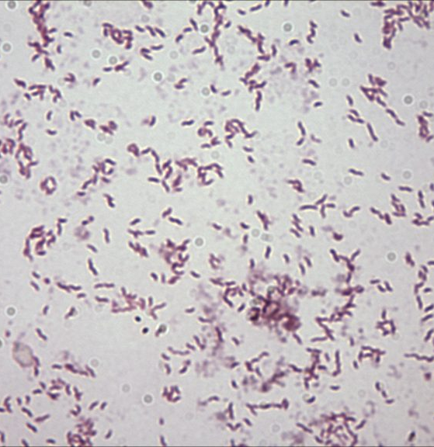
CASE 1
Being the amazing clinician you are, you obtain a stool sample and look at it under a microscope after gram staining.
Describe what you see:
https://www.stepwards.com/?page_id=7207
Notes:
Campylobacter jejuni is a gram negative, comma/S-shaped rod bacteria. It has polar flagella. Gull-wing shaped.

Slide 9
QUESTION
In addition to recommending supportive care, you order which of the following tests to confirm the diagnosis?
A) Stool culture
B) Molecular identification – immunoassay or pcr
C) Stool O&P
D) Stool C. diff PCR

Slide 10
QUESTION
In addition to recommending supportive care, you order which of the following tests to confirm the diagnosis?
A) Stool culture
B) Molecular identification – immunoassay or pcr
C) Stool O&P
D) Stool C. diff PCR

Slide 11
CASE 1: FOLLOW UP
Before you send the patient home, you instruct him to call your office should he develop which of the following complications?
A) Weakness, fatigue, easy bruising
B) Ascending paralysis
C) Toxic megacolon
D) Headache and neck stiffness
Notes:
HUS from E coli 0157:H7 Shiga-like toxin causes hemolytic uremic syndrome: triad of anemia, thrombocytopenia, and acute kidney injury due to microthrombi forming on damaged endothelium -> mechanical hemolysis (with schistocytes on peripheral smear), platelet consumption, and decreased renal blood flow.
Correct answer – Gilliam barre
C diff
Strongy hypereosinophilic syndrome with GNR meningitis

Slide 12
CASE 1: FOLLOW UP
Before you send the patient home, you instruct him to call your office should he develop which of the following complications?
A) Weakness, fatigue, easy bruising
B) Ascending paralysis
C) Toxic megacolon
D) Headache and neck stiffness
Notes:
HUS from E coli 0157:H7 Shiga-like toxin causes hemolytic uremic syndrome: triad of anemia, thrombocytopenia, and acute kidney injury due to microthrombi forming on damaged endothelium -> mechanical hemolysis (with schistocytes on peripheral smear), platelet consumption, and decreased renal blood flow.
Correct answer – Gilliam barre
C diff
Strongy hypereosinophilic syndrome with GNR meningitis

Slide 13
CASE 1 TAKEAWAY – CAMPYLOBACTER
Bloody diarrhea with fever: shigella, campylobacter, Salmonella, E. coli
Incubation 1-3 days, duration 7 days
Pathogen shedding may occur for weeks after disease
Gram negative, curved/S-shaped rod
Typically, self-limited in immunocompetent
  Single dose azithromycin vs 500mg per day x3 days
Could be severe, prolonged in the extreme of ages or immunocompromised
Be aware of post-infectious complications, including GBS

Slide 14
CASE 2
A 24 year old male presents to the emergency department with complaint of progressive worsening of diarrhea. He states he started to have some watery stools and abdominal pain 2 or 3 weeks ago. In the past day he has developed bloody diarrhea and more severe abdominal pain.
Vitals in ED: T 99.0^{F} P 85 RR 16 BP 128/74 O2 98% on room air.
Patient appears uncomfortable but is non toxic appearing

Slide 15
CASE 2
Patient reports to you that he returned from mission work in a remote Honduras village one month ago. He had lived in the village for the prior two months. He does not recall any sick contacts at the time. He has no sick contacts at home.
Differential diagnosis?

Slide 16
CASE 2 SUMMARY
Otherwise healthy young male, diarrhea for several weeks now worsening
Recent travel to Honduras
No sick contacts

Slide 17
Question
Which of the following is the most likely cause for his clinical presentation?
A) Listeria
B) Enteroinvasive E coli
C) Yersinia enterolytica
D) Entamoeba histolytica

Slide 18
Question
Which of the following is the most likely cause for his clinical presentation?
A) Listeria
B) Enteroinvasive E coli
C) Yersinia enterolytica
D) Entamoeba histolytica
Notes:
Listeria - This syndrome is characterized by frequent watery diarrhea, fever, abdominal cramps, headache, and myalgias, with a median incubation period of 20 to 31 hours.
E coli – timeline
Yersinia - <2 weeks, may be bloody, pseudoappendicitis

Slide 19
Question
What test should you order to confirm the diagnosis?
A) Stool PCR
B) Stool culture
C) Stool ova and parasite examination
D) Blood cultures

Slide 20
Question
What test should you order to confirm the diagnosis?
A) Stool PCR
B) Stool culture
C) Stool ova and parasite examination
D) Blood cultures
Notes:
Stool O&P insensitive, non specific. PCR or antigen detection is best.

Slide 21
CASE 2 TAKEAWAY ENTAMOEBA HISTOLYTICA
30-50 million cases/year worldwide, up to 100K deaths
Most cases from Central/South America, Africa, Indian subcontinent
3rd most common parasitic infection in USA
2nd most common cause of diarrhea in a returning traveler
Notes:
Giardiasis and Cryptosporidiosis most common US parasitic infections

Slide 22
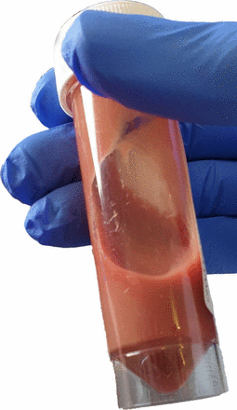

CASE 2 TAKEAWAY ENTAMOEBA HISTOLYTICA
Clinical Manifestations
Amebic diarrhea
Amebic dysentery/colitis
Amebic liver abscess
Kakoullis L, Hadjihannas L, Louppides S, et al Aspiration of anchovy paste liquid from a multilobulated liver space-occupying lesion in a patient presenting with fever and weight loss: early stage amoebic liver abscess BMJ Case Reports CP 2020;13:e234107.
Notes:
Giardiasis and Cryptosporidiosis m
E. histolytica induces apoptosis in hepatocytes and neutrophils, forming large, nonpurulent, “anchovy paste” abscesses that grow inexorably without treatmentost common US parasitic infections

Slide 23
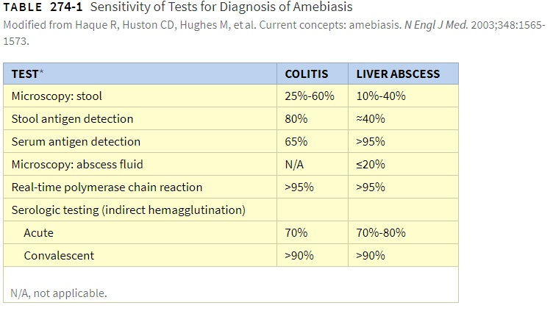
CASE 2 TAKEAWAY ENTAMOEBA HISTOLYTICA
Diagnosis
Mandell et al. Principles and Practice of Infectious Diseases 8th Ed. Philadelphia, PA: Elsevier, 2015
Notes:
Giardiasis and Cryptosporidiosis most common US parasitic infections

Slide 24
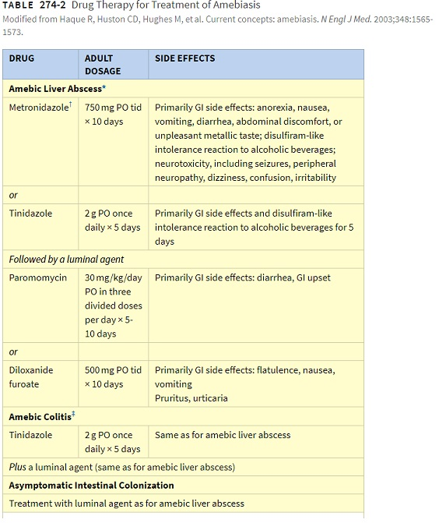
CASE 1 TAKEAWAY ENTAMOEBA HISTOLYTICA
Treatment
Notes:
Giardiasis and Cryptosporidiosis most common US parasitic infections

Slide 25
CASE 3
A 30-year-old woman presents to your office with complaints of 3 months of diarrhea. Her symptoms include abdominal cramping, bloating and non-bloody diarrhea. PMHx is significant for IgA deficiency with recurrent sinus infections. It has been nearly a year since the last time she was treated with antibiotics for a sinus infection.
She is afebrile, vital signs are normal. Abdominal exam reveals active bowel sounds and minimal diffuse tenderness. Stool occult testing for blood is negative.

Slide 26
CASE 3 SUMMARY
Young woman with IgA deficiency
3 months of non-bloody diarrhea
Afebrile

Slide 27
QUESTION
Which of the following is the most likely cause of her diarrheal illness?
C difficile
Nontyphoidal Salmonella
Enterohemorrhagic E. coli
Listeria monocytogenes
Giardia duodenalis (formerly G. lamblia)
Notes:
Non typhoidal salmonella - Typically self limiting, N/V, abdominal cramps, watery diarrhea, usually non-bloody
C diff associated with abx useage, fever, acutely ill
Enterohemorrhagic E coli – acute bloody diarrhea, undercooked meat
Listeria - Deli/processes meats, soft cheeses, unpasteurized milk, cantaloupe, high inoculum, self limited, invasive disease can occur in patients with cell mediated deficiencies

Slide 28
QUESTION
Which of the following is the most likely cause of her diarrheal illness?
C difficile
Nontyphoidal Salmonella
Enterohemorrhagic E. coli
Listeria monocytogenes
Giardia duodenalis (formerly G. lamblia)
Notes:
Non typhoidal salmonella - Typically self limiting, N/V, abdominal cramps, watery diarrhea, usually non-bloody
C diff associated with abx useage, fever, acutely ill
Enterohemorrhagic E coli – acute bloody diarrhea, undercooked meat
Listeria - Deli/processes meats, soft cheeses, unpasteurized milk, cantaloupe, high inoculum, self limited, invasive disease can occur in patients with cell mediated deficiencies

Slide 29
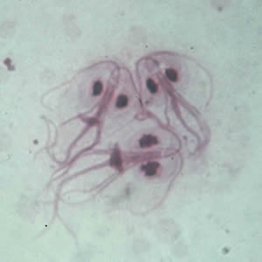
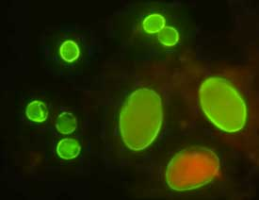
CASE 3 TAKEAWAY - GIARDIA
Infection with 10-25 cysts
Pathophysiology: villous atrophy, deactivate bile salts
Symptoms: steatorrhea (foul-smelling/fatty) watery diarrhea, flatulence, bloating, crampy abdominal pain, and significant weight loss (10% of body weight)
Duration: > 2 weeks; can be chronic in patients with humoral deficiencies
Diagnosis: usually made by detection in stool with immunofluorescence
https://www.cdc.gov/parasites/giardia/general-info.html
Cysts of G. duodenalis (lower right) and Cryptosporidium (upper left) labeled with commercially available immunofluorescent antibodies.

Slide 30
CASE 4
Your 33-year-old healthy male friend calls you to cancel plans due to abdominal cramping, nausea, vomiting, and diarrhea that started abruptly 2 nights ago.
He describes his bowel movements as watery, without blood or mucus. At first, he had 7-8 stools a day but now he has 3-4. He is afebrile. He has not taken any recent antibiotics.
He went to a picnic two weeks ago where he ate potato salad, kimchi fried rice and cold cut sandwiches.
Three days ago, he went to a work meeting with 12 of his coworkers. One of his friends at work reports similar symptoms in herself and her kids.

Slide 31
Case 4 summary
Otherwise healthy male, acute onset diarrhea, now resolving
Other contacts sick with similar symptoms
Starting to improve

Slide 32
Question
Which of the following is the most likely cause for his clinical presentation?
A) Listeria
B) Norovirus
C) Bacillus
D) E. coli O157:H7
Notes:
Listeria - Infrequent outbreaks of diarrhea with fever caused by Listeria monocytogenes (see Chapter 206) have been reported among previously healthy people. 53 – 55 This syndrome is characterized by frequent watery diarrhea, fever, abdominal cramps, headache, and myalgias, with a median incubation period of 20 to 31 hours.
Bacillus -

Slide 33
Case 4 Takeaway Norovirus
The most common cause of acute gastroenteritis in the U.S. and causes 90% of epidemic gastroenteritis in restaurants, cruise ships, schools, congregate settings, and healthcare settings due to contaminated foods
Extremely contagious (requires low inoculum: infectious dose = 10-100 virions, 2000 virion dose leads to infection in 50% of individuals)
Fecal-oral, person to person transmission (viral shedding up to 2 weeks), fomites (lives on surfaces for 5-12 days)
Incubation period: 12-48 hrs
Duration of illness: 12-72 hrs (except in immunocompromised can last weeks to months)
Sx: sudden onset of nausea, vomiting, abdominal cramps, and non-bloody diarrhea (4-8 stools over 24 hrs; diarrhea may be absent)

Slide 34
Foodborne Illnesses
The actual number of foodborne illnesses in the United States is unknown but has been estimated to be approximately 48 million cases, with 128,000 hospitalizations and 3000 deaths each year
Nausea/vomiting <24 hours
  S. aureus, B. cereus preformed enterotoxins – incubation 1-6 hours
Watery diarrhea 1-2 days
  C. perfringens, B. cereus
Watery diarrhea, abd cramps >2 days
  Enterotoxigenic E. coli, Vibrio sp. (Illness may be prolonged)
Diarrhea, abd cramps, Fever (may be bloody; 2-7 days)
  Nontyphoidal Salmonella, Shigella, Vibrio, Campylobacter, Yersinia
Scallan E, Hoekstra RM, Angulo FJ, et al. Foodborne illness acquired in the United States—major pathogens. Emerg Infect Dis. 2011;17:7–15.
Notes:
Listeria - Infrequent outbreaks of diarrhea with fever caused by Listeria monocytogenes (see Chapter 206) have been reported among previously healthy people. 53 – 55 This syndrome is characterized by frequent watery diarrhea, fever, abdominal cramps, headache, and myalgias, with a median incubation period of 20 to 31 hours.
Bacillus -

Slide 35
CASE 5
A 56-year-old man presents to the ER for evaluation of acute non-bloody diarrhea. PMHx is significant for GERD and he takes a PPI. He reports feeling fine the day prior. Over the weekend he went to a local farmers’ market and purchased some fresh eggs, chicken and vegetables. His wife has similar complaints today but is not as sick as he is. Two weeks ago he ate out at Chinese restaurant and took home leftovers including some fried rice. He has not been treated with any antibiotics recently. On physical exam he has a fever of 100.4F, with the remainder of his vital signs normal. Abdominal examination reveals mild diffuse tenderness.

Slide 36
CASE 5 SUMMARY
Pertinent Positives:
Diarrhea x 1 day
PPI
Ingestion of fresh eggs, chicken and vegetables from farmers' market
+ sick contact
Pertinent Negatives:
Non-bloody
Fried rice 2 weeks ago
No recent antibiotics

Slide 37
QUESTION
In addition to supportive care, you recommend the following:
Ciprofloxacin 500mg PO BID
Stool culture
Stool ova and parasite examination
C diff testing
No additional treatment

Slide 38
QUESTION
In addition to supportive care, you recommend the following:
Ciprofloxacin 500mg PO BID
Stool culture
Stool ova and parasite examination
C diff testing
No additional treatment

Slide 39
CASE 5 TAKEAWAY – NONTYPHOIDAL SALMONELLA
Common enteric pathogen
Cause enterocolitis and are a major cause of food-borne infection, primarily from poultry and eggs
  Typically, self limiting, N/V, abdominal cramps, watery diarrhea, usually non-bloody
  Incubation: 12-72 hrs with symptoms often self-limiting within 3-7 days
Most common cause of hospitalization and death from foodborne diarrheal disease

Slide 40
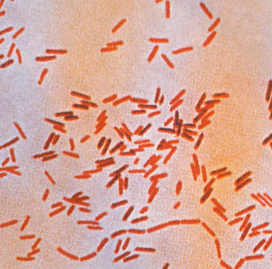
CASE 5
Two days after you discharge the patient home, the lab calls to report positive blood cultures drawn in the ER, which are positive for a non-lactose fermenting bacteria with the following gram stain pictured here.
You interpret this as:
Gram negative rod
Gram positive rod
Gram positive beaded branching rod
Gram negative cocci
Polymicrobial, likely contamination
Notes:
http://textbookofbacteriology.net/salmonella.html

Slide 41
ENTERIC FEVER/TYPHOIDAL SALMONELLA
Micro:
  Salmonella enterica serotype Typhi or Paratyphi
  Human reservoir only. 22 million cases 🡪 200,000 deaths / year
Clinical:
  Symptoms: fever & abdominal pain, diarrhea (preceding fever), constipation
  PE: relative bradycardia, hepatosplenomegaly, Rose spots
  Laboratory: leukopenia, thrombocytopenia, transaminase elevations
  Prognosis:
    Intestinal perforation – necrosis of ileocecal lymphoid tissue
    Mortality ~15-50% without antibiotic therapy
    Resolution at 4 weeks 🡪 relapsing disease possible
  Diagnosis: blood culture, BM culture, cx of Rose spot biopsy
  Treatment:
    3rd generation Cephalosporin, Azithromycin, Quinolones
    Significant resistance worldwide to Ampicillin/Amoxicillin, TMP-SMX

Slide 42
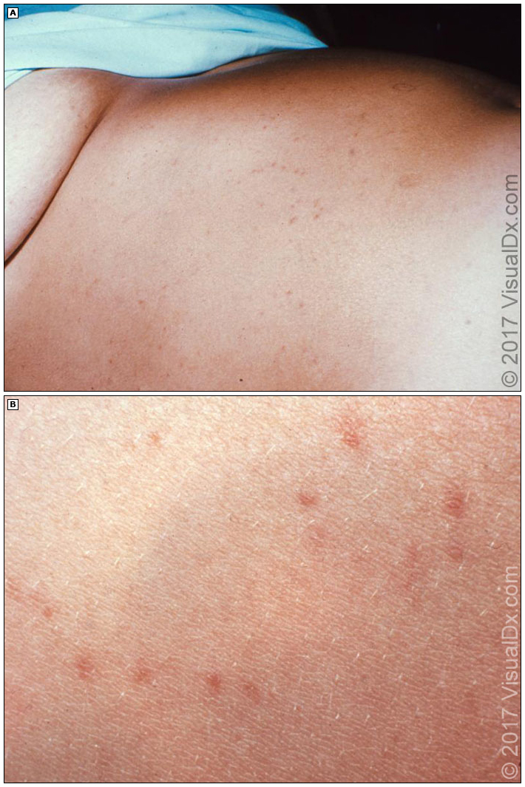
ENTERIC FEVER / TYPHOIDAL SALMONELLA – ROSE SPOTS
Small (1 to 5 mm), erythematous, blanchable, nontender papules, which begin during the acute febrile period of typhoid fever.
Crops of lesions (10 to 20) appear at irregular intervals for approximately 10 to 14 days, typically distributed on the abdomen, chest, and back.
Rarely, vesicular or hemorrhagic lesions appear. The lesions persist for two to three days.
https://www.uptodate.com/contents/epidemiology-microbiology-clinical-manifestations-and-diagnosis-of-enteric-typhoid-and-paratyphoid-fever?search=rose%20spots&source=search_result&selectedTitle=1~12&use_type=default&display_rank=1

Slide 43
CASE 6
A 57-year-old female undergoes orthotopic liver transplantation for HCV related cirrhosis. 13 days after her transplant, she becomes febrile to 101.1F and her WBC rises to 18.7K. She has been on an empiric course of vancomycin and zosyn since the transplant and now has VRE bacteremia, which is treated with daptomycin.
She is discharged from the hospital on day #27 following transplant. One week following this, she is admitted with one day of LLQ abdominal pain, fever, watery non-bloody diarrhea x 10 episodes.
VS: Temp 101.7F, P109, BP 121/75.
She has left lower abdominal pain on exam.
WBC count is 29,000.

Slide 44
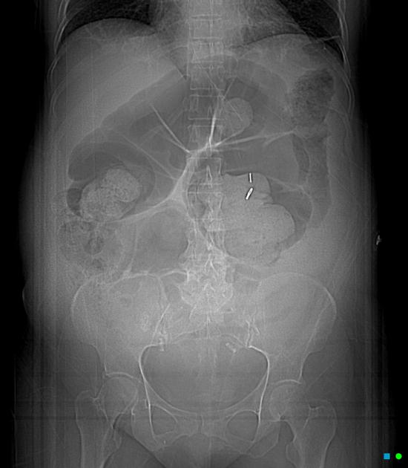
INITIAL WORKUP
Notes:
https://radiopaedia.org/cases/pseudomembranous-colitis-toxic-megacolon?lang=us

Slide 45
QUESTION
What is the most likely diagnosis and testing strategy?
Norovirus; No testing indicated as self limiting viral illness
Invasive salmonella; blood cultures
Recurrent bacteremia; blood cultures and empiric antibiotics
C. diff; C. difficile NAAT/PCR with reflex toxin EIA
Cystoisospora;, stool O&P

Slide 46
QUESTION
What is the most likely diagnosis and testing strategy?
Norovirus; No testing indicated as self limiting viral illness
Invasive salmonella; blood cultures
Recurrent bacteremia; blood cultures and empiric antibiotics
C. diff; C. difficile NAAT/PCR with reflex toxin EIA
Cystoisospora;, stool O&P

Slide 47
CASE 6 SUMMARY
Liver transplant recipient, complicated by long hospitalization, broad spectrum antibiotics
Abdominal pain, profuse watery diarrhea, marked leukocytosis, sepsis

Slide 48
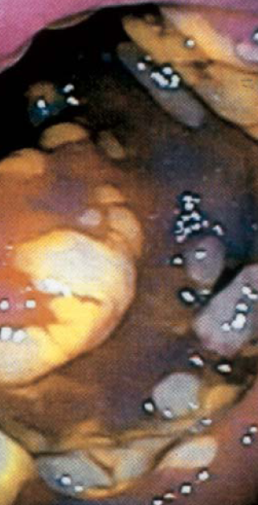
CASE 6 TAKEAWAY: CLOSTRIDIUM DIFFICILE
Micro:
  Toxigenic and nontoxigenic. Asymptomatic colonization possible.
  Pathogenesis: Loss of normal flora 🡪 colonization 🡪 toxin
  Toxin A (enterotoxin) & Toxin B (cytotoxin)
  NAP1/027: ↑ Toxin A & B, production of binary toxin
Clinical:
  Inflammatory diarrhea, leukocytosis can be extreme
  Complications: toxic megacolon, perforation, protein-losing enteropathy
  Treatment: PO Vancomycin, fidaxomicin
Mandell et al. Principles and Practice of Infectious Diseases 6th Ed. Philadelphia, PA: Elsevier, 2005

Slide 49
CASE 7
A 37-year-old man with history of HIV presents to the ED with 2 days of fever, abdominal cramping, and bloody diarrhea. Initially the diarrhea was watery, then it turned bloody today so he came to the ED.
The patient reports that he was at a cookout the weekend prior where they ate hamburgers, hot dogs and potato salad. He is unsure if anyone from it is ill.
Reports that he has been sexually active with three other male partners in the past 6 months. No recent antibiotics. He only takes his HIV medications intermittently and not for the past month.
He is febrile to 102.7, pulse 110, respirations 16, BP 100/61. He is started on empiric antibiotics and admitted to the hospital for further workup.
Notes:
Microsporidia – can affect HIV +, causes watery diarrhea or intestinal/bile duct obstruction
Can cause bloody diarrhea, would not likely cause systemic symptoms unless enteroinvasive
Correct similar to E coli 0157:H7, Shiga toxin (cytotoxin) 🡪 E.coli O157:H7 (HUS)
No recent abx

Slide 50
CASE 7 SUMMARY
37 year old male, HIV+ not currently on medication
Acute bloody diarrhea with systemic illness
Recent cookout? MSM?

Slide 51
QUESTION
Based on his presentation, what do you suspect the following cause of his illness?
Microsporidia
Enterohemorrhagic E. coli
Shigellosis
C difficile colitis
Notes:
Microsporidia – can affect HIV +, causes watery diarrhea or intestinal/bile duct obstruction
Can cause bloody diarrhea, would not likely cause systemic symptoms unless enteroinvasive
Correct similar to E coli 0157:H7, Shiga toxin (cytotoxin) 🡪 E.coli O157:H7 (HUS)
No recent abx

Slide 52
QUESTION
Based on his presentation, what do you suspect the following cause of his illness?
Microsporidia
Enterohemorrhagic E. coli
Shigellosis
C difficile colitis

Slide 53
CASE 7 TAKEAWAY - SHIGELLOSIS
Shigellosis is the most infectious bacterial enteropathogen – 1 to 100 organisms needed for transmission
Spread person to person, usually fecal/oral transmission
Antibiotic treatment recommended for severe illness, immunocompromised – quinolone or 3rd generation cephalosporin
Complications:
    Bacteremia, HUS, post-infectious reactive arthritis, acute GN

Slide 54
Bloody diarrhea with fever
Hemorrhagic colitis STEC (0157:H7 or Shigella)
  Shiga toxin 1 or 2 – cytotoxins that damage vascular endothelial cells in gut and kidneys
Severe abdominal cramping, watery → grossly bloody diarrhea
HUS is children

Slide 55
CASE 8
A 55-year-old woman is admitted to the hospital with diarrhea for the past 3 months. She tells you this is her 4th admission in the past year for the same complaint. Past medical history is significant for HIV diagnosed 25 years ago.
She is not adherent to her antiretroviral medications, last took as directed about a year ago.
ROS positive for unintentional weight loss. Physical exam reveals afebrile, cachectic-appearing woman. Vital signs are normal.

Slide 56
INITIAL WORKUP
CD4 count is 47.
HIV viral load 36,521 copies/mL
Stool C diff negative
Stool culture negative.
Labs?
Other tests?

Slide 57
CASE 8 SUMMARY
HIV+ not on antiretrovirals
Chronic Diarrhea, weight loss
Stool culture, C diff negative

Slide 58
QUESTION
What is the next best test to order?
Repeat stool culture
Stool O&P with immunofluorescence
Stool acid fast stain
Endoscopy with intestinal biopsy

Slide 59
QUESTION
What is the next best test to order?
Repeat stool culture
Stool O&P with immunofluorescence
Stool acid fast stain
Endoscopy with intestinal biopsy

Slide 60
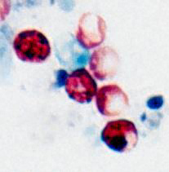
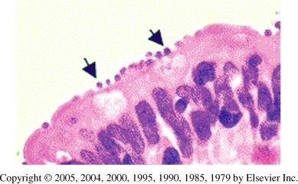
CRYPTOSPORIDIUM
Cryptosporidium oocysts in stool with acid-fast stain.
Cryptosporidium & Giardia oocysts in stool with IFA.
http://www.dpd.cdc.gov/dpdx
Intestinal biopsy showing intracellular Cryptosporidium.
Mandell et al. Principles and Practice of Infectious Diseases 6th Ed. Philadelphia: Elsevier, 2005.
Treatment:
Difficult due to unique location of the protozoa
Nitazoxanide – has activity against Giardia and Cryptosporidium.
HAART – most effective therapy in patients with HIV.
Notes:
Cryptosporidium
Oocytes on modified acid fast stain
Causes severe/prolonged diarrhea in AIDS patients
worldwide distribution, resource -limited and -sufficient countries
Most common causes: cryptosporidiosis and giardiasis

Slide 61
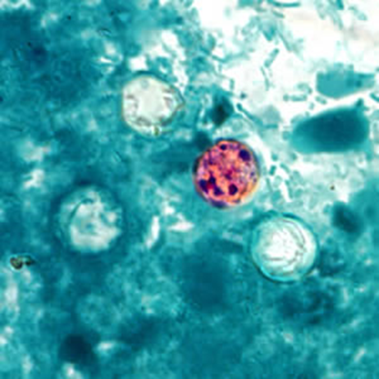
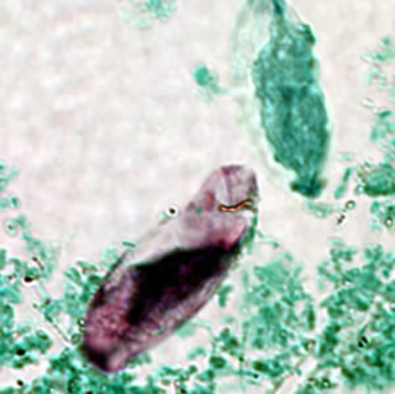
CASE 8 TAKEAWAY - INTESTINAL SPOROZOITES
Microbiology:
  Ingestion of oocyst 🡪 sporozoite penetrates intestinal epithelial cell.
  Can propagate asexually within cell and/or sexual stage 🡪 oocyst in feces
Cryptosporidium
  Distributed worldwide. Higher rates in developing countries.
  Outbreaks: swimming pools, water, foodborne (produce, unpasteurized milk, shellfish)
Cyclospora
  Distributed worldwide: Nepal, Latin America, Caribbean.
  U.S. foodborne outbreaks: imported raspberries, basil, snow peas, salad greens.
Isospora
  Distributed in tropical / sub-tropical regions: Africa, South America, SE Asia
  U.S.: immunocompromised, daycare centers, psychiatric institutions
Above: Cyclospora oocyst in stool - acid-fast stain
Below: Isospora oocyst in stool – acid-fast stain

Slide 62

CASE 9: BONUS CASE
Your patient is a 50-year-old wagon driver on the Oregon trail who presents with two days of fevers, chills, abdominal pain and 1 day of diarrhea. The diarrhea is watery, non-bloody, occurring almost every 2 hours. He drinks a bottle of whiskey a day. As the physician in the wagon trail, you examine him and find he is febrile, hypotensive, and confused. Sclera are icteric. He also has a distended abdomen with shifting dullness.
Which of the following is the most likely cause for his clinical presentation?
Vibrio
Shigella
Listeria
Clostridium
Campylobacter

Slide 63
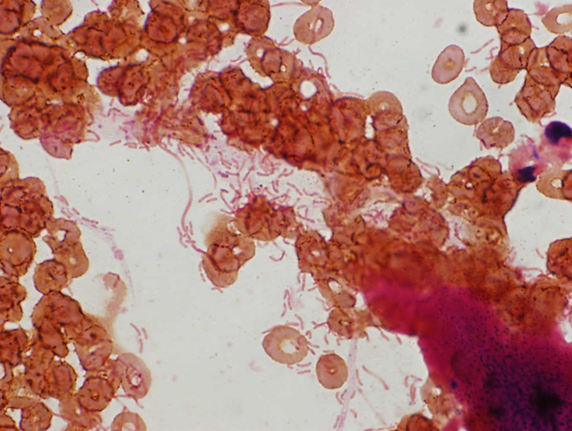
CASE 9 SUMMARY – VIBRIO / CHOLERA
Micro:
  GNR with curved or comma shape.
  Natural reservoir: marine, brackish lakes, plankton – warm temperature
    Commonly isolated from shellfish, shrimp, crabs, sediment.
Clinical:
  Vibrio cholerae
    Toxigenic (O1 & O139) – contaminated water / food
    Non-toxigenic – shellfish, wounds
  Vibrio parahemolyticus
    Diarrhea can range from watery to dysentery-like.
    Diarrhea > wound infection / septicemia
  Vibrio vulnificus
    Septicemia with secondary cellulitis in cirrhotics / iron overload.
    Wound infection with severe cellulitis / necrosis in healthy patients.

Slide 64
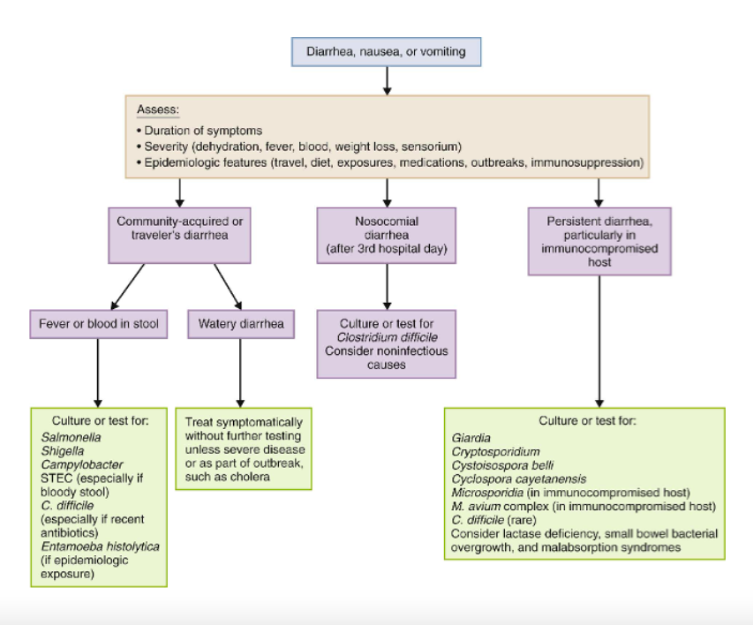
Figure 98-1: Approach to diagnosis of infectious diarrhea. Mandell, Douglas and Bennett’s Principles and Practice of Infectious Diseases
Notes:
A thorough history and physical examination should be the first step in evaluating the patient with a gastrointestinal illness. The history should focus on recent travel, specific items in the diet, animal and other epidemiologic exposures, recent and current medications, and underlying medical conditions, particularly immunosuppressive conditions. The nature of the symptoms (vomiting, type of diarrhea—watery, mucus, or blood—and the presence of fever or other systemic symptoms) should also be explored. The clinician should be aware of any relevant ongoing outbreaks in the community or in the patient’s travel destinations. A directed physical examination is important and should focus on vital signs (particularly fever and orthostasis), volume status, abdominal tenderness, complications outside the gastrointestinal tract, and the sensorium.
For purposes of directing the diagnostic evaluation, diarrheal illness can be divided into community-acquired/traveler’s diarrhea, nosocomial diarrhea, and persistent diarrhea (Fig. 98-1). Most cases of community-acquired or traveler’s diarrhea are mild and self-limited, and a specific microbiologic diagnosis usually is not necessary.¹²³ However, the presence of fever or blood in the stool should prompt evaluation of a fecal specimen for commonly associated pathogens, including Salmonella, Shigella, Campylobacter, STEC, and, in the case of appropriate epidemiologic exposure, E. histolytica. Testing for C. difficile should also be considered if there is a history of recent anti­biotic use or if other testing is negative. Nosocomial diarrhea is a common complication in hospitalized patients. C. difficile is by far the most common infectious cause of nosocomial diarrhea, with 10% to 20% of patients becoming colonized with this organism during hospitalization.^{20,124} Other causes of antibiotic-associated nosocomial diarrhea, including cytotoxic K. oxytoca, enterotoxin-producing C. perfringens, and potentially S. aureus, are rare and not readily diagnosed. Importantly, most cases of diarrhea in the hospitalized patient are noninfectious and are due to medications, enteral feeding, or underlying illness.¹²⁵ Persistent diarrhea, particularly in the immunocompromised host, should prompt consideration of a distinct array of organisms, including parasites (Giardia, C. hominis/parvum, I. belli, C. cayetanensis, microsporidia) and M. avium complex. In transplant patients, cytomegalovirus and gastrointestinal viruses, such as rotavirus, adenovirus, and norovirus, should be considered, as well as parasites and bacteria that are typically associated with community-acquired diarrhea.
Most laboratories are able to culture for Salmonella, Shigella, and Campylobacter and to test for C. difficile and STEC. Consultation with the laboratory and use of special media may be required if other pathogens, such as Yersinia or Vibrio, are suspected. The specimen of choice for laboratory testing is a loose stool that takes the shape of the container. Multiple stool specimens are rarely indicated for the detection of stool pathogens. In a study of 1,256 adult patients who submitted more than one specimen, the enteric pathogen was detected in the first sample 87% to 94% of the time, with the second specimen increasing the detection rate to 98%.¹²⁶ In pediatric patients, the first specimen detects 98% of the identifiable enteric pathogens.¹²⁷ Thus, one sample for children and a second for selected adult patients are generally sufficient. Rectal swabs are less sensitive than stool specimens and are not recommended in adults, but in symptomatic pediatric patients, rectal swabs and stool culture are equivalent in the ability to detect fecal pathogens.^{128,129} Given that most community-acquired gastroenteritis has an incubation period of less than 3 days, evaluation in a hospitalized patient after the third hospital day can be focused on nosocomial pathogens alone.¹³⁰

Slide 65
HIGH-YIELD DIFFERENTIATORS: BACTERIAL ENTERITIS
Board-style clues that separate the common invasive and toxin-mediated pathogens.
Pathogen
Classic clue
Stool / fever
Pearl / complication
Shigella
Person-to-person; daycare; MSM
Bloody/mucoid + fever; tenesmus
Very low inoculum; treat severe/high-risk disease
ETEC
International travel; food/water
Watery; usually no blood
Heat-labile + heat-stable enterotoxins
STEC / EHEC
Undercooked beef; leafy greens
Severe cramps; bloody; little/no fever
HUS risk → avoid antibiotics + antimotility agents
Campylobacter
Undercooked poultry; unpasteurized milk
Fever; inflammatory/bloody
GBS; reactive arthritis; azithro if severe/prolonged
Yersinia
Pork/chitterlings
Watery or bloody + fever
RLQ pain / pseudoappendicitis; reactive arthritis
Nontyphoidal Salmonella
Poultry/eggs; reptiles
Usually watery + fever
Bacteremia/endovascular seeding in high-risk hosts
Testing trigger: fever, bloody/mucoid stool, severe abdominal pain/tenderness, or sepsis → test for Salmonella, Shigella, Campylobacter, Yersinia, STEC ± C. difficile based on context.
Sources: IDSA Infectious Diarrhea Guideline (2017); CDC Yellow Book / enteric pathogen guidance. Updated teaching slide added Aug 2026.

Slide 66
BACTERIAL DIARRHEA: PATTERN RECOGNITION
Start with stool phenotype + fever, then use the exposure to narrow the organism.
WATERY / SECRETORY
INFLAMMATORY / DYSENTERY
BLOODY — THINK BEFORE TREATING
ETEC — traveler’s diarrhea; contaminated food/water; watery, crampy, usually afebrile.
Vibrio cholerae — profuse “rice-water” stool; travel/endemic water exposure.
C. perfringens / B. cereus — abrupt foodborne illness; short incubation.
Shigella — fever, tenesmus, scant bloody/mucoid stool; very low infectious dose; person-to-person/MSM/daycare.
Campylobacter — fever + abdominal pain → bloody diarrhea; poultry; can mimic appendicitis.
Salmonella — fever + diarrhea; poultry/eggs/reptiles; bacteremia risk in high-risk hosts.
STEC/EHEC — severe cramping, watery → bloody diarrhea; fever often absent or low; undercooked beef/leafy greens.
Yersinia enterocolitica — pork; fever/diarrhea + terminal ileitis or mesenteric adenitis (“pseudoappendicitis”).
Key trap: suspected STEC → test for Shiga toxin and avoid antibiotics/antimotility drugs.
Clinical overlap is substantial—multiplex stool NAAT/PCR is often the fastest discriminator when testing is indicated.

Slide 67
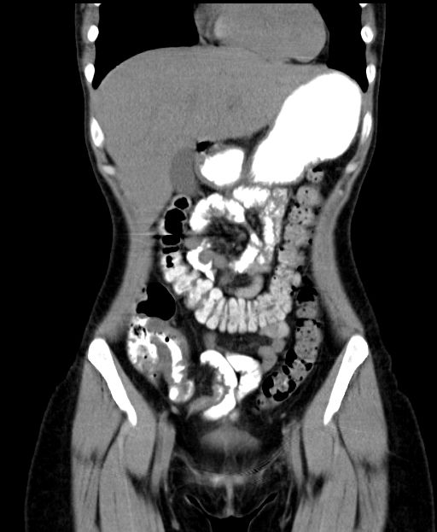
Yersinia enterocolitica: The Appendicitis Mimic
Think pork + fever/diarrhea + right-lower-quadrant pain
• Typical exposure: undercooked pork/chitterlings; contaminated food or water.
• Can cause fever and watery or bloody diarrhea.
• Terminal ileitis + mesenteric adenitis can produce striking RLQ pain.
• May be mistaken for appendicitis or Crohn disease.
• Reactive arthritis can occur after infection.
• Diagnostic pearl: if specifically suspected and culture is used, the laboratory may need special culture conditions/media.
Terminal ileitis → pseudoappendicitis
CT image: Radiopaedia case redistributed via NC Commons; terminal ileal thickening with adjacent inflammatory change.

Slide 68
STEC / EHEC: Why the HUS Warning Matters
The management distinction residents should remember
STEC exposure
Undercooked beef • leafy greens • unpasteurized food • animal contact
Shiga toxin
Endothelial injury, especially in gut and renal microvasculature
Hemorrhagic colitis
Severe cramps • watery → bloody diarrhea • often little/no fever
HUS
Microangiopathic hemolytic anemia + thrombocytopenia + acute kidney injury
MANAGEMENT TRAP
When STEC is suspected: obtain Shiga toxin/STEC testing, give supportive care, and avoid antibiotics and antimotility drugs because of concern for HUS.
CDC: HUS is a serious complication of STEC infection; especially associated with STEC O157.

Slide 69
REFERENCES
Corte, Liliam Dalla et al. “Simultaneous Larva Migrans and Larva Currens Caused by Strongyloides stercoralis: A Case Report.” Case Reports in Dermatological Medicine 2013 (2013): n. pag.
https://www.cdc.gov/dpdx/strongyloidiasis/index.html
Mandell: Mandell, Douglas, and Bennett's Principles and Practice of Infectious Diseases, 8th ed.;
Kakoullis L, Hadjihannas L, Louppides S, et al Aspiration of anchovy paste liquid from a multilobulated liver space-occupying lesion in a patient presenting with fever and weight loss: early stage amoebic liver abscess BMJ Case Reports CP 2020;13:e234107. (Slide 11)
Shane AL, et al. IDSA Clinical Practice Guidelines for Infectious Diarrhea. Clin Infect Dis. 2017;65:e45–e80.

