Slide 1
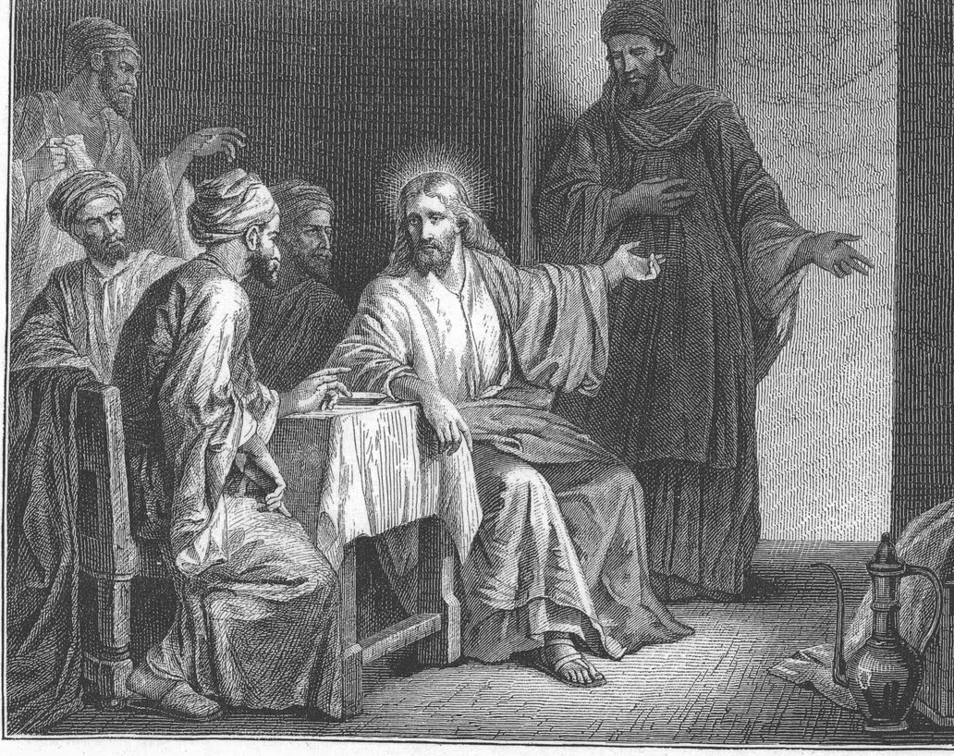
Acute Heart Failure
Luke 14, 1-6: One Sabbath, when Jesus went to eat in the house of a prominent Pharisee, he was being carefully watched. There in front of him was a man suffering from abnormal swelling of his body… So taking hold of the man, he healed him and sent him on his way.
Zack Wilson
Heart Failure Fellow, PGY7

Slide 2
Learning Objectives
1) Describe the fundamental pathophysiology and natural history of heart failure.
2) Assess a patient’s volume status through comprehensive clinical evaluation and bedside examination.
3) Explain the principles and strategies of decongestion, including the use of loop diuretics, thiazide diuretics, and adjunctive agents.
4) Compare and evaluate in-hospital strategies for initiation and up-titration of guideline-directed medical therapy (GDMT).
5) Identify clinical features indicative of cardiogenic shock and advanced heart failure.

Slide 3
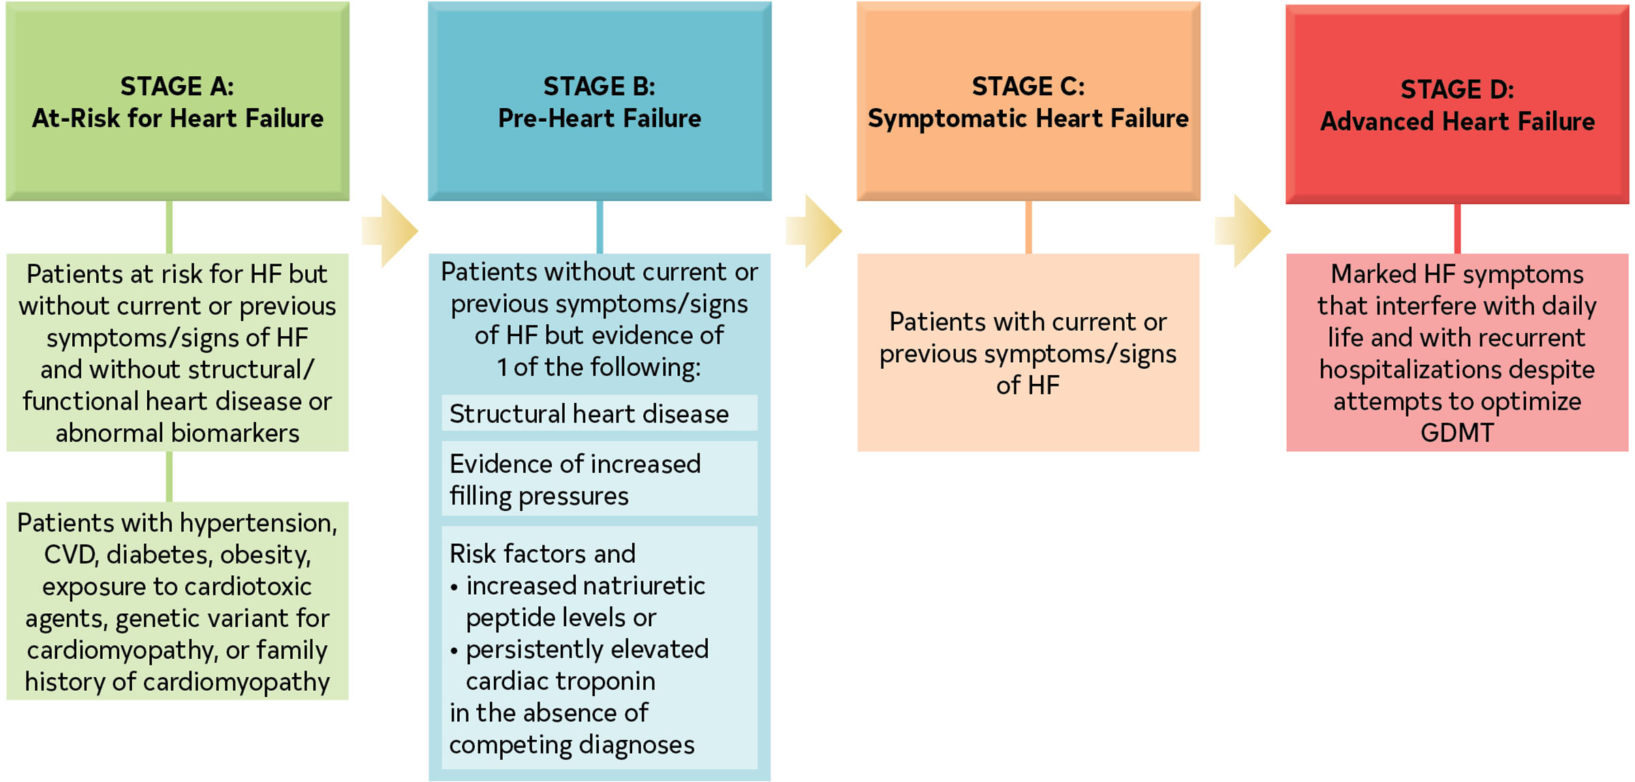
Definition of heart failure
HF is a complex clinical syndrome with symptoms and signs that result from any structural or functional impairment of ventricular filling or ejection of blood.

Slide 4
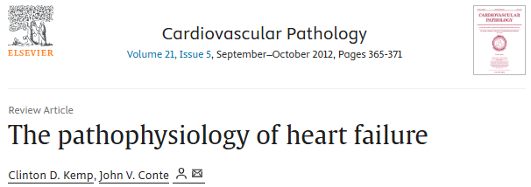
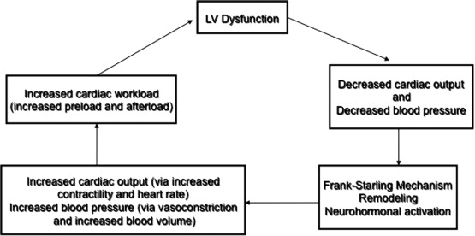
Pathophysiology of heart failure
Simple
Treatments:
Diuretics
GDMT

Slide 5
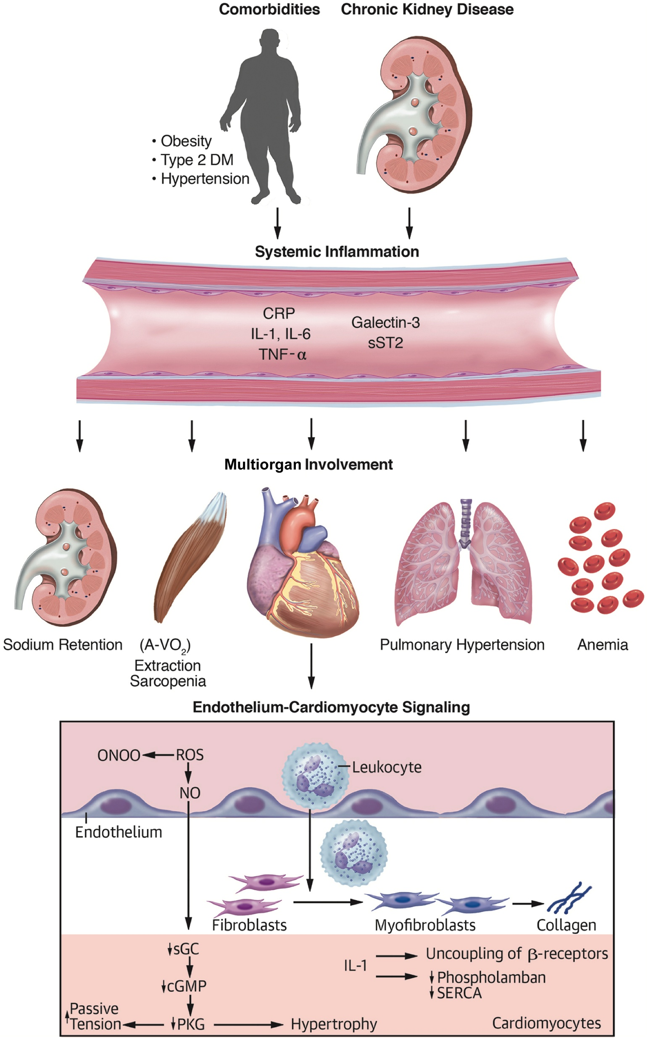
MUCH MORE COMPLEX!

Slide 6
Question 1
Which of the following clinical conditions has been shown to carry a worst prognosis?
Myocardial Infarction
Heart Failure
Bowel Cancer
Ovarian Cancer
Breast Cancer

Slide 7
Question 1
Which of the following clinical conditions has been shown to carry a worst prognosis?
Myocardial Infarction
Heart Failure
Bowel Cancer
Ovarian Cancer
Breast Cancer

Slide 8
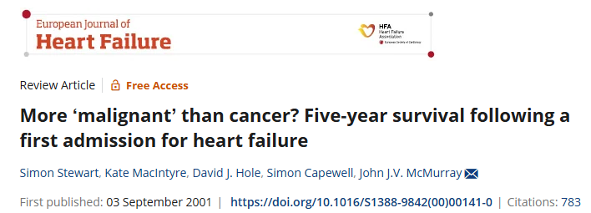
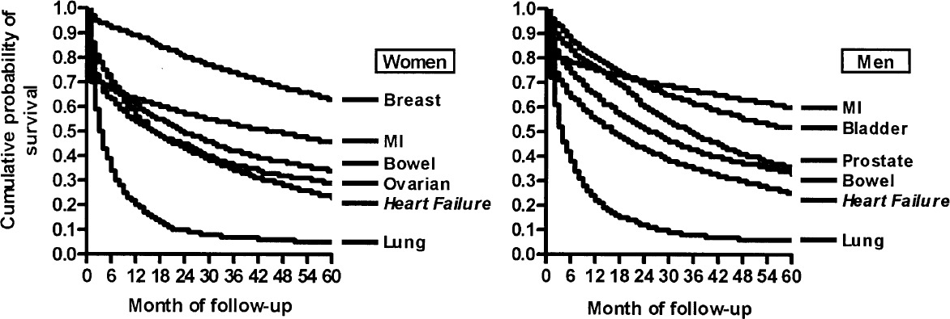
Natural history of heart failure
With the exception of lung cancer, heart failure was associated with the poorest 5-year survival rate (approximately 25% for both sexes). Data from 1991 in Scottland

Slide 9
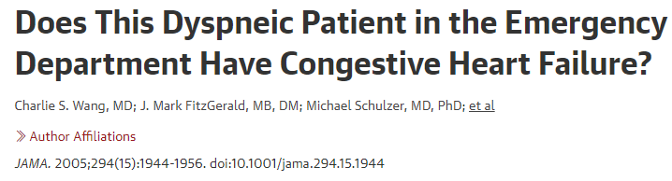
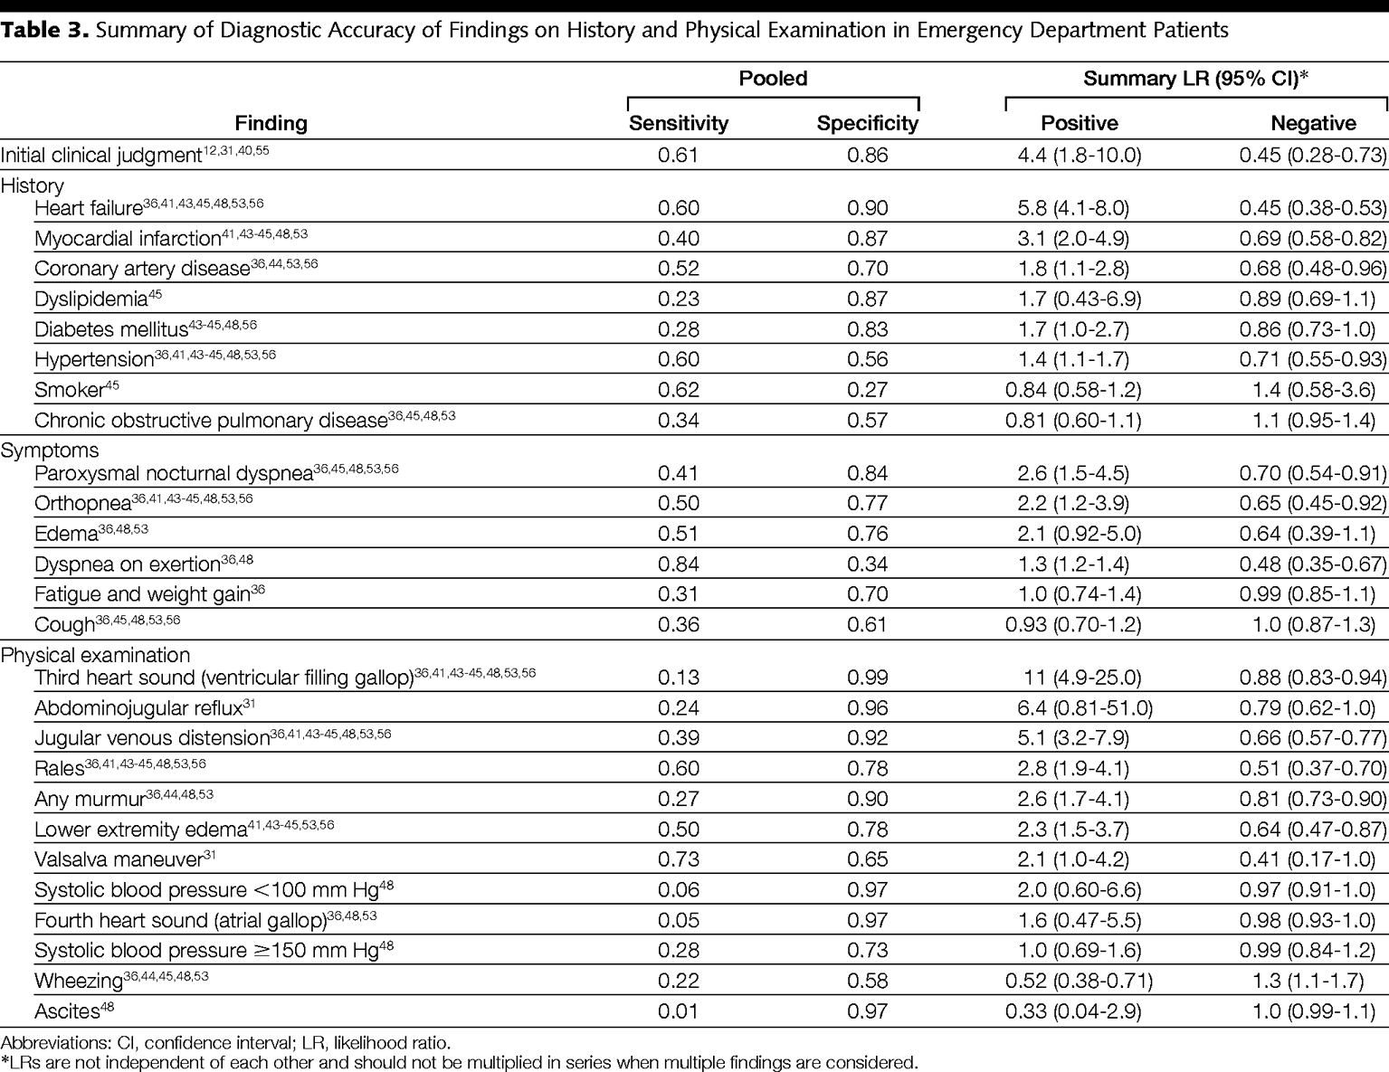
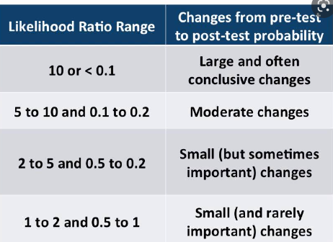

Slide 10
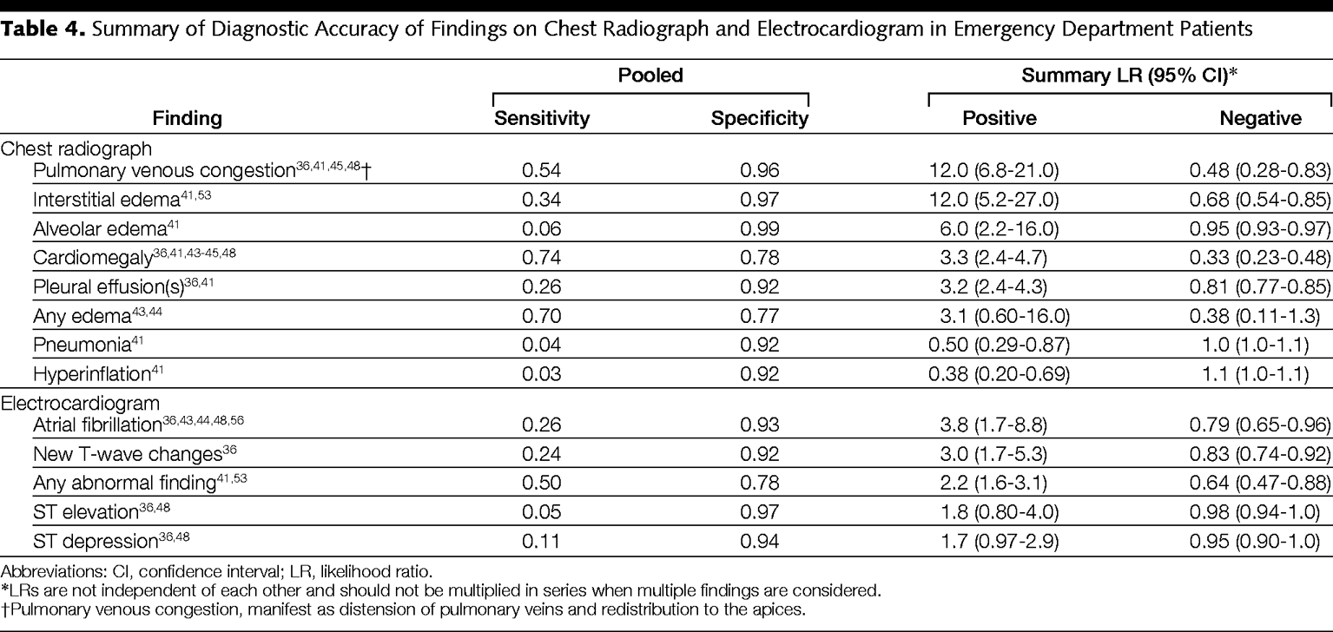
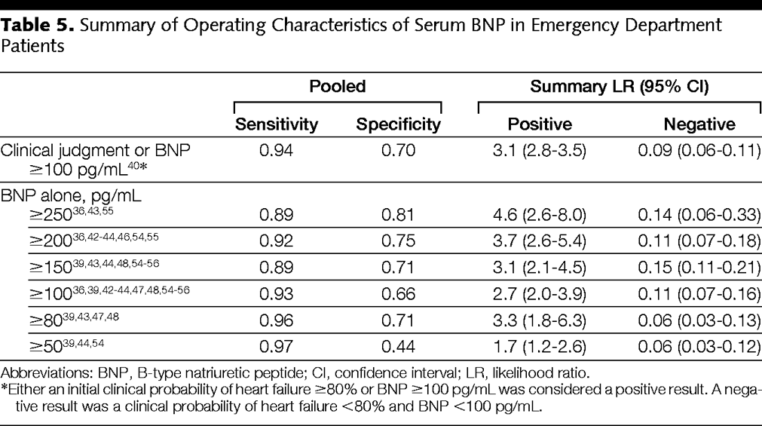

Slide 11
Diagnosis

Slide 12
Question #2
Which sign and/or symptom is the most specific for an acute heart failure diagnosis?
A) Orthopnea
B) Presence of edema
C) Rales
D) Weight Gain
E) Audible S3

Slide 13
Question #2
Which sign and/or symptoms is the most specific for heart failure diagnosis?
A) Orthopnea
B) Presence of edema
C) Rales
D) Weight Gain
E) Audible S3

Slide 14
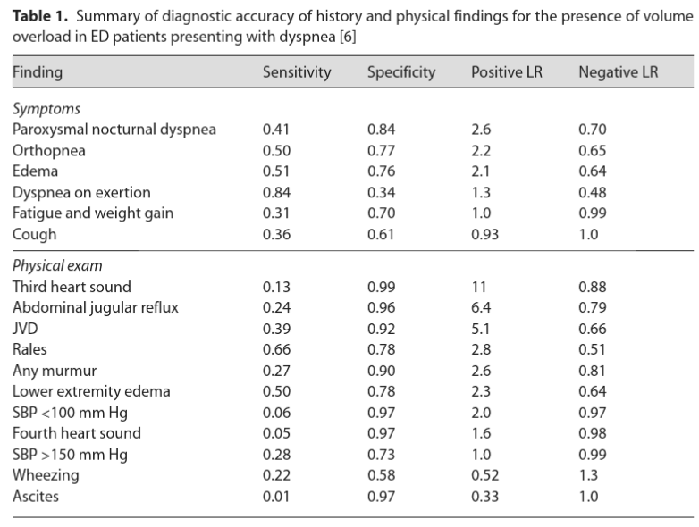

Slide 15
Most helpful history findings:
Hx of CHF or MI (presence or absence)
PND (presence or absence)
DOE (absence)
Least helpful exam findings :
Fatigue/Weight Gain (presence or absence)
Cough (presence or absence)
Most helpful exam findings:
3rd Heart Sound (presence)
HJR or AJR (presence)
JVD (presence or absence)
Least helpful exam findings :
Edema (presence or absence)
Blood Pressure cutoffs
Wheeze (presence or absence)
Ascites (presence or absence)
Most helpful diagnostic findings:
BNP (presence (>80) or absence (<80))
Pulmonary Venous Congestion (presence or absence)
Interstitial Edema (presence)
Alveolar Edema (presence)
Cardiomegaly (absence)
Afib on ECG (presence)
Least helpful diagnostic findings:
Any edema (presence or absence)
Hyperinflation (presence or absence)
ST Changes (presence or absence)

Slide 16
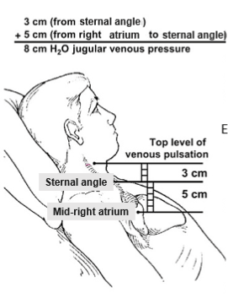
My approach to measuring jugular venous pressure/distention
Technique:
Sit patient upright
Turn neck to the left. Ensure you have good lighting.
Scan from temple down to the clavicle looking for triphasic waveform.
Press firmly on RUQ, it should rise 1-2cm, if it remains elevated for ~30 secs then +HJR.
Try occluding below the pulsation, it will disappear. Carotid won’t occlude.
Try tilting patient back to 45 degrees or farther.
Look at both sides.
Alternate:
Hand vein distension
U/S guided JVP
Tips:
When patient is upright.
  JVP not visible at clavicle? <10cm
  Just visible at clavicle? ~10cm
  Mid neck? ~15cm
  Mandible or above? >20cm
Both the EJV and IJV are valid for assessment.
Use a penlight, otoscope to shine light on neck
Pitfalls:
Not checking both sides
Not checking upright and looking from temple down
Not occluding to exclude carotid pulsation
Presence of TR which overestimates volume status.
To convert JVP in cm H2O to CVP in mmHg divided by 1.3.

Slide 17
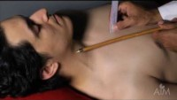
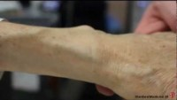
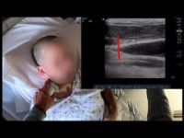

Slide 18
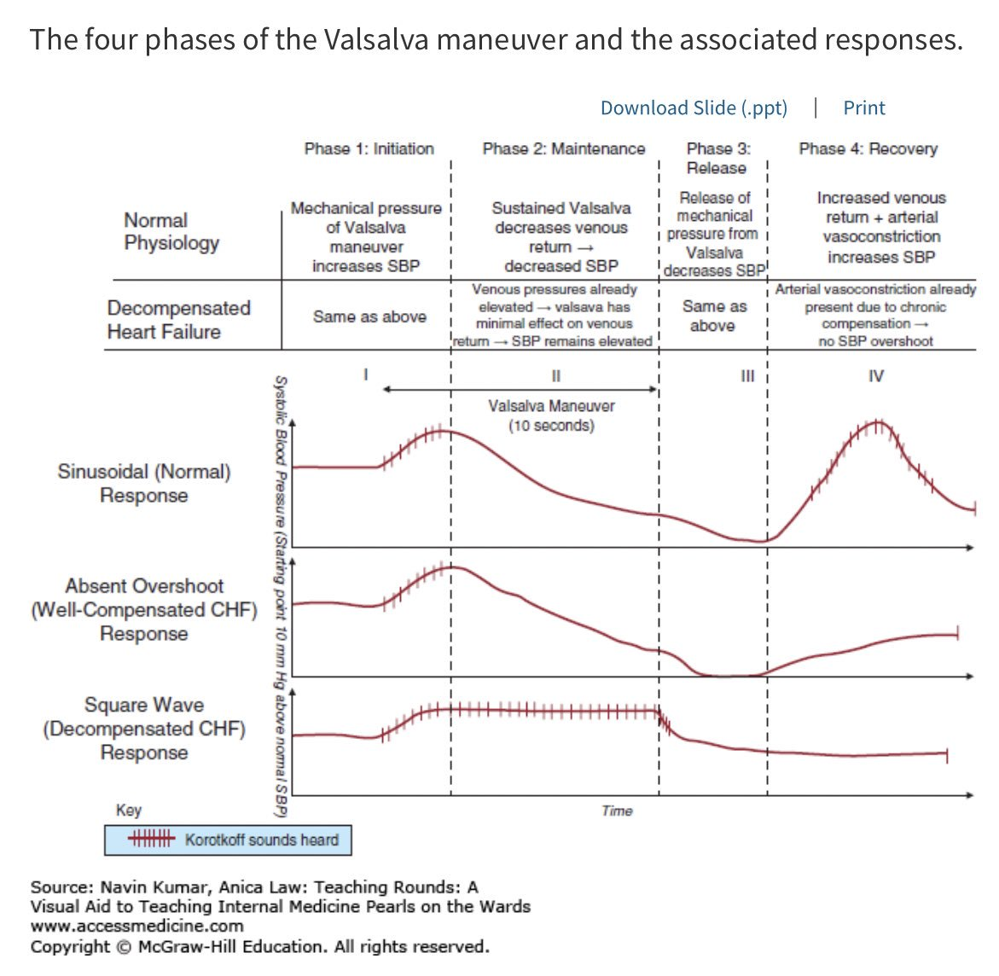

Slide 19
What is square wave response?
Technique:
Inflate and lock a blood pressure cuff to 15 mm Hg above the resting supine systolic pressure (Korotkoff sounds should not be audible at this point)
Have the patient performs a sustained Valsalva (exhalation against a closed glottis) for at least 10 seconds.
Monitor and record BP response for another 15 seconds.
Normal response:
Systolic blood pressure immediately rises 30 to 40 mm Hg above baseline for 1 to 3 seconds (phase 1, appearance of Korotkoff sounds).
As venous return decreases, systolic blood pressure drops sharply below baseline (phase 2, disappearance of Korotkoff sounds).
When the Valsalva is released, there is a further drop of systolic blood pressure below baseline (phase 3, continued absence of Korotkoff sounds).
Between 3 to 15 seconds after release, systolic blood pressure rises 15 mm Hg or more above the baseline level (phase 4, reappearance of Korotkoff sounds).^{21,31-34}
Abnormal responses described in heart failure:
Absent overshoot response, phases 1 to 3 are normal, but Korotkoff sounds do not reappear in phase 4.
Squarewave response, phase 1 is normal, but Korotkoff sounds are present in phases 2 and 3, followed by disappearance in phase 4.

Slide 20
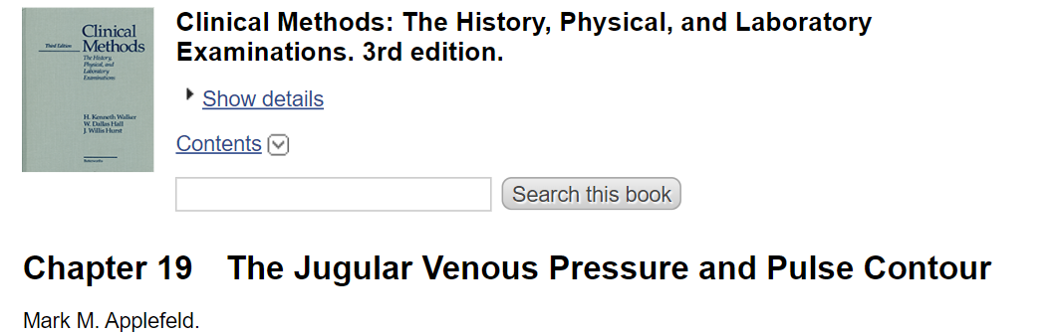
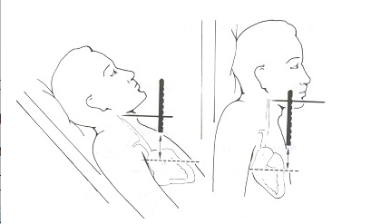
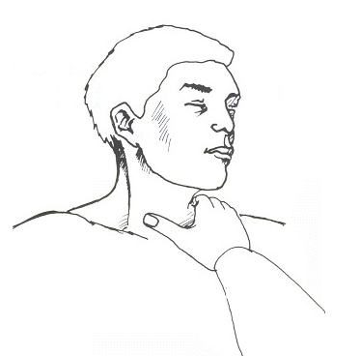
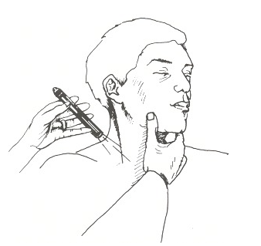

Slide 21
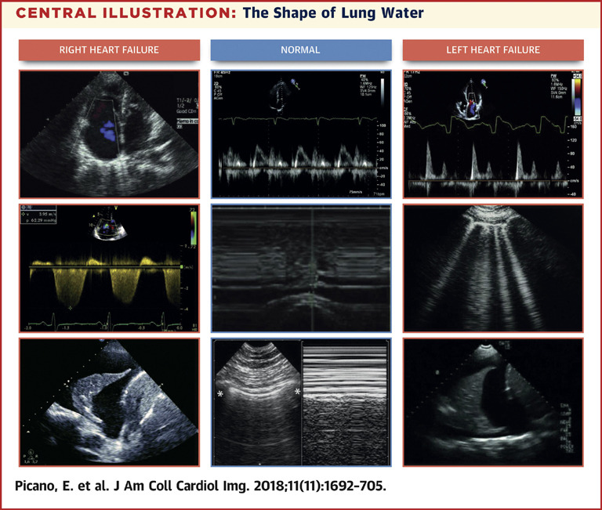

Slide 22
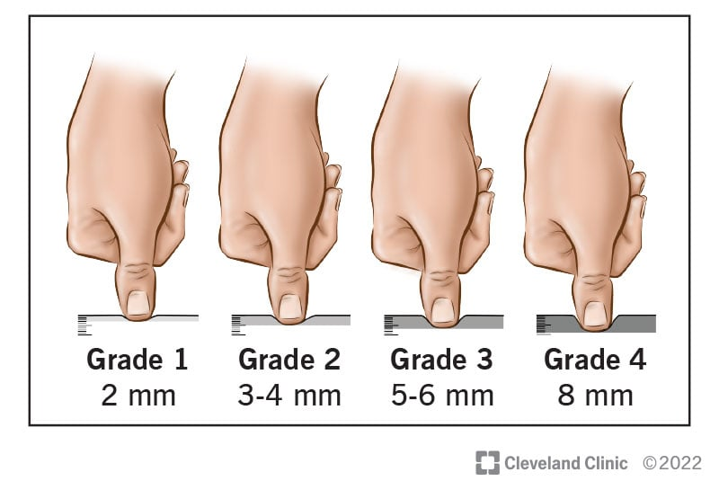
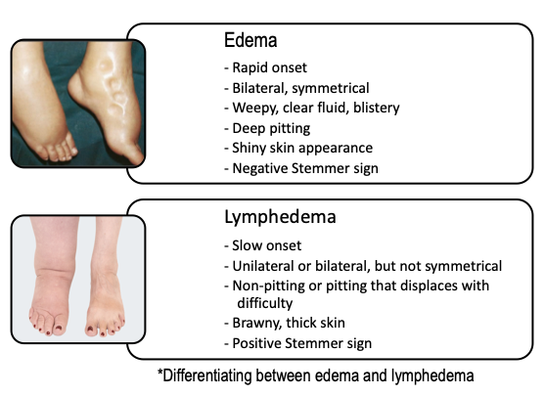
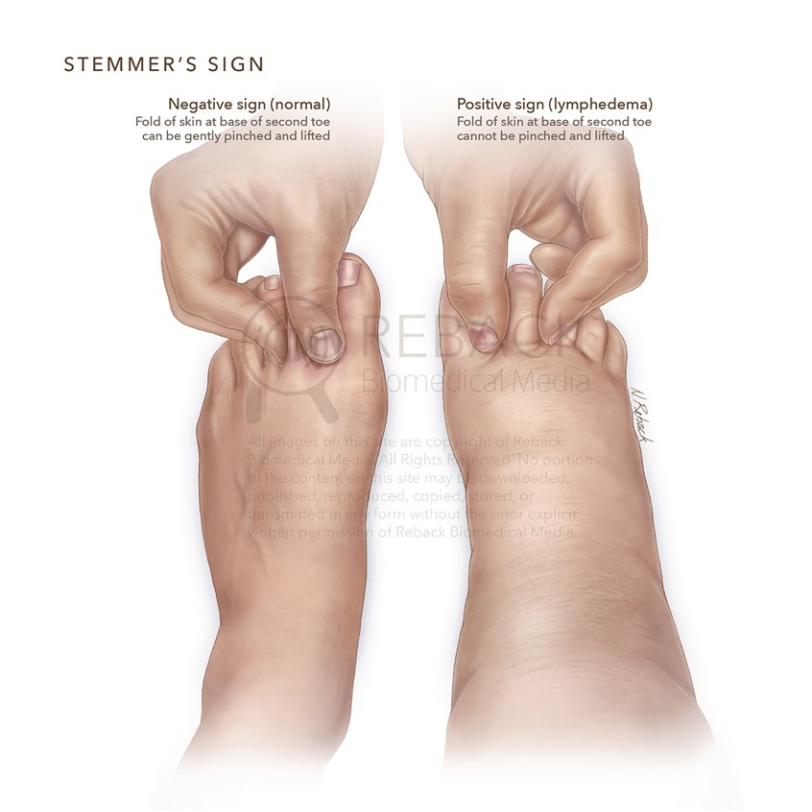

Slide 23
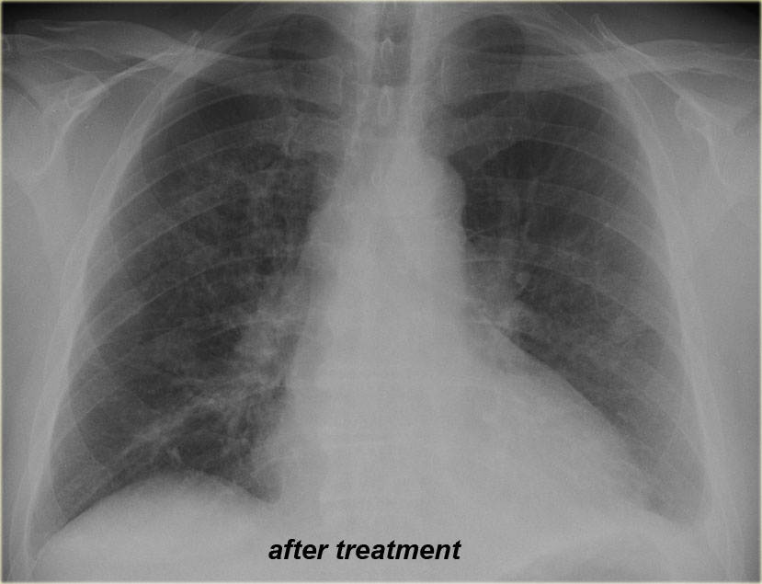
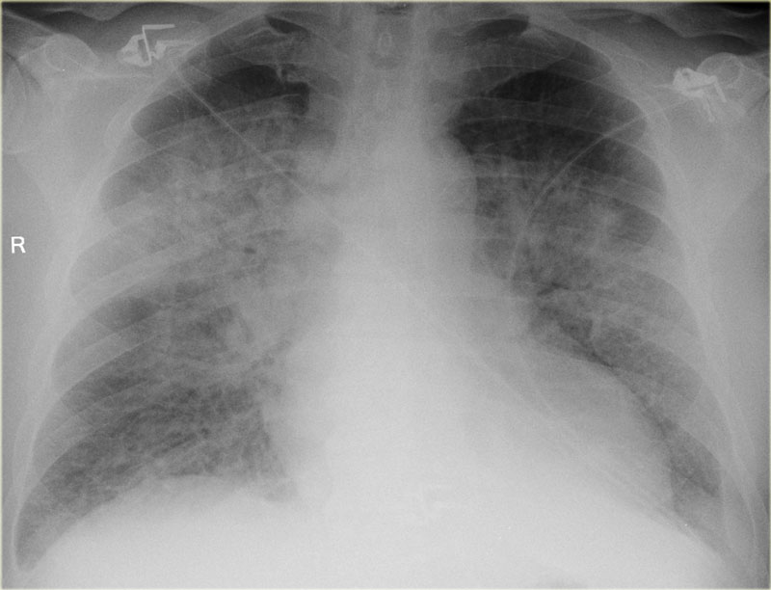
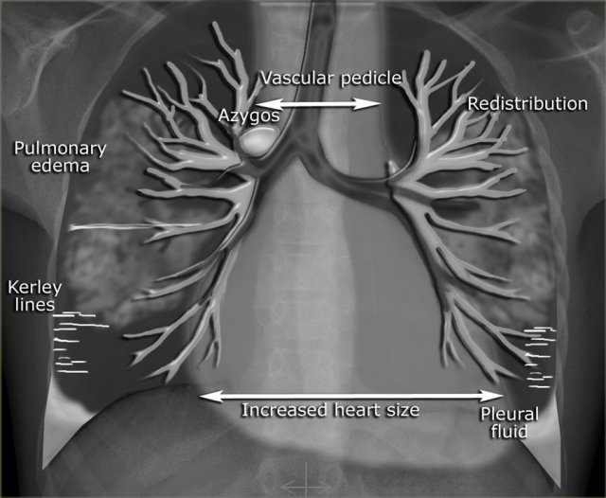

Slide 24
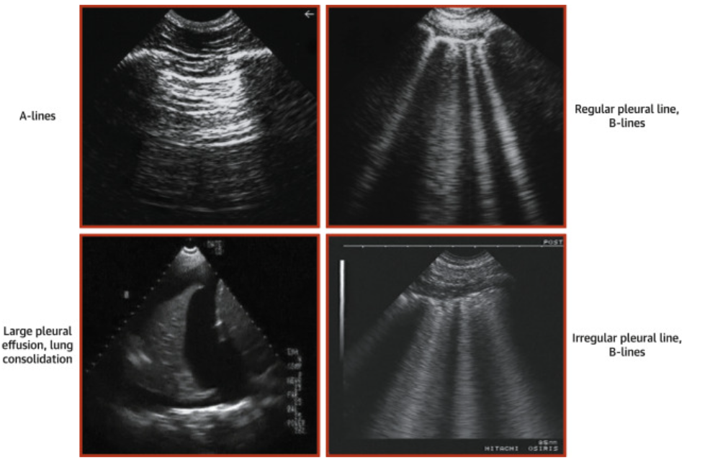
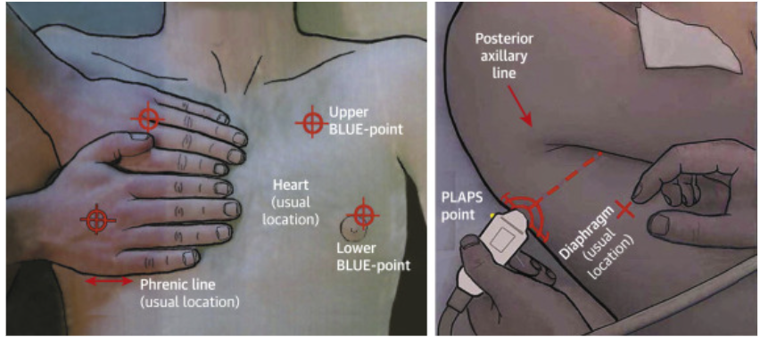
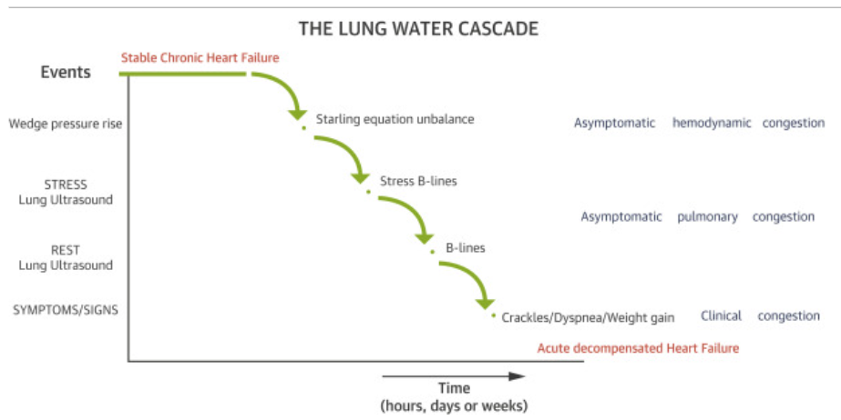
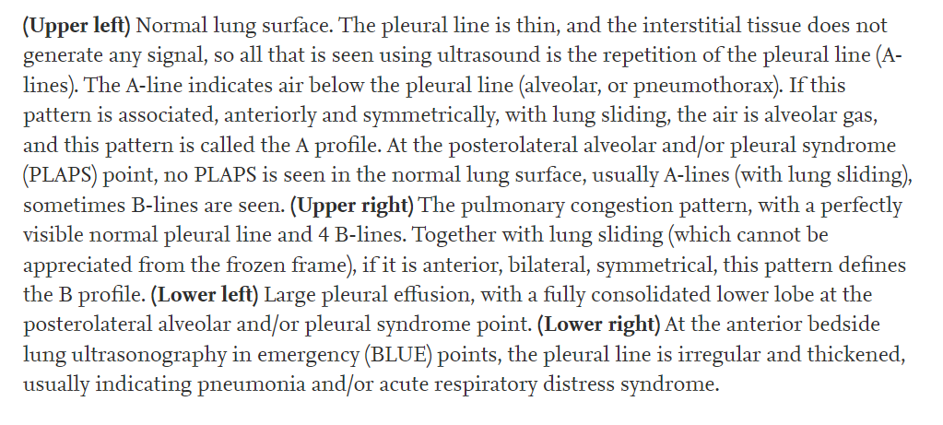

Slide 25
Question #3
A 67-year-old man with multivessel CAD s/p multiple MI’s and known LVEF 20% on Entresto 24/26mg BID, spironolactone 25mg QD, Coreg 6.25mg BID and Bumex 2mg BID presents to the ED with worsening dizziness and dyspnea. He has had multiple hospital admissions this year for congestion. During his last admission, his diuretics were intensified.
Vitals: BP 87/44, HR 112, SpO2 95%
Exam: Obese man, alert but lethargic, Lungs clear, JVP estimated at 6cm H2O, Heart RRR with III/VI systolic murmur, no pitting edema is noted, legs are cool to touch.
What is the hemodynamic profile of this patient and its appropriate treatment?
A) Warm and Wet -> start diuretics and hold all GDMT
B) Cold and Wet -> Hold beta blocker and give IVFs
C) Cold and Dry -> Hold beta blocker and give IVFs
D) Warm and Dry -> Continue GDMT

Slide 26
Question #3
A 67-year-old man with multivessel CAD s/p multiple MI’s and known LVEF 20% on Entresto 24/26mg BID, spironolactone 25mg QD, Coreg 6.25mg BID and Bumex 2mg BID presents to the ED with worsening dizziness and dyspnea. He has had multiple hospital admissions this year for congestion. During his last admission, his diuretics were intensified.
Vitals: BP 87/44, HR 112, SpO2 95%
Exam: Obese man, alert but lethargic, Lungs clear, JVP estimated at 6cm H2O, Heart RRR with III/VI systolic murmur, no pitting edema is noted.
What is the hemodynamic profile of this patient and its appropriate treatment?
A) Warm and Wet -> start diuretics and hold all GDMT
B) Cold and Wet -> Hold beta blocker and give IVFs
C) Cold and Dry -> Hold beta blocker and give IVFs
D) Warm and Dry -> start diuretics and continue GDMT

Slide 27
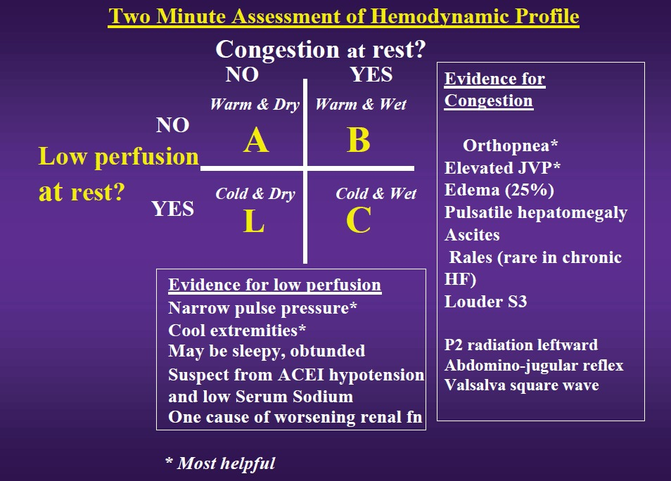

Slide 28
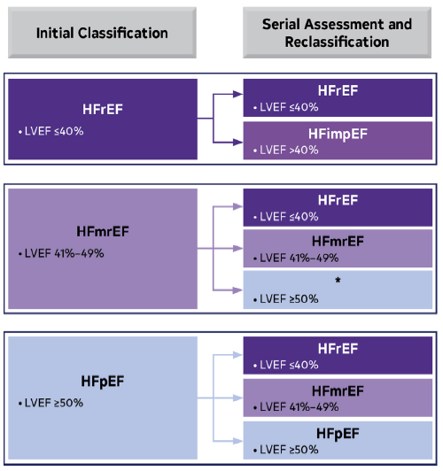
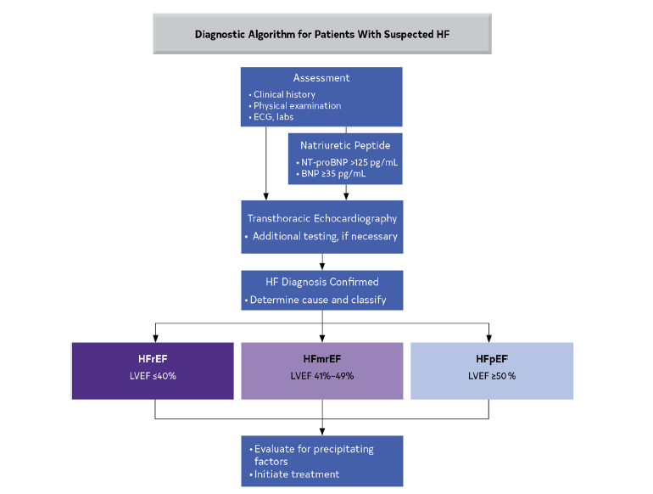
Basic HF Labs: CBC, CMP, HS-troponin, NT-pro BNP, TSH, Iron Profile (with ferritin), UA, and CK. Consider UDS.

Slide 29
Treatment - Overview
Goal #1 Decongestion:
Loop diuretics
  IV bolus vs continuous infusion?
  Dosing?
Thiazide diuretics
  When to add?
  What do we monitor?
Acetazolamide
  When to add?
  What do we monitor?
How do we define euvolemia?
Worsening renal function
Goal #2 Initiation of guideline directed medical therapy:
  Renin-Angiotensin System inhibitors
  Beta Blockers
  Mineralocorticoid receptor blockers
  Sodium-glucose co-transporter 2 inhibitors
When to add?
In what order?
At what dose?
How many while inpatients?

Slide 30
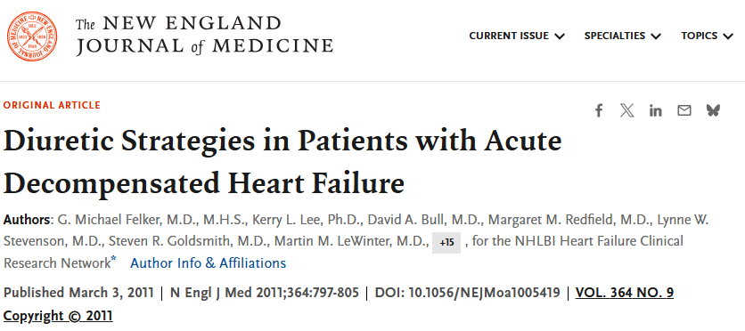
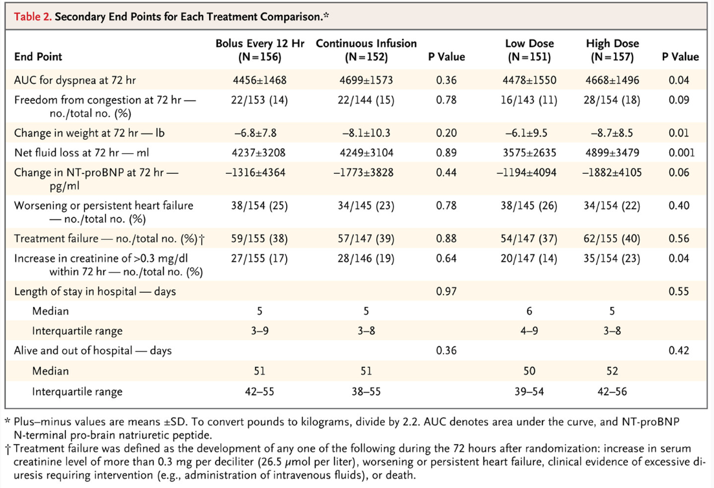
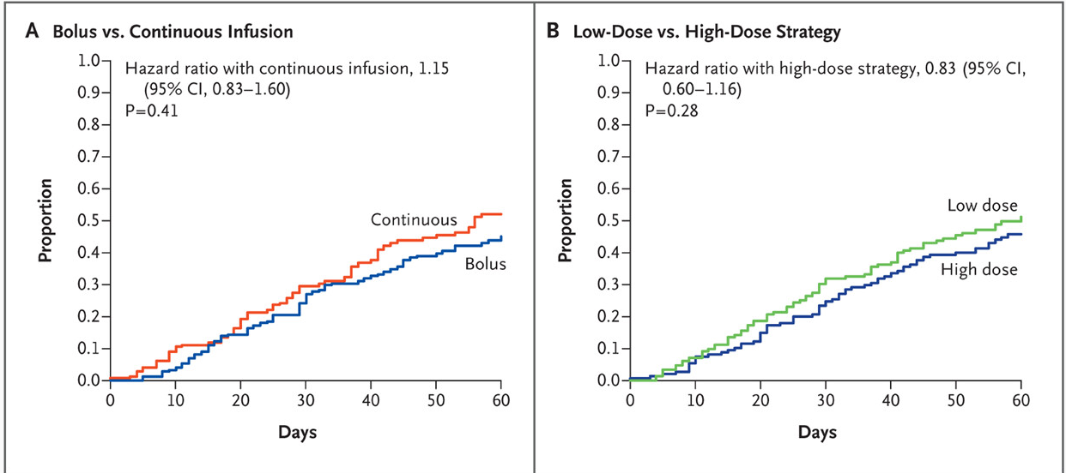
Treatment
Goal #1 Decongestion:
Loop diuretics
  Furosemide 20-160mg IV BID or TID
  Bumetanide 0.5-3mg IV BID or TID
IV bolus Q12H vs continuous infusion?
    Doesn’t matter, no difference.
    This doesn’t mean a continuous infusion is wrong.
Dosing?
    High dose (2.5x home oral dose) is better than low dose.
    Double the dose until desired response, please don’t wait 12 hours.

Slide 31
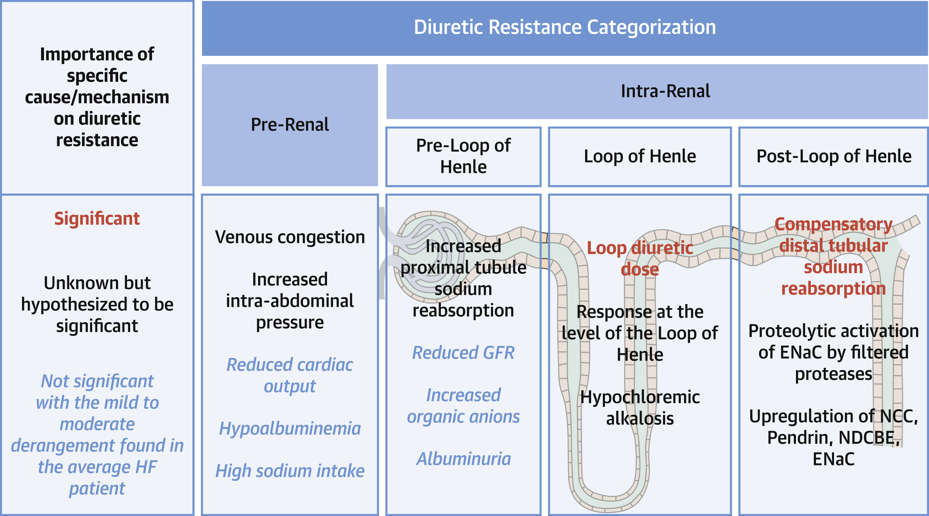
Treatment
Goal #1 Decongestion:
Thiazide diuretics
  Metolazone 2.5-5mg once daily or Chlorthalidone 250-500mg BID
  When to add?
    When “diuretic resistance” is encountered. No clear definition.
    >150cc/hr (3600cc in 24 hrs) is a reasonable goal
    Post-diuretic spot urine sodium <50 to 70 mmol/l is associated with higher risk of worsening kidney function, worsening HF, and long-term adverse events. Can be useful.
  What do we monitor?
    BMP at least Q12, consider Q6H if using continuous infusion or daily thiazide augmentation.

Slide 32
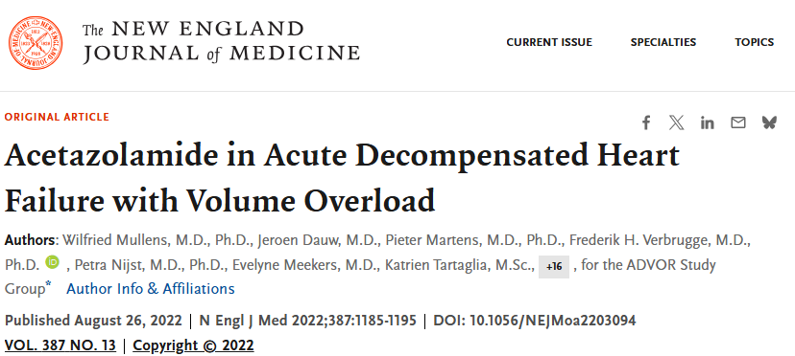
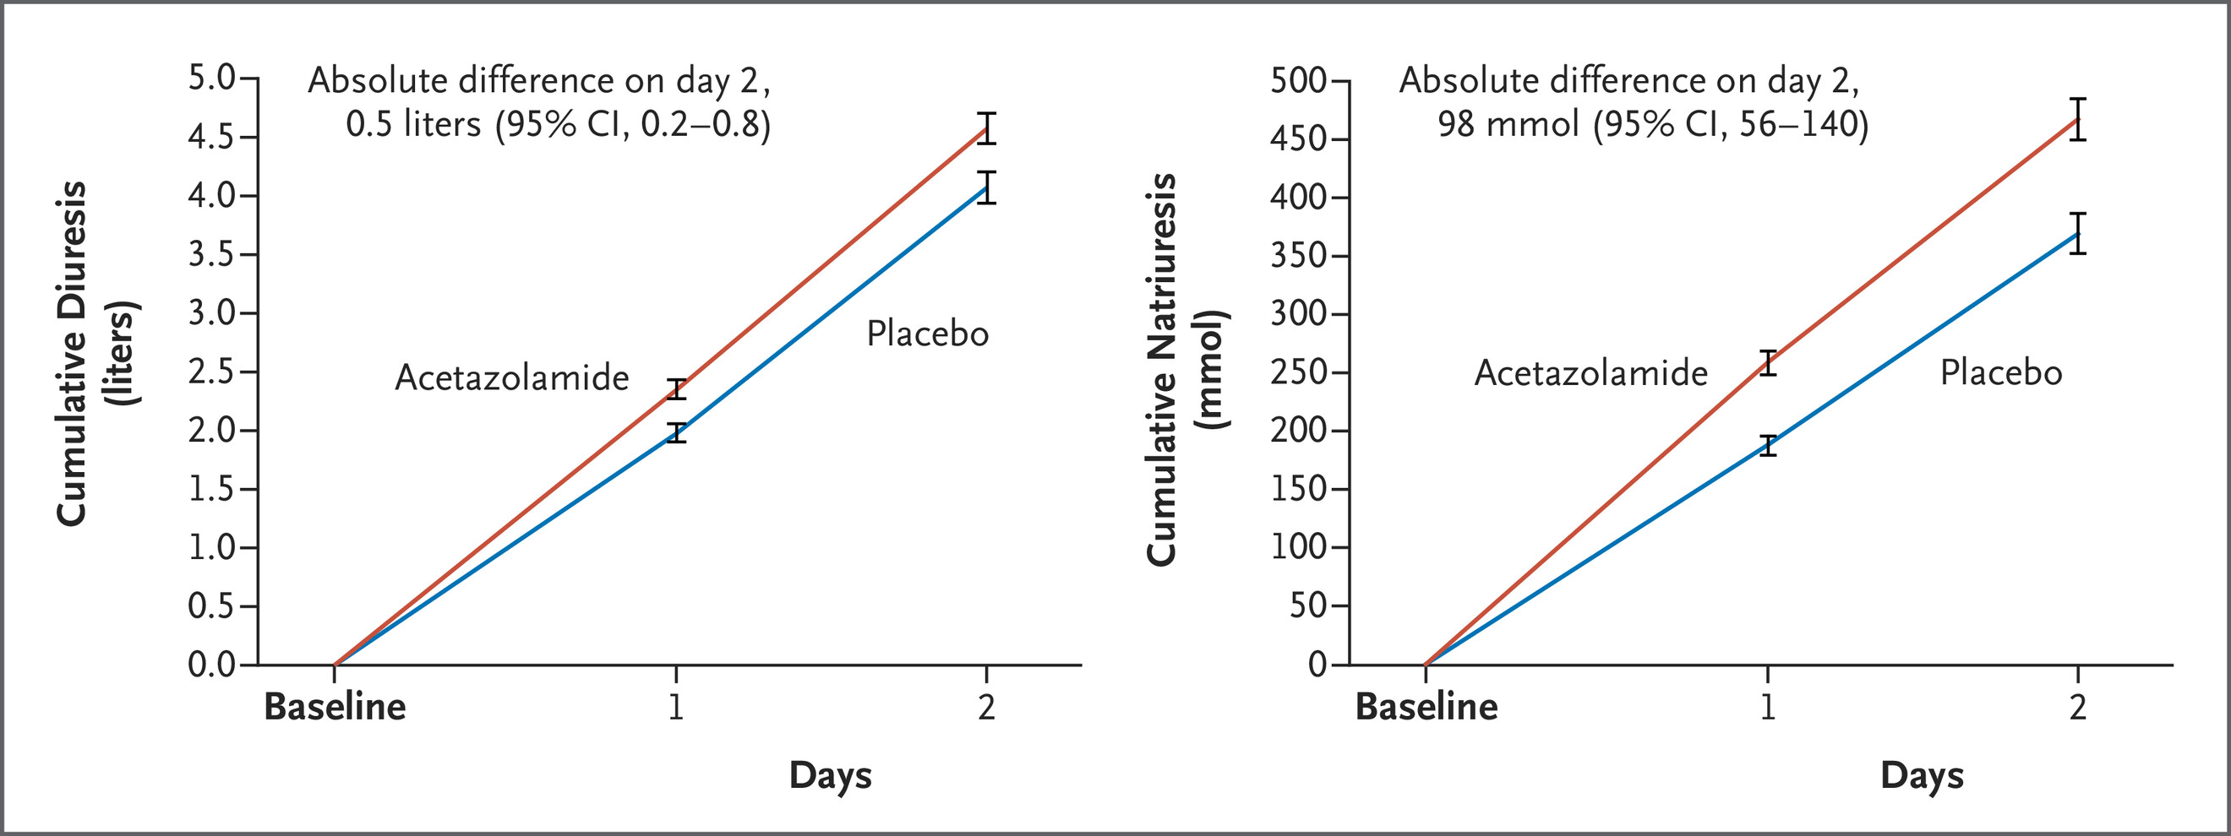
Treatment
Goal #1 Decongestion:
Acetazolamide 250-500mg PO or IV daily
  When to add?
    Often when HCO3 > 27 so called contraction alkalosis.
  What do we monitor?
    BMP daily at minimum

Slide 33
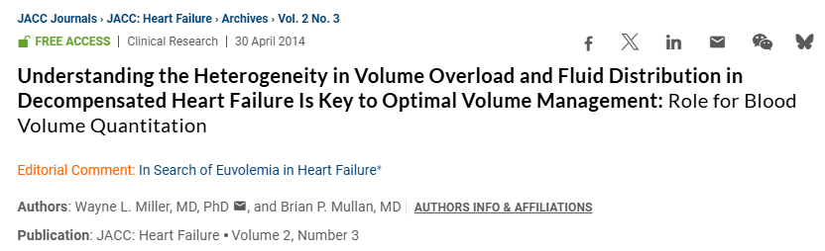
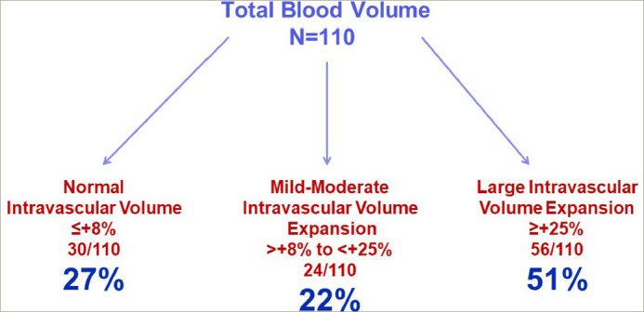
Treatment
Goal #1 Decongestion:
How do we define euvolemia?
  No more dyspnea?
  No more JVD?
  No more edema?
  Patient looks like a raisin?
  Your nephrologist is getting upset at this AKI?
  The pharmacist has no more loop diuretics left?
  Patient is now dust?
  Doesn’t matter and what we are doing is working

Slide 34
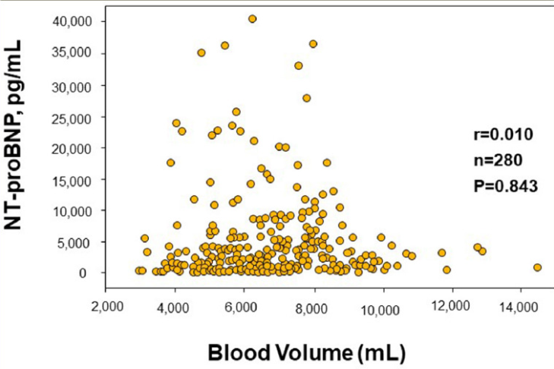
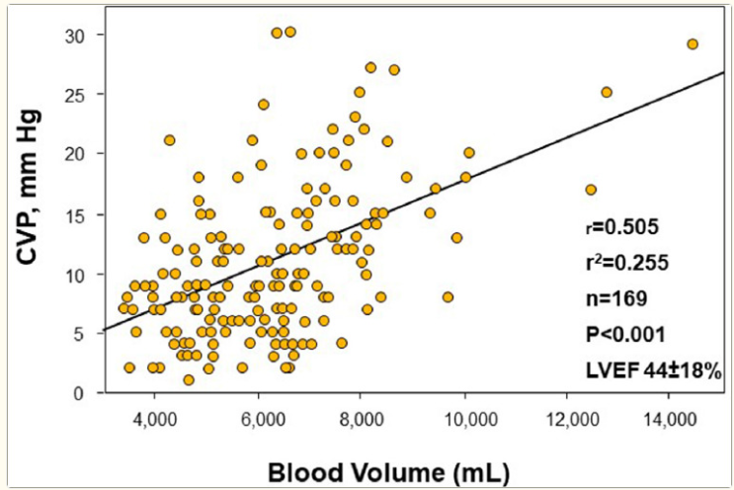
Treatment
Goal #1 Decongestion:
How do we define euvolemia?
  Clinical targets:
    Improvement in symptoms and exam findings
    Negative fluid balance
    Decreased body weight
    RHC:
      CVP <5 mmHg
      PCWP <10 mmHg
    NT-pro BNP improvement
    IVC size on echo
    Increased hematocrit
    Chest X-ray

Slide 35
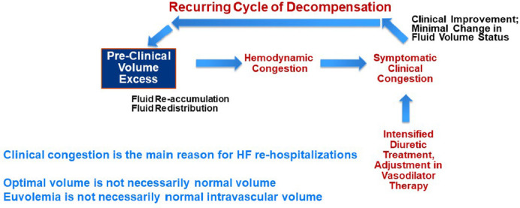
Treatment
Goal #1 Decongestion:
How do we define euvolemia?

Slide 36
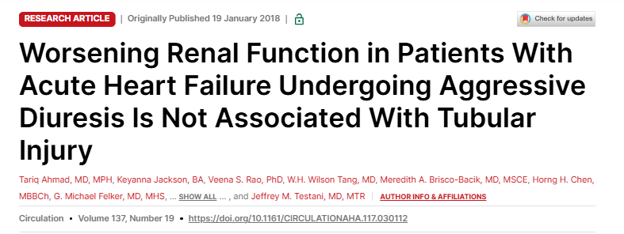
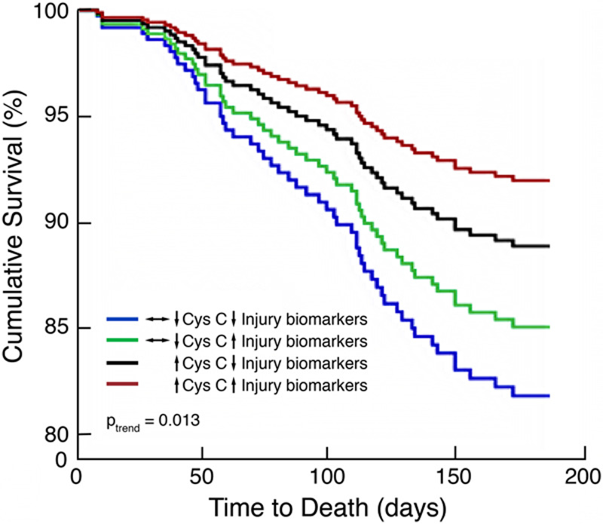
Treatment
Goal #1 Decongestion:
Worsening renal function, >20% decrease in eGFR
  Normal to see a rise in creatinine.
  Patients are better off decongested with mild-moderate increase in creatinine than falsely reassured with “normal” renal function but persistent congestion.
  RHC if suspected poor perfusion
Median total Lasix dose of 560mg in 72 hrs

Slide 37
Treatment
Goal #2 Initiation of guideline directed medical therapy:
  Renin-Angiotensin System inhibitors
  Beta Blockers
  Mineralocorticoid receptor blockers
  Sodium-glucose co-transporter 2 inhibitors
When to add?
In what order?
At what dose?
How many while inpatients?

Slide 38
Treatment
Goal #2 Initiation of guideline directed medical therapy:
When do I add GDMT?
  ASAP
  RASI early, especially if hypertensive with preference to ARNI > ACEi/ARB
    ACE and ARNI C/I if history of angioedema; ARB may be okay
  MRA has minimal effect on BP and offsets hypokalemia of diuretics
    Avoid if eGFR <30 or K >5
  SGLT2 is well tolerated with mild BP lowering.
    Caution in poorly controlled DM.
    Avoid if eGFR <20, frequent/active UTIs or genital yeast infections and T1DM
  Beta-blocker once euvolemic
    Caution if patient is tachycardic at rest (can suggest poor output state)

Slide 39
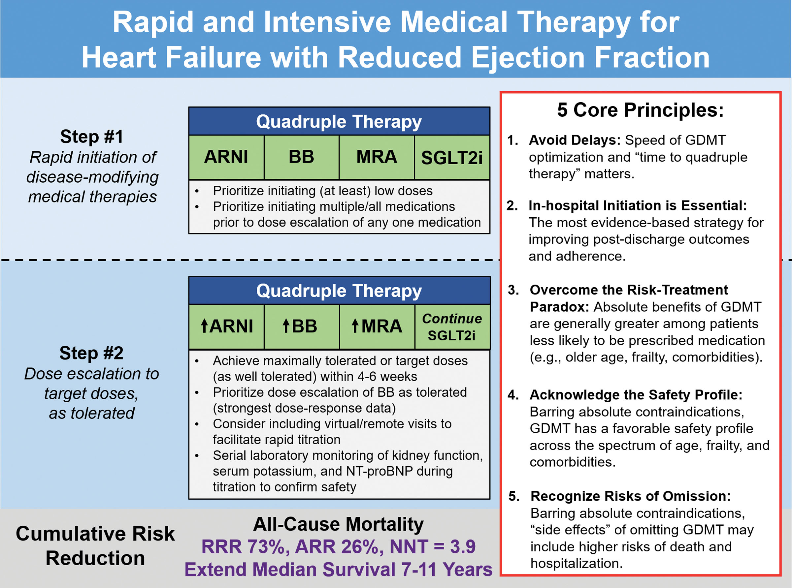
Treatment
Goal #2 Initiation of guideline directed medical therapy:
In what order do I add GDMT?

Slide 40

Treatment
Goal #2 Initiation of guideline directed medical therapy:
What doses should I target?

Slide 41



Treatment
Goal #2 Initiation of guideline directed medical therapy:
How many can I add while inpatient?

Slide 42


A brief word on “advanced” heart failure
Cardiogenic Shock
Stage D Heart Failure

Slide 43
Discharge Checklist
Patient has been classified
  HFpEF, HFmrEF, HFrEF, HFimpEF
  Warm and wet, etc…
Etiology of exacerbation has been addressed?
  HF education
  Prescriptions refilled
  Vaccines updated
  Follow-up established (1-2 weeks)
Patient is euvolemic.
  Did I try to decongest them as much as reasonably possible?
Guideline directed medical therapy has been started
  As many agents as possible at low doses preferred

