Slide 1





Breast Cancer Screening
Academic Half-Day
May 19, 2026

Slide 2
Join Your Team
Go to: https://buzzin.live/play
Room Code:
Enter your name and join team:
    [Team A]:
    [Team B]:
    [Team C]:
    [Team D]:

Slide 3
Numbers to Memorize (Screening Guidelines)
Risky Business
(Tools & Models)
Just Get Imaging
(Modalities)
Correlate Clinically
(BI-RADS)
Are We Done Yet?
(Cases)
200
200
200
200
200
200
200
200
200
200
400
400
400
400
400
400
400
400
400
400
600
600
600
600
600
600
600
600
600
600
800
800
800
800
800
800
800
800
800
800
1000
1000
1000
1000
1000
1000
1000
1000
1000
1000

Slide 4
200
This organization recommends biennial mammography for women age 40–74 at average risk

Slide 5
U.S. Preventive Services Task Force (USPSTF)
Biennial screening mammography for all average-risk women aged 40–74
Major update in 2024 from 2016: previously recommended starting at age 50 with shared decision-making for ages 40–49; now universally starts at 40
Starting at 40 (vs. 50) averts ~1.3 additional breast cancer deaths per 1,000 women screened over a lifetime
USPSTF Recommendation Statement, JAMA 2024; Trentham-Dietz et al., JAMA 2024 (CISNET modeling); ACR Appropriateness Criteria, JACR 2024
Notes:
Why biennial, not annual? Biennial captures most of the mortality benefit while halving false-positive recalls (~1,376 per 1,000 women lifetime) and benign biopsies
Why not ACR? ACR recommends annual mammography starting at 40 with no upper age limit
Why not ACS? ACS recommends annual starting at age 45 (option to start at 40), transitioning to biennial at 55

Slide 6
400
This modality can be used by a 45-year-old average-risk woman for screening instead of mammogram:
MRI, breast ultrasound, or clinical breast exam?

Slide 7
None. Mammography is the ONLY screening modality recommended by the USPSTF for average-risk women
Clinical breast exam: USPSTF issues an I statement (insufficient evidence)
  No mortality benefit of CBE when added to mammography.
  ACS explicitly recommends against routine CBE
  ACOG and NCCN state CBE "may be offered" but is not required
Breast self-exam: USPSTF gives a Grade D recommendation (recommend against)
  No mortality benefit but significantly increased benign biopsies
Ultrasound and MRI: Not recommended as primary screening for average-risk women
  Both are supplemental tools reserved for specific populations (dense breasts, high-risk patients)
  Ultrasound has high false-positive rates; MRI is expensive and has lower specificity
USPSTF Recommendation Statement, JAMA 2024; NCCN Breast Cancer Screening and Diagnosis v1.2026
Notes:
Any boards question offering MRI, BSE, or ultrasound as an alternative to mammography → the answer is mammography is the standard of care. The only acceptable substitution question on boards is digital mammography vs. tomosynthesis (both are acceptable per USPSTF, ACR, and NCCN)

Slide 8
600
This is the recommendation regarding supplemental MRI screening in women with dense breasts but otherwise average risk
Notes:
Bonus points for NCCN and ACS. Which one is most important on boards?

Slide 9
Supplemental MRI is not routinely recommended for average-risk women with dense breasts
USPSTF issues an "I statement" (insufficient evidence) for supplemental MRI or ultrasound in women with dense breasts and a negative mammogram
Adding MRI markedly increases false-positive recalls and biopsies with only modest increase in cancer detection
Dense breasts ≠ high risk: Breast density is an independent risk factor and reduces mammographic sensitivity, but alone does not reclassify a woman as high-risk
Supplemental MRI IS recommended for high-risk women: lifetime risk ≥20%, BRCA1/2 carriers, prior chest radiation, Li-Fraumeni/Cowden syndrome
As of Sept 2024, FDA requires breast density notification on all mammograms
Expect patient questions but do not reflexively order supplemental imaging for average-risk women
USPSTF Recommendation Statement, JAMA 2024; Trentham-Dietz et al. (CISNET), JAMA 2024; NCCN Breast Cancer Screening and Diagnosis v1.2026 (BSCR-1); ACP Guidance Statement on Screening for Breast Cancer, Version 2, 2026
Notes:
What changed in 2024? The USPSTF lowered the starting age from 50 to 40
Previously a C recommendation for ages 40–49, now a B recommendation for all 40–74
Key drivers:
Rising breast cancer incidence in women aged 40–49
Modeling showing 1.3 additional deaths averted per 1,000 women by starting at 40 vs. 50
Greater absolute benefit for Black women (1.8 additional deaths averted per 1,000)

Slide 10
800
These patients qualify for risk-reducing medications such as tamoxifen or raloxifene based on elevated 5-year risk
(Percent risk level)

Slide 11
Women with ≥3% 5-year breast cancer risk
(and low risk of adverse effects)
The historical trial enrollment threshold was ≥1.67%, but the USPSTF recommends the higher ≥3% threshold because net benefit is substantially greater at this level
Approved agents:
  Tamoxifen (pre- or postmenopausal)
  Raloxifene (postmenopausal only)
  Aromatase inhibitors, anastrozole or exemestane (postmenopausal only)
  All given for 5 years
Key harms to weigh: VTE (tamoxifen, raloxifene), endometrial cancer (tamoxifen)
USPSTF Recommendation Statement, JAMA 2019; Visvanathan et al. (ASCO Guideline Update), JCO 2019
Notes:
On boards, if 5-year risk ≥3%, discuss chemoprevention; if 3%, harms likely outweigh benefits

Slide 12


Slide 13
1000
This is the recommended starting age, screening interval, and stopping age for average-risk breast cancer screening according to the USPSTF and ACR

Slide 14
USPSTF: biennial starting at 40
ACR and NCCN: annual starting at 40
ACS: annual at 45 then biennial at 55
No RCT has directly compared annual vs. biennial screening
Modeling estimated that annual screening averts 2 additional deaths per 1,000 women over biennial but causes 845 more false-positives per 1,000 women
 | USPSTF (2024) | ACR / NCCN / ASBrS | ACS | ACP
Start Age | 40 | 40 | 45 (can start at 40) | 50 (can start at 40)
Frequency | Biennial | Annual | Annual (Biennial at 55) | Biennial
Stop Age | 74 | No age limit (<10 yr expect) | No age limit (<10 yr expect) | No age limit (<10 yr expect)
All organizations agree that screening should be stopped when life expectancy is 10 years or less
Most agree risk assessment should start at age 25
USPSTF issues an I statement (insufficient evidence) for age ≥75
USPSTF Recommendation Statement, JAMA 2024; Henderson et al. (USPSTF Evidence Review), JAMA 2024; ACR Appropriateness Criteria 2025; ACP Guidance Statement on Screening for Breast Cancer, Version 2, 2026; NCCN Breast Cancer Risk Reduction Guidelines v1.2026
Notes:
On boards: Average-risk woman with dense breasts and negative mammogram → continue routine biennial mammography (do NOT order MRI)

Slide 15
200
This model is used in primary care to estimate
5-year breast cancer risk for chemoprevention decisions

Slide 16
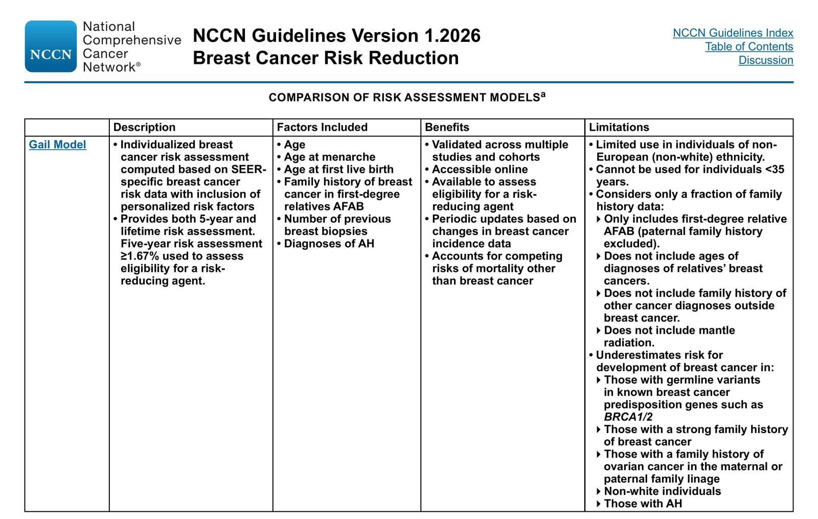
Gail Model
(NCI Breast Cancer Risk Assessment Tool)
Most widely used and validated tool in primary care for estimating individualized 5-year and lifetime breast cancer risk
Inputs:
  Current age
  Age at menarche
  Age at first live birth
  Number of first-degree relatives with breast cancer
  Number of prior breast biopsies
  Presence of atypical hyperplasia on biopsy
Determines eligibility for chemoprevention (5-year risk ≥1.7% per NCCN; ≥3% per USPSTF)
Cannot be used in women <35 years old
NCCN Breast Cancer Risk Reduction Guidelines v1.2026 (BRISK-C)
Notes:
Why not Tyrer-Cuzick? Tyrer-Cuzick is more comprehensive (includes 2nd/3rd-degree relatives, ovarian cancer, breast density, BRCA status) but is primarily used for hereditary risk assessment and lifetime risk estimation — not the standard primary care chemoprevention eligibility tool

Slide 17
400
This is the major limitation of the Gail Model in assessing cancer risk

Slide 18
The Gail Model underestimates hereditary risk
Only includes first-degree relatives assigned female at birth; excludes paternal family history
Does not include age at diagnosis of relatives' cancers
Does not include family history of ovarian, pancreatic, or prostate cancer
Does not account for BRCA1/2 or other germline pathogenic variants
Cannot be used in individuals <35 years old
Also underestimates risk in: Non-white individuals and those with strong family history of breast cancer
NCCN Breast Cancer Risk Reduction v1.2026 (BRISK-C); McCarthy et al., JNCI 2020; ACOG Practice Bulletin 179, 2017
Notes:
In a large mammography cohort (n=35,921), all major risk models showed only moderate discriminatory accuracy (AUCs 0.61–0.64)
Board pearl: If a question describes a patient with extensive family history (multiple relatives, ovarian cancer, young-onset cancers), the Gail model is the wrong tool — use Tyrer-Cuzick, BRCAPRO, or BOADICEA/CanRisk instead

Slide 19
600
This is the approximate
5-year risk threshold at which chemoprevention is considered

Slide 20
≥1.67% 5-year risk (trial eligibility) vs.
≥3% (USPSTF recommendation)
Per NCCN:
  ≥1.67% (1.7%) was the eligibility threshold for the landmark NSABP P-1 and STAR chemoprevention trials
  Discuss risk-reducing agents at ≥1.7% Gail risk
  Recommend them at ≥3% Gail risk or ≥5% 10-year Tyrer-Cuzick risk
Per USPSTF:
  Threshold of ≥3% 5-year risk for chemoprevention recommendation
  Net benefit is substantially greater at this level
  ** This is likely what boards will test **
USPSTF Chemoprevention Recommendation, JAMA 2019; NCCN Breast Cancer Risk Reduction v1.2026 (BRISK-5, BRISK-B)
Notes:
Agents: Tamoxifen (pre- or postmenopausal), Raloxifene (postmenopausal only), Aromatase inhibitors — exemestane or anastrozole (postmenopausal only); all for 5 years
Board tip: If a question asks "at what risk level should chemoprevention be offered/recommended," the answer is ≥3% (USPSTF); if it asks about trial eligibility or consideration, the answer is ≥1.67%

Slide 21
800
This model or tool is preferred over Gail for assessing hereditary breast cancer syndromes such as BRCA

Slide 22
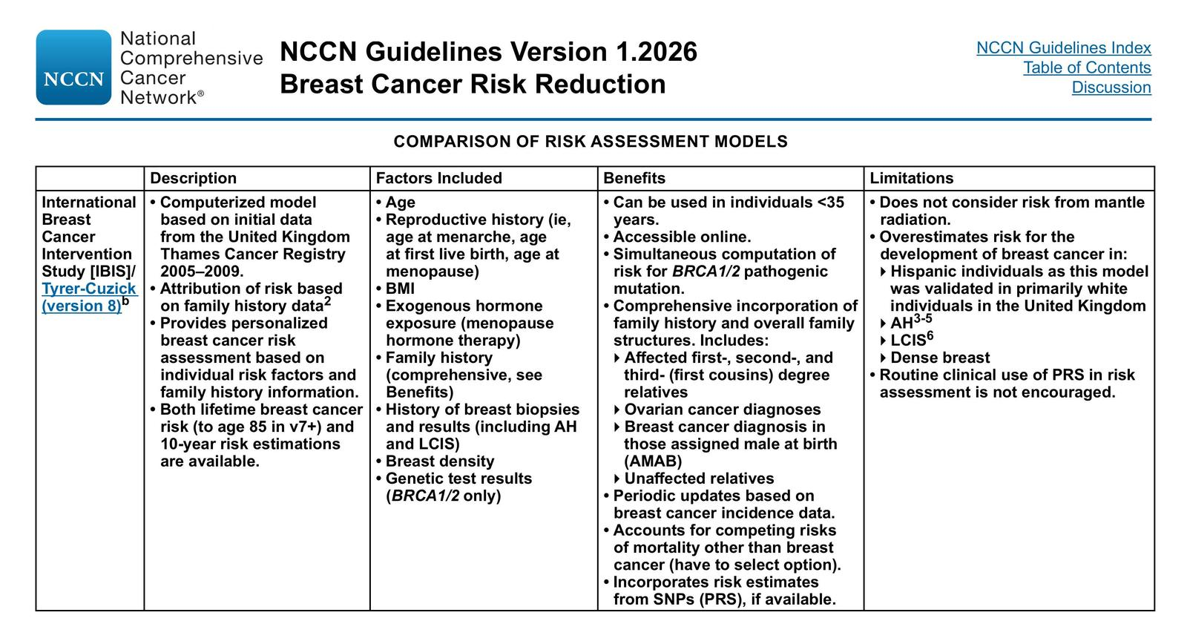
Tyrer-Cuzick (IBIS) Model
(or BOADICEA/CanRisk)
Uses comprehensive family history (1st-, 2nd-, and 3rd-degree relatives), ovarian cancer, male breast cancer, reproductive history, BMI, breast density, and BRCA1/2 test results
Provides both 10-year and lifetime risk estimates
Can compute probability of carrying BRCA1/2
Tyrer-Cuzick is the more consistently accurate model (AUC 0.762 vs. Gail 0.61–0.64)
BOADICEA/CanRisk is another pedigree-based alternative that incorporates BRCA1/2, PALB2, CHEK2, ATM, RAD51C, RAD51D, and polygenic risk scores
NCCN uses Tyrer-Cuzick/BOADICEA (not Gail) to define the ≥20% lifetime risk threshold for enhanced screening with annual breast MRI
Boards:
  “… hereditary risk?" → Tyrer-Cuzick or BOADICEA
  “… chemoprevention eligibility?" → Gail
NCCN Breast Cancer Risk Reduction v1.2026 (BRISK-C); NCCN Genetic/Familial High-Risk Assessment v3.2026

Slide 23
1000
A 42-year-old woman has a mother diagnosed with breast cancer at age 48 and a maternal aunt with ovarian cancer at age 55.
She has no personal history of breast cancer, no prior biopsies, and genetic testing is negative for BRCA1/2.
Her Gail model 5-year risk is 2.1% and lifetime risk is 15.4%. She asks whether she qualifies for screening breast MRI. What is the next best step?

Slide 24
Recalculate with a model that incorporates comprehensive family history (e.g., Tyrer-Cuzick)
The Gail model cannot be used to determine MRI eligibility
The ≥20% lifetime risk threshold for MRI screening requires a model with comprehensive family history input
5-year risk (Gail model)
  Triggers discussion of chemoprevention (tamoxifen, raloxifene, or aromatase inhibitor)
  NCCN recommends discussing chemoprevention when risk ≥1.7%, and strongly recommends it when ≥3%
≥20% lifetime risk (Tyrer-Cuzick, BRCAPRO, BOADICEA, or BCSC)
  Triggers annual breast MRI in addition to mammography
The Gail model underestimates this patient's risk: it misses the maternal aunt with ovarian cancer entirely, does not capture the age at diagnosis of the mother's cancer, and excludes paternal lineage.
NCCN Breast Cancer Screening and Diagnosis v1.2026 (BSCR-1, BSCR-2); NCCN Breast Cancer Risk Reduction v1.2026 (BRISK-C-4, BRISK-C-5, BRISK-5); ACR Recommendations for Higher-Than-Average Risk, JACR 2023
Notes:
Why not just order MRI anyway? Insurance coverage for screening MRI typically requires documented ≥20% lifetime risk using a validated model.

Slide 25
200
This is the first-line imaging modality for a palpable breast mass in a woman under age 30

Slide 26
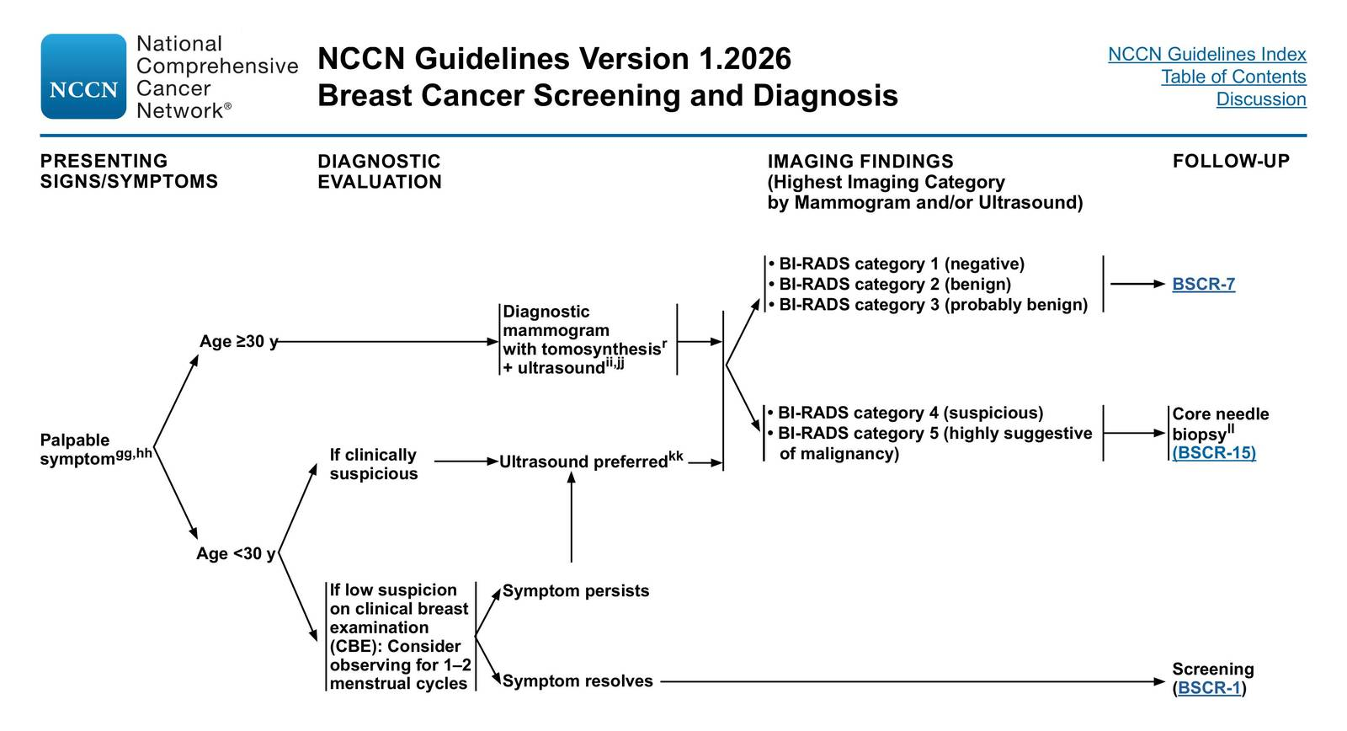
Breast Ultrasound
Per NCCN and ACR Appropriateness Criteria, ultrasound is the preferred initial imaging modality for palpable masses in women 30 years
Breast tissue in young women is dense, reducing mammographic sensitivity (~61%) vs. ultrasound sensitivity (~96%)
Ultrasound also avoids ionizing radiation
If ultrasound is clinically suspicious (BI-RADS 4–5), THEN add diagnostic mammogram; do not start with mammography
For women ≥40 years: diagnostic mammogram with tomosynthesis + ultrasound is the standard workup for palpable masses
For women 30–39 years: either ultrasound or mammography may be performed first at the discretion of the radiologist
NCCN Breast Cancer Screening and Diagnosis v1.2026 (BSCR-6); ACR Appropriateness Criteria: Palpable Breast Masses, JACR 2023;

Slide 27
400
This is the first step after an abnormal screening mammogram

Slide 28
Diagnostic mammography (with tomosynthesis) ± targeted ultrasound
An abnormal screening mammogram is classified as BI-RADS 0 ("needs additional imaging evaluation"), which triggers a diagnostic workup
The diagnostic workup includes diagnostic mammogram with tomosynthesis and/or ultrasound as indicated
After diagnostic workup, a FINAL BI-RADS assessment is assigned:
  BI-RADS 1–2 → return to routine screening
  BI-RADS 3 → short-interval follow-up imaging at 6, 12, and 24 months
  BI-RADS 4–5 → image-guided core needle biopsy
  BI-RADS 6 → known malignancy, refer for treatment
NCCN Breast Cancer Screening and Diagnosis v1.2026 (BSCR-18)
Notes:
Why not go straight to biopsy? Most BI-RADS 0 findings resolve to benign on diagnostic workup; only ~4.4% of recalled women have cancer — diagnostic imaging prevents unnecessary biopsies
Why not MRI? MRI is rarely indicated for routine diagnostic evaluation of mammographic abnormalities; it is reserved for high-risk screening or specific clinical scenarios

Slide 29
600
This imaging modality best distinguishes cystic vs solid breast lesions

Slide 30
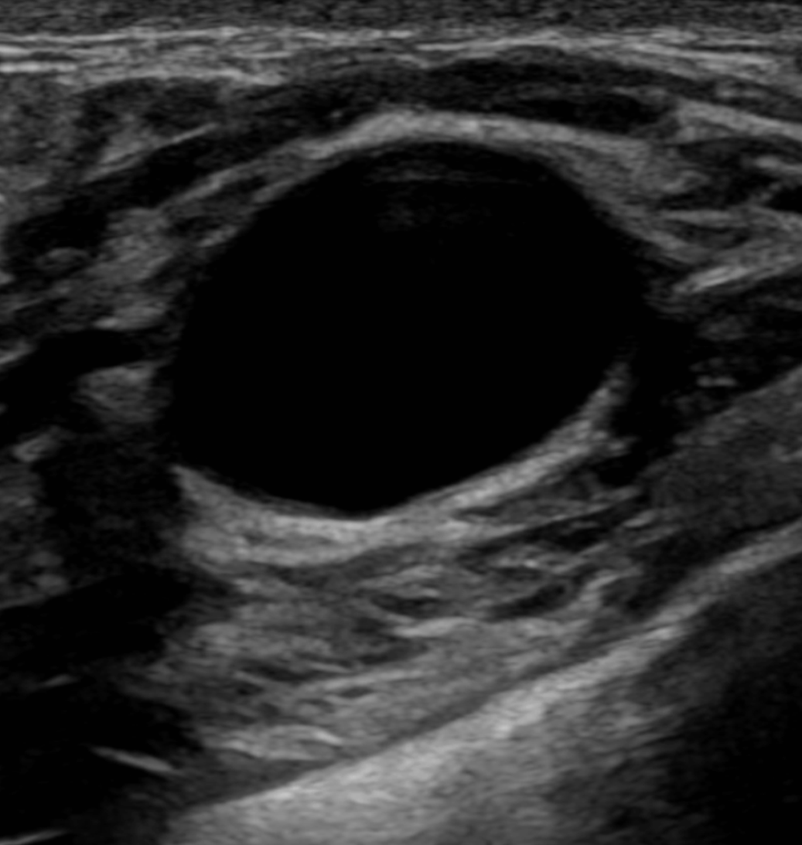
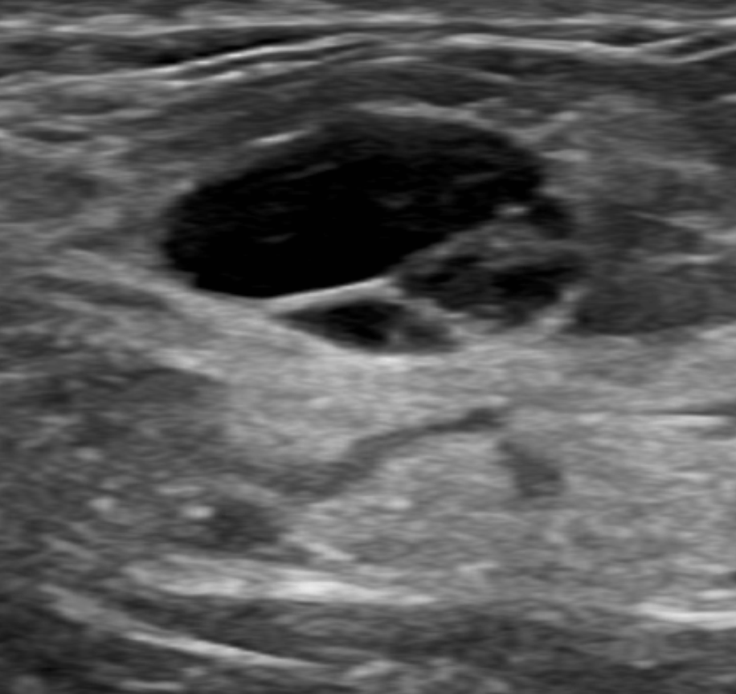
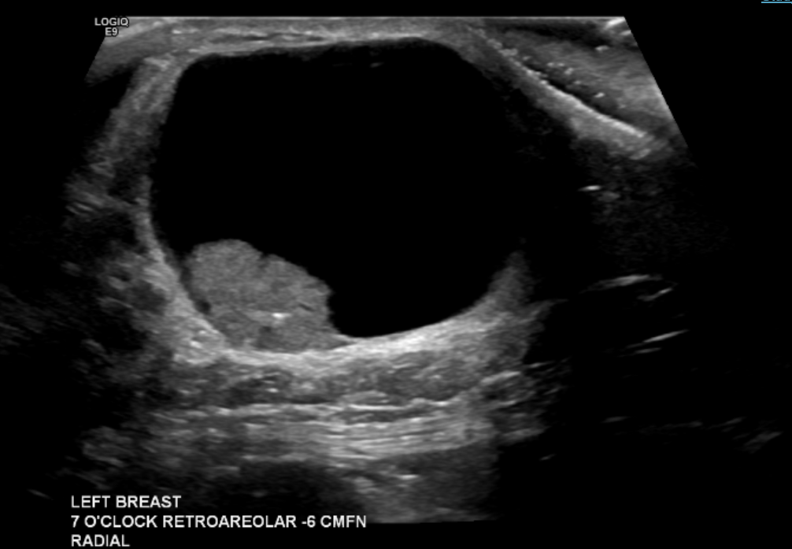
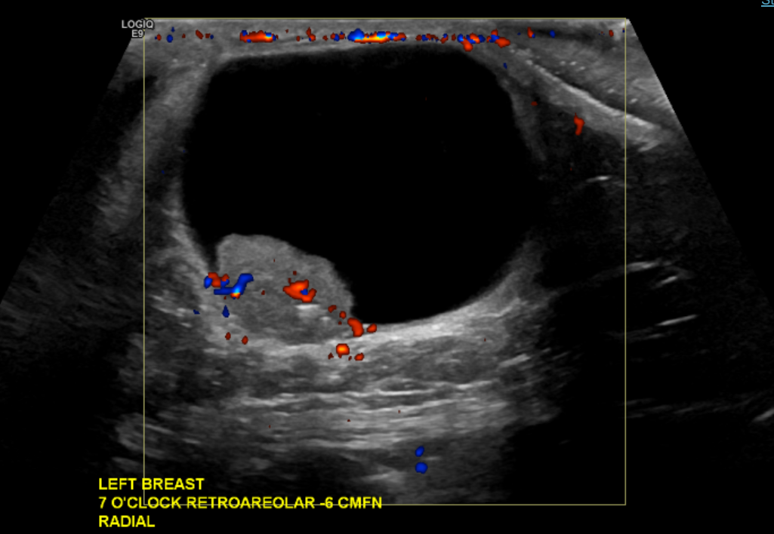
Ultrasound
The primary clinical function of breast ultrasound is differentiating cystic from solid lesions
Diagnostic accuracy for simple cysts approaches 100%
Simple cyst
  Anechoic interior
  Circumscribed margins
  Round/oval shape
  Posterior acoustic enhancement
  → BI-RADS 2 (benign)
  No further workup needed
Complicated cysts
  → BI-RADS 3 (probably benign)
  ~2% malignancy risk
  Short-interval follow-up
Complex solid and cystic masses
  Thick wall, thick septations, intracystic mass, mixed components
  → BI-RADS 4 (suspicious),
  ~23% malignancy rate
  Biopsy
Berg et al., Radiology 2003; Lim et al., RadioGraphics 2025; ACR BI-RADS Ultrasound Assessment Categories
Notes:
Why not mammography? Mammography cannot reliably distinguish cystic from solid lesions — round dense lesions on mammography require ultrasound for characterization
Board pearl: Simple cyst on ultrasound = reassurance and return to screening; do NOT aspirate or biopsy unless symptomatic

Slide 31
800
These are the main clinical indications for Breast MRI in screening

Slide 32
High-risk patients
(≥20% lifetime risk, BRCA mutation, prior chest radiation)
Estimated lifetime risk ≥20% (by Tyrer-Cuzick, BRCAPRO, BOADICEA/CanRisk)
Known BRCA1/2 or other high-penetrance pathogenic variant (TP53, PTEN, CDH1, PALB2)
Prior chest radiation (≥10 Gy) between ages 10–30 years
Li-Fraumeni or Cowden syndrome
MRI sensitivity for breast cancer in high-risk women: 77–100% vs. mammography 25–59%
MRI should be performed in addition to (not instead of) annual mammography
Some recommend alternating MRI and mammography every 6 months
NCCN Breast Cancer Screening and Diagnosis v1.2026 (BSCR-2, BSCR-3); NCCN Genetic/Familial High-Risk Assessment v3.2026 (BRCA-A-1); ACR Higher-Risk Recommendations, JACR 2023;
Notes:
For patients who cannot undergo MRI: contrast-enhanced mammography (CEM); whole breast ultrasound is a fallback but has ~4× lower cancer detection rate than MRI
Why not MRI for average-risk women? Lower specificity (81–99%) leads to more false-positive recalls and benign biopsies; no proven mortality benefit in average-risk populations
Also: Breast cancer before age 50 or a personal history of breast cancer with dense breast

Slide 33
1000
A 55-year-old woman with a lifetime breast cancer risk of 25% (BRCA2 carrier) has severe claustrophobia and cannot tolerate breast MRI. She has very dense breasts.
What is the best alternative supplemental screening modality?

Slide 34
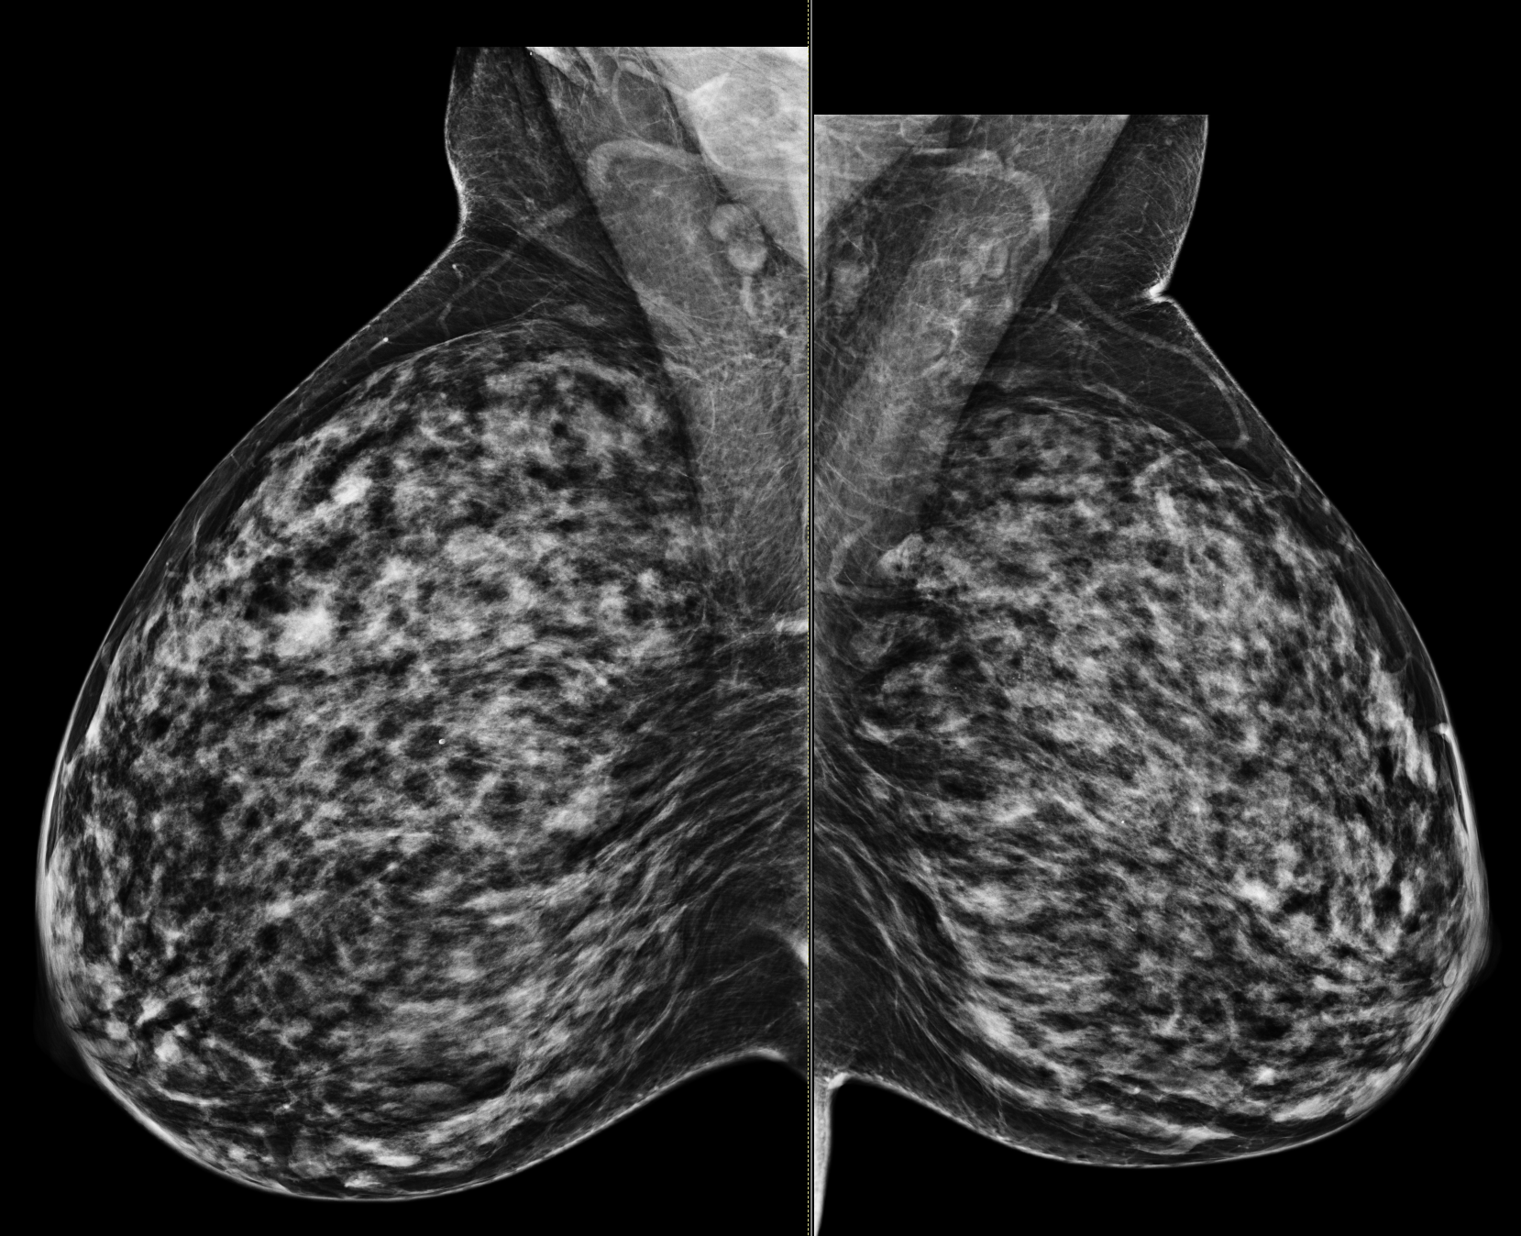
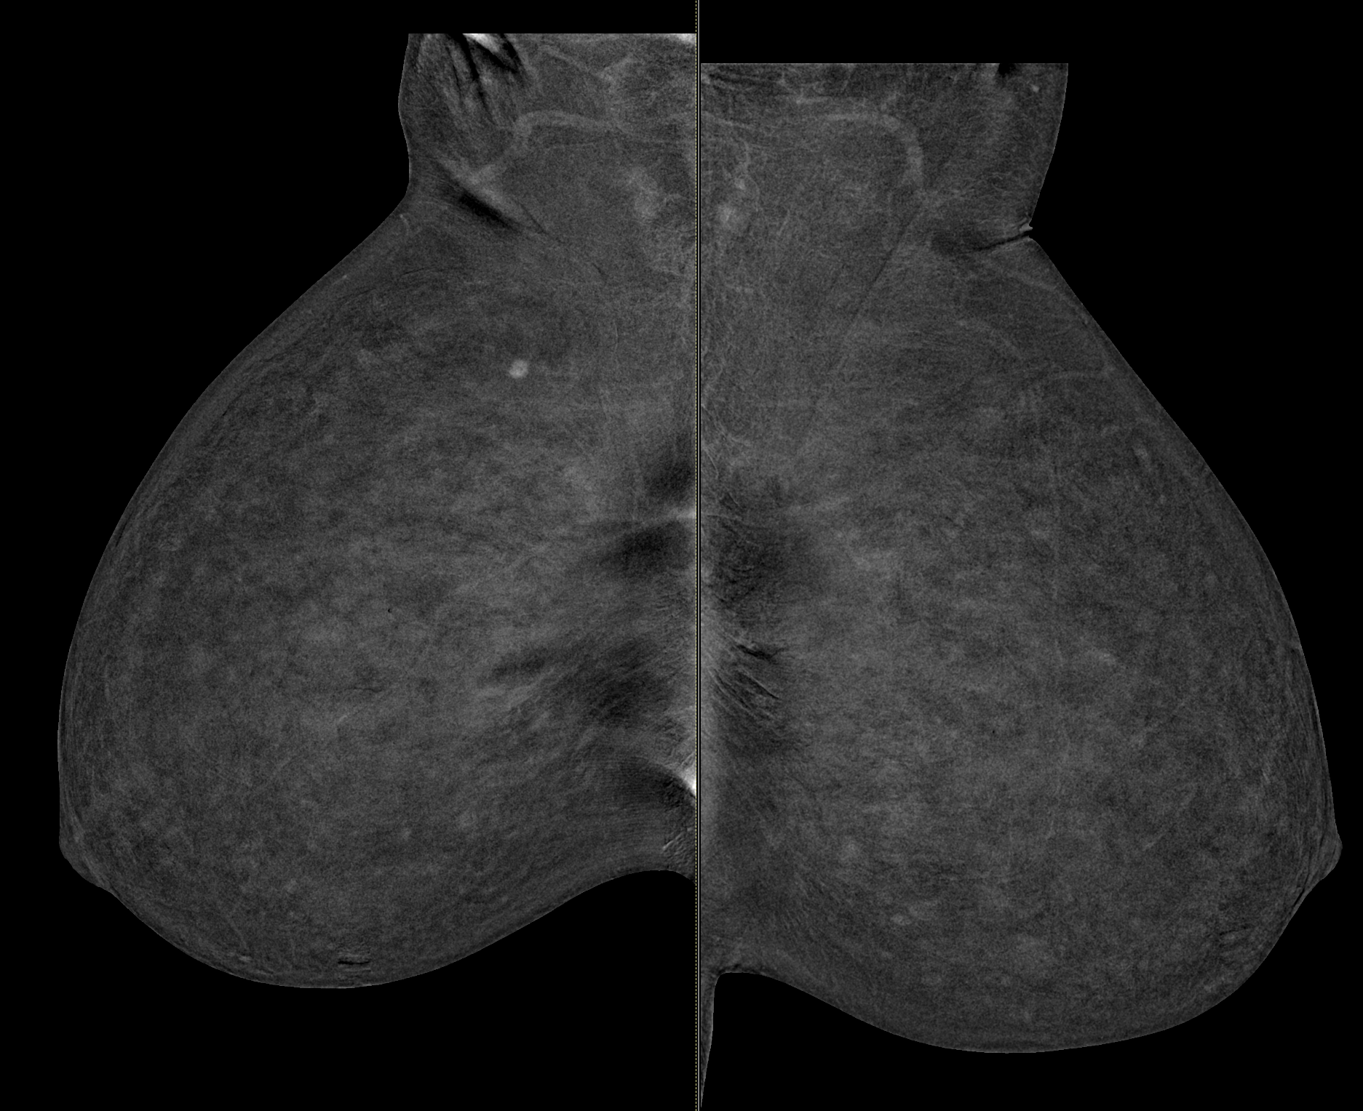
Contrast-enhanced mammography
Whole breast ultrasound may be used if CEM/MBI is not available
Method: IV iodinated contrast → dual-energy mammography → produces a low-energy image (equivalent to standard mammogram) AND a recombined image highlighting enhancing lesions
Acquisition takes only 8–10 minutes vs. 30–45 min for MRI
CEM vs. MRI:
  Comparable cancer detection rates (19.2 vs. 17.4 per 1,000)
  MRI higher sensitivity, CEM had higher specificity
Limitations:
  Risk of iodinated contrast reaction (~0.82%; severe ~0.04%)
  Slightly higher radiation dose than standard mammography
IDC
Notes:
Board pearl: CEM is NOT recommended for average-risk women with dense breasts (insufficient evidence); it is currently positioned as an MRI alternative for intermediate- and high-risk patients only. The low-energy CEM image counts as the patient's annual screening mammogram, so CEM replaces (not supplements) the mammogram

Slide 35
200
These BI-RADS categories indicates a negative or benign study with routine screening follow-up

Slide 36
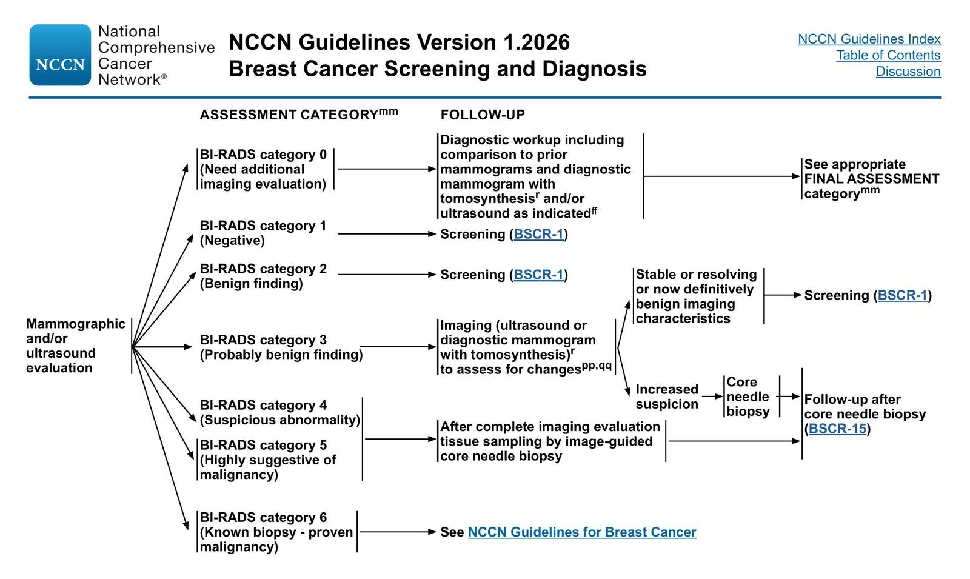
BI-RADS 1 (Negative) or BI-RADS 2 (Benign)
Both categories carry an essentially 0% likelihood of malignancy and require no further workup
  → resume routine screening
BI-RADS 1 = no mammographic finding to comment on
BI-RADS 2 = definitively benign finding (e.g., calcified fibroadenoma, oil cyst, lipoma, simple cyst on ultrasound)
Exception on boards:
  If a palpable mass is present AND clinically suspicious, and is
  BI-RADS 2 on imaging
  Clinical suspicion overrides imaging
  → refer to breast surgeon for palpation-guided biopsy further evaluation (and likely MRI)
ACR BI-RADS 5th Edition, 2025; NCCN Breast Cancer Screening and Diagnosis v1.2026 (BSCR-18, BSCR-C)
Notes:
The BI-RADS system is standardized by the ACR and mandated by the Mammography Quality Standards Act (MQSA) for all mammography reports

Slide 37
400
This BI-RADS category requires short-interval (6-month) follow-up imaging

Slide 38
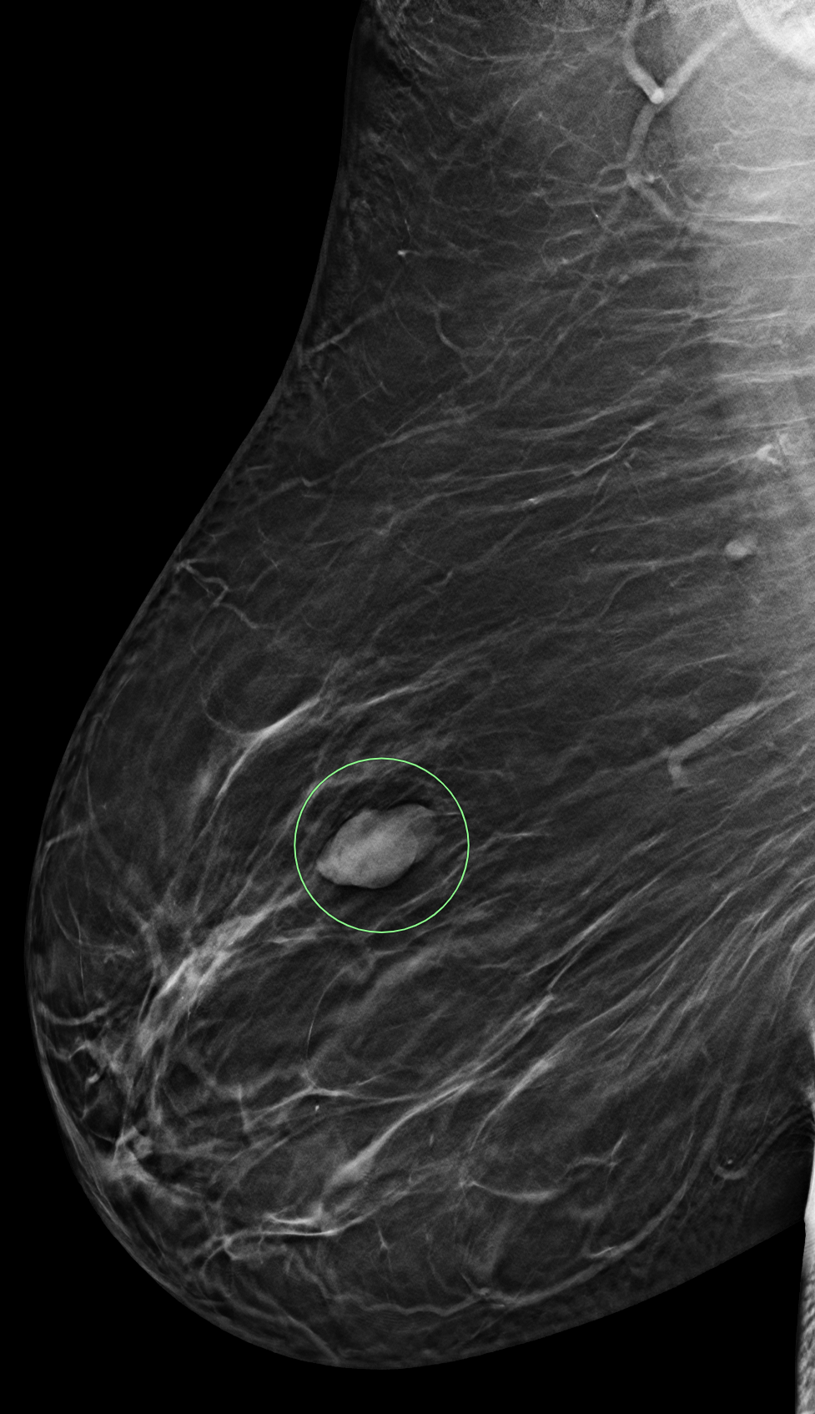
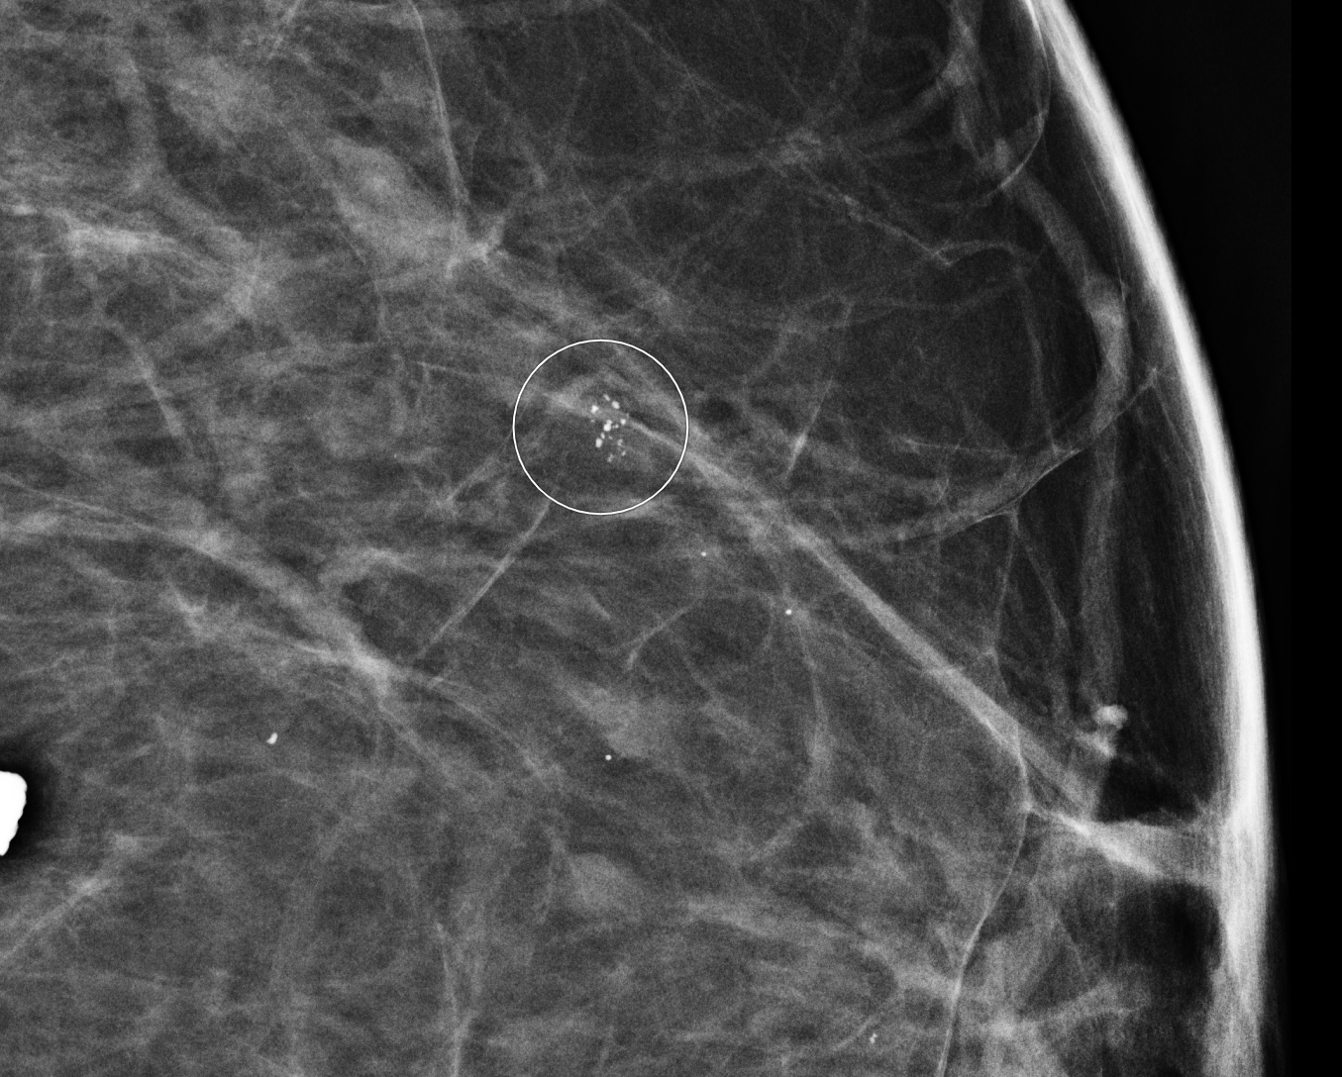
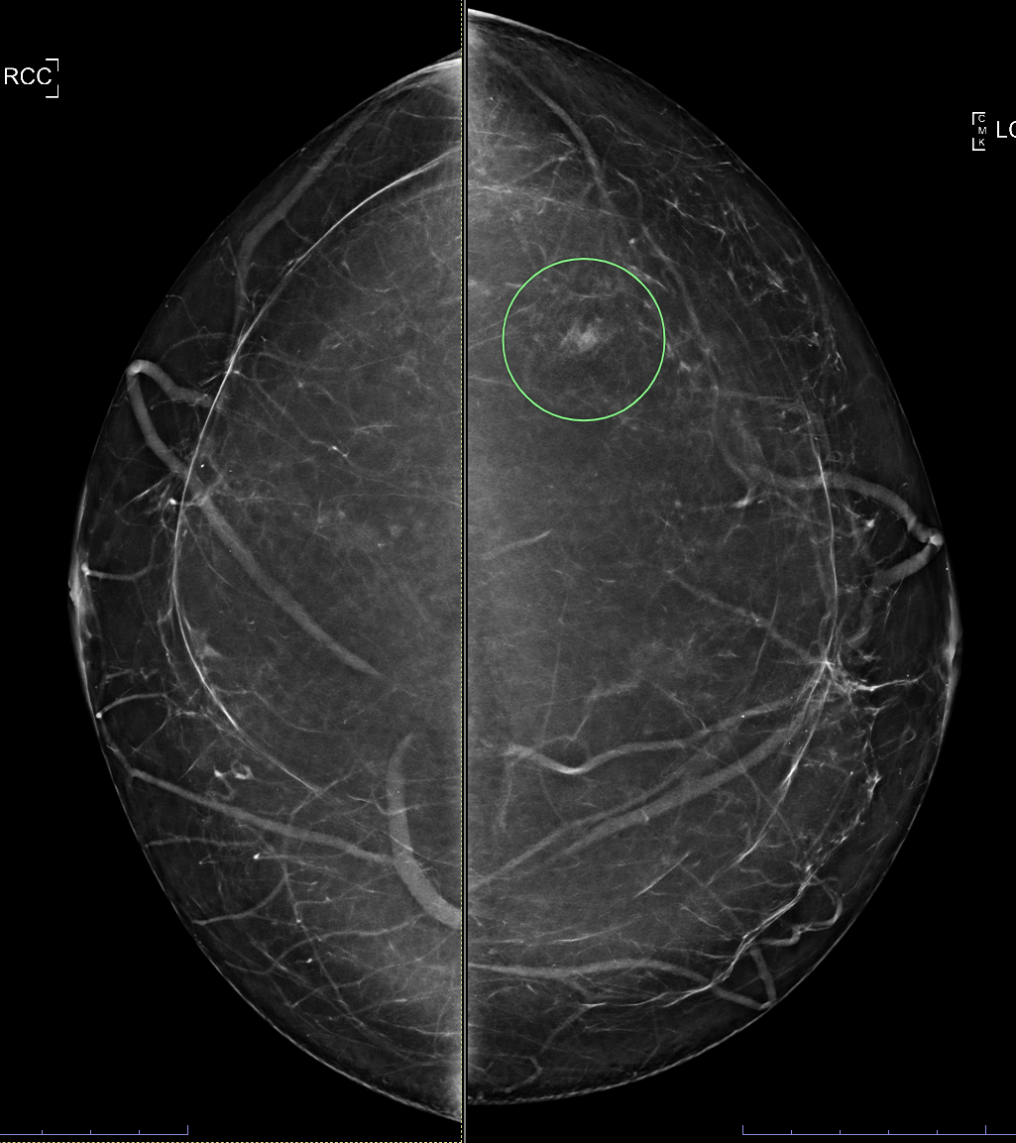
BI-RADS 3 (Probably Benign)
Defined as ≤2% likelihood of malignancy
Short-interval diagnostic mammography surveillance at 6, 12, and 24 months
No immediate biopsy
Validated BI-RADS 3 mammographic findings:
  Noncalcified circumscribed solid mass
  Focal asymmetry that is less dense on spot compression
  Solitary group of punctate calcifications
After 2–3 years of stability, the finding is reclassified as BI-RADS 2 (benign) → returns to routine screening
If the finding increases in size or suspicion at any follow-up → upgrade to BI-RADS 4 → core needle biopsy
ACR BI-RADS 5th Edition, 2025; NCCN Breast Cancer Screening and Diagnosis v1.2026 (BSCR-C-3, BSCR-18); Berg et al., Radiology 2020
Notes:
Why not biopsy immediately? Surveillance avoids unnecessary biopsies of benign lesions; in the National Mammography Database (n=43,628), cumulative cancer yield through 2-year follow-up was only 1.86%, validating the safety of this approach
Boards: BI-RADS 3 should only be assigned AFTER a complete diagnostic workup — never directly from a screening mammogram; also not validated for palpable lesions

Slide 39
600
This is the minimum BI-RADS category at which biopsy is recommended

Slide 40
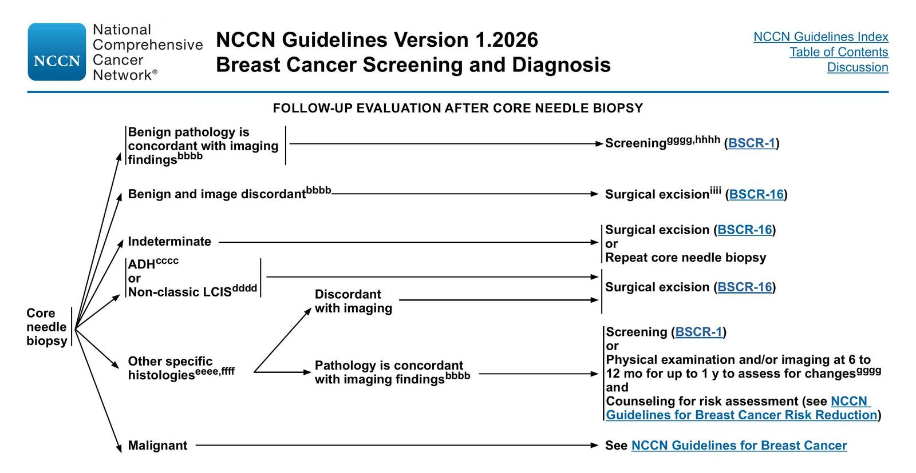
BI-RADS 4 (Suspicious Abnormality)
Covers the wide malignancy range between >2% and <95%
BI-RADS 4 are suspicious lesions that don’t fall to 3 or 5
BI-RADS 5 (≥95% malignancy) also requires biopsy, but for boards, remember 4 is the threshold for tissue sampling; defined as 2+ of:
  Spiculated or irregular mass
  High density
  Fine linear or linear branching segmental calcifications
ACR BI-RADS 5th Edition, 2025; NCCN Breast Cancer Screening and Diagnosis v1.2026 (BSCR-C-4, BSCR-18)
Notes:
Why core needle biopsy, not surgical excision? Core needle biopsy is less invasive, allows preoperative tissue diagnosis, and facilitates treatment planning (e.g., neoadjuvant chemotherapy, sentinel node biopsy)
Almost all breast interventional procedures originate from BI-RADS 4 assessments — this is the workhorse category in clinical practice
Board tip: Any BI-RADS 5 lesion with a benign biopsy result is automatically considered discordant → requires repeat biopsy or surgical excision

Slide 42
800
A 48-year-old woman had a screening mammogram 6 months ago showing a noncalcified circumscribed solid mass classified as BI-RADS 3
She returns for her 6-month follow-up mammogram, which shows the lesion is unchanged in size and morphology
She is anxious and asks if continued follow up is reasonable or if she should get a biopsy. What do you do?

Slide 43
Continue short-interval follow-up imaging the lesion is stable and within the surveillance window
The lesion is stable at 6 months, consistent with the expected BI-RADS 3 protocol:
  Standard follow-up is imaging at 6, 12, and 24 months
  After 2–3 years of stability, the lesion is downgraded to BI-RADS 2 (benign)
  Returns to routine screening
When SHOULD a BI-RADS 3 lesion be biopsied?
  Lesion increases in size or changes morphology on follow-up → upgraded to BI-RADS 4 → core needle biopsy
  High clinical suspicion (palpable, clinically suspicious exam) overrides imaging category
  NCCN: "if a return visit is uncertain or there is strong patient preference"
BI-RADS 3 should ONLY be assigned after a complete diagnostic workup, never on a screening mammogram
NCCN Breast Cancer Screening and Diagnosis v1.2026 (BSCR-18, BSCR-C); ACR BI-RADS 5th Edition, 2025; Berg et al., Radiology 2020
Notes:
Why not MRI instead of short-interval mammography? MRI is not indicated for BI-RADS 3 surveillance in average-risk women — it is expensive, has lower specificity, and would generate additional false positives. Short-interval mammographic or ultrasound follow-up is the validated, cost-effective approach
In practice, can get biopsy per pt preference (BIRADS 3 or 4 depending on insurance)

Slide 44
1000
This is the appropriate next step when imaging findings and biopsy results are discordant

Slide 45
Repeat biopsy or surgical excision
(do NOT rely on a discordant benign result)
Discordance = the histologic diagnosis does not provide a sufficient explanation for the imaging features (BI-RADS 5 spiculated mass with biopsy showing only normal breast tissue or fat necrosis)
Malignancy rate in discordant lesions: ~24% overall, ~44% for BI-RADS 5
Concordance is established by the radiologist/breast specialist after reviewing both the pathology report and imaging findings
Any non-malignant percutaneous biopsy result from a BI-RADS 5 lesion is automatically considered discordant → repeat (usually surgical) biopsy
NCCN Breast Cancer Screening and Diagnosis v1.2026 (BSCR-15, BSCR-C-4); Liberman et al., Cancer 2000; Jörg et al., J Cancer Res Clin Oncol 2021
Notes:
Board pearl: Never reassure a patient based on a benign biopsy if the imaging is suspicious — the next best step is ALWAYS repeat tissue sampling or surgical excision

Slide 46
200
A 38-year-old premenopausal woman with atypical ductal hyperplasia on biopsy has a Gail Model 5-year risk of 2.5%
She asks about medications to reduce her breast cancer risk.
What is the recommended risk-reducing agent?

Slide 47
Tamoxifen
(the only option for premenopausal women)
Tamoxifen 20 mg/day for 5 years
Raloxifene and aromatase inhibitors are restricted to postmenopausal women
Tamoxifen reduces invasive breast cancer risk by 49% overall
Risk threshold: USPSTF recommends discussing chemoprevention to women at increased risk (≥1.67% 5-year Gail risk) and low risk of adverse effects
USPSTF and NCCN both strongly recommend when 5-year Gail risk ≥3%
Adverse effects of tamoxifen: VTE, endometrial cancer, cataracts, hot flashes
NCCN Breast Cancer Risk Reduction v1.2026 (BRISK-6, BRISK-B); USPSTF Chemoprevention Recommendation, JAMA 2019; Nelson et al., JAMA 2019
Notes:
Board pearl: Low-dose tamoxifen (5 mg/day or 10 mg every other day) is an alternative if the patient is intolerant of the standard dose; CYP2D6 testing is NOT recommended before starting tamoxifen

Slide 48
400
A 58-year-old postmenopausal woman with a 5-year Gail risk of 3.2% and a history of prior DVT wants chemoprevention. What is the best agent?

Slide 49
Aromatase inhibitor (exemestane or anastrozole) postmenopausal women with history of DVT
Aromatase inhibitor (exemestane 25 mg/day or anastrozole 1 mg/day)
Tamoxifen and raloxifene are contraindicated in patients with a history of DVT, PE, thrombotic stroke, TIA, or inherited clotting trait
Reduce invasive breast cancer by 55–65% (~16 fewer cancers per 1,000 women over 5 years)
Comorbidity-based agent selection for boards:
  History of VTE → aromatase inhibitor
  Osteoporosis → raloxifene (reduces vertebral fractures) or tamoxifen, avoid AIs
  Age >60 with uterus → AI or raloxifene preferred over tamoxifen (endometrial cancer risk)
NCCN Breast Cancer Risk Reduction v1.2026 (BRISK-A, BRISK-B); ASCO Chemoprevention Guideline Update, JCO 2019; USPSTF, JAMA 2019
Notes:
Board pearl: None of these agents reduce ER-negative breast cancer risk or all-cause mortality; benefit is limited to ER-positive cancers

Slide 50
600
A 42-year-old woman presents with 3 weeks of rapidly progressive breast erythema, edema, and peau d'orange involving half the breast.
She has no fever. A 10-day course of antibiotics produced no improvement
What is the most likely diagnosis and next step?

Slide 51
Inflammatory breast cancer (IBC) not mastitis
Clinical diagnosis: rapid onset (≤6 months) erythema, edema, and/or peau d'orange occupying ≥1/3 of the breast
Next step: Diagnostic mammogram with tomosynthesis + ultrasound → core needle biopsy of breast parenchyma AND skin punch biopsy
A benign skin punch biopsy does NOT rule out IBC; it is a clinical diagnosis, not dependent on dermal lymphatic invasion on biopsy
Neoadjuvant chemotherapy → modified radical mastectomy with level axillary dissection (NOT sentinel node biopsy, NOT breast conservation) → post-mastectomy radiation
NCCN Breast Cancer v2.2026 (IBC-1, IBC-2); NCCN Breast Cancer Screening and Diagnosis v1.2026 (BSCR-10)
Notes:
Why not mastitis? Key red flags: non-lactating, no fever, no response to antibiotics, skin changes ≥1/3 of breast, peau d'orange; if antibiotics fail after 7–10 days → imaging and biopsy are mandatory
Board pearl: Skin-sparing and nipple-sparing mastectomy are contraindicated in IBC; immediate breast reconstruction is also contraindicated due to need for post-mastectomy radiation

Slide 52
800
A 45-year-old woman presents with spontaneous, unilateral, bloody nipple discharge from a single duct.
There is no palpable mass.
What is the next best step?

Slide 53
Pathologic nipple discharge next step is age-appropriate diagnostic imaging
Diagnostic mammogram with tomosynthesis + targeted ultrasound
Pathologic discharge
  Spontaneous, unilateral, single-duct, and bloody or clear (all must be present)
  Malignancy rate in pathologic discharge is ~5–15%
  → diagnostic imaging regardless of age
Almost always benign
  Non-spontaneous, multi-duct, or milky discharge
  → observation
If mammogram/ultrasound is
  BI-RADS 4–5 → core needle biopsy
  BI-RADS 1–3 → breast MRI
  If all imaging is negative (MRI BI-RADS 1–3) → options include 6-month follow-up with physical exam ± imaging OR duct excision
NCCN Breast Cancer Screening and Diagnosis v1.2026 (BSCR-9)
Notes:
Most common cause of bloody nipple discharge: intraductal papilloma (~50–60% of cases);
Board pearl: Nipple smear cytology and ductography are NOT routinely recommended; for bilateral milky discharge, consider endocrine workup (prolactin, TSH, pregnancy test) — this is galactorrhea, not pathologic discharge

Slide 54
1000
A 42-year-old woman is newly diagnosed with triple-negative breast cancer. She has no family history of cancer
What additional evaluation is recommended?

Slide 55
Refer for genetic counseling and testing
Genetic counseling and germline testing for BRCA1/2 and other high-penetrance genes
NCCN recommends testing for ALL patients with triple-negative breast cancer at any age, regardless of family history
Also indicated for:
  Breast cancer ≤50 years
  Male breast cancer
  Multiple primary breast cancers
  Ashkenazi Jewish ancestry with breast cancer at any age
  ≥1 close relative with breast/ovarian/pancreatic/prostate cancer
USPSTF: PCPs should screen all women with personal/family history or high-risk ancestry using a brief familial risk assessment tool → positive screen → genetic counseling → testing if indicated
NCCN Genetic/Familial High-Risk Assessment v3.2026 (CRIT-1, CRIT-2); USPSTF BRCA Recommendation, JAMA 2019
Notes:
Why not the Gail Model for this purpose? The Gail Model estimates overall breast cancer risk for chemoprevention decisions but does NOT assess hereditary risk or BRCA mutation probability — use Tyrer-Cuzick, BRCAPRO, or CanRisk/BOADICEA instead
Board pearl: A negative family history does NOT rule out hereditary breast cancer — limited family structure (few female relatives, paternal transmission) can mask autosomal dominant inheritance; BRCA mutations were found in 13.7% of women with breast cancer 50 and no affected relatives when family structure was limited

