Slide 1
Staph aureus bacteremia
Hillary Hunsinger, DO
Infectious Diseases
Phoenix VA

Slide 2
Case 1
A 66yo lady is admitted to the mental health unit and later moved to the medical unit due to uncontrolled blood sugars.
On hospital day 24, she developed fever of 102 and tachycardia.
She was started on vancomycin and ceftriaxone.
Blood cultures are drawn and at 16 hours turn positive with GPCs in clusters
Micro lab calls back an hour later and says the Biofire detected Staph aureus but the mecA gene was not detected

Slide 3
Question
Which should we do about her antibiotics?
  A. Continue vancomycin and ceftriaxone until the culture is back
  B. Continue vancomycin only for MRSA
  C. Continue ceftriaxone only for MSSA and easy dosing
  D. Switch to nafcillin for MSSA
  E. Switch to cefazolin for MSSA

Slide 4
Answer
Cefazolin
This is MSSA bacteremia – the mecA gene causes methicillin (beta-lactam) resistance, which is not present in this isolate
Cefazolin is the treatment of choice in most cases of MSSA bacteremia. Nafcillin is also effective but has more side effects and issues

Slide 5
Treatment of MSSA bacteremia
Cefazolin 2gm q8h
Well-tolerated
AEs: elevated LFTs, bone marrow suppression
CNS penetration? Myth!
Inoculum effect?
May be a/w lower mortality compared to anti-staph PCNs (RR 0.7)
Nafcillin 2gm q4h or 12gm/24h infusion
AEs: AIN, elevated LFTs, potassium wasting
Much more frequent dosing
Challenging at home
A lot of fluid

Slide 6
Avoid for MSSA:
Vancomycin
  Higher mortality risk compared to cefazolin
  30% failure rate in one trial
  Trial of pt with PCN allergy: reassessing allergy and treating with cefazolin was superior to vancomycin
Ceftriaxone
  Inferior in multiple trials
  A few trials in OPAT found that ceftriaxone was non-inferior, but they are flawed

Slide 7
Question
Repeat BC are drawn. She happened to have a TTE the morning of the fever for LE edema and it did not show any vegetations. What is the next step?
  A. Place PICC and set up home antibiotics
  B. Repeat an echo
  C. Obtain CT chest, abdomen and pelvis
  D. Obtain MRI spine
  E. Talk to the patient and do an exam

Slide 8
Answer
Reassess patient for symptoms and PE signs for a source of infection
She has a warm, red area on her left volar forearm with a palpable cord just proximal to a pIV

Slide 9
Initial search for a source (portal of entry) of bacteremia
Review of systems, especially skin, musculoskeletal, dental
Full skin exam, including pIV/CVC sites
Examine all joints
Percuss entire spine
Examine teeth
Continue to examine daily for development of new metastatic sites of infection

Slide 10
Case 1 cont.
The pIV is removed and US doppler shows superficial thrombophlebitis
Repeat blood cultures drawn on day 2 also grow MSSA
On re-evaluation, she reports worsening of her chronic neck and upper back pain with tenderness to percussion from C6-T3-ish area

Slide 11
Question
Besides ID consultation, what is the next step in the management of this patient?
  A. Change cefazolin to nafcillin
  B. Order repeat TTE
  C. Order TEE
  D. Order MRI C-spine and T-spine
  E. Order CT chest

Slide 12
Answer
D. Order MRI C- and T-spine
The most important next step is identifying any metastatic sites of infection based on signs/symptoms so that source control can be pursued and/or antibiotic duration can be determined

Slide 13
Source vs. metastatic infection
Common sites of seeding:
  Bones, esp vertebrae
  Joints
  Any prosthetic material
  Anatomical abnormality
  Emboli from IE: lungs, kidneys, spleen, brain
Entry point for bacteria
Bloodstream
Endocarditis
Other sites

Slide 14
The search for a source
Image anything that hurts
  CTAP
  MRI of the spine
  Joint/extremity imaging, venous ultrasounds for DVT
PET-CT?
  Helpful for diagnostic uncertainty of possible sites of infection, especially with prosthetic material
  Contraindication to TEE
  Persistent bacteremia despite source control procedures

Slide 15
Case 1 cont.
MRI showed multilevel discitis/osteomyelitis with epidural phlegmon and paraspinal abscesses
She is transferred to another hospital for Neurosurgery evaluation

Slide 16
Case 1 takeaways
Cefazolin is the drug of choice for MSSA
Don’t forget to look at pIVs as a source
Do not be shy about searching for metastatic infection in SAB

Slide 17
Case 2
A 54yo gentleman with obesity and chronic undiagnosed intermittent rash and itching presented to the ED with left chest wall redness and swelling that started after he aggressively scratched the area. He also had fever of 101.5. CT shows a subcutaneous abscess of the left pectoral area.
Blood cultures grow MRSA and he is started on vancomycin.

Slide 18
Question
Which of the following factors has NOT been associated with reduced mortality in SAB?
A. Use of cefazolin for MSSA
B. Infectious Diseases consultation
  C. Early clearance of blood cultures
  D. PET-CT to identify metastatic infection
  E. Early source control procedures

Slide 19
Answer
D. PET-CT
One study showed mortality benefit, but this result has been disputed due to immortal time bias. An RCT is ongoing
C and E will be discussed with case #3

Slide 20
ID Consultation
Over 40 clinical trials have proven the benefit of ID consult for Staph aureus bacteremia on improving outcomes
Several trials have shown a mortality benefit
Even if the primary team follows IDSA guidelines perfectly, there is still additional benefit to ID consult
Due to more aggressive search for source? More aggressive source control?

Slide 21
Case 2 cont.
Your medical student tries to look up the dose of vancomycin and gets confused. She asks you what is the best way to determine the dose of vancomyin?
  A. Adjusted daily based on weight
  B. Adjusted daily based on renal function
  C. Adjusted daily based on both weight and renal function
  D. Adjusted for a trough goal of 20
  E. Adjusted for an AUC (area-under-the-curve) to MIC ratio, goal of >400

Slide 22
Answer
E. It is adjusted based on AUC calculations, for a goal AUC:MIC >400
Initial doses are chosen based on weight and renal function

Slide 23
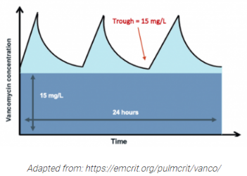
Vancomycin and SAB
AUC monitoring is now the standard of care
Goal is an AUC:MIC of >400
  If MIC is 1, then goal AUC is 400
  If MIC is 1.5, then goal AUC is 600
  If MIC is 2, then goal is AUC is 800 which is very difficult to achieve without toxicity
  For vancomycin with MIC = 2, need to switch
  MIC >2 is resistant

Slide 24
Other options for MRSAB
Daptomycin
  Weight-based dosing: for Staph aureus, 8-10mg/kg daily
  Resistance very rare
  Cannot use for pneumonia caused by MRSA
  However, it CAN be used in right-sided IE with pulmonary emboli!
Ceftobiprole
  Approved by FDA in 2024 for Staph aureus bacteremia
  Non-inferior to daptomycin for both MSSA and MRSA bacteremia in ERADICATE trial

Slide 25
Case 2 cont.
He undergoes I&D of the abscess in the OR by General Surgery with good results and the area improves rapidly in the next few days
Repeat blood cultures (from day 2) are negative
He has no further fevers, no new complaints, no signs or symptoms of further infection
TTE is negative

Slide 26
Question
He really wants to go home on oral antibiotics, as short as possible (2 weeks). Today is hospital day 4. Yay or nay?
  A. No, because it’s MRSA
  B. No, because of the abscess
  C. No, we haven’t done enough tests to meet criteria for uncomplicated SAB
  D. Yes, he meets criteria for uncomplicated SAB, but it’s too soon
  E. Yes, he meets criteria for uncomplicated SAB and can go today

Slide 27
Answer
D. Yes, he meets criteria for uncomplicated SAB, but it’s too soon
He needs 5-7 days of IV antibiotics prior to switching to PO, per the SABATO trial

Slide 28
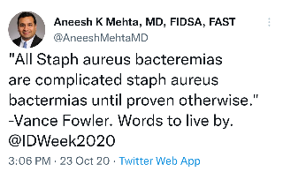
Uncomplicated SAB
IDSA definition (2011):
  Exclusion of IE by echo
  No implanted prostheses
  Negative BC after 2-4 days
  Defervescence within 72h of initiation of appropriate abx
  No evidence of metastatic infection
All other cases are considered complicated
  Community onset (BC positive within 48h of admission) is a significant risk factor for complicated bacteremia

Slide 29
Short course (2 weeks) for SAB
Uncomplicated, plus additional criteria:
  No immunocompromising condition (+/- DM)
  Removable source of infection (line) – no venous thrombosis
  Short duration of bacteremia – hospital-acquired
Traditionally, even a 2-week course has been IV
Several trials have examined switch to PO AND short course in uncomplicated SAB

Slide 30
SABATO trial (2024)
Randomized, controlled non-inferiority trial in Europe
Inclusion/exclusion criteria largely similar to prior definitions for uncomplicated SAB/short course criteria
  Excluded if SAB in last 3 months, injection drug use, presence of prosthetic heart valve
  Did not specify community-acquired vs. hospital-acquired
All patients received 5-7 days of appropriate antibiotics prior to randomization to oral vs. IV
Total duration 14 days

Slide 31
SABATO trial
Over 5000 patients screened; only 213 enrolled, less than planned size (430)
Only 8% MRSA
Most sources were pIV, CVC, or SSTI
Oral options: TMP-SMX 1 DS BID or linezolid 600mg BID
Met non-inferiority criteria on primary outcome (SAB-related complication within 90 days) and secondary outcomes (LOS, adverse events)

Slide 32
Applying SABATO trial to Case 2
His abscess was drained satisfactorily, BC cleared right away, fever resolved right away
No prosthetic implants, immunosuppression, or metastatic infection
TTE negative
He needs to stay and continue IV antibiotics at least one more day, preferably a few more, to meet SABATO criteria
SABATO included relatively few cases of MRSA. His bacteremia was community-acquired which also increases the risk of complications. I would counsel the patient that this strategy is based on one trial that has not been repeated yet and there is a risk of failure with relapse of infection. I would have him follow up closely in clinic to make sure he finishes his TMP-SMX and continues to recover.

Slide 33
Takeaways from Case 2
ID consultation for SAB is mandatory
Pay attention to MIC to vancomycin and know the goal AUC:MIC ratio
Very, very few people qualify for a 2-week course: less than 1% of people screened in large trials
SABATO trial can be applied to determine who is appropriate for a 2-week, oral course (TMP-SMX or linezolid) after receipt of 5-7 days of IV antibiotics

Slide 34
Case 3
A 70yo gentleman with a history of cirrhosis due to alcohol and tachy-brady syndrome with PPM placed 6 months ago presented with chest pain and shortness of breath. He was found to have sepsis and hypotension that responded to fluids. He is requiring 5L supplemental O2. He is delirious and can’t provide a ROS, however chart review shows that he has hardware in his cervical spine, right tibia, and right pelvis. On exam, he has warmth and fluctuance at the pacemaker pocket. Blood cultures are growing MRSA at 15 hours.

Slide 35
Case 3 cont.
The patient’s significant other asks “what his chances are.”
How do we advise her about the risk of mortality?

Slide 36
SAB risk of mortality
Mortality rate in all comers is 25-30% at 3 months
Increased mortality:
  Comorbidities, older age
  MRSA infection (OR 9.3%)
  Time to positivity of ≤12 hours
  Persistent bacteremia
Persistent bacteremia associated with:
  Endocarditis/endovascular source
  Metastatic infection and lack of source control
  Retained catheter or foreign body
  Using vancomycin for MSSA
  MRSA infection

Slide 37
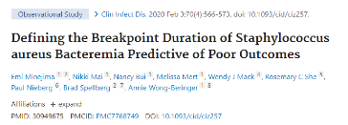
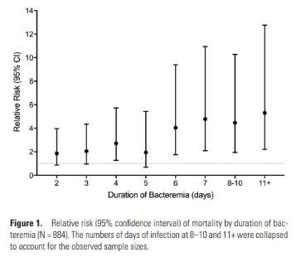
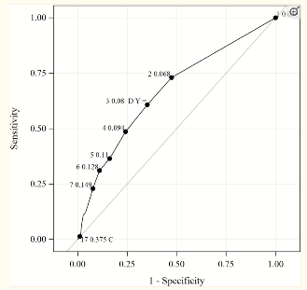
Risk of mortality increases 16-20% for every day of bacteremia!
Day 3 is the most significant to predict survival vs. death

Slide 38
Question
This patient’s risk of mortality is quite high given the MRSA bacteremia with TTP of 15 hours and severe sepsis, and cirrhosis.
Besides ID consultation, what is the next step in the management of this patient?
  A. Change vancomycin to daptomycin
  B. Order repeat blood cultures
  C. Order a bunch of imaging
  D. Consult palliative care
  E. Change all his lines

Slide 39
Answer
C. Order a bunch of imaging
I would get a CT chest to evaluate the hypoxia, ultrasound of the pacemaker pocket, MRI brain due to delirium, and TTE to start
Image sites of known hardware if he develops pain or if the above imaging is unrevealing
Could also consider PET-CT to cover everything, everywhere, all at once

Slide 40
Case 3 cont
CT chest shows multiple bilateral peripheral dense pulmonary infiltrates suggestive of septic pulmonary emboli
Ultrasound of his pacemaker pocket shows an abscess
TTE is negative, doesn’t have a good view of the pacemaker wire
MRI brain is negative.
He remains septic and delirious. BC are positive on days 2 and 3.
AUC monitoring indicates his vancomycin AUC is 410.

Slide 41
Question
What is the next best step for his persistent bacteremia?
  A. Increase vancomycin for a target AUC of 600
  B. Obtain TEE
  C. Get more imaging of the sites of hardware
  D. Switch to daptomycin and ceftaroline
  E. Consult Cardiology

Slide 42
Answer
Consult Cardiology to obtain some gosh-darn source control by removing the pacemaker!
More imaging and TEE might be reasonable, but would reserve them for after pacemaker removal, if he continues to be bacteremic

Slide 43
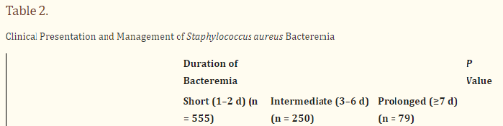
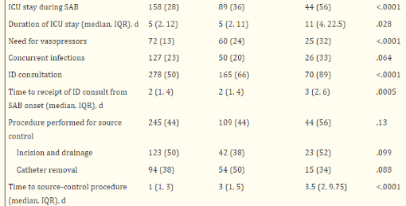
Importance of source control
Minejima et al. Clin Infect Dis. 2020;70(4):566-573.

Slide 44
Importance of cardiac device removal
2024 AHA guidelines on CIED infections recommends complete device extraction in the setting of SAB when CIED is suspected
In a cohort of over 5000 patients with SAB and an indwelling cardiac device who were considered to have IE, in-hospital mortality was lower among patients whose device was removed with an adjusted OR of 0.31 (5.6% vs. 16.4%)

Slide 45
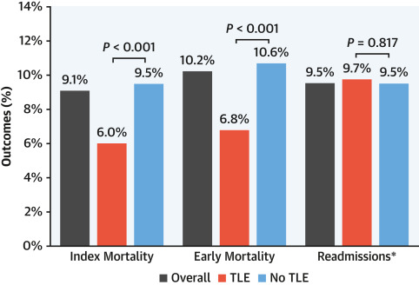
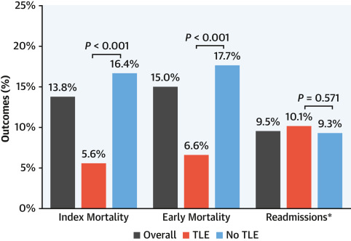
Mortality after Total Lead Extraction for all bacterial causes of endocarditis (index = during index admission; early = index + 30-day)
Mortality after Total Lead Extraction for Staph aureus endocarditis subgroup
Sciria et al. JACC 2023;81(17):1714-1725.

Slide 46
Case 3 cont.
His pacemaker is removed in its entirety and the pocket is debrided.
Blood cultures drawn the day after the procedure grow MRSA in 19 hours
He is now awake and alert and denies any new sites of pain or new symptoms
There is concern that TEE might be contraindicated since he has never been screened for esophageal varices before.
How do you weigh the need for TEE?

Slide 47
TTE vs. TEE for endocarditis
TTE is about 60-80% sensitive (depending on the study); TEE is about 95% sensitive
If TTE shows a vegetation but likelihood of complications is low, TEE is unlikely to change management
TTE is superior for quantifying hemodynamic dysfunction and pressures/gradients
TEE is superior for identifying abscess/fistulas/aneurysms

Slide 48
When to get a TEE
High clinical suspicion for IE with negative TTE
Cardiac devices or prostheses
Preexisting valvular damage
Abnormal TTE (thickened valves, sclerotic) or valves poorly visualized
Persistent bacteremia (>72d)
Established IE with concerns for cardiac complications
  Unexplained progression of HF symptoms
  Change in cardiac murmur
  New AV block or arrhythmia

Slide 49
Better question: when can we skip TEE?
Low pre-test probability for IE (low risk):
  Hospital-acquired bacteremia
  Negative repeat BC
  No cardiac prosthesis/device
  Not on dialysis
  No clinical signs/symptoms of IE
  Some scoring systems such as VIRSTA
Already planning for 6-week course of abx (osteomyelitis, epidural abscess, etc) and no concern for cardiac complications

Slide 50
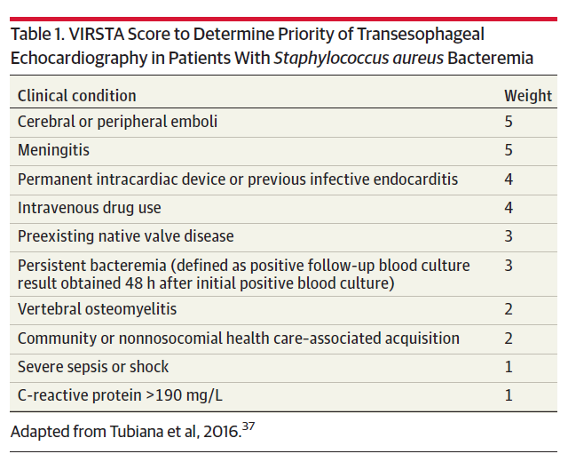
VIRSTA score
Score less than 3: can forego TEE

Slide 51
Repeat echo?
If TEE negative and clinical suspicion persists, repeat in 3-5 days
  Sooner if clinical findings change
If TEE shows a vegetation and worrisome clinical findings develop during treatment, repeat TEE urgently/emergently
  Unexplained progression of HF symptoms
  Change in cardiac murmur
  New AV block or arrhythmia
If patient cannot undergo TEE but there is high suspicion for IE, can repeat TTE in 5-7 days

Slide 52
Case 3 cont
Based on persistent bacteremia, VIRSTA score, and presence of septic pulmonary emboli, he should undergo TEE
  Alternative would be PET-CT or repeat TTE
PET-CT showed hypermetabolic activity at the tricuspid valve, suspicious for a vegetation, and no other sites of hypermetabolic activity
Repeat blood cultures continue to be positive.
The vancomycin MIC is 1, and AUC continues to be >400

Slide 53
Question 9
What is the next best step for his persistent bacteremia?
  A. Increase vancomycin for a target AUC of 800
  B. Switch to ceftaroline
  C. Switch to daptomycin
  D. Switch to daptomycin and ceftaroline
  E. Advise comfort care measures only

Slide 54
Answer
D. Switch to combination therapy for synergistic antimicrobial effect
Some case reports of daptomycin resistance when switching from vanc → dapto monotherapy, so it may be safer to switch to combo

Slide 55
Combo therapy for MRSAB
Studies are still ongoing; some controversy
  Some studies have shown mortality benefit; others no benefit
  Timing is also controversial but many will switch at day 3-4 of persistent bacteremia
Most common regimen is daptomycin + ceftaroline
Daptomycin + beta-lactam? Under investigation
Vancomycin + nafcillin? No benefit, increased harm
Vancomycin + ceftaroline is also an option

Slide 56
Takeaways from Case 3
Don’t underestimate Staph aureus
Have a low index of suspicion for IE and other invasive infections
Understand when to order a TEE
Source control, including cardiac device removal, is everything
For persistent bacteremia with everything else optimized, can switch to combination therapy as early as day 3-4

Slide 57
Questions?
Hillary.hunsinger@va.gov

Slide 58
References
Lowy FD. Staphylococcus aureus infections. N Engl J Med 1998; 339:520–32.
Tong SYC, Davis JS, Eichenberger E, et al. Staphylococcus aureus infections: Epidemiology, pathophysiology, clinical manifestations, and management. Clin Micr Rev 2015;28(3):603-661.
Liu C, Bayer A, Cosgrove SE, et al; Infectious Diseases Society of America. Clinical practice guidelines by the Infectious Diseases Society of America for the treatment of methicillin-resistant Staphylococcus aureus infections in adults and children. Clin Infect Dis 2011; 52:e18–55.
Mermel LA, Allon M, Bouza E, et al. Clinical practice guidelines for the diagnosis and management of intravascular catheter-related infection: 2009 update by the Infectious Diseases Society of America. Clin Infect Dis 2009; 49:1–45.
Stevens DL et al. Practice Guidelines for the Diagnosis and Management of Skin and Soft Tissue Infections: 2014 Update by the Infectious Diseases Society of America.Clin Inf Dis 2014;
Baddour LM et al. Infective Endocarditis in Adults: Diagnosis, Antimicrobial Therapy, and Management of Complications: A Scientific Statement for Healthcare Professionals from the American Heart Association. Circ 2015;132:1435-1486.
Tong et al. Management of Staphylococcus aureus bacteremia. JAMA. 2025
Minter et al. Contemporary Management of Staphylococcus aureus bacteremia: controversies in clinical practice. Clin Infect Dis. 2023;77(11):e57-68.

