Slide 1


Primary care for patients with inflammatory bowel disease
Nisha Sharma, MD
Clinical Assistant Professor
Banner Digestive Institute

Slide 2
Key Literature & Guidelines
Farraye et al. ACG Clinical Guideline Update. Am J Gastroenterol. 2025
  Caldera et al. AGA Clinical Practice Update. Clin Gastroenterol Hepatol. 2025
  Grohskopf et al. ACIP Influenza Recommendations. MMWR 2024–25
  Anderson et al. Recombinant Zoster Vaccine in Immunocompromised Adults. MMWR 2022

Slide 3
Background information
● Autoimmune disorders
○ No clear inciting factors, although, some things have been implicated such as
antibiotic use as a child, early appendectomy, hygiene hypothesis, etc
● Crohn’s can affect anywhere in the GI tract - from mouth to anus
○ Causes transmural inflammation
● Ulcerative colitis primarily affects the colon
○ More superficial inflammation the GI tract - from mouth to anus
○ Causes transmural inflammation
● Ulcerative colitis primarily affects the colon
○ More superficial inflammation

Slide 4
Demographics
● Affects approximately 1:200 Americans
● 708,000 with Crohn’s, 907,000 with UC
● Highest incidence of new cases diagnosed between age 15 and 35
○ Second peak in patients in their 60s-70s
○ No difference between males and females

Slide 5
Why Preventive Care Matters in IBD
IBD patients have higher risk of infections, malignancy, and bone disease
  Immunosuppressive therapies change vaccine eligibility
  Primary care and inpatient teams often miss preventive care opportunities

Slide 6
Systemic immunosuppression
Systemic immunosuppression refers to current treatment with Prednisone (more than 20 mg per day for more than 14 days), azathioprine, mercaptopurine, methotrexate, cyclosporine, tacrolimus, infliximab, adalimumab, golimumab, certolizumab, ustekinumab, risankizumab, mirikizumab, guselkumab, etrasimod, ozanimod, upadacitinib, or tofacitinib

Slide 7
Vaccination
A 28-year-old woman with Crohn disease on infliximab presents for routine care. Which vaccine is CONTRAINDICATED?
  A. Influenza (inactivated)
  B. Recombinant zoster vaccine (Shingrix)
  C. MMR vaccine
  D. PCV20

Slide 8
Vaccination Framework for IBD
Inactivated vaccines: SAFE on immunosuppression
  Live vaccines: CONTRAINDICATED during immunosuppression
  Always assess vaccines BEFORE starting biologics or steroids

Slide 9
Core Vaccines You Should Know
Influenza: Annually (high-dose or adjuvanted if ≥65)
COVID-19: Follow CDC general population guidance
Pneumococcal: PCV20 or PCV21 for most adults
Shingrix: 2-dose non-live vaccine for all adults ≥19 with IBD
Patients on biologics travelling to endemic areas for yellow fever should see ID
○ Should NOT receive the vaccine as they are at risk for Yellow Fever vaccine associated viscerotropic disease which causes multi-organ failure and death
○ Can give if biologics are held for at least 3 months prior and one month after vaccination
Adolescents with IBD should receive the meningococcal vaccine

Slide 10
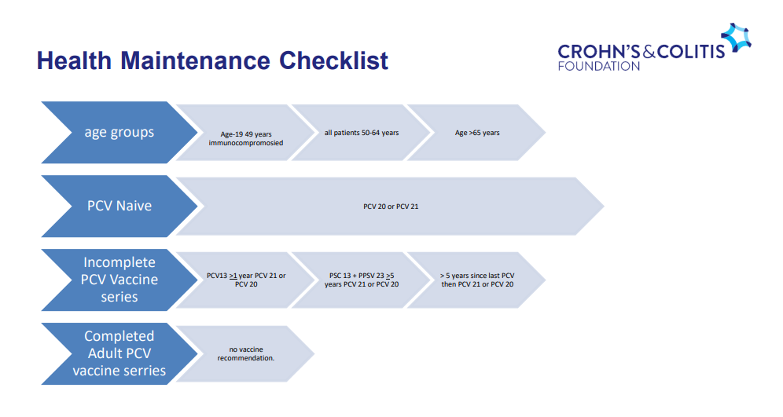

Slide 11
Human Papillomavirus (HPV) – Adults 27-45 years of age
Respiratory Syncytial Virus (RSV) – Adults > 75 years of age, Adults >60 with certain risk factors for severe disease
Hepatitis B – All adult patients with IBD
.

Slide 12
Live Vaccines
MMR and Varicella are LIVE vaccines
  Give ≥4 weeks BEFORE immunosuppression if needed
  Never give during biologic or high-dose steroid therapy

Slide 13
A 32‑year‑old man with ulcerative colitis diagnosed 10 years ago presents for routine follow‑up. His disease involves the entire colon. He feels well and is in clinical remission. He takes mesalamine daily. His last colonoscopy was 3 years ago. Which of the following is the most appropriate next step in health maintenance? A. Repeat colonoscopy now B. Colonoscopy in 2 years C. No further colonoscopic screening until age 45 D. CT colonography every 3 years
Notes:
myocardial infarction was reported more commonly in the omeprazole than in the open ARS group in the SOPRAN study. This numerical imbalance was communicated to regulatory authorities worldwide and is also presented in a previous paper by Lundell et al. (2009).8 The data were evaluated by the FDA which concluded that this difference could have been driven by baseline differences [e.g. the higher median age (54 vs. 50 years) in the omeprazole group compared with the open ARS group, the higher frequency of previous myocardial infarction

Slide 14
A 29‑year‑old woman with Crohn’s ileocolitis is starting azathioprine therapy. She has never had Pap testing before. Which of the following is the most appropriate recommendation regarding cervical cancer screening? A. Begin screening at age 30 with HPV testing only B. Begin screening now with Pap smear, then repeat based on standard intervals C. No Pap testing needed until age 35 due to immunosuppression D. Defer Pap testing until azathioprine dose is stabilized

Slide 15
Cancer Screening in IBD
Colorectal cancer risk increases after 8 years of extensive colitis
  PSC + IBD = annual colonoscopy starting at diagnosis
  Repeat every 1-3 years based on risk factors
Annual screening for cervical cancer recommended for ALL women with IBD on immunosuppressants
○ Studies have shown that women with IBD are screened less frequently than the general population - especially those on immunosuppressants
○ Higher risk of dysplasia and cervical cancer in women with Crohn’s and UC on immunosuppressants
Interestingly, higher risk of dysplasia seen in IBD patients 1-9 years before diagnosis as well
○ Even higher risk for patients on azathioprine or with a history of use

Slide 16
Skin Cancer Risk
Patients with IBD should be seen by a dermatologist
All patients with IBD should be screened for melanoma
○ 37% higher risk than the general population regardless of biologic use
○ Patients on TNF-a inhibitors have a two-fold higher occurrence of melanoma
○ All patients should be counselled on sunscreen use and regular skin exams
All patients on 6-MP or azathioprine need to be screened for non-melanoma cancers
○ Prolonged exposure to immunosuppressants seems to increase risk of basal cell and squamous cell cancers
Risk may return to general population risk after stopping treatment
Notes:
Gastrin level doubled from baseline value in the PPI group. But there was no increased incidence of gastric polyps, ECL hyperplasia or gastric malignancies in PPI group.

Slide 17
Depression and Anxiety
All patients with IBD should be screened for depression and anxiety
○ Depression and anxiety have been associated with disease course
Depression has been associated with higher relapse rate and less chance of achieving remission
○ Both present at higher rates in patient with IBD
■ Depression present in 21.4% of patients with IBD vs 13.4% of general population
■ Anxiety present in 19% of patients with IBD vs 9.6% in general population
■ Higher rates of depression in the year following surgery
○ Patients with fewer relapses and improved remission in the year after starting an antidepressant
○ Depression and other psychiatric diseases associated with non-compliance

Slide 18
Bone Health
Which patient with IBD should undergo DEXA screening?
25 yo on mesalamine only
40 yo on prednisone for 4 months
30 yo with no steroid exposure
35 yo newly diagnosed, asymptomatic

Slide 19
Bone Health
● Patients with traditional risk factors and IBD should undergo bone mineral density testing at the time of diagnosis
Low BMI
> 3 months cumulative steroid exposure
Smoker
Post-menopausal
Malnutrition
Vitamin D/ calcium deficiency
Vitamin D and calcium supplements for women >65 yo and men >70

Slide 20
Smoking
Patients with Crohn’s disease should be told to quit and referred to smoking cessation therapy
■ Studies have shown up to 3x prevalence of Crohns in smokers vs non-smokers
○ Smoking is associated with disease progression
■ Associated with need for steroids or thiopurines as well as development of arthropathy
■ Decreased time to development of stricturing disease
■ Decreased time to first surgery
■ Increased risk of flares and flares after surgery
■ Less likely to respond to treatment
■ Less likely to have good surgical outcomes
■ Improved outcomes after quitting

Slide 21
Latent Infections
Check for TB and hepatitis B prior to starting advanced IBD therapy

Slide 22
Pregnancy
A 36‑year‑old woman with Crohn’s disease on ustekinumab asks about pregnancy planning. Which of the following is the most appropriate recommendation? A. Discontinue ustekinumab 6 months before conception B. Continue ustekinumab, as disease remission is the priority for pregnancy outcomes C. Switch to methotrexate to maintain remission during pregnancy D. Avoid all vaccines during pregnancy

Slide 23
Pregnancy and IBD
Safe Biologic Therapies​
Biologic therapies like anti-TNF agents, vedolizumab, Ustekinumab, and IL23i are generally safe and essential to continue during pregnancy for remission maintenance.​ JAKi at present do not have enough data for pregnancy
Thiopurine Use Guidelines​
Thiopurines are safe for ongoing use but should not be started during pregnancy due to delayed effects and potential risks.​
Contraindicated Methotrexate​
Methotrexate is strictly contraindicated during pregnancy due toteratogenic effects and must be stopped three months beforeconception.​
Corticosteroids and Aminosalicylates​
Corticosteroids should be minimized for chronic use due to risks;aminosalicylates are safe but avoid formulations with dibutyl phthalate.​

Slide 24
Labor and Delivery
Individualized Delivery Decisions​
Delivery plans for women with IBD must consider disease activity and obstetric factors for safe outcomes.​
Cesarean Section Indications​
Cesarean delivery is recommended for active perianal Crohn’s or complex fistulas to prevent complications.​
Medication and Maintenance Therapy​
Continuing maintenance therapy during delivery reduces risk of IBD flares in vulnerable periods.​
Breastfeeding Safety and Education​
Breastfeeding is safe with most IBD medications; patient education promotes adherence and infant health.​

Slide 25
Post partum
Postpartum Monitoring​
Close monitoring for IBD flares postpartum is essential to prevent disease relapse and ensure maternal health.​
Vaccination Timing for Infants​
Delay live vaccines like rotavirus until six months for infants exposed to biologics; inactivated vaccines follow standard schedules.​
Breastfeeding Safety​
Breastfeeding is safe during biologic and immunomodulator therapy due to minimal drug transfer into breast milk.​
Pediatric Follow-up​
Ongoing pediatric follow-up focuses on growth monitoring and infection prevention to promote infant well-being.​

Slide 27
Bottom Line
✔ Preventive care is part of IBD management
✔ PCPs play a key role in closing care gaps
✔ Use guidelines to guide safe, evidence-based decisions

Slide 28
