Slide 1
RHEUMATOID
ARTHRITIS Trent Smith, MD
BUMCP Rheumatology
March, 2026

Slide 2
Objectives
■Define rheumatoid arthritis and identify clinical symptoms
that would prompt evaluation and referral
■Describe diagnostic criteria for RA according to the
American College of Rheumatology (ACR)
■Describe genetic and environmental risk factors for RA
therapies used
■Describe biologic and small-molecule therapies
■Identify extra-articular manifestations of RA
■Describe Disease Modifying Anti-Rheumatic Agent (DMARD)

Slide 3
Most Common Chronic Inflammatory Arthritis
■Systemic: Articular and Extra-articular ■Chronic, relapsing/remitting course ■Tissue damage and destruction
–
■Labs and Imaging are helpful
Pannus formation and synovial destruction
■History and Exam are key

Slide 4
Who Is At Risk?
■Genetic: HLA DR4 and DR1
–
60% of the risk, alleles responsible for citrullinated peptide antigens
■Environment: Smoking
–
Activates enzymes that promote citrullination in the lungs
■Infection: bacteria, viruses (EBV, parvovirus B19),
gut microbiome
–Dental disease: P gingivalis
■Hormones: Females>Males (2-3:1) ■ COVID?

Slide 5
Who Is At Risk?
■MKSAP 19, Rheum Q9
-36 F seen in routine wellness exam. Asymptomatic, no medical problems. On OCP.
-Accountant without much physical activity.
-One glass red wine qpm, diet high protein, low fruit/vegetables
-Tobacco 1 ppd x 5 years
-Mom has rheumatoid arthritis, worried she may develop RA
■Which of the following is most likely to reduce patient’s risk of developing RA?
A. Alcohol cessation
B. Discontinuation of combined OCP
C. Increased physical activity
D. Mediterranean diet
E. Smoking cessation

Slide 6
Patient with ”joint pain”
■Location: Polyarticular, small joints > large joints ■Duration: 6 weeks or more
■Timing: AM stiffness > 1 hr
or pain
■Severity: How difficult are things for patient to do
■Modifying factors: AM routine
–Is the morning more difficult for you than the
evening?
■Relieving factors: NSAIDs variably helpful
■Quality: Stiffness, change in behavior due to swelling

Slide 7
2010 ACR Criteria
Joint Involvement
Score
1 Large joint (shoulders, elbows, hips, knees, ankles)
0
2-10 Large joints
1-3 Small joints (MCPs, PIPs, wrists, 2-5 MTPs)
1 2
4-10 small joints
3
More than 10 small joints
5
****Need a score of 6 for Rheumatoid arthritis****

Slide 8
Serology
Negative RF or CCP antibodies
Low-positive RF or anti-CCP antibodies (<3X ULN)
Points 0
2
High-titer RF or anti-CCP antibodies (>3X ULN)
3
Acute Phase Reactants
Normal CRP or ESR
Abnormal CRP or ESR
Duration
Less than 6 weeks
More than 6 weeks
0
1
0 1

Slide 9
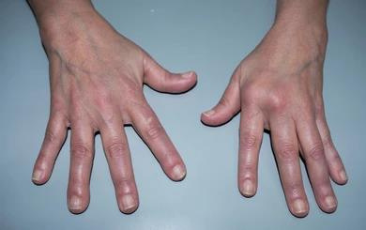
20 yoF with 4 weeks of hand pain
She tells you:
I have to wake up at 5 am for my 8 am class
I struggle to type, I’ve been missing
classes in the afternoon due to pain
I had to stop doing yoga/Pilates because
my wrists hurt
It’s hard for me to wash my hair or pick
up clothes off the floor
My maternal grandmother had RA

Slide 10
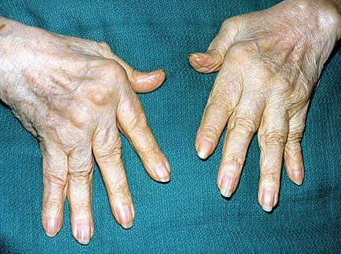
70 yoF with 2 years of gradual deformities
She tells you:
My kids and husband tell me I need to
ask you about my hands
I don’t have pain but my fingers don’t
work like they used to
I don’t wear clothes with buttons,
shoelaces, or tie my hair up anymore
I’m not taking any medication for my joints, I thought this was just part of getting older

Slide 11
What will you order?
A. RF and CCP B. TSH
C. UA
D. DsDNA

Slide 12
Workup
■Rheumatoid Factor
–
–
■Anti-cyclic citrullinated peptide (CCP)
–
specificity (90-95%)
■ESR
■Anemia of chronic disease
Autoantibody directed against Fc fragment of IgG
False positives or not clinically significant for RA
Directed against citrulline residues, increased
■CRP
■Thrombocytosis

Slide 13
Imaging
■Bilateral hands
–
■Baseline and monitor disease progression
■Determine RA vs OA vs gout vs psoriatic arthritis
■Key findings:
–Periarticular osteopenia
–Central or marginal erosions
–Joint-space narrowing of MCP and PIP joints
Imaging of ALL the fingers is extremely helpful

Slide 14
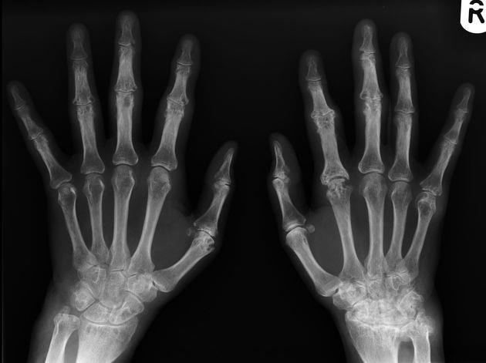

Slide 15
A 57-year-old woman is evaluated for a 2.5-year history of pain and swelling in the hands and wrists. She also has joint stiffness for over an hour after awakening.
On physical examination, vital signs are normal. She has swelling and tenderness of the following: second, third, and fourth proximal interphalangeal joints of the right hand and third and fourth proximal interphalangeal joints of the left hand; the left second and right third metacarpophalangeal joints; and both wrists.
Question continues….
MKSAP 19, Rheum Q90

Slide 16
Question continued….
Laboratory evaluation reveals a blood C-reactive protein level of 4.8 mg/dL (48 mg/L) and positive results on tests for serum rheumatoid factor and anti–cyclic citrullinated peptide antibodies.
Radiographs of the hands show periarticular osteopenia and joint-space narrowing of the proximal interphalangeal joints, periarticular osteopenia and marginal erosions at the second proximal interphalangeal and metacarpophalangeal joints of both hands, and radiocarpal joint-space narrowing.
Which of the following imaging studies should be done next?
(A) Bone scanning
(B) MRI of hands
(C) Ultrasonography of hands
(D) No further imaging
MKSAP 19, Rheum Q90

Slide 17
Pathophysiology
■HLA-DR B1, Genetic predisposition
■Environmental trigger –typically a virus
■Smoking, triggers citrullination in the lungs ■Activation of CD4 T cells activates macrophages and
synovial cells
■Production of IL-4 and TNF
■B lymphocytes activate immune complexes in joints
and other tissues
■RANKL activates osteoclasts

Slide 18
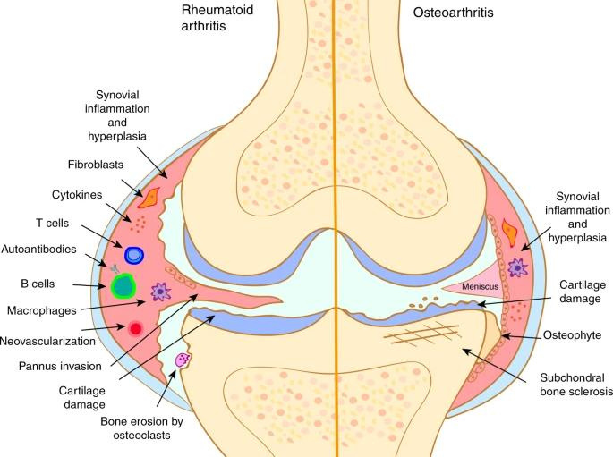
Macfarlane, E., Seibel, M.J. & Zhou, H. Arthritis and the role of endogenous glucocorticoids.Bone Res8,33 (2020). https://doi.org/10.1038/s41413-020-00112-2

Slide 19
Articular Pathology of RA
Consequences of Persistent Inflammation on Joints and Supporting Structures
Joint Area | Implications
C1-C2 articulation and transverse ligament | Laxity of transverse ligament results in increased posterior motion of dens on C2 because of atlantoaxial subluxation. Rheumatoid synovitis may lead to erosion of dens; with neck flexion, dens can affect the midbrain and other vital neurologic structures. This must be evaluated before intubation or neck manipulation in patients with long-standing RA.
Shoulder and rotator cuff tendons | Restricted range of motion of glenohumeral joint and rotator cuff tears
Elbow joint | Elbow contractures and difficulty with hand pronation and supination
Wrist carpal joints and finger tendons | Restricted range of motion of wrist; carpal tunnel syndrome; rupture of finger extensor tendons, especially fourth and fifth
MCPs and surrounding structures | Ulnar deviation and subluxation of MCPs
PIPs and surrounding structures | Swan neck or boutonniere deformity due to inflammatory disruption of periarticular support structures
Hip joint | Axial migration of femoral head in acetabulum (protrusio acetabuli)
Knee joint | Tricompartmental joint-space narrowing
Ankle and mid-foot joints and tendons | Restricted range of motion of ankle; progressive pronated flat foot deformity
MTPs and surrounding structures | Fibular deviation of MTPs; cock-up deformities; skin ulceration underneath subluxed MTP heads
MKSAP 19

Slide 20
Extra-Articular Manifestations
■Cutaneous: rheumatoid nodules
–
■Kerato-conjunctivitis sicca, episcleritis, scleritis
–Most severe form: corneal melt
■ Atherosclerosis
■ Cricoarytenoid arthritis of the larynx
~30% of patients, olecranon area, induced by methotrexate
■Felty syndrome: Neutropenia, splenomegaly, and severe RA
-- think Large granular lymphocyte leukemia!

Slide 21
Lung Disease
■Most often presents after joint manifestations
■Increased incidence of interstitial lung disease as
first presentation, common but uncommon clinically significant
■ Nodules
■Pleural effusions
-low pH
-Mononuclear
-exudative
-What if neutrophil predominant?
■

Slide 22
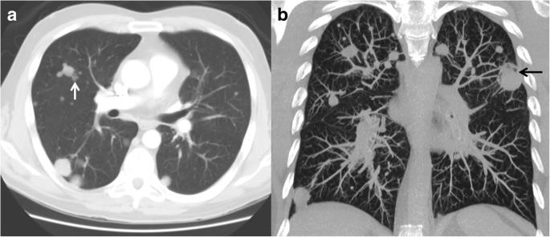

Slide 23
Treatment
■Early diagnosis and aggressive early therapy
–
■Disease-Modifying Antirheumatic Drugs (DMARDs)
■Non biologic:
–
Low dose prednisone if waiting for referral (prednisone 5-10 mg daily)
Methotrexate, leflunomide, sulfasalazine,
hydroxychloroquine (azathioprine? Gold? Minocycline?)
JAK inhibitors (targeted synthetic): baracitinib, tofacitinib,
upadacitinib
Etanercept, adalimumab, infliximab
Tocilizumab, Abatacept, Rituximab, Anakinra
–
■Biologic: Tumor Necrosis Factor (TNF-α) Inhibitors
–
–
Other Biologics:

Slide 24
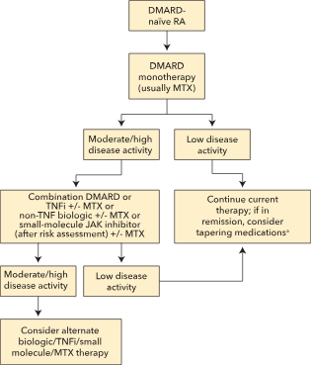
Treatment
“Treat to target”
MKSAP 19

Slide 25
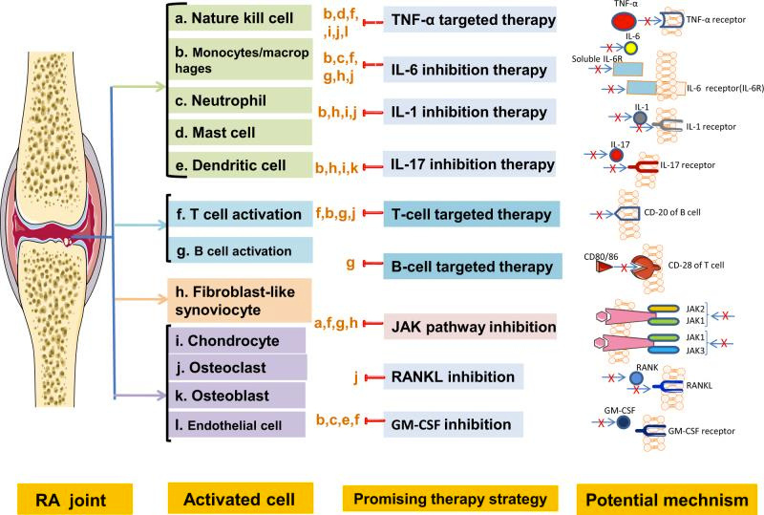

Slide 26
■67 yoF is evaluated for 3-year history of severe RA.
She had an inadequate response to methotrexate
and low-dose prednisone. She responded well to
infliximab, but eventually lost efficacy. She was then
placed on tocilizumab with methotrexate.
■She notes several months of prominent fatigue. She
also has DM2, HTN, HLD.
■She is on methotrexate, folic acid, tocilizumab, basal
insulin, lisinopril, metoprolol, atorvastatin, ibuprofen, omeprazole
MKSAP 18, Rheum #43

Slide 27
Exam: Normal VS, no swollen or tender joints, RRR and lungs
are clear.
Labs show WBC 5.6, Hgb 9.3, MCV 111, Platelet 330
Which of the following is the most likely cause of her anemia?
(A) Inflammation
(B) Iron deficiency (C) Methotrexate
(D) Tocilizumab
MKSAP 18, Rheum #43

Slide 28
■Methotrexate can cause megaloblastic anemia from folic
acid deficiency
need more folic acid
■Can also cause increased LFTs, more toxic with CKD
■Expect some increase in MCV but if >105 then patient may
■Requires Q3 month lab monitoring

Slide 29
A 36-year-old woman is evaluated for preconception counseling. She has a 3-year history of rheumatoid arthritis well controlled with leflunomide, hydroxychloroquine, and certolizumab. Her most recent disease activity score showed remission. In the past, attempts to discontinue her medications have been unsuccessful because of recurrent active disease.
On physical examination, vital signs are normal. BMI is 24. Range of motion is normal, and joints are not warm or swollen.
Which of the following is the most appropriate treatment at this time?
(A) Stop all drugs
(B) Stop certolizumab
(C) Stop hydroxychloroquine
(D) Discontinue leflunomide
(E) No changes are needed
MKSAP 19, Rheum Q57

Slide 30
▪ ▪ ▪ ▪
TNF inhibitors are safe while pregnant
Uncontrolled disease can lead to pregnancy complications Typically co-management with MFM if biologics are involved Teratogenic meds for boards (leflunomide, methotrexate, JAK
inhibitors) -- how long do you hold prior to conception??

Slide 31
A 58-year-old man is evaluated at a follow-up visit. He has had rheumatoid arthritis for 5 years. Increasing morning stiffness, fatigue, increasing joint pain, and swelling of small hand joints have developed in the past 6 months. His disease activity score shows moderate activity. He has coronary artery disease, COPD, and a history of diverticulitis. Current meds are aspirin, lisinopril, metoprolol, a tiotropium inhaler, methotrexate, and sulfasalazine.
Continued….
MKSAP 19, Rheum Q36

Slide 32
Continued…
On exam, BPis 136/84 mm Hg. BMI is 29. Multiple metacarpophalangeal joints are tender to palpation, and there is active synovitis.
Result of an interferon-gamma release assay is negative.
Hand radiographs show joint-space narrowing and three new erosions.
Which of the following is the most appropriate treatment?
(A) Abatacept
(B) Adalimumab
(C) Anakinra
(D) Tocilizumab
(E) Tofacitinib
MKSAP 19, Rheum Q36

Slide 33
Screening for Biologics
Tuberculosis
Hepatitis B
Hepatitis C
HIV
Concerns of TNF Biologics
Infections!
Demyelinating disease
Nonmelanoma skin cancer, lymphoma

Slide 34
References
■Davis III, J. M., MD, & Matteson, E. L., MD (2012). My Treatment approach to
Rheumatoid arthritis. Mayo Clinic Preceedings.
https://doi.org/https://www.mayoclinicproceedings.org/article/S0025-
6196(12)00472-7/fulltext
■Guo Q, Wang Y, Xu D, NossentJ, PavlosNJ, Xu J. Rheumatoid arthritis: pathological
mechanisms and modern pharmacologic therapies.Bone Res. 2018;6:15.
Published 2018 Apr 27. doi:10.1038/s41413-018-0016-9
■Macfarlane, E., Seibel, M.J. & Zhou, H. Arthritis and the role of endogenous
glucocorticoids.Bone Res8,33 (2020). https://doi.org/10.1038/s41413-020-
00112-2
■MKSAP 18 and MKSAP 19

