Slide 1
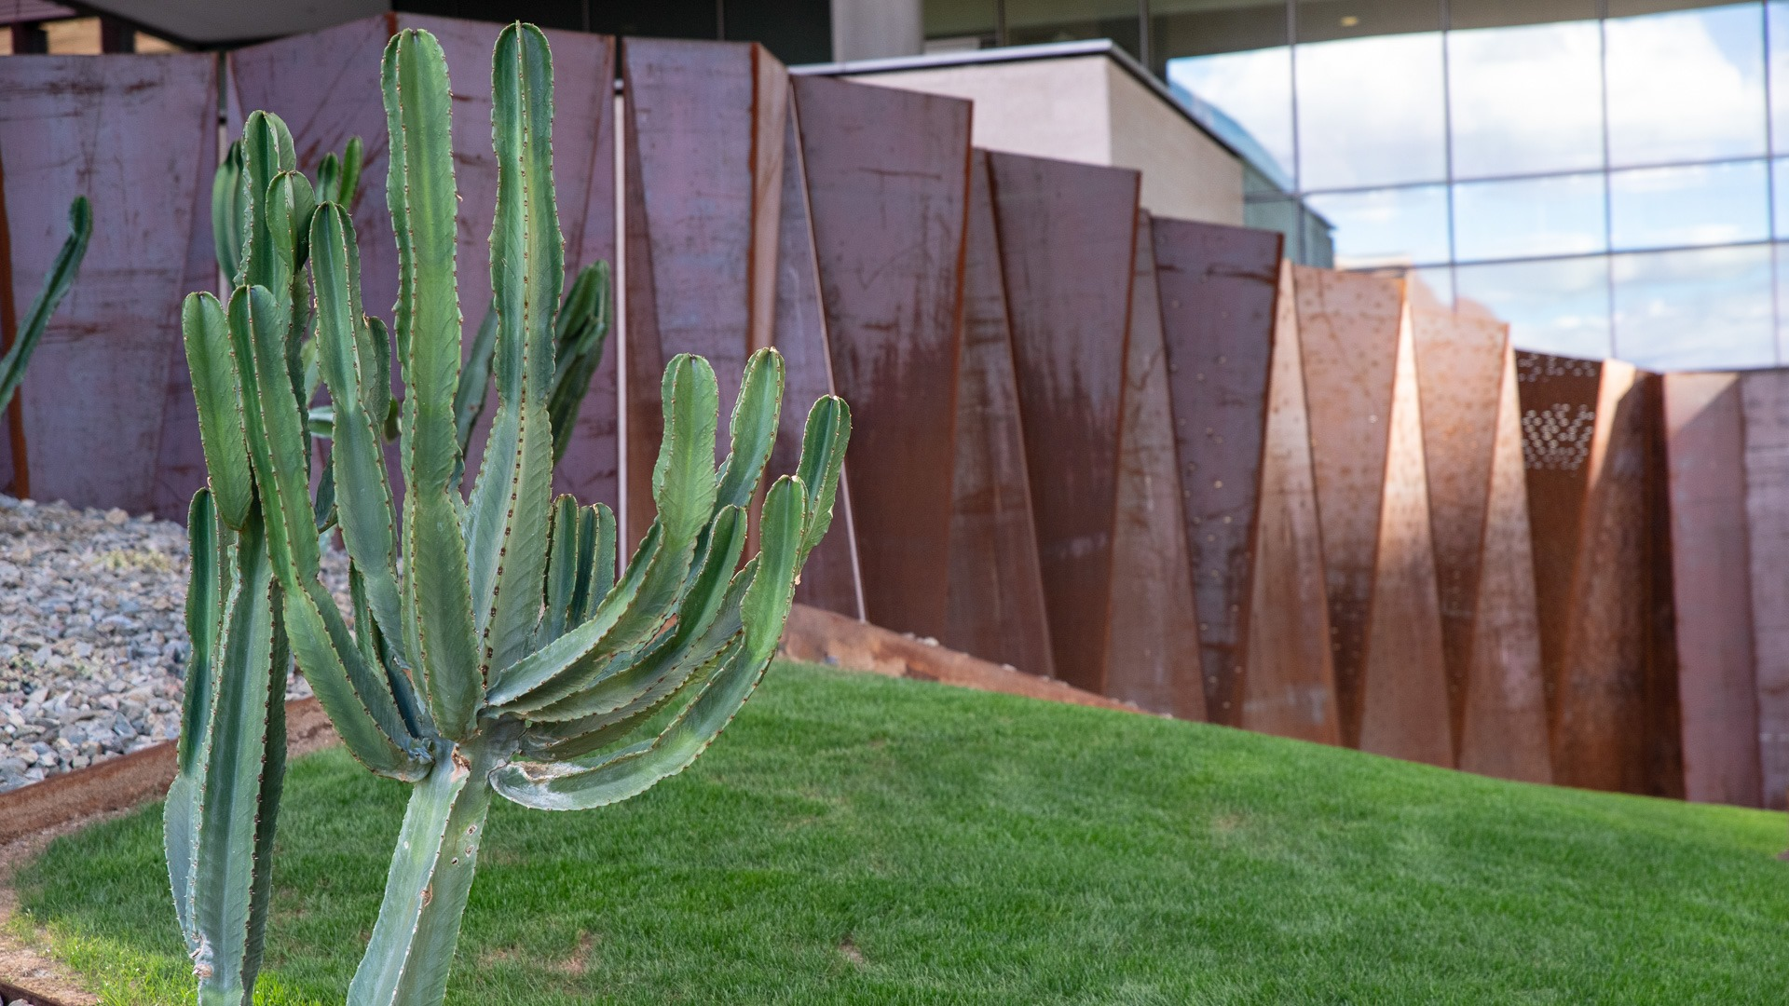

Board Review
Nephrology
28th October 2025
Ralph Mohty MD MPH

Slide 2

Question №1
A rapid-response is called on a 70-year-old woman admitted to the Family Medicine service.
She was admitted earlier today for intractable pain related to metastatic lung cancer, and at that time was noted to have a serum [Na] of 121 confirmed by blood gas.
On examination she is confused but arousable, and the bedside RN reports she vomited an hour ago after complaining of progressively worsening nausea.
Your team checks a blood gas [Na] and notes it to be 113.
Which of the following is the most appropriate next step?
CT Head
Check serum ammonia level
1 litre bolus of 0.9% NS
150mL bolus of 3% NS

Slide 3
Question №1
A rapid-response is called on a 70-year-old woman admitted to the Family Medicine service.
She was admitted earlier today for intractable pain related to metastatic lung cancer, and at that time was noted to have a serum [Na] of 121 confirmed by blood gas.
On examination she is confused but arousable, and the bedside RN reports she vomited an hour ago after complaining of progressively worsening nausea.
Your team checks a blood gas [Na] and notes it to be 113.
Which of the following is the most appropriate next step?
CT Head
Check serum ammonia level
1 litre bolus of 0.9% NS
150mL bolus of 3% NS

Slide 4
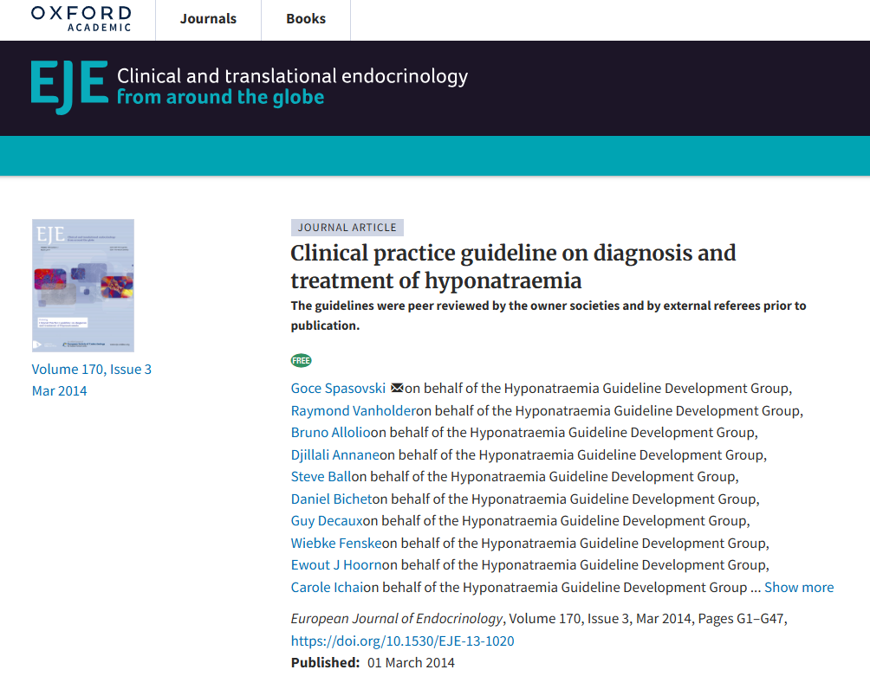

Slide 5
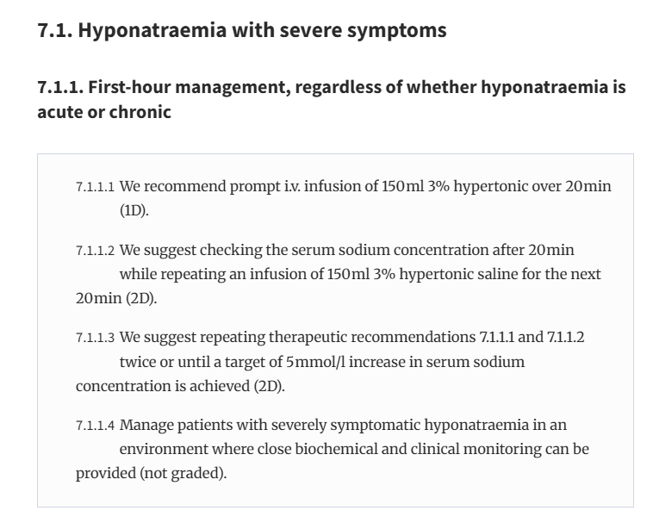

Slide 6
Question №2
You admit a 37-year-old man with a history of HTN, high risk APOL1 genotype, and CKD-G4-A3 (bCr of ~6 for the past year) who presented with worsening nausea and fatigue.
While examining him in the ED you notice that he has 4 beats of bilateral asterixis and 1+ lower extremity edema, but otherwise is alert and oriented to self, situation, and date. He subsequently vomits while you attempt to continue your exam—he confirms random nausea and pruritus.
His vitals are unremarkable.
Labs are notable for a BUN of 190, Cr 8, Na 134, K 4.4, bicarb 14, UA with only 1+ protein.
You request a manual urine spin from Nephrology and they report scattered waxy and granular casts.
Which of the following is the most appropriate next step in management?
Consult Nephrology for initiation of HD
IV 0.9% saline
Pulse steroids
Kidney biopsy

Slide 7
Question №2
You admit a 37-year-old man with a history of HTN, high risk APOL1 genotype, and CKD-G4-A3 (bCr of ~6 for the past year) who presented with worsening nausea and fatigue.
While examining him in the ED you notice that he has 4 beats of bilateral asterixis and 1+ lower extremity edema, but otherwise is alert and oriented to self, situation, and date. He subsequently vomits while you attempt to continue your exam—he confirms random nausea and pruritus.
His vitals are unremarkable.
Labs are notable for a BUN of 190, Cr 8, Na 134, K 4.4, bicarb 14, UA with only 1+ protein.
You request a manual urine spin from Nephrology and they report scattered waxy and granular casts.
Which of the following is the most appropriate next step in management?
Consult Nephrology for initiation of HD
IV 0.9% saline
Pulse steroids
Kidney biopsy

Slide 8
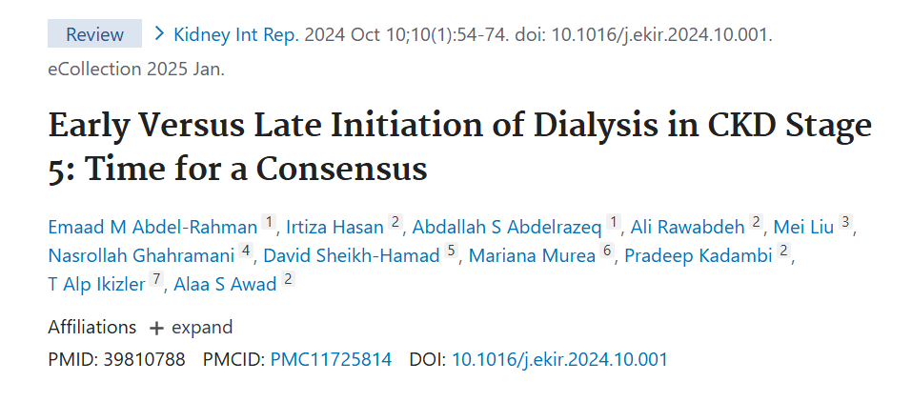

Slide 9
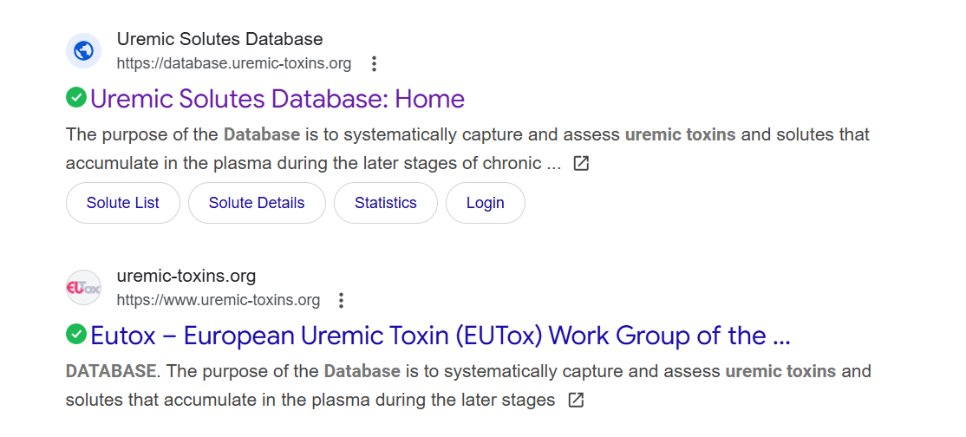

Slide 10
Question №3
A rapid-response is called on your patient--a 59-year-old woman with CKD-G4-A3 and HFrEF admitted for small bowel obstruction.
The bedside nurse had noted worsening weakness.
While your colleague is assessing the patient, you notice frequent wide-complex ectopy, and a widened QRS that was not present on morning rounds.
Vitals are notable for BP 148/86 (HR 90), otherwise his exam is notable for whole-body 4/5 strength, no focal deficits.
A blood-gas potassium is checked and is 7.5. You remember from your initial GoC conversation that he is a DNR/DNI and adamantly refuses dialysis.
Which of the following therapies should be prioritized?
IV 1Gm calcium
IV 10U regular insulin + 50mL D50
Sodium zirconium cyclosilicate
10mg IV bumetanide

Slide 11
Question №3
A rapid-response is called on your patient--a 59-year-old woman with CKD-G4-A3 and HFrEF admitted for small bowel obstruction.
The bedside nurse had noted worsening weakness.
While your colleague is assessing the patient, you notice frequent wide-complex ectopy, and a widened QRS that was not present on morning rounds.
Vitals are notable for BP 148/86 (HR 90), otherwise his exam is notable for whole-body 4/5 strength, no focal deficits.
A blood-gas potassium is checked and is 7.5. You remember from your initial GoC conversation that he is a DNR/DNI and adamantly refuses dialysis.
Which of the following therapies should be prioritized?
IV 1Gm calcium
IV 10U regular insulin + 50mL D50
Sodium zirconium cyclosilicate
10mg IV bumetanide

Slide 12
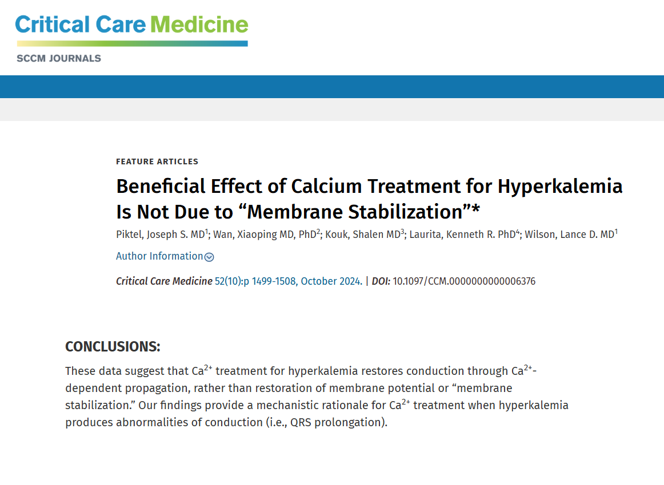

Slide 13
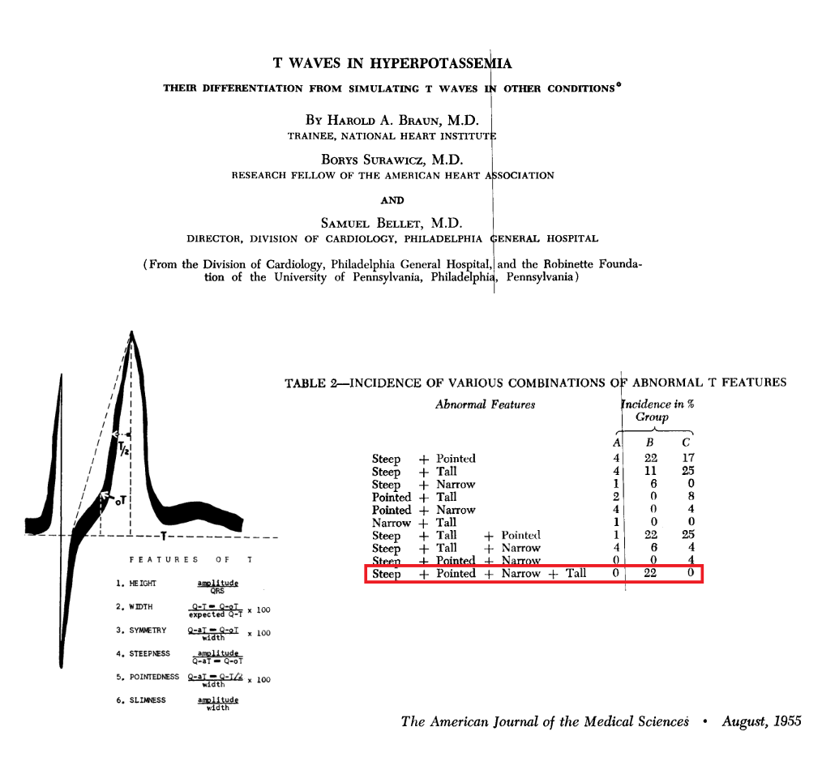

Slide 14
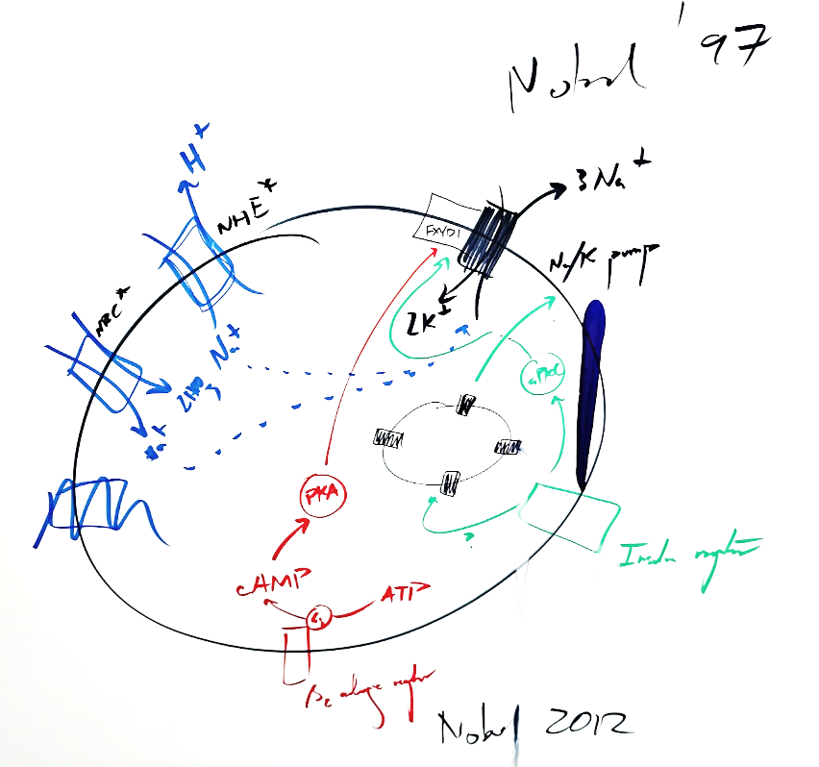

Slide 15
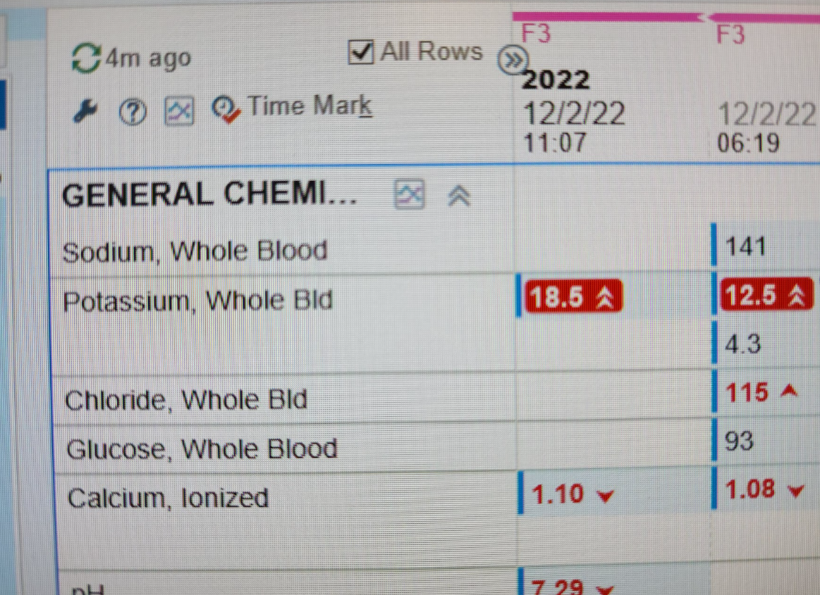

Slide 16
Question №4
A 34-year-old unhoused man with t2DM is admitted to the Internal Medicine service with failure-to-thrive, intermittent fevers. On admission his Cr is 3.6, a foley catheter is placed and dipstick UA is notable for 2+ proteinuria, 3+ blood, 1+ leukocyte esterase.
Despite fluid resuscitation, his kidney function continues to slowly deteriorate.
You check a C3 and C4 level which are both low.
A rheumatoid factor level is elevated. ANA is +1:160 (speckled) and p-ANCA and c-ANCA are both positive.
Blood cultures checked in triplicate are persistently negative. A TTE does not demonstrate any vegetations.
Which of the following is the next best step in management?
Cyclophosphamide
Rituximab
Bartonella serologies
Kidney biopsy

Slide 17
Question №4
A 34-year-old unhoused man with t2DM is admitted to the Internal Medicine service with failure-to-thrive, intermittent fevers. On admission his Cr is 3.6, a foley catheter is placed and dipstick UA is notable for 2+ proteinuria, 3+ blood, 1+ leukocyte esterase.
Despite fluid resuscitation, his kidney function continues to slowly deteriorate.
You check a C3 and C4 level which are both low.
A rheumatoid factor level is elevated. ANA is +1:160 (speckled) and p-ANCA and c-ANCA are both positive.
Blood cultures checked in triplicate are persistently negative. A TTE does not demonstrate any vegetations.
Which of the following is the next best step in management?
Cyclophosphamide
Rituximab
Bartonella serologies
Kidney biopsy

Slide 18
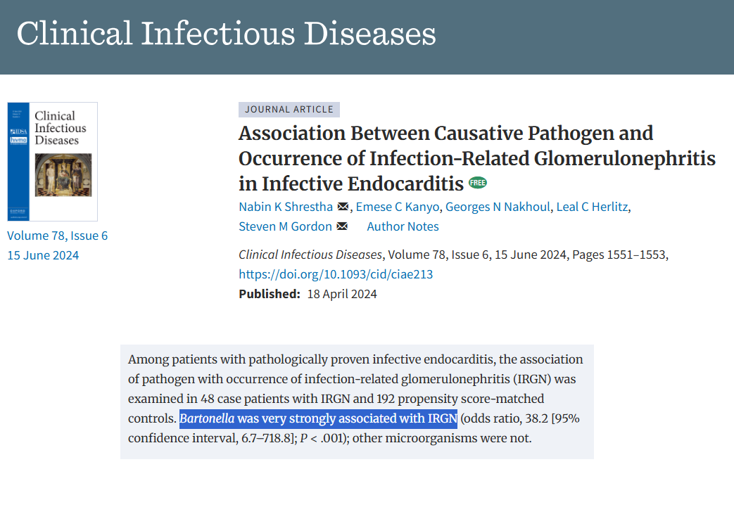

Slide 19
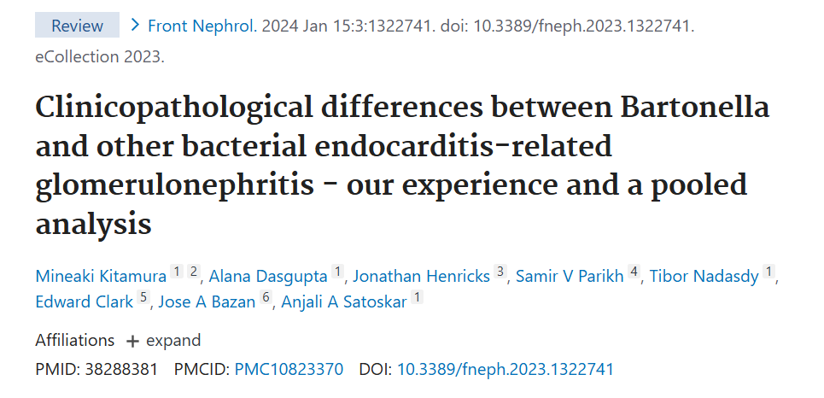
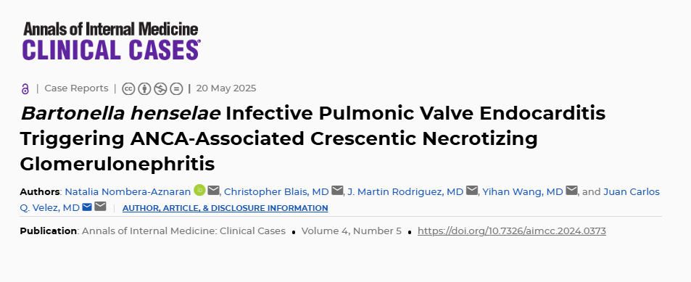

Slide 20
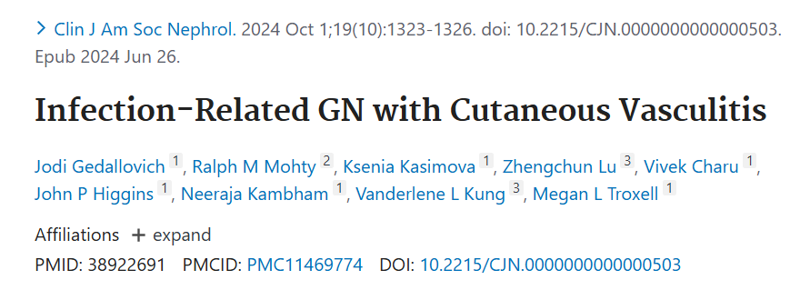

Slide 21
Question №5
You are rounding on a 55-year-old man with type 1 diabetes mellitus in the ICU.
He was admitted a few days ago with hyperosmotic hyperglycemic nonketotic state, necessitating endotracheal intubation due to inability to protect his airway. He received multiple litres of normal saline and is on a continuous insulin infusion.
Today his serum [Na] is 158, and serum glucose ranges from 250-300 overnight.
He is subsequently extubated and is pending speech language therapy clearance for oral intake.
Which of the following is the most appropriate treatment for this patient’s hypernatremia?
IV D5W
IV 0.45% NS
IV 0.9% NS
FWF via NG

Slide 22
Question №5
You are rounding on a 55-year-old man with type 1 diabetes mellitus in the ICU.
He was admitted a few days ago with hyperosmotic hyperglycemic nonketotic state, necessitating endotracheal intubation due to inability to protect his airway. He received multiple litres of normal saline and is on a continuous insulin infusion.
Today his serum [Na] is 158, and serum glucose ranges from 250-300 overnight.
He is subsequently extubated and is pending speech language therapy clearance for oral intake.
Which of the following is the most appropriate treatment for this patient’s hypernatremia?
IV D5W
IV 0.45% NS
IV 0.9% NS
FWF via NG

Slide 23
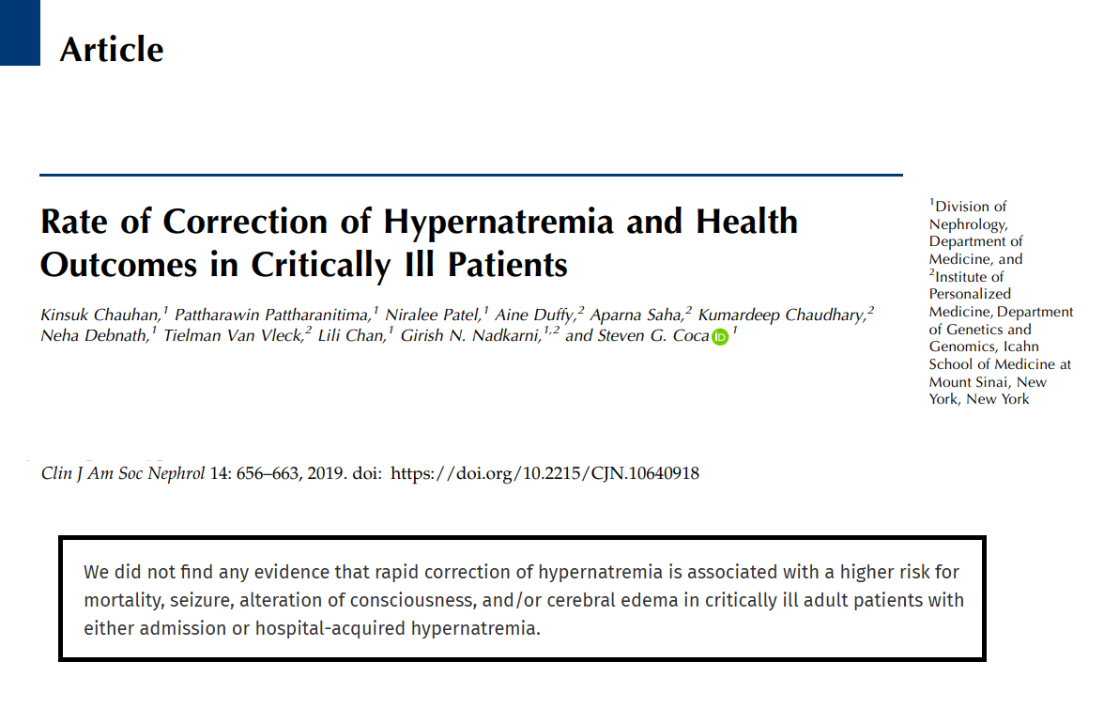

Slide 24
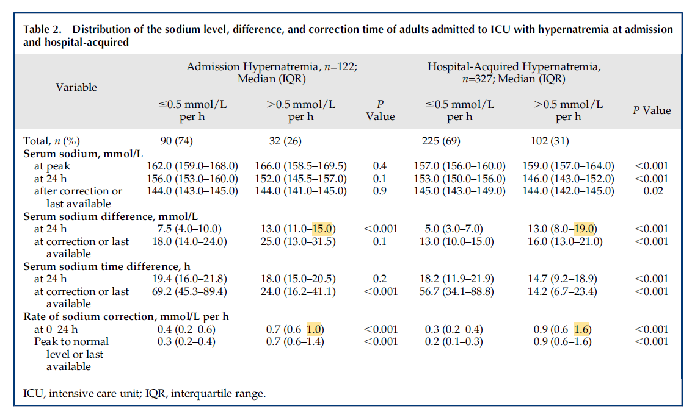

Slide 25
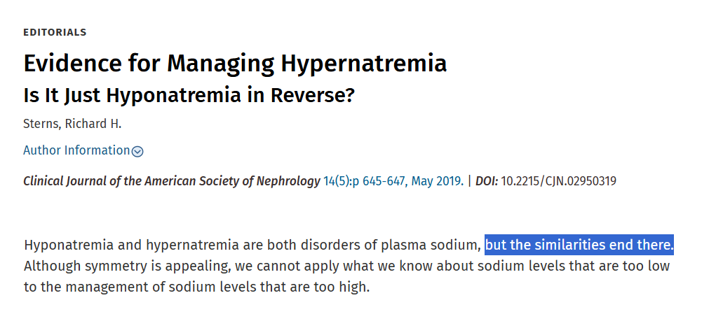

Slide 26
Question №6
You see a 71-year-old gentleman in Internal Medicine clinic as a referral from General Surgery—sent for preoperative evaluation before inguinal hernia repair.
He has a history of HTN, CKD (bCr ~1.8), and DLD. Rx: metoprolol-t, amlodipine, furosemide, hydralazine, and simvastatin.
On your exam his BP is 160/100 (HR 55), and you notice a bruit over the umbilicus.
You send him for labs and imaging, revealing a Cr of 1.7, UACR of 300 mg/g, and abdominal ultrasound with >70% RAS.
Which of the following is the most appropriate next step in management?
Start an ACEi or ARB (or DRI)
Refer to IR for renal arterial angiography
Refer to IR for renal artery angioplasty and stenting
Refer to Vascular for renal artery revascularization

Slide 27
Question №6
You see a 71-year-old gentleman in Internal Medicine clinic as a referral from General Surgery—sent for preoperative evaluation before inguinal hernia repair.
He has a history of HTN, CKD (bCr ~1.8), and DLD. Rx: metoprolol-t, amlodipine, furosemide, hydralazine, and simvastatin.
On your exam his BP is 160/100 (HR 55), and you notice a bruit over the umbilicus.
You send him for labs and imaging, revealing a Cr of 1.7, UACR of 300 mg/g, and abdominal ultrasound with >70% RAS.
Which of the following is the most appropriate next step in management?
Start an ACEi or ARB (or DRI)
Refer to IR for renal arterial angiography
Refer to IR for renal artery angioplasty and stenting
Refer to Vascular for renal artery revascularization

Slide 28
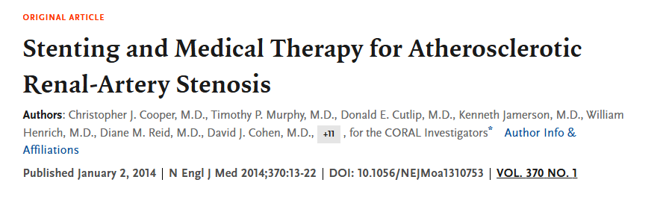
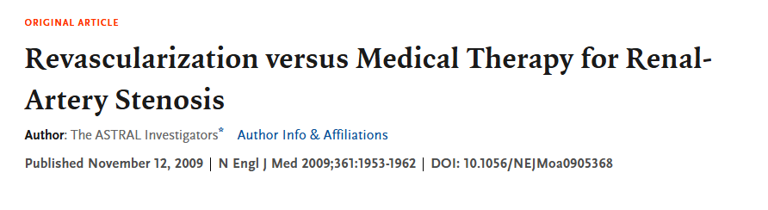
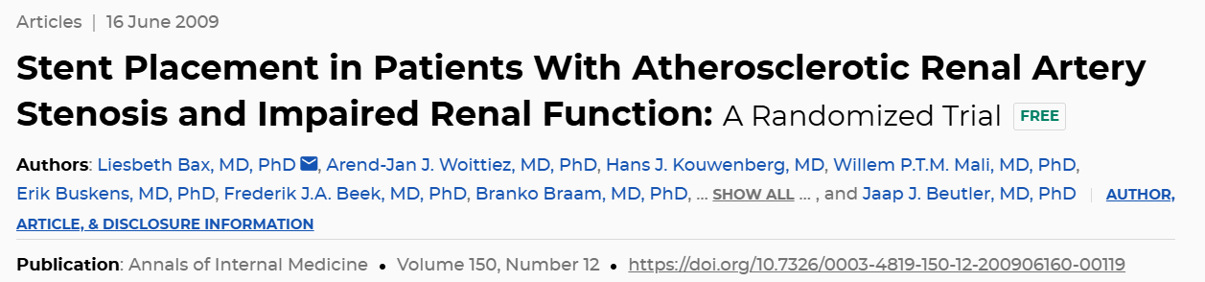

Slide 29
Question №7
A 45-year-old man is hospitalized with fever, headache, and confusion.
A lumbar puncture is performed and reveals lymphocytic pleocytosis, normal glucose, and elevated protein.
CSF PCR reveals HSV DNA 2mil copies/mL and intravenous acyclovir therapy is subsequently added.
After 3 days of treatment, he becomes oliguric and you notice his serum Cr has increased from 0.9 to 3.2 mg/dL. Automated urinalysis shows only hematuria.
Which of the following is the most likely mechanism of his AKI?
Acute tubular necrosis
Allergic interstitial nephritis
Crystalline nephropathy
Glomerulonephritis

Slide 30
Question №7
A 45-year-old man is hospitalized with fever, headache, and confusion.
A lumbar puncture is performed and reveals lymphocytic pleocytosis, normal glucose, and elevated protein.
CSF PCR reveals HSV DNA 2mil copies/mL and intravenous acyclovir therapy is subsequently added.
After 3 days of treatment, he becomes oliguric and you notice his serum Cr has increased from 0.9 to 3.2 mg/dL. Automated urinalysis shows only hematuria.
Which of the following is the most likely mechanism of his AKI?
Acute tubular necrosis
Allergic interstitial nephritis
Crystalline nephropathy
Glomerulonephritis

Slide 31
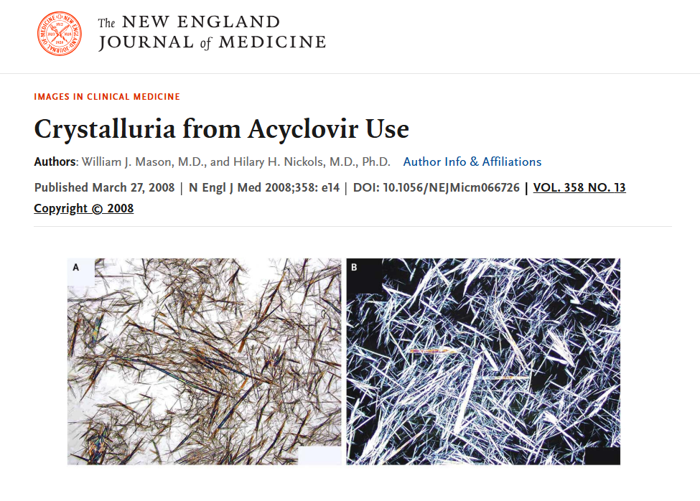

Slide 32
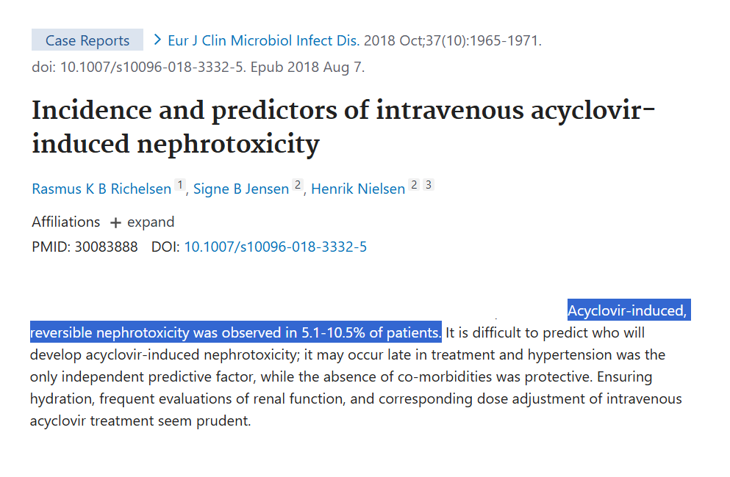

Slide 33
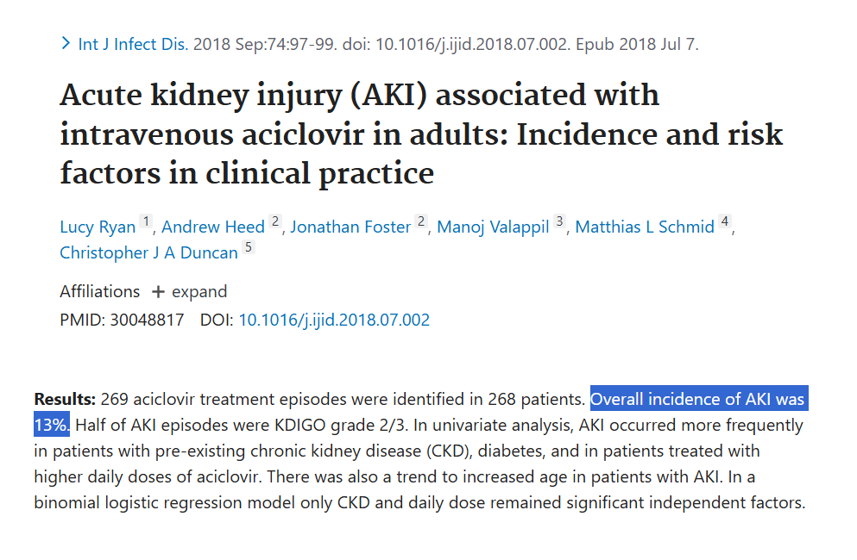

Slide 34
Question №8
A 57-year-woman self-refers to Internal Medicine clinic for evaluation of back discomfort.
While reviewing her chart from a recent hospital stay for anemia, you notice a UPCR and UACR were both checked to follow-up 2+ proteinuria from a UA done in the ED.
The UPCR is 5,000 mg/g and the UACR is 30 mg/g.
Otherwise her vitals are notable for a BP of ~130/~80 (HR ~80).
What is the next best step in evaluating this patient’s discordant proteinuria?
Repeat UA
Repeat UPCR and UACR
Check an a1c
SPEP, UPEP, FLC

Slide 35
Question №8
A 57-year-woman self-refers to Internal Medicine clinic for evaluation of back discomfort.
While reviewing her chart from a recent hospital stay for anemia, you notice a UPCR and UACR were both checked to follow-up 2+ proteinuria from a UA done in the ED.
The UPCR is 5,000 mg/g and the UACR is 30 mg/g.
Otherwise her vitals are notable for a BP of ~130/~80 (HR ~80).
What is the next best step in evaluating this patient’s discordant proteinuria?
Repeat UA
Repeat UPCR and UACR
Check an a1c
SPEP, UPEP, FLC

Slide 36
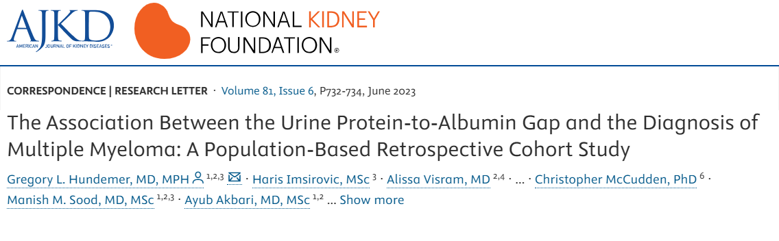

Slide 37
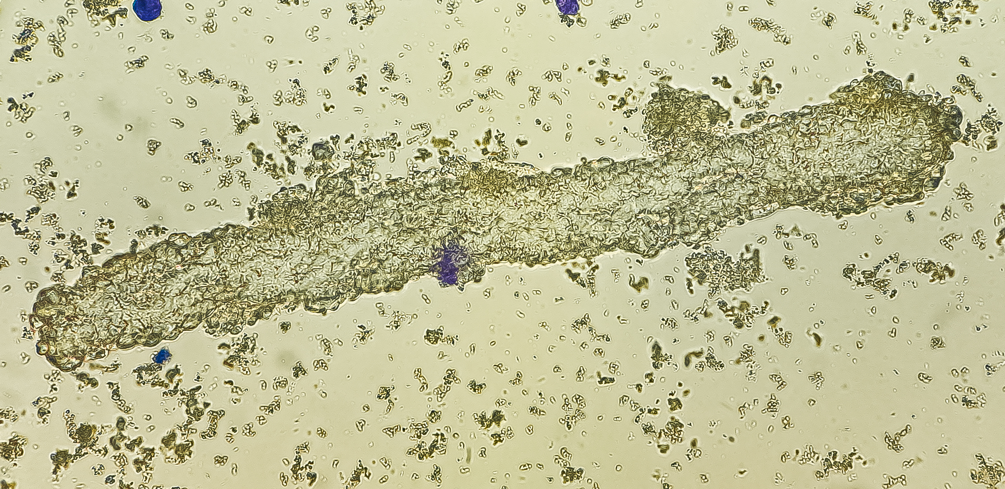

Slide 38
Question №9
You are admitting a 76-year-old woman from the ED who is presenting with malaise. Work-up in the ED was notable for a newly elevated Cr of 5.6 (bCr of ~1.1).
History is notable for locally advanced gastric cancer for which she receives pembrolizumab every 6 weeks, HTN, GERD, and t2DM.
Rx: amlodipine, insulin (glargine and aspart), pantoprazole.
Vitals: BP 130/80 (HR 70s), afebrile, comfortable on AA (SpO2 ~95%, RR 12)
You order a UA which is notable for trace proteinuria and 1+ WBCs without any bacteria.
What is the most likely cause of her kidney injury?
Prerenal Azotemia
Acute tubular necrosis/injury
Glomerulonephritis
Interstitial Nephritis

Slide 39
Question №9
You are admitting a 76-year-old woman from the ED who is presenting with malaise. Work-up in the ED was notable for a newly elevated Cr of 5.6 (bCr of ~1.1).
History is notable for locally advanced gastric cancer for which she receives pembrolizumab every 6 weeks, HTN, GERD, and t2DM.
Rx: amlodipine, insulin (glargine and aspart), pantoprazole.
Vitals: BP 130/80 (HR 70s), afebrile, comfortable on AA (SpO2 ~95%, RR 12)
You order a UA which is notable for trace proteinuria and 1+ WBCs without any bacteria.
What is the most likely cause of her kidney injury?
Prerenal Azotemia
Acute tubular necrosis/injury
Glomerulonephritis
Interstitial Nephritis

Slide 40
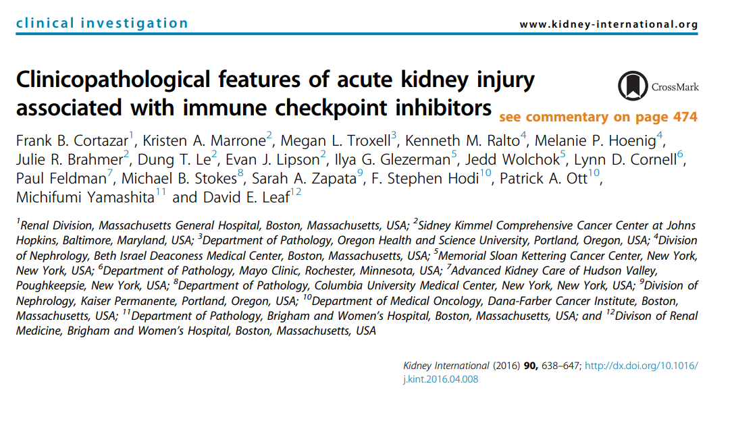

Slide 41
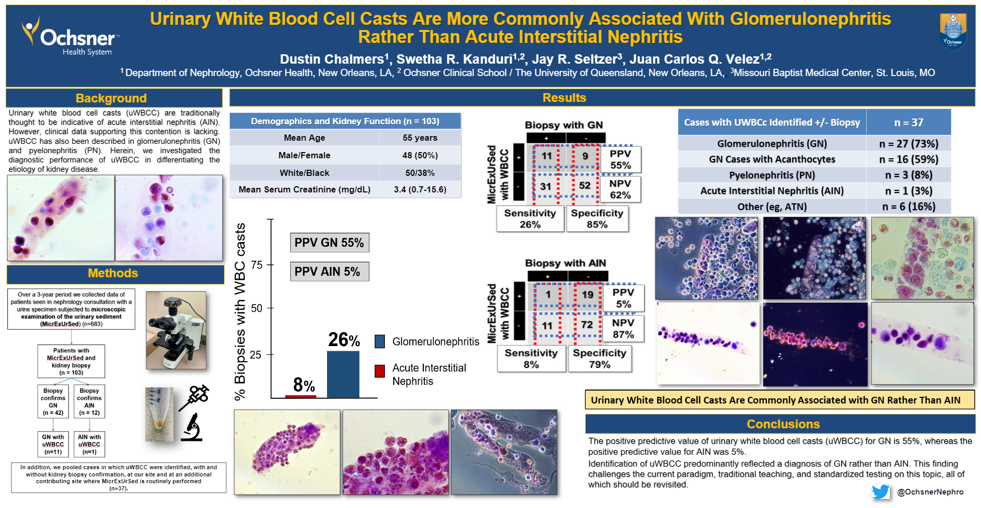

Slide 42
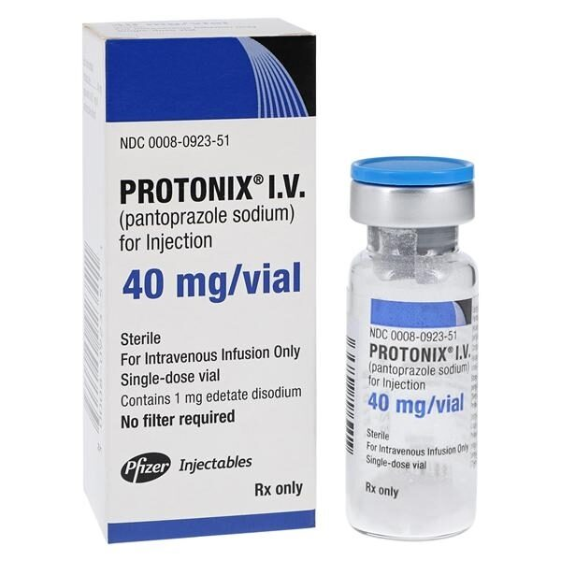
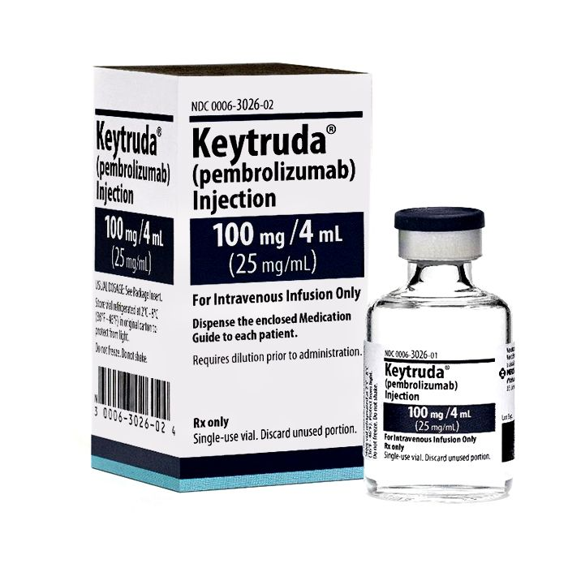
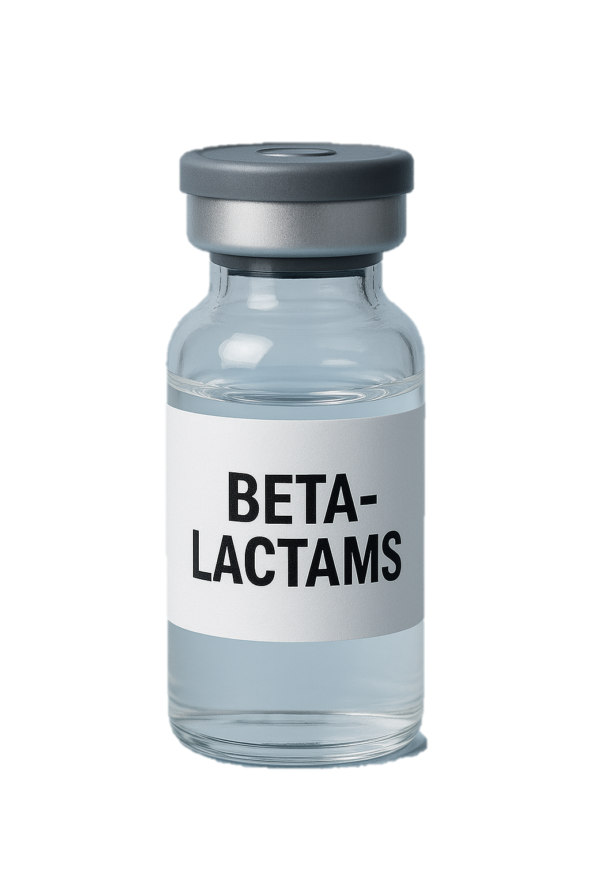
Interstitial Nephritis (IN)
Stop the drug…IN may persist
May need glucocorticoid
Refractory cases may need infliximab

Slide 43
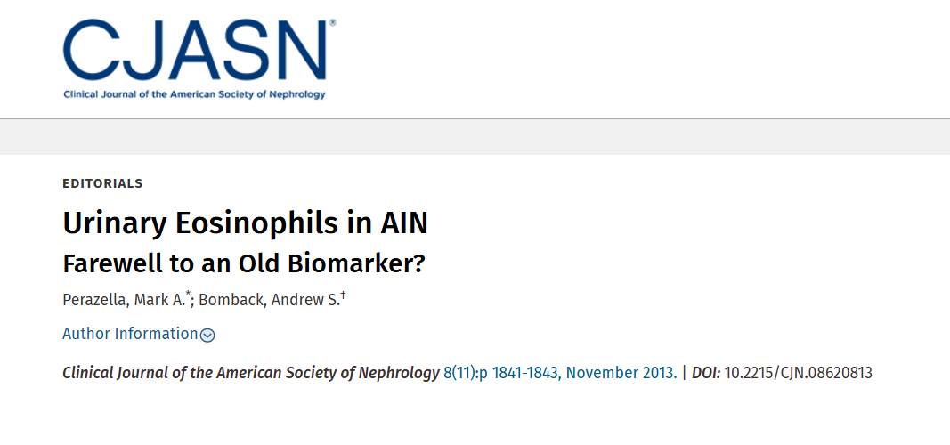

Slide 44
Question №10
You are seeing a 58-year-old man with t2DM complicated by CKD-G3a-A3, neuropathy, and retinopathy in follow-up. He reports feeling well and is still working to get his blood glucose levels under better control.
His current medications include lisinopril, metformin, and atorvastatin.
Vitals are notable for BP 118/72 (HR 78), otherwise his exam is notable for symmetric loss of light touch sensation to monofilament in most toes.
Labs done just before his clinic visit are notable for a Cr of 2.1 (unchanged), K of 5.2 (averaging 5.1-5.4 over past few months), and a UACR of 950mg/g.
Which of the following is the most appropriate next step in management to reduce progression of kidney disease?
Add finerenone
Add dapagliflozin
Add losartan
Refer to RD for low-protein diet

Slide 45
Question №10
You are seeing a 58-year-old man with t2DM complicated by CKD-G3a-A3, neuropathy, and retinopathy in follow-up. He reports feeling well and is still working to get his blood glucose levels under better control.
His current medications include lisinopril, metformin, and atorvastatin.
Vitals are notable for BP 118/72 (HR 78), otherwise his exam is notable for symmetric loss of light touch sensation to monofilament in most toes.
Labs done just before his clinic visit are notable for a Cr of 2.1 (unchanged), K of 5.2 (averaging 5.1-5.4 over past few months), and a UACR of 950mg/g.
Which of the following is the most appropriate next step in management to reduce progression of kidney disease?
Add finerenone
Add dapagliflozin
Add losartan
Refer to RD for low-protein diet

Slide 46
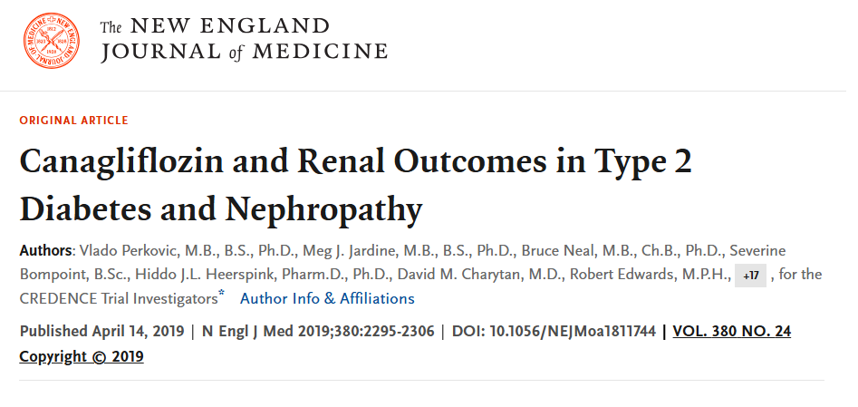
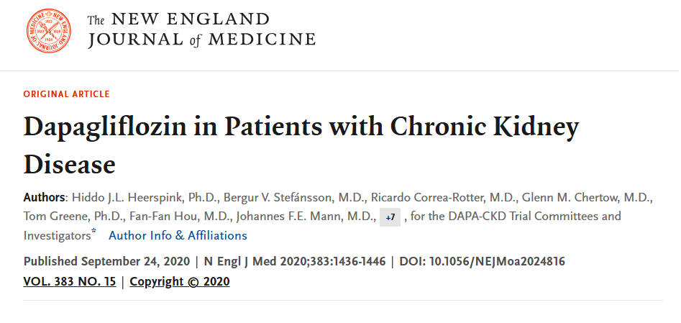
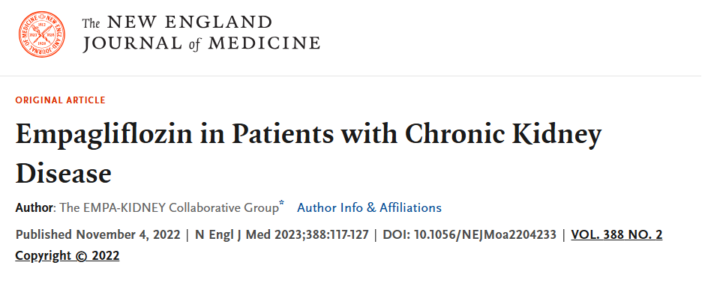

Slide 47
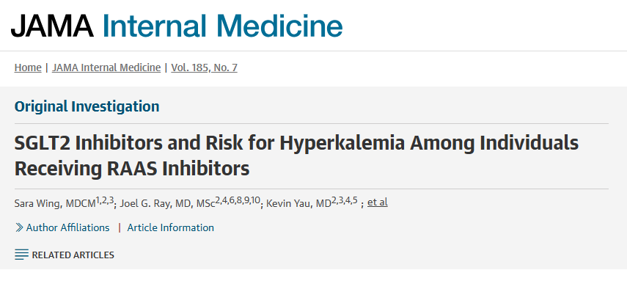

Slide 48
Question №11
A 34-year-old man with a history of EtOH use disorder is admitted to the hospital with worsening fatigue, abdominal distension, and confusion.
He is subsequently found to have a cirrhotic-appearing liver with decompensated features including esophageal varices, ascites, and suspected right-sided hepatic hydrothorax.
While hospitalized you notice his Cr rapidly rise from an admission Cr of 0.3 to 1.0. He remains afebrile, a diagnostic para reveals an ANC of <250 cells/microL with no organisms on gram stain nor subsequent culture.
MAP is consistently ~75. TTE reveals normal biV function, no severe valvulopathy, no effusion. Una is <20 on multiple rechecks with normal appearing kidneys without hydro on ultrasound and a bland UA.
A trial of albumin is attempted but he develops worsening hypoxemia and confusion.
What is the most appropriate AKI therapy?
Terlipressin
Midodrine & octreotide
Vasopressin
Norepinephrine

Slide 49
Question №11
A 34-year-old man with a history of EtOH use disorder is admitted to the hospital with worsening fatigue, abdominal distension, and confusion.
He is subsequently found to have a cirrhotic-appearing liver with decompensated features including esophageal varices, ascites, and suspected right-sided hepatic hydrothorax.
While hospitalized you notice his Cr rapidly rise from an admission Cr of 0.3 to 1.0. He remains afebrile, a diagnostic para reveals an ANC of <250 cells/microL with no organisms on gram stain nor subsequent culture.
MAP is consistently ~75. TTE reveals normal biV function, no severe valvulopathy, no effusion. Una is <20 on multiple rechecks with normal appearing kidneys without hydro on ultrasound and a bland UA.
A trial of albumin is attempted but he develops worsening hypoxemia and confusion.
What is the most appropriate AKI therapy?
Terlipressin
Midodrine & octreotide
Vasopressin
Norepinephrine

Slide 50
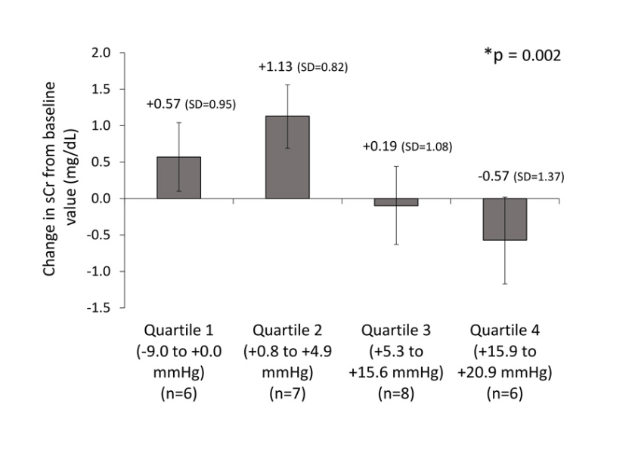
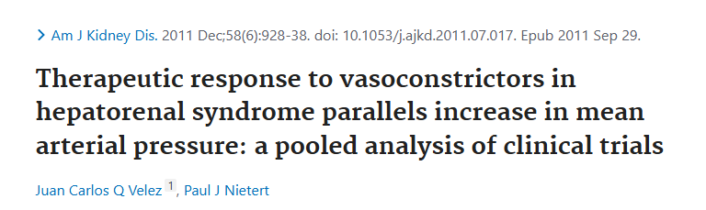
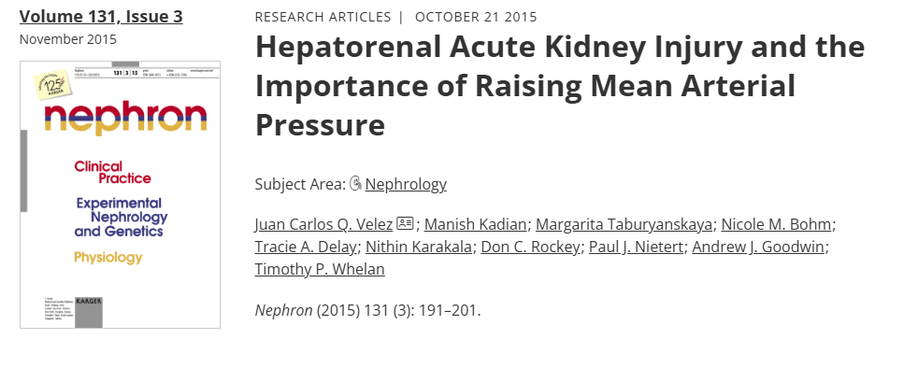

$$∆MAP↑↑$$

Slide 51
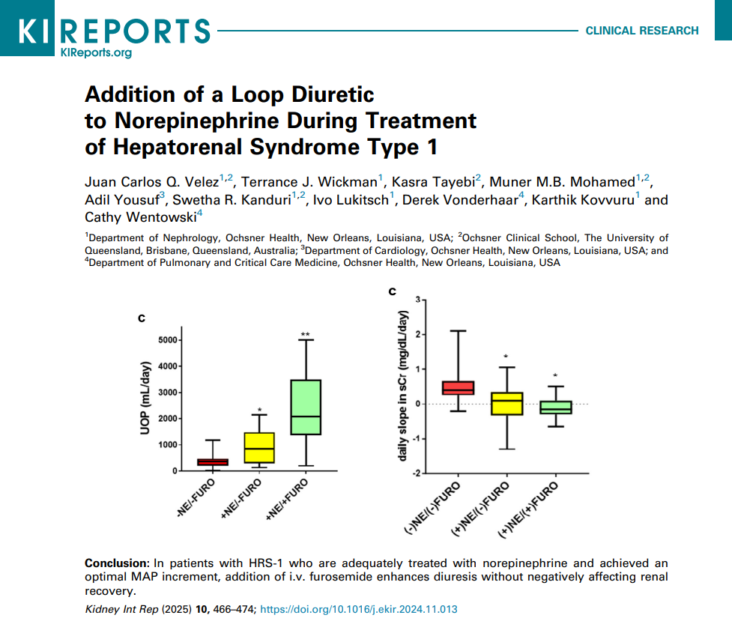

Slide 52
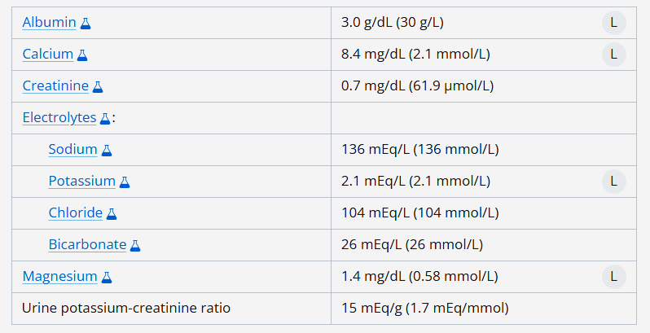
Question №12
You are seeing a 37-year-old woman with a long-standing history of GERD who is presenting with extreme fatigue and muscle weakness.
She reports no muscle pain, no travel, no fevers, and no new medications other than her chronic PPI. Physical examination and vitals are quite unremarkable. You send her for chemistries which reveal the following:
Which of the following is the most likely cause of this patient’s hypokalemia?
Hypoalbuminemia
Hypocalcemia
Hypomagnesemia
Poor nutrition

Slide 53
Question №12
You are seeing a 37-year-old woman with a long-standing history of GERD who is presenting with extreme fatigue and muscle weakness.
She reports no muscle pain, no travel, no fevers, and no new medications other than her chronic PPI. Physical examination and vitals are quite unremarkable. You send her for chemistries which reveal the following:
Which of the following is the most likely cause of this patient’s hypokalemia?
Hypoalbuminemia
Hypocalcemia
Hypomagnesemia
Poor nutrition

Slide 54
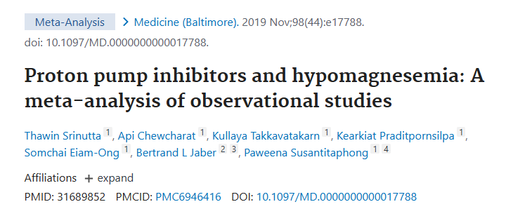

Slide 55
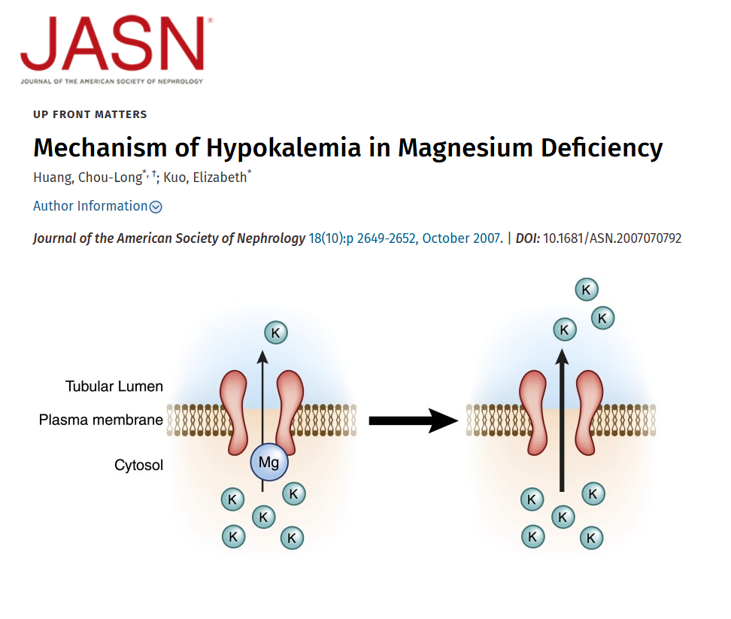

Slide 56
Question №13
A 46-year-old man presents to Internal Medicine clinic. He has not seen a doctor since he was an adolescent, and his wife urged him to visit a doctor for a regular check-up.
He is asymptomatic, works in tech, and takes no supplements nor medications. He exercises 3x/week mixed cardio and weights and enjoys a mixed drink once a month socially. He doesn’t smoke nor use any illicit drugs.
His wife who has HTN remarks that she tested his BP at home sporadically over the past few weeks (with good form) and noted it to be ~140-150/~60-70 consistently throughout the day; she took him to a local lab company and check his labs handing you a sheet of labs demonstrating unremarkable CBC, CMP, and a1c.
Vitals are notable for a BMI of 20, BP 144/68 (HR 70), otherwise his examination is unremarkable.
You discuss starting an antiHTN Rx with him, for which his wife eagerly nods and he sighs heavily.
In addition to prescribing antiHTN Rx, what additional management is recommended?
Referral for a sleep study
Plasma/urine metanephrines/catecholamines
PRA/PAC level
1mg overnight dex suppression, 24hr urinary free cortisol, and late-night salivary cortisol

Slide 57
Question №13
A 46-year-old man presents to Internal Medicine clinic. He has not seen a doctor since he was an adolescent, and his wife urged him to visit a doctor for a regular check-up.
He is asymptomatic, works in tech, and takes no supplements nor medications. He exercises 3x/week mixed cardio and weights and enjoys a mixed drink once a month socially. He doesn’t smoke nor use any illicit drugs.
His wife who has HTN remarks that she tested his BP at home sporadically over the past few weeks (with good form) and noted it to be ~140-150/~60-70 consistently throughout the day; she took him to a local lab company and check his labs handing you a sheet of labs demonstrating unremarkable CBC, CMP, and a1c.
Vitals are notable for a BMI of 20, BP 144/68 (HR 70), otherwise his examination is unremarkable.
You discuss starting an antiHTN Rx with him, for which his wife eagerly nods and he sighs heavily.
In addition to prescribing antiHTN Rx, what additional management is recommended?
Referral for a sleep study
Plasma/urine metanephrines/catecholamines
PRA/PAC level
1mg overnight dex suppression, 24hr urinary free cortisol, and late-night salivary cortisol

Slide 58
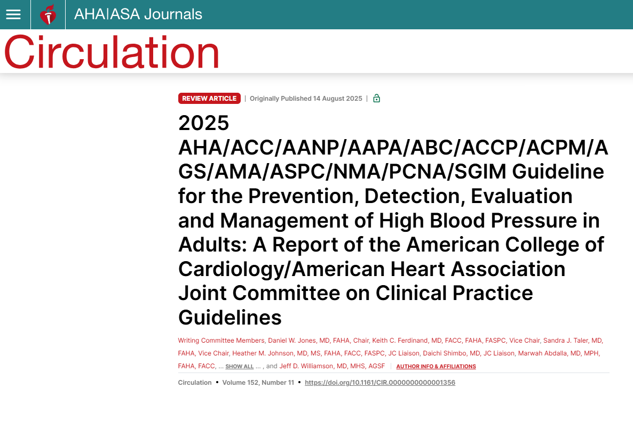

Slide 59
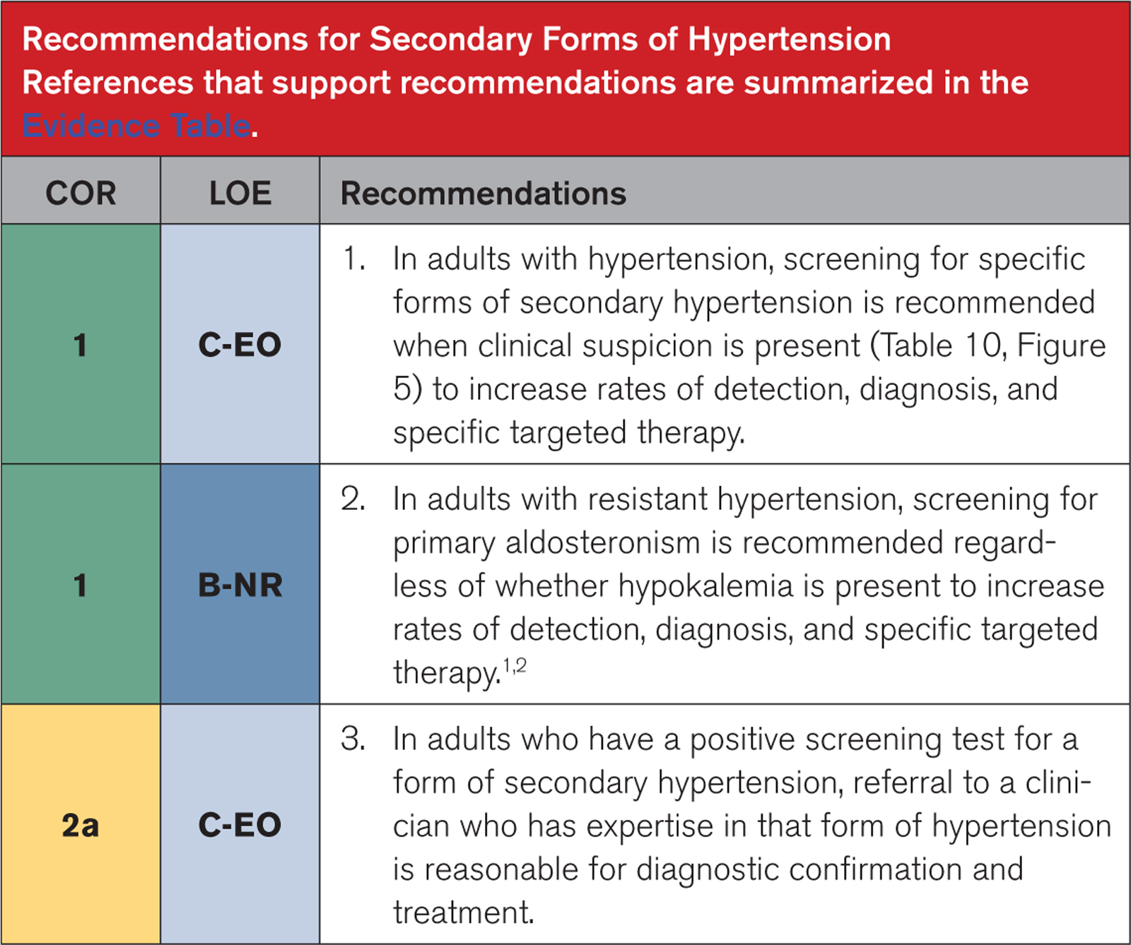

Slide 60
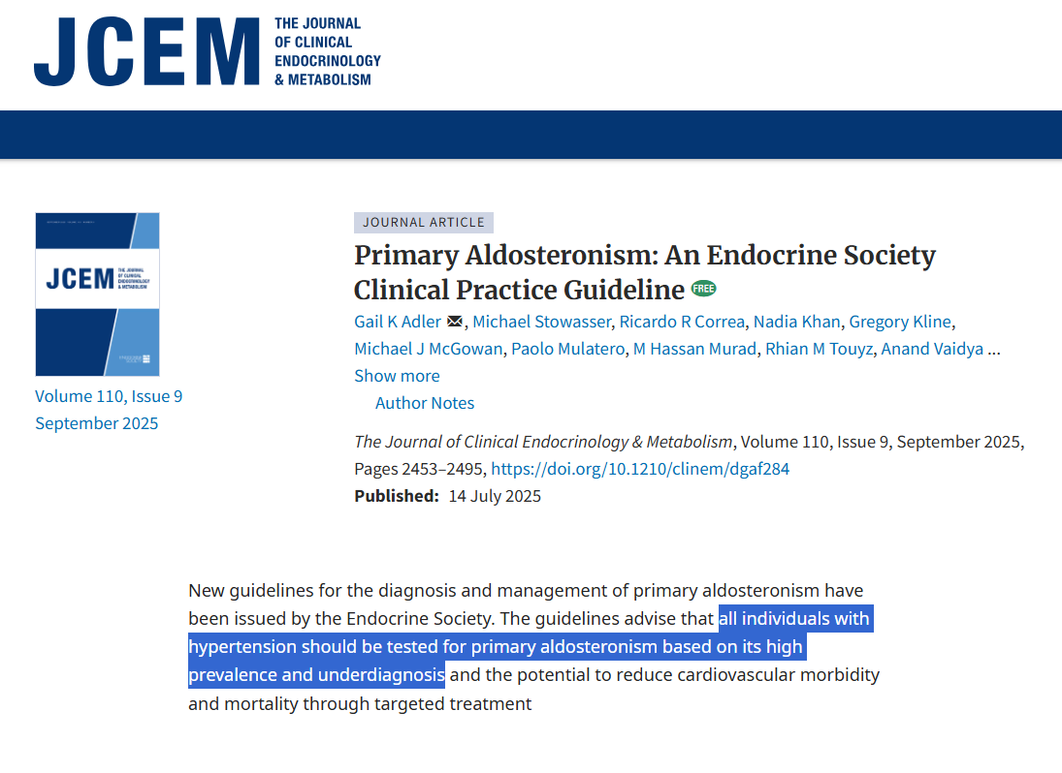

Slide 61
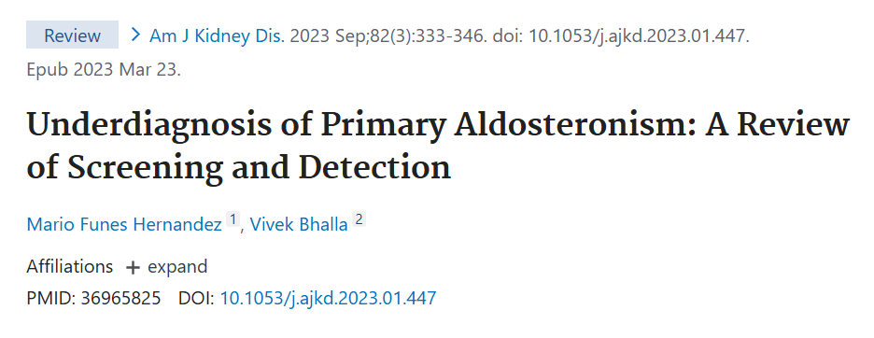
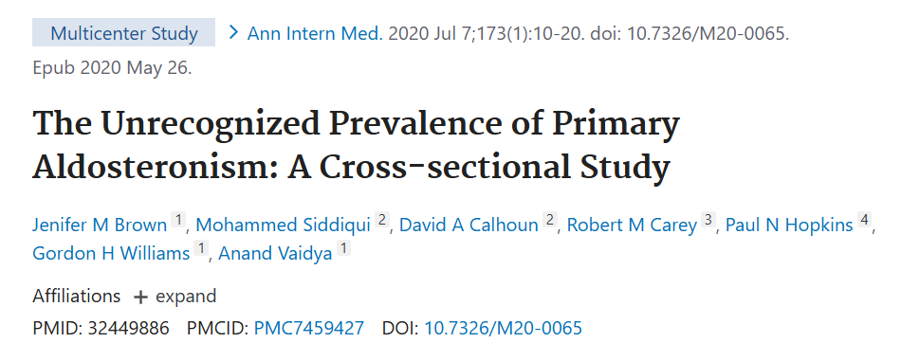

Slide 62
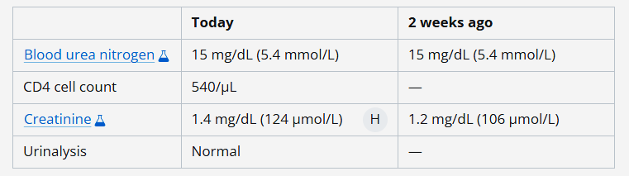
Question №14
You are in Internal Medicine clinic seeing a 45-year-old man with recently diagnosed HIV for which he is now taking tenofovir alafenamide-emtricitabine and dolutegravir, and reports no other medical problems and takes no other medications.
Physical examination findings, including vital signs, are unremarkable.
You send him for routine chemistries:
Which of the following is the most likely cause of this patient’s elevated serum creatinine level?
Acute interstitial nephritis
Dolutegravir
HIV-associated nephropathy
Tenofovir alafenamide-emtricitabine

Slide 63
Question №14
You are in Internal Medicine clinic seeing a 45-year-old man with recently diagnosed HIV for which he is now taking tenofovir alafenamide-emtricitabine and dolutegravir, and reports no other medical problems and takes no other medications.
Physical examination findings, including vital signs, are unremarkable.
You send him for routine chemistries:
Which of the following is the most likely cause of this patient’s elevated serum creatinine level?
Acute interstitial nephritis
Dolutegravir
HIV-associated nephropathy
Tenofovir alafenamide-emtricitabine

Slide 64
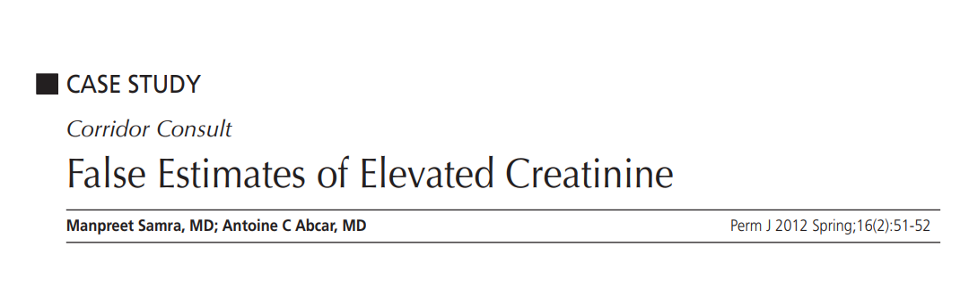
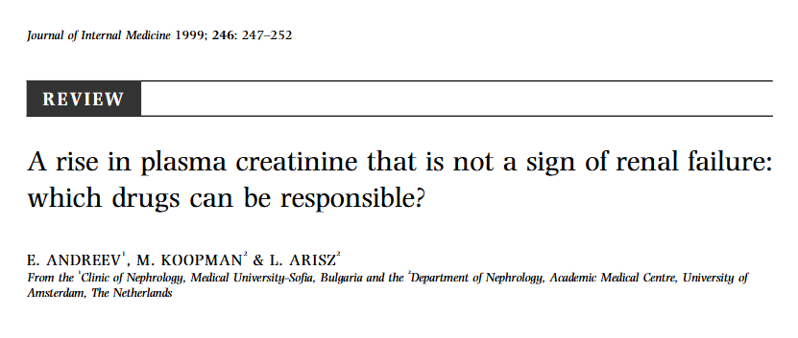

Slide 65
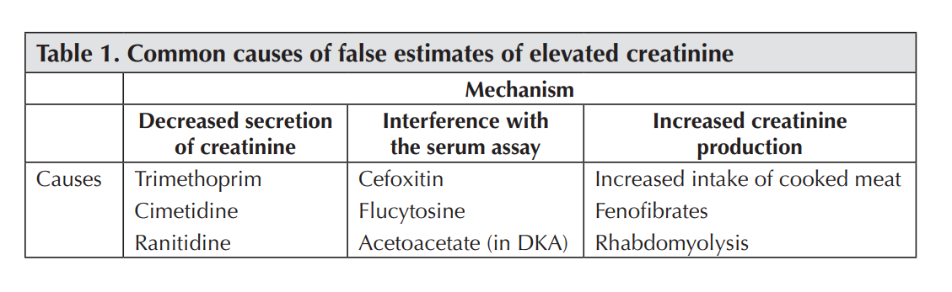

Slide 66


Slide 67
Question №15
You are admitting a 76-year-old man with pancreatic cancer is to the Internal Medicine service with worsening malaise and jaundice.
Labs are notable for a tbili of 10 mg/dL, serum protein of 6, and central lab [Na] of 109, central lab [bicarb] of 13.
You request blood gas electrolytes which reveal a [Na] of 136, and a [bicarb] of 25.
As the bedside nurse is drawing further labs, you notice the blood draw is not lipemic.
Which of the following is the most likely cause of this patient’s hyponatremia?
SIAD
Hypertriglyceridemia
Lipoprotein X
Paraproteinemia

Slide 68
Question №15
You are admitting a 76-year-old man with pancreatic cancer is to the Internal Medicine service with worsening malaise and jaundice.
Labs are notable for a tbili of 10 mg/dL, serum protein of 6, and central lab [Na] of 109, central lab [bicarb] of 13.
You request blood gas electrolytes which reveal a [Na] of 136, and a [bicarb] of 25.
As the bedside nurse is drawing further labs, you notice the blood draw is not lipemic.
Which of the following is the most likely cause of this patient’s hyponatremia?
SIAD
Hypertriglyceridemia
Lipoprotein X
Paraproteinemia

Slide 69


Slide 70



Slide 71


Slide 72
Question №16
A 52-year-old man with pancreatitis is admitted to the Internal Medicine service, over the course of 2 days he is given 15 litres of crystalloid yet reports increasing abdominal discomfort.
Bedside RN reports decreasing UOP.
PoCUS reveals normal biV function, no severe valvulopathy, no rWMA/stress features, no effusion, and no hydronephrosis
Vitals: 120/80 (HR 90), afebrile, tachypneic ~22 (SpO2 ~95% on 5L NC)
What is the next best step in evaluating this patients oliguria?
CK
Bladder pressure
NGAL
Contrasted CT Abd/Pelvis

Slide 73
Question №16
A 52-year-old man with pancreatitis is admitted to the Internal Medicine service, over the course of 2 days he is given 15 litres of crystalloid yet reports increasing abdominal discomfort.
Bedside RN reports decreasing UOP.
PoCUS reveals normal biV function, no severe valvulopathy, no rWMA/stress features, no effusion, and no hydronephrosis
Vitals: 120/80 (HR 90), afebrile, tachypneic ~22 (SpO2 ~95% on 5L NC)
What is the next best step in evaluating this patients oliguria?
CK
Bladder pressure
NGAL
Contrasted CT Abd/Pelvis

Slide 74



Slide 75

IAH – ACS spectrum
Oliguria generally develops at ~15 mmHg, while anuria usually develops at ~30 mmHg

Slide 76
Question №17
A 47-year-old woman with HIV self-refers to Internal Medicine clinic for fatigue.
She reports no recent trauma, she eats a regular diet, has a normal a1c/no history of diabetes, and her only medication is tenofovir disoproxil fumarate--which she has taken for years without missing a dose.
Labs are notable for normal Hgb, normal TSH/fT4, normal serum glucose, serum K of 2.9, low serum Phos, serum bicarb of 15; urinalysis notable for 3+ glucose, 1+ protein.
What is the most likely cause of her hypophosphatemia?
HIV-associated nephropathy
Cerebral salt wasting
Fanconi’s syndrome
Poor nutrition

Slide 77
Question №17
A 47-year-old woman with HIV self-refers to Internal Medicine clinic for fatigue.
She reports no recent trauma, she eats a regular diet, has a normal a1c/no history of diabetes, and her only medication is tenofovir disoproxil fumarate--which she has taken for years without missing a dose.
Labs are notable for normal Hgb, normal TSH/fT4, normal serum glucose, serum K of 2.9, low serum Phos, serum bicarb of 15; urinalysis notable for 3+ glucose, 1+ protein.
What is the most likely cause of her hypophosphatemia?
HIV-associated nephropathy
Cerebral salt wasting
Fanconi’s syndrome
Poor nutrition

Slide 78


Slide 79

Question №18
A 72-year-old man with a history of ESRD on HD presents to the ED with an extremely painful skin lesion that has been enlarging over the past few weeks-months.
He reports no new medications, trauma, exposures, travel.
He takes fosinopril, carvedilol, calcium acetate, sucroferric oxyhydroxide, calcitriol, cinacalcet, tenapanor, in-center EPO, insulin, hydroxyzine.
On examination his vitals are unremarkable but you notice the following skin findings.
Which of the following is the most likely diagnosis?
Calcific uremic arteriolopathy (calciphylaxis)
Vasculitis
Venous stasis ulcer
Warfarin skin necrosis

Slide 80
Question №18
A 72-year-old man with a history of ESRD on HD presents to the ED with an extremely painful skin lesion that has been enlarging over the past few weeks-months.
He reports no new medications, trauma, exposures, travel.
He takes fosinopril, carvedilol, calcium acetate, sucroferric oxyhydroxide, calcitriol, cinacalcet, tenapanor, in-center EPO, insulin, hydroxyzine.
On examination his vitals are unremarkable but you notice the following skin findings.
Which of the following is the most likely diagnosis?
Calcific uremic arteriolopathy (calciphylaxis)
Vasculitis
Venous stasis ulcer
Warfarin skin necrosis

Slide 81


Slide 82


Slide 83


Slide 84
Question №19
A 56-year-old man with metastatic squamous cell cancer is admitted for control of refractory pain.
Despite such he reports no decrease in PO intake. Rx: lisinopril, oxycodone, gabapentin.
On admission it is noted that he has a serum [Na] of 119, and no symptoms are present that could be attributed to his biochemically severe hyponatremia.
Urine studies notable for UNa of 55 and UOsm of 500.
Which of the following is the most appropriate next step?
1 litre bolus of 0.9% NS
DDAVP clamp + intermittent boluses of D5W or 3%HTS
Tolvaptan
Oral urea

Slide 85
Question №19
A 56-year-old man with metastatic squamous cell cancer is admitted for control of refractory pain.
Despite such he reports no decrease in PO intake. Rx: lisinopril, oxycodone, gabapentin.
On admission it is noted that he has a serum [Na] of 119, and no symptoms are present that could be attributed to his biochemically severe hyponatremia.
Urine studies notable for UNa of 55 and UOsm of 500.
Which of the following is the most appropriate next step?
1 litre bolus of 0.9% NS
DDAVP clamp + intermittent boluses of D5W or 3%HTS
Tolvaptan
Oral urea

Slide 86


Slide 87


Slide 88


Slide 89


Slide 90



Slide 91
Question №20
You admit a 64-year-old man with HTN, cocaine use disorder, and osteoarthritis to your service for evaluation of mild hypoxemia and AKI.
On examination, his SpO2 is 91% on ambient air, and he reports no cough nor hemoptysis.
Vitals are notable for BP 148/86 (HR 81), lung fields are clear to auscultation, but you note 2+ lower extremity edema.
Labs are notable for Cr of 3.1 (it was 0.9 a year ago), UA 1+ protein and 1+ hematuria. CXR is unremarkable.
He is given 1 litre of NS with no improvement of his Cr, but his SpO2 worsens to 88%. A TTE reveals normal biV function without any valvulopathy.
Which of the following is the most likely cause of this patient’s acute kidney injury?
Acute tubular necrosis
Acute interstitial nephritis
ANCA-associated vasculitis
Prerenal azotemia

Slide 92
Question №20
You admit a 64-year-old man with HTN, cocaine use disorder, and osteoarthritis to your service for evaluation of mild hypoxemia and AKI.
On examination, his SpO2 is 91% on ambient air, and he reports no cough nor hemoptysis.
Vitals are notable for BP 148/86 (HR 81), lung fields are clear to auscultation, but you note 2+ lower extremity edema.
Labs are notable for Cr of 3.1 (it was 0.9 a year ago), UA 1+ protein and 1+ hematuria. CXR is unremarkable.
He is given 1 litre of NS with no improvement of his Cr, but his SpO2 worsens to 88%. A TTE reveals normal biV function without any valvulopathy.
Which of the following is the most likely cause of this patient’s acute kidney injury?
Acute tubular necrosis
Acute interstitial nephritis
ANCA-associated vasculitis
Prerenal azotemia

Slide 93


Slide 94




Slide 95
Questions?

Slide 96
Question №x
x
x?
x
x
x
x

