Slide 1


Sepsis and Septic Shock: Recognition and Initial Management
Esa Rayyan, DO
Pulmonary/Critical Care
July 27th, 2026
Notes:
Today I want to give you a practical framework for the first several hours of sepsis care. The goal is not to memorize every guideline statement. The goal is to recognize when infection has become organ-threatening, act quickly on the interventions that change outcome, and then reassess so that our treatment does not become harmful

Slide 2
Objectives
Recognize sepsis and septic shock without relying on a single score
Initiate appropriate antimicrobials, fluid assessment, vasopressors and source control
Reassess perfusion and tailor therapy while avoiding fluid overload and unnecessary antibiotics

Slide 3

Pathophysiology of Sepsis
Dysregulated host response
Endothelium damage, cell mediator activation, disruption of coagulation system homeostasis
Vasodilation and capillary permeability
Systemic inflammatory response
End-organ damage, death
Notes:
Sepsis is not simply overwhelming inflammation. It is a dysregulated host response involving pro-inflammatory and anti-inflammatory pathways, endothelial injury, altered coagulation, microcirculatory dysfunction, vasodilation, capillary leak, mitochondrial and metabolic abnormalities, and sometimes myocardial depression. The bedside consequence is heterogeneous organ dysfunction: one patient is vasoplegic, another is volume depleted, another has septic cardiomyopathy, and many have more than one phenotype.”
“That heterogeneity is why protocolized initial care must quickly transition to individualized reassessment

Slide 4
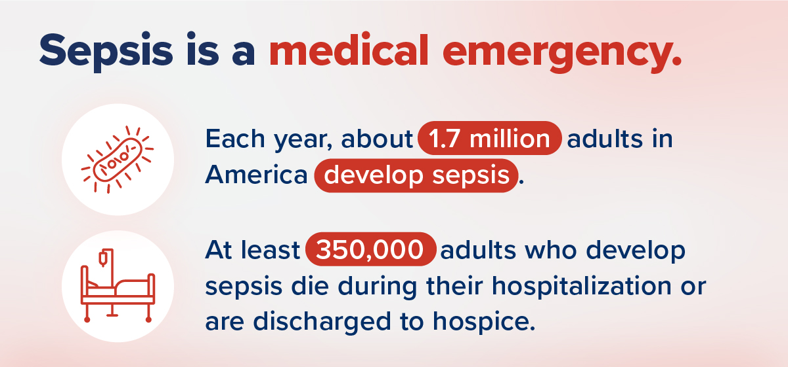
More than 1.7 million people are diagnosed with sepsis each year in the U.S.
270,000 people die every year from sepsis, and is the number one cause of death in U.S. hospitals
1 in 3 patients who die in the hospital have sepsis
WHO states that Sepsis is the cause of 20% of the global deaths

Slide 5
Epidemiology
Sepsis begins outside the hospital in 87% of patients
Most common sources: lungs (25%), urine (25%), skin (11%) and gut (11%)
More than $70 billion is spent on sepsis healthcare costs annually
Notes:
At least half of the septic patients will have either infection in the lungs or urinary tract
Sepsis is common, expensive, and lethal. Most cases begin outside the hospital

Slide 6
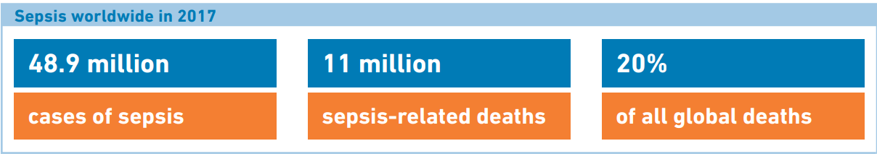
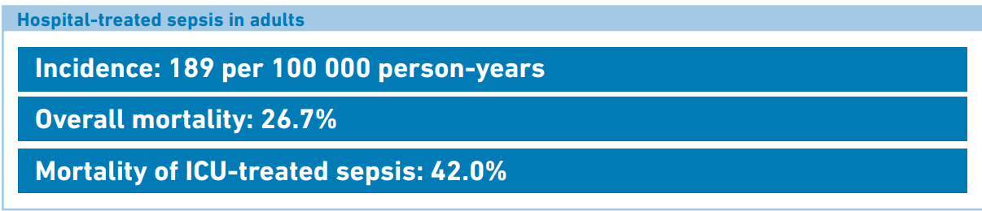
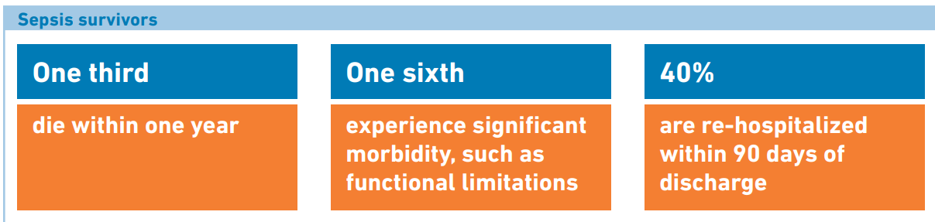
Notes:
sepsis national center for health statistics

Slide 7
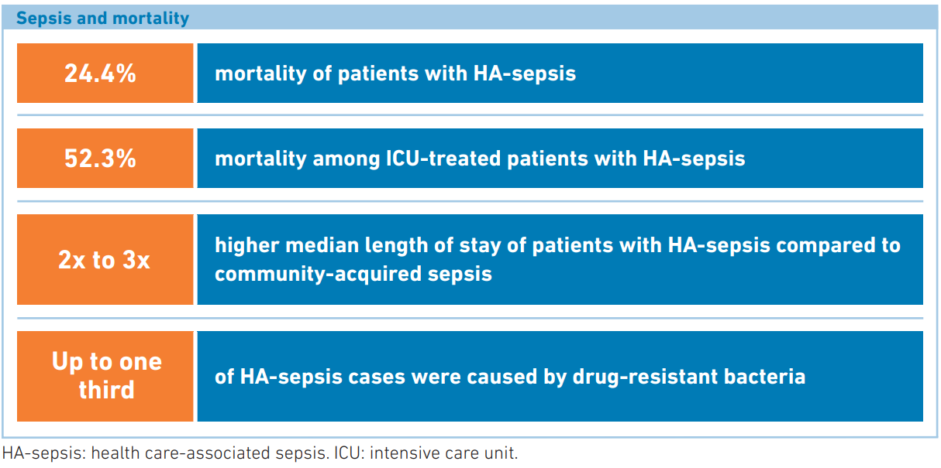
Notes:
sepsis national center for health statistics

Slide 8

Sepsis mortality
AZDHS
Notes:
Just to put it into context I wanted us to compare sepsis mortality with other commonly seen disease processes that also have time sensitive intervention.
This graphic was taken from the AZ department of health regarding local mortality, and as you can see Sepsis has a 4-5 fold increase in mortality compared to STEMI or Strokes. This does not even include septic shock patients.
Though we become numb to sepsis as an entity, we need to have the same sense of alarm as we do in treating sepsis as we do for a STEMI or CVA

Slide 9
pathogens
Bacteria are the predominant pathogen of sepsis.
Sepsis by viruses underdiagnosed worldwide.
Gram positive bacteremia are most frequently identified in patients with sepsis in the united states.
Incidence of fungal sepsis is increasing but remains lower than bacterial.
In one-half of cases, an organism is not identified (culture negative sepsis)
Notes:
Bacteria remain the most frequently identified pathogens, but viral and fungal sepsis are clinically important, and roughly half of patients may remain culture negative. Culture-negative sepsis is not synonymous with ‘no infection’; however, it should trigger repeated diagnostic reassessment and early de-escalation when an alternative diagnosis becomes more likely

Slide 10
Surviving Sepsis Campaign
The European Society of Intensive Care Medicine and The Society of Critical Care Medicine convenes a task force of critical care, infectious disease, surgical and pulmonary specialists. Most recent meeting in 2026
  2026 guideline updates the 2021 version and introduces new recommendations regarding screening, antimicrobial certainty, fluids, vasopressor sequencing, respiratory support and survivorship
When compiled, the task force recommendations are circulated to major international societies and other relevant bodies for peer review and endorsement (24 endorsing societies)

Slide 11
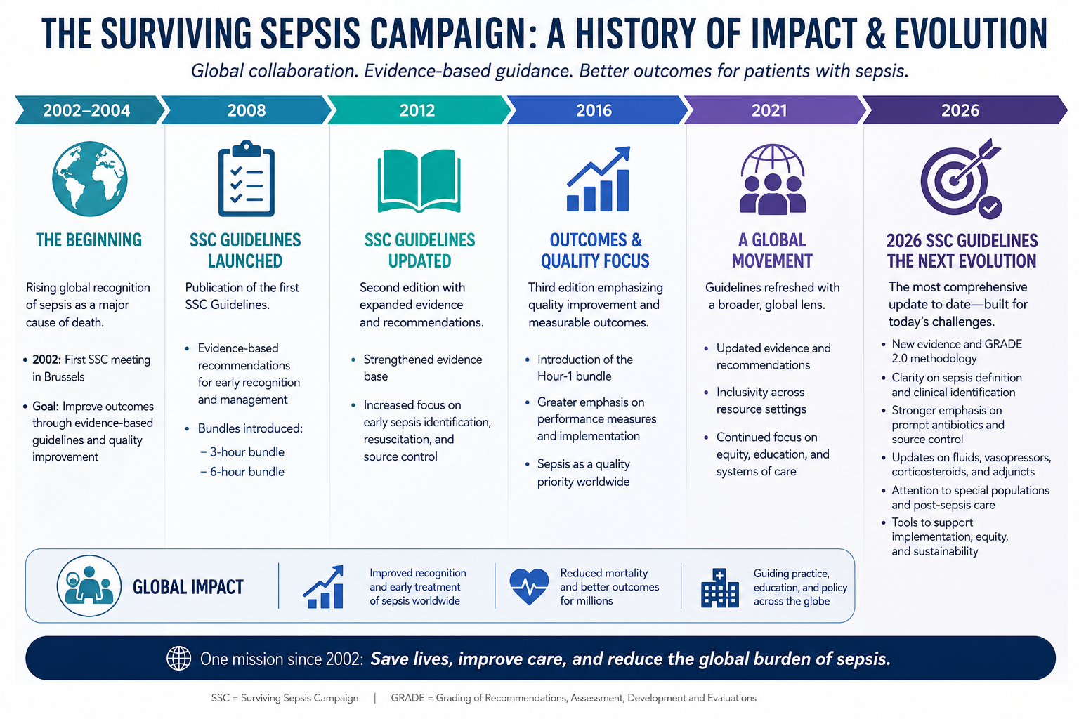
Sepsis through time
Notes:
As we have learned more about sepsis we have tailored our recognition and treatment.
Surviving sepsis guidelines launched in 2002. Lots of research had been going into recognition, definition, management and improving patient outcomes.
Over the last several years these guidelines have been revised, with the latest revision in 2026.
The evolution of the guidelines is important in order to understand why we do what we do.

Slide 12
Surviving Sepsis 2026 Updates Overview
Recognition
Antibiotics
Fluids
NEWS/MEWS/SIRS preferred over qSOFA alone
1-hour for shock/probable sepsis; rapid investigation for possible sepsis
30 mL/kg remains, but reassessment and obesity dosing are explicit
Stewardship
Pressors
Recovery
Less empiric antifungal/anaerobic/MDR coverage unless risk-based
Discharge education, med rec, PCP handoff, support needs now emphasized
Peripheral norepinephrine is endorsed to avoid delay
Source: SCCM/ESICM Surviving Sepsis Campaign adult guidelines 2026; compared with 2021 SSC guideline themes.
Notes:
Keep that framework in mind: act rapidly when probability and severity are high, but do not confuse speed with indiscriminate treatment

Slide 13
The “Old” Sepsis Definition: Sepsis 2.0
SIRS
Sepsis
2 SIRS Criteria + Infection
Severe Sepsis
Sepsis + Organ dysfunction
Septic Shock
Severe Sepsis + Persistent hypotension after appropriate fluid resuscitation
Temp >38 or <36
RR >20 or PaCO2 <32
HR > 90/min
WBC>12k or <4k or Band >10%
Notes:
In order to understand sepsis, we have to start off with where things started and where things are now.
These labels matter because there is a mortality difference associated with it.
This was an okay framework to define sepsis, but not ideal. IT was not specific, but also not sensitive. Infection isn’t the only thing than can cause SIRs.

Slide 14
Severe sepsis
Septic
shock
SIRS
Sepsis
Mortality
Notes:
Sepsis is a continuum and mortality increases as you progress to the right

Slide 15
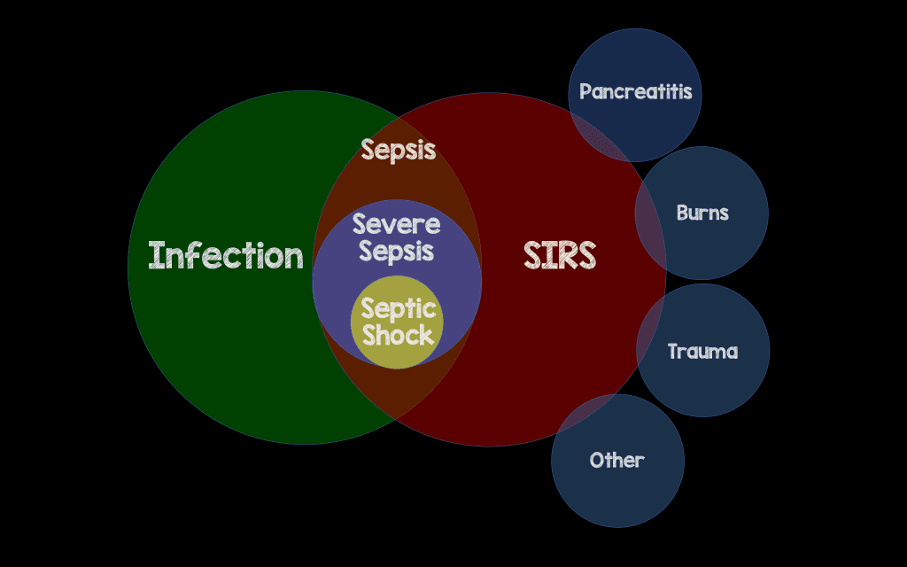
The “Old” Sepsis
Notes:
We have already mentioned that not all infections lead to sepsis, but also not all SIRS are infection related.
What we found with this definition was that it was not very sensitive or specific for sepsis.

Slide 16
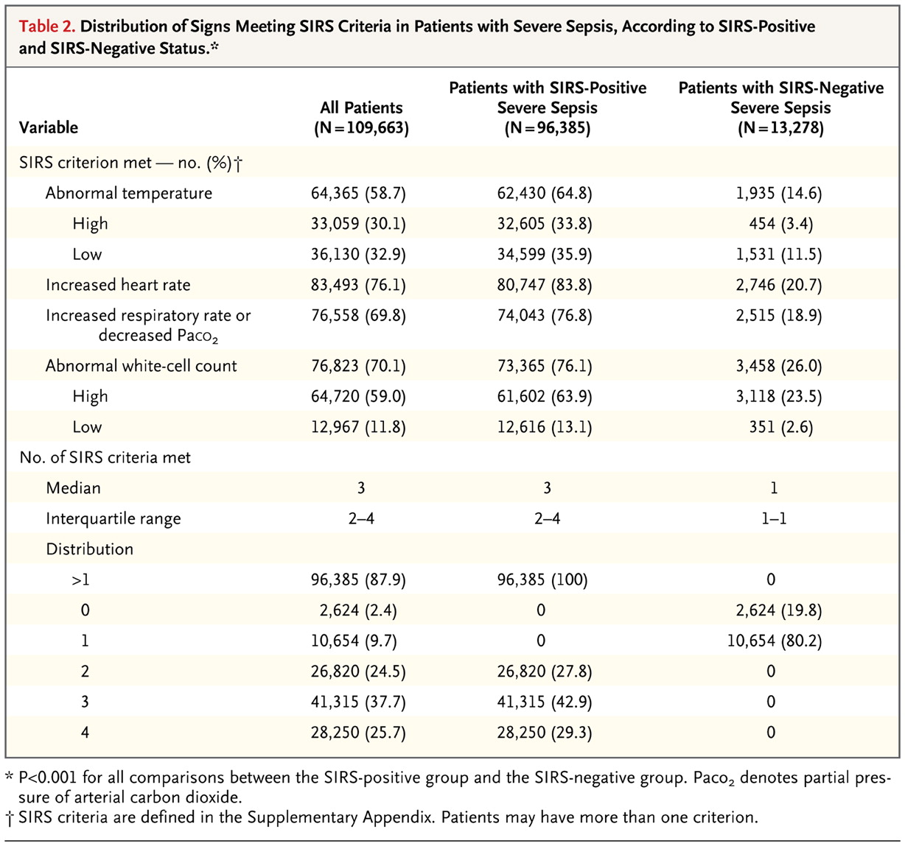
Kaukonen K et al. N Engl J Med 2015;372:1629-1638.
How useful are these definitions?
This study analyzed > 100,000 patients with severe sepsis and stratified by SIRS status (< 2 vs. ≥ 2 criteria)
Notes:
In 2015 there was a study performed where they looked at those with severe sepsis to determine how many of them had more than 2 or less than 2 SIRS criteria.

Slide 17
Kaukonen K et al. N Engl J Med 2015;372:1629-1638.
How useful are these definitions?
This study analyzed > 100,000 patients with severe sepsis and stratified by SIRS status (< 2 vs. ≥ 2 criteria)
12% of patients with severe sepsis (1 in 8) met only 0 or 1 SIRS criterion
This was especially true of older patients, use of β-blockers, etc.
Notes:
This was over 13 thousand severely septic patients that did not meet the criteria for 2 positive SIRS.

Slide 18
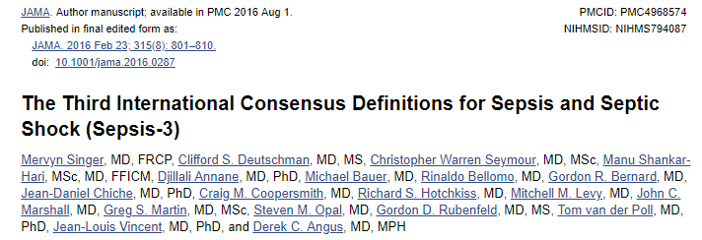
Sepsis 3.0 Definition (2016)
Notes:
Redefined in 2016
In this definition, severe sepsis is no longer used. Just sepsis or septic shock.

Slide 19
Sepsis 3.0 Definition (2016)
Sepsis is a clinical syndrome that has physiologic, biologic, and biochemical abnormalities caused by a dysregulated host response to infection.
There is no gold standard diagnostic test that exists to diagnose sepsis.
Sepsis is a syndrome, not a disease
Notes:
Redefined in 2016. In this definition, severe sepsis is no longer used. Just sepsis or septic shock.
This is operationalized as an acute SOFA increase of two points. This is not a perfect bedside diagnostic test

Slide 20
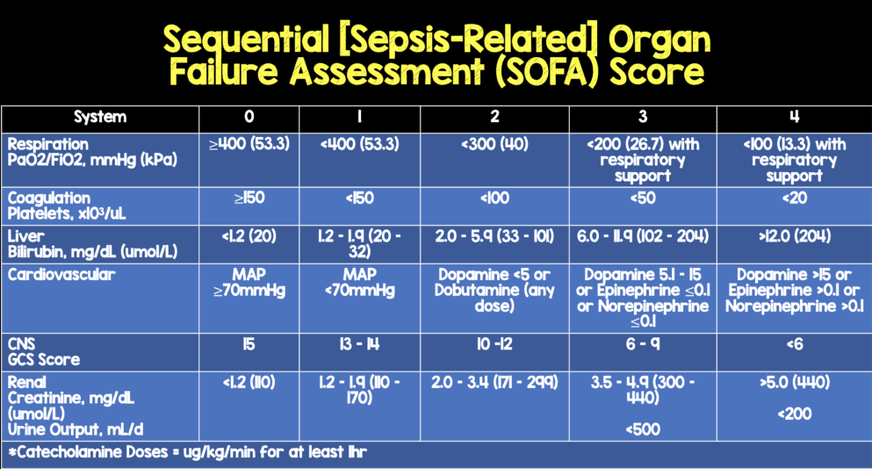
Organ dysfunction can be identified as an acute change in total SOFA score ≥2 points due to the infection
Notes:
Determining severity of organ dysfunction in sepsis
SOFA quantifies dysfunction across six organ systems. Serial change can help determine the trajectory of your patient. It is not sensitive or practical as a screening tool.
Score of >10 correlates with 50% mortality

Slide 21
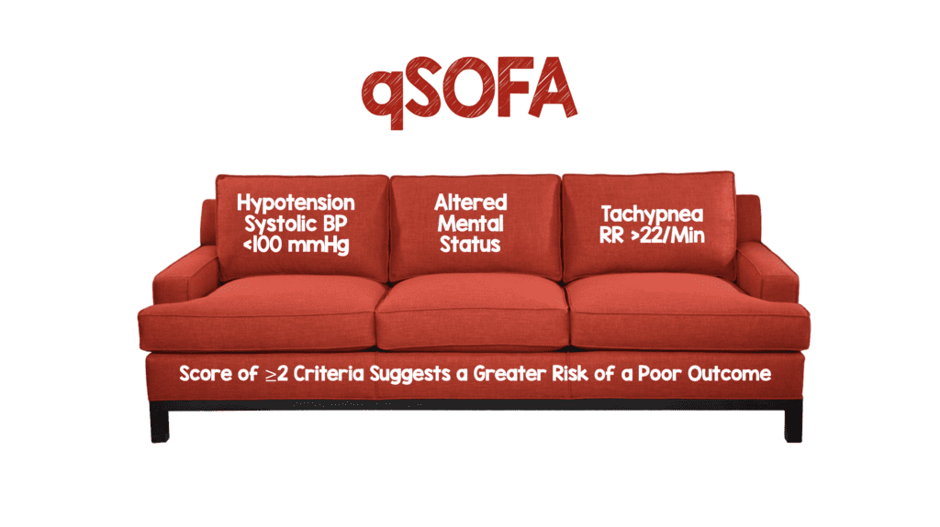
Notes:
More convenient to do bedside, does not require calculations
Q Sofa score greater than or equal to 2 correlates with 10% mortality
Q SOFA is a prognostic enrichment tool, but not a diagnostic screening tool.

Slide 22
Sepsis Recognition and management
Sepsis and Septic shock are medical EMERGENCIES that requires immediate treatment and resuscitation
Early recognition and aggressive treatments are key for improved outcomes
Neither qSOFA nor SOFA are intended to be a stand-alone definition of sepsis.
Notes:
I wanted to go over this point because I wanted it to be clear to everyone in here that despite all the time, research, dedication to studying and defining sepsis there is still so much gray area. So much of this field is evolving, and though we have seen some improvements in overall mortality in the past few years the progress has been much slower than other disease processes such as STEMI.
Defining a patient’s individual immunologic response, and the point at which it becomes pathologic, is not easy.

Slide 23
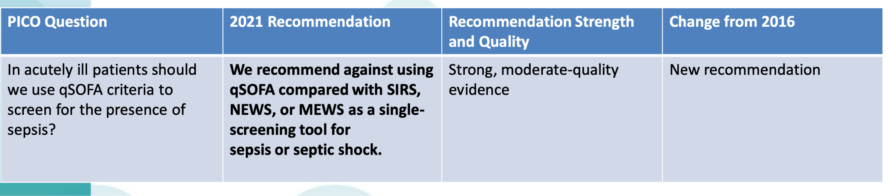
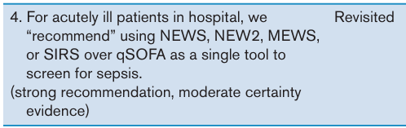
Recognition: Infection plus new organ dysfunction
2026

Slide 24
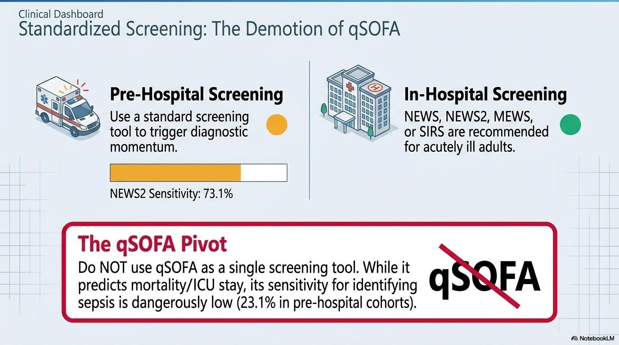

Slide 25
Clinical signs of sepsis
Altered mentation
New oxygen requirement
Hypotension Oliguria or AKI
Thrombocytopenia or coagulopathy
Hyperbilirubinemia
Lactate elevation
Worsening respiratory failure

Slide 26
Septic shock
Septic shock is defined as sepsis that has circulatory, cellular, and metabolic abnormalities that are associated with a greater risk of mortality than sepsis alone.
Approximately 15% of patients with sepsis develop shock
Clinically, this includes patients who fulfill the criteria for sepsis who, despite adequate fluid resuscitation, require vasopressors to maintain a MAP ≥65 mmHg and have a lactate >2 mmol/L
Notes:
Sepsis is by no means a new phenomenon.

Slide 27
Sepsis Management
Treat infection
Restore perfusion
Control the source
Reassess repeatedly
Early Identification is key

Slide 28
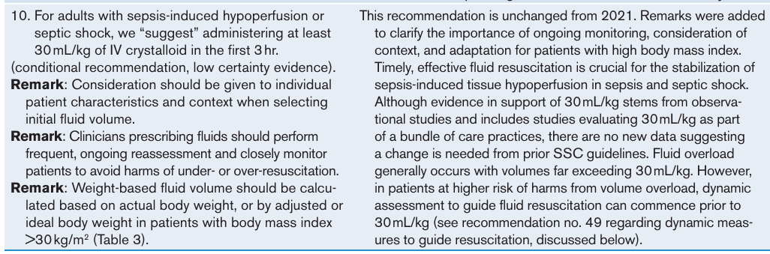
Guiding resuscitation

Slide 29
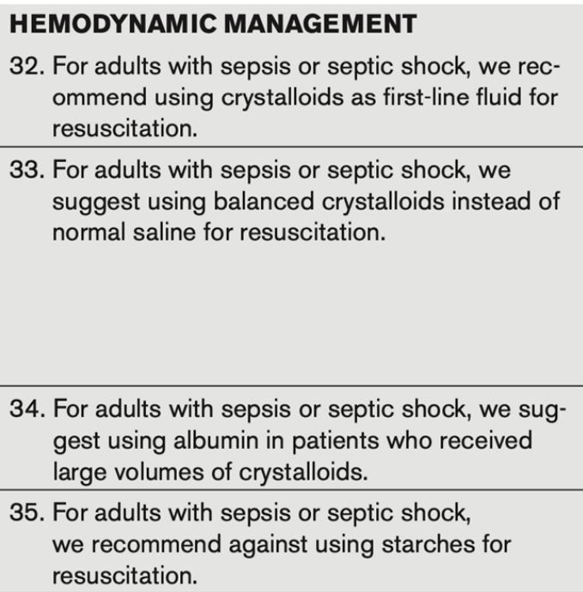
Resuscitation fluids

Slide 30
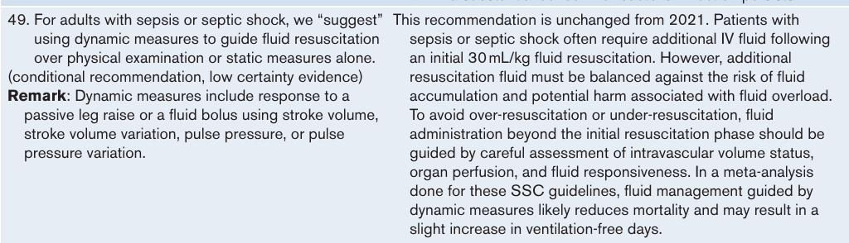
Guiding resuscitation

Slide 31
After the first bolus
Initial Resuscitation
Passive leg raise + stroke volume
Sepsis-induced hypoperfusion or septic shock:
30 mL/kg IV crystalloid in first 3 hours
BMI > 30: use actual, adjusted, or ideal body weight based on context
Fluid bolus response
Pulse pressure / SV variation
Serial lactate trend
Capillary refill time adjunct
Do not keep giving fluids until lactate normalizes. Use perfusion response and congestion risk.
Notes:
2026 keeps at least 30 mL/kg crystalloid in first 3 hours for sepsis-induced hypoperfusion or septic shock, with explicit patient context and frequent reassessment. It suggests dynamic measures and serial lactate, while saying not to keep giving fluids until lactate normalization.

Slide 32
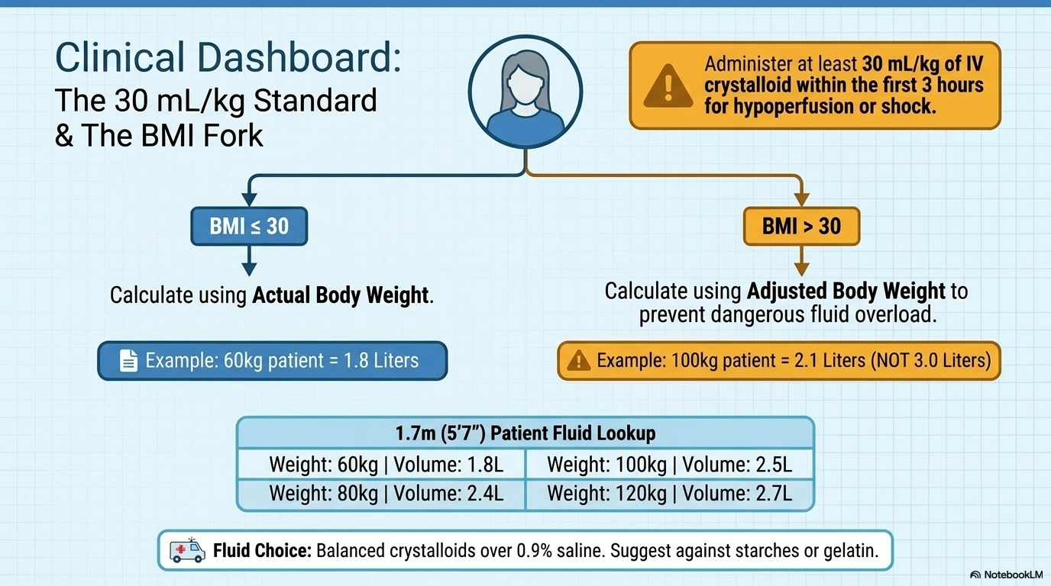

Slide 33
Antibiotic administration
Blood cultures should be obtained as soon as possible before antibiotics
In hospital mortality is ~14.7% for patients who received antibiotics after 1 hour compared to 9.6% for those treated within an hour.
  Adjusted odds ratio of 2.0, indicating a two-fold increase in mortality with delayed treatment
  Each additional hour of delay increased mortality risk by 6%
Notes:
Reference: Philippon AL et al. Association between time to antibiotic and mortality in patients with suspected sepsis. European Journal of Eemergency Medicine 2025

Slide 34
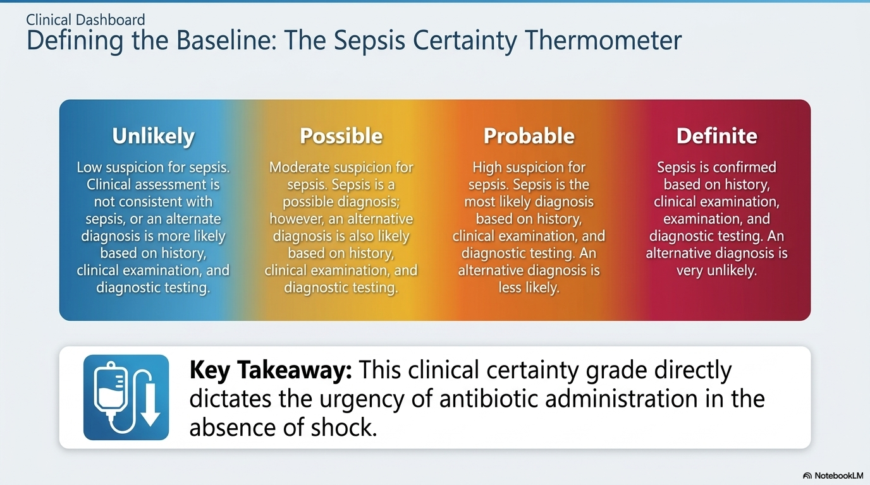

Slide 35
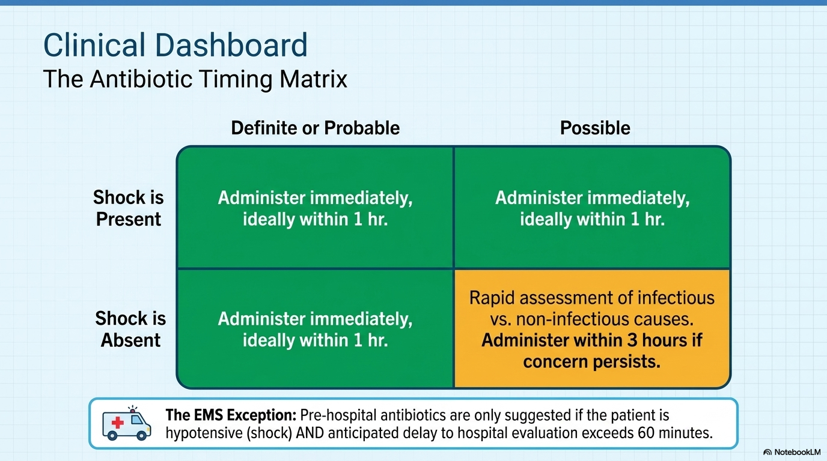

Slide 36
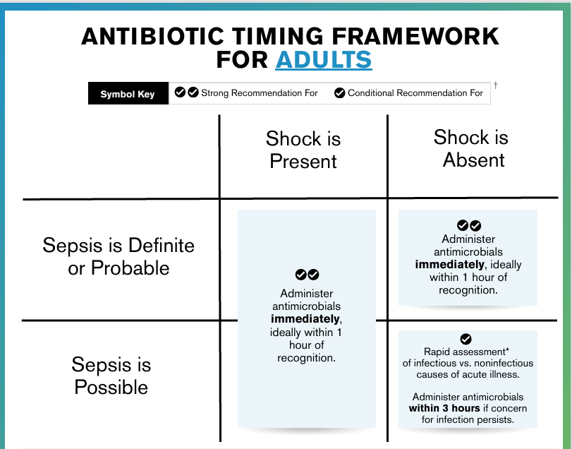
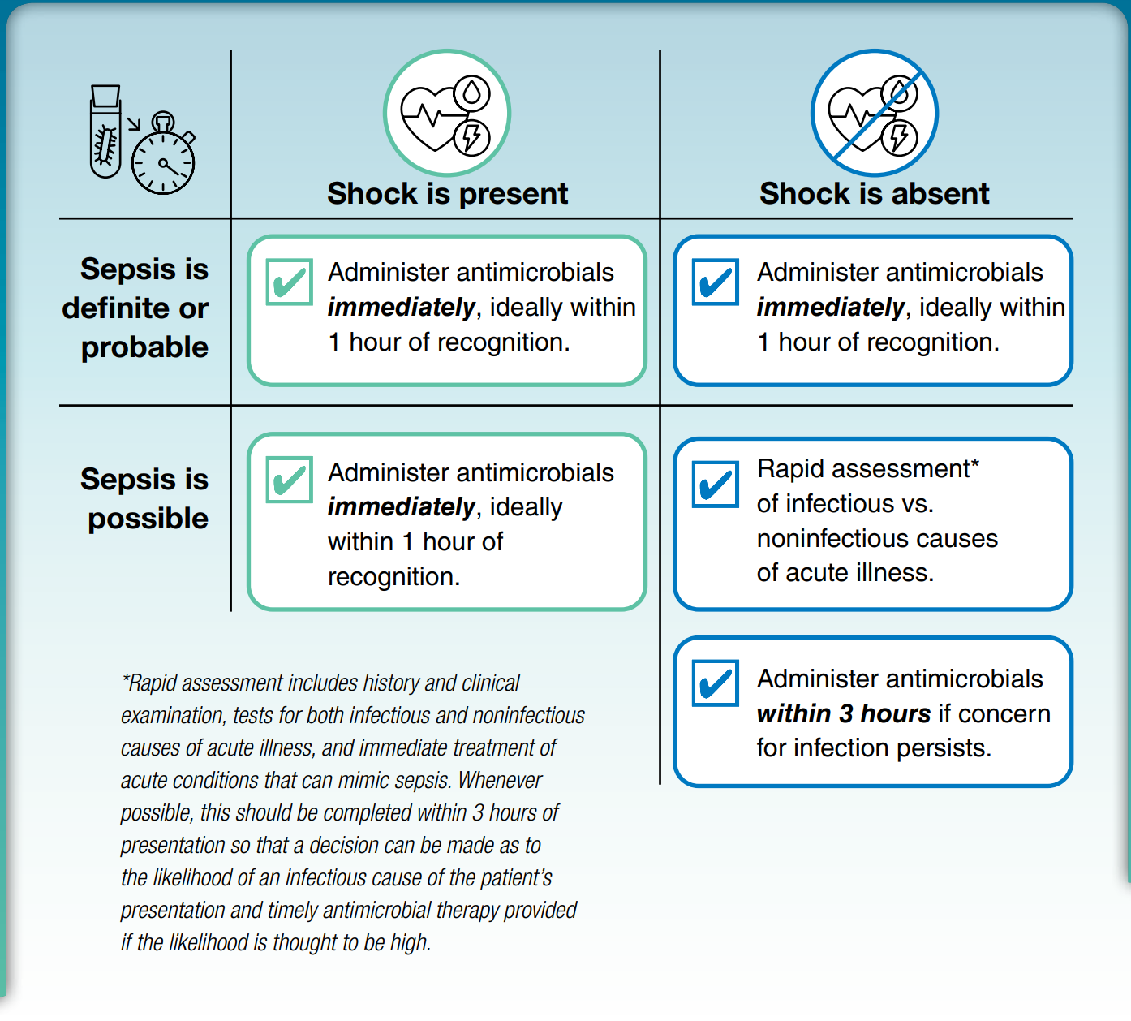

Slide 37
Stewardship is now embedded in “early sepsis care”
Empiric coverage
After 24–72 hours
Before antibiotics
De-escalate when susceptibilities return; consider de-escalation even with negative cultures. Shorter courses after adequate source control.
Blood cultures ASAP, ideally before antimicrobials.
Do not use procalcitonin to decide whether to start.
MDR, anaerobic, and antifungal coverage should be risk-based — not automatic for every septic patient.
Notes:
2026 recommends cultures early; clinical evaluation alone rather than procalcitonin plus clinical evaluation to initiate antimicrobials; prolonged infusion beta-lactams after loading dose; de-escalation with microbiology and suggests de-escalation when cultures are negative.

Slide 38
Pressors and MAP: Avoid delay, Target thoughtfully
Peripheral vasopressors
MAP target
Arterial line
Start vasopressors peripherally to restore MAP rather than delaying until central access is secured.
Initial MAP target remains 65 mm Hg; in adults ≥ 65 years, consider 60–65 mm Hg rather than higher ranges.
Noninvasive or invasive BP monitoring can be used initially; arterial line is favored with escalating or multiple pressors.
Source: SCCM/ESICM Surviving Sepsis Campaign adult guidelines 2026; compared with 2021 SSC guideline themes.
Notes:
2026 suggests starting peripheral vasopressors rather than delaying for central venous access. It recommends MAP target 65 over higher targets and suggests 60-65 for adults 65 and older. It suggests either invasive or noninvasive BP monitoring, with remarks on arterial indications.

Slide 39
Vasoactive agents
Norepinephrine is the first choice of vasopressor
Second line: add vasopressin, then epinephrine (to raise MAP or decrease norepinephrine dosage)
Dopamine is no longer used for septic shock, has worse outcomes than with norepinephrine
Notes:
By decreasing norepinephrine, it helps avoid some of the adverse effects of levophed by minimizing dose such as tachycardia

Slide 40
Vasopressors
1
2
3
4
Norepinephrine
Add vasopressin
Add epinephrine
Inotrope if needed
First Line
Escalating norepinephrine
if MAP inadequate despite norepi + vaso
Cardiac dysfunction + persistent hypoperfusion
Source: SCCM/ESICM Surviving Sepsis Campaign adult guidelines 2026; compared with 2021 SSC guideline themes.
Notes:
2026: norepinephrine first line; add vasopressin for escalating norepi; add epinephrine if inadequate MAP despite norepi and vasopressin. Inotropes for septic shock with cardiac dysfunction and persistent hypoperfusion despite adequate fluids and arterial pressure. Suggest against beta-blockers, terlipressin, levosimendan; insufficient for methylene blue and midodrine.

Slide 41
2026 Hemodynamic Adjuncts to Avoid
Terlipressin
Methylene Blue
Routine Midodrine
Beta Blockers for Sepsis
Source: SCCM/ESICM Surviving Sepsis Campaign adult guidelines 2026; compared with 2021 SSC guideline themes.
Notes:
2026: norepinephrine first line; add vasopressin for escalating norepi; add epinephrine if inadequate MAP despite norepi and vasopressin. Inotropes for septic shock with cardiac dysfunction and persistent hypoperfusion despite adequate fluids and arterial pressure. Suggest against beta-blockers, terlipressin, levosimendan; insufficient for methylene blue and midodrine.

Slide 42
Adjuvant Therapies
Consider Use
Avoid Use
✓ IV corticosteroids for septic shock
× IV vitamin C
× IVIG
✓ Bicarbonate only when pH ≤7.2 + AKI
× Blood purification / PMX hemoperfusion
× Vitamin D as sepsis therapy
✓ Stress ulcer prophylaxis if GI bleed risk
× Probiotics
✓ Early enteral nutrition within 72h
× Antipyretics solely to improve outcomes
Source: SCCM/ESICM Surviving Sepsis Campaign adult guidelines 2026; compared with 2021 SSC guideline themes.
Notes:
2026 suggests IV corticosteroids for septic shock. Suggests against antipyretics for the purpose of improving outcomes; IV vitamin C; IVIG; blood purification including polymyxin B hemoperfusion; vitamin D as sepsis therapy; probiotics. Bicarbonate for pH <=7.2 plus AKI, not simply to reduce pressor needs.

Slide 43
New emphasis: after resuscitation,
de-resuscitate and plan recovery
1
2
3
4
5
Acute shock
Stabilization
De-resuscitation
Transition
Recovery
Fluids + pressors + source control
Reassess perfusion and congestion
Active fluid removal after acute phase
Structured handoff + medication reconciliation
Sepsis education + support needs + PCP handoff
Source: SCCM/ESICM Surviving Sepsis Campaign adult guidelines 2026; compared with 2021 SSC guideline themes.
Notes:
2026 includes active fluid removal after acute resuscitation phase; transition programs; handoff of critically important information; support needs screening; medication reconciliation; patient and family education; PCP education/support during post-hospital recovery.

Slide 44
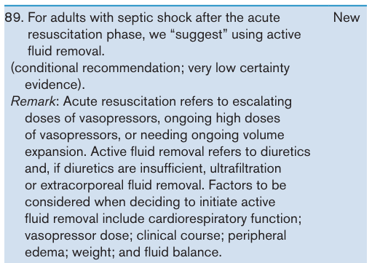
De-resuscitation after resuscitation

Slide 45
Role of Lactate
With sepsis, lactate is viewed as a marker of global tissue perfusion.
LA should guide resuscitation- goal is not to normalize lactate in patients with elevated levels
Lactate has some predictive use:
  Sustained > 6 hours, an elevated lactate foreshadows increased mortality
  Mortality increases as lactate levels increase
Lactate Level | Mortality
0-2.5 mmol/L | 4.9 percent mortality
2.5-4.0 mmol/L | 9.0 percent mortality
> 4.0 mmol/L | 28.4 percent mortality

Slide 46
Rapid fire questions

Slide 47
Rapid fire questions
What components are in the Sepsis 1 hour bundle?

Slide 48
Rapid fire questions
What components are in the Sepsis 1 hour bundle?
  Lactic acid, fluid resuscitation, blood cultures, antibiotic administration, vasopressors if MAP <65

Slide 49
Rapid fire questions
What components are in the Sepsis 1 hour bundle?
  Lactic acid, fluid resuscitation, blood cultures, antibiotic administration, vasopressors if MAP <65
What IVF is preferred for the resuscitation for the Septic patient?

Slide 50
Rapid fire questions
What components are in the Sepsis 1 hour bundle?
  Lactic acid, fluid resuscitation, blood cultures, antibiotic administration, vasopressors if MAP <65
What IVF is preferred for the resuscitation for the Septic patient?
  Balanced crystalloid fluids

Slide 51
Rapid fire questions
What components are in the Sepsis 1 hour bundle?
  Lactic acid, fluid resuscitation, blood cultures, antibiotic administration, vasopressors if MAP <65
What IVF is preferred for the resuscitation for the Septic patient?
  Balanced crystalloid fluids
What is the goal MAP for septic and septic shock patients?

Slide 52
Rapid fire questions
What components are in the Sepsis 1 hour bundle?
  Lactic acid, fluid resuscitation, blood cultures, antibiotic administration, vasopressors if MAP <65
What IVF is preferred for the resuscitation for the Septic patient?
  Balanced crystalloid fluids
What is the goal MAP for septic and septic shock patients?
  MAP goal of 65 mmHg
  MAP goal of 60-65 in adults ≥ 65 years

Slide 53
Rapid fire questions
What components are in the Sepsis 1 hour bundle?
  Lactic acid, fluid resuscitation, blood cultures, antibiotic administration, vasopressors if MAP <65
What IVF is preferred for the resuscitation for the Septic patient?
  Balanced crystalloid fluids
What is the goal MAP for septic and septic shock patients?
  MAP goal of 65 mmHg
  MAP goal of 60-65 in adults ≥ 65 years
What is the preferred initial vasopressor?

Slide 54
Rapid fire questions
What components are in the Sepsis 1 hour bundle?
  Lactic acid, fluid resuscitation, blood cultures, antibiotic administration, vasopressors if MAP <65
What IVF is preferred for the resuscitation for the Septic patient?
  Balanced crystalloid fluids
What is the goal MAP for septic and septic shock patients?
  MAP goal of 65 mmHg
  MAP goal of 60-65 in adults ≥ 65 years
What is the preferred initial vasopressor?
  Norepinephrine

Slide 55
Rapid fire questions
What components are in the Sepsis 1 hour bundle?
  Lactic acid, fluid resuscitation, blood cultures, antibiotic administration, vasopressors if MAP <65
What IVF is preferred for the resuscitation for the Septic patient?
  Balanced crystalloid fluids
What is the goal MAP for septic and septic shock patients?
  MAP goal of 65 mmHg
  MAP goal of 60-65 in adults ≥ 65 years
What is the preferred initial vasopressor?
  Norepinephrine
What vasopressor has been associated with worse outcomes?

Slide 56
Rapid fire questions
What components are in the Sepsis 1 hour bundle?
  Lactic acid, fluid resuscitation, blood cultures, antibiotic administration, vasopressors if MAP <65
What IVF is preferred for the resuscitation for the Septic patient?
  Balanced crystalloid fluids
What is the goal MAP for septic and septic shock patients?
  MAP goal of 65 mmHg
  MAP goal of 60-65 in adults ≥ 65 years
What is the preferred initial vasopressor?
  Norepinephrine
What vasopressor has been associated with worse outcomes?
  Dopamine

Slide 57
Rapid fire questions
What components are in the Sepsis 1 hour bundle?
  Lactic acid, fluid resuscitation, blood cultures, antibiotic administration, vasopressors if MAP <65
What IVF is preferred for the resuscitation for the Septic patient?
  Balanced crystalloid fluids
What is the goal MAP for septic and septic shock patients?
  MAP goal of 65 mmHg
  MAP goal of 60-65 in adults ≥ 65 years
What is the preferred initial vasopressor?
  Norepinephrine
What vasopressor has been associated with worse outcomes?
  Dopamine
What is the second add on vasoactive agent? What is the third?

Slide 58
Rapid fire questions
What components are in the Sepsis 1 hour bundle?
  Lactic acid, fluid resuscitation, blood cultures, antibiotic administration, vasopressors if MAP <65
What IVF is preferred for the resuscitation for the Septic patient?
  Balanced crystalloid fluids
What is the goal MAP for septic and septic shock patients?
  MAP goal of 65 mmHg
  MAP goal of 60-65 in adults ≥ 65 years
What is the preferred initial vasopressor?
  Norepinephrine
What vasopressor has been associated with worse outcomes?
  Dopamine
What is the second add on vasoactive agent? What is the third?
  Vasopressin. Epinephrine (per surviving sepsis guidelines)

Slide 59
Rapid fire questions
What components are in the Sepsis 1 hour bundle?
  Lactic acid, fluid resuscitation, blood cultures, antibiotic administration, vasopressors if MAP <65
What IVF is preferred for the resuscitation for the Septic patient?
  Balanced crystalloid fluids
What is the goal MAP for septic and septic shock patients?
  MAP goal of 65 mmHg
  MAP goal of 60-65 in adults ≥ 65 years
What is the preferred initial vasopressor?
  Norepinephrine
What vasopressor has been associated with worse outcomes?
  Dopamine
What is the second add on vasoactive agent? What is the third?
  Vasopressin. Epinephrine (per surviving sepsis guidelines)
What adjunct therapy can you give for refractory shock?

Slide 60
Rapid fire questions
What components are in the Sepsis 1 hour bundle?
  Lactic acid, fluid resuscitation, blood cultures, antibiotic administration, vasopressors if MAP <65
What IVF is preferred for the resuscitation for the Septic patient?
  Balanced crystalloid fluids
What is the goal MAP for septic and septic shock patients?
  MAP goal of 65 mmHg
  MAP goal of 60-65 in adults ≥ 65 years
What is the preferred initial vasopressor?
  Norepinephrine
What vasopressor has been associated with worse outcomes?
  Dopamine
What is the second add on vasoactive agent? What is the third?
  Vasopressin. Epinephrine (per surviving sepsis guidelines)
What adjunct therapy can you give for refractory shock?
  Steroids! (Hydrocortisone 200mg/day or equivalent)

Slide 61
Questions?

