Slide 1
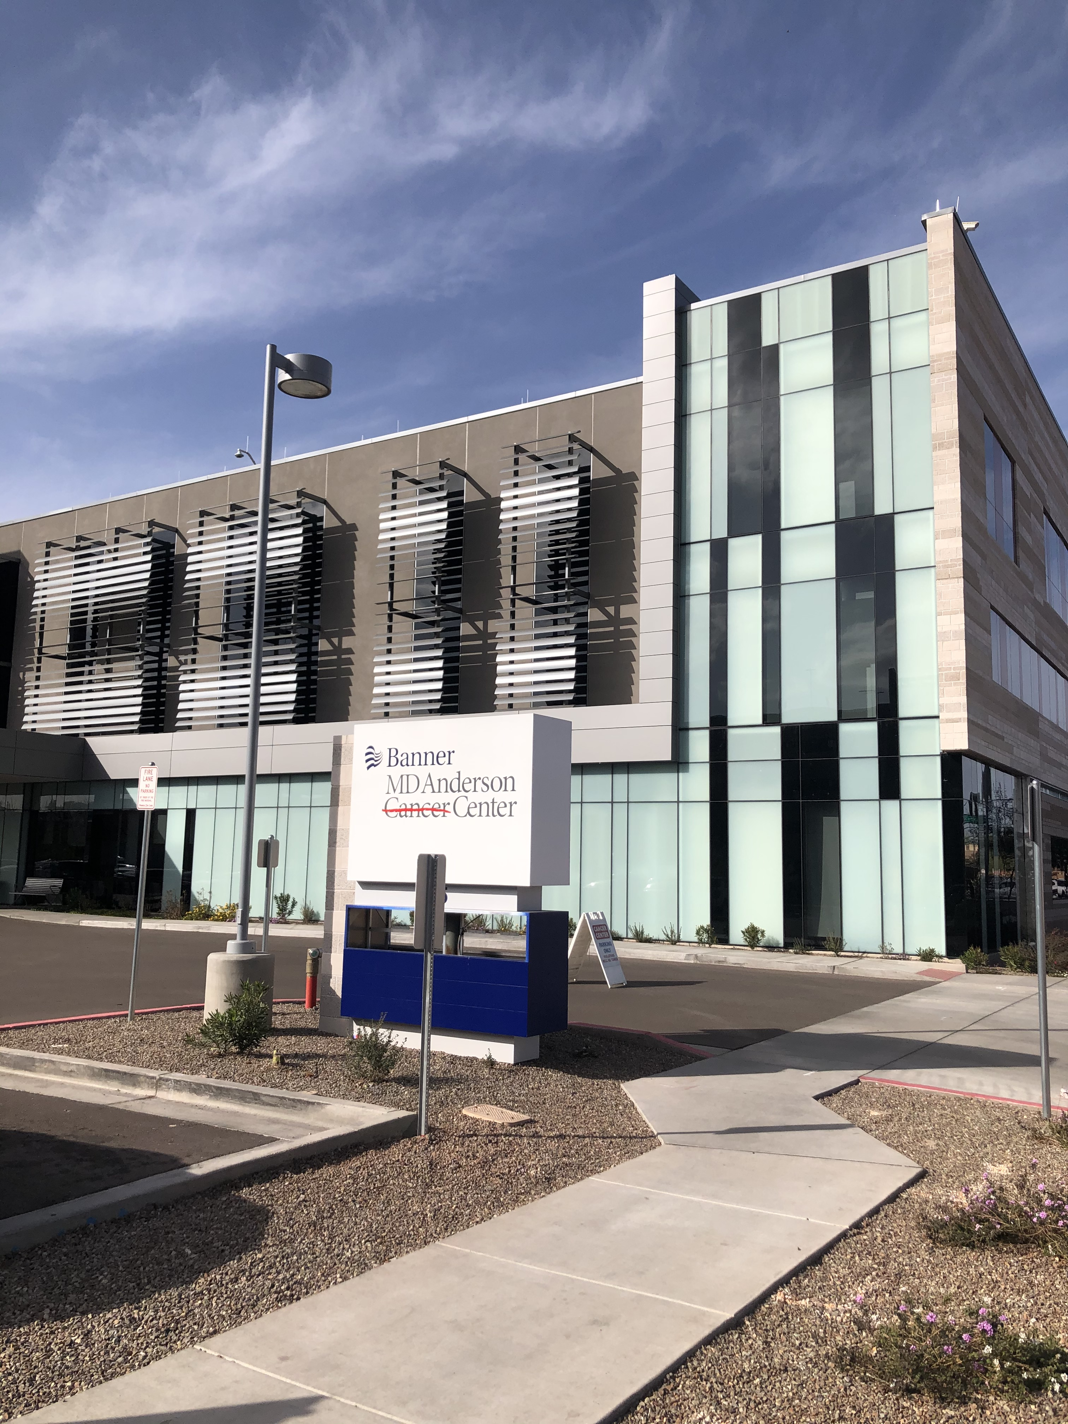
Lung Cancer for Internal Medicine Physicians
Todd Erickson, MD
Banner MD Anderson Phoenix
Thoracic Oncology Lead at Phoenix Campus

Slide 2
Question # 1
52 yo gentleman presents to you for follow up requesting test to make sure that he does not have lung cancer
Actively smokes 1PPD and has done so for last 22 years
Asymptomatic aside from morning cough intermittently
PMX asthma, HTN, BMI 32
Normal exam aside from blood pressure of 157/82
In regards to his lung cancer risk, what do you recommend?
  A. Screening chest x-ray
  B. Low dose screening chest CT
  C. Low dose screening chest CT and counseling and discuss RX for smoking cessation
  D. Regular CT with iv contrast given history of asthma
  E. Counseling and discuss RX for smoking cessation

Slide 3
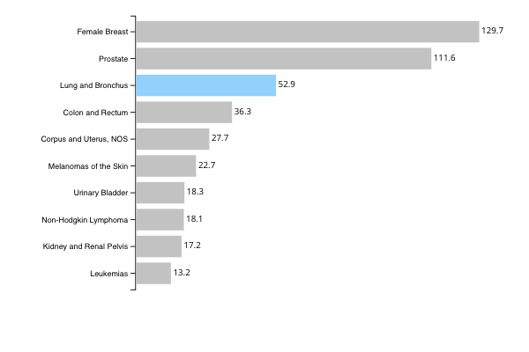
Top 10 Cancers by Rates of New Cancer Cases
United States, 2019
Rate per 100,000 people
Source - U.S. Cancer Statistics Working Group. U.S. Cancer Statistics Data Visualizations Tool, based on 2021 submission data (1999-2019): U.S. Department of Health and Human Services, Centers for Disease Control and Prevention and National Cancer Institute; https://www.cdc.gov/cancer/dataviz, released in June 2022.

Slide 4
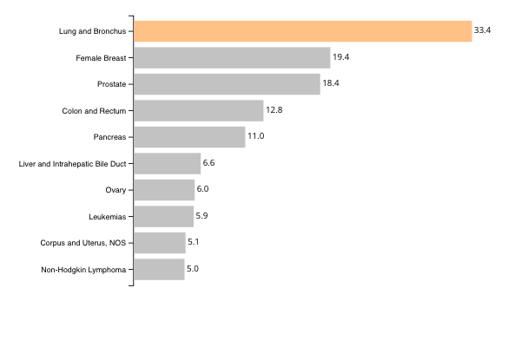
Top 10 Cancers by Rates of Cancer Deaths
United States, 2019
Rate per 100,000 people
Source - U.S. Cancer Statistics Working Group. U.S. Cancer Statistics Data Visualizations Tool, based on 2021 submission data (1999-2019): U.S. Department of Health and Human Services, Centers for Disease Control and Prevention and National Cancer Institute; https://www.cdc.gov/cancer/dataviz, released in June 2022.

Slide 5
Lung Cancer Treatment Improving
Trends continue to show improvement
Incidence of lung cancer between 2015 to 2020 decreased by 10% in the United States
Two year lung cancer survival rate at two years increased from 30% during 2009-2010 to 36% during 2016-2017
Death rate for lung cancer declined 2.4% from 2017-2018
Lung cancer mortality rate has declined 31% since peak in 1991

Slide 7
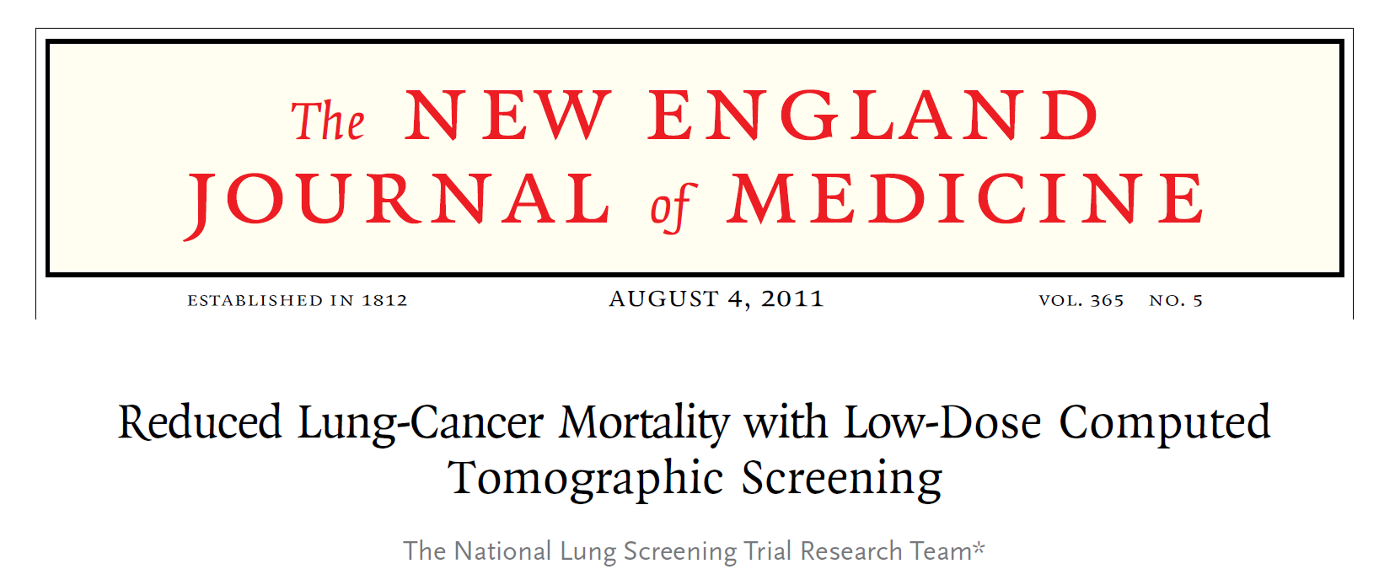
Massive NCI sponsored multi-centered randomized prospective study which enrolled participants from 08/2002 – 04/2004 at 33 US medical centers
Compared 26,722 participants randomized to low-dose screening CT (annual x 3) with 26,732 participants randomized to chest X-ray (annual x 3)
Primary endpoint was reduction in lung cancer mortality which was met with 20% reduction in lung cancer mortality in the screening CT group
In low dose CT arm 247 deaths per 100,000 person years vs 309 deaths per 100,000 person years
NNT to prevent one lung cancer death was 320; Rate of false positives in CT arm 96.4%, CXR 94.5%
Proof of concept that screening could reduce lung cancer mortality, majority of lung cancers detected in CT arm were early stage (most stage I)

Slide 8
USPSTF Lung Cancer Screening Guideline Updated 03/2021
Recommendation for annual low dose CT for active or former smokers who are at high risk of developing lung cancer
  Patients 50 yo – 80 yo (previously 55-78)
  20 pack year history of smoking (decreased from 30)
  Active smoker or quit within the past 15 years
Based on the National Lung Screening Trial inclusion criteria (age 55-75 yo at time of enrollment)
In Arizona 2% of lung cancer cases detected on screening vs national average of 6%. Arizona ranks 46th in terms of surgical resection of lung cancer.

Slide 9
Radiographic Findings on Screening CT
Pulmonary nodule = < 3cm lesion surrounded by pulmonary parenchyma
  Solid Pulmonary Nodule
  Sub Solid Pulmonary Nodule
    Pure ground glass
    Part solid nodule
Lung mass = > 3cm
Risk calculators to determine risk of malignancy
  Low probability = < 5% chance malignant
  Moderate probability = 5 – 65% chance malignant
  High probability = > 65% chance malignant

Slide 10
Well, that’s kind of the radiologists problem isn’t it?

Slide 11
Lung RADS Reporting of CT

Slide 13
Risk Factors for Lung Cancer
Cigarette smoking (personal and second hand exposure)
Prior radiation exposure
Environmental toxins (asbestos, radon, metal and diesel fumes)
Pulmonary fibrosis
HIV infection
Family history of lung cancer
  Few familial syndromes. Environmental factors seem to play the primary role in the development
Likely vaping

Slide 14
Question # 2
64 year old gentleman noted to have 3 cm lung mass on screening CT
PMX with longstanding emphysema and COPD
55 pack year history of smoking
Exam significant for markedly diminished air movement, wheezing, uses 2 liters of oxygen
CT guided biopsy with poorly differentiated adenocarcinoma

Slide 15
Question 2 continued
PET/CT and MRI of the head performed and there is no evidence of metastatic disease
Patient with normal myocardial stress test 2 months ago
PFTs with FEV1 of 50% (1.0 liter) and DLCO of 50%
What is the best treatment for this patient?
  A. Surgical resection
  B. Hospice and palliative care
  C. Concurrent chemoradiotherapy
  D. Chemoimmunotherapy
  E. Stereotactic radiation therapy

Slide 16
Lung Cancer Presentation
Most common presenting symptoms: cough (50-75%), hemoptysis (25-50%), dyspnea (25%), chest pain (20%)
~75% of lung cancer presents at advanced stage (Stage III or IV)
Symptoms of metastatic disease: back pain and bone met, seizure and brain met
Paraneoplastic syndromes (classic test questions)
  Horner syndrome
  SIADH
  Hypercalcemia
  SVC syndrome

Slide 17
Initial Evaluation of Lung Cancer
Example: patient presents with hemoptysis
CT Chest with iv contrast (+/- oral).
PET/CT or CT A/P and bone scan
Needle biopsy (potentially bronchoscopy and biopsy or CT guided biopsy)
  Not every mass in the lung is lung cancer (lymphoma, TB, sarcoid)
  Treatment different based on type of lung cancer
  Treatment guided by molecular testing performed on biopsy
MRI Head if small cell lung CA or NSCLC > stage IB (tumor > 3cm)
PFTs with DLCO and possibly pulmonary perfusion scan and pulmonary exercise testing for localized tumors

Slide 18
Non-Small Cell Lung Cancer
Majority of lung cancer (85%)
Different subtypes based on morphology
  Squamous cell carcinoma
  Adenocarcinoma
  Adenosquamous
  Large cell carcinoma
Treatment has now become tailored to morphologic subtype and molecular profile of lung cancer
  EGFR, ALK, PDL1, ROS1, BRAF, MET, KRAS, HER2

Slide 19
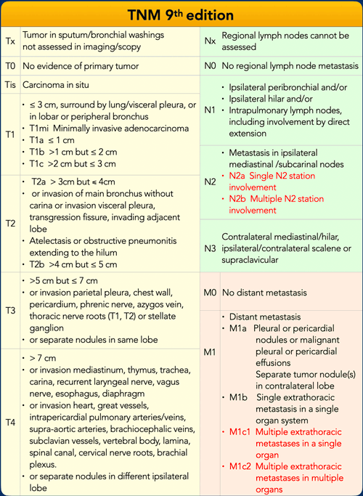

Slide 20
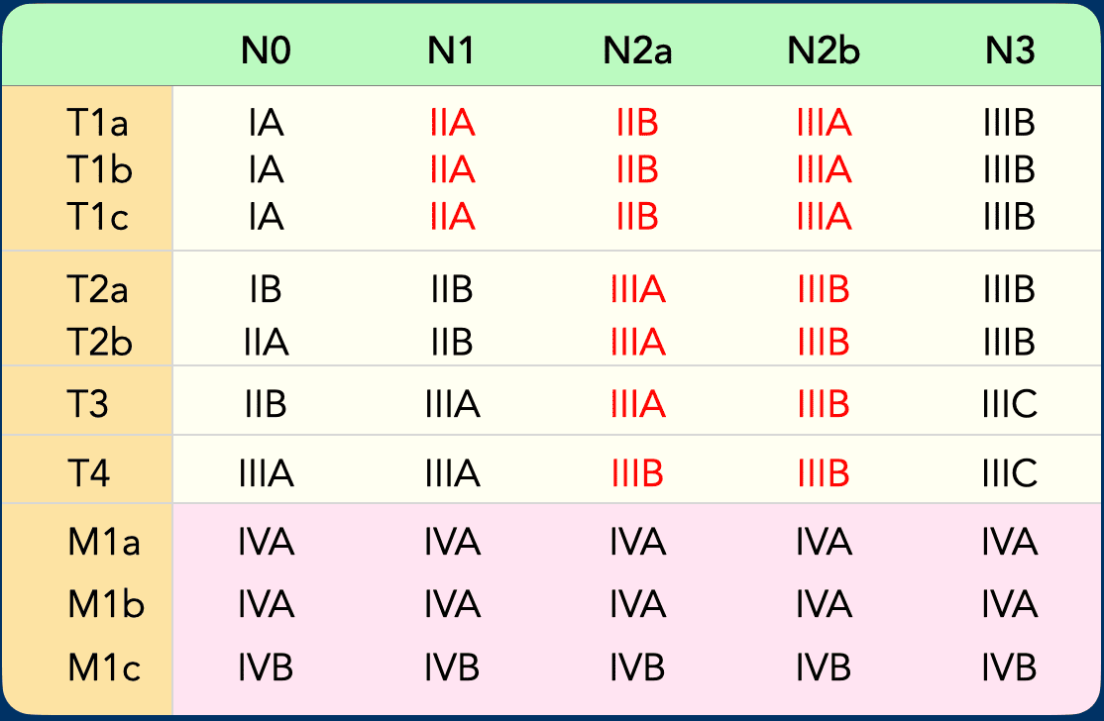

Slide 21
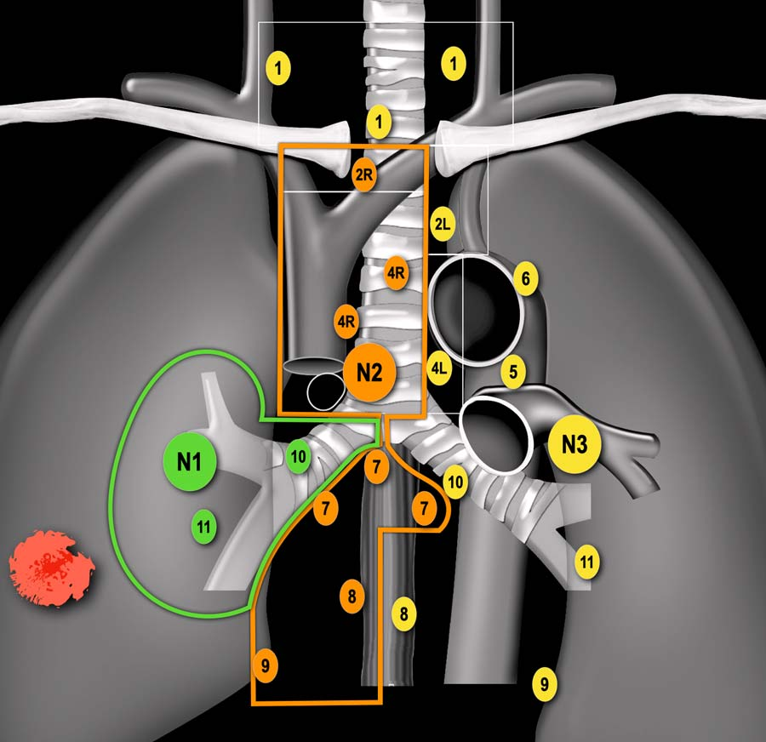

Slide 23
Treatment of NSCLC
Stage I, II = Surgery or SBRT if not surgical candidates or preference
  Goal of treatment is cure (50-70%)
  Surgical resection is gold standard
  Stereotactic radiation with similar cure rates
Stage IIIA (Resectable) = Neoadjuvant chemoimmunotherapy + surgery vs Neoadjuvant chemoradiotherapy + surgery vs Definitive chemoradiotherapy
Stage IIIA (Unresectable) or IIIB/C = Concurrent chemotherapy and radiation (followed by immunotherapy)
  Curative in ~20% of patients
  Median survival on order of 30 months
Stage IV = Systemic Therapy (Immunotherapy or Cytotoxic chemotherapy + Immunotherapy or Targeted Oral Therapy)
  Palliative
  Median survival on order of 16 months

Slide 24
Surgery for Stage I and II NSCLC
Pre-operative pulmonary evaluation
  If FEV < 2.0 liters then generally not candidate for pneumonectomy
  If FEV < 1.5 liters then generally not candidate for lobectomy
  DLCO < 60% generally poor surgical candidates as well
Lung cancer is curable if diagnosed at early stage
  Stage I = ~ 70% cure rate
  Stage II = ~50% cure rate
Stage II, III lung cancers should be considered for adjuvant therapy
  Most should be considered for four cycles of cisplatin “doublet” (ex. Cisplatin + Docetaxel, Cisplatin + Pemetrexed)
  LACE meta-analysis with ~5% reduction in risk of death with chemotherapy doublet
  EGFR positive tumors treated with adjuvant Osimertinib
  ALK positive tumors treated with adjuvant Alectanib
  PDL1+ tumors may receive atezolizumab after platinum chemotherapy (Impower 010)

Slide 25
Neoadjuvant Chemoimmunotherapy
Several studies demonstrate benefit of neoadjuvant chemoimmunotherapy for NSCLC where tumor is > 4cm
Chemotherapy + nivolumab or pembrolizumab has been demonstrated to improve event free survival and pathologic complete response compared to chemotherapy alone
Uncertain if treating N2 stage disease with surgery will translate to improvement in overall survival compared to chemoradiotherapy
Updated guidelines with shift to upfront surgical resection of lung cancer in node negative patients

Slide 26
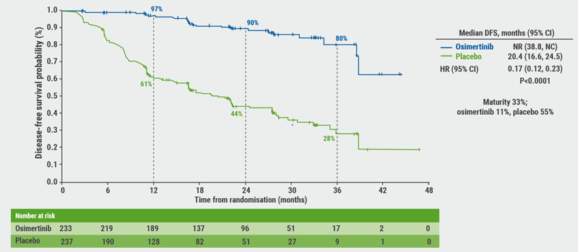
Osimertinib is FDA approved for adjuvant therapy in NSCLC with EGFR mutation
(ADAURA trial)

Slide 27
Adjuvant PDL1 therapy and Alectanib for ALK positive NSCLC
Adjuvant immunotherapy for resected NSCLC
Adjuvant atezolizumab (PDL1 Inhibitor) after platinum based chemotherapy for Stage II – IIIA NSCLC (with PDL1 >1%) resulted in significant disease free survival advantage compared to best supportive care in Impower 010 study
Data on overall survival are not mature
Atezolizumab received FDA indication for adjuvant therapy following surgical resection in Stage II-IIIA NSCLC
Alectanib beneficial in adjuvant therapy of ALK positive NSCLC

Slide 28
Concurrent chemoradiation for Stage III NSCLC
Stage III = lymph node involvement with no distant mets
Standard coarse of radiation is 60 Gy in 30 fractions (6 week course) along with chemotherapy
  Several chemotherapy regimens which are given for 6-9 weeks concurrent with radiation
More toxic and some patients may not be candidates if too frail
Significantly longer median survival ~ 30 months
~15% of patients cured
Standard of care in U.S. is to administer maintenance immunotherapy with PDL1 inhibitor (ex. durvalumab) for 12 months following radiotherapy

