Slide 1


Transfusion Medicine
Matthew Ulrickson, MD

Slide 2
Goals and Objectives
Select the appropriate blood products (RBCs, platelets, fresh frozen plasma, or cryoprecipitate) based on specific clinical scenarios such as active hemorrhage, severe thrombocytopenia, or coagulopathy.
Identify clinical indications for modified blood products including irradiated, washed, or leukoreduced products.
Apply evidence-based restrictive hemoglobin thresholds (typically <7 g/dL) for red cell transfusions in hemodynamically stable patients without chronic anemia/bone marrow disorders.
Interpret the clinical significance of a type and screen, type and crossmatch, and the implications of unexpected red blood cell antibodies.
Differentiate between acute transfusion reactions including febrile non-hemolytic, allergic, anaphylactic, acute hemolytic and septic reactions.
Distinguish between Transfusion-Related Acute Lung Injury (TRALI) and Transfusion- Associated Circulatory Overload (TACO) using clinical presentation, volume status, and timing.

Slide 3
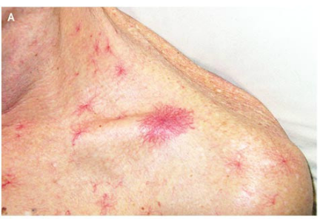
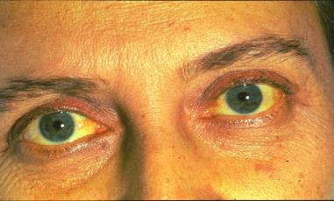
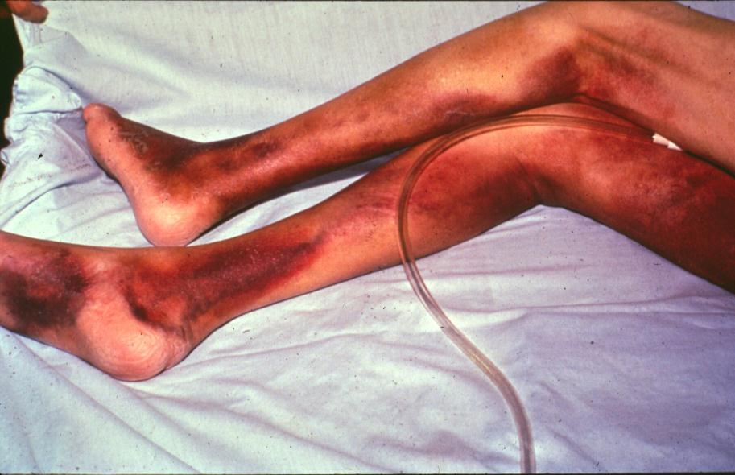
Case 1
A 62-year old retired Navy commander with a history of chronic alcohol abuse presents to the VA hospital with 2 days of black tarry stools and hematemesis.
On physical examination, his vital signs reveal orthostatic hypotension and a pulse of 120. His oxygenation and temperature are normal. His sclera are icteric, his chest reveals spider angiomata, and his abdomen reveals ascites. He has ecchymosis of the extremities bilaterally. Rectal exam reveals black stool.

Slide 4
Which of the following therapies is best to initially address this patient’s hypovolemia?
Laboratories are as follows:
Hemoglobin: 6.3 g/dL
Hematocrit: 19%
Peripheral smear: Poikilocytosis, macrocytosis, and decreased platelets
Platelets:42,000/uL (150,000-400,000/uL)
Prothrombin time: 20 sec (INR 3.0) (11-13.6 sec)
Partial Thromboplastin time: 67 sec (24-36 sec)
Thrombin time: 32 sec (18-28 sec)
Fibrinogen 390 mg/dL (150-400 mg/dL)
A. Red blood cells
B. Platelets
C. FFP
D. Cryoprecipitate
E. None of the above

Slide 5
Which of the following therapies is best to initially address this patient’s hypovolemia?
A. Red blood cells
B. Platelets
C. FFP
D. Cryoprecipitate
E. None of the above – isotonic IV fluid (NS, LR) remains the best choice for initial volume resuscitation

Slide 6
GI is consulted and wants to perform endoscopy…
Your patient is appropriately resuscitated and ready for endoscopy. Which of the following blood components will you transfuse?
A. Red blood cells
B. Platelets
C. FFP
D. Cryoprecipitate
E. None of the above
Hemoglobin: 6.3 g/dL
Platelets:42,000/uL
Prothrombin time: 20 sec (INR 3.0) Partial Thromboplastin time: 67 sec Fibrinogen 390 mg/dL (150-400 mg/dL)

Slide 7
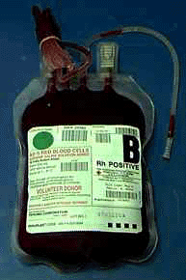
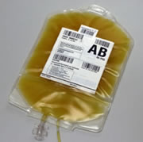
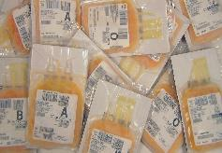
Your patient is appropriately resuscitated and ready for endoscopy. Which of the following blood components will you transfuse?
A. Red blood cells
B. Platelets
C. FFP
D. Cryoprecipitate
E. None of the above
Defect Therapy
Hypovolemia IVF
Oxygen-carrying capacity RBC
Primary Hemostasis Platelet
Secondary Hemostasis FFP and Cryo
Cryoprecipitate contains:
Fibrinogen
Von Willebrand Factor
Factor VIII
Factor XIII
Fibronectin

Slide 8
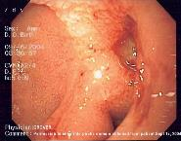
On Endoscopy…
You transfuse your patient with FFP at 6am and his INR improves from 3.0 to 1.5 on 7am lab check. However, a multi-trauma casualty arrives at the ED and the case is bumped. What do you expect the INR will be at 2pm?
A. 1.5
B. 1.0
C. 3.0
On endoscopy: a briskly bleeding ulcer!

Slide 9
On Endoscopy…
You transfuse your patient with FFP at 6am and his INR improves from 3.0 to 1.5 on 7am lab check. However, a multi-trauma casualty arrives at the ED and the case is bumped. What do you expect the INR will be at 2pm?
A. 1.5
B. 1.0
C. 3.0
On endoscopy: a briskly bleeding ulcer!

Slide 10
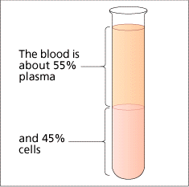
Plasma
Appropriate Use
  Correct coagulopathy
    Multiple factor deficiencies
  Patients facing hemostatic challenge
    Liver disease
    DIC
    Warfarin reversal
    Massive transfusion
Do Not Use
  Specific factor deficiencies (!)
  Volume expansion
  Hypogammaglobulinemia
Duration of effect ~ 4hrs due to half life of Factor VII!
www.cancerhelp.org.uk

Slide 11

Indication for plasma transfusion
Documented factor deficiency
  AND active bleeding
  OR about to have procedure
    PT or PTT x 1.5 times normal, or INR ≥ 1.6
Warfarin Reversal or Vitamin K deficiency
  Significant bleeding or procedure imminent
  How long does it take to get plasma for transfusion?
  Is there something faster for life-threatening bleeding?

Slide 12
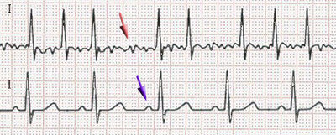
Case 2
A 68 yo man with atrial fibrillation on metoprolol and apixaban presents with bright red blood per rectum (BRBPR).
On examination, you confirm maroon stool. BP 100/55. HR 130s and irregular. He continues to have maroon stool x 4 overnight.
CBC 8.2>10.1<182
Platelet count = 182,000/μl ( 150-400k/ μl )
Prothrombin time = 19 (INR=2.8) (11 – 13.6 sec )
Partial Thromboplastin Time = 57 (24 – 36 sec)
Fibrinogen = 390 mg/dl (150 – 400 mg/dl)
Which of the following do you want to transfuse?
A. Red blood cells
B. Platelets
C. FFP
D. Cryoprecipitate
E. None of the above

Slide 13
Case 2
A 68 yo man with atrial fibrillation on metoprolol and apixaban presents with bright red blood per rectum (BRBPR).
On examination, you confirm maroon stool. BP 100/55. HR 130s and irregular. He continues to have maroon stool x 4 overnight.
CBC 8.2>10.1<182
Platelet count = 182,000/μl ( 150-400k/ μl )
Prothrombin time = 19 (INR=2.8) (11 – 13.6 sec )
Partial Thromboplastin Time = 57 (24 – 36 sec)
Fibrinogen = 390 mg/dl (150 – 400 mg/dl)
Which of the following do you want to transfuse?
A. Red blood cells
B. Platelets
C. FFP
D. Cryoprecipitate
E. None of the above
DOACs will change PT/PTT (not predictably) and do not correct with FFP (they are inhibitors!)

Slide 14
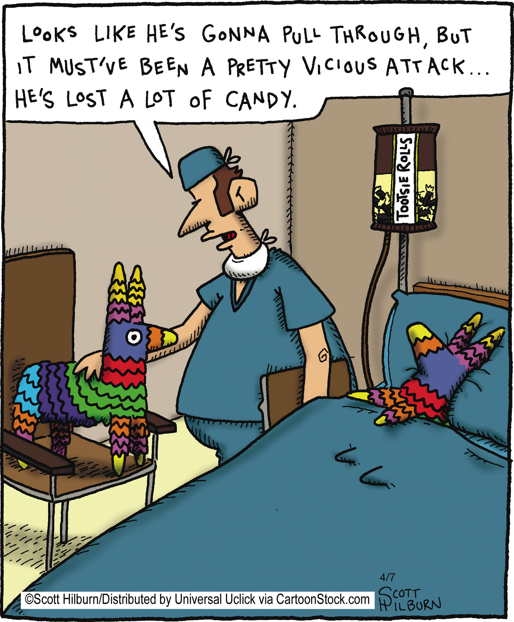

Slide 15
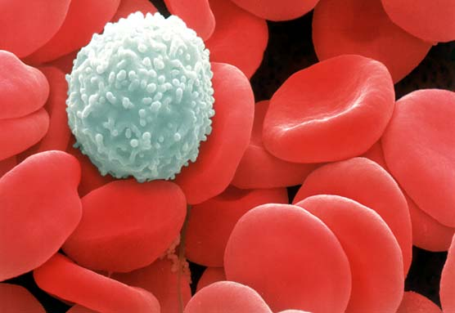
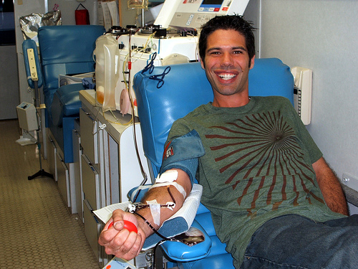
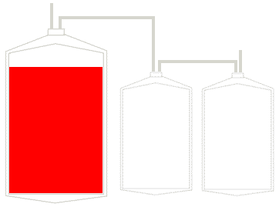
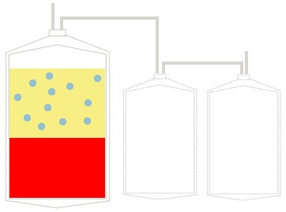
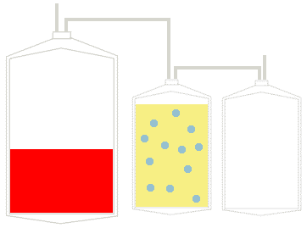
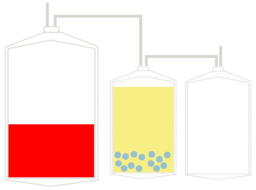
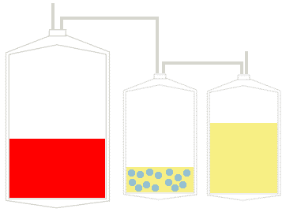
Whole blood fractionation
https://www.vitalant.org/Home.aspx#
You can donate too!!
Centrifuge
Platelet rich plasma
Men who have sex with men now able to donate if no new sexual partner within 3m or more than one partner within 3m
Centrifuge
PRBC
FFP
Platelets
www-medlib.med.utah.edu
www.biologycorner.com
Transfusion of whole blood is returning in a few settings

Slide 16
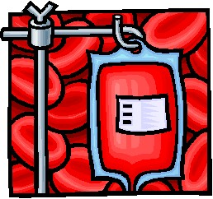
One red cell unit =
200 mL red blood cells
100 mL storage solution
  42 days, 4ºC
30 mL plasma
250 mg/dL iron
Donor & Recipient
  ABO, RhD and crossmatch compatible
Effect
  Hb 1g/dL or Hct 3%

Slide 17
Case 1 update
After endoscopy, the patient’s blood pressure stabilizes and his bleeding has stopped. HR 108 BP 108/52.
Repeat labs reveal:
WBC 2.3
Hb 7.7/Hct 23%
Plt 38k
Which of the following therapies do you recommend?
A. Red blood cells
B. Platelets
C. FFP
D. Cryoprecipitate
E. None of the above

Slide 18
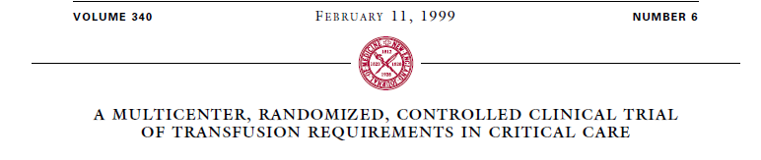
RBC Transfusion Thresholds
This trial excluded patients with chronic anemia and active blood loss
838 ICU Patients
Hgb < 9, euvolemic
Random
Restrictive Transfusion
pRBC if Hgb <7 (7
N=418– 9)
Liberal Transfusion
pRBC if Hgb <10 (10 – 12)
N=420
30 day mortality 18.7%
Mortality during
hospitalization 22.2%
30 day mortality 23.3%
Mortality during
hospitalization 28.1%
P = 0.11
P = 0.05
No differences between liberal and restrictive transfusion (7 vs 10) in TBI patients (NEJM 2024. DOI 10.1056) and in pts with acute MI (MINT trial. NEJM 2023; 389:2446)
  TRICC, Herbert, NEJM 1999; 340: 409

Slide 19

Platelet Targets
Clinical Situation | Target Platelet Count
“Lower risk” procedure = lumbar puncture, paracentesis, central line | >30,000 – 50,000
Higher risk = Biopsy of internal organs | >50,000
Neurosurgical procedure | >75 – 100,000
Bleeding patient (major - GI) | >50,000
Bleeding patient (minor – mucosal) | >30,000
Prophylaxis | >10,000
Slichter SJ. Evidence-based platelet transfusion guidelines. Hematology Am Soc Hem Educ Program 2007:172-8.

Slide 20
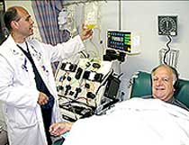
2 Types of Platelet Products
Whole blood platelets
Apheresis Platelets
4 – 6 donors combined together to make 1 adult dose
Single donor
Equivalent to 4-6 pooled units
www.jeevan.org

Slide 21

Cryoprecipitate
Prepared by slowly thawing FFP in the cold
  Insoluable precipitate
    Factors VIII, XIII, vWF, fibrinogen
  One ”pool” = 6-10 donor units = one adult patient dose
Indications for Cryoprecipitate Transfusion:
Hypofibrinogenemia or dysfibrinogenemia
    < 100 - 150 mg
Obstetrical bleeding
DIC
Massive transfusion

Slide 22
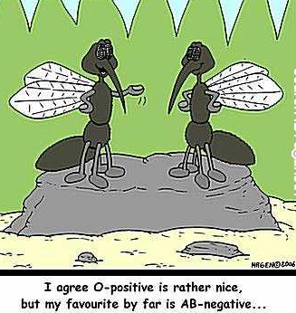
(II) Blood Product Selection:
Compatibility Testing

Slide 23
Case 3
A 42yo man has hematemesis and Hb of 5.2 g/dL. He is short of breath with exertion.
His blood type is A+. You request RBC for transfusion.
The type and screen is positive.
Which of the following blood types do you transfuse?
A. A-
B. B+
C. AB-
D. O+
E. None of the above

Slide 24
Case 3
A 42yo man has hematemesis and Hb of 5.2 g/dL. He is short of breath with exertion.
His blood type is A+. You request RBC for transfusion.
The type and screen is positive.
Which of the following blood types do you transfuse?
A. A-
B. B+
C. AB-
D. O+
E. None of the above

Slide 25
Blood Groups
Genetically related antigens on red blood cell surface
There are 29 blood groups systems
  >300 different antigens
ABO Discovered in 1901 by Karl Landsteiner
Antigens
  A, B, AB, none = O
Chromosome 9q
  ABO genetic loci codes for enzymes
  O is recessive allele
Red Blood Cell
B
D
Other
RBC
antigens
A
MOM
 | A | O
B | AB | BO
O | AO | OO
DAD

Slide 26
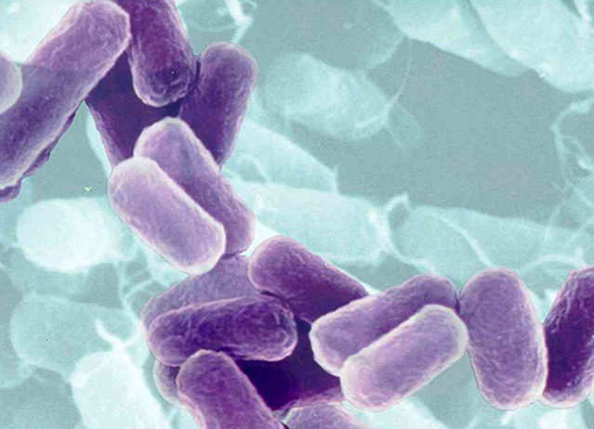
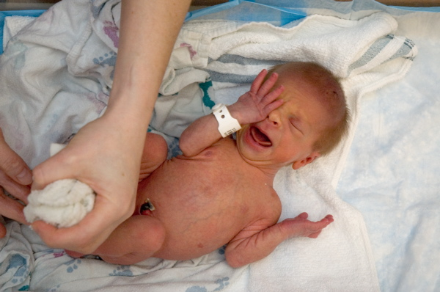
Why is ABO so important?
It’s the plasma!
Plasma = Anti-ABO antibodies are NATURALLY OCCURRING
  Antibodies made in first 6 months of life
  Only blood group system where antithetical antibodies predictably present
  Gut bacteria contribute to antigen exposure

Slide 27
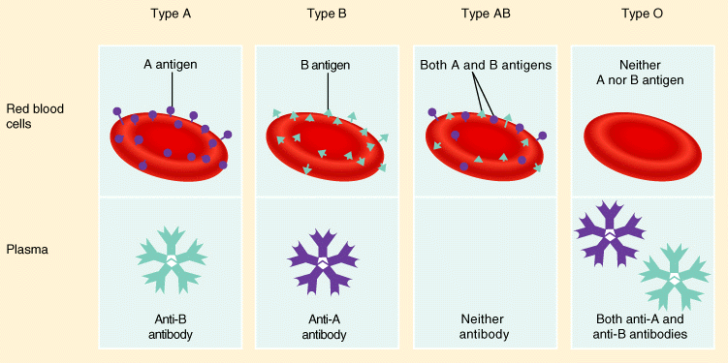
ABO System
© John Wiley & sons, www.Irn.org

Slide 28

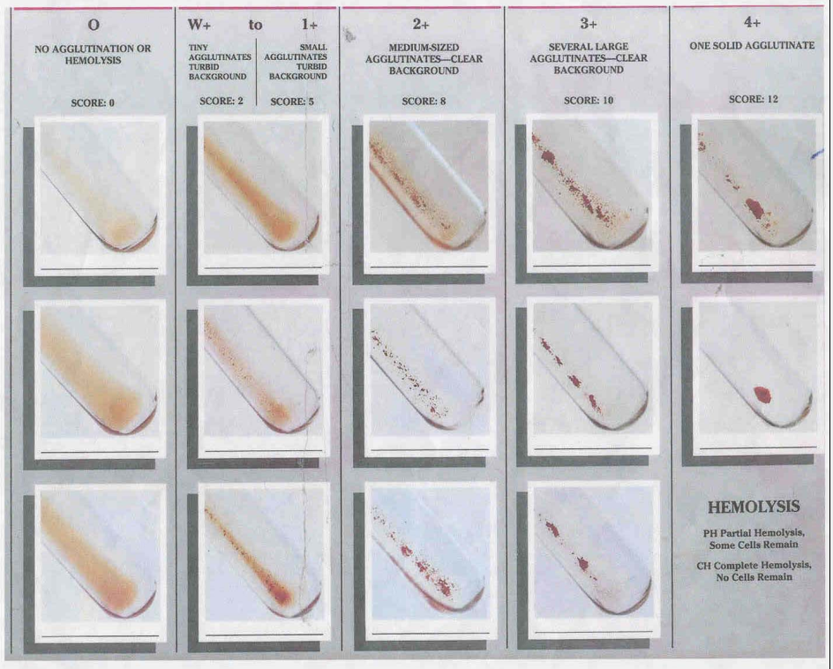
Antibody Screen = Indirect Coombs =
Indirect Antiglobulin test (IAT)
Add Coombs Reagent
(anti-IgG)
Add Reagent Red Cells
Patient plasma:
Antibodies present?
Check for agglutination
NEGATIVE
POSITIVE →

Slide 29
Warm autoantibodies and the crossmatch
“Least incompatible”
  When there is a public antibody that reacts against all RBCs, crossmatch always positive
  Ok to transfuse ‘antigen matched’ or ‘least incompatible’
    CLL
    SLE
  Also can occur with medications like daratumumab (CD38)

Slide 30
Direct Coombs = Direct Antiglobulin Test = DAT
Add Coombs Reagent
(anti-IgG)
Check for agglutination
NEGATIVE
Patient RBC’s:
Are they coated with
Antibodies?
POSITIVE →

Slide 31

“Type and Screen”
Blood Type
  ABO and RhD typing
Antibody Screen
  Test patient plasma for presence of red cell alloantibodies
    Anti-D, Anti-E, Anti-e, Anti-C, Anti-c, Anti-K,
    Anti-Jka, etc….
  Ab screen positive = O- may not be safe

Slide 32
”Type and
Cross”
Crossmatch
Donor rbc
YES: Do not give
NO: Ok to give
Agglutination or hemolysis ?
Patient Plasma
TYPE & CROSS: Includes ABO, RhD type, antibody screen and crossmatch

Slide 33
Case 5
A 42yo woman is 8 months s/p allogeneic SCT for AML. Her Hb is 6.9.
Which of the following modifications do you recommend to decrease the risk of CMV transmission?
A. Irradiation
B. Volume Reduction
C. Leukocyte Reduced
D. Washed
E. Directed Donation

Slide 34
Case 5
A 42yo woman is 8 months s/p allogeneic SCT for AML. Her Hb is 6.9.
Which of the following modifications do you recommend to decrease the risk of CMV transmission?
A. Irradiation
B. Volume Reduction
C. Leukocyte Reduced
D. Washed
E. Directed Donation
Leukocyte-reduced transfusion is considered ‘CMV-safe’ since CMV resides predominately within WBC

Slide 35
Leukoreduction
Filtration of blood products to remove WBC
  Decrease risk of febrile rections from 2% → 1%
  Decrease risk of allosensitization
  Decrease risk of CMV transmission
    Cellular restricted pathogen
ciboulette.blogspot.com

Slide 36
Irradiation
  Protects from Transfusion Associated
  Graft Versus Host Disease (TA-GVHD)
  Inactivates lymphocyte division in blood product
  2,500 cGy (cesium)
    Fetuses / newborns
    Bone marrow transplant patients / candidates
    Hematological malignancy
    Congenital immunodeficiency (DiGeorge Syndrome, etc)
    Blood relative blood donations

Slide 37
68 y.o. female restrained passenger in a high-speed motor vehicle crash is brought to BUMCP trauma bay where she is diagnosed with a pelvic fracture and requires urgent surgery. She has a history of a mechanical mitral valve replacement 10 years prior and is on warfarin.
Laboratories:
WBC = 7.9 (normal: 4.3-10k/uL)
Hct = 37% (normal :36-45%)
Platelet count = 225,000/μL (normal: 150-400,000/uL)
PT = 23 sec (normal: 10.4-12.8 seconds) INR : 2.3
PTT = 39 sec (normal: 24-36 seconds)
Fibrinogen = 175 mg/dL (normal: 150-400 mg/dL)
She is given IV vitamin K, 4 units of FFP and 4 units pRBCs and taken to surgery. Postoperatively, she is transfused 2 units of pRBCs + 2 more units of FFP.
One hour later, you are called to see her for trouble breathing and chest tightness. You auscultate bilateral inspiratory rales throughout. Her O2 saturations fell from 98% to 82% on room air.
Case 5

Slide 38
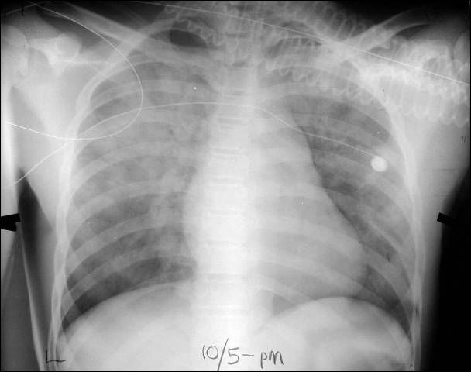
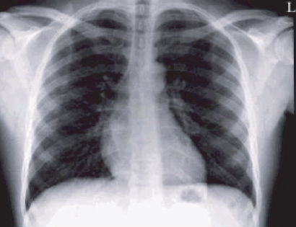
Preoperative Chest Xray
Chest Xray Now

Slide 39
A repeat EKG shows no ischemic changes and cardiac biomarkers are negative. Her oxygenation continues to deteriorate and despite 80 mg of IV furosemide, she requires intubation. Her urine output is 1 liter over the next 2 hours and her hematocrit remains stable. After 6 hours on the ventilator, her chest xray remains unchanged.
Case 5
What is the most likely diagnosis?
Hemolytic transfusion reaction
TRALI
TACO
Sepsis
Diffuse alveolar hemorrhage
Notes:
Changed to resolution of the ischemic changes – point was she needed rbc’s because hct too low.
You say she remains on the ventilator, but we never told them that she required it. I changed it a little bit

Slide 40
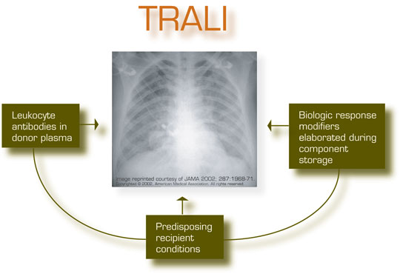
Notes:
- 1st event: Predisposed pt, inflammatory cytokines activating pulmonary endothelium and priming neutrophils
- 2nd event: Transfusion of blood components containing Biological Response Modifiers activate neutrophils

Slide 41
Possible Etiologies of TRALI
Donor Antibodies
  - anti HLA, Class I & II
  - anti PMN
Recipient antibodies
Leukocyte priming activity
  - lipids increase with component storage
Cytokines – IL6, IL8

Slide 42
Two days later her O2 requirement is significantly decreased, her CXR has improved and she is extubated.
At that time, her laboratories showed the following:
WBC: 8.2 K/uL (4.3-10 K/uL)
Hematocrit: 32% (36-45%)
Platelets: 285 K/uL (150-400K/uL)
PT 11.2 sec (10.4-12.8 sec) INR:1.0
Today, on post-op day #4, her Hb is 6g/dL (Hct 21%). This is significantly lower, which causes a concern for bleeding, so the heparin for the mitral valve is discontinued. An abdominal/pelvic CT is negative for retroperitoneal bleed. There is no obvious GI bleeding from the NG or stool. Another 4 units of pRBCs are ordered, and you are called from the blood bank.
What is the most likely mechanism of the patient’s drop in Hct?
Operative site bleeding
Fluid overload
Immune-mediated
Bone Marrow dysfunction
Case 5:
New Problem!
Notes:
I added that she is extubated.

Slide 43
Two days later her O2 requirement is significantly decreased, her CXR has improved and she is extubated.
At that time, her laboratories showed the following:
WBC: 8.2 K/uL (4.3-10 K/uL)
Hematocrit: 32% (36-45%)
Platelets: 285 K/uL (150-400K/uL)
PT 11.2 sec (10.4-12.8 sec) INR:1.0
Today, on post-op day #4, her Hb is 6g/dL (Hct 21%). This is significantly lower, which causes a concern for bleeding, so the heparin for the mitral valve is discontinued. An abdominal/pelvic CT is negative for retroperitoneal bleed. There is no obvious GI bleeding from the NG or stool. Another 4 units of pRBCs are ordered, and you are called from the blood bank.
What is the most likely mechanism of the patient’s drop in Hct?
Operative site bleeding
Fluid overload
Immune-mediated
Bone Marrow dysfunction
Case 5:
New Problem!
Notes:
I added that she is extubated.

Slide 44
Delayed Hemolytic Transfusion Reaction
Falling Hct 3 – 7 days after transfusion
Fever
Mild jaundice, hyperbilirubinemia
Increased lactate dehydrogenase (LDH)
+ Direct and Indirect Antiglobulin Tests
  Mixed field
  IgG
Renal failure and DIC are rare

Slide 45
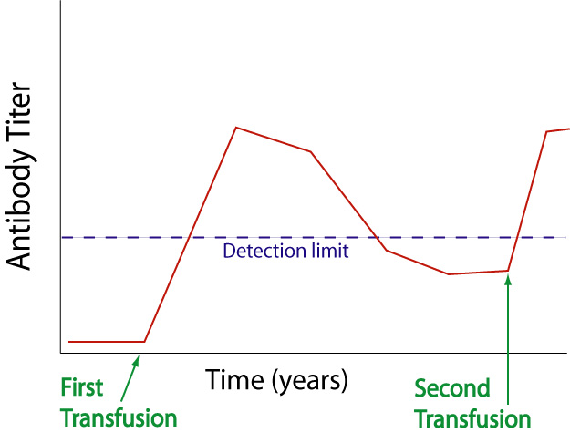
Delayed Hemolytic
Transfusion Reaction

Slide 46
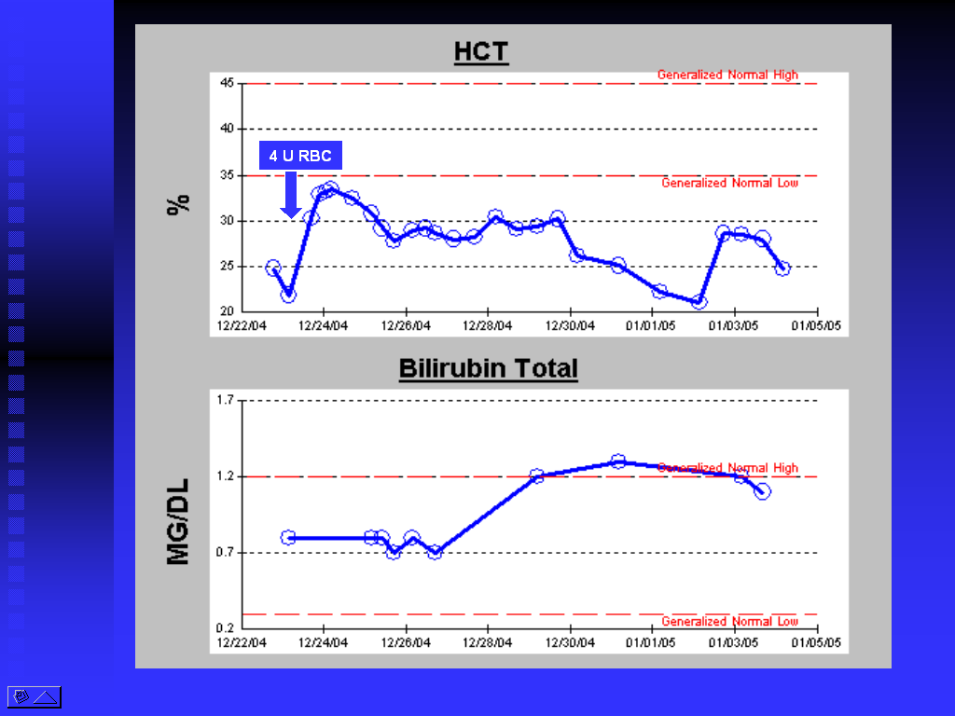
Hematocrit and Bilirubin
in
Delayed
Hemolytic
TransfusionReaction
DHTR associated with anti-Jk(a) 7 days after transfusion in previously transfused patient

Slide 47
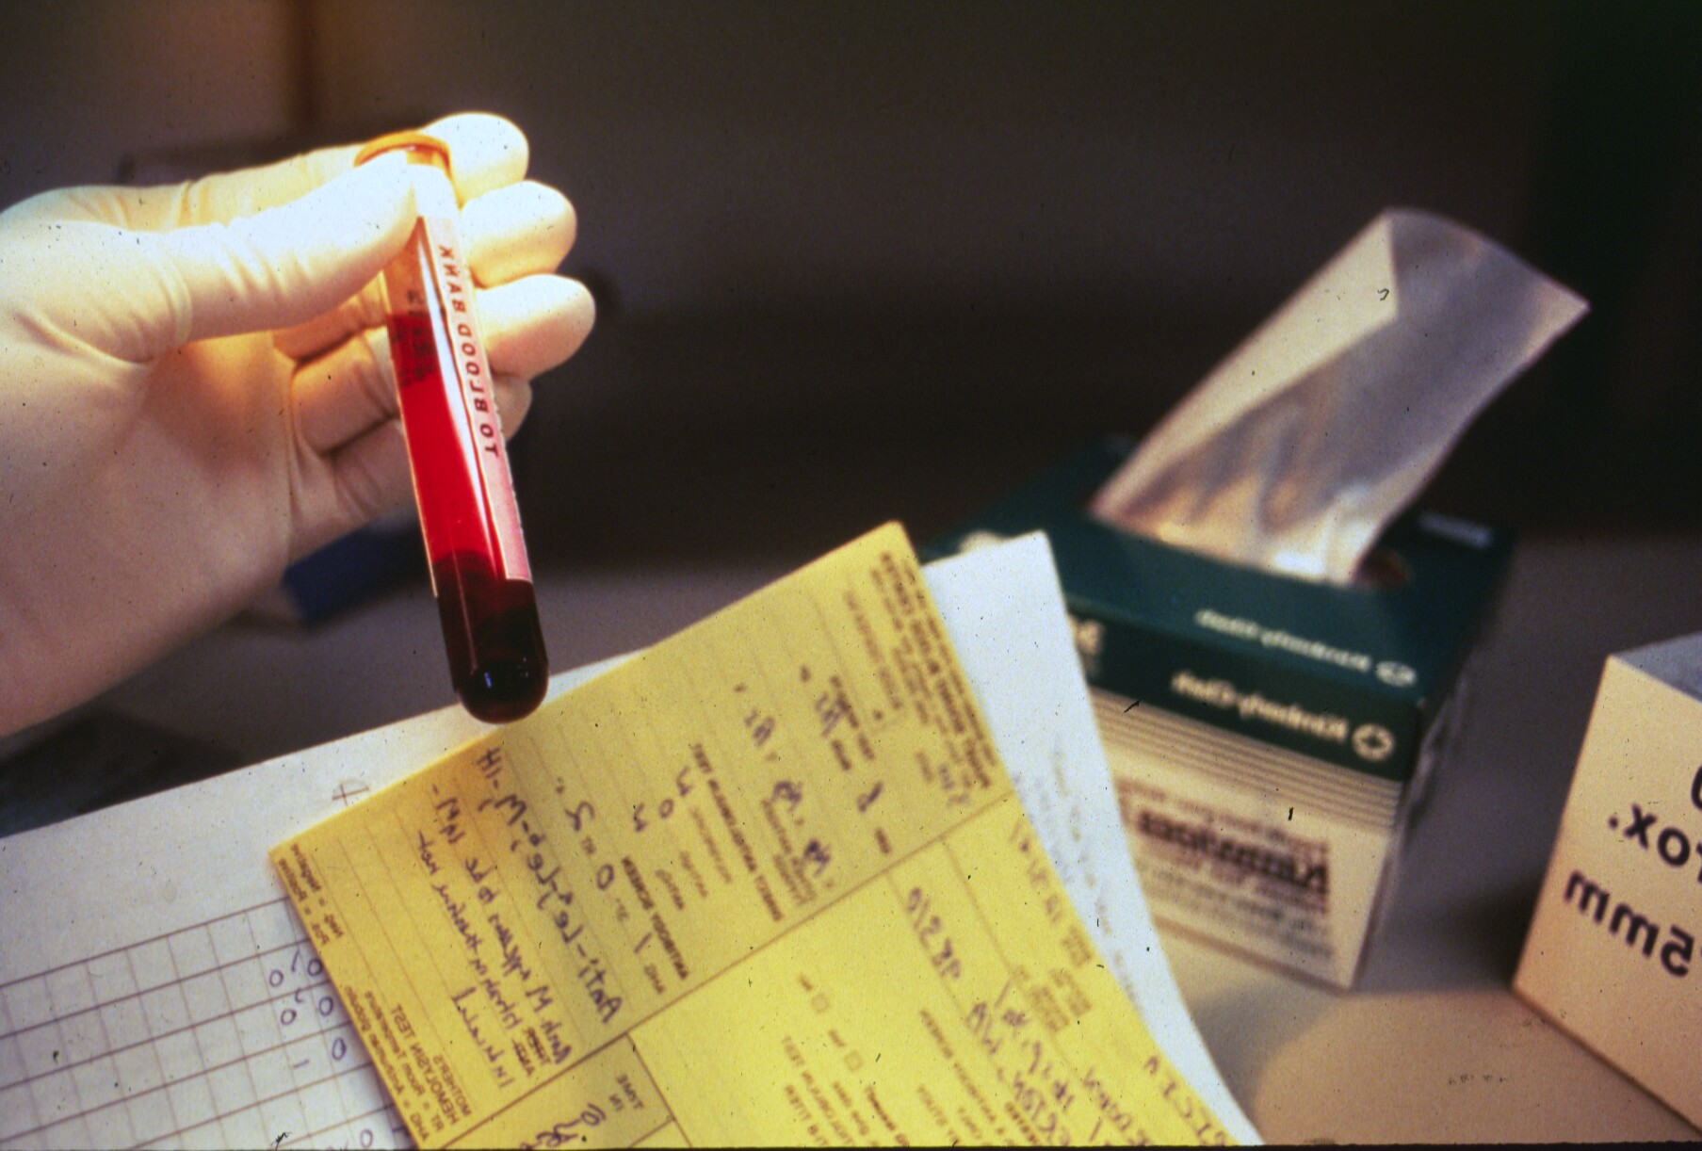
Case 6
73 yo man admitted for routine hip replacement. He was typed and cross matched for 2 units RBC. On admission, his hematocrit was 40%. On post-op day 1, he is doing well with tolerable pain at the incision site and mild swelling of the hip. His vital signs are stable. His hematocrit returns at 26%. Transfusion of one unit of pRBCs is ordered.
Ten minutes after the transfusion begins, he complains of “feeling funny” and appears flushed. He begins to rigor and has a measured temperature of 40⁰ C.
The paperwork is re-examined and both donor and the patient are recorded as A Rh+.
The patient’s urine is dark and a centrifuged specimen of the patient’s blood reveals a bright red plasma.

Slide 48
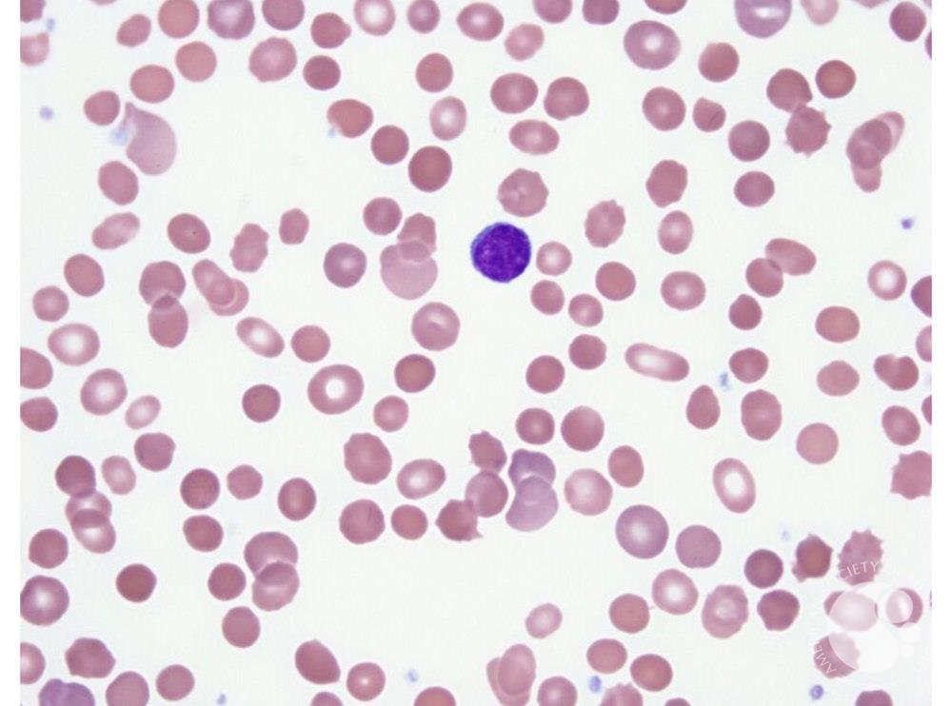
Case 7
The patient’s pre-transfusion blood sample and the donor’s blood sample are retyped as A Rh+, and are negative for antibodies.
A repeat crossmatch is done and the blood is compatible.
Three hours later, the patient’s labs are as follows:
WBC 15,000/ ul (80% neutrophils)
Hematocrit: 22%
Platelets: 73,000/uL
PT: 17/13 sec (INR - 1.8)
TT: 20/15 sec
Fibrinogen: 105, D-Dimer >2500
BUN: 18
Bilirubin: 2.3 (2.0 indirect)
Urine dipstick: 4+ Hemoglobin
Which of the following is the most likely cause of this patient’s symptoms?
Sepsis
ABO incompatibility
Retained surgical device
Babesiosis
TRALI

Slide 49
Case 7
The patient’s pre-transfusion blood sample and the donor’s blood sample are retyped as A Rh+, and are negative for antibodies.
A repeat crossmatch is done and the blood is compatible.
Three hours later, the patient’s labs are as follows:
WBC 15,000/ ul (80% neutrophils)
Hematocrit: 22%
Platelets: 73,000/uL
PT: 17/13 sec (INR - 1.8)
TT: 20/15 sec
Fibrinogen: 105, D-Dimer >2500
BUN: 18
Bilirubin: 2.3 (2.0 indirect)
Urine dipstick: 4+ Hemoglobin
Which of the following is the most likely cause of this patient’s symptoms?
Sepsis
ABO incompatibility
Retained surgical device
Babesiosis
TRALI

Slide 50
Post Transfusion Blood Typing
Post transfusion blood sample from patient types O Rh+
No type A cells identified.
Direct Coombs= negative; no antibodies detected

Slide 51
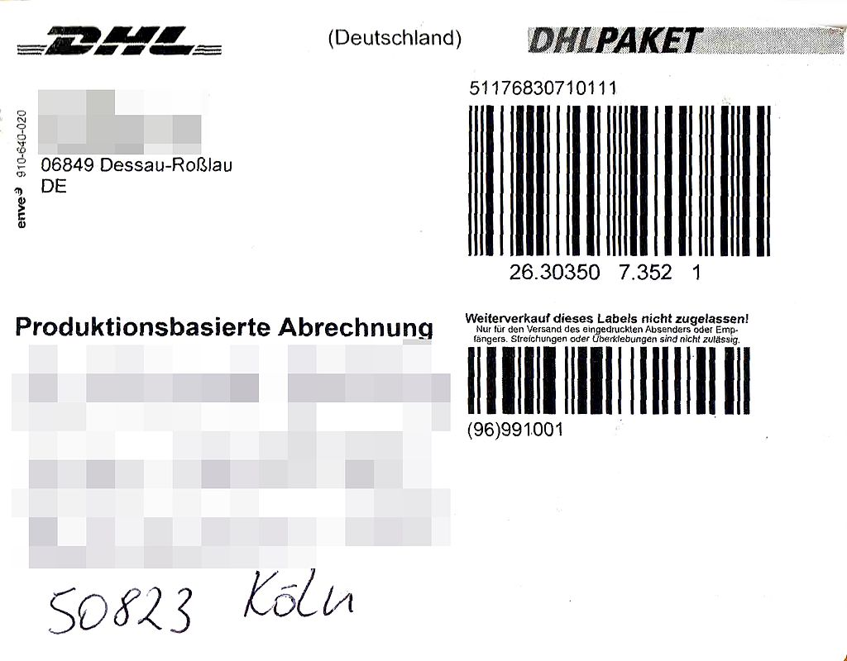
Post Transfusion Blood Typing
Post transfusion blood sample from patient types O Rh+
No type A cells identified.
Direct Coombs= negative; no antibodies detected

Slide 52

Transfusion Reactions
Most importantly, what do you do?
  STOP the transfusion
  Keep the IV line open
  Perform clerical check of product and patient
  Signs & Symptoms
    Follow and document vital signs
    Supportive treatment
      Anti-pyretics, anti-histamines, anti-inflammatories
    Send for pertinent labs
  Note type of product
  Notify and send patient tube and product to blood bank
www.mitchamcouncil.sa.gov.au

Slide 53
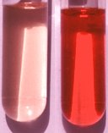
Acute Hemolytic Transfusion Reaction
Signs & Symptoms
  Fever, hypotension
  Flank and transfusion site pain
  Nausea, vomiting
  Renal failure
  DIC
Laboratories
  Hemoglobinemia
  Hemoglobinuria
  LDH elevated
  DAT +
www.diaglab.vet.cornell.edu

Slide 54
Questions and thanks
Donate Blood!

Slide 55
Delayed Hemolytic Transfusion Reaction (DHTR)
Hemolytic Anemia
Low Hgb
High bilirubin, LDH
Spherocytosis
Reticulocytosis
Positive Ab Screen
Positive DAT
3d - 2w
1 unit red cells
1 unit red cells
Antibody Titer
Time
Negative Antibody Screen Negative Antibody Screen

Slide 56
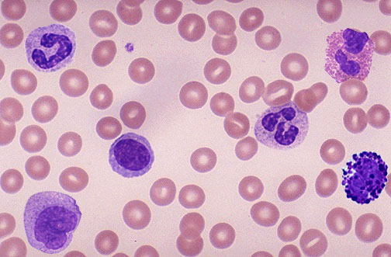

Febrile
(Non-Hemolytic) Transfusion
Reaction
Relatively common
Cause
  Cytokines from donor leukocytes
Signs & Symptoms
  Fever (2ºF), chills within a few hours of transfusion
  N/V, hypotension
Action
  Discontinue transfusion
  Support & monitor
  Ok to give next transfusion if no hemolysis
Leukoreduction decreases incidence from 2% to 1%

Slide 57
Urticarial, Allergic & Anaphylaxis
URTICARIAL ANAPHYLACTIC
(Common) (Rare)
Hypersensitivity Reactions
  Proteins in donor plasma cause hypersensitivity reaction in recipient
  IgA deficient patient
  Washed RBC (plasma removed)

Slide 58

Urticarial / Allergic Reaction
Plasma
Donor proteins cause IgE mediated histamine release in patient
  Flushing, pruritis, urticaria
  Usually no temperature
Treat with anti-histamines
Ok to re-start transfusion at slower rate if symptoms subside or stabilize

Slide 59
Anaphylaxis & Anaphylactoid
Y
Y
Plasma
Y
Y
Y
Y
Hypotension, dyspnea, airway edema, anxiety, larger rash
Requires emergent care
  Anti-histamines
  Epinephrine, corticosteroids, pressors and intubation if necessary
  May have to wash platelets or rbc’s (blood products) for future

Slide 60
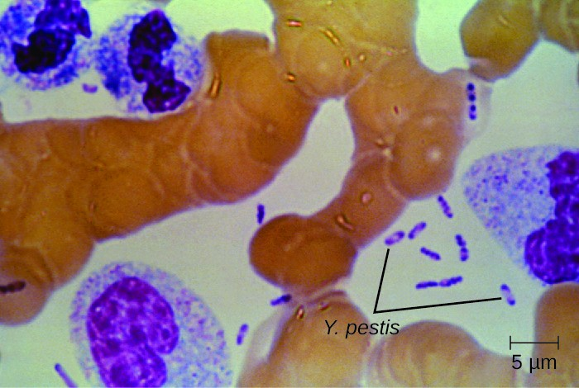
Sepsis
Blood components contaminated by bacteria
  Blood donor skin flora
  Blood donor unrecognized bacteremia
  Environmental or product handling during processing
Most common in platelets because stored at room temp
  Up to 1 in 1,300 platelet transfusions
Always let blood bank know if septic reaction suspected so products can be cultured
www.greenfacts.org

Slide 61
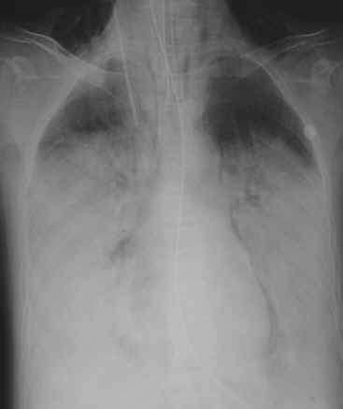
Transfusion Related Acute Lung Injury (TRALI)
Acute onset hypoxemia
  Within 6h of transfusion
  Bilateral lung infiltration
  No sign circulatory overload
True frequency unknown
  1 in 2-5,000 plasma containing transfusions
  Under diagnosed
  72% require mechanical ventilation
  5 - 10% mortality
www.aic.cuhk.edu.hk

Slide 62
TRALI proposed mechanism
Product with
multiple HLA
antibodies
Mother Donates Blood
When product infused, antibodies passively transfused.
Agglutinate with leukocytes in pulmonary microvasculature.
Causes respiratory distress and ARDS picture.
Important to notify blood bank so that donor-recipient testing can be done

Slide 63
Transfusion Associated GVHD
Engraftment and proliferation of donor lymphocytes in transfusion recipient.
Who’s at risk?
  Immunocompetent patient transfused with HLA haploidentical product (blood relative)
  Severely immunocompromised patients
Donor cells attack
  Hematopoietic cells → refractory pancytopenia
  Other organ systems: Fever, enterocolitis, rash, hepatitis
Usually fatal: 90-100%

Slide 64
Blood related donor: ta-GVHD risk
TOLERANCE
HLA-A2
HLA-A3
HLA-A3
HLA-A3
RECIPIENT
(Child)
DONOR
(Parent)
RECOGNITION → DESTROY

Slide 65

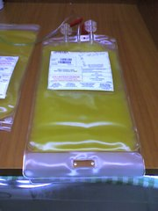
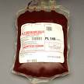
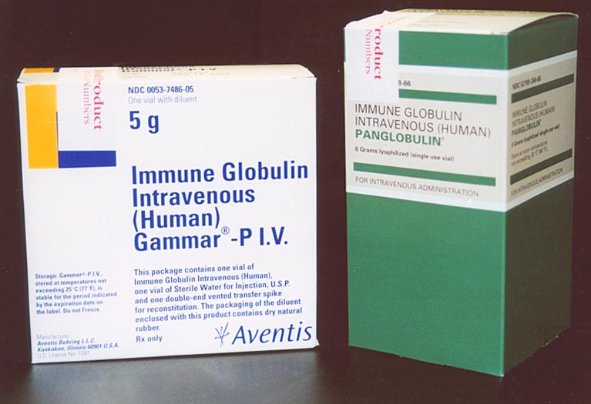
Blood Products
Red Blood Cells
Platelets
Plasma
  Cryoprecipitate
  Albumin
  IVIG
Coagulation factors
  Plasma derived or recombinant

Slide 66
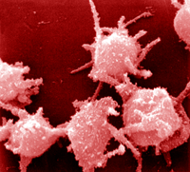
Platelets
Function
  Initial phase of coagulation
Use
  Treat thrombocytopenia
  Platelet function disorders
Not used
  Pre-procedure prophylaxis to prevent serious bleeding
  Expand intravascular compartment
Activated Platelets
www.cbr.ubc.ca

Slide 67
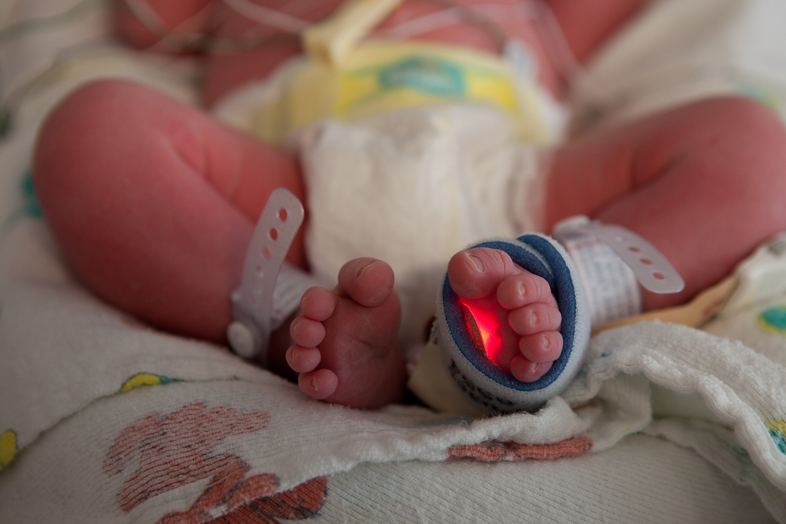
Special Considerations
 | CMV ”Safe” | Irradiated | Leukoreduced
Hematopoietic Stem Cell Transplant | X | X | X
Chemotherapy |  | X | X
Lymphoproliferative Disorder |  | X | X
Organ Transplant Candidates | X (if CMV-) |  | X
Neonates | X | X | X

Slide 68
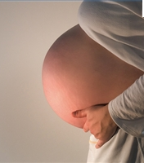
Transfusion associated CMV
50% or more of blood donors CMV are seropositive
  ~1% thought to be infectious
  Usually transfusion associated CMV of no clinical consequence
Certain categories of immunocompromised patients can have progressive disease
  Fetuses / newborns
    Pregnant mothers
  Bone marrow transplant patients / candidates
  Solid organ transplant patients
  Seronegative HIV/AIDS patients

Slide 69
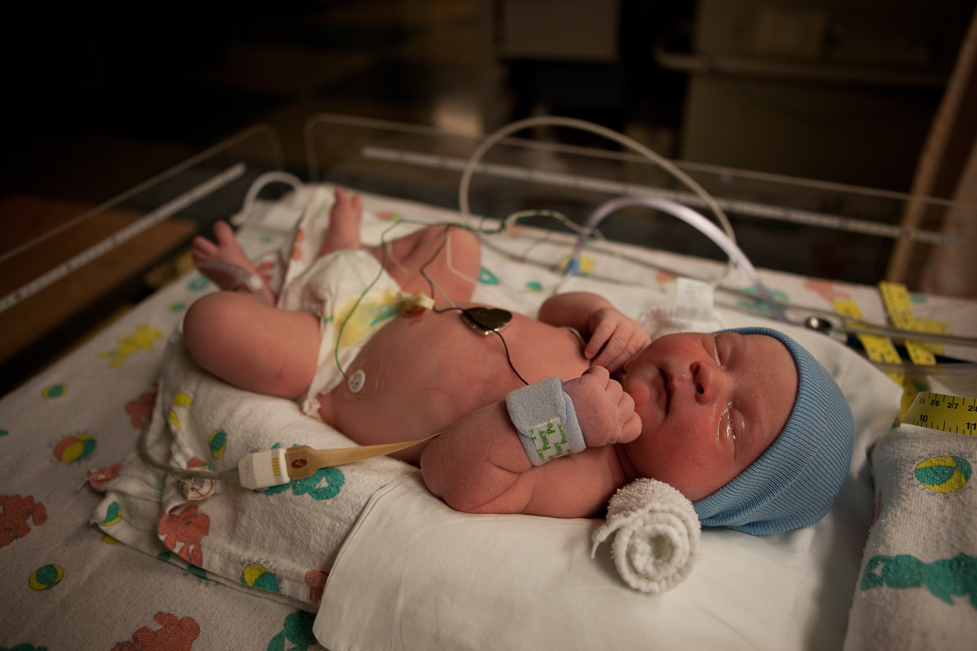
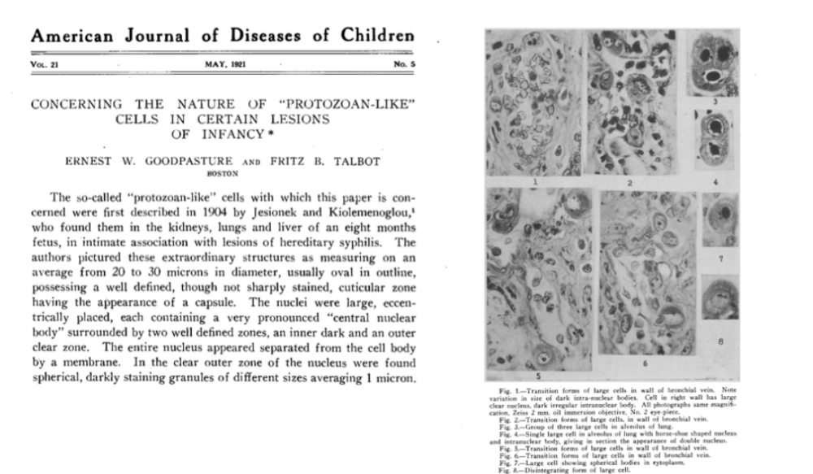
”CMV Safe”
Blood Products
Prevent transfusion associated-CMV disease in patients at risk
”CMV safe” products made by two methods
  Donor negative for CMV antibodies (CMV negative)
    OR
  Blood product leukoreduced
    CMV cellular restricted pathogen
May 1921
www.defiers.com

Slide 70
Case 4
Type and cross is negative on repeat unit.
RBC is about to be transfused and he asks you, “Which infectious disease am I most likely to acquire from this RBC unit?” You answer:
A. Hepatitis A
B. Hepatitis B
C. Hepatitis C
D. HIV
E. Zika Virus

Slide 71
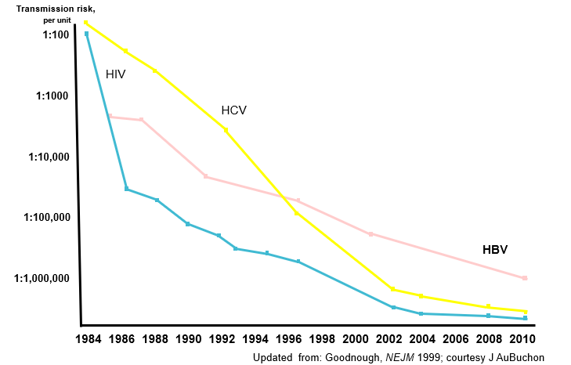
The evolution of transfusion risks
Transmission risk,
per unit
1:100
HIV
1:1000
HCV
1:10,000
1:100,000
HBV
1:1,000,000
1984 1986 1988 1990 1992 1994 1996 1998 2000 2002 2004 2006 2008 2010
Updated from: Goodnough, NEJM 1999; courtesy J AuBuchon
Notes:
Our successes in transfusion safety over the last two decades are evident. But this slide can also be used to illustrate our next challenges. Let’s not look backwards,

Slide 72
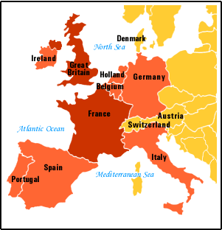
Transfusion Transmitted Disease
Has significantly decreased over last two decades
We make the blood supply safer using several tactics
  Only volunteer donors
  Blood donor questionnaire
  Blood donor testing
Look for donor risk factors
  1. Disease we test for
    HIV, HBV, HCV, Syphilis, Chagas, WNV, HTLV
    Sepsis
  2. Disease we cannot test for
    variant Jacob-Creutzfeldt
    “classical” Jacob-Creutzfeldt
    Malaria (we don’t test for)
    Diseases we don’t know about

Slide 73
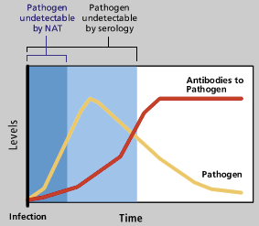
Why are there any residual risks?
Residual risk: Test sensitivity
Notes:
Estimated window periods
HIV: 11 days
HCV: 10 days
HBV: 10 – 59 days

