Slide 1


All you need to know about infection prevention in 10 minutes
Jonas Marschall, MD
August 4, 2026

Slide 2
Infection Prevention: Friends and Relatives
PUBLIC HEALTH
Quality management
Patient safety
Microbiology
Infection Prevention
Occupational health
Infectious diseases

Slide 3
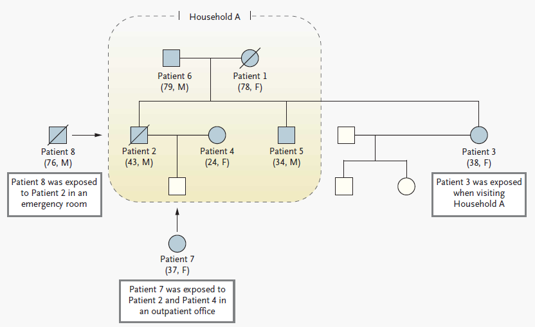
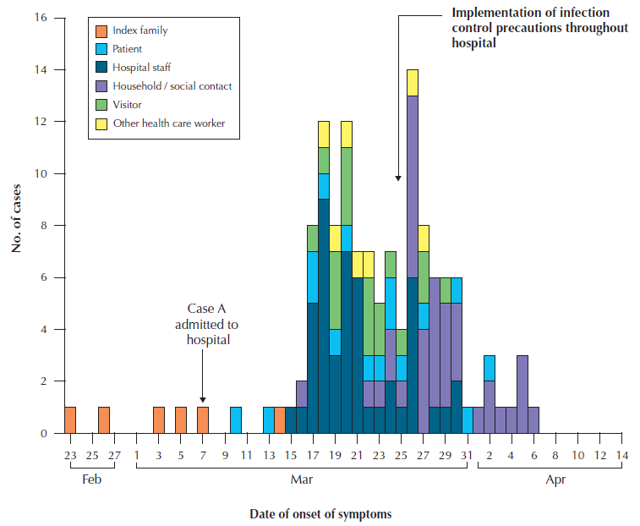
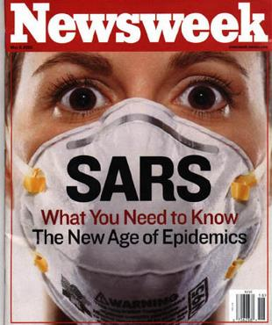
Outbreak investigation
Case definition
Case finding
Line list & chart review
Risk factors
Case-control study
Intervention(s)
Epidemic curve

Slide 4
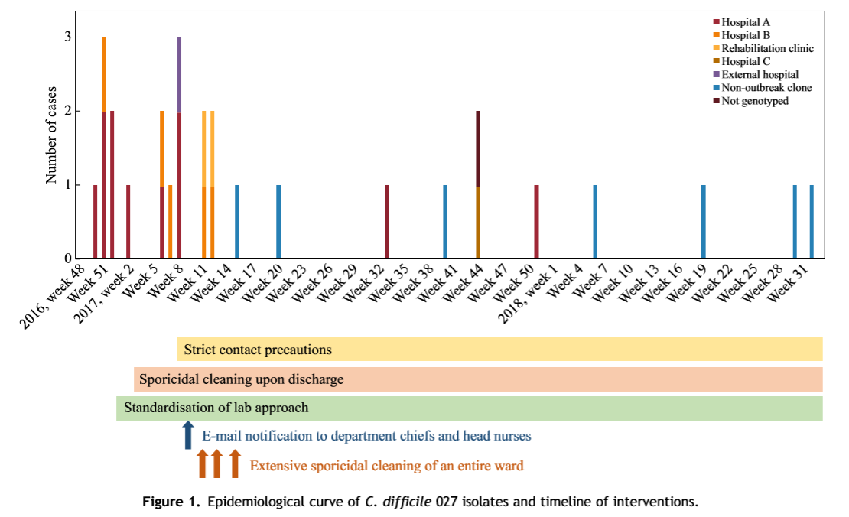
Example: C. difficile 027 cluster, epidemic curve and interventions
C. difficile ribotype 027 / NAP1 / BI
Hypervirulent, produces toxins A, B, and binary toxin
All patients had h/o recent antibiotic treatment
25% mortality
Kuenzli et al, J Hosp Infect 2020

Slide 5
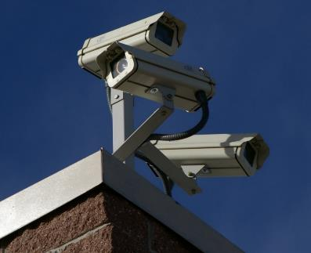
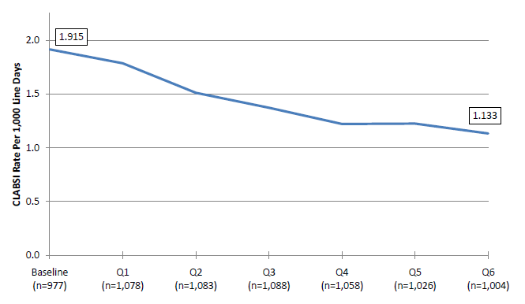
Surveillance: Central line associated bloodstream infection (CLABSI)
Incidence rate : cases during period of observation / patient-time at risk

Slide 6
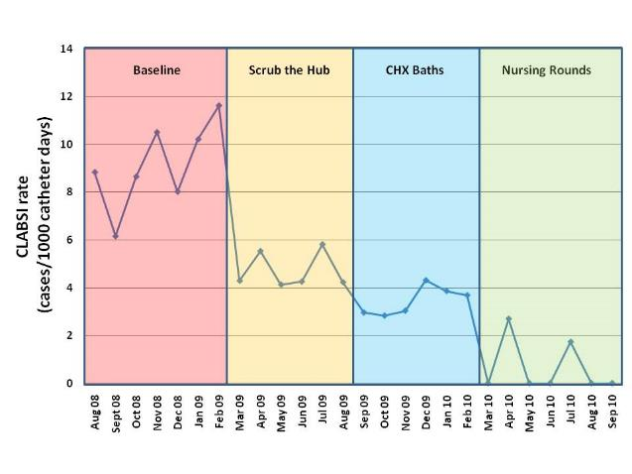
Example: CLABSI surveillance and interventions
Standardized identification of hospital-acquired infections (HAI)
Quality indicator
Allows comparison over time, between centers
Tool for measuring the effect of an intervention
Benchmarking & reimbursement

Slide 7
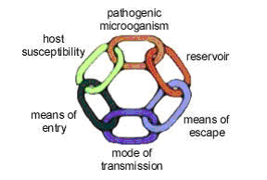
Pathogen transmission – “The chain of infection”

Slide 8
Example: Reducing flu transmission
Treat patients with positive influenza test
Flu vaccine; post-exposure prophylaxis
Screen patients with respiratory symptoms
Surgical mask
Cover your cough
Droplet precautions

Slide 9
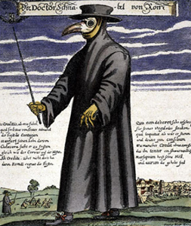

What information do you need to pick the correct isolation precautions?
Transmission mode of a pathogen

Slide 10
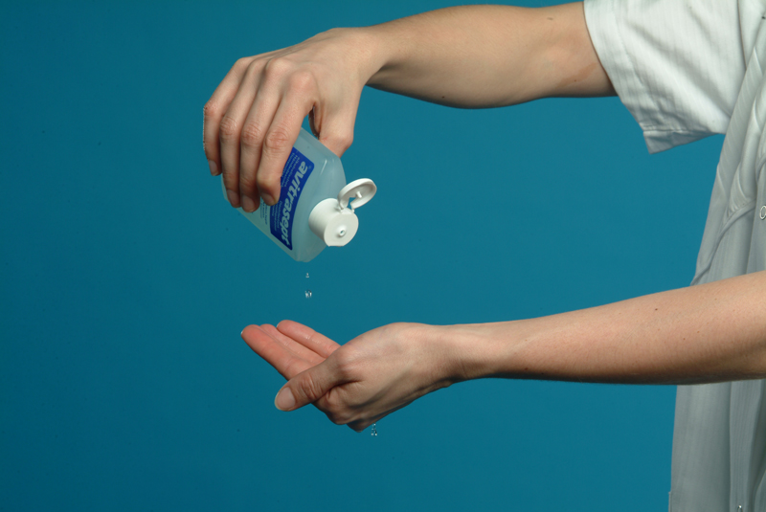
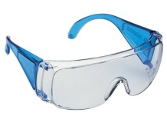
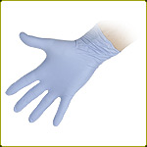

Transmission-based precautions
Contact
Droplet
Airborne
(Protective)
Transmission-based precautions
Standard precautions
Note. “Enhanced” precautions for COVID-19 = Contact precautions & N95
Siegel at al: 2007 Guideline for Isolation Precautions (CDC)

Slide 11
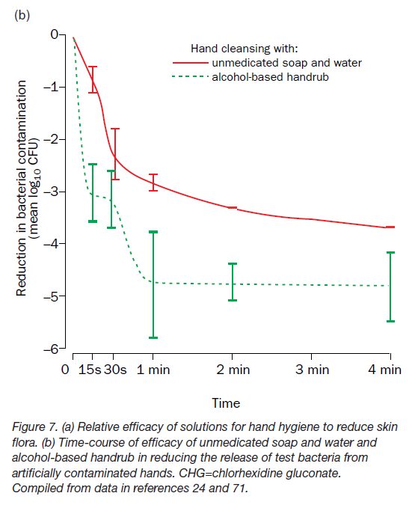
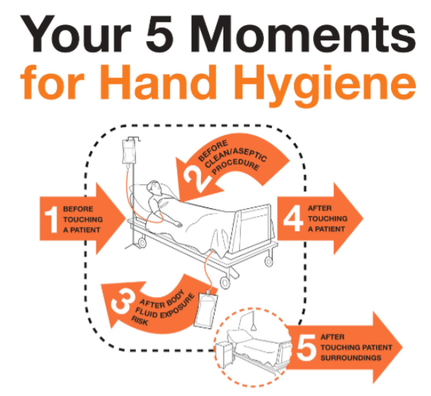
Hand hygiene – a process indicator for patient safety
Pittet et al, Lancet ID 2001;1:9. Pires et al, Clin Microbiol Infect 2019; 25: 851.

Slide 12
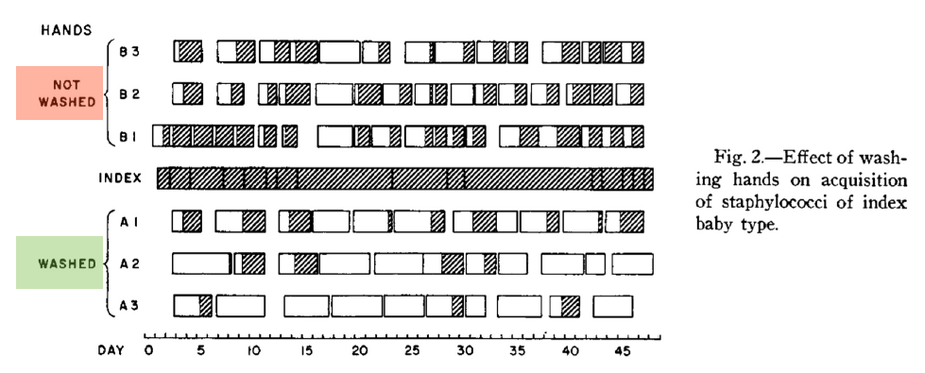
Staphylococcus aureus transmission in function of hand hygiene
Mortimer et al, Am J Dis Child 1962

Slide 13
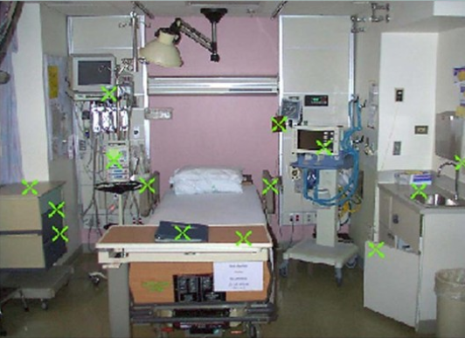
Courtesy of Mary Hayden, MD, Rush Medical Center:
VRE detection in an ICU room following patient discharge, 2001

Slide 14
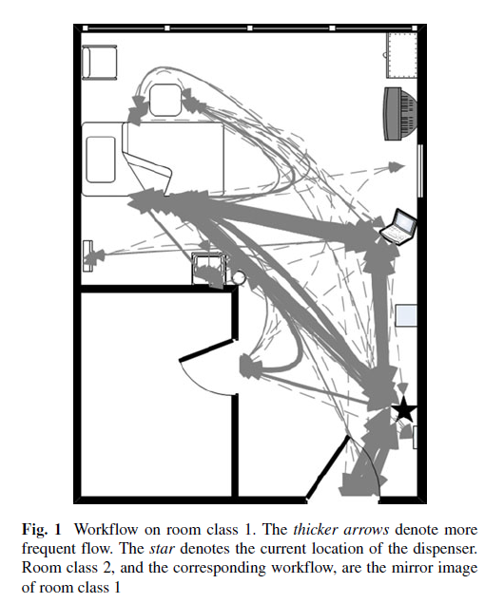
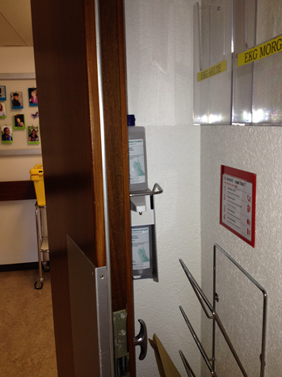
Cure L et al, Health Care Manag Sci 2014.

Slide 15

SSI CLABSI CAUTI VAP CDI

Slide 16
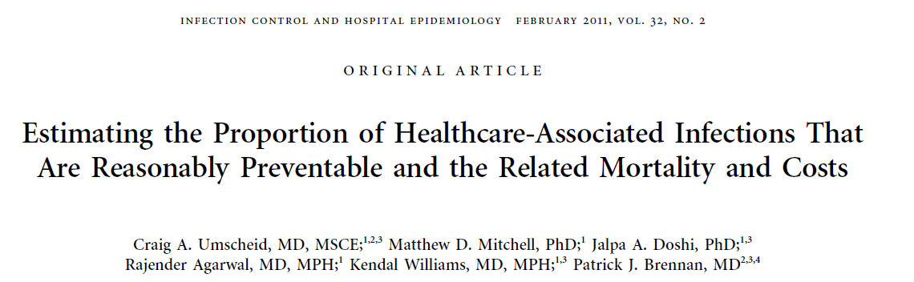
A large proportion of HAIs can be prevented…
…with evidence-based strategies:
CLABSI, CAUTI: 65-70% preventable
VAP, SSI: 55% preventable
Umscheid et al, ICHE 2011 Schreiber et al, ICHE 2018 (2005-16 data)

Slide 17

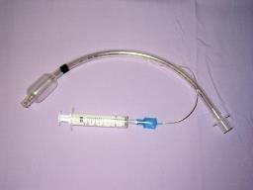
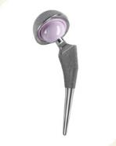
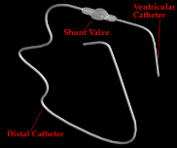
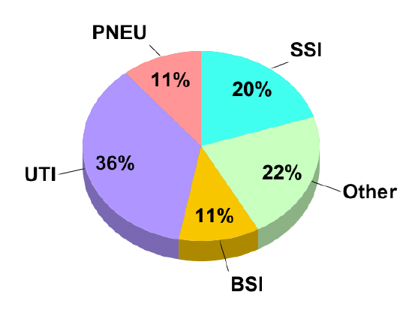

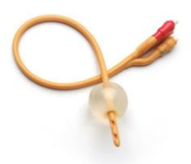
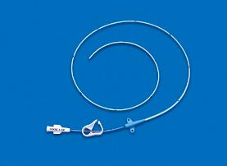
What’s driving HAIs?
SSI
VAP
CAUTI
CLABSI

Slide 18
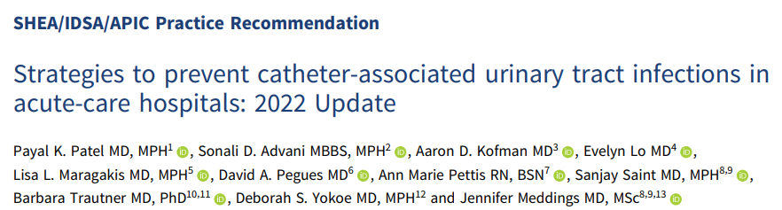
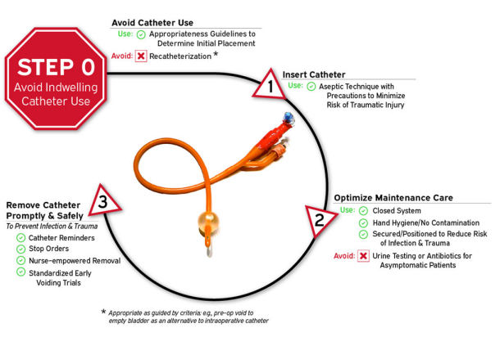
Part of the SHEA/IDSA/APIC compendium of prevention strategies
Succinct source of guidance on preventive measures
Patel et al, Infect Control Hosp Epidemiol 2023; 44: 1209

Slide 19
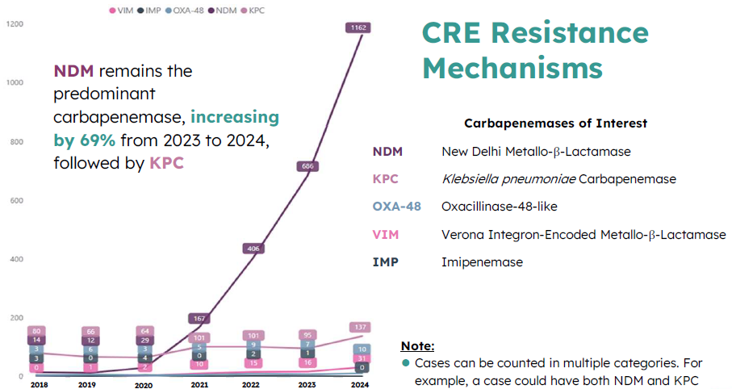
Multi-drug resistant organisms on the rise
Courtesy of Tho Pham, PharmD, AZDHS, 2025

Slide 20
Thank you!
jmarschall@arizona.edu

