Slide 1
Approach to Antibiotics for Inpatient Care
Hillary Hunsinger, DO
Infectious Diseases attending
Phoenix VA

Slide 2
Objectives
Understand how to choose empiric antibiotics
Understand how to de-escalate antibiotics
Understand how to use and interpret cultures and infection biomarkers
Understand where to look for further resources

Slide 3
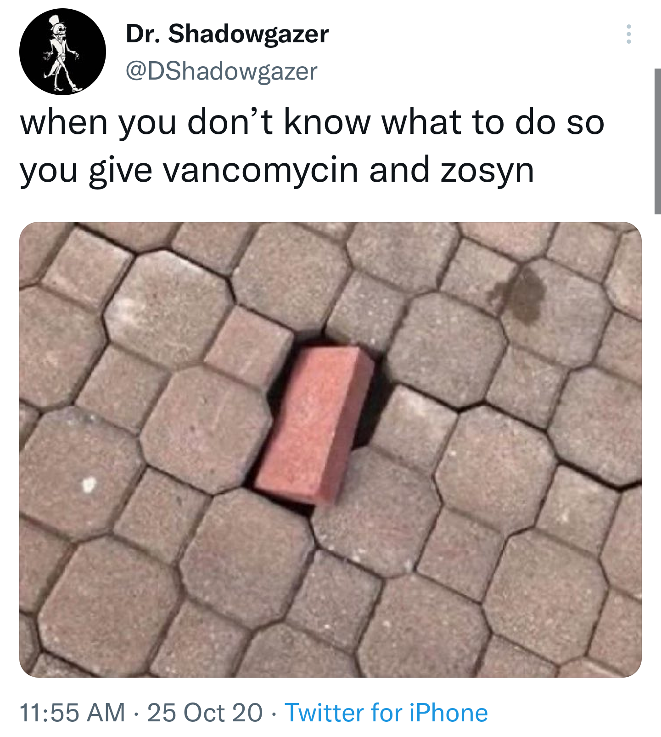
1.
Choosing empiric antibiotics

Slide 4
Right diagnosis
Right drug
Right dose
Right duration

Slide 5
Considerations for antibiotic choice
Body site → likely organisms
History of previous cultures – previous resistance?
Recent antibiotic exposure?
Immunocompetent vs. immunocompromised
Comorbidities, risk of antibiotic adverse effects
Drug-drug interactions
PO vs. IV

Slide 6
Right Diagnosis
Sepsis – find the source
Respiratory
Skin, surgical site
Intra-abdominal, UTI
CNS
Device-associated (pacemaker, HD catheter)
Environmental exposure?
Community acquired vs. hospital-acquired

Slide 7
Respiratory
Community-acquired
Viral
Oral flora (“aspiration”)
Strep pneumoniae
Haemophilus
Legionella
Hospital-acquired
Oral flora changes to colon flora – more Gram negatives
MRSA
Pseudomonas
Ceftriaxone + azithromycin
Vancomycin + cefepime

Slide 8
Skin infections
Nonpurulent
Cellulitis, erysipelas
Group A Strep causes the vast majority
1/3 of cases of cellulitis are misdiagnosed – many mimics
Purulent
Abscesses
Surgical site infection
Group A Strep, Group B Strep, other Strep
Staph aureus, other Staph
Cefazolin
Vancomycin + cefazolin

Slide 9
Intra-abdominal, UTI
GI flora – Gram negative bacilli, Gram-negative anaerobes, Enterococcus
Pseudomonas is typically NOT GI flora
Ceftriaxone + metronidazole
Cefepime + metronidazole
Pip-tazo

Slide 10
Device-associated
Skin flora
Staph aureus, Staph epi, Strep species
MRSA
Candida
Vancomycin

Slide 11
Anaerobic coverage or not?
Generally way overused
Valid:
Intraabdominal infections, especially if rupture of viscera
Gas forming?
Not necessary:
Skin infections
Diabetic foot infections, mostly

Slide 12
Which anaerobes?
Oral flora: usually Gram-positive anaerobes
Aspiration pneumonia, head & neck infections
Covered by ceftriaxone and other cephs, ampicillin-sulbactam, amox-clav
GI flora: usually Gram-negative anaerobes (Bacteroides)
Produces beta-lactamases, resistant to ceftriaxone, amox-clav, etc
Pip-tazo, meropenem, metronidazole

Slide 13
Antibiotics with MRSA coverage
IV
Vancomycin
Daptomycin
Linezolid
Ceftaroline
PO
Linezolid
TMP-SMX
Doxycycline
Clindamycin

Slide 14
Antibiotics with Pseudomonas coverage
IV
Cefepime, ceftazidime
Pip-tazo
Meropenem (NOT erta)
Levo, ciprofloxacin
Aminoglycosides
For resistant Pseudomonas:
Avycaz (ceftazidime-avibactam)
Zerbaxa (ceftolozane-tazobactam)
Vabormere (meropenem-vaborbactam)
Recarbrio (imipenem-relebactam)
Cefidericol
PO
Ciprofloxacin
Levofloxacin

Slide 15
Enterococcus
Intrinsically resistant to ALL cephalosporins
Ampicillin if susceptible
Pip-tazo, +/- meropenem, NO ertapenem
If resistant to ampicillin → vancomycin
Vancomycin-resistant (VRE) → daptomycin or linezolid

Slide 16
Blood vs. Tissue levels (PO antibiotics)
High serum concentration
Fluoroquinolones
TMP-SMX
Linezolid
Some high-dose beta-lactams
Poor serum, good tissue
Beta-lactams
Doxycycline
*PO vancomycin is NOT absorbed systemically

Slide 17
Drug Distribution
CNS
Pip-tazo*
Vancomycin
Daptomycin
Micafungin
Cefazolin – disproved!
Urine
Micafungin
Moxifloxacin
Beta-lactams – not great levels
Eyes
Micafungin
Amphotericin B
Lung tissue
Daptomycin

Slide 18
Cultures and other tests

Slide 19
Culture process
Blood cultures – incubated in bottles for 5 days
Urine – incubated 2 days on plates
Tissues, other fluids – incubated 3-5 days on plates
Colony on the plate →
Gram stain, other biochemical tests
Blood → Biofire, 1 hour rapid multiplex PCR
Vitek (ID)
Vitek (susceptibilities)

Slide 20
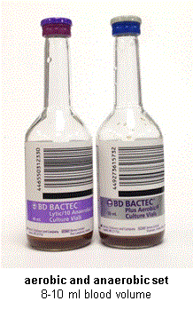
Blood cultures
One set = an aerobic bottle & anaerobic bottle, drawn from the same site (e.g., left antecubital (AC) vein)
Should not be drawn from an IV but from a new stick
Typically, we want two sets drawn from two different body sites, 15 min apart
Volume → sensitivity
If endocarditis is suspected, draw 2 sets every 8 hours x3

Slide 21
Blood cultures
BC are incubated for 5 days but most pathogens will grow within the first 48-72 hours
Depends on the bacterial burden, if antibiotics were already given, etc
Candida will grow on regular BC – do NOT need fungal cultures

Slide 22
Blood culture interpretation – contaminant vs “real”
Number of bottles/sets (1/4 or 2/4 vs. 4/4)
Patient context is important: septic or not, likely source, immunocompromised state?
Always assume is real:
Staph aureus (MSSA or MRSA)
Most Strep species
Gram-negative bacillus (E. coli, Klebsiella, etc)
Gram-positive bacillus in an anaerobic bottle (Clostridium)
Candida

Slide 23
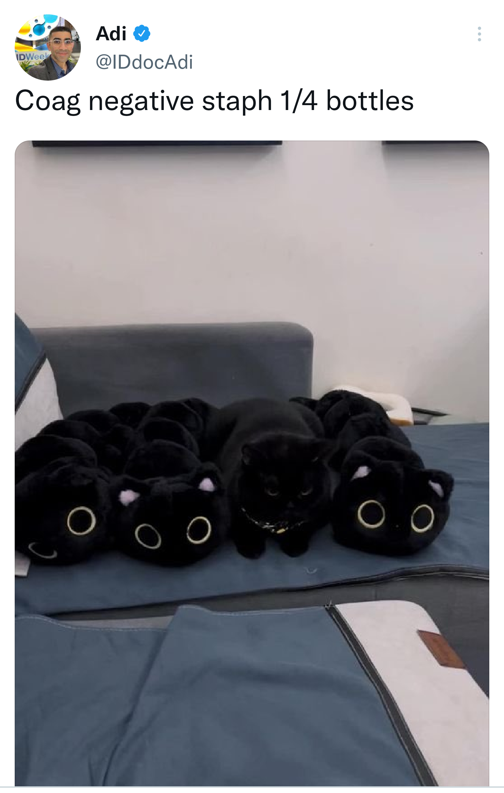
Blood culture contaminants
Possible contamination: skin flora
Especially if only grows in one bottle or one set (1/4 or 2/4)
Especially if 2 bottles but bacteria doesn’t match
Coag-neg Staph, Corynebacteria (“coryneforms”), maybe Bacillus, Lactobacillus
HOWEVER! May be real if there is an implantable device
Prosthetic heart valve, pacemaker/ICD
Hemodialysis catheter,
Central line (CVC), PICC

Slide 25
Blood cultures cont.
What to do when Lab calls with a positive BC:
Obtain repeat blood cultures
Typically start antibiotics empirically unless patient is extremely stable
Gram-positive cocci → vancomycin
Gram-negative bacilli → ceftriaxone, cefepime, etc
FIND THE SOURCE, DRAIN THE PUS

Slide 26
Help! I don’t recognize this bacteria!
Notes:
B, DT 8469

Slide 27
Procalcitonin
Procalcitonin is a host-response marker: upregulated in host epithelial cells that encounter bacterial pathogens
Can differentiate between bacterial and viral infections
Decreases when bacterial infection is controlled
May be falsely elevated in CKD/ESRD
When negative, can be used to support discontinuing/not starting antibiotics
<0.5 or <0.25

Slide 28
MRSA nares
Culture or PCR to detect MRSA colonization in nares
Obtained on admission or ward change per hospital policy
At VA: MRSA+ → contact precautions
Negative for MRSA has a high NPV for infections caused by MRSA
Can discontinue empiric vancomycin in most cases
Positive for MRSA does NOT have a high PPV for infections caused by MRSA

Slide 30
De-escalation

Slide 31
Ok to narrow gradually as patient improves and infections ruled out
However, the more times you change antibiotics, the greater the risk of C.diff

Slide 32
When to de-escalate?
MRSA nares negative – can drop empiric vancomycin
Culture and susceptibility resulted – or negative
Staph aureus and Pseudomonas will always grow easily
Alternative diagnosis made? Just stop abx
Clinically stabilized
Symptoms improved

Slide 33
How to de-escalate
Just stop – duration already reached
Determine what further duration needed
PO vs. IV
Indications for IV
No oral option based on susceptibilities
Staph aureus bacteremia (most cases)
Endocarditis – sometimes
Osteomyelitis - sometimes

Slide 34
Preparing for OPAT
OPAT = outpatient parenteral antimicrobial therapy
Patient disposition – home or SNF?
Substance use/injection drug use?
Help at home?
Physical/mental ability to administer IV antibiotics
Convenient antibiotic dosing
Placement of PICC or midline
ID places orders, case manager works with home infusion company

Slide 35
Example Case 1
A 70yo vet presents from AZ vets home with altered mental status. Found to have a fever, leukocytosis, hypotension, and hypoxia. He was found to have bilateral fluffy pulmonary infilrates, urinary retention and wounds on his legs that look red. He also has a port for chemotherapy for lung cancer and an ICD.
Possible sources of infection?
What empiric antibiotics would you start?
What workup would you order?

Slide 36
Case 1 cont.
Acute exac. Heart failure – explains pulmonary infiltrates
Urine culture: Klebsiella pneumoniae, >100,000 cfu with UA c/w infection
Blood cultures: Klebsiella pneumoniae
Sputum culture: mixed flora
TTE: no vegetations on ICD
Can you narrow antibiotics?

Slide 37
Case 1 cont.
He rapidly improves over 48 hours. On day 4, he’s ready for discharge and susceptibilities are back. What would you send him out on?

Slide 38
Example case 2
A 60yo lady presents with chills, body aches and abdominal and back pain. She has a history of ADPKD on dialysis: previously on hemodialysis via a RUE AV graft, recently switched to peritoneal dialysis due to graft dysfunction. She has a long history of kidney cyst infections. She is found to have fever, leukocytosis. She still makes urine, no urinary symptoms. CT showed large stool burden and possible right kidney fat stranding.
Possible sources of infection?
Empiric antibiotics?
Workup?

Slide 39
Case 2 cont.
Blood cultures: MRSA
Urine culture: E. faecalis, 10k cfu, UA with microscopic hematuria only
Peritoneal fluid culture is negative
Narrow antibiotics?
How to find the source of MRSA?

Slide 40
Case 2
Ultrasound shows thrombosed AV graft
Vascular surgery consulted, removes graft
Tissue cultures from graft grow MRSA
TTE shows a vegetation on the mitral valve
Repeat blood cultures are negative
Antibiotic plan?

Slide 41
Housekeeping & Resources

Slide 42
Restricted antibiotics – need ID consult or specific situation to prescribe
VA
Carbapenems
Linezolid
Daptomycin
Ceftaroline
Posa, vori, isavuconazole
Fidaxomicin
Banner
Carbapenems
Linezolid
Daptomycin
Ceftaroline
Aztreonam
Posa, vori, isavuconazole
Colistin/polymyxin B
Micafungin
Fidaxomicin
Fosfomycin

Slide 43
Indications for ID consult
Essentially mandatory: Staph aureus bacteremia (MSSA or MRSA), Enterococcus bacteremia, Candidemia
Other GPC bacteremia not mandatory but happy to help
Invasive infections: meningitis, septic arthritis, intra-abdominal infections, spinal infections, complicated SSTI
Immunocompromised patient (transplant, chemotherapy, biologics): consult earlier
Multi-drug resistant organism, difficult antibiotic choice
Possible need for home IV antibiotics
Other questions

Slide 44
ID consult suggested/recommended at Banner

Slide 45
How to call a consult to ID
I’m ___ and we have a consult for you. Is this a good time?
The reason for consult is: ____
This is a Xyo man with [RELEVANT pmh], presented for [symptom], found to have ____, [brief hospital course]. On [SPECIFC antibiotics]. Our question is: ______
Example: The reason for consult is septic arthritis.
This is a 60yo man with RA on Humira, presented for left knee pain, found to have sepsis and a red hot knee, underwent arthrocentesis by Ortho, BC growing S. aureus, synovial fluid with >50k WBCs and GPCs, he is on vancomycin. Ortho is taking to OR tomorrow for washout. Our question is how can we optimize the antibiotic therapy?

Slide 46
Resources
Antibiogram – institution specific
VA’s empiric antibiotic guidelines
IDSA Guidelines
Sanford Guide – in CPRS, Tools → Clinical Resources → Sanford guide
Up-to-Date: has full drug package insert with dosing information, renal dosing, adverse effects, etc

Slide 47
Example antibiogram

Slide 48
At Banner - BANNERCONNECT
Clinical → Providers → Physician portal → Antibiograms → choose our site
Additional resources at “Antimicrobial Stewardship Resources for Providers” link
Recs for empiric abx, duration, restricted abx, etc
Guidelines for various scenarios
Use Powerplans to order antibiotics because it will guide you with correct dosing and duration

Slide 49
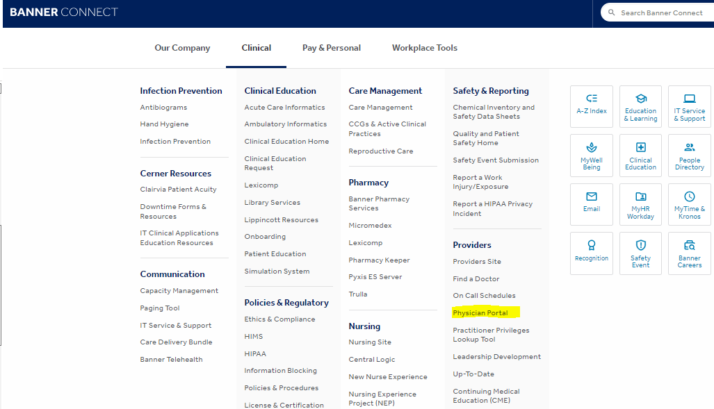

Slide 50
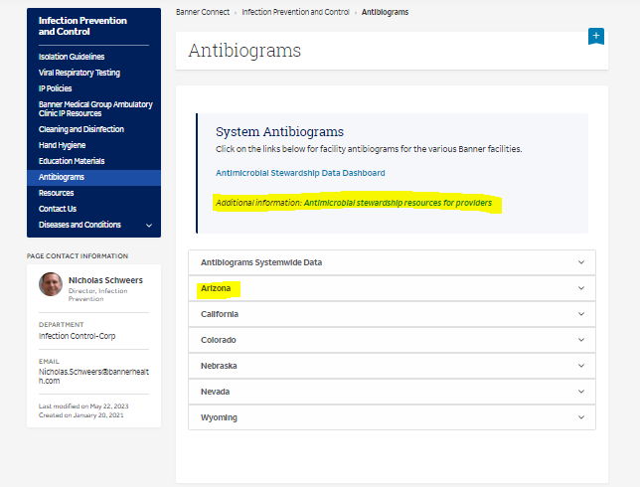

Slide 51
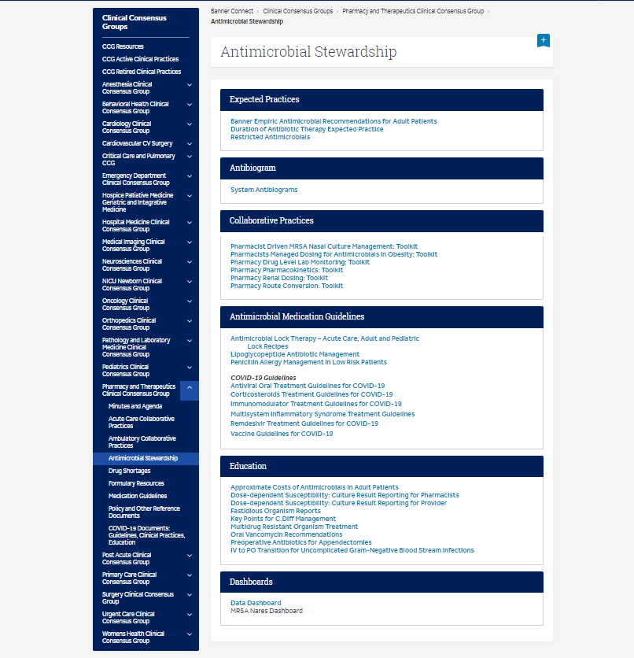

Slide 52
Key points
Ok to use broad spectrum antibiotics when patients are sick, but within reason, based on the likely diagnosis(es)
Find the source of infection
Narrow when able based on susceptibilities or other tests
Consider antibiotic penetration to body site, comorbidities, possible side effects
Switch to PO when able; shortest duration possible

Slide 53
Answers to Case 1
Possible sources: pneumonia, UTI (retention), leg wounds, port
Significant healthcare exposure
Empiric antibiotics: vancomycin (skin, wounds, devices) and cefepime (pneumonia, UTI)
Workup: blood cultures, UA and urine culture, sputum culture, echo, wound care evaluation
Deescalation: can discontinue vancomycin
Discharge: PO levo/cipro, PO TMP-SMX

Slide 54
Answers to Case 2
Possible sources: PD catheter/peritonitis (abdominal pain), renal cyst infection (back pain, fat stranding), graft infection
Extensive health care exposure
Empiric abx: vancomycin for skin (PD catheter, vascular graft), cefepime (peritonitis, renal cyst infection)
Workup: blood cultures, UA and urine culture, peritoneal fluid culture
De-escalation: can discontinue cefepime. E. faecalis is likely colonization, but vancomycin will cover it as well as MRSA
Further workup: Imaging of graft, echo
Antibiotic plan: needs 6 weeks of vancomycin or daptomycin for endocarditis

