Slide 1
Introduction to ILD
Sally Suliman, MD
Associate Professor of Medicine
Director of Pulmonary Fibrosis

Slide 2
Objectives
Basic anatomy
Approach to evaluating ILD
Importance of imaging
Brief overview of common ILDs
Treatments
summary

Slide 3
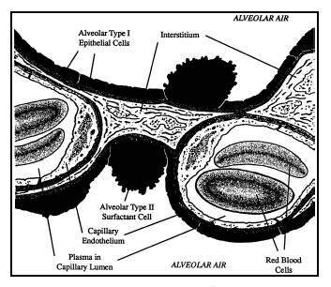
What Is The Interstitium and What Happens There
Notes:
The interstitial space is made up of the alveolar epithelium, the capillaries, and supporting protein matrix structures.
A common basement membrane is shared by both the epithelium and capillary endothelium.
Composed of fibroblasts, macrophages, capillaries
Provides structural support
Gas exchange-Type 1
Type 2 surfactant
Immune defense
Fluid regulation
misnomer-Vascular involvement-PH, airway involvement- BOOP
Damage to the fine alveolar structures involved in gas exchange DOE primary complaint

Slide 4
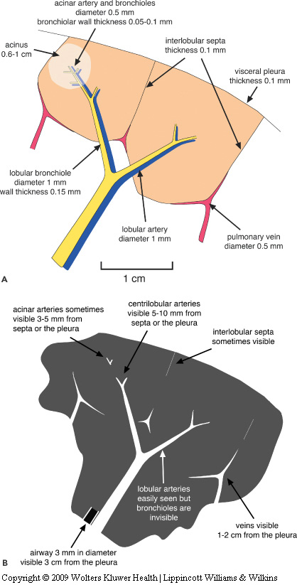
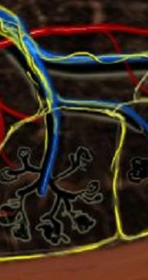
Secondary lobule
Smallest lung unit surrounded by connective tissue
Basic anatomic unit
Interlobular septa and subpleural interstitium
Centrilobular structures
Notes:
Various diseases that affect the interstitium, e.g. ILDs, pulmonary edema, cancer etc

Slide 5

What are the ILDs?

Slide 6
A diverse group of pulmonary disorders classified based on similar clinical, radiographic, physiologic, or pathologic manifestations
The major abnormality in ILD is disruption of the distal lung parenchyma.
also affect airways, blood vessels, and pleural in addition to the parenchyma- making terminology confusing
Excludes emphysema, RADs, and pulmonary vascular disease

Slide 7
Pathophysiology
The pathogenesis of the majority of ILD remains unknown
Generally agreed that some injury to the alveolar epithelial cells initiates an inflammatory response, which leads to fibrosis and structural changes
Injury can be introduced through the airways- via inhalation, or the circulation

Slide 8
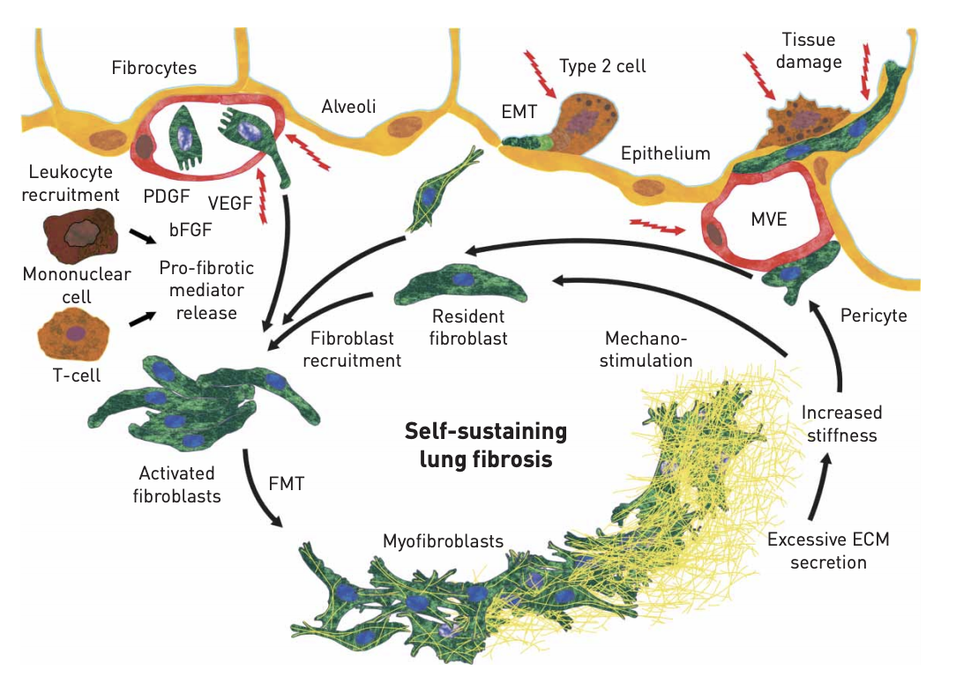
Pathogenesis of Pulmonary Fibrosis.
Notes:
Risk factors such as aging, tobacco smoking, occupational exposures, genetic background increase a persons risk of developing pulmonary fibrosis following repeated injury to the alveolar cell,
The early phase of pathway, is disease-specific, can consist of lymphocyte activation and exaggerated immune response in CTD-ILD, or chronic granulomatous inflammation in (sarcoid/HP)
Due to repeated injury and inflammation, fibroblasts are activated by profibrotic cytokines and then proliferate and differentiate into myofibroblasts
These migrate to the alveolar interstitium leading to fibroblastic foci
The final common pathway is thought to be shared by all conditions, regardless of the initial cause or trigger, and consists of extracellular matrix production by fibroblasts, leading to lung tissue remodeling and subpleural microscopic honeycombing
This is a self perpetuating process

Slide 9
An Overview
Over 300 distinct ILDs
IIPs distinct entities most commonly identified clinically
IPF most common IIP’s
Notes:
not every ILD is IPF
Idiopathic- not sarcoid, asbestosis, or HP

Slide 10
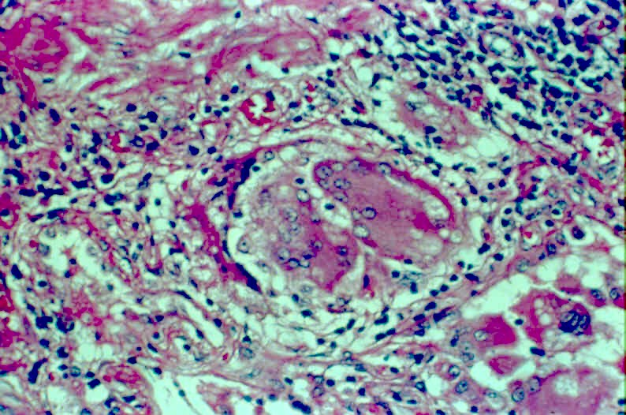
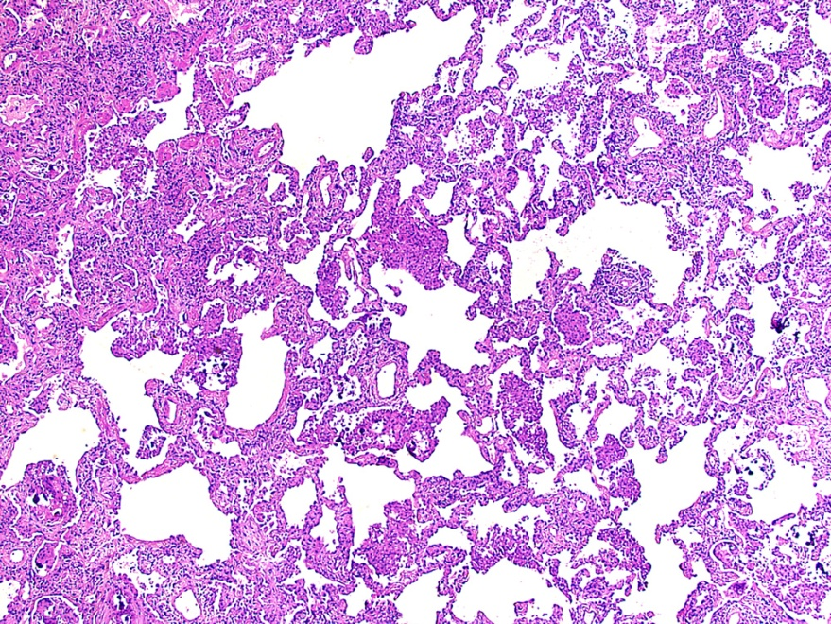
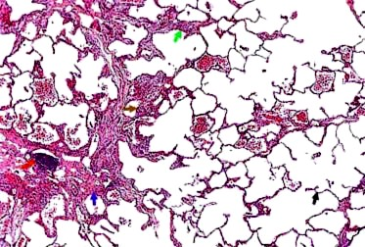
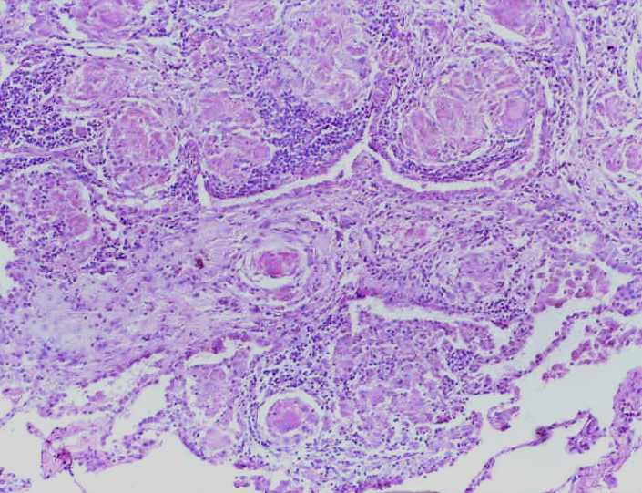
Alternative Classification
Sarcoidosis
Hypersensitivity
Pneumonitis
Granulomatous
Known
Unknown
Idiopathic Interstitial
Pneumonias
Collagen-Vascular
Diseases
Non-granulomatous

Slide 11
Typical symptoms
Shortness of Breath
Dyspnea on exertion
Dyspnea at rest
tachypnea
Cough - Typically nonproductive
Fever is not a primary finding in ILD
Crackles or “dry rales” with inspiration
Symptoms and signs of right heart failure

Slide 12
Diagnostics/Testing
Imaging
Physiological testing- PFTs
Biopsy

Slide 13
IMAGING

Slide 14
HRCT
DIAGNOSTIC IMAGING OF CHOICE
Usually performed at full inspiration, allowing maximal contrast between the inflated lung and diseased areas.
Full expiration to detect air trapping
prone and supine scans to unmask interstitial abnormalities in the dependent lung.
Accuracy increases for end-stage disease

Slide 15
Structured approach
What is the dominant CT pattern?
Reticular
Nodular
Cystic
Airspace disease
Ground Glass Opacities
Dense consolidation
Mosaic Attenuation

Slide 16
Idiopathic Pulmonary Fibrosis
Notes:
Focus on IPF- most common, carries poorest prognosis and really where the importance of MDD comes into play

Slide 17
Idiopathic Pulmonary Fibrosis
Clinical-Radiographic- histopathological diagnosis
History and physical exam
> 50 years old
Gender ???
Progressive dyspnea > 3 months
Over 70% are ex-smokers or exposed to tobacco
Imaging- ??
Physiological testing
Notes:
We will be seeing more of these pts as our general population continues to live longer- increase aging. See more referrals from other clinics
Increase hospitalizations, with 20% not making it home- SNIF, LTAC

Slide 18
Definite UIP on HRCT
UIP Pattern
  Basilar, sometimes diffuse, subpleural distribution
  Reticulations dominate
  Traction Bronchiectasis
  Honeycombing
  Heterogenous pattern
Atypical features:
  Upper/mid lung predominant
  Peribronchovascular, subpleural sparing
  Consolidations or extensive GGO
  Mosaic attenuation
  Diffuse Nodules/Cysts
Notes:
UIP is Observed in IPF, RA-ILD, and advanced disease (any)

Slide 19
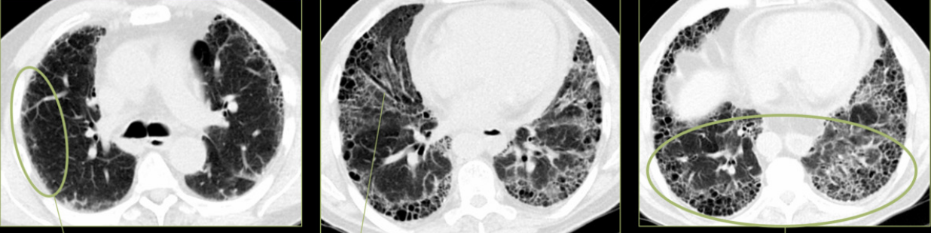
Imaging-HRCT UIP Pattern
Reticular opacities
Traction
Subpleural,
Honeycombing

Slide 20
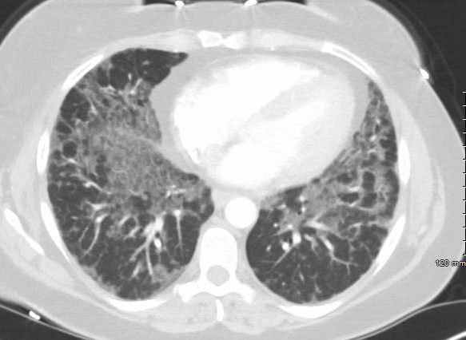
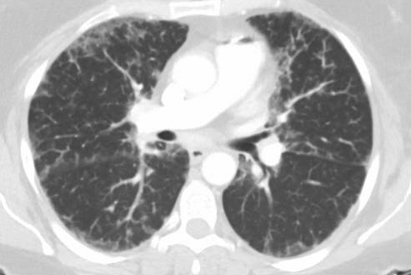
Alternative Diagnosis

Slide 21
HP
UIP
NSIP
RBILD/DIP
LIP
Notes:
NSIP- homogenous, GGO, subpleural sparing,
DIP- lower lobe, some thing wall cystic involvement,
HP air trapping, moasaic attenuation, small nodules
Peripheral: BOOP/COP, Eosinophilic pneumonia
Upper Zone:, Sarcoidosis, PCLC, CHP, Infections-TB, Silicosis, RA-ILD, Radiation
Lower Zone: IPF, RA-UIP

Slide 22
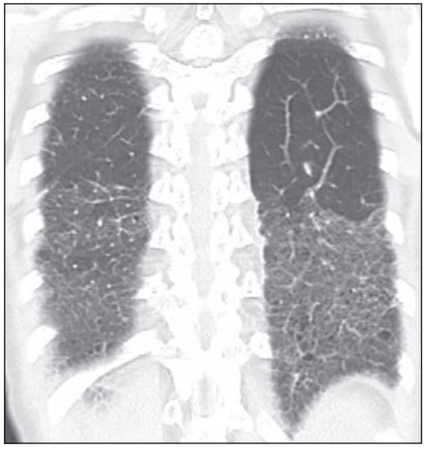
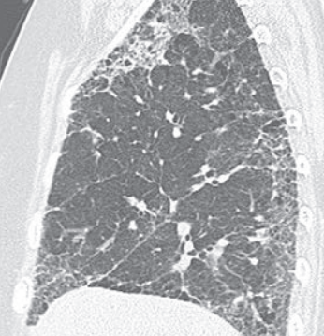
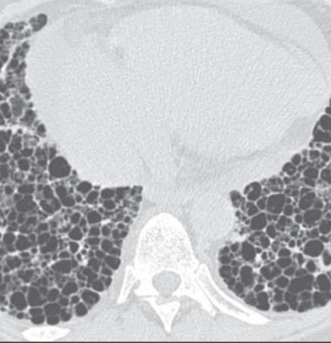
Other Causes of UIP
Straight edge sign
Anterior Upper lobe sign
Exuberant honeycombing
Chung et al. AJR Am J Roentgenol. 2018.

Slide 23
Physiological Testing
PFTs:
  Not diagnostic.
  Help evaluate impairment and follow the disease over time
6MWT: a valid and useful test to provide functional and near-term prognosis data
Serology– ANA etc
Biomarkers- serum
Notes:
CHF, chest wall disease, effusions

Slide 24

To Biopsy or Not To Biopsy- That is the Question?
Notes:
PFF CCN
Risk and benefits
will it change your clinical management

Slide 25
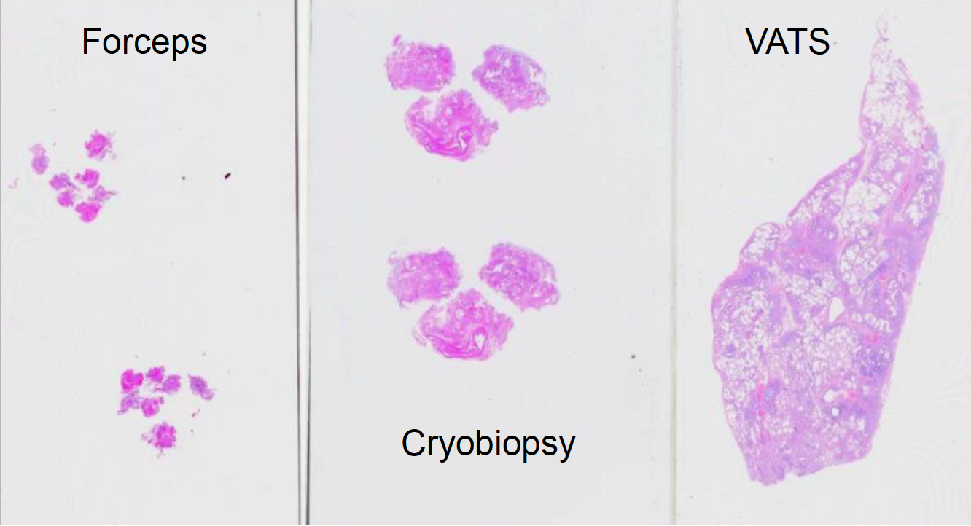
Size of Lung Biopsy Specimens
Notes:
Many of these diseases are heterogenous so need large enough samples to capture the pathology
Crush artifact, location

Slide 26
 | TBBX | SLB
Granulomatous diseases | Yes | Yes
Tumors | Yes
DAD | Yes
Infections | Yes
Alveolar proteinosis | Yes
Eosinophilic pneumonia | Yes
Vasculitis | Maybe
Amyloidosis | Maybe
PLCH | Maybe
LAM | Maybe
RB/RBILD/DIP | No
UIP/NSIP/LIP/OP | No
Small airway disease | No
PAH/PVOD | No
Leslie: Chest 2005

Slide 27
Cryobiopsy??
COLDICE- 2020
COLD study 2024
COLD-ICE Comparative multicenter prospective study to evaluate diagnostic agreement between TBLC and VATs
Favored SLB as the gold standard
COLD Study: start with Cryobiopsy → SLB if needed
Fewer adverse events with similar diagnostic yield
Notes:
COLDICE : showed high level of concordance between SLB and Cryo following MDD- safer future option
COLD primary endpoint looked at procedure risk, with yield as 2nd end point

Slide 28
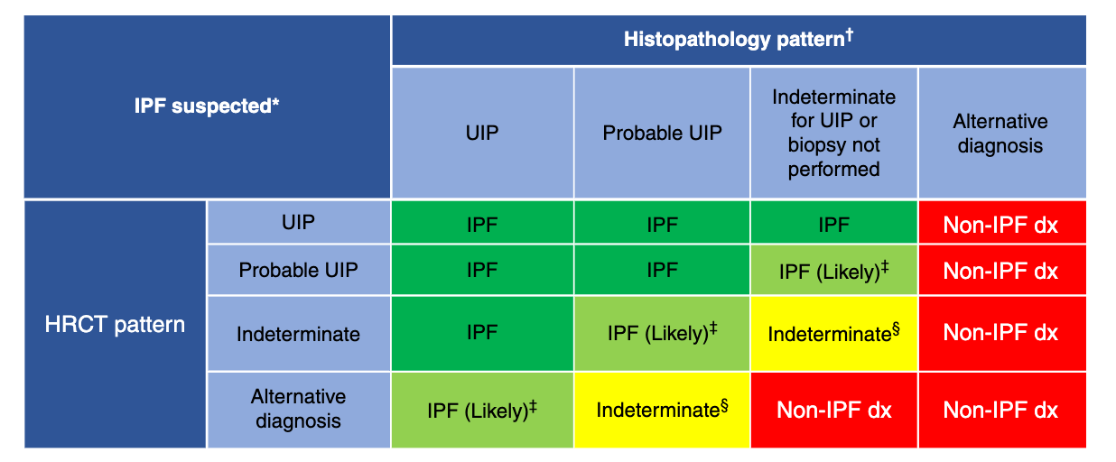
Raghu et al. Am J Respir Crit Care Med. 2022

Slide 29

IPF TREATMENT

Slide 30
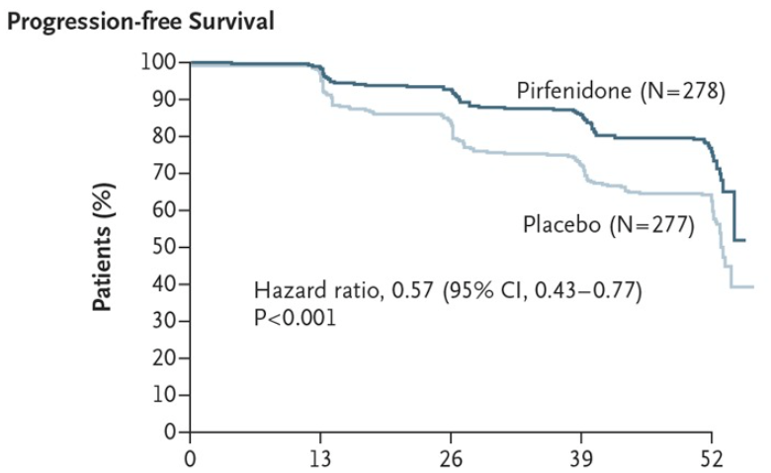
Ascend Trial 2014
(Pirfenidone)
Inhibits TGF-B, PDGF, AND TNF- a?
Phase 3 RCT double blinded
Reduction in number of pts who had a decline of 10% or more on FVC or those who died
Reduced decline in 6MWT
Shown to reduce respiratory related hospitalizations
Possibly reduces exacerbation when combined with steroids and Recombinant human thrombomodulin?
King et al. N Engl J Med. 2014
Notes:
555 pts
Decreased progression,
? Death
Following CAPACITY
No difference inf SOB questionnaire

Slide 31
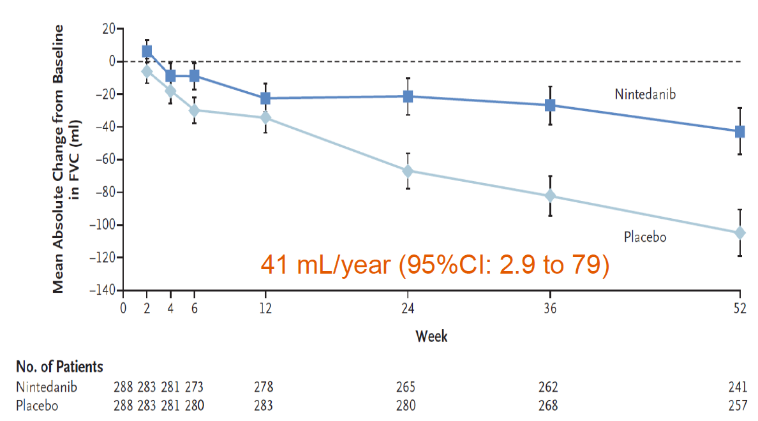
Inpulsis Trial (Nintedanib)
Published 2014
Nintedanib at 150mg BID treatment
Inhibits tyrosine kinase, targets growth factors
Reduced rate of decline in FVC vs placebo
Improvement in time to first exacerbation
Collard et al. N Engl J Med. 2014

Slide 32
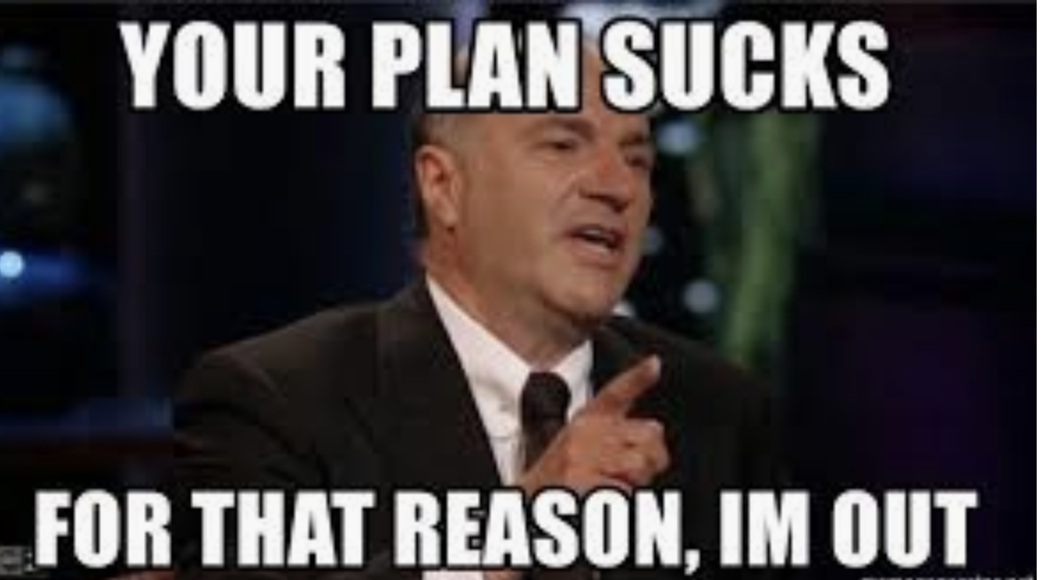

Slide 33
“Recent ” Advances
INBUILD trial: NEJM 2019
  Nintedanib 150 mg BID vs placebo
  Overall, fibrosis pts vs UIP-like pattern
  Reduction in the decline of FVC
SENSCIS NEJM 2019
  576 pts enrolled, SSc-associated ILD
  Stable dose of Mycophenolate or Methotrexate
  Reduction in the decline of FVC
  No changes to other systemic sclerosis symptoms

Slide 34
Fibroneer-IPF
Name: Nerandomilast (Jascayd)
What is the MOA??
Now approved for 18mg Q12hours as solo or add-on therapy for IPF
9mg dose available for side effects/combination with pirfenidone
No drug monitoring
RCI: eGFR <15mL, and in severe hepatic impairment
Notes:
PDE4B ihibitor

Slide 35
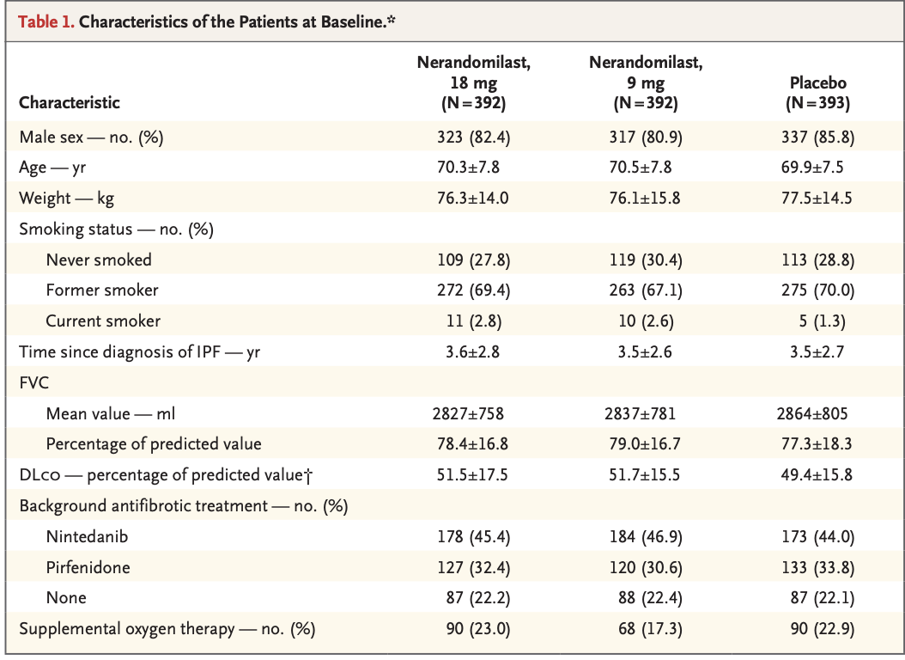
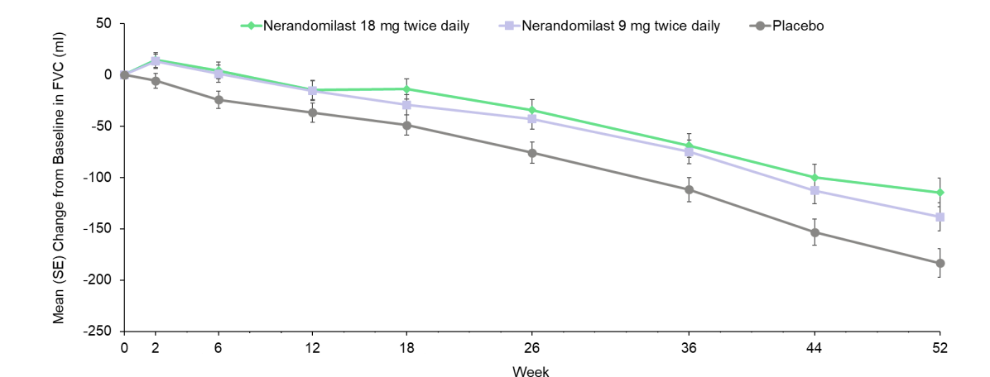

Slide 36
Acute Exacerbations of IPF
Unexplained worsening of symptoms and lung function within 30 days + new infiltrates in HRCT
Occurs in 5-10% of pts
More common in advanced disease, smokers, LTOT, GERD, post intervention and PH
Post exacerbation survival is 3-4 months
Treatment is supportive care, high dose steroids/Immunosuppressive therapy and antibiotics- no data
No role for bronchoscopy in most cases

Slide 37
Prognosis
3-5 years
But…….be mindful

Slide 38
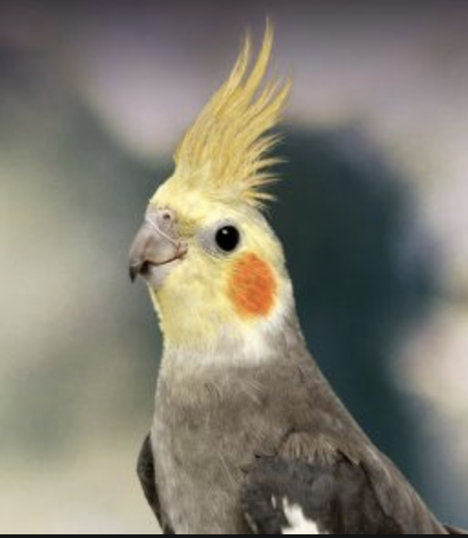
HYPERSENSITIVITY PNEUMONITIS

Slide 39
Introduction/Definition
New 2020 guidelines definition: HP is an inflammatory and or fibrotic disease affecting lung parenchyma and small airways.
1
Caused by the sensitization to an “inhaled” antigen- usually after repeated exposure
2
“Extrinsic allergic alveolitis”
3

Slide 40
Current Classification
New classification proposed by ATS/ERS in 2020
Based primarily on imaging (HRCT) characteristics
Current classification
Non-fibrotic HP (NFHP)
Fibrotic HP (FHP)

Slide 41
Sings and Symptoms
Dyspnea
Cough
Constitutional symptoms- weight loss, chills, low grade fevers, malaise
Chest tightness and wheezing
Symptoms may develop over days to months to years
Inspiratory squeaks are characteristic
Pts may stabilize, or progress to resp failure and death

Slide 42
Inciting Agents/Risk Factors
Birds
Painters/Glue
Humidifiers
Automobile-polyurethan
Woodwork
lifeguards

Slide 43
Imaging
GGO
Mosaic attenuation
Air trapping
3-Density sign

Slide 44
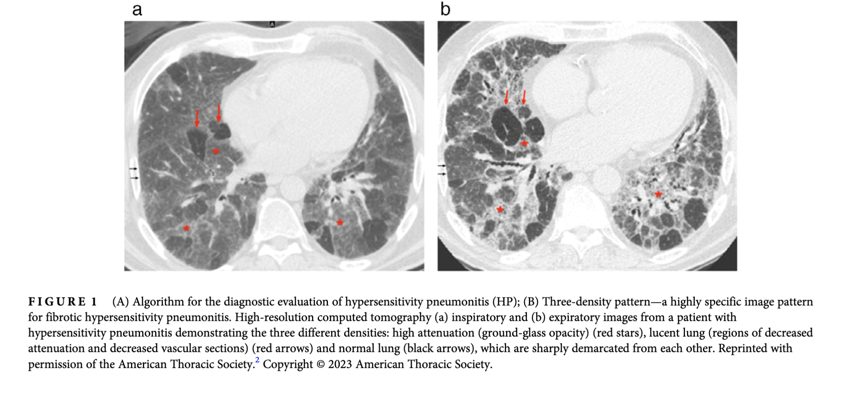

Slide 45
Role of bronchoscopy -BAL and Cellular Analysis
One of the most sensitive tools to detect alveolitis in HP
Preferably done when pt in “acute "phase
Typical pattern is marked lymphocytosis often > 30% in NFHP
CD4/CD8 controversial
Less marked elevation in FHP or following treatment (increased neutrophil) poor prognostic sign

Slide 46
Bronchoscopy
CELL TYPE | HEALTHY | UIP/IPF | NSIP | HP | AEP | OP
MACROPHAGES | 80%
LYMPHOCYTES | 15% | ↑ | ↑↑ | >50%↑↑↑ |  | ↑↑ 20%
NEUTROPHILS | 3% | ↑↑-PROGNOSIS |  | ↑ |  | ↑
EOSINOPHILS | 0.5% | ↑ |  | ↑ | >25% | ↑ 2-25%
MAST CELLS | 0.5% |  |  | ↑ |  | ↑
CD4/CD8 |  |  |  | REDUCED |  | REDUCED

Slide 47
Histopathology
NFHP
Airway centric – bronchiolocentric
Lymphocyte predominance
Poorly formed granulomas
FHP
Chronic fibrosing interstitial pneumonia with fibrotic NSIP/UIP pattern
Fibroblastic foci, peribronchial metaplasia
Airway centric fibrosis
Poorly formed granulomas

Slide 48
Management and Prognosis
Prednisone 0.5/1mg/kg/d for up to 8 weeks followed by slow taper
Immunomodulating agents:
AZA, MMF- improve gas exchange (DLCO)and reduces steroid use, not FVC
INBUILD trial
Rituximab
Treat for 1 year and re-evaluate- wean medications
Approx 25% of pts die within 5 years of diagnosis

Slide 49
NSIP

Slide 50
NSIP
Homogenous alveolar wall thickening and underlying inflammation/fibrosis
Prognosis is substantially better than that of UIP/IPF
More commonly seen in females, younger
Subtypes include cellular- greater inflammatory cells, and better prognosis (uncommon) vs fibrotic

Slide 51
NSIP on imaging
Most widely contested findings
Peripheral and lower lobe findings
GGO most common finding
reticular pattern
Traction Bronchiectasis is rare
Unusual to have honeycombing –consider UIP
Subpleural sparing

Slide 52
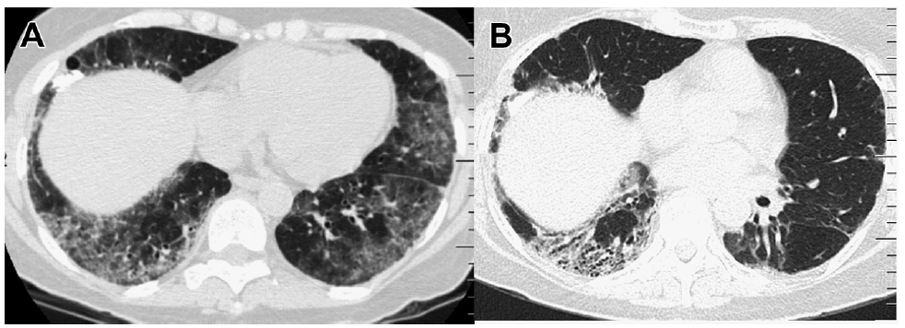
Left: Cellular NSIP- subpleural sparing
Right: fibrotic NSIP- peribronchavscular opacity and traction BE

Slide 53
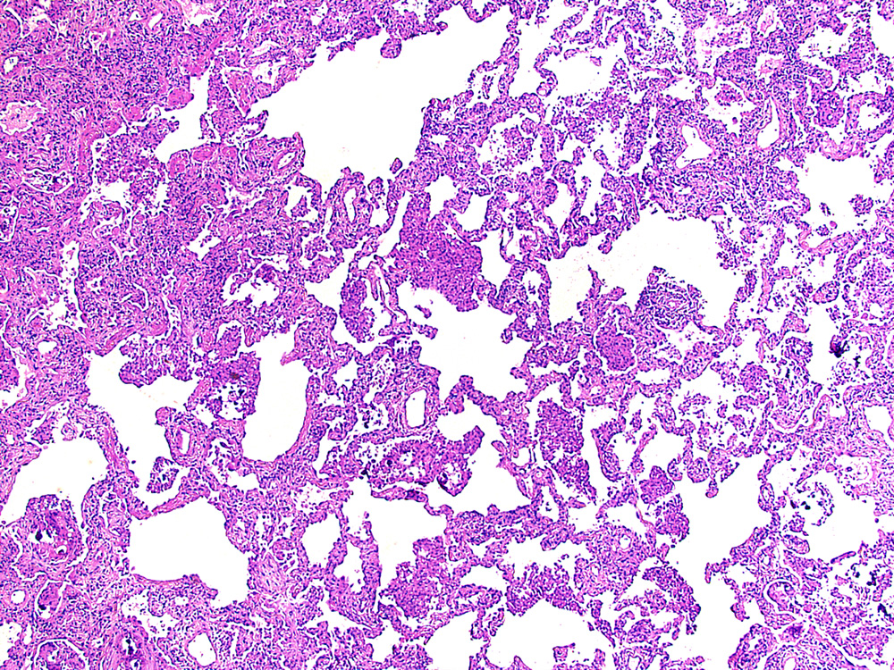
NSIP on pathology- dense inflammatory cells

Slide 54
Findings may be reversible and are typically steroid responsive
Most cases remain unchanged or progress
Associated with CTD, HP, drug induced lung injury

Slide 55
Summary and Future Directions
Suspect the disease early- refer to specialist centers/ MDD
Treat and manage comorbidities- PH/OSA
Antifibrotic therapies work in IPF
Antifibrotics may work in non-IPF disorders
Biomarkers' future directions, blood and breath, etc
Must still distinguish IPF/UIP from other forms
Transplant referral
End of life discussions/ Managing expectations

Slide 56
Don’t Forget The Simple Stuff
Smoking cessation, GERD
Avoid exposure to offending agents,
Vaccinations
Cough treatments- OTC----morphine
Pulmonary rehab
Oxygen supplementation
Depression/sleep disorders/co-morbidities (PH)
Transplant referral
Notes:
Too much misdiagnosis
Cough usually main problem pts desire to have fixed. Social implications.
PH- we know increases mortality
Transplant- limited access for pts so refer early

Slide 57

QUESTIONS

