Slide 1
HYPERTENSION
Academic Half Day
October 7, 2025
Katharine Dahl, MD
Arizona Kidney Disease & Hypertension Center
kdahl1@arizona.edu

Slide 2
Learning Objectives
Understand the importance of standardized office BP measurements with preference for using automated, validated oscillometric devices (as opposed to routine office BP measurements) and the use of ambulatory or home BP monitoring to complement standardized office BP readings in the management of HTN.
Define normal blood pressure, stage 1 hypertension, and stage 2 hypertension, and know when to initiate pharmacological treatment for hypertension based on various guidelines (KDIGO, ACC/AHA).
Define white coat hypertension, masked hypertension and resistant hypertension.
Describe the initial management of a patient who is diagnosed with hypertension, including lifestyle modifications and medications.
Recognize the flaws and consequences of the use of race-based guidelines in hypertension management.
Describe the patient that should be evaluated for secondary hypertension and know the appropriate evaluation for each condition.
Understand hypertension management in the hospital, including the risks of over-treating hypertension in the hospital as well as guidelines for the treatment of hypertensive emergency.

Slide 3
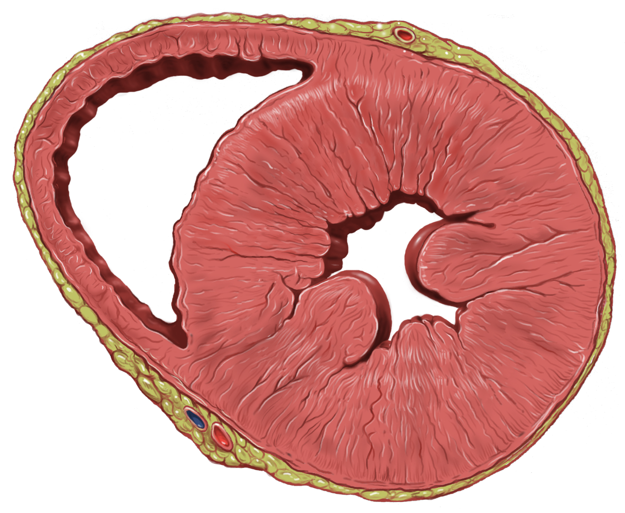
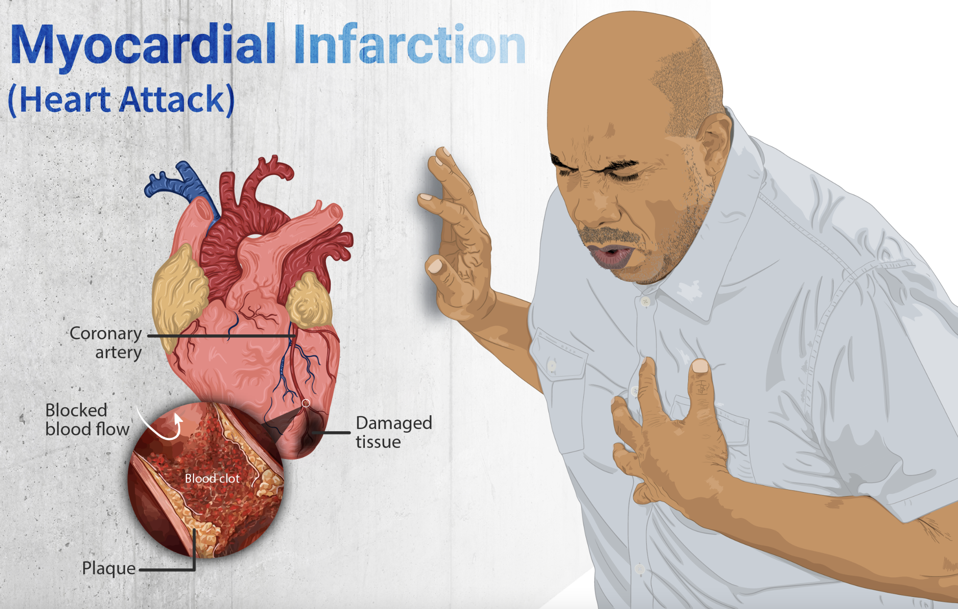
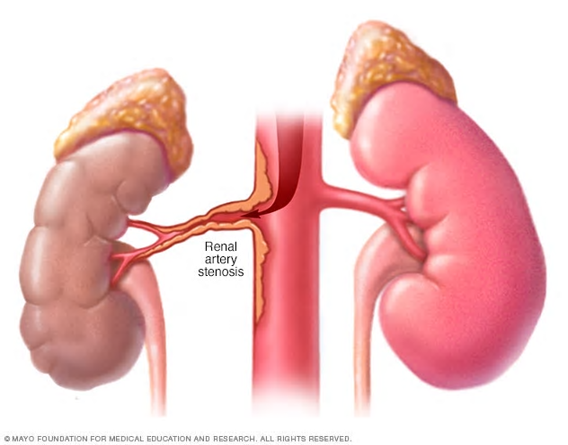
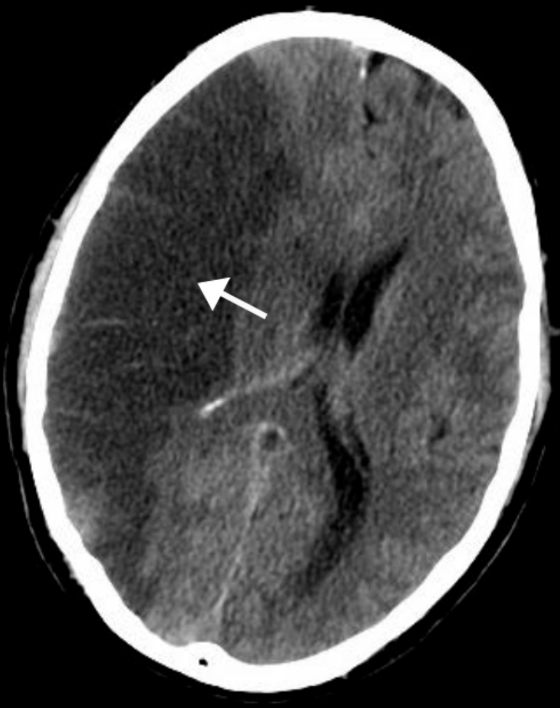
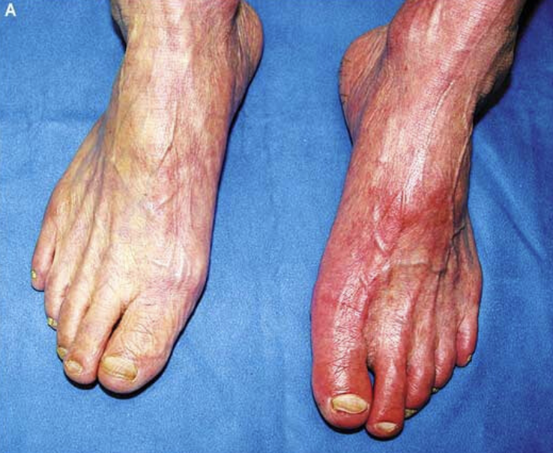
Cardiovascular Consequences of Hypertension
Myocardial hypertrophy
  Diastolic heart failure
Atherosclerosis
  Thrombotic and embolic events
    MI
    Renal artery stenosis
    CVA
    Peripheral arterial disease
Patrick J. Lynch, medical illustrator on Wikppedia
myUpchar via Wikimedia Commons
Gaillard F (11 April 2011). "Ischaemic stroke". radiopaedia.org.
Ho-Cheol Kang, M.D., Ph.D., and Min-Young Chung, M.D., Ph.D.N Engl J Med 2007;357: e19

Slide 4
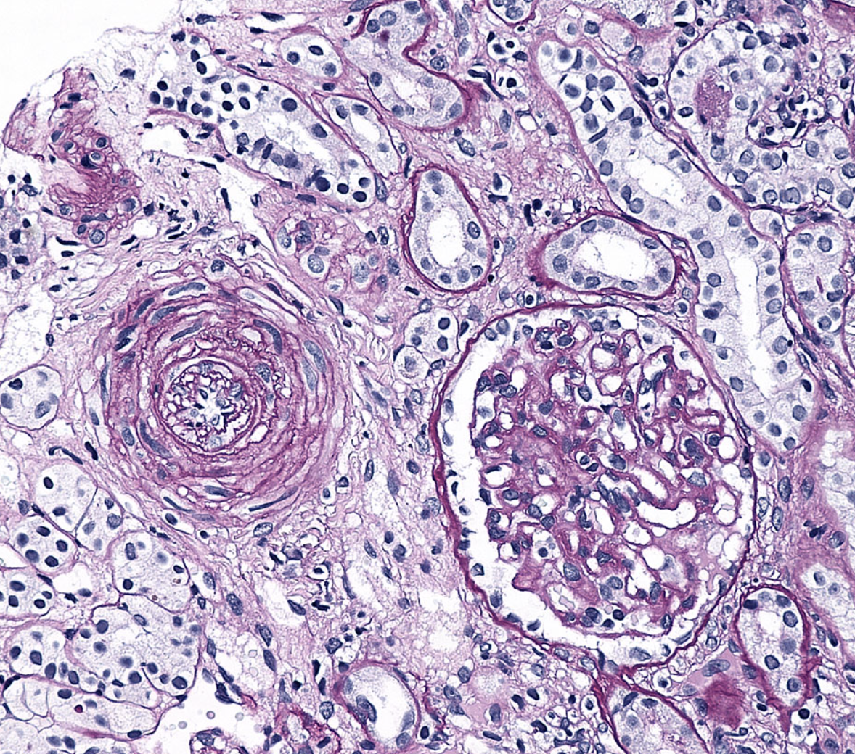
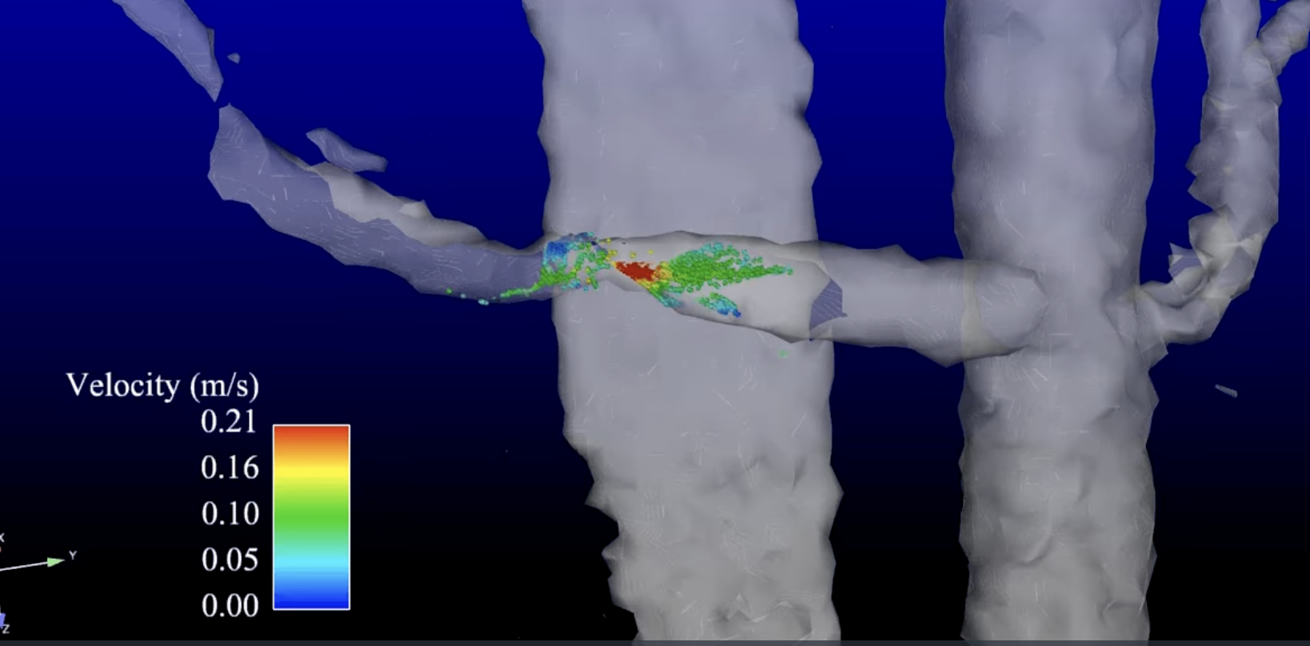
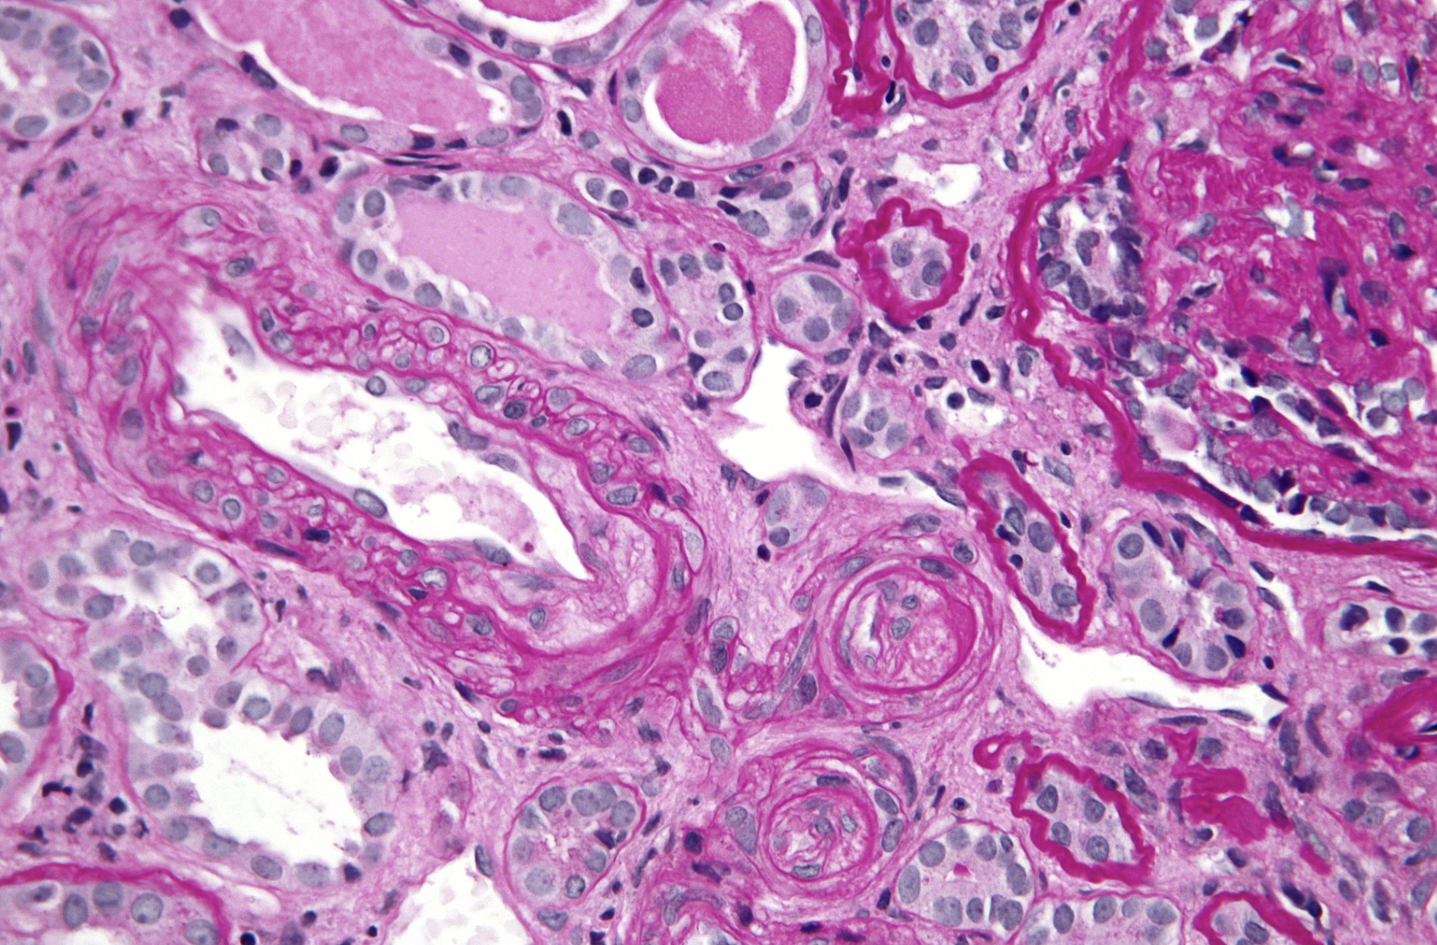
Renal Consequences of Hypertension
Arteriolosclerosis Atherosclerosis Thrombotic microangiopathy
https://commons.wikimedia.org/w/index.php?title=
User:Pacolarosa
Courtesy of PD Dr. Bley, UKE Hamburg.
https://creativecommons.org/licenses/by/2.0/deed.en
Copyright © 2011 Michael Bonert
( https://commons.wikimedia.org/wiki/User:Nephron

Slide 5
Best Way to Check BP:
ACC/AHA 2025 Guideline Changes
  Strong preference for automated, validated oscillometric device AOBP (standardized manual measurement ok but not preferred)
    AOBP more closely correlated with ambulatory BP and with outcomes
  Out of office BP confirmation is now a Class 1A recommendation
  Validated devices: https://www.validatebp.org/devices

Slide 6
Blood Pressure Terms
Normotension: BP <120/80
White Coat Hypertension: BP ≥ 130/90 in the office but <130/90 at home
  Less CV risk than sustained HTN, but more than normotension
  10-15% general population
Masked Hypertension: BP <130/90 in the office but ≥ 130/90 at home
  Similar CV risk to sustained HTN
  10-20% general population
Resistant Hypertension:
  BP ≥ 130/90 despite being on ≥ 3 antihypertensives which include a diuretic
  OR
  BP controlled but requiring ≥ 4 medications
  Approx 5% of adults with HTN (when confirmed with ambulatory or home BP)

Slide 7
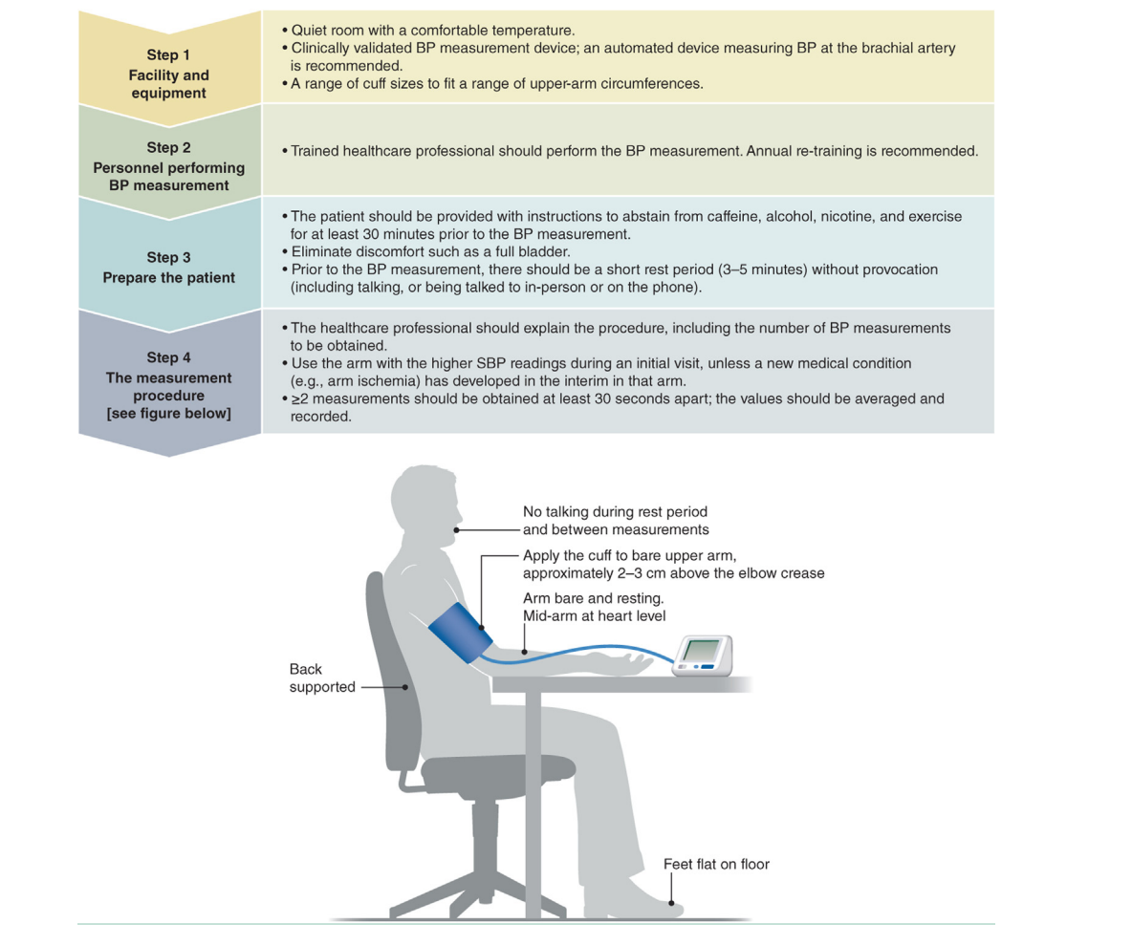
Standardized BP measurements

Slide 8
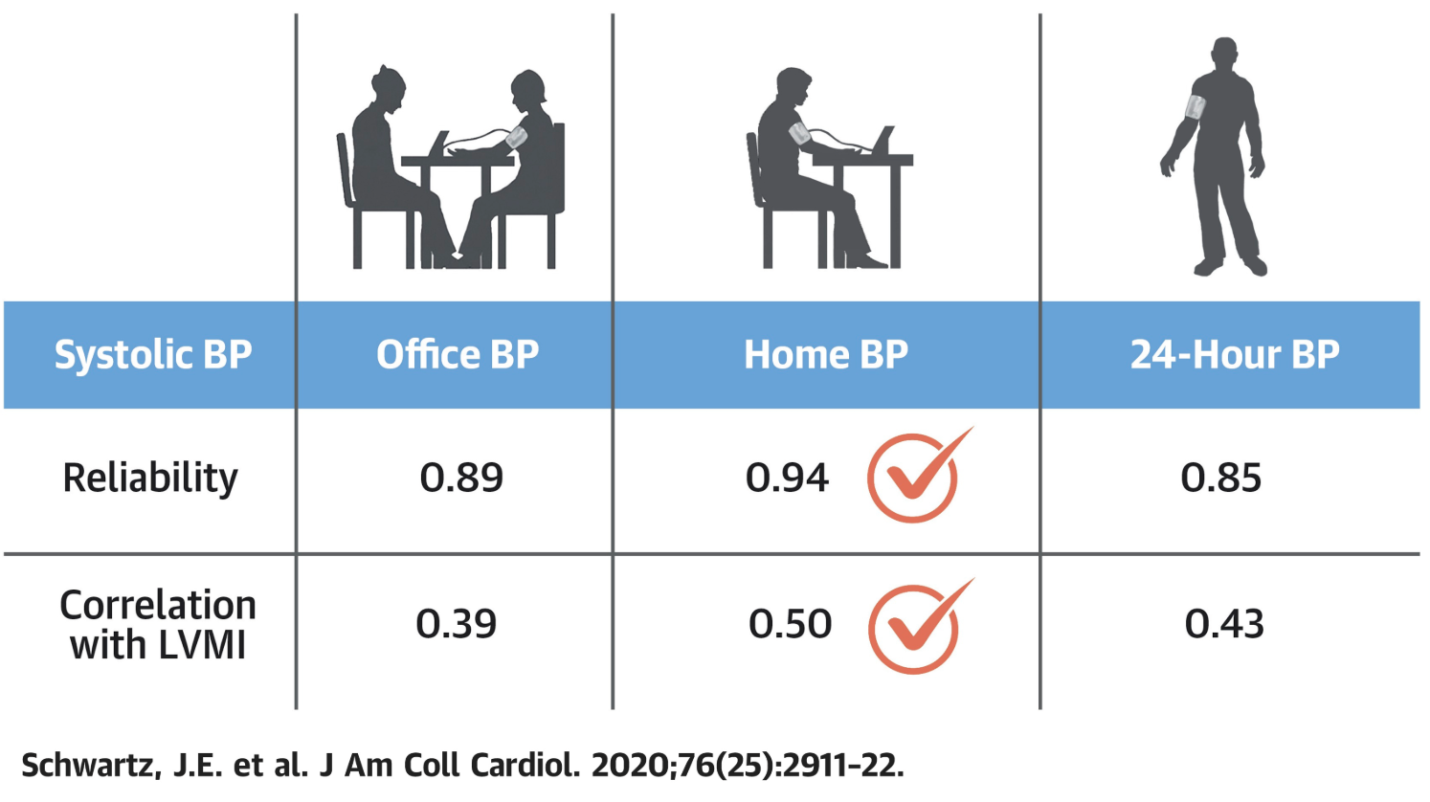
Office vs Ambulatory vs Home BP Measurement
Home BP is more reliable and more correlated with Left Ventricular Mass Index than Ambulatory and Office BP measurements
408 patients
3 Office BP Measurements x 3 visits – each visit with:
mercury sphygmomanometer and stethoscope
clinic-grade oscillometric device
Omron oscillometric device designed for HBPM
3 weeks of Home BP
2 - 24hr ABP recordings
Echo done at the end
Reliability assessed using Intraclass Correlation Coefficient - ICC

Slide 9
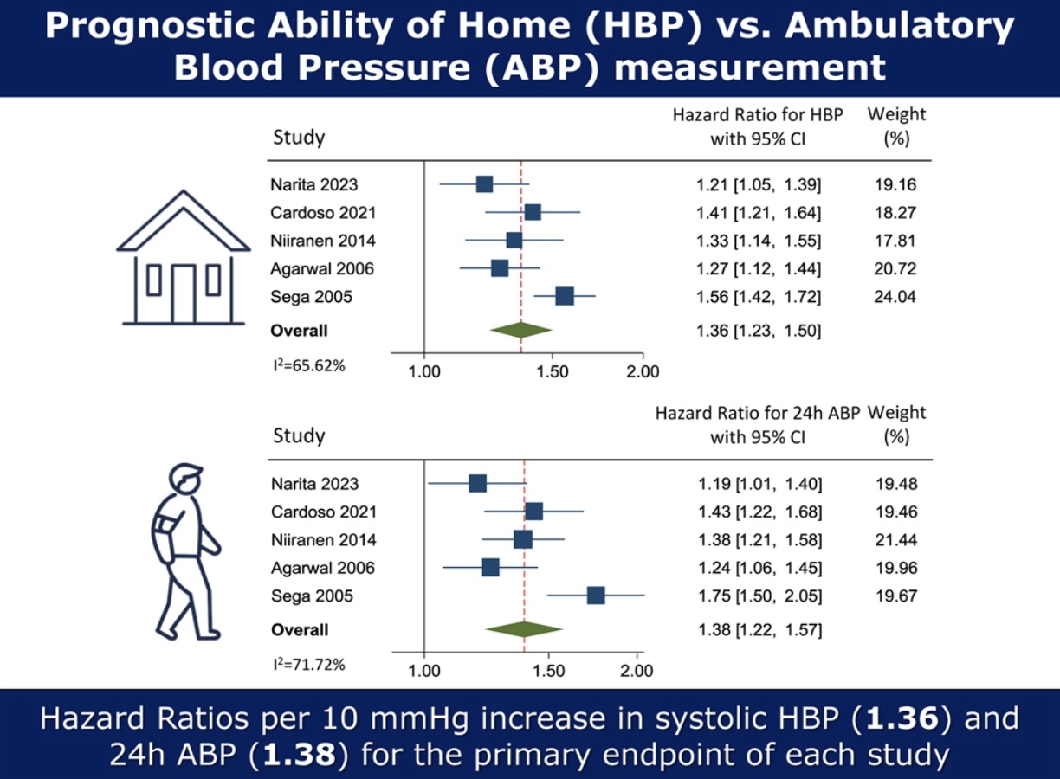
Office vs Ambulatory vs Home BP Measurement
Meta-analysis - HBP and ABP measurements are equivalent in predicting cardiovascular events and superior to OBP measurement
Kollias, Anastasios, et al. Journal of Hypertension 42(3):p 385-392, March 2024.

Slide 10
Definition of Hypertension
KDIGO 2021
ACC/AHA 2017 & 2025
Normal BP: <120/80
Elevated BP: 120-129/80
Stage 1: 130-139/80-89
Stage 2: ≥140/90
HTN: ≥140/90

Slide 11
Risk Factors for Hypertension
Age
Obesity
Family history
Lack of exercise
Lack of sleep
Social determinants of health
Reduced nephron number
High salt diet (>3g/day)

Slide 12
Major Causes of Hypertension
Essential 90%
(no single identifiable cause: combo of genetic, environmental, lifestyle)
Renal disease 3%
Renovascular disease 2%
Medications 2-4%
Primary aldosteronism 2%
Coarctation of the aorta 0.2%
Pheochromocytoma 0.1%
All others 0.5%
Johnson RJ, Feehally J ed. Comprehensive Clinical Nephrology 2nd ed. 2003.

Slide 13
Medications Causing Hypertension
Oral contraceptives
NSAIDs
Antidepressants
Corticosteroids
Decongestants: phenylephrine, pseudoephedrine
Erythropoietin
Calcineurin inhibitors
Stimulants
Atypical antipsychotics
Angiogenesis inhibitors
Tyrosine kinase inhibitors

Slide 14
Treatment of Hypertension
ACC/AHA 2017
KDIGO 2021
ACC/AHA 2025
Stage 1: 130-139/80-89
- Meds if high risk ASCVD 10 year risk >10%
Stage 2: ≥140/≥90
Start meds
- If BP 20/10mm/hg above BP target, 2 first line drugs
Stage 1: BP 130-139/80-89, start meds if high risk:
CVD, CKD, DM present
PREVENT risk model has ≥ 10% cardiac risk in 10 years
Stage 2: BP ≥140/≥90
Start 2 first line drugs
If frail, ≥ 85yrs old, orthostatic hypotension, may relax goals to <140/90 if risk of adverse events is high
SBP <120
Unless frail

Slide 15
Cardiac Risk Stratification
ASCVD Calculator
Outcomes: MI, stroke, CHD death
Age: 40-79
Risk Domains:
  race-based
Long term Risk: 10y
PREVENT risk calculator
Outcomes: MI, stroke, CHD death + heart failure
Age: 30-79
Risk domains:
  not-race based
  kidney health: urine albumin:creatinine ratio (ACR)
  metabolic factors: A1c
  SDOH/SDI: zip code
Long term risk: 10y + 30y

Slide 16
Lifestyle Modifications
Increased exercise
Healthy diet (DASH or Mediterranean-style)
Weight loss
Low sodium diet
Decrease alcohol
Decrease stress

Slide 17
ACC/AHA 2025 Treatment of Hypertension: First Line Drugs
Thiazide & Thiazide-like diuretics – emphasis on thiazide-like diuretics over thiazides
Thus chlorthalidone and indapamide favored over hydrochlorothiazide
  Longer half lives
  Vascular smooth muscle relaxation properties in addition to Na⁺/Cl⁻ cotransporter blockade
ACE-I/ARB – except for pregnant patients, no longer race-based recommendation against ACE-I/ARB as monotherapy
Calcium channel blocker – dihydropyridines (amlodipine, nifedipine ER) favored over non-dihydropyridines (diltiazem, verapamil) unless specific cardiac indication for rate control
Emphasis on combination single pill (but there are no combo pills with indapamide in the US, and the only combo pill with 2 first line drugs including chlorthalidone in the US is azilsartan+chlorthalidone which is very expensive).

Slide 18
KDIGO: Treatment of Hypertension
RAAS Blockade for patients with proteinuria/CKD
ACE-I/ARB
MRA
SGLT2i also recommended in CKD which can lower BP

Slide 19
Race-Based Practice Guidelines: the first 2 guidelines to provide evidence “Grade” or “Class” to each recommendation
2014 JNC 8
Thiazide or calcium channel blocker as initial antihypertensive in blacks (Grade B), including diabetics (Grade C)
2017 ACC/AHA
Thiazide or calcium channel blockers as initial therapy in blacks (including diabetics) without heart failure or chronic kidney disease (Class 1)
JNC 8 Report: James PA, et al. JAMA. 2014; 311:507–520. doi: 10.1001/jama.2013.284427
2017 ACC/AHA Guidelines: Whelton PK, et al. Hypertension. 2018; 71:e13–e115. doi: 10.1161/HYP.00000000000000

Slide 20
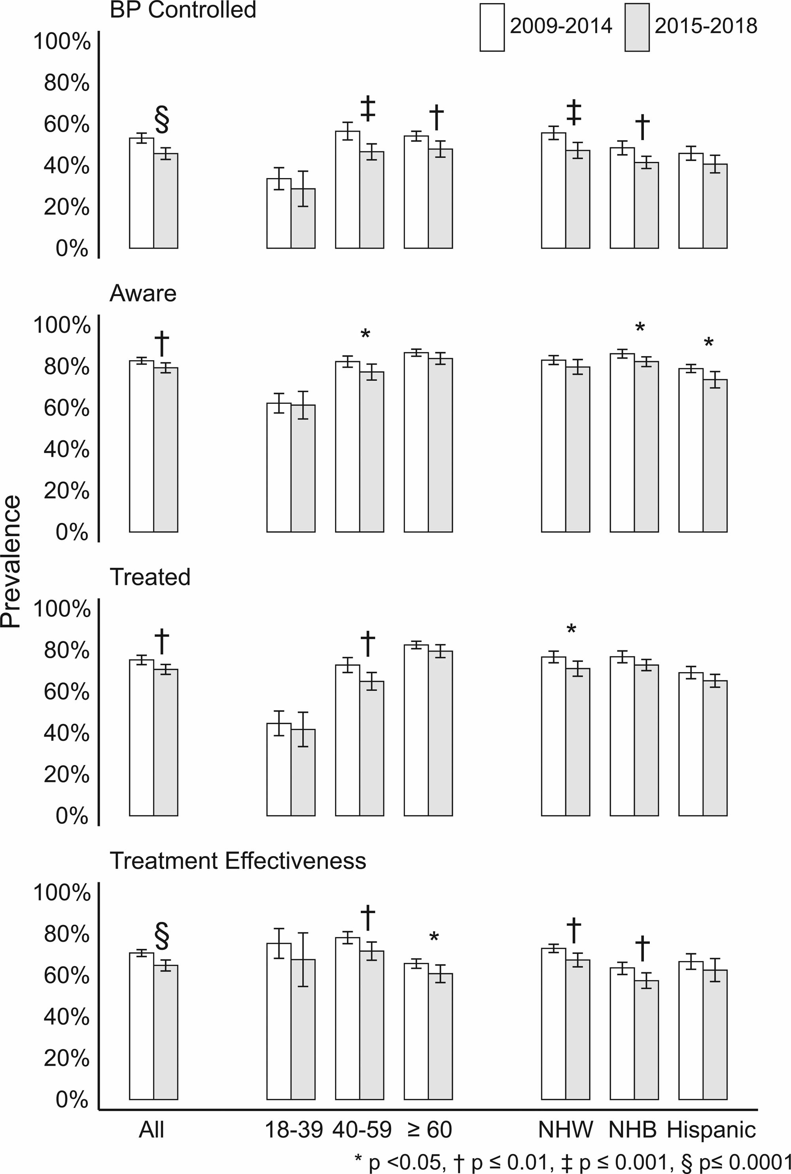

HTN Control Worsened After JNC 8 and ACC/AHA Guidelines Came Out
© 2021 American Heart Association, Inc.
Brent M. Egan. Hypertension. Hypertension Control in the United States 2009 to 2018: Factors Underlying Falling Control Rates During 2015 to 2018 Across Age- and Race-Ethnicity Groups, Volume: 78, Issue: 3, Pages: 578-587, DOI: (10.1161/HYPERTENSIONAHA.120.16418)

Slide 21
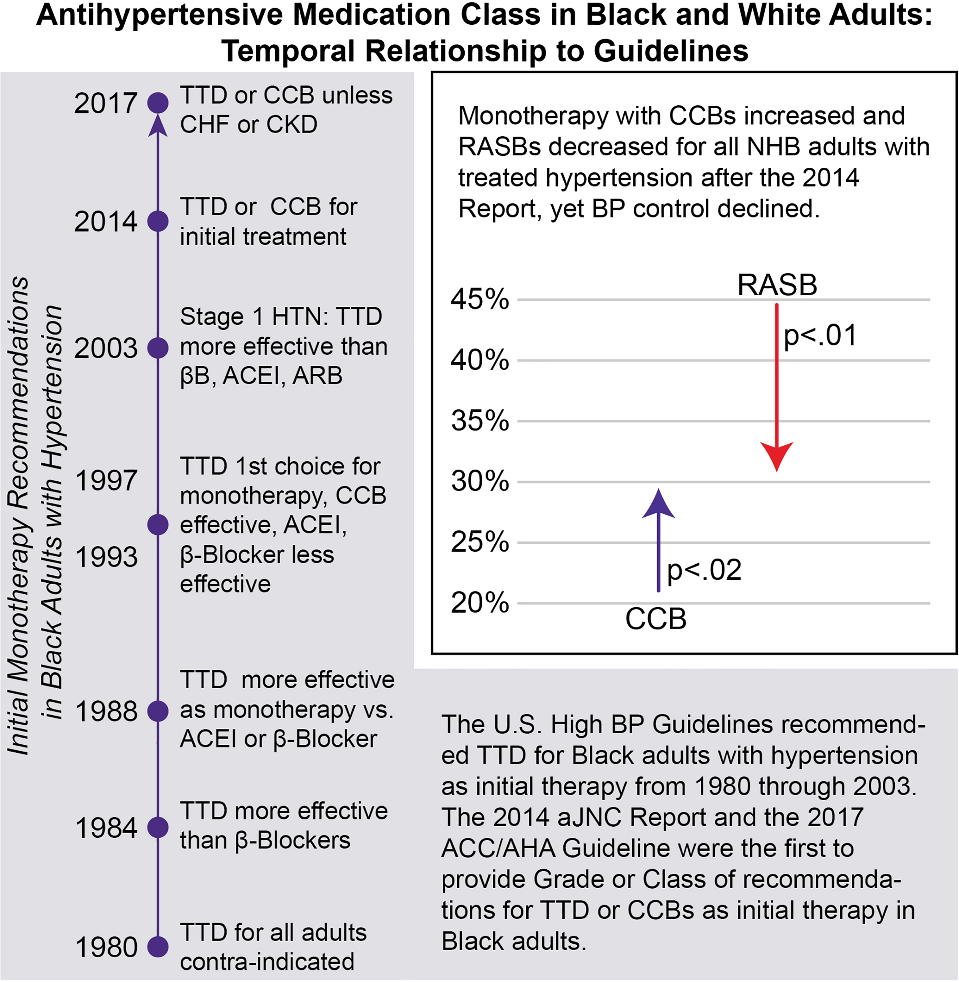
Since these guidelines came out, calcium channel blocker (CCB) use has increased, and renin angiotensin system blockade (RASB) use has decreased in black adults
National Health and Nutrition Examination Survey (NHANES) data spanning 2 time periods were contrasted (2007–2012 versus 2015–2018)
Brent M. Egan. Hypertension. Self-Reported Antihypertensive Medication Class and Temporal Relationship to Treatment Guidelines, Volume: 79, Issue: 2, Pages: 338-348, DOI: (10.1161/HYPERTENSIONAHA.121.17102)
© 2021 The Authors. Hypertension is published on behalf of the American Heart Association, Inc., by Wolters Kluwer Health, Inc. This is an open access article under the terms of the Creative Commons Attribution Non-Commercial License, which permits use, distribution, and reproduction in any medium, provided that the original work is properly cited and is not used for commercial purposes.

Slide 22
ALLHAT – Subgroup analysis - Results
No difference in primary outcome
Chlorthalidone had lower rate of heart failure in all groups
Lisinopril had higher rate of stroke (RR 1.40) and combined CVD outcomes (1.19) vs chlorthalidone for blacks
Chlorthalidone had greater decrease in systolic BP for blacks compared to lisinopril (4-5 mmHg difference in SBP)
Wright JT, et al; ALLHAT Collaborative Research Group. JAMA. 2005; 293:1595–1608. doi: 10.1001/jama.293.13.1595

Slide 23
Problems with Race-Based HTN Guidelines: Why translating ALLHAT race-based HTN treatment results into race-based guidelines is bad
Guidelines reflect the definition of race as a biological rather than social construct
Ignore possible link between lesser efficacy of RASB monotherapy and adverse SDOH (instead concluding a link of RASB resistance with race itself rather than with social determinants)
  Ignore that higher allostatic load (rather than race) is linked with accelerated aging, which contributes to salt-sensitive hypertension
  Ignore that structural racism (rather than race) leads to lower diet quality and less potassium intake, enhancing salt sensitivity
  Ignore that psychological stress (rather than race) is linked with sodium retention

Slide 24
Problems with Race-Based HTN Guidelines: Ignores that differences between group outcomes may be driven by outliers, not the majority
Some of the different outcomes reported in ALLHAT and other trials likely driven by patients who are outliers, not the majority
The majority of black and white patients have similar responses to antihypertensive drugs

Slide 25
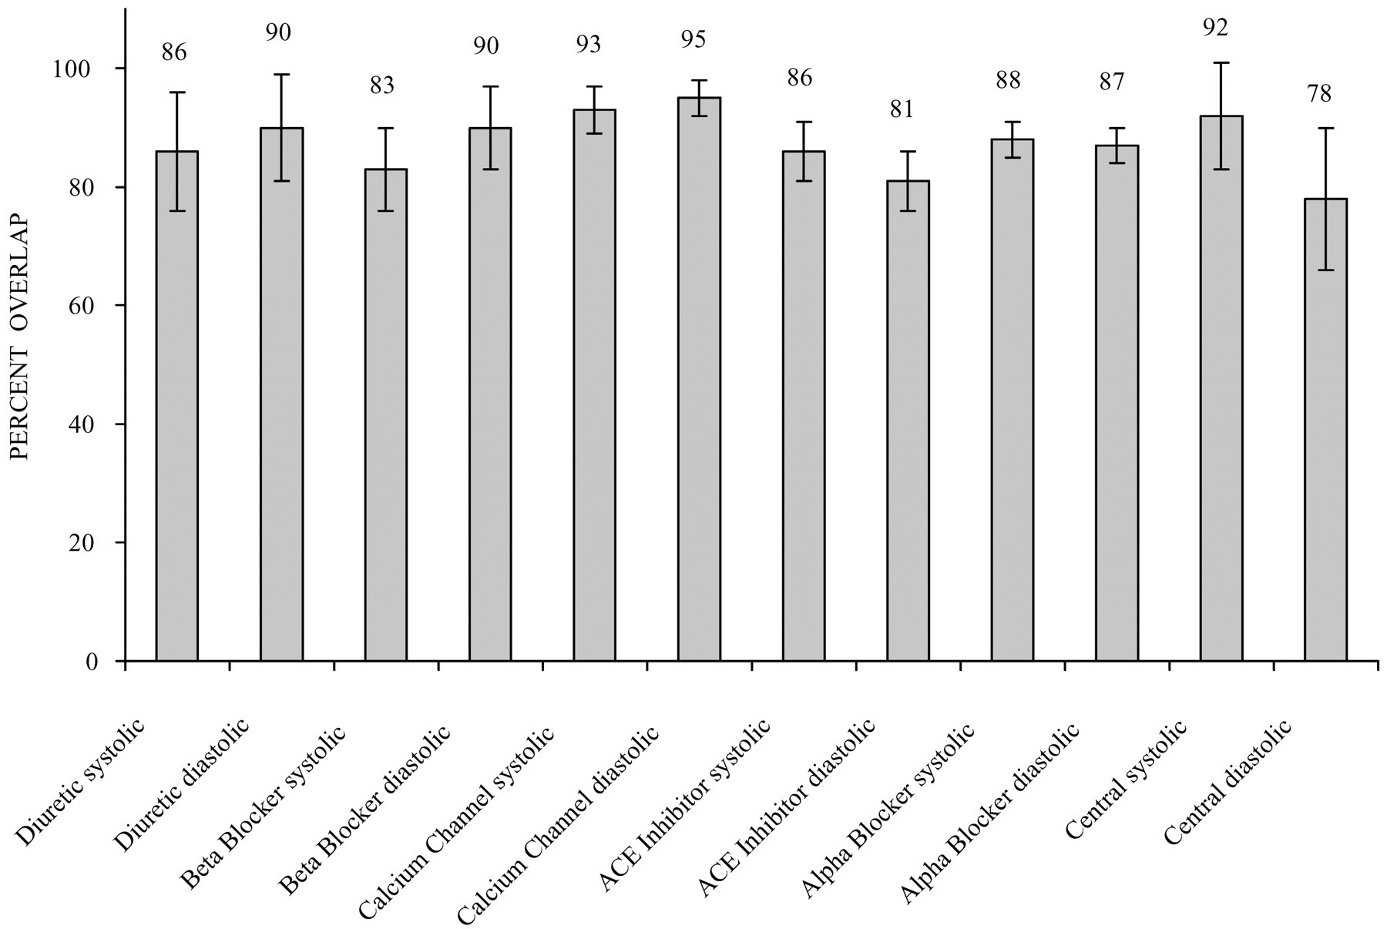
Metanalysis Shows Mean differences are not statistically significant (confidence intervals overlap)
Ashwini R. Sehgal. Hypertension. Overlap Between Whites and Blacks in Response to Antihypertensive Drugs, Volume: 43, Issue: 3, Pages: 566-572, DOI: (10.1161/01.HYP.0000118019.28487.9c)

Slide 26
Moving from Race-Based to Race-Conscious
HTN Treatment Strategies
Recognize that social determinants of health affect blood pressure
Understand that patients that do not have access to healthy food, have a higher allostatic load, and have increased stressors may have increased salt sensitivity
A regimen that includes a diuretic may benefit patients with increased salt sensitivity, but this does not mean that patients adversely affected by social determinants should not also be given RASB which has clearly-proven long-term benefits
Combination therapy (RASB + diuretic) rather than monotherapy should be considered
Race-conscious therapy recognizes and addresses the effects of racism on SDOH and thus on etiology of hypertension

Slide 27
CASES

Slide 28
Classification and Treatment
A 57-year-old woman comes to the office for evaluation. Her CV risk is <10%. She has no medical problems. Her BP is 132/70. Classify and recommend treatment for her hypertension based on ACC/AHA guidelines.
Elevated blood pressure – lifestyle modification
Stage 1 hypertension - lifestyle modification
Stage 1 hypertension – lifestyle modification and drugs
Stage 2 hypertension – lifestyle modification and drugs

Slide 29
Classification and Treatment
A 57-year-old woman comes to the office for evaluation. Her CV risk is <10%. She has no medical problems. Her BP is 132/70. Classify and recommend treatment for her hypertension based on ACC/AHA guidelines.
Elevated blood pressure – lifestyle modification
Stage 1 hypertension - lifestyle modification
Stage 1 hypertension – lifestyle modification and 1 drug
Stage 2 hypertension – lifestyle modification and 2 drugs

Slide 30
Treatment of Hypertension
ACC/AHA 2025
Stage 1 : 130-139/80-89 and 10-year CV risk <10% (lifestyle modification)
Stage 2: >140/90 (lifestyle modification + 2 drugs)

Slide 31
Classification and Treatment
A 57-year-old woman comes to the office for evaluation. Her CV risk is >10%. She has hyperlipidemia, hypertension, and is a smoker. Her BP is 134/73. Classify and recommend treatment for her hypertension based on ACC/AHA guidelines.
Elevated blood pressure – lifestyle modification
Stage 1 hypertension - lifestyle modification
Stage 1 hypertension – lifestyle modification and drug
Stage 2 hypertension – lifestyle modification and drugs

Slide 32
Classification and Treatment
A 57 year old woman comes to the office for evaluation. Her CV risk is >10%. She has hyperlipidemia, hypertension, and is a smoker. Her BP is 134/73. Classify and recommend treatment for her hypertension based on ACC/AHA guidelines.
Elevated blood pressure – lifestyle modification
Stage 1 hypertension - lifestyle modification
Stage 1 hypertension – lifestyle modification and drug
Stage 2 hypertension – lifestyle modification and drugs

Slide 33
Treatment of Hypertension
ACC/AHA goals in special populations:
10-year cardiac risk (PREVENT calculator) >10%: <130/80
CVD: <130/80
DM: <130/80
CKD: <130/80 (KDIGO goal SBP <120)
Frail, ≥ 85yrs old, or orthostatic Hypotension: <140/90 if risk of adverse events is high

Slide 34
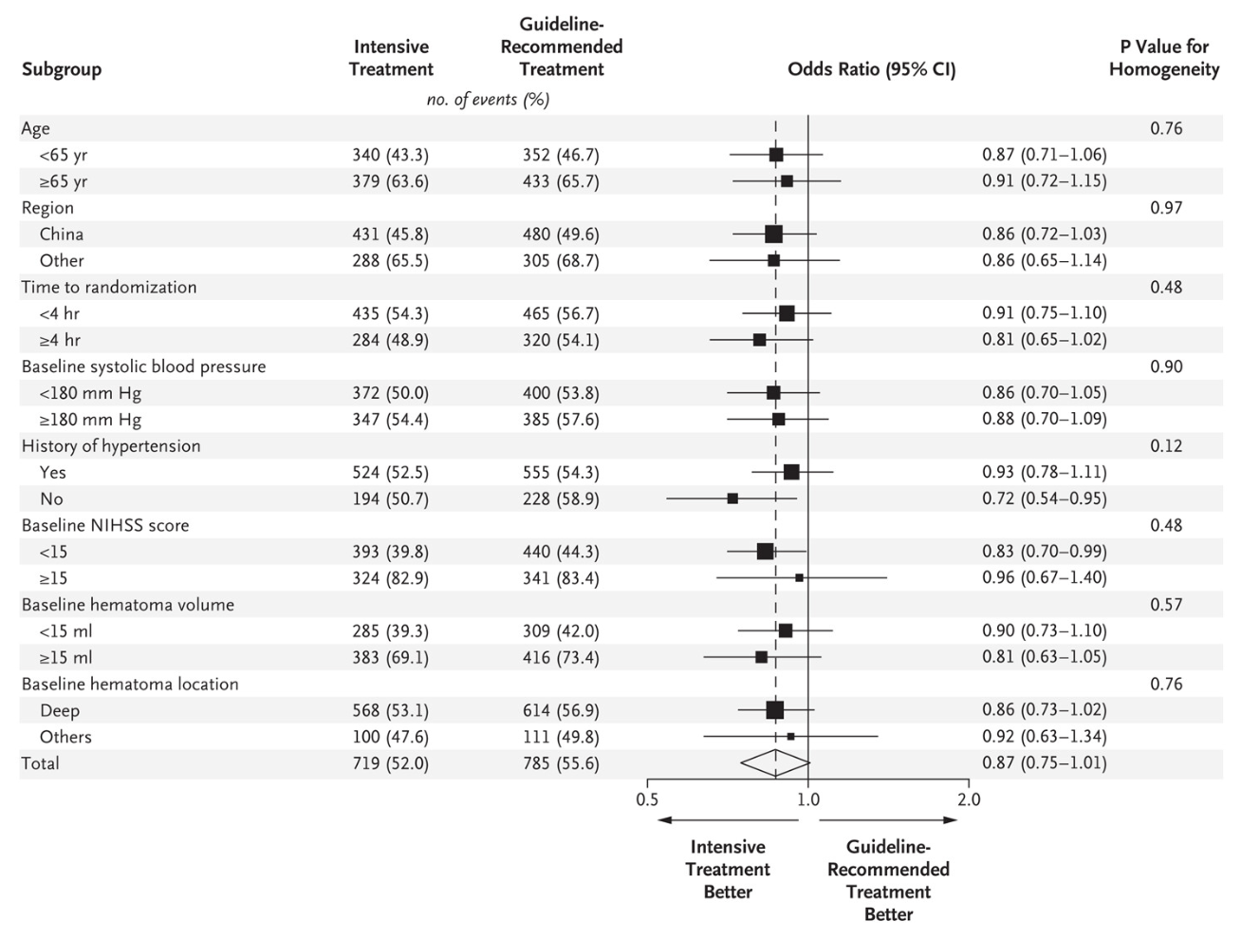
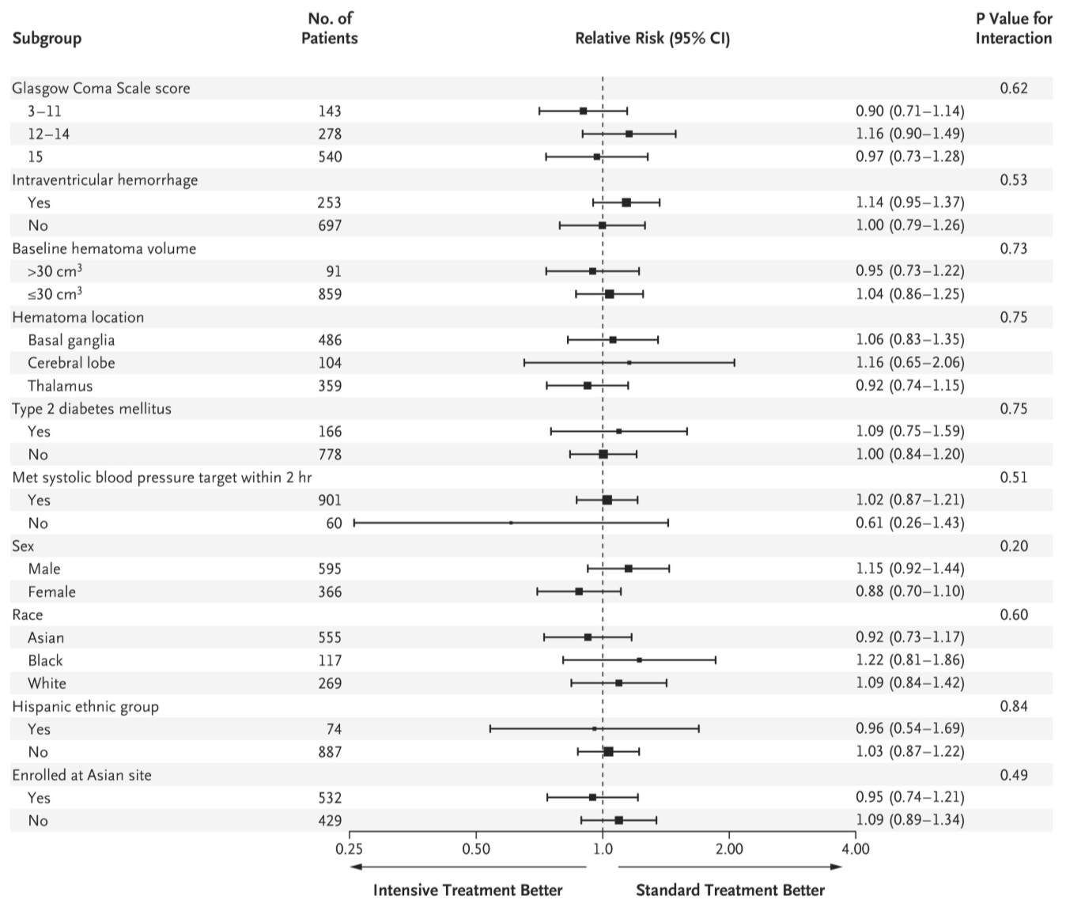
Treatment of Hypertension: special populations
Intracerebral Hemorrhage: ≅ SBP 140
INTERACT-2 Trial
Randomized to <140 within 1 hour vs. <180 mmHg
More intensive treatment had lower odds ratio for disability
ATACH-2 trial
Randomized to 110-139 mm Hg (intensive treatment) vs. 140-179 mm Hg
No difference
Anderson, CS, et al. N Engl J Med 2013;368:2355-2365
Qureshi, AI et al. N Engl J Med 2016;375:1033-1043

Slide 35
Treatment
45-year-old woman with a history of HTN and diabetes comes to the office for evaluation.
PE is normal. VS: 142/78 80
BMI 32
SH: non-smoker
Medication: metformin
Labs: creatinine 0.8, potassium 5.3, urine microalbumin 28mg/g
In addition to lifestyle changes, which of the following management strategies are best?
Only lifestyle changes
Add lisinopril
Add chlorthalidone
Add carvedilol

Slide 36
Treatment
45-year-old woman with a history of HTN and diabetes comes to the office for evaluation.
PE is normal. VS: 142/78 80
BMI 32
SH: non-smoker
Medication: metformin
Labs: creatinine 0.8, potassium 5.3, urine microalbumin 28mg/g
In addition to lifestyle changes, which of the following management strategies are best?
Only lifestyle changes
Add lisinopril
Add chlorthalidone
Add carvedilol

Slide 37
Pharmacologic Therapy - special populations
CKD 4 or greater
Likely needs a diuretic: loop or chlorthalidone or both
High cardiovascular risk patients
Consider targeting SBP <120 if tolerated
Patients already on ACE-I or ARB
Use caution with potassium – sparing diuretics (spironolactone, eplerenone, amiloride, finerenone)
Proteinuria
ACE-I/ARB
Mineralocorticoid receptor blocker
Non-dihydropyridine CCB (diltiazem)
Pregnancy
Avoid ACE-I/ARB

Slide 38
Treatment
48yo man with HTN, CKD, hyperlipidemia comes for routine office visit.
Meds: metoprolol, hctz, atorvastatin
PE: 142/84 66 BMI 29. Exam otherwise normal
Which is the most appropriate management?
Target SBP <120
Target SBP <130
Target SBP <140
No change in management.

Slide 39
Treatment
48yo man with HTN, CKD, hyperlipidemia comes for routine office visit.
Meds: metoprolol, hctz, atorvastatin
PE: 142/84 66 BMI 29. Exam otherwise normal
Which is the most appropriate management?
Target SBP <120 KDIGO)
Target SBP <130 (ACC/AHA)
Target SBP <140
No change in management.

Slide 40
Treatment
65yo woman with HTN but no other cardiovascular risk factors comes for routine office visit. She plays tennis or does yoga 5 days per week.
Home BP average 156/62
Meds: none
PE: 158/70 70 BMI 28. Exam otherwise normal
Which is the most appropriate management?
Target SBP <110
Target SBP <130
Target SBP <150
No change in management.
ACP and AAFP guidelines 2017

Slide 41
Treatment
65yo woman with HTN but no other cardiovascular risk factors comes for routine office visit. She plays tennis or does yoga 5 days per week.
Home BP average 156/62
Meds: none
PE: 158/70 70 BMI 28. Exam otherwise normal
Which is the most appropriate management?
Target SBP <110
Target SBP <130 (but SPRINT trial would argue <120)
Target SBP <150
No change in management.

Slide 42
Treatment - SPRINT
Patients with HTN but without DM randomized to SBP <140 vs <120mm Hg
Lower incidence of MI, ACS, CVA, heart failure, death from cardiovascular causes in <120 mmHg group
SPRINT Research Group. NEJM. 2015 Nov26;373(22):2103-16.

Slide 43

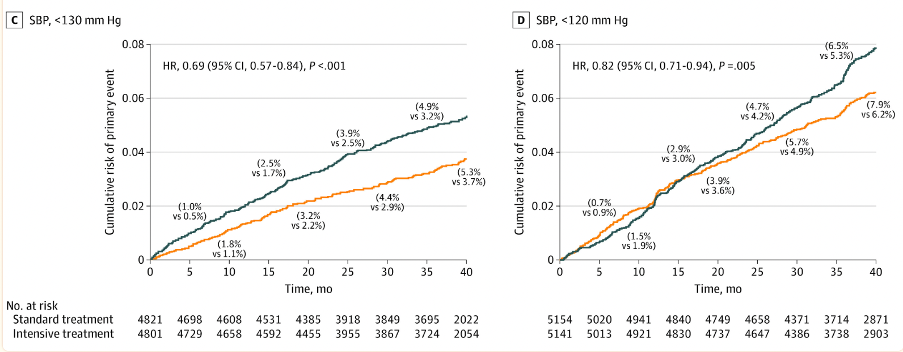
Intensive BP treatment with SBP target below 120-130 mm Hg was significantly associated with a 21% reduction in Major Adverse Cardiovascular Events
<130vs 150 STEP; <130vs 14o Cardio-SIS
<120 vs 140 SPRINT and ACCORD)
Tao Chen, et al. JAMA Intern Med. 2022 Jun; 182(6): 660–667.
Notes:
C: target SBP less than 130 vs 150/140 (STEP⁴ and Cardio-Sis²⁶ studies) (HR, 0.69; 95% CI, 0.57-0.84; P < .001)
D: target SBP less than 120 vs 140 (SPRINT²⁴ and ACCORD BP²⁵ studies) (HR, 0.82; 95% CI, 0.71-0.94; P = .005) (Figure 2D).
(hazard ratio, 0.79; 95% CI, 0.71-0.88; P < .001).
On average, 9.1 (95% CI, 4.0-20.6) months were needed to prevent 1 MACE per 500 patients with the intensive BP treatment (absolute risk reduction [ARR], 0.002). Likewise, 19.1 (95% CI, 10.9-34.2) and 34.4 (95% CI, 22.7-59.8) months were estimated to avoid 1 MACE per 200 (ARR, 0.005) and 100 (ARR, 0.01) patients, respectively.

Slide 44
Treatment
68yo man with HTN, CAD, hyperlipidemia comes for routine office visit.
He quit smoking 4 years ago, exercises and follows a low salt diet. Home BP average 135/79
Meds: metoprolol, hctz, atorvastatin, clopidogrel
PE: 142/84 66 BMI 29. Exam otherwise normal
Which is the most appropriate management?
Target home SBP <120
Target home SBP <120 if he demonstrates SBP >170 on stress echo
Order 24hr ambulatory BP monitoring
No change in therapy

Slide 45
Treatment
68yo man with HTN, CAD, MI, and hyperlipidemia comes for routine office visit.
He quit smoking 4 years ago, exercises and follows a low salt diet. Home BP average 135/79
Meds: metoprolol, hctz, atorvastatin, clopidogrel
PE: 142/84 66 BMI 29. Exam otherwise normal
Which is the most appropriate management?
Target Home SBP <120
Target Home SBP <120 if he demonstrates SBP >170 on stress echo
Order 24hr ambulatory BP monitoring
No change in therapy

Slide 46
Older Patients Take Home Points
No difference in BP goals in healthy older patients
Data for patients >85yrs old is sparce – need to assess frailty and risk of orthostatic hypotension; goal <140-150 is reasonable
Avoid DBP <60 especially if has CAD
Patients with orthostatic hypotension were excluded in SPRINT - so benefits of tighter control may not apply to these patients
The “frail” patients in SPRINT were not very frail
Shared decision making important

Slide 47
Treatment
35yo woman with a history of HTN and diabetes complains that she wants to reduce her pill burden.
Medications: lisinopril 20mg qd, amlodipine 5mg qd, metformin 500mg bid, vitamin D3 2000 iu qd.
BP 130/80 in the office
Home BP average 128/78
How do you advise her to maintain optimal BP control?
Continue current management.
Stop amlodipine and increase lisinopril to 40mg qd
Stop lisinopril and increase amlodipine to 10mg qd.
Stop amlodipine and monitor

Slide 48
Treatment
35yo woman with a history of HTN and diabetes complains that she wants to reduce her pill burden.
Medications: lisinopril 20mg qd, amlodipine 5mg qd, metformin 500mg bid, vitamin D3 2000 iu qd.
BP 130/80 in the office
Home BP average 128/78
How do you advise her to maintain optimal BP control?
Continue current management.
Stop amlodipine and increase lisinopril to 40mg qd
Stop lisinopril and increase amlodipine to 10mg qd.
Stop amlodipine and monitor
A combination of 2 agents at moderate doses often works better than 1 medication at max dose

Slide 49
Evaluation
35yo man with no medical history is noted to have a BP of 146/90 in the office. A friend took his BP at work recently and it was 155/92.
FH: HTN, DM2, father with MI at age 55
SH: no tobacco, 2 drinks/week
PE normal. BP 146/90 HR 76 BMI 24.
Which is the most appropriate methods to confirm HTN in this patient
Home BP readings
24hr ambulatory BP monitoring
Repeat in-office BP measurements over 5 days
Plasma aldosterone-renin ratio

Slide 50
Evaluation
35yo man with no medical history is noted to have a BP of 146/90 in the office. A friend took his BP at work recently and it was 155/92.
FH: HTN, DM2, father with MI at age 55
SH: no tobacco, 2 drinks/week
PE normal. BP 146/90 HR 76 BMI 24.
Which is the most appropriate methods to confirm HTN in this patient
Home BP readings
24hr ambulatory BP monitoring
Repeat in-office BP measurements over 5 days
Plasma aldosterone-renin ratio
Siu AL; US Preventative Task Force. Ann Intern Med. 2015 Nov 17;163(10):778-86.

Slide 51
Treatment
55yo woman with hyperlipidemia, hypothyroidism and longstanding difficult to control HTN here for evaluation of HTN. Home BP average 155/82.
Medications: telmisartan-hctz, nifedipine, atorvastatin, levothyroxine
SH: 1ppd tobacco, social EtOH
PE: 164/82, HR 76, BMI 34. Exam normal
Labs: Creatinine 0.8, K 3.8, TSH 2.5
What would be a good add on therapy?
Lisinopril
Doxazosin
Spironolactone
Bisoprolol

Slide 52
Treatment
55yo woman with hyperlipidemia, hypothyroidism and longstanding difficult to control HTN here for evaluation of HTN. Home BP average 155/82.
Medications: telmisartan-hctz, nifedipine, atorvastatin, levothyroxine
SH: 1ppd tobacco, social EtOH
PE: 164/82, HR 76, BMI 34. Exam normal
Labs: Creatinine 0.8, K 3.8
What would be a good add on therapy?
Lisinopril
Doxazosin
Spironolactone
Bisoprolol

Slide 53
Treatment – PATHWAY 2 trial
Patients randomized to 12 weeks of spironolactone, bisoprolol, doxazosin or placebo.
Spironolactone superior to:
Placebo (-8.7mmHg)
Doxazosin and bisoprolol (-4.26mmHg)
Bisoprolol (-4.48mmHg)
Williams B et al. Lancet. 2015 Nov 21;386(10008);2059-68.

Slide 54
Evaluation
65yo man with uncontrolled hypertension. Clinic BPs always above 140/90, and home BP readings 150s-170s/90s.
ROS: negative
Medications: lisinopril 40mg qd, nifedipine 60mg qd, and atenolol 100mg qd
PE: BP 165/95, HR 62
S4 gallop, no edema
Labs: creatinine 1.5, potassium 4.0, urinalysis normal
Which is the next best step in management?
Check aldosterone:renin ratio
Check renal artery dopplers
Add chlorthalidone
Add clonidine

Slide 55
Evaluation
65yo man with uncontrolled hypertension. Clinic BPs always above 140/90, and home BP readings 150s-170s/90s.
ROS: negative
Medications: lisinopril 40mg qd, nifedipine 60mg qd, and atenolol 100mg qd
PE: BP 165/95, HR 62
S4 gallop, no edema
Labs: creatinine 1.5, potassium 4.0, urinalysis normal
Which is the next best step in management?
Check aldosterone:renin ratio
Check renal artery dopplers
Add chlorthalidone
Add clonidine
Resistant HTN: Addition of a diuretic is needed before diagnosing a patient with resistant hypertension

Slide 56
Secondary HTN: Who Should Be Worked Up?
Young patients (childhood or adolescence), especially without family history
Resistant HTN
Abrupt worsening of HTN
Clinical features of disorder causing hypertension

Slide 57
Clinical Patterns of Secondary HTN
Renovascular HTN
  Early <30 or late > 50 onset
  Acceleration of treated HTN
  Worsening renal function during HTN treatment
  Flash pulmonary edema
  Progressive renal failure
Hyperaldosteronism
  Hypokalemia, metabolic alkalosis (muscle weakness, cramps)
Pheochromocytoma
  Headache, sweating, tachycardia, anxiety, chest/abd pain, nausea/vomiting

Slide 58
Secondary HTN: Classification
Endocrine causes
  Adrenal cortex
    Primary aldosteronism
    Pseudoaldosteronism
    Cushing’s syndrome
  Adrenal medulla
    Pheochromocytoma
  Pituitary
    Cushing’s disease
    Acromegaly
  Thyroid (hypo/hyper)
  Renin secreting tumors
Renal disease
Renovascular HTN
  Fibromuscular disease
  Atherosclerotic disease

Slide 59
Secondary Hypertension
A 65-year-old woman is evaluated for resistant hypertension. Despite use of antihypertensive therapy for over 20 years, her blood pressure usually is approximately 160/90 mm Hg. For several years she has been taking amlodipine, 10 mg/d, and metoprolol, 100 mg/d. However, her regimen recently was changed to lisinopril, 20 mg/d, and sustained-release verapamil, 180 mg/d.
PE: BP 178/100 mmHg
CV PMI prominent and laterally displaced
Lungs CTA
Otherwise normal
Laboratory Studies
BUN 18 mg/dL
Creatinine 0.9 mg/dL
Sodium 147 meq/L
Potassium 3.3 meq/L
Chloride100 meq/L
Bicarbonate28 meq/L
An echocardiogram reveals increased left ventricular mass.
Which of the following is the most appropriate next step in this patient's management?
A Magnetic resonance angiography
B Hydrochlorothiazide, 25 mg/d
C Aldosterone–renin ratio
D CT scanning

Slide 60
Secondary Hypertension
A 65-year-old woman is evaluated for resistant hypertension. Despite use of antihypertensive therapy for over 20 years, her blood pressure usually is approximately 160/90 mm Hg. For several years she has been taking amlodipine, 10 mg/d, and metoprolol, 100 mg/d. However, her regimen recently was changed to lisinopril, 20 mg/d, and sustained-release verapamil, 180 mg/d.
PE: BP 178/100 mmHg
CV PMI prominent and laterally displaced
Lungs CTA
Otherwise normal
Laboratory Studies
BUN 18 mg/dL
Creatinine 0.9 mg/dL
Sodium 147 meq/L
Potassium 3.3 meq/L
Chloride100 meq/L
Bicarbonate28 meq/L
An echocardiogram reveals increased left ventricular mass.
Which of the following is the most appropriate next step in this patient's management?
A Magnetic resonance angiography
B Hydrochlorothiazide, 25 mg/d
C Aldosterone–renin ratio
D CT scanning

Slide 61
Secondary Hypertension
A 68-year-old woman with a longstanding history of poorly controlled hypertension is evaluated for primary aldosteronism.
On physical examination, blood pressure is 176/105 mm Hg. Cardiac examination reveals an S3 gallop. The lungs are clear to auscultation.
Plasma renin activity is 0.06 ng/mL (0.06 μg/L) per hour and 24-hour urine aldosterone excretion is 18 µg.
An adrenal CT scan reveals a 1.5-cm solitary nodule in the left adrenal gland. The right adrenal gland appears normal but may be slightly enlarged.
Which of the following is the most appropriate next step in this patient's management?
A Laparoscopic left adrenalectomy
B Adrenal vein sampling for aldosterone and cortisol
C Renal arteriography
D Dexamethasone suppression test

Slide 62
Secondary Hypertension
A 68-year-old woman with a longstanding history of poorly controlled hypertension is evaluated for primary aldosteronism.
On physical examination, blood pressure is 176/105 mm Hg. Cardiac examination reveals an S3 gallop. The lungs are clear to auscultation.
Plasma renin activity is 0.06 ng/mL (0.06 μg/L) per hour and 24-hour urine aldosterone excretion is 18 µg.
An adrenal CT scan reveals a 1.5-cm solitary nodule in the left adrenal gland. The right adrenal gland appears normal but may be slightly enlarged.
Which of the following is the most appropriate next step in this patient's management?
A Laparoscopic left adrenalectomy
B Adrenal vein sampling for aldosterone and cortisol
C Renal arteriography
D Dexamethasone suppression test

Slide 63
Secondary HTN
A 79-year-old man is evaluated for poorly controlled hypertension. He has had hypertension for 30 years, but his condition has become more difficult to control during the past 2 years. Over the last 6 months, his home blood pressure measurements have ranged from 150/70 mm Hg to 170/90 mm Hg.
Medications are atenolol 50 mg/d; enalapril 20 mg twice daily; and hydrochlorothiazide 25 mg/d.
PE: BP 168/80 same on 2 previous office visits
Abd: faint abdominal bruit
CV: L femoral bruit
Creatinine 1.1 mg/dL, which has not changed for 2 years.
Low-density lipoprotein cholesterol level is 160 mg/dL.
Which of the following is the most appropriate management at this time?
A Renal angiography
B Amlodipine
C Plasma renin activity measurement
D Renal vein renin sampling
E Magnetic resonance angiography of the renal arteries

Slide 64
Secondary HTN
A 79-year-old man is evaluated for poorly controlled hypertension. He has had hypertension for 30 years, but his condition has become more difficult to control during the past 2 years. Over the last 6 months, his home blood pressure measurements have ranged from 150/70 mm Hg to 170/90 mm Hg.
Medications are atenolol 50 mg/d; enalapril 20 mg twice daily; and hydrochlorothiazide 25 mg/d.
PE: BP 168/80 same on 2 previous office visits
Abd: faint abdominal bruit
CV: L femoral bruit
Creatinine 1.1 mg/dL, which has not changed for 2 years.
Low-density lipoprotein cholesterol level is 160 mg/dL.
Which of the following is the most appropriate management at this time?
A Renal angiography
B Amlodipine
C Plasma renin activity measurement
D Renal vein renin sampling
E Magnetic resonance angiography of the renal arteries

Slide 65
Secondary HTN
A 64-year-old man with a history of coronary artery disease, peripheral vascular disease, chronic cigarette smoking, chronic kidney disease, and uncontrolled hypertension comes for a follow-up office visit. He was recently hospitalized for acute pulmonary edema. His estimated glomerular filtration rate is 45 mL/min.
Medications are aspirin, 81 mg/d; simvastatin, 40 mg/d; carvedilol, 25 mg twice daily; furosemide, 40 mg twice daily; digoxin, 0.125 mg once daily; losartan, 100 mg/d; amlodipine, 5 mg/d; and clonidine, 0.2 mg twice daily.
PE: BP 186/72, HR 62
CV S4 gallop
Abd: abd bruit is heard
Ext 1+ LE edema
Renal ultrasound performed during his hospitalization revealed a left kidney of 8.5 cm and a right kidney of 11 cm and increased echogenicity of the kidneys. He states that he has been compliant with his diet restrictions.
Which of the following is the most appropriate next step in managing this patient's hypertension?
A Increase amlodipine to 10 mg/d
B Perform renal artery dopplers
C Discontinue carvedilol
D Add lisinopril

Slide 66
Secondary HTN
A 64-year-old man with a history of coronary artery disease, peripheral vascular disease, chronic cigarette smoking, chronic kidney disease, and uncontrolled hypertension comes for a follow-up office visit. He was recently hospitalized for acute pulmonary edema. His estimated glomerular filtration rate is 45 mL/min.
Medications are aspirin, 81 mg/d; simvastatin, 40 mg/d; carvedilol, 25 mg twice daily; furosemide, 40 mg twice daily; digoxin, 0.125 mg once daily; losartan, 100 mg/d; amlodipine, 5 mg/d; and clonidine, 0.2 mg twice daily.
PE: BP 186/72, HR 62
CV S4 gallop
Abd: abd bruit is heard
Ext 1+ LE edema
Renal ultrasound performed during his hospitalization revealed a left kidney of 8.5 cm and a right kidney of 11 cm and increased echogenicity of the kidneys. He states that he has been compliant with his diet restrictions.
Which of the following is the most appropriate next step in managing this patient's hypertension?
A Increase amlodipine to 10 mg/d
B Perform renal artery dopplers
C Discontinue carvedilol
D Add lisinopril

Slide 67
Hospitalized Patients with HTN
Hemorrhagic CVA
SBP ≅ 140 within 1 hour if possible
Ischemic CVA
BP 185/110 (if thrombolysis candidate)
Acute MI
SBP <180, DBP <100
Avoid hypotension to avoid ischemia in acute phase
Acute Heart failure
SBP <140
Avoid Beta-blocker in acute decompensation
Aortic dissection
SBP 100-120
HR <60
Use Beta-blocker
HTN Emergency (end organ compromise):
Decrease MAP by 25% 1st hour
≅ 160/100 next 2-6 hours
<130/80 next 24-48 hours (with caution
Nicardipine, labetalol, esmolol, NTG
HTN Urgency (no end organ compromise)
Gradual decrease over 24-48hrs with oral medications
ACC/AHA 2025 guidelines

Slide 68
Hypertensive Emergency and Urgency
56yo man presents to the emergency with dyspnea. He has not seen a doctor in 20 years and is unaware of any medical history.
PE BP 220/113 87 O2 sat 85%
Bibasilar rales
CXR with pulmonary edema
What is the initial goal BP decrease for him?
10%
20%
30%
50%

Slide 69
Hypertensive Emergency and Urgency
56yo man presents to the emergency with dyspnea. He has not seen a doctor in 20 years and is unaware of any medical history.
PE BP 220/113 87 O2 sat 85%
Bibasilar rales
CXR with pulmonary edema
What is the initial goal BP decrease for him?
10%
20%
30%
50%

Slide 70
Take Home Points - Goals
1. ACC/AHA: if 10-year CV risk <10%
Elevated BP: 120-129/80 (lifestyle modification)
Stage 1: 130-139/80-89 (lifestyle modification)
Stage 2: >140/90 (lifestyle modification + 2 drugs)
Add drug for Stage 1 if CV risk >10%
2. KDIGO guidelines: standardized SBP <120
3. Shared decision making about aggressive BP control is extremely important in older patients or patients who are frail

Slide 71
Take Home Points - Treatment
4. Best drugs:
CKD 4 or greater: likely needs a diuretic, can keep ACE-I/ARB on unless problems with hyperkalemia
Patients already on ACE-I or ARB: Use caution with potassium – sparing diuretics (spironolactone, eplerenone, amiloride, finerenone)
Proteinuria: ACE-I/ARB; non-dihydropyridine CCB
Pregnancy: Avoid ACE-I/ARB
5. Secondary HTN Workup:
  Early <30 or late > 50 onset
  Acceleration of treated HTN
  Worsening renal function during HTN treatment
  Flash pulmonary edema
  Progressive renal failure
  Hypokalemia, metabolic alkalosis (muscle weakness, cramps)
6. Hypertensive emergency (with end organ damage): MAP <20% first hour, 160/100 hrs 2-6, < 130/80 24-48 hours with caution
Hypertensive urgency – gradual normalization over 24-48 hours with oral meds.

