Slide 1
FEVER OF UNKNOWN ORIGIN:A RHEUMATOLOGIC APPROACH TO A DIAGNOSTIC DILEMMA
CHANDANA KESHAVAMURTHY
MARCH 3RD 2026

Slide 2
WHY THIS MATTERS
FUO remains one of medicine’s greatest diagnostic challenges
Rheumatic diseases are under-recognized causes
Misdiagnosis → inappropriate steroids → harm
Over-testing → confusion, cost, delay
When obvious clues are absent and initial investigations are unhelpful, discovering the cause of fever can be extremely challenging for the physician and frustrating for the patient

Slide 3
THE CORE PROBLEM
Rheumatic disease can:
Mimic infection
Mimic malignancy
Coexist with infection
Be masked by immunosuppressives

Slide 4
FEVER
Increase in core body temperature above the normal daily range for that individual
Often accompanied by physical symptoms that lead to prompt diagnosis

Slide 5
DEFINITION OF FEVER OF UNKOWN ORIGIN
Petersdorf & Beeson- Classic definition , 1961
Temp > 38.3°C on several occasions
Duration ≥ 3 weeks
No diagnosis after 1 week inpatient evaluation

Slide 6
MODERN DEFINITION
Durack & Street- 1990
Included outpatient evaluation
≥ 3 days inpatient OR ≥ 2 outpatient visits
Recognized new subgroups

Slide 7
CATEGORIES OF FUO
Classic ( Infection, neoplasm, inflammatory, miscellaneous, unknown )
Nosocomial
Neutropenic
HIV-associated

Slide 8
EPIDEMIOLOGY- WHAT CAUSES FUO?
Infection: ~30–40%
Malignancy: ~10–20%
Non-infectious inflammatory disease (NIID): 15–30%
Miscellaneous: 5–20%
Undiagnosed: up to 50%

Slide 9
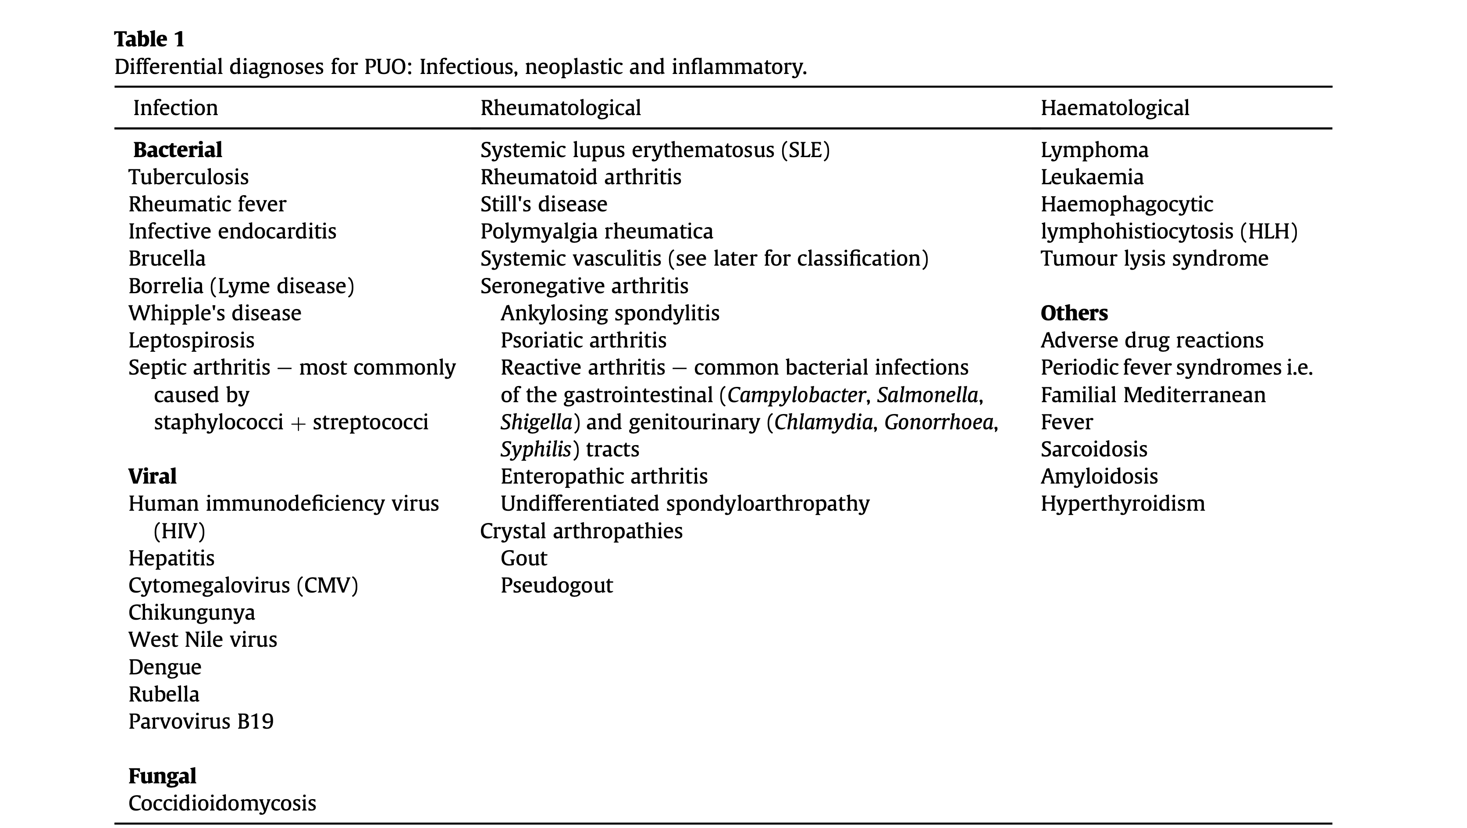

Slide 10
WHY DO RHEUMATIC DISEASES CAUSE FEVER?
Exogenous pyrogens → immune activation-including neutrophils and monocytes and macrophages, thereby leading to the production and release of pro-inflammatory molecules known as endogenous pyrogens.
IL-1, IL-6, TNF-α
Prostaglandin-mediated hypothalamic reset
These same cytokines drive autoimmune disease

Slide 11
STEPWISE APPROACH TO FUO
History
Physical examination
Basic labs
Directed imaging
Targeted autoantibodies
Biopsy (if indicated)

Slide 12
HISTORY-WHAT MATTERS
Fever pattern (quotidian? double quotidian?)
Travel
TB exposure
Drug history
Sexual history
Immunosuppression
Family history

Slide 13
CLUES IN PHYSICAL EXAM
Oral ulcers → SLE, Behçet
Malar rash, body rash
Nailfold capillaries → dermatomyositis/systemic sclerosis
Pulse discrepancy → Takayasu
Temporal tenderness → GCA
Lymphadenopathy → lymphoma/SLE
Eye- uveitis, scleritis, episcleritis
Pathergy at the site of phlebotomy- Behcet’s disease

Slide 14
Detailed joint examination- to map the quantity and distribution of any arthropathy.
Symmetrical polyarthritis – suggests RA
Asymmetrical polyarthritis – suggests seronegative arthritis
One joint affected – crystalline arthritis vs septic arthritis
Genital examination – look for ulcers- Behcet’s
Urethritis and abnormal discharge- reactive arthritis

Slide 15
BASIC LABS AND INTERPRETING PATTERNS
ESR ↑, CRP normal → SLE flare
ESR & CRP ↑ → infection likely
ESR >100 → GCA, PMR, TB, myeloma
Normal ESR → High negative predictive value for GCA

Slide 16
Complete Blood Count (CBC)
  Leukocytosis → Consider Still’s disease
  Leukopenia → Suggestive of Systemic Lupus Erythematosus (SLE)
  Eosinophilia → Seen in EGPA, PAN

Slide 17
Markedly elevated ferritin → Suggestive of:
  Adult-Onset Still’s Disease (AOSD)
  Coexisting HLH
Uncomplicated infections → Usually do not cause extreme ferritin elevation

Slide 18
Urine Analysis
Proteinuria / Hematuria →
  Lupus nephritis
  Vasculitis

Slide 19
Gastrointestinal Symptoms Present?
If diarrhea:
  Send stool for:
    Microscopy
    Culture & sensitivity
    Ova, cysts, parasites
    Fecal calprotectin

Slide 20
ANTIBODIES –USE WITH DISCIPLINE
ANA → sensitive, not specific- ANA : sensitivity is 93% for SLE, specificity of 57%. It can be positive in infection, malignancy, rheumatic disease, healthy general population.
Positive result with a convincing story is helpful. Negative result with weaker story rules out rheumatic disease. False negatives are also common, hence when the clinical suspicion is high, then repeat them.
If ANA is positive, and there are clinical symptoms of Systemic lupus, then check anti dsdna since it has a specificity of 97.4% for Lupus, and it also correlates with SLE disease activity.
Cryoglobulins → don’t forget. Cryoglobulinemias can present with a range of nonspecific clinical features including fever and thus may be easily missed in the diagnostic work up for PUO.

Slide 21
RF → seen in TB, endocarditis
Anti-CCP → high specificity for RA, up to 90%
RF is also seen in early undifferentiated arthritis, Sjogren’s disease, Systemic lupus.
RF is more useful in the diagnosis of RA when combined with anti-CCP antibodies.

Slide 22
ANCA → confirm with PR3/MPO ELISA
The combination of these tests has a higher specificity for small vessel vasculitis and higher sensitivity than immunofluorescence alone.
Positive ANCA with negative anti-PR3/MPO antibodies is a non specific finding, thus clinical correlation is important.

Slide 23
IMAGING
CXR for all patients ( hilar lymphadenopathy in sarcoidosis )
CT/MRI → localized symptoms
FDG-PET/CT → no focal clues + inflammatory markers elevated

Slide 24
Duplex Ultrasound in Giant Cell Arteritis (GCA)
Look for
  Vessel wall thickening (“halo sign”)
  Non-compressible arteries (“compression sign”)
  Arterial stenosis and occlusion
Diagnostic performance (meta-analysis):
  Sensitivity: 77%
  Specificity: 96%
Advantages in suspected cranial GCA:
  More accessible
  Lower cost
  No radiation exposure
  Safer compared to CT and FDG-PET-CT

Slide 25
When to Use FDG-PET/CT ?
No localizing signs
Elevated ESR/CRP
Suspected large vessel vasculitis ( extra cranial GCA )
Suspected occult malignancy
Add caution: steroids reduce sensitivity.
FDG-PET-CT is less sensitive in the diagnosis of rheumatological condition than in the diagnosis of infection and malignancy. This is because there are more rheumatological conditions without a sole focal abnormality or with abnormalities too small to be detected such as small vessel vasculitides.

Slide 26
BIOPSY
Skin biopsy → If cutaneous lesions present
Liver biopsy → If hepatic involvement suspected
Kidney biopsy → If renal abnormalities present
Bone Marrow Biopsy – to be performed if Blood tests suggest bone marrow failure/Suspicion of hematologic malignancy- in addition to histopathology, culture for tuberculosis should be performed

Slide 27
MAJOR RHEUMATIC CAUSES OF FEVER
Adult onset Still’s disease
Systemic lupus
Vasculitis
Inflammatory arthritis
HLH
Infections due to DMARDs
Periodic fever syndromes

Slide 28
CASE 1
42 year old woman presents with progressive joint pain and swelling, with intermittent fevers for 6 weeks. The pain is symmetrical and swelling affects the metacarpophalangeal joints, proximal interphalangeal joints and wrists bilaterally. She has marked stiffness in the morning lasting for 60 minutes that improves with activity. Over the past 2 weeks, she has developed intermittent low-grade fevers (temperatures up to 38.2°C), particularly in the evenings, accompanied by fatigue, malaise, and a 3-kg unintentional weight loss.
The patient describes a "gelling phenomenon" where her joints become stiff after periods of rest.
She denies recent travel, tick bites, rashes, or gastrointestinal symptoms.
Past Medical History: Unremarkable

Slide 29
Physical Examination:
Temperature: 38.1°C
Bilateral swelling, warmth, and tenderness of the 2nd and 3rd MCP joints and PIP joints
Bilateral wrist effusions with decreased range of motion
Tenderness across the metatarsophalangeal joints bilaterally
Symmetrical polyarthritis involving 8 joints total
No subcutaneous nodules, rash, or lymphadenopathy

Slide 30
Laboratory Results:
ESR: 62 mm/hr (elevated)
CRP: 4.8 mg/dL (elevated)
Rheumatoid factor: positive (titer 1:320)
Anti-CCP antibodies: positive (>200 units/mL)
CBC: mild normocytic anemia (Hb 11.2 g/dL), normal WBC
Comprehensive metabolic panel: within normal limits

Slide 31
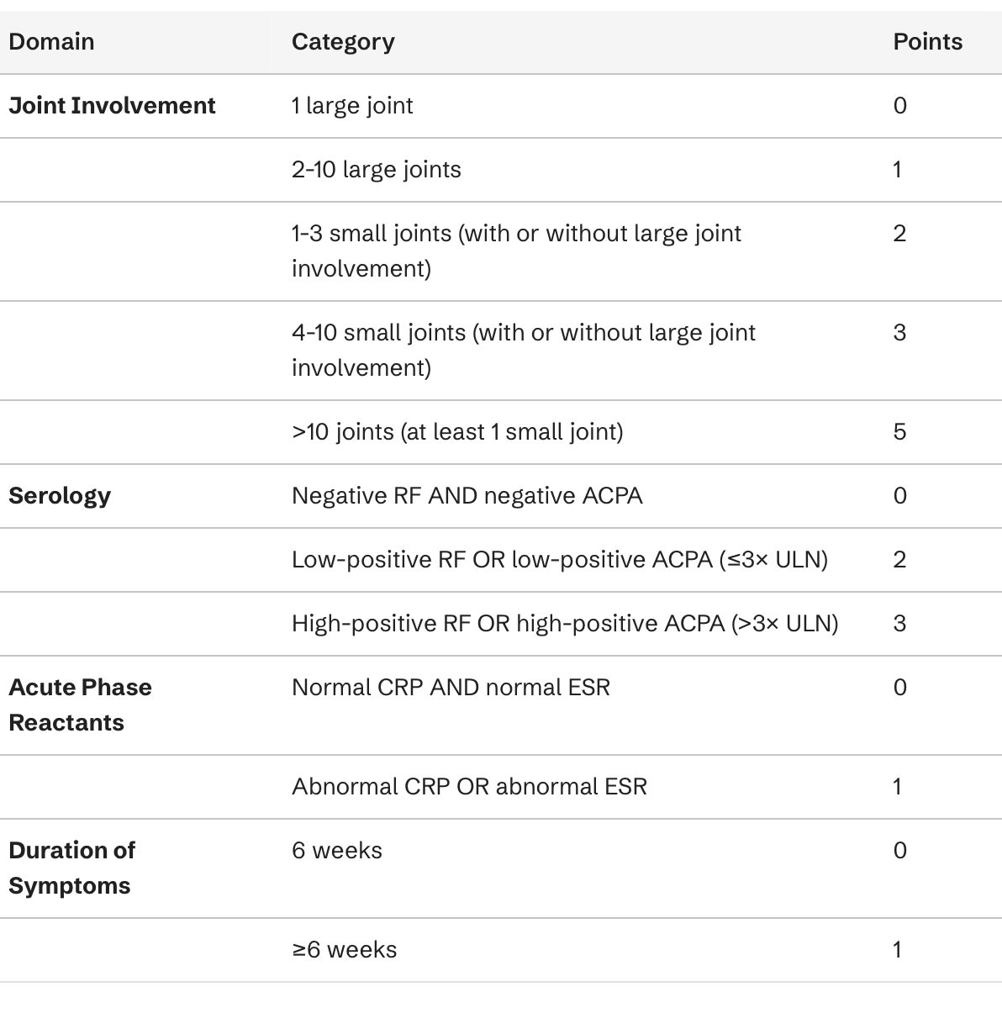
This patient meets the 2010 ACR/EULAR classification criteria for rheumatoid arthritis with a score of 8 points (5 points for joint involvement of 4-10 small joints, 3 points for high-titer RF and anti-CCP antibodies, 1 point for elevated acute phase reactants, and 1 point for symptom duration ≥6 weeks).

Slide 32
The presence of low-grade fever is consistent with severe systemic inflammation in the setting of active RA, as evidenced by markedly elevated inflammatory markers.

Slide 33
RHEUMATOID ARTHRITIS
Fever is uncommon at the onset of rheumatoid arthritis in adults, occurring in only about 5% of patients with continuous low-grade fever (<38°C) and just 1% with temperatures >38.3°C.
When fever does occur, it typically accompanies severe systemic inflammation with markedly elevated inflammatory markers (ESR, CRP), anorexia, and weight loss.
Fever may also accompany intense exacerbations of synovitis, vasculitis, or serositis in established disease, but septic arthritis must be urgently excluded when fever develops with worsening synovitis.
Also important to consider rheumatoid vasculitis where RA patients present with fever more commonly. This is quite a devastating consequence of the disease.

Slide 34
SERONEGATIVE ARTHRITIDES
Seronegative rheumatoid arthritis (RF and anti-CCP negative) presents with higher disease activity at baseline compared to seropositive disease, including higher swollen joint counts (median 10 vs 5), tender joint counts, and DAS28 scores (4.7 vs 3.7).
Constitutional symptoms including fever can occur.
Fever at presentation of psoriatic arthritis is rare.
Whipple’s disease can present with seronegative arthritis and fever can be the initial presentation. Fever can come first and then the gastrointestinal symptoms months later.
Seronegative spondyloarthropathies can present with fever as an initial manifestation. In such patients, peripheral joint involvement is more common than axial, and they have very elevated inflammatory markers. The spondyloarthropathies presenting with fever include reactive arthritis (50%), undifferentiated SpA (26.9%), and ankylosing spondylitis (15.4%).

Slide 35
CRYSTALLINE ARTHRITIS
Polyarticular gout is frequently accompanied by fever, occurring in 44% of patients, with 10% having temperatures ≥39°C.
Leukocytosis is present in >40% of patients, often raising concern for septic arthritis.
Elderly patients exhibit particularly strong inflammatory responses during gout attacks, with 51.1% developing fever compared to 20.8% in younger patients.
Polyarticular flares can be associated with pronounced systemic symptoms including fever, chills, and even delirium.

Slide 36
Pseudogout (calcium pyrophosphate deposition disease) can present with high fever even with monoarthritis.
In one series, 25 of 50 patients (50%) had fevers averaging 38°C, with five patients experiencing mental confusion alongside fever.
Septic arthritis is often suspected, particularly when synovial fluid leukocyte counts exceed 50,000/mm³.
Elderly hospitalized patients with pseudogout may have fever overlooked as an explanation for systemic symptoms, but defervescence occurs quickly with anti-inflammatory treatment.

Slide 37
CASE 2
A 60-year-old retired teacher presented to the rheumatology clinic with widespread joint pain and variable joint swelling. She described early morning stiffness lasting for one hour but no extra-articular symptoms.
She was otherwise well with no systemic upset. She had a background of hypertension and hypercholesterolemia. Her regular medications included amlodipine, enalapril and a statin. She had no significant family history. She was born in the Philippines but had been residing in the UK for more than thirty years. She had last travelled home over two years ago and had no other travel history.
On examination, there was left knee effusion and synovitis affecting the right knee.

Slide 38
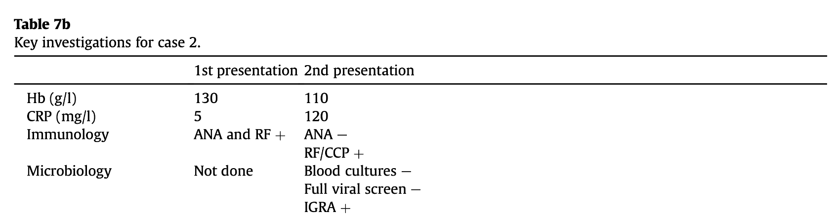

Slide 39
She had X-rays of her hands and left knee, which showed no erosions.
The left knee was aspirated and the fluid sent for analysis. The aspirate was negative for crystals, no malignant cells were seen, and the cultures were negative.
Based on the clinical presentation and positive anti-CCP, this woman was diagnosed with poly- articular rheumatoid arthritis. She received a steroid injection into the knee and was started on methotrexate.

Slide 40
Two months later, she re-presented to the clinic with a three-week history of fever and swelling affecting her face, right wrist and left shoulder.
On examination, she was found to have a facial abscess over her right zygoma and a red, hot and tender left knee. She was admitted for investigation.

Slide 41
The facial abscess was aspirated, and two weeks later, the fluid was found to contain Mycobacterium tuberculosis.
At this stage, it was not clear whether she had a latent reactivation of tuberculosis in addition to an inflammatory polyarthritis or whether her original presenting complaint and subsequent symptoms were all caused by tuberculosis.
Her methotrexate was stopped, and she was treated for tuberculosis with rifampicin, isoniazid, pyr- azinamide, ethambutol, and pyridoxine.
She made a full recovery with this treatment and had no re- occurrence of symptoms. It was concluded that tuberculosis was the most likely cause of her polyarthritis.

Slide 42
Tuberculosis is a common cause of PUO and can present in a wide variety of ways. Tuberculosis screening is strongly recommended before starting biologic therapy, particularly TNF inhibitors, which carry the highest risk of TB reactivation among biologics.
Current U.S. guidelines recommend performing either an IGRA or tuberculin skin test (TST) for latent TB infection (LTBI) screening, with IGRA generally preferred in certain populations.
IGRAs offer several advantages over TST in the biologic therapy population:
Unaffected by prior BCG vaccination, which can cause false-positive TST results
Objective results requiring only one clinical visit (versus two for TST)
Higher specificity (>95% in low TB prevalence settings)
Remember - Anti-CCP and rheumatoid factor can both be seen in the context of TB infection.

Slide 43
CASE 3
68-year-old woman presents with persistent fever and fatigue for 8 weeks.
The patient presents with an 8-week history of intermittent fevers ranging from 38.5°C to 39.5°C, accompanied by profound fatigue, anorexia, and a 7-kg unintentional weight loss. She describes generalized malaise and night sweats. She denies headache, visual changes, jaw pain with chewing, or scalp tenderness. She reports vague bilateral shoulder and hip girdle stiffness that is worse in the mornings, lasting about 30 minutes.
Over the past 2 weeks, she has developed intermittent pain in her left calf when walking more than two blocks, which resolves with rest. She also notes occasional aching discomfort in her upper arms.
Past Medical History: Hypertension, hyperlipidemia
Medications: Amlodipine, atorvastatin
Workup to Date:
The patient has been extensively evaluated by her primary care physician and infectious disease consultant. Blood cultures (×3), urine cultures, chest X-ray, abdominal/pelvic CT scan, and transthoracic echocardiogram were all unrevealing. She completed a 10-day course of empiric antibiotics without improvement.

Slide 44
Physical Examination:
Temperature: 38.8°C
Blood pressure: Right arm 148/82 mmHg, Left arm 132/78 mmHg
Pulse: 88 bpm, regular
Temporal arteries: Normal caliber, palpable pulses bilaterally, non-tender, no nodularity
No scalp tenderness
Fundoscopic examination: Normal
Cardiovascular: Soft bruit heard over left subclavian artery
Musculoskeletal: Mild tenderness over bilateral shoulders with full range of motion, no synovitis
Peripheral pulses: Left radial pulse diminished compared to right; left dorsalis pedis pulse diminished

Slide 45
Laboratory Results:
ESR: 98 mm/hr (markedly elevated)
CRP: 12.4 mg/dL (markedly elevated)
CBC: Hemoglobin 10.1 g/dL (normocytic anemia), WBC 11,200/μL with normal differential, platelets 485,000/μL (thrombocytosis)
Comprehensive metabolic panel: Normal except albumin 3.1 g/dL
ANA, RF, anti-CCP: Negative
Procalcitonin: 0.08 ng/mL (normal)

Slide 46
Imaging:
18F-FDG PET-CT scan ordered to evaluate fever of unknown origin revealed:
Diffuse increased FDG uptake in the thoracic aorta, bilateral subclavian arteries, and bilateral axillary arteries
Moderate uptake in bilateral common iliac and femoral arteries
No evidence of malignancy or infection
Temporal Artery Biopsy:
Given the imaging findings suggestive of large-vessel vasculitis and markedly elevated inflammatory markers in a patient >50 years old with fever of unknown origin, bilateral temporal artery biopsies were performed (despite absence of cranial symptoms).
Pathology: Left temporal artery (2.5 cm specimen) showed transmural inflammation with lymphocytes and histiocytes, disruption of the internal elastic lamina, and multinucleated giant cells consistent with giant cell arteritis.

Slide 47
This patient represents giant cell arteritis presenting as isolated inflammatory response and fever of unknown origin (IFUO), a well-defined clinical pattern affecting approximately 9-10% of GCA patients.
She had no classic cranial symptoms (headache, visual disturbances, jaw claudication, or temporal artery abnormalities on examination), making the diagnosis particularly challenging.
Key diagnostic clues included:
Extracranial large-vessel involvement with limb claudication and asymmetric pulses
Markedly elevated inflammatory markers (ESR 98, CRP 12.4) with severe anemia
Constitutional symptoms dominating the clinical picture
PET-CT findings showing characteristic large-vessel inflammation
Patients with GCA presenting as IFUO are typically younger, have longer time to diagnosis, and show more intense inflammatory responses compared to those with classic cranial presentations.
Importantly, fever can reach 39-40°C in about 15% of GCA patients and may be the sole presenting manifestation.
GCA accounts for up to 16% of fever of unknown origin cases in patients >65 years.

Slide 48
Plan:
Immediate initiation of high-dose glucocorticoid therapy (prednisone 60 mg daily) was started following biopsy confirmation. The patient defervesced within 48 hours, and inflammatory markers began declining. She will require prolonged glucocorticoid taper,IL-6 inhibitor with monitoring for relapse and screening for glucocorticoid-related complications. Annual chest imaging is recommended to monitor for thoracic aortic aneurysm development.

Slide 49
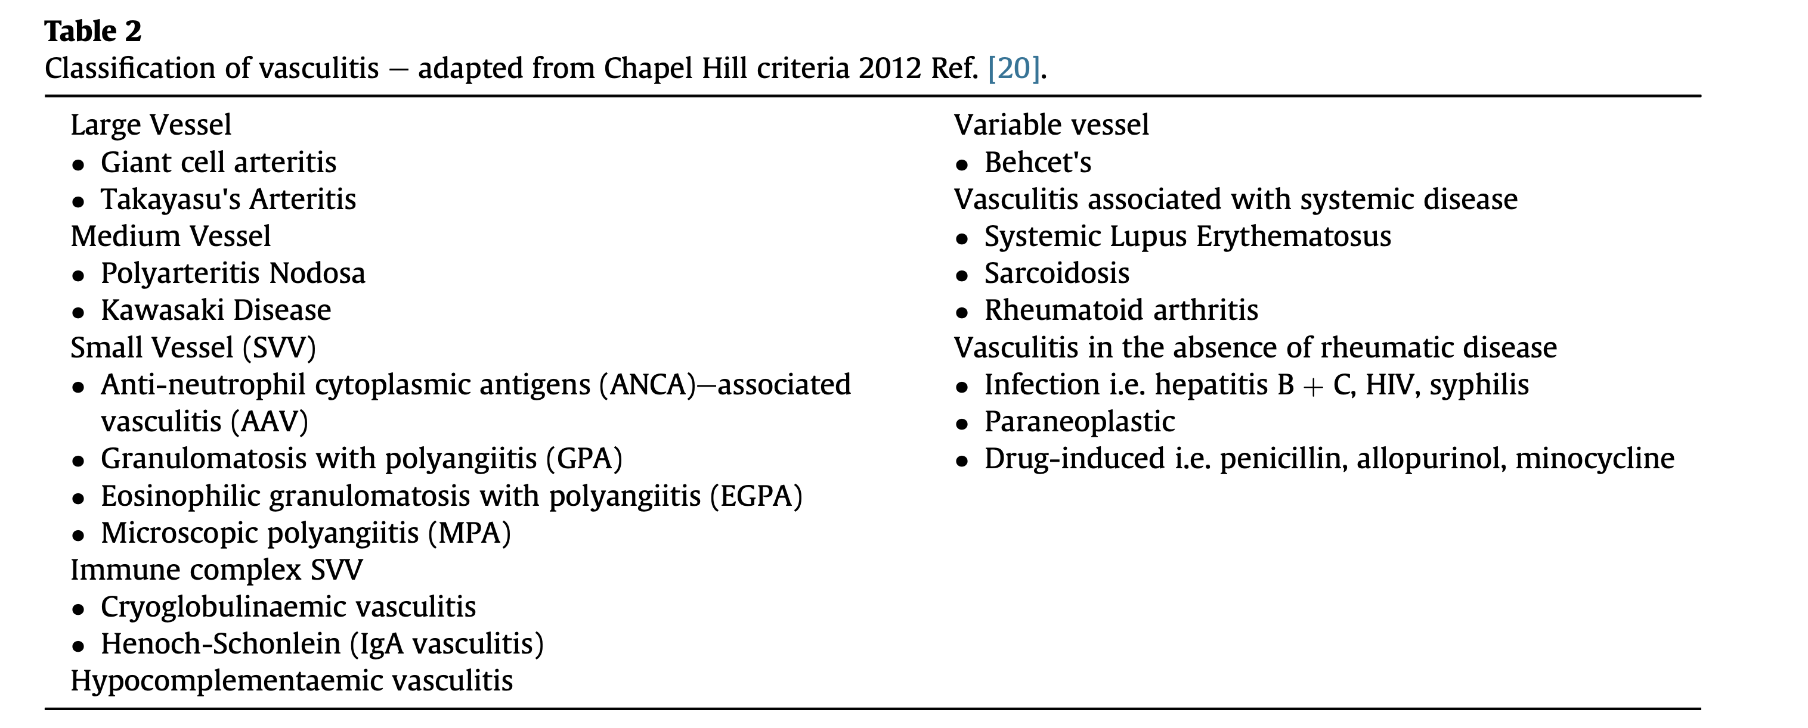

Slide 50
Other types of vasculitis presenting as fevers
Takayasu’s arteritis : affects young women in their second and third decade.
Symptoms such as constitutional upset, fever and limb claudication and reduced or absent peripheral pulses are the common findings.

Slide 51
Medium vessel vasculitis : PAN : necrotizing vasculitis affecting medium and small arteries. Affects between 2 to 33 per million. Presents with generalized constitutional symptoms. Fever is a presenting clinical feature in 60% of patients with PAN, it can precede organ involvement.
There is no single diagnostic test or hallmark clinical feature that makes the diagnosis of PAN obvious to the clinician, therefore a high index of suspicion is required.
Confirmation of diagnosis requires either histological evidence of necrotising vasculitis and/or abnormal angiography showing microaneurysms and/or stenoses.

Slide 52
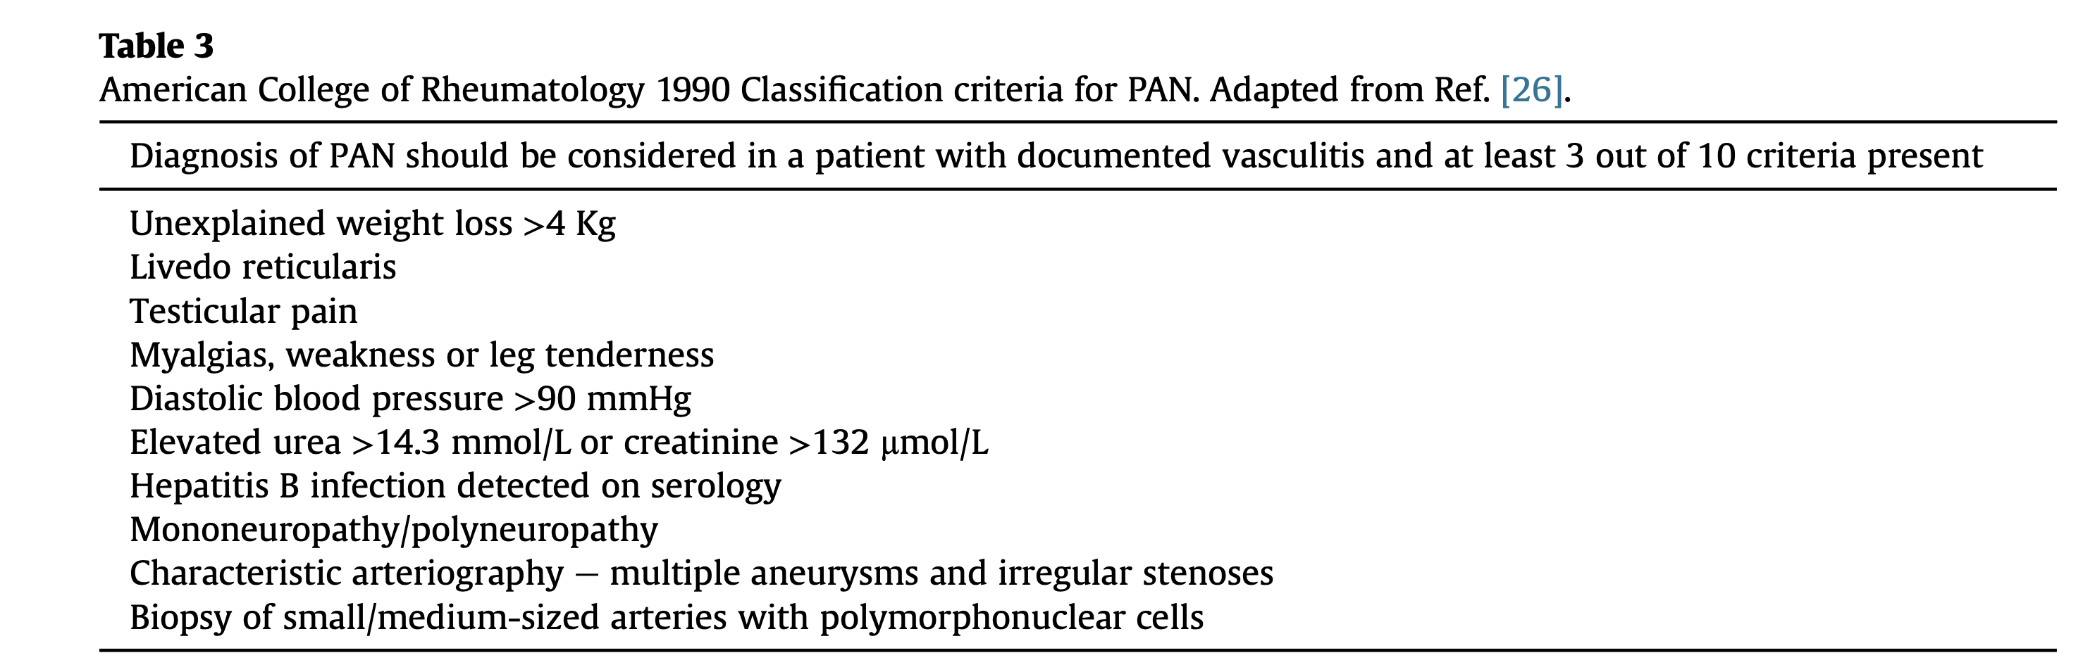

Slide 53
Variable vessel vasculitis : Behcet’s disease : affects small, medium and large vessels. Clinical manifestations include recurrent oral and genital ulcers, arthritis, erythema nodosum, venous and arterial thrombotic disease, aneurysm formation, neurological involvement. Rarely it can manifest as PUO-hence, the associated disease features should actively be identified if the cause of fever remains unclear.

Slide 54
SMALL VESSEL VASCULITIS
You will hear more from Dr. Smith on this topic

Slide 55
CASE 3
Patient: 62-year-old woman
Chief Complaint: Progressive bilateral parotid swelling and new-onset cervical lymphadenopathy
History of Present Illness:
The patient has a 12-year history of primary Sjögren's syndrome, diagnosed based on positive anti-SSA/Ro and anti-SSB/La antibodies, abnormal Schirmer's test, and labial salivary gland biopsy showing focal lymphocytic sialadenitis (focus score 3). Her disease has been relatively stable on hydroxychloroquine 400 mg daily, with manageable dry eyes and dry mouth symptoms.
Over the past 4 months, she has noticed progressive, painless bilateral parotid gland enlargement, more prominent on the right side. The swelling is persistent rather than intermittent. Two weeks ago, she developed a firm, non-tender 2.5 cm left cervical lymph node. She reports new-onset fatigue, unintentional 5-kg weight loss, and occasional low-grade fevers (37.8-38.2°C). She denies night sweats, cough, dysphagia, or hoarseness.
Her dry eye and dry mouth symptoms have paradoxically worsened despite stable medication use. She has developed new purpuric lesions on her lower extremities over the past month.

Slide 56
Past Medical History:
Primary Sjögren's syndrome (12 years)
Hypothyroidism
Raynaud's phenomenon
Medications: Hydroxychloroquine 400 mg daily, levothyroxine 75 mcg daily, artificial tears, pilocarpine 5 mg TID
Family History: Mother with rheumatoid arthritis; no family history of lymphoma

Slide 57
Physical Examination:
Temperature: 37.9°C
General: Appears fatigued but not acutely ill
HEENT: Bilateral parotid enlargement, right > left (right parotid firm, 4×3 cm; left parotid 3×2 cm), non-tender, no overlying erythema. Dry oral mucosa with minimal pooled saliva. No oral ulcers or masses.
Neck: Left level II cervical lymph node 2.5 cm, firm, mobile, non-tender; right level III node 1.5 cm with similar characteristics
Lungs: Clear to auscultation
Abdomen: Soft, non-tender, no hepatosplenomegaly appreciated
Skin: Palpable purpura on bilateral lower extremities
Extremities: No peripheral edema

Slide 58
Laboratory Results:
CBC: WBC 3,200/μL (mild leukopenia), hemoglobin 11.2 g/dL, platelets 142,000/μL
Comprehensive metabolic panel: Normal except total protein 8.9 g/dL (elevated)
ESR: 68 mm/hr
CRP: 2.8 mg/dL
Serum protein electrophoresis: Monoclonal IgM kappa spike (1.8 g/dL)
Immunofixation: Positive for IgM kappa monoclonal protein
Serum free light chains: Kappa 45 mg/L, lambda 18 mg/L (elevated kappa/lambda ratio 2.5)
Cryoglobulins: Positive (type II mixed cryoglobulinemia)
C3: 72 mg/dL (low), C4: 8 mg/dL (markedly low)
RF: 485 IU/mL (markedly elevated from baseline of 120)
Anti-SSA/Ro: Positive (stable), Anti-SSB/La: Positive (stable)
LDH: 312 U/L (mildly elevated)
Beta-2 microglobulin: 4.2 mg/L (elevated)

Slide 59
Imaging:
CT neck/chest/abdomen/pelvis with contrast:
Bilateral parotid gland enlargement with heterogeneous enhancement
Multiple enlarged cervical lymph nodes bilaterally (largest 2.6 cm left level II)
Small mediastinal and hilar lymphadenopathy
Mild splenomegaly (13 cm)
No pulmonary nodules or masses
PET-CT:
Moderate FDG uptake in bilateral parotid glands (SUVmax 6.8 right, 5.2 left)
FDG-avid cervical, mediastinal, and retroperitoneal lymphadenopathy
Mild splenic uptake

Slide 60
Diagnostic Procedures:
Excisional biopsy of left cervical lymph node:
Pathology: Effacement of normal lymph node architecture by a monotonous proliferation of small to medium-sized lymphocytes with abundant pale cytoplasm (monocytoid appearance) and scattered plasma cells. Lymphoepithelial lesions present. Dutcher bodies noted.
Immunohistochemistry: CD20+, CD79a+, BCL2+, CD5-, CD10-, CD23-, cyclin D1-. Kappa light chain restriction confirmed. Ki-67 proliferation index 15%.
Flow cytometry: Monoclonal B-cell population with kappa light chain restriction
FISH: No evidence of t(11;14), t(14;18), or MYC rearrangement
Molecular studies: IGH gene rearrangement detected, confirming clonality
Final Diagnosis: Extranodal marginal zone lymphoma of mucosa-associated lymphoid tissue (MALT lymphoma), stage IV, with parotid gland and nodal involvement, arising in the setting of primary Sjögren's syndrome

Slide 61
MALT lymphoma complicates long-standing Sjögren's syndrome, occurring in approximately 5-10% of Sjögren's patients over their lifetime. The risk of non-Hodgkin lymphoma in Sjögren's syndrome is increased 7-19 fold compared to the general population, with MALT lymphoma being the most common subtype (48-75% of cases).
Key clinical features that raised suspicion for lymphoma:
Persistent parotid swelling (rather than recurrent episodic swelling)
Palpable purpura suggesting cryoglobulinemic vasculitis
Monoclonal gammopathy (IgM kappa spike)
Type II mixed cryoglobulinemia
Severe hypocomplementemia (C4 <8 mg/dL)
Constitutional symptoms (fever, weight loss, fatigue)
Lymphadenopathy beyond typical Sjögren's presentation

Slide 62
The presence of germinal center-like structures in salivary gland biopsies (ectopic lymphoid tissue) is also a strong predictor, though not assessed in this case.
Patients with multiple risk factors have up to a 40% cumulative risk of lymphoma at 15 years.

Slide 63
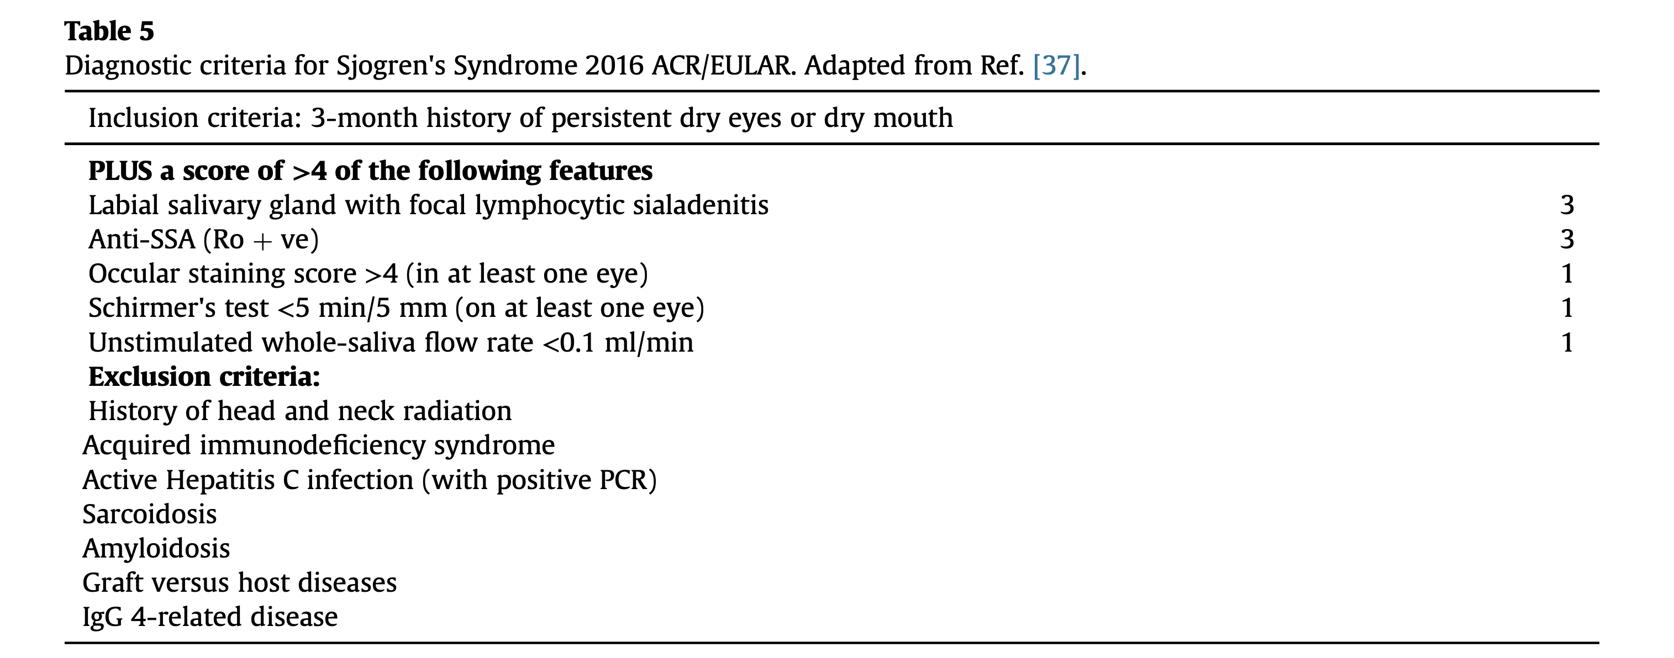

Slide 64
CASE 4
28-year-old woman- Chief Complaint: High fevers and rash for 3 weeks
History of Present Illness:
The patient presents with a 3-week history of daily high-spiking fevers reaching 39.5-40°C, typically occurring in the late afternoon and evening, with return to normal or near-normal temperatures by morning. She describes severe fatigue, diffuse myalgias, and a 4-kg unintentional weight loss. She has noted a recurrent, non-pruritic, salmon-pink rash on her trunk and proximal extremities that appears during febrile episodes and fades when her temperature normalizes—she initially dismissed it as a "heat rash."
She reports severe sore throat for the past 2 weeks without cough, rhinorrhea, or nasal congestion. She has developed bilateral wrist, knee, and ankle pain with morning stiffness lasting approximately 2 hours. She denies photosensitivity, oral ulcers, Raynaud's phenomenon, or sicca symptoms.
She was seen at an urgent care 10 days ago and prescribed amoxicillin-clavulanate for presumed pharyngitis without improvement. Blood cultures and a monospot test were negative.
Past Medical History: None

Slide 65
Medications: Ibuprofen 600 mg PRN (minimal relief)
Social History: Works as a graphic designer; no tobacco, alcohol, or illicit drug use; no recent travel; no sick contacts
Family History: No autoimmune or rheumatologic diseases
Physical Examination:
Temperature: 39.8°C (obtained during late afternoon evaluation)
Heart rate: 112 bpm
Blood pressure: 118/72 mmHg
General: Ill-appearing young woman, appears fatigued
Skin: Evanescent salmon-pink maculopapular rash on anterior chest, upper back, and proximal upper extremities; lesions are flat to slightly raised, non-pruritic, blanching; Koebner phenomenon present (rash accentuated at waistband and bra line)

Slide 66
HEENT: Pharyngeal erythema without exudate; no tonsillar enlargement; no oral ulcers; no lymphadenopathy
Neck: Supple, mild bilateral anterior cervical lymphadenopathy (1 cm nodes, mobile, non-tender)
Cardiovascular: Tachycardic, regular rhythm, no murmurs, rubs, or gallops
Lungs: Clear to auscultation bilaterally
Abdomen: Soft, mild hepatomegaly (liver edge 3 cm below costal margin), splenomegaly (palpable 2 cm below costal margin), non-tender
Musculoskeletal: Bilateral wrist synovitis with warmth and tenderness; bilateral knee effusions; bilateral ankle tenderness without overt swelling
Neurologic: Non-focal

Slide 67
Laboratory Results:
WBC: 24,800/μL with 92% neutrophils (striking neutrophilic leukocytosis)
Hemoglobin: 11.8 g/dL (mild normocytic anemia)
Platelets: 412,000/μL (thrombocytosis)
ESR: 98 mm/hr (markedly elevated)
CRP: 18.6 mg/dL (markedly elevated)
Ferritin: 12,450 ng/mL (markedly elevated; >5× upper limit of normal)
Glycosylated ferritin: 8% (markedly low; normal >20%)
AST: 128 U/L, ALT: 156 U/L (elevated)
Alkaline phosphatase: 142 U/L (mildly elevated)
LDH: 485 U/L (elevated)
Albumin: 3.2 g/dL (low)
Procalcitonin: 0.12 ng/mL (normal, arguing against bacterial infection)

Slide 68
ANA: Negative
RF: Negative
Anti-CCP: Negative
Blood cultures (×3): No growth
Throat culture: Normal flora
CMV, EBV serologies: Negative for acute infection
HIV: Negative
Hepatitis B/C serologies: Negative

Slide 69
Imaging:
Chest X-ray: No infiltrates, no cardiomegaly
CT chest/abdomen/pelvis: Hepatosplenomegaly confirmed; small bilateral axillary and mediastinal lymph nodes (reactive appearing); no masses or abscess
Echocardiogram: Normal ejection fraction, no vegetations, trace pericardial effusion

Slide 70
This patient meets Yamaguchi criteria for adult-onset Still's disease (AOSD), the most widely used classification criteria with sensitivity of approximately 79% and specificity >90%.
Yamaguchi Criteria Fulfilled:
Major criteria (requires ≥2):
✓ Fever ≥39°C lasting ≥1 week (quotidian pattern)
✓ Arthralgia or arthritis lasting ≥2 weeks
✓ Typical rash (salmon-pink, evanescent, maculopapular)
✓ Leukocytosis ≥10,000/mm³ with ≥80% granulocytes

Slide 71
Minor criteria (requires ≥3):
✓ Sore throat
✓ Lymphadenopathy
✓ Hepatomegaly or splenomegaly
✓ Abnormal liver function tests
✓ Negative ANA and RF

Slide 72
Exclusion criteria satisfied:
No infection (negative cultures, viral serologies, procalcitonin)
No malignancy (CT imaging, clinical course)
No other rheumatic disease (negative serologies, clinical features)

Slide 73
Key Diagnostic Features:
The quotidian fever pattern (daily spikes to ≥39°C returning to baseline) is characteristic of AOSD, occurring in the majority of patients.
The evanescent salmon-pink maculopapular rash appearing during fever spikes and resolving when afebrile is highly specific, occurring in approximately 80% of patients. Histopathology of this rash characteristically shows interstitial dermal neutrophils aligned between collagen bundles.
Hyper ferritinemia (>5× upper limit of normal) is a hallmark of AOSD, with levels typically much higher than in other inflammatory, infectious, or neoplastic conditions.
The glycosylated ferritin fraction <20% is highly specific for AOSD (specificity 93%) and helps distinguish it from other causes of elevated ferritin.

Slide 74
Differential Diagnosis Considered and Excluded:
Infection: Negative blood cultures, viral serologies, normal procalcitonin, failure to respond to antibiotics
Malignancy/lymphoma: No concerning findings on CT imaging; clinical course inconsistent
Systemic lupus erythematosus: Negative ANA, no photosensitivity, no malar rash, no oral ulcers
Reactive arthritis: No preceding GI/GU infection, no enthesitis, no uveitis
Viral syndrome: Negative EBV/CMV serologies, prolonged course

Slide 75
Disease Course Patterns:
AOSD follows three clinical patterns: (1) monocyclic (single self-limited episode, ~30% of patients); (2) polycyclic (recurrent flares with remissions); and (3) chronic articular (persistent polyarthritis).
Two phenotypes are recognized at diagnosis: a systemic/feverish phenotype (evolving to mono/polycyclic patterns) and an articular phenotype with less systemic symptoms (evolving to chronic arthritis).
Complications to Monitor:
Macrophage activation syndrome (MAS) occurs in up to 15% of AOSD patients and carries high mortality. Warning signs include paradoxically falling ferritin (though still elevated), cytopenias, rising triglycerides, and falling fibrinogen. This patient's current laboratory values do not suggest MAS.

Slide 76
Treatment :
Initiate high-dose corticosteroids: Prednisone 0.5-1 mg/kg/day (approximately 60 mg daily) as first-line therapy for systemic AOSD.
Monitor for MAS: Serial CBC, ferritin, triglycerides, fibrinogen, LDH
Hepatic monitoring: Serial LFTs given baseline elevation
If steroid-refractory or for steroid-sparing:
  Anakinra (IL-1 receptor antagonist): Highly effective for systemic AOSD, particularly the feverish phenotype.
  Canakinumab (anti-IL-1β): FDA-approved for active Still's disease
  Tocilizumab (anti-IL-6): Effective for both systemic symptoms and arthritis
Methotrexate may be added for steroid-sparing effect, particularly if chronic articular disease develops
Patient education regarding disease course, medication side effects, and warning signs of MAS

Slide 77
CASE 4
Patient is a 34 year old woman with
Chief Complaint: Fever, painful rash on legs, and bilateral ankle swelling for 10 days
History of Present Illness:
The patient presents with a 10-day history of daily fevers reaching 38.5-39°C, accompanied by malaise and fatigue. Eight days ago, she developed multiple painful, raised, red nodules on her anterior shins bilaterally. Five days ago, she noticed progressive bilateral ankle swelling and pain, making ambulation difficult. She reports mild dry cough but denies dyspnea, chest pain, or hemoptysis. She has had no recent travel, sick contacts, or new medications.
She was seen at urgent care 5 days ago and prescribed ibuprofen for presumed "viral syndrome with reactive arthritis." Her fevers have persisted, and the ankle swelling has worsened.
Past Medical History: None
Medications: Ibuprofen 600 mg TID (partial relief of ankle pain)
Social History: Works as an elementary school teacher; no tobacco, alcohol, or illicit drug use; lives in the northeastern United States
Family History: No autoimmune or rheumatologic diseases
Allergies: None

Slide 78
Physical Examination:
Temperature: 38.7°C
Heart rate: 92 bpm
Blood pressure: 122/76 mmHg
Oxygen saturation: 98% on room air
General: Mildly ill-appearing young woman, uncomfortable due to ankle pain
HEENT: No conjunctival injection, no uveitis on penlight examination, no parotid swelling, no oral lesions
Neck: No lymphadenopathy
Cardiovascular: Regular rate and rhythm, no murmurs
Lungs: Clear to auscultation bilaterally, no wheezes or crackles
Abdomen: Soft, non-tender, no hepatosplenomegaly
Skin: Multiple tender, erythematous, raised nodules (2-5 cm) on bilateral anterior shins consistent with erythema nodosum; no ulceration, no violaceous discoloration
Musculoskeletal: Bilateral ankle periarticular swelling with warmth, erythema, and tenderness; no true joint effusion appreciated; pain with dorsiflexion and plantar flexion; bilateral Achilles tendon tenderness; no wrist, knee, or small joint involvement
Neurologic: Non-focal; no facial weakness

Slide 79
Laboratory Results:
WBC: 9,800/μL with normal differential
Hemoglobin: 13.2 g/dL
Platelets: 298,000/μL
ESR: 68 mm/hr (elevated)
CRP: 6.8 mg/dL (elevated)
Comprehensive metabolic panel: Normal
Calcium: 10.4 mg/dL (high-normal)
Liver function tests: Normal
Serum ACE level: 78 U/L (elevated; normal 8-52 U/L)
ANA: Negative
RF: Negative
Anti-streptolysin O (ASO) titer: Negative
Throat culture: Normal flora
Urinalysis: Normal
Blood cultures: No growth (×2)
QuantiFERON-TB Gold: Negative
HIV: Negative

Slide 80
Imaging:
Chest X-ray:
Bilateral hilar lymphadenopathy (symmetric, prominent)
No parenchymal infiltrates
No pleural effusion
Consistent with Scadding Stage I sarcoidosis
CT Chest (obtained for further characterization):
Symmetric bilateral hilar and right paratracheal lymphadenopathy (largest node 2.8 cm)
No pulmonary nodules or parenchymal infiltrates
No mediastinal masses
Ankle X-rays:
Bilateral soft tissue swelling around ankles
No erosions, no joint space narrowing
No fractures

Slide 81
Assessment:
This patient presents with the classic triad of Löfgren syndrome: bilateral hilar lymphadenopathy, erythema nodosum, and periarticular ankle arthritis/inflammation, accompanied by fever. This acute presentation of sarcoidosis is considered highly suggestive and typically does not require tissue biopsy for diagnosis according to the American Thoracic Society guidelines.

Slide 82
Key Clinical Features Supporting Löfgren Syndrome:
Fever: Present in the majority of Löfgren syndrome patients, often accompanying the acute inflammatory presentation.
Erythema nodosum: Classic tender, erythematous nodules on anterior shins; more common in women with Löfgren syndrome.
Bilateral ankle periarticular inflammation: Characteristic of Löfgren syndrome; may present as true arthritis or periarticular inflammation; more common in men as an isolated finding.
Bilateral hilar lymphadenopathy: Present in all cases; Stage I radiographic pattern seen in approximately 82% of Löfgren syndrome patients.
Elevated ACE level: Present in approximately 50% of Löfgren syndrome patients.
Seasonal clustering: Symptoms often begin in spring (49% of cases in one series), as seen in this patient presenting in early March.

Slide 83
Plan:
No biopsy required: The clinical presentation is sufficiently characteristic for Löfgren syndrome that tissue confirmation is not necessary per ATS guidelines.
Symptomatic treatment:
  Continue NSAIDs (naproxen 500 mg BID or ibuprofen 600-800 mg TID) as first-line therapy for arthritis and erythema nodosum
  If inadequate response after 2-3 weeks, consider short course of oral corticosteroids (prednisone 20-40 mg daily with taper)
Ophthalmologic examination: Screen for asymptomatic uveitis (recommended in all sarcoidosis patients)
Baseline pulmonary function tests: Establish baseline FVC and DLCO
Monitoring:
  Clinical follow-up in 4-6 weeks
  Repeat chest X-ray in 3-6 months to document resolution of hilar adenopathy
  Monitor calcium levels (risk of hypercalcemia in sarcoidosis)
Patient education: Reassure regarding excellent prognosis; counsel that symptoms typically resolve within weeks to months, with radiographic resolution within 1-2 years

Slide 84
CASE 5
26 year old woman presents with high fevers, confusion and worsening fatigue for 5 days
The patient has a 4-year history of systemic lupus erythematosus, previously well-controlled on hydroxychloroquine 400 mg daily and low-dose prednisone 5 mg daily.
Her disease has been characterized by arthritis, malar rash, and class III lupus nephritis (treated with mycophenolate mofetil, now in remission).
Three weeks ago, she developed an upper respiratory infection with cough and rhinorrhea. She was seen at urgent care and prescribed azithromycin. Her respiratory symptoms improved, but 5 days ago she developed high-spiking fevers reaching 39.5-40.2°C, profound fatigue, diffuse myalgias, and progressive confusion. Her family notes she has been increasingly somnolent and "not herself." She has had poor oral intake and reports easy bruising on her extremities.
She denies recent medication changes, new sexual partners, or travel. She has not been adherent with her mycophenolate mofetil for the past 2 months due to insurance issues.

Slide 85
Past Medical History:
Systemic lupus erythematosus (4 years)
  Class III lupus nephritis (in remission)
  Polyarthritis
  Malar rash
  Positive ANA, anti-dsDNA, anti-Smith antibodies
  History of leukopenia and thrombocytopenia
Hypothyroidism
Medications: Hydroxychloroquine 400 mg daily, prednisone 5 mg daily, levothyroxine 50 mcg daily (mycophenolate mofetil held for 2 months)

Slide 86
Social History: Graduate student; no tobacco, alcohol, or illicit drug use
Family History: Mother with Hashimoto's thyroiditis; no family history of HLH or immunodeficiency

Slide 87
Physical Examination:
Temperature: 40.1°C
Heart rate: 128 bpm
Blood pressure: 92/58 mmHg
Respiratory rate: 22/min
Oxygen saturation: 94% on room air
General: Ill-appearing, lethargic, arousable but slow to respond
HEENT: Dry mucous membranes, no oral ulcers, no malar rash currently
Neck: Bilateral cervical lymphadenopathy (1-1.5 cm nodes)
Cardiovascular: Tachycardic, regular rhythm, no murmurs or rubs
Lungs: Clear to auscultation bilaterally
Abdomen: Hepatomegaly (liver edge 4 cm below costal margin), splenomegaly (palpable 5 cm below costal margin), mild diffuse tenderness
Skin: Scattered ecchymoses on extremities, petechiae on lower legs, no active rash
Neurologic: Lethargic but arousable, oriented to person only, no focal deficits, no meningismus
Extremities: No synovitis, 1+ bilateral lower extremity edema

Slide 88
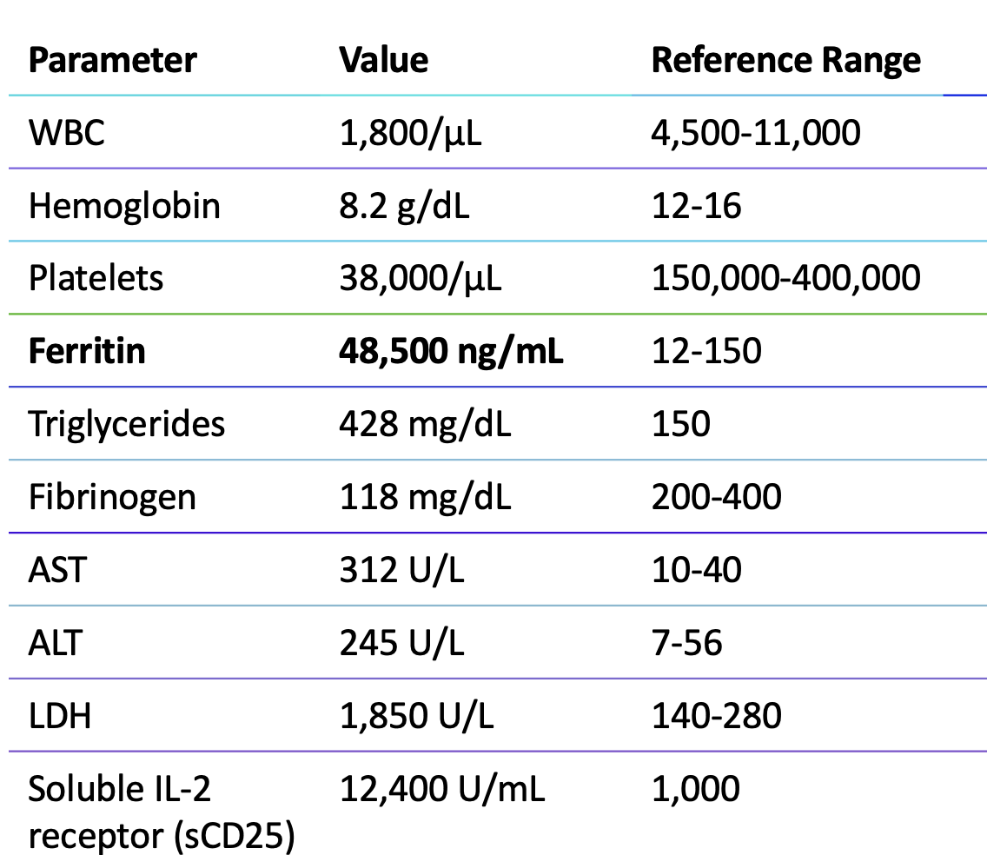

Slide 89
Additional Laboratory Results:
Creatinine: 1.4 mg/dL (baseline 0.9)
Total bilirubin: 2.8 mg/dL (direct 1.2 mg/dL)
Albumin: 2.4 g/dL
D-dimer: >20,000 ng/mL (markedly elevated)
PT/INR: 16.2 sec / 1.4
aPTT: 42 sec
Haptoglobin: <10 mg/dL (undetectable)
Reticulocyte count: 0.8% (inappropriately low)
Direct Coombs: Positive (IgG)
C3: 42 mg/dL (low), C4: 6 mg/dL (markedly low)
Anti-dsDNA: 1:640 (elevated from baseline 1:80)
ESR: 8 mm/hr (paradoxically low despite inflammation)
CRP: 14.2 mg/dL (elevated)
Procalcitonin: 1.8 ng/mL (mildly elevated)
SLEDAI-2K: 24 (very high activity)

Slide 90
Infectious Workup:
Blood cultures (×2): Pending
Urine culture: No growth
Respiratory viral panel: Positive for influenza A
CMV PCR: Negative
EBV PCR: 850 copies/mL (low-level viremia)
HIV: Negative
Hepatitis B/C: Negative
Bone Marrow Biopsy:
Performed on hospital day 2 due to high suspicion for HLH.
Findings: Hypercellular marrow (80% cellularity) with trilineage hematopoiesis. Prominent hemo phagocytosis identified—numerous activated macrophages engulfing erythrocytes, platelets, and nucleated cells. No evidence of malignancy or lymphoma. Flow cytometry negative for abnormal lymphoid or myeloid populations.

Slide 91
Imaging:
CT chest/abdomen/pelvis: Hepatosplenomegaly confirmed (liver 22 cm, spleen 16 cm); small bilateral pleural effusions; no lymphadenopathy concerning for malignancy; no pulmonary infiltrates
MRI brain: Mild diffuse leptomeningeal enhancement; no focal lesions

Slide 92
Diagnostic Scoring:
HLH-2004 Criteria (≥5 of 8 required):
✓ Fever ≥38.5°C
✓ Splenomegaly
✓ Cytopenias (≥2 lineages): Hemoglobin <9 g/dL, platelets <100,000/μL, neutrophils <1,000/μL
✓ Hypertriglyceridemia (>265 mg/dL) and/or hypofibrinogenemia (<150 mg/dL)
✓ Hemophagocytosis in bone marrow
✓ Ferritin ≥500 ng/mL
✓ Elevated soluble CD25 (sIL-2R) ≥2,400 U/mL
NK cell activity- pending lab results
(Score: 7/8 criteria met → Diagnostic for HLH
H-Score: 285 points (>99% probability of HLH)

Slide 93
This patient presents with macrophage activation syndrome (MAS)/secondary HLH complicating systemic lupus erythematosus, triggered by a combination of SLE flare (elevated anti-dsDNA, low complements, high SLEDAI) and influenza A infection in the setting of immunosuppression withdrawal (mycophenolate non-adherence).
Key Features Distinguishing MAS from SLE Flare Alone:
The distinction between severe SLE flare and MAS can be challenging, as both share features of fever, cytopenias, and multiorgan involvement. However, several findings strongly favor MAS:
Extreme hyperferritinemia (>48,000 ng/mL): Ferritin >695 ng/mL has been identified as an optimal cutoff for predicting MAS in SLE
Paradoxically low ESR despite high CRP: Hypofibrinogenemia in MAS leads to low ESR, whereas SLE flares typically have elevated ESR
Hypofibrinogenemia (118 mg/dL): Unusual in SLE flare alone
Hypertriglyceridemia (428 mg/dL): Not typical of SLE flare
Markedly elevated LDH (>359 U/L is predictive)
Hemophagocytosis on bone marrow biopsy
Elevated soluble IL-2 receptor (sCD25)

Slide 94
Triggers Identified:
SLE flare: Medication non-adherence led to disease reactivation (elevated anti-dsDNA, low complements, high SLEDAI)
Influenza A infection: Viral infections are common triggers of HLH/MAS
Low-level EBV reactivation: May be contributory
MAS occurs in approximately 0.9-4.6% of SLE patients and is a life-threatening complication with mortality rates of 5-20% in treated patients.
In one large series, MAS was inaugural (presenting feature) in 46% of SLE-MAS cases.

Slide 95
Treatment escalation ladder for SLE-MAS:
First-line: High-dose corticosteroids (methylprednisolone pulse)
  Second-line: Add cyclosporine A
  Third-line: IL-1 inhibition (anakinra) for refractory cases
  Etoposide reserved for severe, persistent, or relapsing MAS
Mortality in SLE-MAS ranges from 5-20% with treatment; ICU admission is required in approximately one-third of cases

Slide 96
How was this patient treated?
Vasopressors
IV steroids
Oseltamivir for influenza
anakinra 100 mg subcutaneous every 6 hours
Discharged on:
  Prednisone 60 mg daily (slow taper planned)
  Cyclosporine 150 mg BID (target trough 150-200 ng/mL)
  Anakinra 100 mg daily
  Hydroxychloroquine 400 mg daily
  PCP prophylaxis (trimethoprim-sulfamethoxazole)

